Slide 1

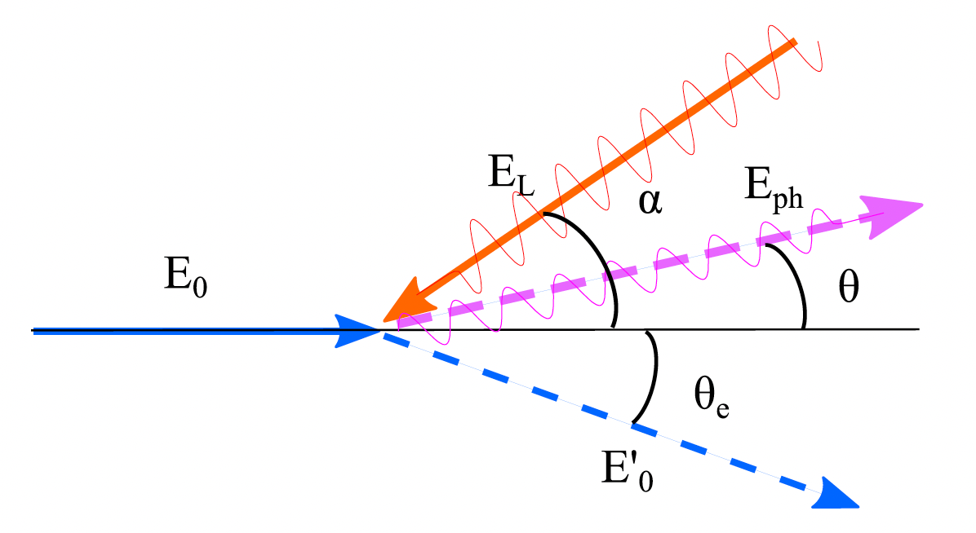




General Compton Scattering geometry
between an incident eletron E_{e} and a photon E_{ph}
at a collision angle α, photon E’_{ph} scattering angle θ
and electron E’_{e} scattering angle θ_{e}
$$E_{ph}$$
$${E′}_{ph}$$
$$E_{e}$$
$${E′}_{e}$$
8th African School of Physics - Marrakech (MO) - July 2024

Slide 2
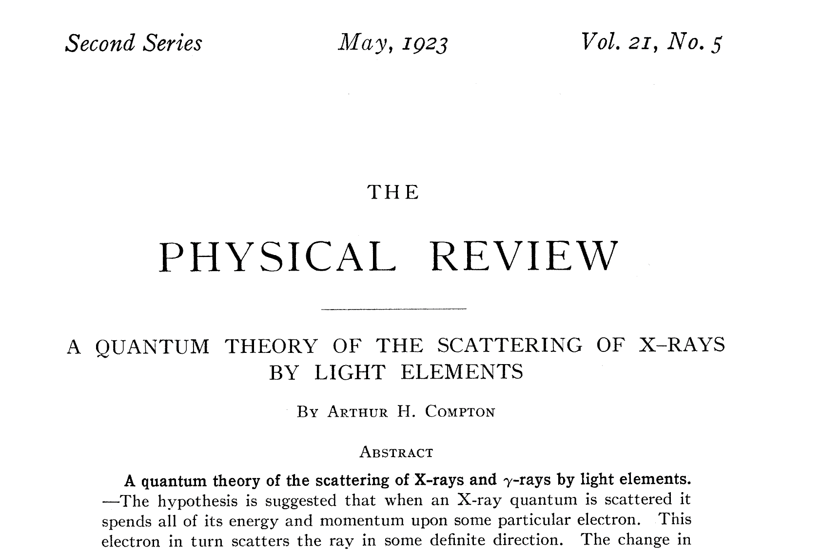
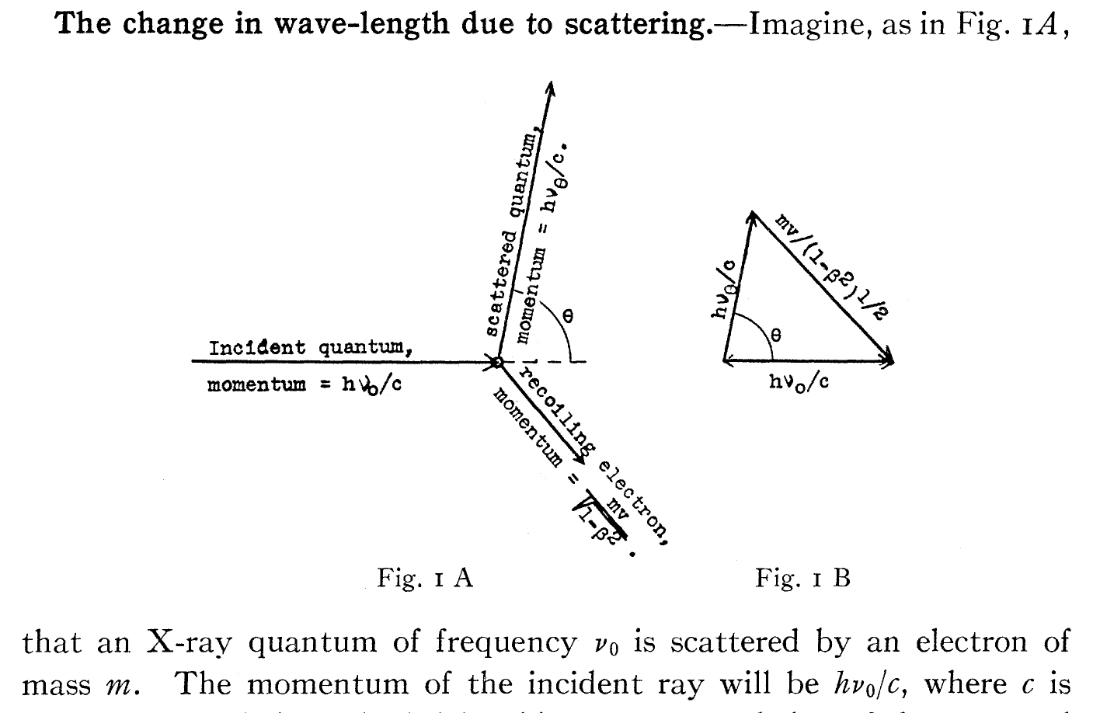
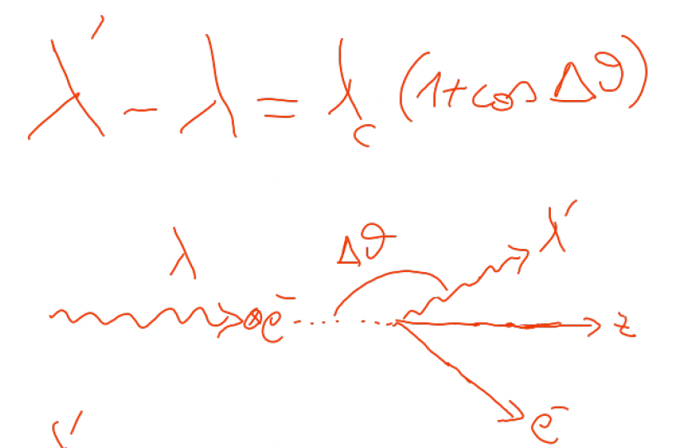
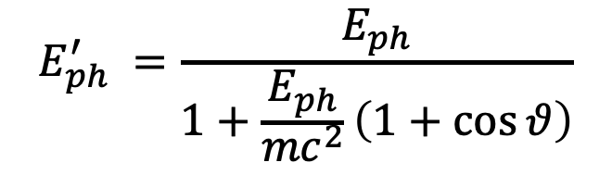
beginning of the story – the photon, quantum of energy
$$E_{ph}^{′} =\frac{E_{ph}}{1+\frac{E_{ph}}{{mc}^{2}}\left(1+\cos{θ}\right)}$$

Slide 3
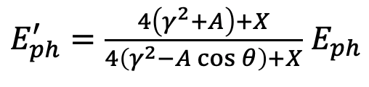




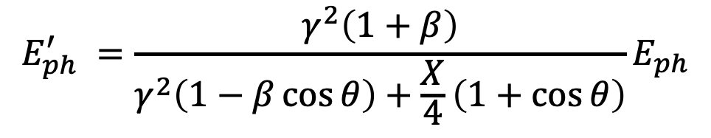
$$E_{ph}^{′} =\frac{γ^{2}\left(1+β\right)}{γ^{2}\left(1−β\cos{θ}\right)+\frac{X}{4}\left(1+\cos{θ}\right)}E_{ph}$$
$$E_{ph}$$
$${E′}_{ph}$$
X ≡ 4γ² E_{ph} /E_{e}
A ≡ βγ²− X/4 = γ²(β− E_{ph} /E_{e})
$$E_{e}$$
$${E′}_{e}$$
A=0 , i.e. Symmetric Compton Scattering cancels the γ²θ² correlation

Slide 4
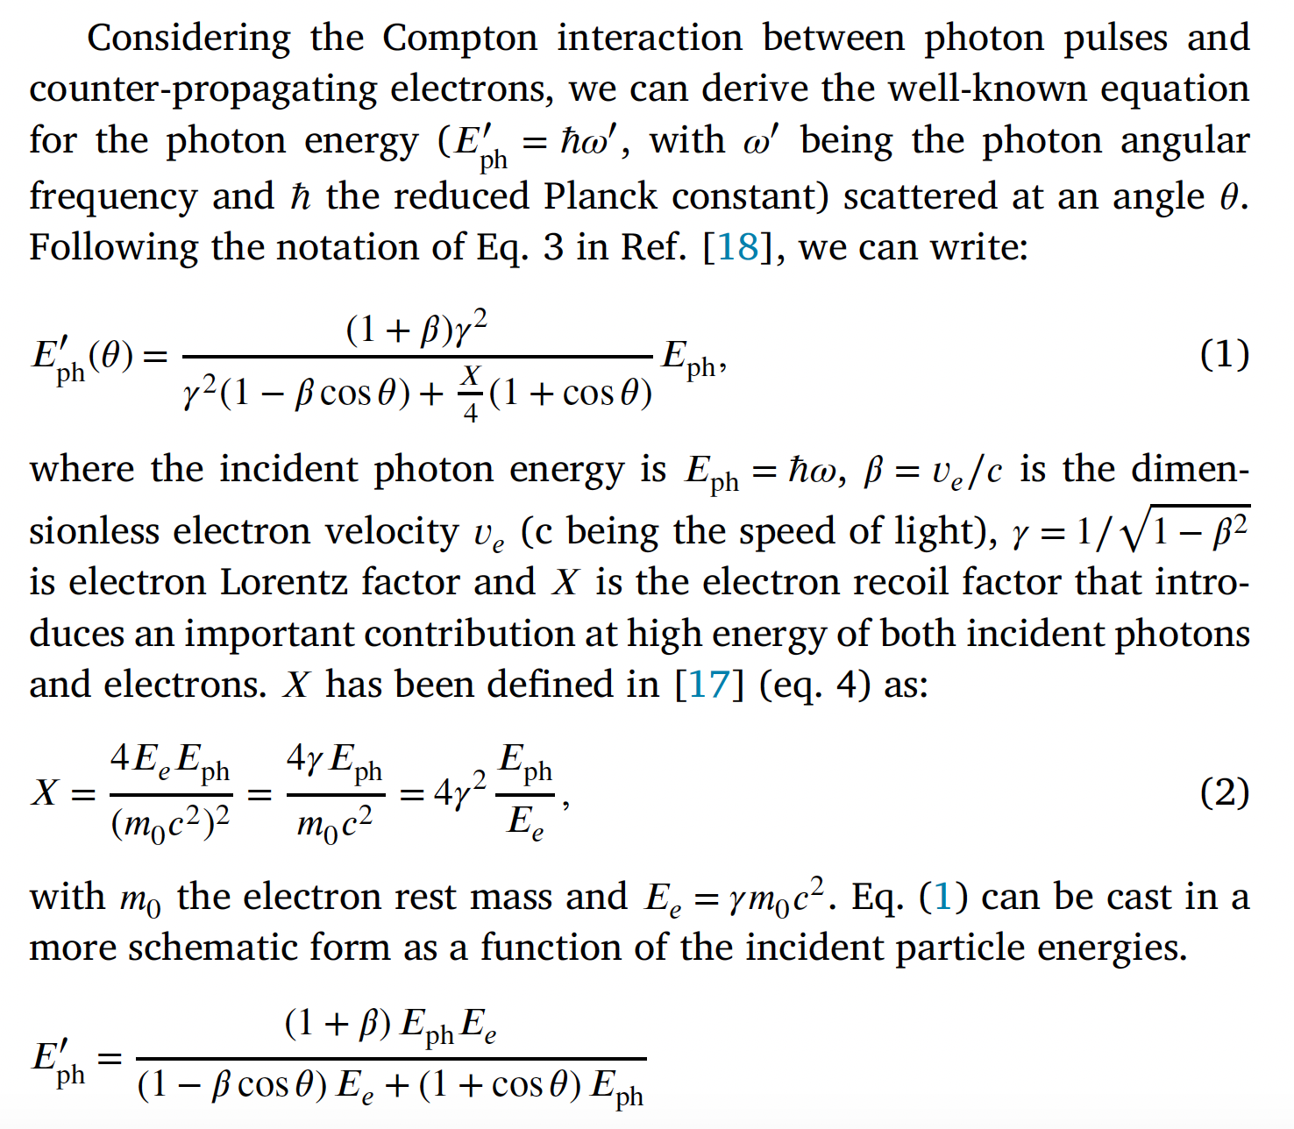
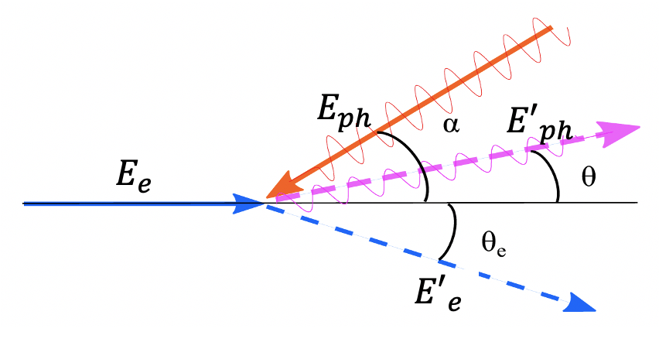
N. Ranjan et al., PRAB 21, 030701 (2018)
α=0

Slide 5
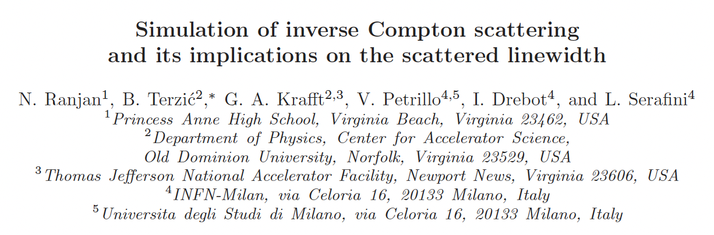
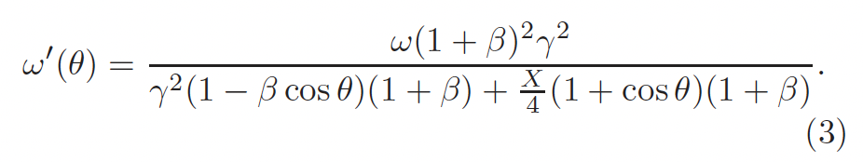

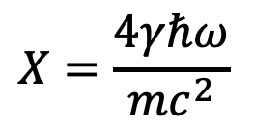



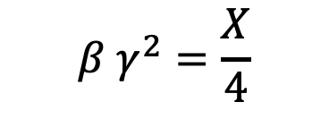
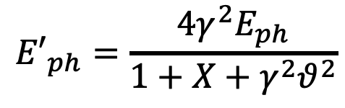
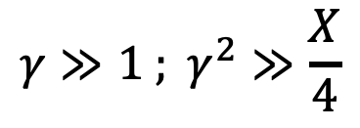

An invariant view at Compton effect - 1
(any inertial ref. frame)
Phys. Rev. AB (2018)
21, 030701
$$X=\frac{4γℏω}{mc^{2}}$$
Arthur Compton,
Nobel Prize 1927
A>0
$$γ≫1 ; γ^{2}≫\frac{X}{4}$$
A<0
A=0
photon looses energy
electron looses energy
$$β=0$$
S.C.S.
I.C.S.
$$β γ^{2}=\frac{X}{4}$$
$${E′}_{ph}=\frac{4γ^{2}E_{ph}}{1+X+γ^{2}θ^{2}}$$
$${E′}_{ph}={βE}_{e}=βγmc^{2}$$
$$λ′≠∞$$
$${E′}_{ph}≠f\left(γ^{2}θ^{2}\right)$$
$$\lim_{X→∞}{{E′}_{ph}}=E_{e}$$
isolated e⁻ cannot absorb a photon

Slide 6

A. Compton 1923 - Direct Compton effect
First consideration and study of Inverse Compton Scattering….
During the development of the nuclear bomb!
The Manhattan Project
Will the back-scattered photons,
by hot electrons of the plasma
created in the initial stage of the
nuclear bomb explosion, release
energy from the fire-ball decreasing
its temperature???
8th African School of Physics - Marrakech (MO) - July 2024

Slide 7
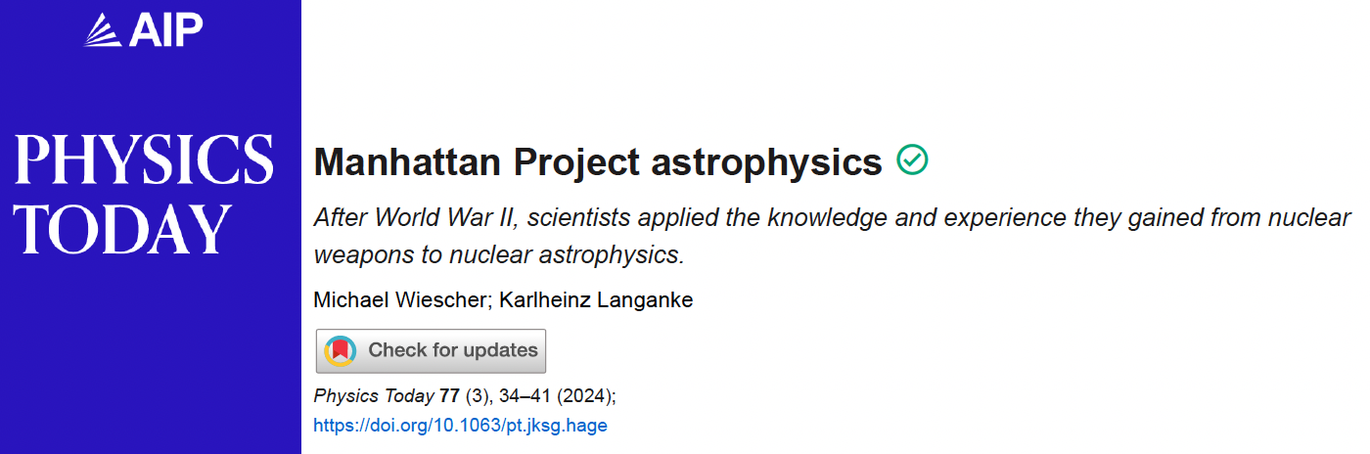
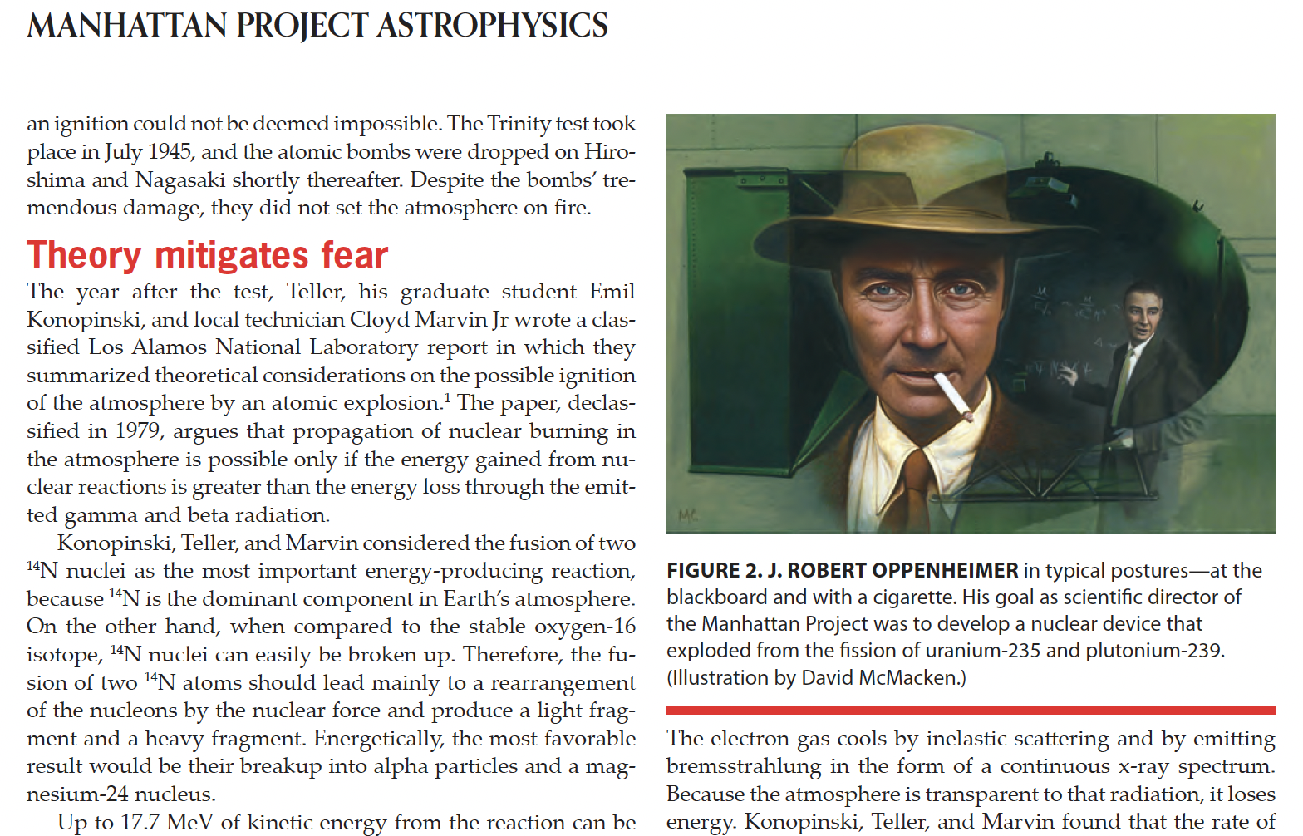
of initiating nuclear fusion
of the whole atmosphere!!!

Slide 8
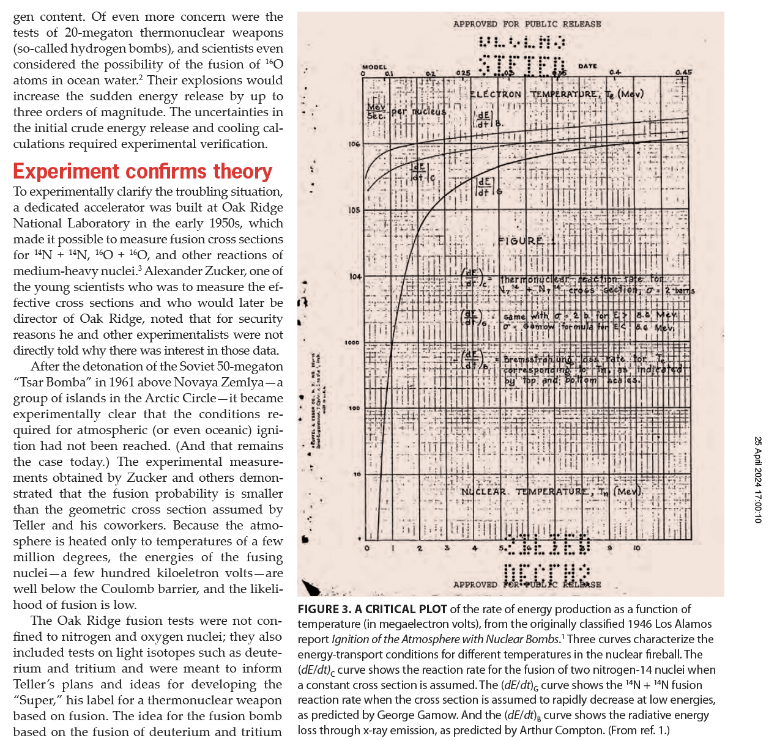
fire-ball becomes transparent to photons, that can take energy
off the fire-ball, limiting the maximum temperature
down to a safe level
8th African School of Physics - Marrakech (MO) - July 2024

Slide 9
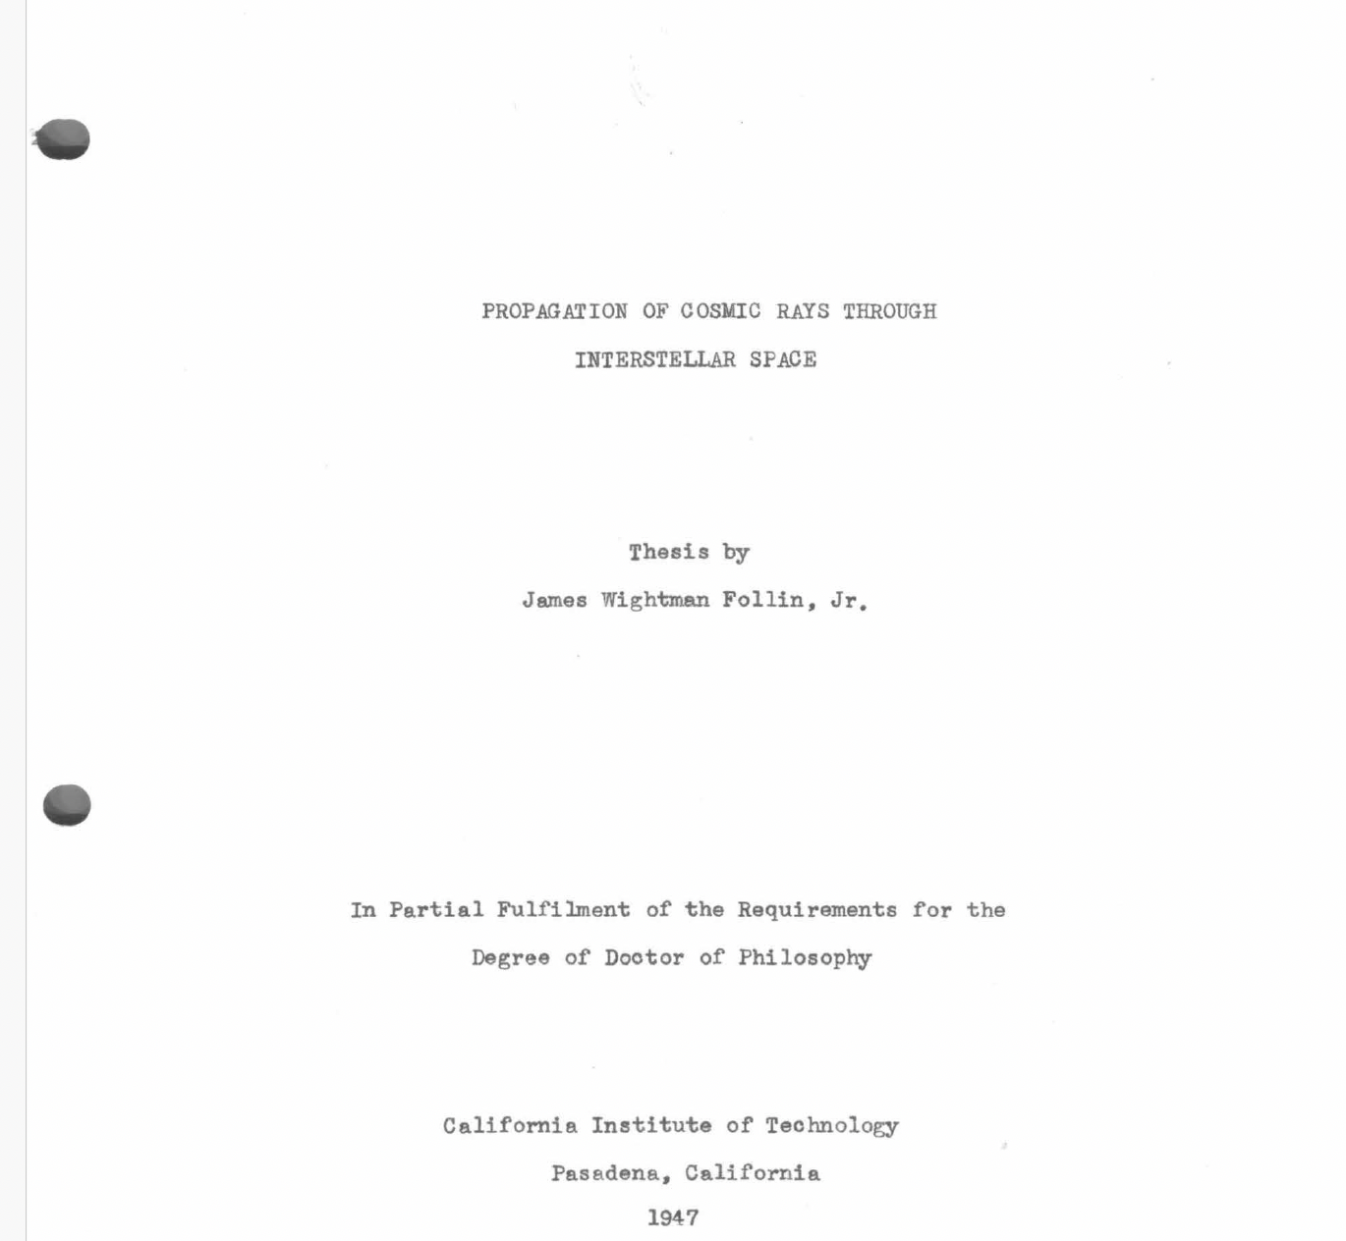
A. Compton 1923 - Direct Compton effect
J. Follin 1947 - Inverse Compton Scattering
first published (non classified) study on ICS*
Second motivation to study ICS in the ‘40s was understanding why
electrons are almost missing in cosmic rays bombarding the upper atmosphere
Both lines (nuclear bomb and astrophysics) were looking for
a mechanism capable to transfer maximum energy from the electrons to the photons
* but unknown and not credited in the whole literature on ICS

Slide 10
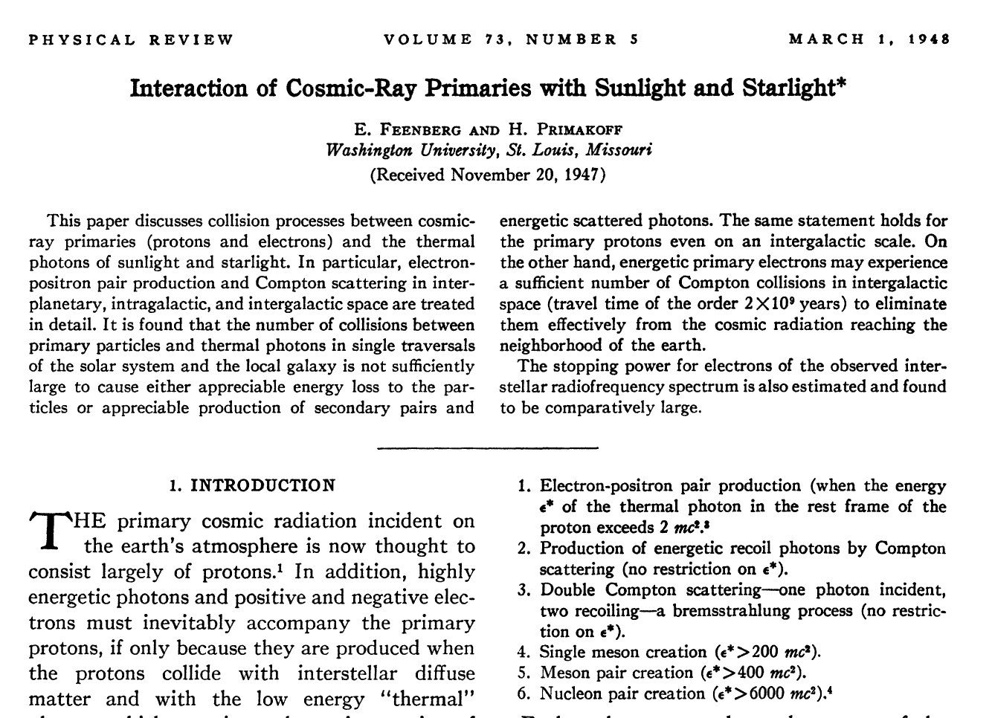
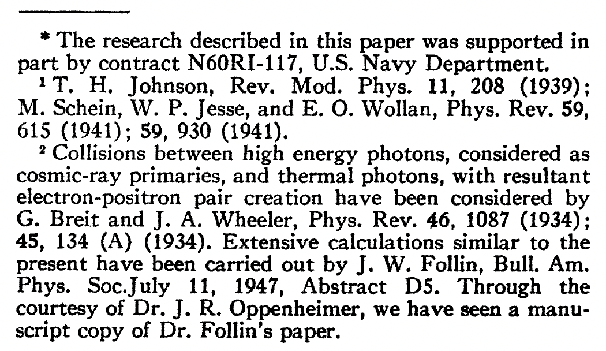
Publication referenced by everybody in ICS community
as the first published paper on ICS

Slide 11
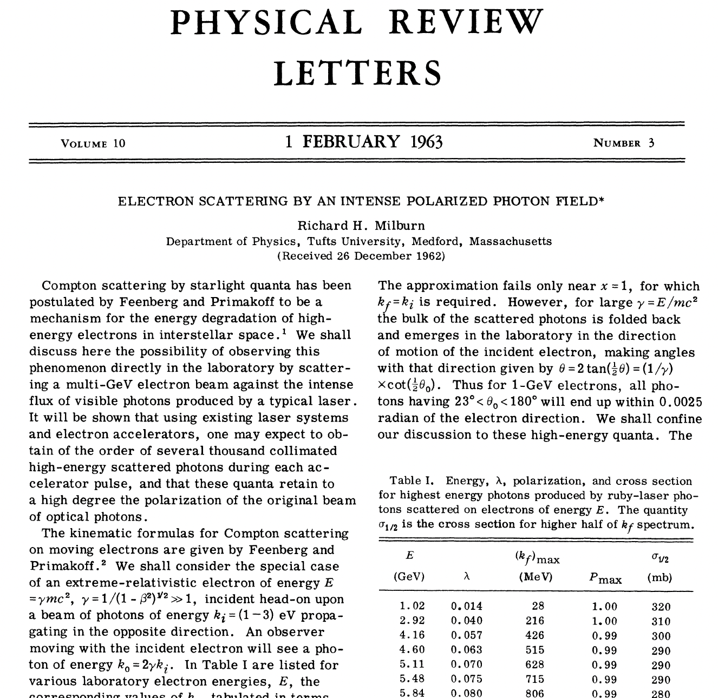
First idea by Milburn: use electron accelerators to perform
Inverse Compton Scattering in the laboratory vs. the cosmos
8th African School of Physics - Marrakech (MO) - July 2024

Slide 12
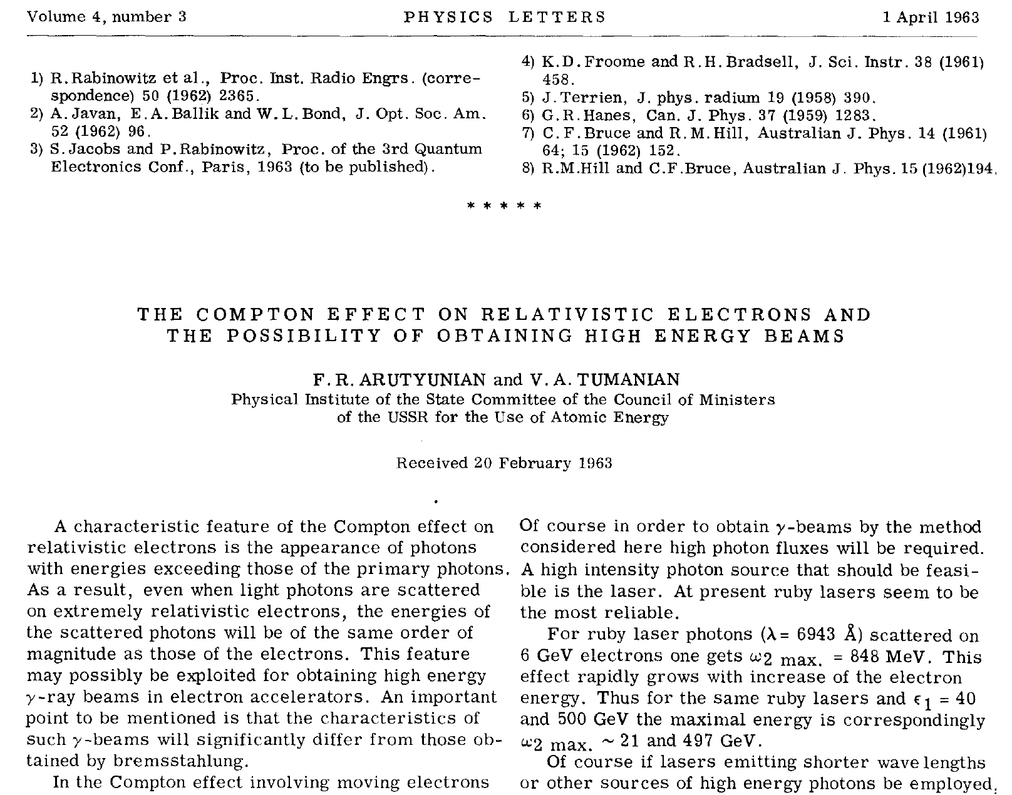
Almost at the same time as Arutyunian and co-workers
8th African School of Physics - Marrakech (MO) - July 2024

Slide 13
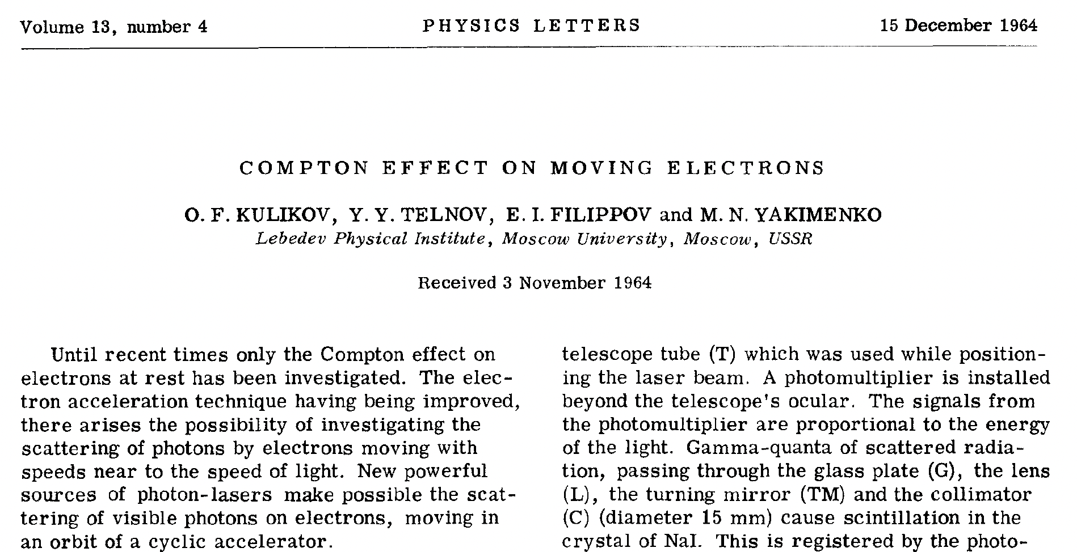
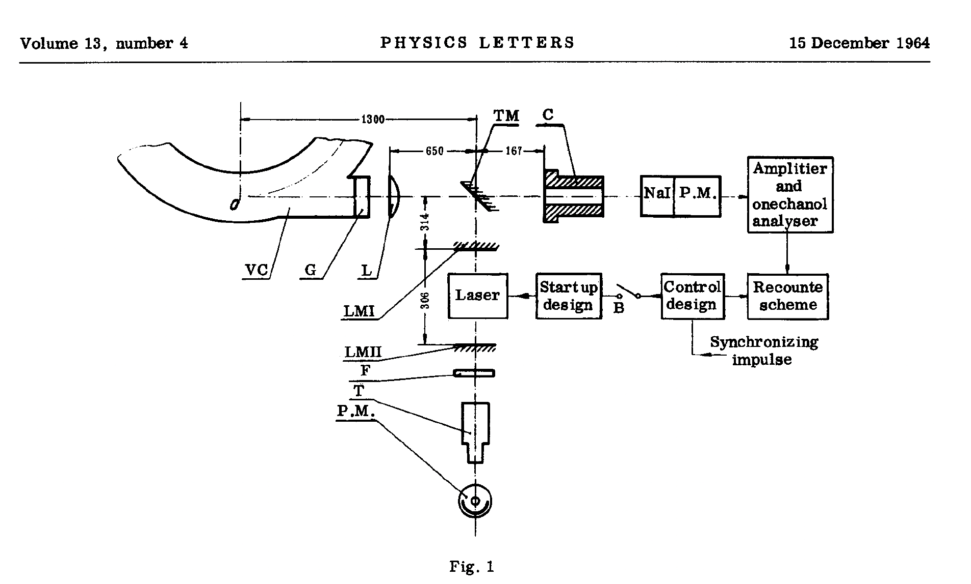
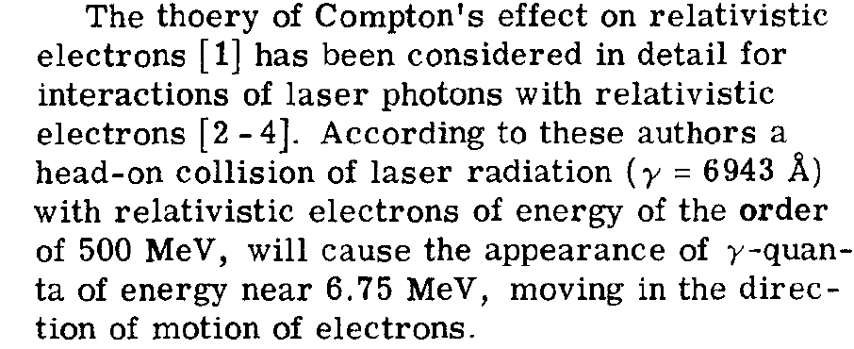
First measured ICS – 500 MeV

Slide 14
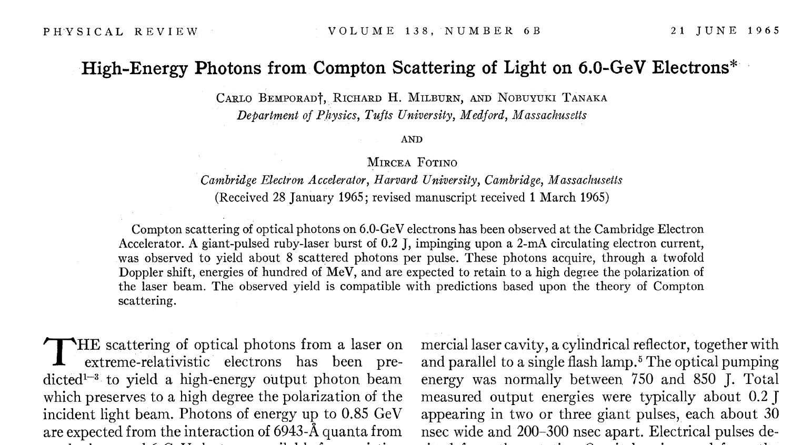
Second measured ICS – 6 GeV
8th African School of Physics - Marrakech (MO) - July 2024

Slide 15
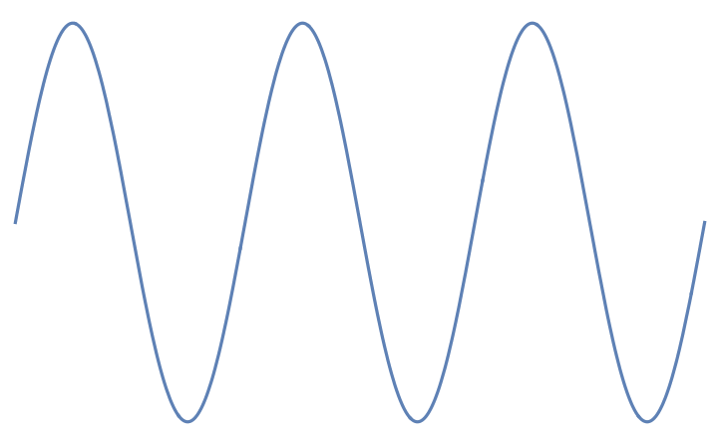
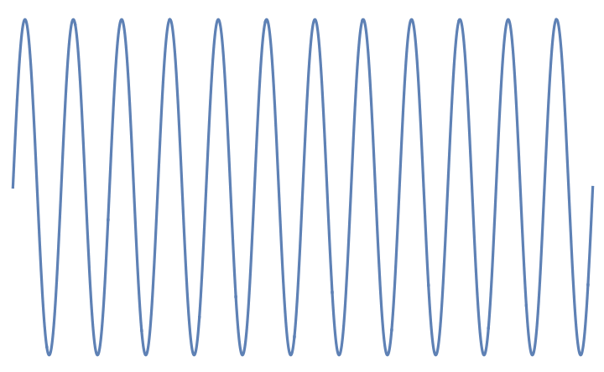
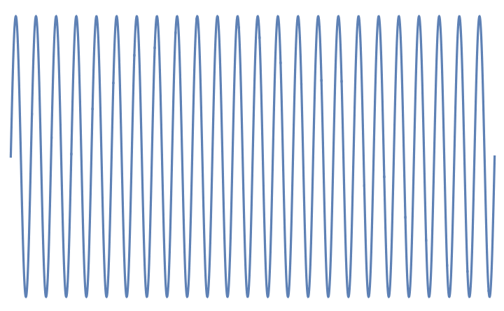


incident electron
E_{e} = γmc²
incident photon E_{ph}
Lab Reference Frame
Kinematics of
Inverse Compton Scattering
a Cartoon
incident photon E*_{ph} = 2γ E_{ph}
Electron rest frame
E*_{e} = mc²
scattered photon at
θ=1/γ E’_{ph} =E’₀ /2
if E*_{ph} << mc² the photon is scattered
back elastically with same energy E*_{ph}
(zero recoil, Thomson limit)
scattered photon at θ
E’_{ph} =E’₀ (1-γ ²θ²)
Lab Reference Frame
after Scattering
θ=1/γ
θ
scattered electron
E’_{e} = γmc² + E_{ph} – E’_{ph}
energy of scattered photon at θ=0 E’₀ = 2γ E*_{ph} = 4γ² E_{ph}

Slide 16
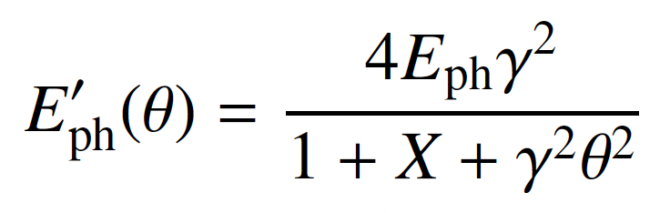
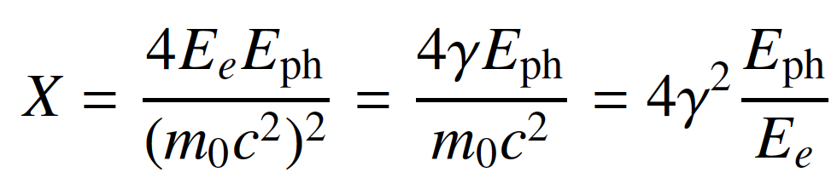
E’_{ph} - energy of scattered photon at θ
red shift at θ≠0
θ
scattered electron
E’_{e} = γmc² + E_{ph} – E’_{ph}
All I.C.S. X/γ ray Sources work at X<1 and A » 1
STAR (350 keV) X_{STAR} < 2.6.10⁻³ A_{STAR} > 10⁴
ELI-NP (20 MeV) X_{ELI-NP} < 0.026 A_{ELI-NP} > 2.4.10⁵
X = recoil parameter – twice the energy of the photon seen
by the electron in its own reference frame normalized to mc²

Slide 17
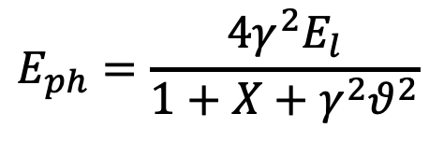



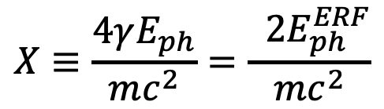


The γ²θ² issue/disease
All radiation originated by a Lorentz Boost associated to relativistic emitting particles (electrons, heavy ions) is intrinsically poli-chromatic because of γθ correlation (energy boost of scattered photons depends on scattering angle, at θ=1/γ photon energy is 50% of max photon energy at θ =0 ) of single electron spectrum (on top of inhomogeneous effects)
True for all kinds of Undulatory and Collisional radiation (bremsstrahlung, wiggler/betatron, synchrotron, RRS, ICS), while resonant or amplified radiation (undulators, FELs), that are diffraction limited thanks to their beam quality, are not (or only partially) affected
$$E_{e}=γmc^{2}$$
$$E_{ph}$$
$${E′}_{ph}$$
$$E_{ph}=\frac{4γ^{2}E_{l}}{1+X+γ^{2}θ^{2}}$$
$$E_{e}$$
$$X≡\frac{4γE_{ph}}{mc^{2}}=\frac{ 2E_{ph}^{ERF}}{mc^{2}}$$
$${E′}_{e}$$

Slide 18
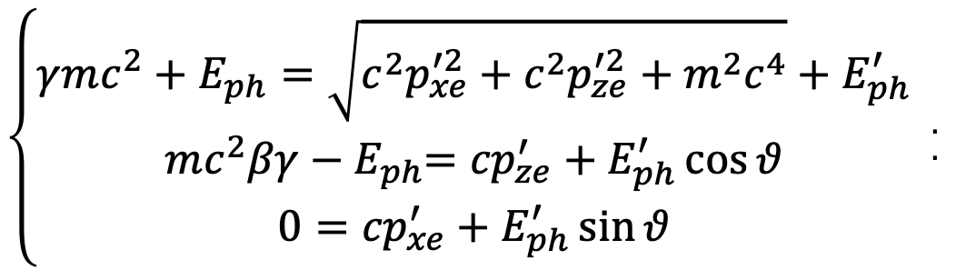
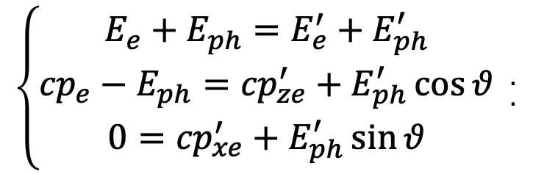
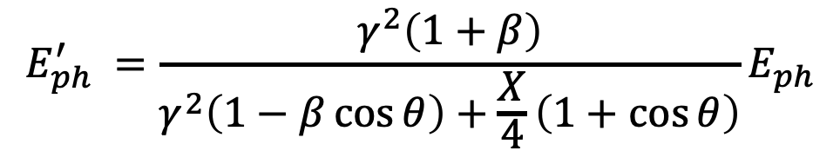
How do we derive fundamental I.C.S. formula?
$$E_{ph}^{′} =\frac{γ^{2}\left(1+β\right)}{γ^{2}\left(1−β\cos{θ}\right)+\frac{X}{4}\left(1+\cos{θ}\right)}E_{ph}$$
that is valid for head-on collision, where electron and photon
counter-propagate along z-axis
$${\left\{\begin{matrix}{{E_{e}+E}_{ph}=E_{e}^{′}+E}_{ph}^{′} \\ {{{cp}_{e}−E}_{ph}={cp}_{ze}^{′}+E}_{ph}^{′}\cos{θ} \\ 0={cp}_{xe}^{′}+E_{ph}^{′}\sin{θ}\end{matrix}\right. }_{.}^{.}$$
conservation of total momentum and total energy
$${\left\{\begin{matrix}{{γmc^{2}+E}_{ph}=\sqrt{c^{2}p_{xe}^{′2}+c^{2}p_{ze}^{′2}+m^{2}c^{4}}+E}_{ph}^{′} \\ mc^{2}βγ{{ − E}_{ph}={cp}_{ze}^{′}+E}_{ph}^{′}\cos{θ} \\ 0={cp}_{xe}^{′}+E_{ph}^{′}\sin{θ}\end{matrix}\right. }_{.}^{.}$$

Slide 19
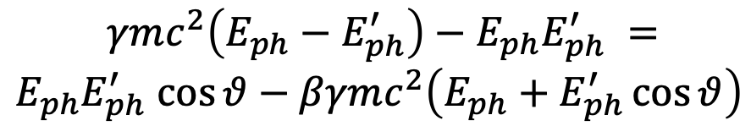
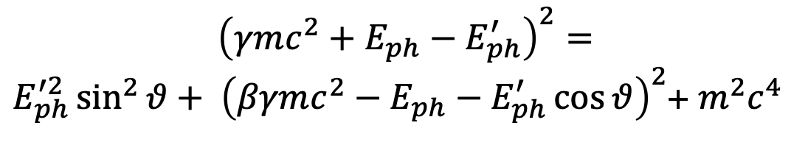
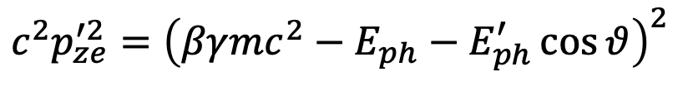

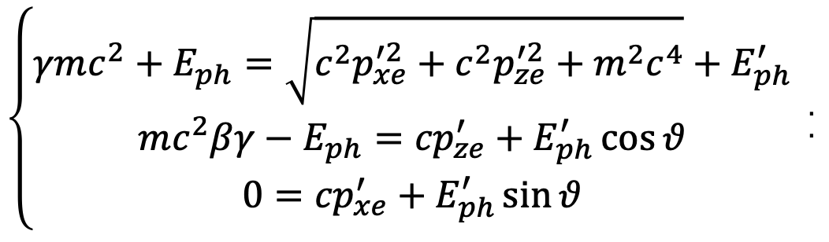
$${\left\{\begin{matrix}{{γmc^{2}+E}_{ph}=\sqrt{c^{2}p_{xe}^{′2}+c^{2}p_{ze}^{′2}+m^{2}c^{4}}+E}_{ph}^{′} \\ mc^{2}{{βγ−E}_{ph}={cp}_{ze}^{′}+E}_{ph}^{′}\cos{θ} \\ 0={cp}_{xe}^{′}+E_{ph}^{′}\sin{θ}\end{matrix}\right. }_{.}^{.}$$
$$c^{2}p_{xe}^{′2}=E_{ph}^{′2}\sin^{2}{θ}$$
$$c^{2}p_{ze}^{′2}={\left(βγmc^{2}−E_{ph}−E_{ph}^{′}\cos{θ}\right)}^{2}$$
$${\left({γmc^{2}+E}_{ph}−E_{ph}^{′}\right)}^{2}=$$
$E_{ph}^{′2}\sin^{2}{θ}+ {\left(βγmc^{2}−E_{ph}−E_{ph}^{′}\cos{θ}\right)}^{2}$+ $m^{2}c^{4}$
$${γmc^{2}\left(E_{ph}−E_{ph}^{′}\right)−E}_{ph}E_{ph}^{′} =$$
$E_{ph}E_{ph}^{′}$ $\cos{θ}−βγmc^{2}\left(E_{ph}+E_{ph}^{′}\cos{θ}\right)$

Slide 20
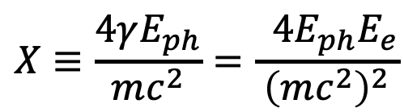
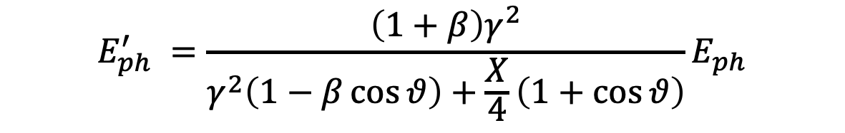
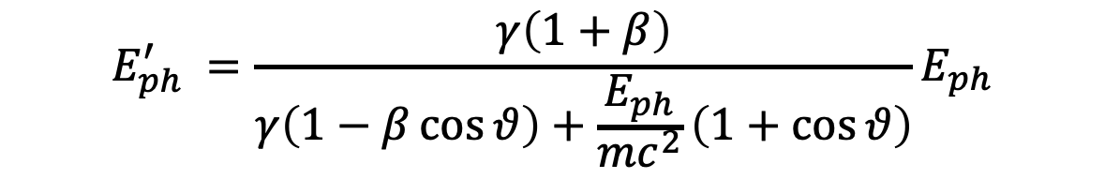
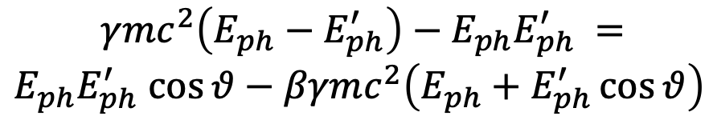
$${γmc^{2}\left(E_{ph}−E_{ph}^{′}\right)−E}_{ph}E_{ph}^{′} =$$
$E_{ph}E_{ph}^{′}$ $\cos{θ}−βγmc^{2}\left(E_{ph}+E_{ph}^{′}\cos{θ}\right)$
$E_{ph}^{′} \left[γmc^{2}\left(β\cos{θ}−1\right){−E}_{ph}\left(1+\cos{θ}\right)\right]={−E}_{ph}$ $γmc^{2}\left(1+β\right)$
$$E_{ph}^{′} =\frac{γ\left(1+β\right)}{γ\left(1−β\cos{θ}\right)+\frac{E_{ph}}{mc^{2}}\left(1+\cos{θ}\right)}E_{ph}$$
$$X≡\frac{4γE_{ph}}{mc^{2}}=\frac{ 4E_{ph}E_{e}}{{\left(mc^{2}\right)}^{2}}$$
valid for any value of
β, γ, X, θ, E_{ph}
$$E_{ph}^{′} =\frac{\left(1+β\right)γ^{2}}{γ^{2}\left(1−β\cos{θ}\right)+\frac{X}{4}\left(1+\cos{θ}\right)}E_{ph}$$
8th African School of Physics - Marrakech (MO) - July 2024

Slide 21


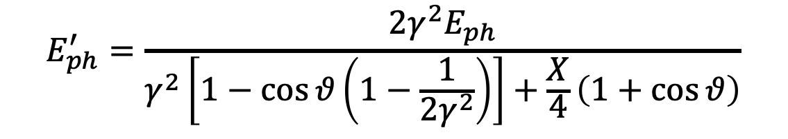
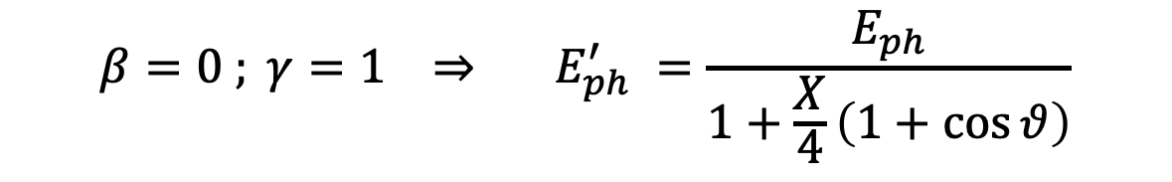
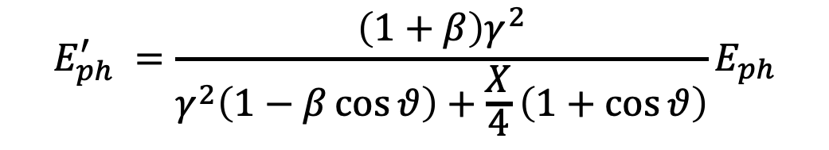
$$E_{ph}^{′} =\frac{\left(1+β\right)γ^{2}}{γ^{2}\left(1−β\cos{θ}\right)+\frac{X}{4}\left(1+\cos{θ}\right)}E_{ph}$$
N.B. if θ = π E’_{ph}=E_{ph} for any γ
$${{{E_{e}^{′}= E}_{e}+E}_{ph}−E}_{ph}^{′}$$
Compton Scattering of X-rays on atomic electrons
$${β=0 ; γ=1 ⇒ E}_{ph}^{′} =\frac{E_{ph}}{1+\frac{X}{4}\left(1+\cos{θ}\right)}$$
Inverse Compton Scattering of photons on relativistic electrons
$γ≫1 ; β≈1−\frac{1}{2γ^{2}}$ $⇒$
$$E_{ph}^{′}=\frac{2{γ^{2}E}_{ph}}{γ^{2}\left[1−\cos{θ}\left(1−\frac{1}{2γ^{2}}\right)\right]+\frac{X}{4}\left(1+\cos{θ}\right)}$$

Slide 22
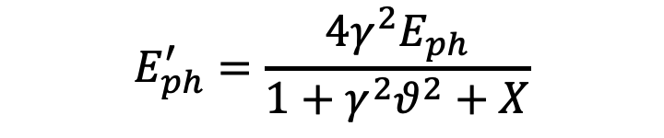



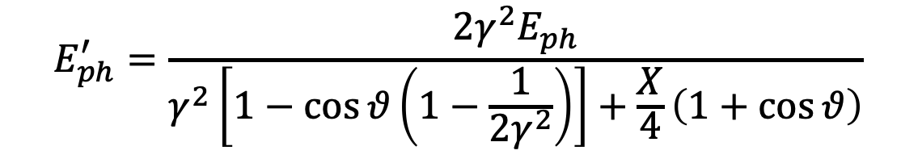
$$E_{ph}^{′}=\frac{2{γ^{2}E}_{ph}}{γ^{2}\left[1−\cos{θ}\left(1−\frac{1}{2γ^{2}}\right)\right]+\frac{X}{4}\left(1+\cos{θ}\right)}$$
$ϑ≪1 ;\cos{θ}≈1−\frac{θ^{2}}{2}$ $⇒$
$$E_{ph}^{′}=\frac{2{γ^{2}E}_{ph}}{γ^{2}\left[\frac{θ^{2}}{2}+\frac{1}{2γ^{2}}\right]+\frac{X}{2}}$$
$$⇓$$
$$E_{ph}^{′}=\frac{4{γ^{2}E}_{ph}}{1+γ^{2}θ^{2}+X}$$
8th African School of Physics - Marrakech (MO) - July 2024

Slide 23
















A look at 4-vectors (head-on collision)
Inverse Compton
Symmetric Compton
$E_{ω}≪γmc^{2 }; γ≫$1
$$E_{ω}=p_{e}c=βγmc^{2}$$
$$\overline{P_{e}}=\left\{γmc,0,0,βγmc\right\}$$
$$\overline{P_{e}}=\left\{γmc,0,0,βγmc\right\}$$
$$\overline{P_{ω}}=\left\{{E_{ω}}/c,0,0,−{E_{ω}}/c\right\}$$
$$\overline{P_{ω}}=\left\{βγmc,0,0,−βγmc\right\}$$
$$\overline{P_{tot}}≅\left\{γmc+\frac{E_{ω}}{c},0,0,βγmc−\frac{E_{ω}}{c}\right\}$$
$$\overline{P_{tot}}=\left\{\left(1+β\right)γmc,0,0,0\right\}$$
$$E_{cm}≡c\sqrt{\overline{P_{tot}}⊗\overline{P_{tot}}}$$
$$E_{cm}=mc^{2 }\sqrt{1+\frac{\left(1+β\right)X}{2}}≈$$
$$≈mc^{2 }\sqrt{1+{4γE_{ω}}/{mc^{2 }}}$$
collider
fixed target
$$γ_{cm}≡\frac{E_{lab}}{E_{cm}}$$
$$E_{cm}=\left(1+β\right)γmc^{2 }$$
$$γ_{cm}≅γ/{\sqrt{1+X}}$$
$${; γ}_{cm}$$
1
$$γ_{cm}=1$$
$$γ→∞$$

Slide 24

Single electron-photon spectra
What happens when we scatter beams of electron against beams of photons?

Slide 25

Courtesy I. Drebot

Slide 26

Courtesy I. Drebot

Slide 27



300 μrad
60 μrad
Courtesy M. Gambaccini

Slide 28

Poli-chromaticity implies using mono-chromators of different kinds (bragg-reflectors, collimators) to select a narrow bandwidth line from a broad-band spectrum
ELI-NP-GBS γ –beam
collimator (2-19 MeV)
X-ray monochromator

Slide 29
Recalling Compton differential cross-section
(2.11)
total cross-section
8th African School of Physics - Marrakech (MO) - July 2024

Slide 30
We need to build a very high luminosity collider,
that needs to maximize the Spectral Luminosity,
i.e. Luminosity per unit bandwidth
negligible diffraction
0 crossing angle
Scattered flux
Luminosity as in HEP collisions
  Many photons, electrons
  Focus tightly
  ELI-NP
f
electrons
laser
  cfr. LHC 10³⁴, Hi-Lumi LHC 10³⁵

Slide 31
Matching Laser Pulse Length and Focus Size
Laser pulse length matched to focus size (Rayleigh length).
Laser pulse too long for small focus size.
Laser pulse must be short compared to Rayleigh length so that whole pulse is focused simultaneously.
Laser may be shorter than Rayleigh length, but less than 0.5 ps is not practical, and could lead to non-linear effects not included in our spectral model.
courtesy of
D. Moncton
8th African School of Physics - Marrakech (MO) - July 2024

Slide 32
Electron Bunch Length Matched to Rayleigh Length
Electron pulse too long
Electron pulse matched
electrons
laser
electrons
laser
Poor efficiency at head and tail
courtesy of
D. Moncton
8th African School of Physics - Marrakech (MO) - July 2024

Slide 33
Bandwidth due to collection angle, laser and electron beam phase space distribution
;
;
etc
angular spread due to scattering angle and angular spread due to single electron incoming angle (emittance) are treated symmetrically

Slide 34

8th African School of Physics - Marrakech (MO) - July 2024
Courtesy C. Barty - LLNL

Slide 35

8th African School of Physics - Marrakech (MO) - July 2024
Courtesy C. Barty - LLNL

Slide 36

Spectral broadening due to ultra-focused beams:
Thomson Source classically described as a
Laser Syncrotron Light Source
X
e⁻
X
e⁻
focus
envelope
Scattering angle in Thomson limit (no recoil) is small, i.e. < 1/γ

Slide 37

Spectral broadening due to ultra-focused beams:
Thomson Source classically described as a
Laser Syncrotron Light Source
focus
X
Limit to focusability due to max acceptable bandwidth

Slide 38

Petrillo-Serafini Formula* for
ICS photon beam bandwidth
electron beam phase space
collimation
laser beam phase space
laser collective effects

Slide 39

with the hope that an ICS compact hard X-ray source will start being
developed somewhere in Africa by the next African School of Physics,
in the context of the African Light Source pan-african initiative
8th African School of Physics - Marrakech (MO) - July 2024

Slide 40
Grazie per l’attenzione
Merci beaucoup
Shukrân - شكرا
ⵜⴰⵏⵎⵎⵉⵔⵜ
8th African School of Physics - Marrakech (MO) - July 2024

Slide 42
An invariant view at Compton effect - 1
(any inertial ref. frame)
Phys. Rev. AB (2018)
21, 030701
$$X=\frac{4γℏω}{mc^{2}}$$
Arthur Compton,
Nobel Prize 1927
A>0
$$γ≫1 ; γ^{2}≫\frac{X}{4}$$
A<0
A=0
photon looses energy
electron looses energy
$$β=0$$
S.C.S.
I.C.S.
$$β γ^{2}=\frac{X}{4}$$
$${E′}_{ph}=\frac{4γ^{2}E_{ph}}{1+X+γ^{2}θ^{2}}$$
$${E′}_{ph}={βE}_{e}=βγmc^{2}$$
$$λ′≠∞$$
$${E′}_{ph}≠f\left(γ^{2}θ^{2}\right)$$
$$\lim_{X→∞}{{E′}_{ph}}=E_{e}$$
isolated e⁻ cannot absorb a photon

Slide 43












An invariant view at Compton effect - 2
(any inertial ref. frame)
$$X=\frac{4γℏω}{mc^{2}}$$
A<0
A=0
A>0
photon looses energy
electron looses energy
$$\overset{⃑}{p_{e}}=−\overset{⃑}{p_{ph}}$$
Direct Compton
S.C.S.
I.C.S.
$$β=0 ; γ=1$$
$$X=4β γ^{2}$$
$${E′}_{ph}=\frac{4γ^{2}E_{ph}}{1+X+γ^{2}θ^{2}}$$
$$ν′=\frac{ν}{1+\frac{X_{DC}}{4}\left(1+\cos{θ}\right)}$$
$$E_{ph}=p_{e}c=βγmc^{2}$$
${E′}_{ph}=E_{ph}$ $∀θ$
$$γ →∞$$
$$X→∞$$
$${E′}_{ph}→E_{e}$$
$$E_{e′}→mc^{2}$$
$X_{DC}=\frac{4ℏω}{mc^{2}}$ $=\frac{4λ_{C}}{λ}$
$${E′}_{e}=E_{e}= γmc^{2} ∀θ$$
$$γ_{cm}=1$$
CM ref. frame = Lab ref. frame

Slide 44


Let’s consider the condition of maximum energy/momentum
transfer between electron and photon, i.e. θ = 0
$$E_{ph}$$
$${E′}_{ph}$$
$$E_{e}$$
$${E′}_{e}$$
$$E_{ph}^{′} =\frac{γ^{2}\left(1+β\right)}{γ^{2}\left(1−β\cos{θ}\right)+\frac{X}{4}\left(1+\cos{θ}\right)}E_{ph}$$
θ = 0
$$E_{ph}^{′} =\frac{2γ^{2}}{γ^{2}\left(1−β\right)+\frac{X}{2}}E_{ph}$$

Slide 45






θ = 0 corresponds to:
maximum energy of back-scattered photon $E_{ph−max}^{′}$
and
minimum energy of electron after scattering $E_{e−min}^{′}$
$$E_{ph−max}^{′}=\frac{4{γ^{2}E}_{ph}}{1+X}$$
Thomson limit: X << 1
Deep recoil Compton: X >> 1
$${E′}_{ph−max} \sim \left(1−\frac{1}{X}\right)E_{e}$$
$$E_{ph−max}^{′}=4{γ^{2}E}_{ph}$$
$${E_{TOT}=E}_{e}+E_{ph}=E_{e−min}^{′}+E_{ph−max}^{′}$$
$$E_{e−min}^{′}=E_{e}+E_{ph}−E_{ph−max}^{′}=E_{e}+E_{ph}−\frac{4{γ^{2}E}_{ph}}{1+X}$$

Slide 46














All quantities normalized to
the total energy E_{tot} = E_{e} + E_{ph}
E_{e} = 100 MeV
X(E_{ph})
$$λ^{′}−λ=λ_{C}\left(1−\cos{θ}\right)$$
$$λ_{min}^{′}−λ=2λ_{C}$$
${E′}_{ph−max} \sim 4γ2$ $E_{ph}$
I.C.S.
STAR, ELI-NP
DICS
SCS
A.H. Compton,
Phys. Rev. 21 (1923)
E’_{e} (E_{ph}) / E_{tot}
E’_{ph} (E_{ph}) / E_{tot}
E_{ph} / E_{tot}
$$E_{cm}=mc^{2}$$
FICS
$$X=1$$
$$X=4γ^{2}$$
$$E_{ph}=\frac{mc^{2}}{4γ}$$
Astro-physics?
$$E_{ph}=γmc^{2}=E_{e}$$
$$E_{cm}=2γmc^{2}$$
$$E_{cm}=\sqrt{2}mc^{2}$$
$$X=2γ$$
$$E_{ph}=\frac{mc^{2}}{2}$$
$E_{ph}^{ERF}=2γ\frac{mc^{2}}{2}$ = E_{e}
E_{ph} (MeV)

Slide 47
Energy Budget towards γ -rays with high spectral density
25 GeV electrons would be needed to generate 2 MeV photons via synchrotron radiation (highest spectral density S 10¹² s⁻¹eV⁻¹, very small bdw 10⁻⁴)
850 MeV electrons were used to Channeling Radiate 2 MeV γ -rays (high S 10⁵-10⁶ s⁻¹eV⁻¹, broad bdw 10 %)
350 MeV e⁻s are needed to Inverse Compton Scatter 2 MeV γ -rays (good S 10⁴-10⁵ s⁻¹eV⁻¹, small bdw 10⁻³)
3.5 MeV electrons to bremsstrahlung 2 MeV γ -rays (poor S 1 s⁻¹eV⁻¹, very broad bandwidth)
2 MeV e⁻s to Symmetric Compton Scatter a photon target 2 MeV γ -ray photons (S 10⁴ s⁻¹eV⁻¹) spectral purification!

Slide 48




when recoil X is large electron swaps with photon,
maximum energy loss by the electron in favour to the photon
$$E_{ph−max}^{′}=\frac{{4E_{ph}{E_{e}}^{2}}/{{\left(mc^{2}\right)}^{2}}}{1+{{4E}_{ph}E_{e}}/{{\left(mc^{2}\right)}^{2}}}$$
$${ E}_{e−min}^{′}≈ { E}_{e}$$
X<<1
$$if γ≫1 { E}_{e−min}^{′}≈ { E}_{e} \frac{1+\left(1+X\right){E_{ph}}/{E_{e}}}{1+X}$$
X>>1
$${ E}_{e−min}^{′}≈ { E}_{ph}$$

Slide 49





Total cross-section for QED ( e,γ ) reactions
$$e^{−}+γ→e^{−}+{e^{+}}/{e^{−}}$$
$$e^{−}+γ→e^{−}+γ$$
$$E_{CM}=2\sqrt{m_{e}c2γhν}$$

Slide 50



Total cross-sections for Compton and Bethe-Heitler
E_{ph} = 255.5 keV (E_{e} from 50 MeV to 5 GeV)
Σ_{tot} (mbarn)
$$e^{−}+γ→e^{−}+{e^{+}}/{e^{−}}$$
$$e^{−}+γ→e^{−}+γ$$
E_{e} (MeV)

Slide 51



Total cross-section for MPP (muon pair production), Bethe-Heitler:
fraction of a μbarn at photon energies > 100 GeV onto electrons at rest
$$e^{−}+γ→e^{−}+{e^{+}}/{e^{−}}$$
$$e^{−}+γ→e^{−}+γ$$
$$e^{−}+γ→e^{−}+{μ^{+}}/{μ^{−}}$$
EXMP
Bethe-Heitler
$σ^{MPP}= αr_{μ}^{2}\left(\frac{28}{9}ln\left(\frac{2γhν}{M_{μ}}\right)−\frac{218}{27}\right)$ ${− σ}^{Borsellino}$
$$E_{CM}=2\sqrt{M_{e}γhν}$$
$$E^{′}=2γhν=\frac{E_{CM}^{2}}{2M_{e}}$$

Slide 52

Inverse Compton Sources rivaling/overcoming
Synchrotron Light Sources at photon energies above 80-100 keV
ELI-NP-GBS
STAR
I.C.S.

Slide 53


3rd-4th Generation Light Sources
Synchrotron light sources: < 50 keV, > 50 ps (100 m, 300 M$)
X-ray FEL (LCLS): energy ≤25 (50?) keV, 1-100 fs (1 km, 1 G$)
New approach: inverse Compton scattering (ICS) 20-200 keV , sub-ps, (10 m , 10 M$) – sometimes called Laser Synchrotron since a laser pulse substitutes the magnetic undulators

Slide 54



Brilliance of Lasers and X-ray sources
ELI
12.4
1.24
0.124
λ (nm)
BELLA
FLASH
$$B_{peak}=\frac{N_{ph}}{{\sqrt{2π}σ_{t}ε}_{x}^{2}\frac{ΔE_{X}}{E_{X}}}$$
Thomson/Compton Sources
$$B_{av}=\frac{N_{ph}f}{ε_{x}^{2}\frac{ΔE_{X}}{E_{X}}}$$

Slide 55


Rivaling with Synchr. Light Sources for energies above 50 keV
$$B_{av}=\frac{N_{ph}f}{ε_{x}^{2}\frac{ΔE_{X}}{E_{X}}}$$

Slide 56

Large Recoil in ICS damps the effect of large bandwidth incident photon beams onto the bandwidth of scattered photons
equivalent to FELs Kim-Pellegrini crit. on 3D inhomogeneous effects on photon bandwidth
beam
en. spread
diffraction
collimation
angle
incident
photons
en. spread
beam
emittance
non
linearity

Slide 57
Lorentz boosted radiation (synchrotron, ICS, FEL, etc)
is strongly affected by the emittacne of the electron beam
Courtesy C. Barty - LLNL

Slide 59










$${E′}_{ph}$$
X ≡ 4γ² E_{ph} /E_{e}
A ≡ βγ²− X/4 = γ²(β− E_{ph} /E_{e})
$$E_{e}$$
$$E_{ph}$$
$E_{ph}^{′}=\frac{4\left(γ^{2}+A\right)+X}{4\left(γ^{2}−A\cos{θ}\right)+X}$ $E_{ph}$
$${E′}_{e}$$
I.C.S. low recoil X<<1
A ~ βγ² ~ γ²-1/2
${E′}_{ph−max} \sim 4γ2$ $E_{ph}$
$${E′}_{ph−max} \sim \frac{4γ^{2}}{1+X}E_{ph} \sim \left(1−\frac{1}{X}\right)E_{e}$$
I.C.S. deep recoil X>>1
A ~ βγ²-X/4 ~ γ²-1/2 - X/4
$${E′}_{ph−max} \sim { E}_{ph}\left(1+\frac{2A}{\left(1+β\right)γ^{2}}\right)$$
S.C.S. (A = 0) or
quasi-SCS ( |A| <<1)
$${E′}_{e−min} \sim {E_{e}−E}_{ph}\frac{2A}{\left(1+β\right)γ^{2}}$$
D.C. γ =1, β =0 , A = -X/4
$E_{ph−min}^{′}=\frac{1}{1+X/2}$ $E_{ph}=\frac{1}{1−2A} E_{ph}$

Slide 60








Direct Compton γ =1, β =0 , X = 4E_{ph}/mc²
$$E_{ph−min}^{′}=\frac{E_{ph}}{1+{2E_{ph}}/{mc^{2}}}$$
$$E_{ph−min}^{′}=\frac{mc^{2}}{2}$$
$$if{ E}_{ph}≫mc^{2}$$
Very energetic photons are scattered back at 255 keV
and electrons pushed to E_{ph} + 0.5mc²
$$E_{e−max}^{′}=E_{ph}+\frac{mc^{2}}{2}$$
$$E_{e−max}^{′}=mc^{2}+E_{ph}−E_{ph−min}^{′}$$
$${ , if E}_{ph}≫mc^{2}$$
General Formula expressed in terms of energies of
primary colliding particles, valid for any γ , A , X , θ
$$E_{ph−max}^{′}=\frac{\left(1+β\right)E_{ph}E_{e}}{\left(1−β\right)E_{e}+2E_{ph}}$$

Slide 61




Generalization to any Collision Angle α , α = π head-on
$$E_{ph}^{′} =\frac{{4γ}^{2}\left(1−β\cos{α}\right)}{{4γ}^{2}\left(1−β\cos{θ}\right)+X\left(1−\cos{α}\cos{θ}+\sin{α\sin{θ}}\right)}E_{ph}$$
$$E_{ph}^{′} =\frac{γ^{2}\left(1+β\right)}{γ^{2}\left(1−β\cos{θ}\right)+\frac{X}{4}\left(1+\cos{θ}\right)}E_{ph}$$
α=π , head-on ⇒
in agreement with Eq.3 in N. Ranjan et al., PRAB 21, 030701 (2018)

Slide 62





$$E_{ph}^{′} =\frac{{4γ}^{2}\left(1−β\cos{α}\right)}{{4γ}^{2}\left(1−β\cos{θ}\right)+X\left(1−\cos{α}\cos{θ}+\sin{α\sin{θ}}\right)}E_{ph}$$
$$if γ≫1 and β≈1−\frac{1}{2γ^{2}} and θ≪1$$
$$E_{ph}^{′} =\frac{{4γ}^{2}\left(\frac{1−\cos{α}}{2}\right)}{1+γ^{2}θ^{2}+X\left(\frac{1−\cos{α}}{2}\right)}E_{ph}$$
$$E_{ph−max}^{′} =\frac{{4γ}^{2}\left(\frac{1−\cos{α}}{2}\right)}{1+X\left(\frac{1−\cos{α}}{2}\right)}E_{ph}$$
$if θ=0 E_{ph}^{′}$= $E_{ph−max}^{′}$
in agreement with Eq.1 in I. Drebot et al., EPL 120, 14002 (2017)

Slide 63





$$E_{ph−max}^{′} =\frac{{4γ}^{2}\left(\frac{1−\cos{α}}{2}\right)}{1+X\left(\frac{1−\cos{α}}{2}\right)}E_{ph}$$
$$E_{ph−max}^{′} ={4γ}^{2}\left(\frac{1−\cos{α}}{2}\right)E_{ph}$$
X <<1 ⇒
$$E_{ph−max}^{′} =\frac{{4γ}^{2}}{1+X}E_{ph}$$
α= π , head-on ⇒
α= π/2 , X << 1 ⇒
$$E_{ph−max}^{′} ={2γ}^{2}E_{ph}$$
$$E_{ph−max}^{′} =\frac{{4γ}^{2}}{X}E_{ph}=E_{e} ∀α ‼$$
X >>1 ⇒

Slide 64

γ -ray in-vacuum mono-chromatization, SCS at large Recoil
20% rms spread
Incoming e- beam 10⁻⁴ rms spread
Electron
Cooling of
photons!!
2.10⁻⁴
rms spread
no energy-
angular
correlation
10⁻¹ spread
e- beam
is heated
C. Curatolo - Whizard

Slide 65
Symmetric Compton Scattering suppresses the γ²θ² correlation
Photons are scattered at same energy at any angle
Lorentz Boost is damped
Radiation emission is intrinsically mono-chromatic
Poli-chromaticity of incident photon beam is transferred to the scattered electron beam and viceversa (photon cooling, electron heating)

Slide 66
SCS - What Matters?
SCS may allow to design a laser-less γ-ray source for nuclear photonics, aka ELI-NP-GBS, using a compact low energy Linac (20-30 MeV versus 750 MeV)
It can be used to extend the photon energy range of Light Sources and Free Electron Lasers up to MeV’s photon beams (LCLS 12 keV, XFEL 19 keV, ESRF 100 keV ⇒ 1-10 MeV)
Follow-ups in Astrophysics: Synchro-Compton catastrophe (see Malcolm Longair, High Energy Astro-Physics)
Applications to Plasma Physics: additive trapping of electrons (positrons?) in magnetic bottles

Slide 67
Colliding a gaussian distributed (20% rms spread) broad-band
radiation beam, representing the first peak
of channeling spectrum at 2 MeV,
with a low energy (variable) electron beam (2,3,5,10 MeV)
Mono-chromatization, Tunability

Slide 68



SCS
Colliding the full spectrum
ICS
DC
Spectral purification
Compton Scattering across SCS

Slide 69



Spectral purification towards
tunable mono-chromatic
γ-rays with laser plasma
deep recoil ICS-SCS?

Slide 70

Turning a radio-active Cobalt-60 fixed energy
gamma-ray source into a tunable sorce of gamma-rays

Slide 71


2 spectral lines merged into a single tunable line

Slide 72


Trapping electrons (positrons) into a magnetic bottle by SCS
at low recoil ( 72 keV photon beam heats up 5 keV e⁻ beam)

Slide 73

S.C.S. – incident photon energy vs.
incident electron kinetic energy
E_{ph} (keV)
T_{e} (MeV)

Slide 74


Slide 75

60% of scattered electrons are (additively) trapped
into the magnetic bottle (w.o. any external field)

Slide 76
Conclusions
If S.C.S. will be the base of
Next Generation hard-X-Ray and gamma-rays,
we are not yet able to say,
but chances are quite promising.
If S.C.S. will play a role in plasma heating,
soon we’ll be able to say.
Within Astro-physics context more studies
must be pursued to check about
Compton Catastrophe and related topics.

Slide 77


Undulator radiation (33 keV from Elettra) vs.
20 MeV e- beam from BriXSinO ERL
about 10⁹ photons/s in 1% bdw (100 MHz rep rate)
V. Petrillo, I. Drebot (INFN-Milan)
S. Dimitri (Elettra)

Slide 78


Symmetric Compton (CSC)
(10 MeV Linac vs. bremsstrahlung/betatron/
channeling/coherent bremsstrahlung beam)
Electron energy=10.013 MeV, Photon energy=10 MeV, ΔE_{phot}/E=20% Deep Recoil X=1533
Q=1.e-9 C N_X=2.*10⁸ σ₀=1 μm rep-rate=200 MHz
HWHM = 10 keV = 0.1%
ΔE_{phot}/E=0.2
ΔE_{e}/E=0.155
FWHM=2.4 MeV
N_el=6.*10⁹ N_X=2.*10⁸ Σ=2.6*10⁻²⁷ =2.6 mbarn N_X’ (s⁻¹)=5*10⁶ S=500 s-¹eV⁻¹
Vittoria Petrillo – Compton montecarlo

Slide 79
Symmetric Compton at moderate recoil
Initial Electron energy=611 keV, Initial Photon energy=335 keV , ΔE_{phot}/E=0.1
Symmetric Compton (p_{e}=-p_{phot}), moderate recoil X=3.13
ΔE_{phot}/E=0.1
ΔE_{phot}/E=0.071
ΔE_{e}/E=0
ΔE_{e}/E=0.023
SCS and large recoil factors are both needed to mono-chromatize broad band incident photon beams

Slide 80
FEL beam vs. compact Linac
Initial Electron energy=20 MeV, Initial Photon energy=20 keV , ΔE_{phot}/E=0.0001
moderate recoil X=6.12
up to 10⁸ photons/s at 17 MeV with 50 keV bdw: S 2000 s⁻¹eV⁻¹

Slide 81

X-ray beam from Light Source vs. compact Linac
Electron energy=20 MeV, Photon energy=100 keV , ΔE_{phot}/E=0.001 recoil X=30.63
up to 10⁷ photons/s at 17 MeV with 50 keV bdw

Slide 82


Slide 83


Ultra-low emittance positron beams from deep recoil
electron-photon collider: 5 GeV ERL vs. 5 keV FEL, X=391
up to 10¹³⁻¹⁴ e⁺/s at 50 MeV within 5% en. spread
Son of
EXMP
E_{cm}=10 MeV
E_{cm}=346 MeV
0.5 MeV/c rms
transv. momentum
0.5-1*10⁻⁷ m.rad rms norm. transv. emittance with round beam (no-cooling)
V. Petrillo, A. Puppin – Whizard

Slide 84



Large Recoil in MPP damps the normalized emittance of the secondary generated muon beam
muon beam norm. emittance
cmp. MAP norm. emitt. 2.5.10⁴ nm.rad
after ionization cooling

Slide 85

The Classical E.M. view (Maxwell eq.): Thomson Sources as synchrotron radiation sources with electro-magnetic undulator
FEL’s and Thomson/Compton Sources common mechanism:
collision between a relativistic electron and a (pseudo)electromagnetic wave
3 km
cm und. period λ_{u}
1-25 GeV
electrons
100-0.5 Å
photons
20-150 MeV electrons
0.8 μm laser λ
20-500 keV
photons
20 m

Slide 86

Spread of incidence angle
(resembles emittance)
cooling of
photons still
effective
as well as
heating of
electrons

Slide 87

To transform to the Lab ref. system we need to compute
Then apply a Lorentz transformation

Slide 88

I.C.S. : Inverse Compton Scattering
Inverse Compton Scattering: why Inverse?
(direct) Compton Scattering is performed by an energetic photon (X-rays) interacting with an atomic electron (eV)
Inverse Compton Scattering is performed by an energetic electron (MeV-GeV) onto a visible (eV) photon (“inverse” refers to the reaction kinematics, not the dynamics)

Slide 89





Deep Recoil I.C.S. helps attenuating the γ²θ² problem through slowing down of Lorentz boost γ_{cm}<<γ
7 GeV e⁻ beam
laser
UV FEL
X FEL
$$Ψ=\frac{γθ}{\sqrt{1+X}}$$
$$\overline{P}=\frac{\sqrt{2}ε_{n}}{σ_{x}\sqrt{1+X}}$$
X=0.13
X=13.
X=1300.
$$γ_{cm}=\frac{γ}{\sqrt{1+X}}$$
R. Hajima and M. Fujiwara, Narrow-band GeV photons
generated from an x-ray free-electron laser oscillator, Phys.
Rev. Accel. Beams 19, 020702 (2016). XFELO Project

Slide 90


E’_{ph}
(keV)
ICS
1 eV – O(100) MeV

Slide 91


Slide 92



Symmetric Compton
Scaling of photon energy vs. electron kinetic energy
$$E_{ω}=p_{e}c=βγmc^{2} (MeV)$$
$$T_{e}=E_{e}−mc^{2}= \left(γ−1\right)mc^{2} (MeV)$$

Slide 93




But Arthur Compton fundamental experiments, leading to Compton scattering interpretation and the proof of light quanta existence (the photon) wouldn’t simply be possible without the discovery of X-rays by Roentgen (1895), who in turns couldn’t obtain his result without the vacuum tubes invented by William Crookes, who in turns exploited the glass-to-metal welding technique invented by Heinrich Geissler.
The Paradigm of Particle Accelerators!

Slide 94




Symmetric Compton
Scaling of X, recoil factor, vs. electron kinetic energy
$$E_{ω}=p_{e}c=βγmc^{2}$$
$$X=4β γ^{2}$$
$T_{e}=E_{e}−mc^{2}= \left(γ−1\right)mc^{2}$ (MeV)

Slide 95
Fixed recoil X=1531
Moving away from Symmetric Compton
incident ΔE_{phot}/E=20%
Initial Electron energy=10.013 MeV,
Initial Photon energy=10.0MeV
Initial Electron energy=11.0 MeV,
Initial Photon energy=9.08MeV
Initial Electron energy=12.0 MeV,
Initial Photon energy=8.33 MeV
No γ²θ² disease
The onset of γ²θ² disease

Slide 96



Fixed recoil X=1531
going from SCS to ICS
Initial Electron energy=20.0 MeV,
Initial Photon energy=5 MeV,
ΔE_{phot}/E=0.2
Initial Electron energy=100.0 MeV,
Initial Photon energy=1 MeV,
ΔE_{phot}/E=0.2
Initial Electron energy=40.0 MeV,
Initial Photon energy=2.5 MeV,
ΔE_{phot}/E=0.2
full γ²θ² disease – the moustache pattern

Slide 97


Slide 98


Slide 99


Slide 100


Slide 101
8th African School of Physics - Marrakech (MO) - July 2024

Slide 102

BriXSinO’s ICS source – Illya Drebot with CAIN –
ICS Moustache
BriXSinO T.D.R. @ www.marix.eu
8th African School of Physics - Marrakech (MO) - July 2024

