Slide 1

Radionuclide production and radiation therapy with particle accelerators
Marco Silari
(retired from CERN, Geneva, Switzerland)
Research Associate with Polytechnic of Milano, Italy
marco.silari@cern.ch

Slide 2
Outline of the lecture
Brief historical introduction of particle accelerators and their use in medicine
Radionuclide production:
  - production routes
  - production methods
  - decay equation, decay scheme
  - nuclear reactions, production rate, cross section, targetry
  Radiation therapy:
  - external photon radiation therapy
  - hadron therapy
  - Boron Neutron Capture Therapy

Slide 3
Brief historical introduction of particle accelerators and their use in medicine

Slide 4
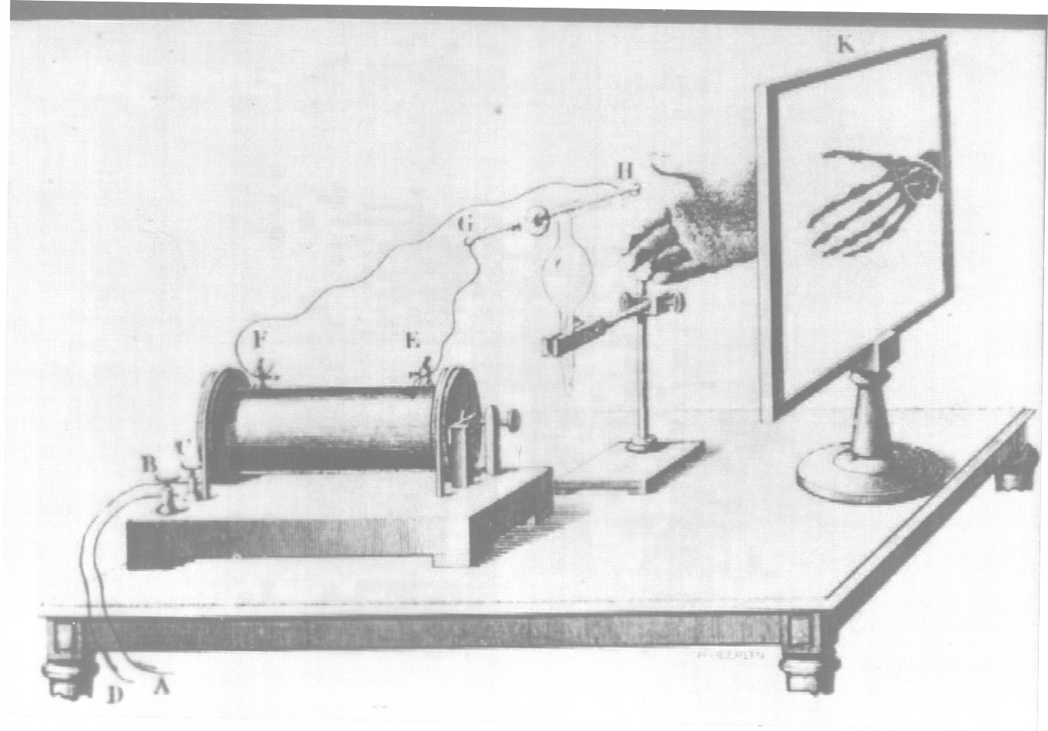
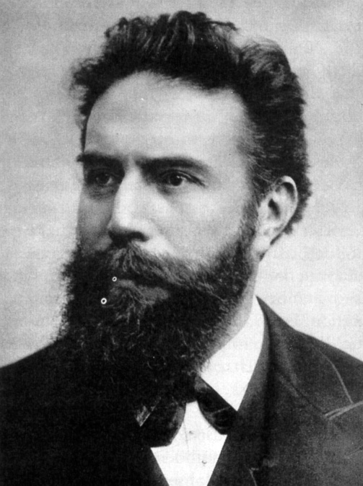
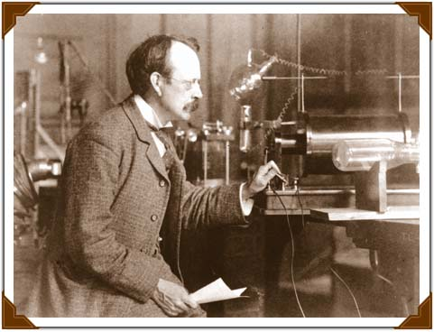
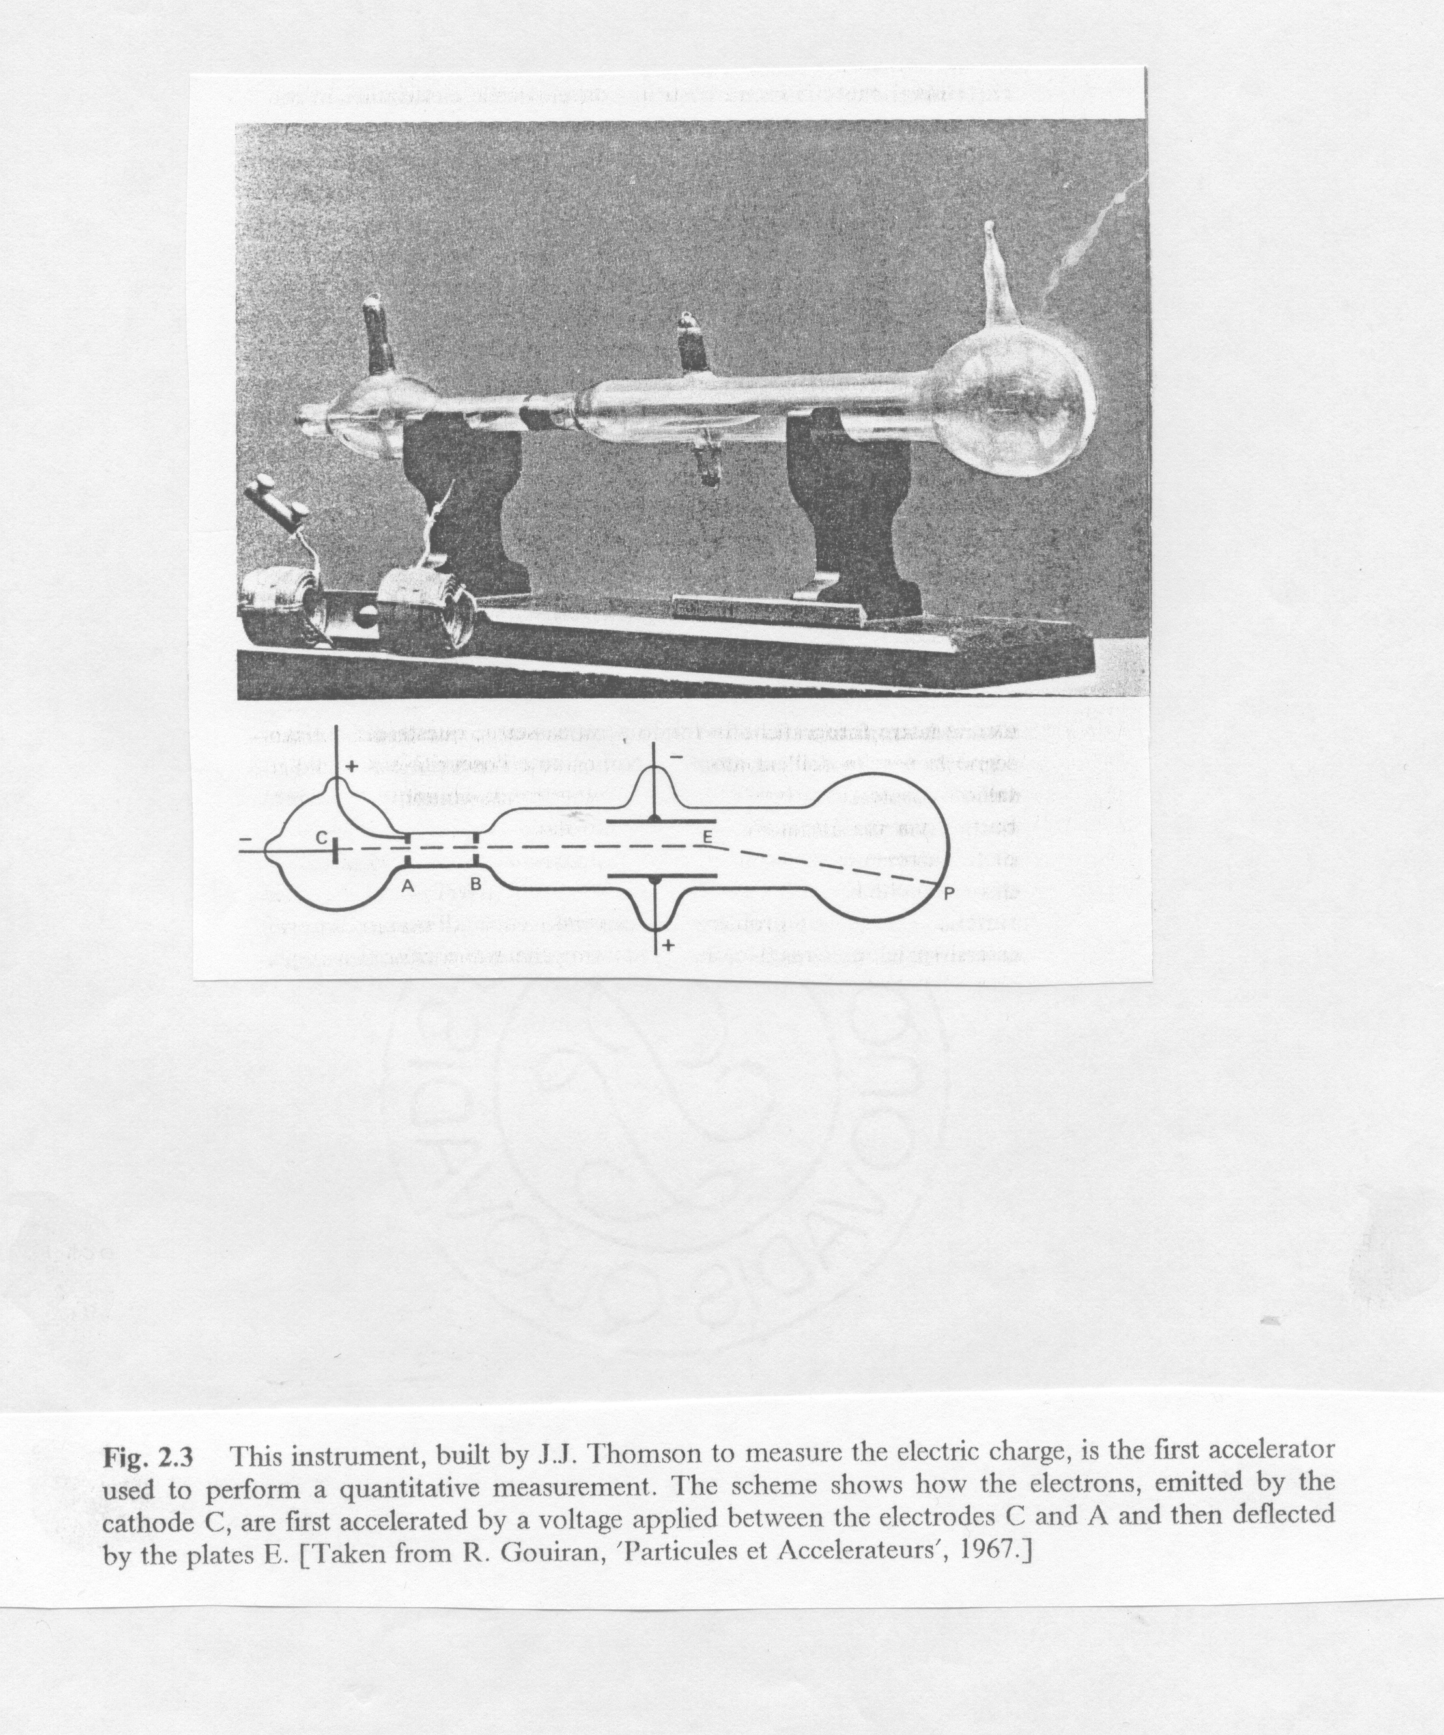
The beginnings of modern physics and of medical physics
1895
discovery of X rays
Wilhelm Conrad Röntgen
J.J. Thompson
1897
“discovery” of the electron
Courtesy Prof. Ugo Amaldi

Slide 5
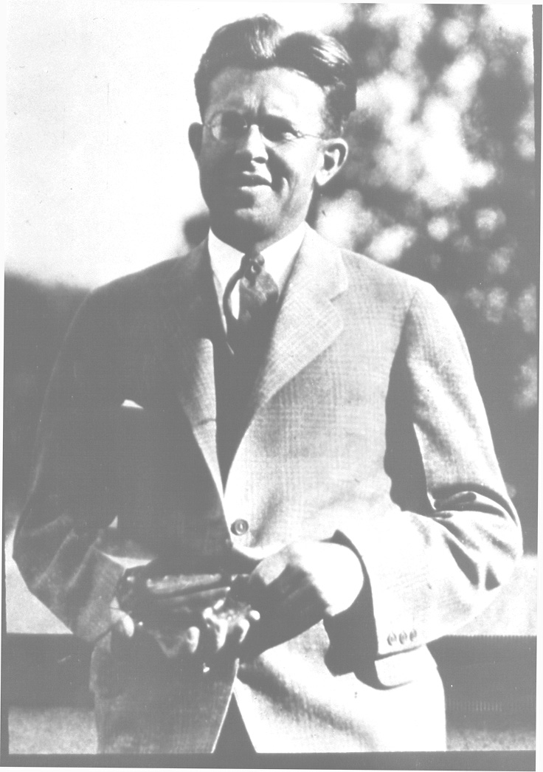
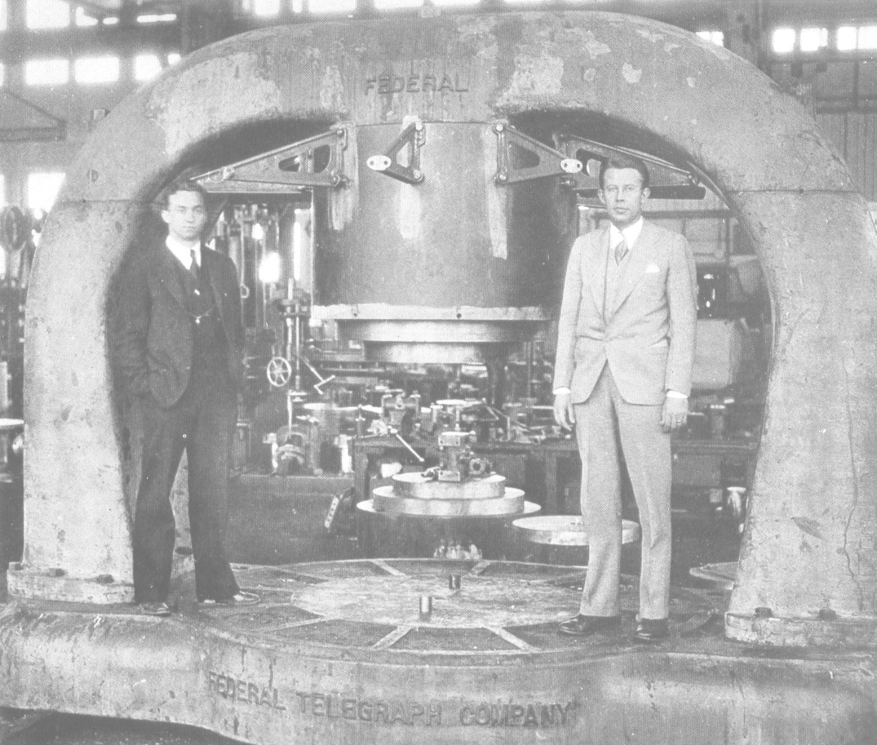
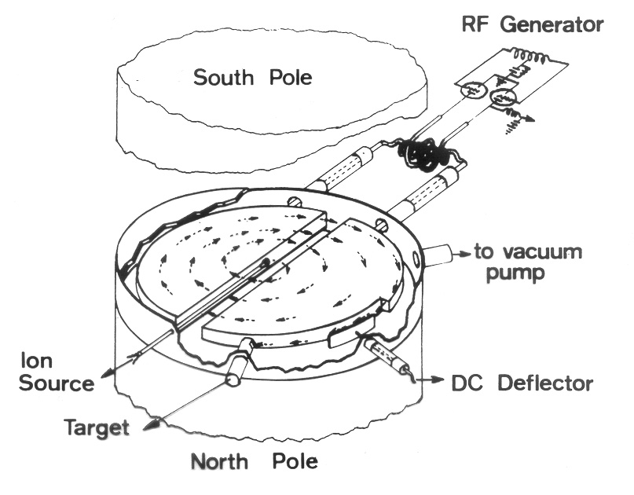
Tools for (medical) physics: the cyclotron
1930
Ernest Lawrence invents the cyclotron
M. S. Livingston and E. Lawrence
with the 25 inch cyclotron
Courtesy Prof. Ugo Amaldi

Slide 6
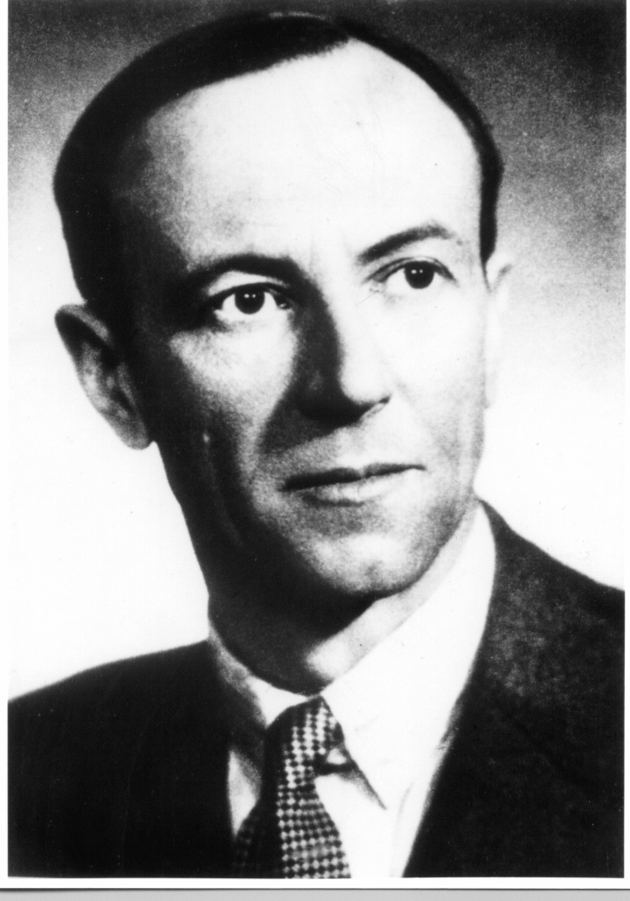
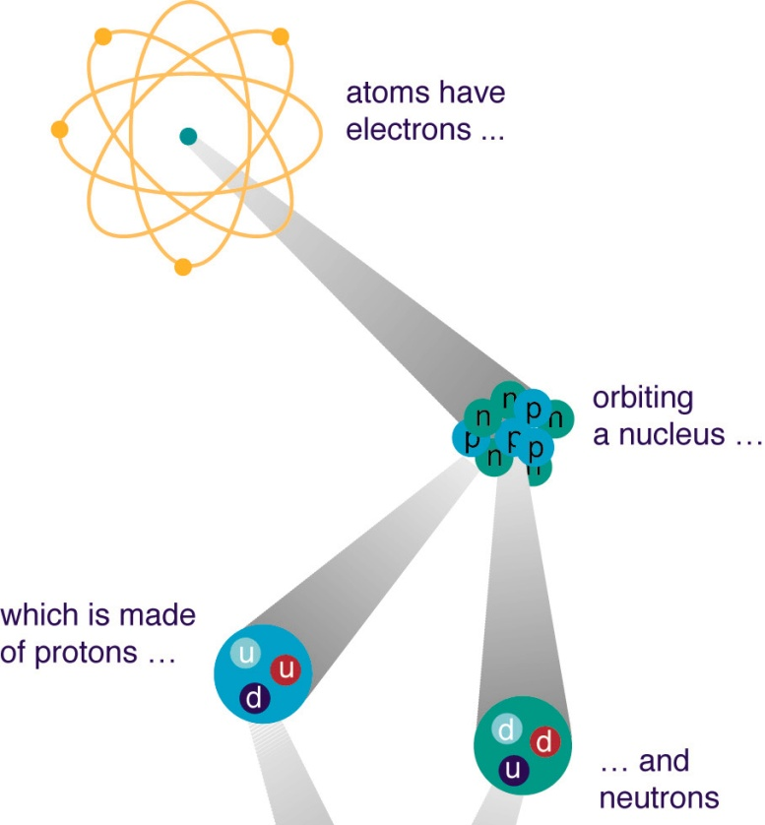
The beginnings of modern physics and of medical physics
1932
Discovery of the neutron
James Chadwick
(1891 – 1974)
Cyclotron + neutrons = first attempt of radiation therapy with fast neutrons at LBL
(R. Stone and J. Lawrence, 1938)
Courtesy Prof. Ugo Amaldi

Slide 7
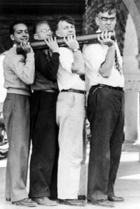
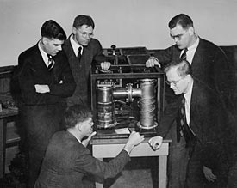
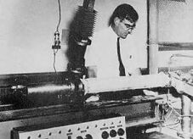
Tools for (medical) physics: the electron linac
Sigmur Varian
William W. Hansen
Russell Varian
1939
Invention of the klystron
1950’s: development of compact linear electron accelerators by various companies
1947
first linac for electrons
4.5 MeV and 3 GHz
Courtesy Prof. Ugo Amaldi

Slide 8
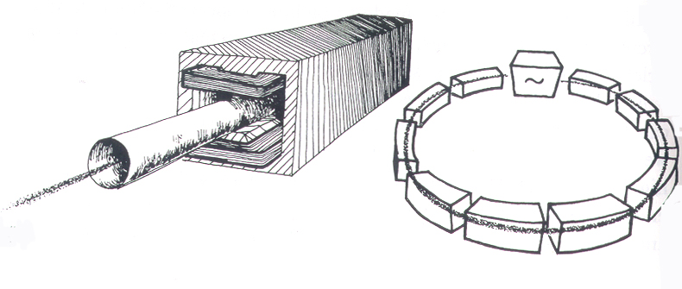
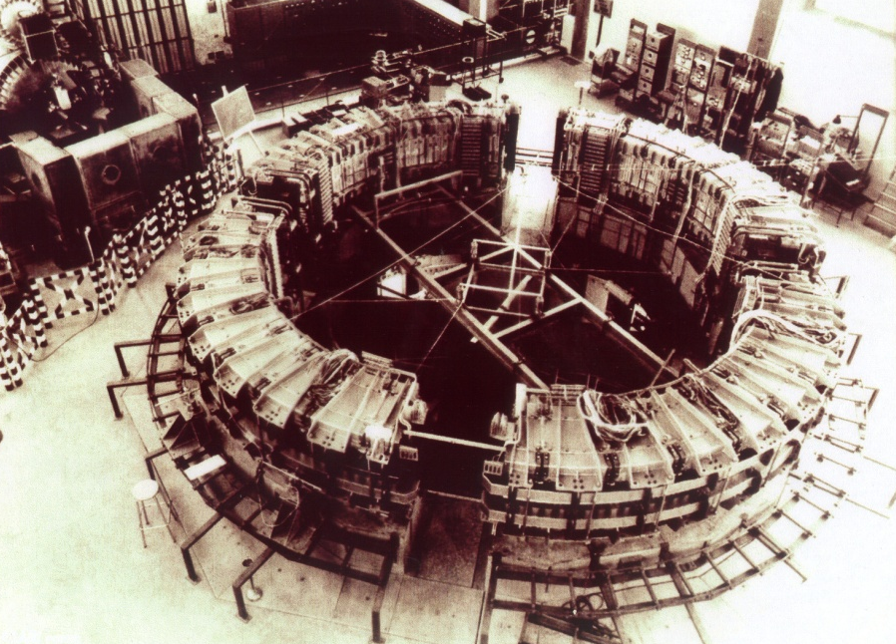
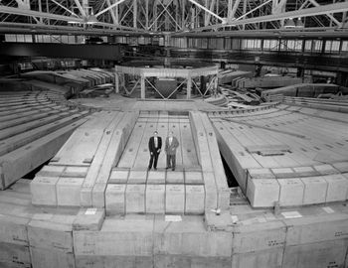
Tools for (medical) physics: the synchrotron
1945: E. McMillan and V.J. Veksler
discover the principle of phase stability
1 GeV electron synchrotron
Frascati - INFN - 1959
6 GeV proton synchrotron
Bevatron - Berkeley - 1954
Courtesy Prof. Ugo Amaldi

Slide 9
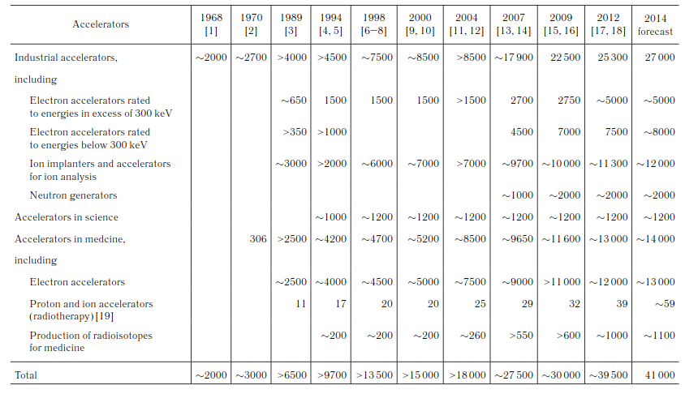
Particle accelerators operational in the world
Medical applications
Three main applications: 1) Scientific research, 2) Medical applications 3) Industrial uses
A. P. Chernyaev and S. M. Varzar, Particle Accelerators in Modern World, Physics of Atomic Nuclei, 2014, Vol. 77, No. 10, pp. 1203–1215.

Slide 10
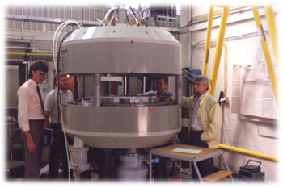
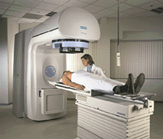
Particle accelerators for medical uses
Production of radionuclides with (low-energy) cyclotrons
  Imaging (PET and SPECT)
  Therapy
Electron linacs for conventional radiation therapy (including advanced modalities)
Medium-energy cyclotrons and synchrotrons for hadron therapy with protons (250 MeV) or light ion beams (400 MeV/u ¹²C-ions)
Compact proton accelerators for BNCT

Slide 11
Radionuclide production

Slide 12
Radionuclide production
The use of radionuclides in the physical and biological sciences can be
broken down into three general categories:
Radiotracers
Imaging (95% of medical uses)
SPECT (^{99m}Tc, ²⁰¹Tl, ¹²³I)
PET (¹¹C, ¹³N, ¹⁵O, ¹⁸F)
Therapy (5% of medical uses)
Brachytherapy (¹⁰³Pd)
Targeted therapy (²¹¹At, ²¹³Bi)
Relevant physical parameters (function of the application)
Type of emission (α, β⁺, β–, γ)
Energy of emission
Half-life
Radiation dose (essentially determined by the parameters above)

Slide 13
Production methods
All radionuclides commonly administered to patients in nuclear medicine are artificially produced
Three production routes:
(n,γ) reactions (nuclear reactor): the resulting nuclide has the same chemical properties as those of the target nuclide
Fission (nuclear reactor) followed by separation
Charged particle induced reaction (cyclotron): the resulting nucleus is usually that of a different element

Slide 14
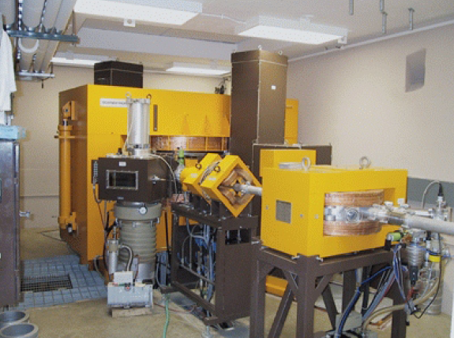
The cyclotron – The work horse for radionuclide production
Scanditronix MC40

Slide 15
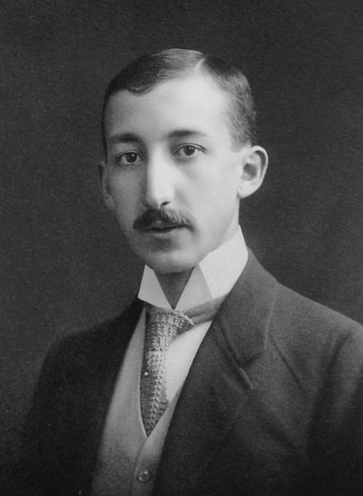
First practical application of a radioisotope (as radiotracer)
1911: first practical application of a radioisotope (as radiotracer) by G. de Hevesy, a young Hungarian student working with naturally radioactive materials in Manchester
1924: de Hevesy, who had become a physician, used radioactive isotopes of lead as tracers in bone studies

Slide 16
Historical development of radioisotopes in medicine
1932: the invention of the cyclotron by E. Lawrence makes it possible to produce radioactive isotopes of a number of biologically important elements
1941: first medical cyclotron installed at Washington University, St. Louis, for the production of radioactive isotopes of phosphorus, iron, arsenic and sulphur
After WWII: following the development of the fission process, most radioisotopes of medical interest begin to be produced in nuclear reactors
1951: Cassen et al. develop the concept of the rectilinear scanner
1955: first cyclotron installed in a hospital (Hammersmith, London)
1957: the ⁹⁹Mo/^{99m}Tc generator system is developed by the Brookhaven National Laboratory
1958: production of the first gamma camera by Anger, later modified to what is now known as the Anger scintillation camera, still in use today

Slide 17
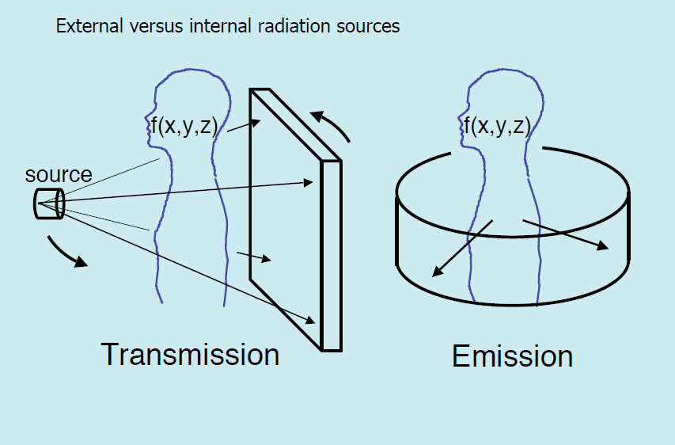
Emission versus transmission imaging
Courtesy P. Kinahan

Slide 18
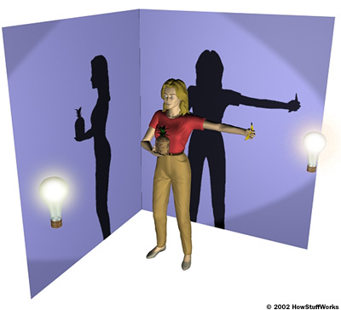
X-ray image versus CT scan
A conventional X-ray image is basically a shadow: you shine a “light” on one side of the body, and a piece of film or a silicon sensor on the other side registers the silhouette of the bones (to be more precise, organs and tissues of different densities show up differently on the radiographic film).
Shadows give an incomplete picture of an object's shape.
Look at the wall, not at the person. If there's a lamp in front of the person, you see the silhouette holding the banana, but not the pineapple as the shadow of the torso blocks the pineapple. If the lamp is to the left, you see the outline of the pineapple, but not the banana.

Slide 19
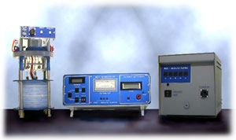
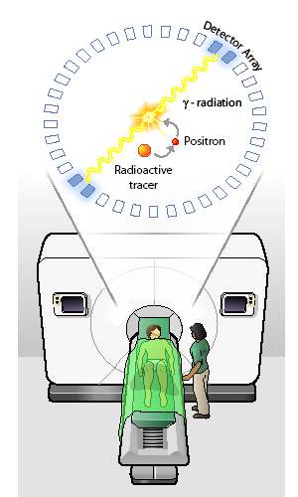
Positron Emission Tomography (PET)
PET camera
Cyclotron
Radiochemistry
J. Long, “The Science Creative Quarterly”,scq.ubc.ca

Slide 20
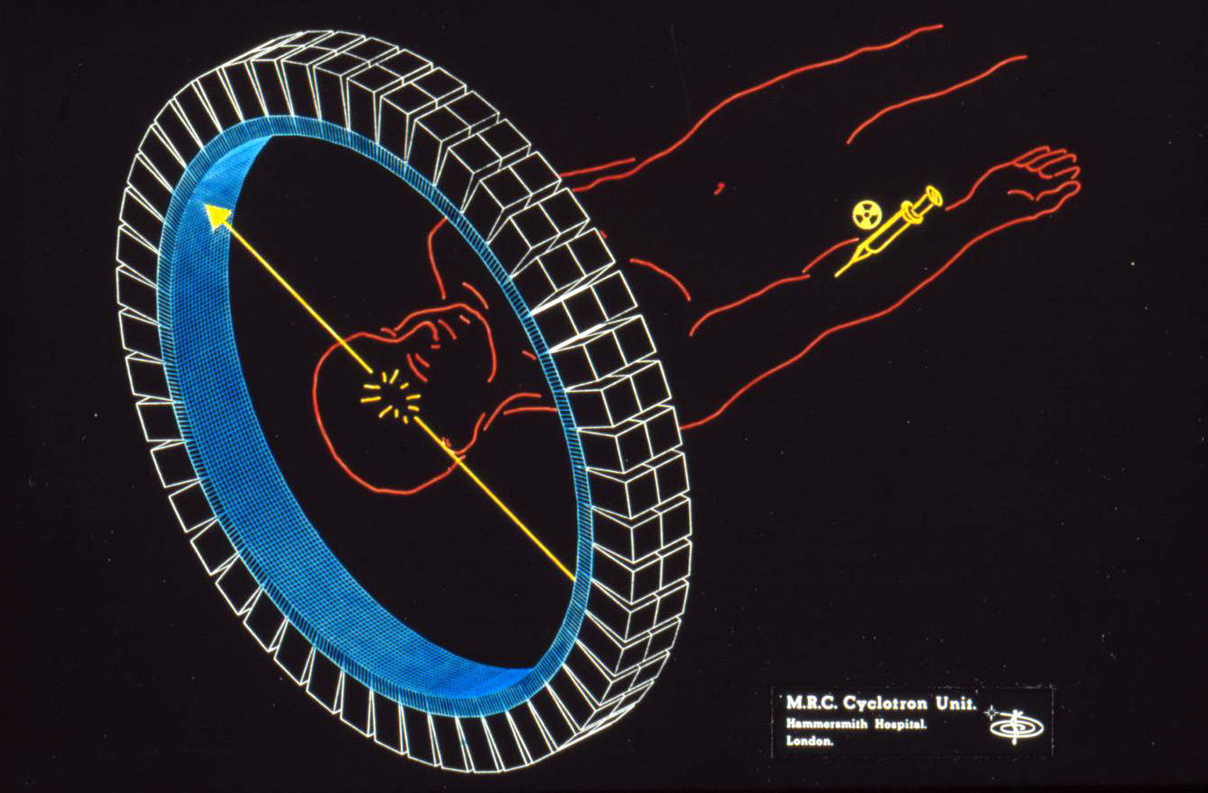
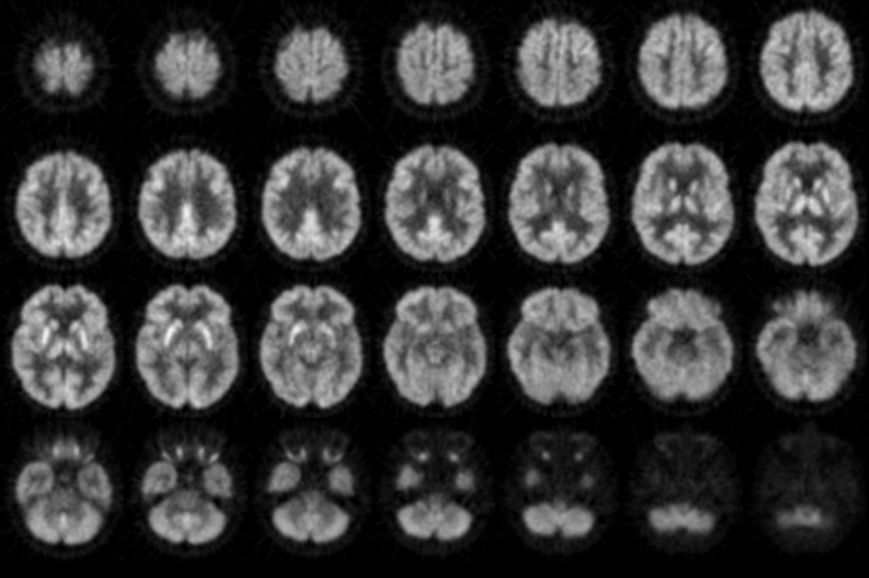
Positron Emission Tomography (PET)
511keV
511keV
COVERAGE:
~ 15-20 cm
SPATIAL RESOLUTION:
~ 5 mm
SCAN TIME to cover an entire organ:
~ 5 min
CONTRAST RESOLUTION:
depends on the radiotracer

Slide 21
Radionuclide production: fundamental decay equation
N(t) = N₀e^{-λt} or A(t) = A(0)e^{-λt}
where:
  N(t) = number of radioactive atoms at time t
  N₀ = initial number of radioactive atoms at t = 0
  A(t) = activity at time t
  A(0) = initial activity at t = 0
  e = base of natural logarithm = 2.71828…
  λ = decay constant = 1/τ = ln 2/T_{1/2} = 0.693/T_{1/2}
  t = time
  and remembering that:
  -dN/dt = λ N
  A = λ N

Slide 22
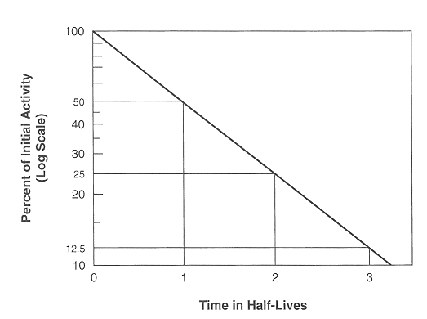
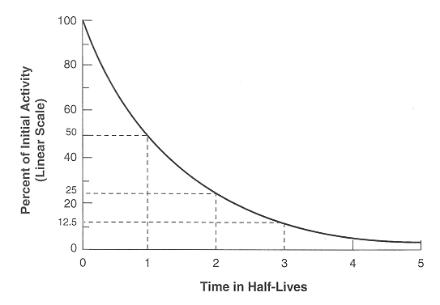
Radionuclide production: fundamental decay equation
Linear-Log scale
Linear-Linear scale

Slide 23
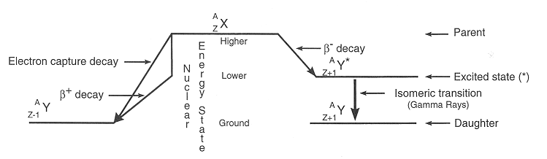
Generalized decay scheme

Slide 24
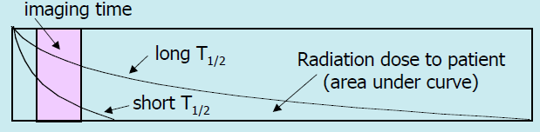

The “ideal” diagnostics radiopharmaceutical
Be readily available at a low cost
Be a pure gamma emitter, i.e., have no particle emission such as alphas and betas (these particles contribute radiation dose to the patient while not providing any diagnostic information)
Have a short effective biological half-life (so that it is eliminated from the body as quickly as possible)
Have a high target to non-target ratio so that the resulting image has a high contrast (the object has much more activity than the background)
Follow or be trapped by the metabolic process of interest

Slide 25
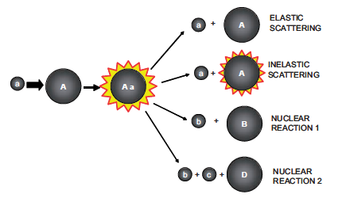
The essential steps in accelerator radionuclide production
Acceleration of charged particles in a cyclotron
Beam transport (or not) to the irradiation station via a transfer line
Irradiation of target (solid, liquid, gas) – internal or external
Nuclear reaction occurring in the target (e.g. ^{A}X_{Z}(p,n)^{A}y_{Z+1})
Target processing and material recovering
Labeling of radiopharmaceuticals and quality control
a = bombarding particle
b, c = emitted particles
A, B, D = nuclei

Slide 26
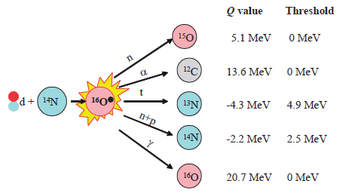
Example: d + ¹⁴N ¹⁶O*
Q values and thresholds of nuclear decomposition for the reaction of a deuteron with a ¹⁴N nucleus after forming the compound nucleus ¹⁶O
Q value = the amount of energy absorbed or released during the nuclear reaction
Q (MeV) = 931.5 ( m₁ + M₂ – m₃ – M₄)

Slide 27
Production rate and cross section
R = the number of nuclei formed per second
n = the target thickness in nuclei per cm²
I = incident particle flux per second (related to the beam current)
λ = decay constant = (ln 2)/T_{1/2}
t = irradiation time in seconds
σ = reaction cross-section, or probability of interaction (cm²), function of E
E = energy of the incident particles
x = distance travelled by the particle
and the integral is from the initial energy (threshold of reaction) to the final energy of the incident particle along its path

Slide 28
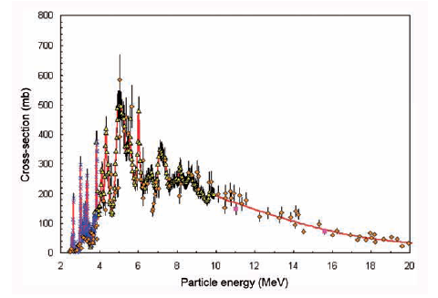
Energy dependence of the cross section σ
Excitation function of the ¹⁸O(p,n)¹⁸F reaction

Slide 29
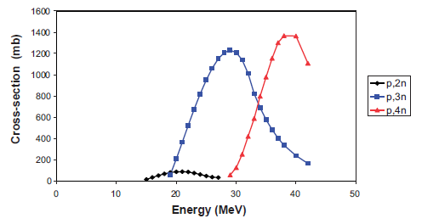
Competing nuclear reactions, example of ²⁰¹Tl
The nuclear reaction used for the production of ²⁰¹Tl is the ²⁰³Tl(p,3n)²⁰¹Pb
²⁰¹Pb (T_{1/2} = 9.33 h) ²⁰¹Tl (T_{1/2} = 76.03 h)
Cross-section versus energy plot for the ²⁰³Tl(p,2n)²⁰²Pb, ²⁰³Tl(p,3n)²⁰¹Pb and ²⁰³Tl(p,4n)²⁰⁰Pb reactions
Below 20 MeV, production of ²⁰¹Tl drops to very low level
(http://www.nndc.bnl.gov/index.jsp)
Around threshold, production of ²⁰¹Tl is comparable to that of ²⁰²Pb
Above 30 MeV, production of ²⁰⁰Pb becomes significant

Slide 30
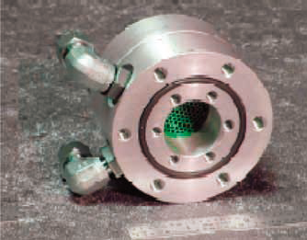
Targets
Internal (beam is not extracted from the cyclotron)
External (extracted beam + beam transport to target)
Simultaneous irradiation of more than one target (H– cyclotrons)
The target can be
Solid
Liquid
Gaseous
Principal constraints on gas targets
removal of heat from the gas (gases are not very good heat conductors)
the targets must be quite large in comparison with solid or liquid targets in order to hold the necessary amount of material.
¹⁸O water target
to produce ¹⁸F via ¹⁸O(p,n)

Slide 31
Production reactions (1)
Radionuclide | Use | Half-life | Reaction | Energy (MeV)
^{99m}Tc | SPECT imaging | 6 h | ¹⁰⁰Mo(p,2n) | 30
¹²³I | SPECT imaging | 13.1 h | ¹²⁴Xe(p,n)¹²³Cs ¹²⁴Xe(p,pn)¹²³Xe ¹²⁴Xe(p,2pn)¹²³I ¹²³Te(p,n)¹²³I ¹²⁴Te(p,2n)¹²³I | 27 15 25
²⁰¹Tl | SPECT imaging | 73.1 h | ²⁰³Tl(p,3n)²⁰¹Pb →²⁰¹Tl | 29
¹¹C | PET imaging | 20.3 min | ¹⁴N(p,α) ¹¹B(p,n) | 11–19 10
¹³N | PET imaging | 9.97 min | ¹⁶O(p,α) ¹³C(p,n) | 19 11

Slide 32
Production reactions (2)
Radionuclide | Use | Half-life | Reaction | Energy (MeV)
¹⁵O | PET imaging | 2.03 min | ¹⁵N(p,n) ¹⁴N(d,2n) ¹⁶O(p,pn) | 11 6 > 26
¹⁸F | PET imaging | 110 min | ¹⁸O(p,n) ²⁰Ne(d,α) ^{nat}Ne(p,X) | 11-17 8-14 40
⁶⁴Cu | PET imaging and radiotherapy | 12.7 h | ⁶⁴Ni(p,n) ⁶⁸Zn(p,αn) ^{nat}Zn(d,αxn) ^{nat}Zn(d,2pxn) | 15 30 19 19
¹²⁴I | PET imaging and radiotherapy | 4.14 d | ¹²⁴Te(p,n) ¹²⁵Te(p,2n) | 13 25

Slide 33
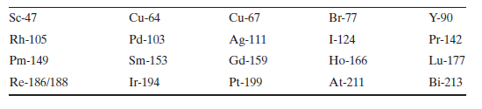
Radionuclides for therapy
High LET decay products (Auger electrons, β-particles or α-particles)
Radionuclide linked to a biologically active molecule that can be directed to a tumour site
Beta emitting radionuclides are neutron rich they are in general produced in reactors
Some of the radionuclides that have been proposed as possible radiotoxic tracers are:
Click here to learn about radionuclide generators

Slide 34
Radiation therapy

Slide 35
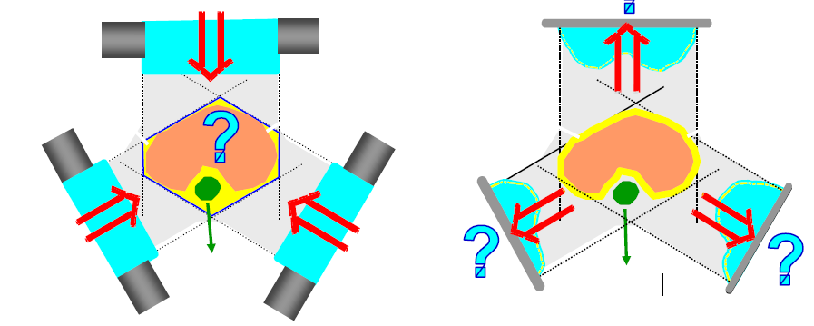
Treatment planning and dose delivery to tumour volume

Slide 36
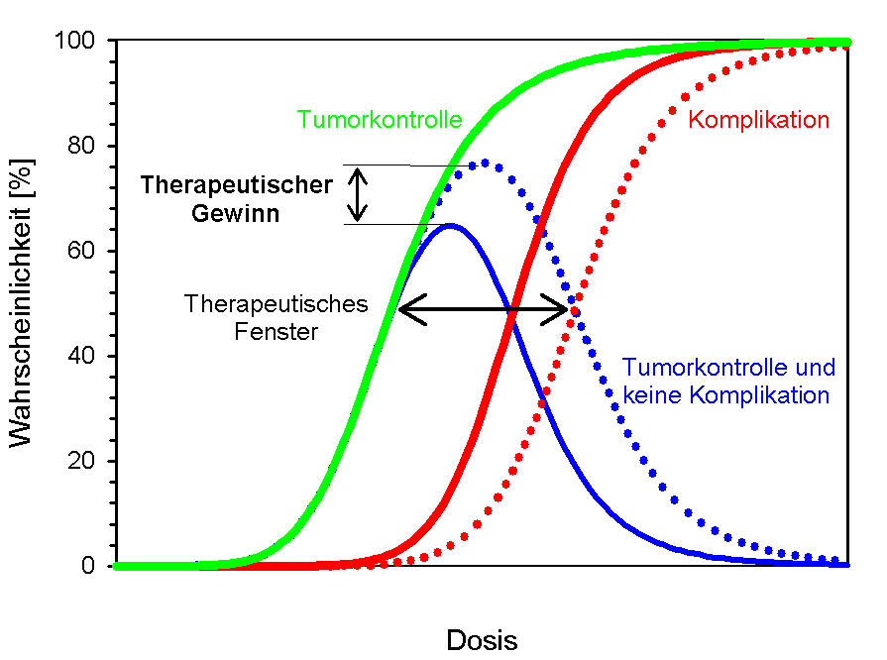
Tumour control and therapeutic window
Tumour control
Therapeutic advantage
Complications
Probability (%)
Therapeutic window
Tumour control w/o complications
Dose

Slide 37
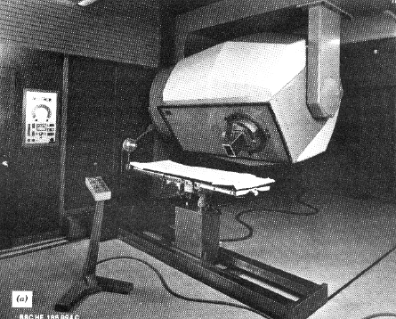
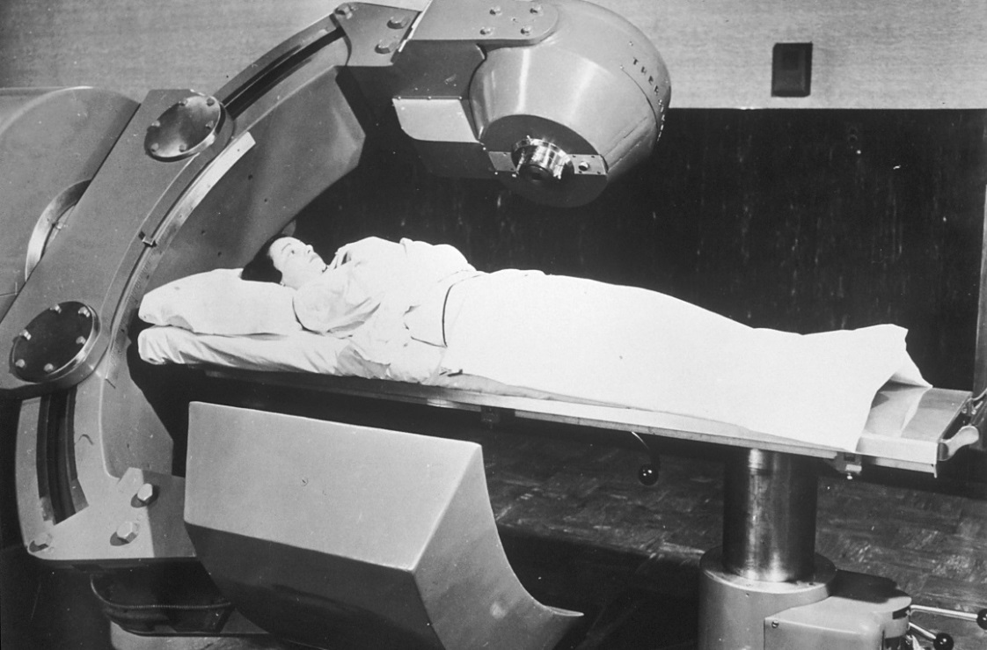
Past radiation therapy equipment
45 MeV Betatron
Co-60 unit
Photo: Wikipedia
Radiation therapy is much more than the radiation source. One also needs:
diagnostic equipment, CT scanners
treatment planning software
patient set-up devices
computers
a broad range of professional figures
Betatron and microtron

Slide 38
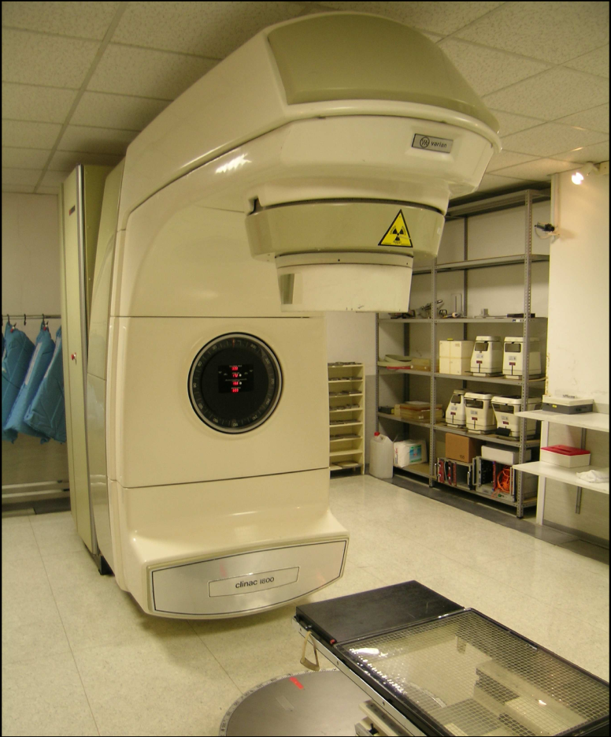
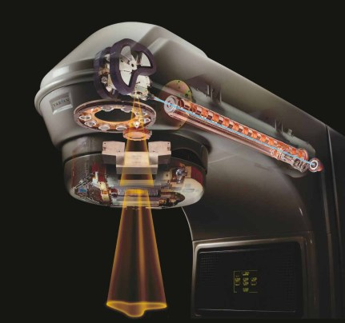

Medical electron linacs
e– + target → X-rays
Energy: 6-25 MeV
Dual e─ / γ beams
Varian Clinac 1800
Courtesy Varian Medical
target
Multi-leaf collimator

Slide 39
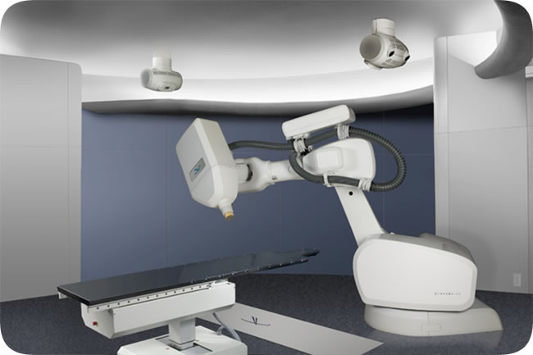
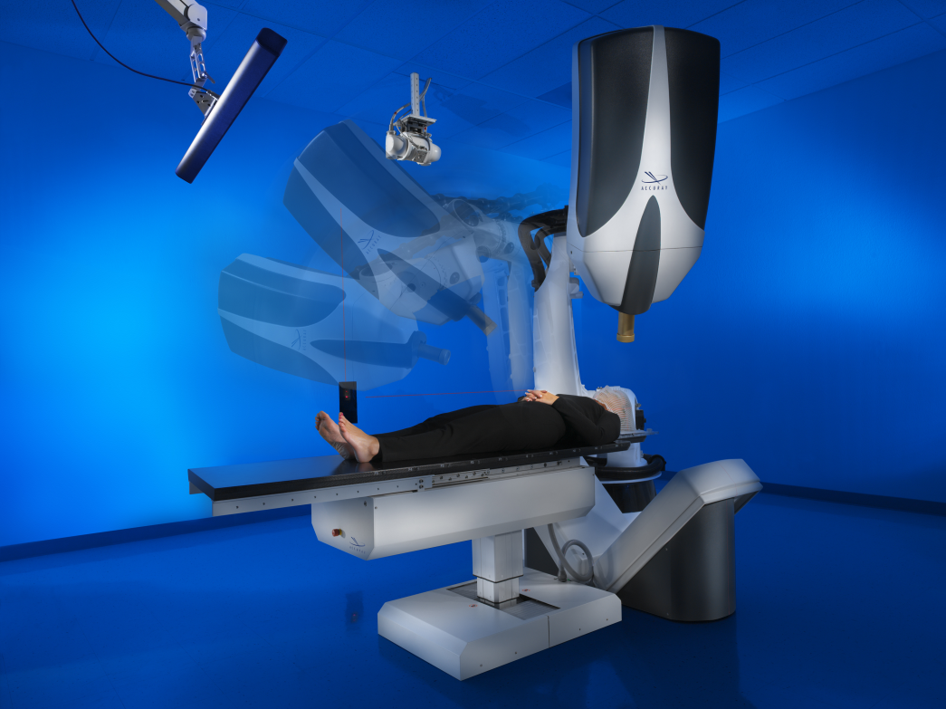
Cyber-knife robotic surgery system
6 MV Linac mounted on a robotic arm
No flattening filter
Uses circular cones of diameter 0.5 to 6 cm
Non-Isocentric
Average dose delivered per session is 12.5 Gy
Dose rate @ 80 cm = 400 cGy/min
http://www.accuray.com/Products/Cyberknife/index.aspx

Slide 40
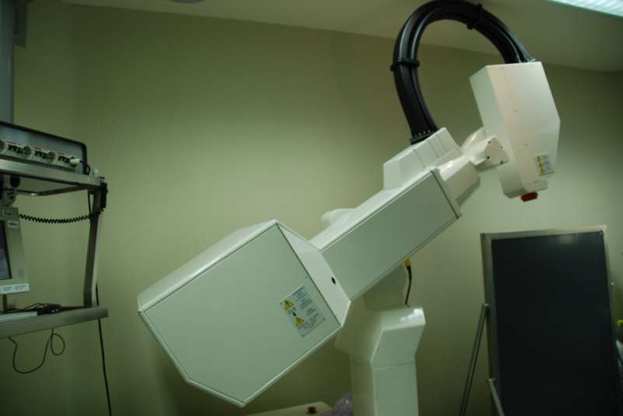
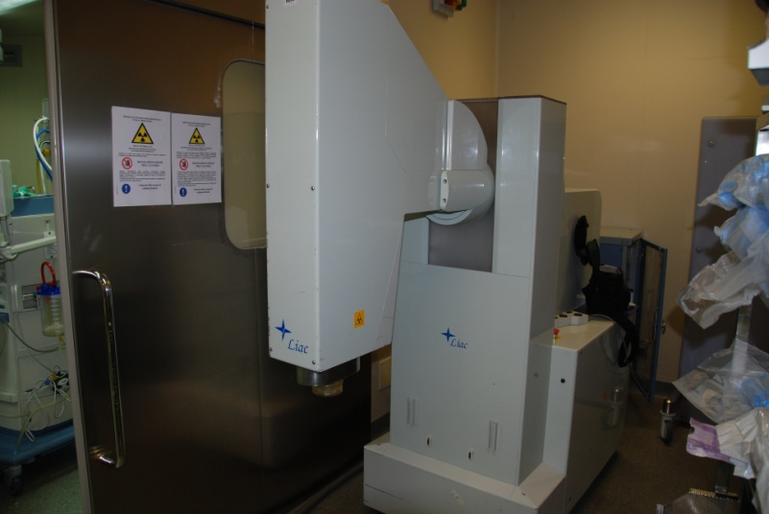
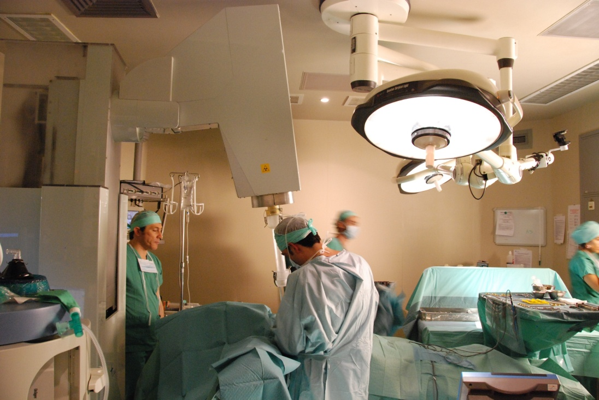
Intra-operative radiation therapy (IORT)
Small electron linac
Energy 6 – 12 MeV
Treatment with electrons only
Single irradiation
Courtesy: myself!

Slide 41
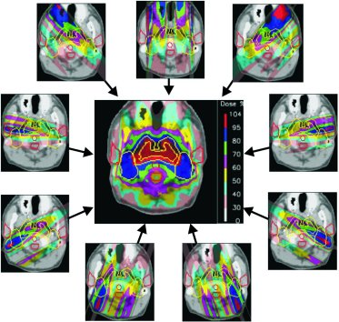
Intensity modulated radiation therapy (IMRT)
An example of intensity modulated treatment planning with photons. Through the addition of 9 fields it is possible to construct a highly conformal dose distribution with good dose sparing in the region of the brain stem (courtesy of T. Lomax, PSI).
E. Pedroni, Europhysics News (2000) Vol. 31 No. 6

Slide 42
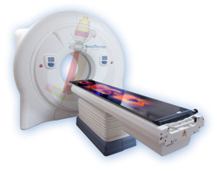
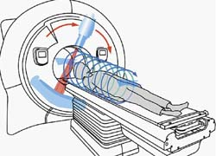
Helical tomotherapy
www.tomotherapy.com
Integrated CT guidance
  Integrated CT scanner allowing efficient 3D CT imaging for ensuring the accuracy of treatment
A binary multi-leaf collimator (MLC) for beam shaping and modulation
A ring gantry design enabling TomoHelical delivery
  As the ring gantry rotates in simultaneous motion to the couch, helical fan-beam IMRT is continuously delivered from all angles around the patient
  Very large volumes can be treated in a single set-up

Slide 43

Hybrid MRI linac

Slide 44





Volumetric Modulated “ARC” Radiation Therapy
Rotate linac gantry while modulating the beam
Fixed 6 or so gantry angles
VMAT
Name-Prof Peter Metcalfe
BSOC lecture 08

Slide 45

Particle therapy (hadron therapy)
electron “e”
“hadrons” are
made of quarks
atom
carbon ion =
6 protons + 6 neutrons
Proton or
neutron
quark “u” or “d”

Slide 46

Particle therapy (hadron therapy)
Courtesy INFN, Italy

Slide 47

Treatment planning

Slide 48


Particle therapy (hadron therapy)
27 cm
tumour
target
200 MeV
protons
4800 MeV
carbon ions
charged hadron beam
that loses energy in matter
www.ptcog.ch

Slide 49



Cyclotrons and synchrotrons for proton therapy
Accel-Varian
(superconducting)
IBA
Loma Linda (built by FNAL)
Hitachi

Slide 50

The LLUMC proton synchrotron
Loma Linda University Medical Center

Slide 51

Beam delivery: passive vs active
A. C. Kraan and A. Del Guerra, Technological Developments and Future Perspectives in Particle Therapy: A Topical Review, IEEE Transactions on Radiation and Plasma Medical Sciences 8, 453-480, 2024
This recent review provides an overview of technological advances in particle therapy hardware (accelerators, gantries and treatment veriﬁcation techniques), software (Monte Carlo simulations, treatment planning calculations), and studies toward clinical applications

Slide 52



A proton therapy facility is not just the accelerator
ISOCENTRIC GANTRIES
10 - 12 m
HIT, Heidelberg
IBA
A gantry is a massive structure that allows directing the beam to the tumour from any direction. It carries:
the final section of the beam line
the beam spreading ‘nozzle’
the proton ‘snout’ which carries the aperture and range compensator

Slide 53




PROSCAN at Paul Scherrer Institut (PSI), Switzerland
PROSCAN
ACCEL
SC cyclotron
250 MeV protons
TERA
Courtesy PSI and U. Amaldi , TERA
J.M. Schippers et al., NIM BB 261 (2007) 773–776

Slide 54
Protons vs carbon: radiobiological effectiveness RBE of radiation

Slide 55

Proton versus carbon-ion synchrotrons
Do you see the difference between the two?
Hitachi proton synchrotron Siemens ion synchrotron
G. Coutrakon, Accelerators for Heavy-charged-particle Radiation Therapy,
Technology in Cancer Research & Treatment, Volume 6, Number 4 Supplement, August 2007

Slide 56

National Centre for Oncological Hadrontherapy, CNAO, Italy

Slide 57
National Centre for Oncological Hadrontherapy, CNAO, Italy
Ion sources
LEBT components
Courtesy S. Rossi, CNAO
Injector linac
Quadrupole magnets
RF cavity
Dipole magnets

Slide 58

National Centre for Oncological Hadrontherapy, CNAO, Italy

Slide 59


Single room proton facilities
IBA Proteus Nano
Mevion Medical Systems

Slide 60






Multi-room versus single-room facilities
29 m (87ft)
2,240 m²
Other Proton Systems
812 m²
28 m (84 ft)
714 m²
Advantages of single-room facility:
Modularity
Reliability / back-up
PT treatment available at more hospitals
(Hopefully) cost
13 m (39 ft)
182 m²
14 m (41 ft)
Courtesy L. Bouchet, Still River Systems

Slide 61



Boron Neutron Capture Therapy (BNCT)
Interaction of an individual epithermal neutron being moderated by the hydrogenous tissue to thermal energies and thereafter being captured by a ¹⁰B atom, triggering the therapeutic α decay

Slide 62





Accelerator-based BNCT
BudkerINP Vacuum Insulated Tandem (VITA)
Ibaraki prefecture RFQ + DTL

Slide 63

Accelerator-based BNCT in Helsinki, Finland
Peeter Karihtala (Helsinki University CCC and University of Helsinki)

Slide 64


Accelerator-based BNCT @ CNAO, Italy
Sandro Rossi, CNAO, Italy

Slide 65




Dosimetry in BNCT
Four separate radiation components with different biological characteristics and spatial distributions
Boron dose (D_{B})
From ¹⁰B(n,α)⁷Li reactions
Incident neutrons (D_{n,} D_{H})
Leading to dose deposition mainly via (n,p) reactions
Photons (D_{γ})
Incident with the n beam and internally generated – mainly 2.2 MeV from ¹H(n,γ)²H reactions (radioactive capture)
Thermal neutrons (D_{N} or D_{Th})
Mainly from ¹⁴N(n,p)¹⁴C reactions

Slide 66

Availability of radiation therapy worldwide

Slide 67

Availability of radiation therapy in African countries
A partnership in pursuit of innovative radiation therapy technology for use in challenging environments - ICEC (iceccancer.org)

Slide 68



Challenges and expected developments in radiation therapy
CERN-ICEC workshop, CERN, November 2016
https://indico.cern.ch/event/560969/
CERN-ICEC-STFC workshop, CERN, October 2017
https://indico.cern.ch/event/661597/
September 2015

Slide 69


Guidelines

Slide 70
Challenges in Radiation Therapy in Africa
Technology
23 of 54 countries have teletherapy services
20 had high- or low-dose brachytherapy resources
293 radiotherapy machines serving 1 billion individuals
1 machine per 3.6 million people
Abdel-Waheb et al, Lancet Oncology, 2013 / Grover et al, Front in Oncology, Jan 2015 / Balogun et al, Radiation Oncology, Aug 2016
Taken from Surbhi Grover’s lecture at the CERN-ICEC-STFC workshop, CERN, October 2017
Human resources
a gap of 7,500 oncologists, 6,000 physicists and 20,000 technicians in LMICs (in Africa: 1600 medical oncologists, 1000 medical physicists and 4000 technicians)
Taken from Andras Fehervary’s lecture at the CERN-ICEC workshop, CERN, November 2016

Slide 71

RT resources needed in 20 years from now
LMICS = Low Medium Income Countries
Taken from Mary Gospodarowicz’s lecture at the CERN-ICEC workshop, CERN, November 2016

Slide 72
Developing RT for challenging environments
Linacs
Ability to operate in a difficult environment
  Interruptions in electricity / power supply
  Heat / problem with temperature control
  Dust and humidity
Highly modular, so that faulty parts can easily be replaced
Self-diagnosing, in case of accelerator malfunctioning
Low power consumption
…
Screening
Improve screening and early diagnosis to make RT more effective
Need for
Qualified professionals: radiation oncologists, medical radiotherapy physicists, radiotherapy technicians, radiation protection officers, maintenance engineers, etc.
Related training programmes
Development of medical infrastructure

Slide 73
Some textbooks
On accelerators & radiation therapy:
C.K. Karzmark, Advances in linear accelerator design for radiotherapy, Medical Physics 11, 105- 128 (1984)
S. Humphries, Principles of charged particle acceleration, John Wiley and Sons
H. Wiedemann, Particle accelerator physics, Springer- Werlag
S. Baird, Accelerators for pedestrians, CERN AB-note-2007-014
PTCOG: Particle Therapy Co-Operative Group (http://ptcog.web.psi.ch/)
On radionuclide production:
Cyclotron Produced Radionuclides: Principles and Practice, IAEA Technical Reports Series No. 465 (2008)
(Downloadable from IAEA web site)
Targetry and Target Chemistry, Proceedings Publications, TRIUMF, Vancouver
(http://trshare.triumf.ca/~buckley/wttc/proceedings.html )
CLARK, J.C., BUCKINGHAM, P.D., Short-Lived Radioactive Gases for Clinical Use, Butterworths, London (1975

Slide 74
Supplementary material

Slide 75
Particle accelerators operational in the world
Medical applications
Three main applications: 1) Scientific research, 2) Medical applications 3) Industrial uses
A. P. Chernyaev and S. M. Varzar, Particle Accelerators in Modern World, Physics of Atomic Nuclei, 2014, Vol. 77, No. 10, pp. 1203–1215.

Slide 76

Motion of a particle in a dipole magnetic field
(the field is in/out of the plane of this slide)
where ρ = radius of curvature of the path
(p = momentum = mv)
Bρ = 33.356·p [kG·m] = 3.3356·p [T·m] (if p is in GeV/c)
Bρ is called “magnetic rigidity” of the particle and is an index of how difficult is to bend the motion of a charged particle by a magnetic field

Slide 77


The cyclotron
F = q(E + v x B)
mv² / ρ = qvB ω = 2πf = v / ρ
Rev. frequency f = qB/2πm
Rev. period τ = 1/f is independent of v
Resonant acceleration with f_{RF} = h∙f
Isochronism
Maximum energy/nucleon:
T/A = k (Bρ)² (Z/A)²
with k = e² / 2m_{p}
K = k (Bρ)² is called “bending limit”
K = 48 (Bρ)² (MeV)
if B is in teslas and m in metres

Slide 78


The classical (non relativistic) cyclotron
B
F
Magnetic fields of uniform-field cyclotron:
(top) Sectional view of cyclotron magnetic poles
showing shims for optimizing field distribution.
(left) Radial variation of vertical field magnitude
and field index.
Weak focusing
Decrease of rev. frequency f with r
Loss of isochronism
Two solutions to achieve higher energies: - synchrocyclotron
  - AVF cyclotron

Slide 79

The AVF (isochronous) cyclotron
AVF = azimuthally varying field
B(r,θ) = <B(r)> + Mod(r, θ)
RF constant
<B> rises with radius r to compensate for the relativistic increase of the particle mass
f = q<B>/2πmγ
Vertical focusing achieved by the azimuthal variation of B
A further component of the axial focusing force is obtained by giving the sectors a spiral shape

Slide 80
Experimental measurements of cross section σ
where
R_{i} = number of processes of type i in the target per unit time
I = number of incident particles per unit time
n = number of target nuclei per cm³ of target = ρN_{A}/A
σ_{i} = cross-section for the specified process in cm²
x = the target thickness in cm
and assuming that
The beam current is constant over the course of the irradiation
The target nuclei are uniformly distributed in the target material
The cross-section is independent of energy over the energy range used

Slide 81

Saturation factor, SF = 1 – e^{-λt}
T_{irr} = 1 half-life results in an activity of 50% of the saturation (max) activity
2 half-lives → 75%
3 half-lives → 90%
The practical production limits of a given radionuclide are determined by the half-life of the isotope, e.g.
¹⁵O, T_{1/2} = 2 minutes
¹⁸F, T_{1/2} = almost 2 hours
1 – e^{-λt}
For long lived species, the production rates are usually expressed in terms of integrated dose or total beam flux (µA·h)

Slide 82
Radionuclide generators
Technetium-99m (^{99m}Tc) has been the most important radionuclide used in nuclear medicine
Short half-life (6 hours) makes it impractical to store even a weekly supply
Supply problem overcome by obtaining parent ⁹⁹Mo, which has a longer half-life (67 hours) and continually produces ^{99m}Tc
A system for holding the parent in such a way that the daughter can be easily separated for clinical use is called a radionuclide generator

Slide 83

Radionuclide generators

Slide 84
Transient equilibrium
Between elutions, the daughter (^{99m}Tc) builds up as the parent (⁹⁹Mo) continues to decay
After approximately 23 hours the ^{99m}Tc activity reaches a maximum, at which time the production rate and the decay rate are equal and the parent and daughter are said to be in transient equilibrium
Once transient equilibrium has been reached, the daughter activity decreases, with an apparent half-life equal to the half-life of the parent
Transient equilibrium occurs when the half-life of the parent is greater than that of the daughter by a factor of about 10

Slide 85

Transient equilibrium

Slide 86

Radionuclide generators

Slide 87

The betatron
Schematic diagram of betatron with air gap
= field at the orbit
= average flux density through the orbit
Magnetic field produced by pulsed coils
The magnetic flux inside the radius of the vacuum chamber changes with time
Increasing flux generates an azimuthal electric field which accelerates electrons in the chamber

Slide 88


The microtron
An “electron cyclotron”
Uniform magnetic field
Fixed-frequency RF system
Well-separated orbits
MICROTRONE
Bending radius
Revolution time
Racetrack microtron
Isocronism only if γ ≈ 1
If γ > 1, Δτ per turn = Δγ
To have isochronism it must be Δτ per turn = hτ_{RF}
Required energy gain per passage
  for electrons ΔE_{e}= 511 keV
  for protons ΔE_{p}= 938 MeV
Magnet weight ≈ (energy)³

Slide 89

Electron acceleration in a waveguide
Particles initially in
cell 1 arrive in cell 2 to get further accelerating
kick. Frequency must match particles
velocity and cell periodicity = ½ λ:

Slide 90

Schematics of a treatment head of a medical electron linac

Slide 91
We have already seen the motion of a particle in a dipole field…
(the field is in/out of the plane of this slide)
where ρ = radius of curvature of the path
(p = momentum = mv)
Bρ = 33.356·p [kG·m] = 3.3356·p [T·m] (if p is in GeV/c)
Bρ is called “magnetic rigidity” of the particle and is an index of how difficult is to bend the motion of a charged particle by a magnetic field

Slide 92



Trajectory of particles in a dipole field
Trajectory of a particle in a bending magnet
Photo: courtesy ANL
Unfortunately an accelerator contains more than one particle!
Number of circulating particles in a synchrotron is typically in the order of 10¹⁰ - 10¹² or more
Two particles in a dipole field, with same momentum but different initial angles

Slide 93


Quadrupole magnets as thin lenses
Light rays passing through a series of focusing and defocusing lenses
The lenses, which are concave in one plane, are convex in the other
In both cases the concave lenses will have little effect as the light passes very close to their centre, and the net result is that the light rays are focused in both planes

Slide 94

The mechanical equivalent
The gutter below illustrates how the particles in a synchrotron behave due to the quadrupole fields.
Whenever a particle beam diverges too far away from the central orbit the quadrupoles focus them back towards the central orbit.
Beam “envelope” defined by the β function
Photo courtesy Fermilab Visual Media Services

