Slide 1

Radiation measurements and dosimetry
Marco Silari
(retired from CERN, Geneva, Switzerland)
Research Associate with Polytechnic of Milano, Italy
marco.silari@cern.ch

Slide 2
Outline of the lecture
A very brief historical introduction
Directly and indirectly ionizing radiation
  Radioactivity
  Natural exposures
The effects of ionizing radiation
  Deterministic and stochastic effects
Radiological quantities and units
  physical, protection and operational quantities
Principles of radiation protection
  Justification, optimization and dose limitation
  The ALARA principle
Protection means
Instrumentation for measuring ionizing radiation

Slide 3
Outline of the lecture
A very brief historical introduction
Directly and indirectly ionizing radiation
  Radioactivity
  Natural exposures
The effects of ionizing radiation
  Deterministic and stochastic effects
Radiological quantities and units
  physical, protection and operational quantities
Principles of radiation protection
  Justification, optimization and dose limitation
  The ALARA principle
Protection means
Instrumentation for measuring ionizing radiation

Slide 4
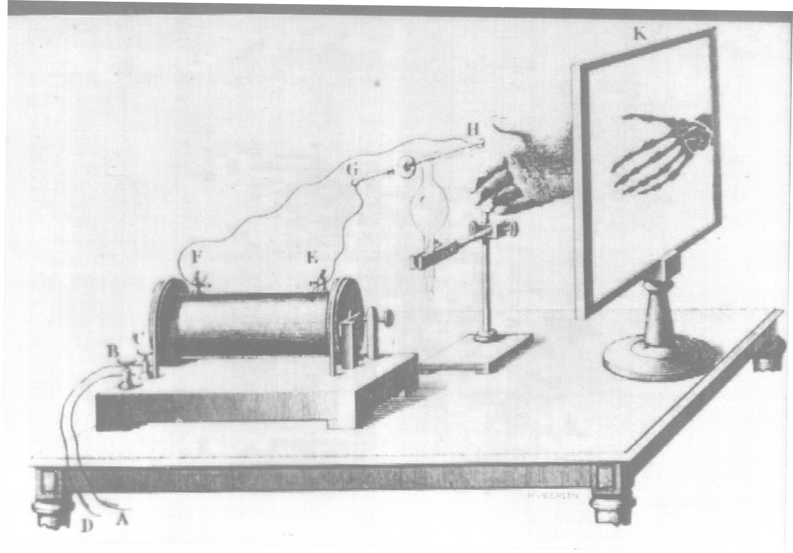
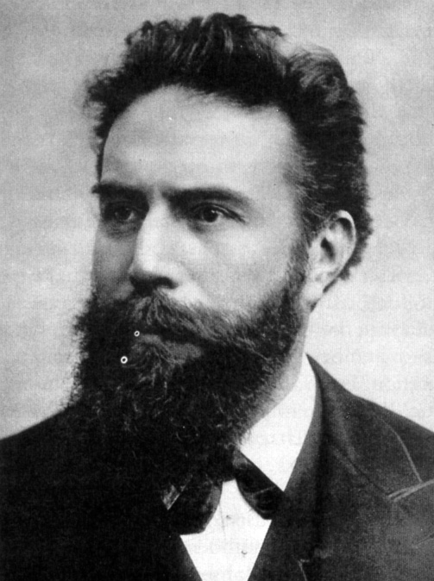
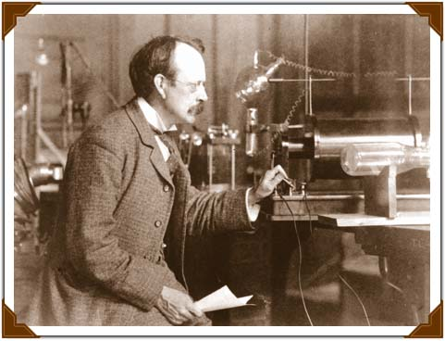
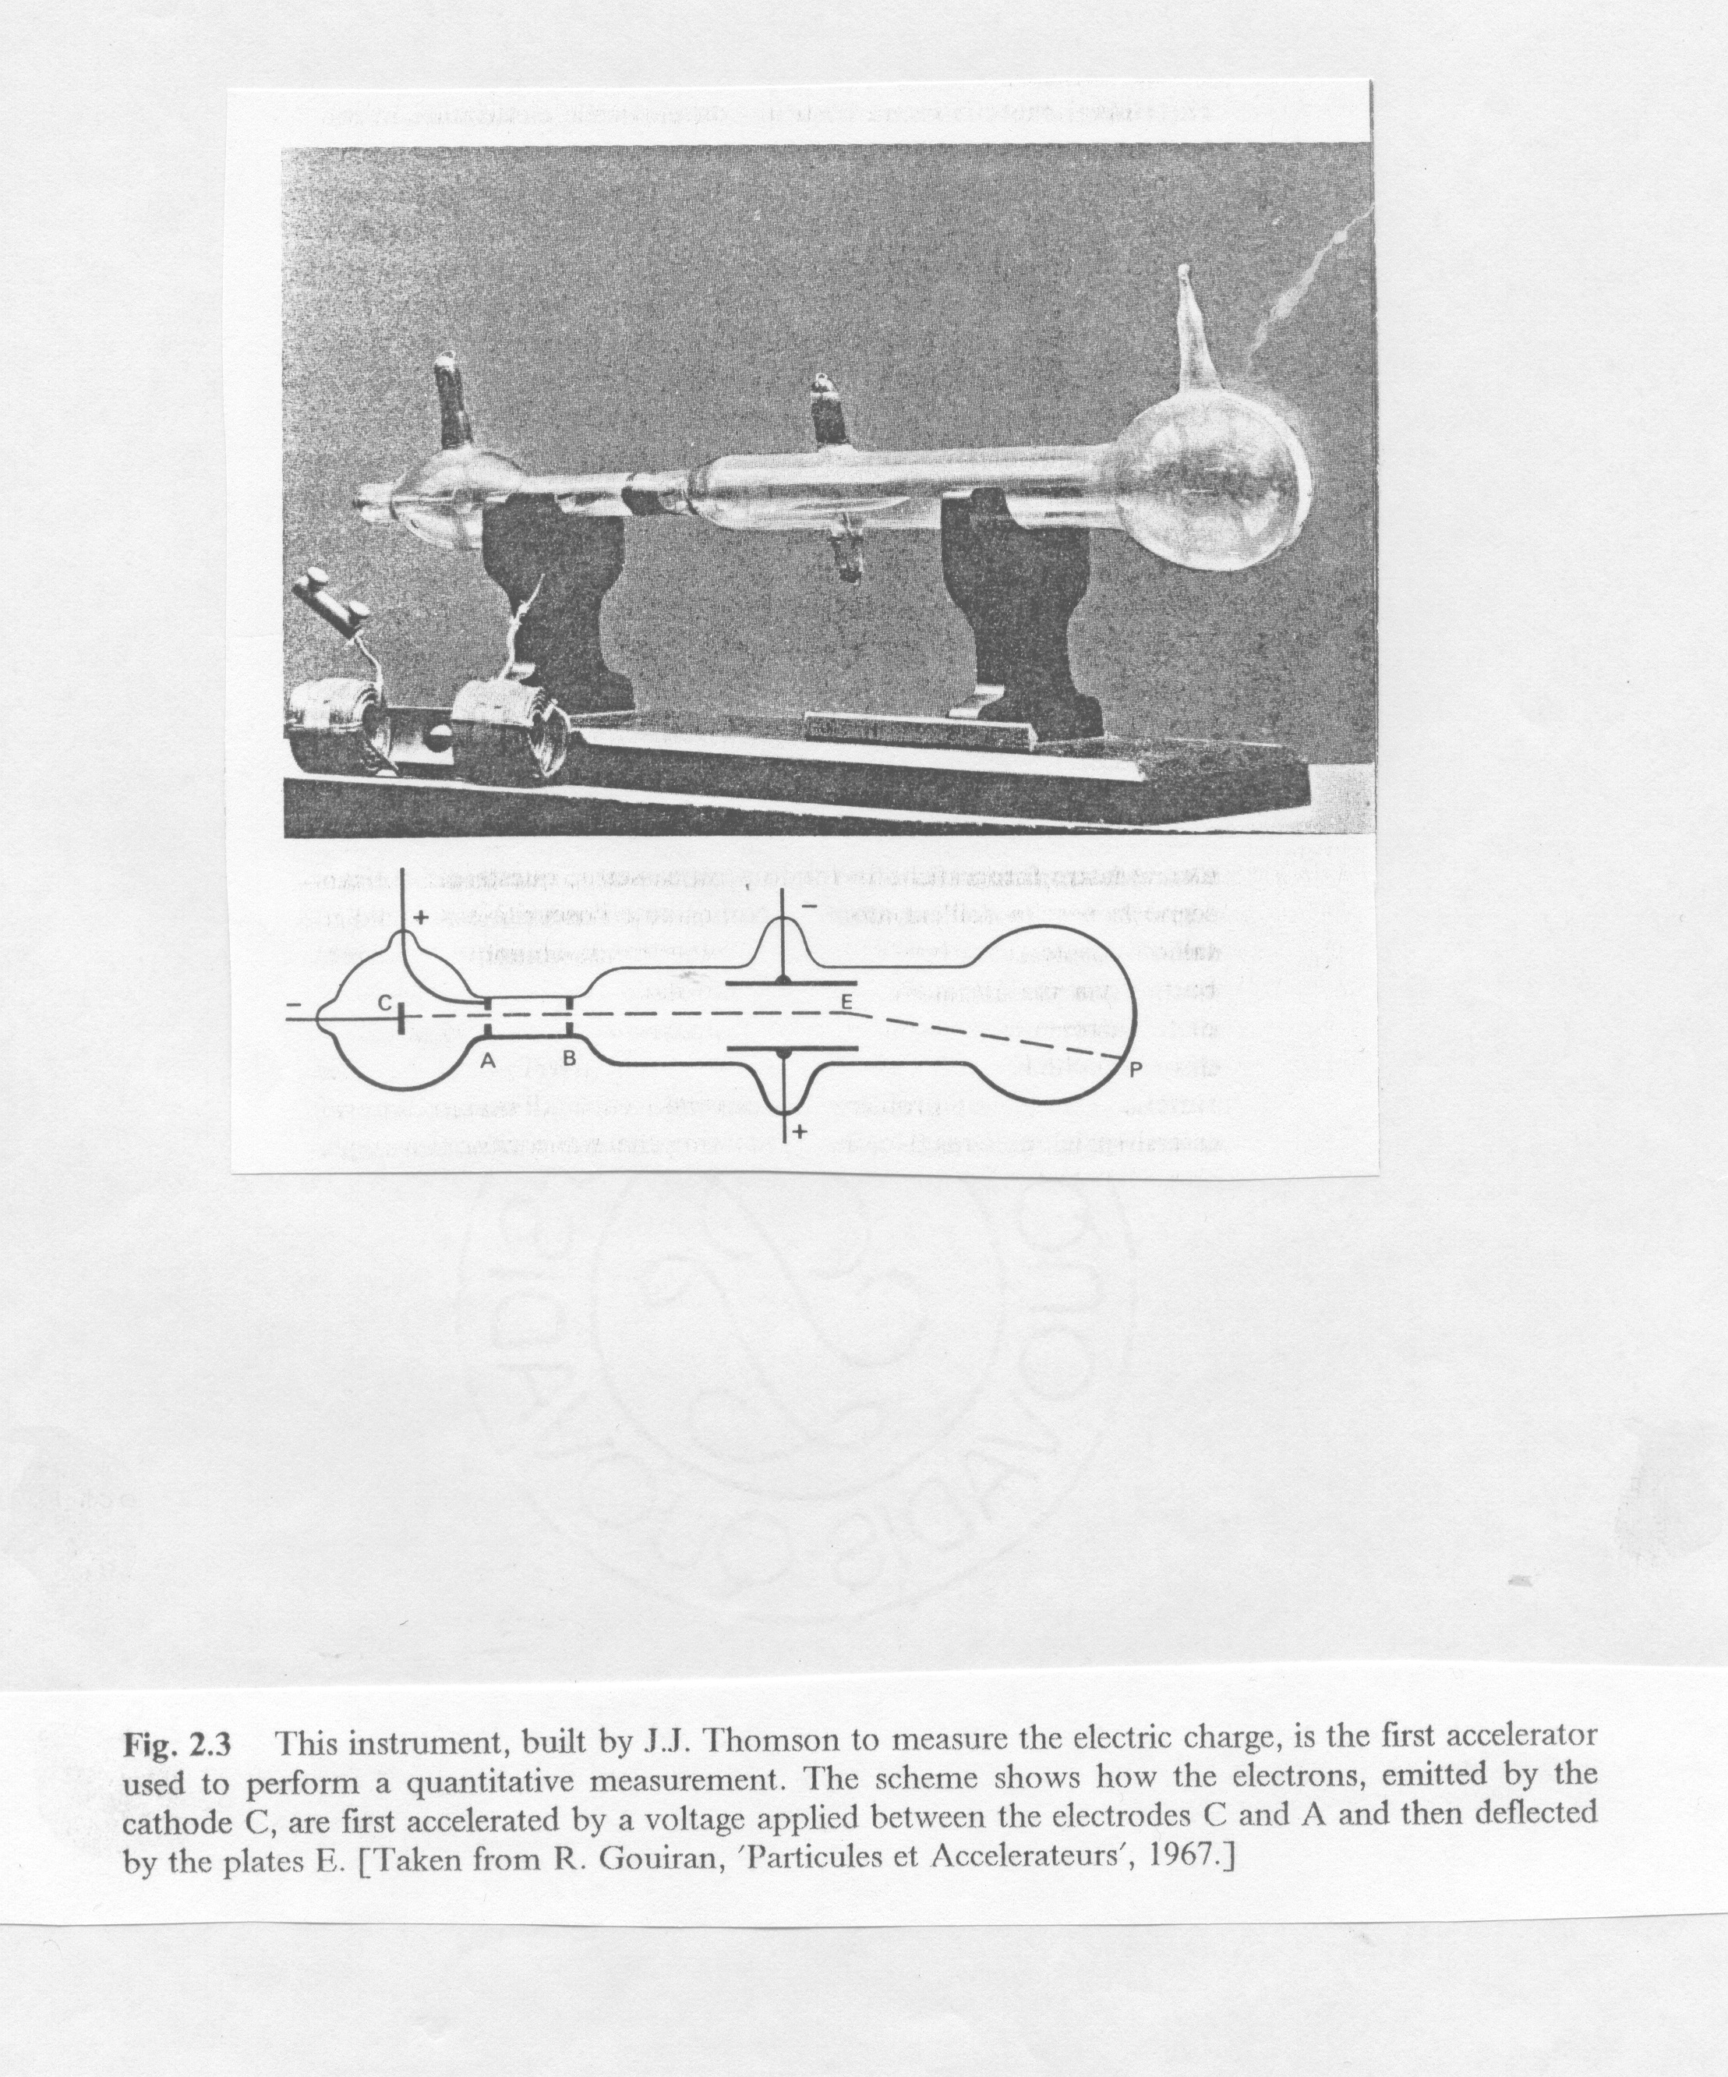
The discovery of radiation
1895
Discovery of X rays
Wilhelm C. Röntgen
1897
First treatment of tissue with X rays
Leopold Freund
J.J. Thompson
1897
“Discovery” of the electron

Slide 5
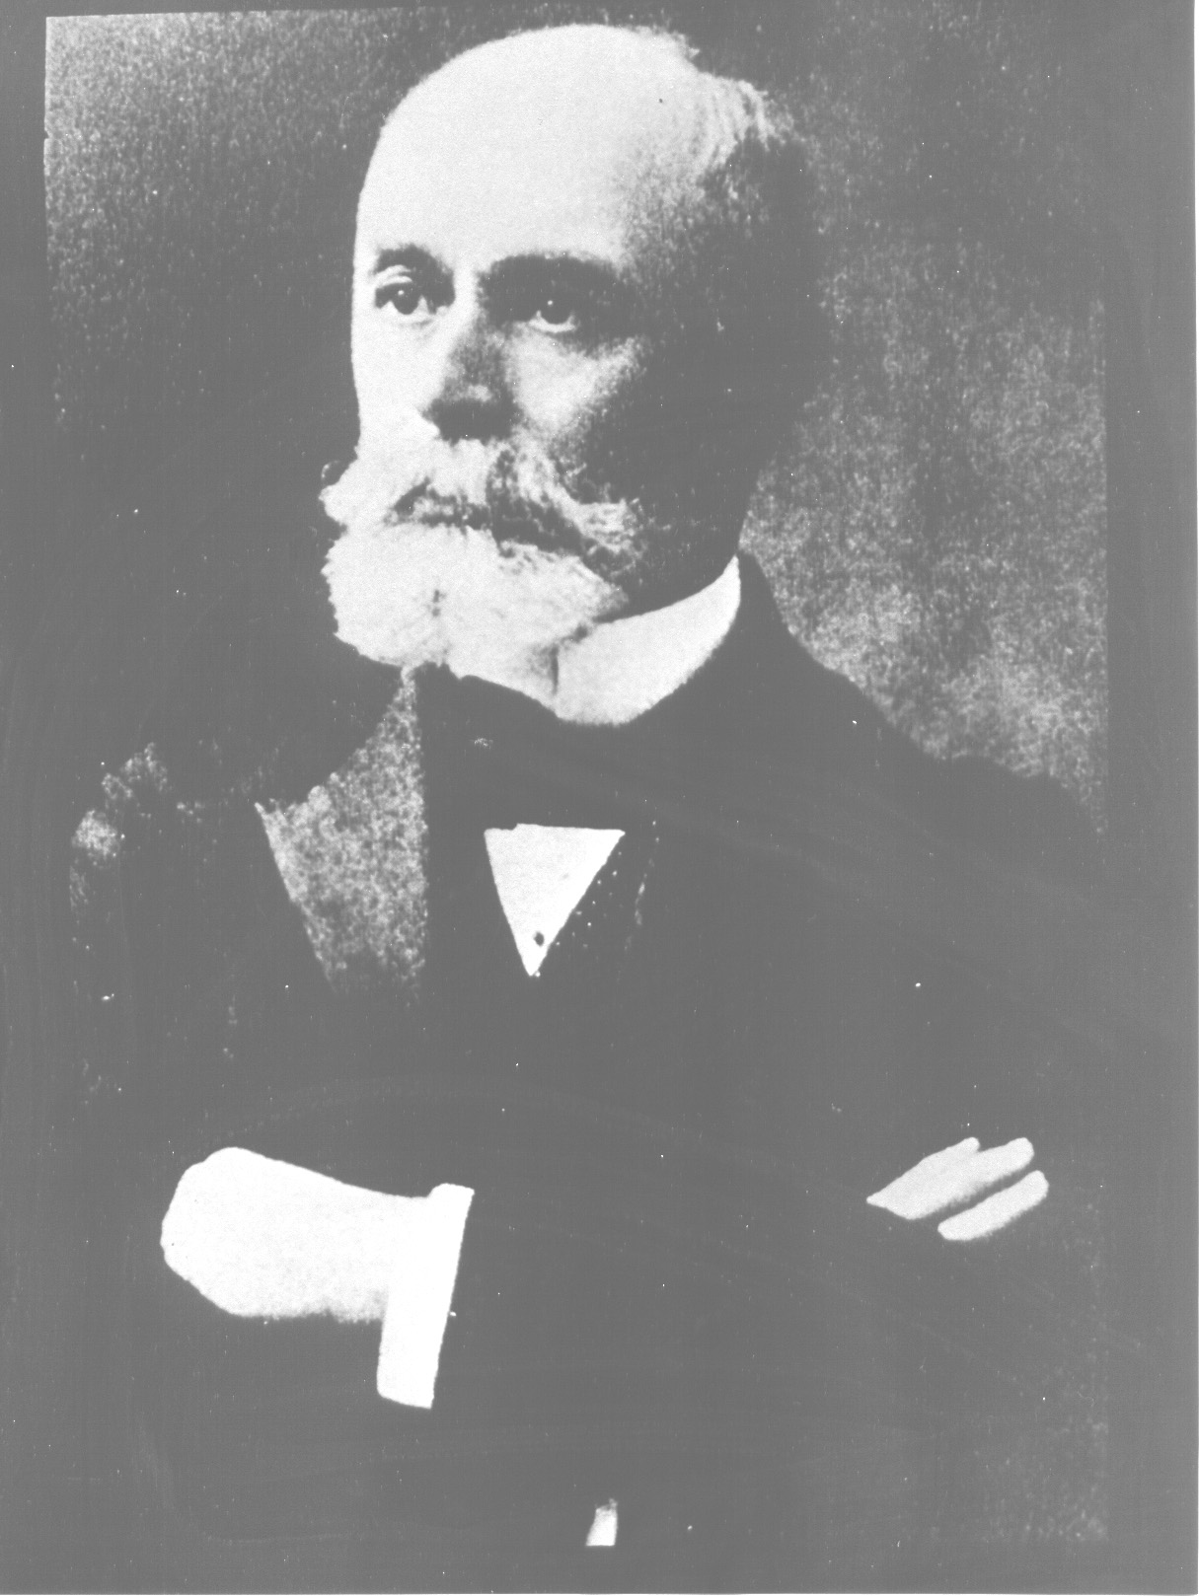
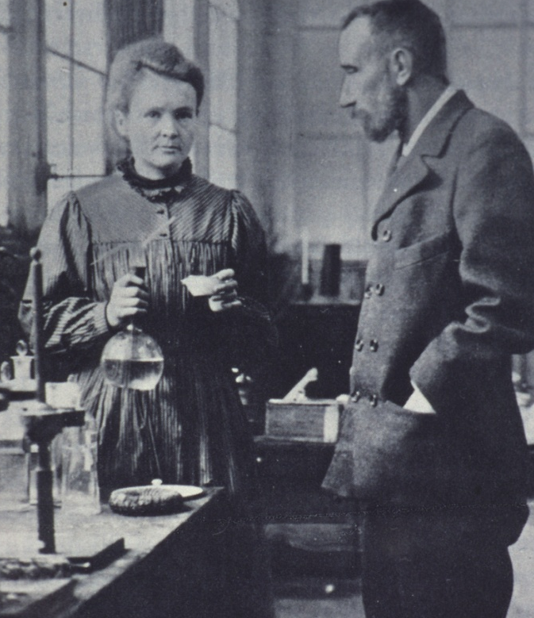
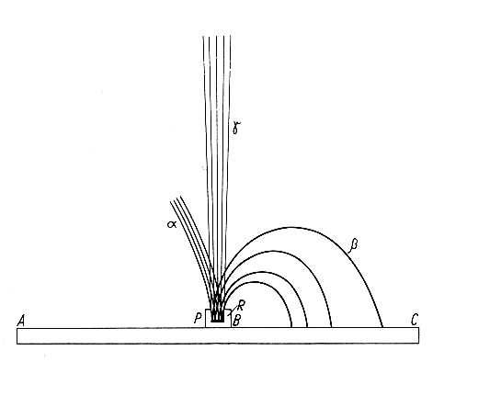
The discovery of radiation
Henri Becquerel (1852-1908)
1896
Discovery of natural
radioactivity
Thesis of Mme. Curie – 1904
α, β, γ in magnetic field
1898
Discovery of polonium and radium
Hundred years ago
Marie Curie Pierre Curie
(1867 – 1934) (1859 – 1906)

Slide 6
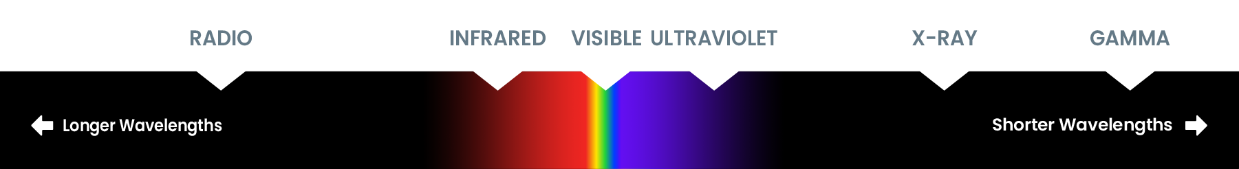

Outline of the lecture
A very brief historical introduction
Directly and indirectly ionizing radiation
  Radioactivity
  Natural exposures
The effects of ionizing radiation
  Deterministic and stochastic effects
Radiological quantities and units
  physical, protection and operational quantities
Principles of radiation protection
  Justification, optimization and dose limitation
  The ALARA principle
Protection means
Instrumentation for measuring ionizing radiation

Slide 7
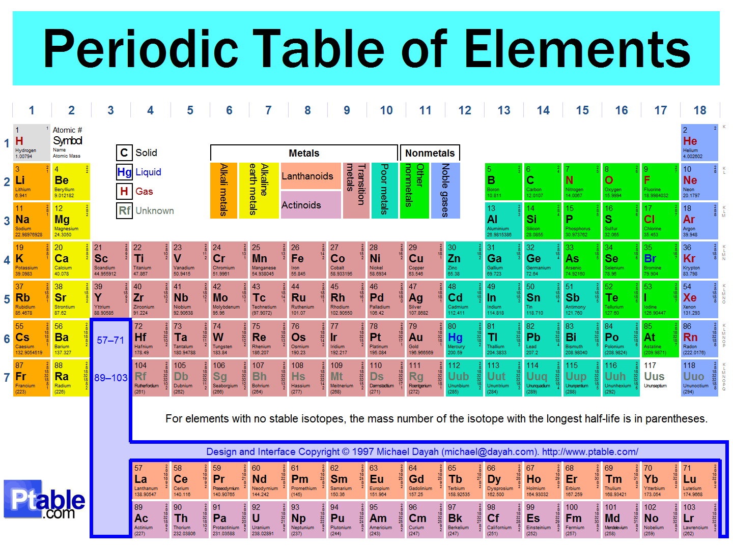
Periodic table of elements
Notes:
As a noble gas, radon is chemically and electrically inert, therefore after inhalation, it is immediately exhaled and it is weakly harmful in itself. However the radon daughter products attach to the ambient areosol, which may be inhaled and stick to the lung surface. Its importance in the exposure of human beings to terrestrial radiation is given by its transport from surface to atmosphere where its decay products may be inhaled. Radon tends to concentrate in enclosed spaces like underground mines or houses. Radon is the largest contributor to daily exposure of radiation.

Slide 8
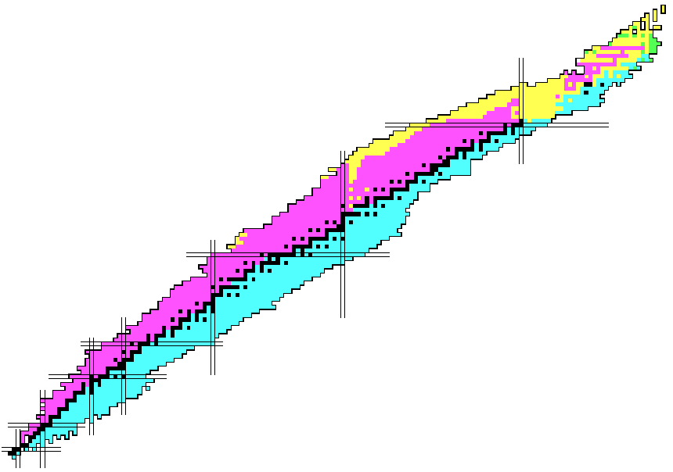
Chart of nuclides
Unstable (=radioactive) nuclides ~ 3000
α-decay
protons
β⁻ : n -> p⁺ + e⁻
β⁺ : p⁺ -> n + e⁺
α : ^{A}X -> ^{A-4}Y + ⁴He²⁺
Stable nuclides ~ 250
neutrons

Slide 9
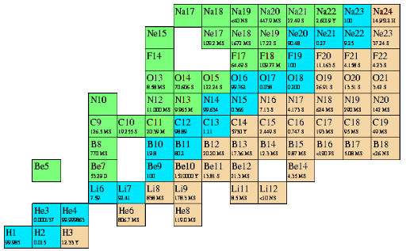


β⁺ and β⁻ decays
¹¹C → ¹¹B + e⁺ + $ν$_{e} + 960 keV
¹⁴C → ¹⁴N + e_ + $\overline{v}$_{e} + 156 keV
http://www.fmboschetto.it/tde4/carta.htm

Slide 10
Directly and indirectly ionising radiation
Directly ionizing radiation:
fast charged particles (e.g., electrons, protons, alpha particles), which deliver their energy to matter directly, through many small Coulomb-force interactions along the particle’s track
Indirectly ionizing radiation:
X- or γ-ray photons or neutrons (i.e., uncharged particles), which first transfer their energy to charged particles in the matter through which they pass in a relatively few large interactions, or cause nuclear reactions
The resulting fast charged particles then in turn deliver the energy in matter
The deposition of energy in matter by indirectly ionising radiation is a two-step process
photon → electron
neutron → proton or recoiling nuclei

Slide 11
Radioactivity and ionising radiation
Radioactivity: the phenomenon whereby atoms undergo spontaneous random disintegration, usually accompanied by the emission of ionising radiation.
The rate at which this nuclear transformations occurs in matter containing radionuclides is called activity and it is expressed in Bequerels:
A(t) = -dN/dt [Bq] 1 Bq = s⁻¹
(the old unit is the Curie: 1 Ci = 3.7 x 10¹⁰ Bq)
where N is the number of nuclei of the radionuclide, and hence the rate of change of N with time is negative
The radioactive half-life (T_{1/2}) of a radionuclide is the time necessary for half of the nuclei present in the sample to decay
Radionuclides are either of natural origin or produced by nuclear reactions (artificial radionuclides)

Slide 12
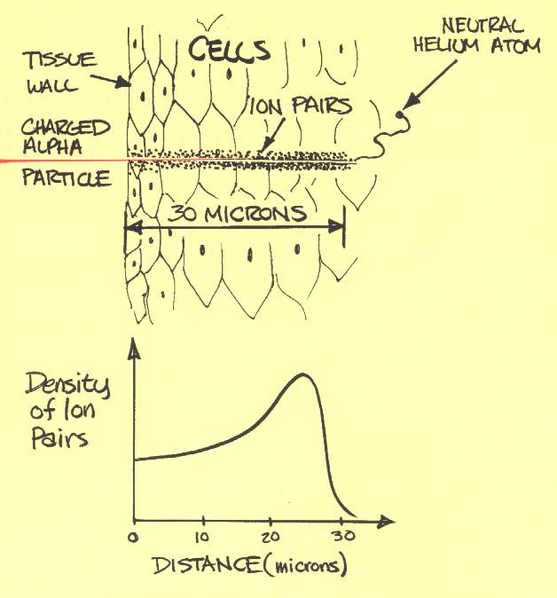
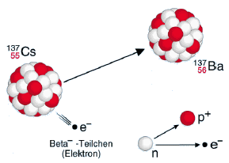
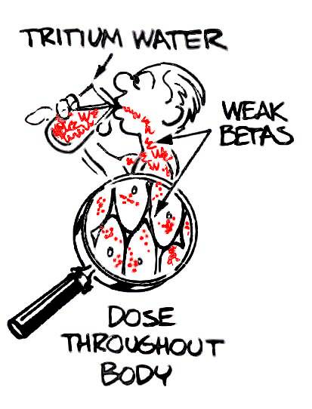
Radioactivity and ionising radiation / hazard
(Emitted in the de-excitation of unstable nuclei)
ALPHA
  Helium nuclei (2 protons + 2 neutrons)
  Energy: a few MeV
  Non-penetrating
  Radiological hazard only if inhaled, ingested or absorbed through a wound (internal irradiation)
BETA
  Electrons or positrons
  Energy: a few keV to a few MeV
  Limited penetration
  Dangerous for skin and eyes in case of external irradiation
  Increased radiological hazard if inhaled, ingested or absorbed through a wound (internal irradiation)

Slide 13
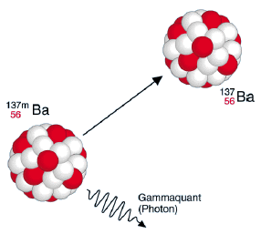
Radioactivity and ionising radiation / hazard
PHOTONS
  Electromagnetic radiation
  Energy: a few keV to a few MeV
  Very penetrating
  Radiological hazard only by external irradiation
NEUTRONS
  Neutral particles (constituents of the atomic nucleus together with protons)
  Very penetrating
  External irradiation
  Enhanced biological effect (high LET – Linear Energy Transfer radiation), which depends on their energy
HEAVY CHARGED PARTICLES (protons, ions)
  External irradiation
  Enhanced biological effect (high LET – Linear Energy Transfer radiation)

Slide 14
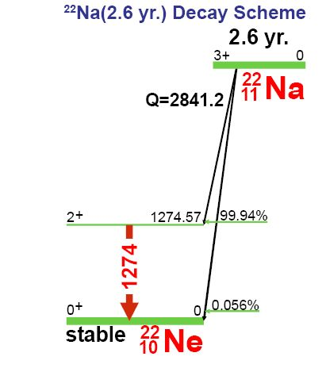
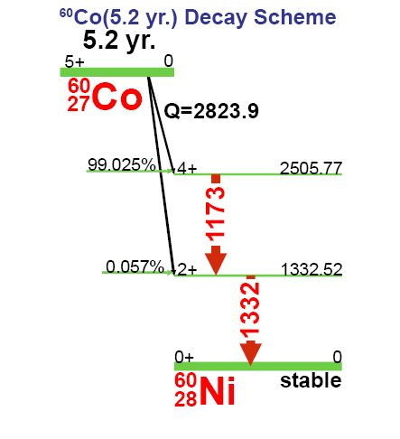
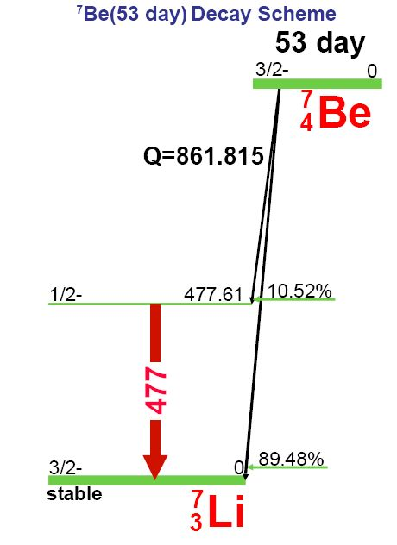
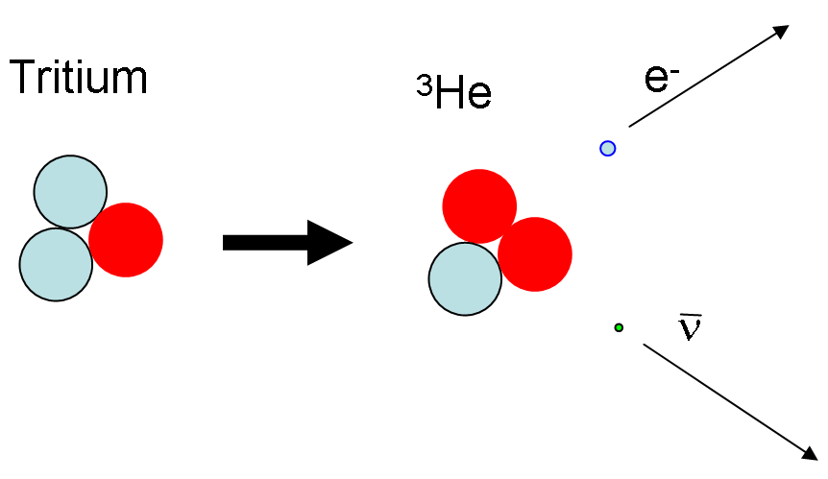
Radioactivity and ionising radiation
β-, γ-emitter
β⁻
β⁺
e
Pure β-emitter
α-, β- and γ are emitted with end energies up to few MeV

Slide 15
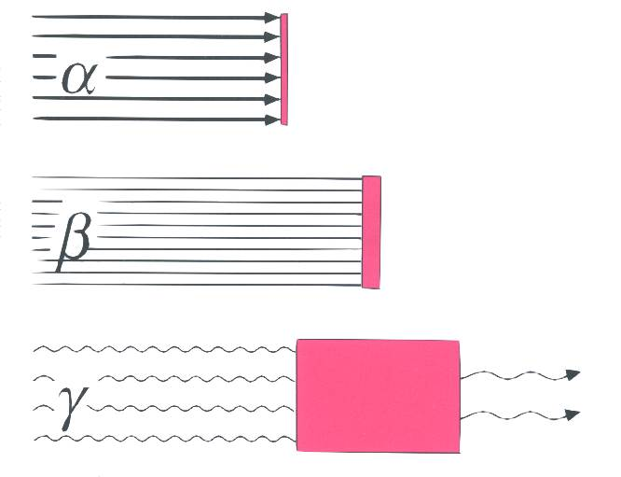
Absorption / attenuation of radiation
α- and β-particles are degraded in energy while traversing a material, until they are completely brought to rest
γ-rays are attenuated in intensity by the material

Slide 16
Absorption / attenuation of radiation
Qualitative!
Paper Plastic Lead Concrete
Alpha
Beta
Gamma
Neutron
mm mm – cm cm – tens tens of cm –
of cm metres
Beta sources are usually shielded with Plexiglas, gamma sources with lead

Slide 17
Production and decay of radionuclides
For a given particle, target element and nuclide
Interaction probability, σ (cross section)
Flux (spectrum), Φ
Beam intensity, I_{p}
Nuclide production rate

Slide 18
Production and decay of radionuclides
Rule-of-thumb (probably very obvious):
The shorter the half-life, the fastest the build-up, the fastest the decay
It takes about 5 half-lives to reach saturation of activity

Slide 19
Unit
The absorbed dose is the energy deposited by a given radiation in a unit mass of matter
The unit of absorbed dose is the Gray (mGy, µGy):
1 Gy = 1 J/kg
(the old unit is the rad: 1 rad = 10⁻² Gy)
Radiation protection uses the operational quantity “dose equivalent H” in Sievert (mSv, µSv)
H=Q∙D
1 Sv = 1 J/kg
Q = quality factor of the radiation
Notes:
Ionizing radiation can also produce gross changes, either desirable or deleterious, in organic compounds by breaking molecular bonds, or in crystalline materials by causing defects in the lattice structure. Even steel can be damaged by large fluxes of fast neutrons, suffering embrittlement and possible fracture under mechanical stress (e.g., ITER)

Slide 20
QUESTION 1
Are we all exposed (voluntarily or not) to some radiation sources?
Yes/No?
If the answer is yes,
what are the natural radiation levels?

Slide 21
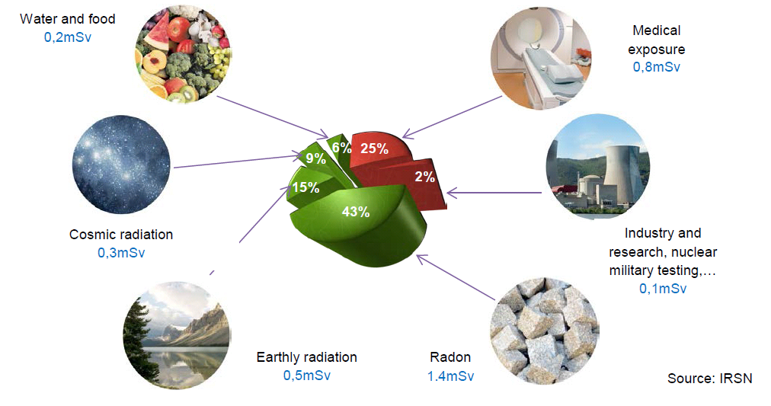
Natural radiation exposures
Annual exposure to natural radioactivity in France = 2.5 mSv
(3.3 mSv including medical exposures)

Slide 22
Terrestrial radionuclides
During the creation of the Earth, terrestrial nuclides had been incorporated into the earth crust (T_{1/2} some millions to billions of years)
Nuclide | Symbol | Half-life
Uranium-235 | ²³⁵U | 7.04 x 10⁸ y | 0.72% of natural Uranium
Uranium-238 | ²³⁸U | 4.47 x 10⁹ y | 99.3% of natural Uranium
Thorium-232 | ²³²Th | 1.41 x 10¹⁰ y
Potassium-40 | ⁴⁰K | 1.28 x 10⁹ y | Earth: 0.037-1.1 Bq/g
...and some more:
⁵⁰V, ⁸⁷Rb, ¹¹³Cd, ¹¹⁵In, … ¹⁹⁰Pt, ¹⁹²Pt, ²⁰⁹Bi, …

Slide 23
Cosmogenic radionuclides
Cosmogenic nuclides are produced by nuclear reactions of cosmic particles with stable nuclei of the atmosphere
Nuclide | Symbol | Half-life | Nuclear Reaction
Carbon-14 | ¹⁴C | 5730 y | e.g. ¹⁴N(n,p)¹⁴C
Tritium-3 | ³H | 12.3 y | Interaction of cosmic radiation with N or O ⁶Li(n,α)³H
Beryllium-7 | ⁷Be | 53.28 d | Interaction of cosmic radiation with N or O
More cosmogenic radionuclides:
¹⁰Be, ²⁶Al, ³⁶Cl, ⁸⁰Kr, …

Slide 24
The radioactivity inside our body
Nuclide | Total activity in human body (~ 70 kg)
Potassium-40 | ~ 5 kBq
Carbon-14 | ~ 3 kBq
Tritium | ~ 20 Bq
Polonium-210 | ~ 18 Bq
Uranium | ~ 1 Bq
Radium | ~ 1 Bq
Thorium | ~ 0.1 Bq
TOTAL ~ 8 kBq

Slide 25
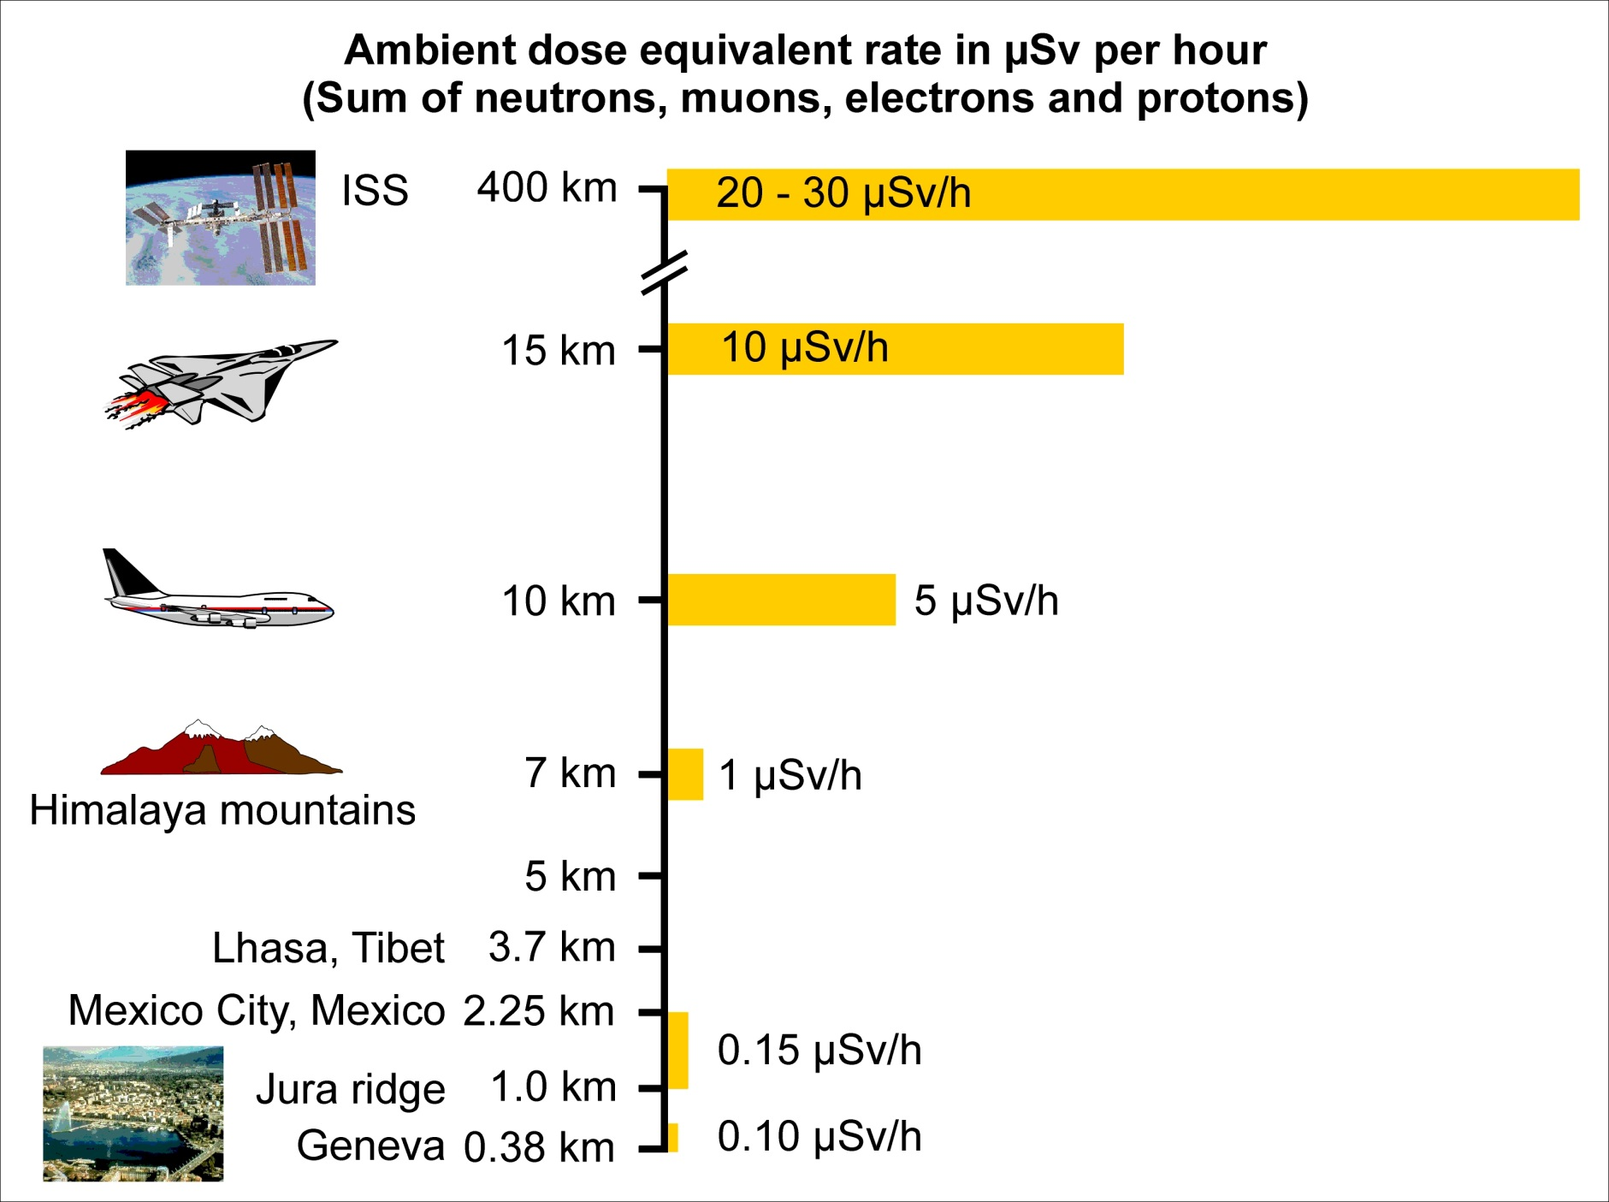
Cosmic radiation exposure versus altitude
Courtesy PTB, Braunschweig

Slide 26
Outline of the lecture
A very brief historical introduction
Directly and indirectly ionizing radiation
  Radioactivity
  Natural exposures
The effects of ionizing radiation
  Deterministic and stochastic effects
Radiological quantities and units
  physical, protection and operational quantities
Principles of radiation protection
  Justification, optimization and dose limitation
  The ALARA principle
Protection means
Instrumentation for measuring ionizing radiation

Slide 27
Why is radiation dosimetry important?
Unique effects of interaction of ionizing radiation with matter
Biological systems (humans in particular) are particularly susceptible to damage by ionizing radiation
The expenditure of a trivial amount of energy (~ 4 J/kg = 4 Gy) to the whole body is likely to cause death…
…even if this amount of energy can only raise the gross temperature by about 0.001 °C
This is because of the ability of ionizing radiation to impart their energy to individual atoms and molecules
The resulting high local concentration of absorbed energy can kill a cell either directly or through the formation of highly reactive chemical species such as free radicals (atom or compound in which there is an unpaired electron, such as H or CH₃) in the water medium that constitutes the bulk of the biological material
Main aim of dosimetry = measurement of the absorbed dose (energy/mass)
Notes:
Ionizing radiation can also produce gross changes, either desirable or deleterious, in organic compounds by breaking molecular bonds, or in crystalline materials by causing defects in the lattice structure. Even steel can be damaged by large fluxes of fast neutrons, suffering embrittlement and possible fracture under mechanical stress (e.g., ITER)

Slide 28
DNA damage
Ionization event (formation of water radicals)
Light damage - reparable
Primary particle track
delta rays
e⁻
Water radicals attack the DNA
OH•
Clustered damage - irreparable
The mean diffusion distance of OH radicals before they react is only 2-3 nm
Courtesy R. Schulte

Slide 29
Radiobiological effectiveness (RBE)
DIFFERENT TYPES OF RADIATION MAKE DIFFERENT DAMAGE

Slide 30
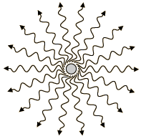
QUESTION 2
What are the biological effects of radiation?

Slide 31
Biological effects of radiation
Stochastic effects
no dose threshold (linear function of dose)
increase of probability by 5% per Sv for:
  genetic defects
  cancer
result does not dependent on the amount of absorbed dose
delayed health detriments
Deterministic effects
dose received in short time interval
dose threshold: > 500 mSv
immediate consequences:
vomiting
immun deficiency
erythema and necrose
health detriments are function of the dose
lethal dose: 5 – 7 Sv

Slide 32
The biological actions of radiation
deterministic
stochastic
deterministic

Slide 33
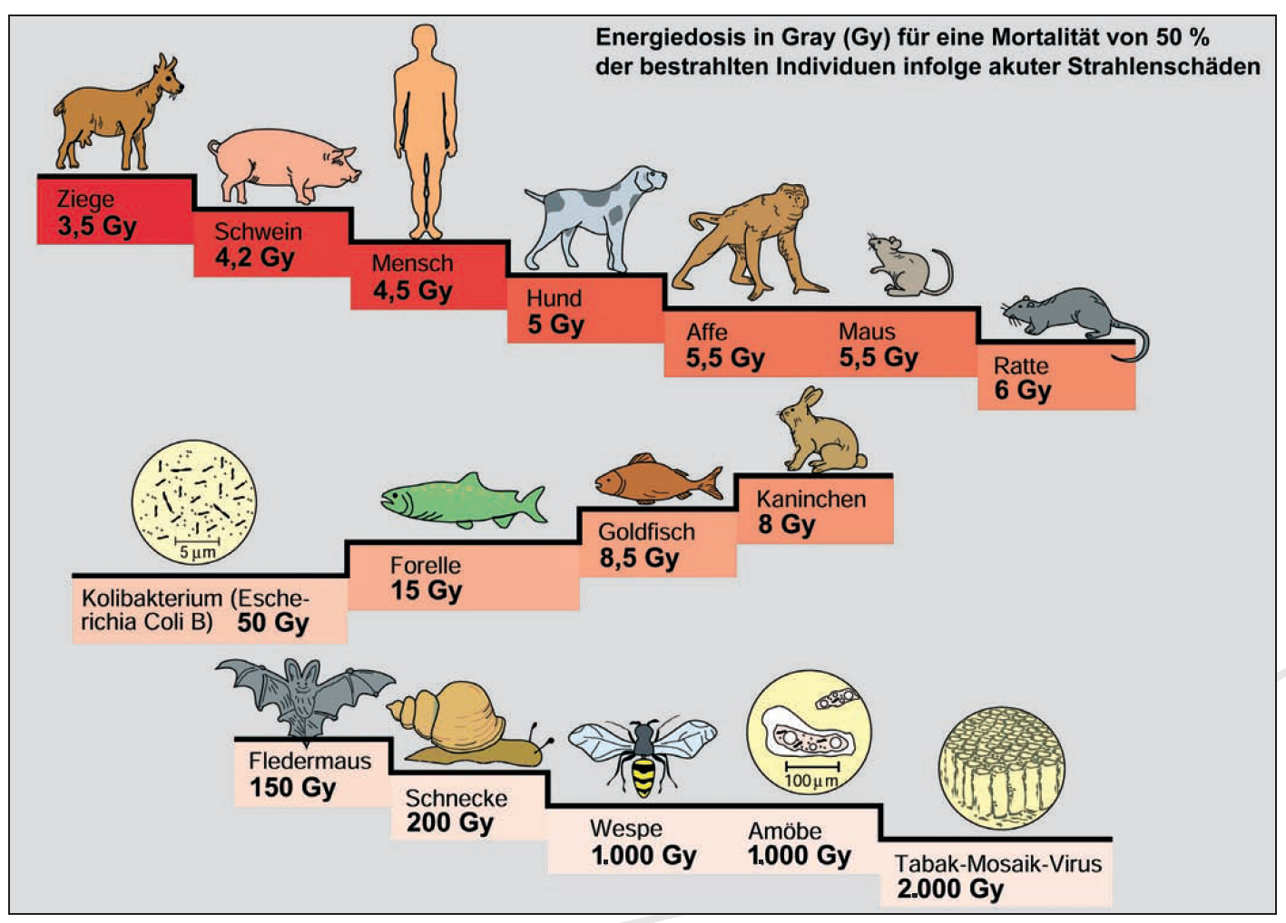
Lethal dose (LD_{50/30}) for various organisms
Source: Martin Volkmer, Radioaktivität und Strahlenschutz, Informationskreis Kernenergie

Slide 34
LD50 and effect of acute irradiation to humans
Whole body dose (Gy) | Organ or tissue failure responsible for death | Time at which death occurs after exposure (days)
3-5 | Bone marrow | 30-60
5-15 | Intestine and lungs | 10-20
>15 | Nervous system | 1-5
Lethal effects: LD50 for humans 3-5 Gy due to damage to bone marrow, in absence of bone marrow transplantation

Slide 35
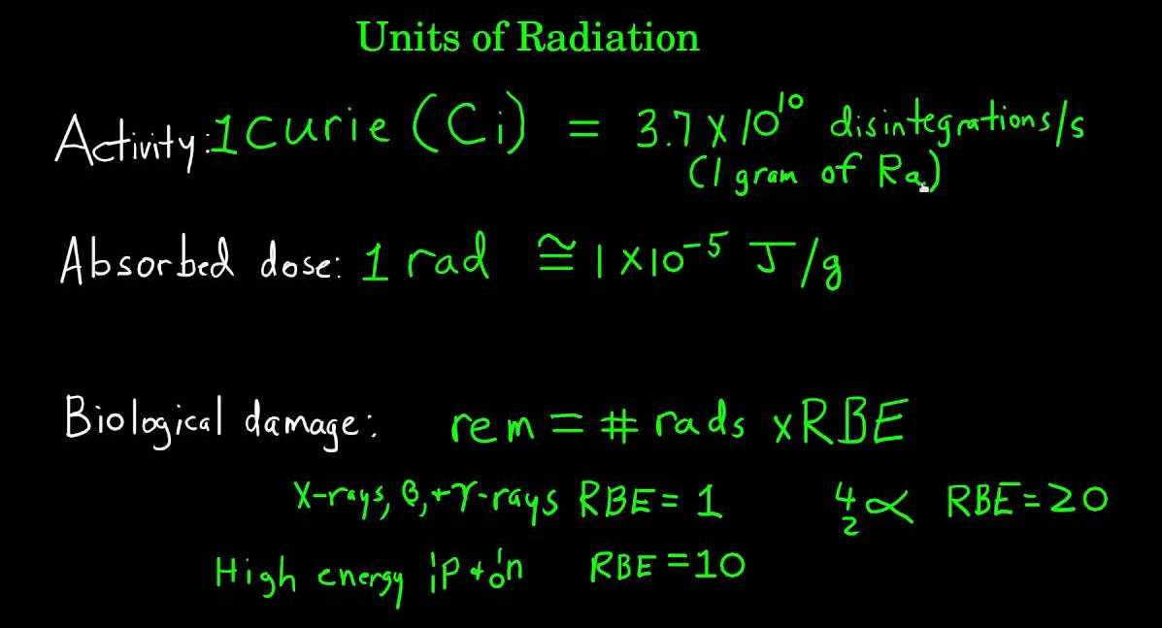
Outline of the lecture
A very brief historical introduction
Directly and indirectly ionizing radiation
  Radioactivity
  Natural exposures
The effects of ionizing radiation
  Deterministic and stochastic effects
Radiological quantities and units
  physical, protection and operational quantities
Principles of radiation protection
  Justification, optimization and dose limitation
  The ALARA principle
Protection means
Instrumentation for measuring ionizing radiation

Slide 36
General principles of radiation protection
Justification
any exposure of persons to ionizing radiation has to be justified
2) Limitation
the personal doses have to be kept below the legal limits
3) Optimization
the personal doses and collective doses have to be kept As Low As Reasonably Achievable (ALARA) – including social and economical factors into account

Slide 37
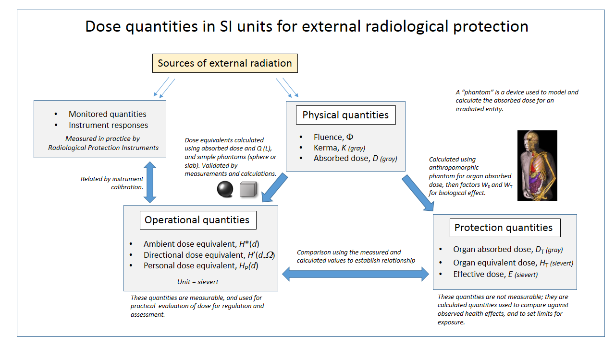
Physical, protection and operational quantities
International Commission on Radiological Protection
Source: Wikipedia

Slide 38
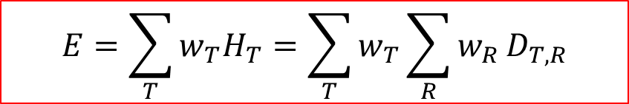
Radiological quantities and units
Absorbed Dose D: energy absorbed per mass
Unit: Gy 1 Gy = 1 J/kg
(1 Gy = 100 rad)
Equivalent Dose H: absorbed dose of organs weighted by
the radiation weighting factor w_{R} of radiation R:
Unit: Sv (1 Sv = 100 rem)
Effective dose E: Sum of all equivalent doses weighted with the weighting factor w_{T} for tissue T
Unit: Sv (1 Sv = 100 rem)
$$E=\sum_{T}{w_{T}H_{T}}=\sum_{T}{w_{T}\sum_{R}{w_{R}}D_{T,R}}$$

Slide 39
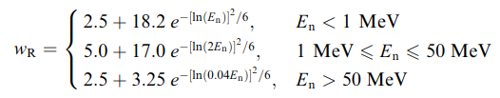
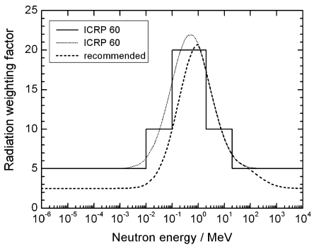
Radiation weighting factors, W_{R}
Type and energy of radiation R | w_{R}
Photons, all energies | 1
Electrons and muons, all energies | 1
Protons and charged pions | 2
Alpha particles, fission fragments, heavy ions | 20
Neutrons

Slide 40
Tissue sensitivity and tissue weighting factors, W_{T}
Organ / tissue | No of tissues | w_{T} | Total contribution
Bone-marrow, colon, lung, breast, stomach, remainder tissues | 6 | 0.12 | 0.72
Gonads | 1 | 0.08 | 0.08
Bladder, esophagus, liver, thyroid | 4 | 0.04 | 0.16
Bone surface, brain, salivary glands, skin | 4 | 0.01 | 0.04
The tissue weighting factors are sex- and age-averaged values for all organs and tissues

Slide 41
Operational quantities
Quantities on which limits are based (effective dose, organ equivalent dose) are not measurable
So operational quantities are defined
  measurable quantities
  quantities which are representative of the quantities on which limits are based (where possible overestimating these)
For external exposure:
  ambient dose: H*(10)
  personal dose: H_{p}(10) and H_{p}(0,07)
For internal exposure (after an intake):
  committed effective dose (over 50 years): E(50)

Slide 42
History of radiation protection
M. Curie
ICRP 103
Source: Los Alamos Science
Nr. 23, 1995, p. 116

Slide 43


Radiological risks
External radiation source external exposure
Surface
Contamination
Volumetric (air)
Internal radiation source internal exposure

Slide 44
Basic concepts in radiation protection
Person occupationally exposed to radiation (> 1 mSv/y)
  Category A workers: > 6 mSv/y
  Category B workers: < 6 mSv/y
Supervised area: area with dose > 1 mSv/y
  (accessible to categories A and B workers)
Controlled area: area with dose > 6 mSv/y
  (accessible to categories A workers, and with limited stay to category B workers)
Exposure situations:
  risk of external exposure only (sealed radioactive sources, radiation generators, for example X-ray tube)
  risk of internal and external exposure (use of unsealed radioactive sources)

Slide 45

QUESTION 3
Can you protect yourself from radiation?
How?

Slide 46
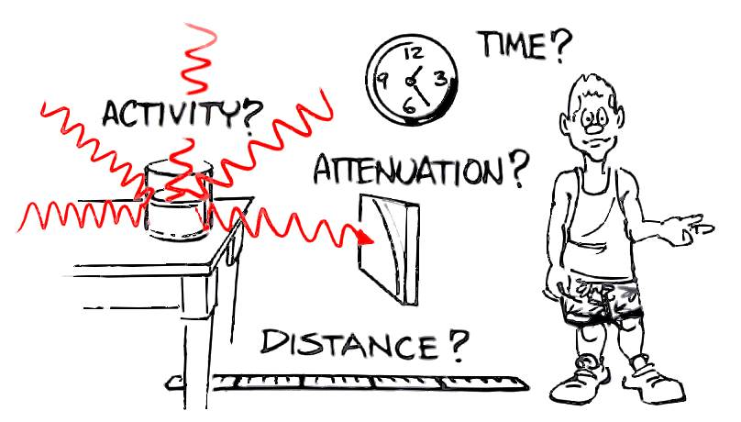
How to reduce external exposure
Three means: distance, time, shielding
Distance: the dose rate
decreases with the inverse
squared of the distance
(from a point-like source)
Time: the dose is proportional
to the time spent close to the
source D = dD/dt x t
Shielding: the dose rate approximately
reduces as exp(-d/λ)
λ = shielding properties of the material
For β radiation: plexiglass
For γ radiation: iron or lead
For n: concrete

Slide 47
Protection against external exposure
Time: limit the duration of the stay in the radiation field
  Job preparation
  Dry run
  Monitoring of the duration of exposure
Distance: stay as far as possible from the source
  Dispersion law: 1/r² for a point source, more like 1/r for an extended source
  Very important at short distances
  Factor of 100 between 1 cm and 10 cm (use of tongs/tweezers)
Shielding: use of protective shields
  Material and thickness of the shield depend of the type and energy of the radiation and of the reduction factor required

Slide 48
Monitoring of external exposure
Wearing a personal dosimeter on the chest or at the waist
  monthly measurement (at least)
  Information may be delayed (depends on dosimeter)
  measurement threshold ~0.1 mSv/month
Wearing an electronic dosimeter
  instantaneous information
  possibility to setting a dose or dose rate alarm
Wearing an extremity dosimeter
  In the case of specific hand exposure risk (handling of radioactive substances)

Slide 49
Operational quantities and dose limits
The dosimeter is calibrated to measure:
  H_{p}(10): personal equivalent dose at a depth of 10 mm in the chest
  H_{p}(0.07): personal equivalent dose at a depth of 0.07 mm in the chest
At low measured doses (less than the limits) it is assumed that:
  the effective dose and the equivalent dose to each organ is equal to H_{p}(10);
  the equivalent dose to the skin is equal to H_{p}(0.07);
At high measured doses (exceeding the limits),
  an investigation is undertaken (dosimetric reconstruction) to determine the effective dose and the equivalent doses to the organs which were actually received.

Slide 50
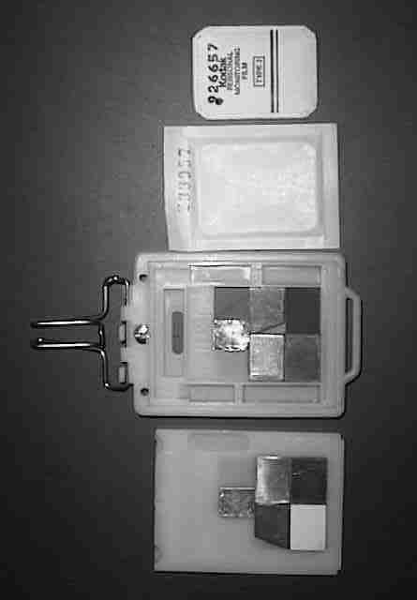
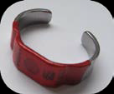
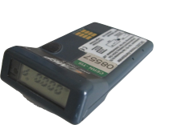
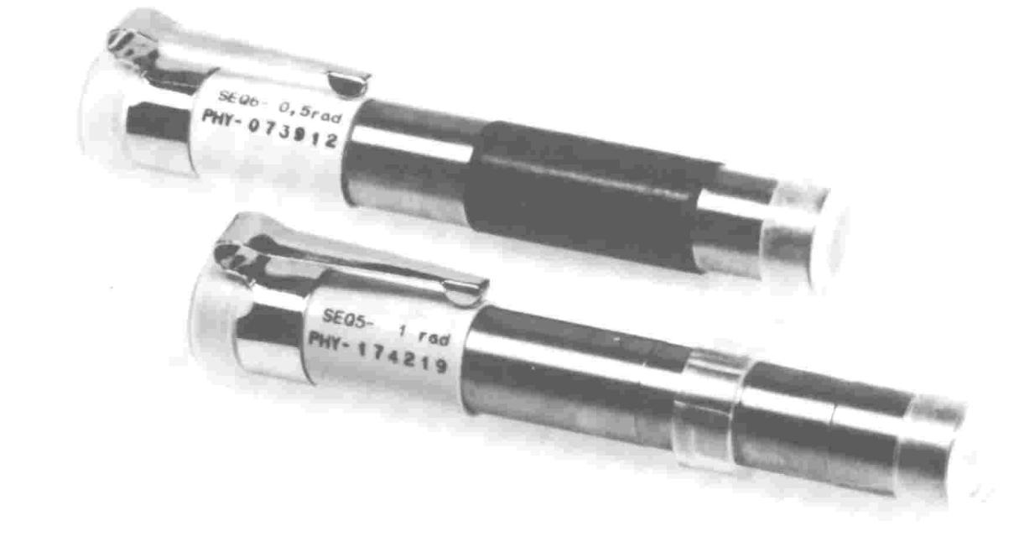
Personal dosimetry for monitoring external exposure
Personal dosimeter: "Legal dose”
RADOS DIS
Kodak film badge
Finger dosimeter
Operational dosimeter DMC: “Operational dose”
Quartz-fiber dosimeter (ionisation chamber and electroscope)

Slide 51
Radioactive contamination at particle accelerators
Radioactive contamination at particle accelerators can arise from:
the use of unsealed radioactive sources
activation of air and dust around the accelerators
activation of oils or cooling fluids
the machining or treatment of radioactive components
normal or accidental emissions from targets whilst they are irradiated or after irradiation
Two factors should be considered in defining precautions for the control of unsealed radioactivity:
the prevention of the contamination of
  personnel
  equipment

Slide 52
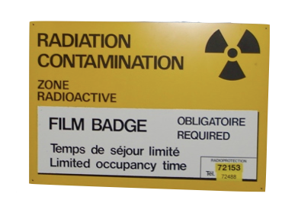
Radioactive contamination at particle accelerators
  Material that has been brought into and removed from an accelerator tunnel or bunker during shutdown (maintenance) will no be activated BUT …
  … it might be contaminated
  If there is a suspicion of contamination, it has to be checked before leaving the area

Slide 53
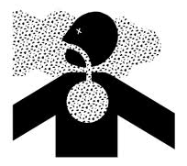
Contamination
Internal (+ external) exposure: the incorporated radionuclides irradiate the organs and tissues to which they attach
Exposure lasts until the complete elimination of the radionuclides by radioactive decay and biological metabolism
Internal exposure can occur by:
- ingestion
- inhalation
- skin

Slide 54
Monitoring of internal exposure
Determination of the activity taken into the body and calculation of the committed effective dose with a standard model
Measurements to determine the activity taken into the body:
  direct measurement of the radiation emitted by the person using a thyroid monitor, a lung monitor or a whole body monitor (WBC, whole body counter)
  measurement of the activity in the excreta (urine, faeces)
Two stages strategy:
  screening measurement (with a simple laboratory instrument)
  If a threshold is exceeded, actual measurement of the intake

Slide 55
Operational quantities and dose limits
Operational quantity: committed effective dose E₅₀
For radionuclides with short half-live, the dose is received in the days following the intake;
For radionuclides with a long half-live (strontium-90, actinides), the dose is received over many years following the intake;
The committed dose is attributed to the period of intake;
Dose is calculated using standard metabolic models;
If dose limits are exceeded an investigation is undertaken (dosimetric reconstruction) to determine the committed dose; an adaptation of the model may be necessary.

Slide 56
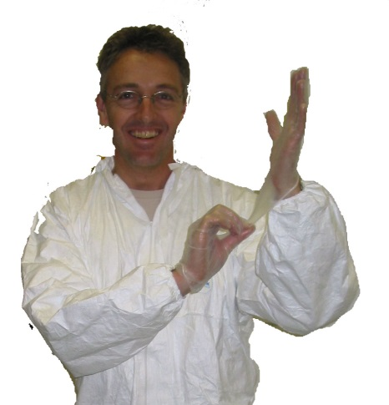
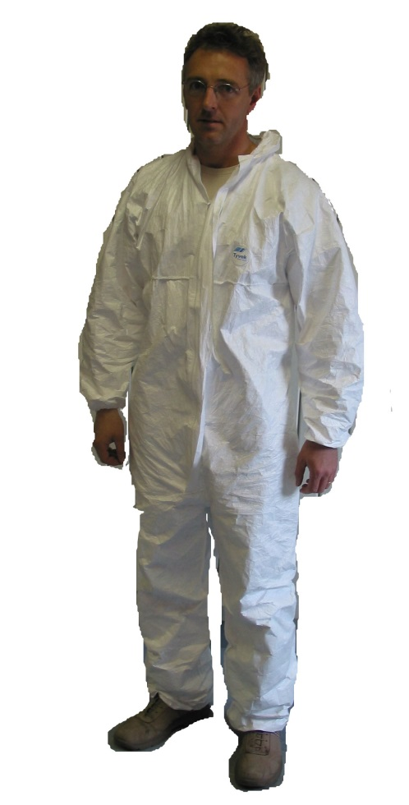
Personal protection equipment against contamination
For low level contamination / low risk
« Tyvek » overall (synthetic paper)
Rubber gloves
… generally completed by overshoes

Slide 57
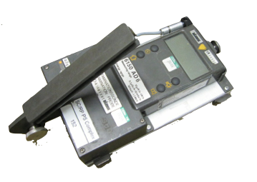
Outline of the lecture
A very brief historical introduction
Directly and indirectly ionizing radiation
  Radioactivity
  Natural exposures
The effects of ionizing radiation
  Deterministic and stochastic effects
Radiological quantities and units
  physical, protection and operational quantities
Principles of radiation protection
  Justification, optimization and dose limitation
  The ALARA principle
Protection means
Instrumentation for measuring ionizing radiation

Slide 58
Radiation measurements
  Since the Radiation Protection quantities are not directly measurable, their estimate involves the measurement of a physical quantity.
45653
-
+
Φ
-
+
-
*
+
-
+
-
+
H*(10)
Courtesy S. Agosteo, Politecnico di Milano

Slide 59
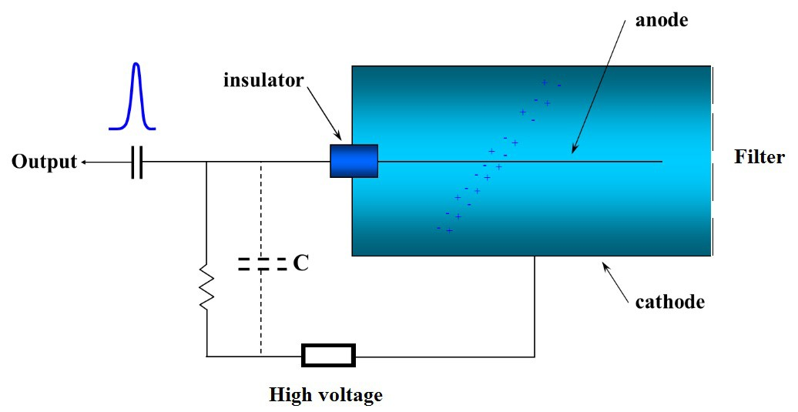
Ionization chamber

Slide 60
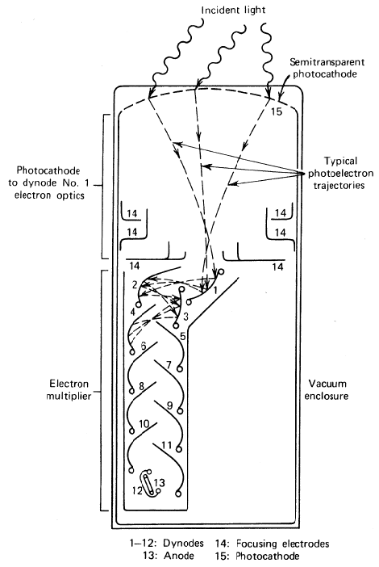
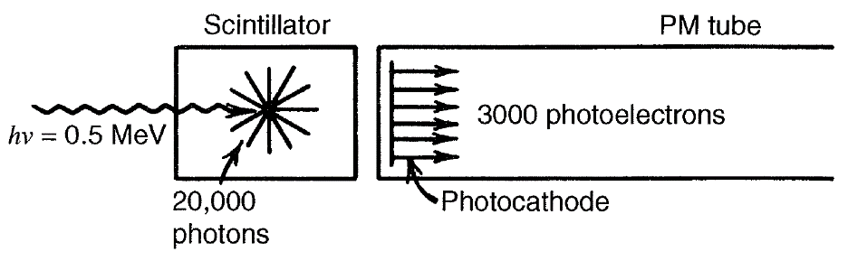
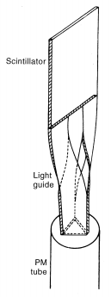
Scintillating crystal coupled to a PMT
From Glenn F. Knoll, Radiation Detection and Measurement

Slide 61
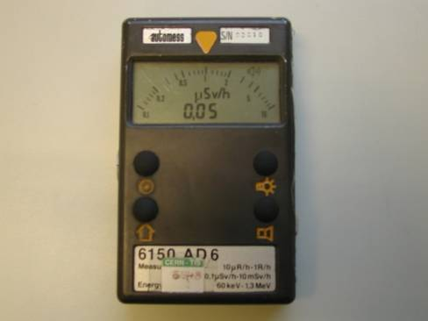
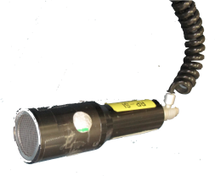
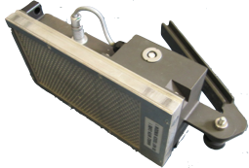
AUTOMESS dose rate meter 6150 AD6
Push button 1
AD17 external probe
Push button 2
Push button 3
Push button 4
Detector: Geiger Müller counter
Range: 0.5 µSv/h – 10 mSv/h
Energy range: 60 keV – 1.3 MeV
Dimensions: 130 mm x 80 mm x 29 mm
Alimentation: 9 V standard battery
ADK surface contamination meter for α, β and γ radiation
Detector: sealed proportional counter
Active surface 100 cm²

Slide 62
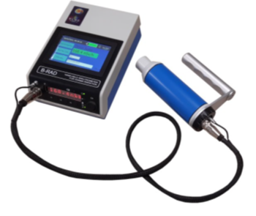
State-of-the-art: B-RAD by ELSE NUCLEAR (Italy)
Developed for operating also in very intense magnetic fields (up to 3 T intensity)
Equipped with LaBr₃ crystal, 15 mm diameter x 15 mm height
Energy resolution approximately 3% (¹³⁷Cs)
User friendly, with double display (small with fast reading, big for detailed analysis)
Leather bag for easy transport
Radioisotope identification capability
A. Fazzi and M. Silari. Portable Radiation Detection Device for Operation in Intense Magnetic Fields. CERN/Politecnico joint patent. Patent Grant number 9977134 (2017)

Slide 63
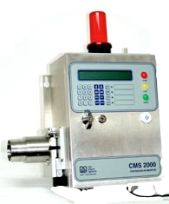
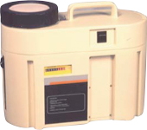
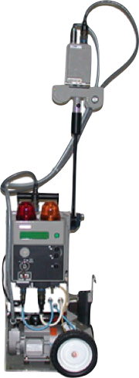

Contamination monitors
CMS2000
APA
Air contamination monitors
Hand and foot monitor
ABPM203M

Slide 64



Whole body counting

Slide 65
Slow neutron detection
Some elements have a very large cross section for slow neutrons and can be exploited for neutron detection
Boron ¹⁰B + n → ⁷Li + α Q = 2.793 MeV
    ¹⁰B + n → ⁷Li* + α Q = 2.310 MeV
Lithium ⁶Li+ n → ³H + α Q = 4.78 MeV
³He ³He + n → ³H + p Q = 764 keV

Slide 66

Neutron cross sections
Mean free path of thermal neutrons
in ³He gas ≈ 7 cm
in solid ¹⁰B ≈ 70 µm

Slide 67
Moderator-type neutron detector
*
*
*
Courtesy S. Agosteo, Politecnico di Milano

Slide 68

Proportional counters for slow neutron detection
BF₃ gas and ³He gas make detectors for slow neutrons with excellent gamma discrimination
Gamma rays can interact in the walls and produce electrons in the gas, but the energy loss of electrons is small (≈ 2 keV/cm), so that these pulses are much smaller than those due to neutrons
A suitable pulse amplitude threshold can thus eliminate most gamma interactions.

Slide 69
Pulse height spectrum from a BF₃ proportional counter
“Wall effect’ continuum
Reaction product full-energy peak
alpha
N
Li
Deposited energy
pulse height
Low-energy event cut
The shape of the pulse height spectrum is due to the energy loss of the recoils in the gas

Slide 70



Rem counters
Boron plastic
Polyethylene
BF₃ tube
Boron plastic
Studsvik 2202D
³He counter
Tungsten layer
Eberline WENDI-2
Berthold LB6411 (also LB6411Pb)
Electronic
³He counter
Bore hole
Cadmium absorber
PE
MAB SNM500(X)

Slide 71
Environmental monitoring
Active monitoring
  Ambient dose rate
  Water contamination
  Airborne contamination
  Weather parameters
  Gate monitors
Passive monitoring
  Thermoluminescent dosimeters placed in the environment

Slide 72















Environmental monitoring at CERN
Other environ-
mental samples
Stray radiation
Air
Water

Slide 73




Operational radiation protection monitoring at CERN
Air filled ionization chamber
REM counter
Gas filled, high pressure ionization chamber
Beam-on: to protect workers
in areas adjacent to accelerator tunnels and experiments against prompt radiation
(mainly neutrons, E < some GeV)
Alarm function
Beam-off: to protect workers during maintenance and repair against radiation fields caused by decay of radionuclides (mainly gammas, E < 2.7 MeV)
No alarm function

Slide 74




Operational radiation protection monitoring at CERN
Site Gate Monitor
Reading of radiation levels directly available
Radiation Alarm Unit
(RAMSES)

Slide 75


Passive environmental monitoring at CERN
Thermoluminescence dosimeters (TLD) inside a polyethylene moderators are used to monitor neutron and gamma doses in the experimental areas and in the environment.
TLDs are passive devices used CERN-wide to integrate radiation doses over a period of several months.

Slide 76
Some textbooks
Glenn F. Knoll, Radiation Detection and Measurement, 4th edition
Frank H. Attix, Introduction to Radiological Physics and Radiation Dosimetry
Annals of the ICRP (International Commission on Radiological Protection)
http://www.icrp.org/publications.asp
ICRU publications, International Commission on Radiation Units and Measurements
http://www.icru.org/

Slide 77
Supplementary material

Slide 78
Periodic table of elements
²¹⁹Rn (Actinion), ²²⁰Rn (Thoron) and ²²²Rn (Radon)
Notes:
As a noble gas, radon is chemically and electrically inert, therefore after inhalation, it is immediately exhaled and it is weakly harmful in itself. However the radon daughter products attach to the ambient areosol, which may be inhaled and stick to the lung surface. Its importance in the exposure of human beings to terrestrial radiation is given by its transport from surface to atmosphere where its decay products may be inhaled. Radon tends to concentrate in enclosed spaces like underground mines or houses. Radon is the largest contributor to daily exposure of radiation.

Slide 79

Decay chain of uranium
Precursor

Slide 80

Worldwide radon risk
Designed by J.M. Zielinski & H. Jiang
http://www.mclaughlincentre.ca/research/map_radon/Index.htm

Slide 81
The biological actions of radiation
Step | Time of appearance | Mechanisms
Physical | ~ 10⁻¹⁶ s | Energy deposition by ionisation and excitation of the atoms
Physico-chemical | ~ 10⁻¹⁰ s | Production of chemical compounds (ions radicals) which diffuse in the cell
Chemical | ~ 10⁻⁶ s | Production of molecular lesions in the DNA
Cellular | ~ hours | Lesions at cellular level and cell repair involvement
Deterministic effects | ~ weeks | Expression of dysfunctions at the tissues and organs level
Stochastic effects | ~ tens of years | Cancer induction and induction of heritable disorders

Slide 82





Classification of radiological areas at CERN
Area | Dose limit [year] | Ambient dose equivalent rate |  | Sign
 |  | Work place | Low occupancy
Non-designated | 1 mSv | 0.5 µSv/h | 2.5 µSv/h
Supervised | 6 mSv | 3 µSv/h | 15 µSv/h
Simple | 20 mSv | 10 µSv/h | 50 µSv/h
Limited Stay | 20 mSv |  | 2 mSv/h
High Radiation | 20 mSv |  | 100 mSv/h
Prohibited | 20 mSv |  | > 100 mSv/h
Radiation Area
Controlled Area

Slide 83

Classification of radiological areas at CERN
New signage scheme introduced in March 2021 to better visualize the level of radiological risk

Slide 84

Job and dose planning
Use of work processes and special tooling to reduce time in work area
Staging and preparation of necessary materials and special tools
Maximization of prefabrication in workshop
Use of mock-ups for complex tasks
“Dry-run” of the activities using applicable procedures
Engineering, design and use of temporary shielding
Use of remote handling procedures
Lead shielding

Slide 85


Protection methods against intakes of radioactivity
Isolating the radioactive substance
  use of containment
  use of glove boxes
  use of fume cupboards
Isolating the person
  do not eat, drink, or smoke in a supervised or controlled area
  wear protection gloves and laboratory coats
  use respiratory protective equipment

Slide 86

Personal dosimetry at CERN
Continuous measurement of βγ-dose (DIS-system) and integration of the neutron dose (track dosimeter)
Obligation to wear the dosimeter in supervised and controlled areas
Wearing of the dosimeter on the chest
Reading at least once a month at a reader (about 50 readers available on the site)
Possibility of checking the dose associated with a given operation (read the dosimeter before and after)
Dosimeter to be returned to the dosimetry service at the end of stay or at the end of a 12 month period

Slide 87
Operational dosimetry at CERN
Obligation to wear an operational dosimeter in a controlled area
Continuous βγ-dose measurement
Instrument: DMC
Display of Hp(10) (resolution of 1 µSv)
Dose alarm at 2 mSv
Dose rate alarm at 2 mSv/h
Audible detection signal (« bip »)
Record the dose before and after the operation

Slide 88





Operational dosimetry at CERN
Before Accessing
Start your DMC
Access
Exit
Reading
PAUSE
DOSE
Type your # IMPACT

Slide 89


Personal protection equipment against contamination
For higher levels of contamination = higher risk
Tyvek overall
Tape-sealed gloves
Overshoes
Respiratory Protective Equipment

Slide 90








Personal protection equipment against contamination
Whole body protection from contamination
Ventilated, filter and over-pressurized
Tyvek

Slide 91


Personal protection equipment against contamination
Individual protection equipment is mandatory for work in areas with contamination risk (cleaning operations, machining of radioactive material or equipment, …)

