Slide 1
High Energy Physics
Broadening Engagement in STEM
Dr. Jacqueline D. Smith
American Association for the Advancement of Science (AAAS) Science & Technology Policy Fellow (2023 -2025)
8th Annual African School of Physics Conference
July 10th, 2024
Marrakech, Morocco

Slide 2

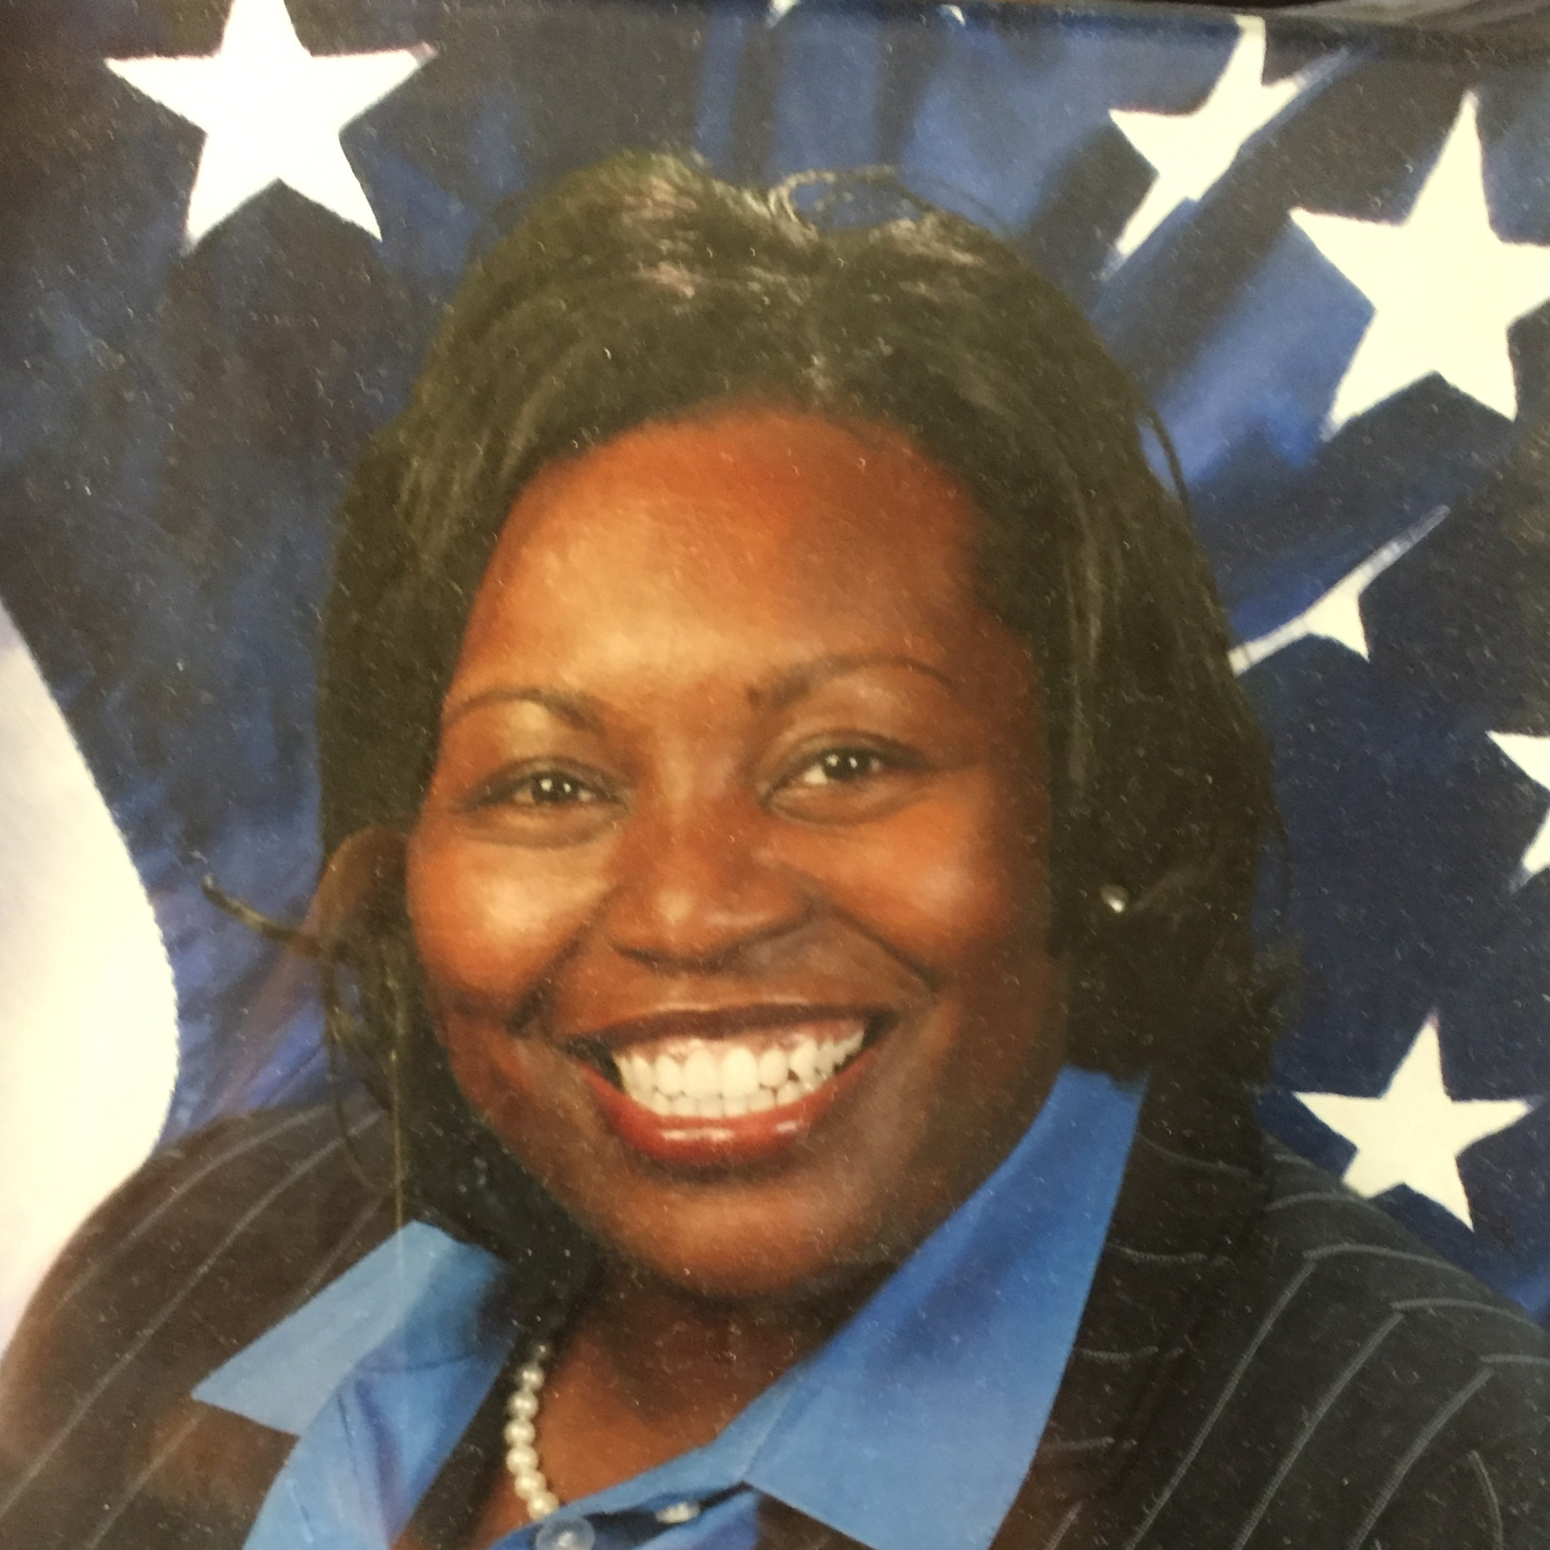



Introductions
Previous Experience
  Criminology
  Police officer/Investigator/Instructor/Supervisor
  International Police Advisor
  Policy – “the foundation for any organization”
  Undergraduate
  Graduate
  Faculty Member (ERI and HBCU)
  Doctoral
  Research and Policy
  AAAS S & T Policy Fellow
  Assist in Supervising MEISPP Intern (Fostering Great Minds)
  Mentor: Alan Stone
  AAAS S & T Policy Fellow (2nd year)
  Mentoring fellow Policy Fellows
  Change Agent (Policy, STEM, Education, & Justice)
Education
Current Status
Future

Slide 3
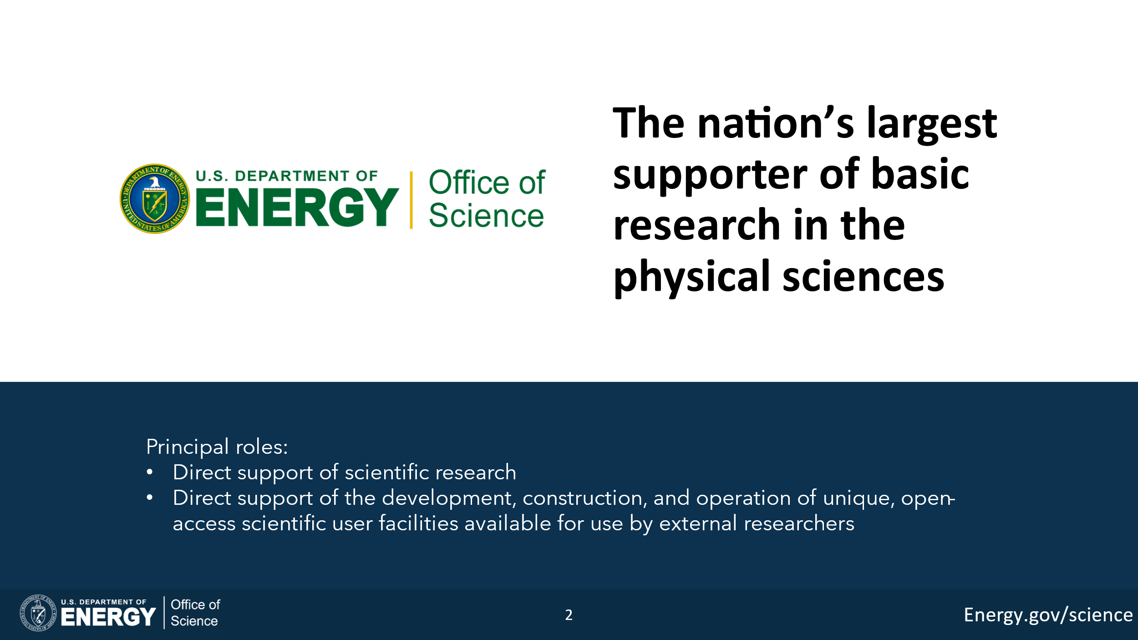
High Energy Physics – Broadening Engagements

Slide 4
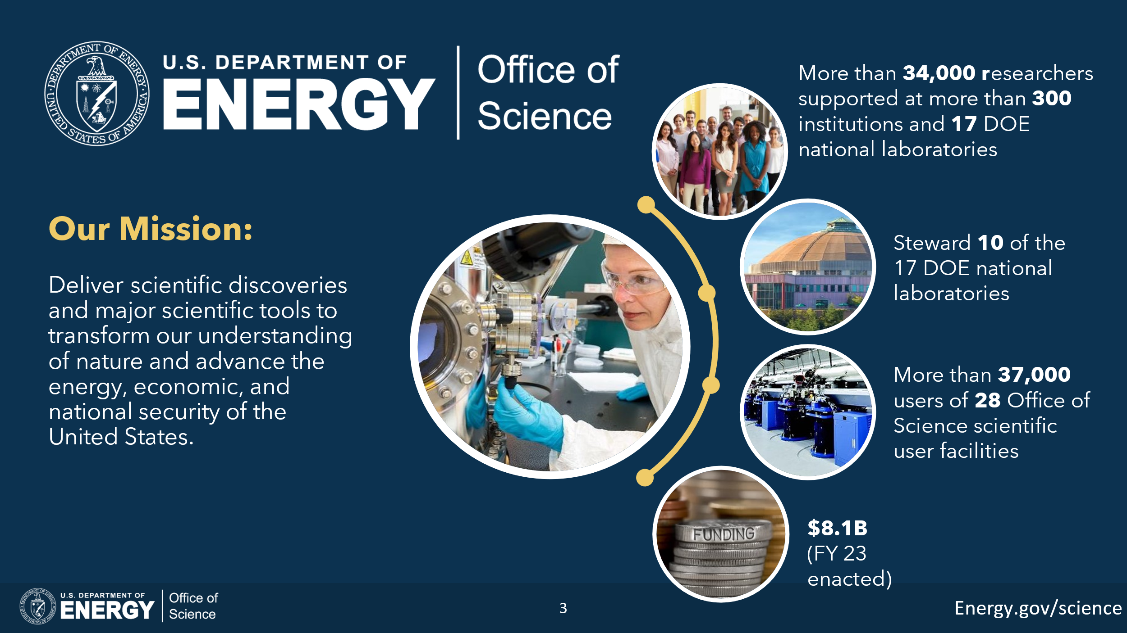
High Energy Physics’ Mission:

Slide 5
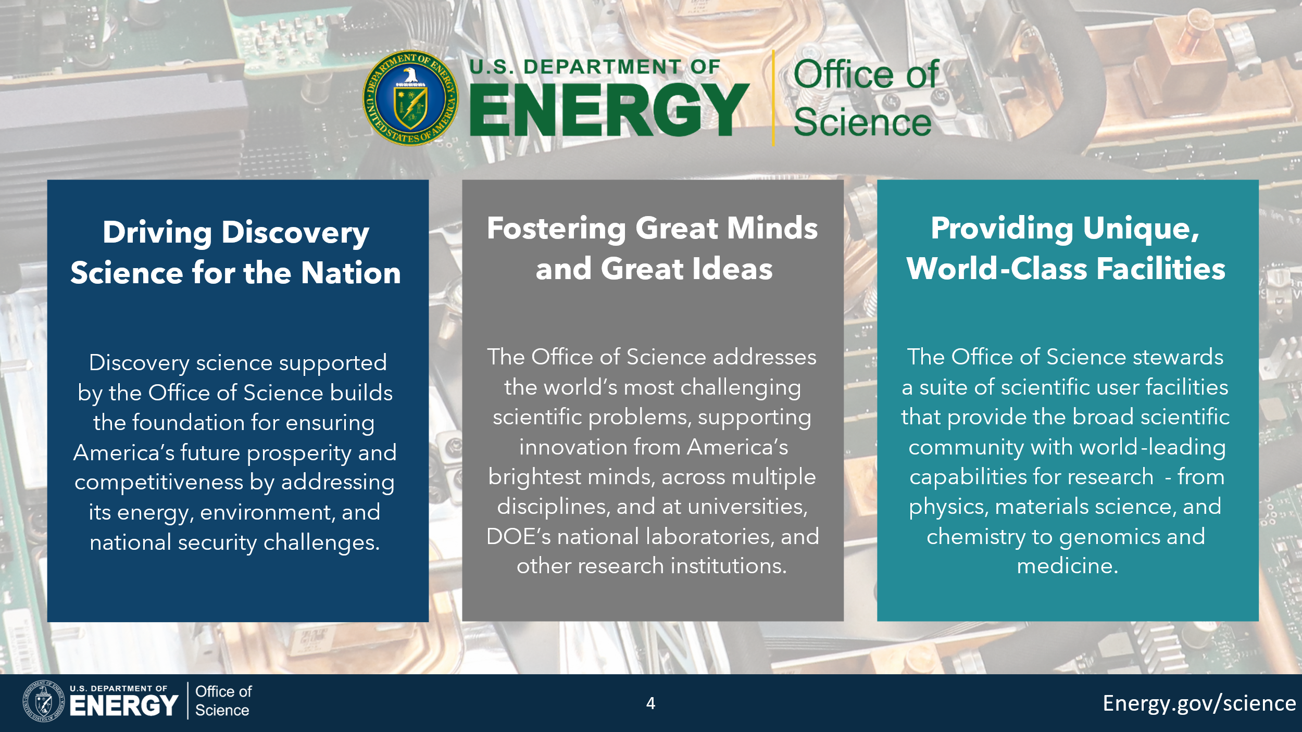

Slide 6
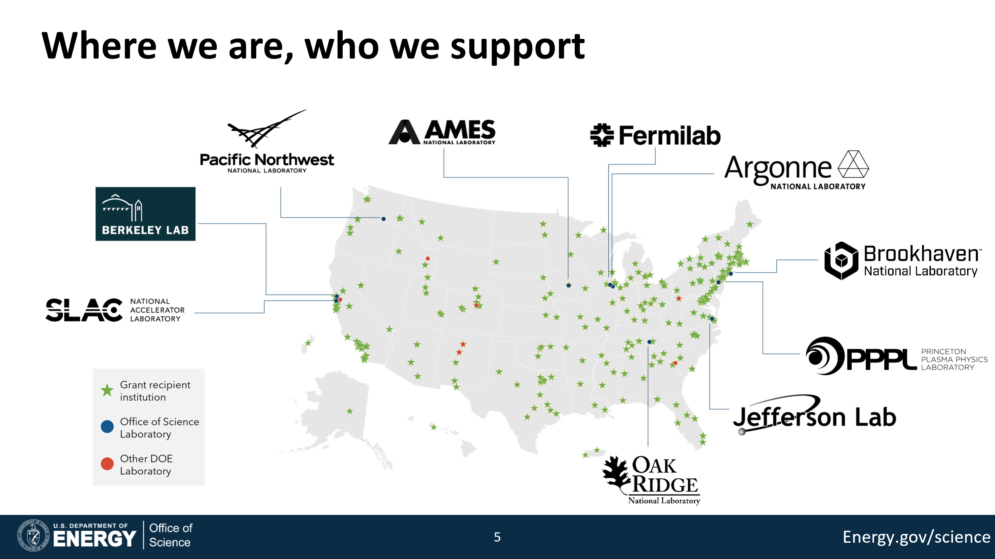

Slide 7
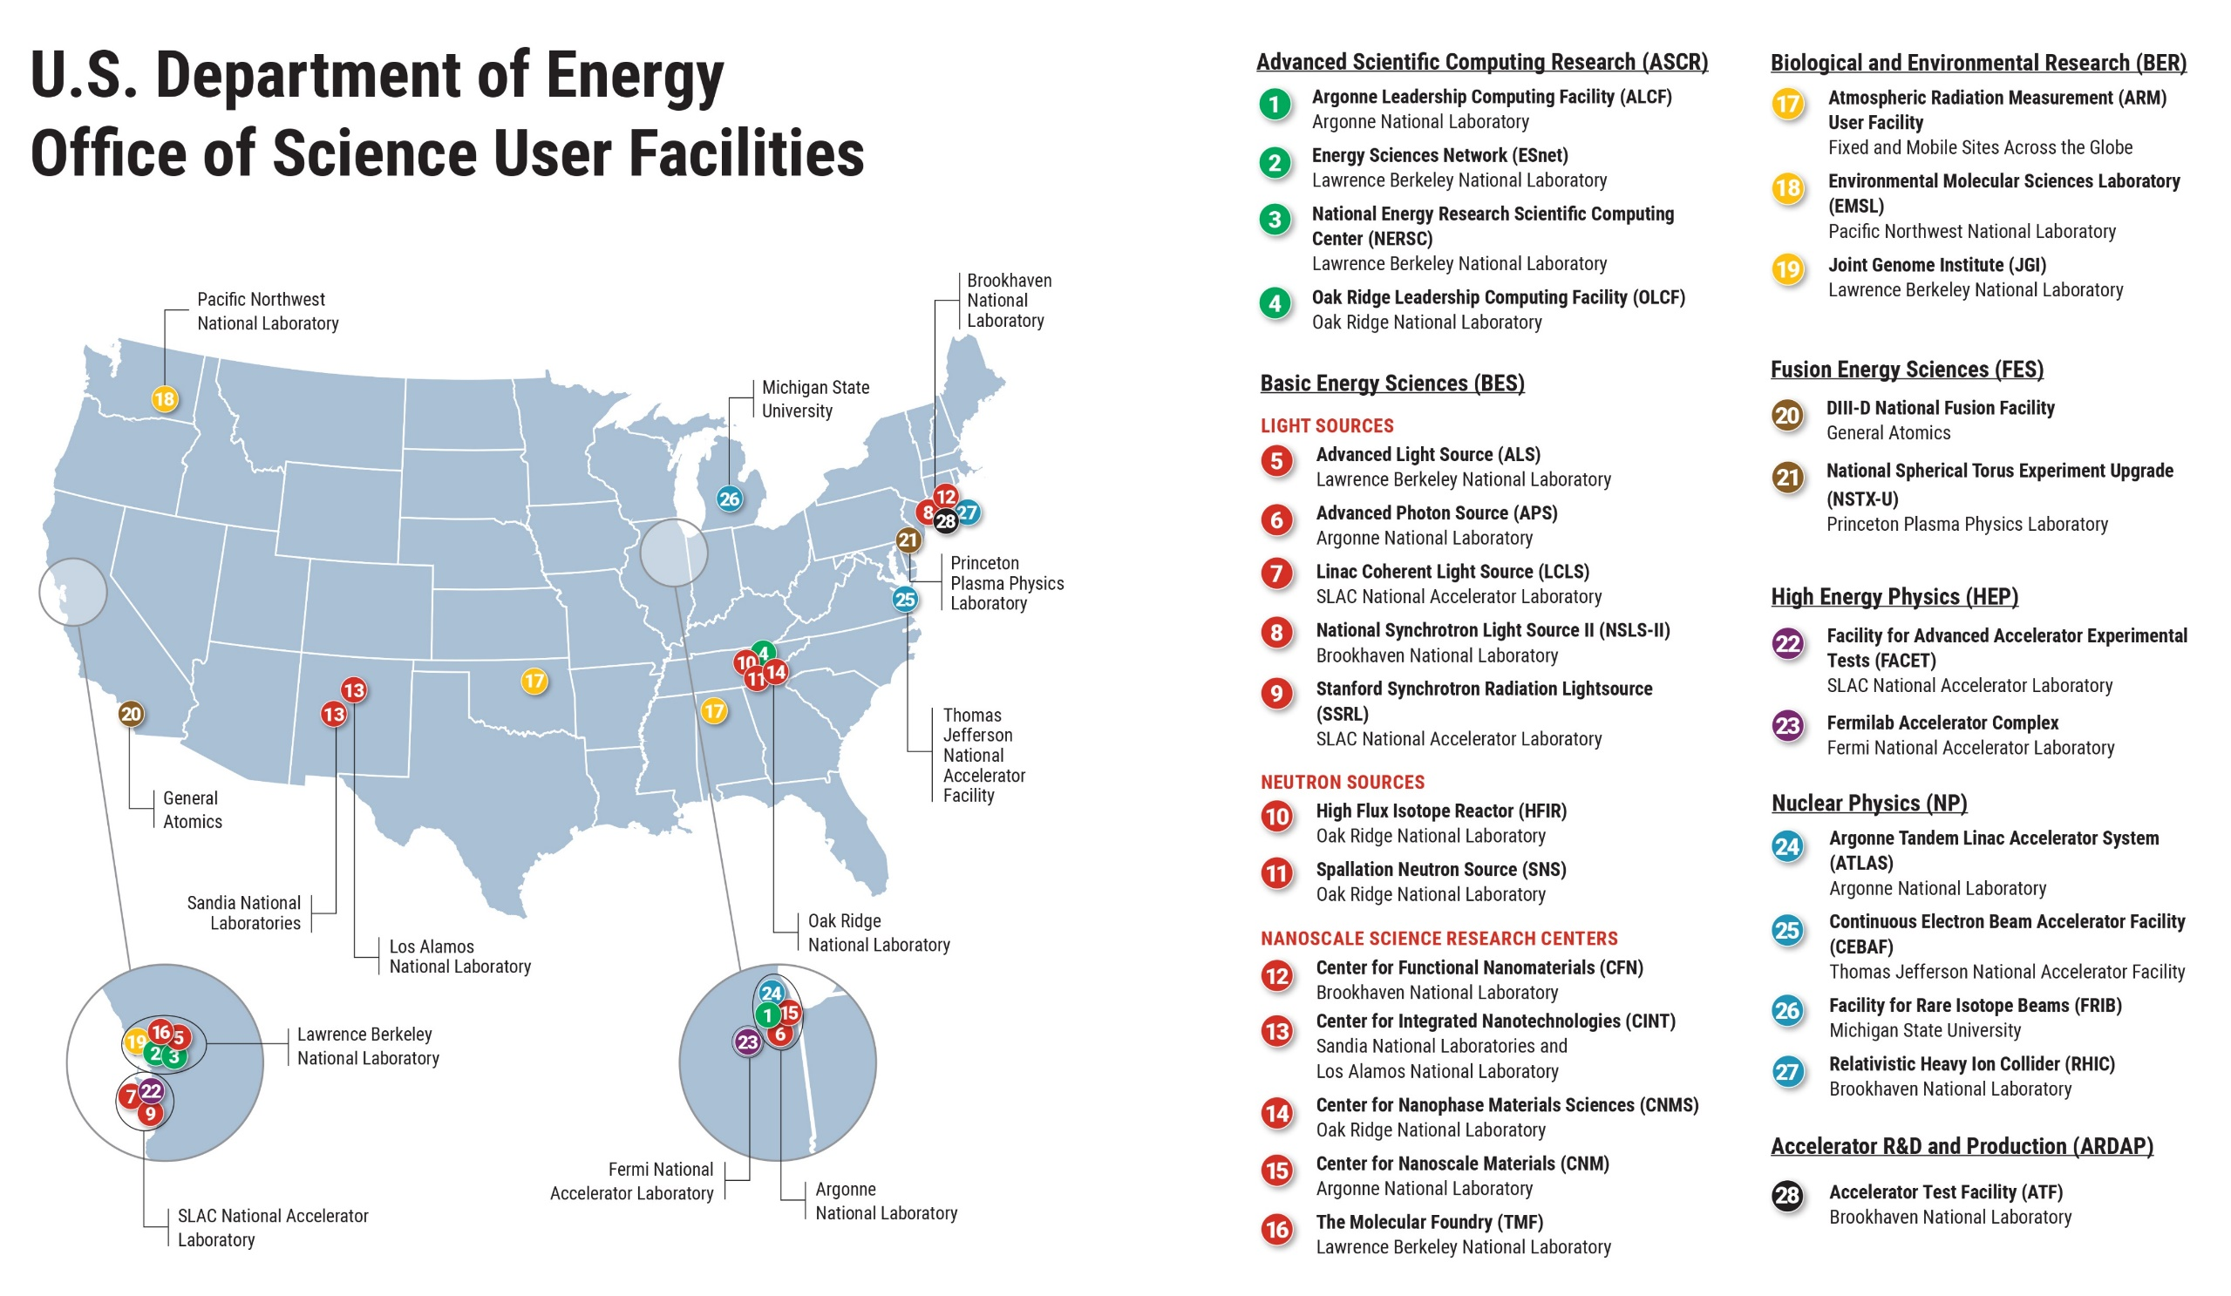

Slide 8


Slide 9
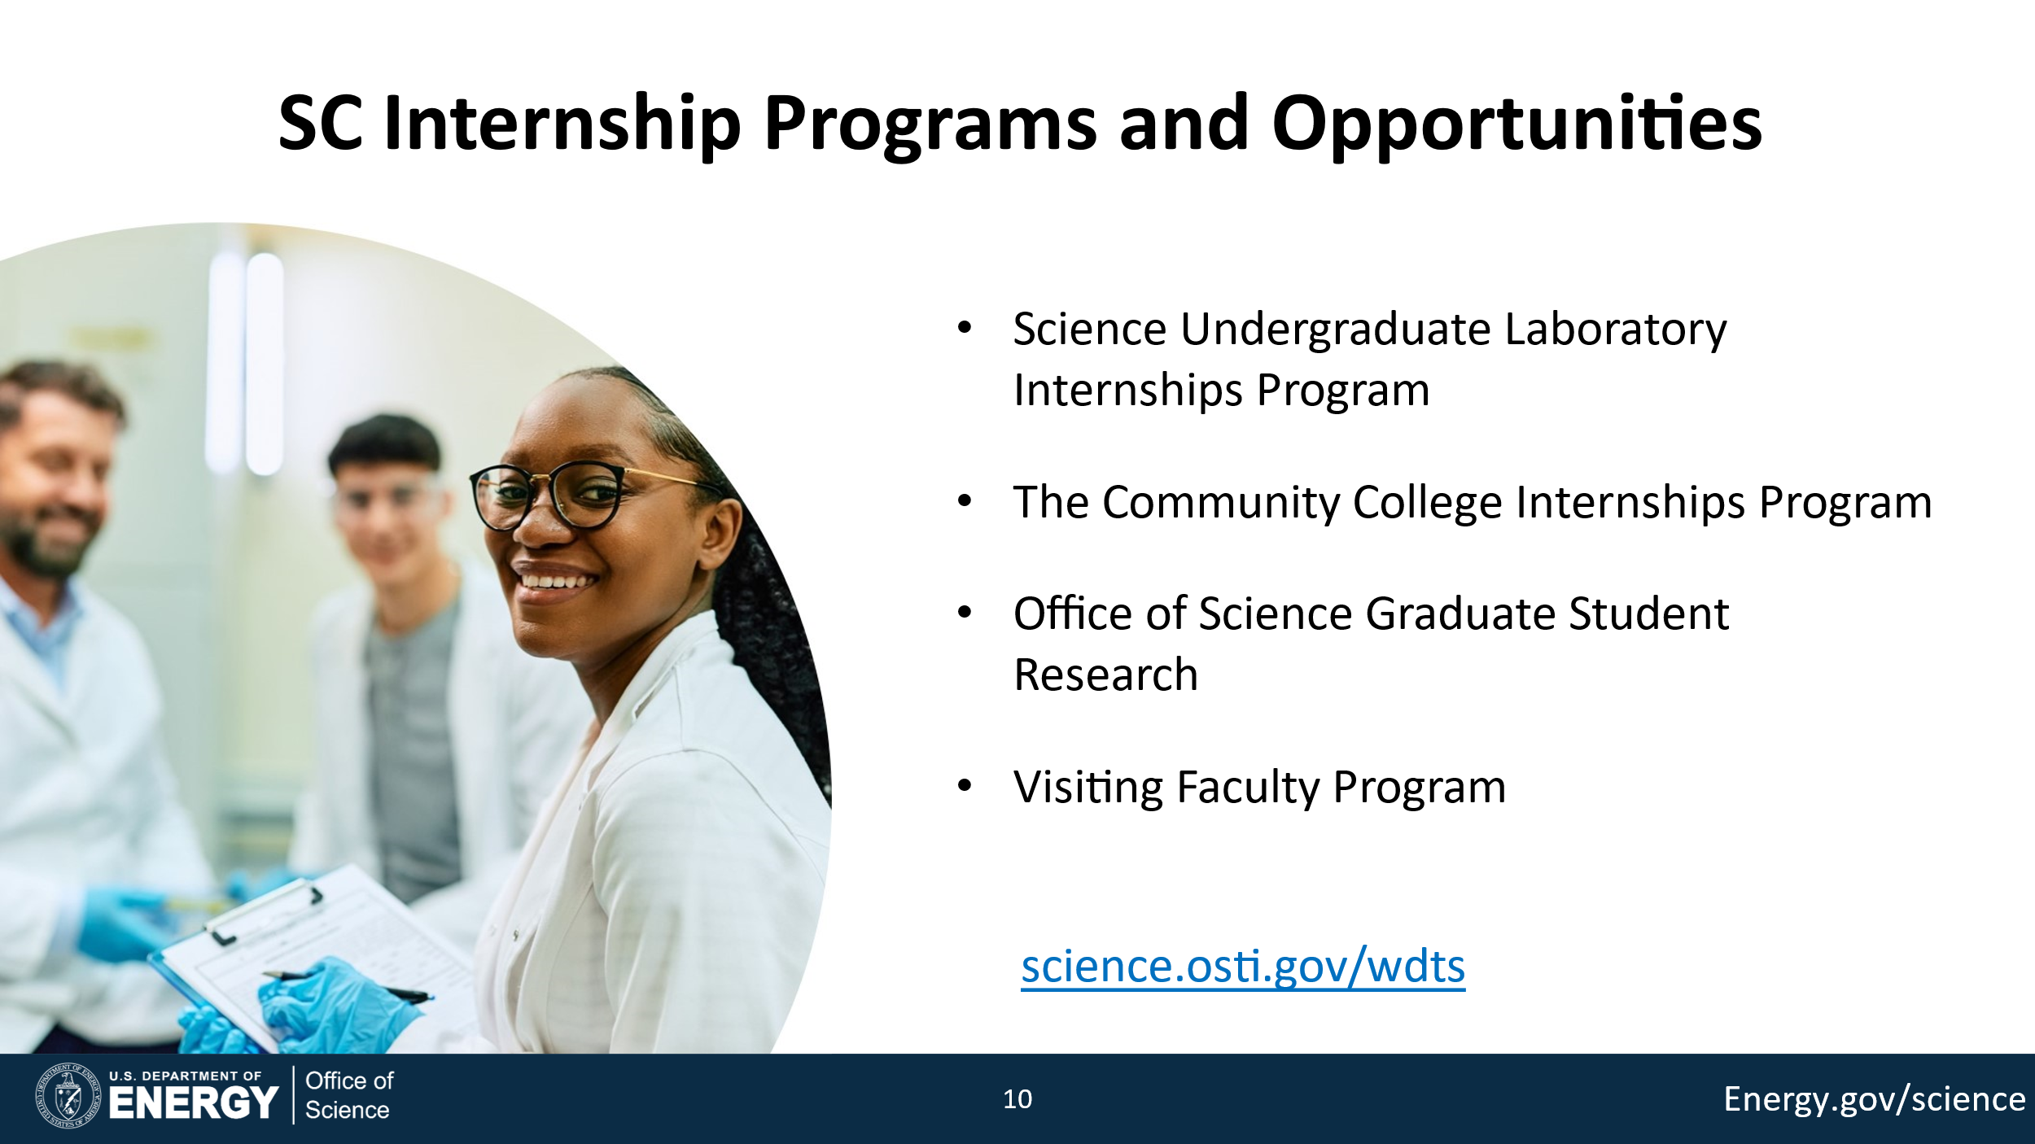

Slide 10
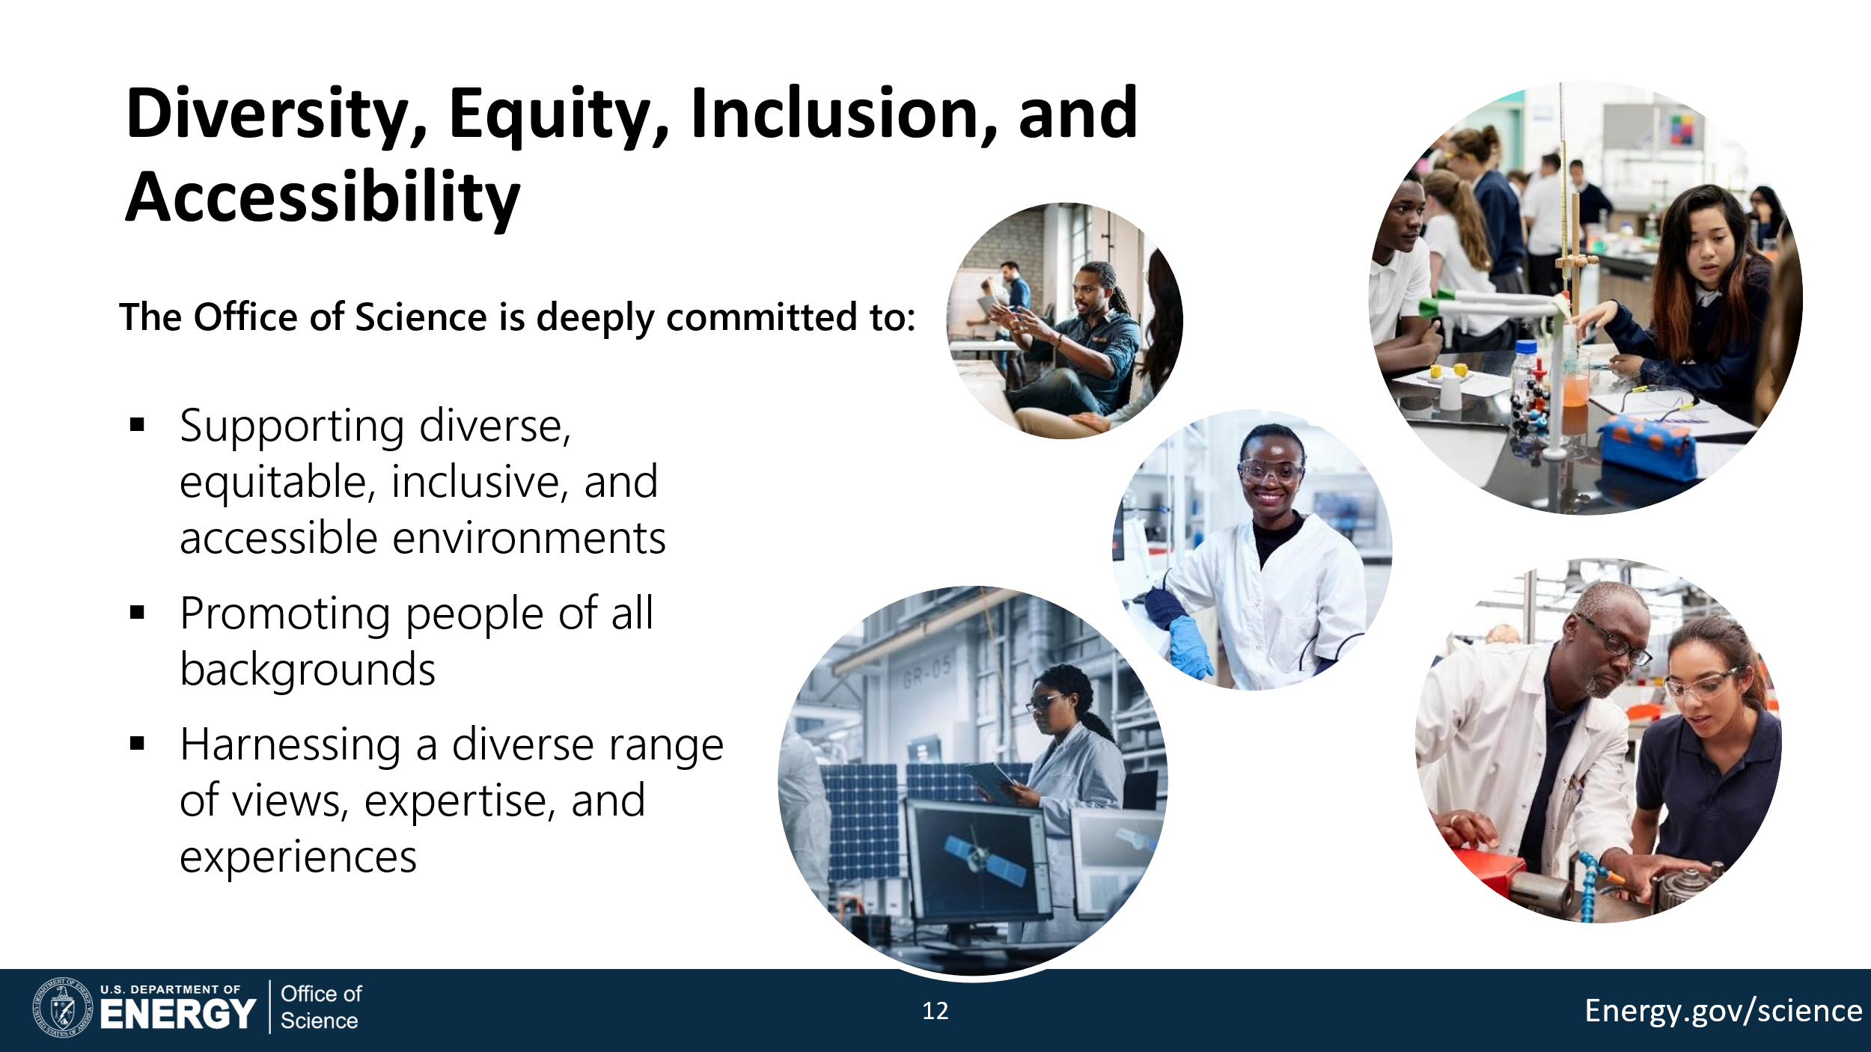

Slide 11
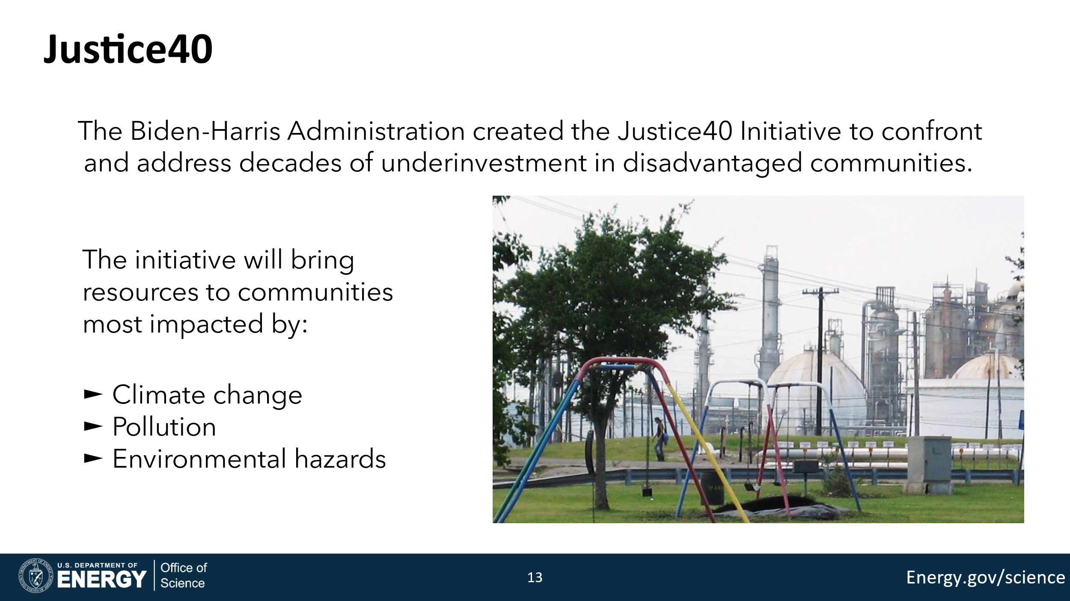

Slide 12
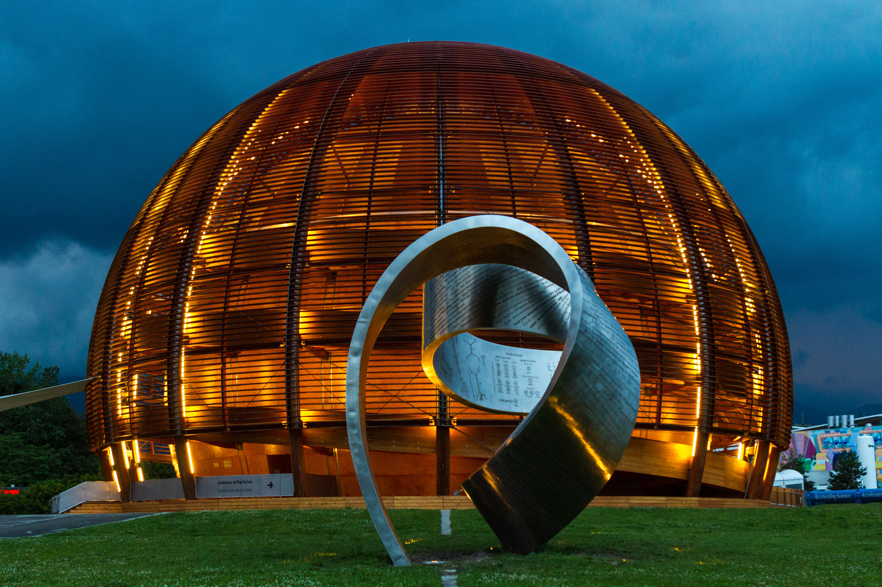
BU Geneva Physics
GENEVA, SWITZERLAND

Slide 13
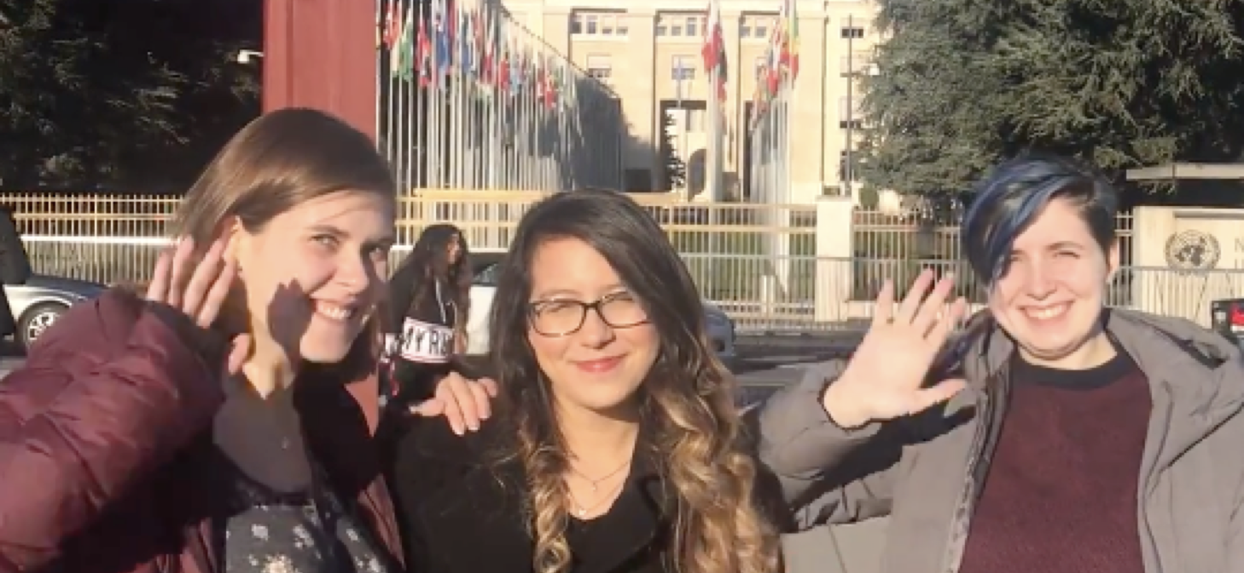
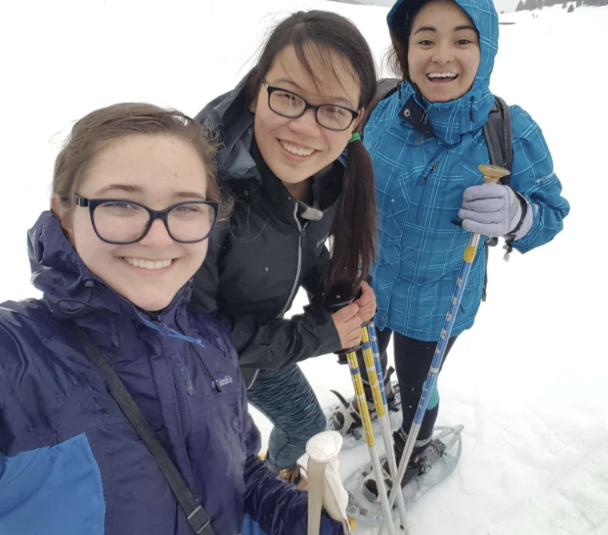
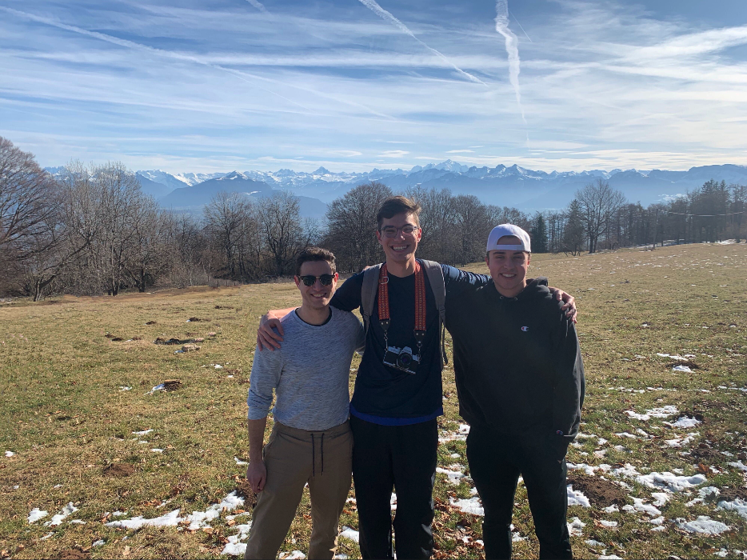
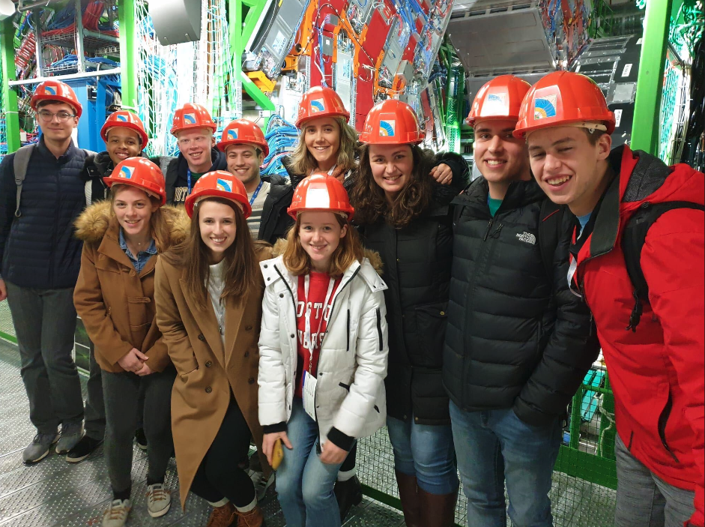
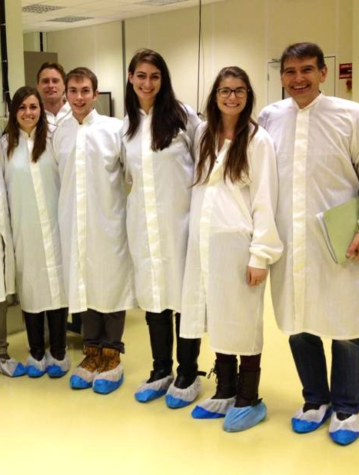
Overview
Study Abroad :
  Junior year, second semester for Physics/Astronomy/Math majors
  6 Months stay in Geneva
  Guided research at CERN
  Get immersed at the University of Geneva
Summer Extension :
  6 weeks extended stay in Geneva
  Full-time research at CERN with a CERN mentor
Live just a short walk from Geneva’s most famous landmarks and attractions
Cultural exchanges & excursions!

Slide 14
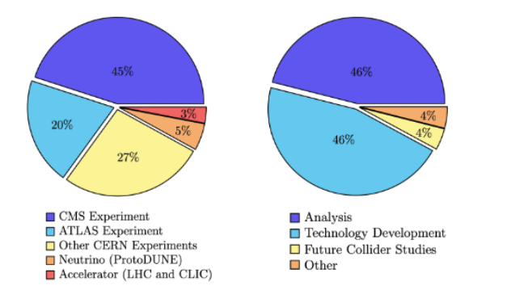
Summer Extension: Research Focus!
A large variety of research projects from data analysis to technology development across multiple experiments and accelerator projects!

Slide 15
Building the Diverse STEM Workforce of the Future: High Energy Physics at PNNL
Evangelina Galvan Shreeve
Chief Diversity Officer & STEM Education Director
June 2024
PNNL-SA-193234
Notes:
EVANGELINA

Slide 16
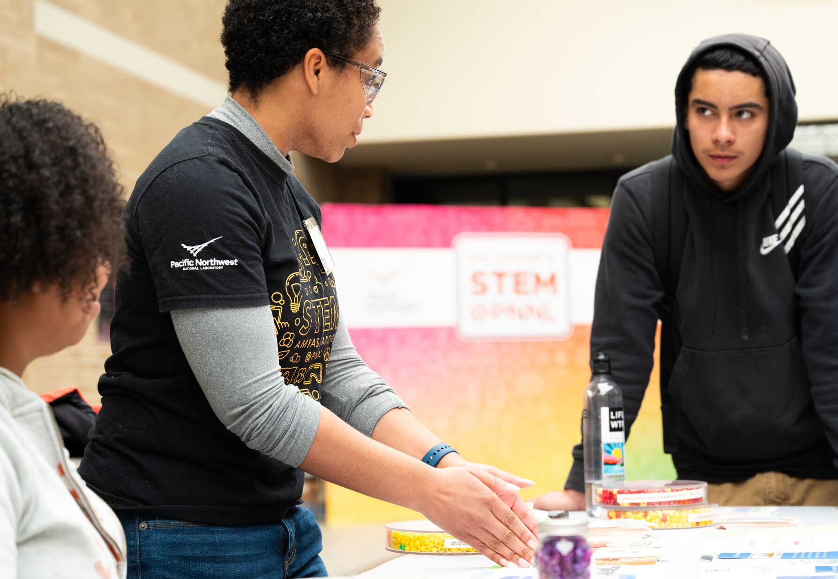
HEP Outreach at PNNL
PNNL prioritizes diversity, equity, inclusion, and accessibility in our HEP efforts.
PNNL conducts strategic HEP outreach by leveraging our STEM Ambassadors. We also develop partnerships with Minority Serving Institutions and Emerging Research Institutions.
PNNL engages faculty and students who are from underrepresented groups to develop interest and awareness of DOE-SC HEP research and workforce development opportunities.
Notes:
HEP Outreach, Equity & Inclusion
STEM Ambassadors & Student STEM Ambassadors conduct outreach to create interest and awareness in HEP studies and careers
Partnerships with local / regional Minority Serving Institutions, 2-year and 4-year, for outreach to faculty and students
Partnerships with educational programs that serve underrepresented students in STEM
HEP Workforce Development
Remote and Hybrid internships for diverse students
HEP Faculty Engagement
Create awareness of HEP research and internships at national laboratories
Create opportunities for new HEP research collaborations

Slide 17
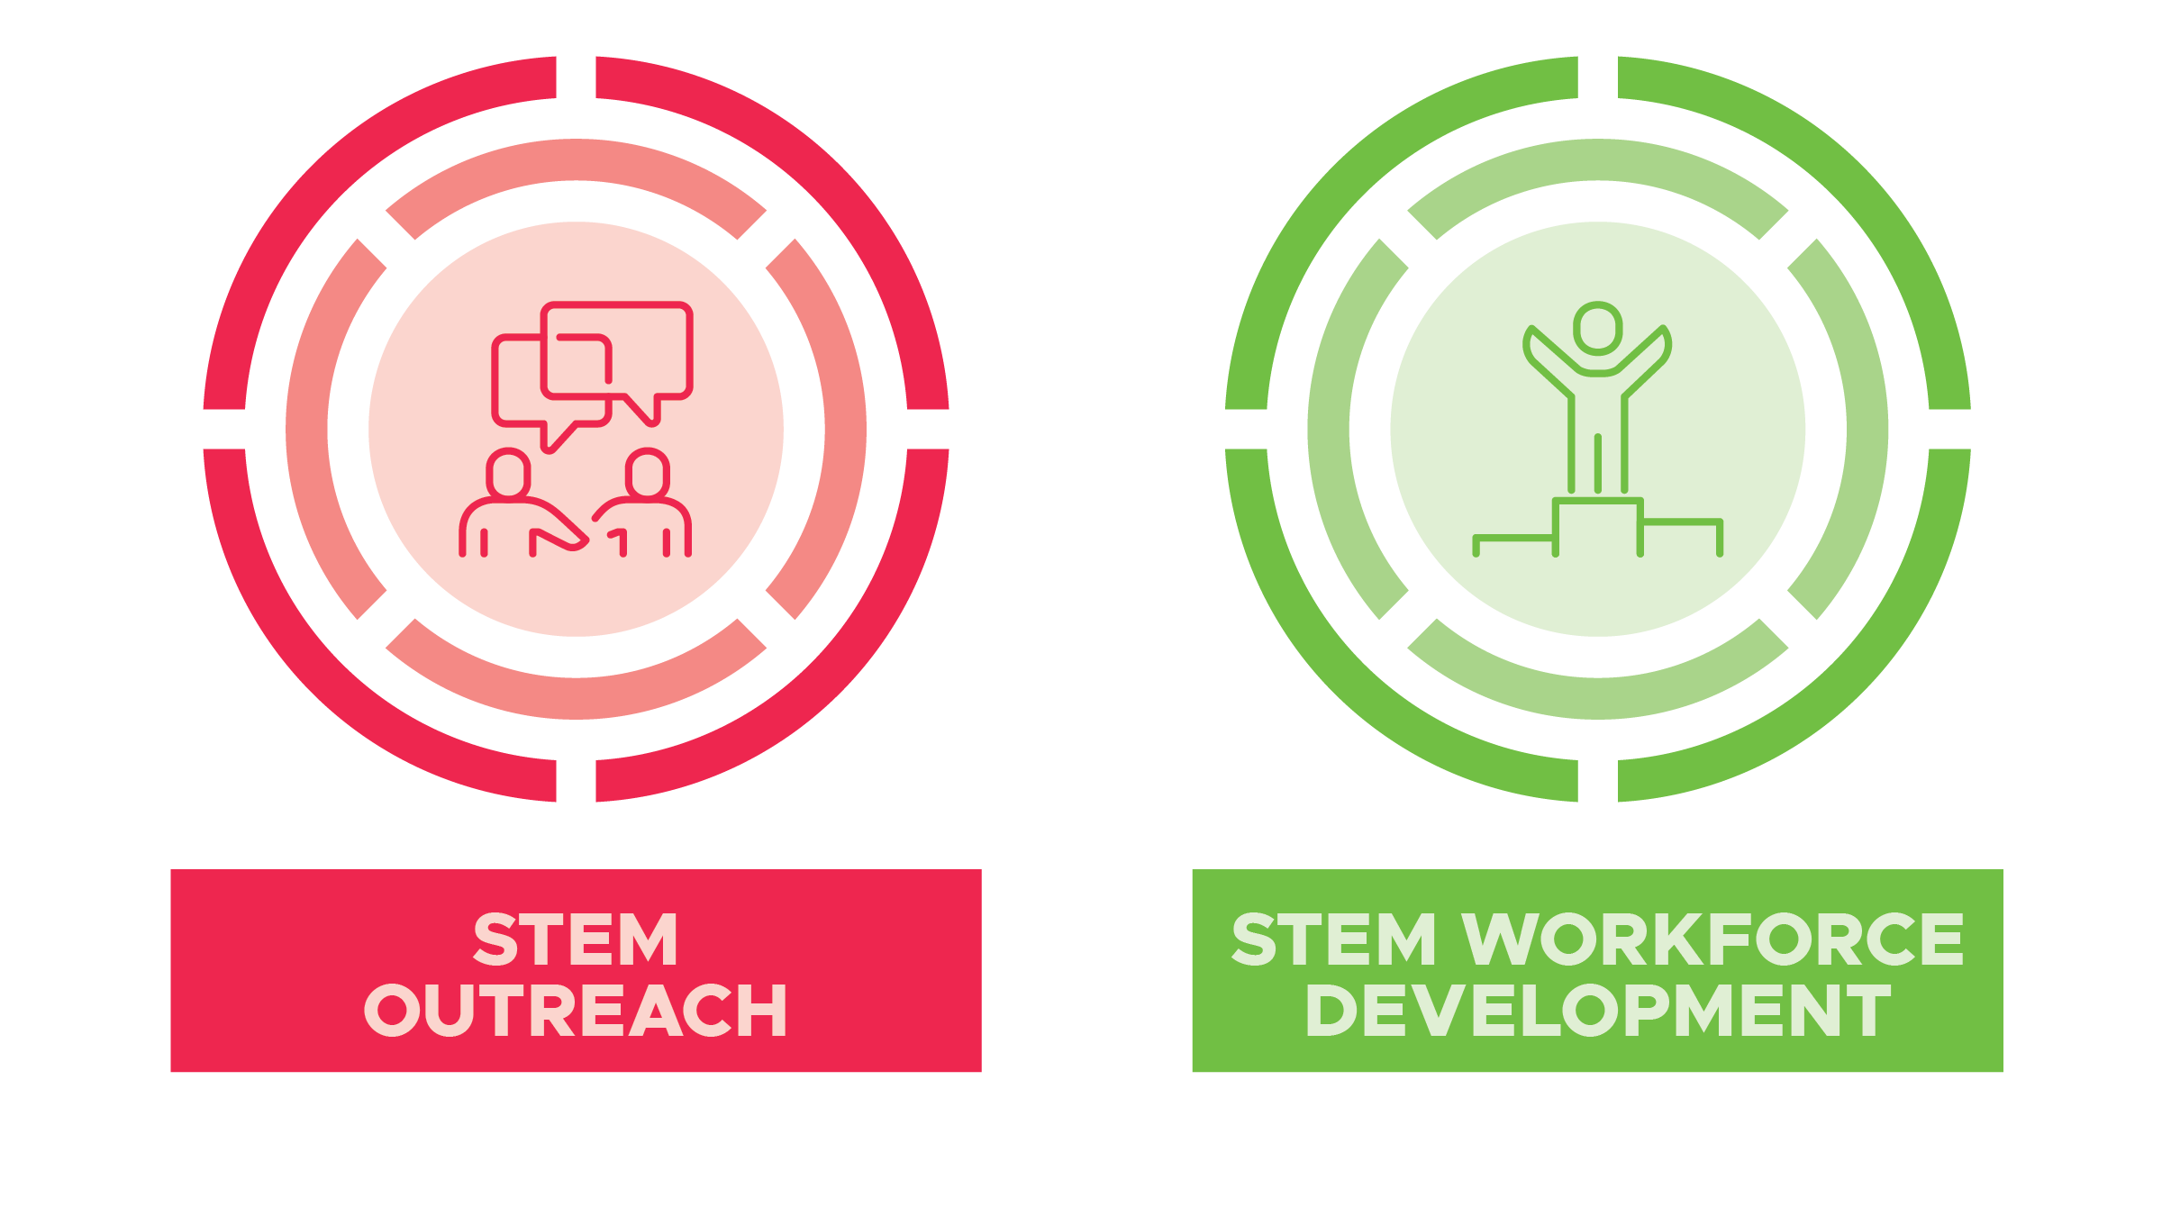
STEM Education Capabilities at PNNL
Notes:
PNNL’s STEM strategy is based on two capabilities we have developed in STEM Outreach and STEM Workforce Development that sets us apart from other national laboratory’s STEM programs. We work closely with S& T partners from across the Lab to integrate PNNL’s research and expertise in all our STEM efforts. At the same time, we have also integrated DEIA as a core component of our capabilities.

Slide 18
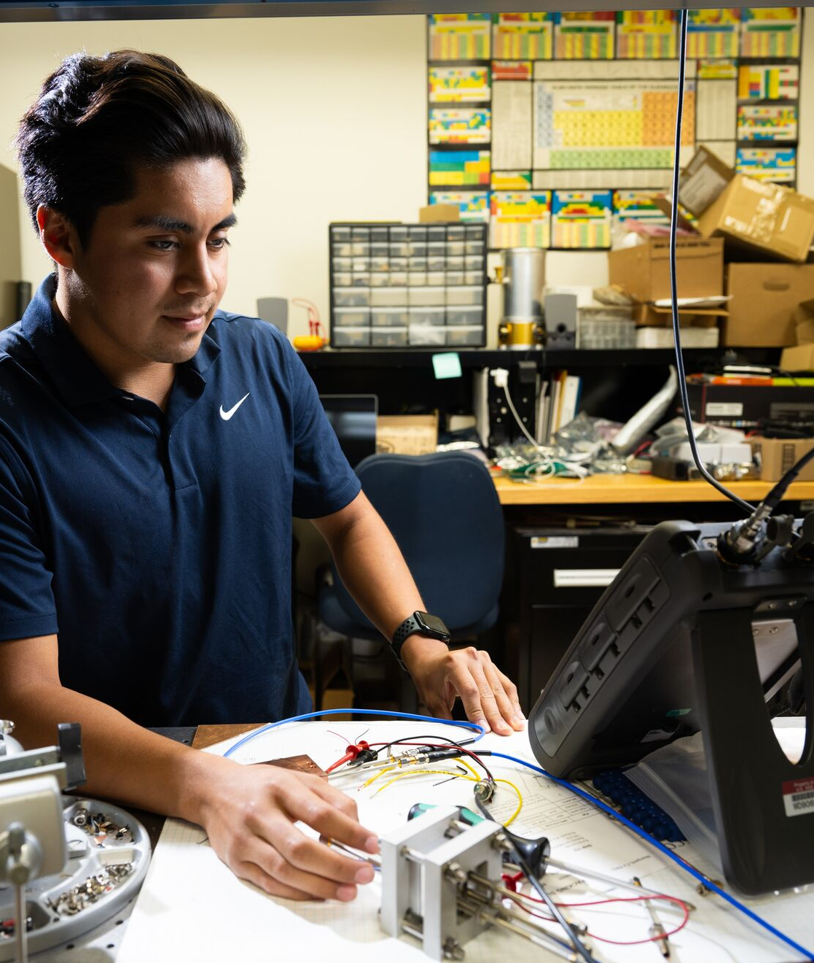
HEP Workforce Development at PNNL
Early STEM pathway project: Engages underrepresented students from two community colleges that are Hispanic Serving Institutions (HSI) in remote and onsite HEP research internships at PNNL.
Undergraduate STEM pathway project: Engages underrepresented undergraduate students from a non-R1, HSI in onsite HEP research internships at PNNL and immersive HEP learning at their college campus. Provides HEP-focused professional development for faculty.
Notes:
Pictured: HEP INSPIRE student testing radio frequencies of a conductive copper cavity to see if we can move/tune the frequencies with the help of a piezoelectric element. The research will aid the bigger idea of Axion dark matter particle detection.
Inland Northwest STEM Preparation for Inclusive RENEW-HEP Experiences (INSPIRE): MSI partnership with Columbia Basin College and Wenatchee Valley College to create STEM career pathways
Experiencing Physics and Inspiring Communities (EPIC): MSI partnership with California State University – San Bernardino to create STEM career pathways HEP-focused professional development for educators
These programs are exclusively geared toward opening pathways and opportunities for a future STEM career in High Energy Physics. By using nuclear and particle physics as a vehicle to explore the nature of interdisciplinary work, students also join an intentionally designed environment that develops their identity and sense of belonging as future STEM experts.

Slide 19
SLAC Returning Citizens Pilot Program
Project Plan FY24
Natalie Holder, Chief Diversity Officer

Slide 20
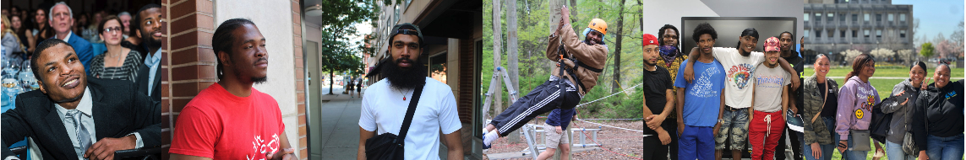
Background: The Pilot and a Potential Solution
For FY24 and FY25,
SLAC received a total of $500k in funding from the DOE to launch a pilot program to determine whether returning citizens could be a talent pipeline for our lab
The pilot would target technicians’ roles
New York State’s Clean Slate Law automatically seals misdemeanor offenses after three years, making it advantageous to work with a NY-based organization to source the talent

Slide 21
Key Facts about Returning Citizens
Over 2 million people are incarcerated in the U.S.
According to the National Reentry Resource Center, about 70 million adults in the United States have a criminal record, and some of them do pursue higher education, including obtaining college degrees.
Hiring formerly incarcerated individuals helps reduce their chances of returning to jail or prison.
Employees with a record are loyal and offer a unique perspective in the workplace.
Companies can help strengthen the economy by hiring formerly incarcerated individuals.

Slide 22
Companies that have successful Returning Citizens Programs
IBM (launched in 2020): IBM's "New Collar" program doesn't focus on a candidate's educational background or traditional qualifications but rather on their skills and potential. They've been open to hiring individuals with non-traditional backgrounds, including those with criminal records.
Google (launched 2016): Google has taken steps to support individuals with criminal records by signing the Obama administration's Fair Chance Pledge. They've committed to considering individuals with criminal records for job opportunities.
Microsoft (launched 2015): Microsoft is known for its initiatives to provide employment opportunities to individuals with criminal backgrounds. They've worked on several programs focusing on skills training and hiring individuals who have been formerly incarcerated.
Amazon (launched 2022): Amazon has a program called "Career Choice" that provides training and education for employees, including those with criminal records, to gain skills for in-demand jobs, both within and outside of Amazon.
Biogen (launched 2015): Biogen, a biotechnology company, has supported programs focusing on workforce development and providing opportunities for individuals with criminal records. They've been involved in initiatives aimed at increasing diversity and inclusivity in the workforce.

Slide 23
Roadmap: Overall Program Framework
Statement of Recruitment, Retention & Promotion Strategy to Increase DEI+, Particularly in S&T
1
2
3
Build
Work with external partners to source, support and hire the pilot participants
Internally partner with Talent Acquisition and the directorate to identify critical and difficult to hire roles
Work
Select Returning Citizens to participate in the program through the interview and hiring process
Assess
Determine the efficacy of the program and lessons learned
Determine whether to extend offers of full-time employment

Slide 24
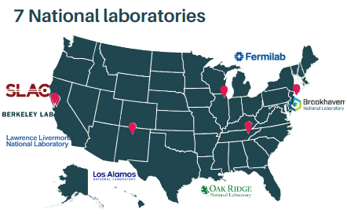
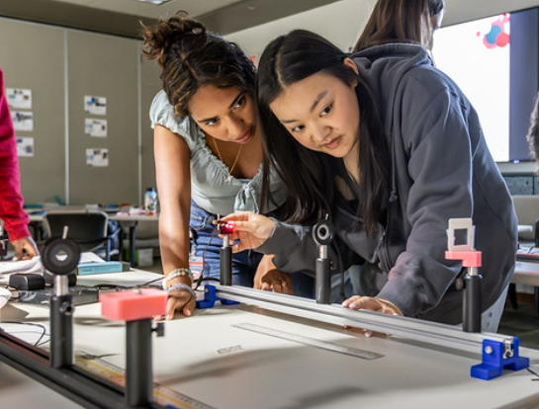
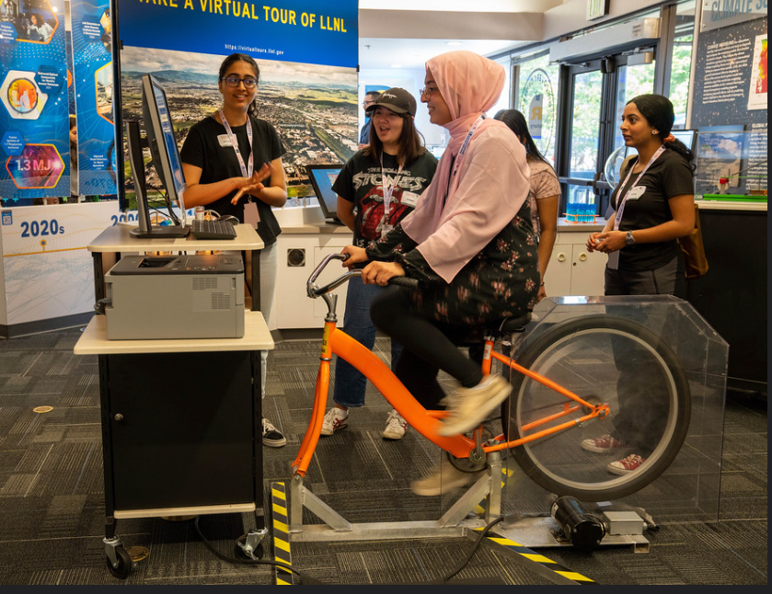
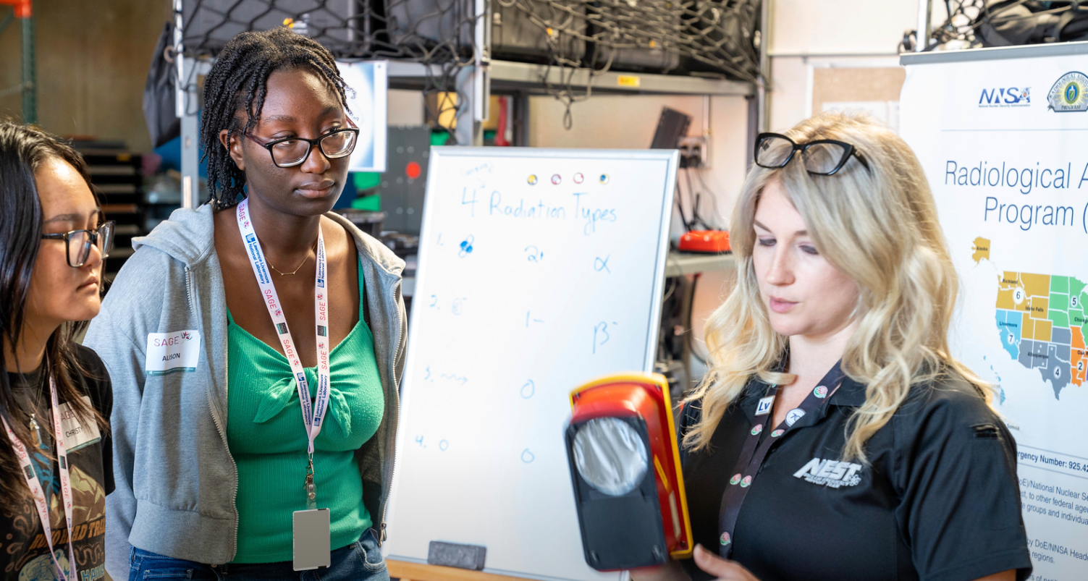
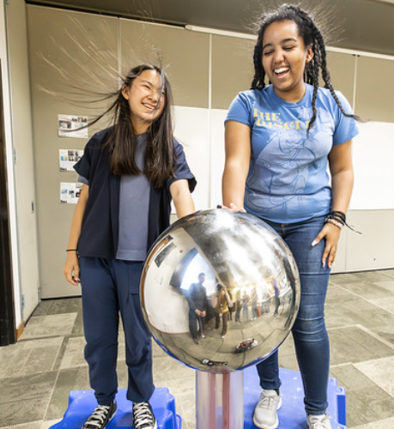
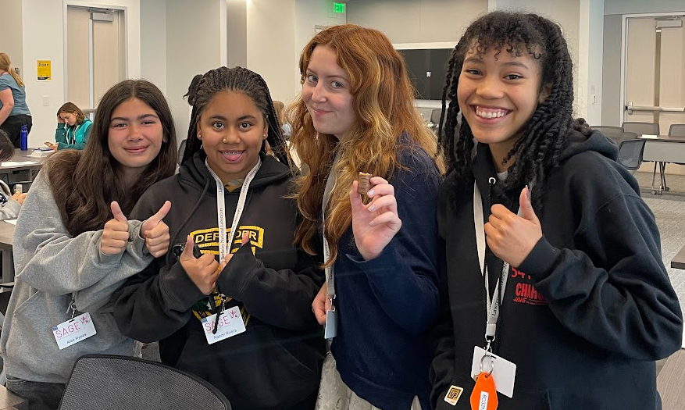
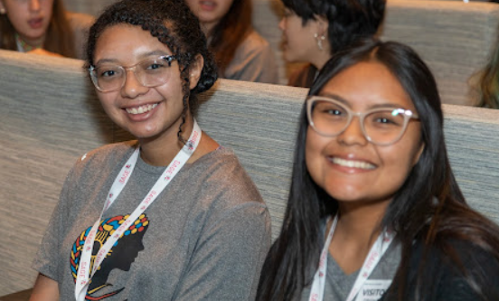
SAGE Journey Program (founded at SLAC is now run in many other national laboratories)
2024 Stanford President’s Award for Excellence in Diversity
2024 Stanford President’s Award for Excellence in Diversity
www.mySAGEjourney.org

Slide 25

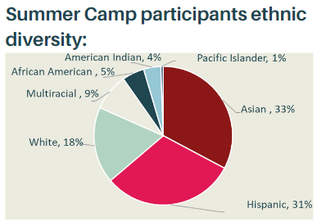
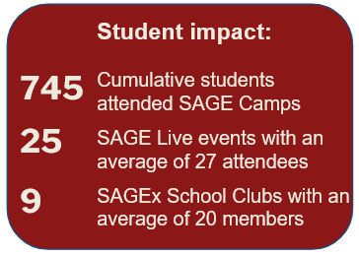
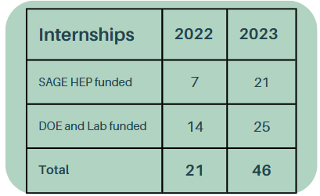
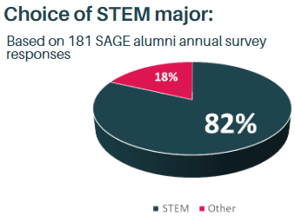
SAGE Journey Program (founded at SLAC is now run in 6 other national labs)
At SLAC, in 2023, out of 809 Technical Research Staff, 148 (18%) were women
SAGE Internship:
advertising existing national lab internship programs within the SAGE community
connecting SAGE participants with mentors at National Laboratories and guiding them through the application and selection processes
developing skills relevant and/or unique to National Laboratories
tracking of skill proficiency level increase
Supported by the Gordon and Betty Moore Foundation 2018-2024
SAGE Journey is a program that guides students from high-school through college and into their first jobs in the Department of Energy (DOE) National Laboratory network.
Mission: to engage curious and passionate students of genders historically underrepresented in STEM, and empower them to explore a wide range of possibilities for their future.
SAGE CAMP
Encourage college bound students with a passion for discovery and innovation to join the DOE community
Allow students to meet women at DOE at various career stages
  Undergraduate and graduate students
  Early and mid career professionals and senior leadership
SAGE Camp Goals
Students with diverse socio-economic background
Create the feeling of awe
Develop professional skills
Show impact of science and engineering on our communities and the world
Grow SAGE Community
Imagine themselves as scientists and engineers
METRICS
Evaluate impact by tracking students for 5 years
Use data to improve program
Strongly supported by HEP
www.mySAGEjourney.org

Slide 26
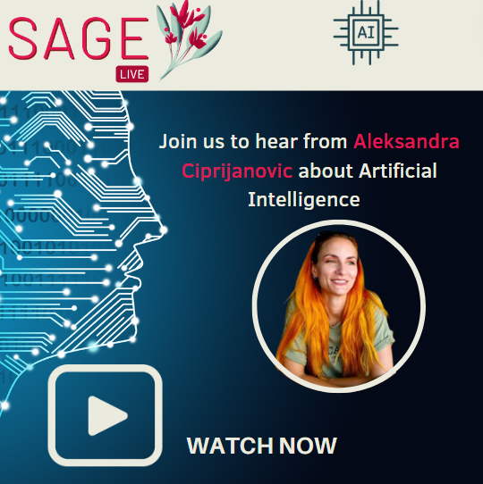
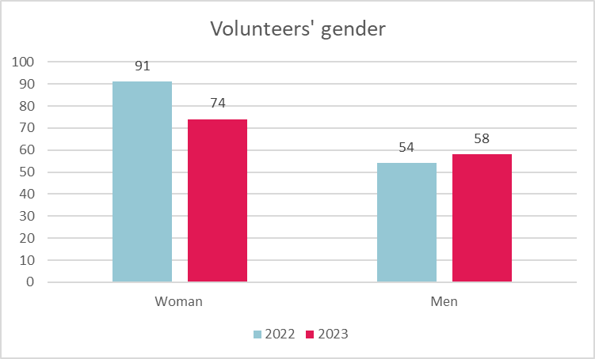
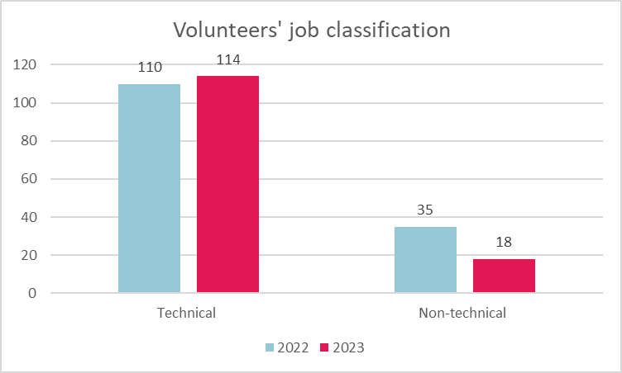

Mission: to engage curious and passionate students, and empower them to explore a wide range of possibilities for their future.
SAGE Live
Keep a connection with the students’ community
SAGEx Clubs
High school clubs that enlarge the SAGE community and give opportunities to our students to apply their leadership skills
SAGE Volunteers
Bring the SLAC community together
12 clubs
8 career talks
2 SLAC tours
~12 members per club

Slide 27
Fermilab Initiatives – TECHS and IDEAS
21 June 2024

Slide 28
New Fermilab Initiatives for Engineers and Technicians
Purpose: Foster innovation and growth in the engineering and technical communities
Provide support to engineers to pursue innovations that lead them into the research and development arena and technology transfer while advancing the lab’s strategic priorities
  Improve mission operations, such as safety, sustainability, advanced manufacturing and fabrication processes, materials, advanced tools and new technology
  Pursue ideas within emerging capabilities such as quantum, microelectronics, and artificial intelligence / machine learning
Create a program to develop the technical skills in high school students desired in technicians
  Also, introduce high schoolers to careers at the lab beyond scientists and engineering
Solution: DOE Office of Science funding of $2M over the next 5 years

Slide 29
Two New Initiatives: TECHS and IDEAS
Technician Education for Careers out of High School (TECHS)
Pilot apprenticeship for high school students
Talent incubator to nurture future technicians
Two-summer commitment starting 2025
  Mentored by lab technicians and program instructors
  First summer for rising high school seniors to receive instruction on basic electrical and mechanical skills and work on lab room projects
  Second summer for the summer after students graduate from high school to work within technician groups
  Upon completion of program, opportunity for qualified students to apply for permanent positions
Innovative Design Engineering to Accelerate Solutions (IDEAS)
The suite of initiatives to support engineering innovations
Disclosure Drive Funding – “What would you do with 30 hours and $5000?”
  Pursue an idea that could lead to an invention disclosure or patent
Microgrants
  For the development of ideas or applications towards proof-of-concept small-scale prototypes
  $25,000 microgrant – 1 award
  $5000 microgrants – 3 awards
Applying for a DOE Early Career Award
  Up to 300 hours of effort to write a proposal, seek out guidance, and incorporate feedback

Slide 30




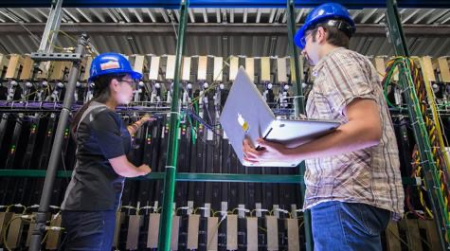
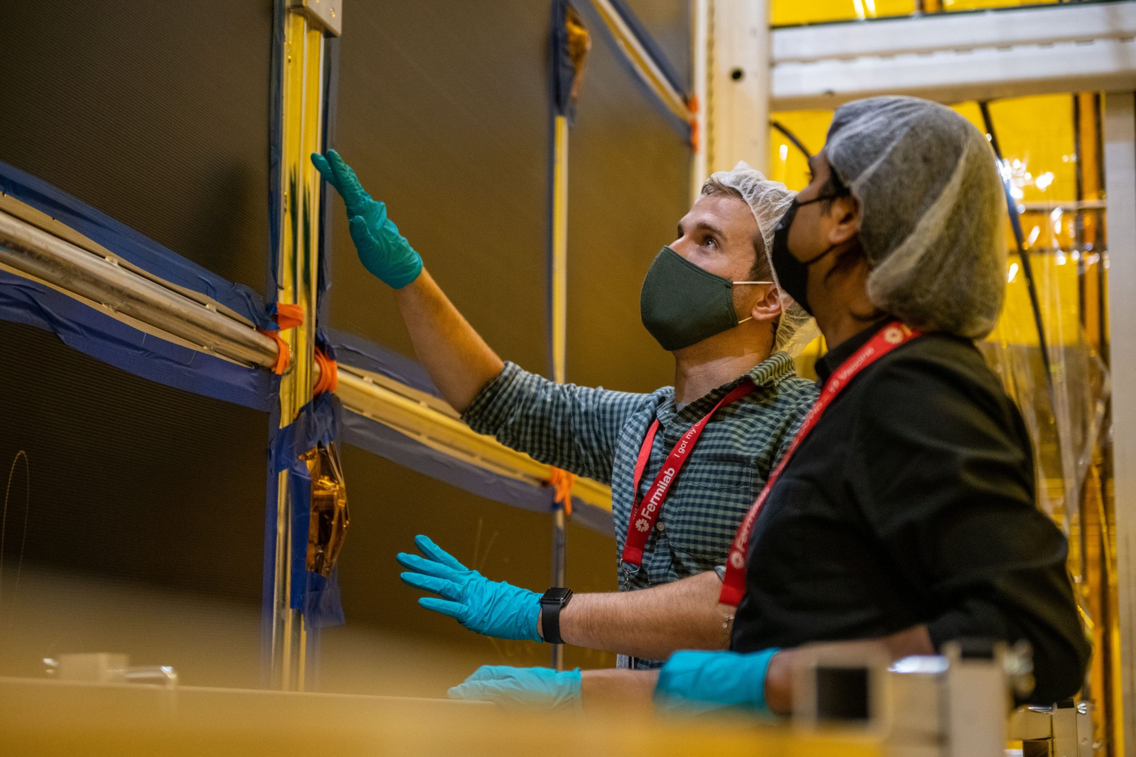
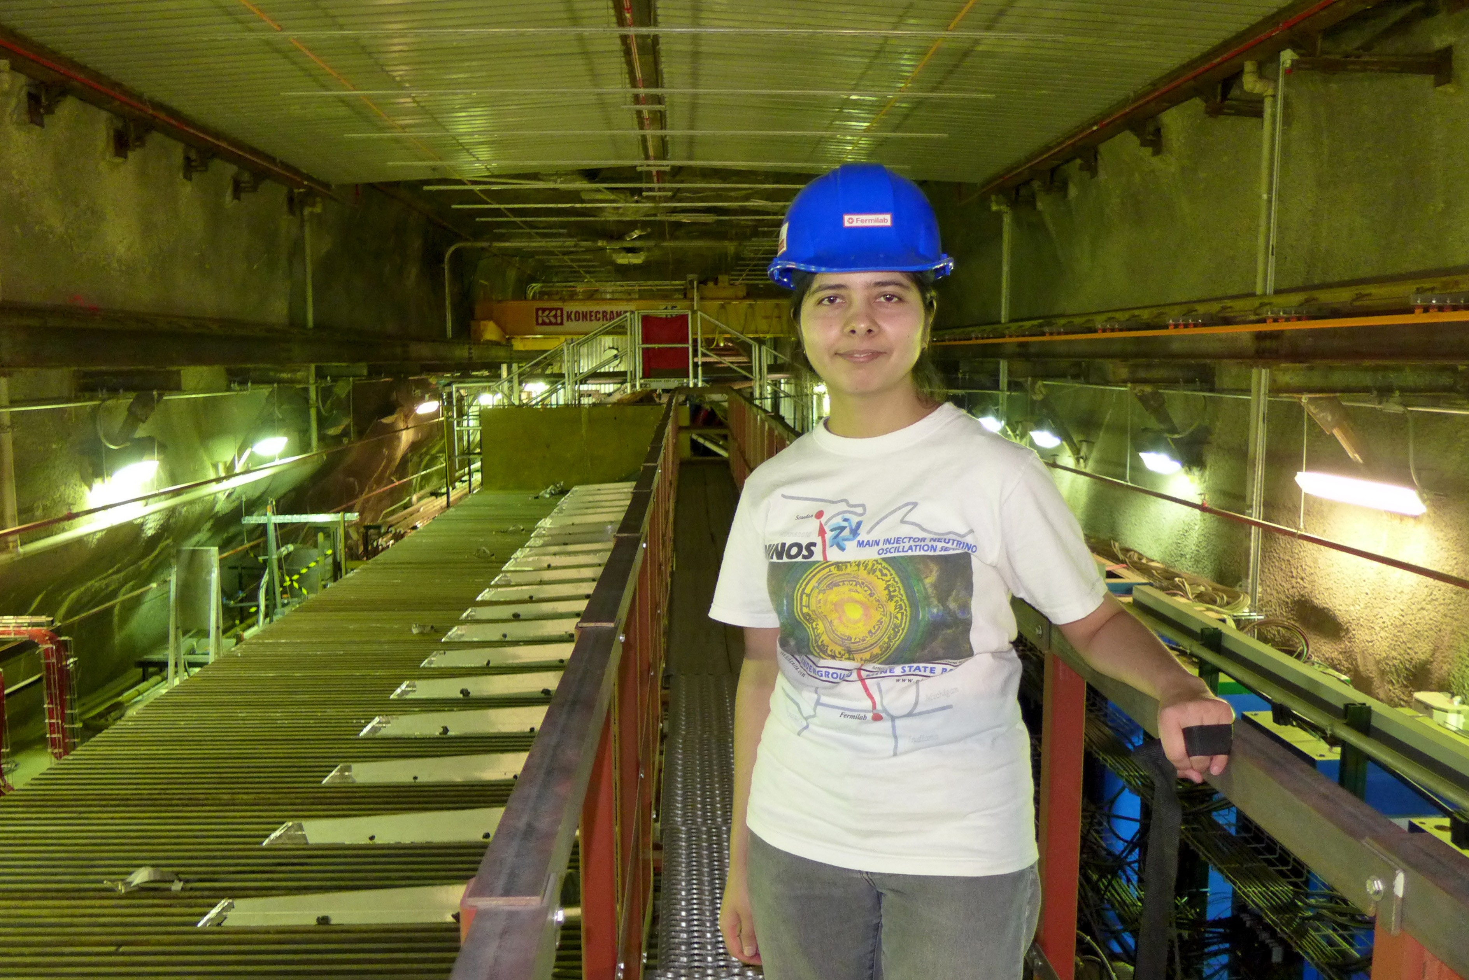
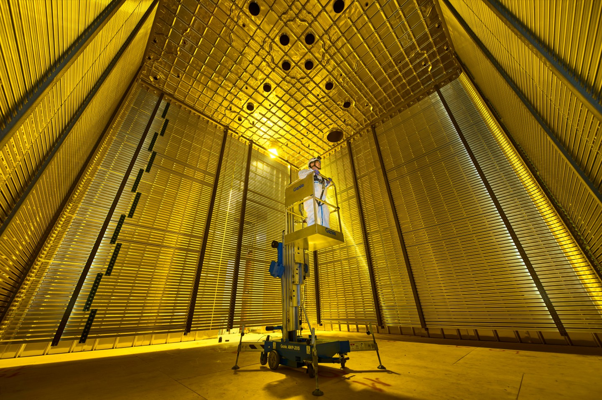
Fermilab Intensity Frontier International Student Program
Enable students to come to Fermilab to conduct research under the supervision of laboratory staff
Short-term: < 6 months stay at Fermilab, undergraduates through Ph.D. students
Long-term: > 6 months stay at Fermilab to work on Masters or Ph.D. thesis research
Students conduct research on a Fermilab-based neutrino experiment (eg, MicroBooNE, ICARUS, SBND, NOvA, DUNE, EMPHATIC, ANNIE).

Slide 31
Fermilab Intensity Frontier International Student Program
A huge success!
  >90% of participants of the long-term program who chose to continue in the field were hired as postdoctoral scholars.
  Participants have made life-long friendships and professional connections
  Participants are highly visible within the experimental collaborations
Details:
  Home institution provides airfare and some level of per-diem
  Fermilab provides housing, additional per-diem and a shared vehicle for local transportation
  International PIs are responsible for arranging research project and Fermilab supervisor
  Participation in the program requires agreements between the institution and Fermilab. Please contact Hema Ramamoorthi (hema@fnal.gov) for more information.

Slide 32

VALOR: (Veteran Applied Laboratory Occupational Retraining) Program
Investment (DOE Office of Science)
$4M over 5 years (2022 – 2026)
Goal
Opportunity for military veterans reentering civilian life.
Build a rich workforce pipeline of trained technicians, and computing and procurement professionals, to fill critical roles as incumbents retire.
Multiple entry points for learning and training
Short-term paid learning opportunities
Long-term employment security
Visibility to post-high-school pathways (may or may not include college)
Opportunities
fabricate, assemble, calibrate, operate, test, repair or modify electronic/mechanical equipment, systems, devices or databases.
information technology, procurement, ESH environmental, wastewater disposal, radiological surveys
JROTC Summer Internship
JROTC - local high schools
6 weeks
VetTech Summer Internship
Military veterans
10 weeks
Apprenticeship
Military vets / JROTC students
6-months, FT, (held 2x per year)

Slide 33
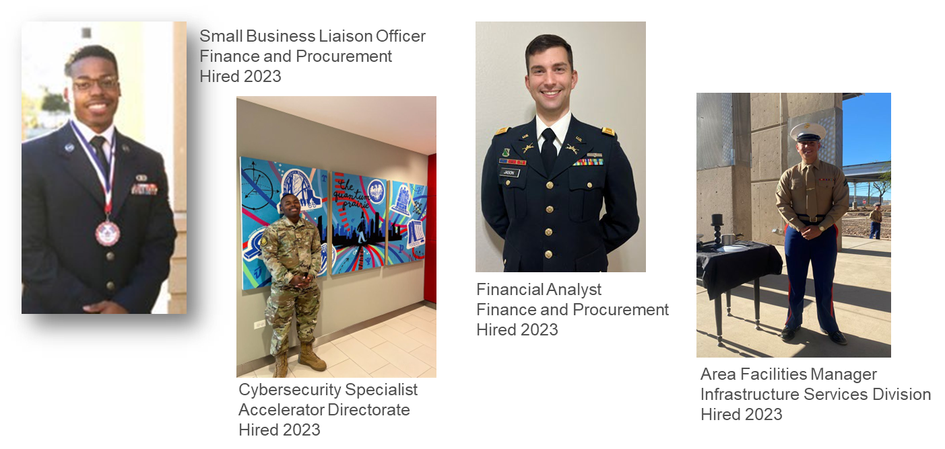
From Service to Science – VALOR Profiles (a few…)

Slide 34

STEM Ambassador: Primary Responsibilities
FY24 RENEW Proposals:
Coordinate efforts with academic institutions to submit full proposals to DOE for the Reaching a New Energy Workforce (RENEW) Funding Opportunity Announcements (FOAs).
PIER Plans:
Review and approve Promoting Inclusive and Equitable Research (PIER) plans for FOAs.
Establish Partnerships:
Connect collaborators from institutions not historically represented in the Office of Science Research Proposal with Fermilab researchers and program opportunities.
Funded Programs:
Lead and coordinate funded program efforts and administer post-award activities and reporting.

Slide 35
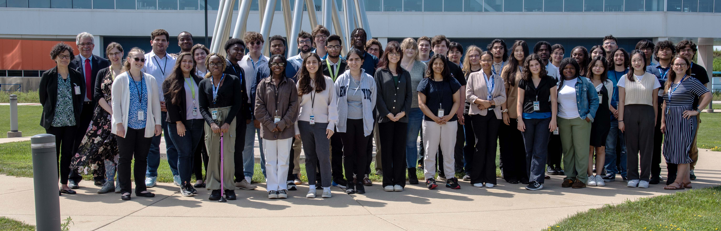
Funded Program
Fermilab and Brookhaven Summer School Exchange Program:
A university freshman undergraduate summer school exchange experience at two national laboratories focused on the DOE mission-critical areas of neutrino research, artificial intelligence/machine learning, and quantum information science. Climate science has been added for the second year of the summer school.

Slide 36
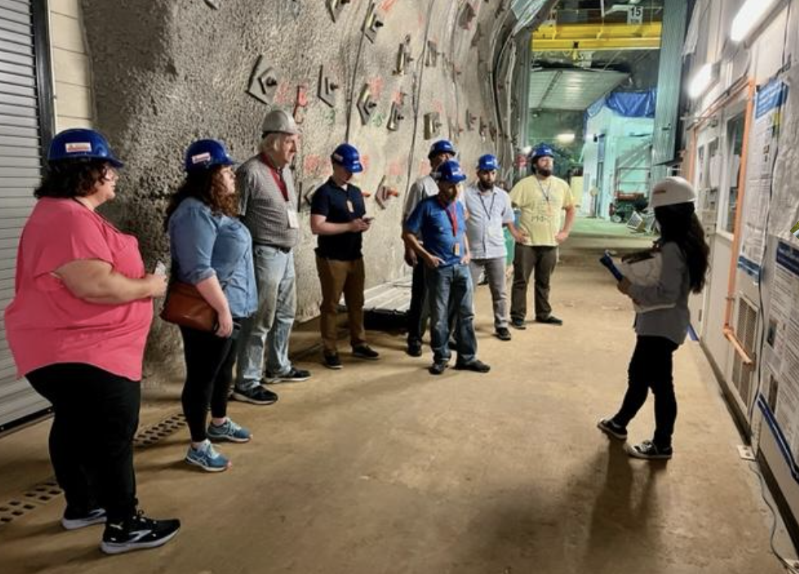
Funded Programs
Fermilab QIS Summer Institute for K-12 STEM Educators:
Selected STEM educators learn about Quantum Information Science (QIS) and create age-appropriate instructional materials for primary through secondary school students.
Educators receive:
weekly stipend
professional development credits
budget to support the development of instructional materials

Slide 37
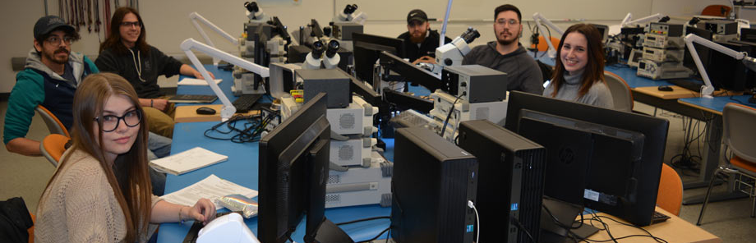
Funded Program
Particle Accelerator Capabilities Enhancement and Modernization Apprenticeship Program (PACEMAP):
A multi-year training program to develop electrical technicians for Department of Energy laboratory workforce needs. The funding provides student tuition for required courses, stipend while taking courses, wrap around support, wages for on-the-job training at Fermilab, and equipment for collaborating academic institution.

Slide 38
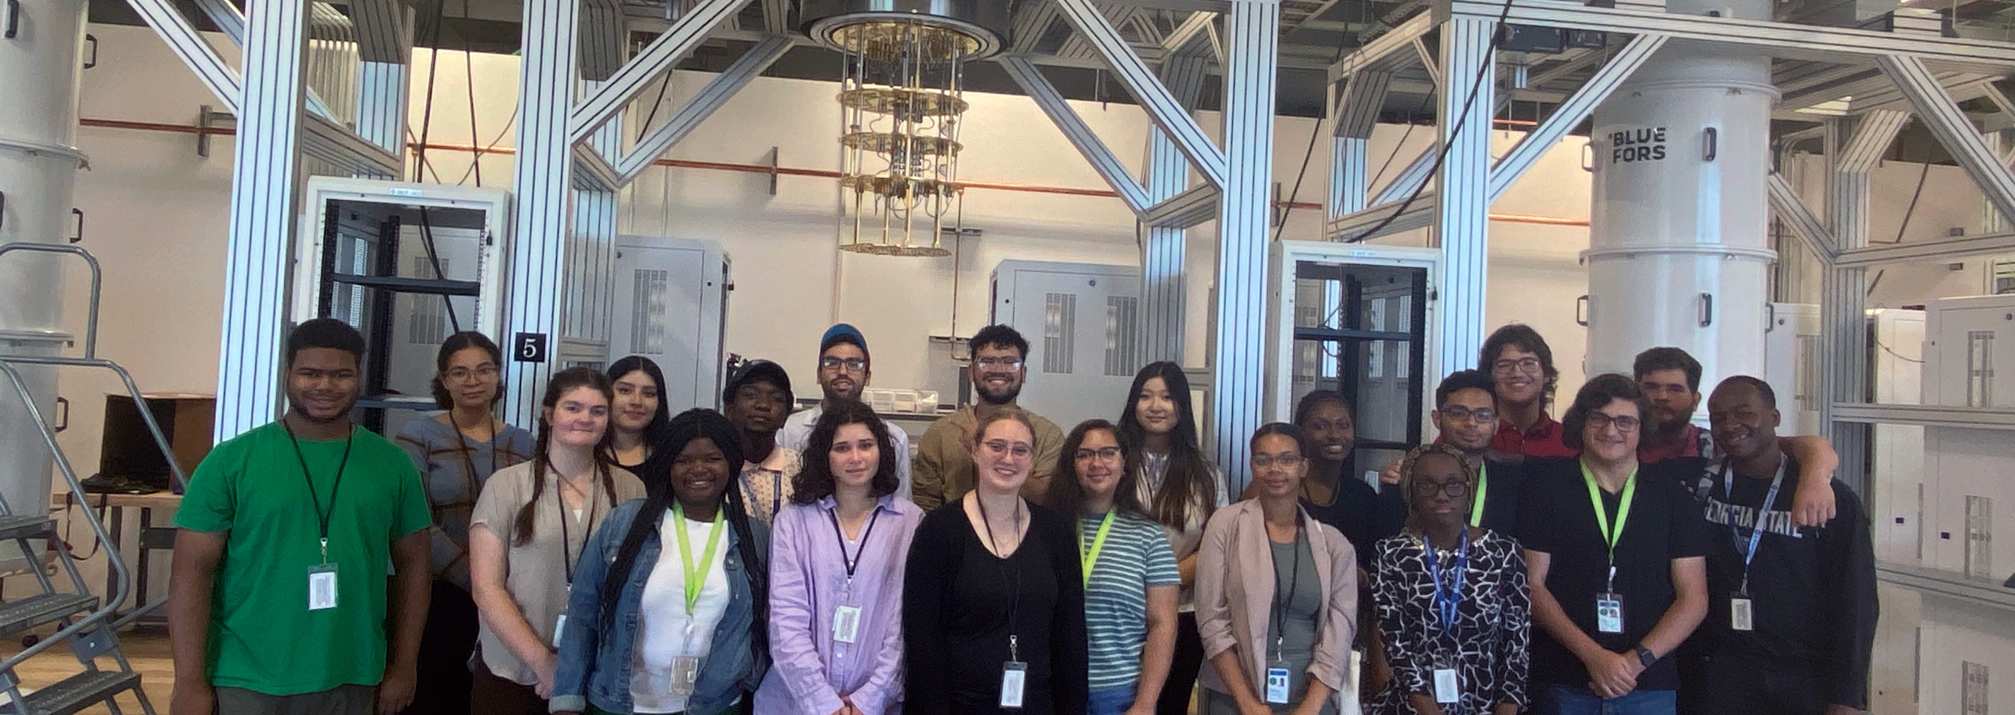
Funded Programs
Training through research in quantum information science and engineering at the SQMS Center:
The funded program supports investigators and students at their institutions through investments in their education and infrastructure​ and includes funding to purchase equipment at partnering institutions, investigators become part of the SQMS collaboration, and internships will be offered at Fermilab to their students.

Slide 39
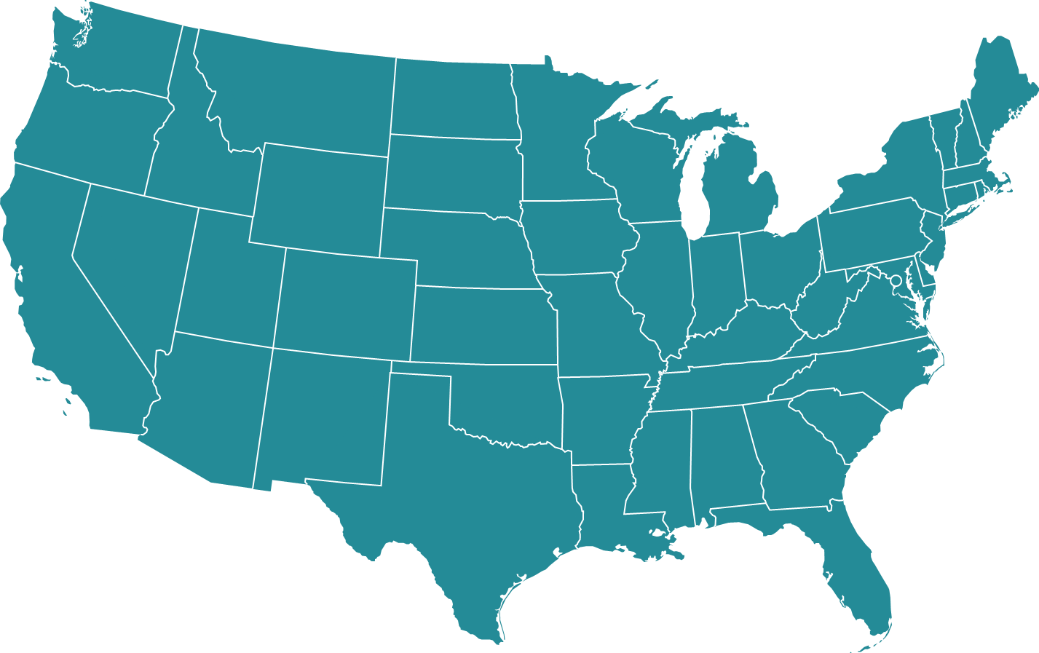

On-the-Ground Visits
Implementation of EDIA with writing policy
Seeking out personnel from MSIs that have the Knowledge Skills and Abilities (KSA)
Incorporating personnel that have the KSA and background
Employ personal so that they can impart knowledge, continue the work, and thrive.

Slide 40



































*
*
*
States with sites visited by -HEP 2023 – 2024
Virtual visits
U.S. DOE National Laboratories
-Visited 6 National Labs
-Attended 3 conferences
-Interacted with over 80 institutions to include 10 HBCUs and 5 TCU

Slide 41

Ozaki Exchange Program
The goals of this program are to strengthen U.S.-Japan scientific collaboration and in particular facilitate greater cooperation in the areas of accelerator and particle physics in projects of mutual benefit to Japan and the United States.
The program was launched in 2018, in honor of Satoshi Ozaki, to support US university students to go to Japanese HEP labs and Japanese university students to US DOE Labs
All graduate students enrolled, or undergraduate students already accepted for enrollment in accredited Japanese or U.S. physics Ph.D. programs are eligible to submit a proposal.
Call for application annually, reviewed by committees and approved by KEK and DOE
The duration of the award is for a three- to twelve-month period.
The award will provide for travel, housing, and cost-of-living expenses for the stay overseas.
There was a pause in 2021 and 2022 due to COVID pandemic.

Slide 42
Ozaki Exchange Program (II)
The exchange program has attracted students for a variety of research opportunities
15 US Students and 9 Japanese students have been selected to participate in the program on High Energy Physics experiments and accelerator R&D
  Belle II, T2K, SuperK, KOTO, neutrino physics and detector, accelerator R&D, Cosmic Microwave Background, silicon detector R&D
The selected students gain research experience at leading particle physics facilities
The program strengthens the US-Japan collaboration in high energy physics

Slide 43


Lessons Learned
Frequent Observations
Meeting people where they are and forging trustworthy and longstanding relationships between SC/HEP and Emerging Research Institutions and Minority Serving Institutions
Important to visit both labs/R1s and ERIs/MSIs on trips. SC initiatives emphasize partnerships between former & latter
Follow up after visit, encouraging further communication
Strengths
  Resilience
  Strong work ethics
  Sense of community
  Small research enterprises with out-sized impact
  Relationship builders
Deficiencies
  Do not know about FOA, are eligible to apply, etc.
  Research grant infrastructure
  Faculty overburden
  Outdated equipment

Slide 44
Additional Information to connect:
Science.osti.gov/wdts
Jacqueline.smith@science.doe.gov

Slide 45


