Slide 1

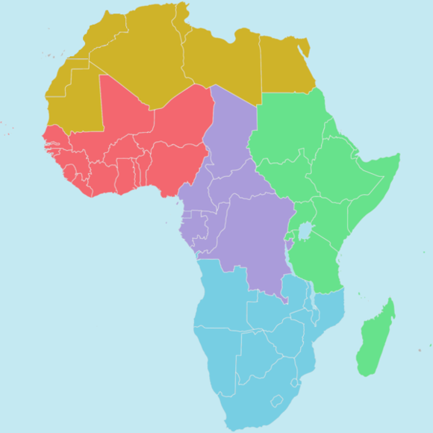


African School of Fundamental Physics and Applications
ASP2024
July 7 - 21, 2024
Marrakech, Morocco
The West African Physical Society
Prof. Oumar KA
West African Physical Society
And
Cheikh Anta Diop University, Dakar, Senegal

Slide 2

Once Upon a Time…
(West) African initiative
APS initiative
2017
2017
Physics in Africa - 18 countries
7 countries from West-Africa
Keyperson : J. Gubernatis
Keyperson : J. Koulidiati
>>> African Physics Newsletter
>>> SOAPHYS / WAPS

Slide 3
SOAPHYS / WAPS (1/5)
7 countries from West-Africa
Benin
Burkina Faso
Côte d’Ivoire
Mali
Niger
Senegal
Togo
French-speaking countries
  www.soaphys.org

Slide 4
SOAPHYS / WAPS (2/5)
Yearly congress
2019 : Ouagadougou, Burkina Faso (70 presentations)
2020 : Dakar, Senegal (140 presentations)
2021 : Abidjan, Ivory Coast (new direction; 103 presentations)
2022 : Lomé, Togo (183 presentations)
2023 : Bamako, Mali (new direction; 173 presentations)
Scheduled
2024 : Niamey, Niger
2025 : Cotonou, Benin

Slide 5
SOAPHYS / WAPS (3/5)
J. Phys. SOAPHYS / WAPS Physical Journal
2 numbers / year
Indexed

Slide 6
SOAPHYS / WAPS (4/5)
A yearly physics competition
High school : final year
Universities : 2d year

Slide 7
SOAPHYS / WAPS (5/5)
Coming soon
SOAPHYS / WAPS research groups
Coming later
  Regional physics programs (from high school to university)

Slide 8
Next Steps
Collaborations (Africa, extra-Africa)
Other physical societies
US

Slide 9
Issues
WAPS research groups
Growth
Gambia
Guinee
Bissau Guinee
Ghana
Nigeria
Sierra Leone
Liberia
Capo Verde
Funding
Higher Ed ministries
Companies

Slide 10
Final words
Key person
Identify goals
Research teams
Continuous inclusion of new objectives
Contacts authorities

Slide 11
African School of Fundamental Physics and Applications
ASP2024
July 7 - 21, 2024
Marrakech, Morocco
The West African Physical Society
Prof. Oumar KA
West African Physical Society
And
Cheikh Anta Diop University, Dakar, Senegal

Slide 14
Thank You !!!

