Slide 1


Fundamentals of Particle Accelerators I
Dr. Karie Badgley
ASP 2024- Morocco

Slide 2
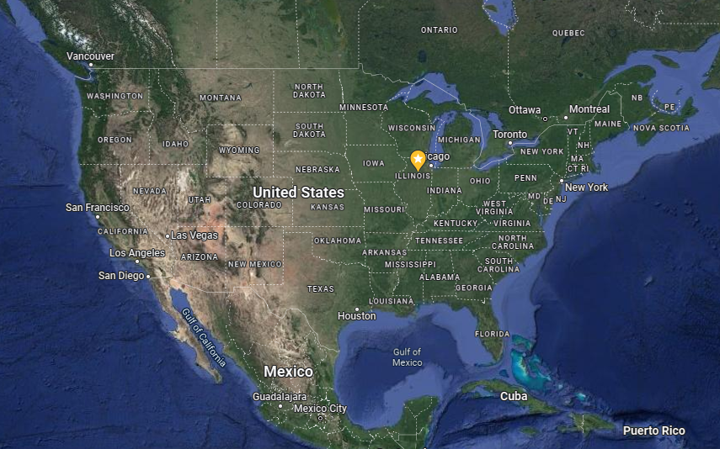
Fermilab

Slide 3
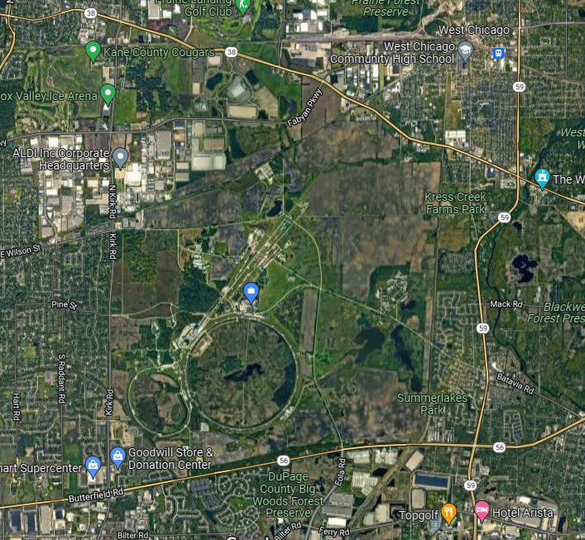
Fermilab

Slide 4
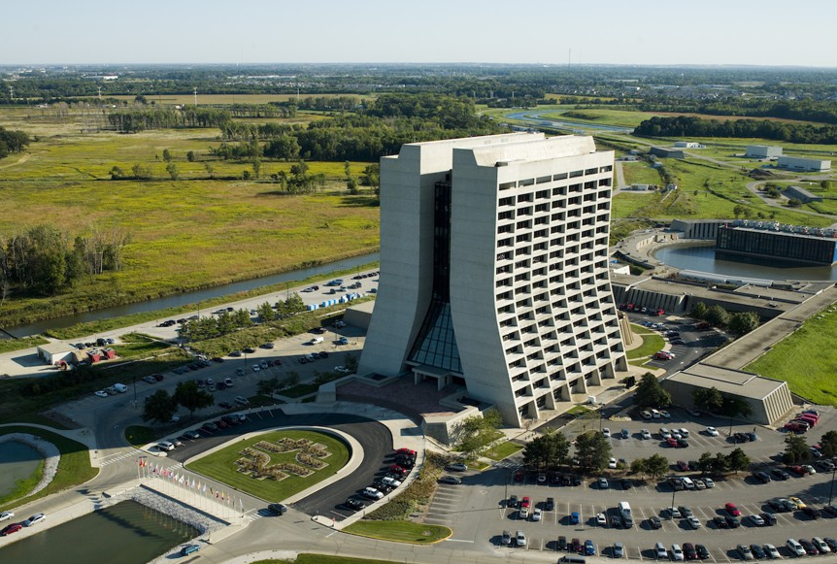
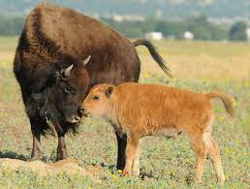
Fermilab

Slide 5
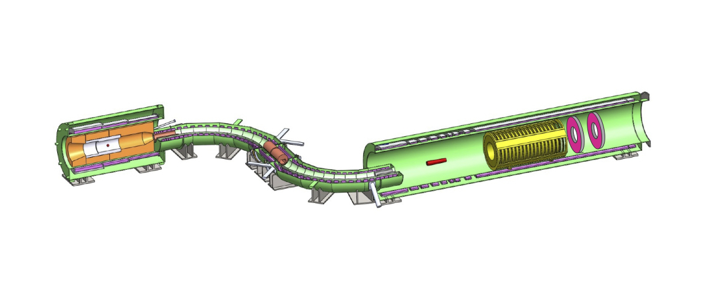
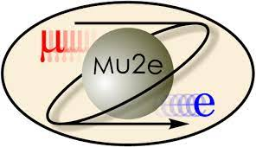
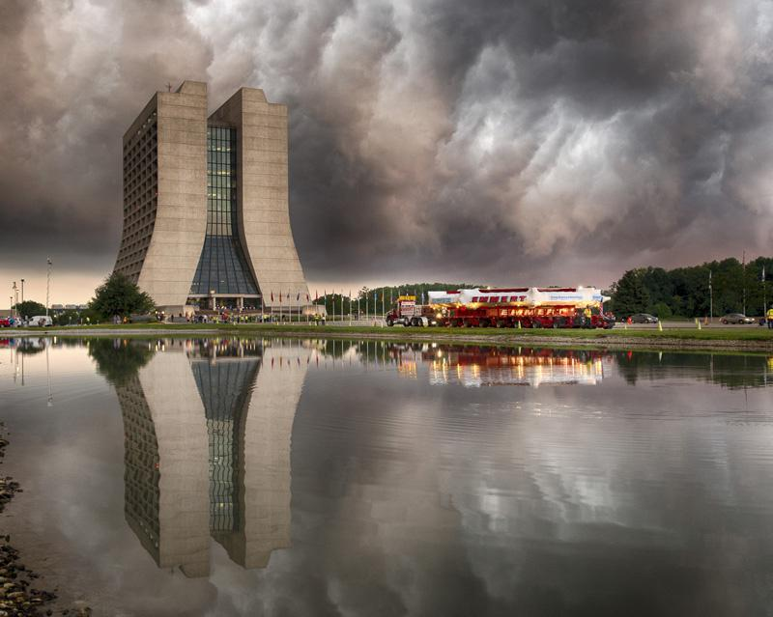
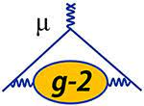
Muon Experiments

Slide 6
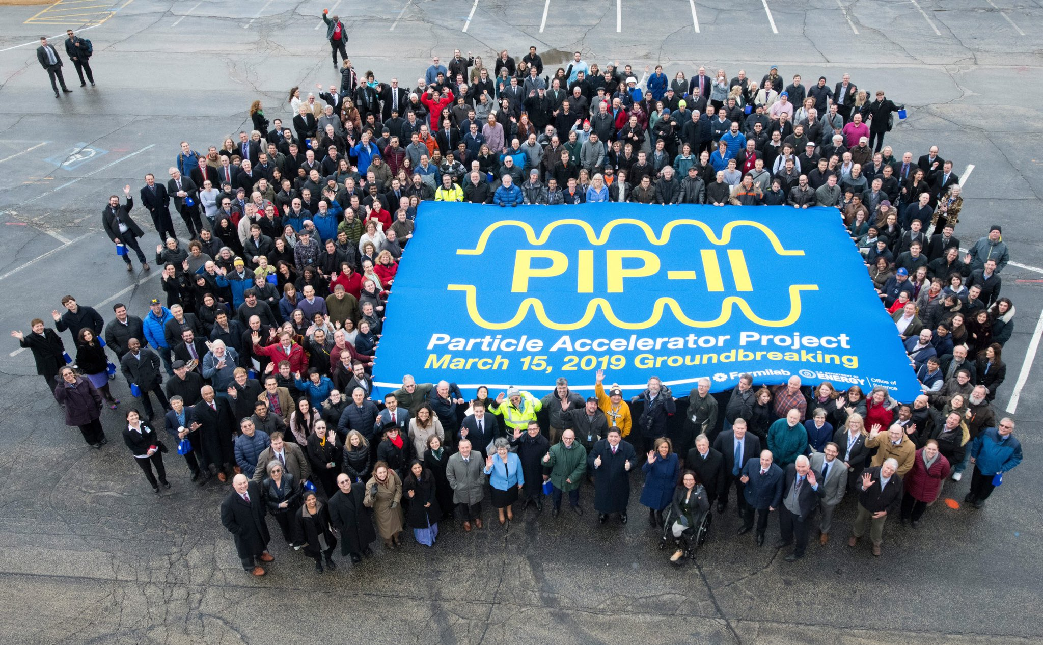
PIP-II
Upgrade to accelerator to enable experiments such as DUNE

Slide 7
Overview
Why accelerate particles
A bit of accelerator history
Components of an accelerator
Magnets
Equations of Transvers Motion
  Weak Focusing
Matrix Representation
Strong Focusing
Betatron motion

Slide 8
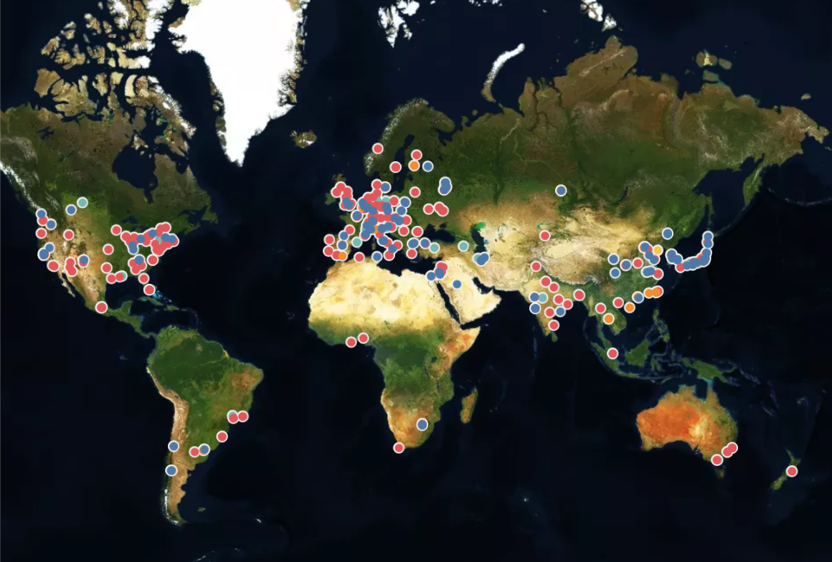
Accelerators Worldwide
Accelerator-Based Neutron Sources
Boron Neutron Capture Therapy (BNCT) facilities
Electrostatic Accelerators
Synchrotron Light Sources
X-ray Free Electron Laser Sources
IAEA.org

Slide 9

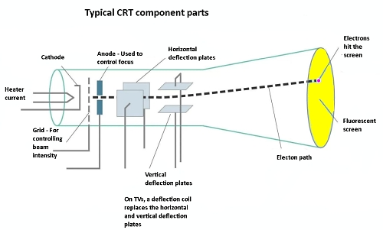
Accelerator Applications
Cathode ray tube TVs
Notes:
Not only for particle physics and research

Slide 10
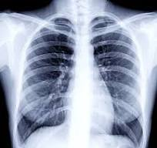
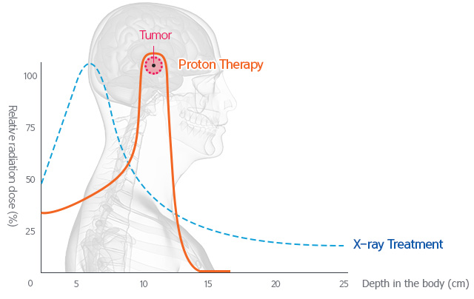
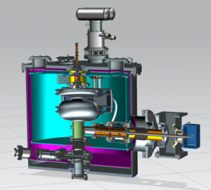
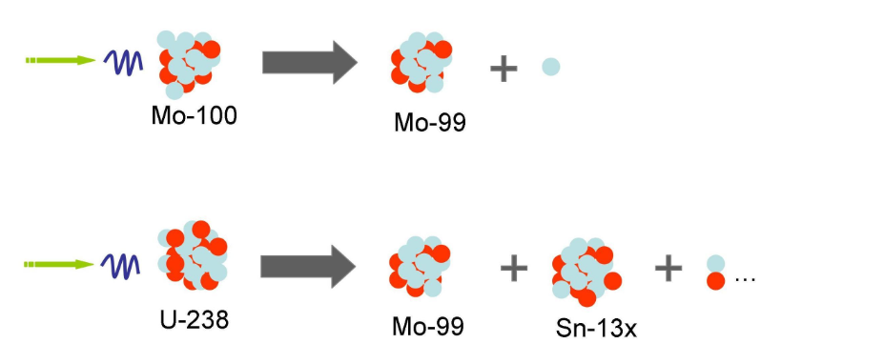
Accelerator Applications- Medicine
Of the ~35,000 accelerators worldwide, roughly half are medical
Proton Therapy
Imaging
Reduce dose to surrounding healthy tissue
Device Sterilization
samsunghospital.com
Looking to replace ethlylene oxide and cobalt-60 with x-rays from electron beams
Isotope Production
Mo-99 to Tc-99m
www.triumf.ca
Fnal.gov

Slide 11
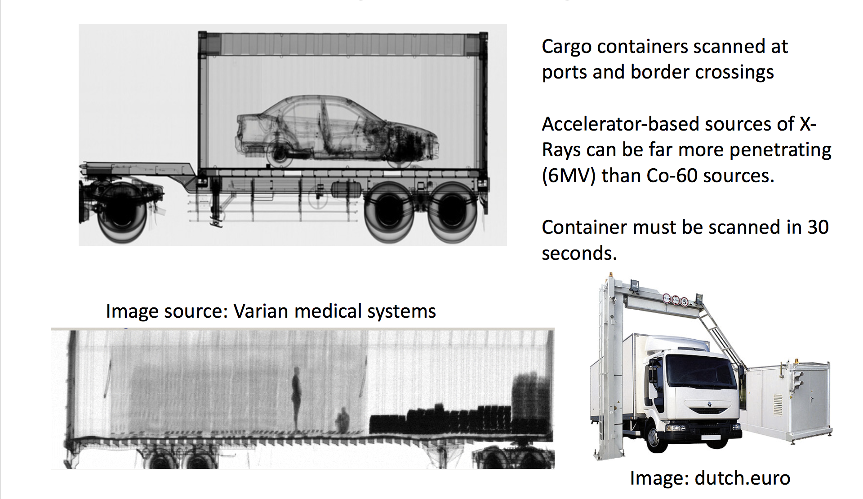
Accelerator Applications- Security

Slide 12
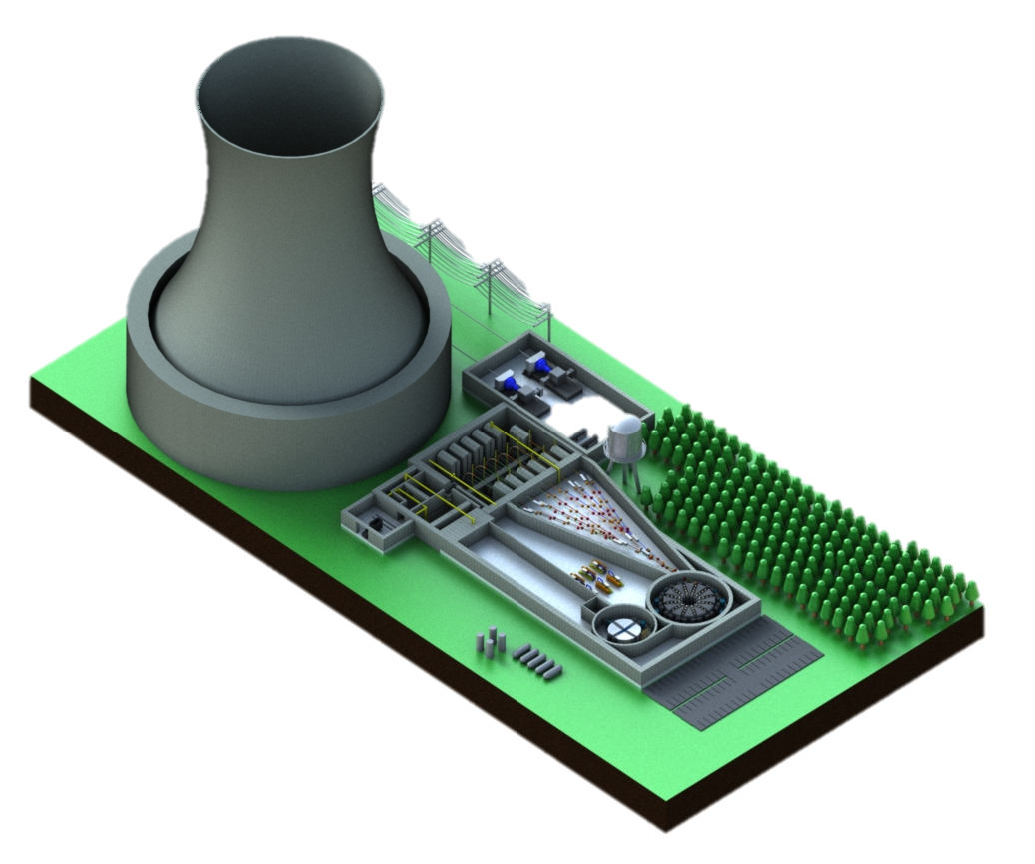
Accelerator Applications- Energy/Environment
Transmute long lived nuclear waste
Subcritical - Safe
Produce power
Close nuclear fuel cycle

Slide 13
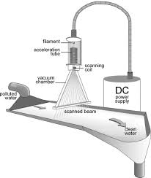
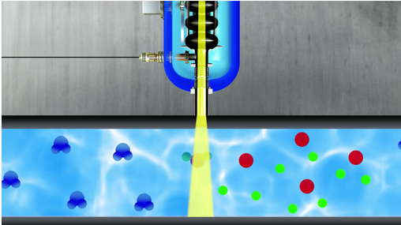
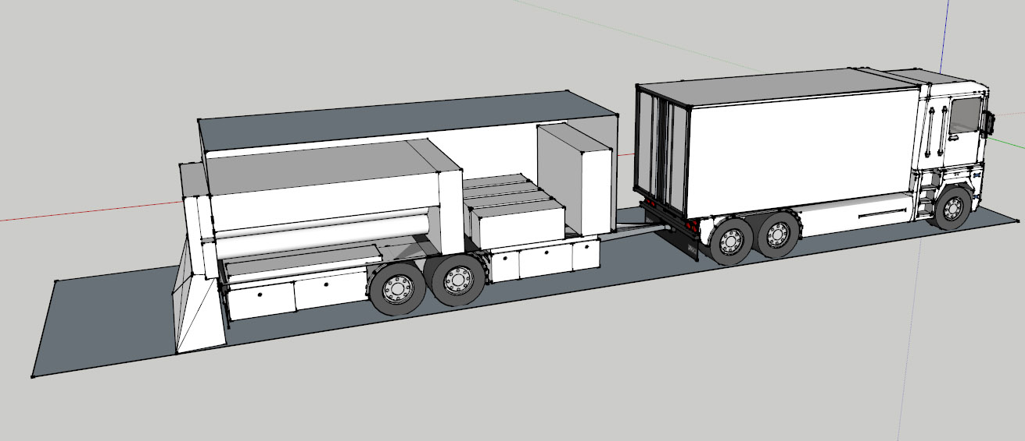
Accelerator Applications- Energy/Environment
Wastewater treatment
High energy electron to break down pollutants
Accelerator on a truck
Use electron beam to resurface road
…and so many more!

Slide 14
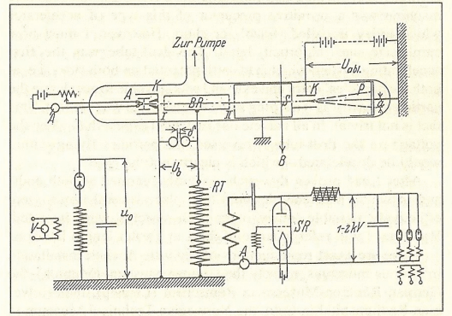
The Accelerator is Born
1919 Ernst Rutherford called for “copious supply” of particles more energetic than produced by natural radioactive sources
1924 Gustav Ising developed the concept of a linear particle accelerator (Linac)
1928 Rolf Wideröe builds the first linac in Aachen, Germany
  He first tried to build a betatron, but when that was unsuccessful, switched to a linac for his thesis
Wideröe, Über ein neues Prinzip zur Herstellung hoher Spannungen, Archiv für Elektrotechnik 21, 387 (1928)
Notes:
Using radioactive decay(alpha particles) of radon to discover atomic nucleus

Slide 15
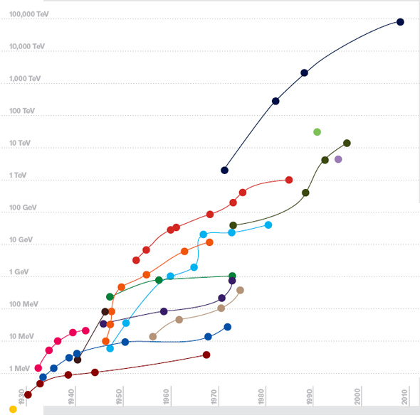
Livingston Plot
Laboratory energy of particles colliding with a proton at rest to reach the same center of mass energy
It was estimated in a 2014 Symmetry article that there were over 30,000 operating particle accelerators
In his 1954 book, Stanley Livingston noted that advances in accelerator technology allowed a factor of 10 increase in energy every 6-7 years
https://www.symmetrymagazine.org/article/october-2009/deconstruction-livingston-plot

Slide 16

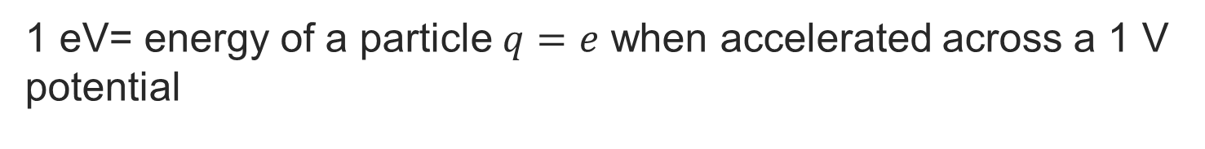

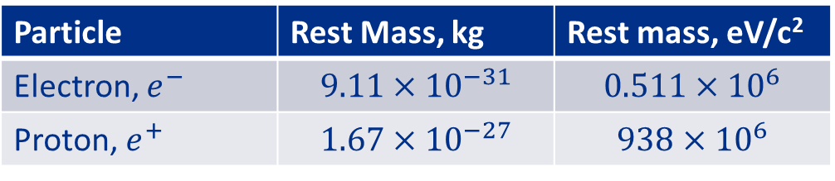

Units
1 eV= energy of a particle $q=e$ when accelerated across a 1 V potential
$$e=1.6×{10}^{−19} C$$
$$1 eV=1.6×{10}^{−19} J$$
Through the relationship between mass and energy, the rest mass can also be expressed in terms of eV
$$U=mc^{2}$$
Particle | Rest Mass, kg | Rest mass, eV/c²
Electron, $e^{−}$ | $$9.11×{10}^{−31}$$ | $$0.511×{10}^{6}$$
Proton, $e^{+}$ | $$1.67×{10}^{−27}$$ | $$938×{10}^{6}$$

Slide 17

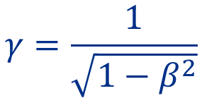
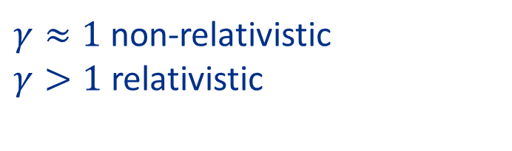
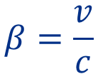



Relativity Review
$$c=2.99792×{10}^{8}m/s$$
Particle velocity
$$β=\frac{v}{c}$$
$γ≈1$ non-relativistic
$γ>1$ relativistic
Speed of light
$$γ=\frac{1}{\sqrt{1−β^{2}}}$$
Rest mass
Momentum
$$p=γmv=βγmc$$
Total energy
$$U=γmc^{2}$$
Kinetic energy
$$K=U−mc^{2}$$
When we refer to the energy of a particle, it is the kinetic energy

Slide 18
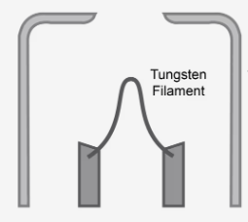
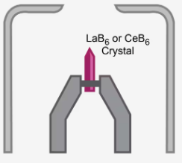
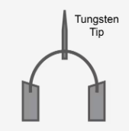
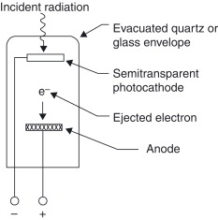
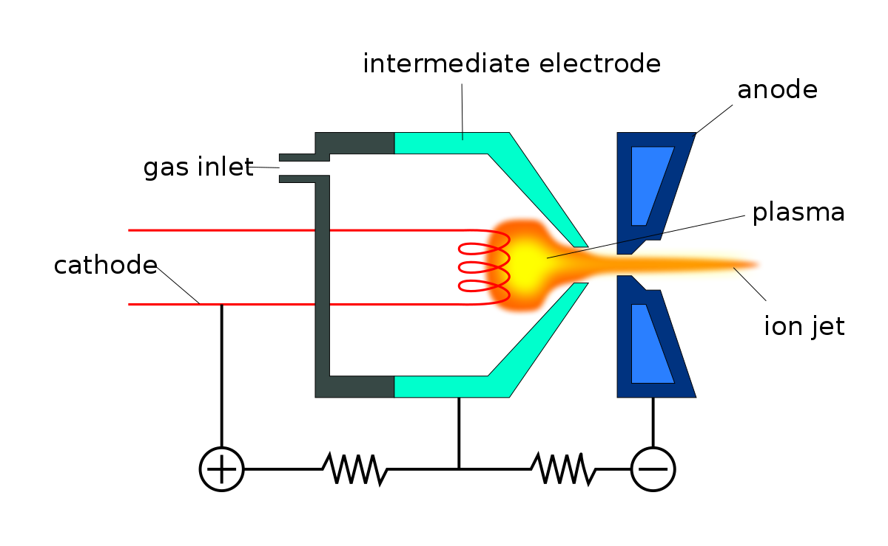
Anatomy of an Accelerator
Charged particles
Thermionic- heated cathode
www.thermofisher.com
Field emission - strong E field to induce emission
Source
  Electrons
  Protons
  Ions
Photo emission - light to produce electrons through photoelectric effect
www.sciencedirect.com
Ion source – electron ionization, plasma, …
wikipedia.org

Slide 19




Electromagnetic force on a charged particle
Lorentz Force:
$$\vec{B}$$
$$\vec{F}=q(\vec{E}+\vec{v}×\vec{B})$$
$$\vec{E}$$
$$\vec{v}$$
q
$$∆K=Work=\vec{F}∙\vec{d}=q\vec{E}∙\vec{d}+q(\vec{v}×\vec{B})∙\vec{d}$$
0
Force from the Electric field is the direction of particle velocity
  Used to accelerate the particle in the direction of the E field
Force from the magnetic field is perpendicular to particle velocity
  Used to bend and focus the particle

Slide 20
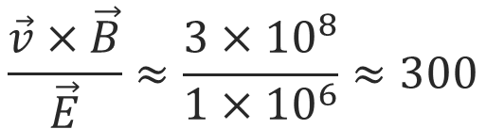

Electromagnetic force on a charged particle
Loretnz Force:
$$\vec{F}=q(\vec{E}+\vec{v}×\vec{B})$$
Magnitude of Force
  Force from magnetic field scales with velocity
  Velocity of high energy particle ~3x10⁸ m/s
  Using a high E field of 1 MV/m and medium B field of 1 T
  the force from the B field will be ~300 times stronger
$$\frac{\vec{v}×\vec{B}}{\vec{E}}≈\frac{3×{10}^{8}}{1×{10}^{6}}≈300$$

Slide 21

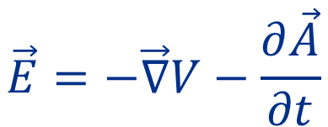

Anatomy of an Accelerator
$$\vec{E}=−\vec{∇}V−\frac{∂\vec{A}}{∂t}$$
$$DC$$
A$C$
Source
  Electrons
  Protons
  Ions
Electric Field
  Electrostatic(DC)
  Time-varying(AC)
More on this when we get to longitudinal motion next lecture

Slide 22
Anatomy of an Accelerator
Source
  Electrons
  Protons
  Ions
Electric Field
  DC
  AC
Magnets
  Dipole
  Quadrupole
  Sextupole
  …

Slide 23
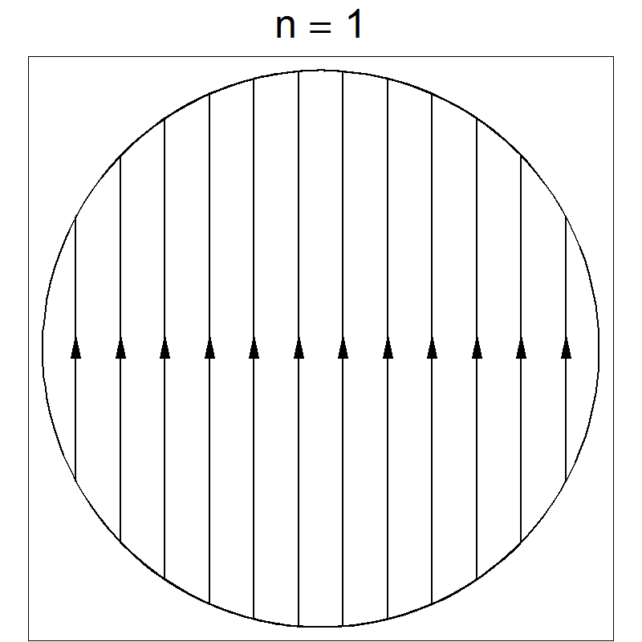
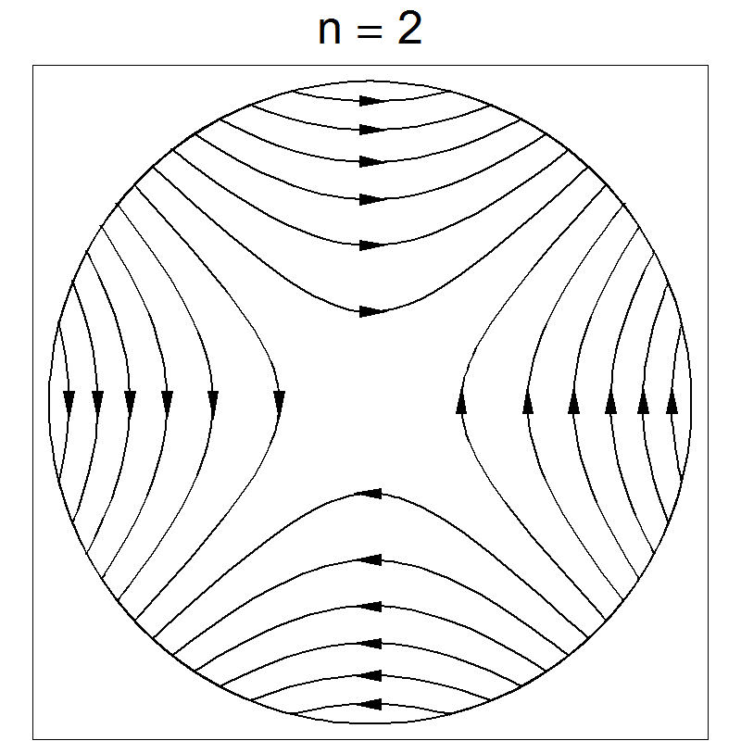
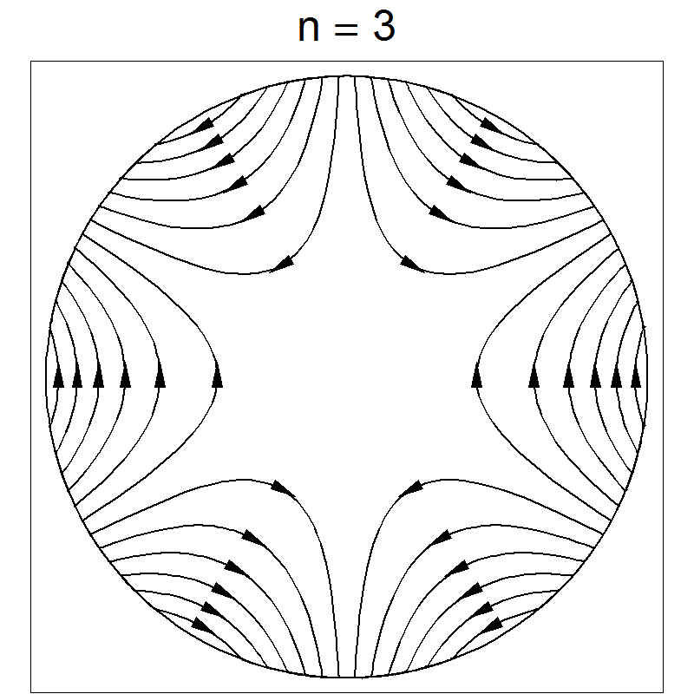


Types of magnets
Dipoles – bending (transport, energy selection…)
Quadrupoles - focusing
Sextupoles - correction
Combined function
Correctors
Septa
Kickers
Solenoids
$$=$$
$$+$$
Less common/specialty magnets

Slide 24

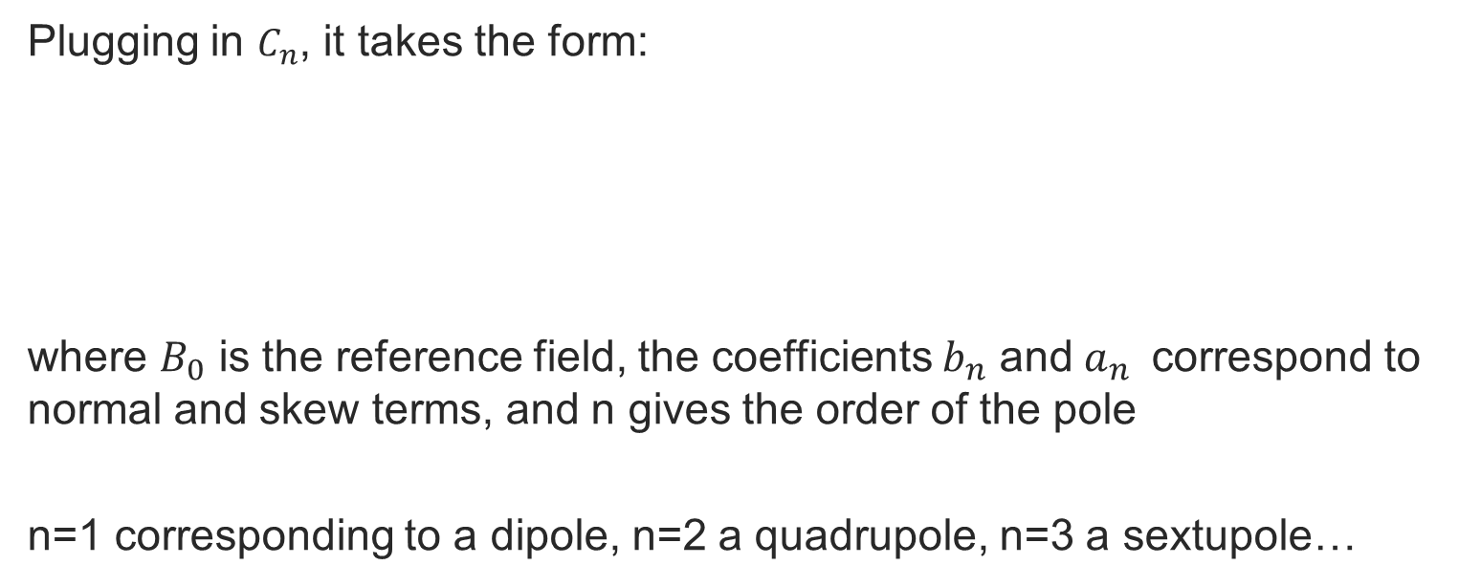
Magnetic Field Harmonics
The magnetic field can be found from the expansion*:
More slides in the backup if anyone is curious about this
$$B_{y}+iB_{x}=n\sum_{n=1}^{ }{C_{n} 𝕫^{n−1}}=n\sum_{n=1}^{ }{C_{n} {(x+iy)}^{n−1}}$$
$$C_{n}=\left(B_{n}+iA_{n}\right)$$
Plugging in $C_{n}$, it takes the form:
where $B_{0}$ is the reference field, the coefficients $b_{n}$ and$a_{n}$ correspond to normal and skew terms, and n gives the order of the pole
n=1 corresponding to a dipole, n=2 a quadrupole, n=3 a sextupole…
$$B_{y}+iB_{x}=\sum_{n}^{ }{\left(B_{n}+iA_{n}\right) {\left(x+iy\right)}^{n−1}}=B_{0}\sum_{n}^{ }{\left(b_{n}+ia_{n}\right) {(x+iy)}^{n−1}}$$

Slide 25
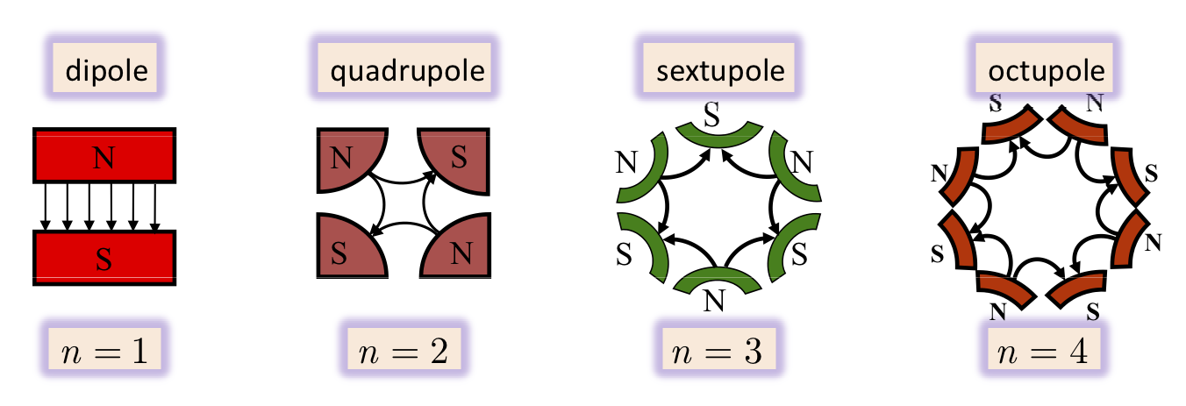

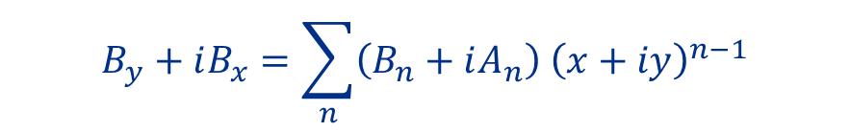
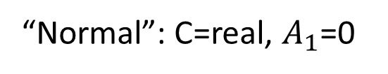
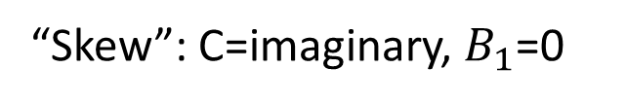





Dipole (two pole, n=1)
$$B_{y}+iB_{x}=\sum_{n}^{ }{\left(B_{n}+iA_{n}\right) {\left(x+iy\right)}^{n−1}}$$
$$B_{y}+iB_{x}=\left(B_{1}+iA_{1}\right){(x+iy)}^{0}=B_{1}+iA_{1}$$
Equate real and imaginary parts:
C
$$B_{y}=B_{1}$$
$$iB_{x}=iA_{1}$$
“Normal”: C=real, $A_{1}$=0
“Skew”: C=imaginary, $B_{1}$=0
$$B_{y}=B_{1}$$
$$B_{x}=A_{1}$$
$$B_{x}=0$$
$$B_{y}=0$$
Force?

Slide 26
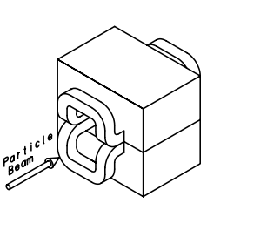
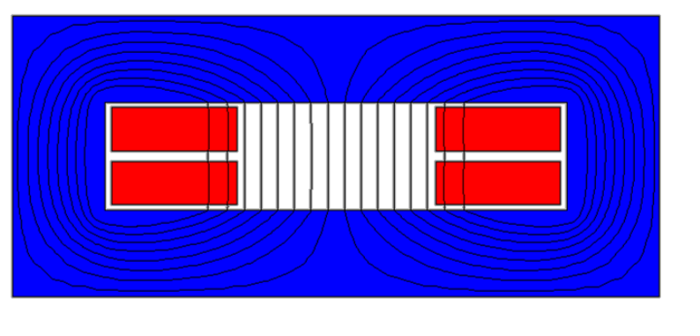
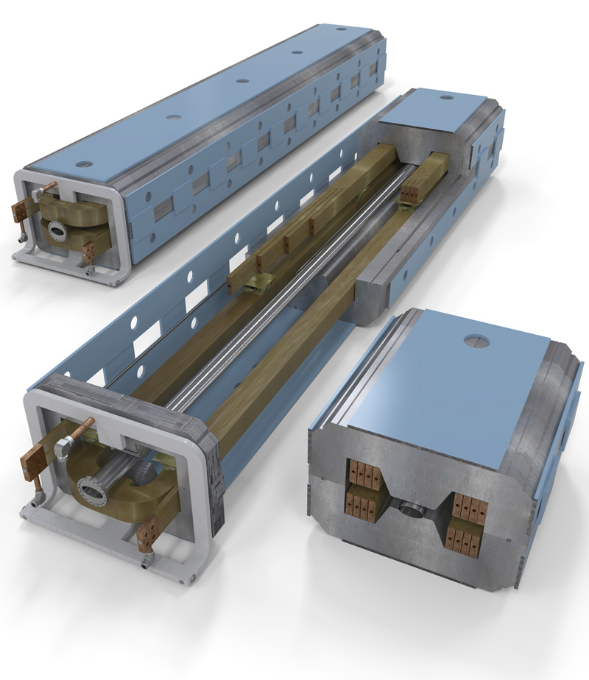
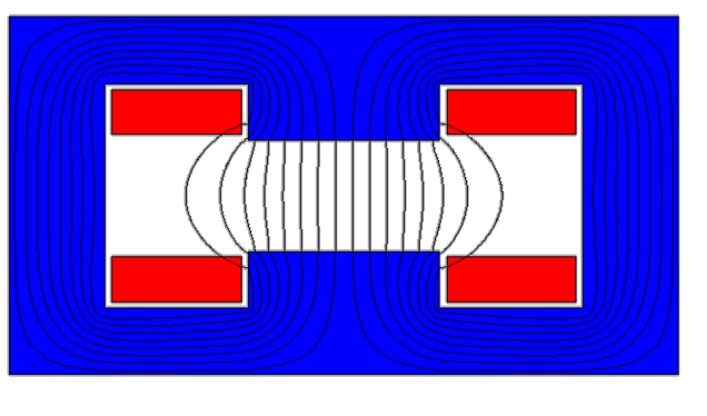
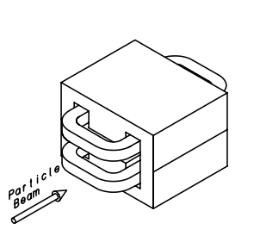
Dipoles
Window frame dipole
Dipole (FNAL)
H dipole

Slide 27
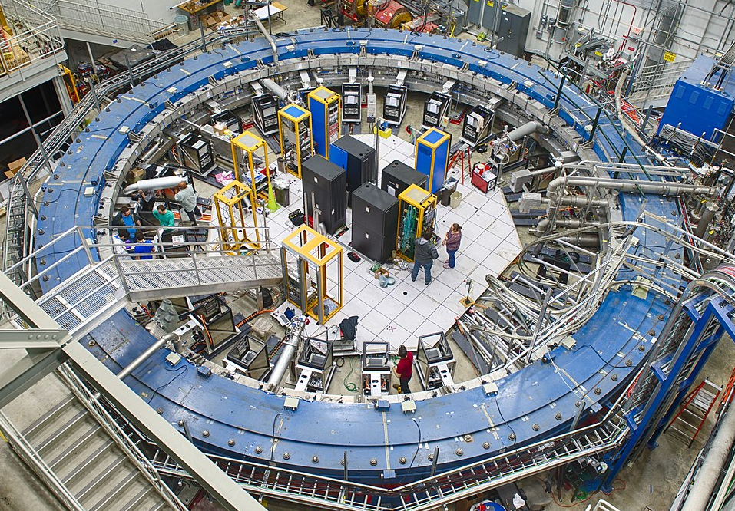
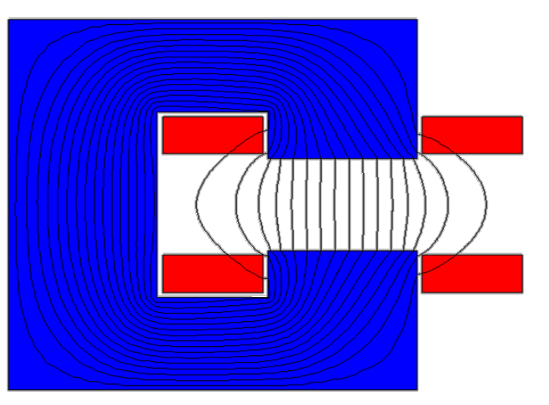
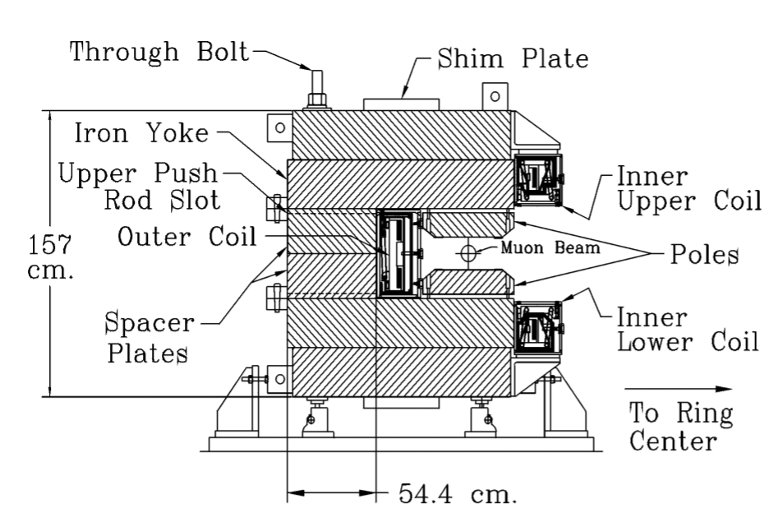
Dipoles
C dipole
Muon g-2

Slide 28








Quadrupole (four pole, n=2)
$$B_{y}+iB_{x}=n\sum_{n=1}^{ }{C_{n} 𝕫^{n−1}}=n\sum_{n=1}^{ }{C_{n} {(x+iy)}^{n−1}}$$
$$B_{y}+iB_{x}=2\left(C_{2}\right){(x+iy)}^{1}={2C}_{2}x+i2C_{2}y$$
Normal, C is real:
$$B_{y}={2C}_{2}x$$
$$B_{x}={2C}_{2}y$$
$$\frac{∂B_{y}}{dx}=2c_{2}=g$$
$$\frac{∂B_{x}}{dy}=2c_{2}=g$$
Skew, C is imaginary:
$$B=gy\hat{x}+gx\hat{y}$$
$$B_{x}=2C_{2}x$$
$$B_{y}={−2C}_{2}y$$
Gradient (T/m)
The quadrupole field varies linearly with the distance from the magnet center. It focuses the beam in one direction and defocuses in the other. An F or focusing quadrupole focuses the particle beam along the horizontal plane.
Force?
Notes:
Can get net focusing

Slide 29




Quadrupole
ALBA SR Quadrupole
Fermilab Quadrupole
Panofsky Quadrupole
Notes:
Focus only in one direction

Slide 30








Sextupole (six pole, n=3)
$$B_{y}+iB_{x}=−n\sum_{n=1}^{ }{C_{n} {(x+iy)}^{n−1}}$$
$${B_{y}+iB_{x}=−3C}_{3} {(x+iy)}^{2}$$
$${B_{y}+iB_{x}=−3C}_{3}\left(x^{2} −y^{2}\right)−i6C_{3}xy$$
Normal, C is real:
$$B_{x}=−6C_{3}xy$$
$$B_{y}=−{3C}_{3}\left(x^{2} −y^{2}\right)$$
$$\frac{∂^{2}B_{y}}{{∂x}^{2}}=B^{′′}=−6C_{3}$$
$$B_{y}=\frac{B′′}{2}\left(x^{2} −y^{2}\right)$$
$$B_{x}=B′′xy$$
The sextupole field varies quadratically with the distance from the magnet center. It’s purpose is to effect the beam at the edges. An F sextupole will steer the particle beam toward the center of the ring.
Note that the sextupole also steers along the 60 and 120 degree lines.

Slide 31


Sextupole
ALBA SR Sextupole
Sextupole (FNAL)

Slide 32
Optics Analogy
Sextupole
Dipole
High energy
Low energy
Quadrupole
Incoming beam
Desired focus
Low energy focus
High energy focus

Slide 33
Anatomy of an Accelerator
Source
  Electrons
  Protons
  Ions
Electric Field
  DC
  AC
Magnets
  Dipole
  Quadrupole
  Sextupole
Vacuum system
Power Supplies
Cryogenics
Beam diagnostics
Control system

Slide 34

Equations of Transverse Motion
0
$$\vec{F}=q(\vec{E}+\vec{v}×\vec{B})$$

Slide 35









Motion in a uniform B field
0
$$\vec{F}=q(\vec{E}+\vec{v}×\vec{B})$$
$$\vec{F}=q\left(\vec{v}×\vec{B}\right)=m\frac{v^{2}}{ρ}$$
$$\vec{B}$$
$$ρ$$
$$qvB=\frac{γm_{0}v^{2}}{ρ}$$
$$θ$$
In terms of momentum,
$$p=γm_{0}v$$
$$qB=\frac{p}{ρ}$$
Magnetic rigidity
$$\frac{p}{q}=Bρ$$
How hard a particle is to deflect [T m]

Slide 36


Slide 37










Equations of motion
Particle motion will be expanded about the ideal or design trajectory ($x$, $y$)
$$y$$
$$\vec{B}=(B_{x},B_{y},0)$$
$$ρ$$
$$θ$$
$$x$$
Reference frame:
$$y$$
x : horizontal
y : vertical
s : longitudinal-along the ideal trajectory(x=y=0)
$$ρ$$
$$x$$
$$s$$

Slide 38






Equations of motion
$$\vec{B}=(B_{x},B_{y},0)$$
Particle motion will be expanded about the ideal or design trajectory ($x$, $y$)
$$y$$
$$F_{x}=−qvB_{y}=ma_{rad}$$
$$F_{y}=qvB_{x}$$
$$ρ$$
$$θ$$
$$x$$
Radial acceleration:
$$a_{rad}=\frac{d^{2}r}{dt^{2}}−r{\left(\frac{dθ}{dt}\right)}^{2}$$
$$r→ρ+x$$
$$F_{x}=m\frac{d^{2}(ρ+x)}{dt^{2}}−m\left(ρ+x\right){\left(\frac{dθ}{dt}\right)}^{2}=−qvB_{y}$$

Slide 39





Equations of motion- Horizontal
$$F_{x}=m\frac{d^{2}(ρ+x)}{dt^{2}}−m\left(ρ+x\right){\left(\frac{dθ}{dt}\right)}^{2}=−qvB_{y}$$
$$\frac{dθ}{dt}=ω=\frac{v}{ρ+x}$$
$$F_{x}=m\frac{d^{2}(ρ+x)}{dt^{2}}−\frac{mv^{2}}{ρ+x}=−qvB_{y}$$
$ρ$is the radius and is constant
$$F_{x}=m\frac{d^{2}x}{dt^{2}}−\frac{mv^{2}}{ρ+x}=−qvB_{y}$$

Slide 40




Equations of motion- Horizontal
$$F_{x}=m\frac{d^{2}x}{dt^{2}}−\frac{mv^{2}}{ρ+x}=−qvB_{y}$$
$x≪ρ$ so we can do a Taylor expansion
$$f\left(x\right)=f\left(x_{0}\right)+\frac{(x−x_{0})}{1!}f^{′}\left(x_{0}\right)+\frac{{(x−x_{0}^{ })}^{2}}{2!}f^{′′}\left(x_{0}\right)+..$$
$$\frac{1}{ρ+x}≈\frac{1}{ρ}−\frac{x}{ρ^{2}}+…≈\frac{1}{ρ}\left(1−\frac{x}{ρ}\right)$$
$$F_{x}=m\frac{d^{2}x}{dt^{2}}−\frac{mv^{2}}{ρ}\left(1−\frac{x}{ρ}\right)=−qvB_{y}$$

Slide 41





Equations of motion- Horizontal
$$F_{x}=m\frac{d^{2}x}{dt^{2}}−\frac{mv^{2}}{ρ}\left(1−\frac{x}{ρ}\right)=−qvB_{y}$$
Divide by $m$ and multiply the r.h.s. by $v/v$
$$\frac{d^{2}x}{dt^{2}}−\frac{v^{2}}{ρ}\left(1−\frac{x}{ρ}\right)=\frac{−qv^{2}B_{y}}{mv}$$
$$\frac{q}{p}=\frac{1}{Bρ}$$
$$p$$
$$\frac{d^{2}x}{dt^{2}}−\frac{v^{2}}{ρ}\left(1−\frac{x}{ρ}\right)=\frac{−v^{2}B_{y}}{Bρ}$$

Slide 42






Equations of motion
$$\frac{d^{2}x}{dt^{2}}−\frac{v^{2}}{ρ}\left(1−\frac{x}{ρ}\right)=\frac{−v^{2}B_{y}}{Bρ}$$
We can also do a Taylor expansion of the $B_{y}$ field about the reference orbit if we assume $\frac{dB_{y}}{dx}$ is small
$$B_{y}\left(x\right)=B_{0}+\frac{dB_{y}}{dx}x+…$$
Define the gradient $g=\frac{dB_{y}}{dx}$
$$B_{y}\left(x\right)=B_{0}+gx+…$$
$$\frac{d^{2}x}{dt^{2}}−\frac{v^{2}}{ρ}\left(1−\frac{x}{ρ}\right)=\frac{−v^{2}{(B+gx}_{ })}{Bρ}=\frac{−v^{2}}{ρ}−\frac{v^{2}gx}{Bρ}$$

Slide 43









Equations of motion - Horizontal
$$\frac{d^{2}x}{dt^{2}}−\frac{v^{2}}{ρ}\left(1−\frac{x}{ρ}\right)=\frac{−v^{2}}{ρ}−\frac{v^{2}gx}{Bρ}$$
$$\frac{d^{2}x}{dt^{2}}+\left(\frac{v^{2}x}{ρ^{2}}\right)=−\frac{v^{2}gx}{Bρ}$$
Convert from t to s
$$\frac{dx}{dt}=\frac{dx}{ds}\frac{ds}{dt}$$
$$\frac{d^{2}x}{dt^{2}}=\frac{d}{dt}\left(\frac{dx}{ds}\frac{ds}{dt}\right)=\frac{d}{ds}\left(\frac{dx}{ds}\frac{ds}{dt}\right)\frac{ds}{dt}$$
$$\frac{d^{2}x}{dt^{2}}=x′′v^{2}$$
$$x′$$
$$v$$
$$\frac{d^{2}xv^{2}}{ds^{2}}+\left(\frac{v^{2}x}{ρ^{2}}\right)=−\frac{v^{2}gx}{Bρ}$$
$$\frac{d^{2}x}{ds^{2}}+\frac{x}{ρ^{2}}+\frac{gx}{Bρ}=0$$

Slide 44






Equations of motion - Horizontal
$$\frac{d^{2}x}{ds^{2}}+\frac{x}{ρ^{2}}+\frac{gx}{Bρ}=0$$
$$x′′+\left(\frac{1}{ρ^{2}}+\frac{g}{Bρ}\right)x=0$$
We can define $k=\frac{g}{Bρ}$
$$x′′+\left(\frac{1}{ρ^{2}}+k\right)x=0$$
and $K=\frac{1}{ρ^{2}}+k$
$$x′′+Kx=0$$

Slide 45






Equations of Motion - Vertical
A similar treatment of the vertical motion yields
$$\frac{d^{2}y}{ds^{2}}−\frac{dB_{x}}{dy}\frac{y}{Bρ}=0$$
$$B_{x}\left(y\right)=\frac{dB_{x}}{dy}y+…$$
$$g$$
$$\frac{d^{2}y}{ds^{2}}−\frac{gy}{Bρ}=0$$
We can define $k=\frac{g}{Bρ}$
$$y′′−ky=0$$

Slide 46









Quick Aside on Springs
$$x′′+Kx=0$$
The form of this equation should look familiar
$$\vec{F}=−k\vec{x}$$
Recall Hooke’s law for a mass, m, on a spring, k
$$F=ma$$
$$−kx=ma$$
$$−kx=m\frac{d^{2}x}{{dt}^{2}}$$
$$−kx=mx′′$$
$$ω=\sqrt{\frac{k}{m}}$$
$$−\frac{k}{m}x=x′′$$
$$x^{′′}+\frac{k}{m}x=0$$

Slide 47





Solutions to the Equations of Motion
$$K=\frac{1}{ρ^{2}}+k$$
Horizontal:
$$x^{′′}+Kx=0$$
Vertical:
$$y^{′′}+Ky=0$$
$$K=−k$$
These look like our familiar harmonic motion equations with known solutions of the form:
$$x\left(s\right)=Acos\left(ωs\right)+Bsin(ωs)$$
$$x^{′}(s)=−Aωsin\left(ωs\right)+Bωcos(ωs)$$
$$x^{′′}(s)=−Aω^{2}cos\left(ωs\right)−Bω^{2}sin\left(ωs\right)=−ω^{2}x(s)$$
$$ω=\sqrt{K}$$

Slide 48










Matrix Representation
$$x\left(s\right)=Acos\left(\sqrt{K}s\right)+Bsin(\sqrt{K}s)$$
$$x^{′}(s)=−A\sqrt{K}sin\left(\sqrt{K}s\right)+B\sqrt{K}cos(\sqrt{K}s)$$
The constants A and B can be found from initial conditions
$$B=\frac{{x′}_{0}}{\sqrt{K}}$$
$$x\left(0\right)=x_{0}$$
$$x′\left(0\right)={x′}_{0}$$
$$A=x_{0}$$
$$\frac{dx}{ds}=x^{′}\sim θ$$
$$θ$$
$$x$$
$$s$$
$$x\left(s\right)=x_{0}cos\left(\sqrt{K}s\right)+\frac{{x′}_{0}}{\sqrt{K}}sin(\sqrt{K}s)$$
$$x′\left(s\right)={−x}_{0}\sqrt{K}sin\left(\sqrt{K}s\right)+{x′}_{0}cos(\sqrt{K}s)$$

Slide 49

Matrix Reminder

Slide 50



Matrix Representation
$$x\left(s\right)=x_{0}cos\left(\sqrt{K}s\right)+\frac{{x′}_{0}}{\sqrt{K}}sin(\sqrt{K}s)$$
$$x′\left(s\right)={−x}_{0}\sqrt{K}sin\left(\sqrt{K}s\right)+{x′}_{0}cos(\sqrt{K}s)$$
These equation can now be expressed in matrix form
$$M_{ }=\left(\begin{matrix}cos\left(\sqrt{K}s\right) & \frac{sin(\sqrt{K}s)}{\sqrt{K}} \\ −\sqrt{K}sin\left(\sqrt{K}s\right) & cos(\sqrt{K}s)\end{matrix}\right)$$
$${\left(\begin{matrix}x \\ x′\end{matrix}\right)}_{s}=M_{ }{\left(\begin{matrix}x \\ x′\end{matrix}\right)}_{s0}$$

Slide 51









Horizontal Focusing
$$x^{′′}+Kx=0$$
For $K>0$, this is focusing
$$M_{ }=\left(\begin{matrix}cos\left(\sqrt{K}s\right) & \frac{sin(\sqrt{K}s)}{\sqrt{K}} \\ −\sqrt{K}sin\left(\sqrt{K}s\right) & cos(\sqrt{K}s)\end{matrix}\right)$$
$$x^{′′}−Kx=0$$
For $K<0$, this is defocusing
$$x\left(s\right)=Acos\left(\sqrt{K}s\right)+Bsin(\sqrt{K}s)$$
$$cos\left(ix\right)=cosh⁡(x)$$
$$−isin\left(ix\right)=sinh⁡(x)$$
$$M_{ }=\left(\begin{matrix}cosh\left(\sqrt{K}s\right) & \frac{sinh(\sqrt{K}s)}{\sqrt{K}} \\ \sqrt{K}sinh\left(\sqrt{K}s\right) & cosh(\sqrt{K}s)\end{matrix}\right)$$

Slide 52





Weak Focusing
Define a field index
$$B_{y}\left(x\right)=B_{0}+\frac{dB_{y}}{dx}x$$
$$B_{x}\left(y\right)=\frac{dB_{x}}{dy}y$$
$$n=−\frac{ρ}{B_{0}}g$$
Fields of this shape lead to focusing when $0<n<1$

Slide 53


Weak Focusing
Several early machines relied on weak focusing
Cyclotrons relied on the uneven field between poles
  First cyclotron built by
  Ernest Lawrence in 1930, 4” diam.
The Betatron, first built by Donald Kerst in 1940, uses this field shape
In 1943, Marcus Oliphant develops the idea for the synchrotron
  The most famous weak focusing was the Bevatron built at Berkely in 1954, led to the discovery of the antiproton( Nobel Prize)

Slide 54











Drift Space
$${\left(\begin{matrix}x \\ x′\end{matrix}\right)}_{s}=M_{ }{\left(\begin{matrix}x \\ x′\end{matrix}\right)}_{s0}$$
For $K=0$, this is just a drift space of length $L$
$$\left(\begin{matrix}x(s) \\ x′(s)\end{matrix}\right)=\left(\begin{matrix}1 & L \\ 0 & 1\end{matrix}\right)\left(\begin{matrix} x(0) \\ x′(0)\end{matrix}\right)$$
$$M_{ }=\left(\begin{matrix}1 & L \\ 0 & 1\end{matrix}\right)$$
$$x$$
$$x(L)$$
$$x\left(s\right)=x\left(0\right)+Lx′(0)$$
$$x_{ }(0)$$
$${x′(0)}_{ }=x′(L)$$
Slope hasn’t changed
$$s$$
$$L$$

Slide 55







Thin Lens Approximation
$$k=\frac{g}{Bρ}$$
$$f=\frac{Bρ}{gL}$$
For a focusing quadrupole of length L
$$M_{ }=\left(\begin{matrix}cos\left(\sqrt{K}L\right) & \frac{sin(\sqrt{K}L)}{\sqrt{K}} \\ −\sqrt{K}sin\left(\sqrt{K}L\right) & cos(\sqrt{K}L)\end{matrix}\right)$$
$$f$$
If the focal length is much longer than the length of the quadrupole
$$f=\frac{1}{kL}≫L$$
We can rewrite the focusing and defocusing matrices as:
$${M_{F}}_{ }=\left(−\begin{matrix}1 & 0 \\ \frac{1}{f} & 1\end{matrix}\right)$$
$${M_{D}}_{ }=\left(\begin{matrix}1 & 0 \\ \frac{1}{f} & 1\end{matrix}\right)$$

Slide 56




Focusing Thin Lens
$${\left(\begin{matrix}x \\ x′\end{matrix}\right)}_{s}=M_{ }{\left(\begin{matrix}x \\ x′\end{matrix}\right)}_{s0}$$
$${M_{F}}_{ }=\left(−\begin{matrix}1 & 0 \\ \frac{1}{f} & 1\end{matrix}\right)$$
$$\left(\begin{matrix}x(s) \\ x′(s)\end{matrix}\right)=\left(−\begin{matrix}1 & 0 \\ \frac{1}{f} & 1\end{matrix}\right)\left(\begin{matrix} x(0) \\ x′(0)\end{matrix}\right)$$
$$x\left(s\right)=x\left(0\right)$$
Initial position hasn’t changed
$${x′(0)}_{ }=x^{′}\left(0\right)−\frac{1}{f}x(0)$$
Slope changed

Slide 57




Sector Dipole Bend
Particle trajectory is perpendicular to the dipole edge
Horizontal plane: $K= 1/{ρ^{2}}−k$
Vertical plane: $K=k$
If $k=0, L= ρθ$
$$M_{H}=\left(\begin{matrix}cosθ & ρsinθ \\ −\frac{1}{ρ}sinθ & cosθ\end{matrix}\right)$$
$$M_{V}=\left(\begin{matrix}1 & ρθ \\ 0 & 1\end{matrix}\right)$$
ρ = bending radius
θ = bending angle
Looks like drift

Slide 58


Transfer Matrices
A simple beam line can now be constructed by combining these elements as a product of the matrices
$$M=M_{N}∙⋯∙M_{4}∙M_{3}∙M_{2}∙M_{1}$$
From $\left(\begin{matrix}x_{0} \\ {x′}_{0}\end{matrix}\right)$, the final position and divergence of the particle are $\left(\begin{matrix}x_{1} \\ {x′}_{1}\end{matrix}\right)$
$$\left(\begin{matrix}x_{1} \\ {x^{′}}_{1}\end{matrix}\right)=M\left(\begin{matrix}x_{0} \\ {x^{′}}_{0}\end{matrix}\right)$$
The elements of the transfer matrix can be referenced with the following notation:
$$M=\left(\begin{matrix}m_{11} & m_{12} \\ m_{21} & m_{22}\end{matrix}\right)$$

Slide 59
Strong Focusing
A common combination is a focusing(F) quadrupole followed by a drift, then a defocusing(D) quadrupole, and another drift. Often referred to as FODO or doublet
The result of this doublet, no matter the order FODO or DOFO, results in a net focusing in the horizontal and vertical direction
Strong focusing also has tunes greater than 1

Slide 60

FODO
D
$${\left(\begin{matrix}x \\ x′\end{matrix}\right)}_{s}=M_{ }{\left(\begin{matrix}x \\ x′\end{matrix}\right)}_{s0}$$
F
L
L
$M=\left(\begin{matrix}1 & L \\ 0 & 1\end{matrix}\right)$ $\left(\begin{matrix}1 & 0 \\ \frac{1}{f} & 1\end{matrix}\right)$ $\left(\begin{matrix}1 & L \\ 0 & 1\end{matrix}\right)$ $\left(−\begin{matrix}1 & 0 \\ \frac{1}{f} & 1\end{matrix}\right)=\left(\begin{matrix}1−\frac{L}{f}−{\left(\frac{L}{f}\right)}^{2} & 2L+\frac{L^{2}}{f} \\ \frac{−L}{f^{2}} & 1+\frac{L}{f}\end{matrix}\right)$
The particle moves from left to right, first encountering the F quadrupole, so we apply that matrix first, and so on
This is only for the x or y, the sign of the quadrupole will need to change for the other plane

Slide 61
Periodic
We will build our accelerator out of cells which are periodic such that:
C is the length of a cell, could be circumference of a circular machine or the length of a FODO cell

Slide 62




Twiss Parameters
The equations of motion found previously:
$$x^{′′}+Kx=0$$
If K = constant => motion of harmonic oscillator
If K varies with s : Hill’s equation (well studied D. E.)
$$x^{′′}+K(s)x=0$$
The solution of the Hill equation is given by:
$$x(s)=Aw(s) cos\left(ψ\left(s\right)+δ\right)$$
Constants of integration
The constants can be distributed and the solution written:
$x(s)=w(s) (A_{1}cos⁡ψ\left(s\right)$+ $A_{2}sin⁡ψ\left(s\right)$)
$$x^{′}\left(s\right)=\left(A_{1}w^{′}+\frac{A_{2}k}{w}\right)cosψ\left(s\right)+\left(A_{2}w^{′}−\frac{A_{1}k}{w}\right)sinψ\left(s\right)$$

Slide 63




Twiss Parameters
As before, solving for initial conditions of $x,x′$ at $s=s_{0}$
$$A_{1}=\frac{x_{0}}{w(s)}$$
$$A_{2}=\frac{{x^{′}}_{0}w(s)−x_{0}w′(s)}{k}$$
Matrix for propagation over one period, $s_{0} to s_{0}+C$
$${\left(\begin{matrix}x \\ x′\end{matrix}\right)}_{s_{0+C}}=\left(\begin{matrix}cos∆ψ−\frac{ww′}{k}sin∆ψ & \frac{w^{2}}{k}sin∆ψ \\ −\frac{1+{\left(ww^{′}/k\right)}^{2}}{w^{2}/k}sin∆ψ & cos∆ψ+\frac{ww′}{k}sin∆ψ\end{matrix}\right){\left(\begin{matrix}x \\ x′\end{matrix}\right)}_{s_{0}}$$
$$∆ψ=\int_{s_{0}}^{s_{0}+C}{\frac{kds}{w^{2}(s)}}$$
Phase of particle’s oscillation advances by

Slide 64






Twiss Parameters
$${\left(\begin{matrix}x \\ x′\end{matrix}\right)}_{s_{0+C}}=\left(\begin{matrix}cos∆ψ−\frac{ww′}{k}sin∆ψ & \frac{w^{2}}{k}sin∆ψ \\ −\frac{1+{\left(ww^{′}/k\right)}^{2}}{w^{2}/k}sin∆ψ & cos∆ψ+\frac{ww′}{k}sin∆ψ\end{matrix}\right){\left(\begin{matrix}x \\ x′\end{matrix}\right)}_{s_{0}}$$
We can define new variables
$$β(s)=\frac{w^{2}(s)}{k}$$
The phase advance becomes:
$$∆ψ=\int_{s_{0}}^{s_{0}+C}{\frac{ds}{β (s)}}$$
$$α\left(s\right)=−\frac{1}{2}\frac{dβ\left(s\right)}{ds}=−\frac{1}{2}\frac{d}{ds}\left(\frac{w^{2}(s)}{k}\right)$$
$$γ\left(s\right)=\frac{1+α^{2}}{β}$$
$α,β,γ$are the Twiss parameters

Slide 65




Twiss Parameters
The matrix simplifies to:
$${\left(\begin{matrix}x \\ x′\end{matrix}\right)}_{s_{0+C}}=\left(\begin{matrix}cos∆ψ+αsin∆ψ & βsin∆ψ \\ −γsin∆ψ & cos∆ψ−αsin∆ψ\end{matrix}\right){\left(\begin{matrix}x \\ x′\end{matrix}\right)}_{s_{0}}$$
or even more succinctly to:
$$M=cosμ\left(\begin{matrix}1 & 0 \\ 0 & 1\end{matrix}\right)+sinμ\left(\begin{matrix}α & β \\ −γ & −α\end{matrix}\right)$$
$$μ=∆ψ$$
phase advance over C
The $α,β,γ$ functions can also be transformed using the elements of the transport matrix

Slide 66




Betatron Motion
We can now describe the particle motion or oscillation
$$x(s)=A\sqrt{β(s)}cos\left(ψ\left(s\right)+δ\right)$$
Deviation from nominal in one plane
Betatron function defines the beam envelope, similar to wavenumber
Small$β$ –lots of oscillations
Large $β$ –few oscillations
$$∆ψ=\int_{s_{0}}^{s_{0}+C}{\frac{ds}{β (s)}}$$
Phase advance
Phase advance in one turn “Betatron Tune”
$$Q_{x,y}=\frac{1}{2π}\oint{\frac{ds}{β_{x,y} (s)}}$$

Slide 67
Betatron Oscillation
Sinusoidal motion in vertical and horizontal are known as betatron oscillations
The betatron function represents a bounding envelope to the beam motion, not the beam motion itself
Particles oscillate around the closed orbit, a number of times which is determined by the betatron tune

Slide 68


Computer Codes for Accelerator Design
The calculations with multiple elements can get complex quickly, so we can turn to computer codes
MAD-X is one of the standard codes, but there are many others
E. Prebys using g4beamline

Slide 69

Beam Envelope
E. Prebys using g4beamline

Slide 70


Tune
Why is the tune so important?
If not carefully chosen, it can lead to harmful resonances which in turn can lead to beam blow-up
Integer values should be avoided $Q_{x},Q_{y}=m$
Coupling between the x and y motion can also result from magnet or alignment errors
Coupling tunes to avoid:
  Integer sum
    $Q_{x}+Q_{y}=m$
  Half integer tunes
    ${2Q}_{x}=±m,$ ${2Q}_{y}=±m$
  Walknsaw resonance
    $Q_{x}−2Q_{y}=m$, ${±3Q}_{x}=m$
  Other higher order
Tune diagram showing the first(red), second(blue), and third(green) order resonances

Slide 71
To be continued…

Slide 72
Bonus Slides

Slide 73

Laplace’s Equation
$$∇^{2}F=\frac{∂^{2}F}{∂x^{2}}+\frac{∂^{2}F}{∂y^{2}}=0$$
In a region free of currents and permeable materials, two dimensional magnetic fields can be derived from Laplace’s equation
Any analytic function of a complex variable satisfies Laplace’s equation

Slide 74








Complex Functions
$$F\left(𝕫\right)=A+iV=\sum_{n=1}^{∞}{C_{n}𝕫^{n}}$$
$$𝕫=x+iy$$
$$\left(x,y\right)∈D$$
$$F\left(x+iy\right)=F_{x}\left(x,y\right)+iF_{y}(x,y)=\sum_{n=1}^{∞}{C_{n}{(x+iy)}^{n}}$$
A complex function is analytic if it converges with its power series in a domain D. To be analytic, the real and imaginary parts of the function must obey the Cauchy-Riemann equations.
$$\frac{∂F_{x}}{∂x}−\frac{∂F_{y}}{∂y}=0$$
$$\frac{∂F_{x}}{∂y}+\frac{∂F_{y}}{∂x}=0$$
Augustin Louis Cauchy
French 1789-1857
Bernhard Riemann
German 1826-1866
Notes:
Analytic definition- Function which can locally be expressed as a convergent power series

Slide 75









Analytic Complex Function
$$F\left(x+iy\right)=F_{x}\left(x,y\right)+iF_{y}(x,y)$$
$$F\left(𝕫\right)=\left(A+iV\right)$$
$Cauchy−Riemann$:
$$\frac{∂F_{x}}{∂x}−\frac{∂F_{y}}{∂y}=0$$
$$\frac{∂A}{∂x}−\frac{∂V}{∂y}=0$$
$$\frac{∂A}{∂x}=\frac{∂V}{∂y}$$
$$\frac{∂F_{x}}{∂y}+\frac{∂F_{y}}{∂x}=0$$
$$\frac{∂A}{∂y}+\frac{∂V}{∂x}=0$$
$$\frac{∂A}{∂y}=−\frac{∂V}{∂x}$$

Slide 76



$$F\left(𝕫\right)=\left(A+iV\right)$$
Vector potential
Using $∇∙B=0$, we can define a vector potential $A$ such that
  $$B=∇×A$$
Adding a gradient to this potential ($A^{′}=A+∇f$) still satisfies
$$∇×A^{′}=∇×A+∇×∇f=B$$
Scalar potential
For charge and magnetic material free regions, $∇×B=0$ and we can define a scalar potential
0
$$B=−∇V$$

Slide 77






The function of a complex variable
A : Vector potential
V : Scalar potential
$$F=A+iV$$
$$B=∇×A=\left|\begin{matrix}i & j & k \\ \frac{∂}{∂x} & \frac{∂}{∂y} & \frac{∂}{∂z} \\ A_{x} & A_{y} & A_{z}\end{matrix}\right|$$
$$B=−∇V=−\left(i\frac{∂V}{∂x}+j\frac{∂V}{∂y}+k\frac{∂V}{∂z}\right)$$
$$∇×B=∇×\left(∇×A\right)=∇\left(∇∙A\right)−∇^{2}A=0$$
$$∇^{2}A=0$$
0 (Coulomb gauge)
A satisfies the Laplace equation!
$$∇∙B=∇∙\left(−∇V\right)={−∇}^{2}V=0$$
$$∇^{2}V=0$$
V also satisfies the Laplace equation!
The complex function $F=A+iV$ must also satisfy the Laplace equation $∇^{2}F=0$
Notes:
In a region with no sources, must satisfy laplace equation

Slide 78









Fields from the 2D function of a complex variable
$Cauchy−Riemann$:
$$\frac{∂A}{∂x}=\frac{∂V}{∂y}$$
$$B=−∇V=−\left(i\frac{∂V}{∂x}+j\frac{∂V}{∂y}+k\frac{∂V}{∂z}\right)$$
$$B_{x}=−\frac{∂V}{∂x}$$
$$B_{y}=−\frac{∂V}{∂y}$$
$$\frac{∂A}{∂y}=−\frac{∂V}{∂x}$$
$$B_{x}=−\frac{∂V}{∂x}=\frac{∂A}{∂y}$$
$$B_{y}=−\frac{∂V}{∂y}=−\frac{∂A}{∂x}$$
$$F^{′}\left(𝕫\right)=\frac{∂F(𝕫)}{∂𝕫}=\frac{∂A+i∂V}{∂x+i∂y}$$

Slide 79















Fields from the 2D function of a complex variable
$$F^{′}\left(𝕫\right)=\frac{∂F(𝕫)}{∂𝕫}=\frac{∂A+i∂V}{∂x+i∂y}$$
$F\left(𝕫\right)=A+iV$,
$$𝕫=x+iy$$
$$∂x$$
$$∂y$$
$$F^{′}\left(𝕫\right)=\frac{\frac{∂A}{∂x}+i\frac{∂V}{∂x}}{\frac{∂x}{∂x}+i\frac{∂y}{∂x}}$$
$$F^{′}\left(𝕫\right)=\frac{\frac{∂A}{∂y}+i\frac{∂V}{∂y}}{\frac{∂x}{∂y}+i\frac{∂y}{∂y}}$$
$$B_{x}=−\frac{∂V}{∂x}=\frac{∂A}{∂y}$$
$$F^{′}\left(𝕫\right)=\frac{∂A}{∂x}+i\frac{∂V}{∂x}$$
$$F^{′}\left(𝕫\right)=−i\frac{∂A}{∂y}+\frac{∂V}{∂y}$$
$$B_{y}=−\frac{∂V}{∂y}=−\frac{∂A}{∂x}$$
$$F^{′}\left(𝕫\right)=−B_{y}−iB_{x}$$
$$F^{′}\left(𝕫\right)=−iB_{x}−B_{y}$$
$$B∗=B_{x}−iB_{y}=iF′\left(𝕫\right)$$
$$B_{y}+iB_{x}=−F′\left(𝕫\right)$$

Slide 80






Vector Operations
Scalar “dot” product
Vector “cross” product
$$\vec{B}$$
$$\vec{A}∙\vec{B}=ABcos\left(θ\right)=|\vec{A}||\vec{B}|cos⁡(θ)$$
$$θ$$
$$\vec{A}$$
$$Bcos(θ)$$
$$\vec{C}=\vec{A}×\vec{B}=ABsin(θ)$$
$$\vec{C}$$
$$\vec{B}$$
$$θ$$
Resulting vector perpendicular to the plane formed by A and B
$$\vec{A}$$

Slide 81
Differential Operators
  Grad operator
  Gradient
  Divergence
  Curl

Slide 82









Maxwell’s Equations
(in vacuum)
$$∯{E∙dA}=\frac{Q}{ε_{o}}$$
$$∇∙E=\frac{ρ}{ε_{o}}$$
Gauss’s law
$$∯{B∙dA} =0$$
James Clerk Maxwell
Scottish 1831-1879
$$∇∙B=0$$
Faraday’s law
$$\oint{E∙dl}=−\iint{\frac{∂B}{∂t}∙dA}$$
$$∇×E=−\frac{∂B}{∂t}$$
Ampere’s law
$$\oint{B∙dl}=μ_{o}I+μ_{o}ε_{o}\iint{\frac{∂E}{∂t}}∙dA$$
$∇×B=μ_{o}J+μ_{o}ε_{o}$ $\frac{∂E}{∂t}$

Slide 83




Gauss’s Law
The total electric flux through a closed surface is equal to the total (net) electric charge inside the surface, divided by $ε_{0}$
$$Φ_{E}=∯{E∙dA}=\frac{Q_{encl}}{ε_{0}}$$
No known magnetic monopoles
$$∯{B∙dA} =0$$
$$ε_{o} is electric constant=\text{8.85418781762× 10}\text{−12} \text{A}\text{2}\text{⋅}\text{s}\text{4}\text{⋅}\text{kg}\text{−1}\text{⋅}\text{m}\text{−3}$$

Slide 84


Faraday’s Law
The integrated electric field around any closed loop is proportional to the rate of change of the magnetic flux passing through the loop
$$\oint{E∙dl}=−\iint{\frac{∂B}{∂t}∙dA}$$

Slide 85

Ampere’s Law
The current passing through a surface is equal to the line integral of the B field around that closed surface
$$\oint{B∙dl}=μ_{o}I+μ_{o}ε_{o}\iint{\frac{∂E}{∂t}}∙dA$$
I
B
Enclosed current
“Displacement current” in charging capacitor for example
B

