Slide 1



Feedback from an ASP alumna
Dr. Sanae SAMSAM
INFN-Milan

Slide 2
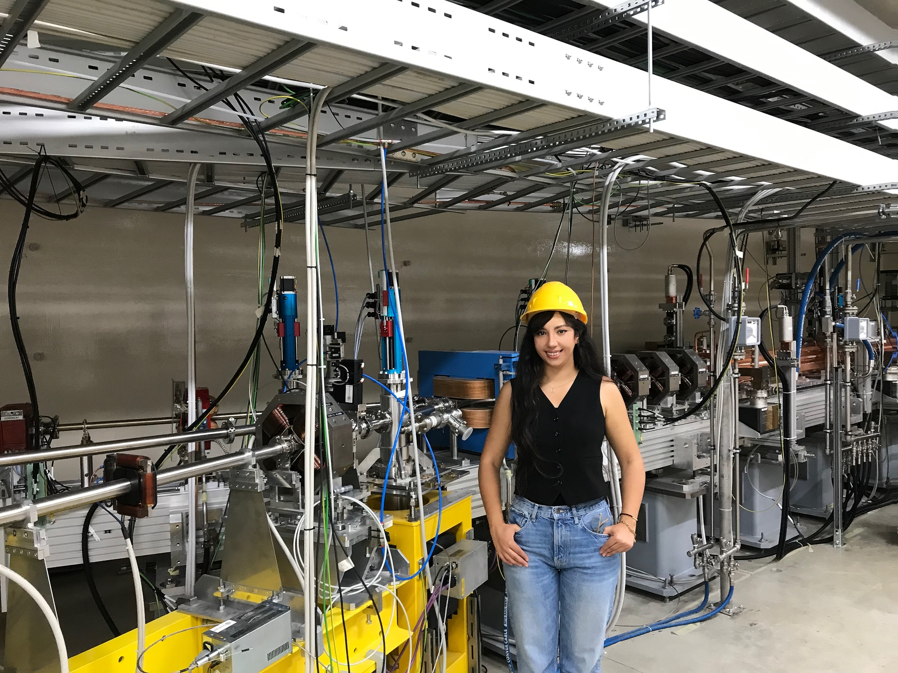





Slide 3





Origines
Salé, Morocco
Kingdom of Morocco
المملكة المغربية
ⵜⴰⴳⵍⴷⵉⵜ ⵏ ⵍⵎⵖⵔⵉⴱ
Rabat, Morocco

Slide 4




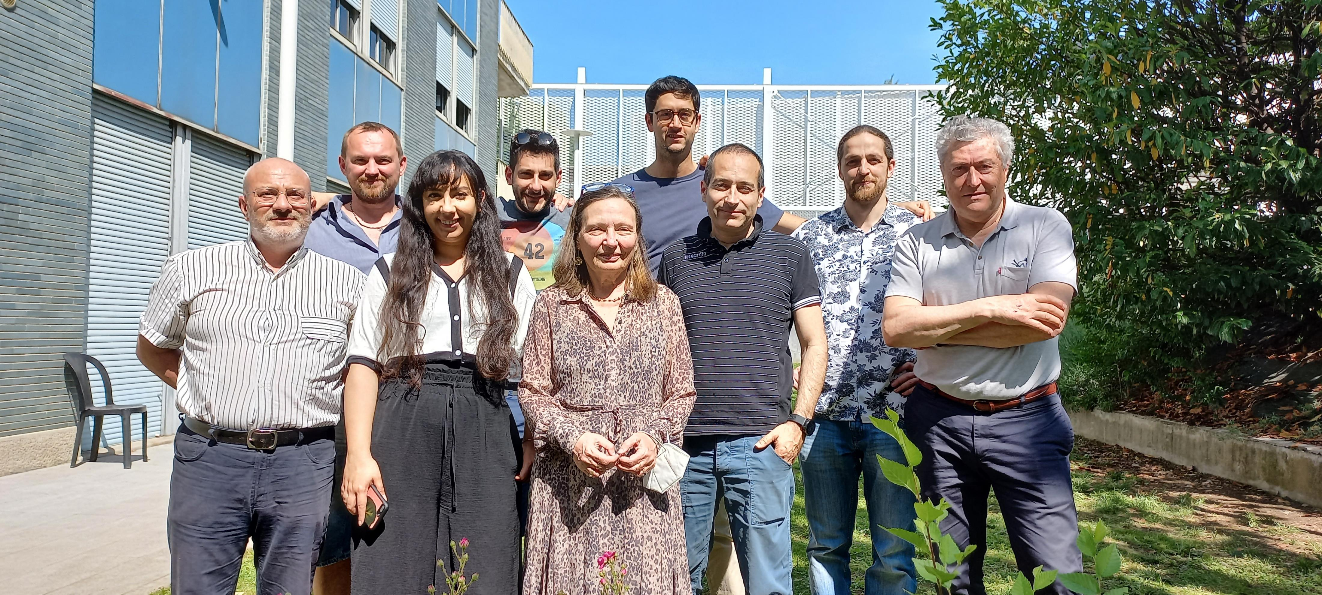
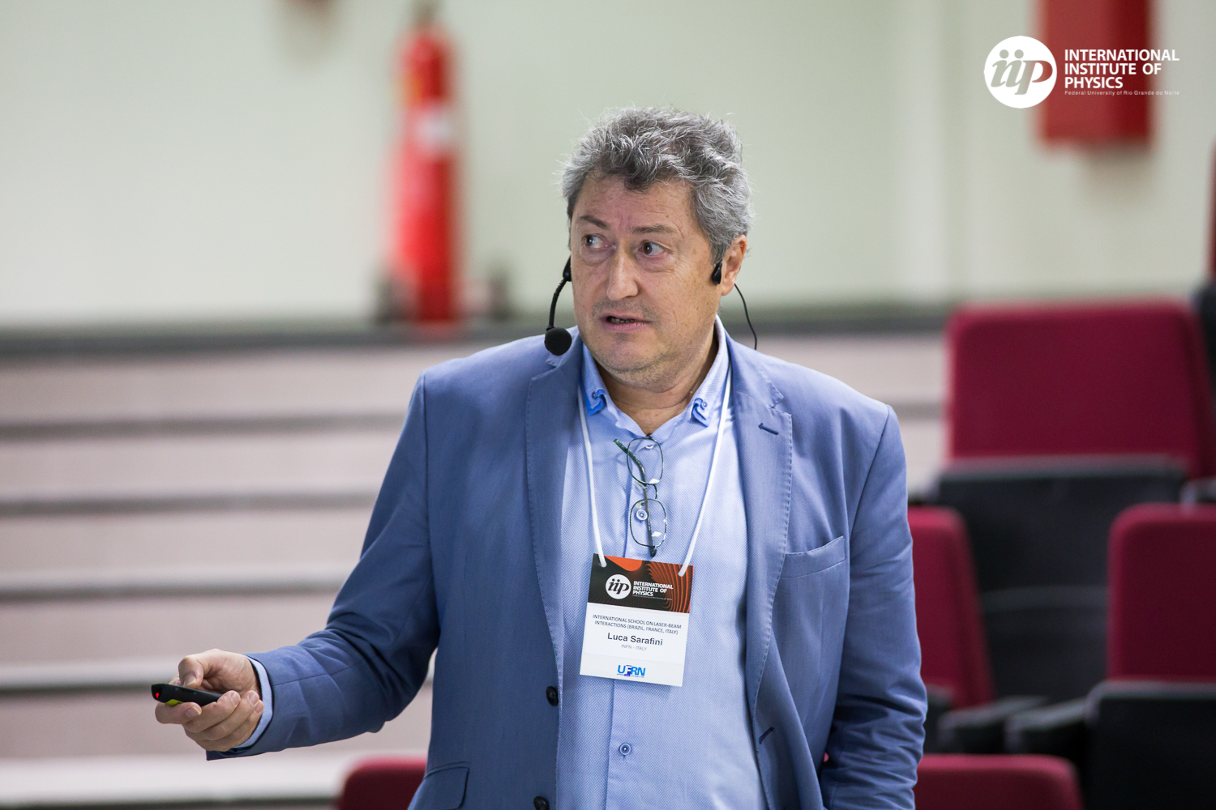
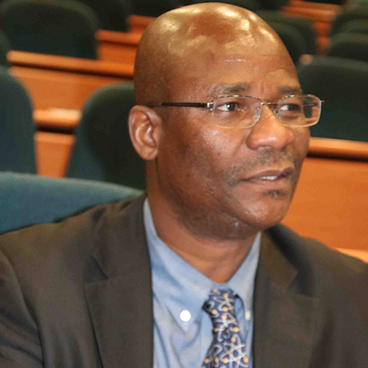
Education
B.Sc : Energy and Mechanics. University of Mohammed V, Rabat, Morocco
Specialized B.Sc : Medical Physics. University of Mohammed V, Rabat, Morocco
M.Sc : M.Sc in Quantum Physics: Applications to information theory. University of Mohammed V, Rabat, Morocco
PhD : INFN PhD school in Accelerator Physics. University of La Sapienza, Rome, Italy.
ASP
Vittoria Petrillo
University of Milan
Luca Serafini
INFN-Milan
Ketevi Assamagan
BNL

Slide 5

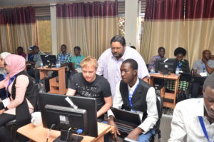
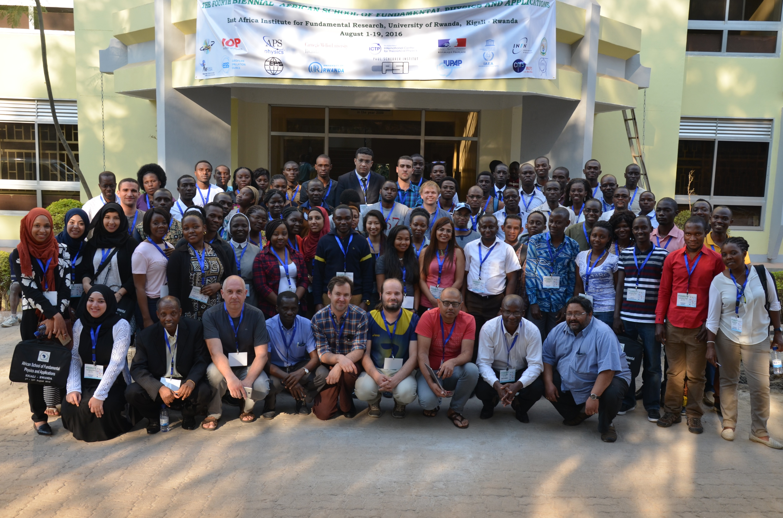
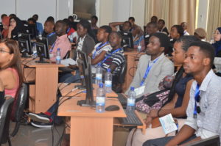
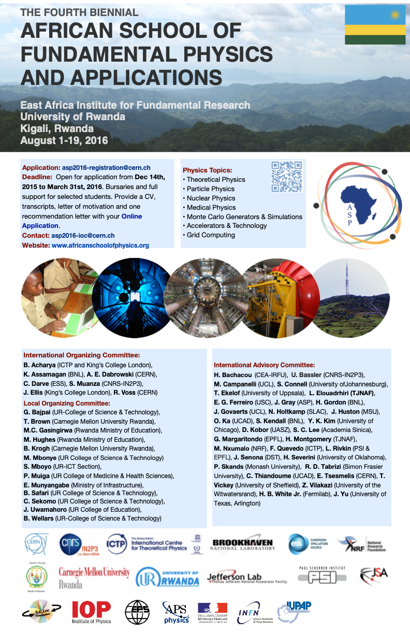
ASP
Experience
ASP School Edition
ASP 2016, Kigali, Rwanda

Slide 6
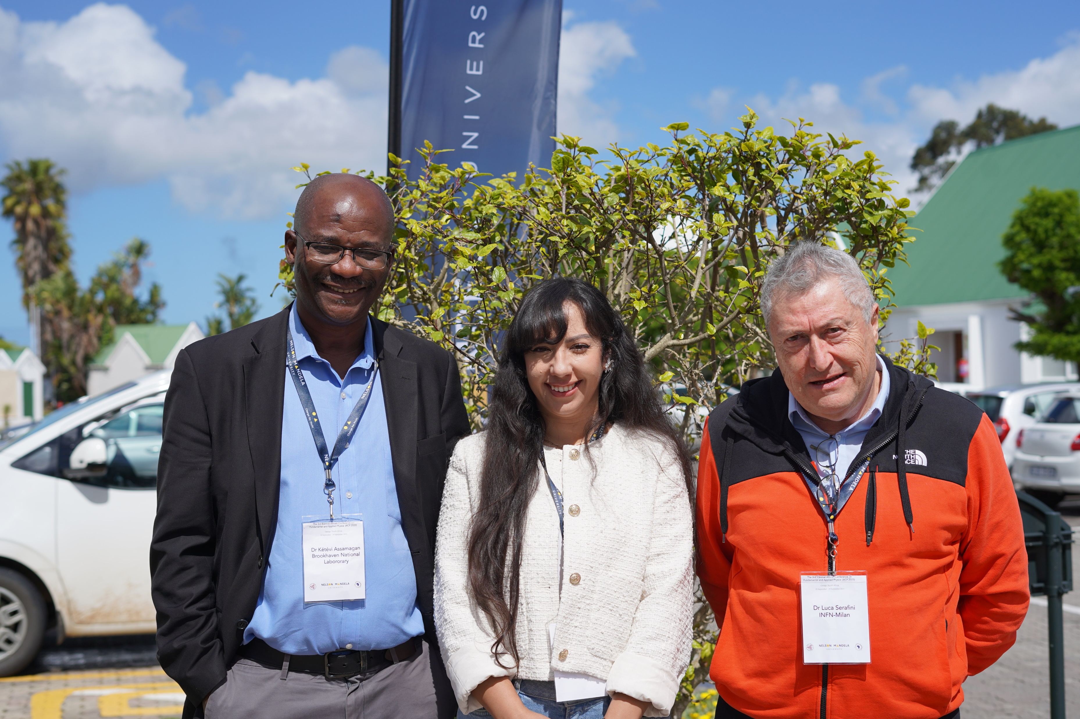



Dr. Luca Serafini
INFN
My Mentor and PhD supervisor
The Mentorship Program
Dr. Kétévi Assamagan
BNL
https://africanschoolofphysics.org/mentoring-and-coaching-program/

Slide 7
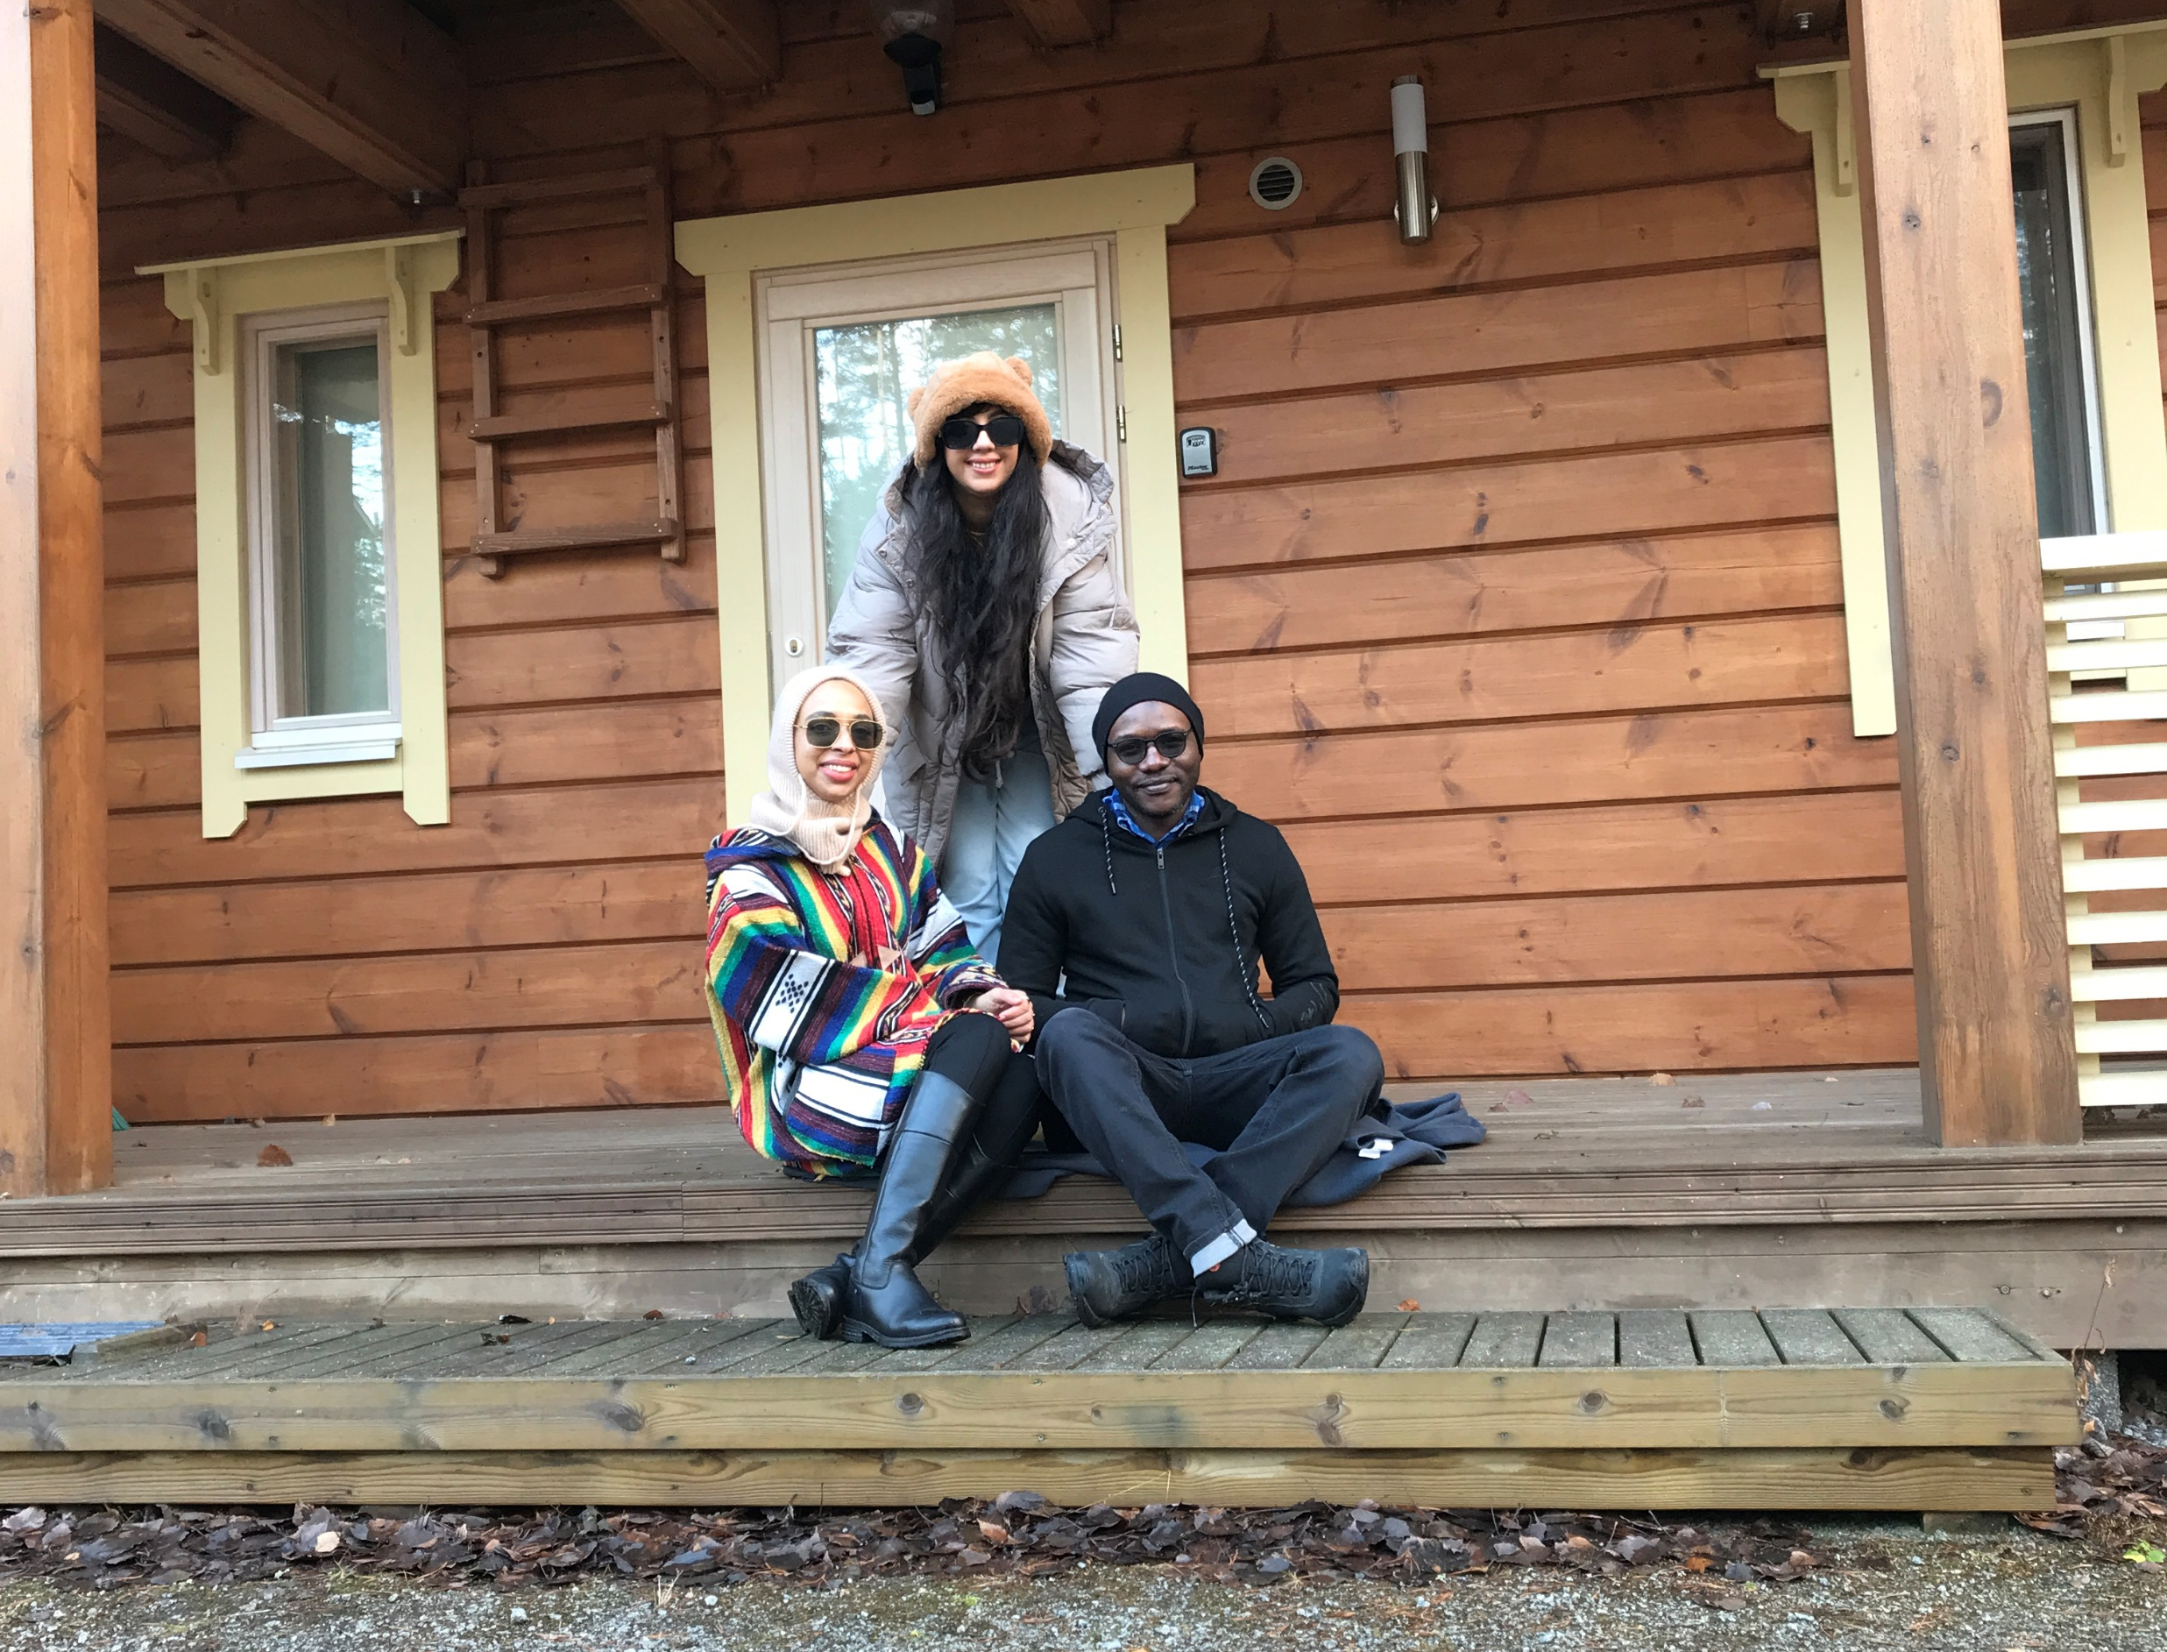
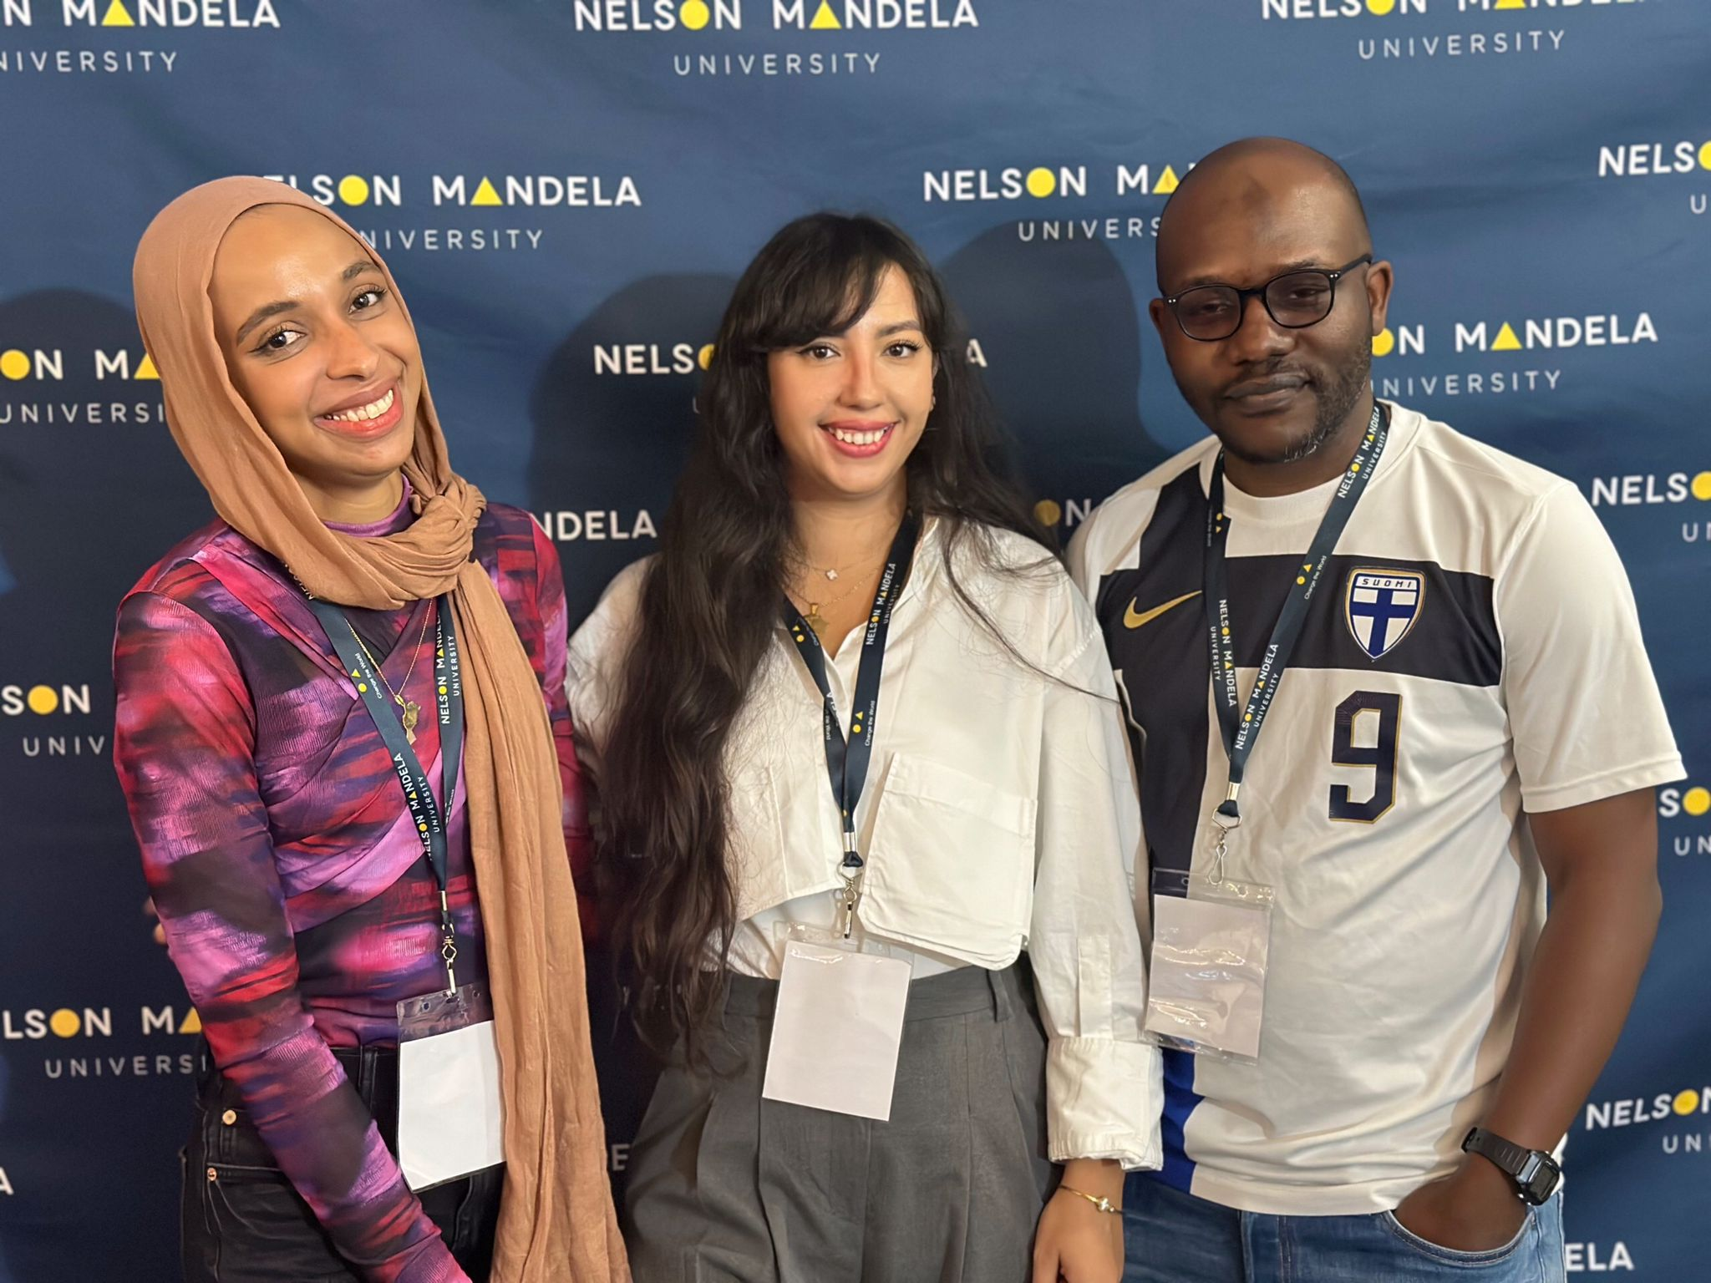

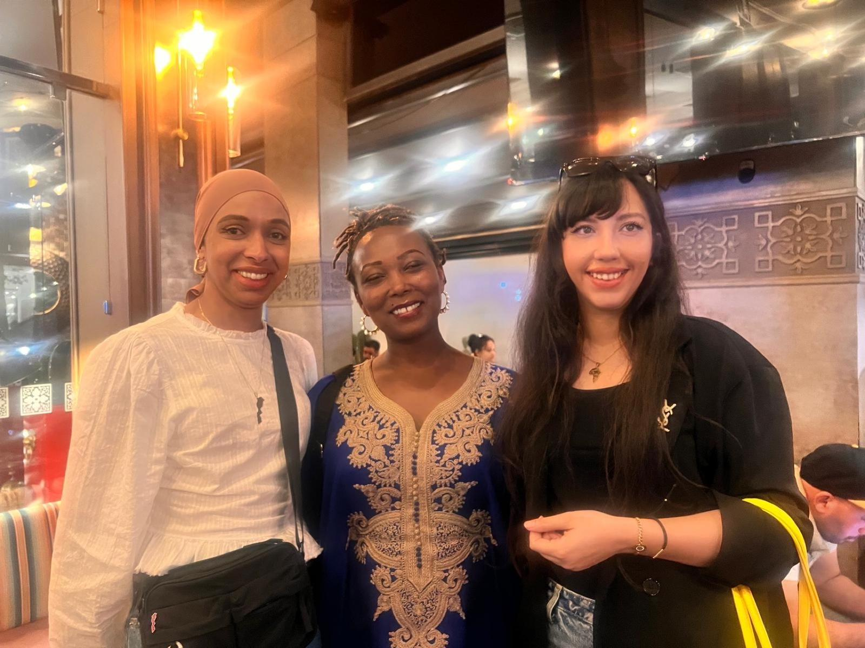
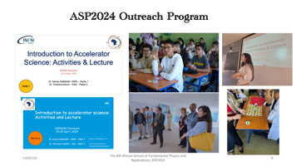
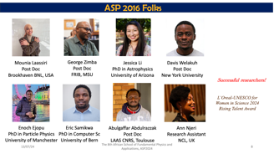
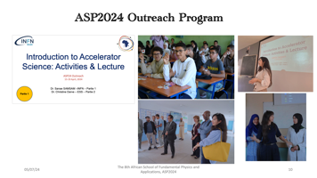
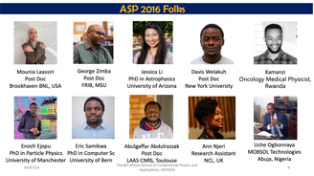
ASP 2016 Folks
With George Zimba & Mounia Laassiri.
November 2022, Finland
ACP23. September 2023, George, South Africa
With Davis Welakuh, February 2024, NewYork, USA
With Ann Nejri, April 2024, Merrakech, Morocco

Slide 8
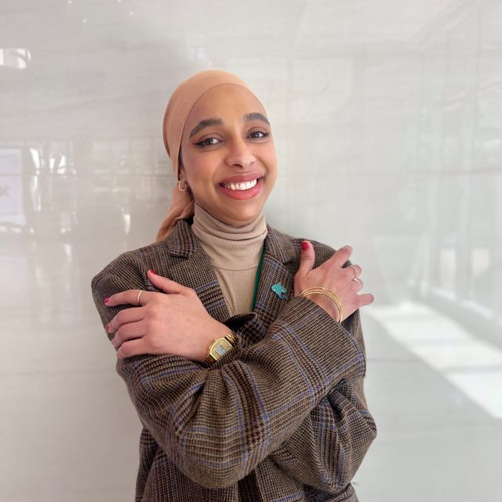
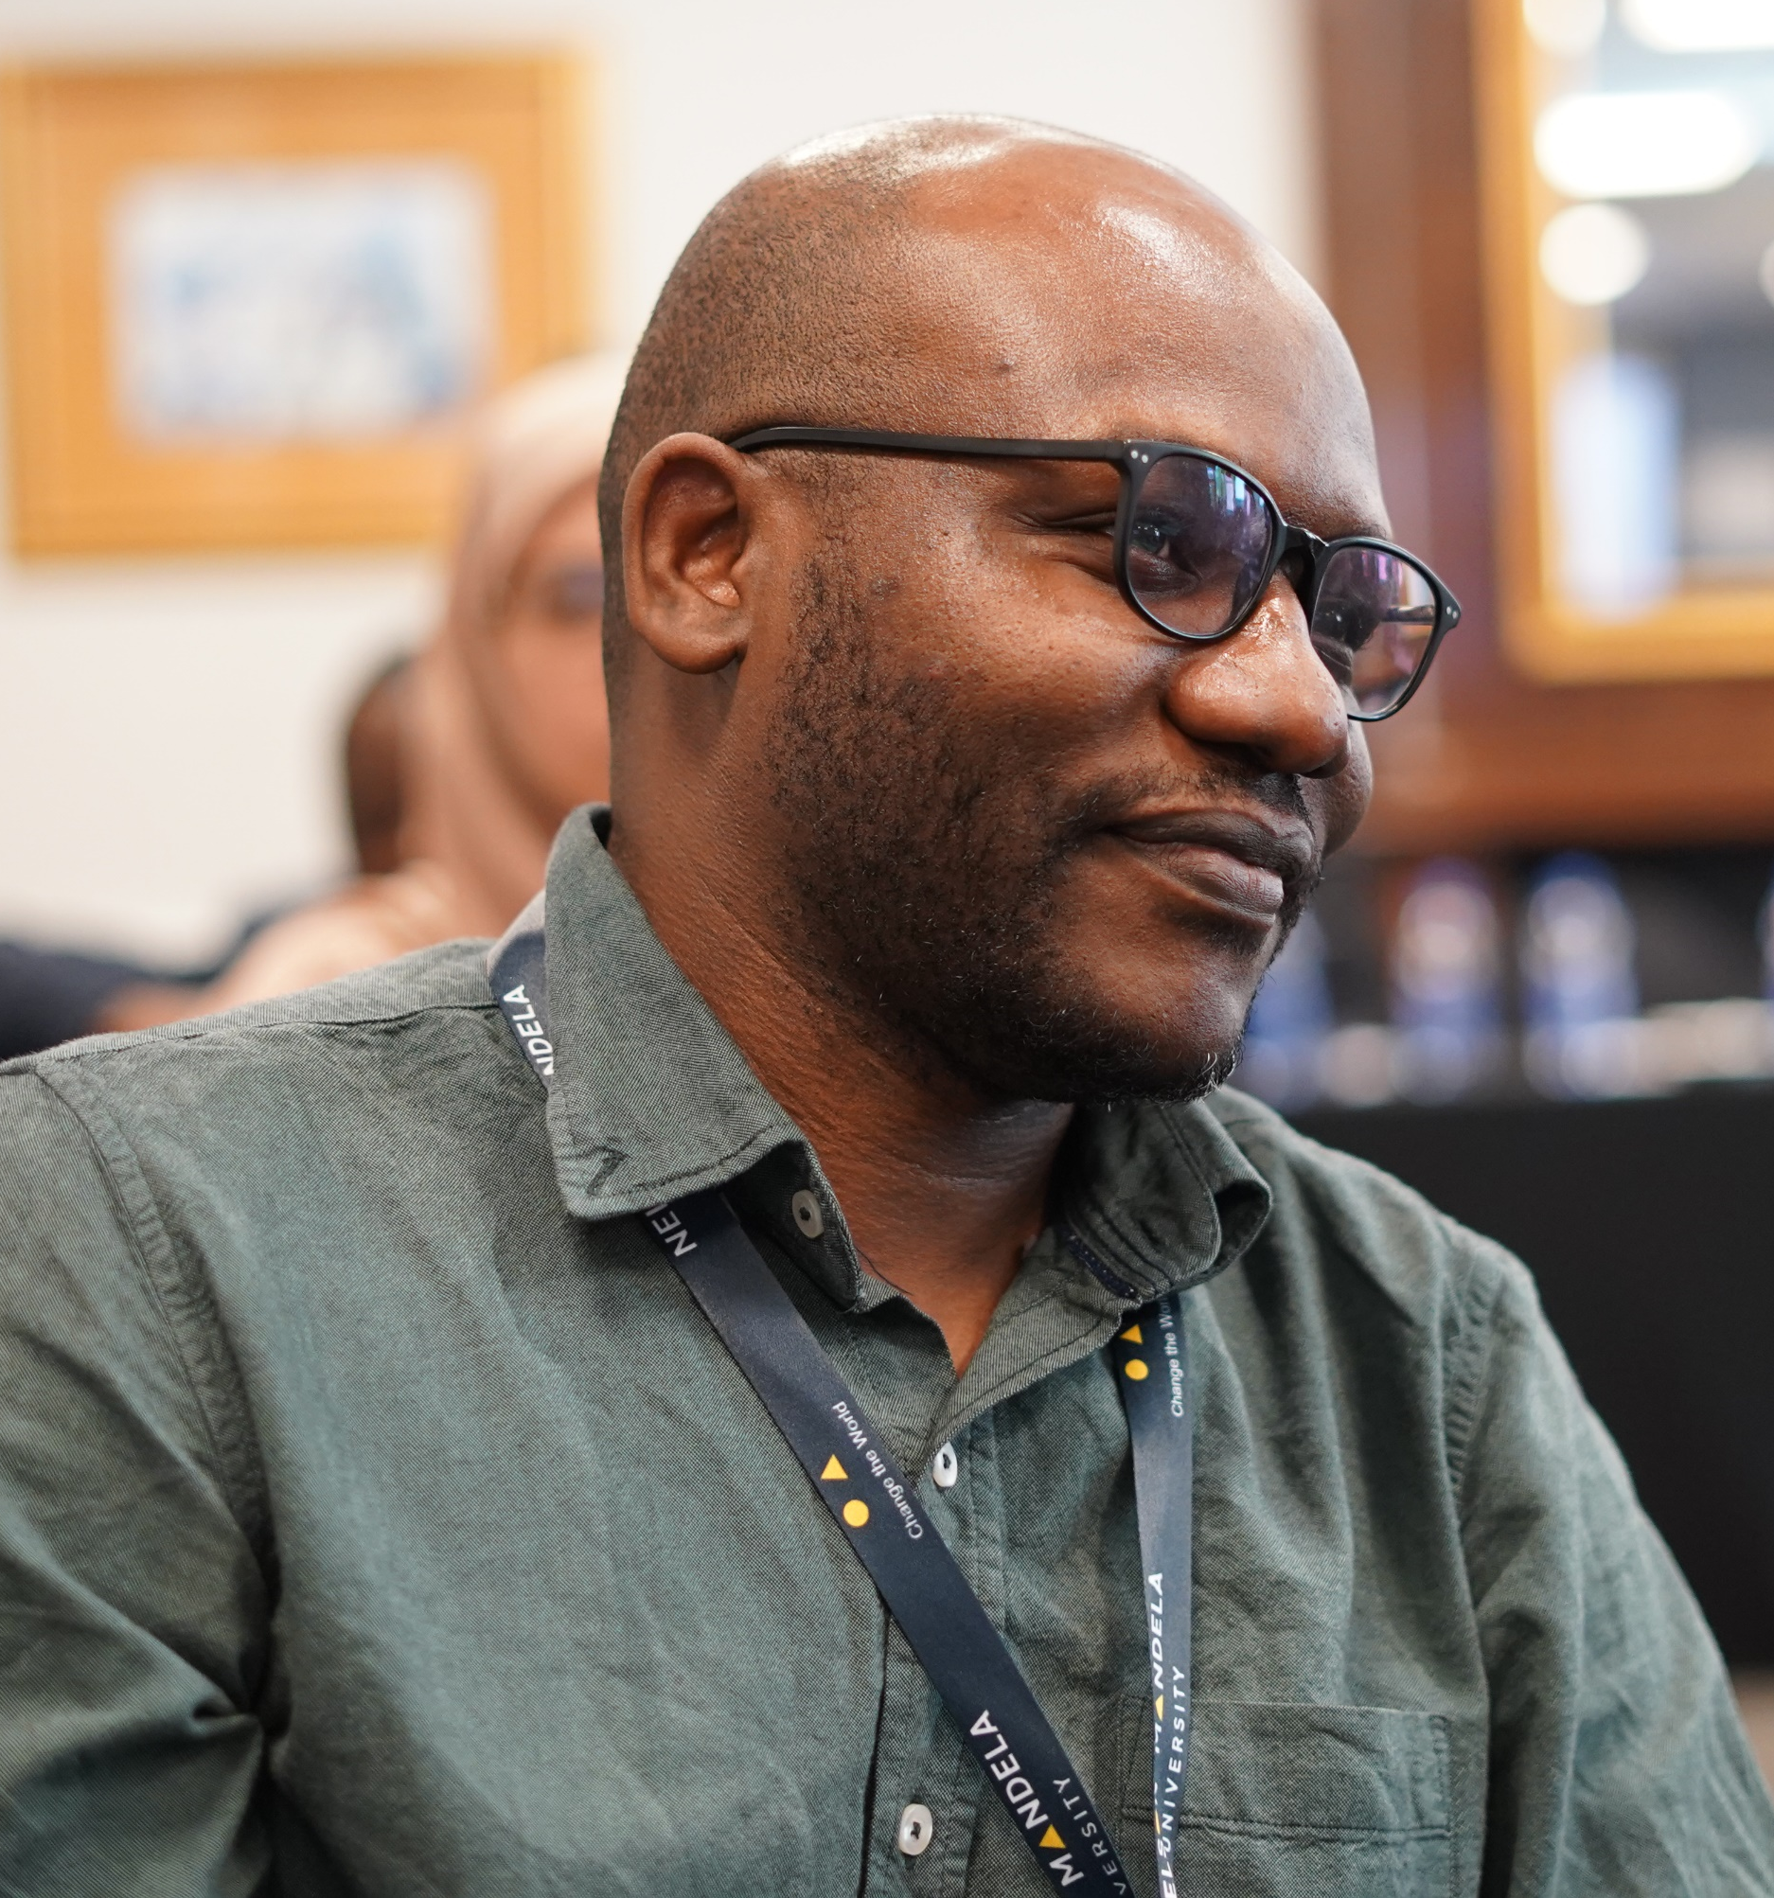
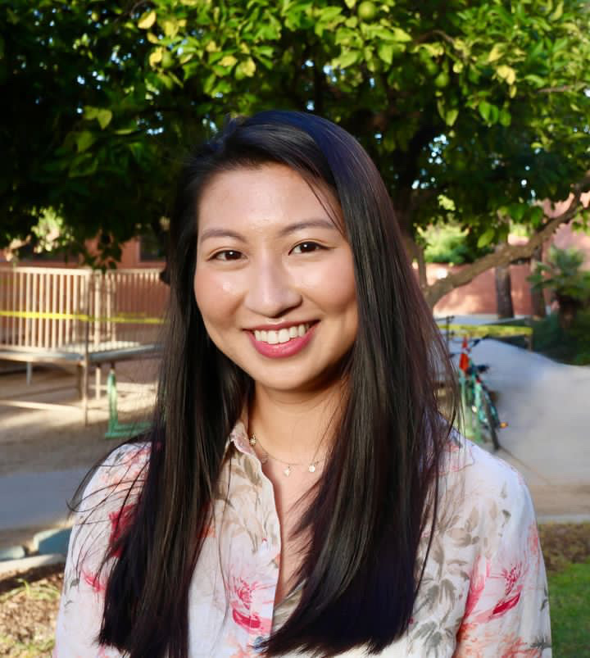
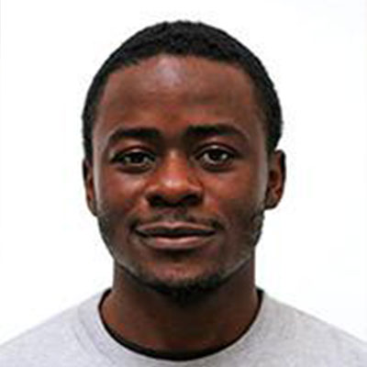
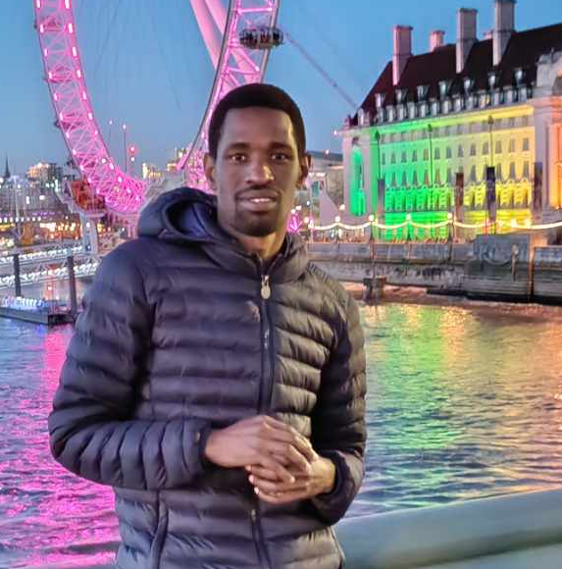
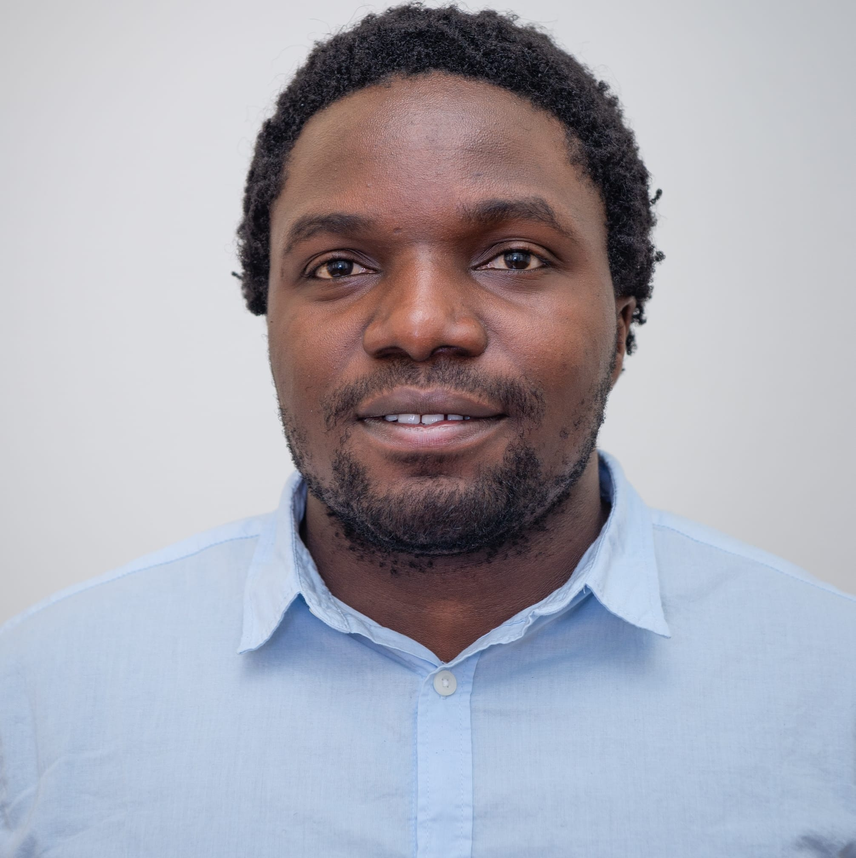
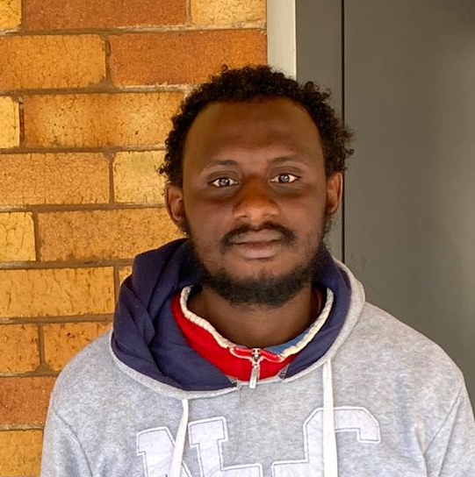

ASP 2016 Folks
Mounia Laassiri
Post Doc
Brookhaven BNL, USA
George Zimba
Post Doc
FRIB, MSU
Jessica Li
PhD in Astrophysics
University of Arizona
Davis Welakuh
Post Doc
New York University
Successful researchers!
L’Oreal-UNESCO for Women in Science 2024 Rising Talent Award
Enoch Ejopu
PhD in Particle Physics
University of Manchester
Eric Samikwa
PhD in Computer Sc
University of Bern
Abulgaffar Abdulrazzak
Post Doc
LAAS CNRS, Toulouse
Ann Njeri
Research Assistant
NCL, UK

Slide 9
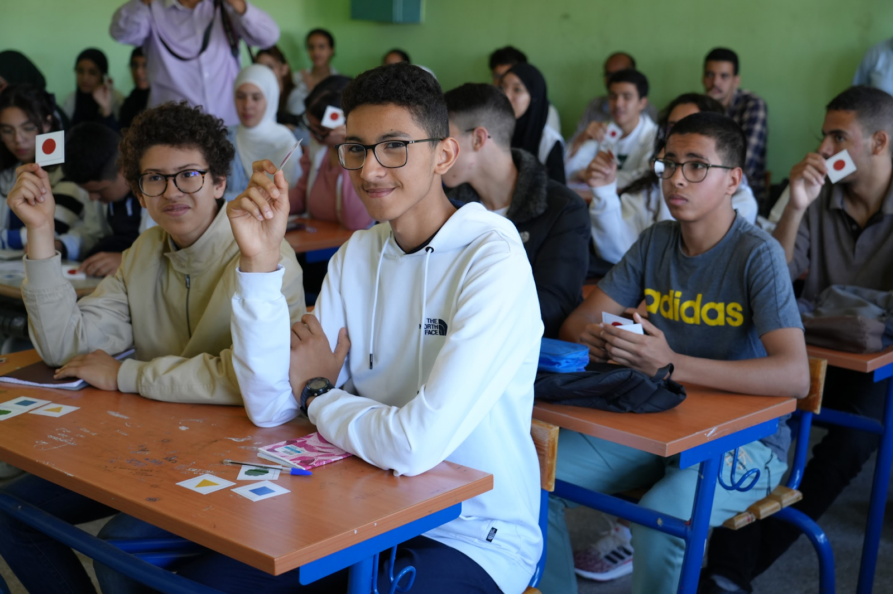
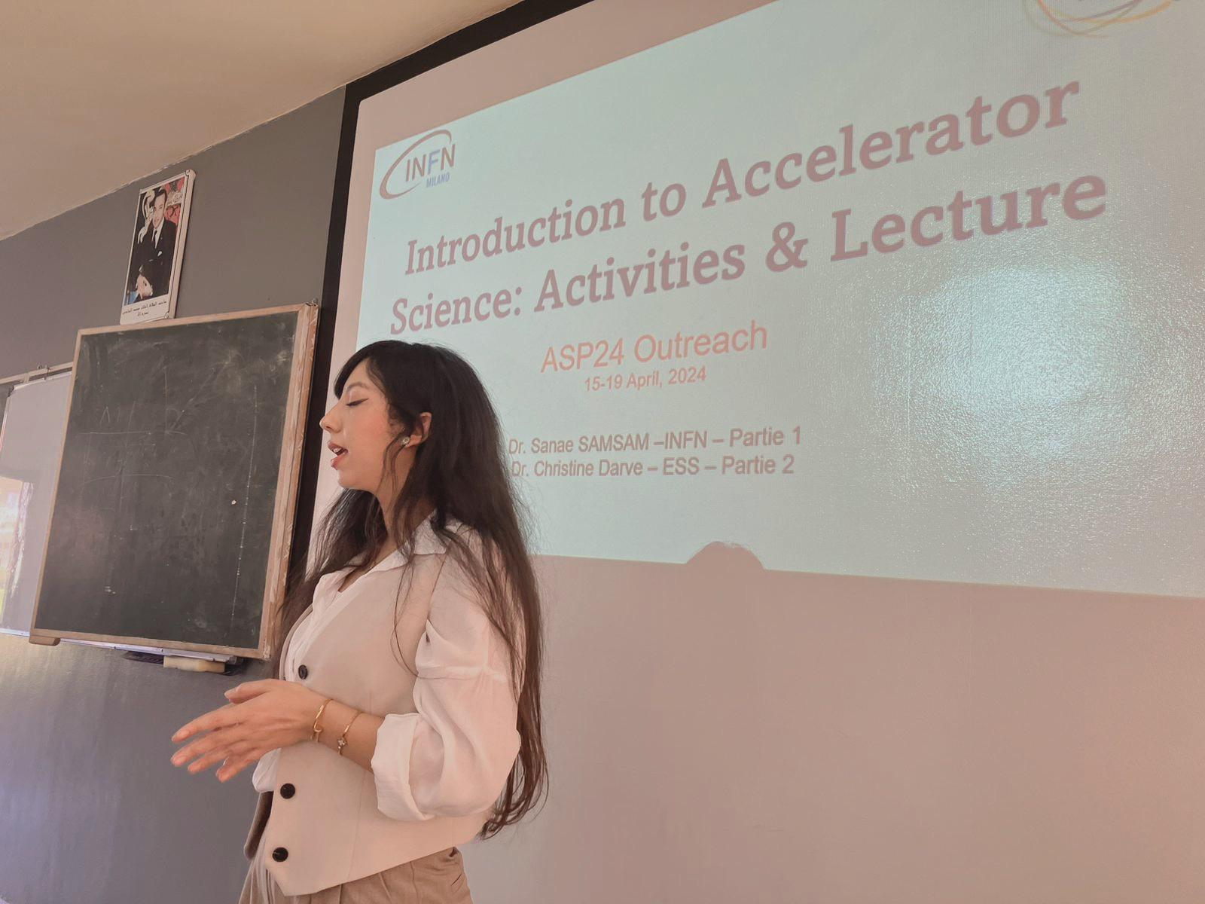
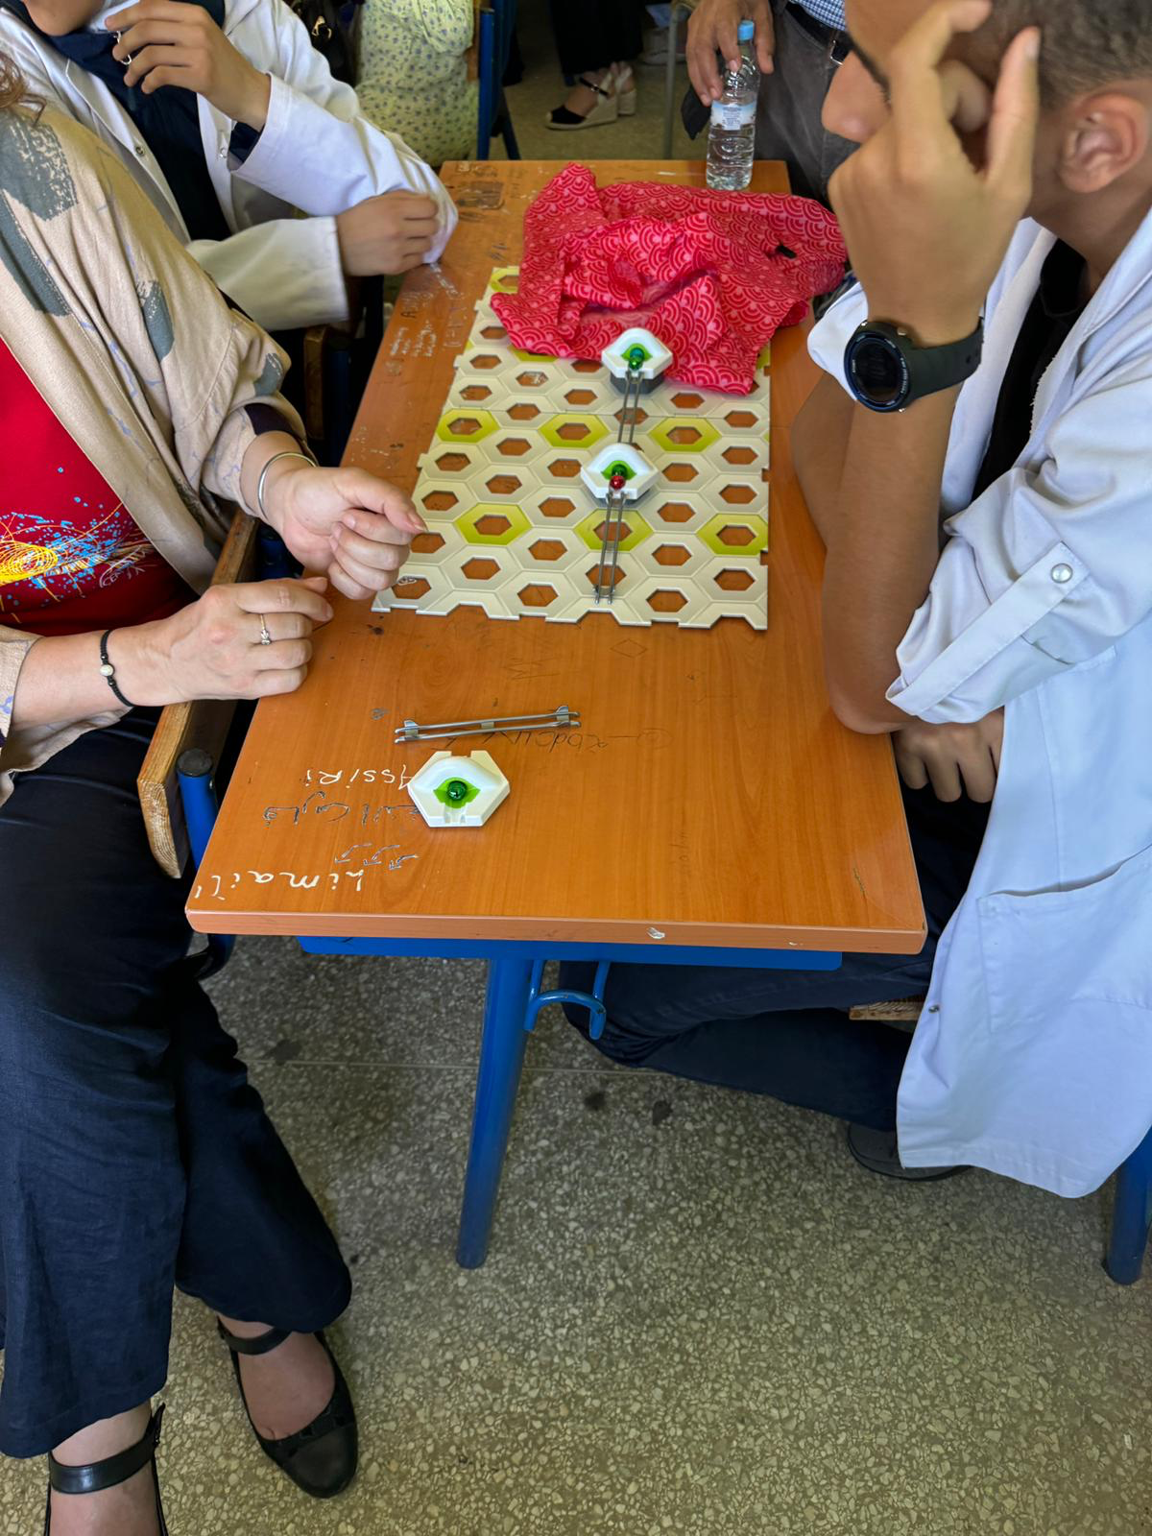
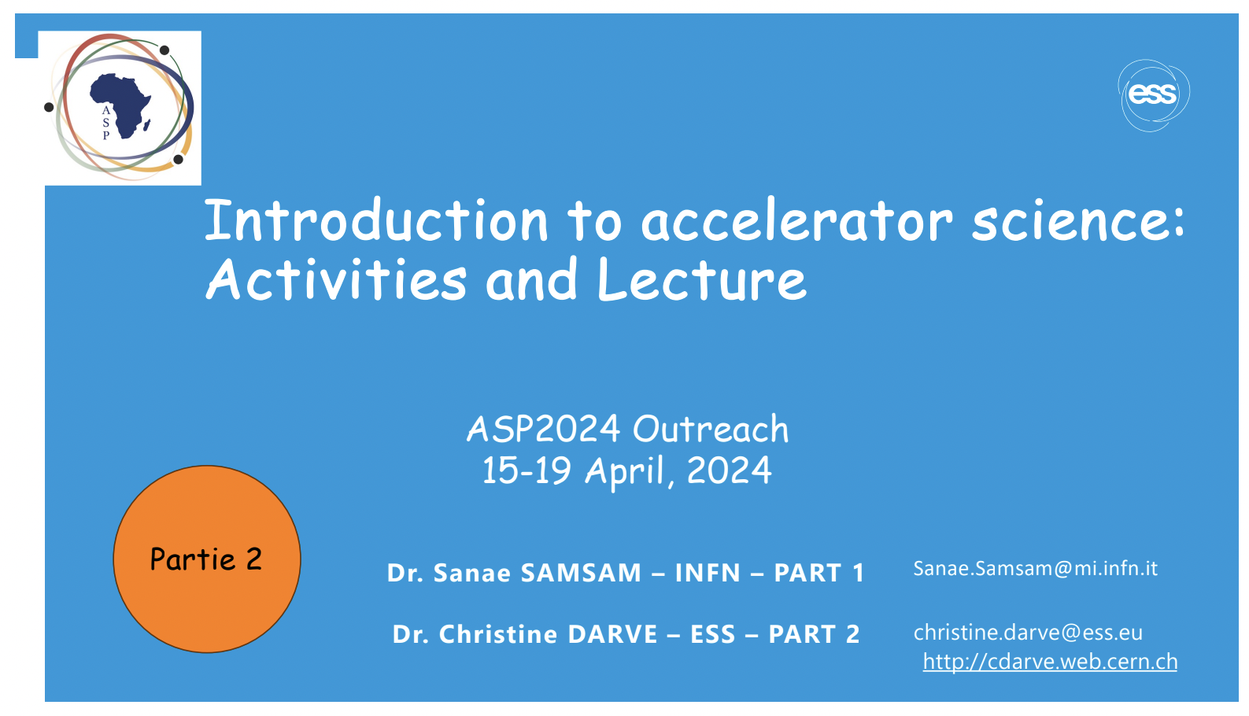
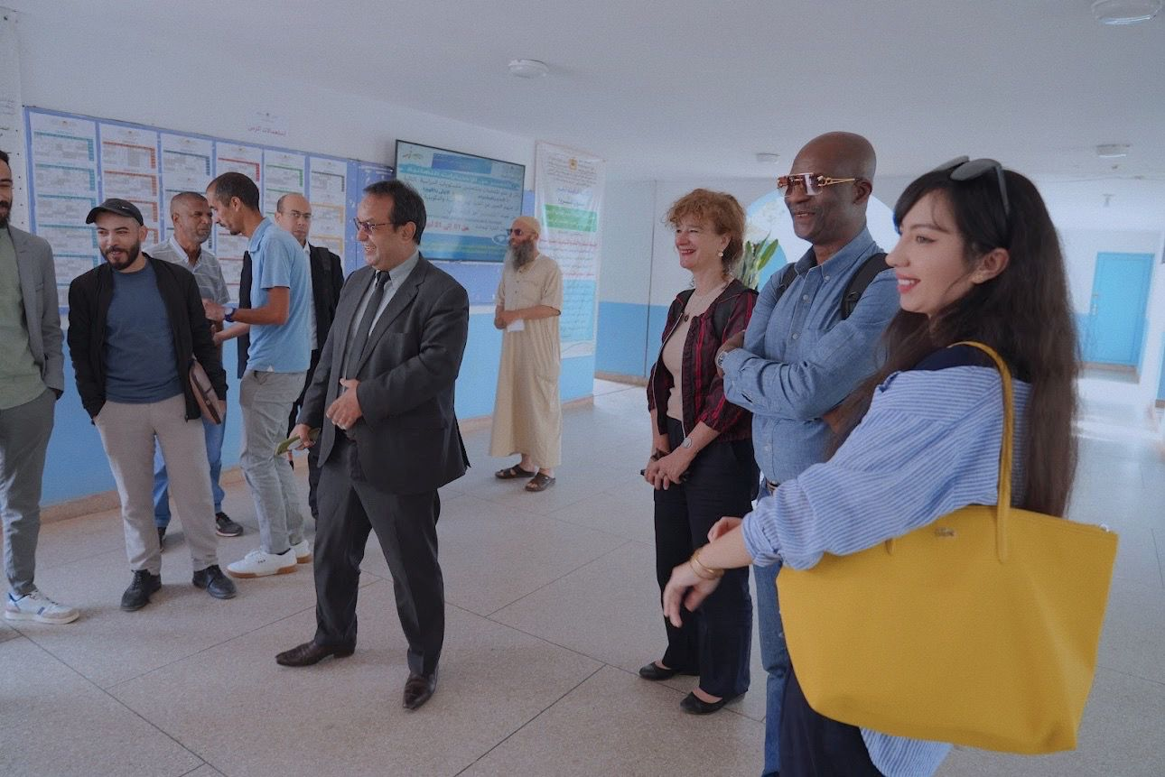
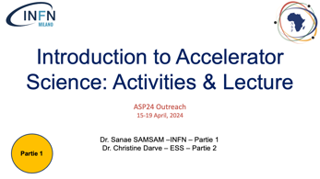
ASP2024 Outreach Program

Slide 10


Introduction to Accelerator Science: Activities & Lecture
ASP24 Outreach
15-19 April, 2024
Partie 1
Dr. Sanae SAMSAM –INFN – Partie 1
Dr. Christine Darve – ESS – Partie 2

Slide 11

Know more about ASP Alumni
https://www.aps.org/publications/african-physics-newsletter

Slide 12
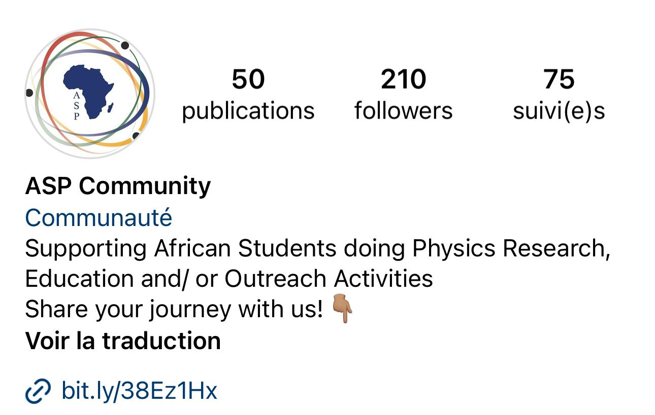
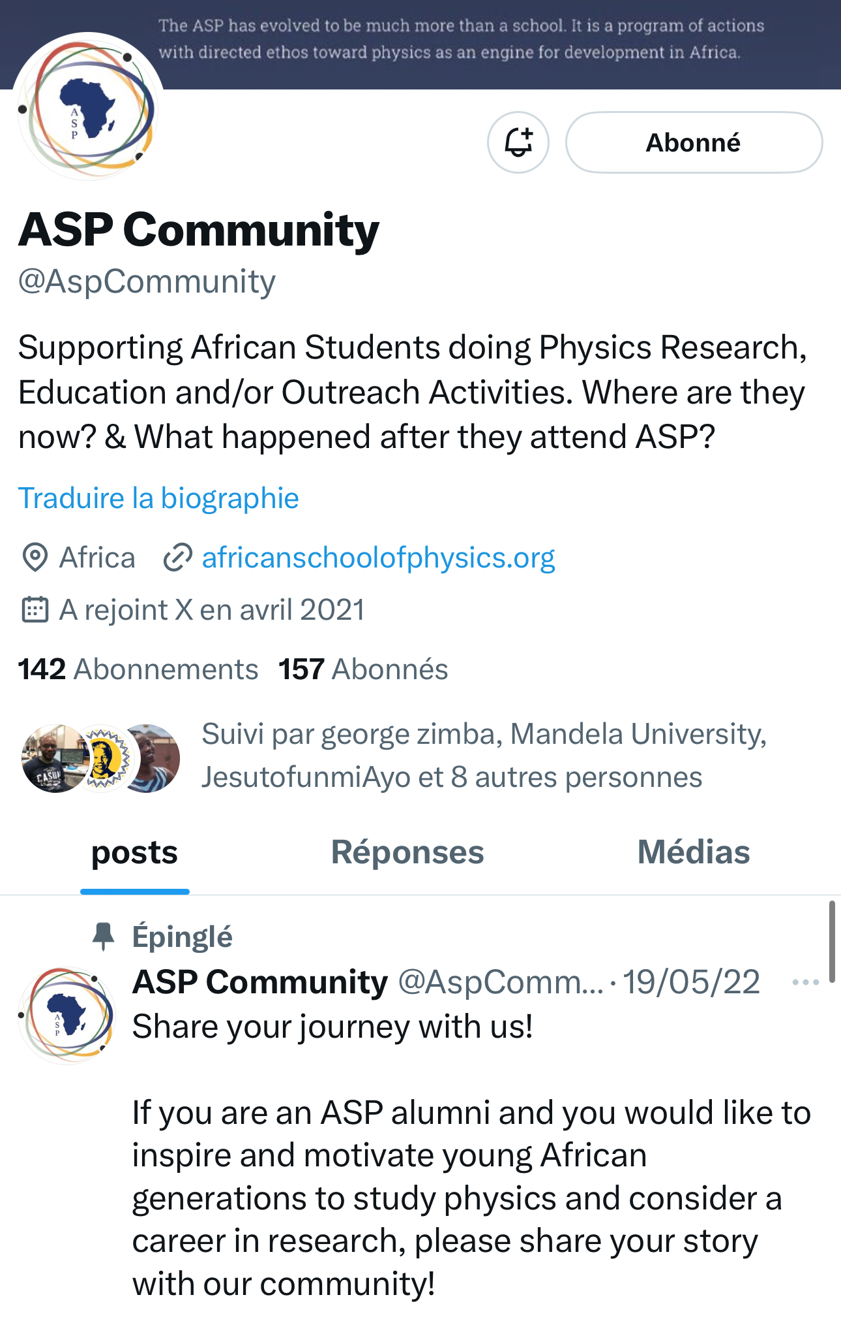
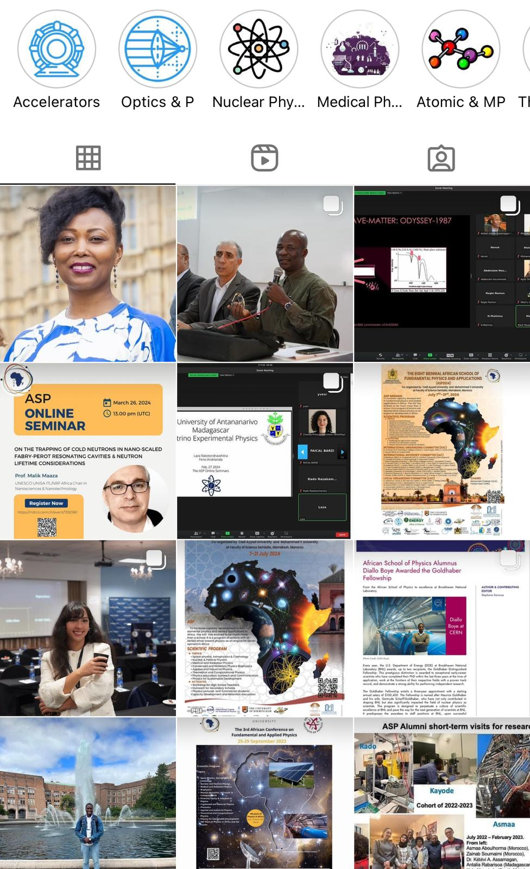




Know more about ASP Alumni
https://x.com/aspcommunity?s=11
https://www.instagram.com/asp.community/
https://www.facebook.com/asp.alumni.community
https://africanschoolofphysics.org/

Slide 13
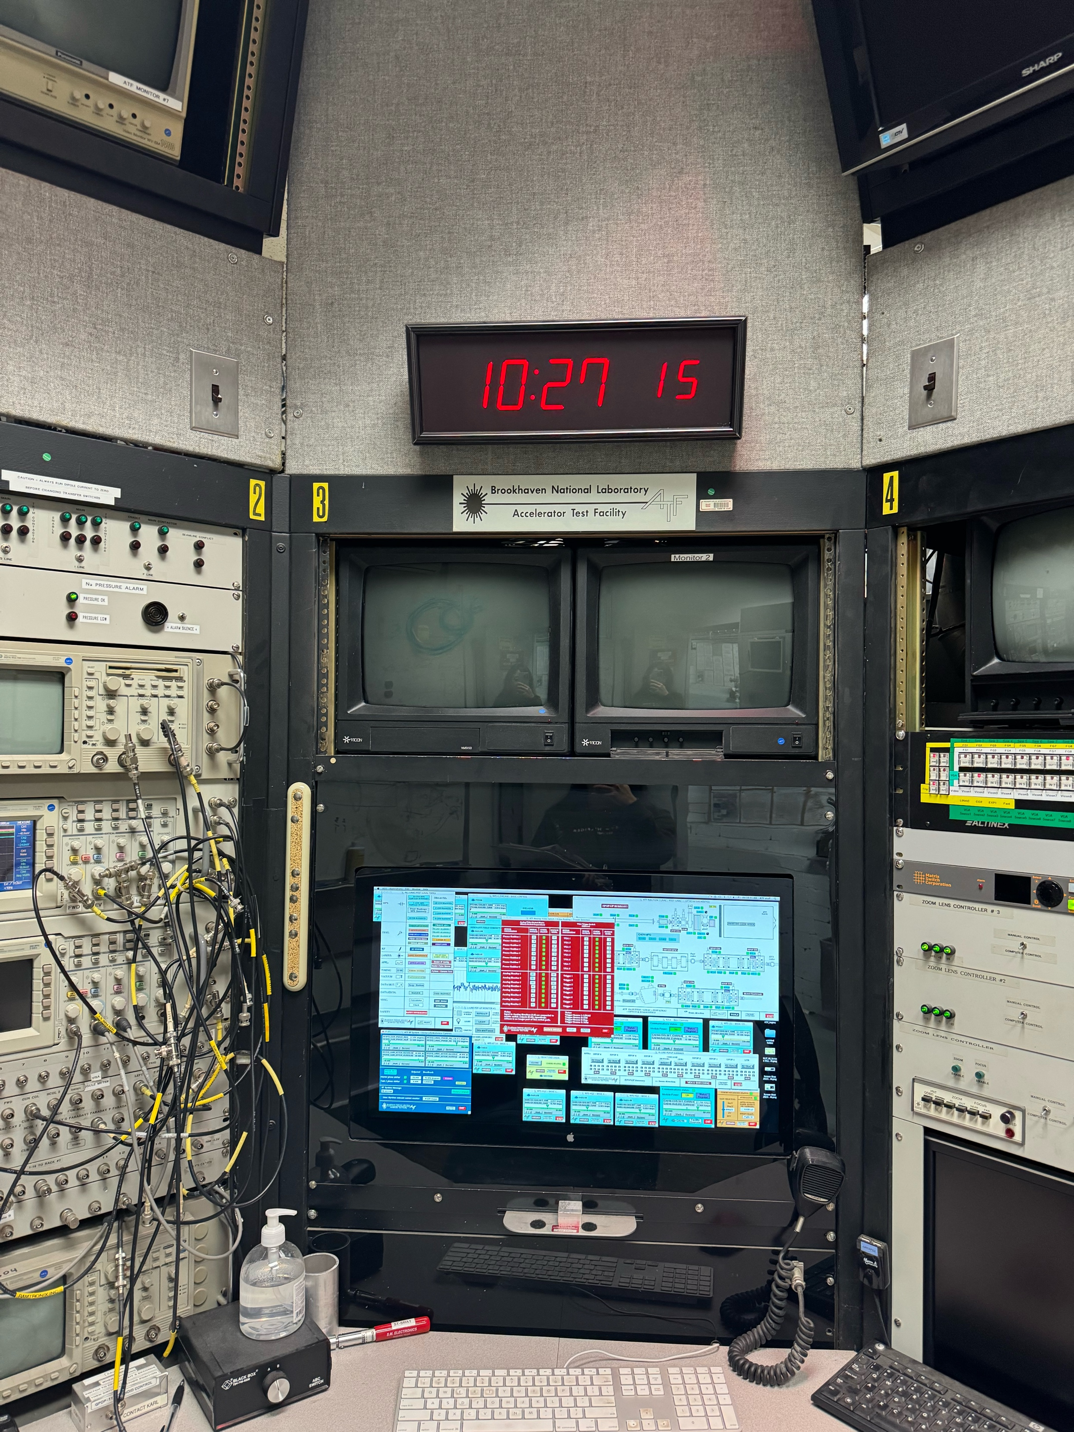
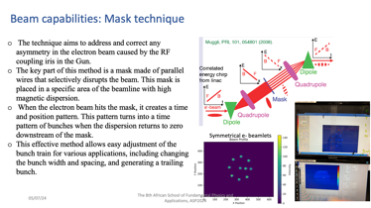
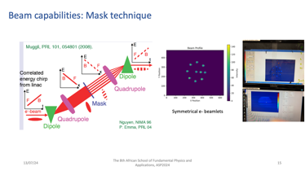
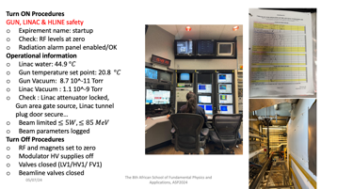
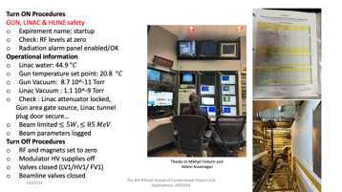
8 years later: BNL visit

Slide 14
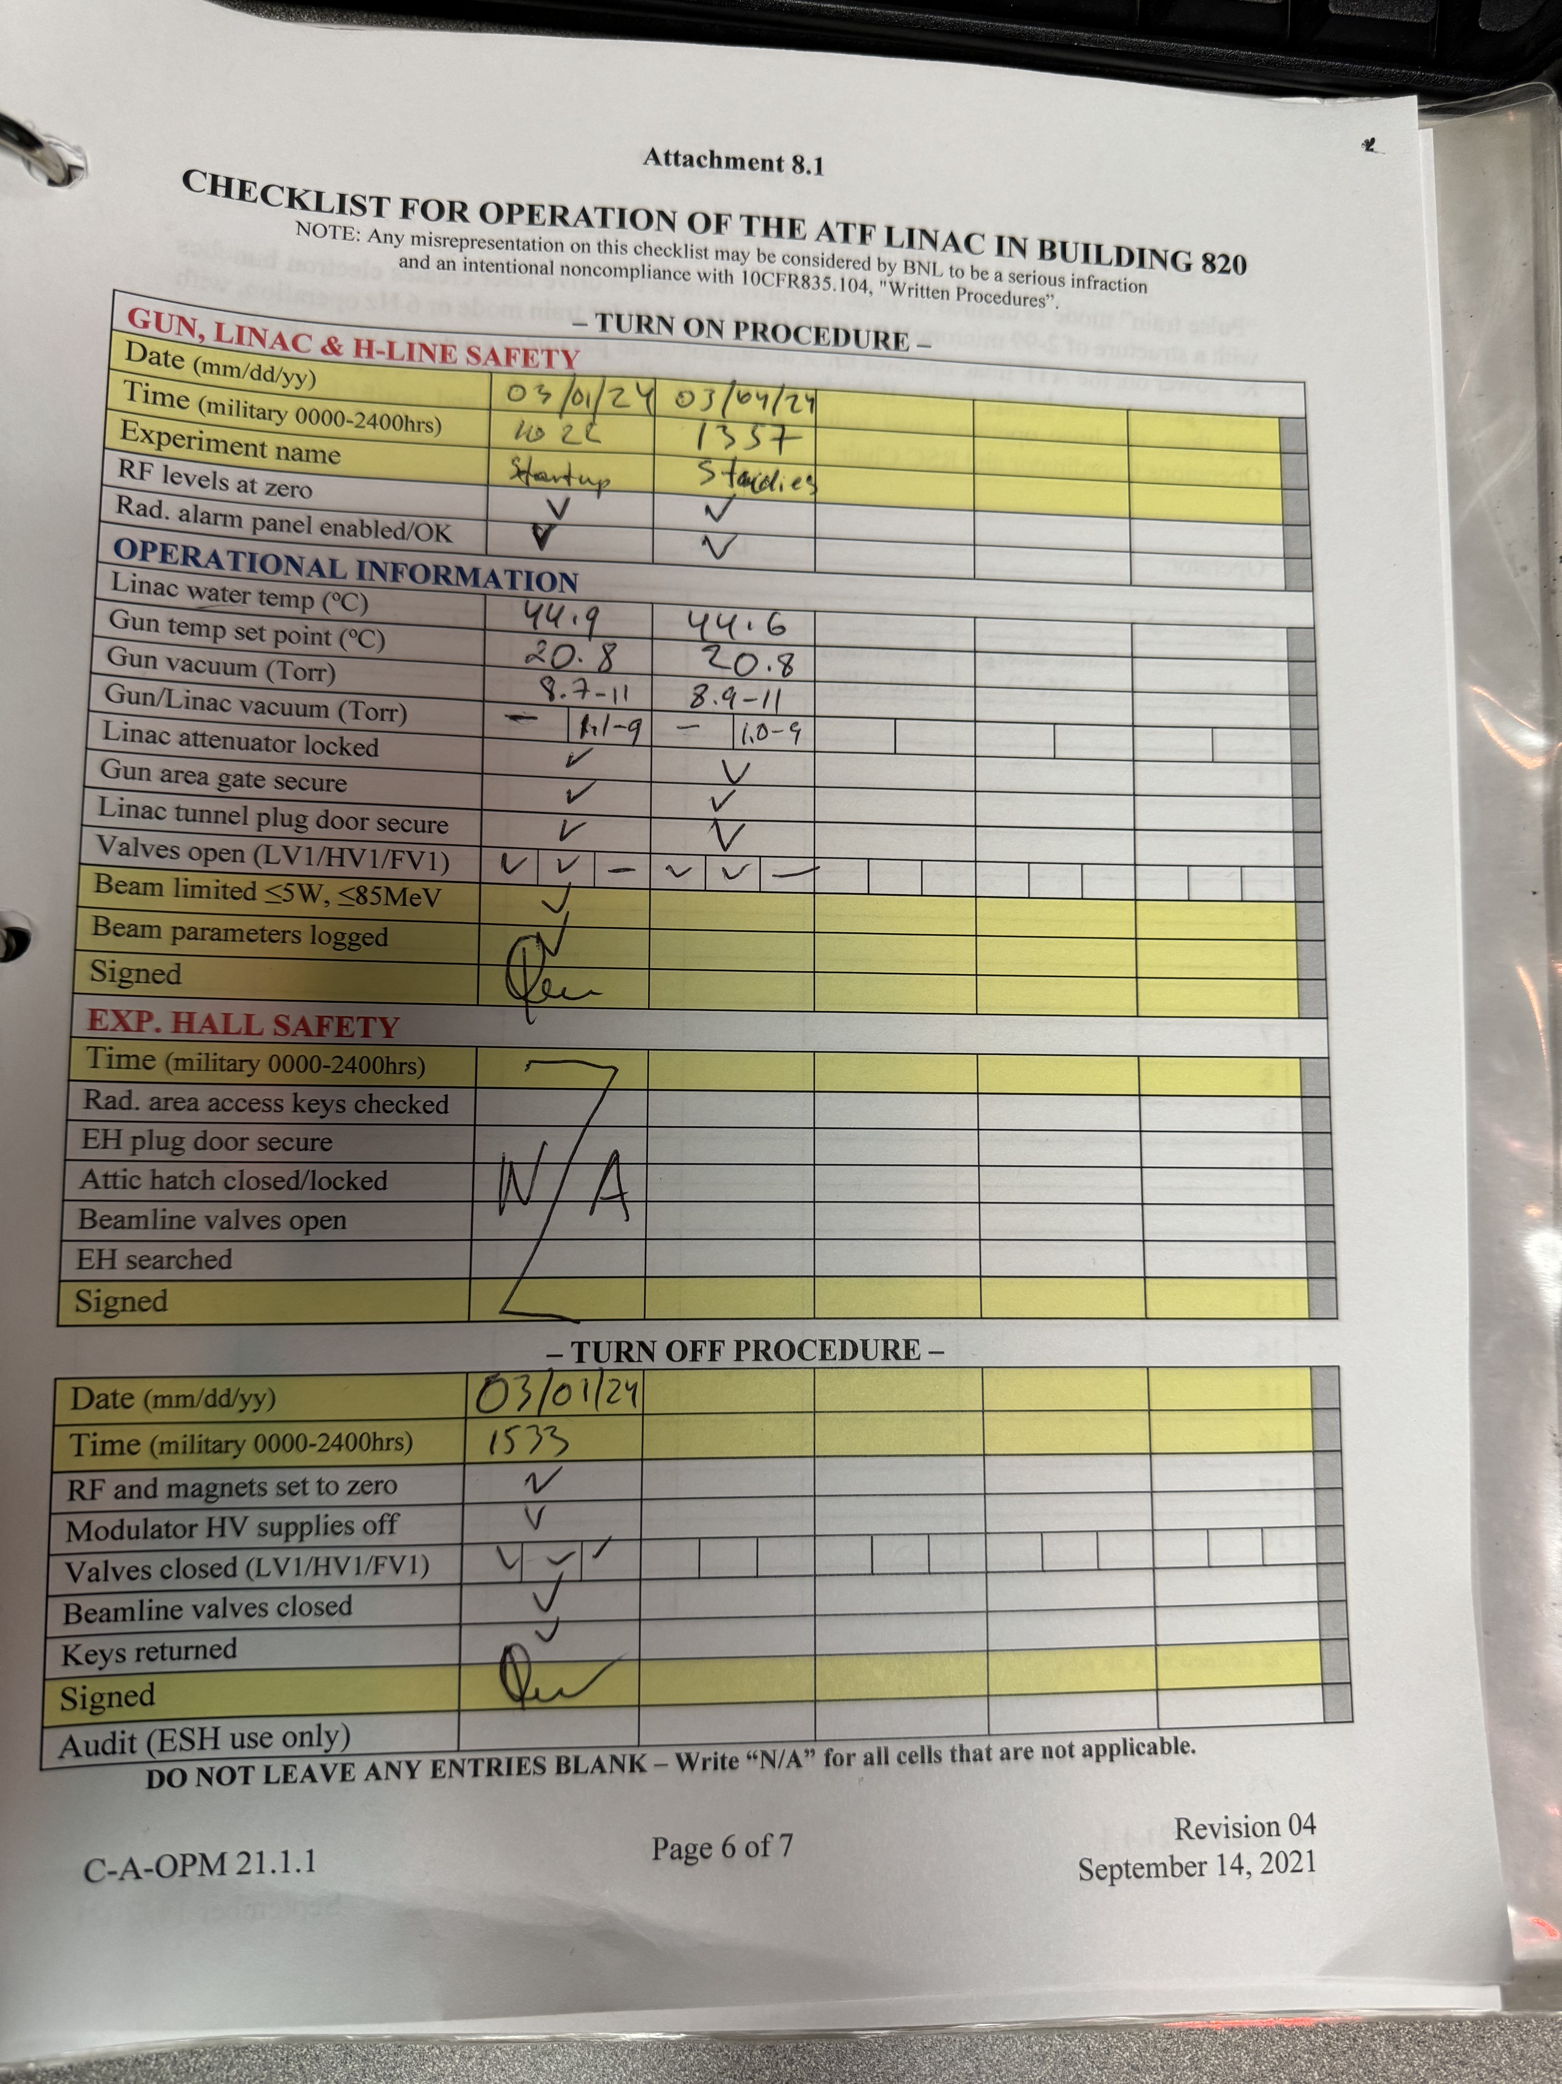
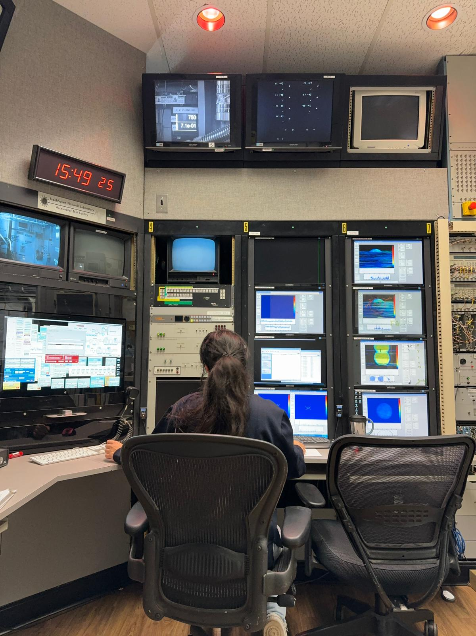
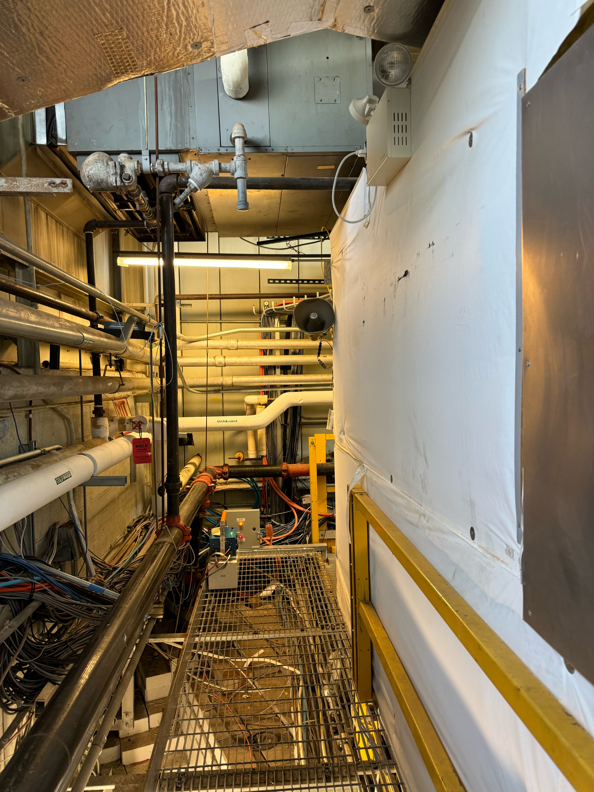

Turn ON Procedures
GUN, LINAC & HLINE safety
Expirement name: startup
Check: RF levels at zero
Radiation alarm panel enabled/OK
Operational information
Linac water: 44.9 $°C$
Gun temperature set point: 20.8 $°C$
Gun Vacuum: 8.7 10^-11 Torr
Linac Vacuum : 1.1 10^-9 Torr
Check : Linac attenuator locked,
Gun area gate source, Linac tunnel
plug door secure…
Beam limited $≤5W, ≤85 MeV$
Beam parameters logged
Turn Off Procedures
RF and magnets set to zero
Modulator HV supplies off
Valves closed (LV1/HV1/ FV1)
Beamline valves closed
Operation of the ATF Linac at building 820
Thanks to Mikhail Fedurin and
Ketevi Assamagan

Slide 15
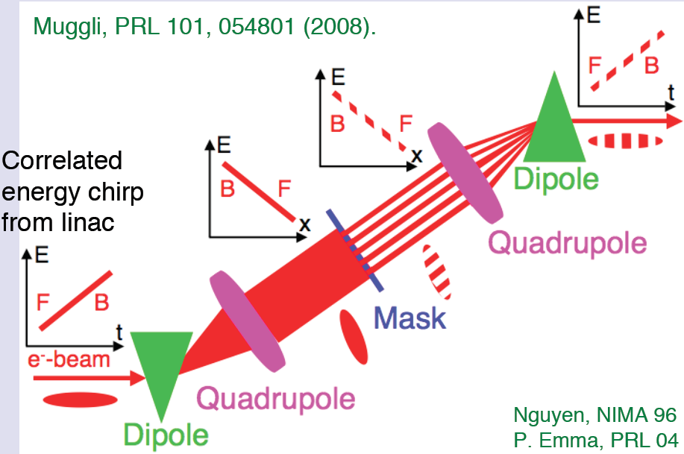
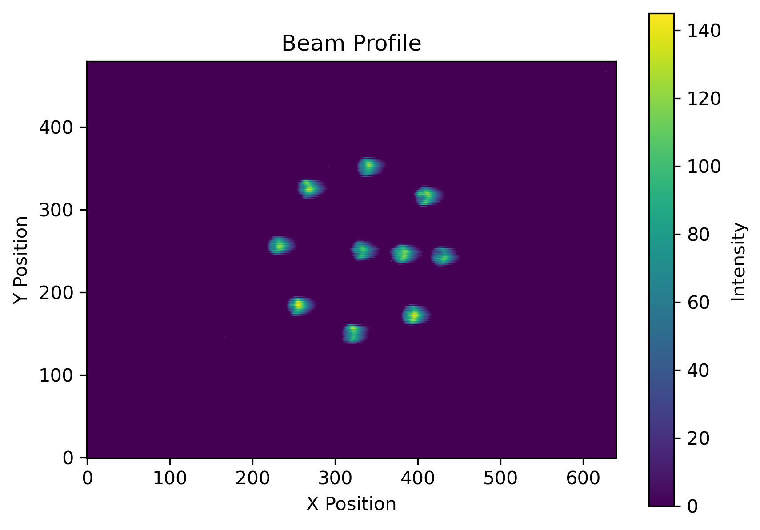
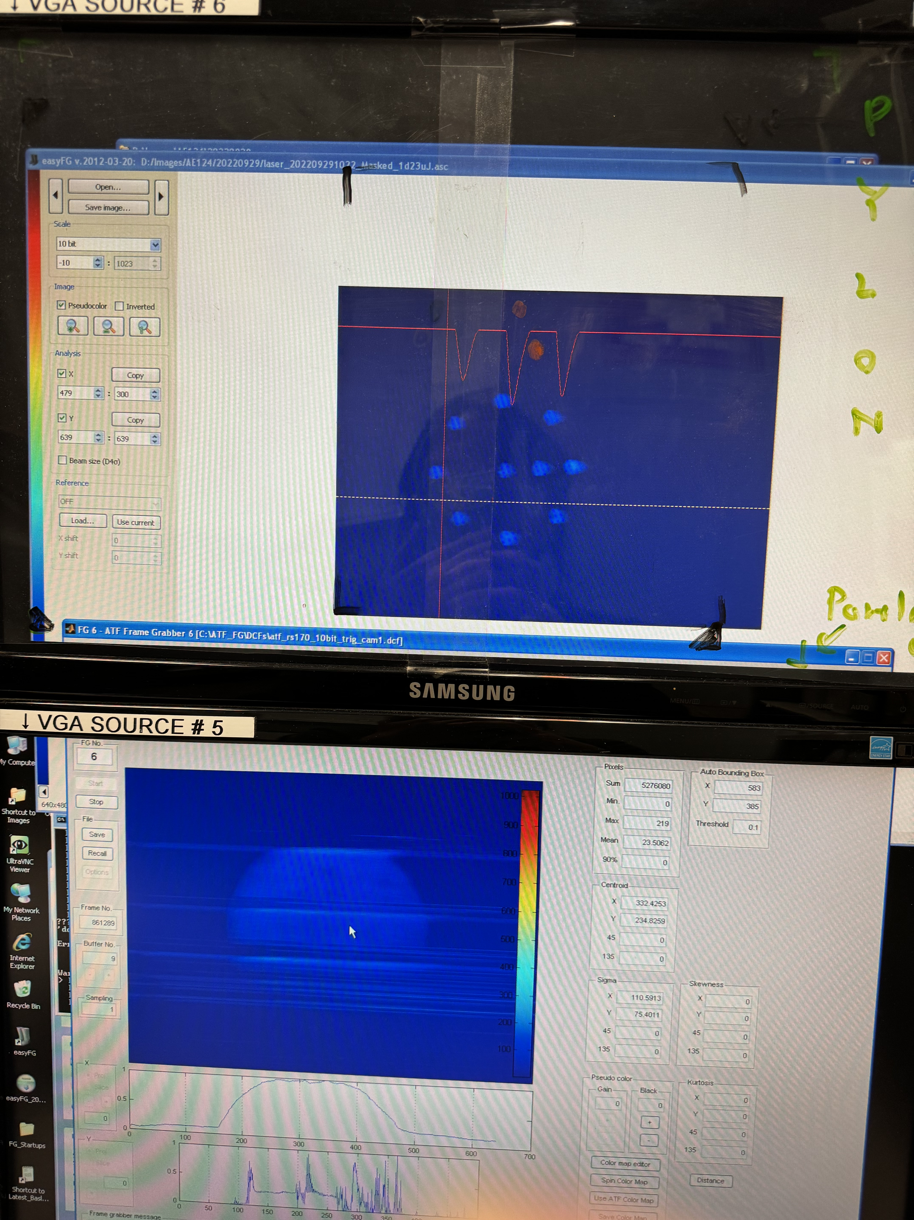
Beam capabilities: Mask technique
Symmetrical e- beamlets
Notes:
Create adjeastable electron beam

Slide 16


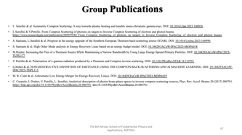
Theoretical researches: Inverse Compton scattering (ICS), Full Inverse Compton Scattering (FICS), Symmetric Compton Scattering (SCS)…
Optimization and simulations of X-ray Compton radiation spectra in the linear and non-linear regime.
High energy line measurements of STAR Project in Calabria, Italy. (soon)
Simulations of High Order Modes effects on beam dynamics in superconducting cavities for BriXSinO project (Proposal to build an Energy Recovery Linac in Milan, Italy).
https://star.unical.it/
https://indico.cern.ch/event/1229551/sessions/505466/#20230925
My experience at STAR & ATF BNL
Where
I am
actually

Slide 17
Group Publications
L. Serafini & al. Symmetric Compton Scattering: A way towards plasma heating and tunable mono-chromatic gamma-rays. DOI: 10.1016/j.fpp.2023.100026
L.Serafini & V.Petrillo. From Compton Scattering of photons on targets to Inverse Compton Scattering of electron and photon beams. https://www.researchgate.net/publication/380397844_From_Compton_Scattering_of_photons_on_targets_to_Inverse_Compton_Scattering_of_electron_and_photon_beams
S. Samsam, L.Serafini & al. Progress in the energy upgrade of the Southern European Thomson back-scattering source (STAR). DOI: 10.1016/j.nima.2023.168990.
S. Samsam & al. High Order Mode analysis in Energy Recovery Linac based on an energy budget model. DOI: 10.18429/JACoW-IPAC2023-MOPA018
M.Ruijter. Increasing the Flux of a Thomson Source While Maintaining a Narrow Bandwidth by Using Large Energy Spread Primary Particles. DOI: 10.18429/JACoW-IPAC2023-TUPL177
V. Petrillo & al. Polarization of x-gamma radiation produced by a Thomson and Compton inverse scattering. DOI: 10.1103/PhysRevSTAB.18.110701
I.Drebot & al. NON-DESTRUCTIVE DEFINITION OF EMITTANCE USING THE COMPTON BACK-SCATTERING AND AI MACHINE LEARNING. DOI: 10.18429/JACoW-IPAC2023-THPL113
M. R. Conti & al. Achromatic Low Energy Merger for Energy Recovery Linacs. DOI: 10.18429/JACoW-IPAC2023-MOPA019
C. Curatolo, I. Drebot, V. Petrillo, L. Serafini, Analytical description of photon beam phase spaces in inverse compton scattering sources, Phys. Rev. Accel. Beams 20 (2017) 080701. https://link.aps.org/doi/10.1103/PhysRevAccelBeams.20.080701. doi:10.1103/PhysRevAccelBeams.20.080701.

Slide 18




References
ASP Mentorship Program
https://www.africanschoolofphysics.org/mentoring-and-coaching-program/
MAEICI Scholarship:
https://www.esteri.it/en/opportunita/borse-di-studio/per-cittadini-stranieri/borsestudio_stranieri/
Training and Research in Italian Laboratories (TRIL)
https://www.ictp.it/opportunity/training-and-research-italian-laboratories-tril
PhD in Accelerator scholarship at LA SAPIENZA University.
https://phd.uniroma1.it/web/ACCELERATOR-PHYSICS_nD3504_EN.aspx

Slide 19
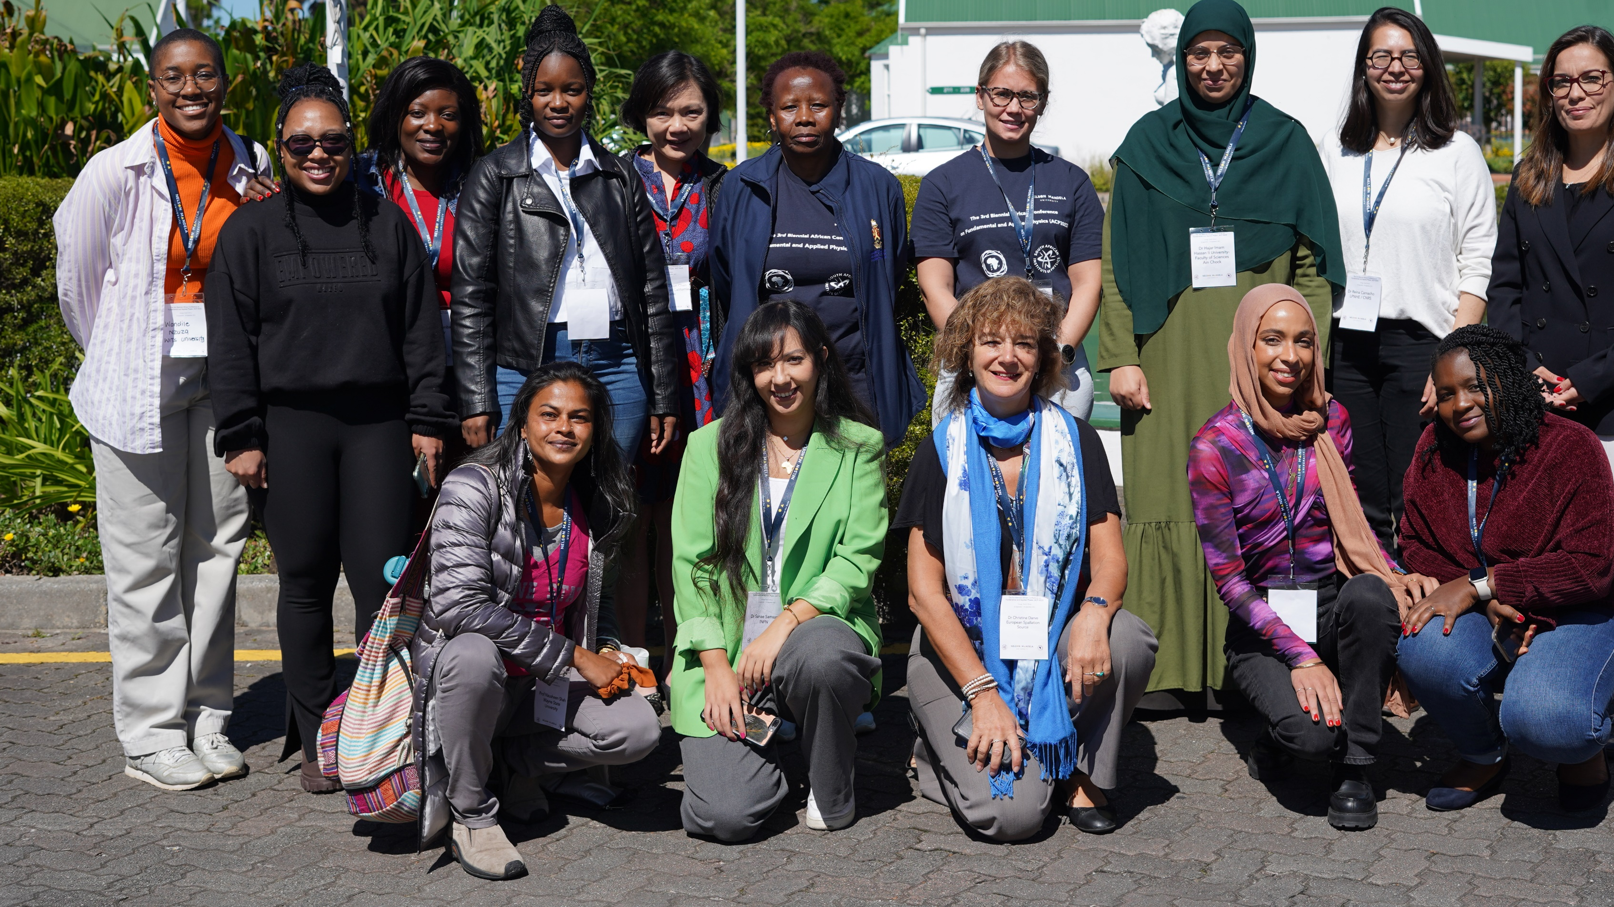
Thank you
I believe that the future of physics in Africa is bright, and it's our collective responsibility to ensure that this light continues to shine. Let us seize this shcool as an opportunity not only to exchange groundbreaking ideas but also to nurture the seeds of curiosity and ambition in the hearts of our young scientists, with a special focus on encouraging women to pursue careers in physics.

