Slide 1
EESD Thermal design
Preliminary numbers

Slide 2
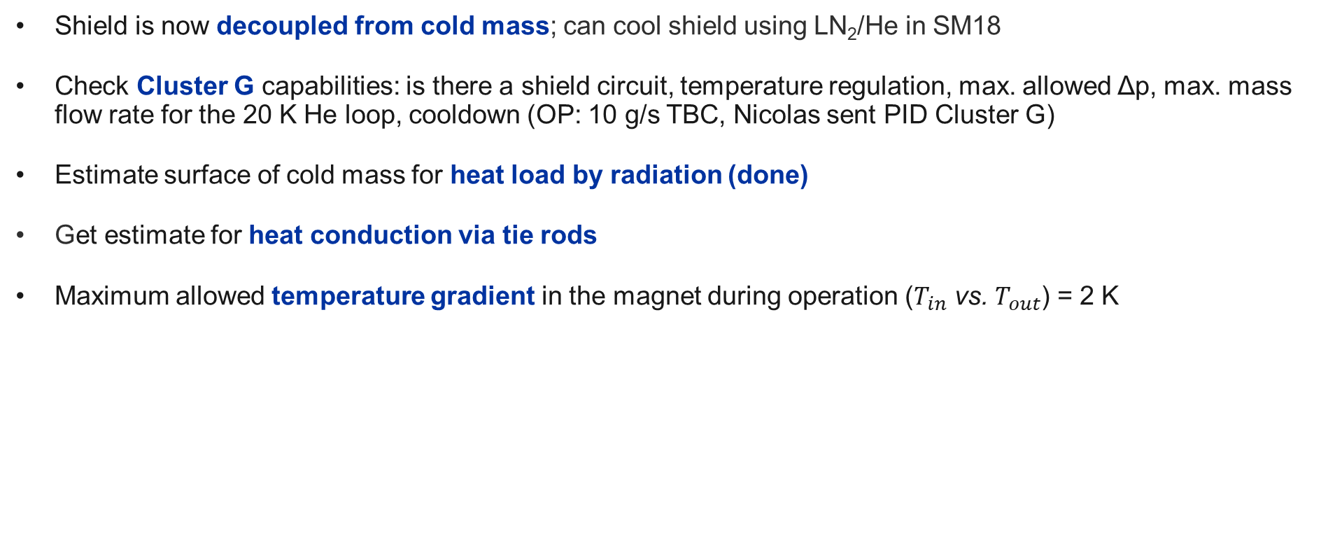
Open points
Shield is now decoupled from cold mass; can cool shield using LN₂/He in SM18
Check Cluster G capabilities: is there a shield circuit, temperature regulation, max. allowed Δp, max. mass flow rate for the 20 K He loop, cooldown (OP: 10 g/s TBC, Nicolas sent PID Cluster G)
Estimate surface of cold mass for heat load by radiation (done)
Get estimate for heat conduction via tie rods
Maximum allowed temperature gradient in the magnet during operation ($T_{in}$ vs. $T_{out}$) = 2 K

Slide 3
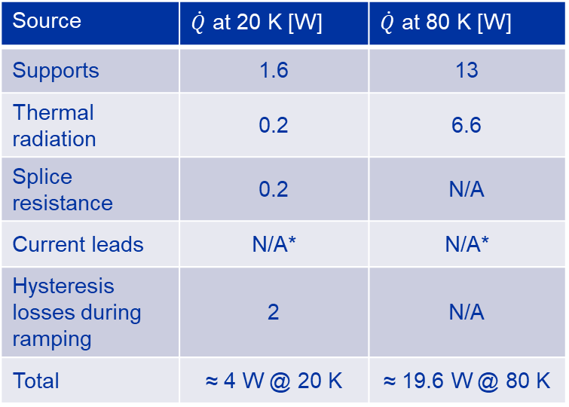
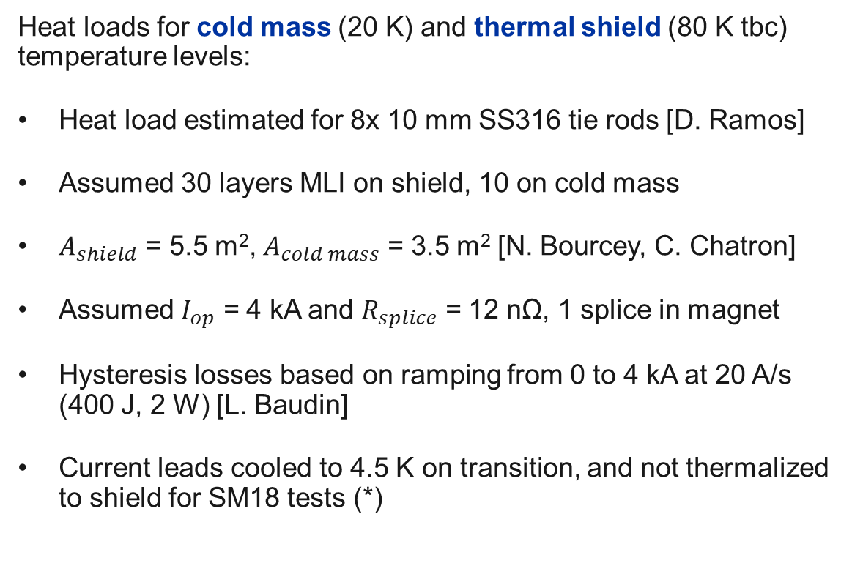
Heat load estimation
Source | $\dot{Q}$ at 20 K [W] | $\dot{Q}$ at 80 K [W]
Supports | 1.6 | 13
Thermal radiation | 0.2 | 6.6
Splice resistance | 0.2 | N/A
Current leads | N/A* | N/A*
Hysteresis losses during ramping | 2 | N/A
Total | ≈ 4 W @ 20 K | ≈ 19.6 W @ 80 K
Heat loads for cold mass (20 K) and thermal shield (80 K tbc) temperature levels:
Heat load estimated for 8x 10 mm SS316 tie rods [D. Ramos]
Assumed 30 layers MLI on shield, 10 on cold mass
$A_{shield}$ = 5.5 m², $A_{cold mass}$ = 3.5 m² [N. Bourcey, C. Chatron]
Assumed $I_{op}$ = 4 kA and $R_{splice}$ = 12 nΩ, 1 splice in magnet
Hysteresis losses based on ramping from 0 to 4 kA at 20 A/s (400 J, 2 W) [L. Baudin]
Current leads cooled to 4.5 K on transition, and not thermalized to shield for SM18 tests (*)

Slide 4
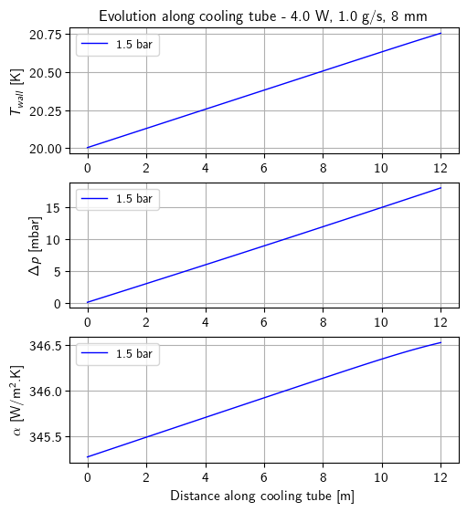
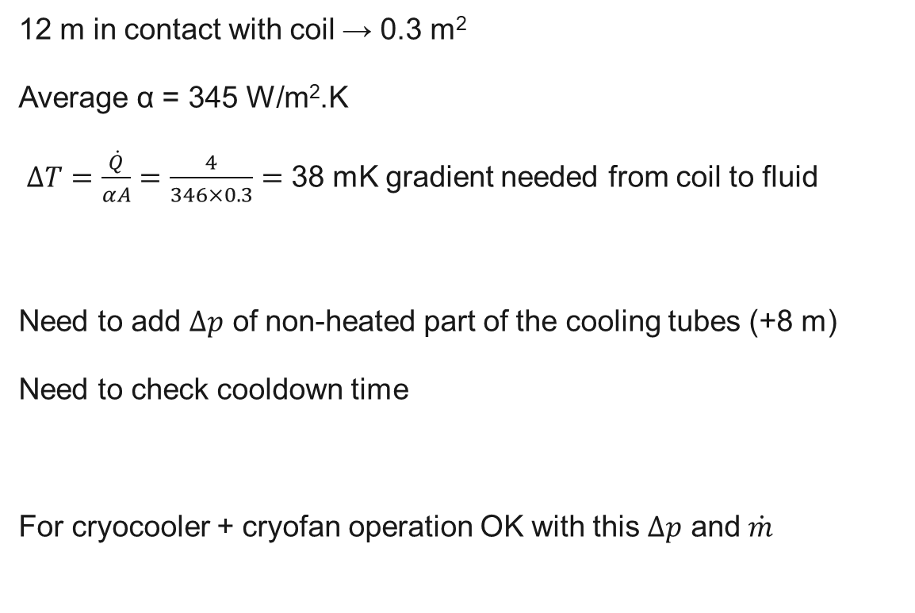
Preliminary numbers – cold mass
12 m in contact with coil → 0.3 m²
Average α = 345 W/m².K
$∆T=\frac{\dot{Q}}{αA}=\frac{4}{346×0.3}=$ 38 mK gradient needed from coil to fluid
Need to add $∆p$ of non-heated part of the cooling tubes (+8 m)
Need to check cooldown time
For cryocooler + cryofan operation OK with this $∆p$ and $\dot{m}$

Slide 5
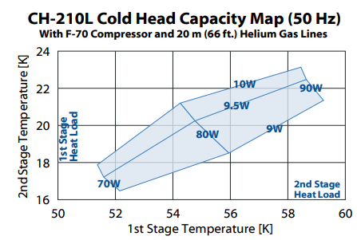
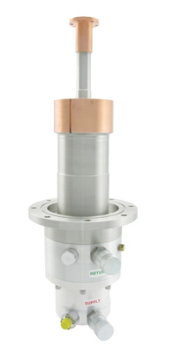
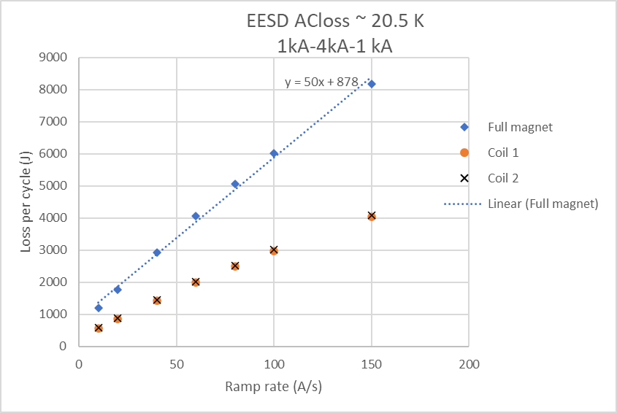
(very) Preliminary numbers
Sizing for operation with cryocooler 210L from Sumitomo:
Cooling power ≈ 10 W at 20 K
At 20 A/s it takes 4000/20 = 200 s to ramp up to 4 kA, loss per ramp up is 1.8 kJ / 2 = 900 kJ of which 40% = 400 J is the coil+former → 2 W
Sizing to maximize testing capability (extended ramp rate range):
Need input from Cluster G, also from test plan.
10 g/s tbc at 20 K
Source: SHI Cryogenics Group
Source: G. Willering, EESD Meeting 12-04-2024

