Slide 1
Introduction to CERN’s
Beam Gas Ionisation (BGI) Profile Monitor
Visit to CNAO, 14th May 2024
James Storey, Clara Fleisig (CERN SY-BI-XEI)
Experimental Areas, Electron Beams & Ionisation Profile Monitors (XEI) Section,
Beam Instrumentation (BI) Group,
Accelerator Systems (SY) Department, CERN.

Slide 2
Outline
[James]
Very brief introduction to Beam Instrumentation (BI) at CERN
Introduction to the Beam Gas Ionisation (BGI) beam monitor
[Clara]
3. Preliminary investigation of BGI for CNAO

Slide 3
CERN Accelerator Complex

Slide 4
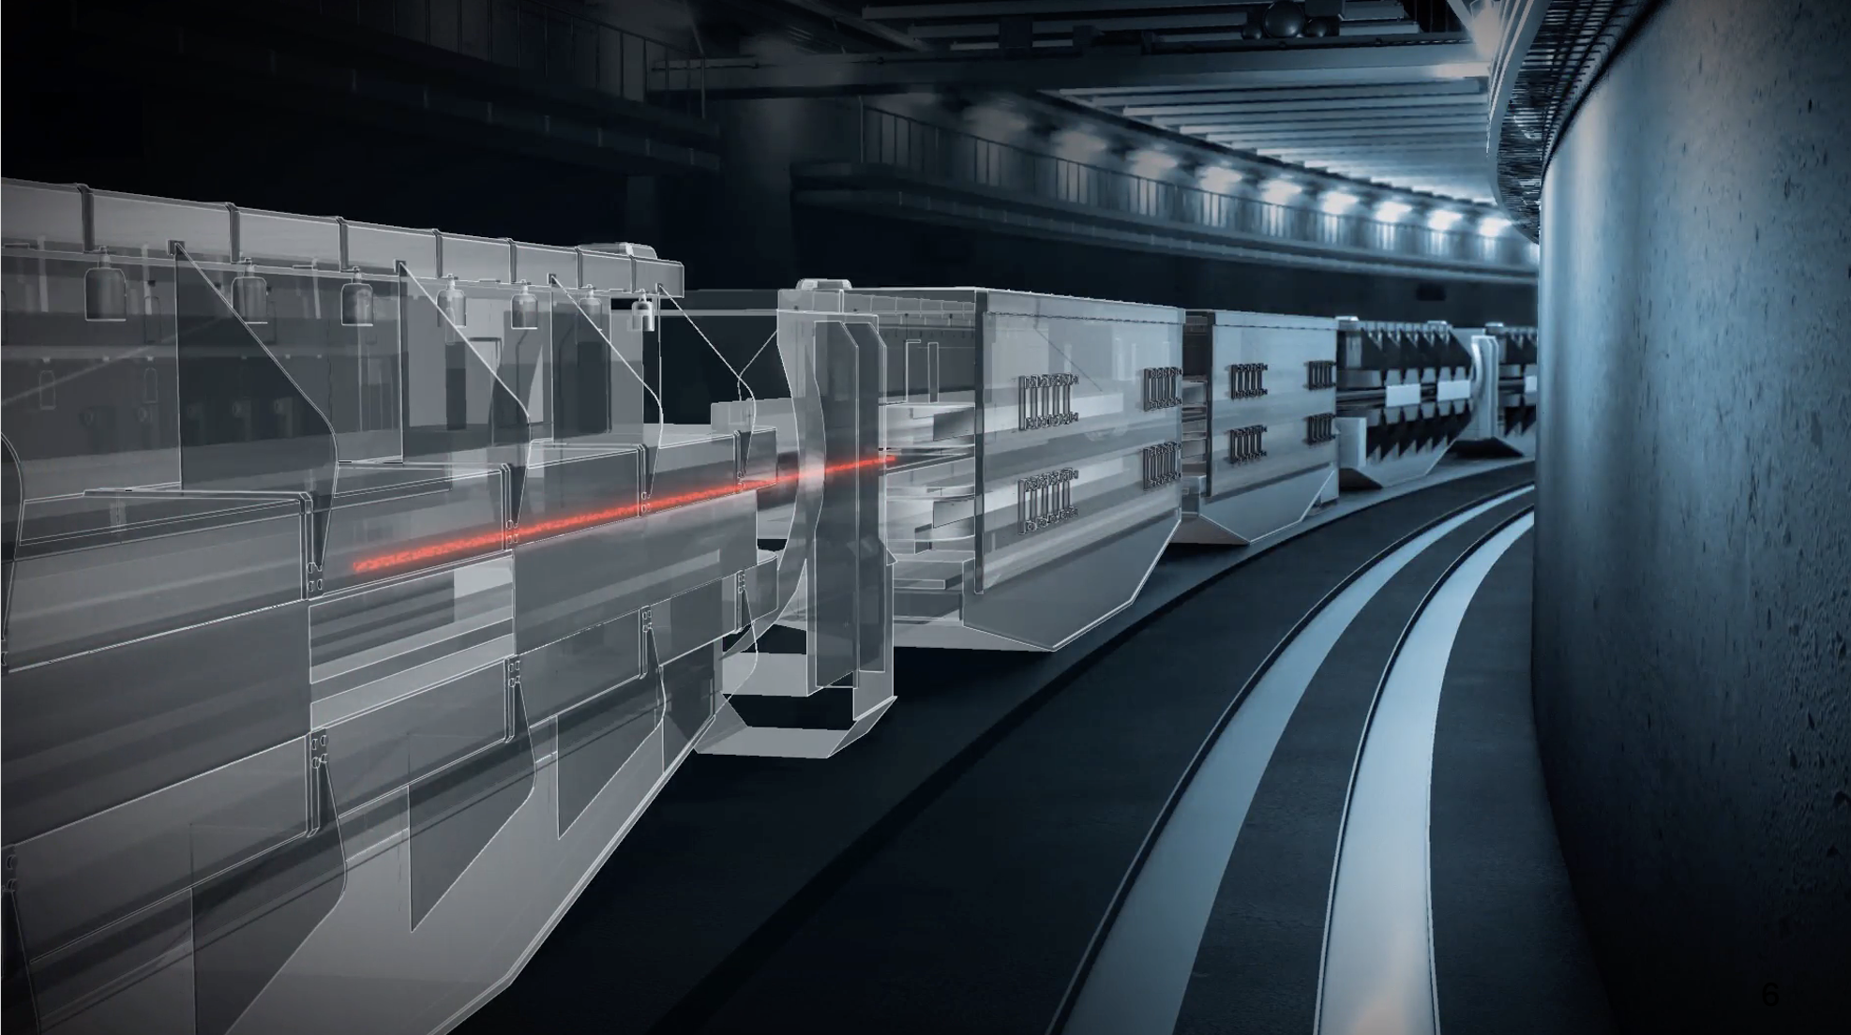
Beam Instrumentation (BI) at CERN
Instruments used to measure beam observables – the “eyes” of the accelerator.
Example beam observables:
Beam position;
Beam intensity & current;
Transverse & longitudinal beam size;
Emittance;
Luminosity;
Particle identification...

Slide 5
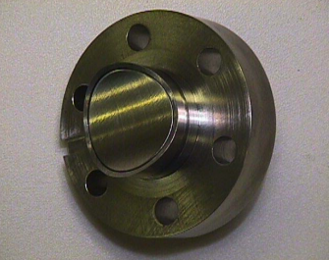
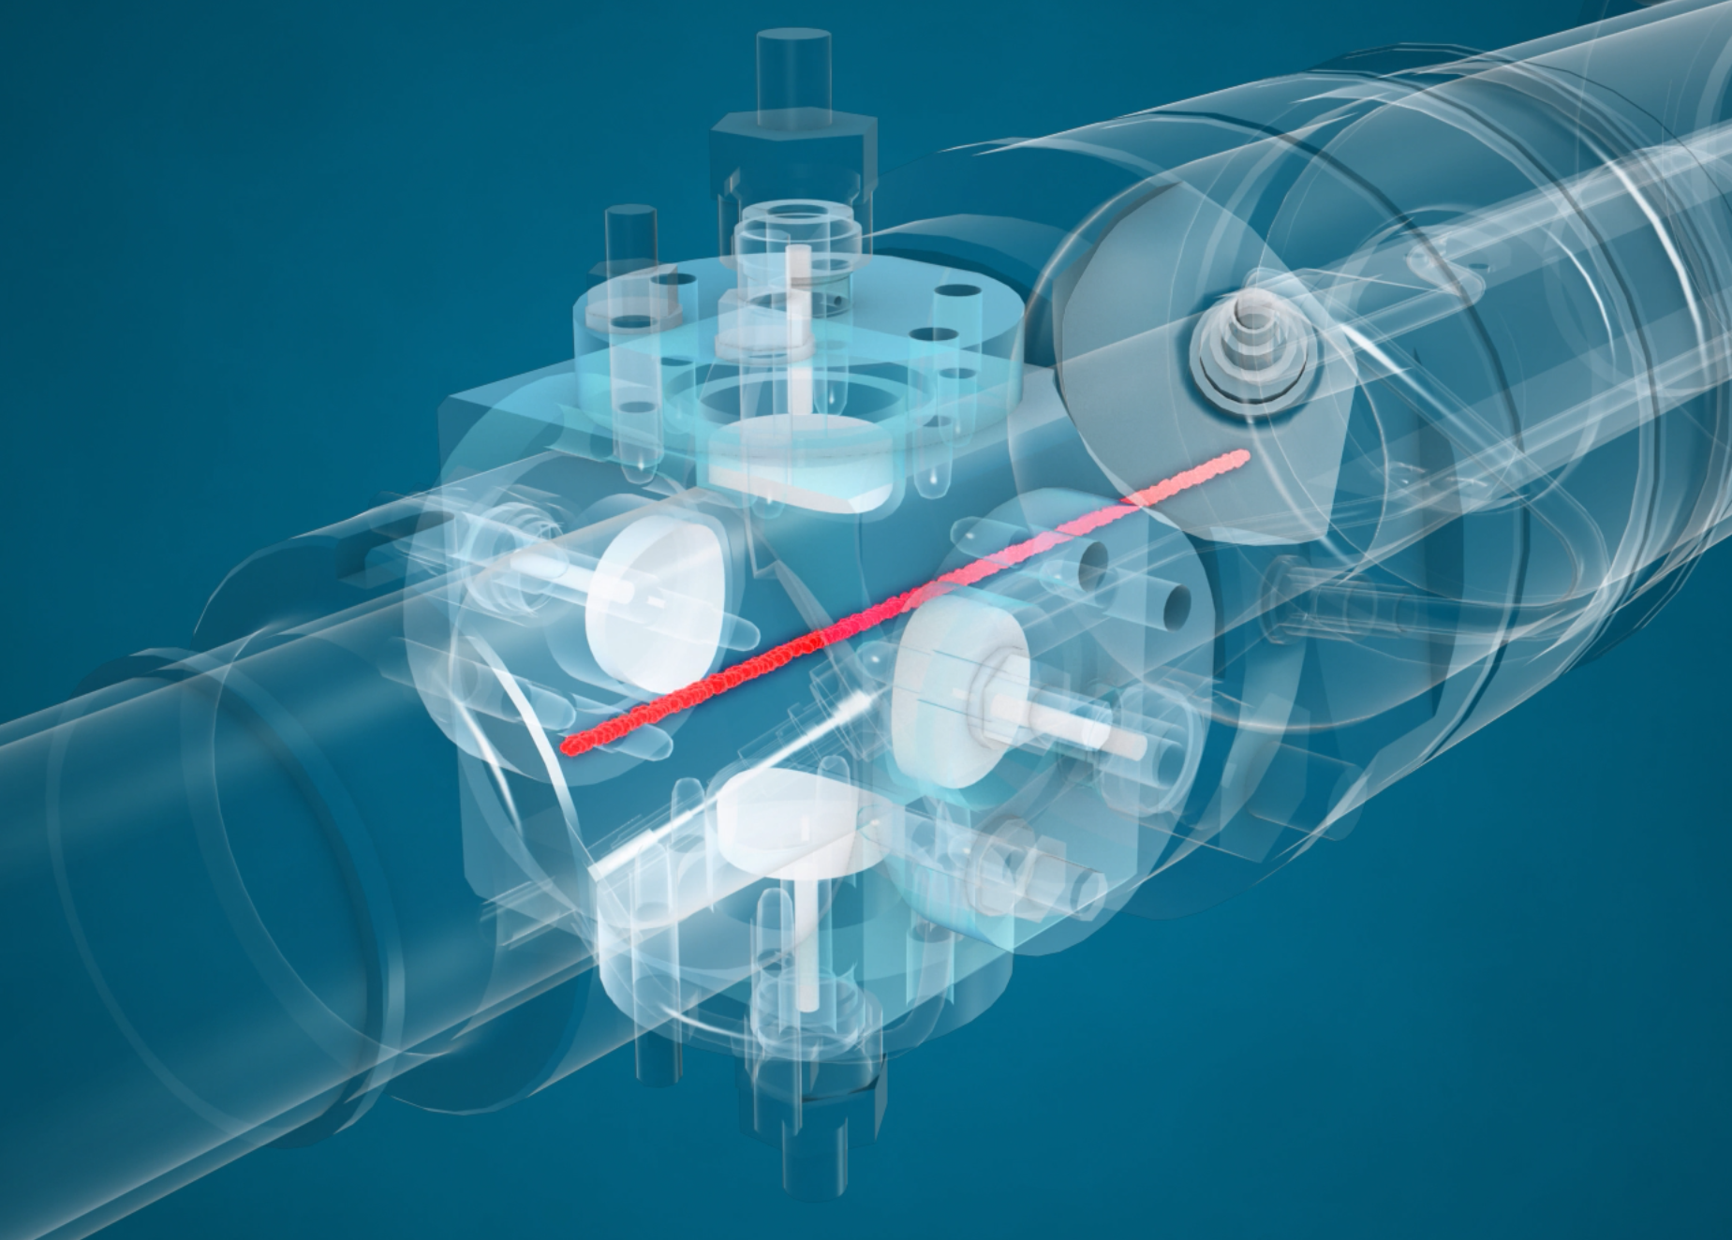
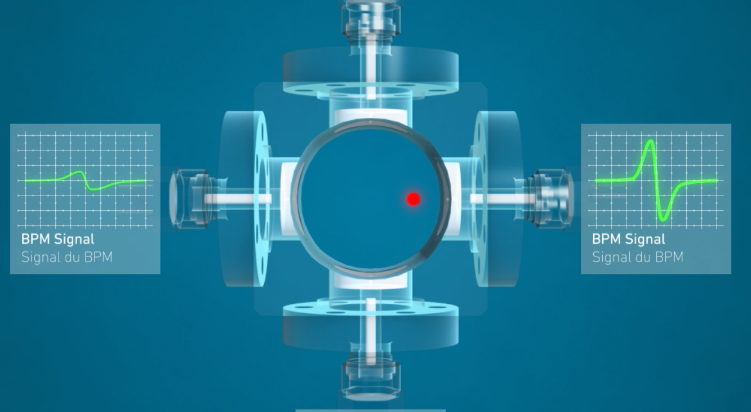
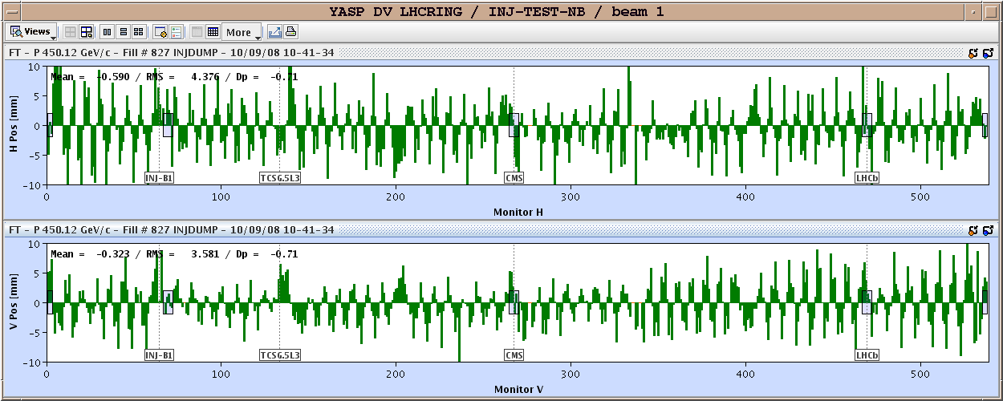
BI @ CERN in a nutshell
Ref. https://videos.cern.ch/record/2697274
How to measure the beam parameters?
Interact with the electromagnetic field of the beam
  Used for measurements of beam position, intensity & current
  + (Almost) no effect on the beam & no effect on the monitor
  - Can’t measure beam profile (size)
Example – Beam position monitor (BPM)
LHC electrostatic button electrode
Electrostatic pickup consists of metallic (button) electrodes situated on opposite sides
As beam passes electric charges induced on electrodes, with more induced on the side closer to the beam
Horizontal (top) and vertical (bot.) position vs. LHC BPM position

Slide 6
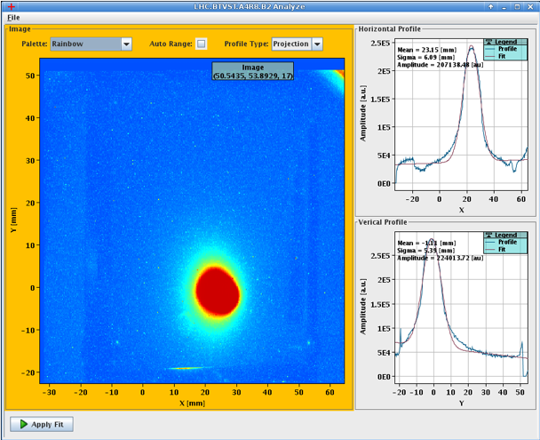
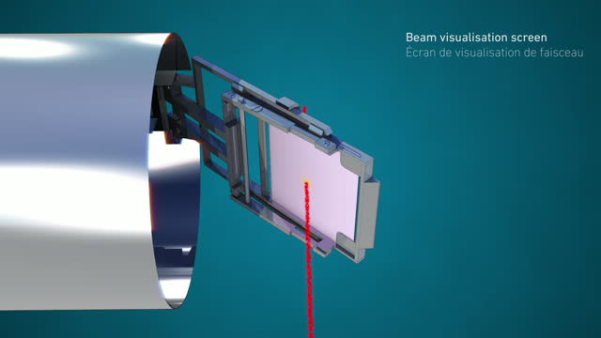
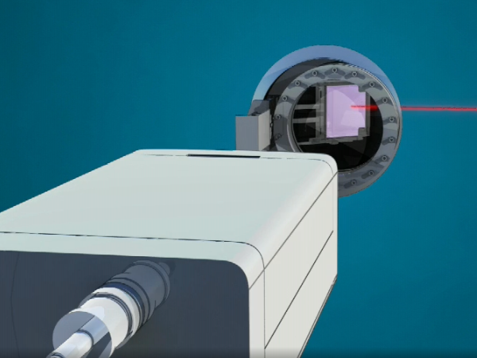
BI @ CERN in a nutshell
Ref. https://videos.cern.ch/record/1750709
How to measure the beam parameters?
Interact with the beam itself (insert material into the beam path)
  Used for measurements of beam profile (size) & loss
  + Allows to measure beam profile (size)
  - Destructive to the beam & damaging to the instrument
Example – Beam observation TV (BTV)
Beam interacts with phosphor screen inserted into beam path
Emitted light passed though viewport & detected by camera
Direct measurement of beam profiles in the transverse (x,y) planes

Slide 7
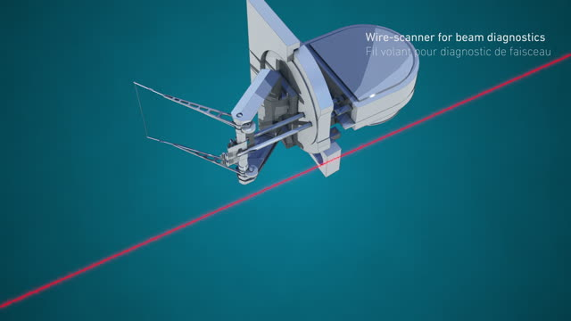
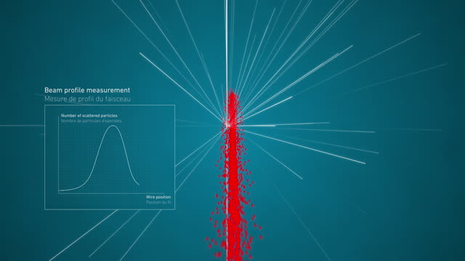
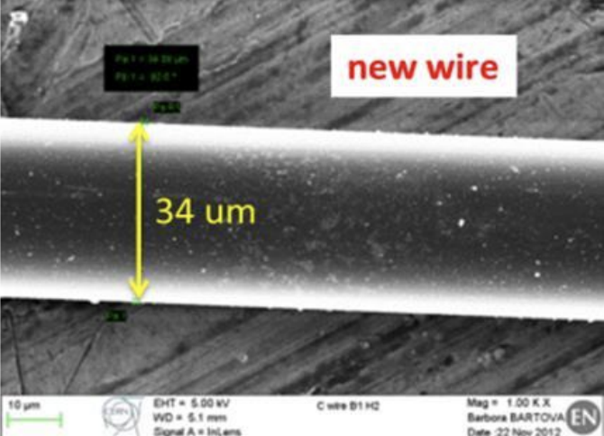
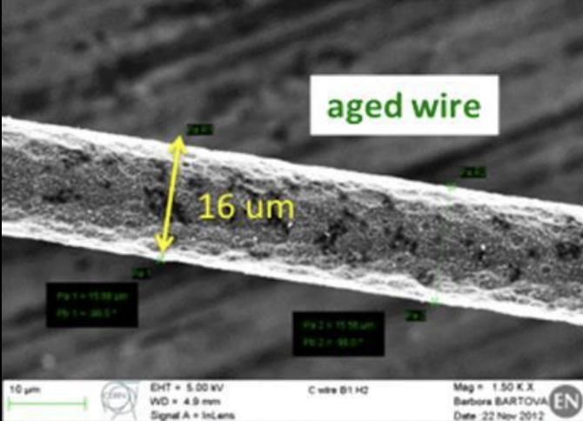
BI @ CERN in a nutshell
Ref. https://videos.cern.ch/record/1750709
How to measure the beam parameters?
Interact with the beam itself (insert material into the beam path)
  Used for measurements of beam profile (size) & loss
  + Allows to measure beam profile (size)
  - Destructive to the beam & damaging to the instrument
Example – Beam Wire Scanner (BWS)
Thin carbon wire (34μm) passes through the beam at up to 20m/s
Correlate wire position with secondary shower
Damage to the wire

Slide 8
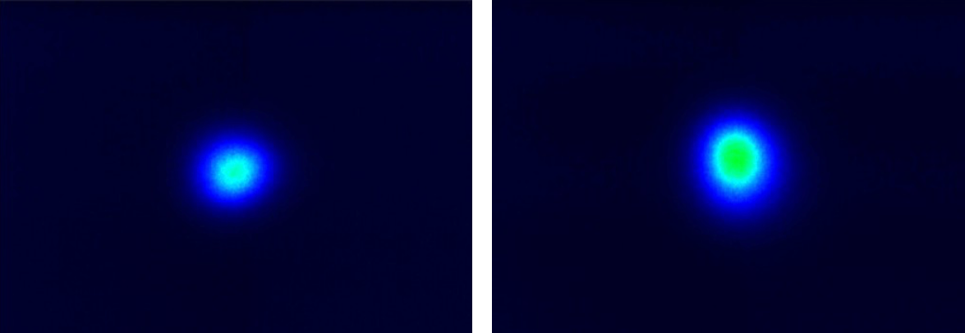
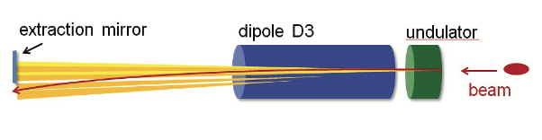
BI @ CERN in a nutshell
How to measure the beam parameters?
Use the synchrotron light emitted by the beam
  E.g. Transverse & longitudinal beam profile monitors
  + Completely non-destructive & continuous measurement
  - For proton accelerators can only be applied for energies above 100 GeV
  - Spatial resolution limited by diffraction & depth of field effects
Example – LHC synchrotron light monitor (BSRT)
Beam traverses superconducting undulator and dipole magnets – extract & detect visible range light produced by the undulator (450 GeV to 1.5 TeV) and dipole (>1.5 TeV)
LHC Beam 1 (left) and Beam 2 (right)

Slide 9
Wishlist for an ideal beam profile monitor
Beam doesn’t damage the instrument & the instrument doesn’t perturb the beam
Continuous measurement throughout the acceleration cycle;
  Ideally every revolution of the accelerator, e.g. PS = 2.3 μs per turn.
Independent measurement with high accuracy & precision;
  Beam size = 270 μm in the LHC at 6.5 TeV.
Bunch-by-Bunch (BbB) and Turn-by-Turn (TbT) measurements
  e.g. LHC beam made up of 2556 bunches separated by 25 ns.
( Very promising ) solution:
Rest gas ionisation beam profile monitor based on Timepix3 hybrid pixel detectors.

Slide 10
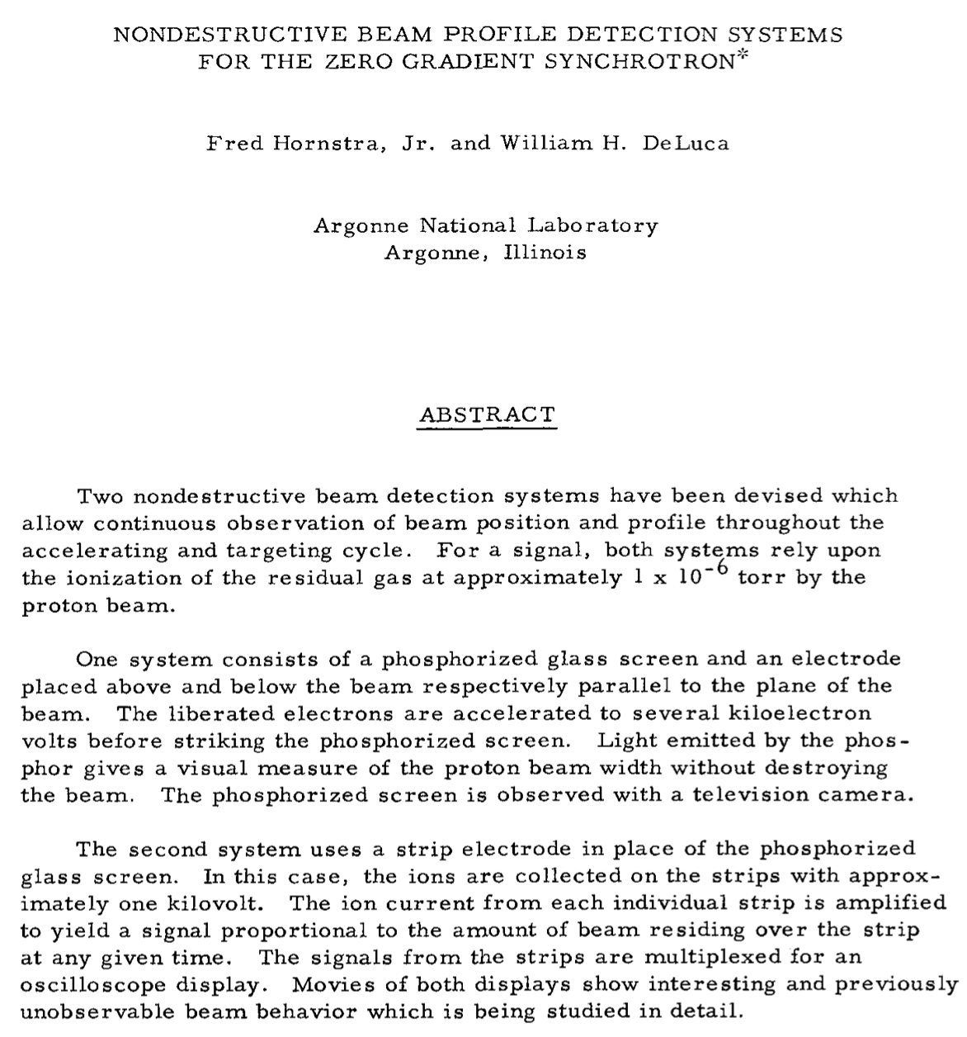
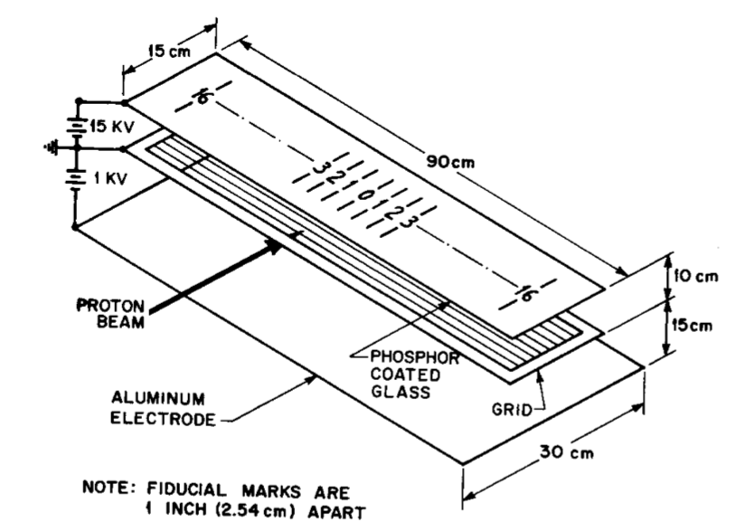
Rest gas ionisation beam profile monitor
Basic principle of operation:
Beam ionizes rest gas particles in the beam pipe vacuum
Transport ionization electrons with E-field and B-field
Image ionization electrons with a Timepix3 hybrid pixel detector
Original proposal for nondestructive beam profile monitor (1967)

Slide 11
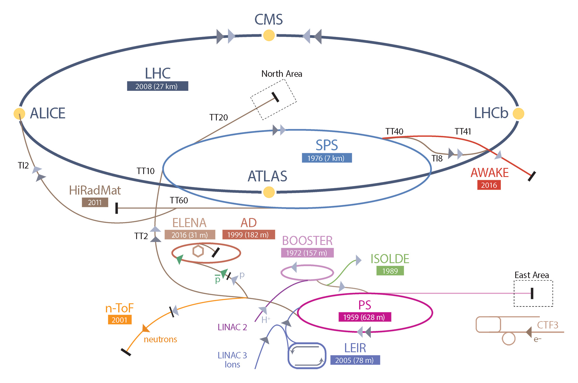
Beam Gas Ionisation (BGI) profile monitor for the CERN Proton Synchrotron (PS)
Requirements:
  Non-destructive;
  Continuous ( 1000 profiles / s );
  Bunch-by-Bunch & Turn-by-Turn;
  Measure beam size with 1% accuracy.
Typical use case e.g. LHC type beam (BCMS)
  Intensity = 13x10¹⁰ protons per bunch
  Number of bunches at extraction = 48
  Beam size = ~1mm
Development is part of the LHC Injector Upgrade (LIU) programme to deliver the high brightness beams required for the High Luminosity LHC.

Slide 12
Instrument operating constraints
Operate directly inside the ultra-high vacuum of the accelerator beam pipe
  Vacuum pressure = 10⁻⁹ – 10⁻¹⁰ mbar
  Degassing < 5x10⁻⁶ mbar l s⁻¹
  Criteria for the gas composition – concentration of:
    Gas species 18 – 44u < ( 1 / 100th ) of water (un-baked vacuum system)
    Gas species 44 – 100u < ( 1 / 1000th ) of water
Operate during the acceleration cycle
  EMI from the beam
  Beam impedance and beam induced heating
Operate in a radiation environment
  10 kGy/yr at beam pipe
  1 kGy/yr at 40cm

Slide 13
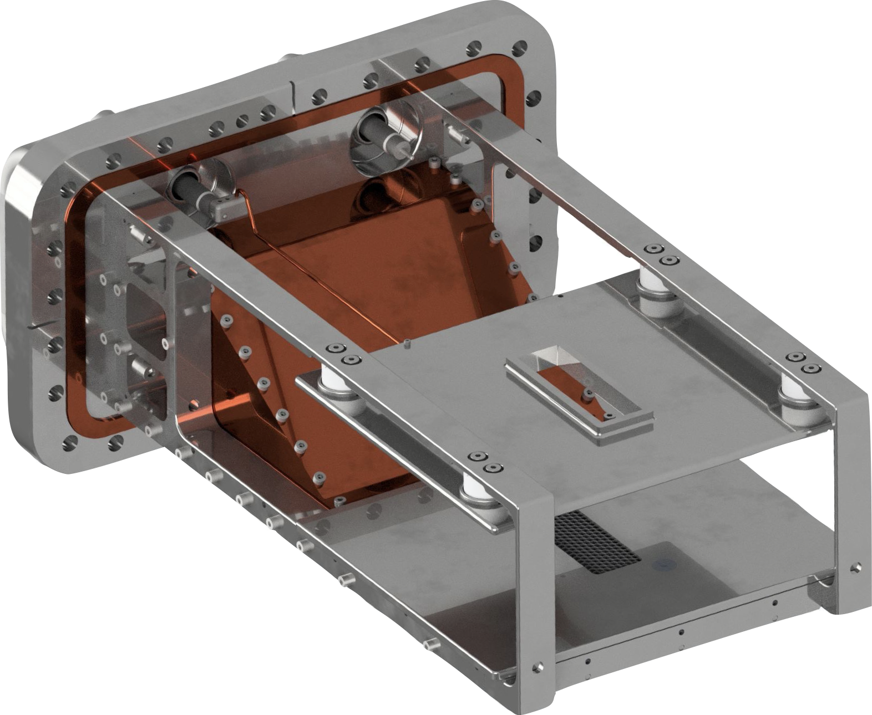

Instrument overview
Measures beam profile in horizontal plane ( x, s ) – second instrument design for vertical plane measurement
vacuum flange
ion trap
cathode (-20kV)
Faraday cage for electronics
E-field (200kV/m)
B-field (0.2T)

Slide 14
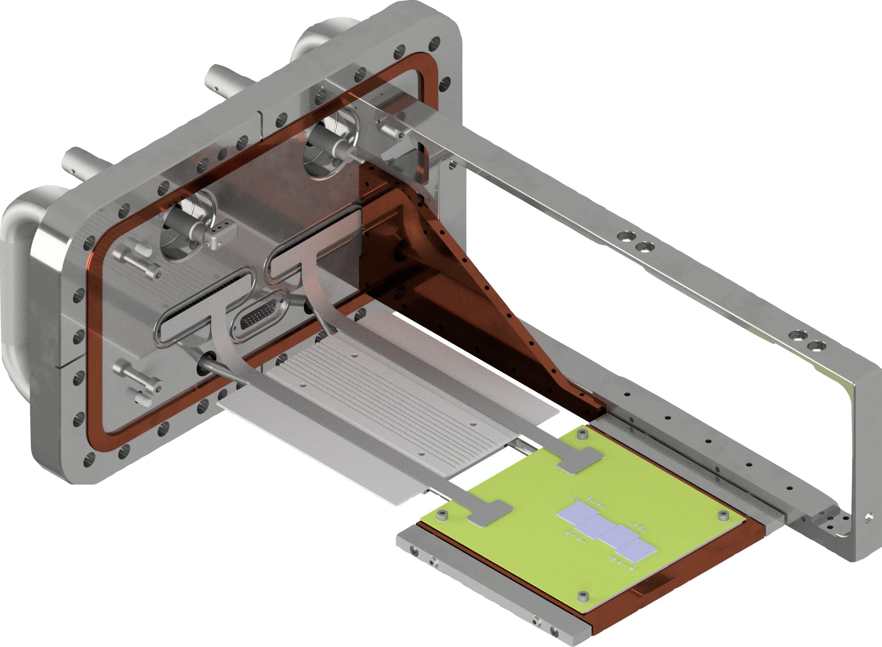
Instrument overview
Power, control & data cables
Ionisation electron detector

Slide 15

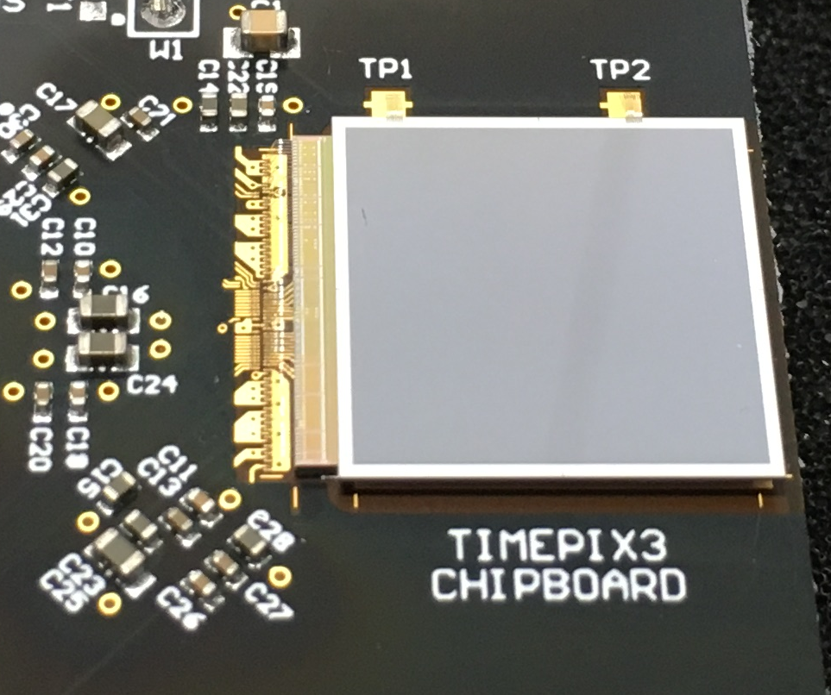






Hybrid pixel detector
Hybrid Pixel Detector (HPD): Pixelated sensor bump bonded to a pixelated readout chip.
Sensor: 2-dimensional array of PN-diodes processed (for example) in high-resistivity silicon.
Readout chip: array of readout channels designed in CMOS technology.
sensor bias voltage
+
Aluminium
-
N+
sensor
N-bulk
Depletion
region
P+
P+
solder
bump
solder
bump
readout
chip
Amp.
Amp.
Disc.
Digital
Timepix3
THR
THR
charged particle

Slide 16
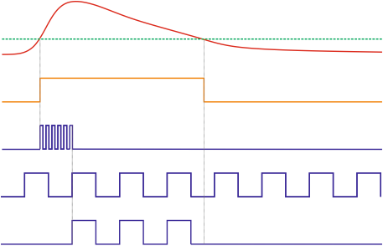
Timepix3 response to charge
Amplifier out
Threshold (THR)
minimum threshold = 500 e⁻ (1.8 keV)
Discriminator
640 MHz clock
time resolution = 1.5625 ns
40 MHz clock
Time-Over-Threshold
(ToT) clock
Amplifier out > threshold
→ Event
Each event consist of:
Pixel position → Where
Time of Arrival (ToA) → When
Time-Over-Threshold (ToT) → Energy
Max.
80M events / s

Slide 17
Ionisation electron detector based on Timepix3 HPD
Cathode = -20kV
Ionisation electron detector requirements
Detect 10keV electrons (penetration depth in silicon = 1.5μm)
Detect each electron with time resolution < 25ns & spatial resolution < 100μm
Meet outgassing requirements for installation in the UHV of the PS beam pipe
Operate during the acceleration cycle
proton beam
E-drift field
Sensor
Non-metalized, p-in-n, 100m deep
256 x 256 array of PN-diodes
Pixel size = 55um x 55um
Sensor area = 14mm x 14mm
N+
Depletion
region
100μm
10keV
N-bulk
P+
P+
solder
bump
solder
bump
Timepix3 readout chip
Each sensor pixel is connected to an individual readout channel (pixel)
Amp.
Disc.
Amp.
Digital
Timepix3
THR
THR

Slide 18
Transport of ionisation electron
Field cage transports ionisation electron from the point of creation to the detection plane, while preserving the initial transverse position of the electron:
Complication 1 –
Bunch space charge
Complication 2 –
Secondary electrons
Ideal

Slide 19
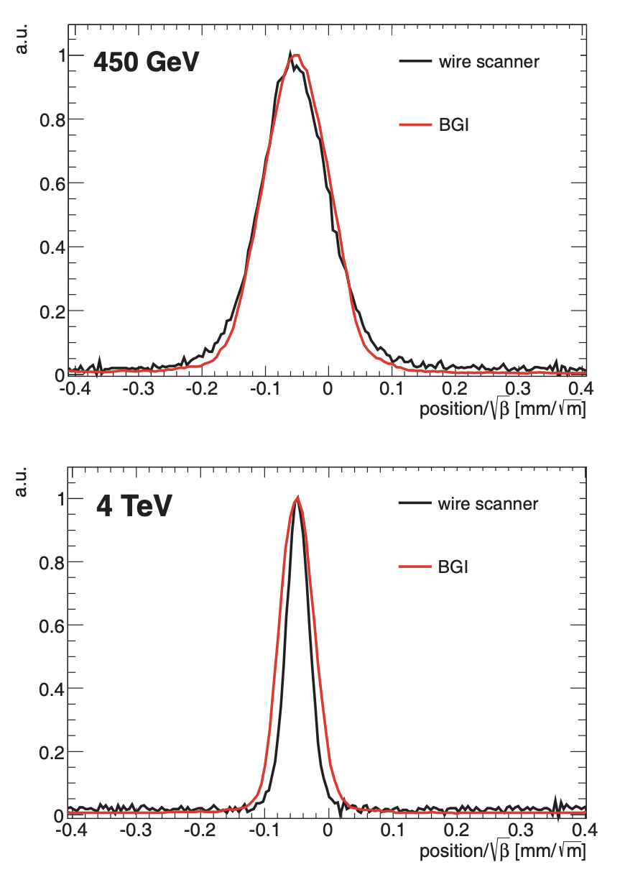
Beam profile distortion due to bunch space charge
Ref. https://accelconf.web.cern.ch/IBIC2012/papers/tupb61.pdf
Solution = B-field parallel to the drift E-field
Strength of LHC BGI B-field (0.2T) insufficient for E > 4 TeV
Simulation tool to aid instrument design
Common interest among several accelerator labs (GSI, J-PARC, CERN, ESS, FNAL) to develop a common IPM simulation tool
Virtual-IPM (D.Vilsmeirer GSI):
Ionisation process
Electron / ion tracking in the EM-fields due to:
  Field cage
  Dipole magnet
  Bunch space charge
ipmsim.gitlab.io/Virtual-IPM
Ref. Sapinski et al., IBIC2012, TUPB61

Slide 20
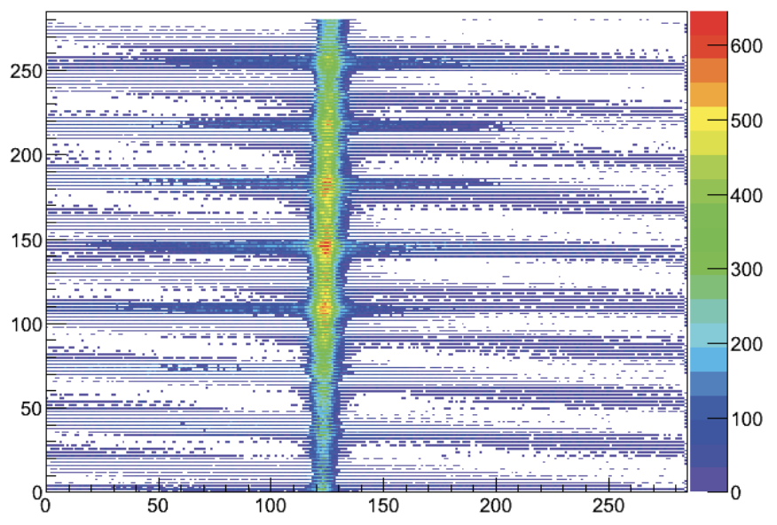

Suppression of secondary electrons
Ref. https://accelconf.web.cern.ch/ipac2018/papers/wepal019.pdf
1. Wire grid – LHC BGI (2007)
2. Ion trap – PS BGI
Secondary electrons repelled by wire grid, but secondary electrons generated by ions bombarding the wires
Ions directed through an opening on the cathode – no path for secondary electrons back to the detector (”ion trap”)

Slide 21
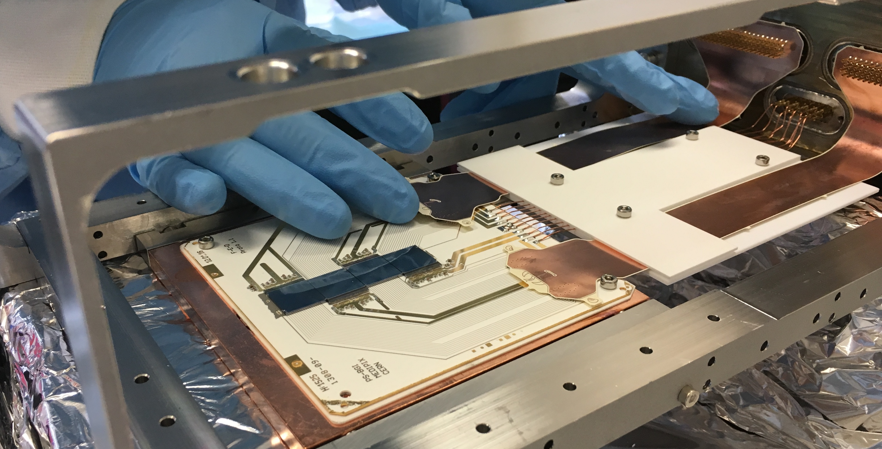
Ionisation electron detector – Prototype
Ref. Swann Levasseur CERN-THESIS-2019-354
Ceramic carrier board
2 metal layers, Al₂O₃ substrate
4 x Timepix3 HPD’s attached with Staystick 672 and wire bonded
Sensor bias wire glued (Mk.1) / wire bonded to Al pad (Mk.2)
Flexible cables
Connects ceramic board to electrical feedthroughs on vacuum flange
Two metals layers with a Liquid Crystal Polymer (LCP) substrate
Qualified for installation in the PS accelerator beam pipe

Slide 22
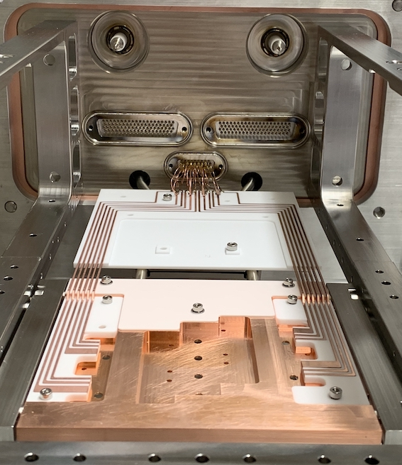
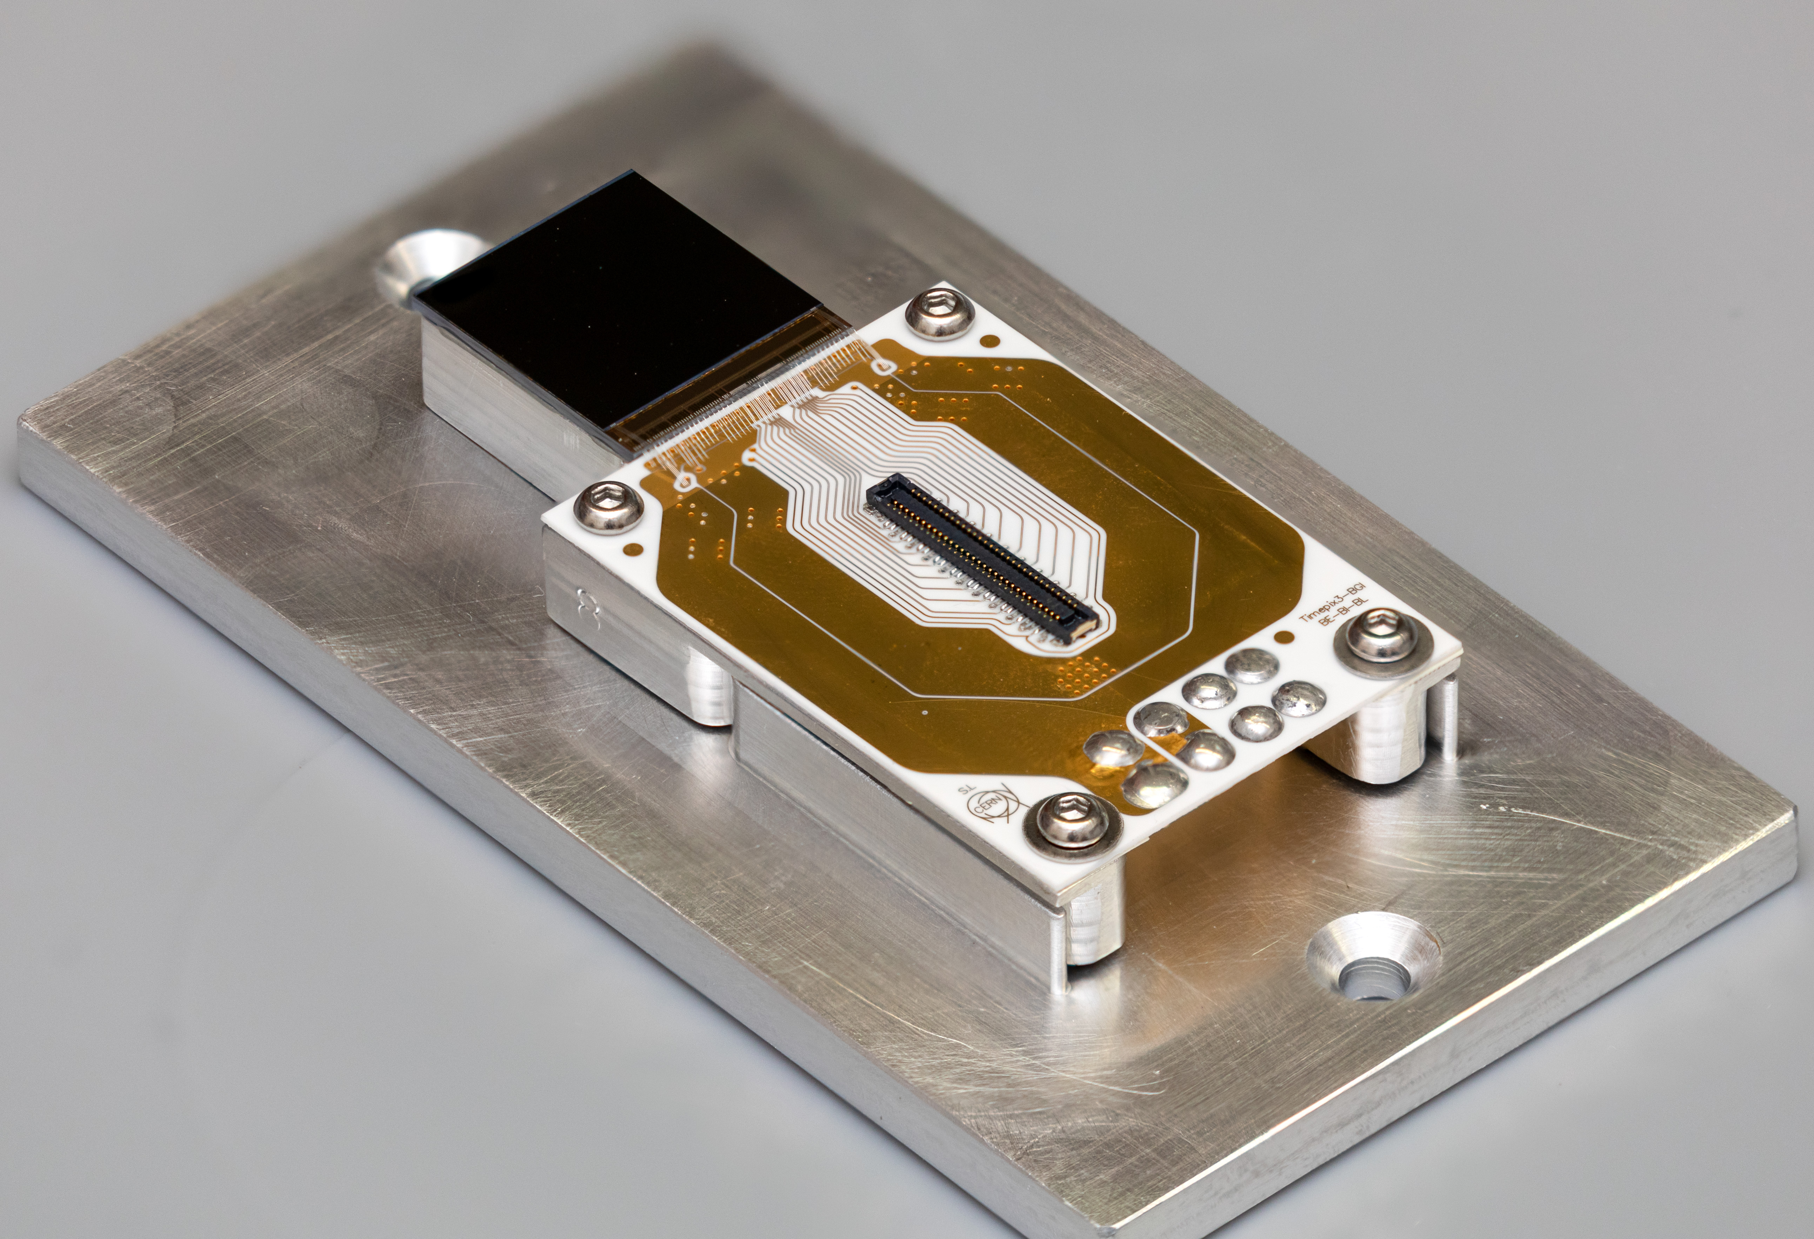
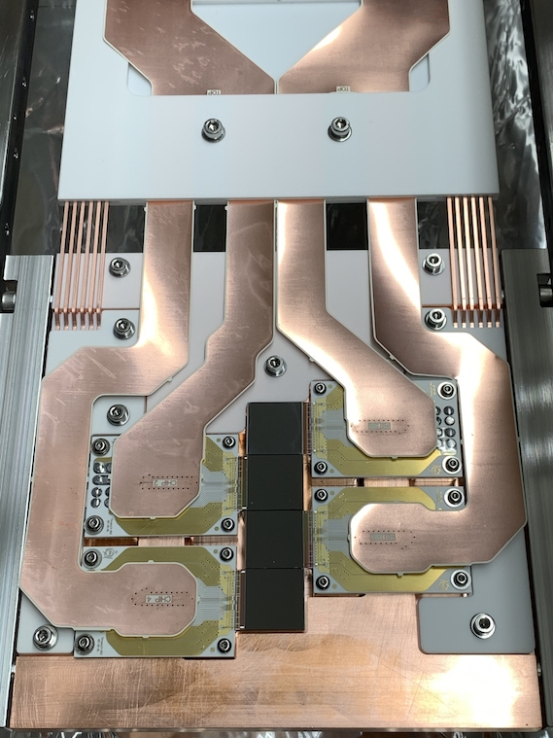
BGI based on Timepix3 UHV modules
Timepix3 UHV modules:
Timepix3 attached to aluminum base with Staystick (672)
Ceramic thin-film PCB to fan out TPX3 control & data signals to Panasonic narrow pitch connectors (A4S)
Connect to DC power (mini-Cu bus bars) via pogo-pins
Timepix3 DC power:
FEAST DC/DC on air side of vacuum flange ( can’t place in UHV )
Network of mini-Cu bus bars, embedded in ceramic, to minimise voltage drop
Final assembly

Slide 23
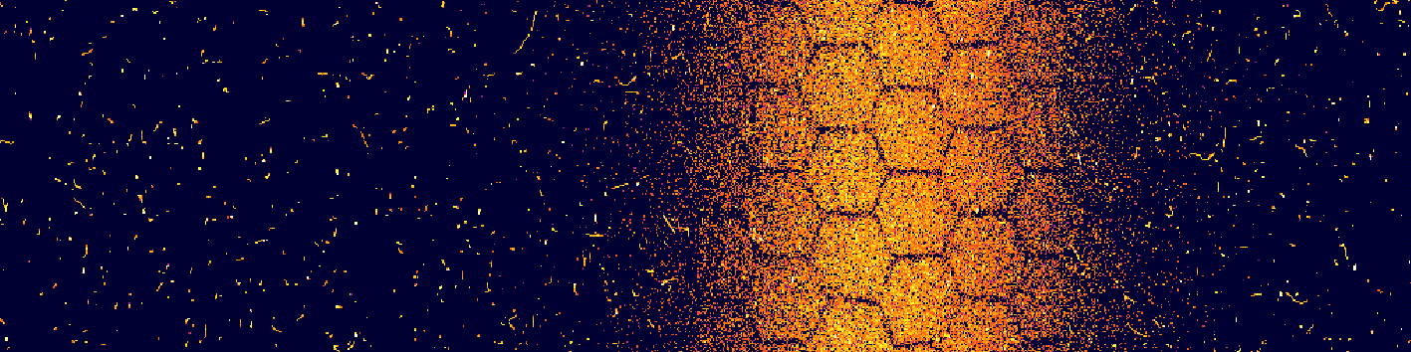
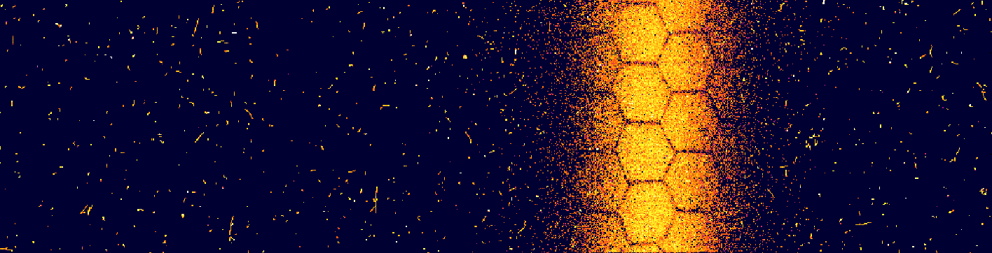
Example beam images
Beam direction
Example 1
TPX3 HPD #1
TPX3 HPD #2
TPX3 HPD #3
TPX3 HPD #4
Example 2

Slide 24
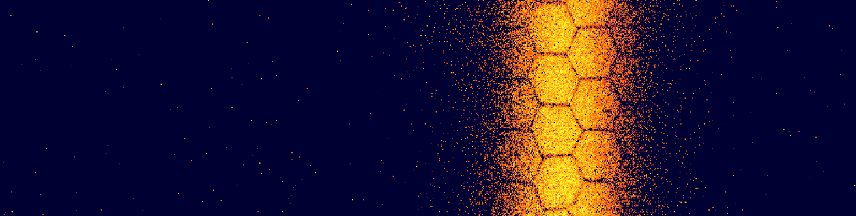
Selecting ionisation electrons
Ref. CERN-THESIS-2019-354 & CERN-THESIS-2020-236
Signal – ionisation electrons:
Mostly single pixel events
Energy < 10keV
Background – shower of secondary particles due to beam loss:
Multi-pixel events
Energy > 26keV
Signal selection:
Cluster finding to identify particle events
Size & energy criteria to select ionisation electrons
Before filtering
After filtering

Slide 25

Preparation of LHC beam in the PS
Timepix3 data-driven readout enables "live" display of the beam throughout the cycle
1.5 seconds in real time: slowed down here for viewing purpose
Each frame is 10 ms of data
Not filtered: background particles are interesting to look at!
LHC type beam, single bunch ( I = 20x10¹⁰ p )

Slide 26
Beam profile measurement
Compute beam profile by summing counts in each column

Slide 27
Single bunch measurements
Single bunch in the PS at the start of beam commissioning
Beam size evolution
Continuous & non-destructive measurement of of beam size and position throughout the PS cycle (1.2s)
Beam position evolution

Slide 28
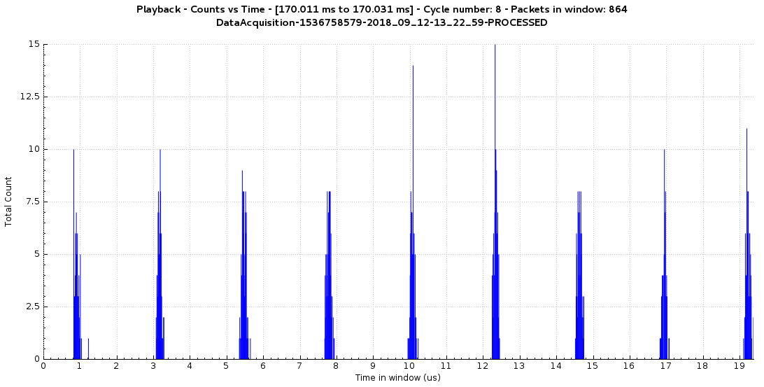
Time structure of ionisation electrons
Time for 1 revolution (turn) of the PS = 2.3 μs.
Ionisation counts from a single bunch circulating in the PS
2.3μs
180ns
Turn 1
Turn 2
Turn 3
Turn 4
Turn 5
Turn 6
Turn 7
Turn 8
Turn 9
→ Longitudinal bunch length consistent with Wall Current Monitor (WCM).

Slide 29
Beam position vs. turn number after injection

Slide 30
Beam position vs. turn number after injection
doi:10.18429/JACoW-IBIC2019-TUBO04
Measure 0.217 ± 0.001 oscillations/turn → Consistent with PS fractional tune!

Slide 31
Beam size vs. turn number after injection
doi:10.18429/JACoW-IBIC2019-TUBO04
Beating of the beam size due to injection mismatch into the PS
→ causes irreversible beam size growth, which ultimately limits the LHC luminosity.

Slide 32
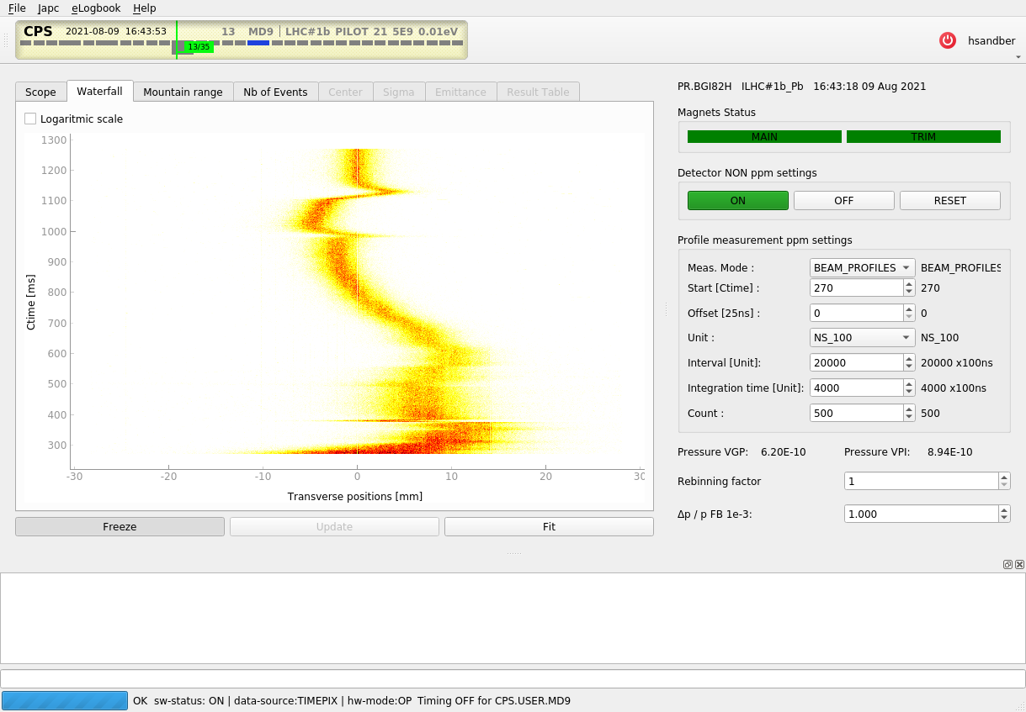
Examples of operational measurements
Following example measurements taken by PS operators & physicists in the CCC (*)
Pb⁵⁴⁺ beam
Operator defines the time to ”Start” the measurement in the cycle and the “Integration time” for each beam profile measurement, in units of seconds or turn revolutions
Up to 1024 profiles can be published per PS cycle (typically 1.2s)
(*) Thanks to Marcel Coly, Matt Fraser & Alexander Huschauer

Slide 33
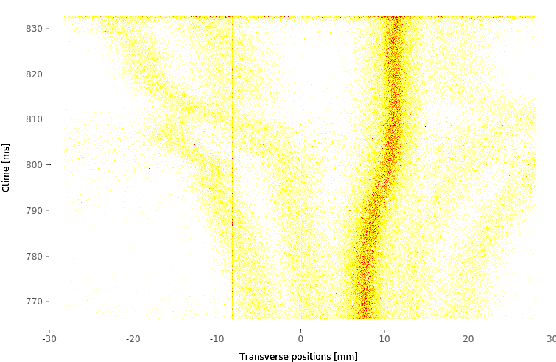
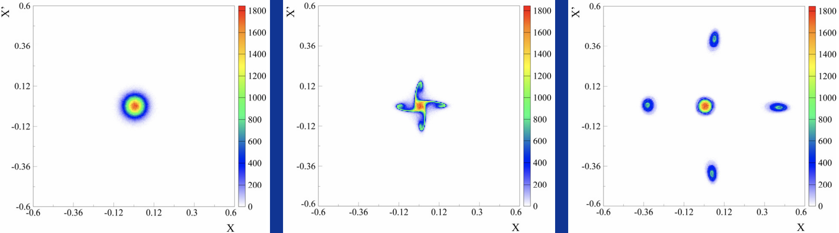
Example 1: Beamlets in Multi-Turn Extraction beam
Extraction method developed to minimise particle loss during extraction
Beam is split into several beamlets in the transverse phase space
Each beamlet is then extracted one by one
First time that is possible to see the time evolution of the beamlets

Slide 34
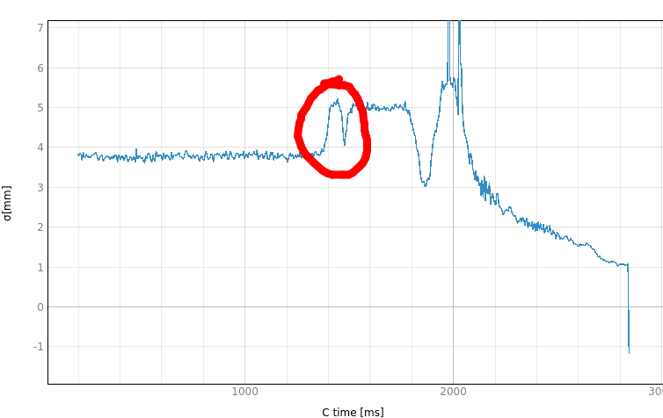
Example 2: Unexpected “bumps”
Horizontal beam size
Observe unexpected sudden change of the horizontal beam size at 1450ms
Explanation: sudden change of the beam’s longitudinal momentum spread, which couples to the horizontal plane through dispersion
New beam diagnostic insights.

Slide 35
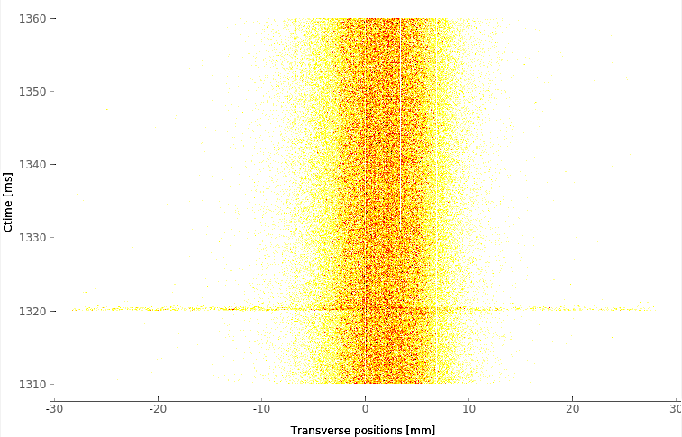
Example 3: Injection beam losses
Part of a cycle with a stable transverse beam size
“Glitch” visible at 1320ms in the cycle
Can distinguish between ionisation electrons and charged particle interaction using ToT data
“Glitch” is actually beam loss, which was subsequently traced to an injection kicker magnet that was active ( but no beam was injected )
Losses were not visible on other nearby beam loss monitors
Very sensitive beam loss monitor.

Slide 36
Backup

Slide 37
Ionisation electron signal
detector length
protons(ions)
per bunch
vacuum
pressure
How many ionisation electrons are needed?
1000 electrons → 2% precision (stat. error) on the beam size of a Gaussian distribution
Assume ~1000 electrons are needed for a meaningful beam profile
Residual gas insufficient for turn-by-turn measurements
ionisation electrons
ionisation cross section
ionisation electrons
- detected
electron detection efficiency
How to do turn-by-turn measurements?
Inject (very small) quantity of argon gas to locally bump pressure to 2x10⁻⁸ mbar
Argon ionisation cross section = ~5 x hydrogen (residual gas)
→ 1000 ionisation electrons per bunch per turn
Residual gas ionisation electron signal:
Vacuum pressure = 1x10⁻⁹ mbar
Intensity = 60x10¹⁰ protons / bunch
→ 10 ionisation electrons per bunch per turn

Slide 38
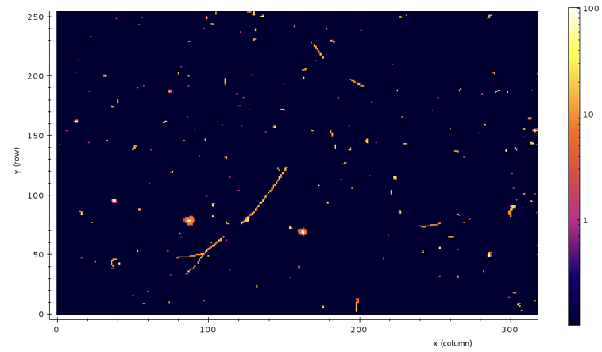
Operation of the Timepix3 inside the beam pipe during the acceleration cycle
Acquisition for 100 ms during acceleration cycle with high voltage off (no ionisation electrons)
Time-Over-Threshold
( ∝ √Energy )
Timepix3 successfully operated inside the beam pipe during the acceleration cycle.

Slide 39
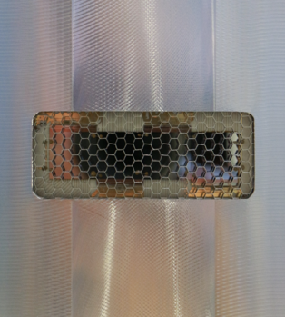
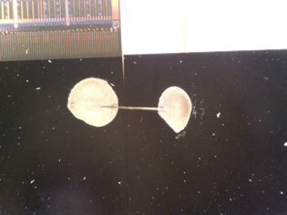
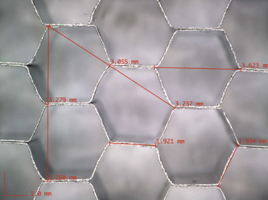
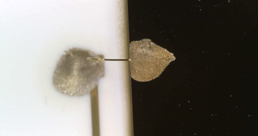
Detection of rest gas ionisation electrons
proton
beam
sensor-to-sensor bias wires
honeycomb structured RF shield
ceramic carrier-to-sensor bias wires

Slide 40
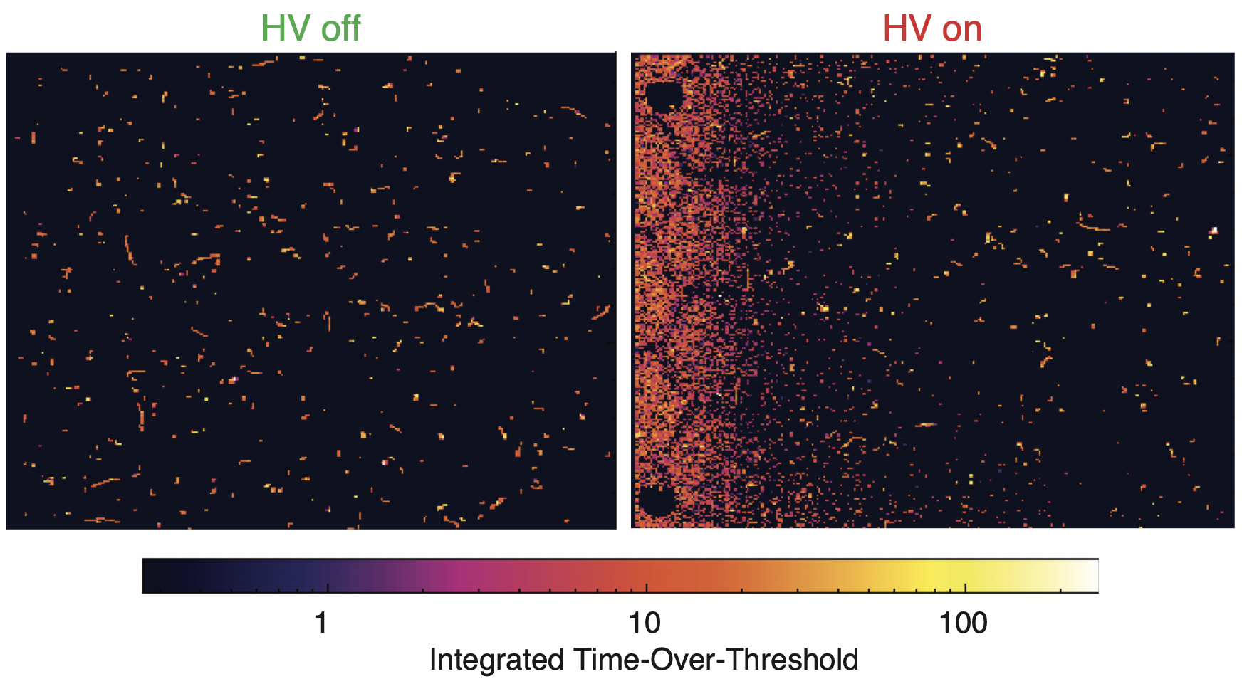
Detection of rest gas ionisation electrons
Ref. http://dx.doi.org/10.18429/JACoW-IBIC2017-WE2AB5

Slide 41
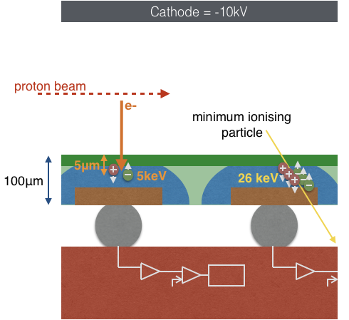

Detection of rest gas ionisation electrons
Ref. doi:10.18429/JACoW-IBIC2017-WE2AB5
10keV
Successful detection of rest-gas ionisation electrons!

Slide 42
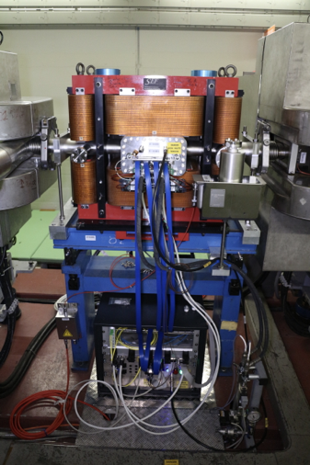
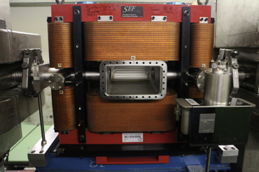
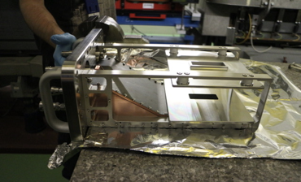
Installation in the CERN PS
0.2T self-compensating triplet dipole magnet (Dominique Bodart TE-MSC) & instrument vacuum chamber
Installation at PS SS82
Instrument prior to installation
Vacuum pump down:
1 x 10⁻⁸ mbar after 24 hours
2 x 10⁻¹⁰ mbar steady state

Slide 43
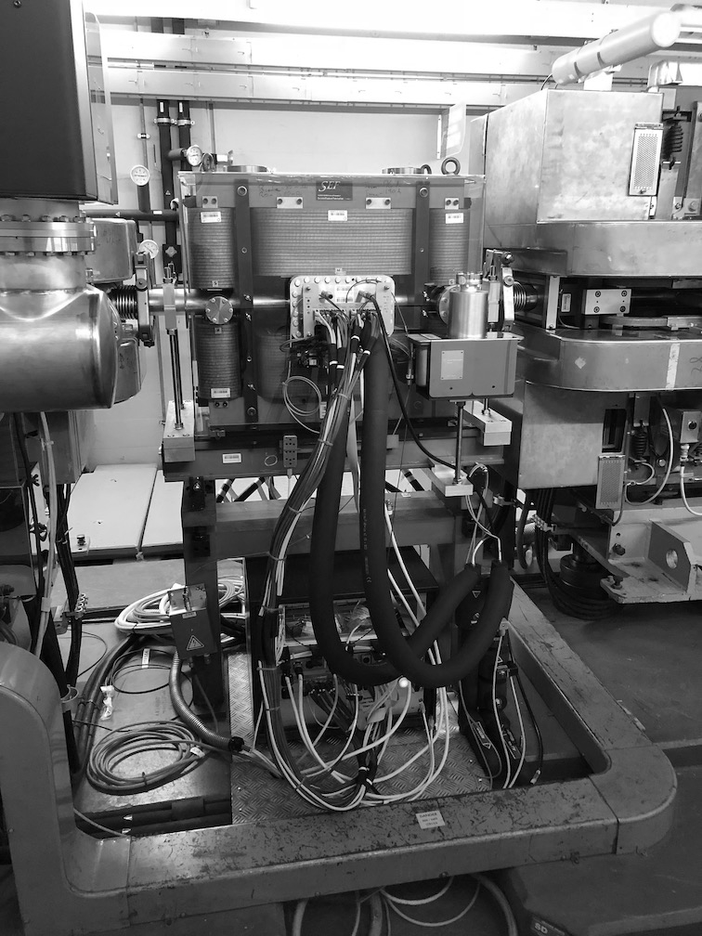
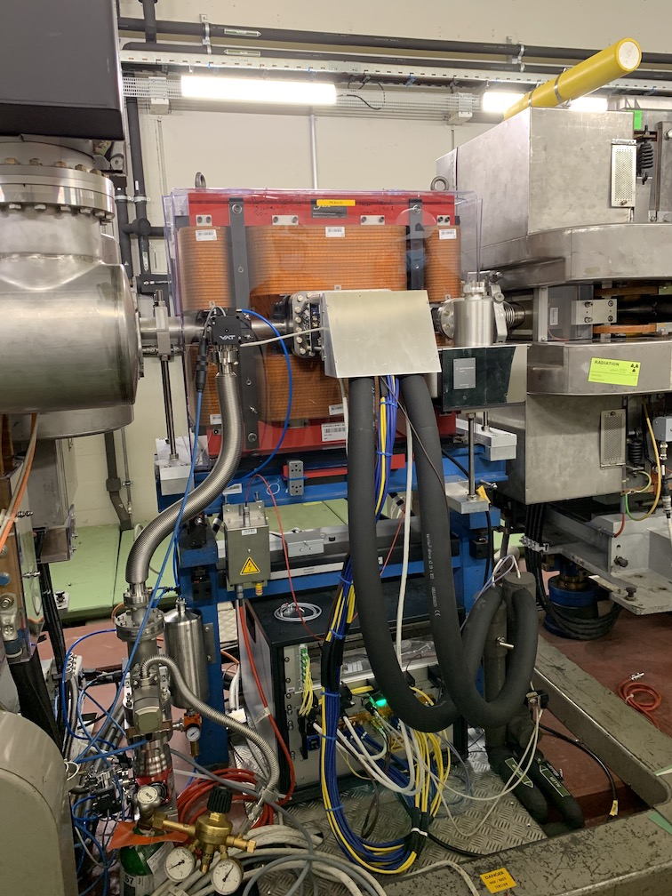
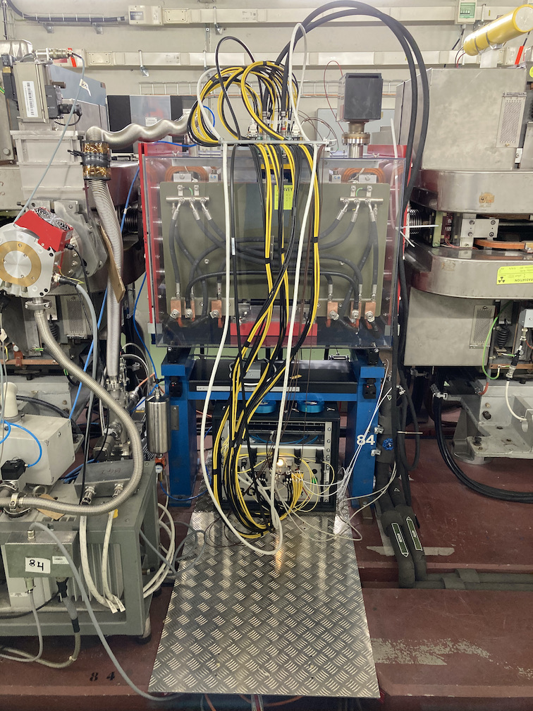
From prototype to operational instruments
BGI-Horizontal prototype
2017-2018
BGI-Horizontal operational
2021
BGI-Vertical operational
2021
Proved feasibility to operate TPX3 in the beam pipe
New modular in-vacuum electronics to improve Timepix3 cooling & production yield

