Slide 1
Medical-BGI Preliminary Investigations
Clara Fleisig
May 14th, 2024
CNAO-CERN Collaboration Meeting

Slide 2
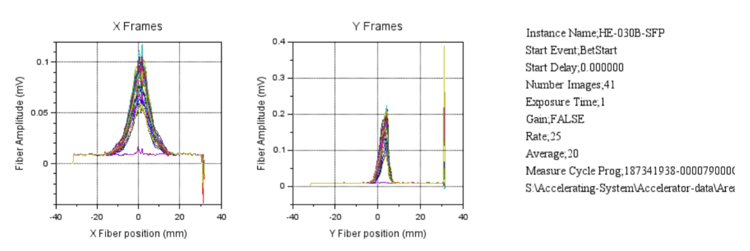
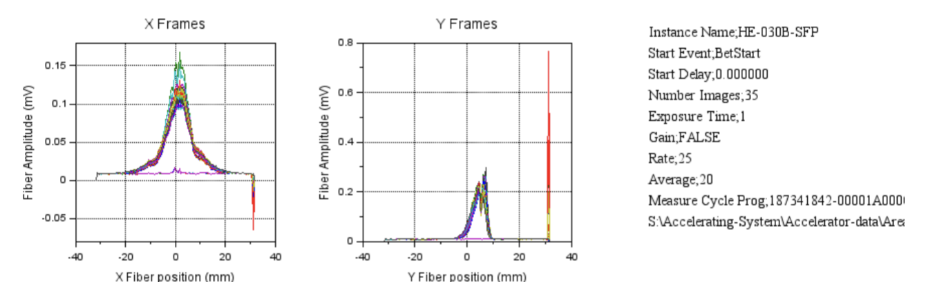
Tentative Focus on HEBT
Closer to end-point of beam
Lower vacuum improves signal per second (reduces required integration time)
A single BGI can validate beam quality for all three treatment rooms
Assumed Beam Parameters
Spills of 1 to 10 seconds
10e-6 to 10e-7 mbar vacuum
60-250 MeV proton beams and 120 to 400 MeV carbon-ion beams
Transverse profile with a maximum of 12 mm at full-width half-maximum
Transverse displacement of a few mm
*Measurements from Claudio Viviani with the SFP

Slide 3
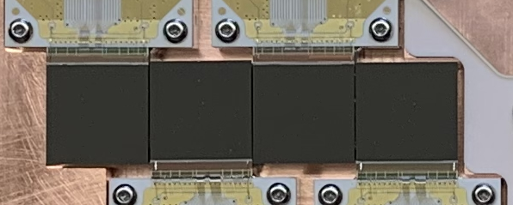
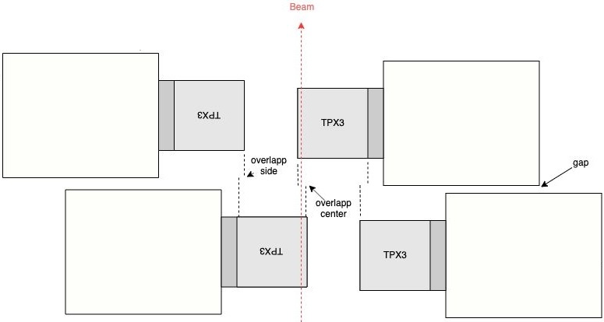
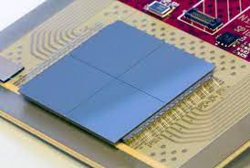
Timepix for the HEBT
Given beam parameter recommend field of view (FOV) > 40 mm
  Timepix3 width is 14 mm
  Timepix4 width is 30 mm
Recommend using two Timepix4 chips per instrument
Larger FOV reduces complications of multiple chips (threshold calibrations and accounting for overlap)
Longer chip length increases signal per spill by 75%
Newest version of chip means more likely to be supported for longer
Increased time resolution of ~200 ps (Timepix3 time resolution is 1.56 ns)

Slide 4
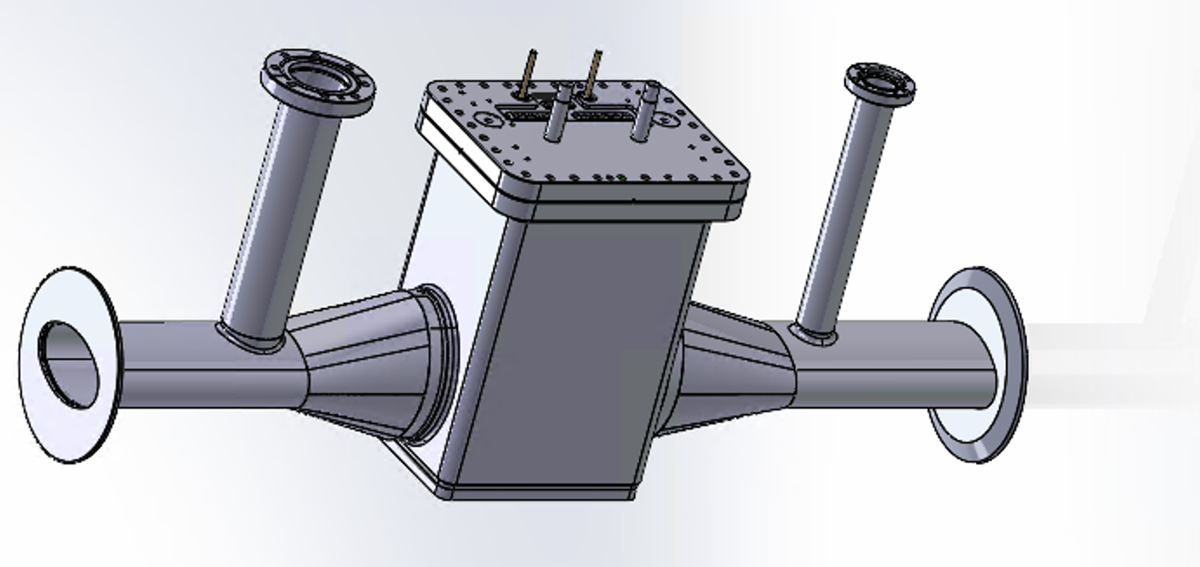
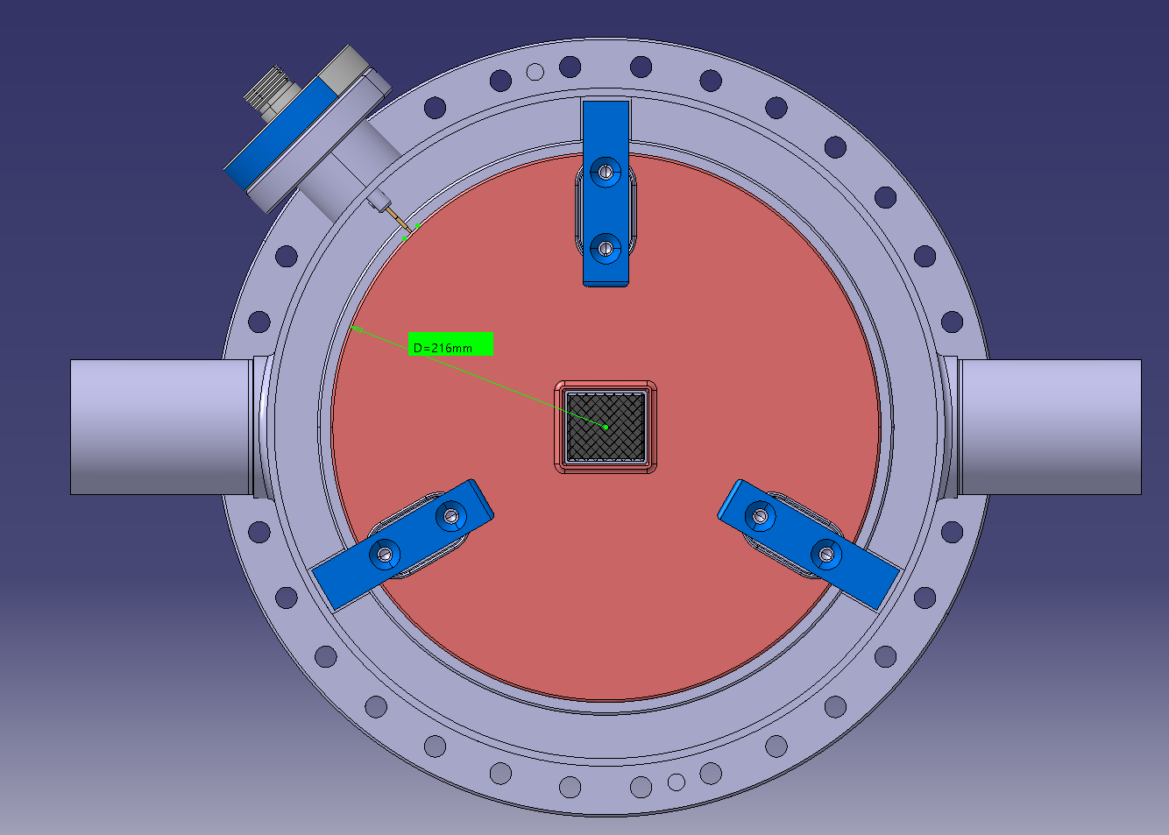
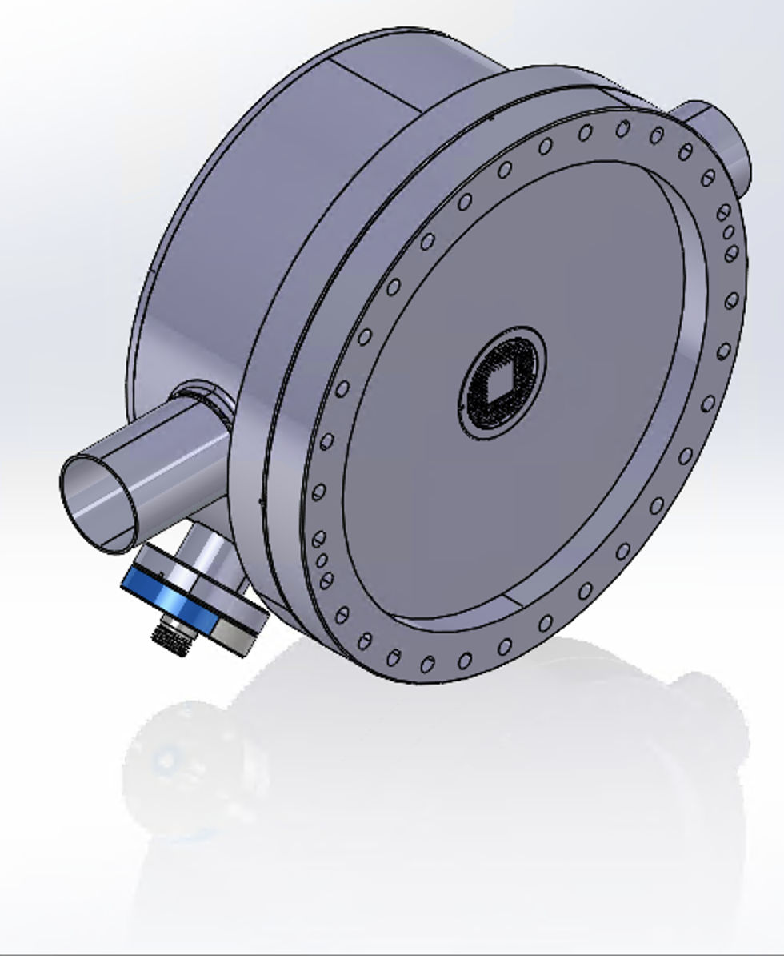
Looking at Mechanics
Investigating use of a standard CF-flange
Size of BGI instruments vary depending on model
Model (without magnet) | Length along Beam Pipe | Height | Width | Depth
Rectangular flange | ~1 m | 215 mm | 283 mm | 435 mm
CF flange | > 350 mm | 130 mm | 310 mm | 310 mm
Circular Flange Model (one Timepix4)
Rectangular Flange Model (four Timepix3s)

Slide 5
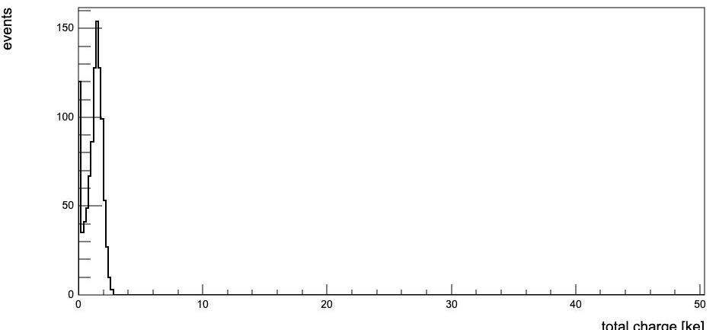
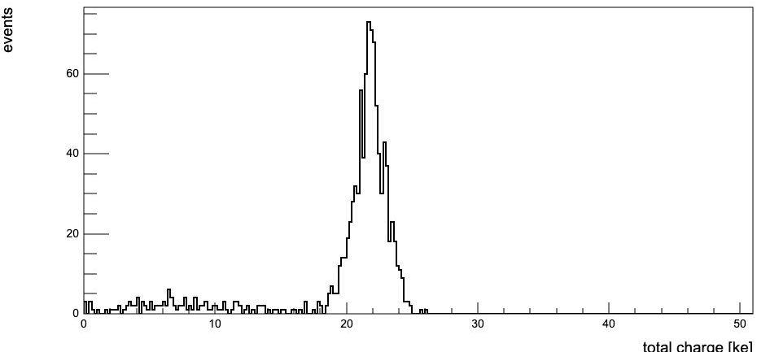
High Voltage Considerations
Increasing high voltage safety changes geometry of design
  Minimum 3 kV/mm in vacuum
  Minimum 1 kV/mm along insulator surfaces
  Minimum 4 kV/mm within insulators
Increasing high voltage increases signal
  Not all electrons have sufficient energy to penetrate silicon
  Higher voltage increases electron energies which increases the number of detected electrons
~9 keV Ionisation Electrons
~90 keV Ionisation Electrons

Slide 6
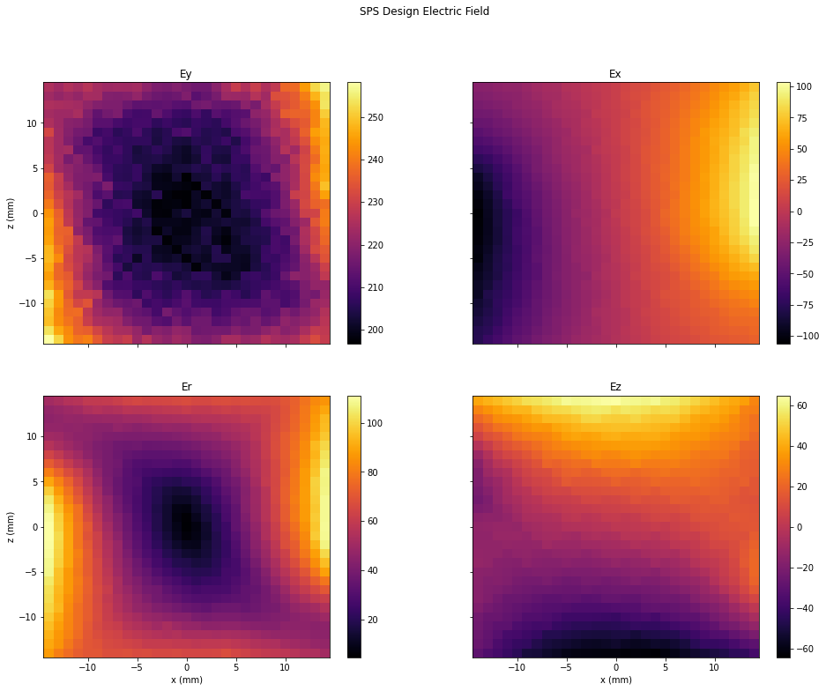
Electric Field Uniformity
Increasing electrode size increases electric field uniformity
More uniform electric fields reduce beam size error
Clara Fleisig | Medical-BGI

Slide 7
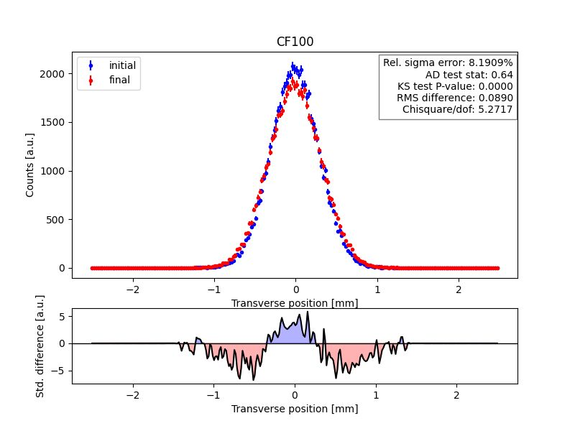
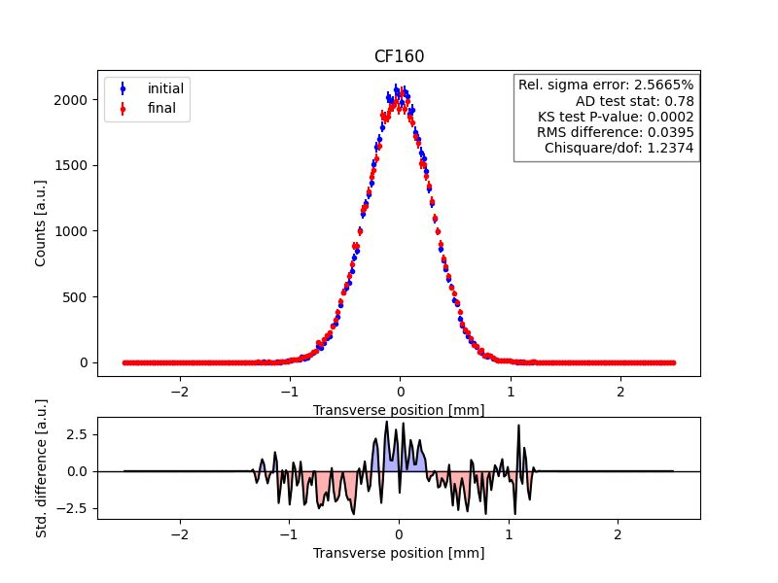
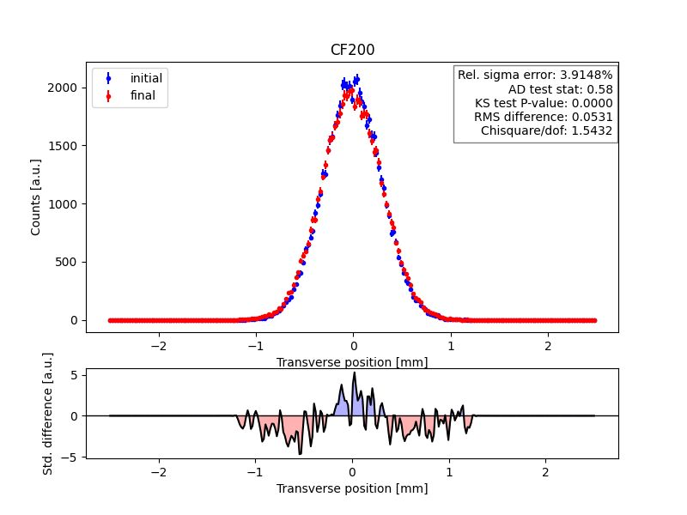
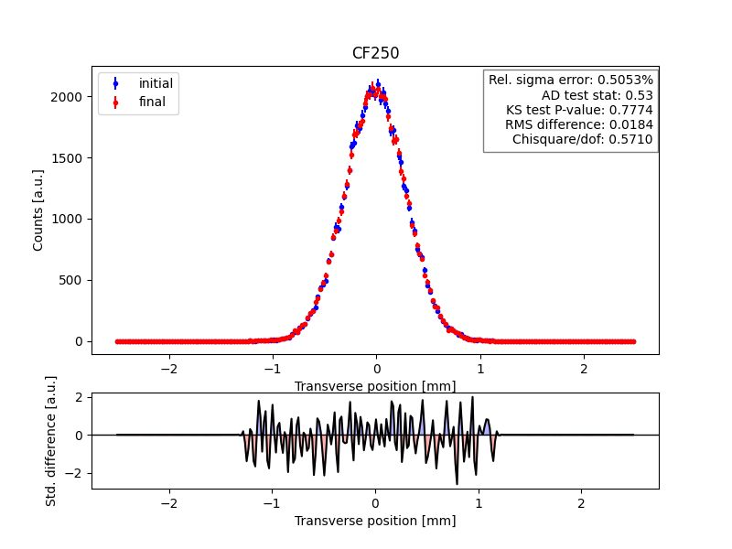
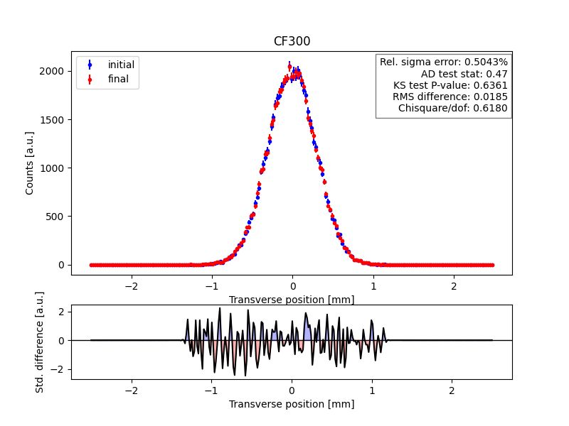
Electric Field Uniformity
Increasing electrode size increases electric field uniformity
More uniform electric fields reduce beam size error
Clara Fleisig | Medical-BGI

Slide 8
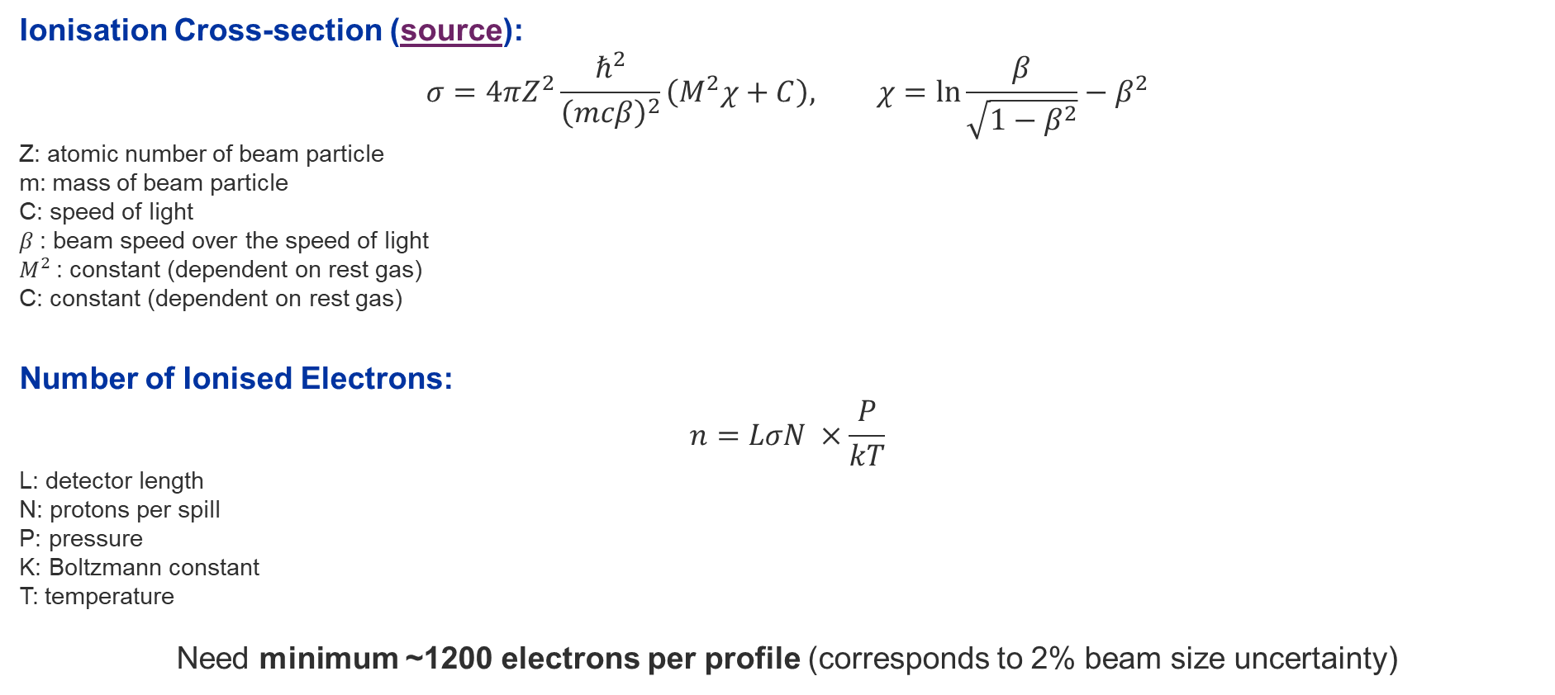
Calculating the Expected Signal (Ionised Electrons)
Ionisation Cross-section (source):
$$σ=4πZ^{2}\frac{ℏ^{2}}{{\left(mcβ\right)}^{2}}\left(M^{2}χ+C\right), χ=\ln{\frac{β}{\sqrt{1−β^{2}}}−β^{2}}$$
Z: atomic number of beam particle
m: mass of beam particle
C: speed of light
$β$: beam speed over the speed of light
$M^{2}$: constant (dependent on rest gas)
C: constant (dependent on rest gas)
Number of Ionised Electrons:
$$n=LσN ×\frac{P}{kT}$$
L: detector length
N: protons per spill
P: pressure
K: Boltzmann constant
T: temperature
Need minimum ~1200 electrons per profile (corresponds to 2% beam size uncertainty)

Slide 9
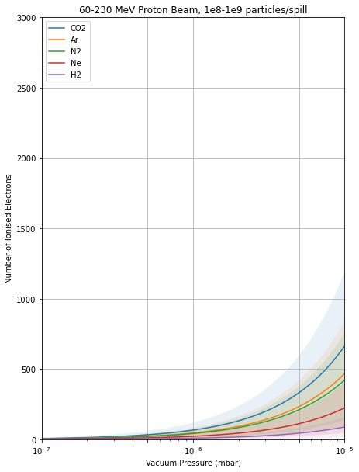
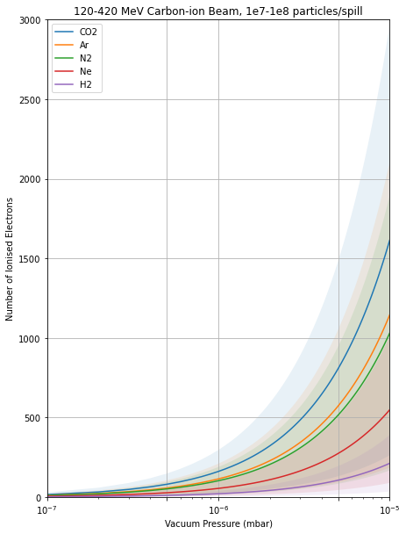
# of Expected Ionised Electrons
Assumed parameters
Detector length of 14.1 mm
23℃ gas temperature
Proton Beam
Best: 60 MeV, 1e09 protons/spill
Worst: 230 MeV, 1e08 protons/spill
Carbon-ion Beam
Best: 120 MeV, 1e08 ions/spill
Worst: 420 MeV, 1e07 ions/spill

Slide 10
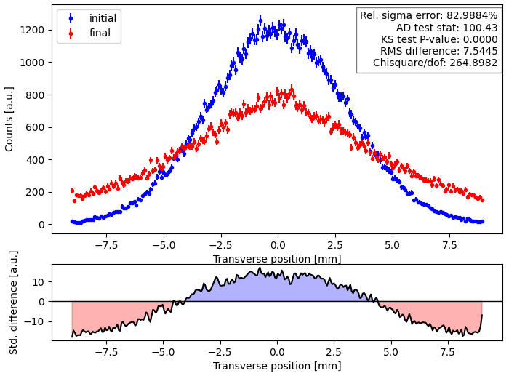
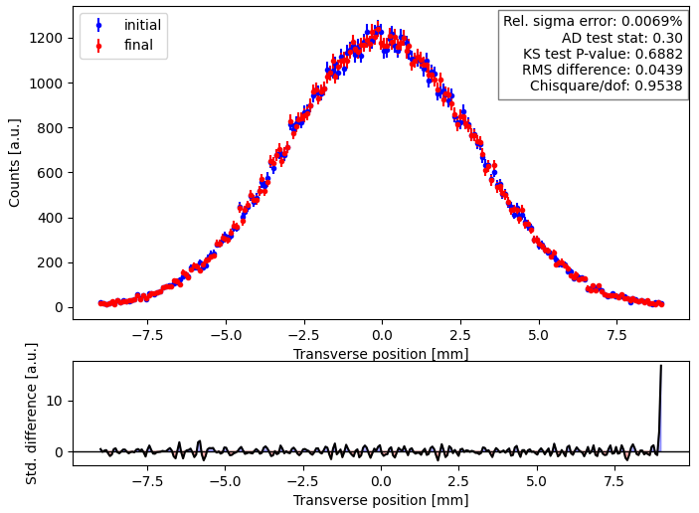
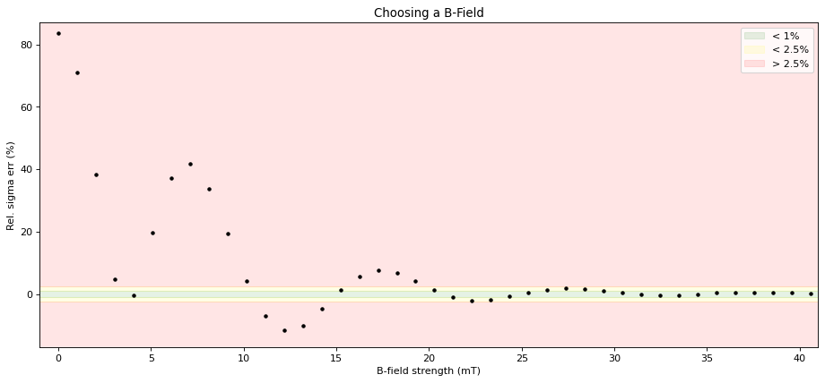
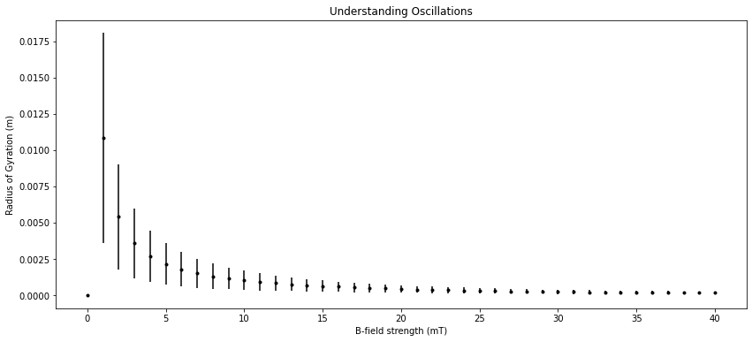
Investigating Magnetic Field
0 mT Magnetic Field
150 mT Magnetic Field
Simulation parameters
3 mm diameter proton beam
240 MeV energy
100,000 counts
Conclusion
|B| > 30 mT

Slide 11
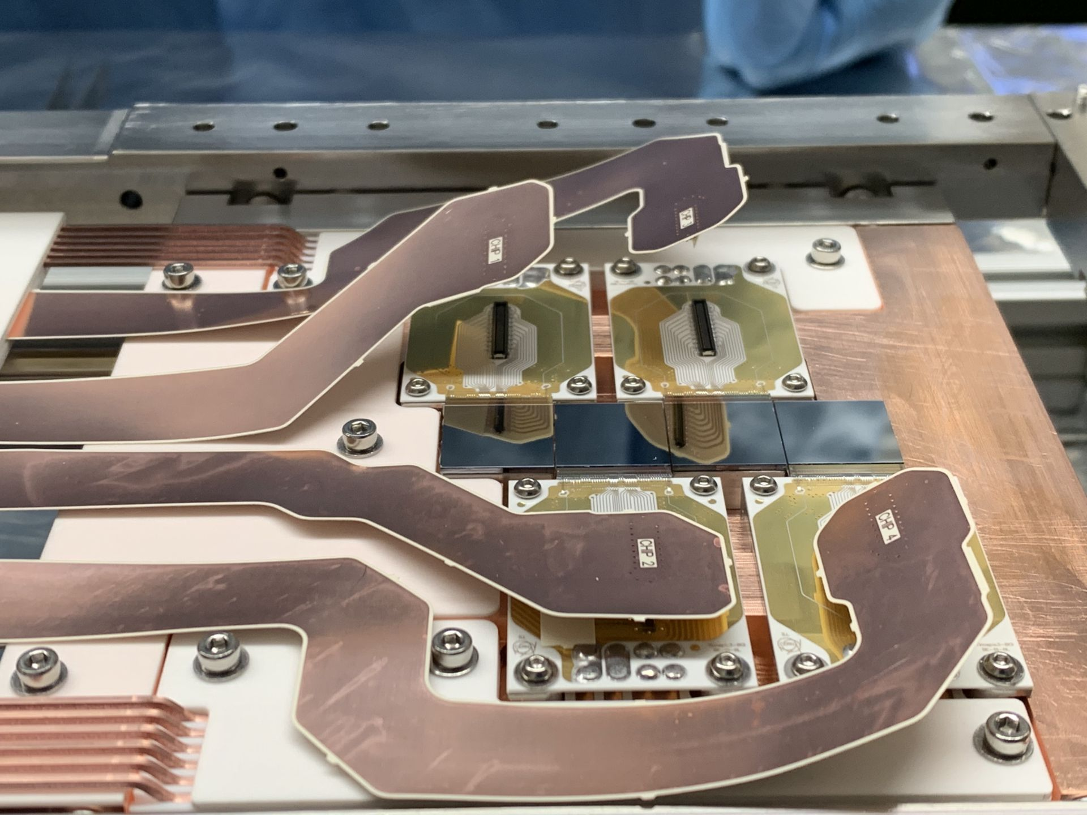
Next Steps
Narrow scope of the project
Investigate ion-based BGIs to reduce the need for a magnetic field
Converge on final mechanical design, high voltage, gas injection system, and magnet
Share conceptual design and get feedback on it,
Clara Fleisig | Medical-BGI

Slide 12
Appendix
Clara Fleisig | Medical-BGI

Slide 13
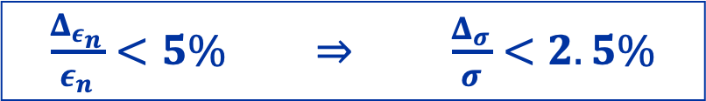
Beam Size Uncertainty
$\frac{Δ_{ε_{n}}}{ε_{n}}<5\% ⇒ \frac{Δ_{σ}}{σ}<2.5\%$
Beam size uncertainty comes from:
$$Δ_{ε_{n}}^{2}={\left(\frac{∂ε_{n}}{∂σ}Δσ\right)}^{2}+{\left(\frac{∂ε_{n}}{∂β}Δβ\right)}^{2}+{\left(\frac{∂ε_{n}}{∂γ_{r}}Δγ_{r}\right)}^{2}+{\left(\frac{∂ε_{n}}{∂β_{r}}Δβ_{r}\right)}^{2} ⇒ \frac{Δ_{ε_{n}}}{ε_{n}}=2\frac{Δ_{σ}}{σ}$$
Systematic Uncertainty Sources | Other Uncertainty Sources
Electric field uniformity and strength Magnetic field uniformity and strength | Number of ionised electrons Noise (e.g. beamloss)
Clara Fleisig | Medical-BGI

Slide 14
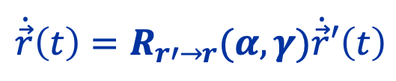
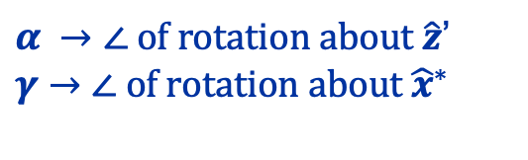
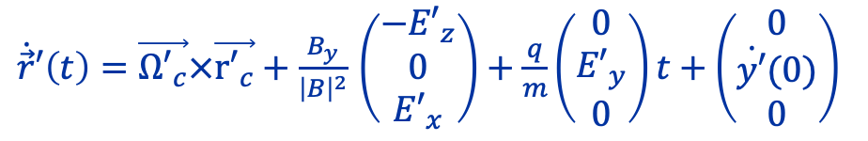
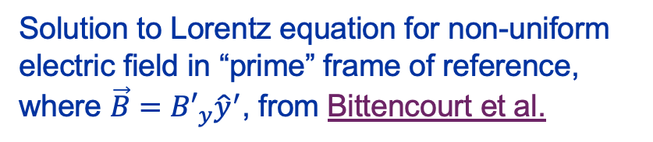
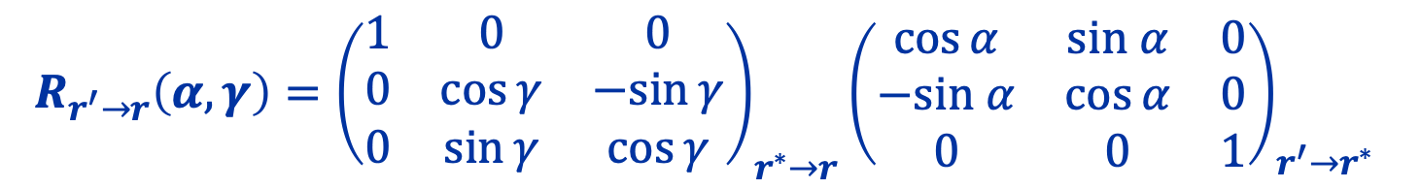
Complications from Non-Uniform Fields
(neglecting space charge)
$\dot{\vec{r}}′\left(t\right)=\vec{{Ω′}_{c}}×\vec{{r′}_{c}}+\frac{B_{y}}{{\left|B\right|}^{2}}$ $\left(\begin{matrix}{−E′}_{z} \\ 0 \\ {E′}_{x}\end{matrix}\right)+\frac{q}{m}\left(\begin{matrix}0 \\ {E′}_{y} \\ 0\end{matrix}\right)t+\left(\begin{matrix}0 \\ \dot{y′}(0) \\ 0\end{matrix}\right)$
Solution to Lorentz equation for non-uniform electric field in “prime” frame of reference, where $\vec{B}={B′}_{y}{\hat{y}}^{′}$, from Bittencourt et al.
ExB Drift
Rotate to BGI’s frame of reference to consider non-uniform magnetic field
$$\dot{\vec{r}}\left(t\right)=R_{r′→r}(α, γ)\dot{\vec{r}}′\left(t\right)$$
$α →∠ of rotation about \hat{z}$’
$$γ→∠ of rotation about {\hat{x}}^{∗}$$
$$R_{r^{′}→r}\left(α, γ\right)={\left(\begin{matrix}1 & 0 & 0 \\ 0 & \cos{γ} & −sin{γ} \\ 0 & \sin{γ} & \cos{γ}\end{matrix}\right)}_{r^{∗}→r}{\left(\begin{matrix}\cos{α} & sin α & 0 \\ −sin α & \cos{α} & 0 \\ 0 & 0 & 1\end{matrix}\right)}_{r^{′}→r^{∗}}$$
Clara Fleisig | Medical-BGI

Slide 15
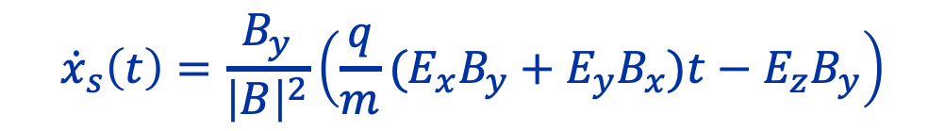
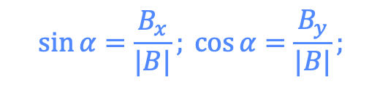
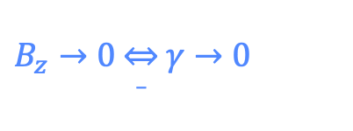
Understanding Profile Shift
(neglecting space charge, omitting cyclotron motion)
$${\dot{x}}_{s}\left(t\right)=\frac{E_{x}\sin{α\cos{α}\sin{γ+E_{y}\sin{γ\cos^{2}{α−E_{z}\cos{γ\cos{α}}}}}}}{\left|B\right|}+\frac{q}{m}\left(E_{x}\sin{α\cos{γ+E_{y}\cos{α\cos{γ+E_{z}}}}}\sin{γ}\right)\sin{α}t$$
$B_{z}→0 \overset{⇔}{_} γ→0$
$${\dot{x}}_{s}\left(t\right)=−\frac{E_{z}B_{y}}{\left|B\right|}\cos{α+\frac{q}{m}(E_{x}\sin^{2}{α+E_{y}\sin{α}\cos{α})t }}$$
$$\sin{α=\frac{B_{x}}{|B|}; }\cos{α=\frac{B_{y}}{|B|}; }$$
$${\dot{x}}_{s}\left(t\right)=\frac{B_{y}}{{\left|B\right|}^{2}}\left(\frac{q}{m}(E_{x}B_{y}+E_{y}B_{x})t−E_{z}B_{y}\right)$$
ExB Drift
Accelerating drift
Clara Fleisig | Medical-BGI

