Slide 1


Test result of MBXF2 in CD1
Michinaka SUGANO, Kento SUZUKI, Tatsushi NAKAMOTO
KEK
On behalf of CERN-KEK Collaboration for D1 Construction for HL-LHC
WP3 meeting, 5 June 2024

Slide 2
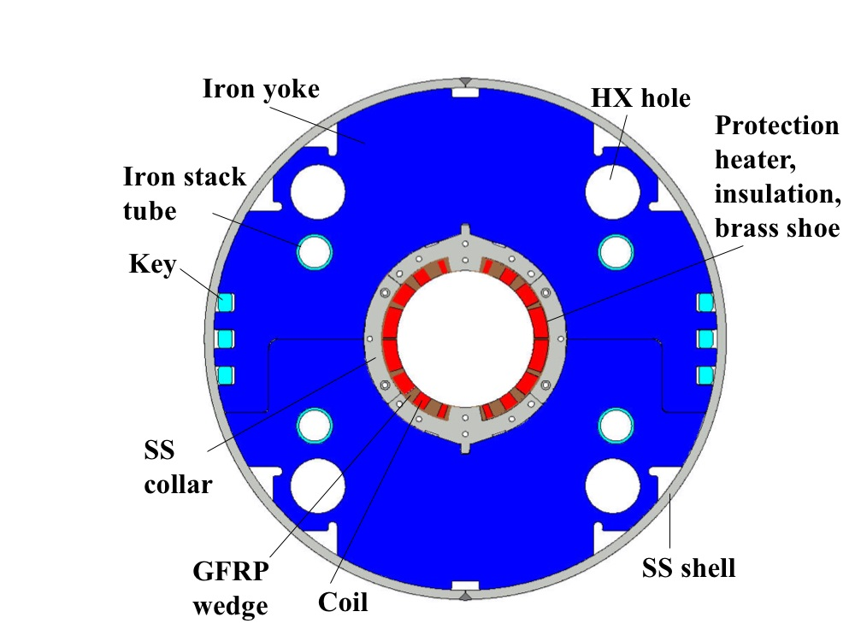
Japanese contribution to HL-LHC: D1 magnets
Beam separation dipole (D1) by KEK
  Design study of D1 for HL-LHC within the framework of the CERN-KEK collaboration since 2011.
  150 mm single aperture, 35 Tm (5.6 T x 6.3 m), Nb-Ti technology.
  Development of 2-m long model magnets (3 units) at KEK
Deliverables for HL-LHC
  1 full-scale prototype cold mass (LMBXFP)
  6 series cold masses (LMBXF1-6)
7 units x 7-m long cold masses

Slide 3
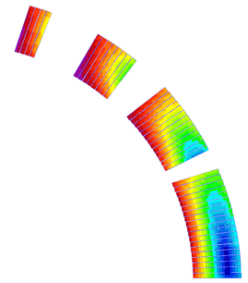
Design parameters
GFRP
wedge
Collar
 | prototype, series production (7m)
Coil aperture | 150 mm
Field integral | 35 T m
Field (3D) | Nominal: 5.60 T, Ultimate: 6.04 T
Peak field (3D) | Nominal: 6.58 T, Ultimate: 7.14 T
Current | Nominal : 12.11 kA, Ultimate 13.23 kA
Operating temperature | 1.9 K
Field quality | <10⁻⁴ w.r.t B₁ (R_{ref}=50 mm)
Load line ratio (3D) | Nominal: 76.5%, Ultimate: 83.1% at 1.9 K
Differential inductance | Nominal: 4.0 mH/m
Conductor | Nb-Ti: LHC-MB outer cable
Stored energy | Nominal: 340 kJ/m
Magnetic length | 6.26 m
Coil mech. length | 6.58 m
Magnet mech. length | 6.73 m
Heat load | 135 W (Magnet total) 2 mW/cm³ (Coil peak) > 25 MGy
Radiation dose
Shell
Nb-Ti/Cu coil
Yoke
QPH
Insulation
Brass shoe
4
8
12 ton
13
4 blocks
44 turns
19
Large-aperture single layer coil
→ Mechanical support of a coil is challenging

Slide 4
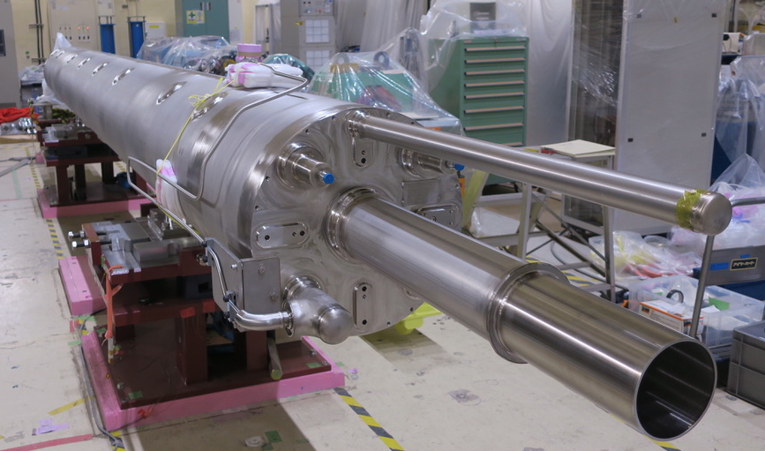
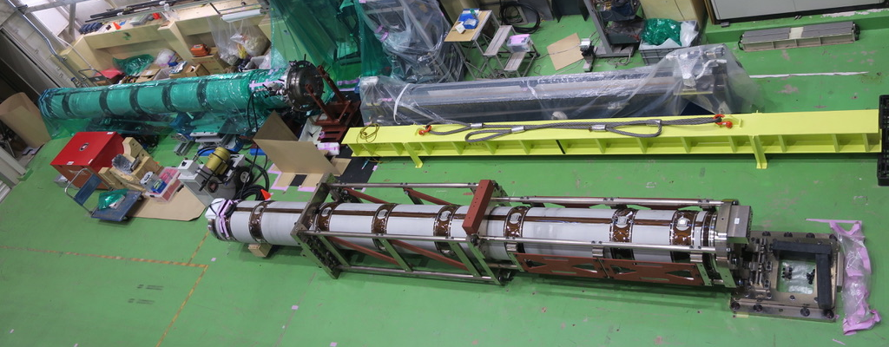
Current status of each series production magnet
1. MBXF1
  Cold mass was completed and transported to KEK in March, 2024.
  A shipping company to be determined by bidding in July. We expect the cold mass will be delivered to CERN in September.
2. MBXF5
  Test result of CD1 was reported in WP3 meeting on Nov 8th, 2023.
  CD2 was postponed due to the malfunction of the He refrigerator in KEK.
3. MBXF2
  Test result of CD1 is reported in this slide.
4. MBXF3
  The magnet assembly in Hitachi is almost completed. The magnet will be delivered to KEK in August.
MBXF5
LMBXF1
MBXF2

Slide 5
Test program of MBXF2 in CD1
Period: May 7th – 31st
Hi-pot test at NOC
System check
Training
  Up to the ultimate current (13.231 kA)
Magnetic field measurement
  z-scan to evaluate field integral
  DC-loop at the magnet center
Other items
  Current holding test for 4h at the ultimate
  Fast ramp test at ±30 A/s
  Measurement of joint resistance
  RRR measurement

Slide 6
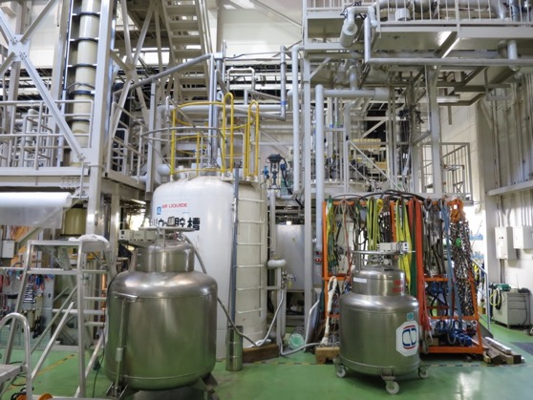
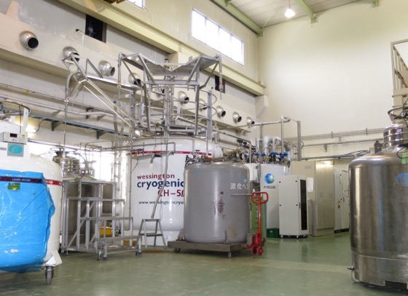
Dual operation of refrigerators
20 m long LHe transfer line connecting #2 and #4 systems.
#4 Refrigerator/Liquefier for Test Stand
180 L/h, 2400 L dewar
Manufactured by Teisan/Air Liquide in 1987
New cold box in 2007
#2 Liquefier (Primary)
400 L/h, 5000 L dewar
LINDE LR280 in 2014
Mandatory to supply LHe to users at KEK.
During CD1 of MBXF5, we had trouble with the warm turbine of #4 refrigerator.
Cooling test of dual operation of the #4 refrigerator and #2 liquefier was conducted before this magnet test. Sufficient total liquefaction ability of 490 L/h was confirmed.
MBXF2 could be cooled down to 1.9 K with such a dual operation.

Slide 7
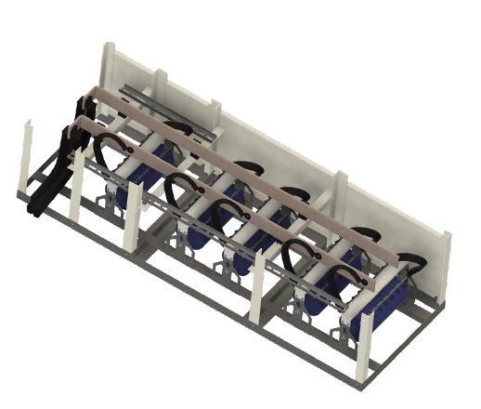
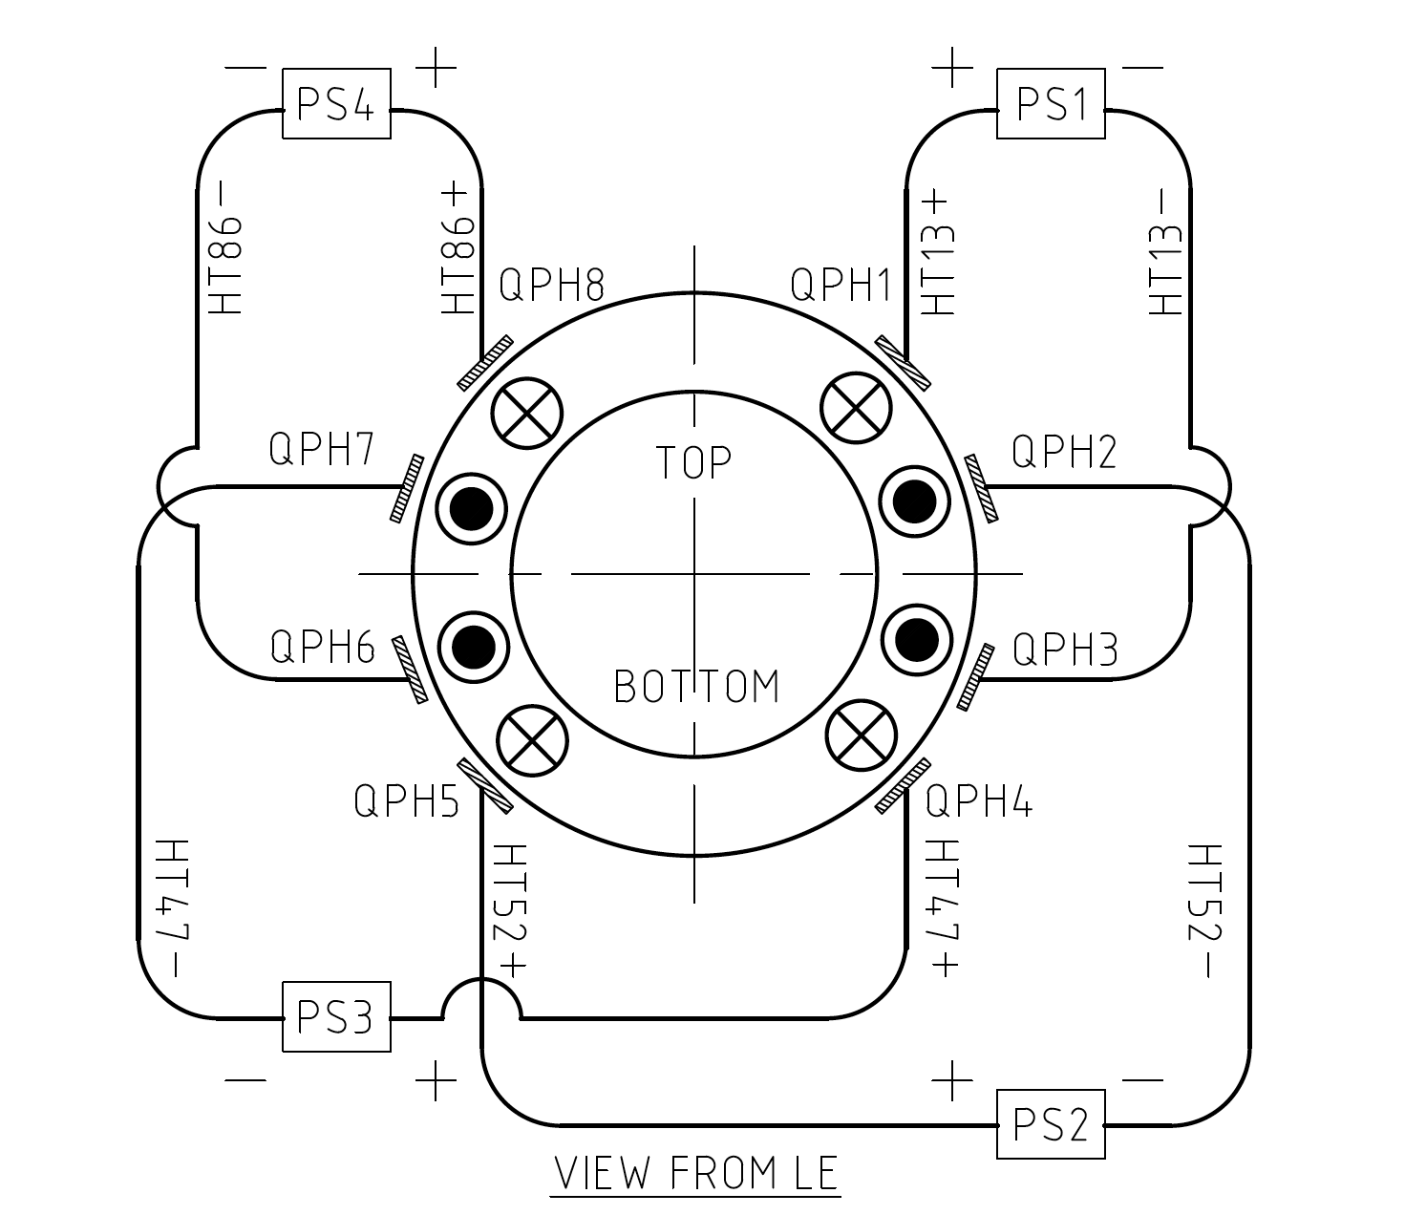
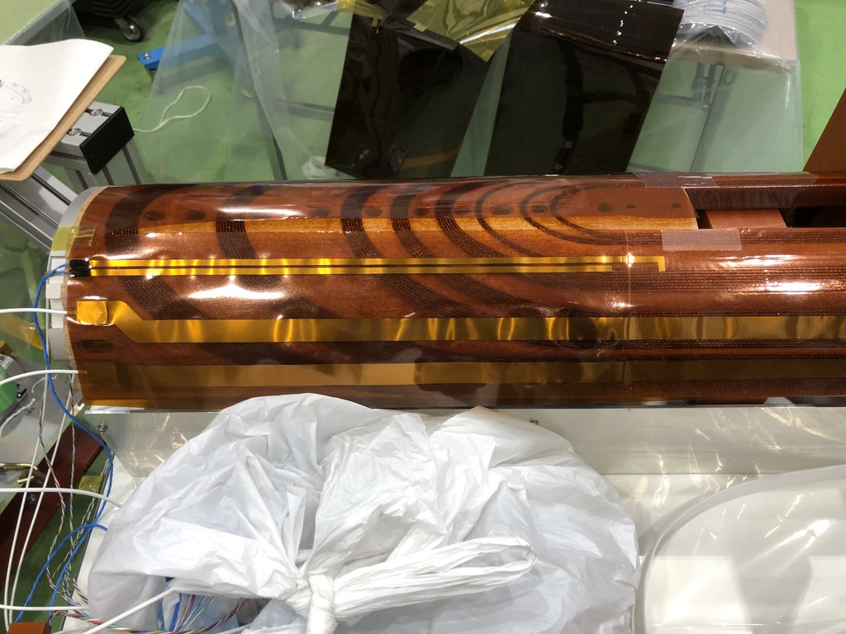
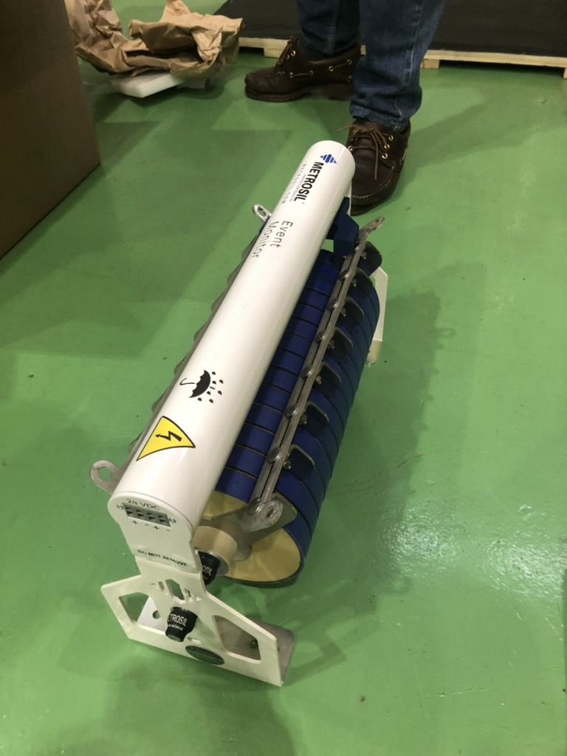
Quench protection
Quench detection
  Voltage threshold: 0.1 V, detection time: 10 msec
Quench protection heaters
  2 strips x 4 circuits
Varistor (Metrosil)
  3 kA x 5 units
  Validated in cold test of MBXF1
  Healthiness is monitored by the Rogowski coils
QPH
Varistor

Slide 8
Hi-pot test, system check
Hi-pot test at NOC
  Criterion: Leak current < 10 μA
  Coil – GND: 1.3 kV, 30sec
  QPH – GND: 2.3 kV, 30sec
  Between QPH strips: 2.3 kV, 30sec
  → Passed
System check
  The soundness of varistors was confirmed by signals from Rogowski coils in shutdown test and training quench at any current.

Slide 9
Training
Relatively long training in MBXF2
  10 quenches to the nominal current
  18 quenched to the ultimate current
  Quench current never decreased during training.
The current holding test at the ultimate current for 4h was successful.
Fast ramp test with ±30 A/s was also done.
Training memory will be checked in CD2.

Slide 10
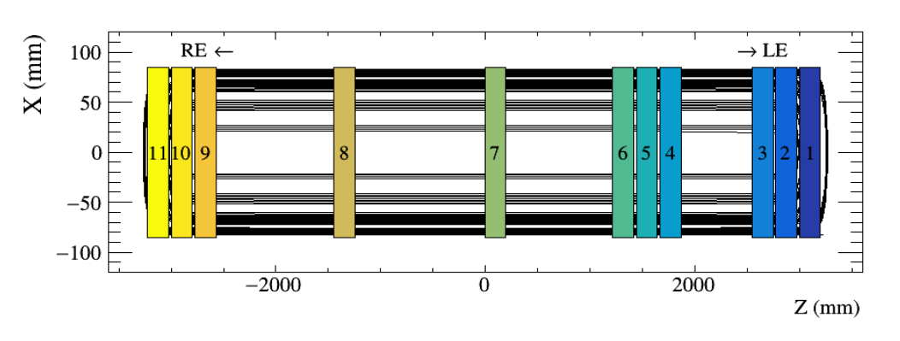
Quench start location
Red: Successful
localization
The coil at which quench initiated changed almost alternately.
Training started with quenches at
LE which is a common nature of
D1 magnet.
The last quench occurred a few seconds after the ultimate current was reached.
A voltage spike appeared at the onset of a balance voltage at quenches at high current, suggesting wire motion.
Run No. | Quench number | Quench current (A) | Top/ Bottom coil | Long. position | Quench antenna
013 | 1 | 9383 | B | LE | 1, 2, 3
014 | 2 | 9925 | B | LE | 1, 2, 3
015 | 3 | 10327 | T |  | 1, 2, 3, 4, 5, 6
016 | 4 | 10480 | B |  | 1, 2, 3, 4, 5, 6, 7, 8
019 | 5 | 11243 | T | LE | 1, 2, 3
020 | 6 | 11563 | B | LE | 2
021 | 7 | 11572 | T | LE | 2, 3
022 | 8 | 11780 | B | LE | 1, 2, 3, 4, 5
023 | 9 | 11832 | T |  | 1, 2, 3, 4, 5, 6, 7
024 | 10 | 11878 | B |  | 1, 2, 3, 4, 5, 6, 7
025 | 11 | 12493 | T | LE | 1, 2, 3
026 | 12 | 12529 | B | LE | 1, 2, 3
027 | 13 | 12628 | B | RE | 9, 10, 11
028 | 14 | 12790 | B | RE | 9, 10, 11
029 | 15 | 12860 | T | LE | 1, 2, 3
030 | 16 | 13054 | B | LE | 1, 2, 3
031 | 17 | 13119 | T | RE | 11
032 | 18 | 13234 | B | RE | 11

Slide 11
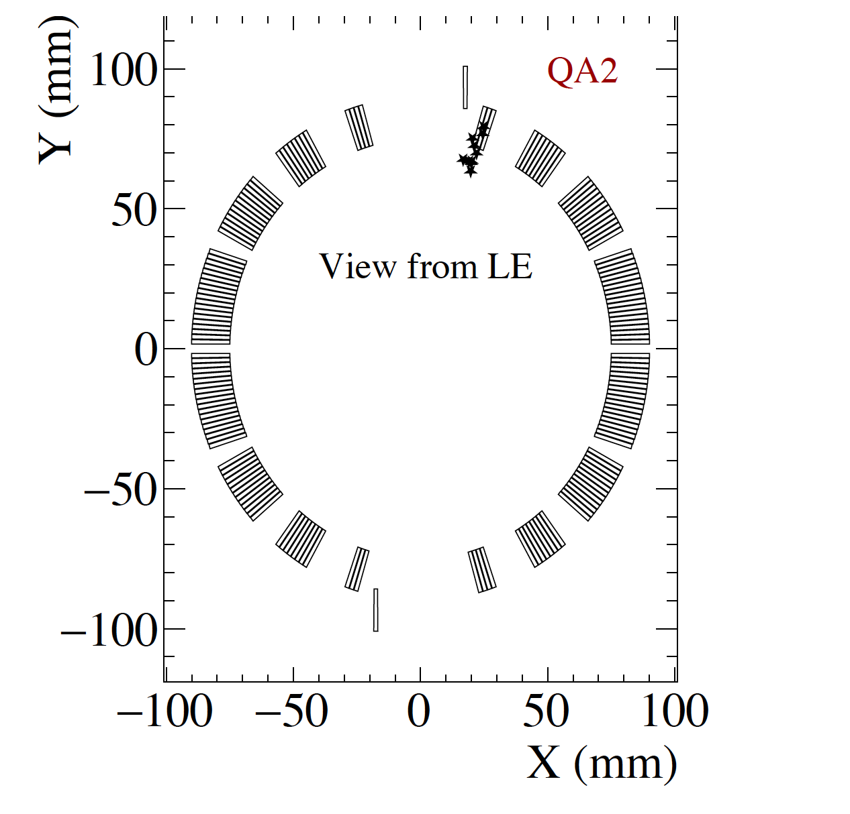
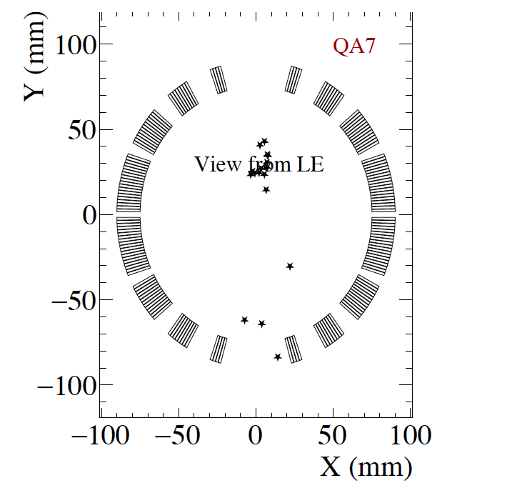
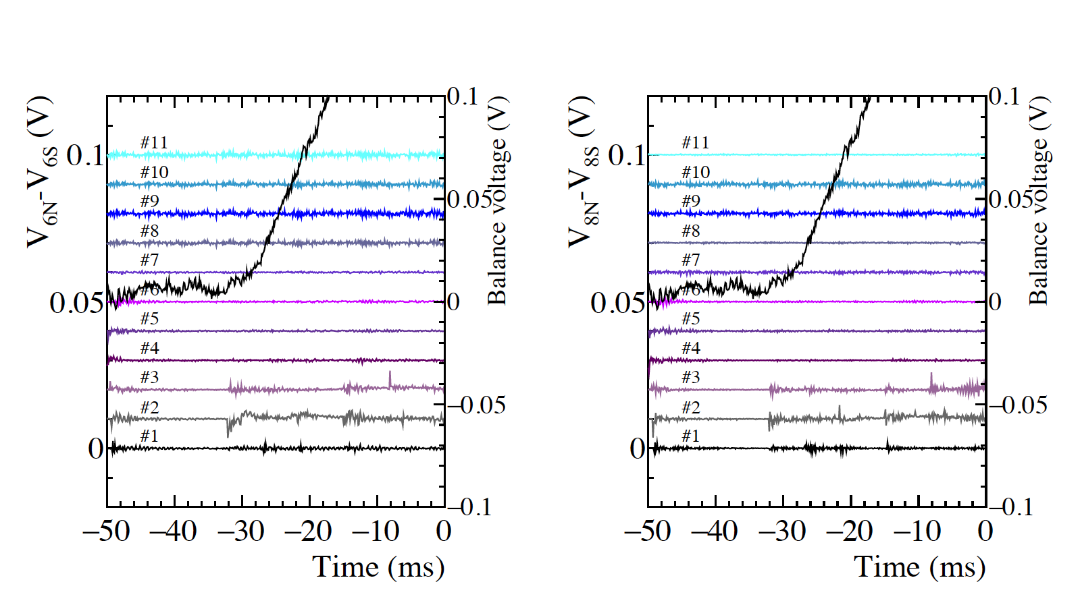
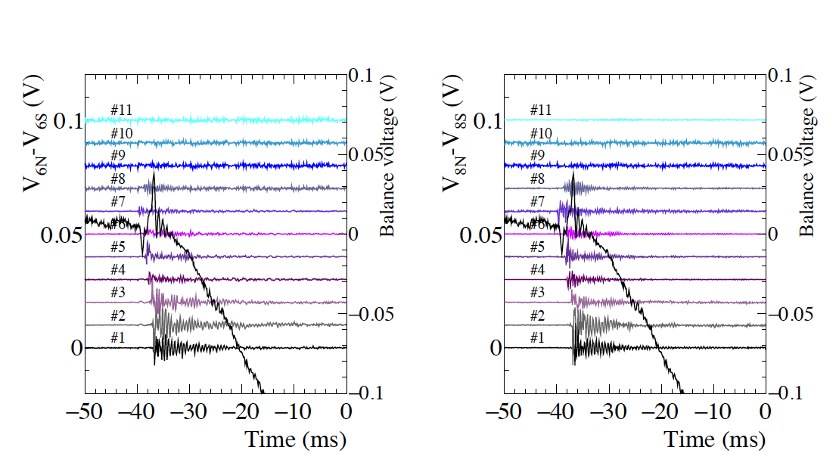
Quench antenna analysis
Successful case
Failed case
Run No.021
Run No.016
Quench occurred
at QA2.
Many QAs detected
signals even in SS.
Balance voltage

Slide 12
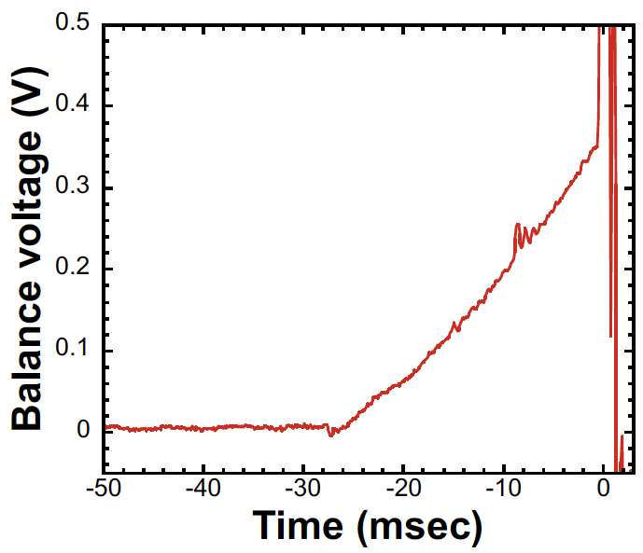
Iq vs Detection delay
QA11
Detection
delay
In any magnets, training started from the LE side
The first RE-side quench emerged in the latter part of training with a detection delay of ~40ms.
Longer detection delay in quenches at RE would be due to quench start location in the low field region.

Slide 13
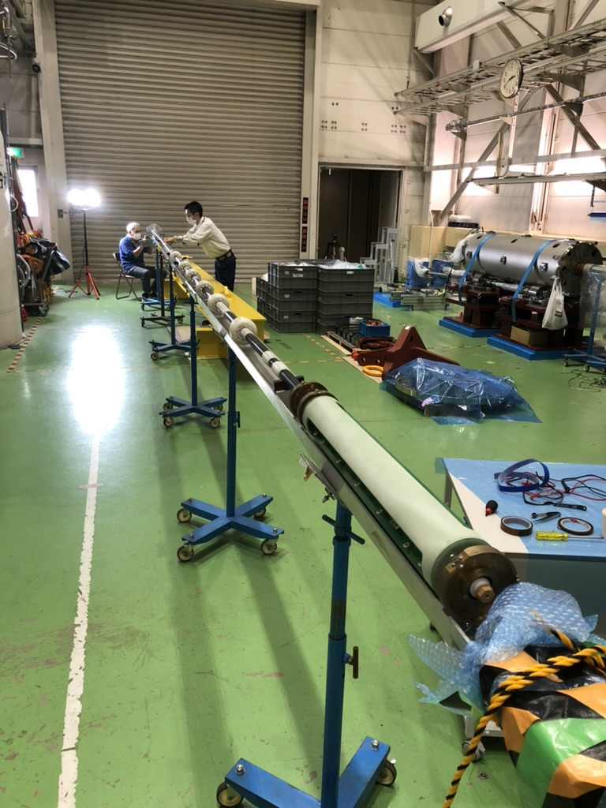
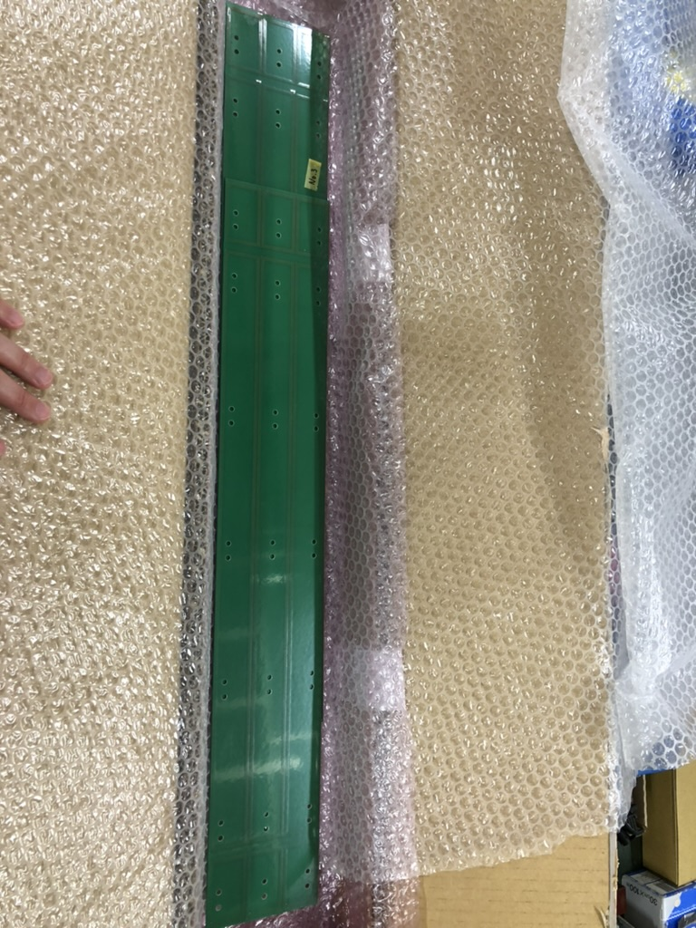
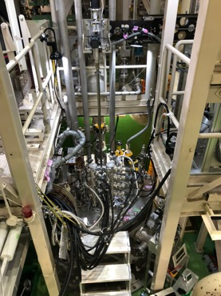
Vertical magnetic field measurement system
Field quality of MBXF5 at room temperature / 1.9 K using the KEK’s vertical measurement system
  Rotating coil (PCB):
    3 sets of radial coils
    Long coils (500 mm) for integral measurement
    Short coils (50 mm) for fine search
  Scanning capability
    Stepping motor and Magnescale®
    10-m-shaft to cover the full-length of the magnet
10-m shaft
50 mm
500 mm
50 mm

Slide 14
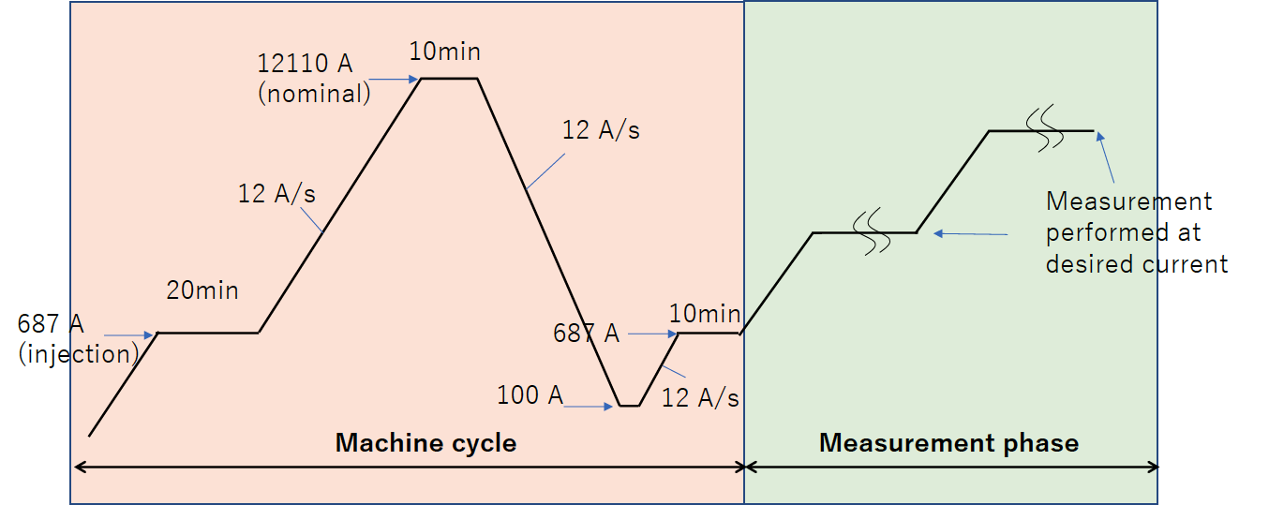
Measured Items
Z-scan
  Warm, before cooling
  I =3 kA, before training
  I = [687, 1k, 3k, 5k, 7k, 9k, 10k, 11k, 12.11k, 11k, 10k, 9k, 7k, 5k, 3k,1k, 687] A, after training and machine cycle (see below)
DC loop at 1.9 K
  Rotating coil position is fixed at the magnet center (z=0)

Slide 15
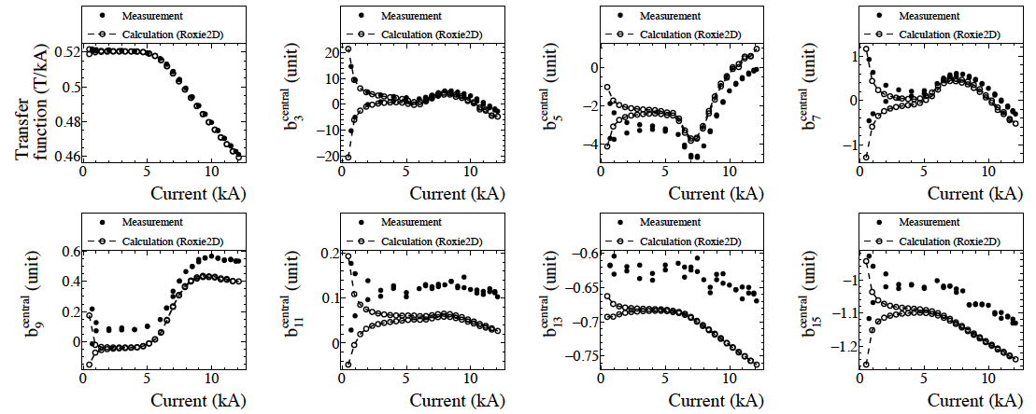
DC loop – comparison with calc.
Central field quality was measured by the long coil (L=500) positioned at the longitudinal magnet center (z=0)
Measured curves are reproducible by the calc. (Roxie2D)

Slide 16
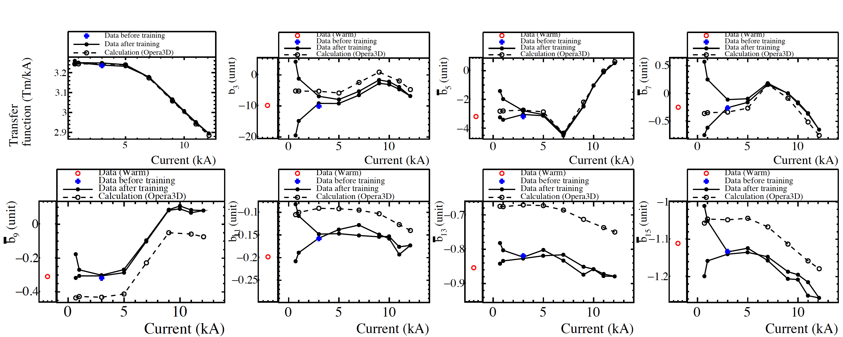
Integral Measurement – comparison with calc.
Good agreement between
warm and cold
Measurements agrees well
with simulation with Opera3D.

Slide 17
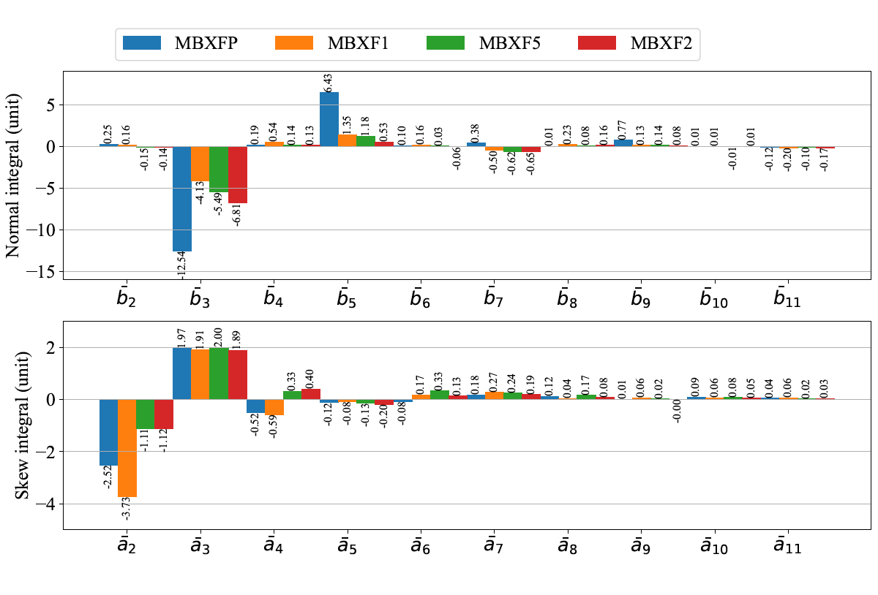
FQ Summary (integral) so far
Prototype
Series
in KEK cryostat
Fine-tuning by modification
of coil cross-section from prototype
to series magnets
in KEK cryostat
＊) MBXFP’s cross-section design is different from the series
Good reproducibility was confirmed among the series production magnets.

Slide 18
FQ Summary and Expectation
Measured field quality of MBXF2 with CERN cryostat
agreed with OPERA3D simulation.

Slide 19
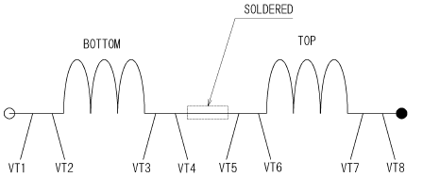
Joint resistance
Splice
V
Joint resistance across the splice: 0.481 nΩ < 1 nΩ → OK

Slide 20
Summary
CD1 test was conducted for MBXF2. The results are summarized as follows.
  Hi-pot test at NOC → passed
  Training: 10 quenches to nominal, 18 quenches to ultimate
  Successful current holding for 4h at ultimate
  Fast ramp with ±30 A/s up to ultimate → OK
  Joint resistance < 1nΩ
  Good and reproducible field quality was confirmed in magnetic field measurement. Measured field quality of MBXF2 with CERN cryostat agreed with OPERA3D simulation.
CD2 will start on June 9th.

Slide 22
Summary of training
Red: Successful
localization
Run No. | Quench number | Quench current (A) | Top/ Bottom coil | Long. position | Quench antenna | Detection delay (ms) | Quench integral from quench (MA²s)
013 | 1 | 9383 | B | LE | 1, 2, 3 | -43.0 | 21.6
014 | 2 | 9925 | B | LE | 1, 2, 3 | -45.5 | 23.7
015 | 3 | 10327 | T |  | 1, 2, 3, 4, 5, 6 | -38.1 | 24.2
016 | 4 | 10480 | B |  | 1, 2, 3, 4, 5, 6, 7, 8 | -38.0 | 24.8
019 | 5 | 11243 | T | LE | 1, 2, 3 | -32.4 | 26.1
020 | 6 | 11563 | B | LE | 2 | -31.1 | 26.6
021 | 7 | 11572 | T | LE | 2, 3 | -32.4 | 27.1
022 | 8 | 11780 | B | LE | 1, 2, 3, 4, 5 | -31.9 | 27.4
023 | 9 | 11832 | T |  | 1, 2, 3, 4, 5, 6, 7 | -31.3 | 27.7
024 | 10 | 11878 | B |  | 1, 2, 3, 4, 5, 6, 7 | -32.3 | 27.8
025 | 11 | 12493 | T | LE | 1, 2, 3 | -27.8 | 28.4
026 | 12 | 12529 | B | LE | 1, 2, 3 | -28.5 | 28.9
027 | 13 | 12628 | B | RE | 9, 10, 11 | -47.2 | 32.1
028 | 14 | 12790 | B | RE | 9, 10, 11 | -43.4 | 31.9
029 | 15 | 12860 | T | LE | 1, 2, 3 | -35.0 | 30.7
030 | 16 | 13054 | B | LE | 1, 2, 3 | -25.1 | 29.0
031 | 17 | 13119 | T | LE | 11 | -38.6 | 31.9
032 | 18 | 13234 | B | RE | 11 | -38.7 | 31.9

Slide 23
FQ Summary Table - SS averaged & Integral for MBXF2
in KEK cryostat
Warm
1.9 K, 12.11 kA

Slide 24
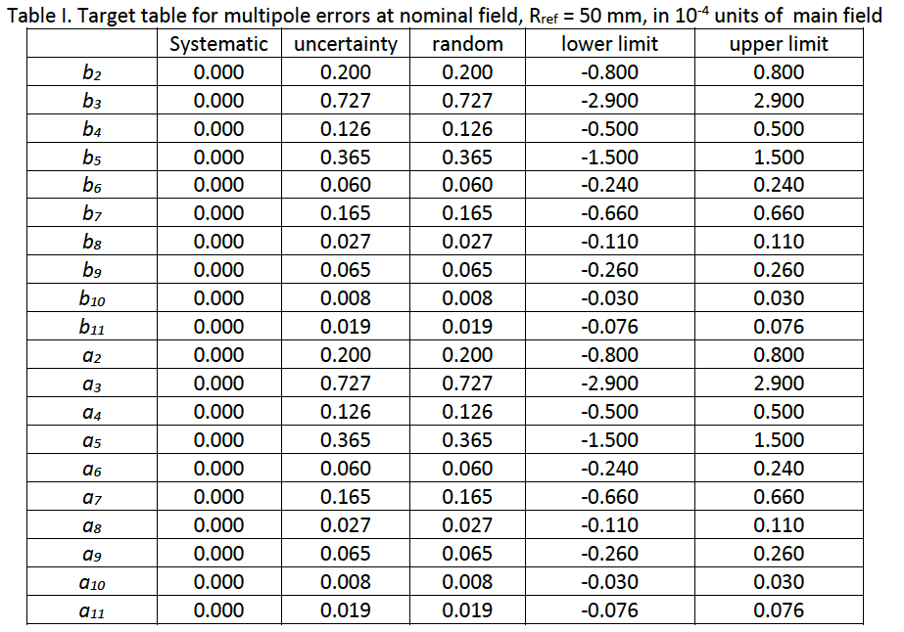
Field quality specified in Acceptance criteria
EDMS No. 2045899

Slide 25
Results of coil size measurement
Magnet | Coil | Total average (MPa) | Max value (MPa) | Min value (MPa) | Standard deviation (MPa)
MBXFP1 | LPT-1 | 112 | 116 | 106 | 2.0
 | LPB-1 | 110 | 113 | 108 | 1.4
MBXF5 | LT-1 | 122 | 125 | 119 | 1.5
 | LB-1 | 122 | 125 | 118 | 1.8
MBXF1 | LT-2 | 117 | 120 | 114 | 1.3
 | LB-2 | 125 | 128 | 112 | 1.6
MBXF2 | LT-3 | 123 | 127 | 119 | 1.9
 | LB-3 | 117 | 122 | 114 | 1.9
MBXF3 | LT-4 | 117 | 124 | 112 | 2.9
 | LB-4 | 129 | 136 | 124 | 2.9

Slide 26
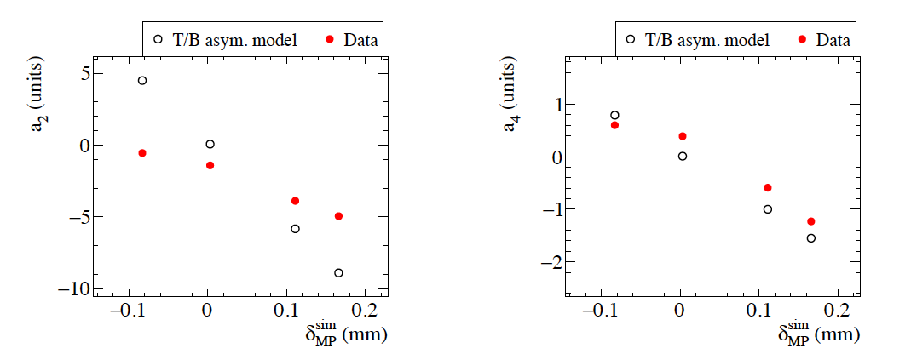
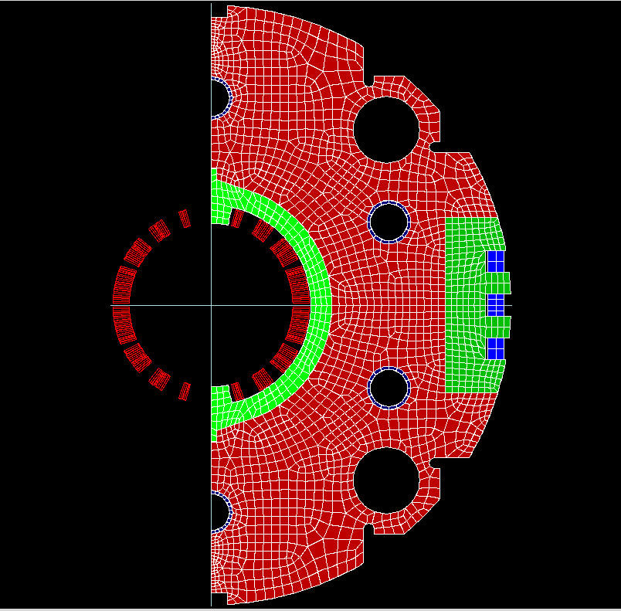
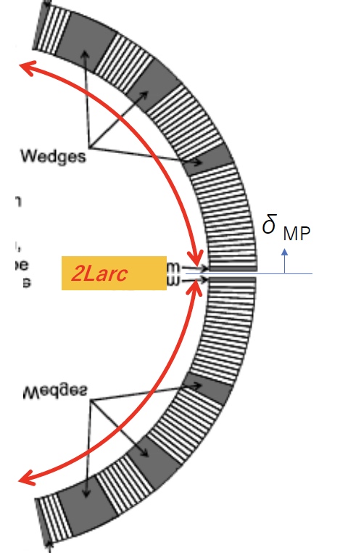
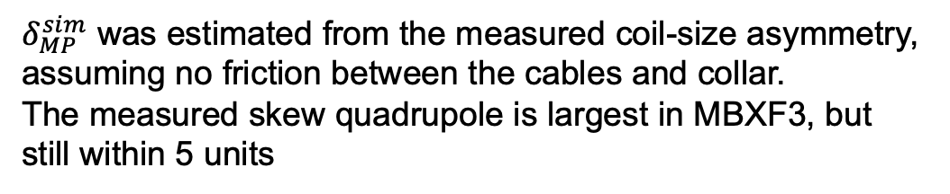
Estimation of a2 and a4 by an MP shift model
Measured data after yoking at Hitachi
MBXF3TOP
MBXF2
MBXF2
MBXF5
MBXF5
MBXF1
MBXF3BTM
MBXF1
MBXF3
MBXF3
$δ_{MP}^{sim}$ was estimated from the measured coil-size asymmetry, assuming no friction between the cables and collar.
The measured skew quadrupole is largest in MBXF3, but still within 5 units

