Slide 1
MCBXF series production at CERN
Update June 2024
Juan Carlos Perez, Jose Ferradas and Gonzalo Hernando
on behalf of the full team!
05/06/2024
HL-LHC WP3 Meeting

Slide 2
Outline
MCBXF general status at CERN
Summary on initial activities
MCBXFB05 assembly
MCBXFA1 assembly
Summary and outlook

Slide 3
Outline
MCBXF general status at CERN
Summary on initial activities
MCBXFB05 assembly
MCBXFA1 assembly
Summary and outlook

Slide 4
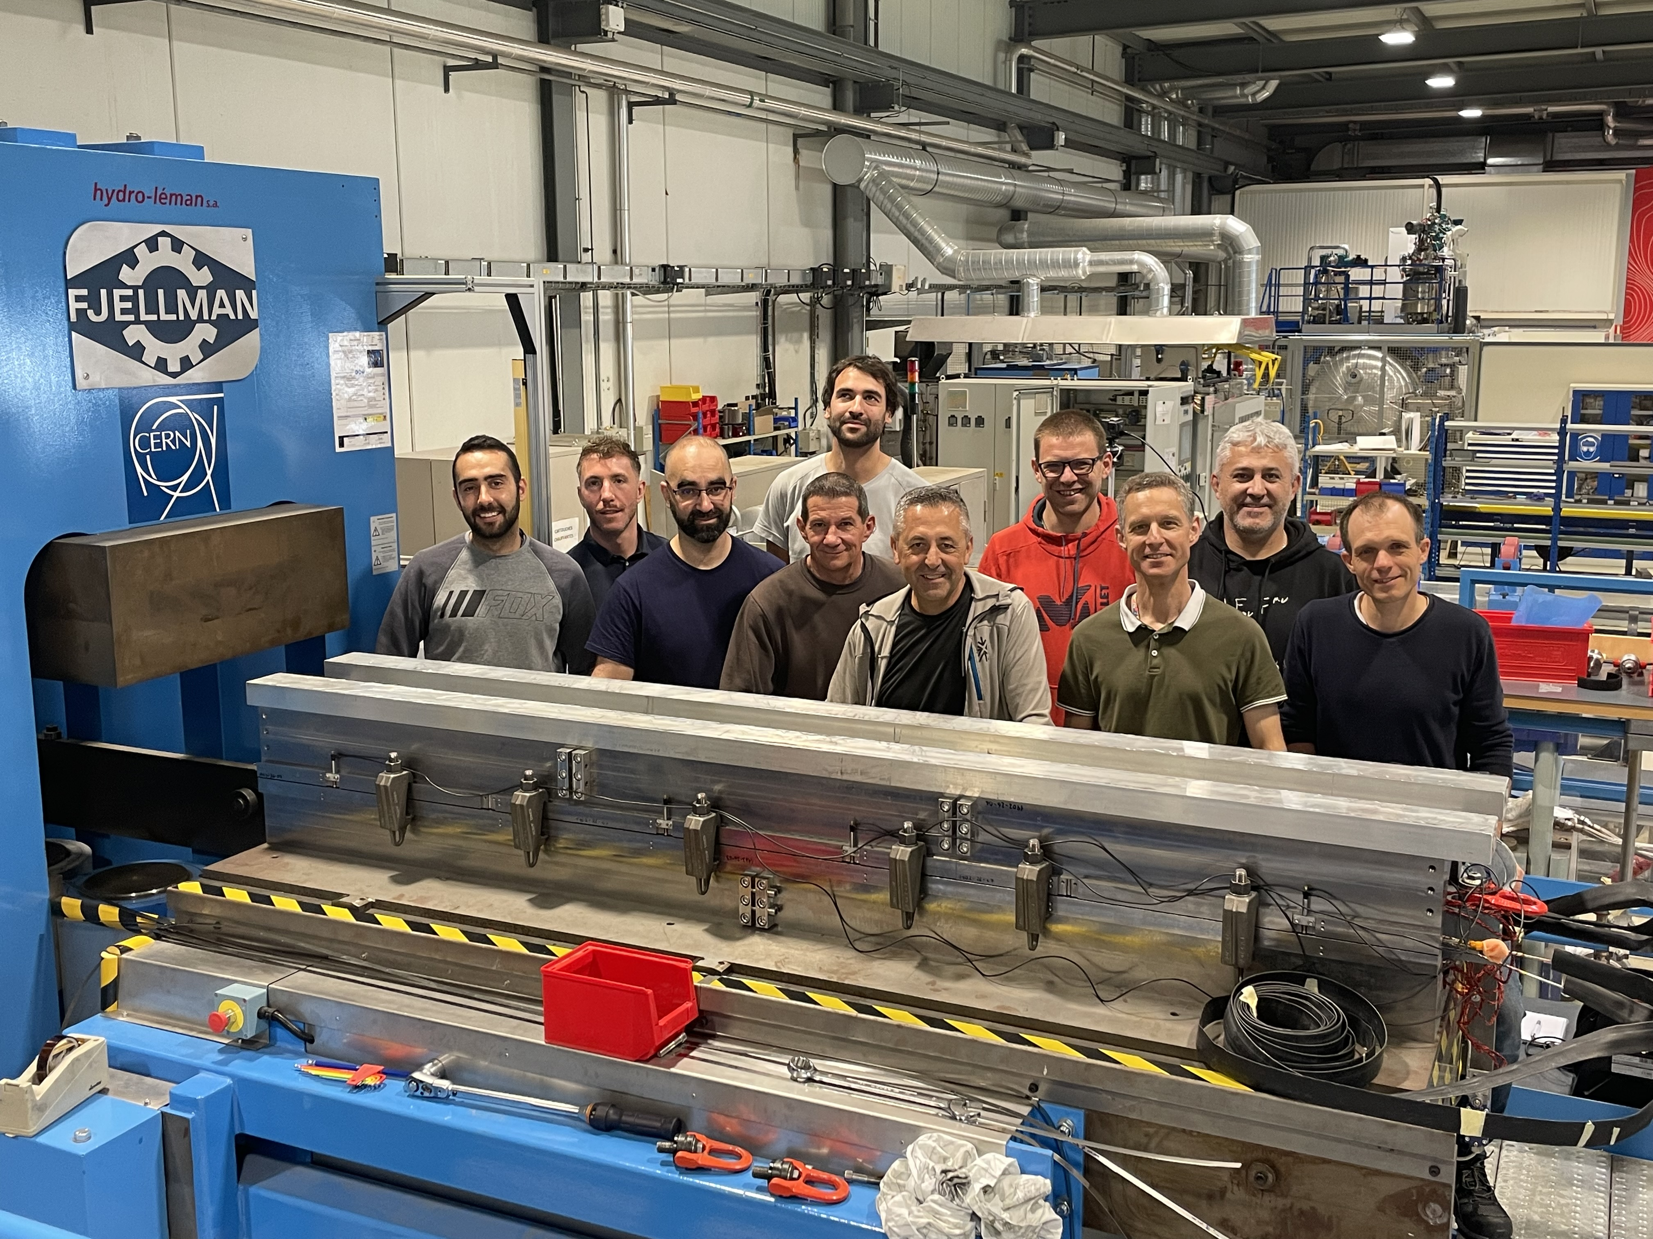

Slide 5
MCBXF status at CERN
Organization:
WP3 Project engineer: J.C. Perez
Magnet assembly activities (including magnetic measurements):
  Gonzalo Hernando (TE-MSC-SMT)
  Jose Ferradas (TE-MSC-SMT)
  Federico Ismail Ben el Caid (TE-MSC-SMT)
  Sebastien Luzieux (TE-MSC-LMF)
  Karim Kallat (TE-MSC-LMF)
  Nicolas Eyraud (TE-MSC-LMF), in charge of knowledge transfer during MCBXFB05 and MCBXFA1 assembly!
Logistics:
  Steve Becle (TE-MSC-LMF), Laurent (TE-MSC-LMF) and Sylvain Caille (TE-MSC-LMF)
Mechanical measurements (EN-MME):
  Sylvain Mugnier and Michael Guinchard
Additional support from LMF and SMT (machining, electrical and magnetic measurements, etc): Pietro Rizzo, P.A. Contat, Ludovic Grand-Clement, Jeremy Pechiney, Franck Evrard, Piotr Rogacki and Lucio Fiscarelli.

Slide 6
MCBXF status at CERN
Timeline:
Meeting CIEMAT-CERN on Sept. 22nd
to announce contract interruption and ask to go with common internal resources
MCBXFA1 inner dipole collaring completed
Magnet assembly activities resumes at CERN
MCBXFB05
Last truck taking material from ELYTT
MCBXFB05 cold test (2nd TC)
Oct. 23
Feb. 24
April. 23
May. 24
Jan. 24
June. 24
Nov. 23
Dec. 23
March. 24
Preparation of the new production line starts at CERN (infrastructure)
Today
First CERN internal meeting on Oct. 19th to propose a production line location
MCBXFB05 completed
Start of MCBXFA1 assembly
Meeting CIEMAT-CERN @ CERN
to inform progress on contract cancelation

Slide 7
MCBXF status at CERN
Updated planning:
 | 2024 |  |  |  |  |  |  |  |  |  |  |  |  |  |  |  |  |  |  |  |  |  |  |  | 2025 |  |  |  |  |  |  |  |  |  |  |  |  |  |  |  |  |  |  |  |  |  |  |  | 2026
 | Jan |  | Feb |  | Mar |  | Apr |  | May |  | Jun |  | Jul |  | Aug |  | Sep |  | Oct |  | Nov |  | Dec |  | Jan |  | Feb |  | Mar |  | Apr |  | May |  | Jun |  | Jul |  | Aug |  | Sep |  | Oct |  | Nov |  | Dec |  | Jan |  | Feb |  | Mar |  | April |  | May
MCBXFB05 |  |  |  | B05
MCBXFA1 |  |  |  |  |  |  |  |  |  | A1
MCBXFB06 |  |  |  |  |  |  |  |  |  |  |  |  |  |  | B06
MCBXFB07 |  |  |  |  |  |  |  |  |  |  |  |  |  |  |  |  |  |  |  | B07
MCBXFA2 |  |  |  |  |  |  |  |  |  |  |  |  |  |  |  |  |  |  |  |  |  |  |  |  | A2
MCBXFB08 |  |  |  |  |  |  |  |  |  |  |  |  |  |  |  |  |  |  |  |  |  |  |  |  |  |  |  |  |  | B08
MCBXFA3 |  |  |  |  |  |  |  |  |  |  |  |  |  |  |  |  |  |  |  |  |  |  |  |  |  |  |  |  |  |  |  |  |  | A3
MCBXFB09 |  |  |  |  |  |  |  |  |  |  |  |  |  |  |  |  |  |  |  |  |  |  |  |  |  |  |  |  |  |  |  |  |  |  |  |  |  |  | B09
MCBXFA4 |  |  |  |  |  |  |  |  |  |  |  |  |  |  |  |  |  |  |  |  |  |  |  |  |  |  |  |  |  |  |  |  |  |  |  |  |  |  |  |  |  |  | A4
MCBXFB10 |  |  |  |  |  |  |  |  |  |  |  |  |  |  |  |  |  |  |  |  |  |  |  |  |  |  |  |  |  |  |  |  |  |  |  |  |  |  |  |  |  |  |  |  |  |  |  |  | B10
MCBXFA5 |  |  |  |  |  |  |  |  |  |  |  |  |  |  |  |  |  |  |  |  |  |  |  |  |  |  |  |  |  |  |  |  |  |  |  |  |  |  |  |  |  |  |  |  |  |  |  |  |  |  |  |  | A10
MCBXFA6
MCBXFB11
MCBXFB12
Initial planning accounted for a delivery rate of 1 magnet every 2 months (MCBXFB) or 2.5 months (MCBXFA)
Exception for the first magnet (B05), with an assembly time of 3 months (used for knowledge transfer and production line set-up)

Slide 8
Outline
MCBXF general status at CERN
Summary on initial activities
MCBXFB05 assembly
MCBXFA1 assembly
Summary and outlook

Slide 9
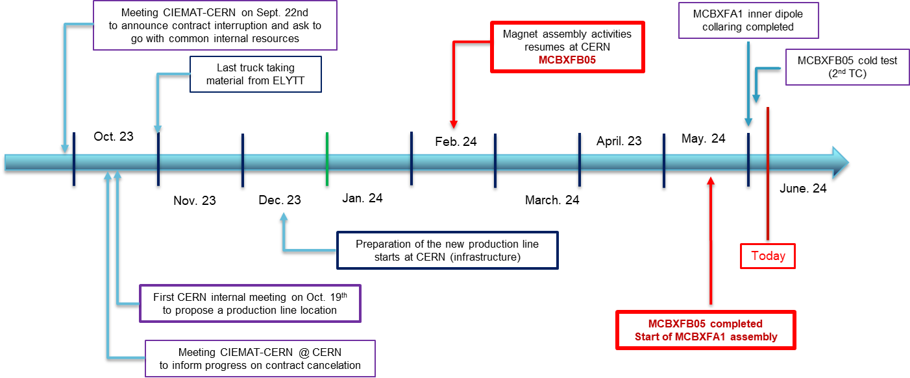
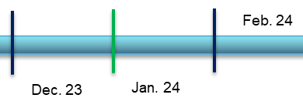
Summary of initial activities
A closer look to the first months…
Magnet assembly activities resumes at CERN
MCBXFB05
Preparation of the new production line starts at CERN (infrastructure)

Slide 10
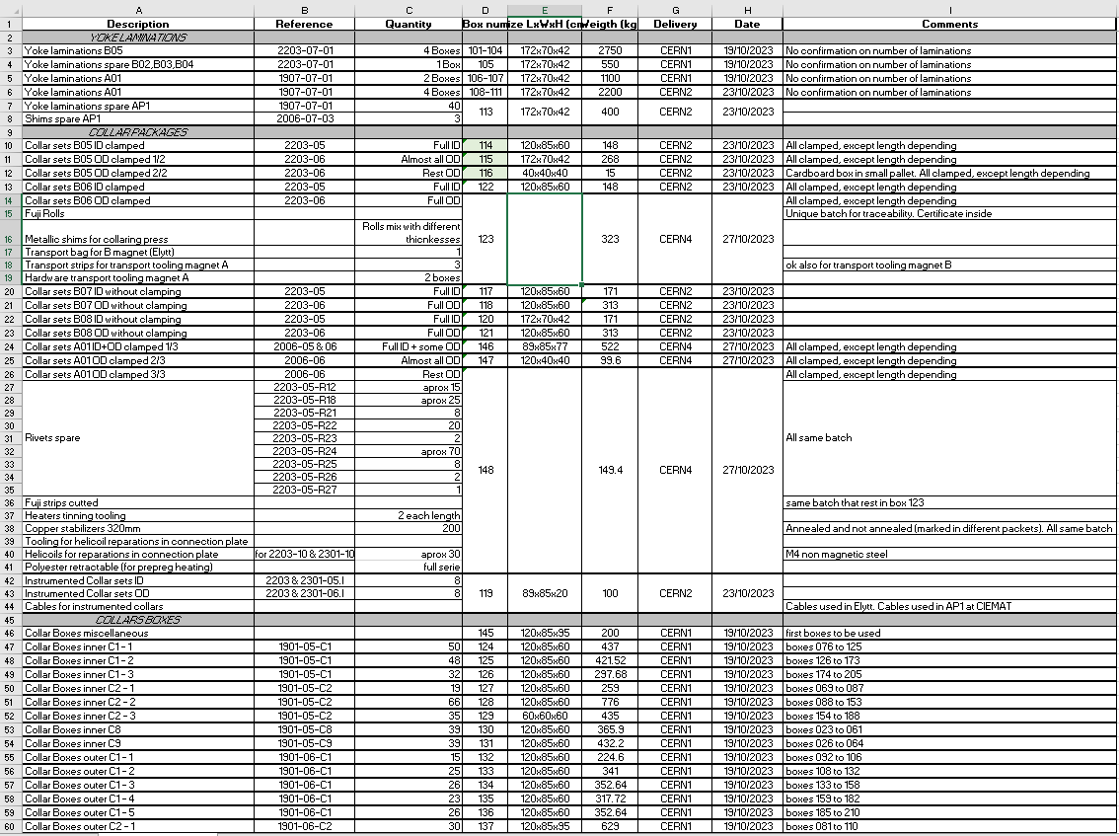
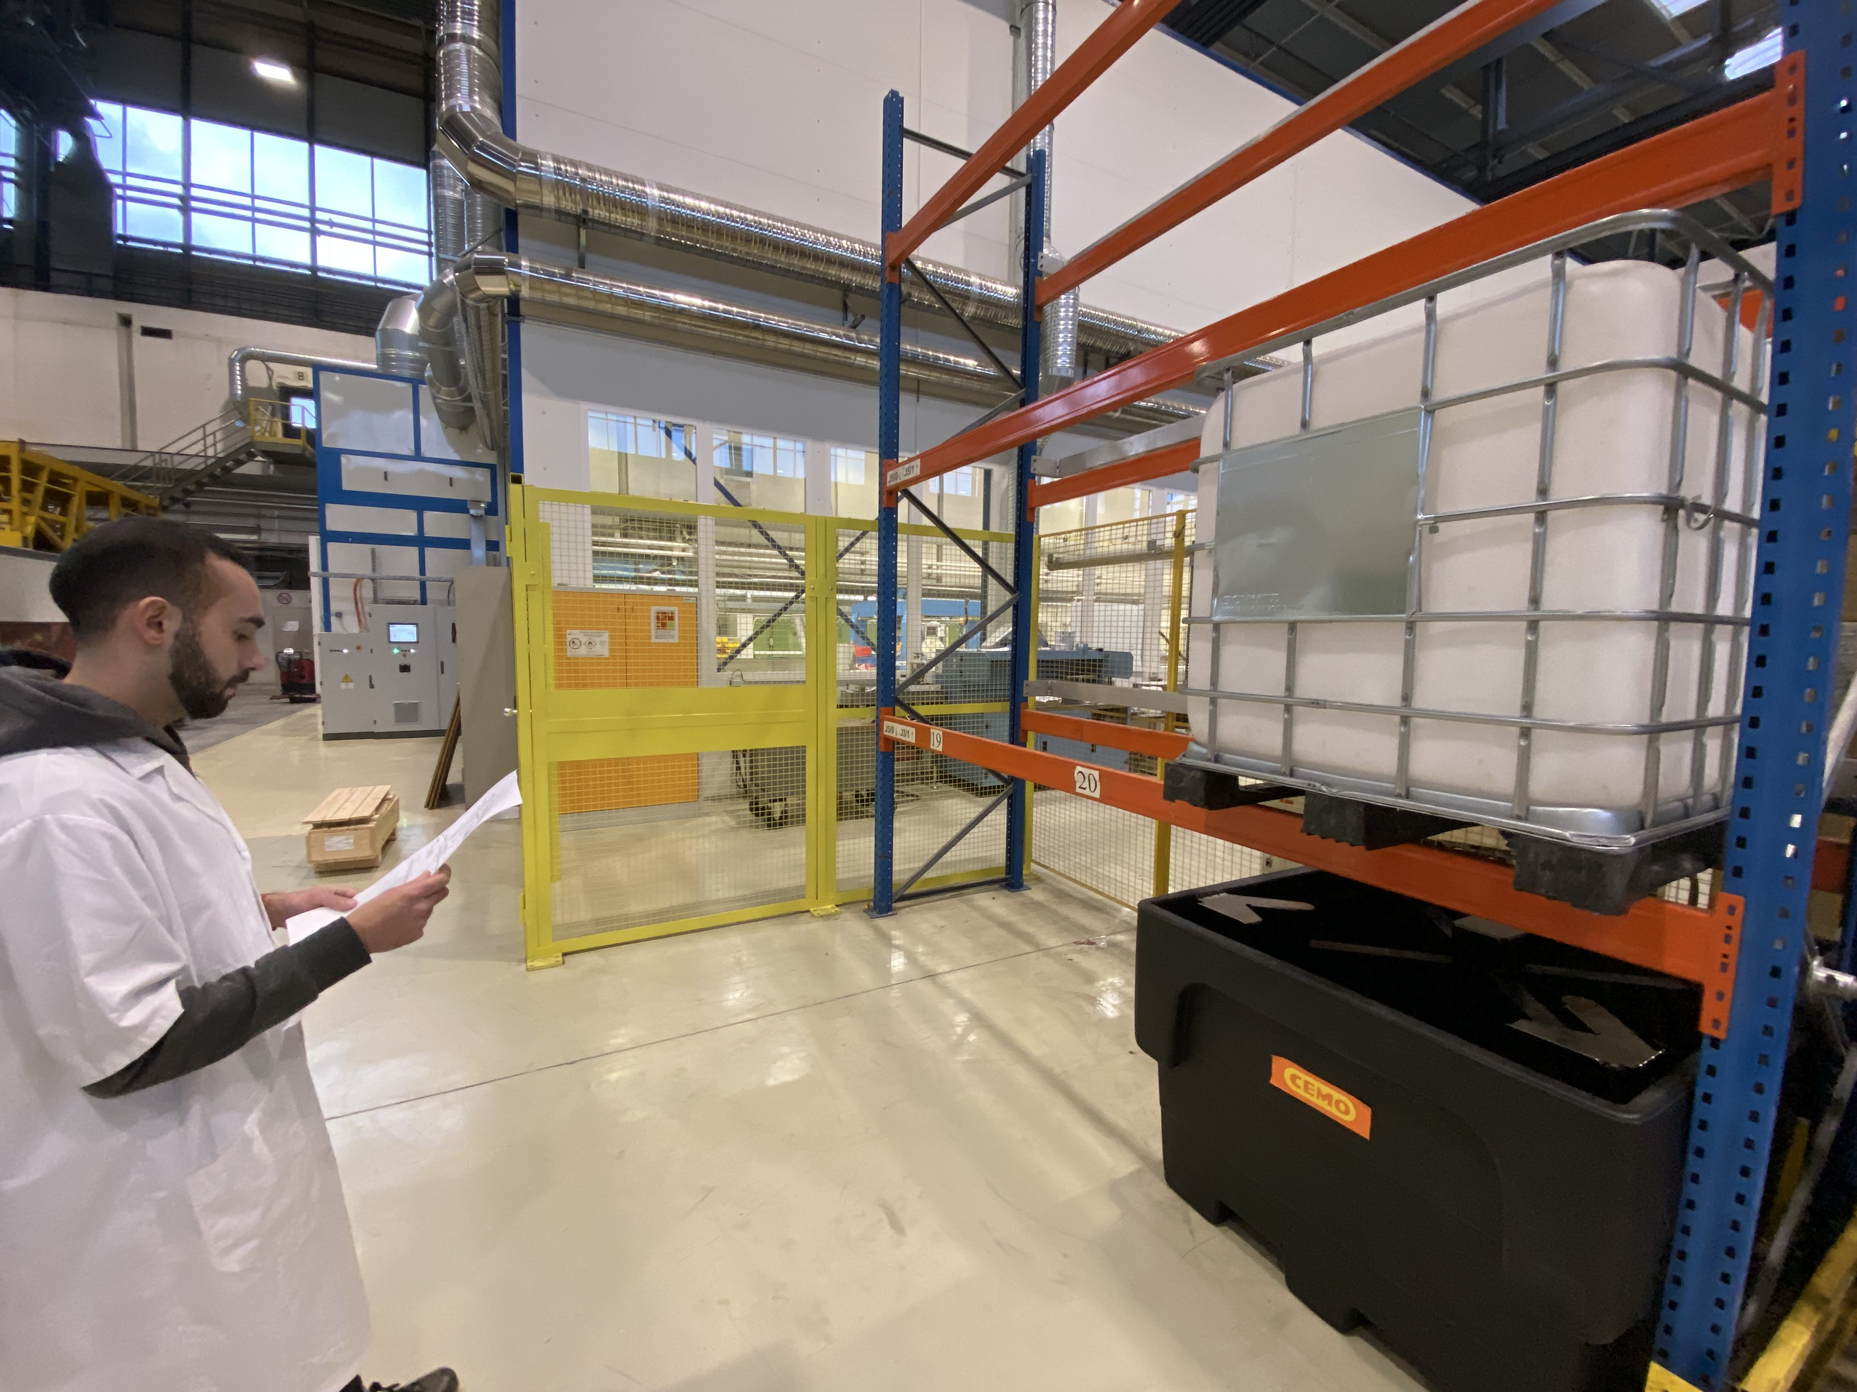
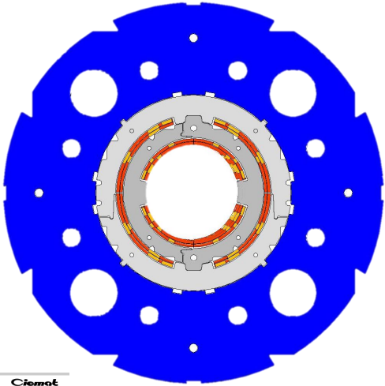
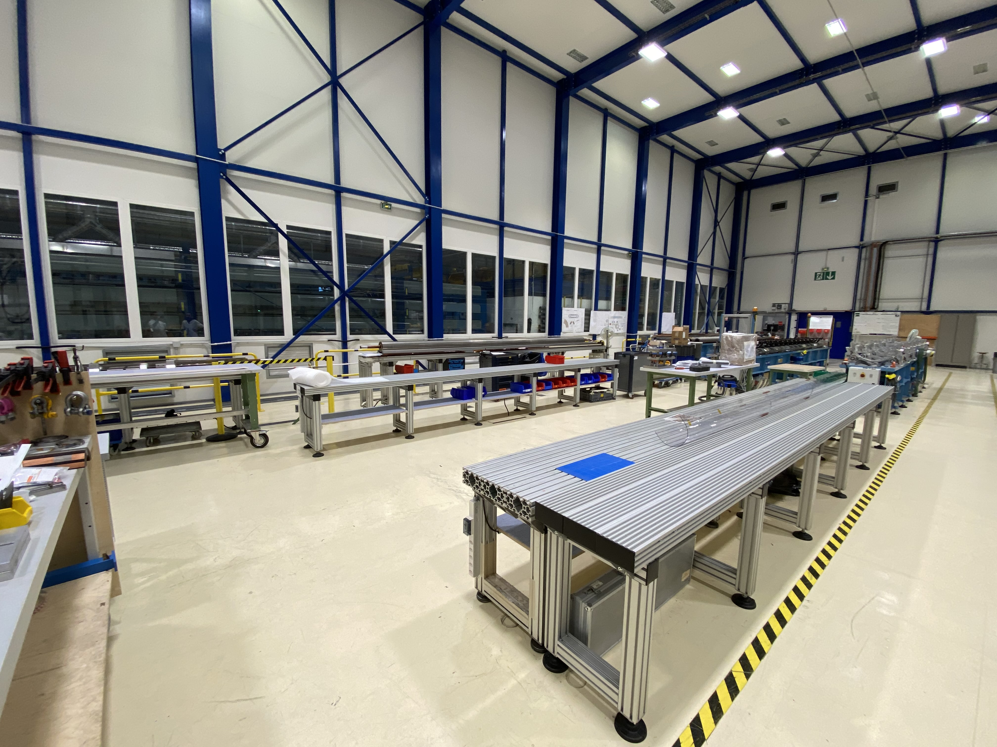
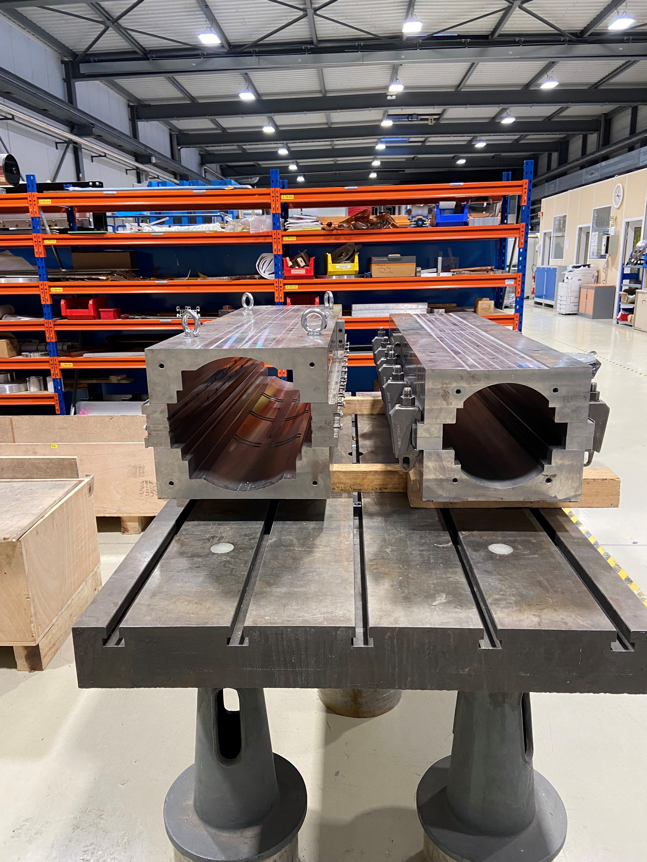
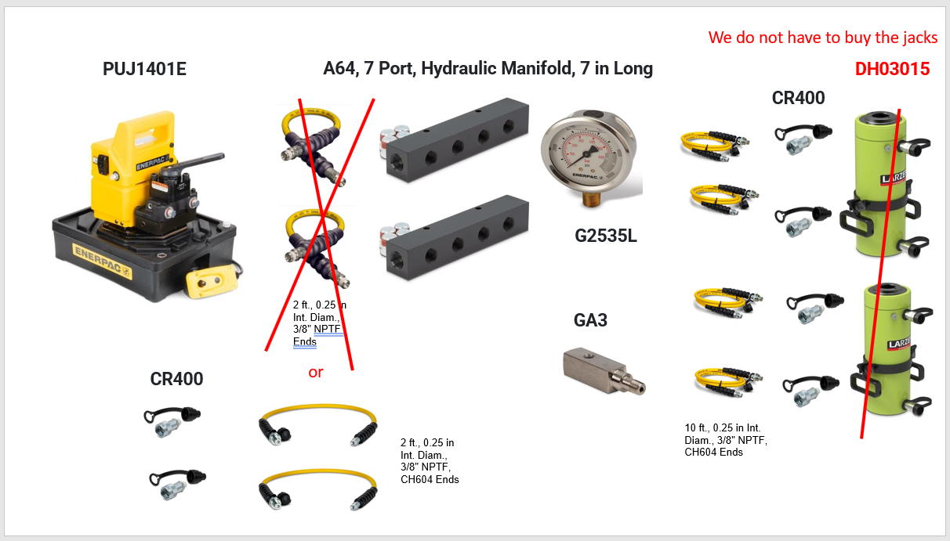
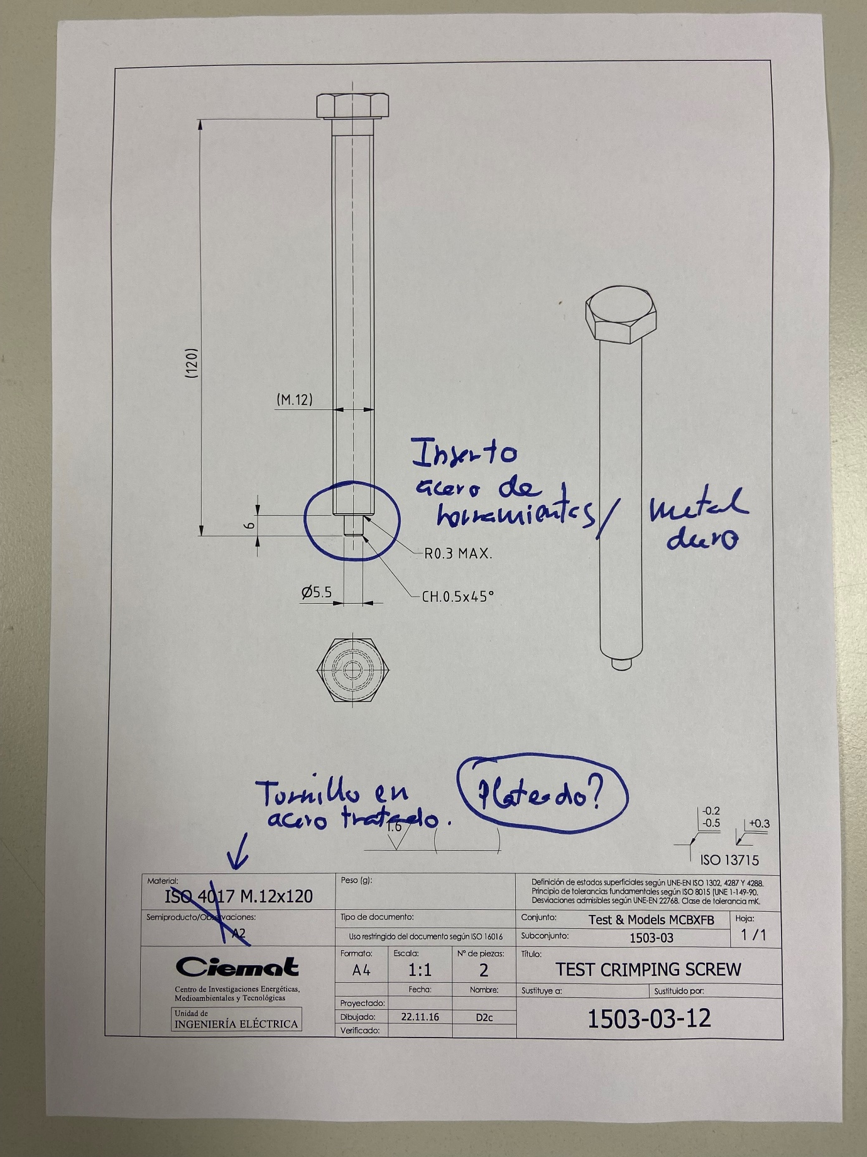
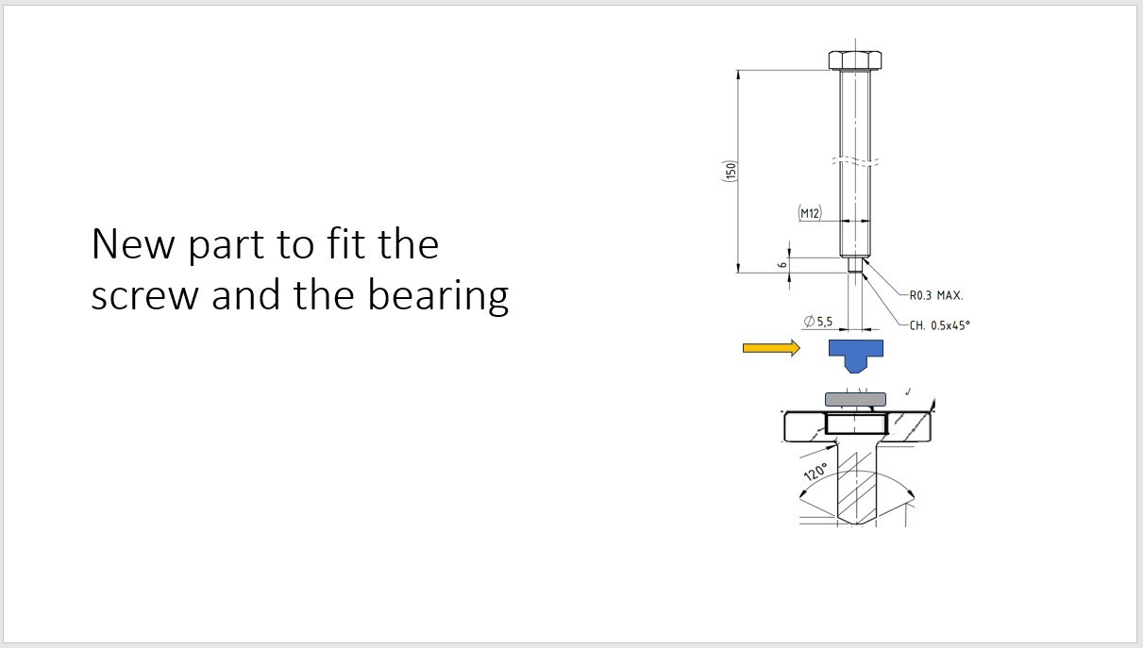
Summary of initial activities
Initial activities structured in 3 main axes:
Identification, control and storage of the magnet components. Documentation!
Setup of the required infrastructure in B.180 and B.927. Planning!
Repairs and modifications on assembly tooling (based on previous exp.). Design of new required tooling.

Slide 11
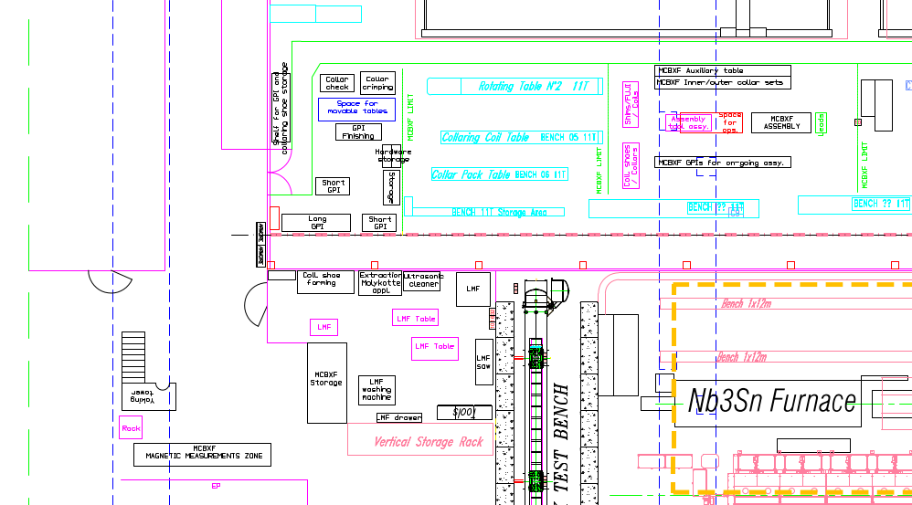
Setup of the required infrastructure
All assembly operations but the Collaring are performed in building 180: 3 zones for MCBXF.
ZONE 2: Collared coil assembly hall
ZONE 1: Ground insulation and collar-packs preparation area
LMF winding house
ZONE 3: Yoking, WMM and auxiliary workshop

Slide 12
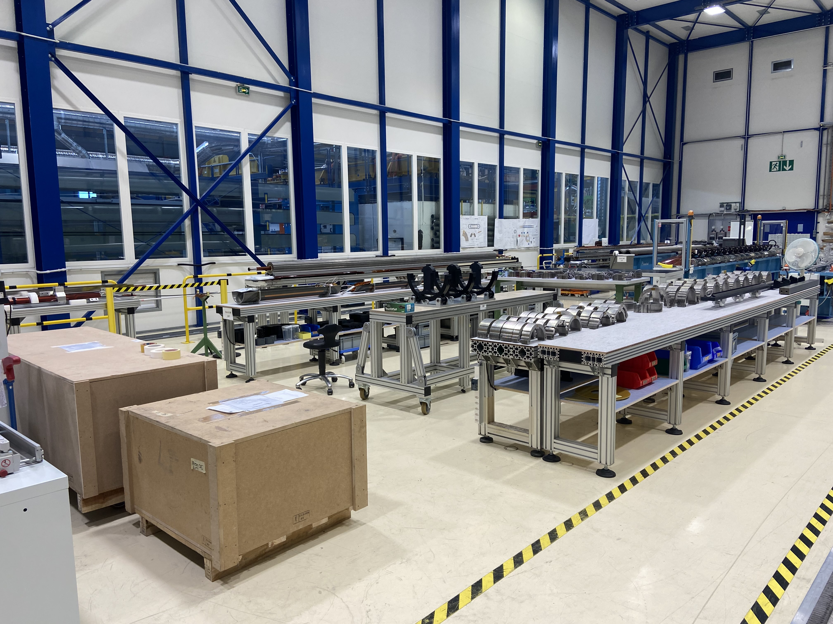
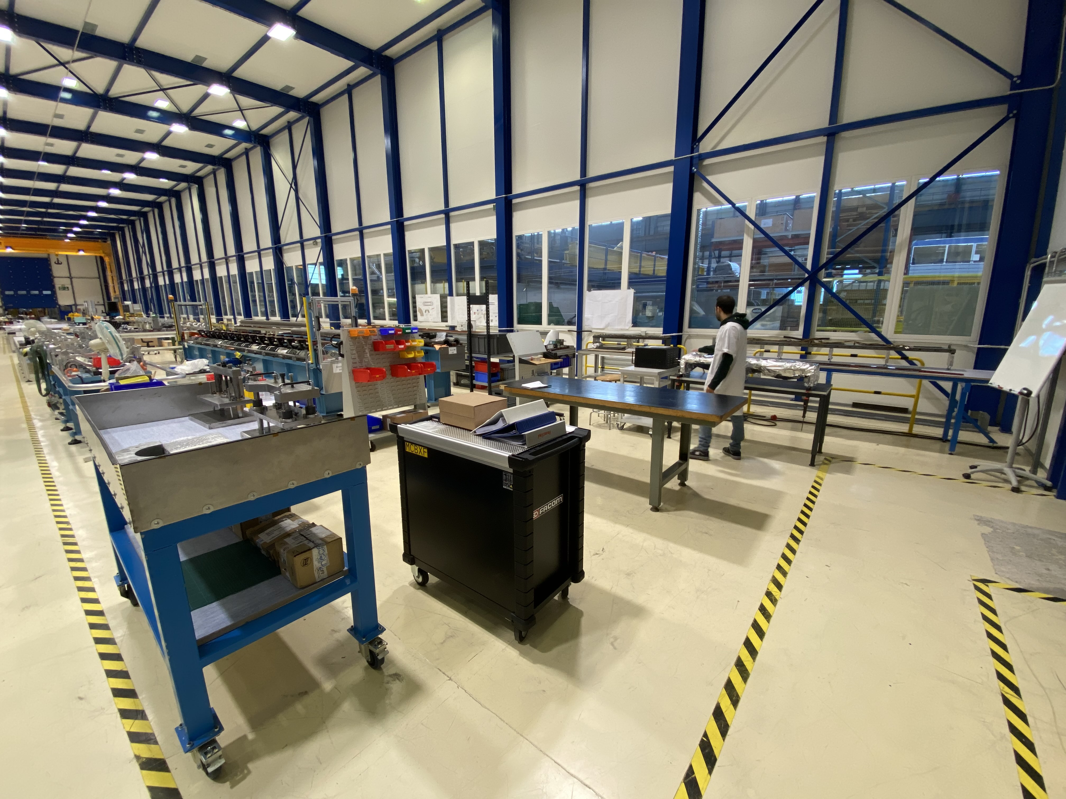
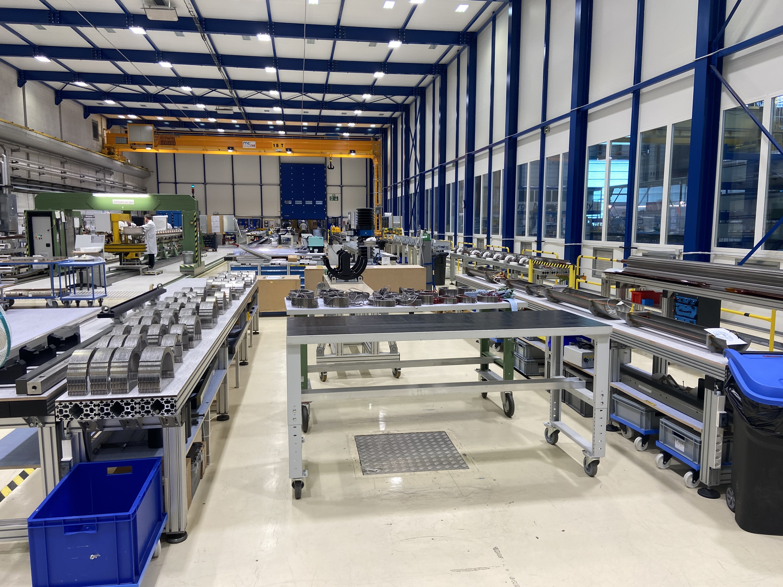
Setup of the required infrastructure
ZONE 1: Ground insulation and collar-packs preparation area
ZONE 2: Collared coil assembly hall

Slide 13
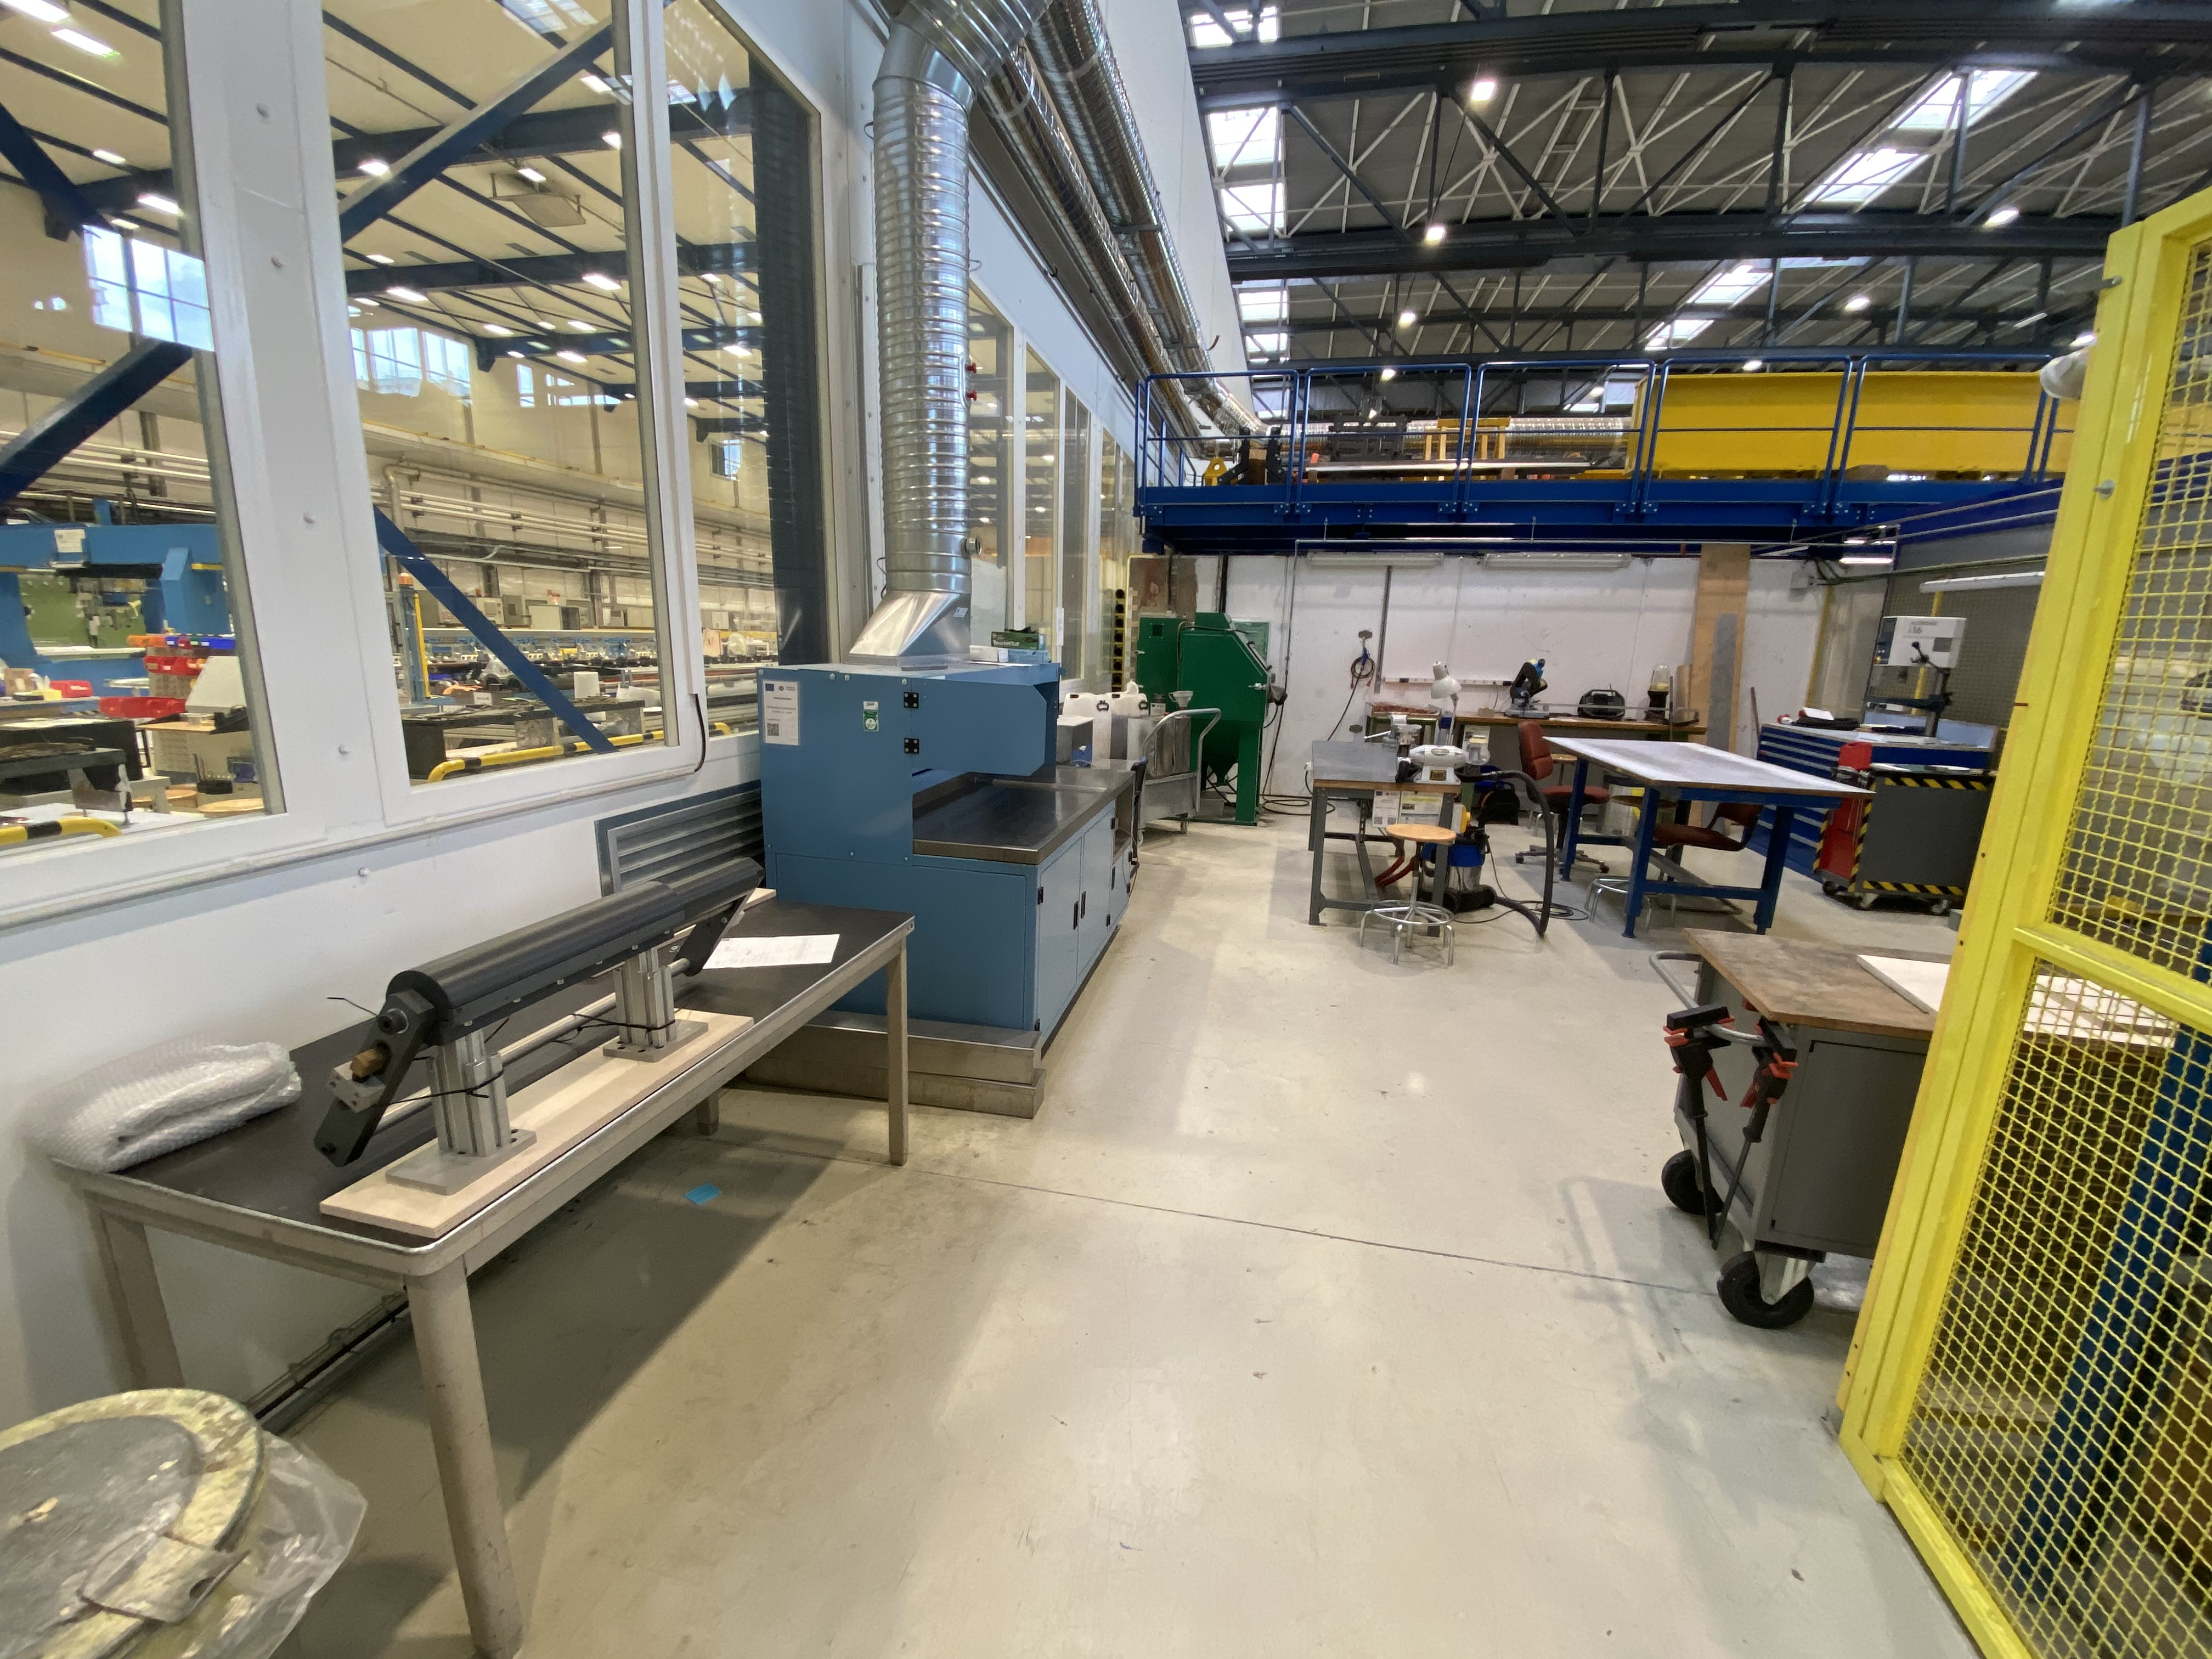
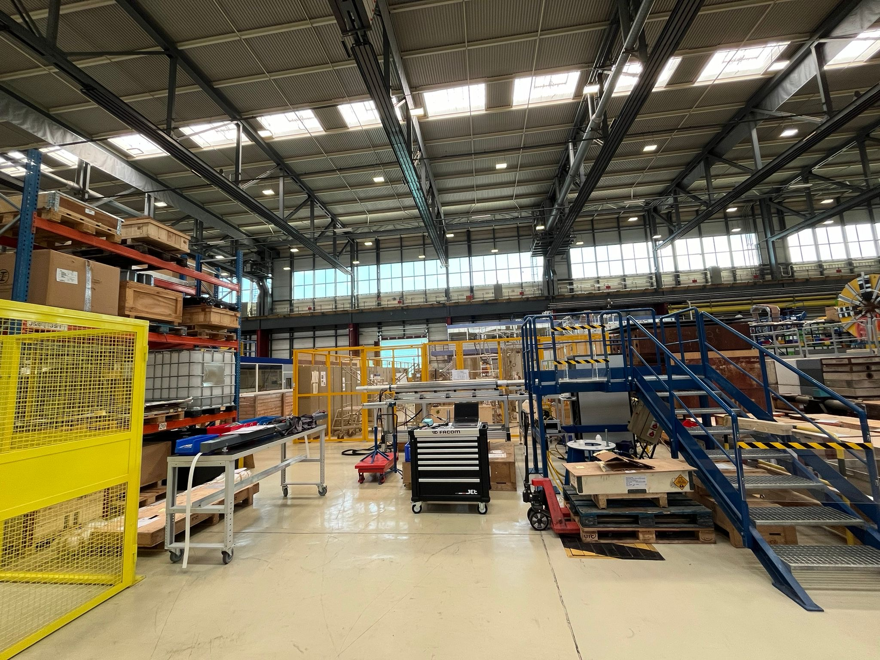
Setup of the required infrastructure
ZONE 3: Yoking, WMM and auxiliary workshop

Slide 14
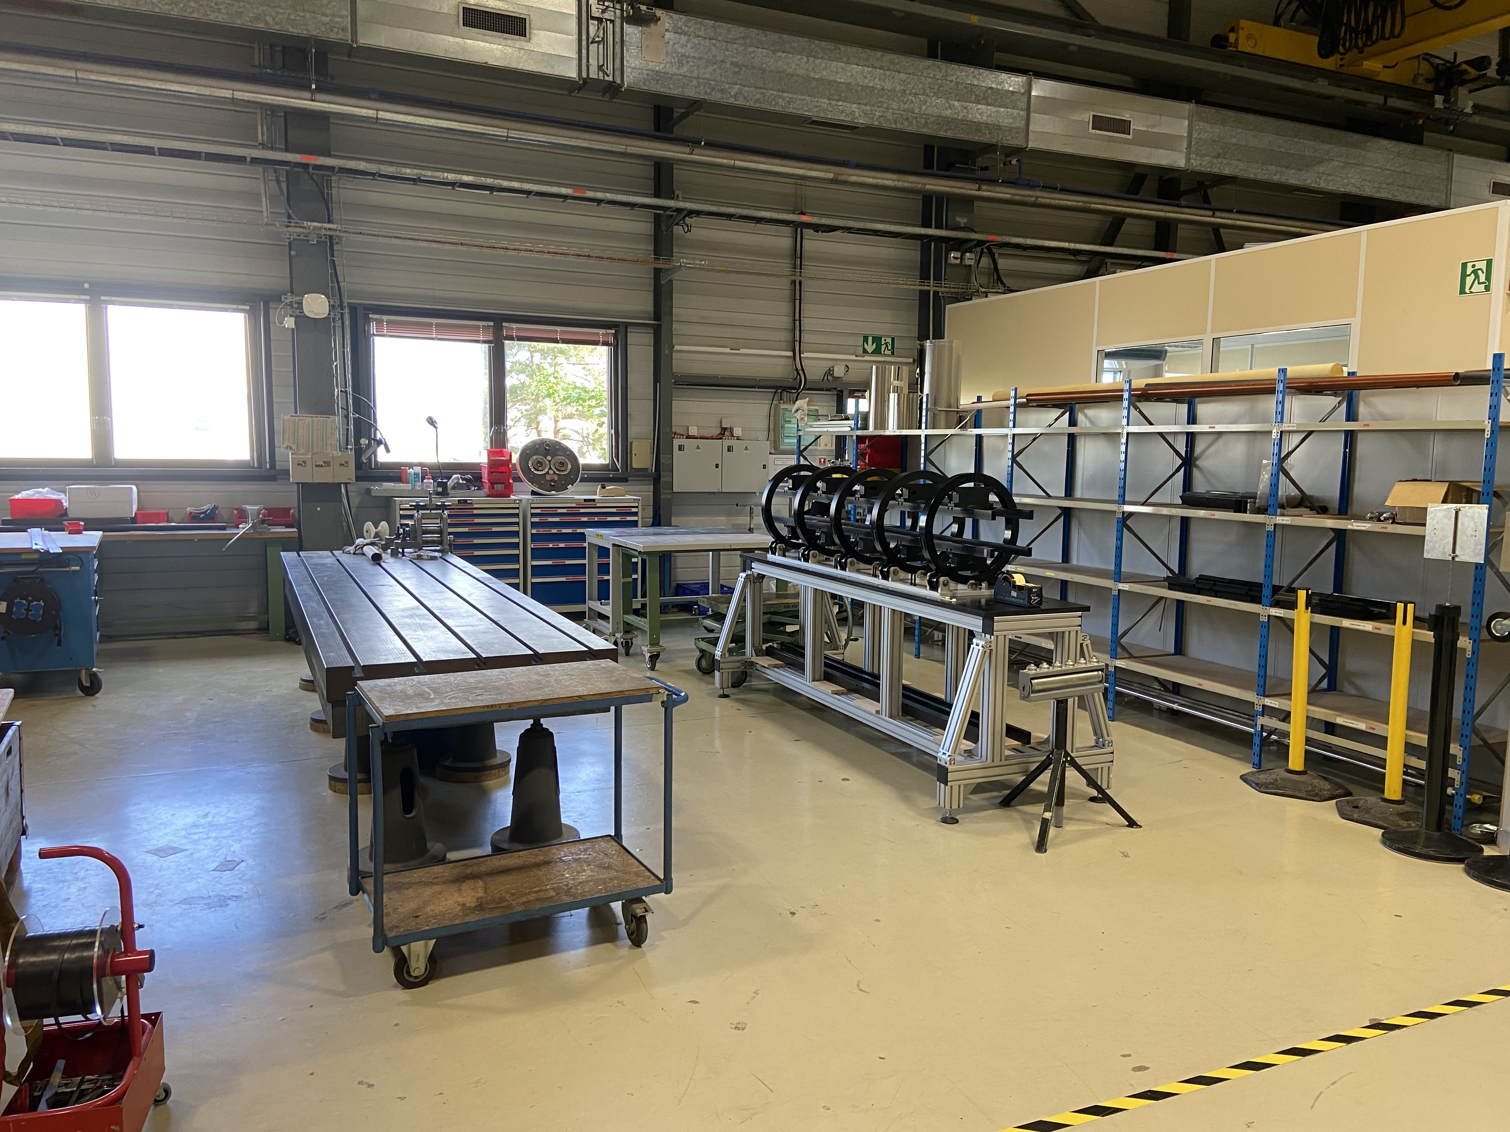
Setup of the required infrastructure
ZONE 4: Collaring press and assembly area at B.927

Slide 15
Outline
MCBXF general status at CERN
Summary on initial activities
MCBXFB05 assembly
MCBXFA1 assembly
Summary and outlook

Slide 16
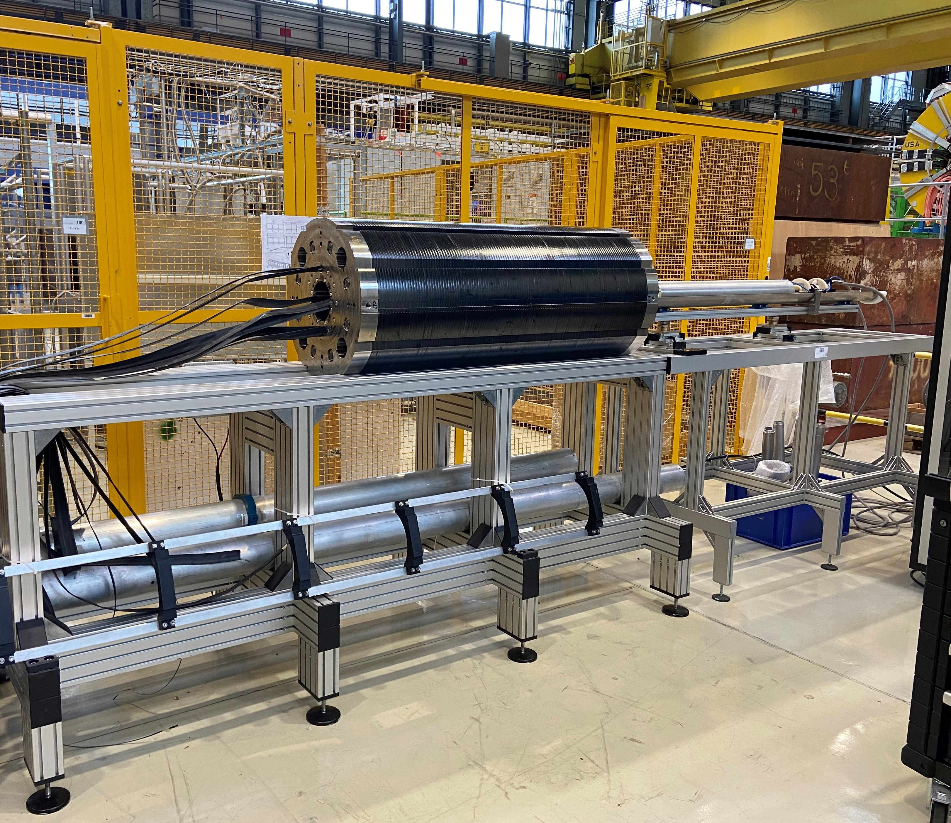
MCBXFB05
First magnet for the new production line
  Assembly duration: 3 months
    Used for transferring the know-how to the new team and setting-up the production line
  Two minor NCR during the assembly process
    Inner dipole collared twice due to the mispositioning of pole shims: EDMS 3089268
    Minimal damage to one Kapton layer outside the coil (on the ground insulation protruding outside the collars): EDMS 3088744
  Commissioning of the magnetic measurement bench took longer than expected
    Results cross-checked with TE-MSC-TM using shorter probes
  Various adjustments in the procedures and tooling according to the new infrastructure and lessons learnt

Slide 17
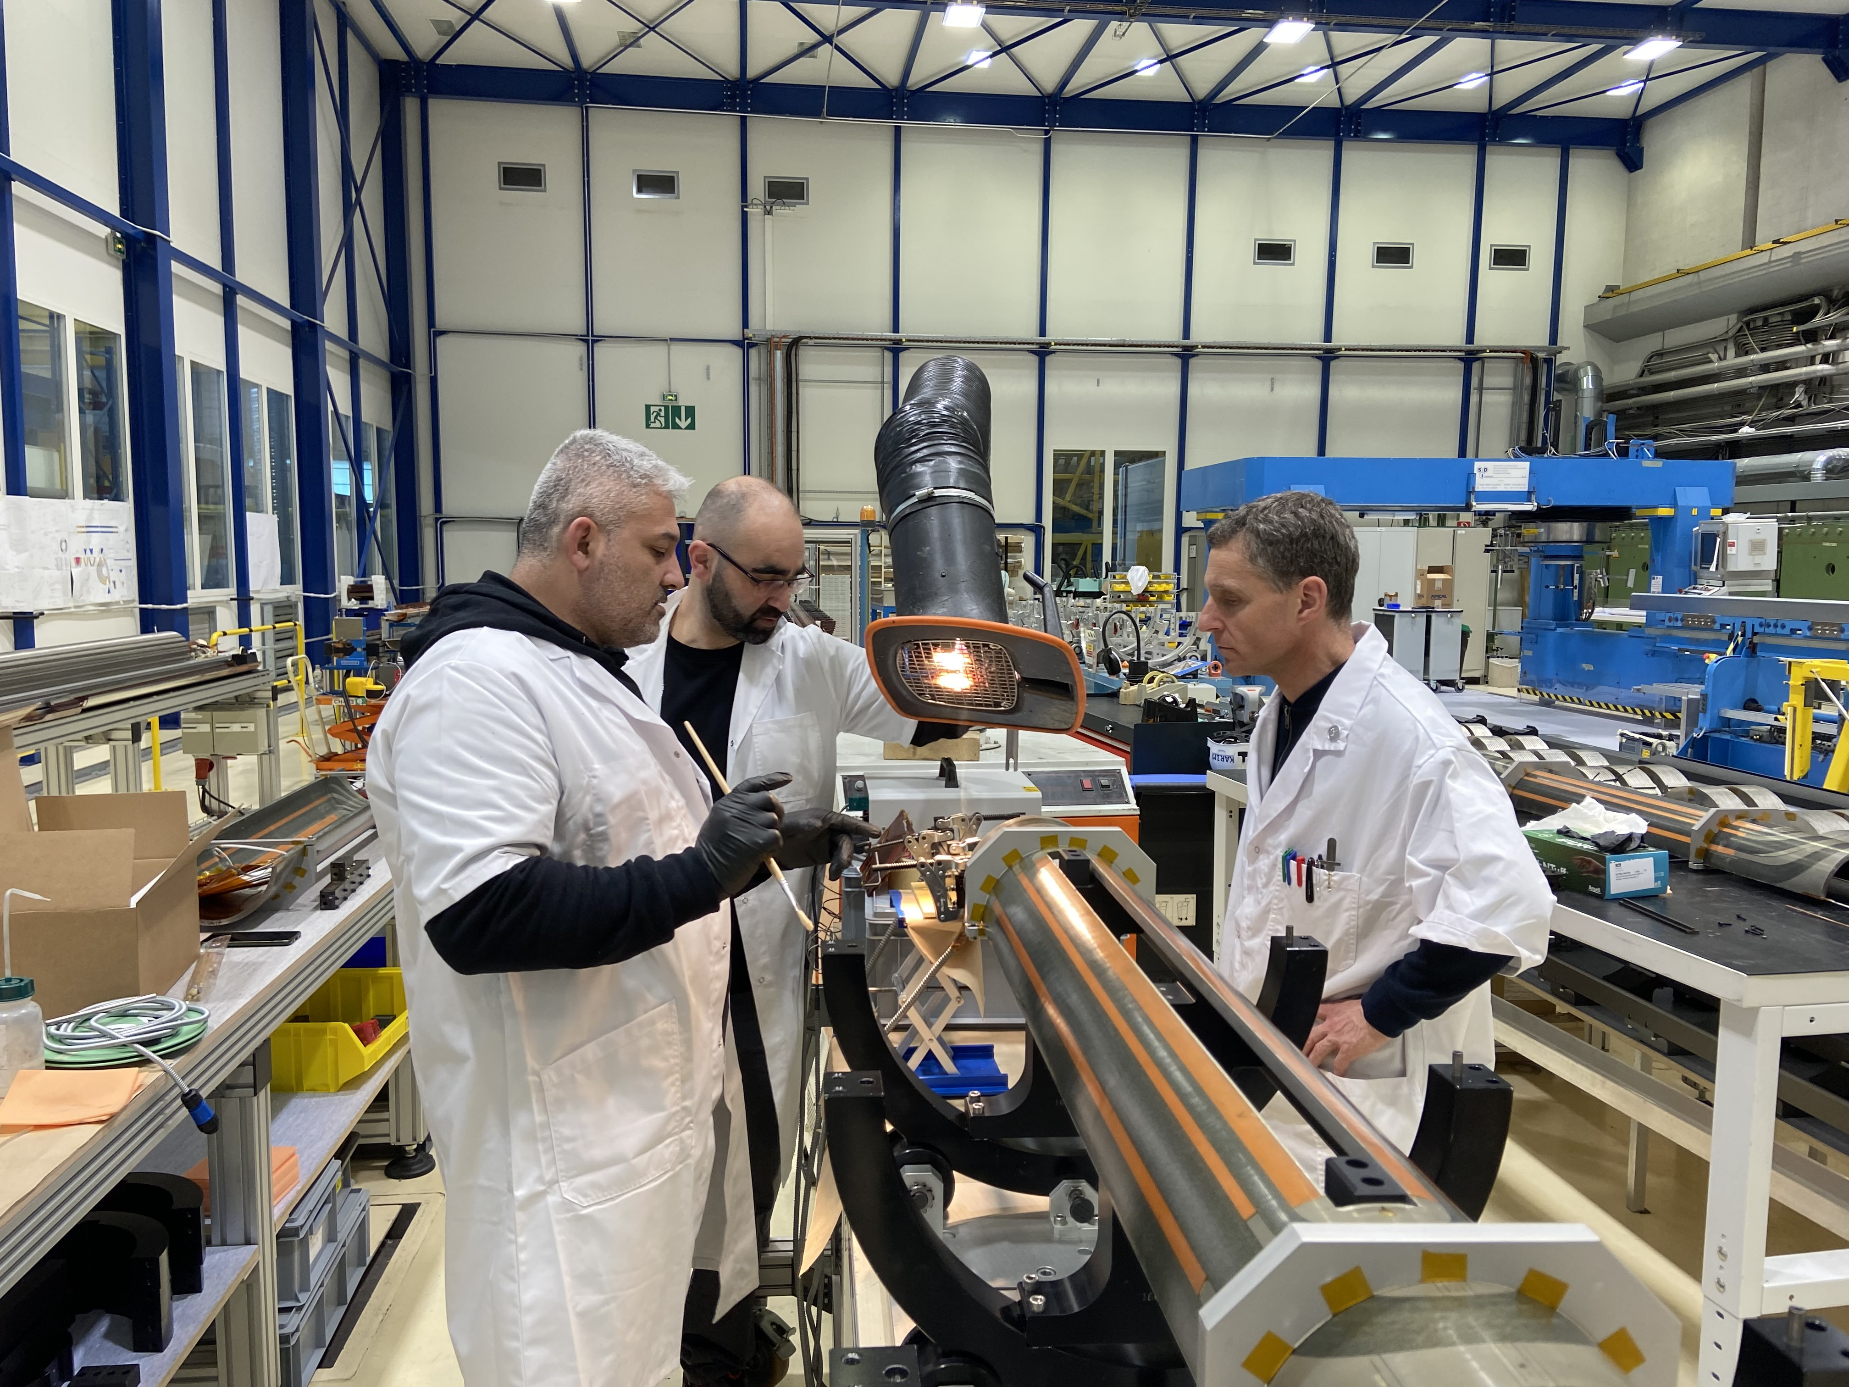
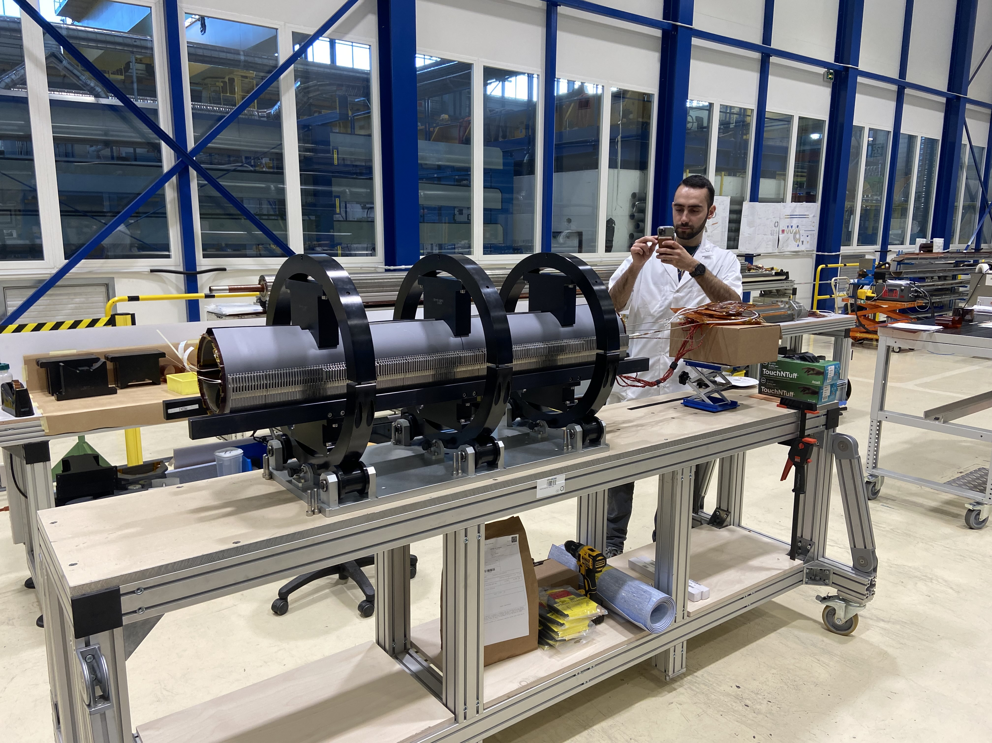
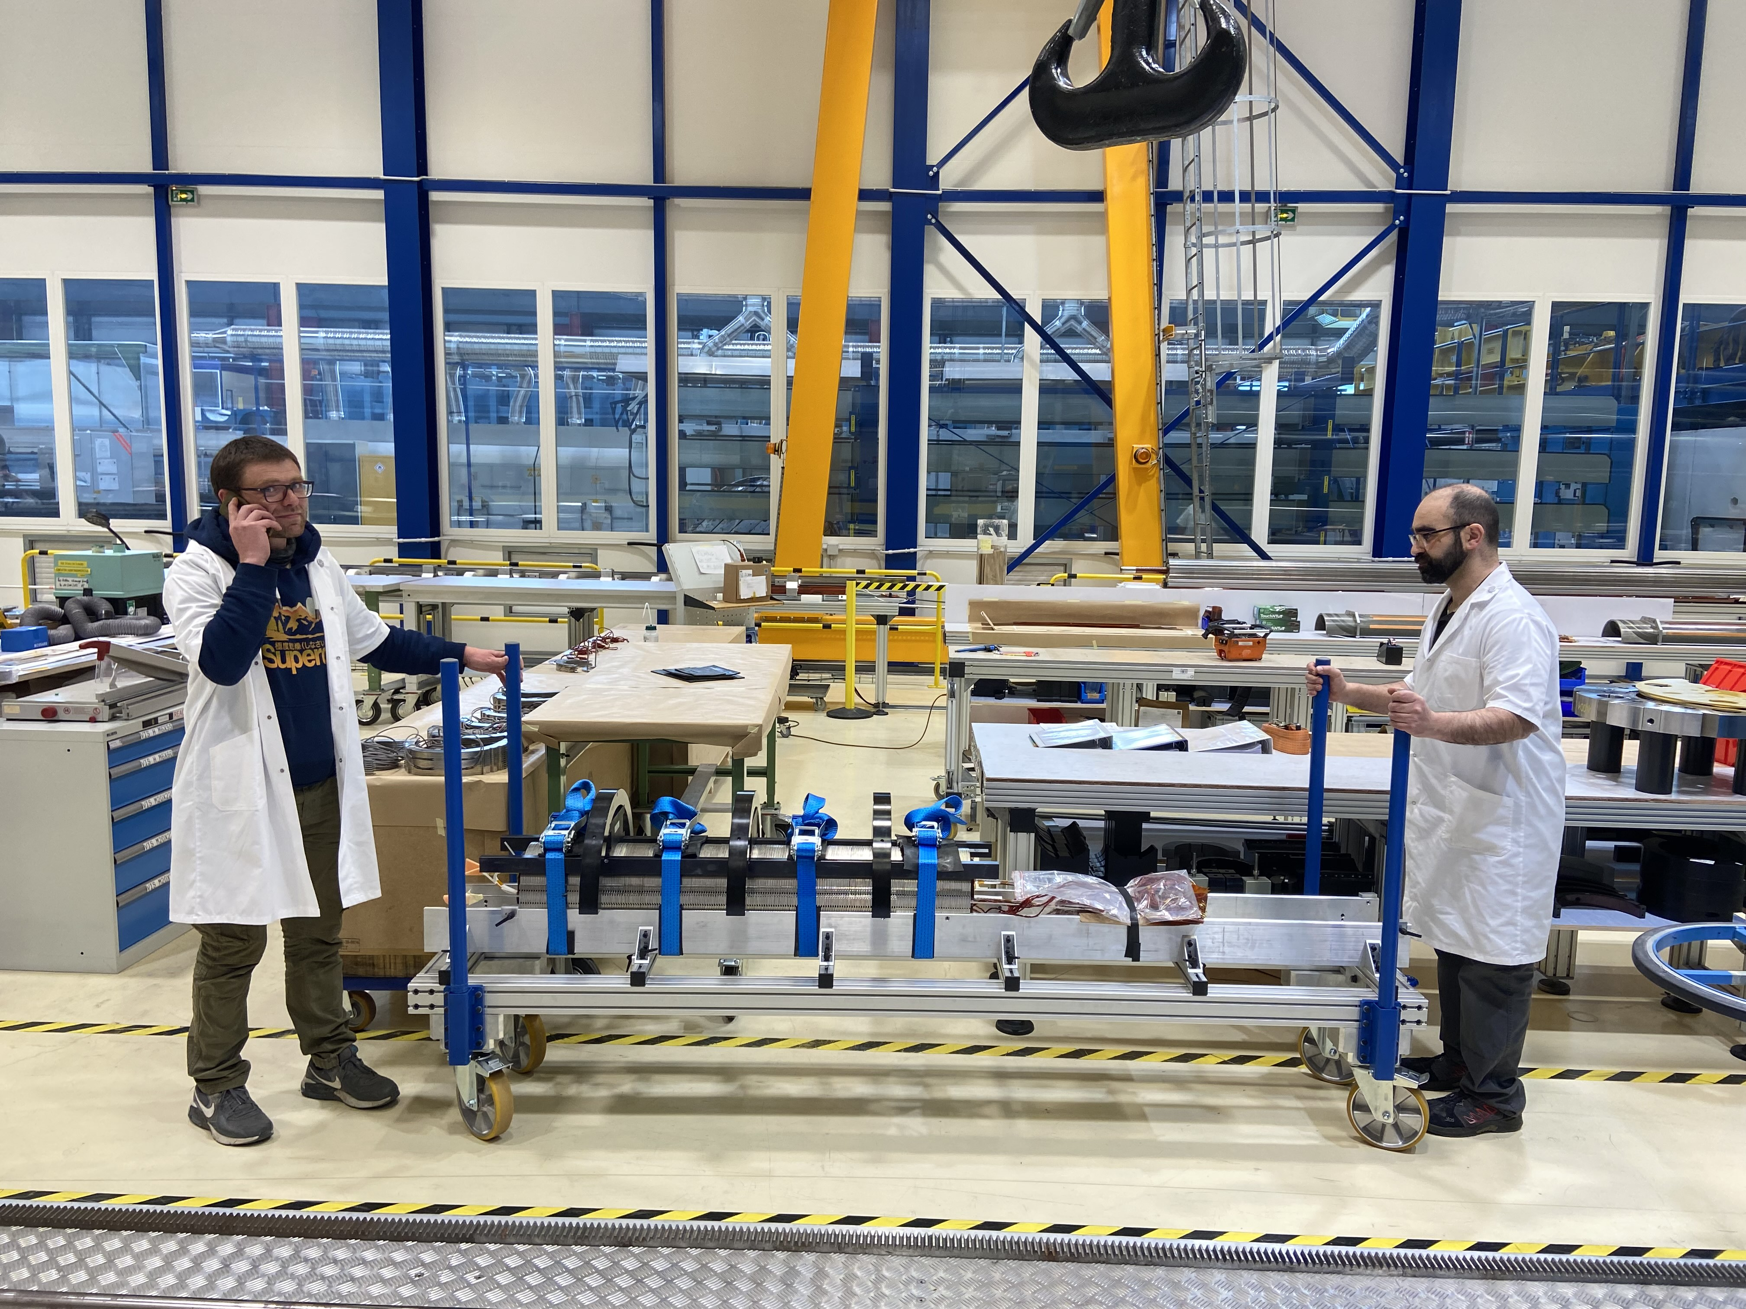
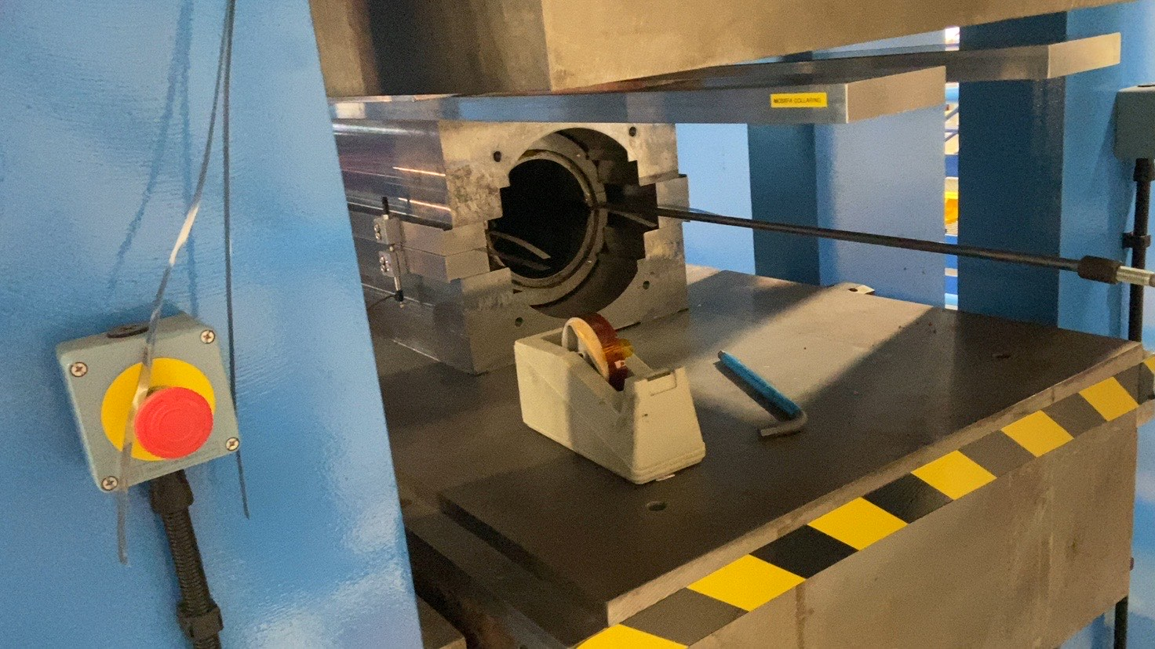
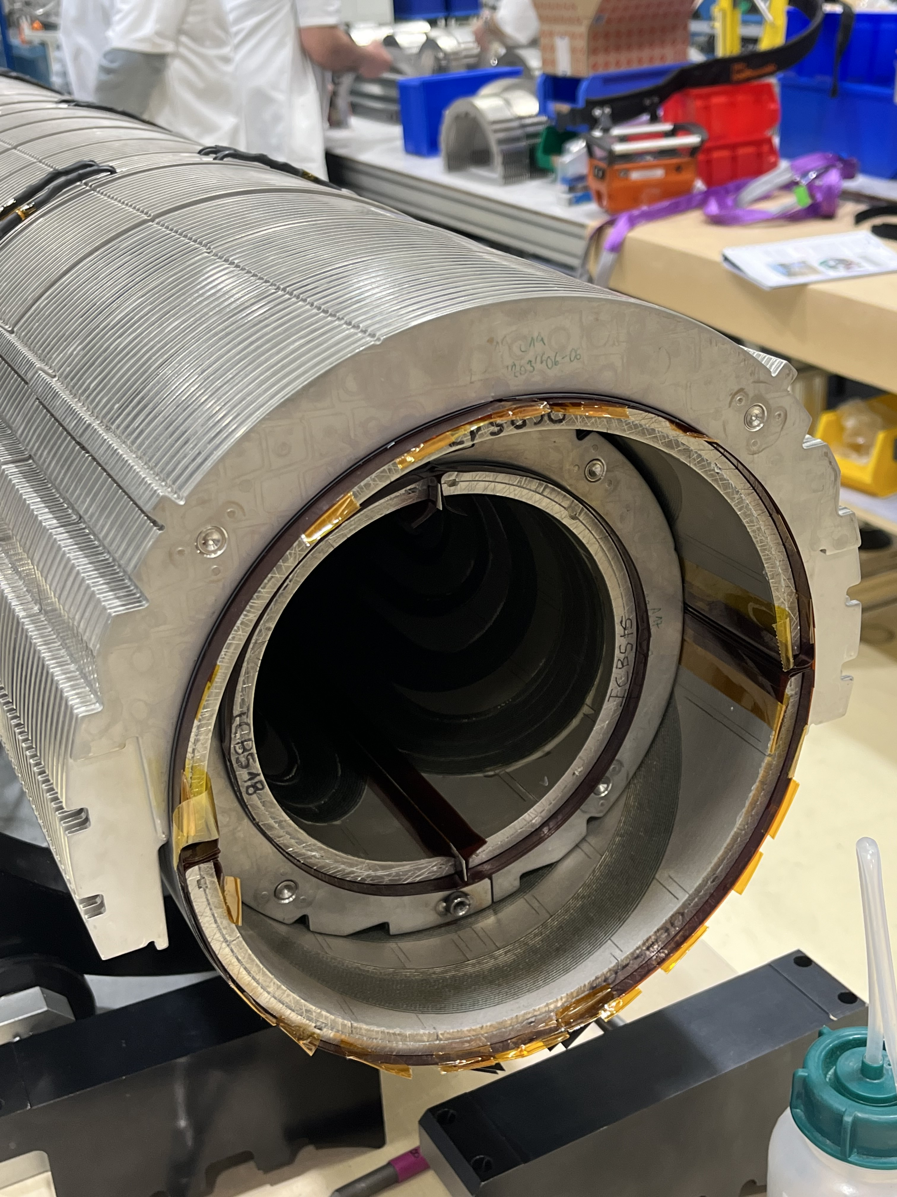
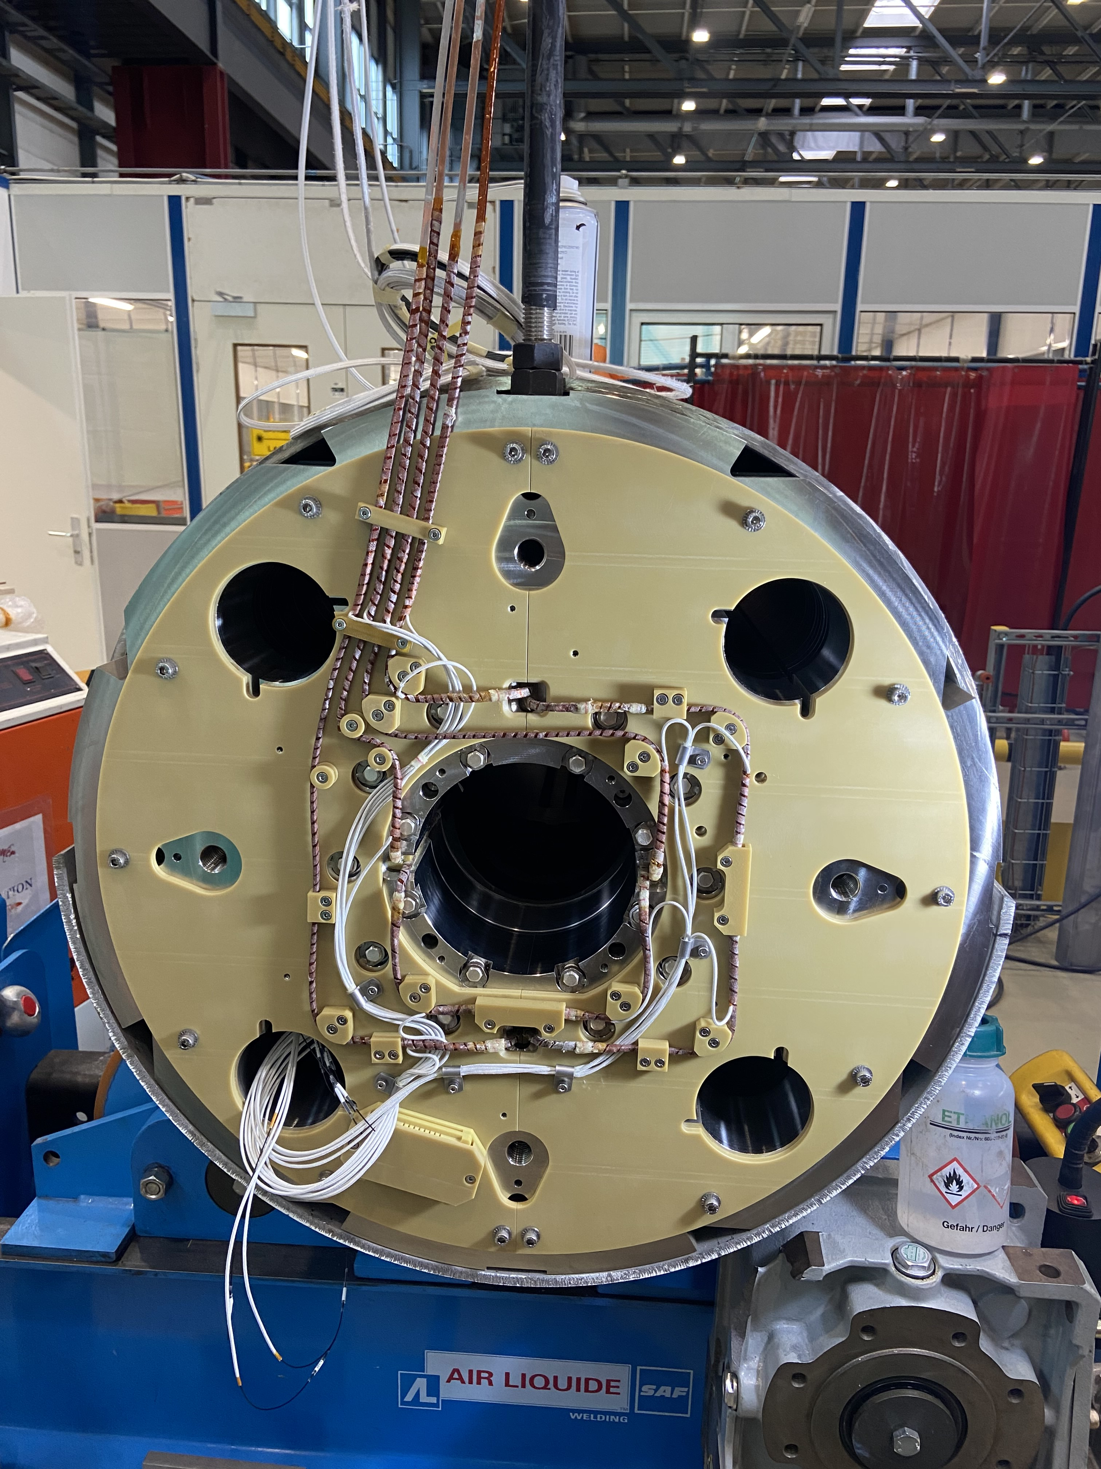
MCBXFB05

Slide 18

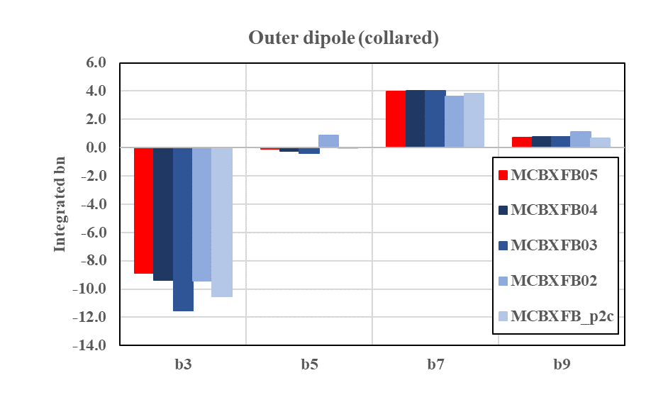
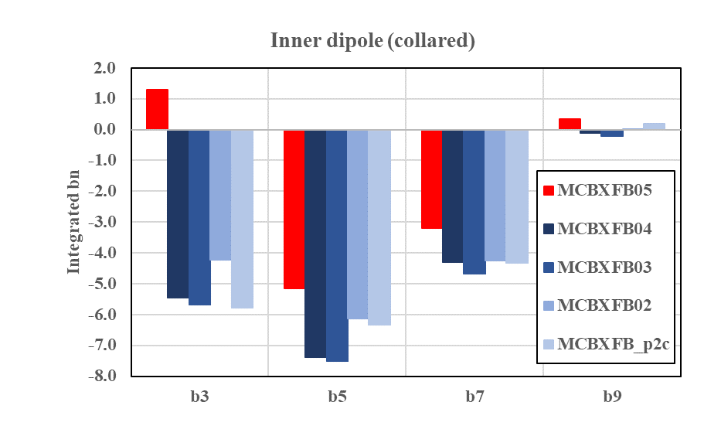
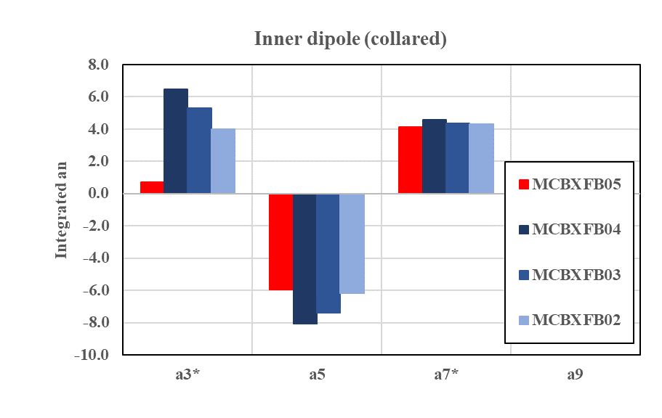
MCBXFB05
  Mechanical measurements and coil contact homogeneity (FUJI)
    Consistent with previous magnets
  All electrical tests successfully passed
    Consistent with previous magnets
  Warm magnetic measurements
    Small difference in b3 and a3 for the inner dipole ~ 5-6 units with respect to previous magnets. We will carefully check results at cold.
    Outer dipole in line with previous assemblies

Slide 19
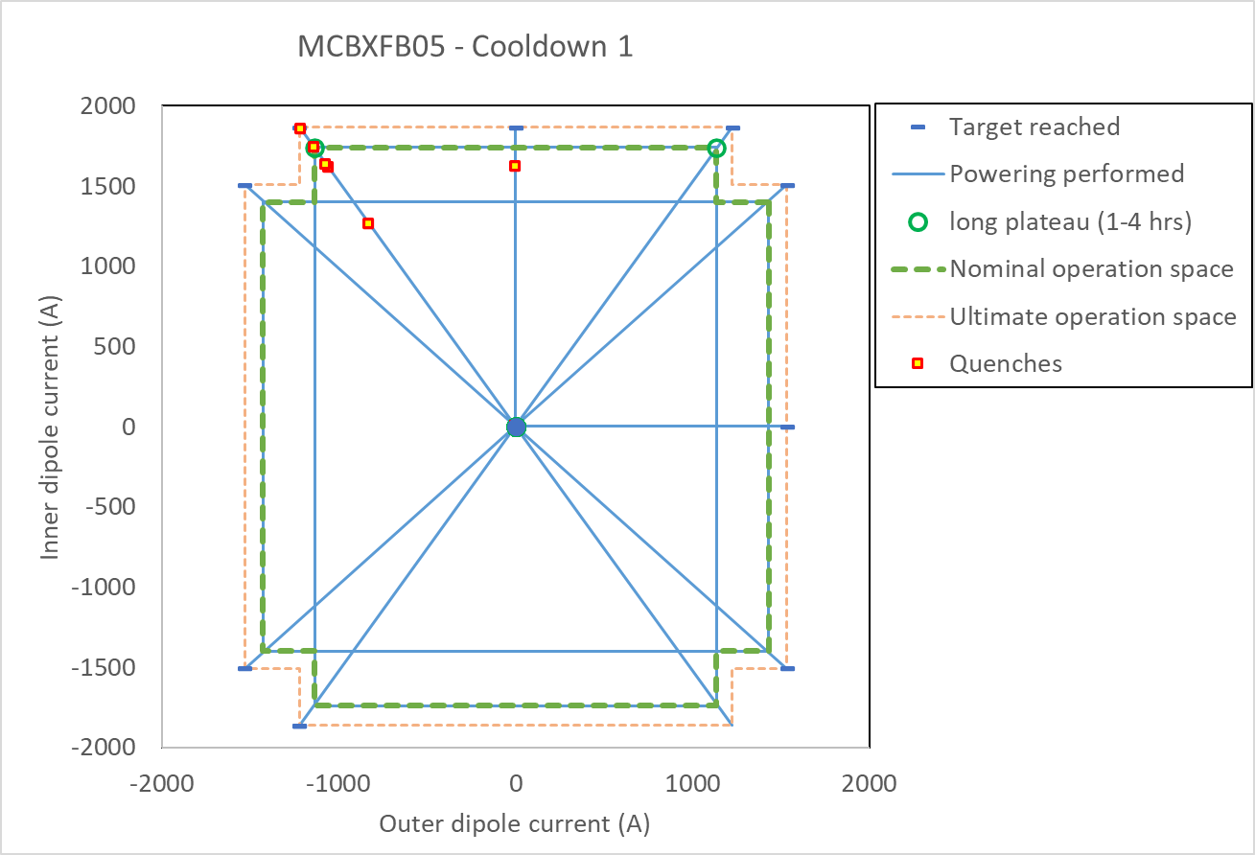
MCBXFB05
  Cold test (1st thermal cycle)
    Single powering:
      1 quench while powering the inner dipole on standalone configuration
      No quench for the outer dipole
    Combined powering:
      No quenches in the first quadrant, but 5 quenches in the second quadrant to reach ultimate.
      We then went through all quadrants without further quenches (see the five markings in the current vs time plot).
  Cold test (2nd thermal cycle)
    Single powering:
      No quench
    Combined powering:
      Test on-going
    Magnetic measurements on-going
  Documentation and EDMS status:
    Documentation is up to date. NCRs are closed.
Courtesy of G. Willering et al.

Slide 20
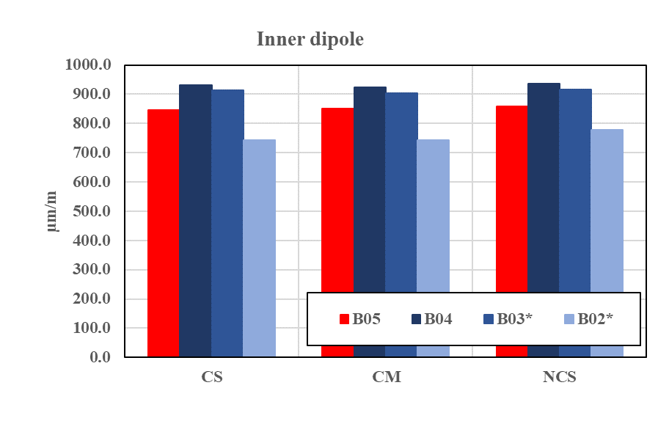
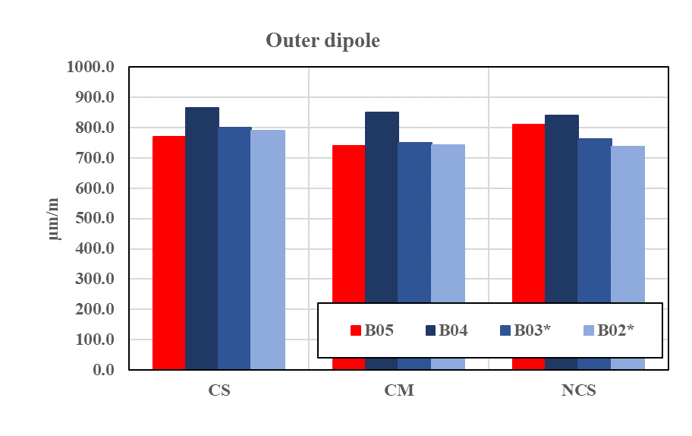
MCBXFB05
Average compressive strain at the last instrumented collaring step (signed changed)

Slide 21
Outline
MCBXF general status at CERN
Summary on initial activities
MCBXFB05 assembly
MCBXFA1 assembly
Summary and outlook

Slide 22
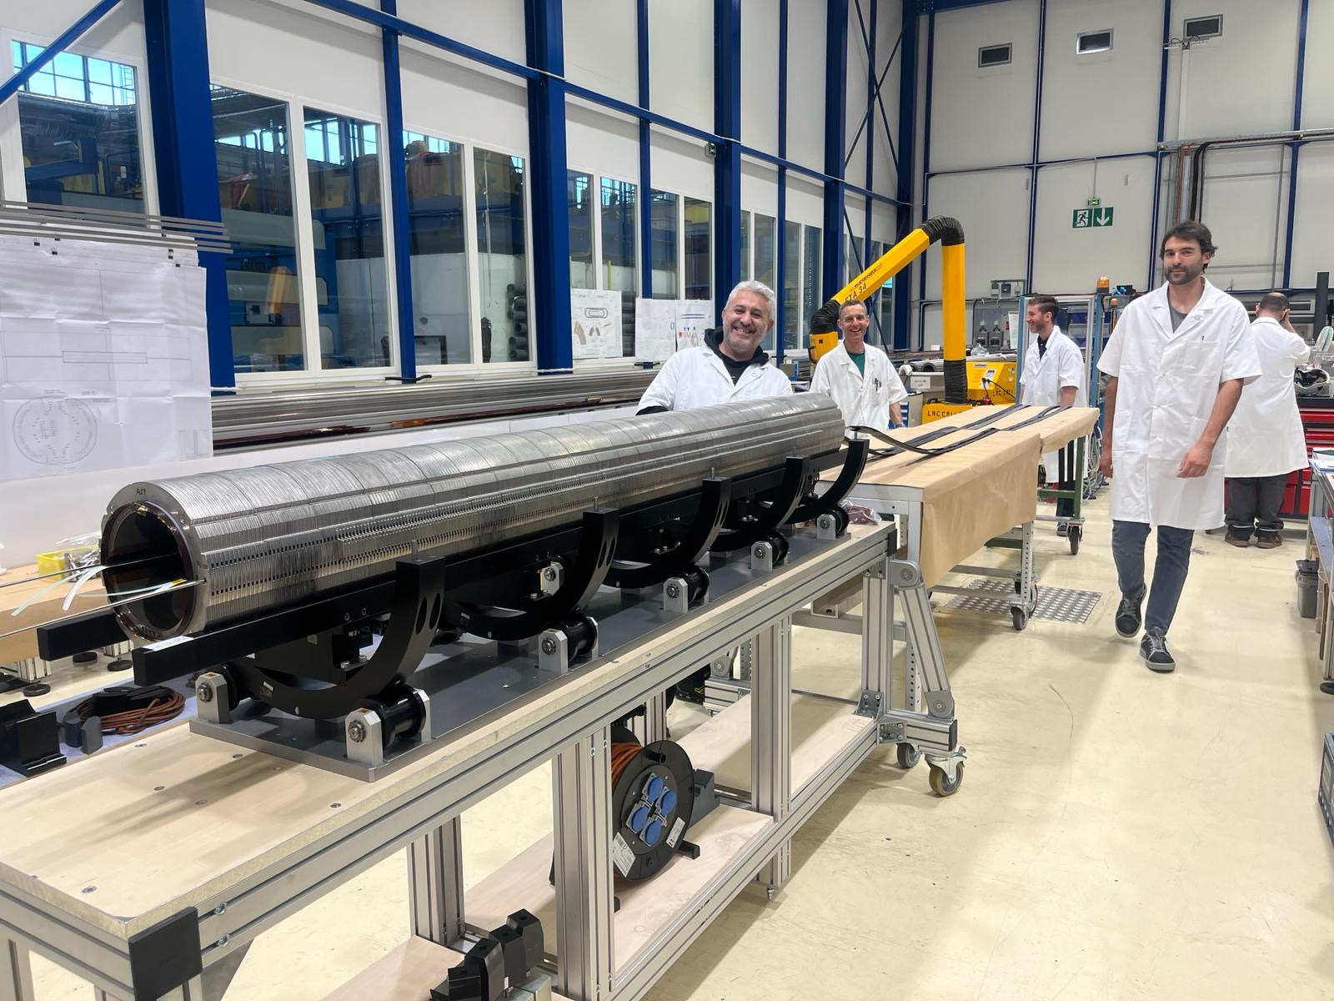
MCBXFA1
Second long MCBXF magnet ever built (no units produced at Elytt Energy)
  Target for completion: July 2024
  The inner dipole has been successfully collared this week
    Two collaring operations due to a broken midplane shim.
    NCR being written
    Electrical tests passed after the final collaring
    Magnetic measurements performed and being analyzed
  The assembly of the outer dipole is now on-going
  As for MCBXFB, various adjustments in the procedures and tooling according to the new infrastructure and lessons learnt.
    For instance: optimized midplane shimming position after the breakage event

Slide 23
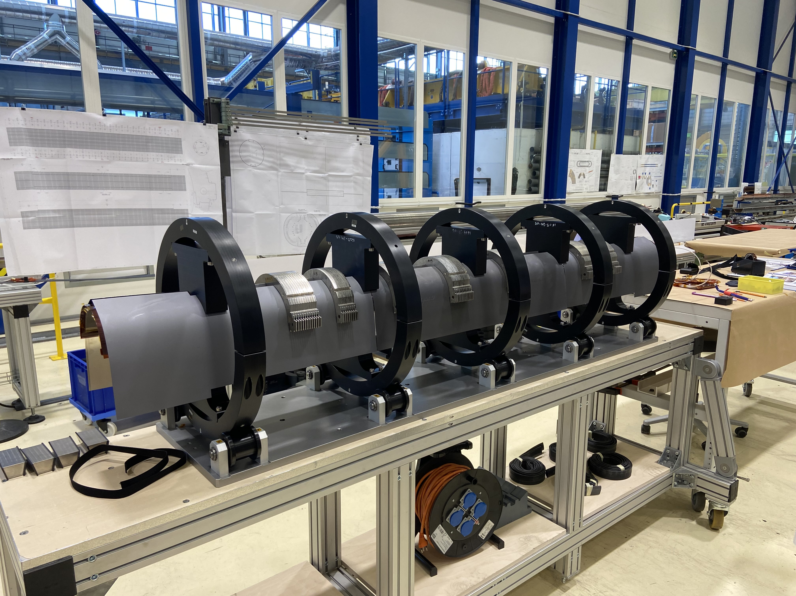
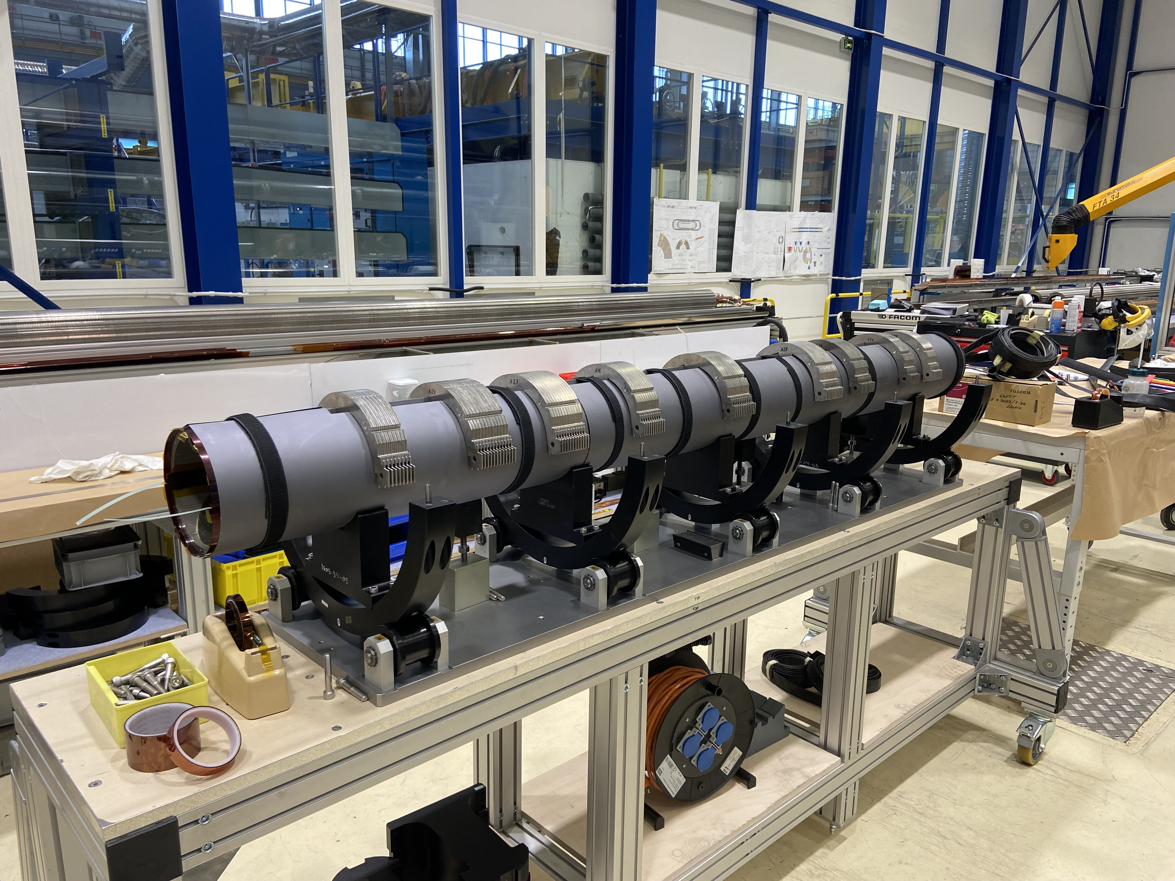
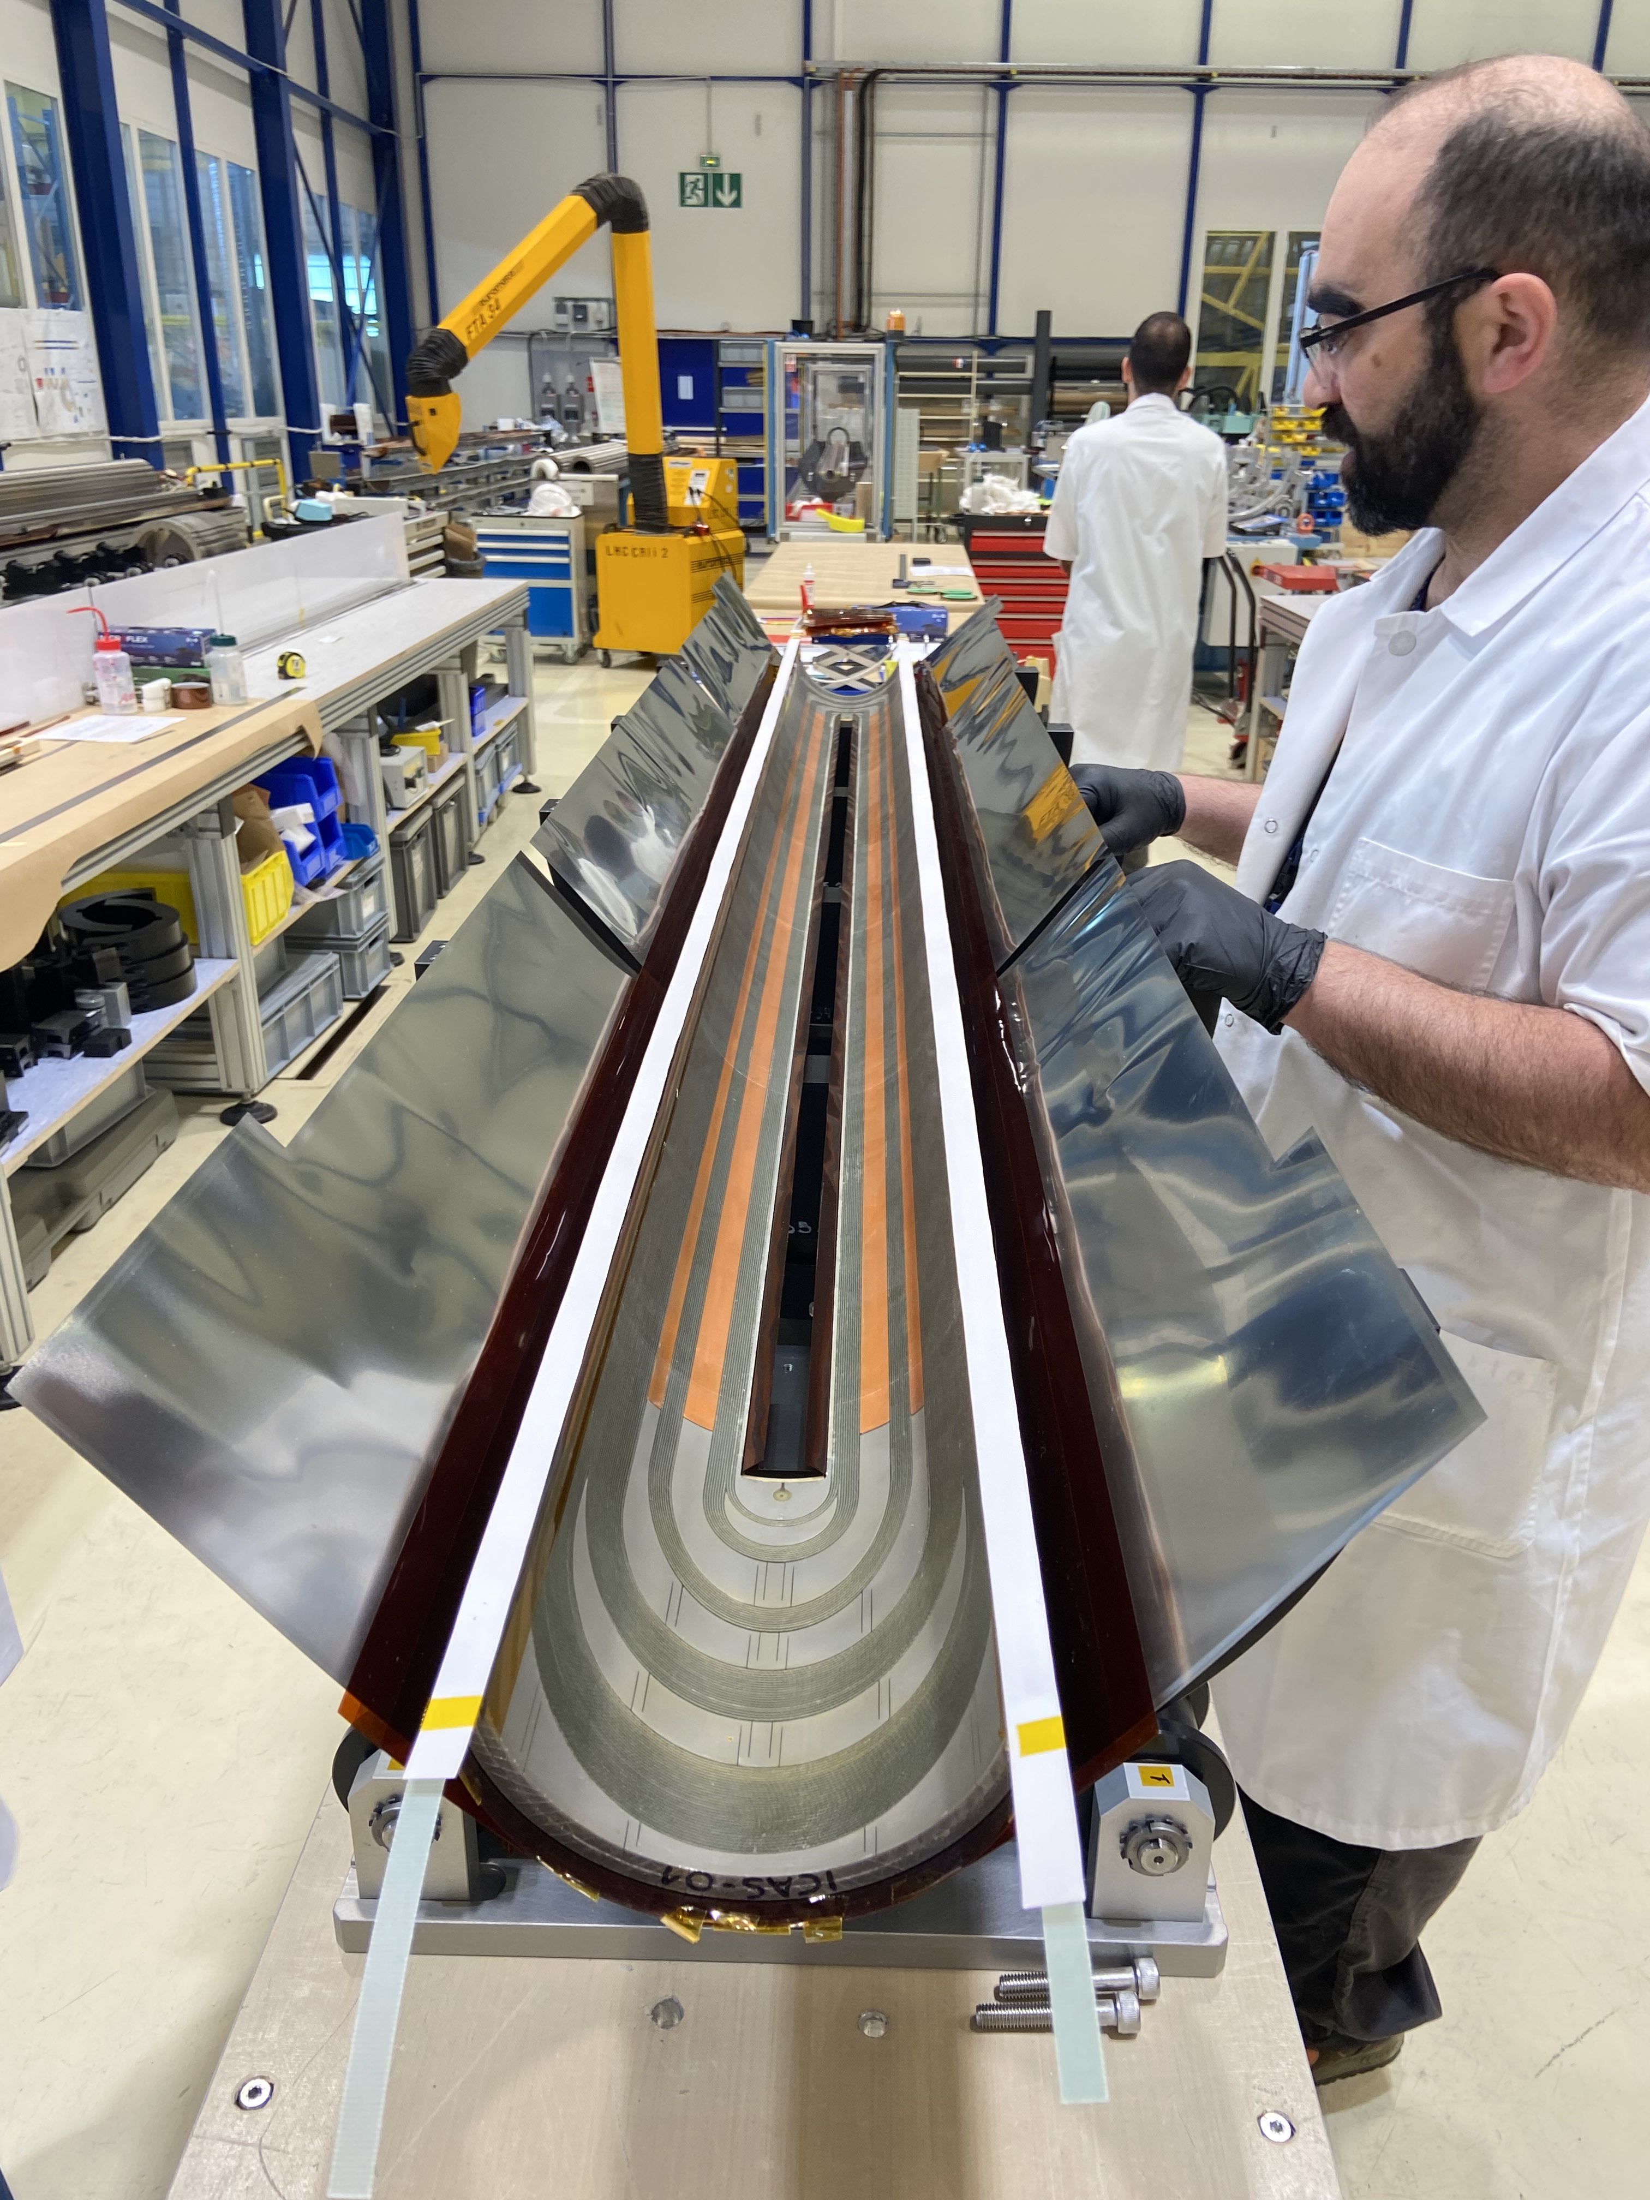
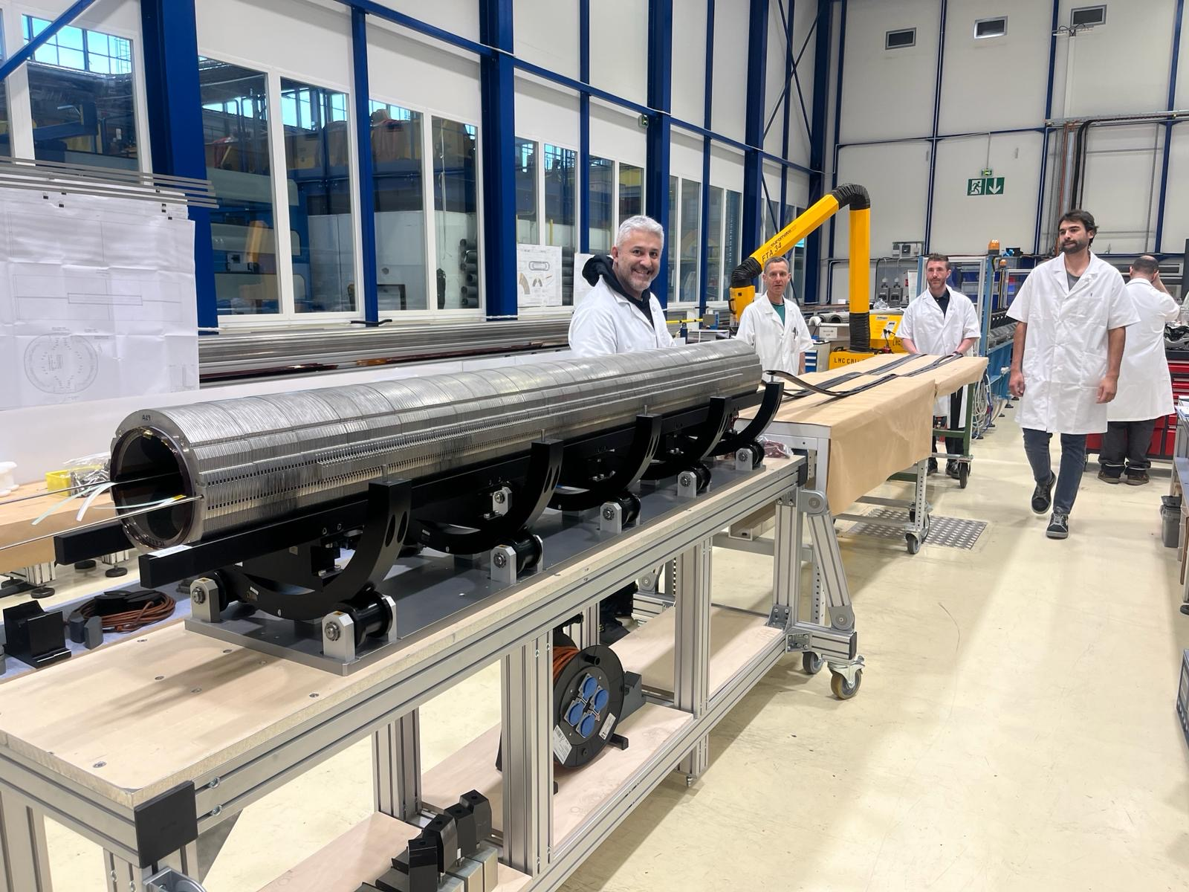
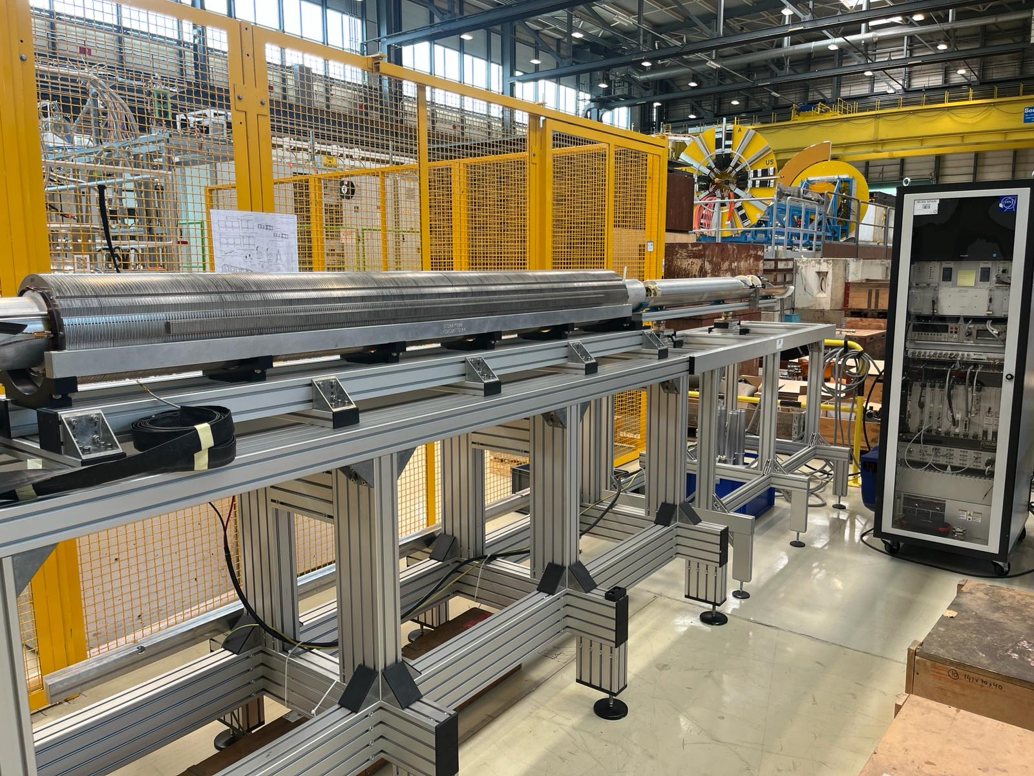
MCBXFA1

Slide 24
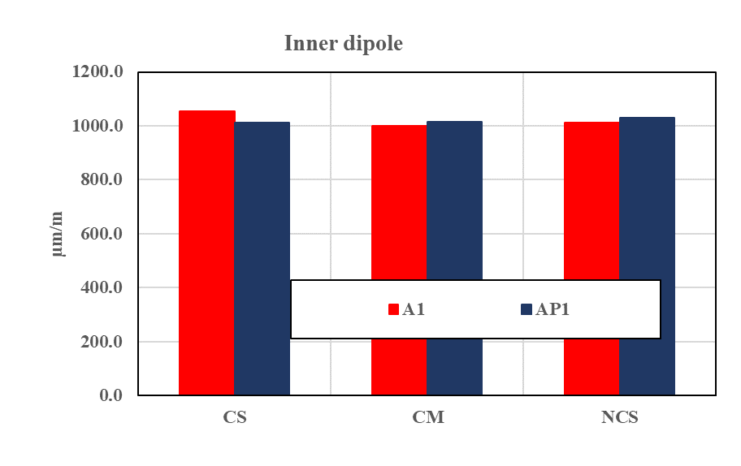
MCBXFA1
Average compressive strain at the last instrumented collaring step (signed changed)

Slide 25
Outline
MCBXF general status at CERN
Summary on initial activities
MCBXFB05 assembly
MCBXFA1 assembly
Summary and outlook

Slide 26
Summary and outlook
Setting the starting date for the new production line on mid-February (instead of the initially considered early-January due to late availability of the assembly area), activities are following the established planning
  Longer assembly time for the first MCBXFB magnet (transfer of know-how to the new team, adjustment of processes, etc)
  For next magnets, we want to keep the production rate at 1 magnet every 2 months (MCBXFB) and 1 magnet every 2.5 months (MCBXFA)
  We are covered in terms of components and coils for the rest of 2024 (see presentation from Fernando Toral)
Minor Non-Conformities during the inner dipole assembly both for MCBXFB05 and MCBXFA1
  Corrective actions and improvements have been already implemented
Continuous communication between the CERN and CIEMAT teams
  Periodic meetings covering the needs in terms of components
  Joint analysis of the main magnet results

