Slide 1
Hadronic G4 databases Radecay,PhotonEvaporation,ENSDFState
L. Desorgher

Slide 2
G4Databases for hadronic
Radioactive Decay
Describe radioactive decay channels for 2990 nuclei
PhotoEvaporation
Describe ground state, nuclear excited state of isotopes plus ,gamma and internal electron conversion emission
for 3172 nuclei
ENSDFState
Describe ground state and some excited state of isotopes

Slide 3
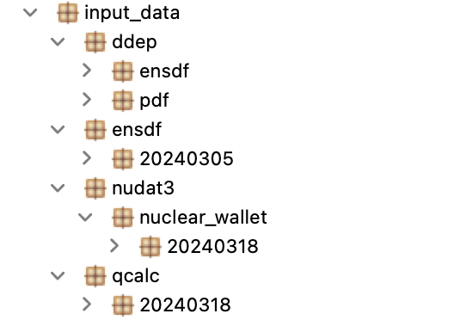
Data from which the databases are produced
Evaluated Nuclear Structure Data Files ENSDF
  Evaluated levels and gamma data
  Decay channels description
  Full archive downloadable in one file from the ENSDF site
Qcalc data
  Provide Q-values for nuclear reactions and decays.
  Computed online from https://www.nndc.bnl.gov/qcalc/
  Full data computed and downloadable with python script GetData.py
  Needed only for RadioactiveDecay database
Nuclear wallet cards
  Downloadable from nudat3 web
  Used to list all radioactive nuclei for which data should be produced
  Give some decays info when ENSDF data are missing
  Installation of data could be automatized with python

Slide 4
Data from which the database are produced
Decay Data Evaluation Data Project
  226 radioactive nuclei validated by experts
  Reference database for nuclear metrology
  Format in ENSDF
  Possibility to build DDEP based Geant4 database specific to these radioactive nuclei
  Betashape data could be used to improve electron capture data

Slide 5
Extra code needed to build the database
BrICC code
  Used to compute electron conversion coefficients when not provided explicitly in ENSDF file
  Downloadable from https://bricc.anu.edu.au/
  Version 2.3 is distributed within the code

Slide 6
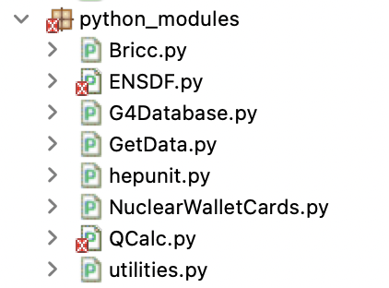
Main Python3 modules to build the database
ENSDF
Read gamma-level and decay data in ENSDF file
G4DATABASE
Write RadDecay and PhotonEvaporation data files
BRICC
Call BriCCV2.3 to compute electron conversion coefficient
NuclearWalletCard
Read list of radioactive decay nucleus
Provide decay data when missing in ENSDF
Qcalc
Read Q-values from Qcalc data

Slide 7
Python3 modules to build the database
Status
All functionalities to build the new G4RadioactiveDecay and PhotonEvaporation were migrated from Python2 to Python3
Existing Python3 functions/script and data ready to be distributed
Production of G4ENSDFSTATE file
Modification of PhotoEvaporation code
  Ensure transition bettwen floating levels wherever possible
  Remove extra dE (1eV, 2eV,3,eV) for +X,+Y,+Z floating levels
Test codes in G4DatabaseCheck
  Check level orders , gamma energies and transition between floating levels
  Check consistency between energy levels of G4RadDecay and PhotoEvaporation
  Check consistency between G4ENDSFState and PhotoEvaporation

Slide 8
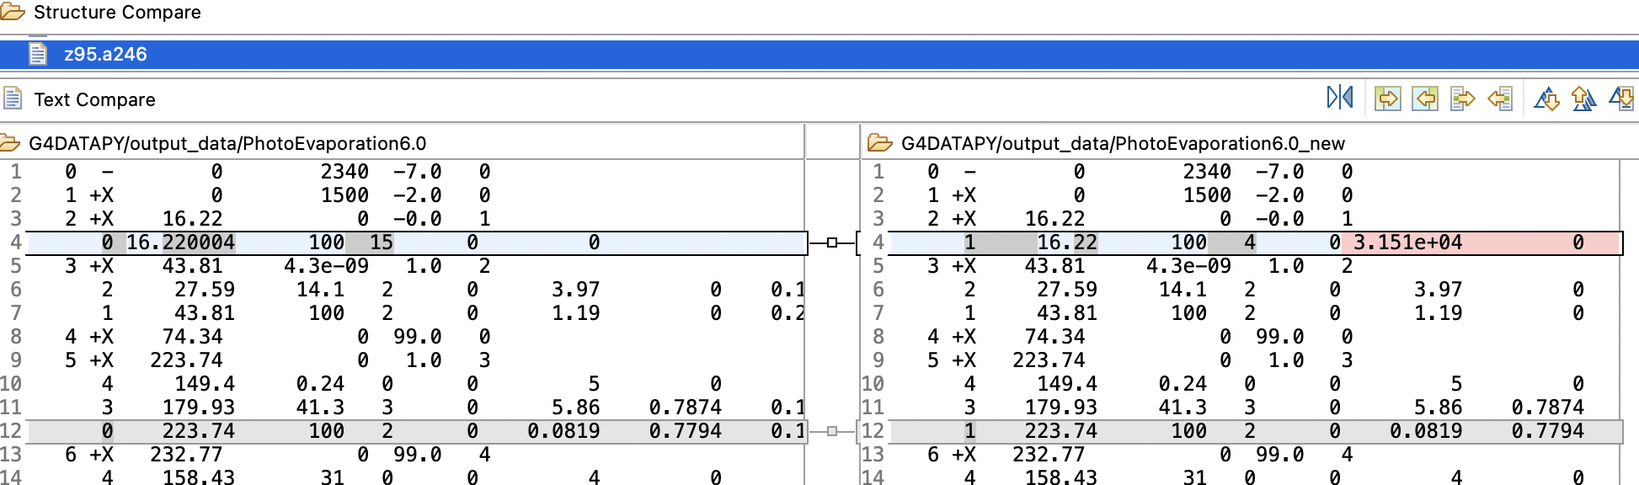
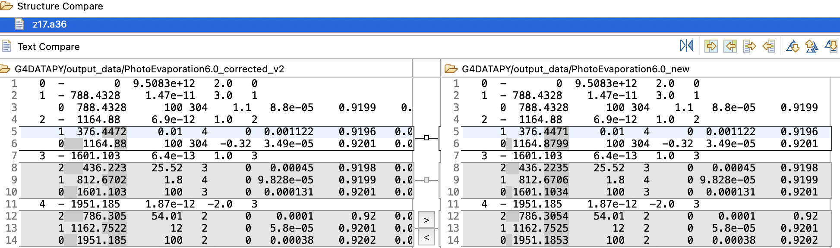
PhotoEvaporation data – status
Correction of transition between floating levels
Correction of gamma energies

Slide 9
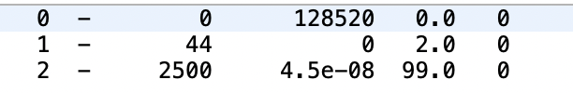
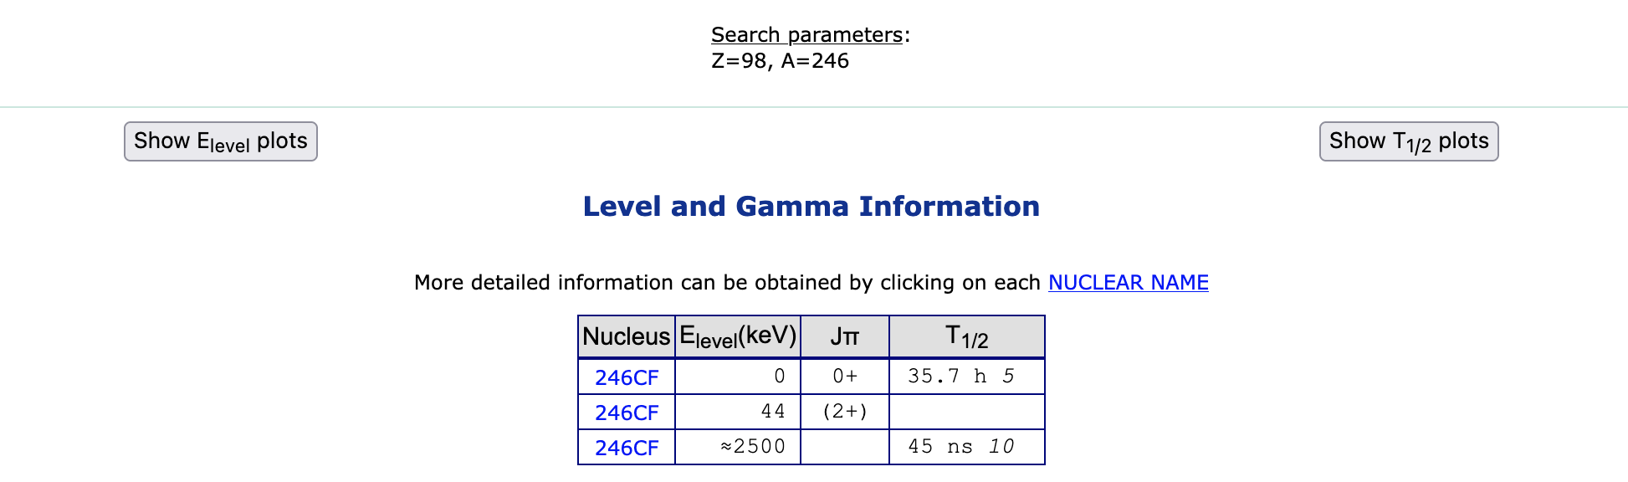
PhotoEvaporation data – issues
How to treat levels without gamma information? Example ²⁴⁶Cf
G4DATA
Nudat3/ENSDF data

Slide 10
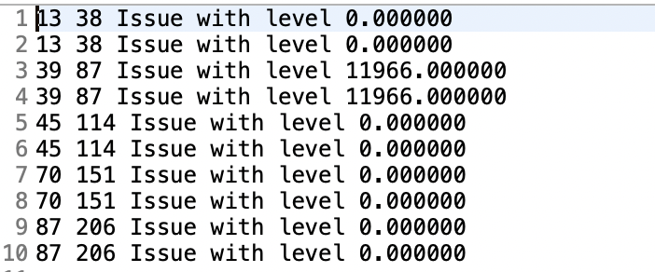
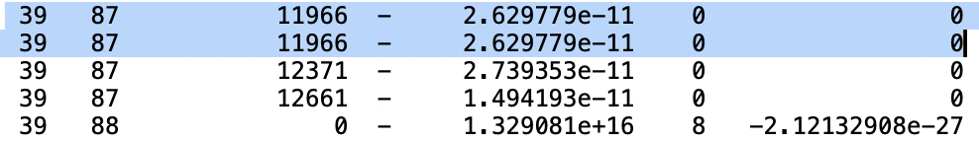
Comparison PhotoEvaporation and G4ENSDFState
Results : only 5 states problematic
Identical levels in G4ENSDFState due to J (spin) set as zero in G4ENSDFState
PhotoEvaporation
G4ENSDFSTATE

Slide 11
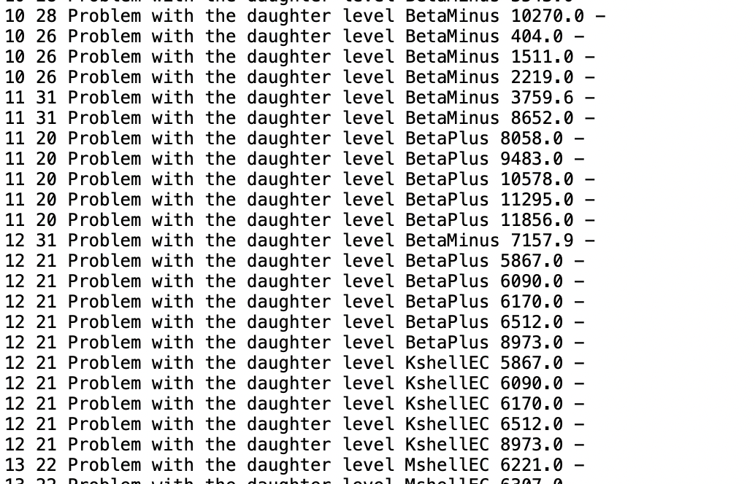
Consitency between G4Raddecay and PhotoEvaporation
Dfferences for excited levels presrnt also in ENSDF data

Slide 12
Next steps
Distribute first version of the code to produce RadDecay and PhotoEvaporation from ENSDF data. Done
Finish code to provide version of the database based on DDEP . June
Production of first test databases. Done
Python scripts to check the validity of the new databases. Done
Python scripts to compute emission spectra analytically from the databases May/June
Geant4 code and postprocessing code to validate some decay in MCsimulations July
Integration in G4-val. August-September
Deliver code to produce G4 databases from DDEP data
Continue tests and correct databases. June-July
Deliver test code to the G4 repository. June-July
Deliver code to produce G4 databases from ENSDF and DDEP data. August-September
Reproduce database with most updated ENSDF data September-October
Deliver tests to compare G4Radecay output with nudat2 and DDEP output in G4val. 2024

Slide 13
Questions
Where to put the code to further develop it?
How to continue with floating levels?
Should we add other informations in PhotonEvaporation?
Are the Q-values still needed in RadioactiveDecay files? Yes
Should we produce database also compliant with DDEP (data decay evaluation project) data (gold standard for metrology)?

