Slide 1
MBHDP301b
11T hybrid magnet
Intermediate results - Thermal cycle n°1 & powering tests
S. Mugnier on behalf of Mechanical Measurement Lab of EN-MME
EDMS #2711698

Slide 2
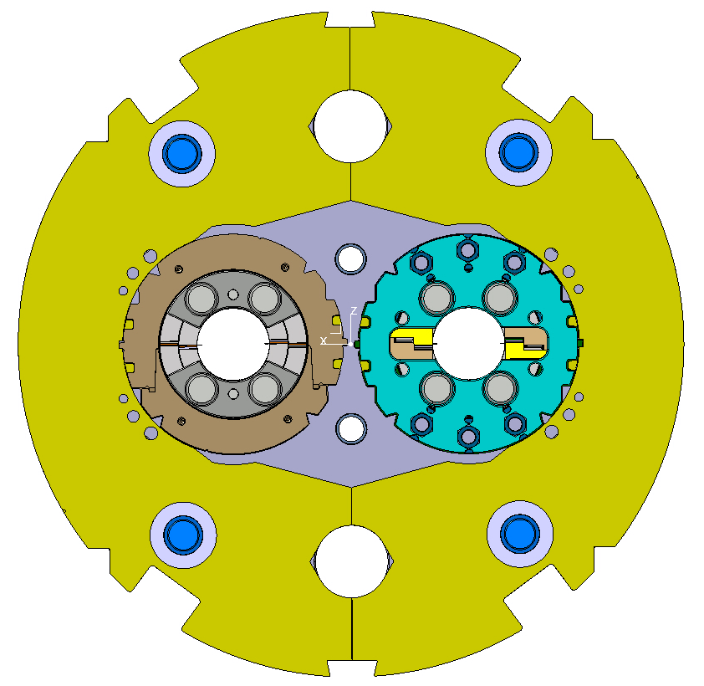
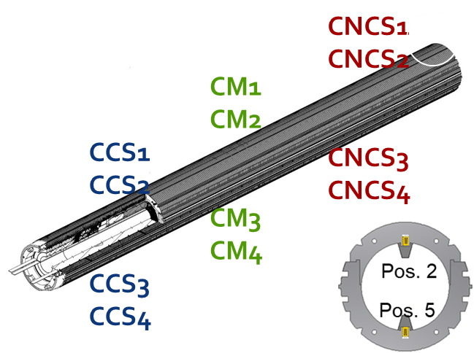
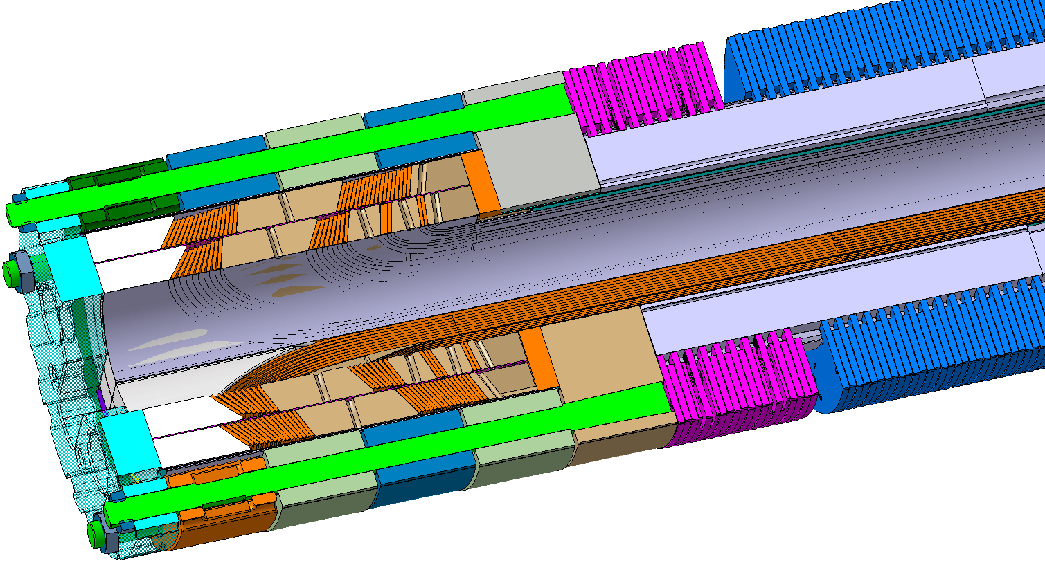
Instrumentation overview
SP301
12 instrumented collars
8 Bullet gauges
SP302
12 instrumented collars
8 Bullet gauges
12 Tie rods (End cage)
Instrumented SS Shell

Slide 3
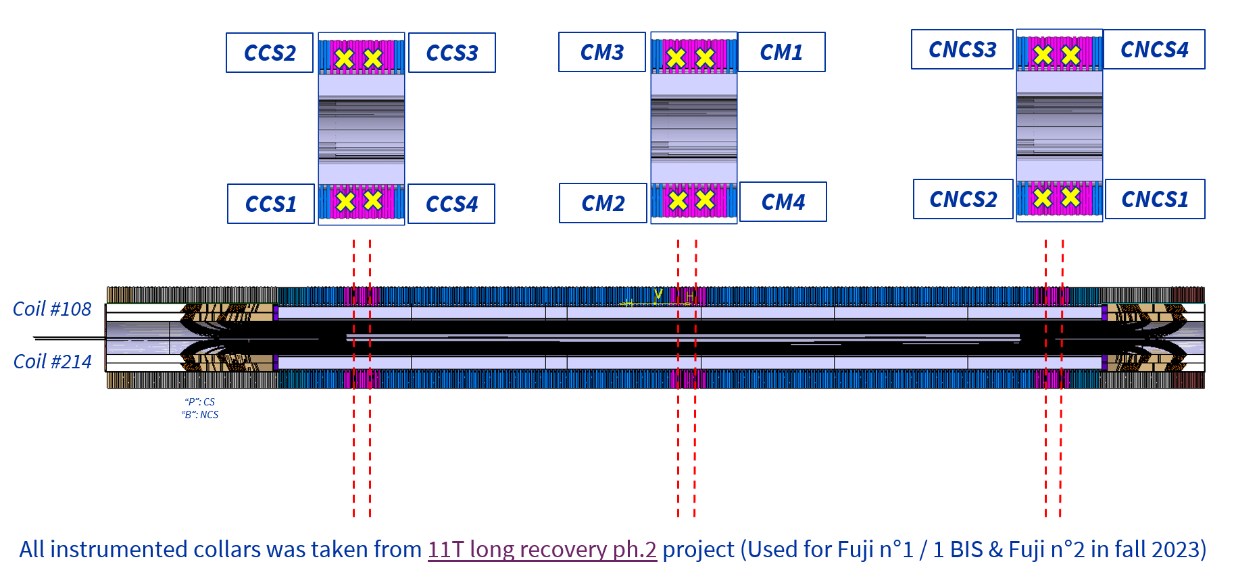
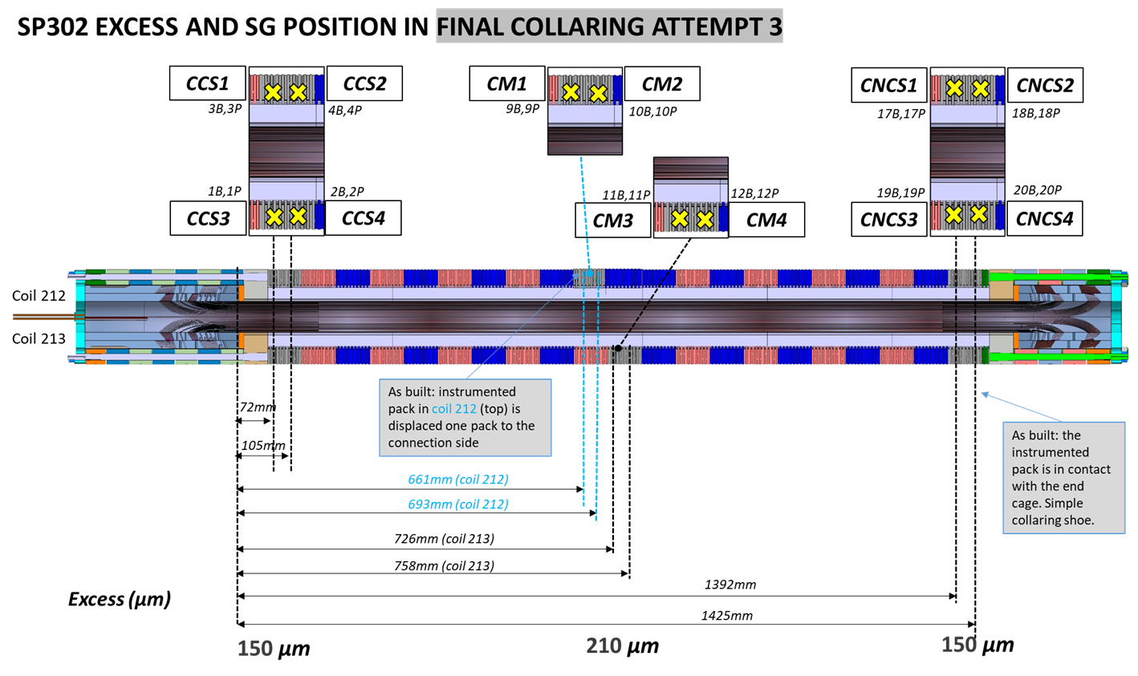
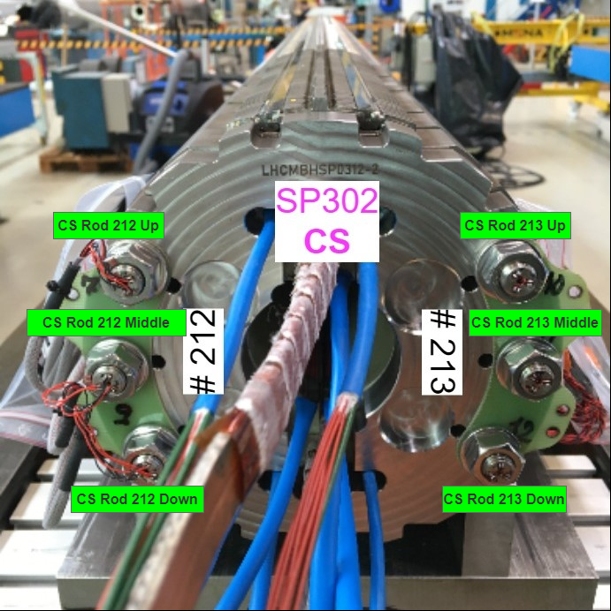
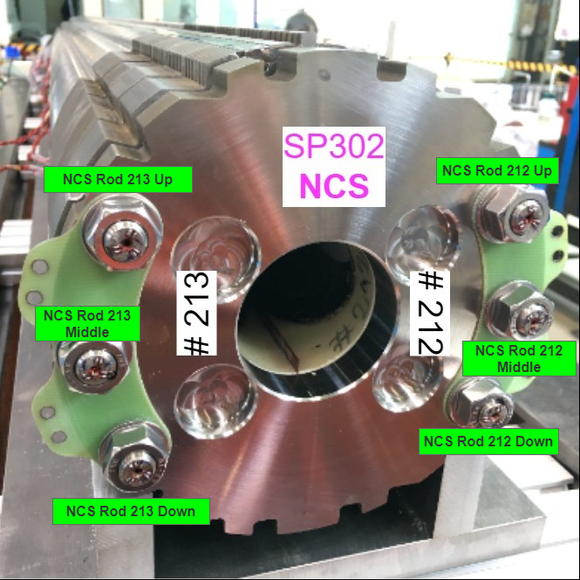
Instrumentation overview
SP301 without end-cage

Slide 4
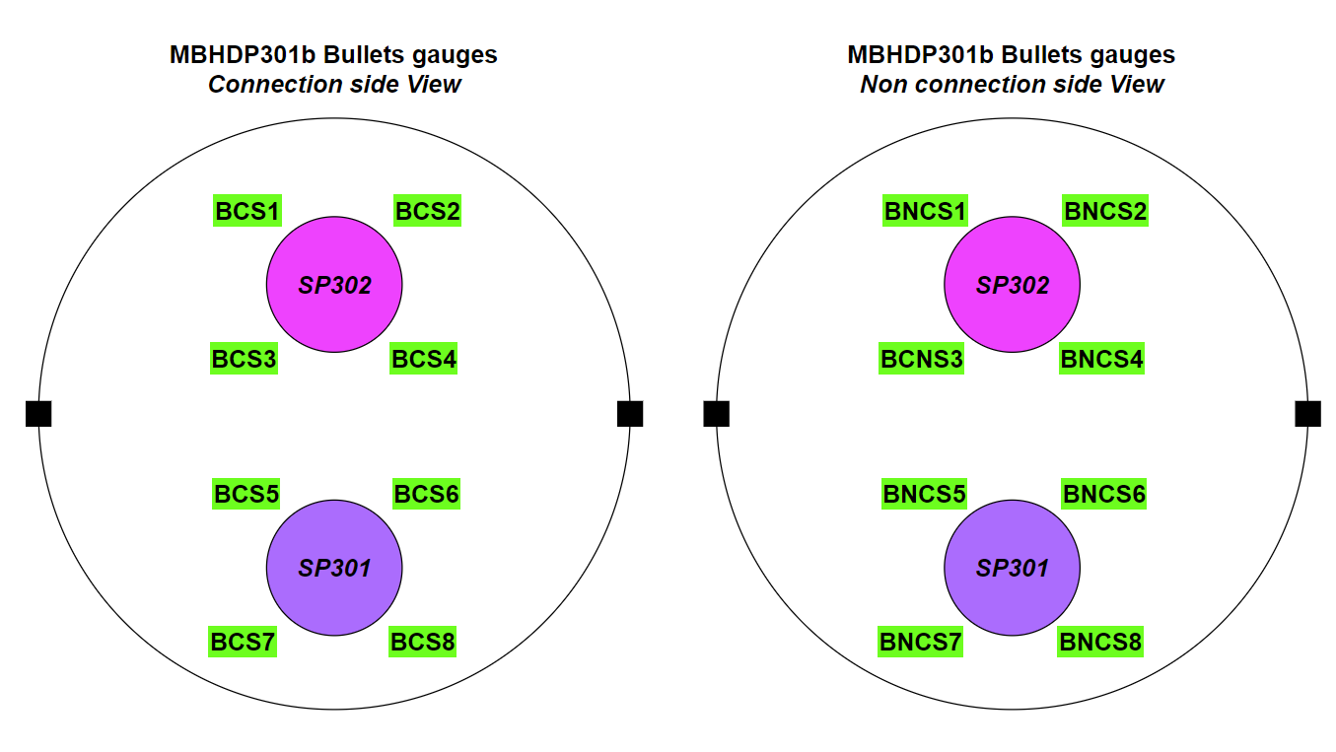
Instrumentation overview

Slide 5
SP301 collars compression stress

Slide 6
SP302 collars compression stress

Slide 7
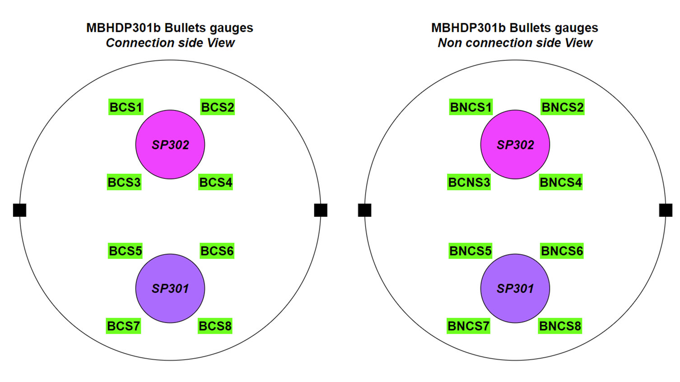
SP301 End plates longitudinal stress

Slide 8
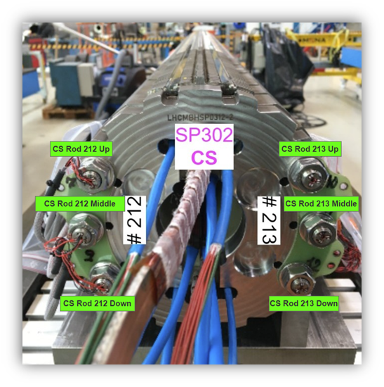
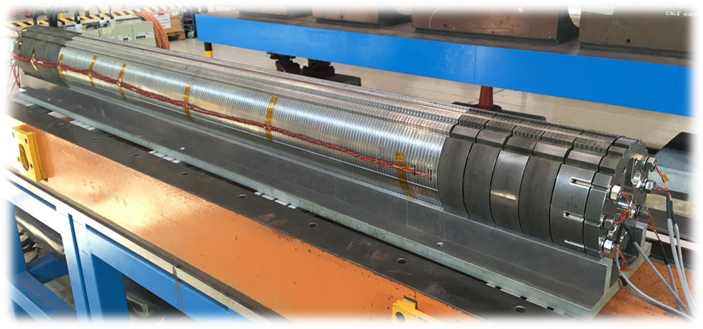
SP302 End cage tie rods stress

Slide 9
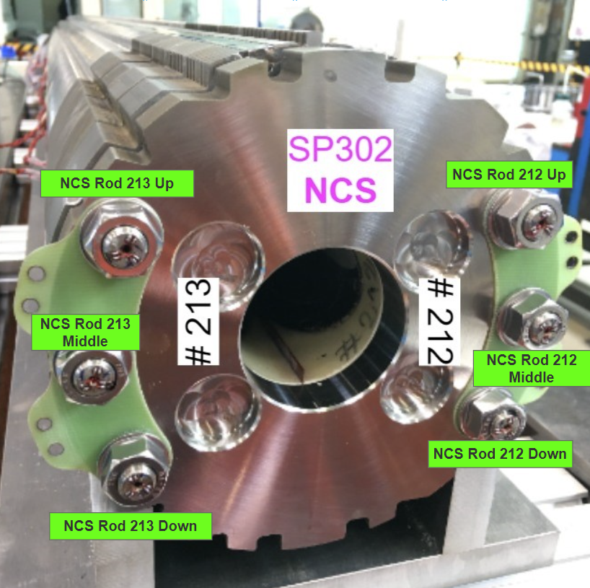
SP302 End cage tie rods stress

Slide 10
MBHSP301 aperture

Slide 11
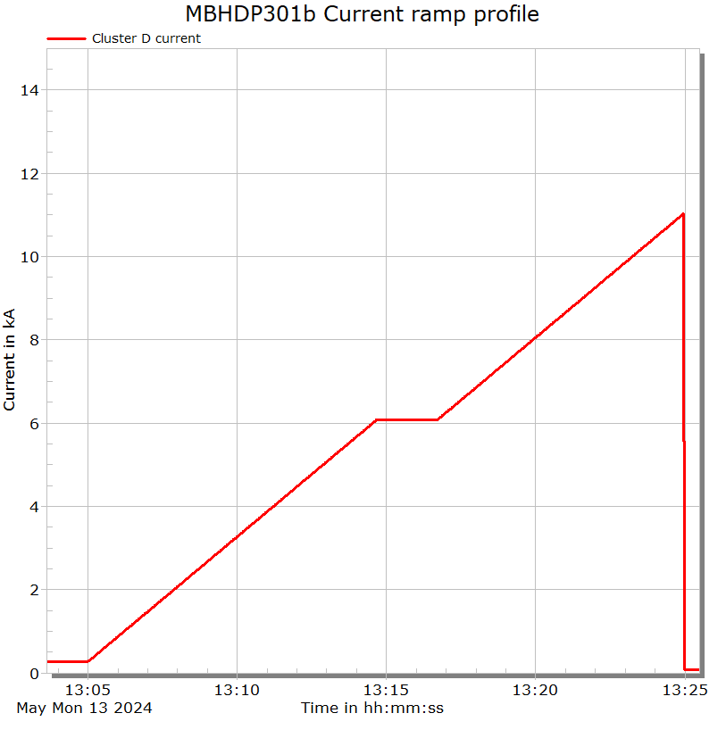
SP301 Powering test
SM18 Event | 13/05/2024 at 13h21
I_{max} | 10,947 kA
Aperture powered | SP301
Magnet temperature | 1,9 K

Slide 12
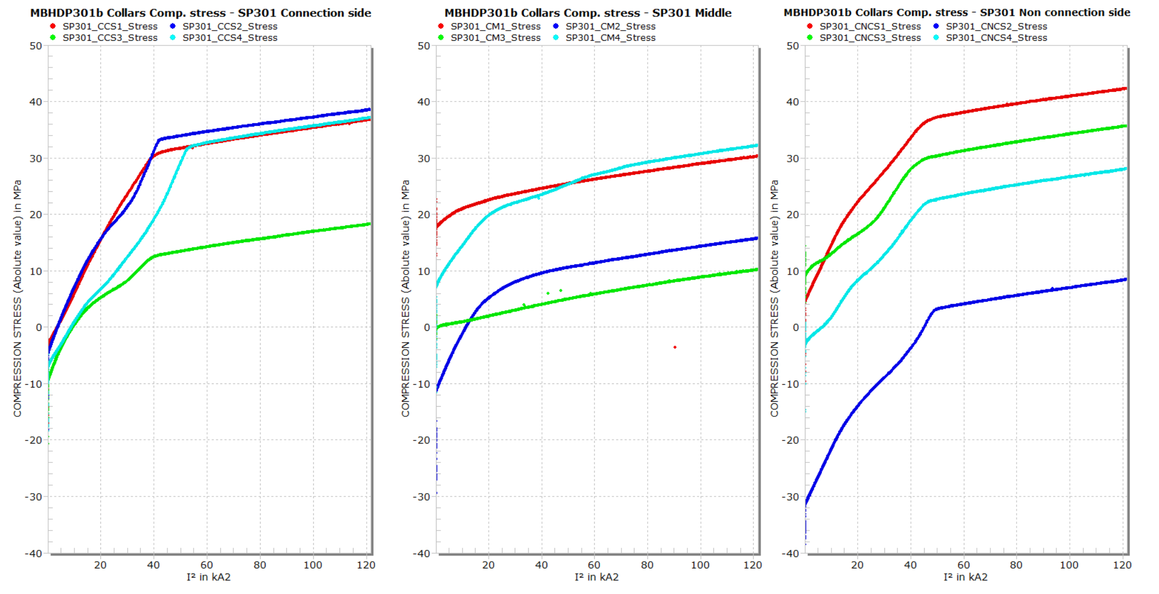
SP301 collars compression stress

Slide 13
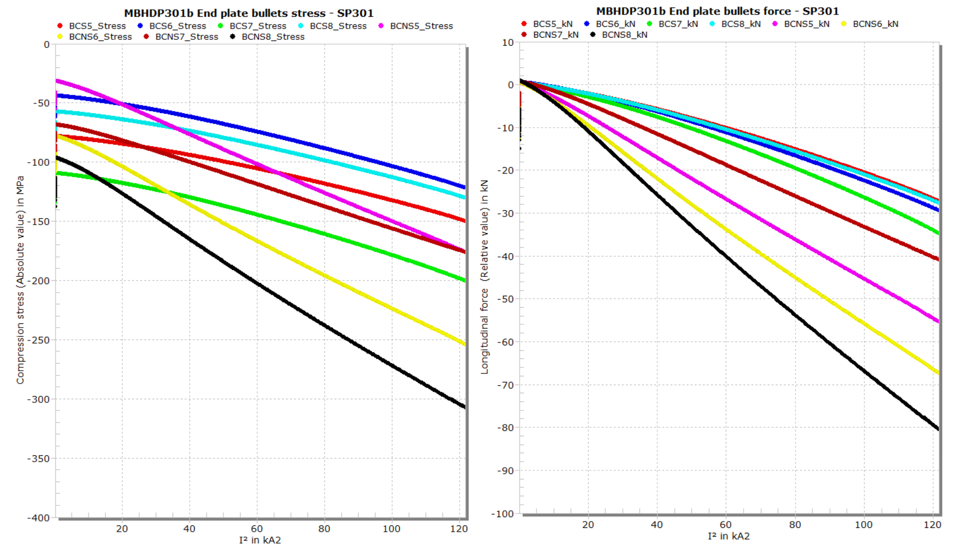
SP301 End plates bullets longitudinal stress & force

Slide 14
MBHSP302 aperture

Slide 15
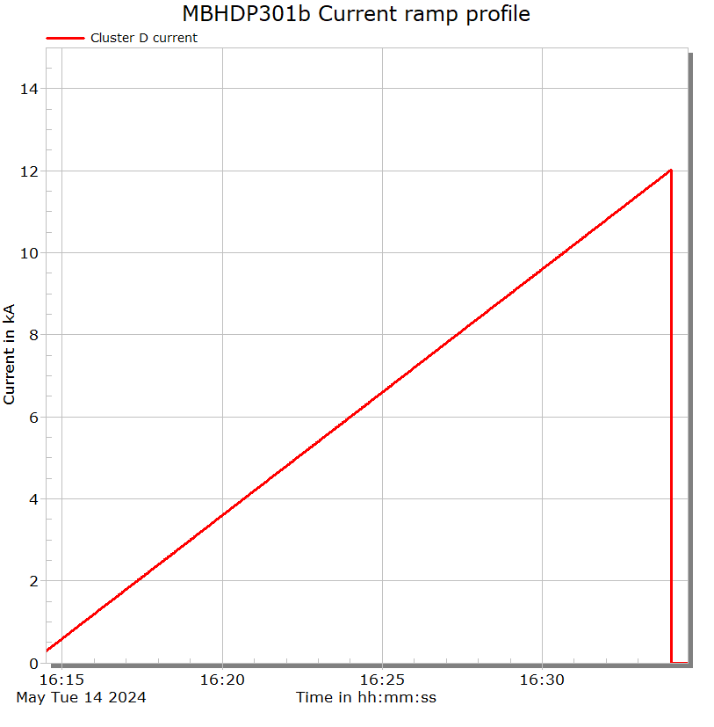
SP302 Powering test
SM18 Event | 14/05/2024 at 16h30
I_{max} | 12,017 kA
Aperture powered | SP302
Magnet temperature | 1,9 K

Slide 16
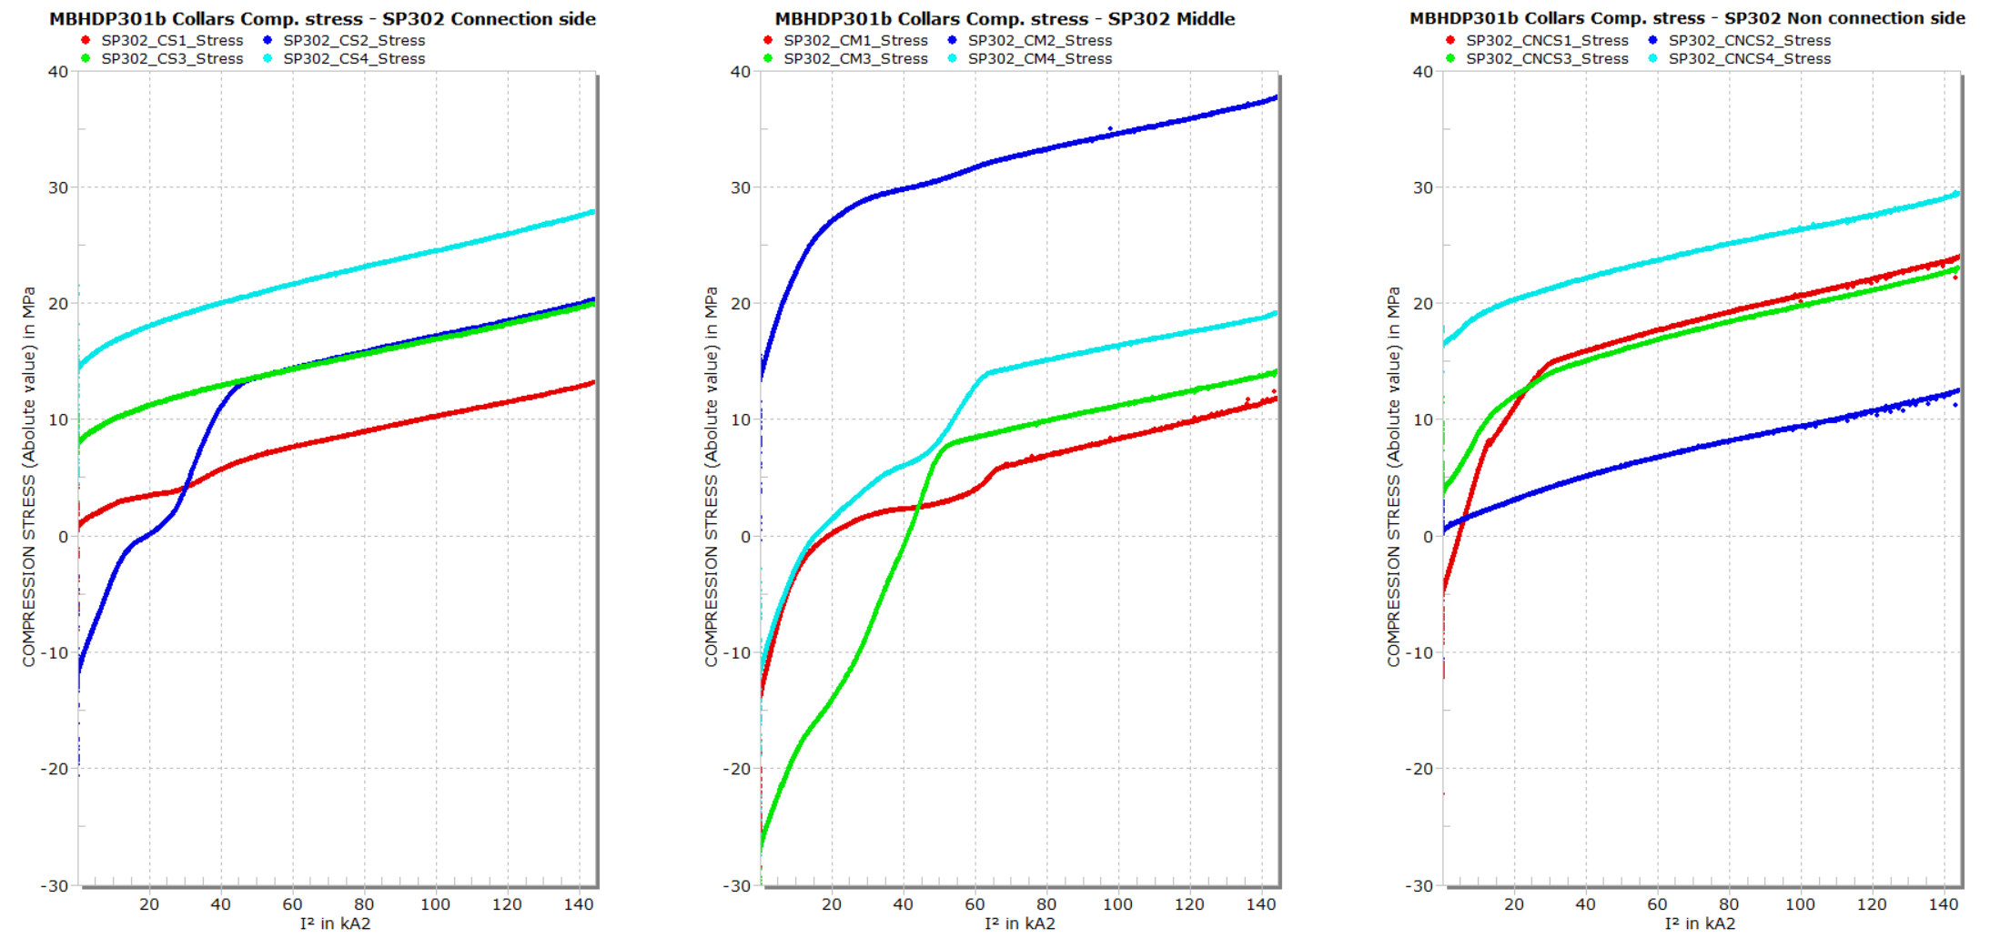
SP302 collars compression stress

Slide 17
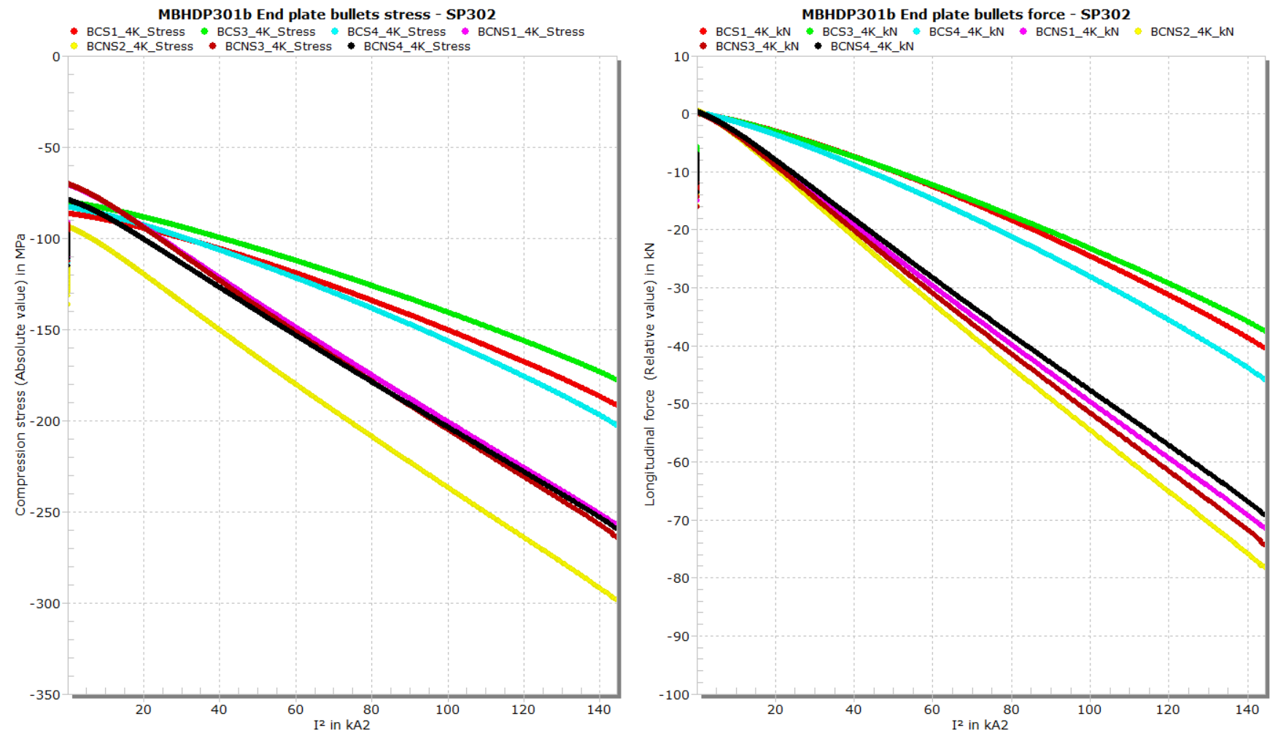
SP302 End plates bullets longitudinal stress & force
CS group
NCS group

Slide 18
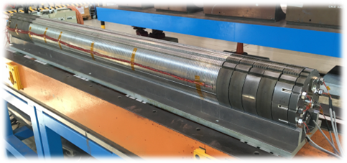
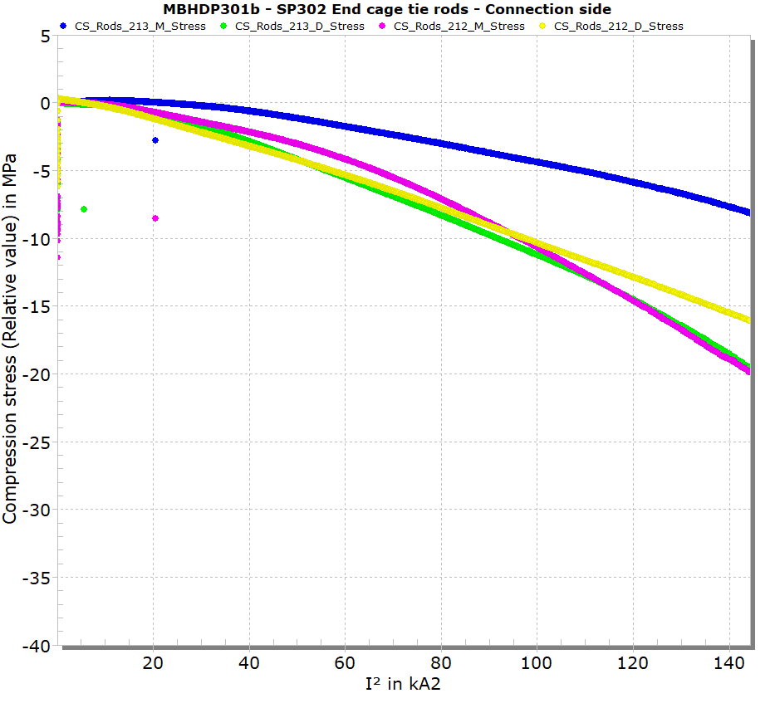
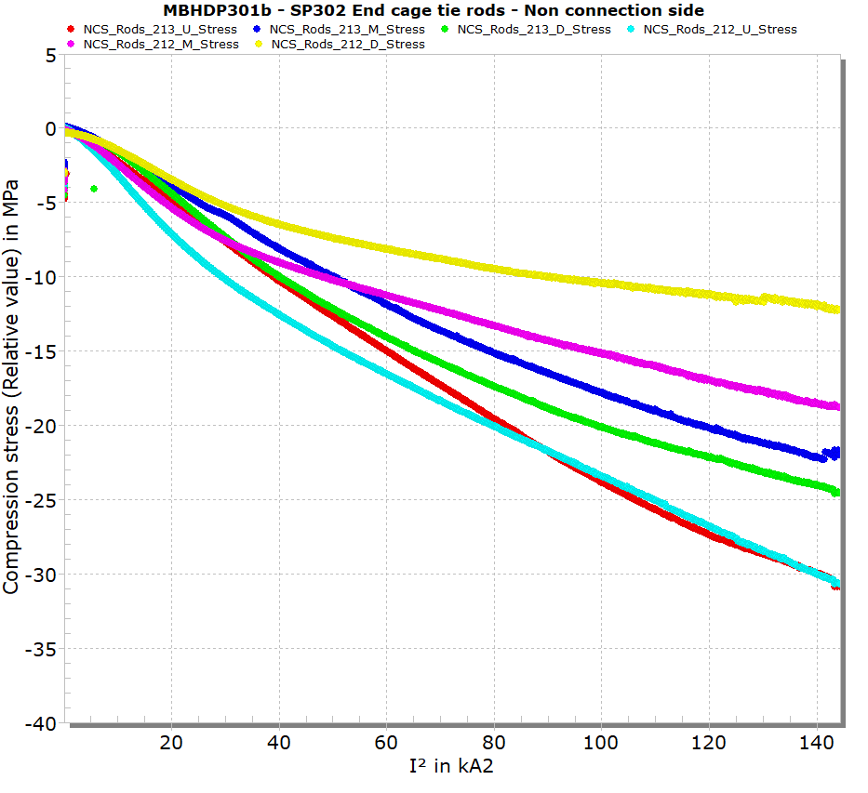
SP302 End cage tie rods (relative values)

