Slide 1
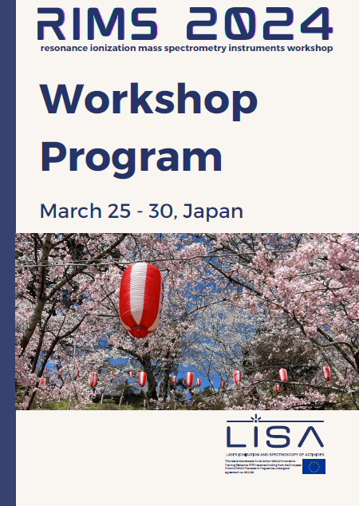
RIMS Workshop
LISA Supervisory Board Meeting
14 May 2024

Slide 2
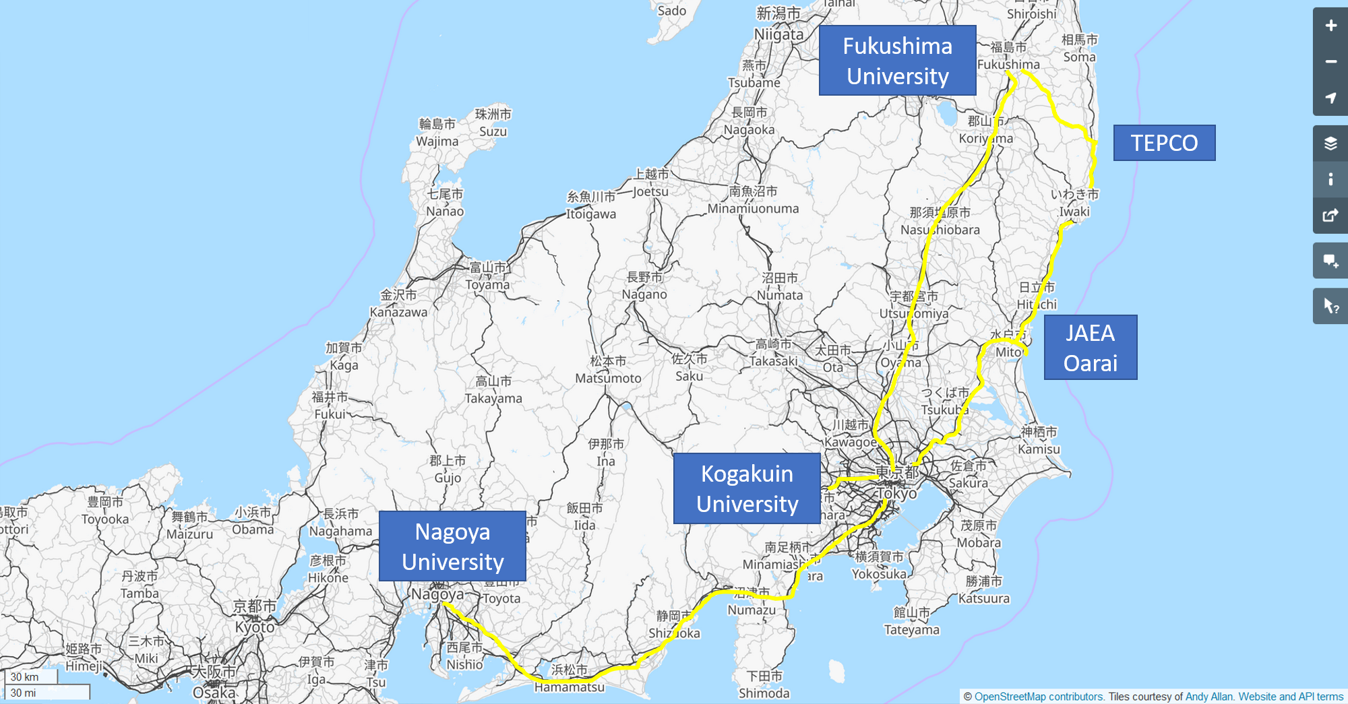
Travel

Slide 3
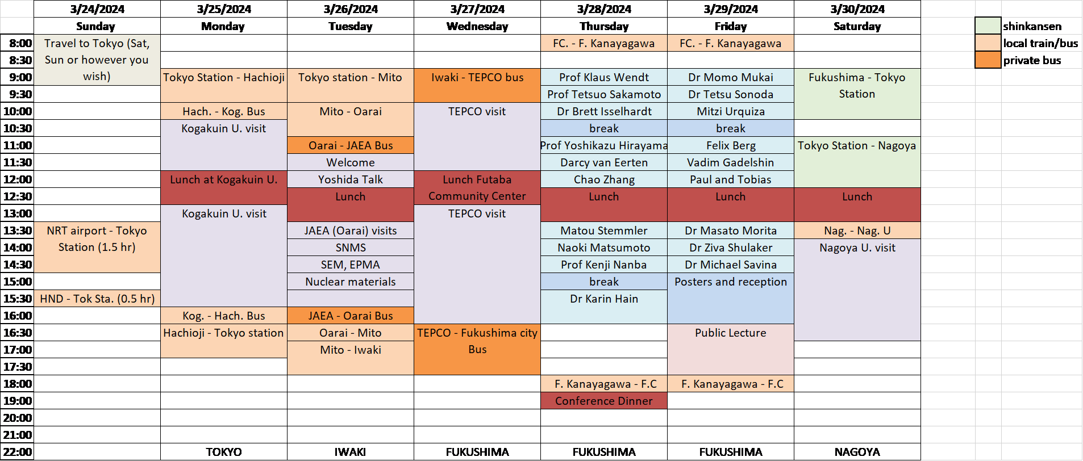
Agenda
Aims:
Discover and discuss state of RIMS in Japan/EU/USA
Establish and deepen connections between RIMS labs/partners

Slide 4
Participants
Institutions
University of Vienna
Hübner Photonics
Johannes Gutenberg Universität Mainz
Leibniz University Hannover - IRS
University of Helsinki
Fukushima University - Institute of Environmental Radioactivity
RIKEN KISS High energy accelerator research organization
RIKEN Nishina Center for Accelerator Based Science
Kogakuin University
Nagoya University
The University of Tokyo
Lawrence Livermore National Laboratory

Slide 5
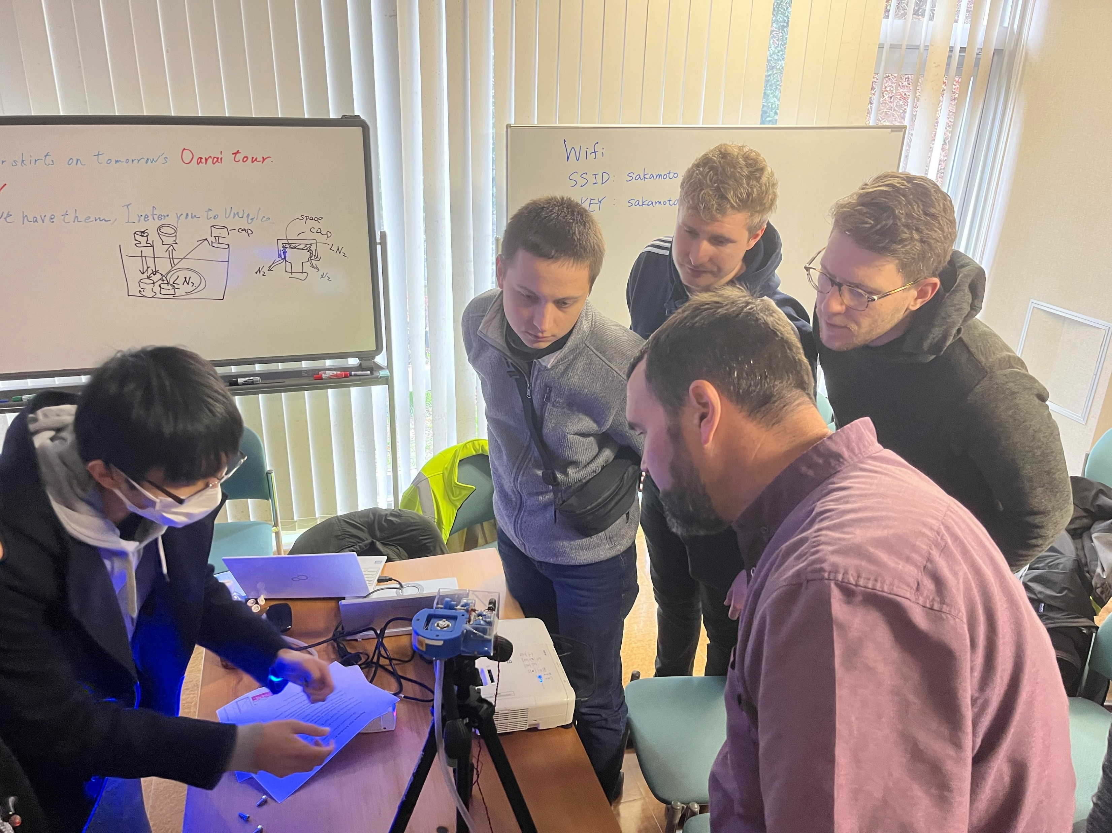
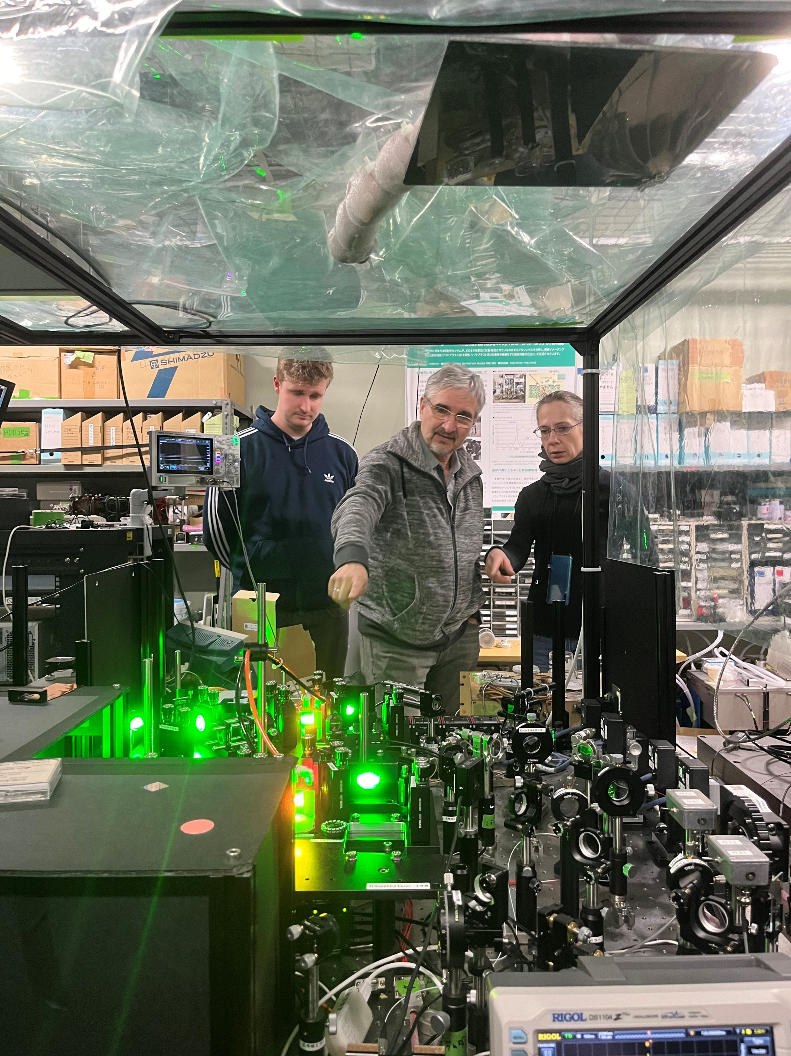
Day 1 - Kogakuin
RIMS lab
Nagoya lasers, custom ToF-SIMS
Particulate matter analysis

Slide 6
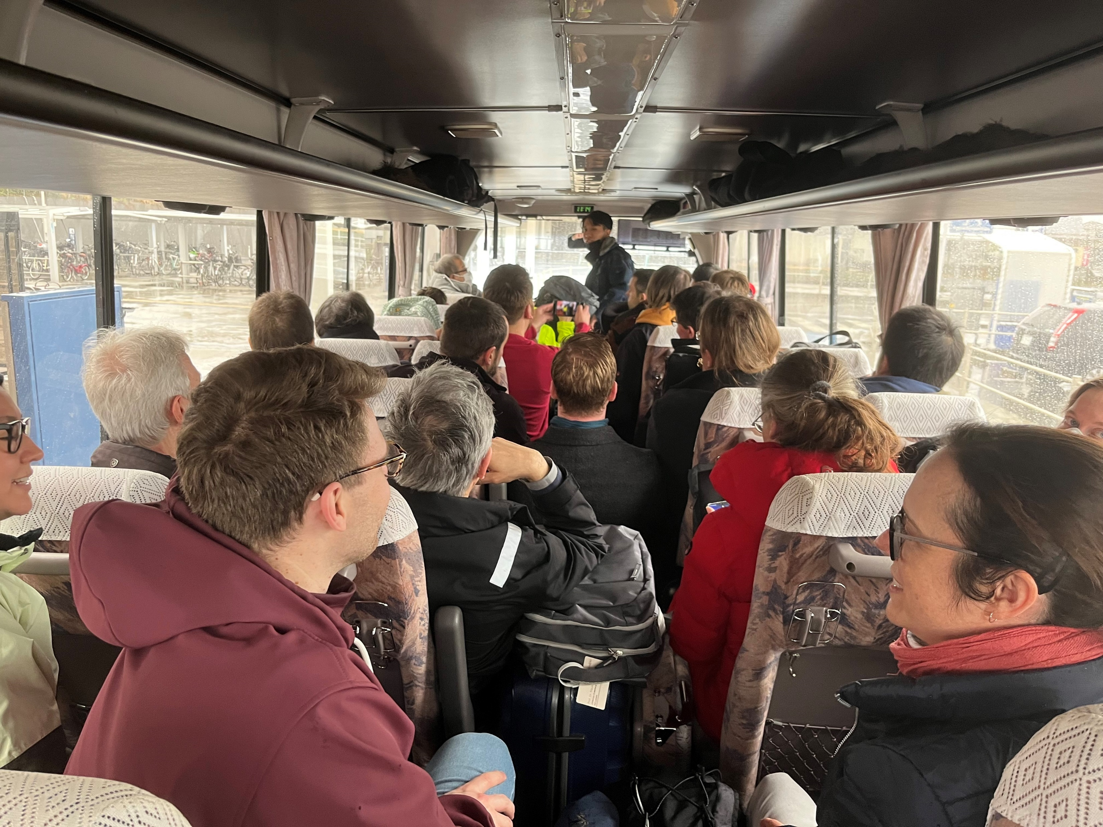
Day 2 - Oarai
JAEA research facility
RIMS system from Kogakuin recently installed
Aims to analyse material from melted fuel for decommissioning at FDNPP

Slide 7
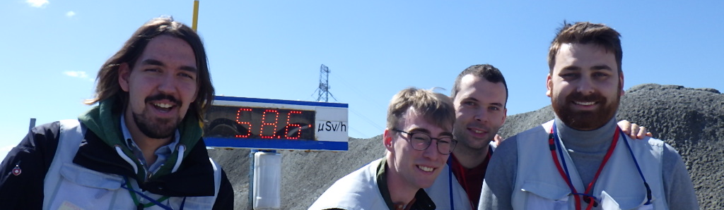
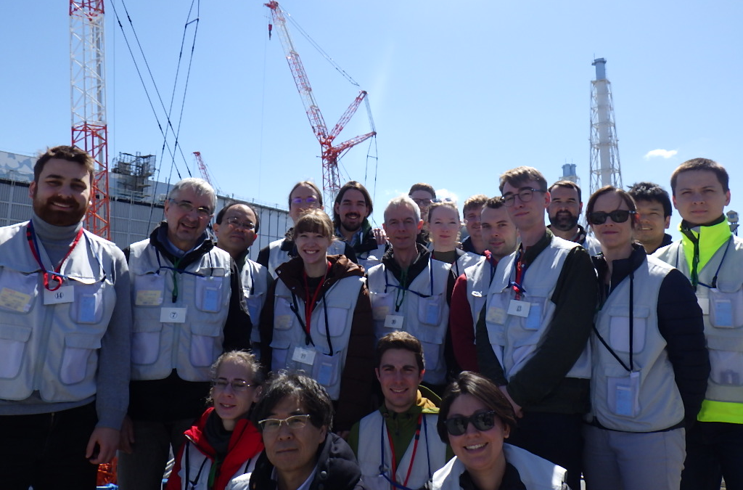
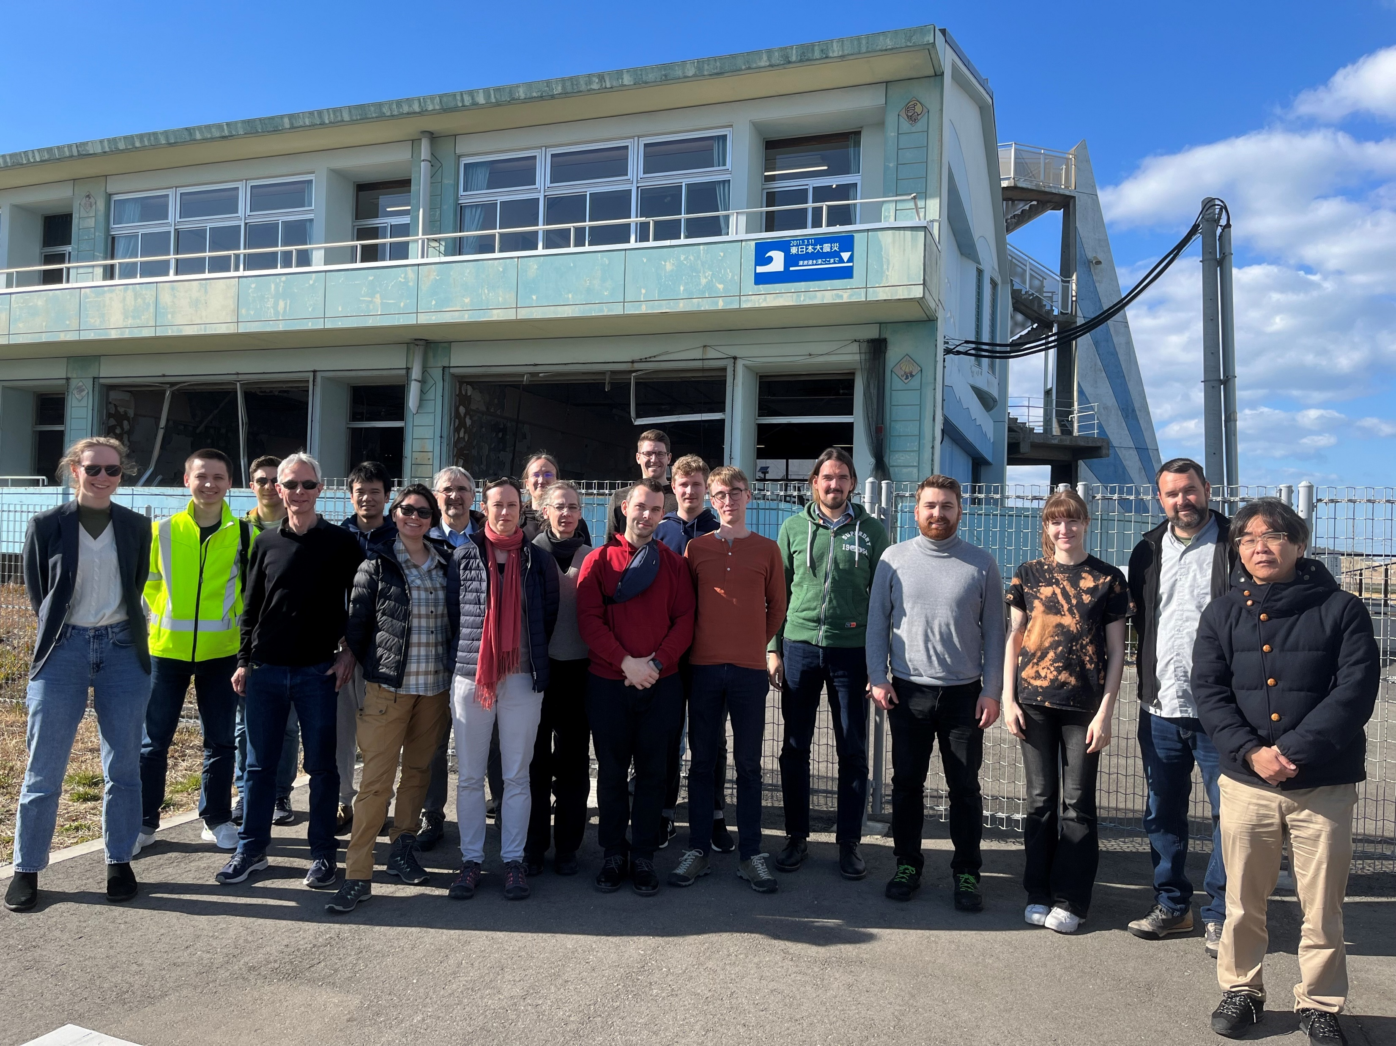
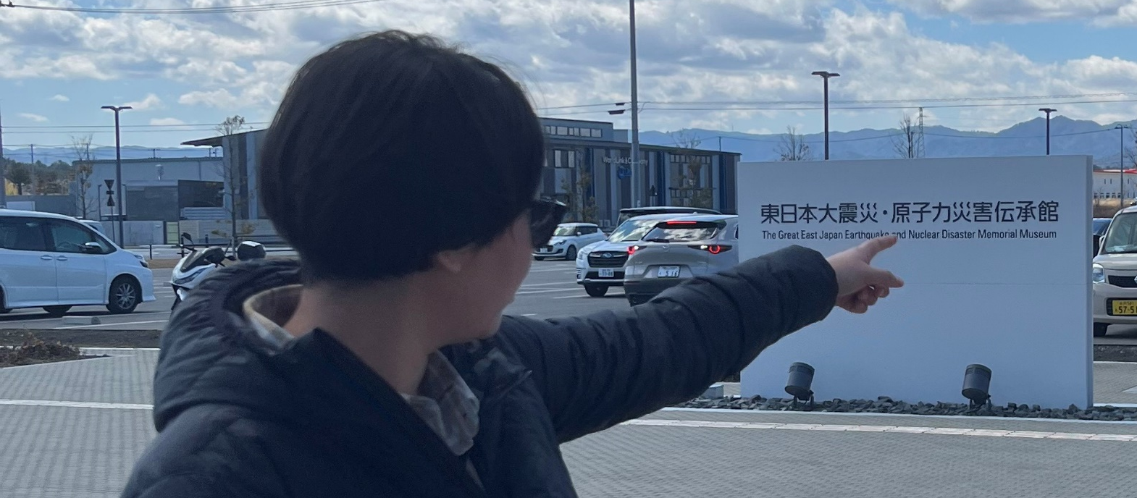
Day 3 - FDNPP
Official tour
Memorial museum visit

Slide 8
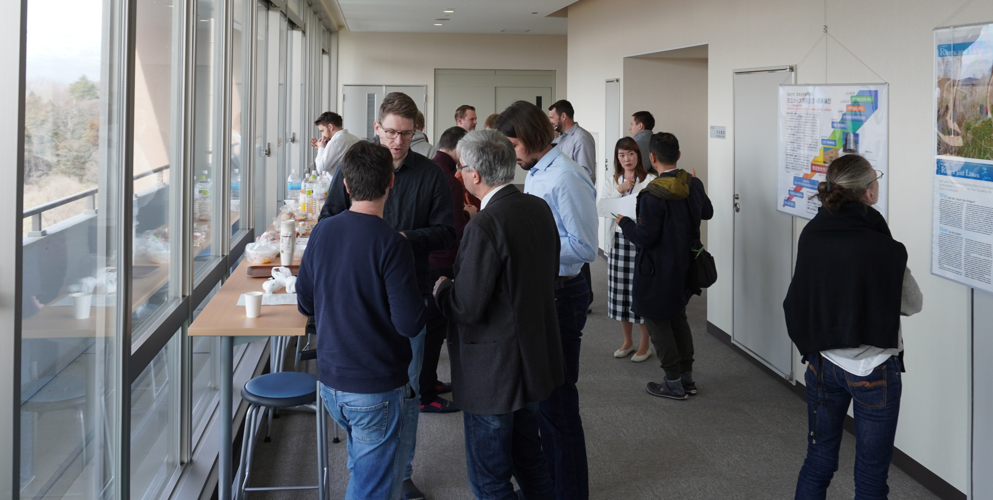
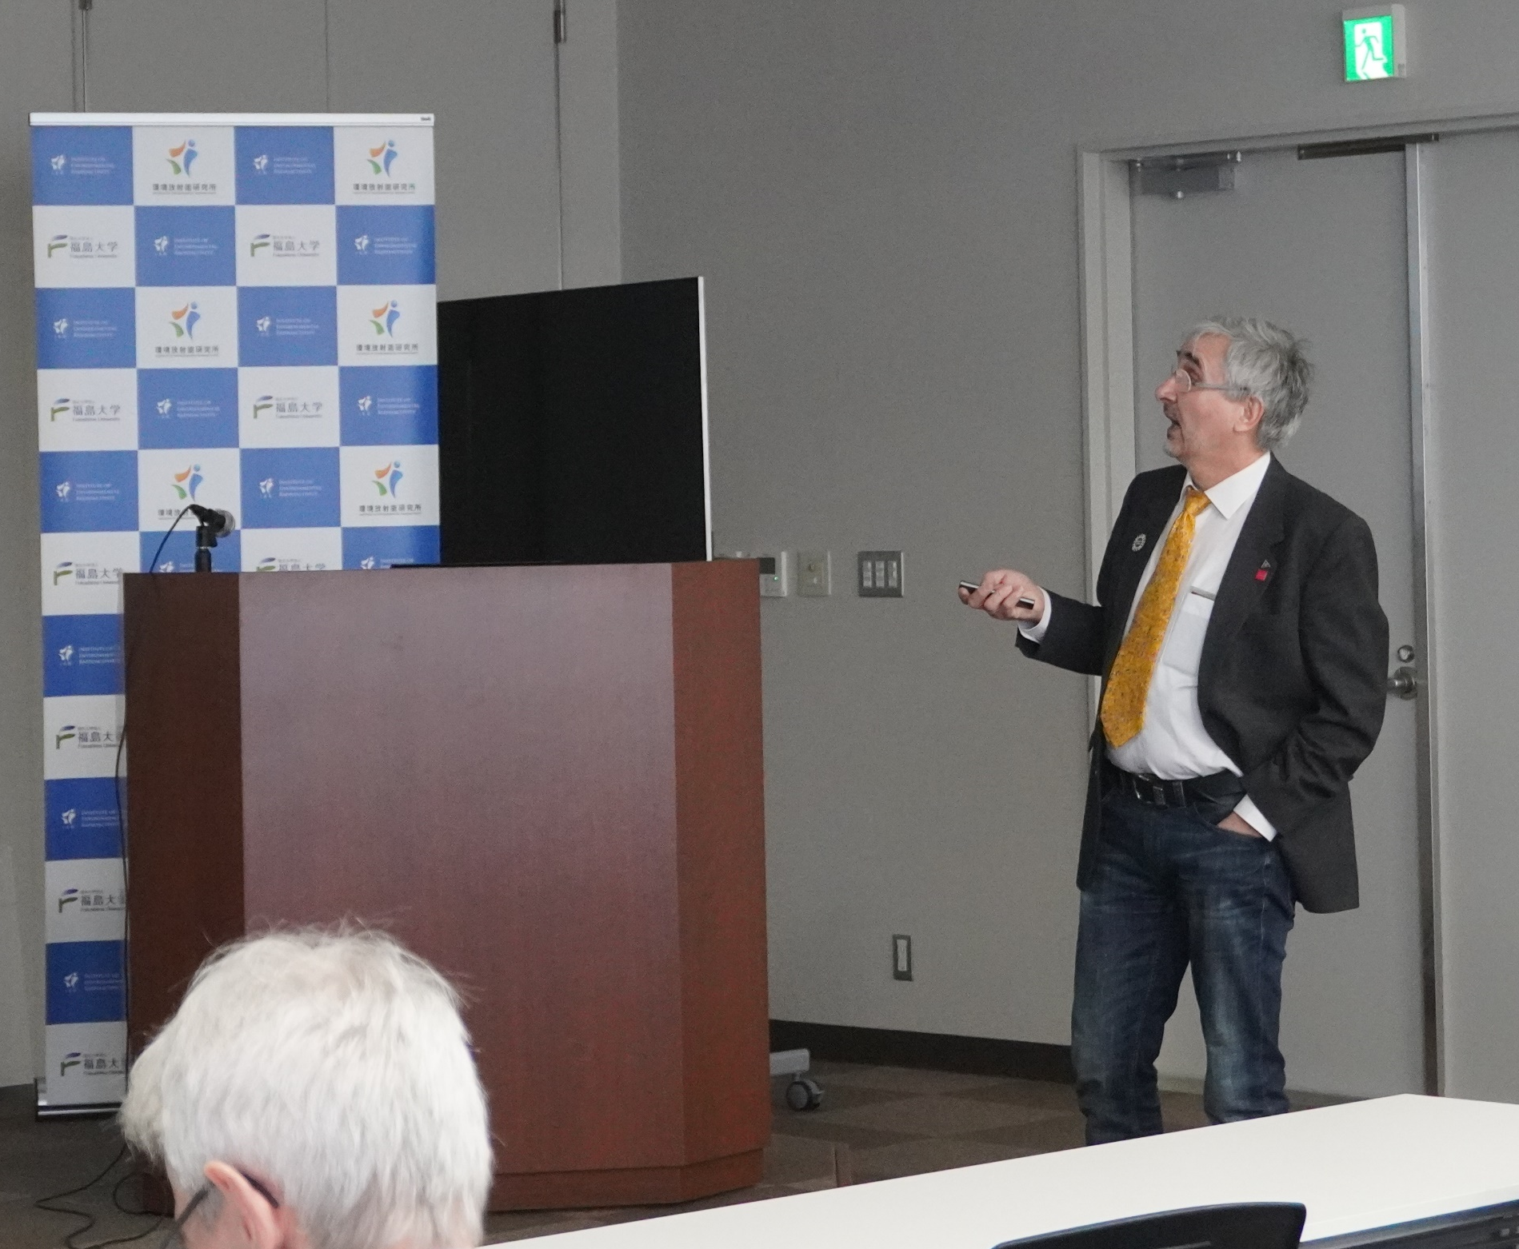
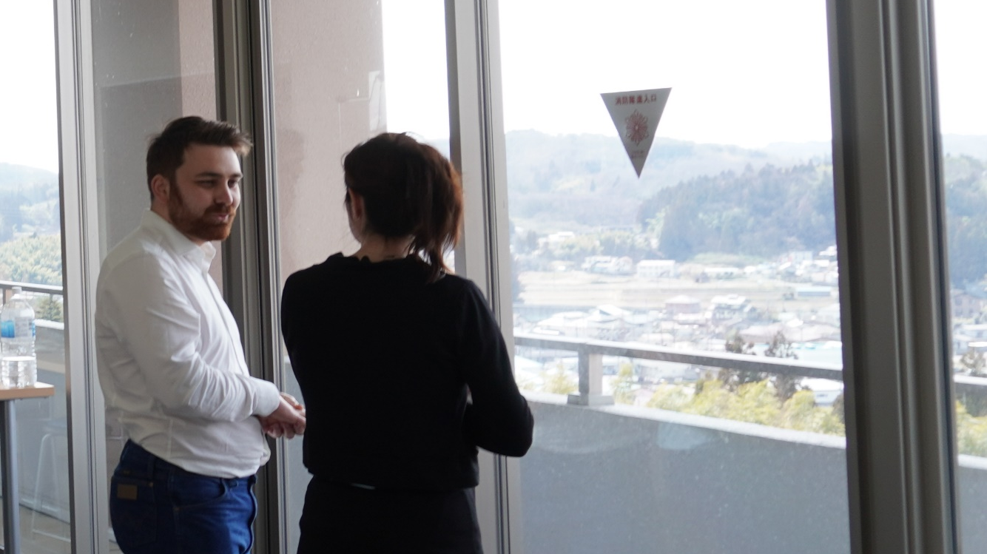
Day 4 – Fukushima University
Talks and discussion

Slide 9
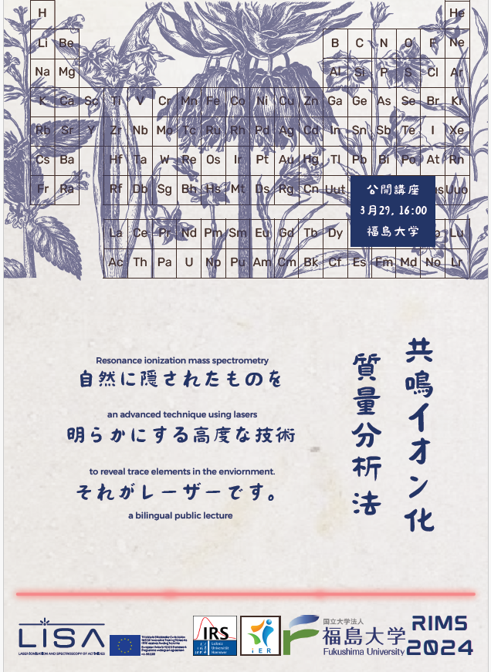
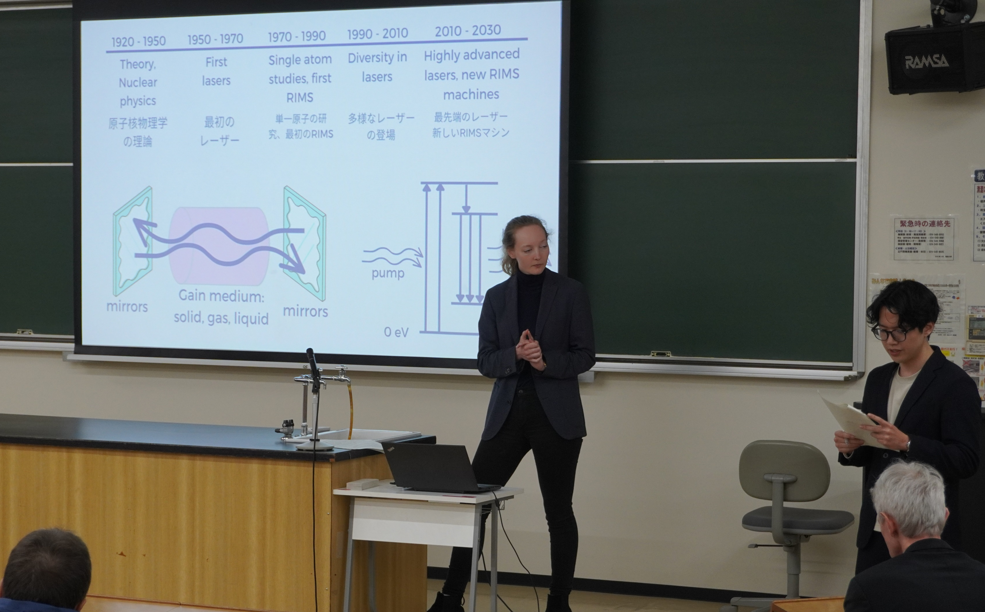
Day 5 – Talks and Public Lecture
Bilingual talk about RIMS
University student audience

Slide 10
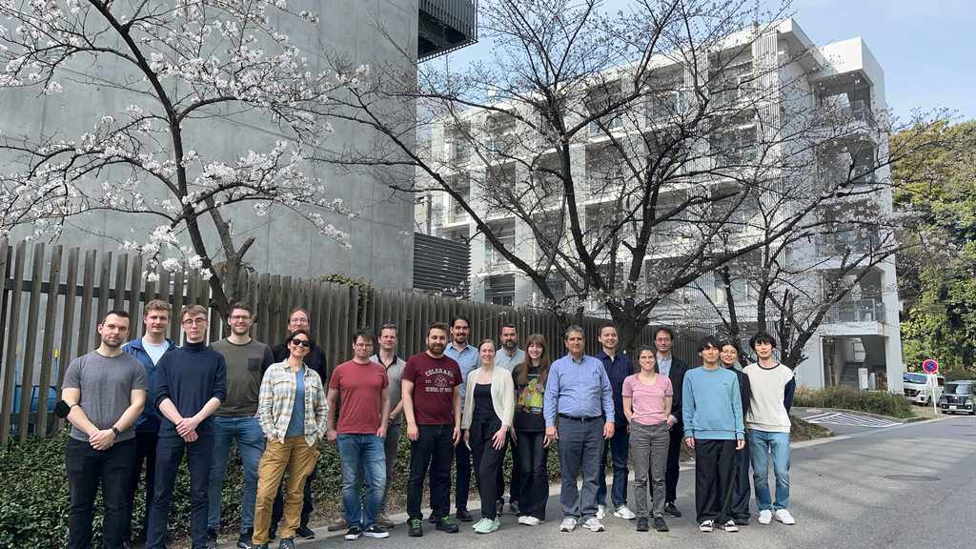
Day 6 - Nagoya
Final lab visit on laser design

Slide 11
Budget/Spending
 |  |  | 156.6906 | EUR>JPY
Item | EUR per person | people | Cost (JPY) | Cost (EUR)
Conference dinner | 55.24 | 32 | 277000 | 1767.82
Bus (all day, Iwaki-TEPCO-Fukushima City) | 54.37 | 20 | 170390 | 1087.43
Karin Hain (Invited Speaker) Accommodation | 528.81 | 1 | 82860 | 528.81
Honorarium invited speakers | 250.00 | 2 | 78345 | 500.00
Host gifts x 8 | 40.34 | 8 | 50569 | 322.73
Welcome reception | 17.95 | 16 | 44991 | 287.13
Rental car (all day, Iwaki-TEPCO-Fukushima City) | 25.35 | 7 | 27801 | 177.43
Yuki Matsumoto (Public Lecture) Accommodation, travel | 163.12 | 1 | 25560 | 163.12
Program Printing | 3.23 | 35 | 17711 | 113.03
Coffee and snacks (four breaks total) | 2.55 | 32 | 12783 | 81.58
Museum tickets Earthquake/Tsunami memorial | 2.95 | 27 | 12480 | 79.65
Kenji Nanba Iwaki Accommodation | 58.08 | 1 | 9100 | 58.08
Total |  |  | 809589 | 5166.80
Original request 15k EUR, budget projection 8.4k, final 5.2k
No catering available at Fukushima University, so limited spending on food and drinks
Group meals very difficult to arrange for 30 people in Japan, especially from abroad

Slide 12
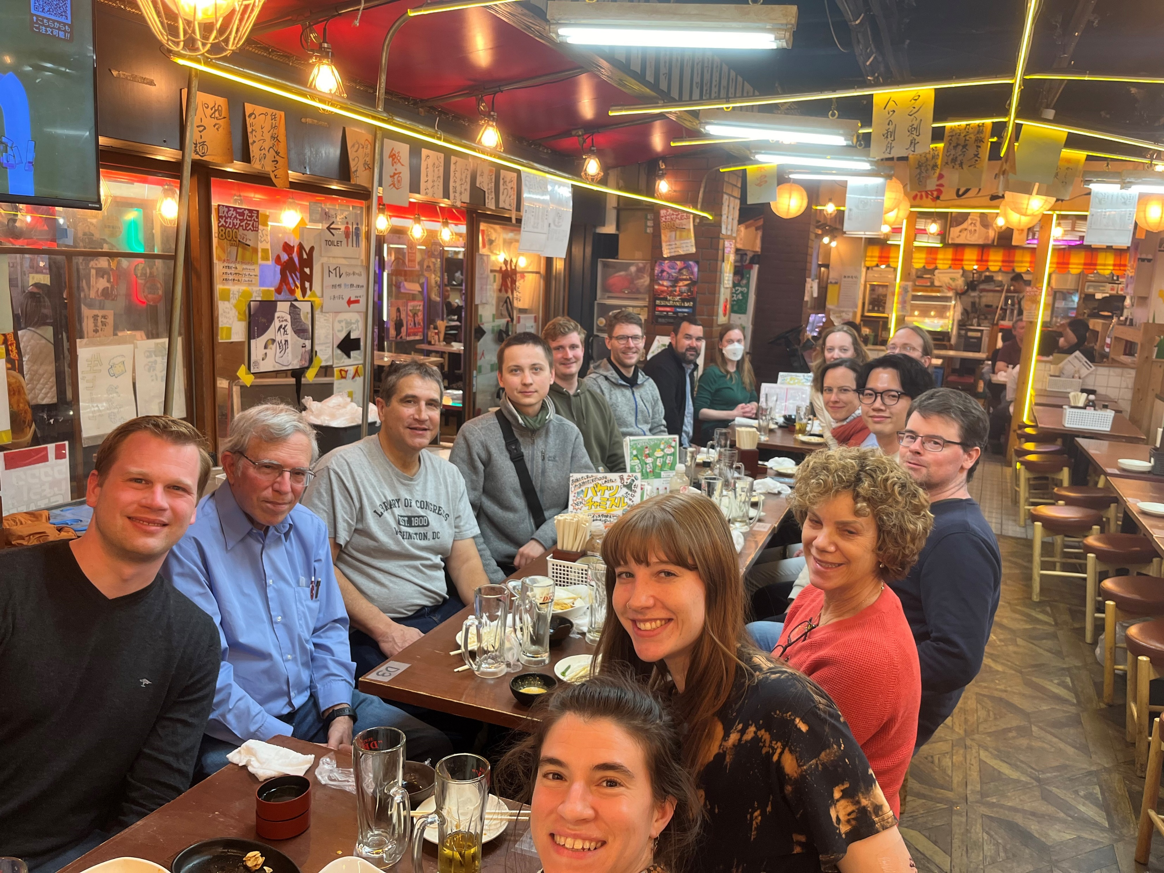
What have we achieved?
Bringing together the global collection of RIMS people into the same room/bus for the first time
Established/solidified connections in Japan
Site visits bridge the gap from laser spectroscopy to (environmental) sample analysis
  Sampling context
  Practicalities of analysis
  Implication of results

Slide 13
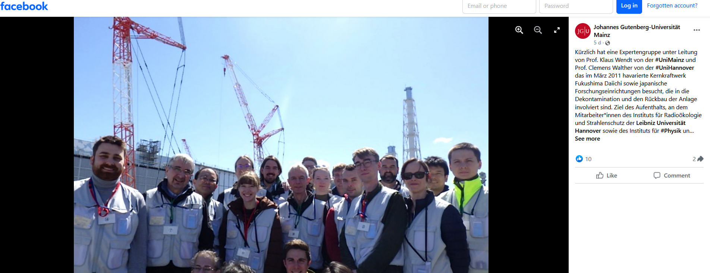
Press Release Mainz
https://www.facebook.com/photo/?fbid=860351759470410&set=a.560858189419770

