Slide 1

AD/ELENA FACILITY
ADTC Meeting 14th March 2024
2024-2025 YETS

Slide 2
YETS generalities
AD YETS start: 2nd December
ELENA will continue running with Hminus till 15th December (GBAR till 9th, PUMA till 15th)
Main activities:
  2 AD magnets refurbishment (sector 2B)
  ELENA ion source maintenance
  Possibly ALPHA platform above CR (TBC)
ELENA restart (Hminus): 10th February (TBC)
AD ring closure: 20th March
Beam on target: 26th March
Start of physics: 28th April

Slide 3
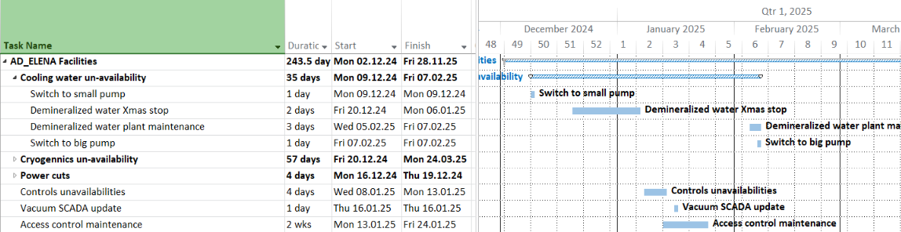
Anticipated Services Disruptions
All dates TBC !

Slide 4
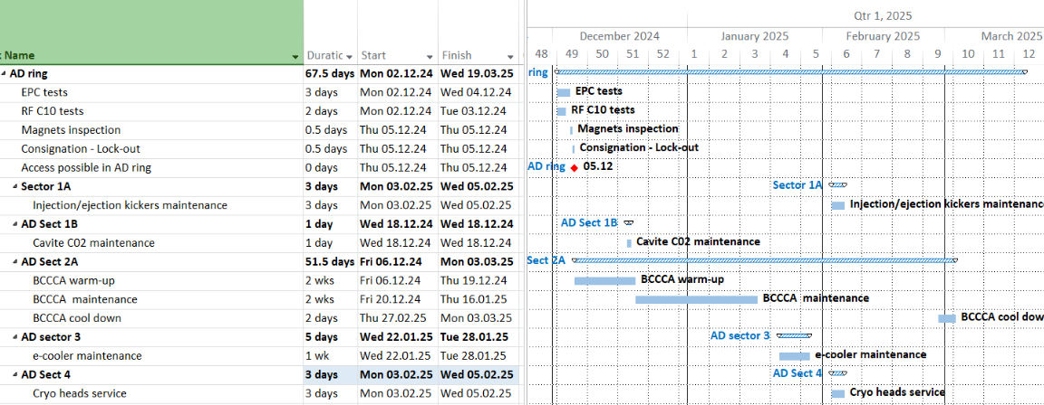
AD ring
All dates are proposals, TBD !

Slide 5
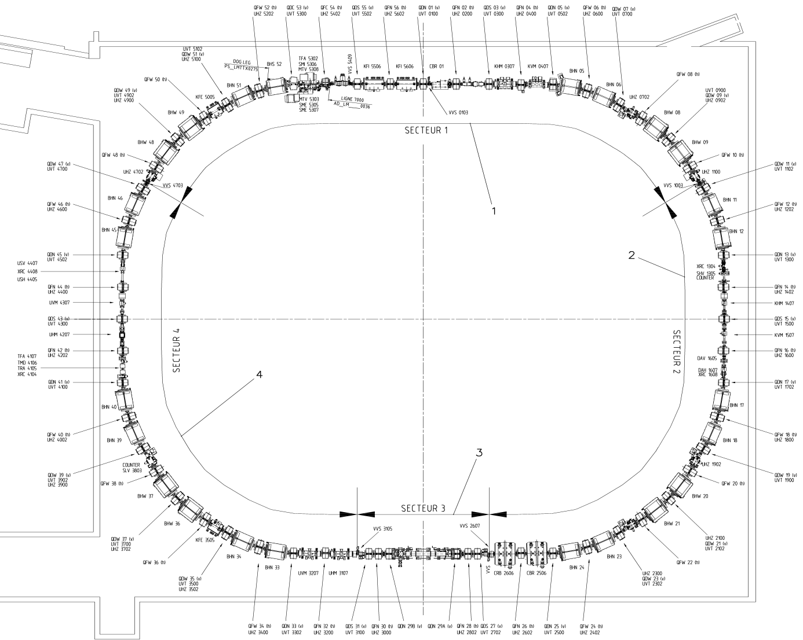
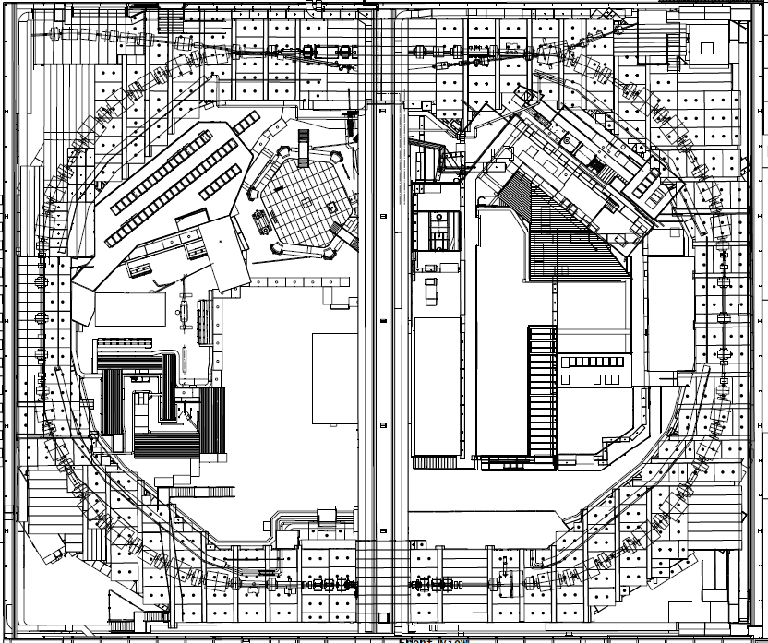
Magnets refurbishment
BHN/BHW Dipoles - Refurbishment Progress
Refurbishment completed
Refurbishment planned
BHN17
Vac Sector 2B
5/29/2024
Document reference
5

Slide 6
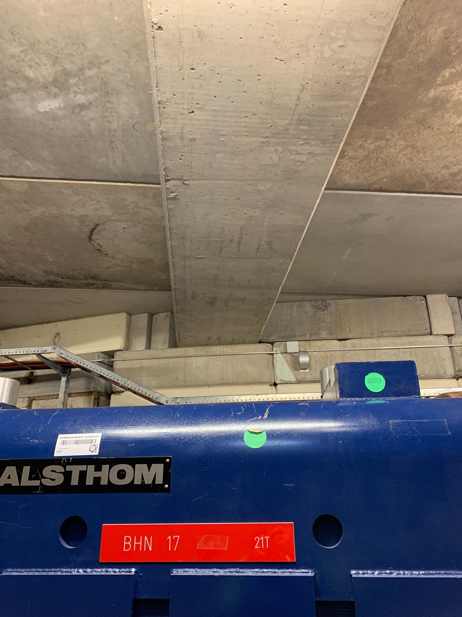
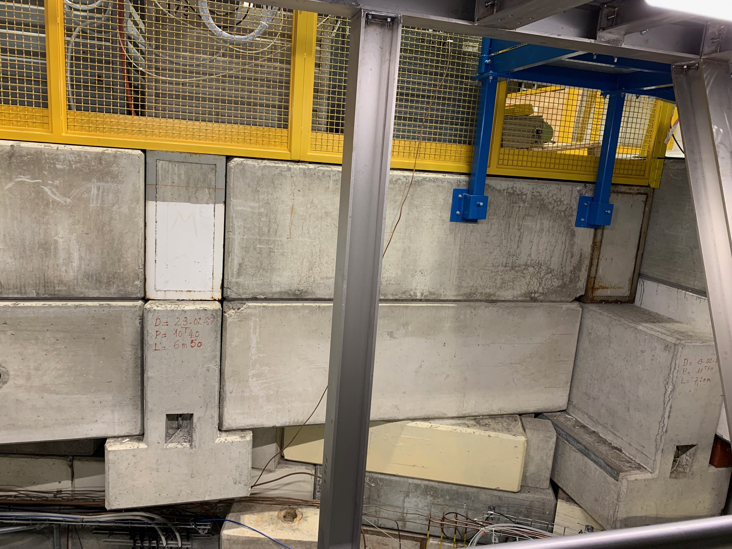
BHN17
This beam to be removed

Slide 7
NARROW QUAD – Refurbishment to be planned
QFN26
Vac Sector 2B
5/29/2024
Document reference
7

Slide 8
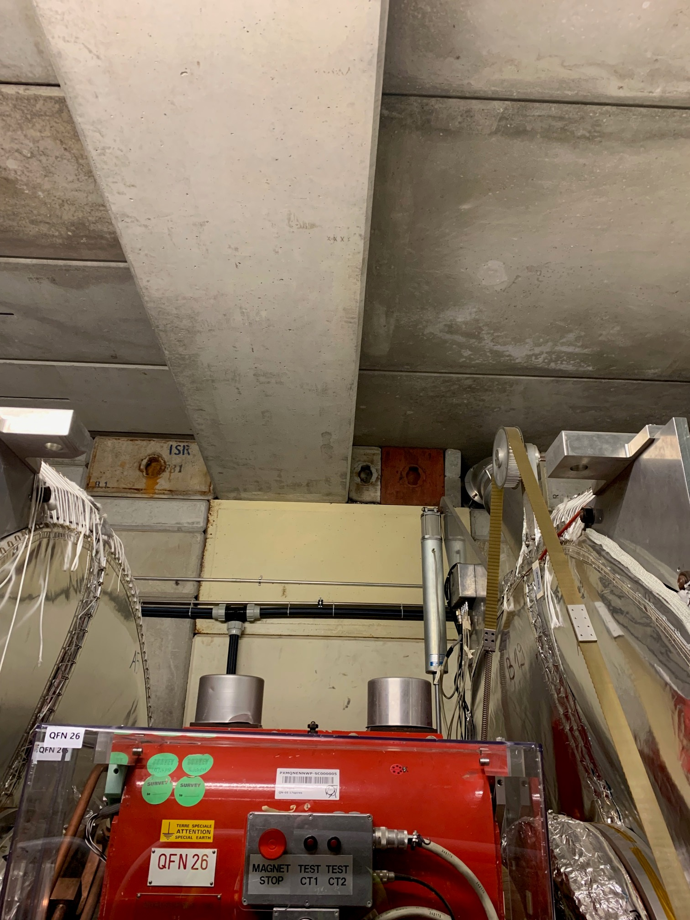
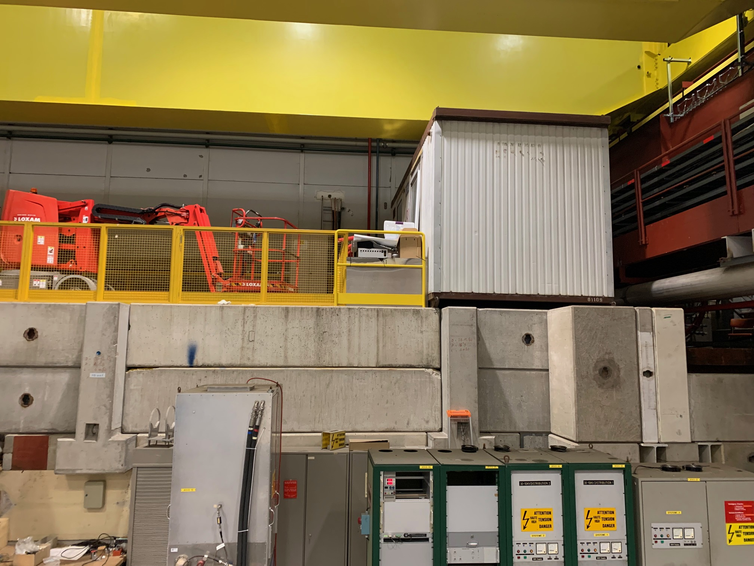
QFN26
20 cm ?
This beam to be removed

Slide 9
Infrastructure works
Activity | Sector
Power convertors Megadiscap MarXdiscap E-cooler | 370 193 R 407

Slide 10
AD target area
YETS 24-25:
  Annual maintenance of magnetic horn
  Replacement of the target
Dates TBC

Slide 11
Experiments during next YETS
BASE + STEP: operation throughout YETS (no beam)
ASACUSA: No operation requiring water. Occasional crane usage
GBAR: Hminus beam till 9th dec. If possible operate from early February 2025 (all services needed)
ALPHA: Helium + cooling-water until X-mas, and as soon as possible again after x-mas
PUMA: operate with Hminus till 15th Dec
AEgIS: operate as normal, just no beam
Note: anticipated services disruption apart from usual ones (AUG, autotransfer tests, Xmas demi water + cryo plant stop, late winter cryo plant+ demi water maintenance) being currently evaluated.

