Slide 1
EN-EL Power activities
YETS24/25 & LS3 – ADTC meeting
Mickael Lonjon & Bruno SAINT SULPICE, on behalf of EN-EL
04/07/2024

Slide 2
EN-EL tests
Projects
Timeline

Slide 3
Tests

Slide 4

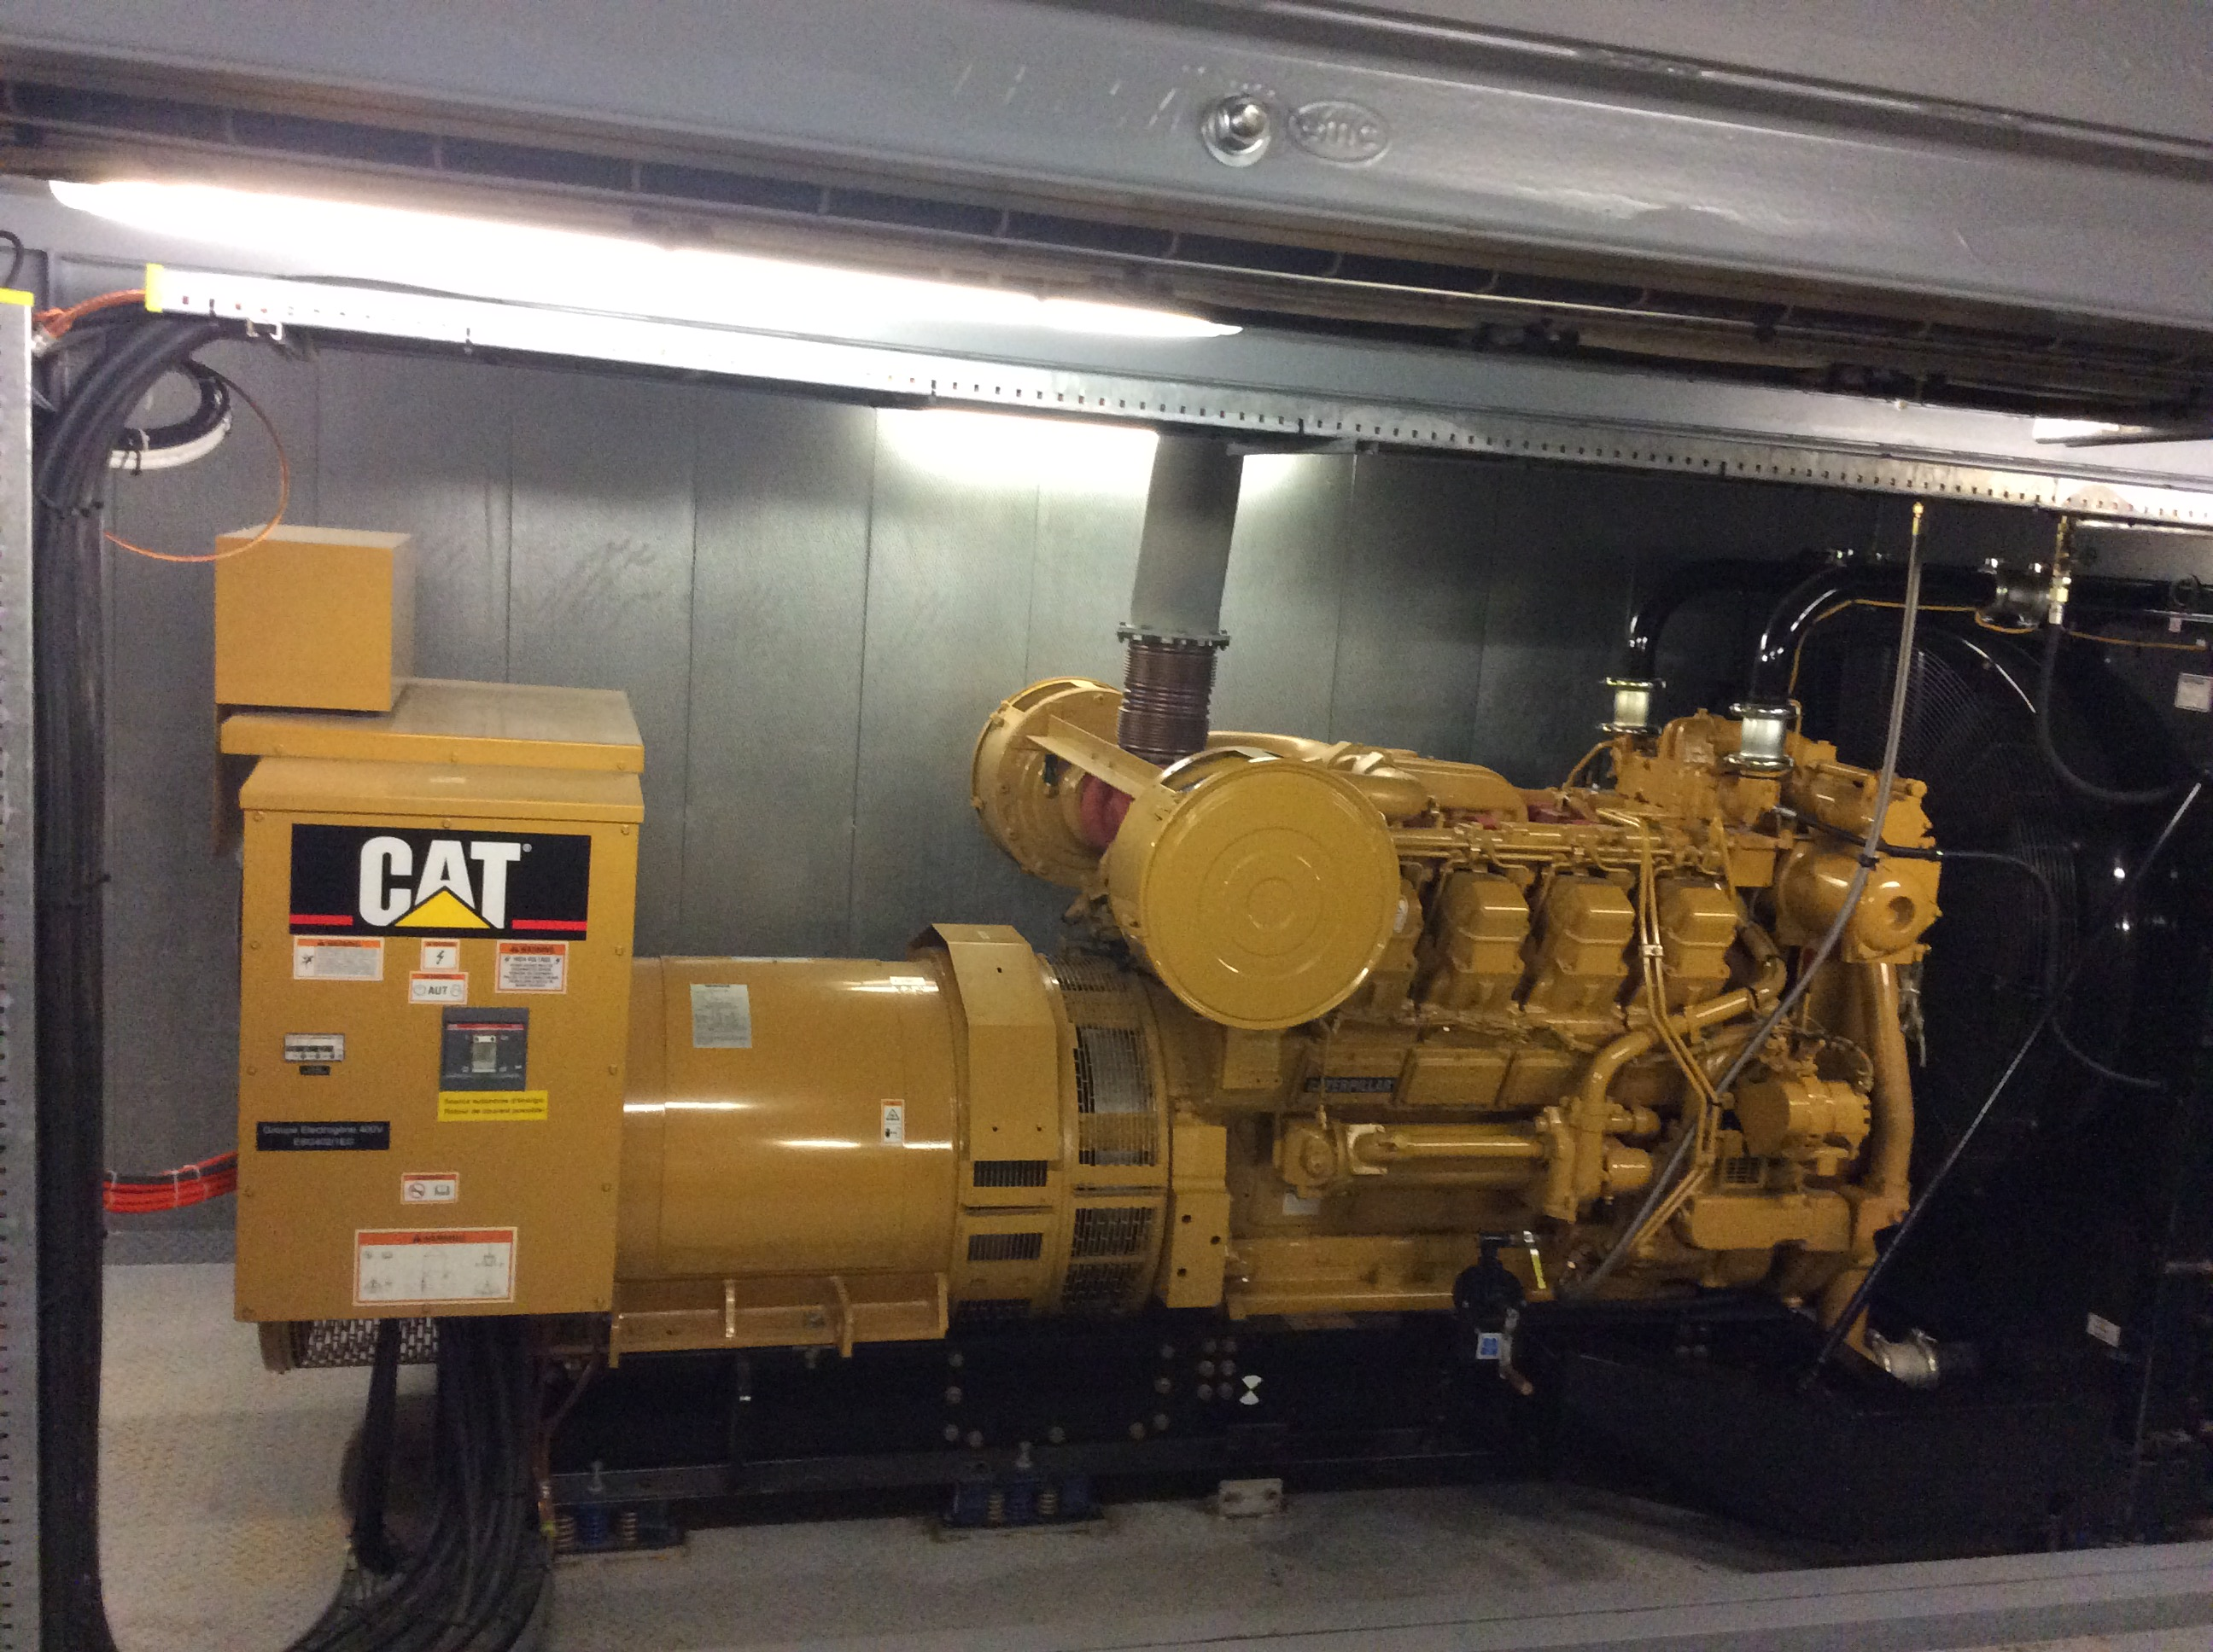
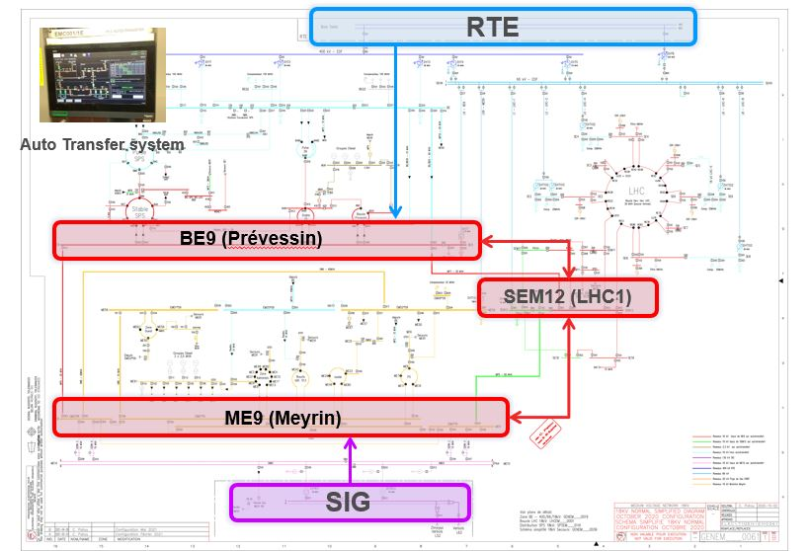
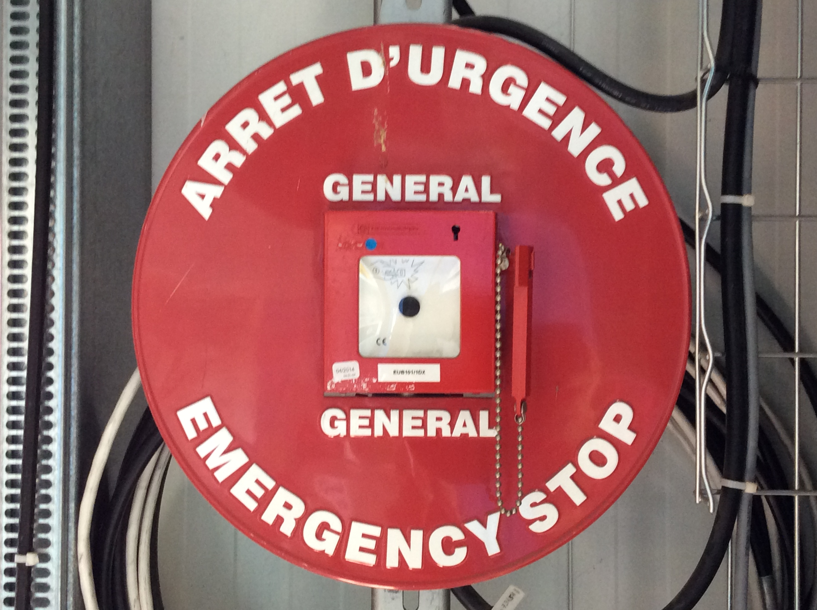
Periodic safety activities on the power grid
Objective
Periodic testing and resolution of non-conformities
When :
During the RUN, YETS and LS
Constraints :
On a case-by-case basis
Regulatory HSE inspection
Objective
Verify the operation of the :
  16 generators
  17 Normal/Secured PLC’s
Carryout a power balance of the safety network
When :
During EYETS and each year of LS
Constraints :
Power outage for secured networks & General Service
One power outage per year from 6:00 to 6:10
Normal / Safety test
Periodic
activities
Objective
Test the Auto transfer system between France and Switzerland
When :
YETS24/25 & end of LS3 (after the SEM12 renovation)
Constraints :
Accelerators must stop operating.
Power usage is limited.
All General Service network refed from Machine networks for 4 days.
Auto transfer Test
Objective
Annually test all of CERN's AUG chains following the IS5.
Where
3 on Meyrin site,
7 on SPS,
3 on North Area,
When :
During YETS and at the beginning and at the end of LS
Co
nstraints :
Power outage for Secured, General Service, and Machine networks
1 day per test, from 6am to 8pm.
9 on LHC,
1 on Prévessin site
AUG test PSB

Slide 5
Projects

Slide 6
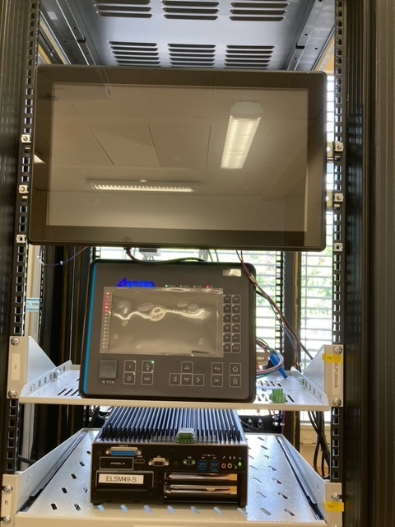
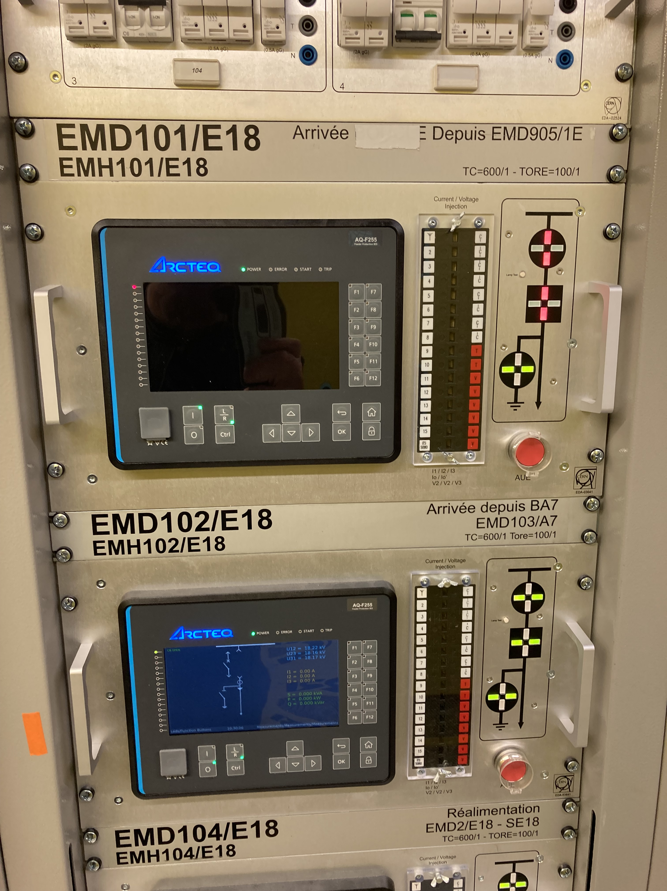
YETS24/25 – Projects/maintenance on AD
Replacement of 18kV protection relay network cards
  1 day of power outages, each load will be cut off for several minutes.
Installation and test of Local SCADA in ME49 (AD)
  2 days of testing with power outages for load reconfiguration.
Replacement of the low voltage switchboard EBD7*49 → EBD1*49 + EBD11*49 in 2 steps (description below)
  Each load will be transferred to EBD1*49, resulting in a power outage of several hours per load.
Protection relay
Local Scada

Slide 7
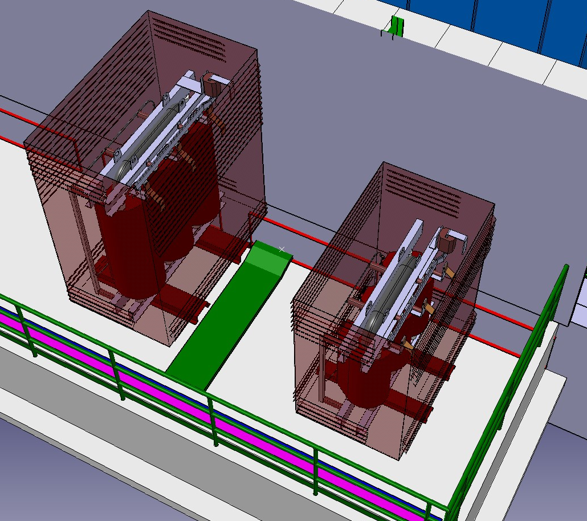
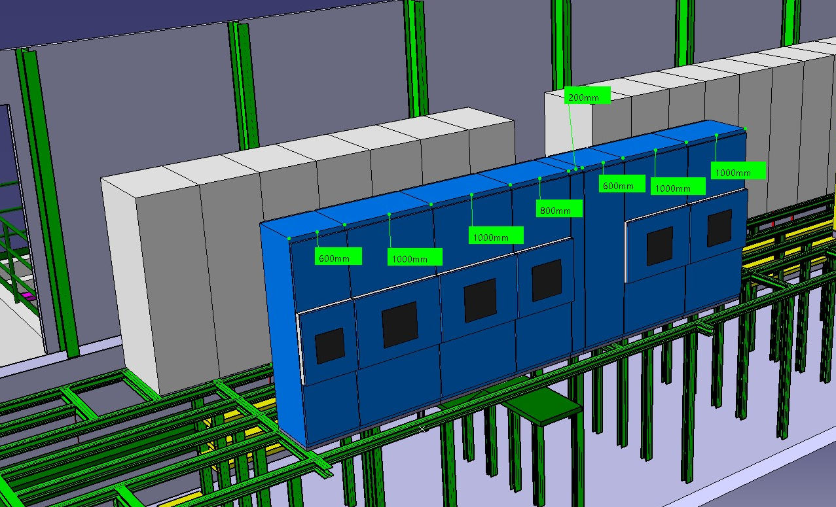
Low voltage AD network renewal (EBD1*49 & EBD11*49) :
Phase 1 : Installation of the new transformer and the new switchboard during the run, (October).
  Small false floor modification and cable trays installation (far from the converters)

Slide 8
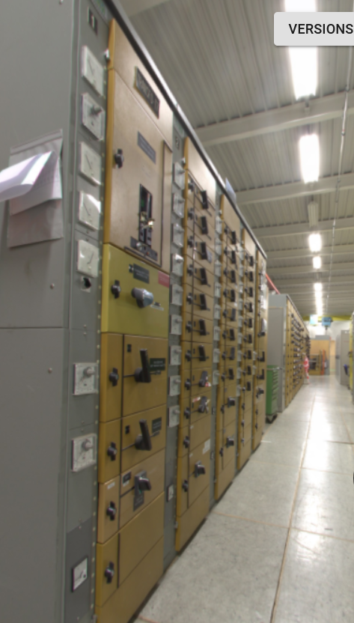
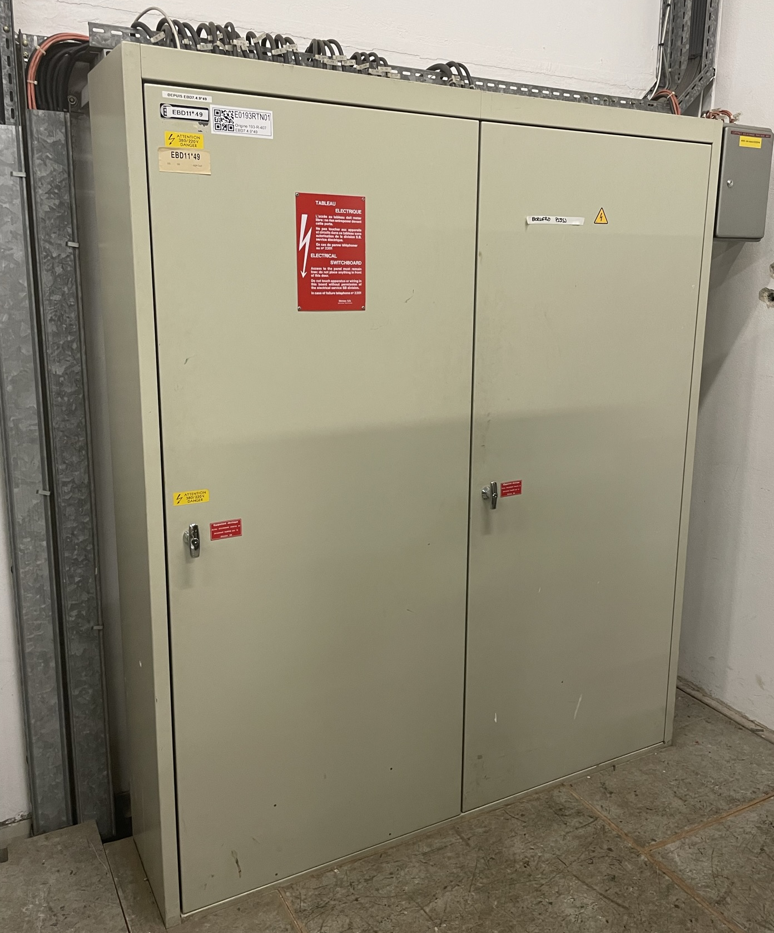
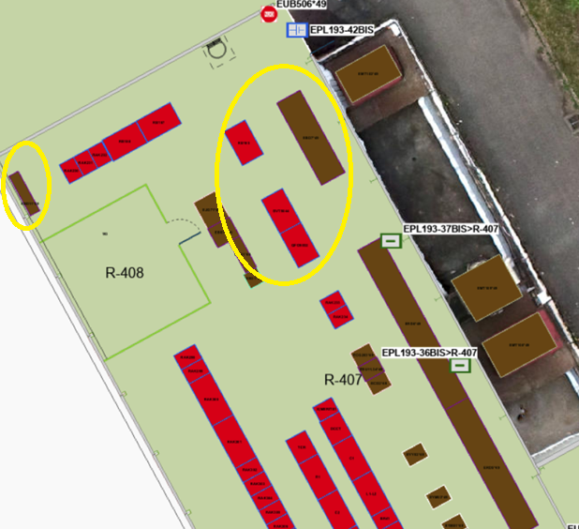
Low voltage AD network renewal (EBD1*49 & EBD11*49) :
  Phase 2 : Transfer of the loads and replacement of small loads switchboard
    Small powercuts (1/2 days) expected for all the services hall and control room equipments
    2 days of power cut for the small loads switchboard replacement
    Affects lighting and power sockets for the service hall + control room

Slide 9
List of loads :
Cranes : PR190, PR191, PR192
CV equipments in 193, 195, 196 :
  Ventilation unit below the roof of the main hall
  Cooling unit in 193/R-410 (Longer power cut due to cable replacement 3 days)
  Ventilation room 193/R-403
Control room equipments :
  Lighting, Power sockets except EOD ones
Experimental Hall lighting, power sockets
  Small switchboard coming from ERD network not affected.
Satellite buildings general services 393, 196

Slide 10
Timeline on AD

Slide 11
Dec 15 - Feb 15
2024
2025
AD Timeline
Dec 29 - Feb 10
Today
YETS24/25
2024
2025
Dec
Jan
Feb
15/12
22/12
29/12
05/01
12/01
19/01
26/01
02/02
09/02
8 Jan
Test Normal / Secours (10 min - 6h-6h10)
6.2 wks
TEST
11 Jan - 12 Jan
AUG (2 jours)
Jan 21 - Jan 23
Test Auto-transfert (3 jours)
1.4 days
Jan 13 - Jan 14
Installation and test of Local SCADA
0.3 wks
2 days
Travaux ME49
Jan 13
Remplacement des cartes réseaux des relais Arcteq (relais 18kV)
1 day
9 wks
Remplacement EBD1*49 --> EBD7*49 (transfert de charges)

Slide 12

Thank you…
EN-EL Power

Slide 13
Spare slide

Slide 14
EBD7*49 loads
Départ | Description | Départ | Description
EBD7.1.1*49 | DEPANNAGE DEPUIS ERD5.2.5*49 | EBD7.3.7*49 | RESERVE
EBD7.1.2*49 | RESERVE EQUIPEE | EBD7.3.8*49 | DESENFUMAGE BS ET HALL ARMOIRE CV UBD07*49 LOCAL 193/R-403
EBD7.1.3*49 | ALIM. EBD12*49 TABLEAU ECLAIRAGE HALL AD | EBD7.3.9*49 | REALIM. ESD1*49 BAT.193
EBD7.1.4*49 | RESEAU 1 ONDULEUR EBS71*49 | EBD7.4.1*49 | COFFRETS PRISES HALL SALLE DE CONTROLE + REUNION 193/R-008
EBD7.2.1*49 | PONT ROULANT 1 HALL AD PR190 | EBD7.4.11*49 | RESERVE EQUIPEE
EBD7.2.11*49 | ALGECO BATIMENT 93 EBD1*49A TRANCHE 2 | EBD7.4.2*49 | BS REFROIDISSEMENT COFFRETS PRISES LOCAL REFROIDISSEMENT 193/R-410
EBD7.2.2*49 | PONT ROULANT 2 HALL AD PR191 | EBD7.4.3*49 | BS EQUIPEMENT COFFRETS PRISES FAUX PLANCHER CELLULES HT LOCAL 193/E-405
EBD7.2.3*49 | ALIM EBJ18*49 193/R-415 | EBD7.4.4*49 | PRISE 75A PILIER 3 DERRIERE LASER ASACUSA 193/SJ11
EBD7.2.4*49 | ALI. COFFRET DTU HHAAS-0096 | EBD7.4.5*49 | ALIM. EBD13*49 SALLE CONTROLE EXTERIEUR BATIMENT 93 (TRANCHE 1) + STAR POINT
EBD7.2.5*49 | PRISES FORCE GALERIE TECHNIQUE TP9 + PUISARD DP76 | EBD7.4.6*49 | COFFRET SUR FAÇADE ENTRE PORTES 305 ET 323 (COTE CENTRE DE CALCUL 513)
EBD7.2.6*49 | PONT ROULANT PR192 LOCAL 193/R-407 | EBD7.4.7*49 | HALL COFFRETS PRISES 2 ZONE ATRAP 193/S3-B193
EBD7.2.7*49 | T-INJECTION MUR BLINDAGE | EBD7.4.8*49 | HALL COFFRETS PRISES 3
EBD7.2.8*49 | MERIT DCCT 7000A | EBD7.4.9*49 | ALIM EBD11*49 LOCAL 193/R-407
EBD7.2.9*49 | BARRAQUE 6503 DEPART COMDAMNE | EBD7.5.6*49 | ALIM. EBD15*49 (PASSARELLE ASACUSA)
EBD7.3.1*49 | VENTILATION 1 COTE JURA ARMOIRE CW2 369 ET CW2 370 D PLATEFORME | EBD7.5.7*49 | ARMOIRE CW2 376 CLIM. SOUS STATION ELEC. 193/E-406 (ACCES DEPUIS 193/R-410)
EBD7.3.11*49 | ALIM. EBD1*49C BATIMMENT 393 | EBD7.5.8*49 | BS CONTROLE CLIMATISATION ARMOIRE CV UBD09*49 LOCAL 193/R-403
EBD7.3.2*49 | VENTILATION 2 COTE SALEVE ARMOIRE CW2 373 ET CW2 374 HALL AD PLATEFORME | EBD7.5.9*49 | RESEAU 2 ONDULEUR EBS71*49
EBD7.3.3*49 | VENTILATION 3 COTE JURA ARMOIRE CW2 367 ET CW2 368 HALL AD PLATEFORME | EBD7.6.1*49 | ALIM. ARMOIRE UIAC-00316
EBD7.3.4*49 | VENTILATION 4 COTE SALEVE ARMOIRE CW2 371 ET CW2 372 HALL AD PLATEFORME | EBD7.6.2*49 | RESERVE EQUIPEE
EBD7.3.5*49 | RESERVE | EBD7.6.3*49 | ALIM. EBD14*49D
EBD7.3.6*49 | ARMOIRE CW2 375 REFROIDISSEMENT AD LOCAL 193/R-410 | EBD7.6.4*49 | ALIM. ARMOIRE UIAC-00315

Slide 15
EBD11*49 loads
Départ | Description | Départ | Description
EBD11.21*49 | RESERVE | EBD11.C13*49 | CDE SALLE DE CNTROLE C13
EBD11.23*49 | RESERVE (REPERE E23) | EBD11.C16*49 | CDE. ECL. ESCALIER C16
EBD11.25*49 | RESERVE (REPERE E25) | EBD11.C18*49 | CDE. ECLAIRAGE FAUX PLANCHER
EBD11.26*49 | ALIM. REGLETTE PC ECRAN 193/R-005 | EBD11.C27*49 | ALIM DP68 PUISARD STATION FLUIDE BA193 R-010
EBD11.33*49 | CHAUFFE EAU 193/R-102 | EBD11.C29*49 | RESERVE
EBD11.34*49 | ALIM. REDRESSEUR EBU11.34*49 | EBD11.C30*49 | RESERVE
EBD11.35*49 | ALIM. COFFRET EBJ14*49 BAT 493/E-404 | EBD11.C31*49 | CHAUFFE-EAU / PLAQUE CHAUF.
EBD11.36*49 | ALIM. REGLETTE 5PC SALLE CONTROLE 193/R-005 | EBD11.C7*49 | CDE. SALLE EQUIPEMENT
EBD11.37*49 | ALIM. REGLETTE 5PC SALLE CONTROLE 193/R-005 | EBD11.E1*49 | ECL. SALLE REFROID. 1.3.5
EBD11.A*49 | ARRIVEE DEPUIS EBD7.4.9*49 | EBD11.E13*49 | SALLE DE CONTROLE
EBD11.C1*49 | CDE SALLE REFROIDISSEMENT | EBD11.E14*49 | SALLE DE CONTROLE

