Slide 1

AD/ELENA FACILITY
TELMAX Exp Area
Status report

Slide 2
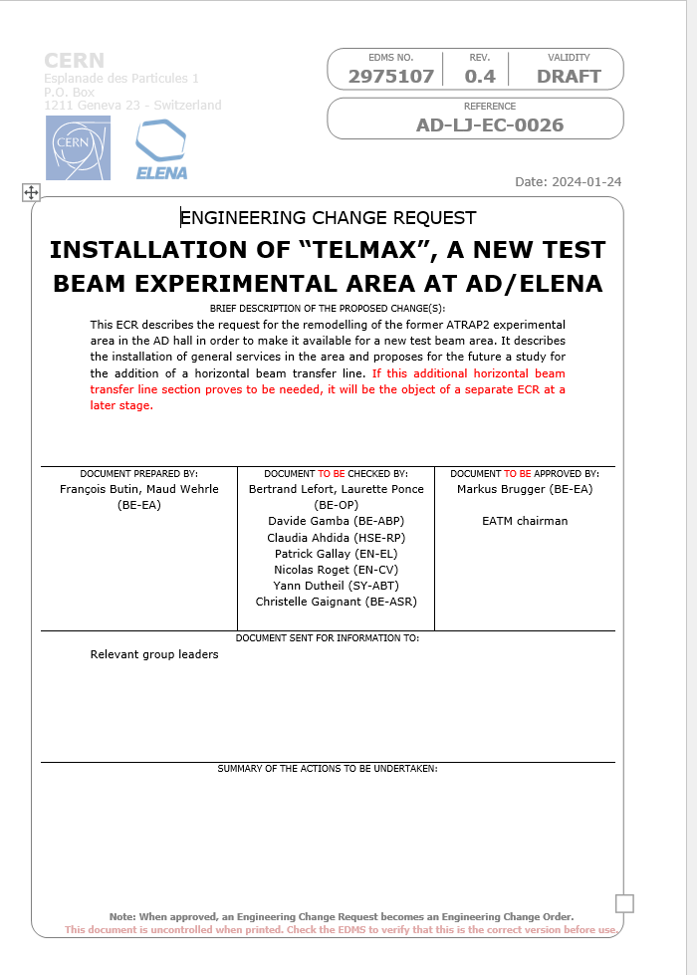
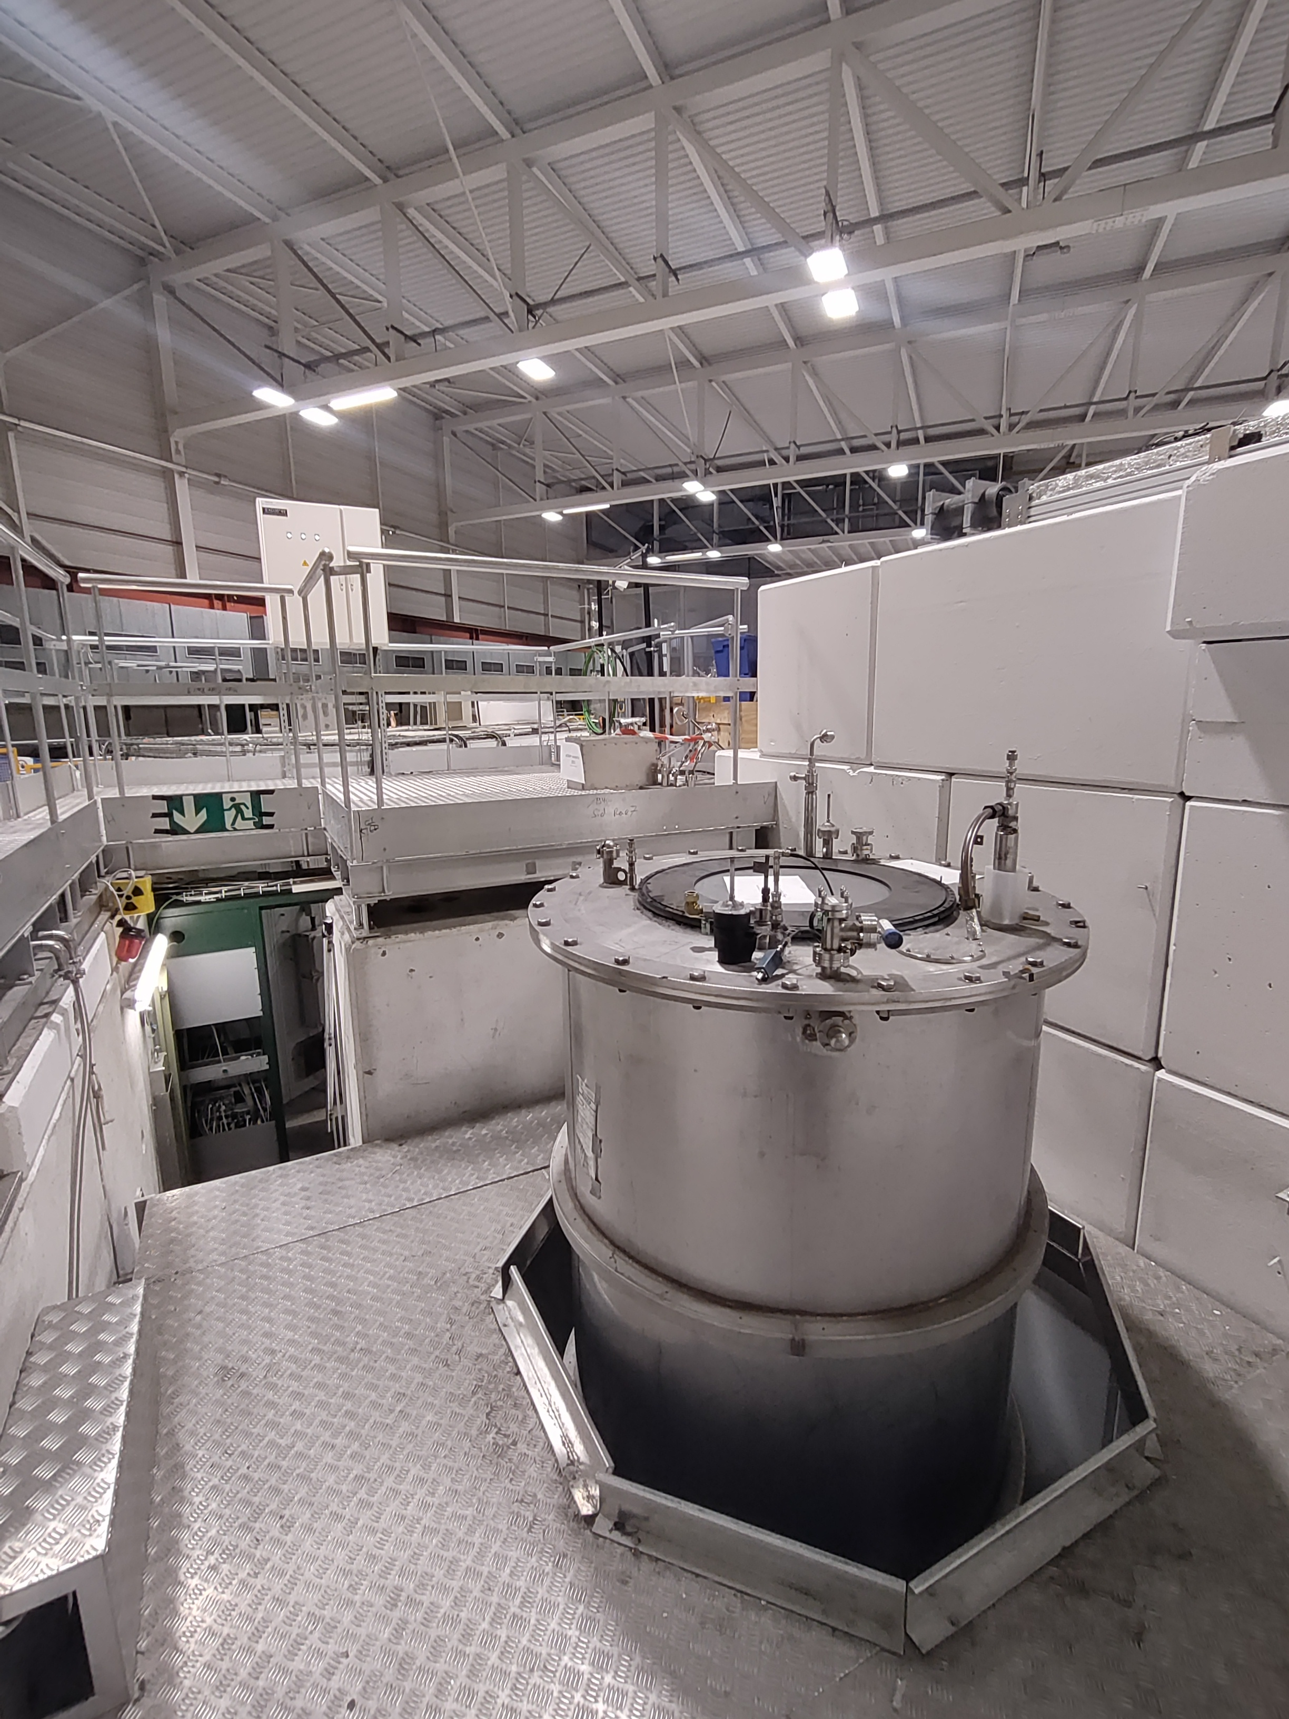
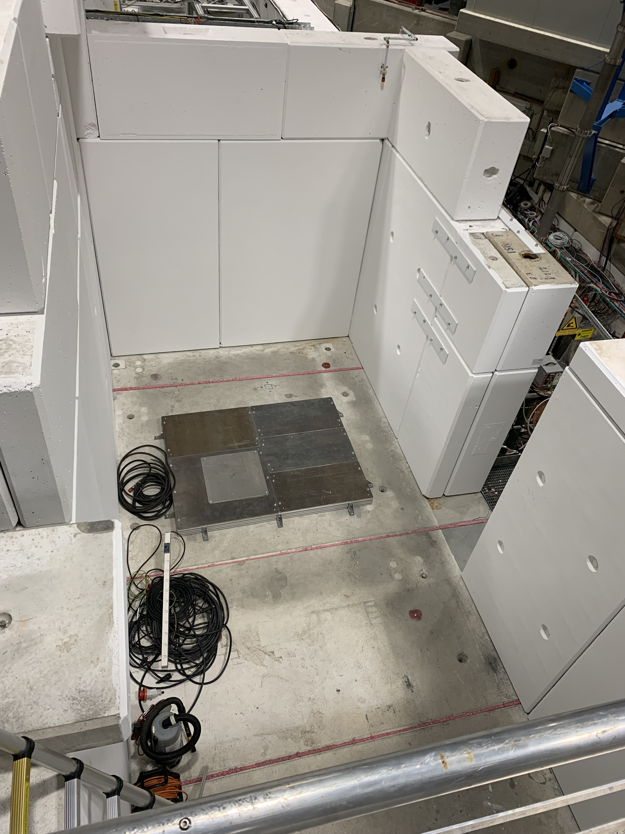
From ATRAP 2 to TELMAX

Slide 3
Objective of the new area
ATRAP 2 hasn’t been running since 2018
The experimental area has been left unused since then
This area shall be repurposed as a test beamline :
  For machine equipment tests (instrumentation, vacuum…)
  By existing / new collaborations to test new equipment

Slide 4
To be done in the near future
The LNE03 line currently ends vertically in the EA: eventually to be bent horizontally
Optics and vacuum layout to be adapted
Shielding needs to be adapted to the new config
Access to the area modified accordingly
Electrical installations to be adapted to the new area. (AUL, sockets, earth bar)
All other services to be installed in the new area (demineralized water, compressed air, networks etc…)

Slide 5
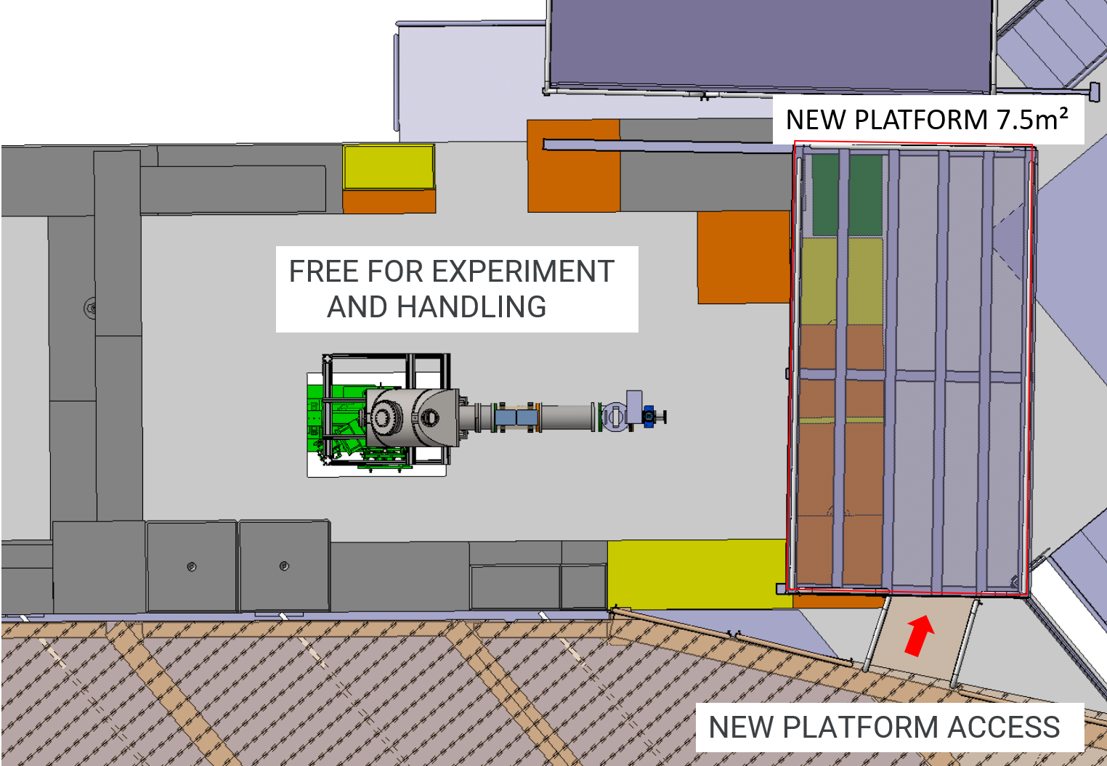
Layout modification
OLD
NEW

Slide 6
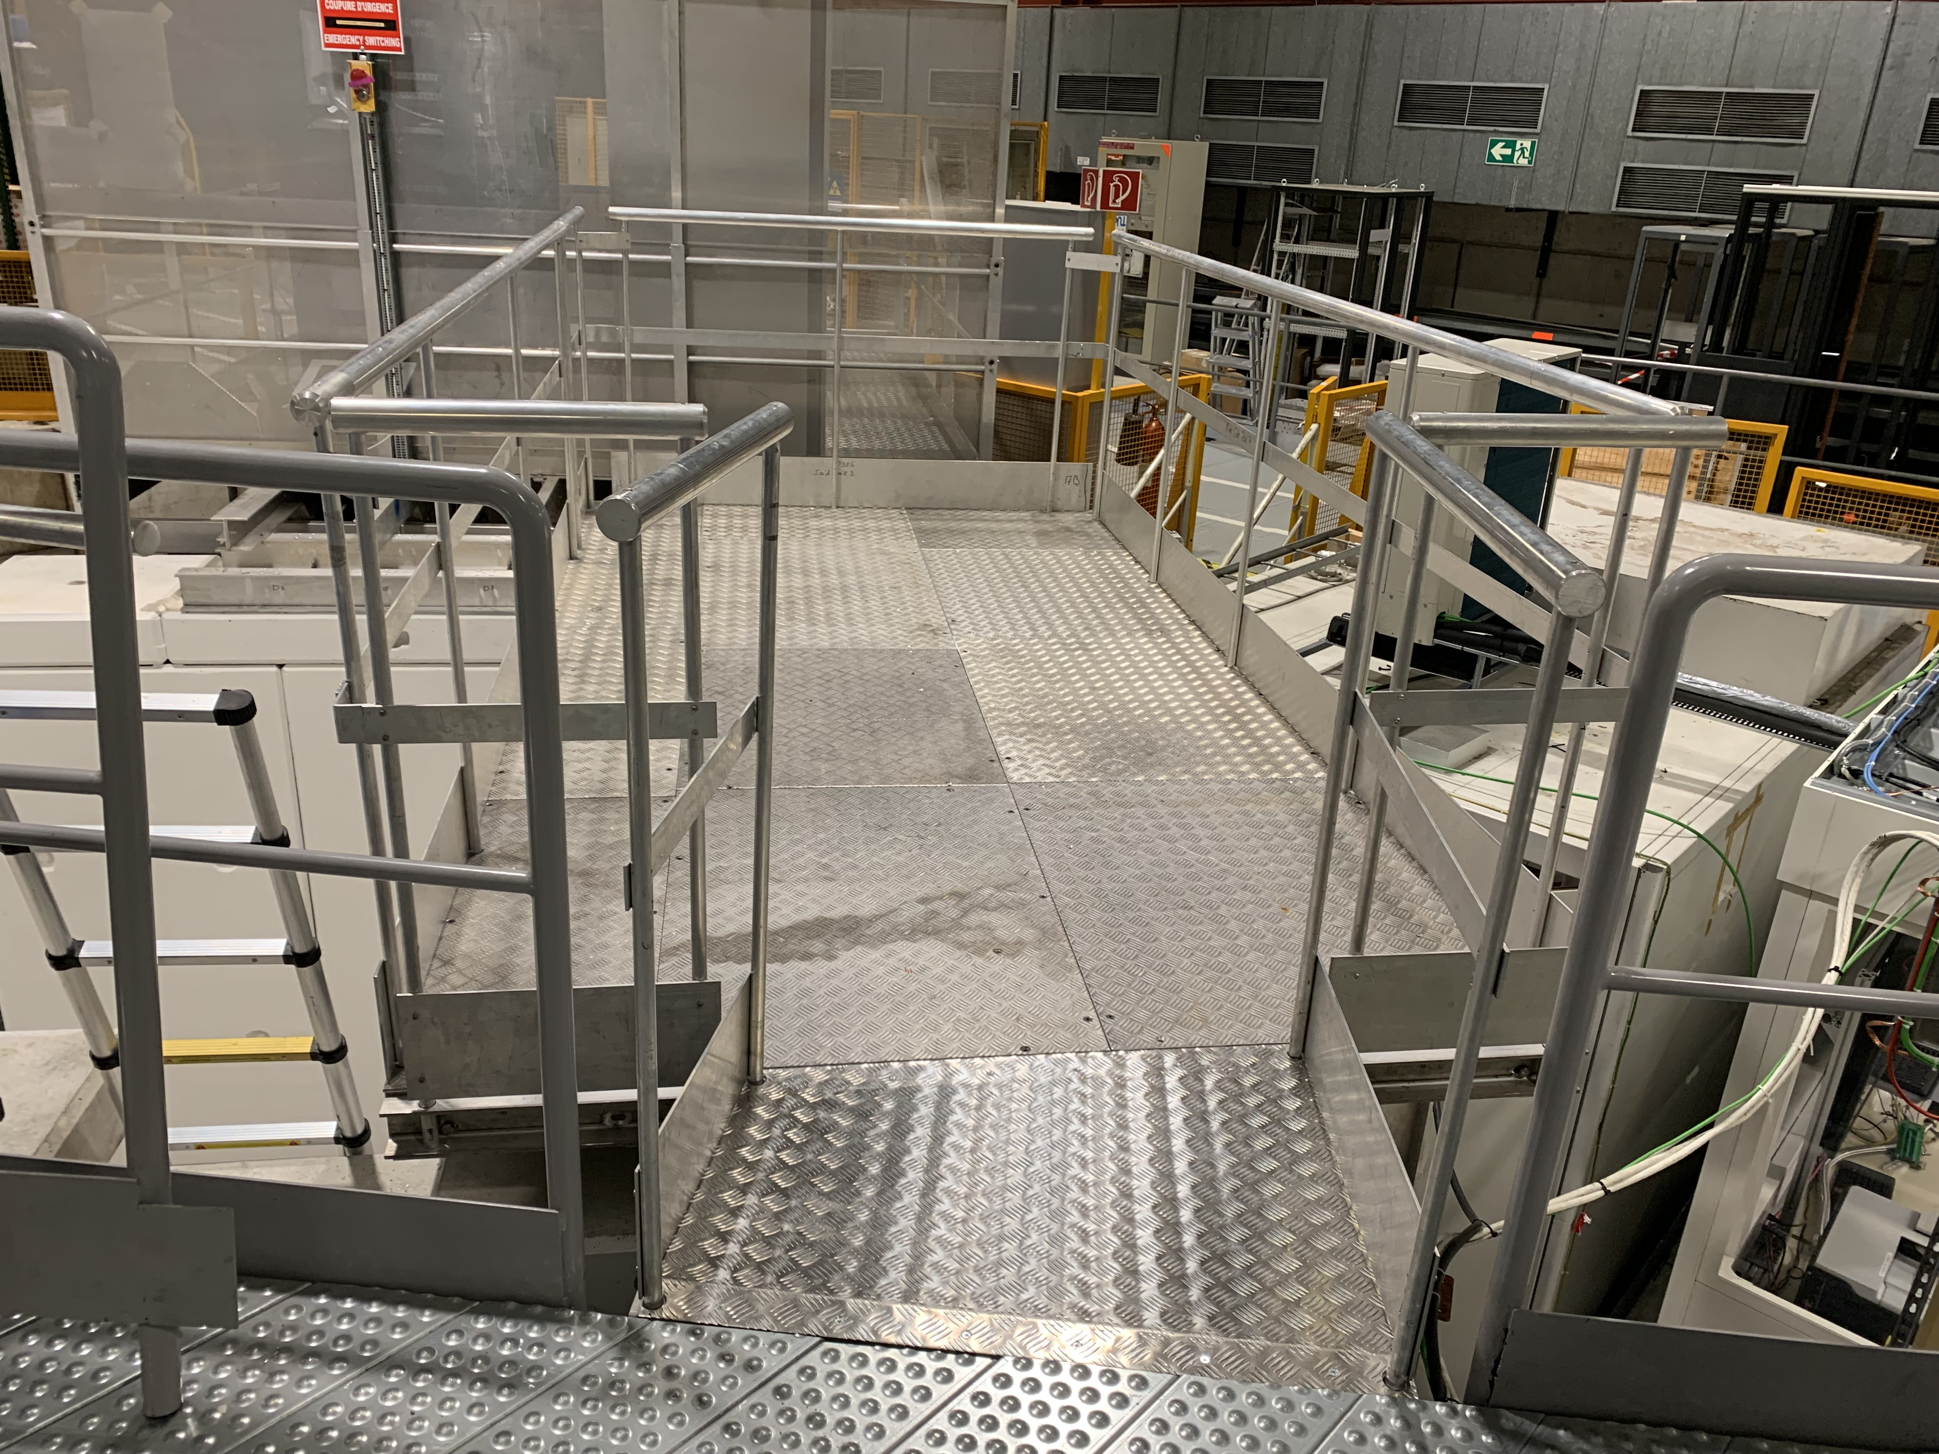
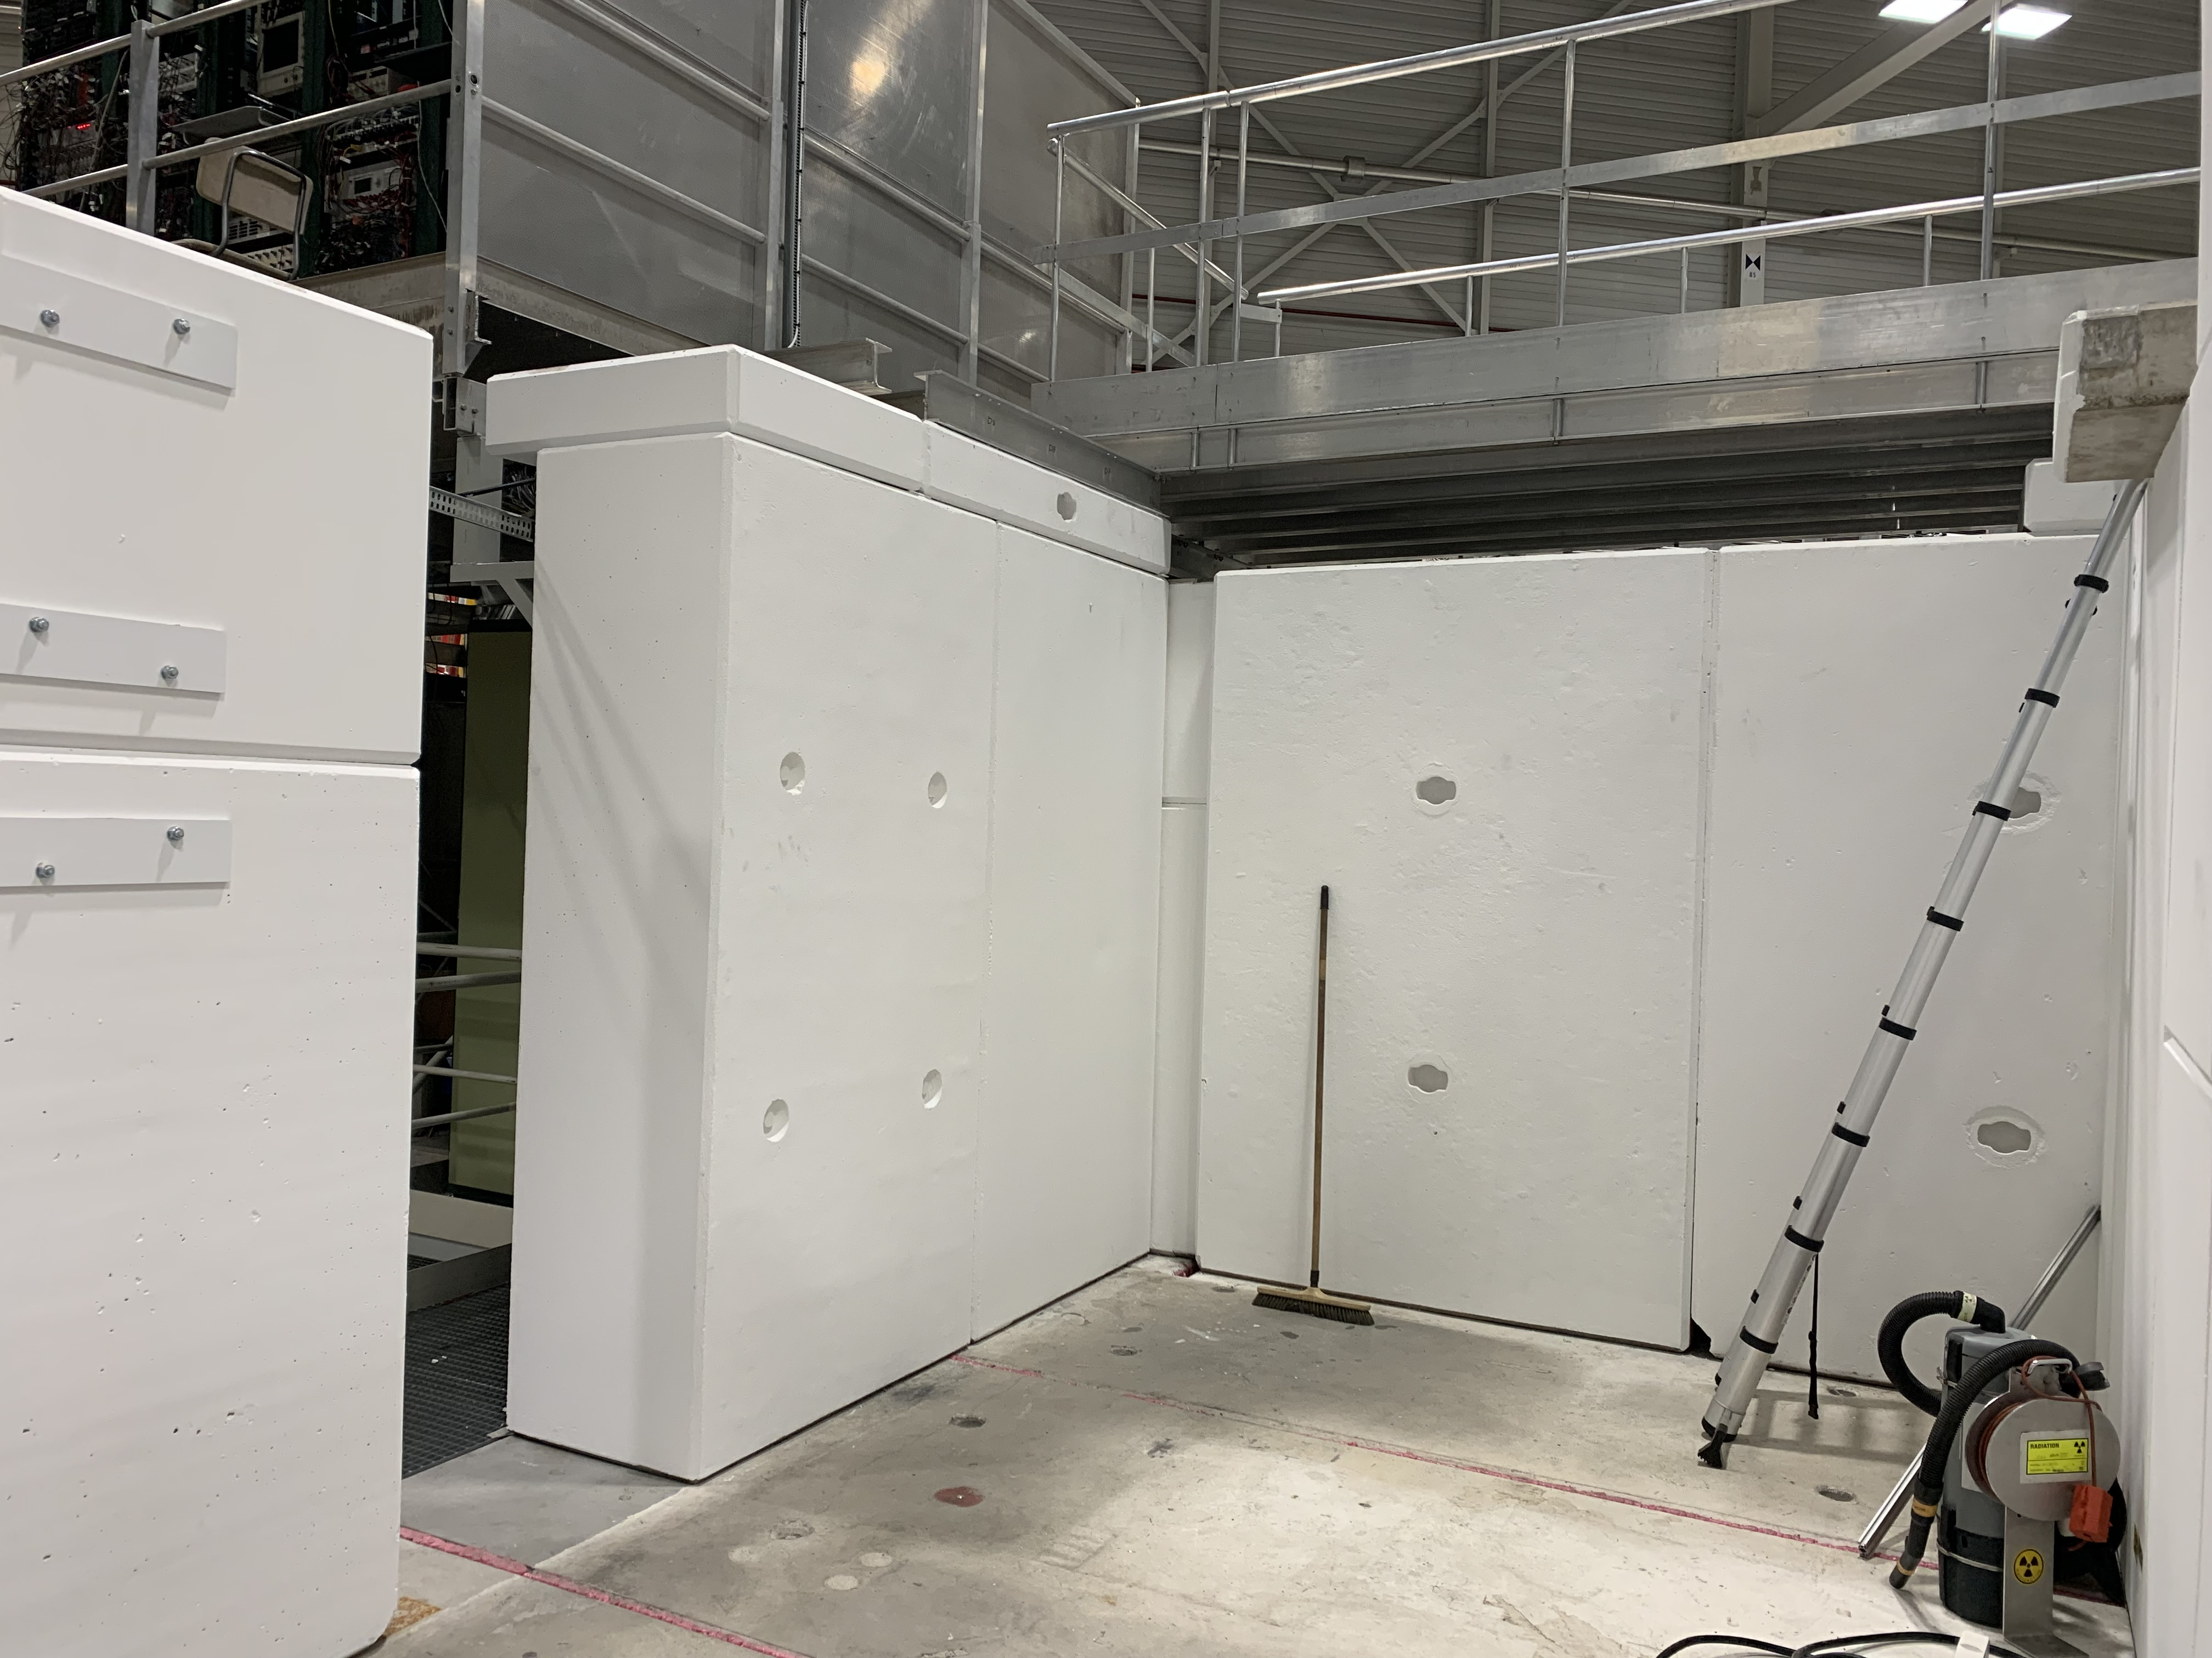
Current situation

Slide 7
Coming next
Power distribution /lighting : 24-26 July
Access safety door (rack already in place): early August
Demineralized water (same as BASE-STEP): August (TBC)
Racks + Networks installation: fibre already here (PUMA CR – TELMAX area), RJ45 ethernet, Technical network (?): YETS 24-25
RP: ?
Control Room to be shared with PUMA (TBC)
Horizontal bend + corresponding optics + SEM: LS3

Slide 8
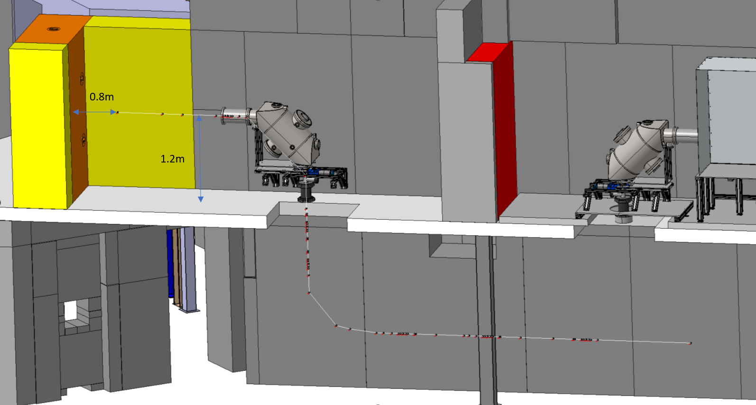
Future horizontal beam setup
Same technology as STEP.
MPI has agreed to produce a 90 deg deflector, details TBC.
New vacuum equipment to be installed is described in the ECR : EDMS 2975107.
Additional ZQNA + SEM
To be installed during LS3

Slide 9
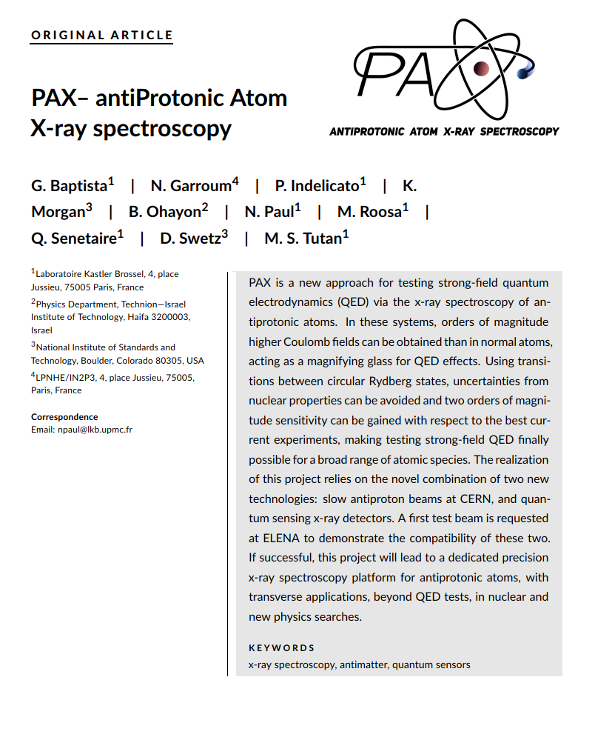
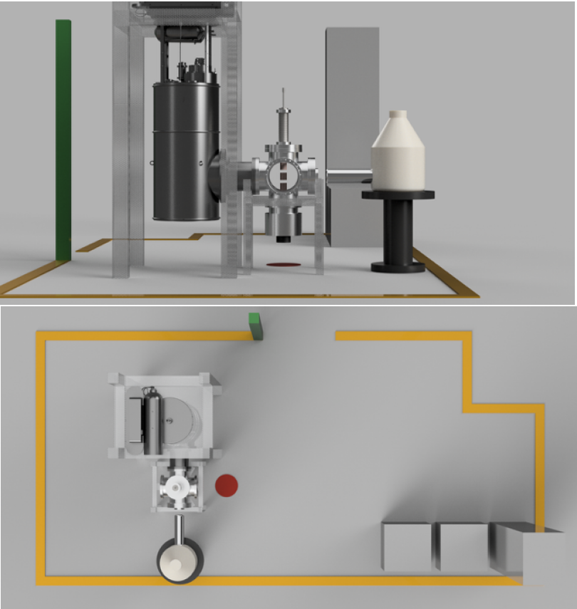
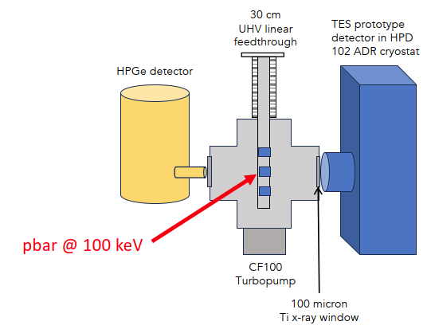
Our future «customers»
PAX (2025 run)
Plus later: HIBEAM, SY-BI equipment, etc… candidates welcome !
Courtesy: Nancy PAUL

