Slide 1
Update on long term improvement plans for the facility
D. Gamba for the AD/ELENA team
04/07/2024 – ADTC

Slide 2
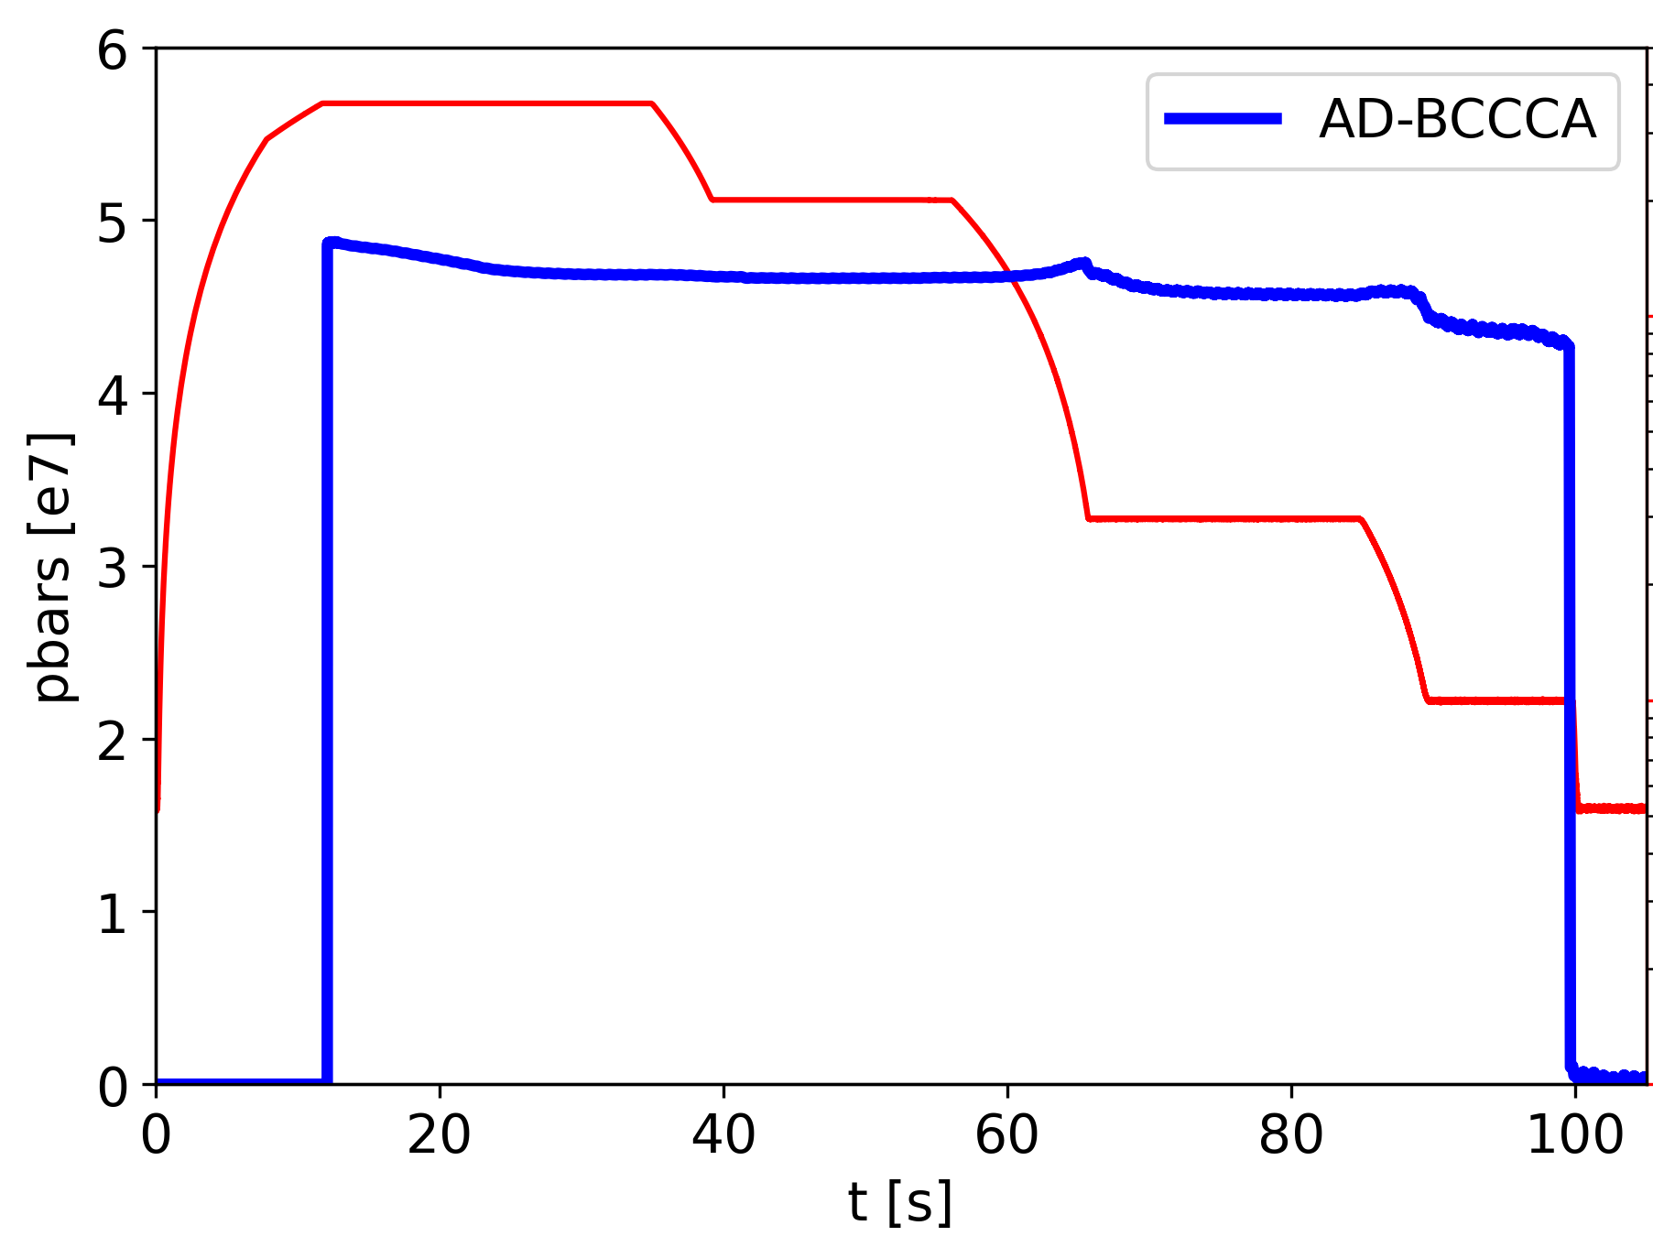
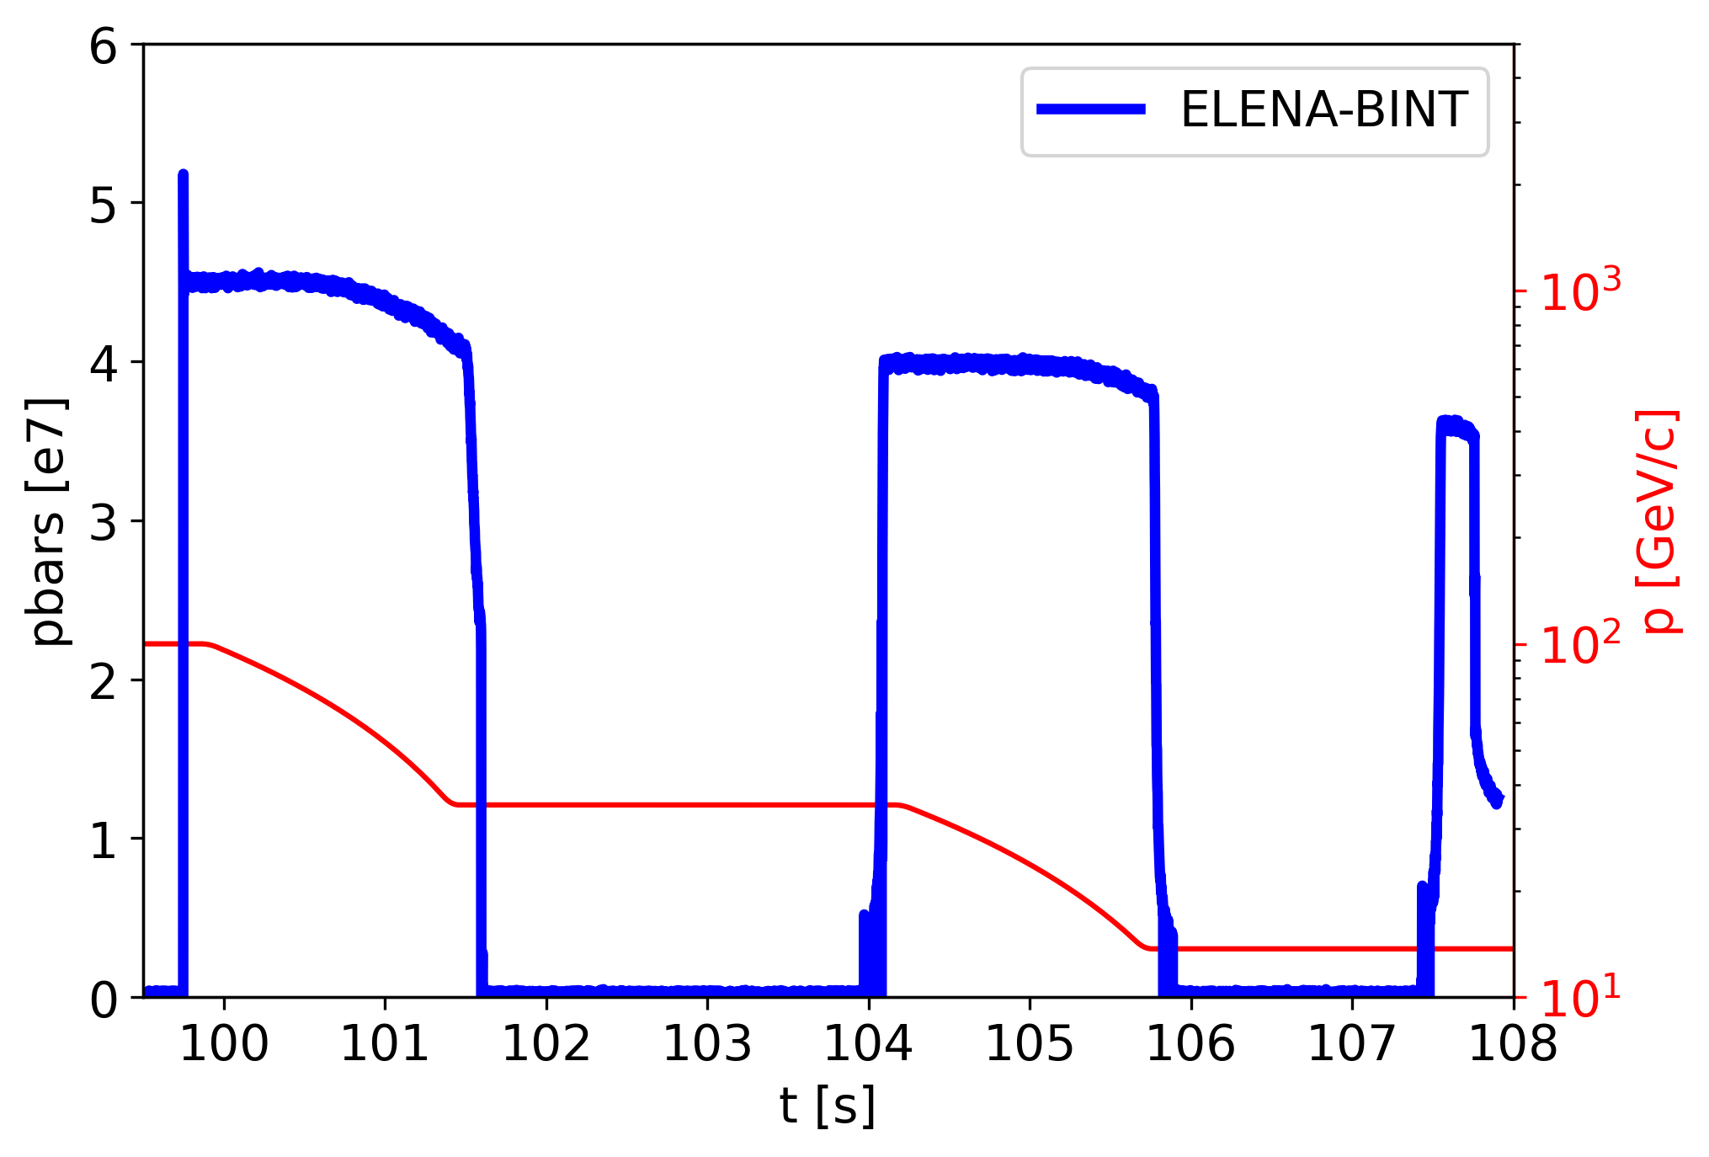
Today: from 25 GeV p to 100 keV pbar: 4e7 pbars/2’
Generating pbars from 25.4 GeV (26.3 GeV/c) protons (yield of the order of 3e-6 pbar/p)
Up to 80% deceleration efficiency from 2.75 GeV (3.57 GeV/c) to 100 keV (13.7 MeV/c)
  Thanks to several stochastic (3.57 and 2 GeV/c) and electron cooling (300, 100, 25, 13.7 MeV/c) steps
p from
PS
p-pbar
yield
AD Cooling and
Deceleration
Transfer to
ELENA
ELENA Cooling and
Deceleration
to users
p
2e13
1.8e13
AD s-cooling
ELENA e-cooling
AD e-cooling
PS eje
FTA9053
(AD target)
Note: after each step, the pbar beams “forgets its history” (n bunches, emittance, …), but intensity!

Slide 3
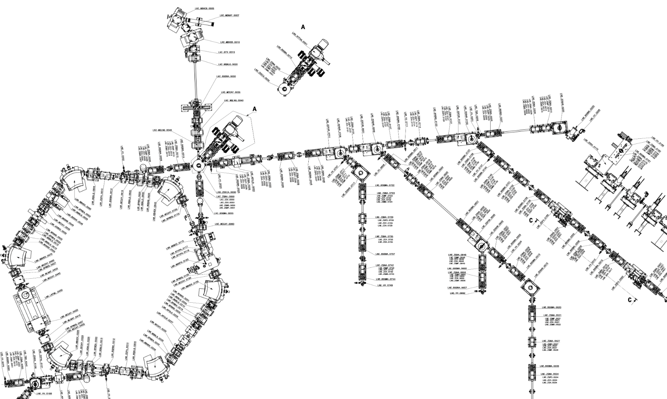


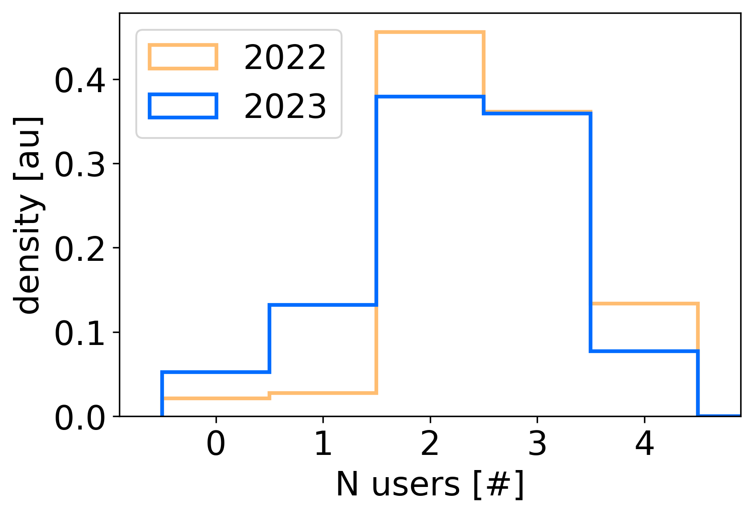





Serving 4 Users at a Time
AD produces 1 bunch at 5.3 MeV
ELENA: 4 bunches at 100 keV
  <200 ns FWHM
  <1e-3 RMS dp/p
  <4 um emittances (<2 um in 2024)
Up to 4 experiments served at the same time with 1e7 pbars/bunch
  24/7 beam availability has been the game changer for AD users!
  ~30% of bunches “wasted”, but comfortable for (most) experiments present “ELENA R&D” phase…
ELENA can use H⁻ from a local source: instrumental for commissioning, but also used for physics (GBAR)
Pbars from AD
H⁻ from
local source

Slide 4
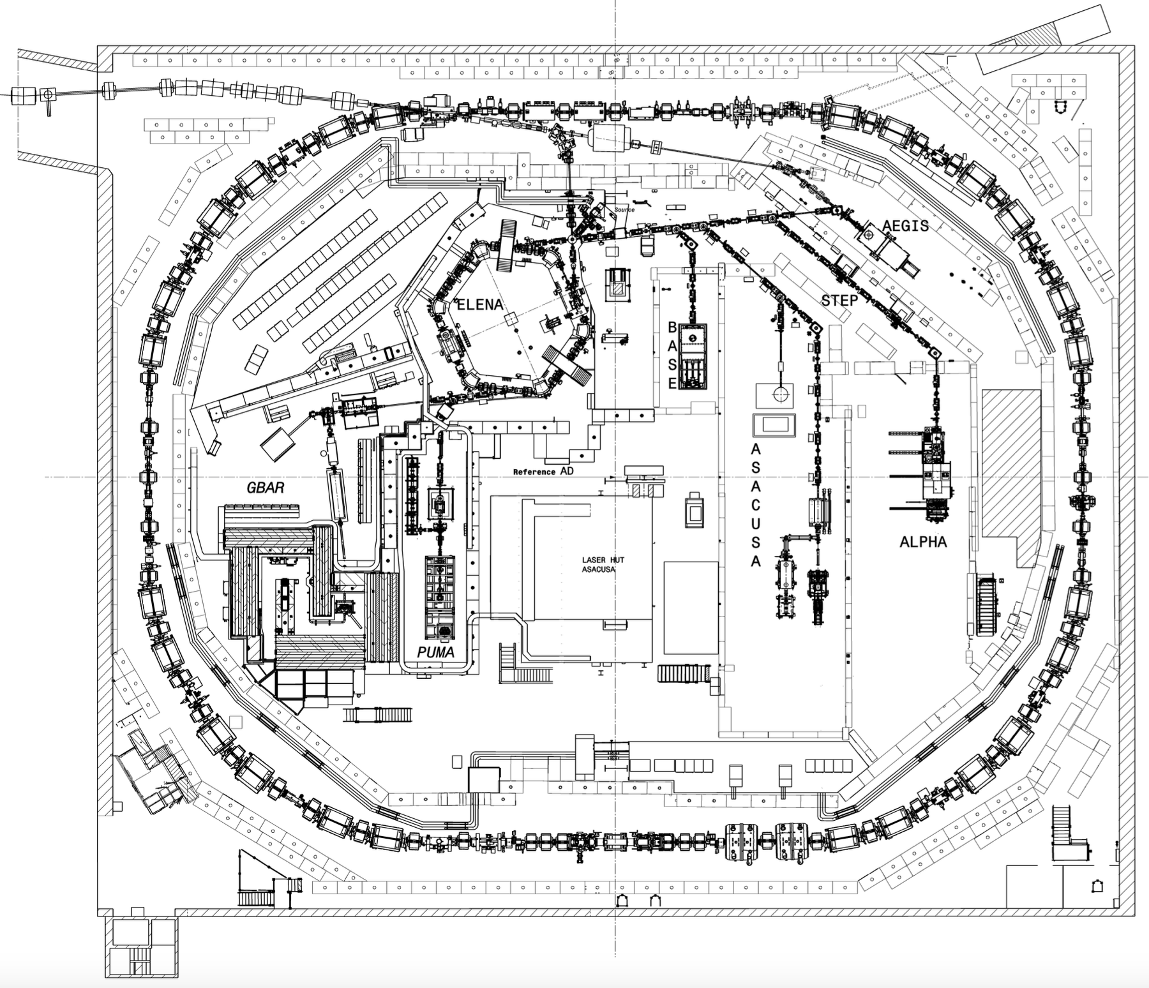
Overview of Long-Term Upgrade Cases
Any of these (but TELMAX) will require well-defined physics experiment cases!
The actual cost and feasibility of each option can only be evaluated if/when requested
External ”high energy” experimental hall?
TELMAX
Test Experimental Area
AntiDeuteron production and deceleration
(need to upgrade also
the s-cooling and RF?)
Higher pbar flux:
x2 on rep rate
x2 on pbar intensity
“Intermediate energy”
(5.3-0.1 MeV) experimental area with single bunch and slow extraction capabilities
“High energy”
(125-5.3 MeV) Experimental area with single bunch and slow extraction capabilities
Pbar filling station
(100 keV)
for “CERN-standard” movable traps
Low energy
(100 keV)
experimental area for present and new (e.g. H2bar) experiments

Slide 5
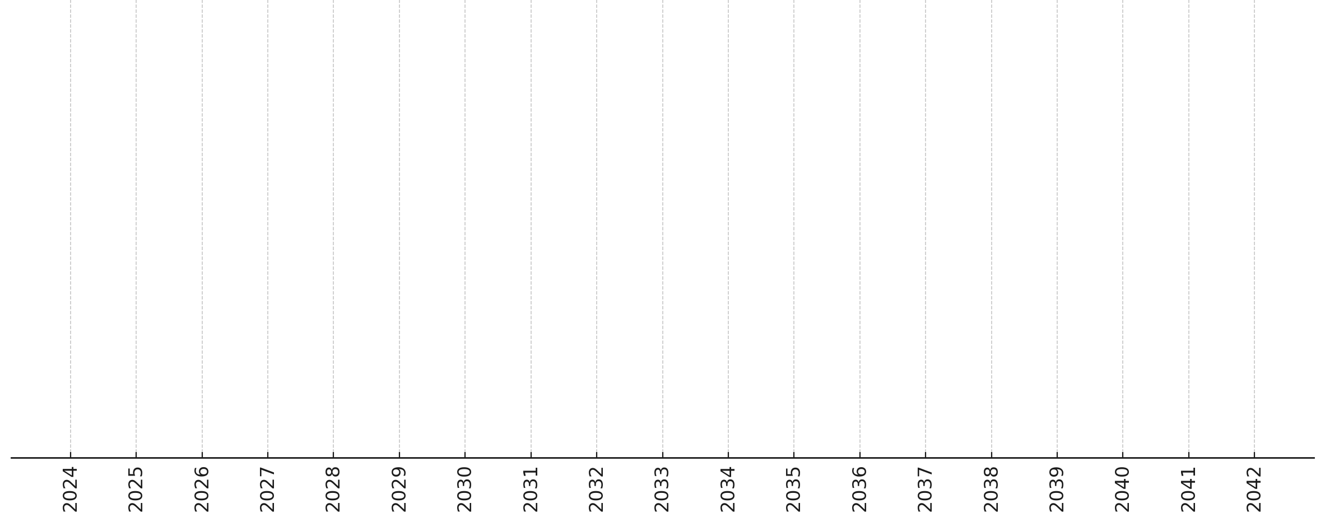
Overall Long-Term Timeline Proposal
Today
LS3 2026-27
LS4 2033
LS5 2039
End Run 6: 2042
… “Baseline” Beam Performance Consolidations
… “Baseline” Hardware Consolidations
… Guaranteeing Efficient, Safe and Sustainable Operation …
Collect Future User Needs… e.g.:
PBC Workshop – CERN – March 2024
FuPhy Workshop – Vienna – April 2024
AD beams @IPP – April 2024
EXA/LEAP - Vienna - August 2024
SPSC – CERN – February(?) 2025
Study and Implement needed upgrades, e.g.:
Low/high energy, multi-turn extraction
Antideuteron Production and Deceleration
…
Permit new, challenging experiments, e.g.:
Exotic Annihilation/Antineutron Experiments?
Completely new physics experiments?
…
Prepare the future of low/high energy antimatter physics at CERN…

Slide 6
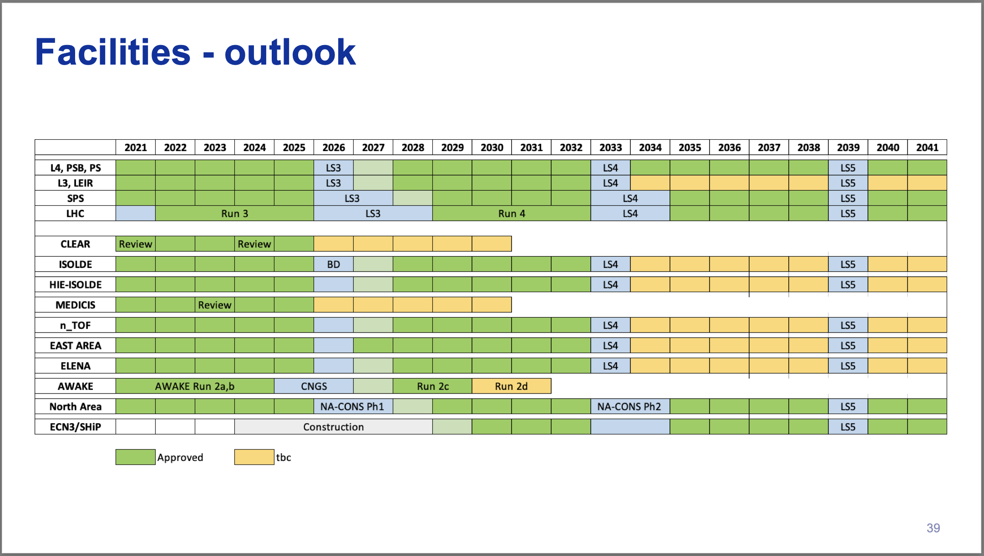
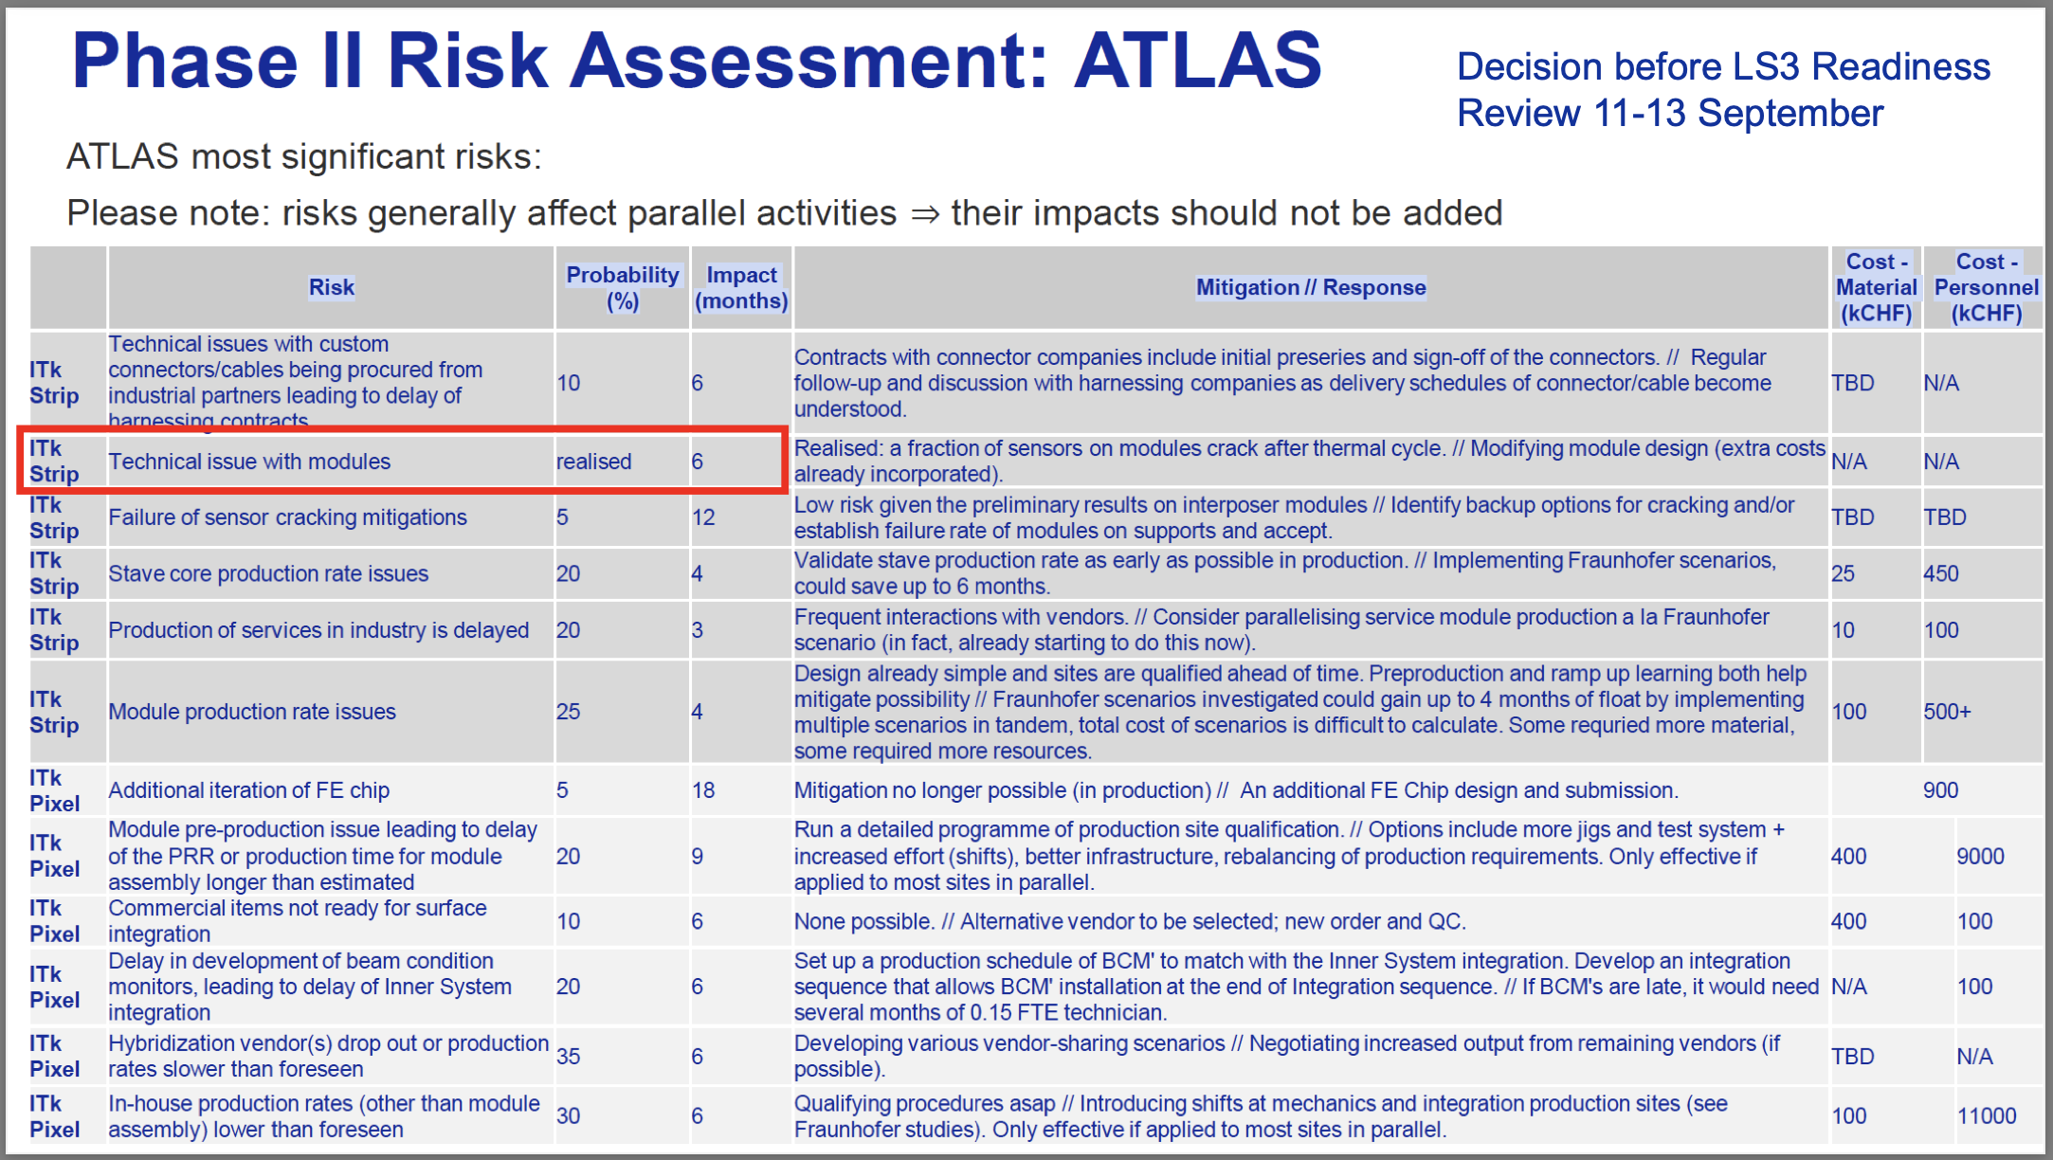
Some Important Updates
ELENA (and so AD) are approved facilities at least until LS4. Future “tbc”.
  Same situation as other “Beyond Collider” facilities at CERN.
There is high probability that LS3 will be delayed by at least 6 months!
  Possibly, some more time for machine tests to think about AD/ELENA improvements…
Mike Lamont – June 2024
Mike Lamont – June 2024

Slide 7
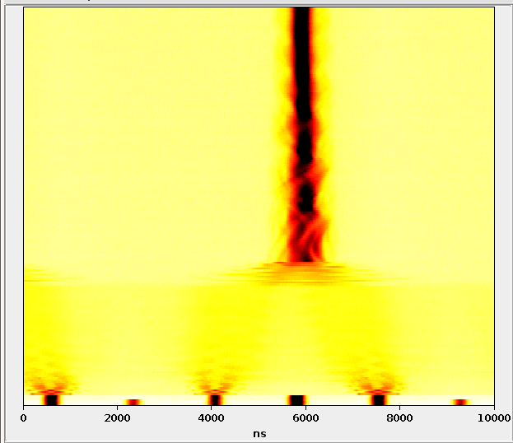
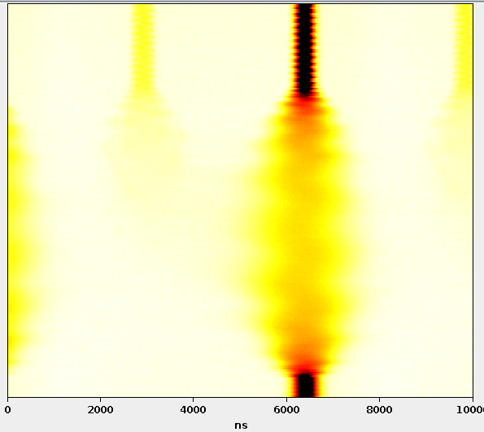
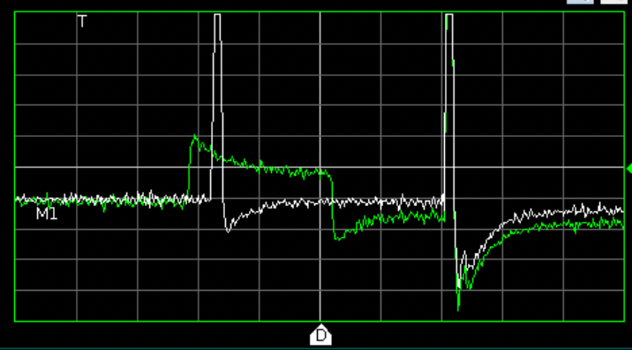
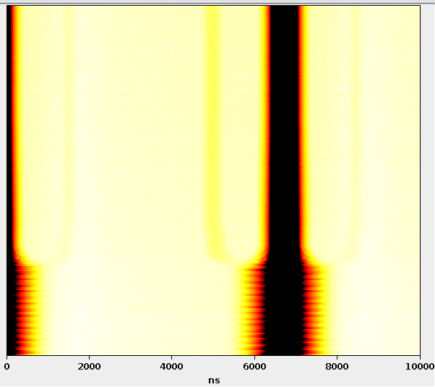
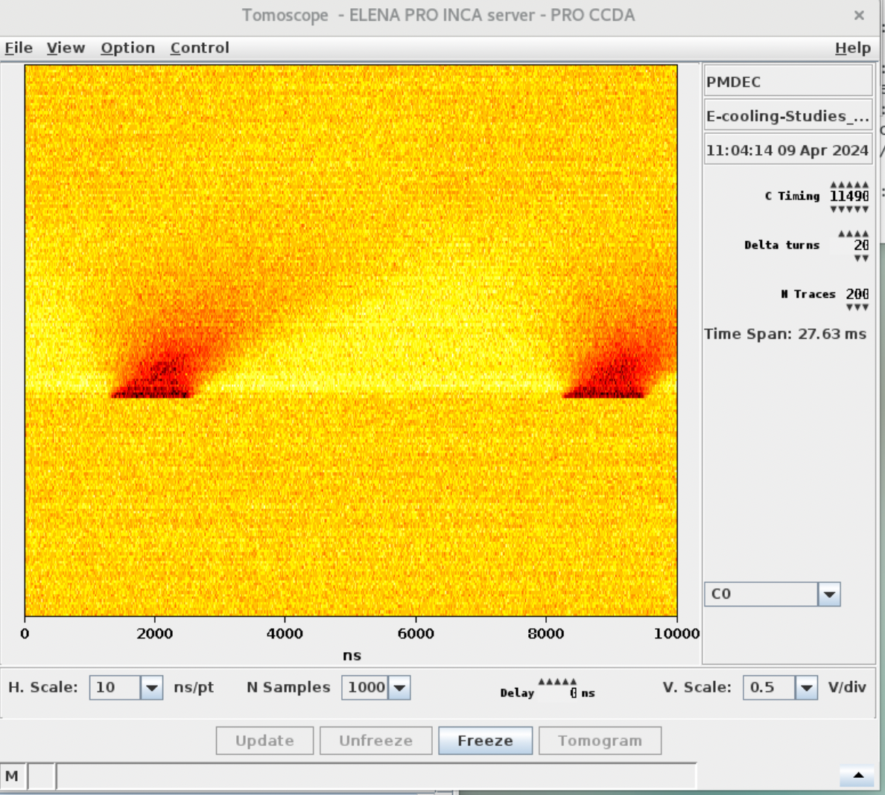
Short-Term Opportunities Leveraging on ELENA
ELENA still has some un-explored potential at extraction
  E.g.: producing 1-to-5 bunches (instead of today’s 4), or other “exotic” configurations, e.g.:
1 turn @ 100 keV
normal
bunch
(reference)
calibration
Low intensity bunch ready to be extracted…
… and repeat ...
∆t=~100 ms
square
bunch
∆t=~500 ms
∆t=~500 ms
“Stack” staying in ELENA
2 us/div
Leftover bunches merged into one
(e.g. for PUMA filling?)
Some beam
go to populate nearby backet…
Particles staying
inside ELENA
(seen till debunching)
1 turn @ 100 keV
”Standard bunch” extracted toward standard experiment
Coasting beam:
monitor sees nothing
1 turn @ 100 keV
1 turn @ 100 keV
Mostly requiring some minor modifications, new logic, tests, …
  … and well-defined use cases, which are slowly emerging

Slide 8
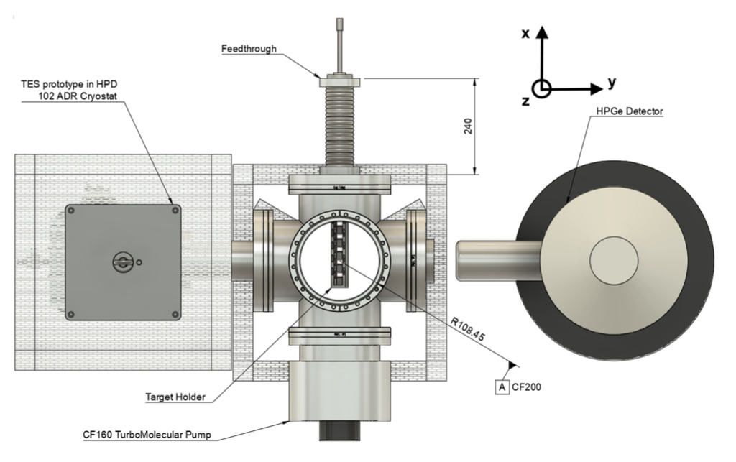
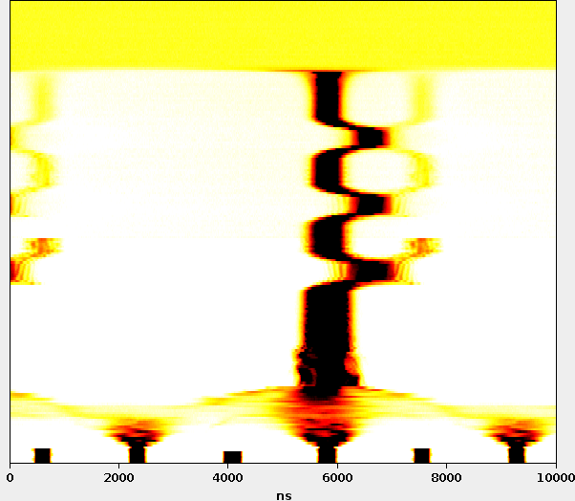
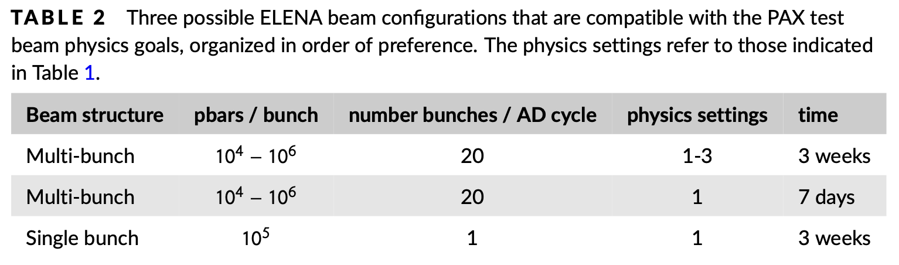
A First Potential User: PAX
Short-term nuclear physics experiment (different community than today’s users)
R&D experiment to test detectors (and possibility for new high precision QED studies)
Requiring something close to “slow extraction”
Testing new detector (much higher resolution) wrt older technology
1 turn @ 100 keV
A possible implementation:
Deliver bunches as usual
Merge remaining beam
Repeatedly populate a “nearby” bucket and extract
What is missing?
Stabilise RF manipulations
  Need of a different synchronisation strategy
  Possibly new controls
Possibility to trigger several times/cycle LNE kickers
  Timings being defined
  Long-term: foresee several-s-long pulses for LNE kickers
∆t=~700 ms
Bucket
re-pupulated
Low-int. bunch extracted!
Low-int. bucket populated
Sending low-intensity pbar beams on different type of targets
“Stack ready”
Merging leftovers
Normal bunches extracted

Slide 9
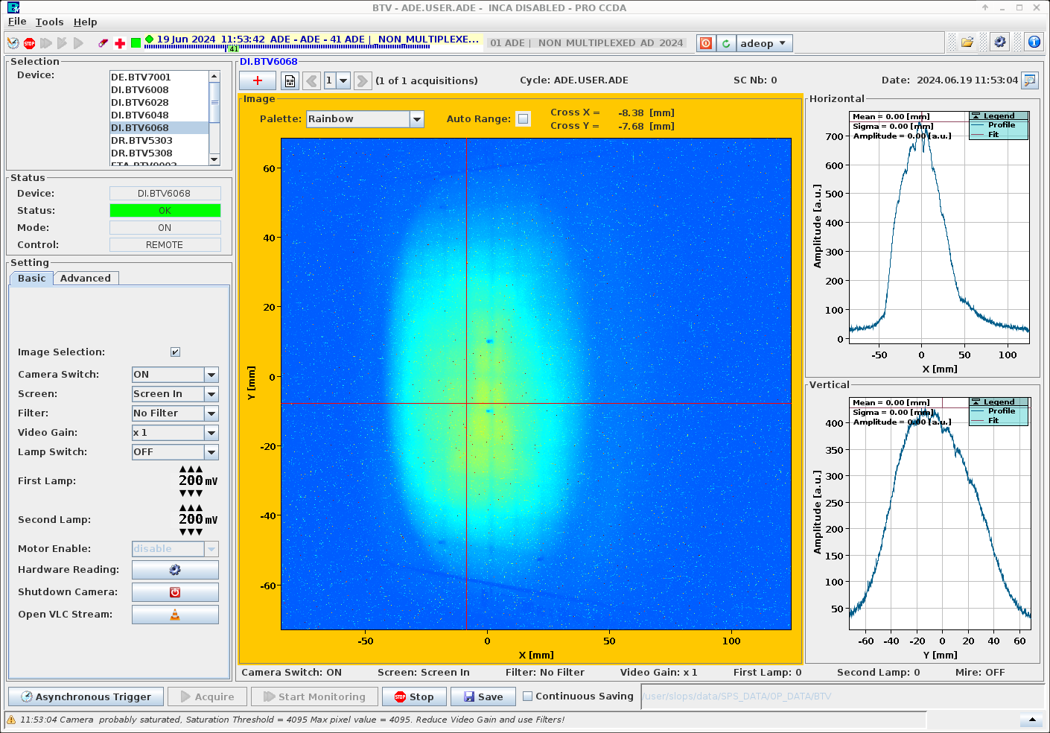
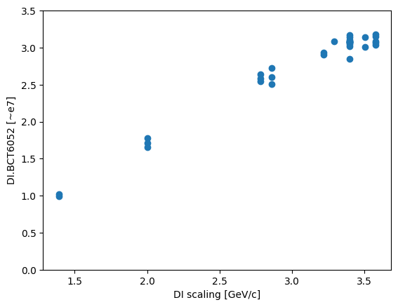
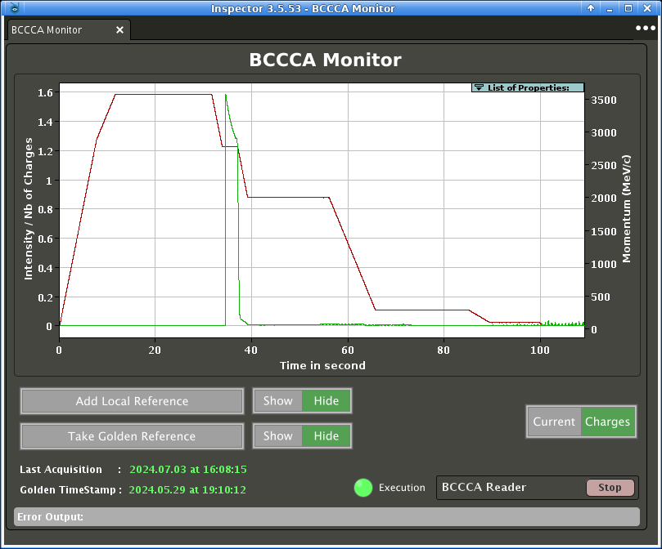
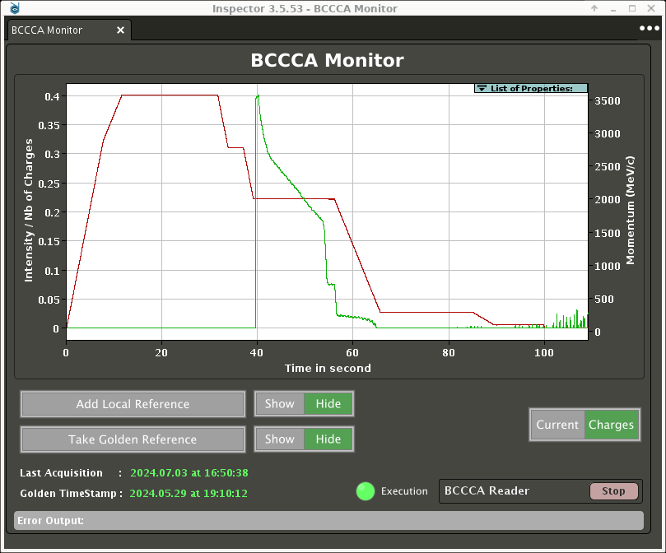
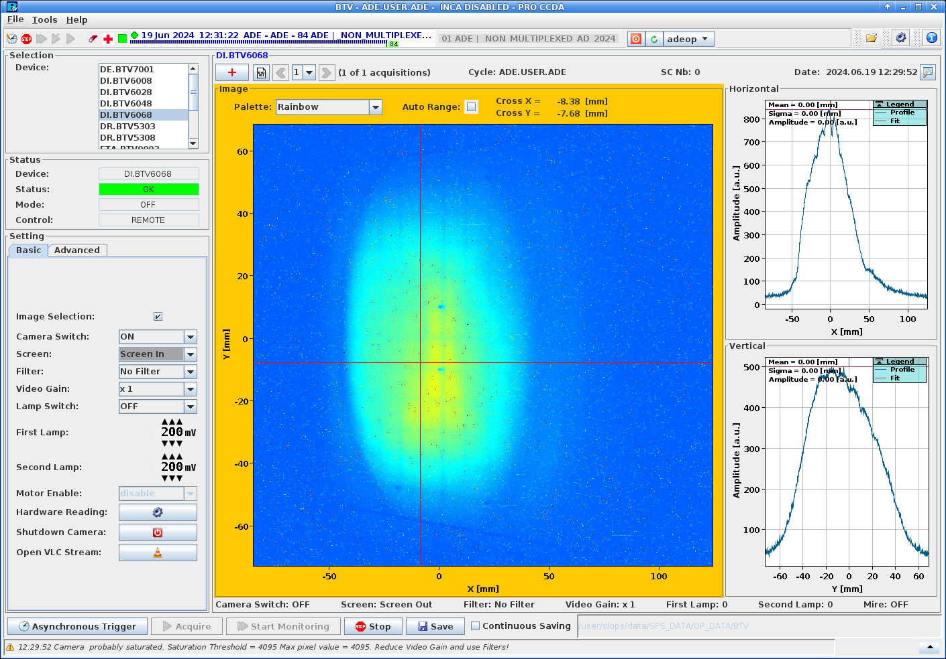
Some Longer Terms Ideas Being Explored
Interest from nuclear physics community for slow-extraction from ELENA at 100 keV
  We should be ready to explore this!
  Main barrier is to design an electrostatic septum for ELENA: According to ABT colleagues, this seems feasible, but no resources allocated as no official request, yet…
Explore other AD injection energies (and possibly look for anti-deuterum)
  Major implications for s-cooling and bunch-rotation (and RF) systems!
  Some proof-of-principle tests ongoing… (see AFMD-8 to follow up development)
Injecting in AD at ~2.7 GeV/c
Injecting in AD at 2 GeV/c

Slide 10
(General) Conclusions
AD/ELENA Facility is a unique facility worldwide
  Delivering up to 4e7 antiprotons at 100 keV bi-minute to six thriving collaborations
  High satisfaction across the physics user community with present parameters
Short-term Prospects
  No pressing demand for “more antiprotons”, today
  Potential for minor performance improvements (+10-20% intensity and/or repetition rate)
  Most of the efforts to be put in improving machines operability and performance stability
  We can still take advantage of some flexibility in ELENA (e.g. number of bunches/extractions, ε_{x/y}, ..)
Long-term Prospects
  Extend facility's physics reach is possible, depending on emerging cases
    Dedicated studies (e.g. slow extraction from ELENA?) are likely to be requested soon
  Hardware consolidation within AD presents new use case opportunities
    Flexibility and forward thinking required by all of us

