Slide 1
AD Target Horn Status report to the ADTC
Sven De Man, Edouard Grenier-Boley, Nicola Solieri, Marco Calviani
25/07/2024

Slide 2
Contents
Following the damage by electric arcs inside the AD Horn SY-STI-TCD prepared for the replacement of the horn by a spare.
The spare horn that ran on the testbench has been disassembled to analyze the concerned area.
Contents:
Observations on the test horn
Conclusions after analysis
Actions

Slide 3
Observations test horn v.2
No signs of flashovers, works flawlessly
The tightening of the inner horn to the current feed starts failing
A black sooth found between the two parts
The exhaustive documentation includes quality control reports confirming the conformity of geometry to the design

Slide 4
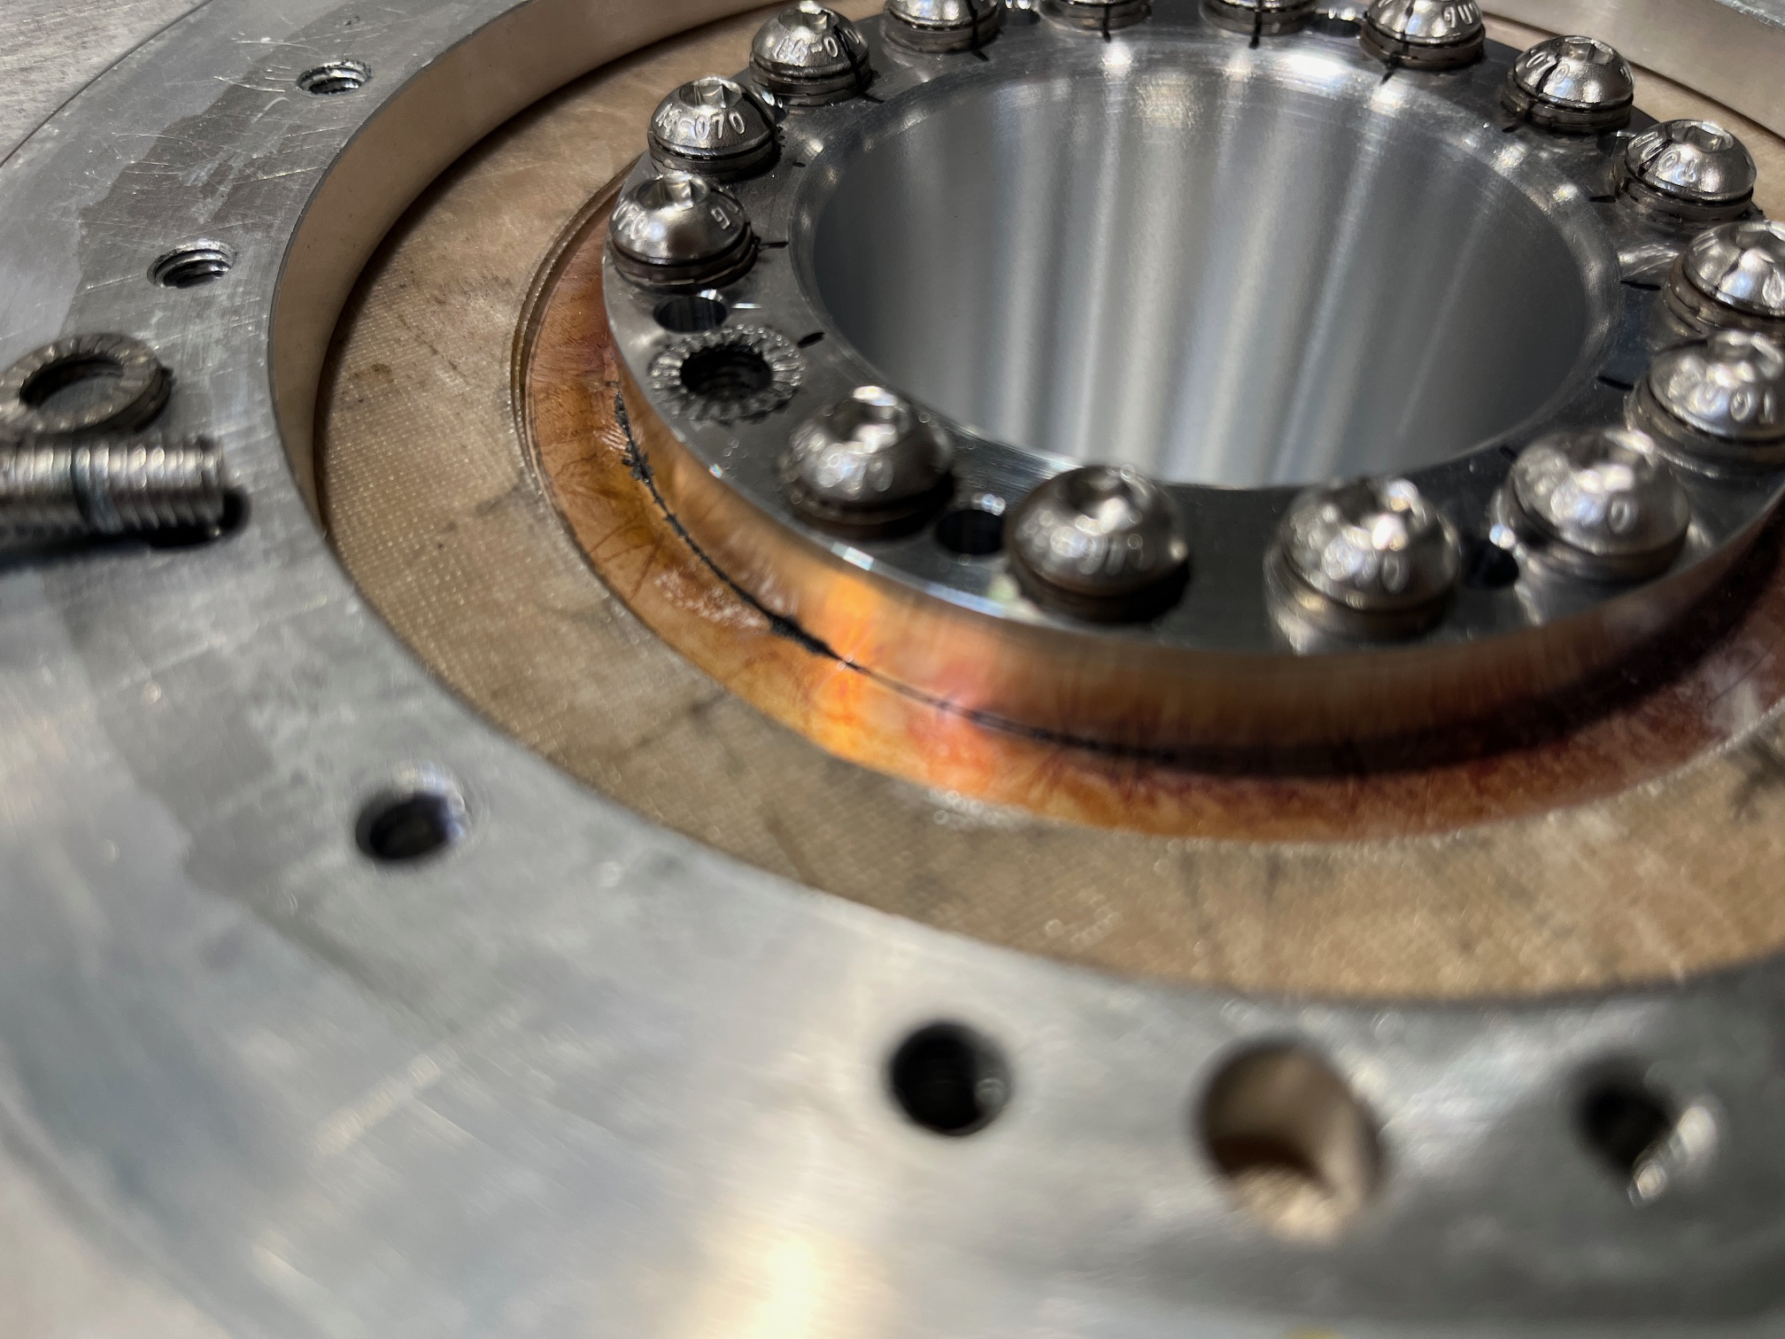
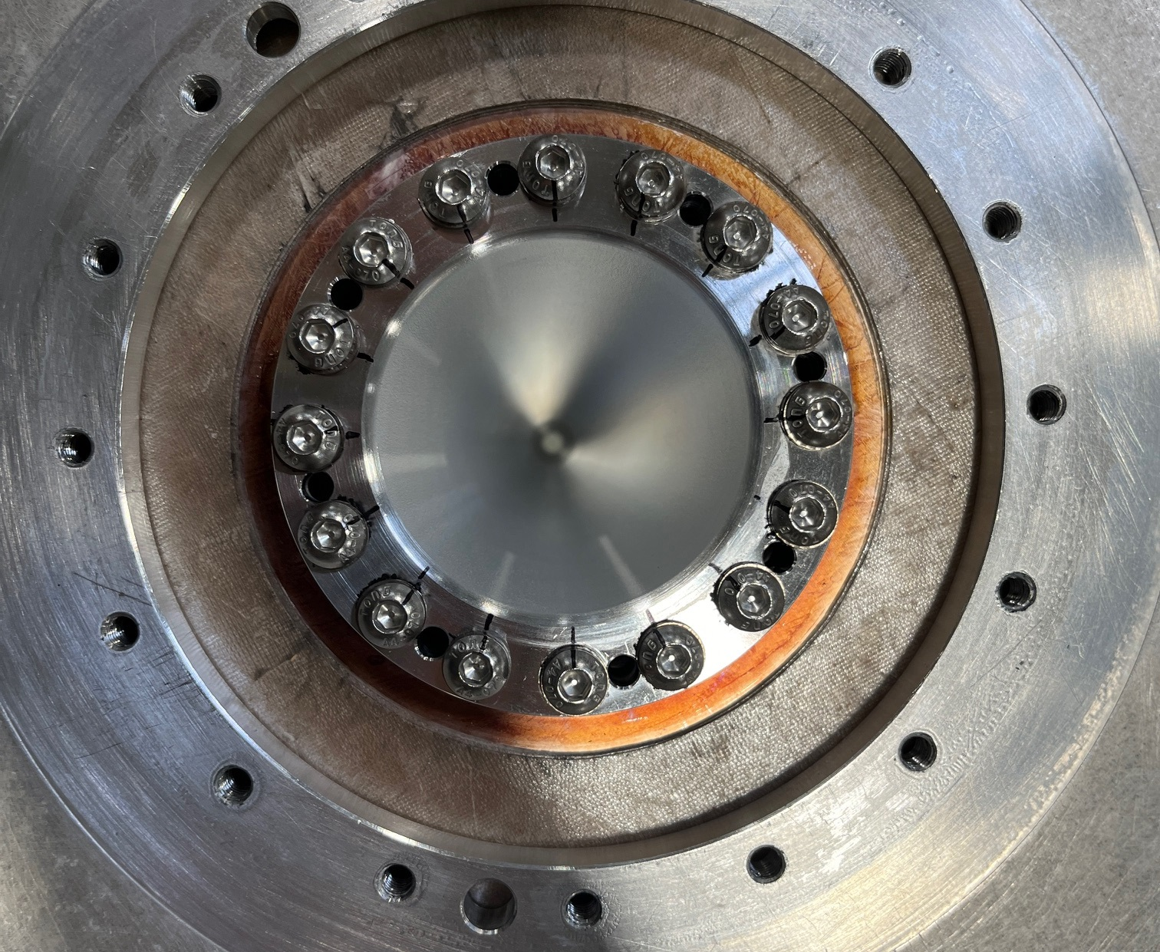
Fasteners clamping horn on current feed line

Slide 5
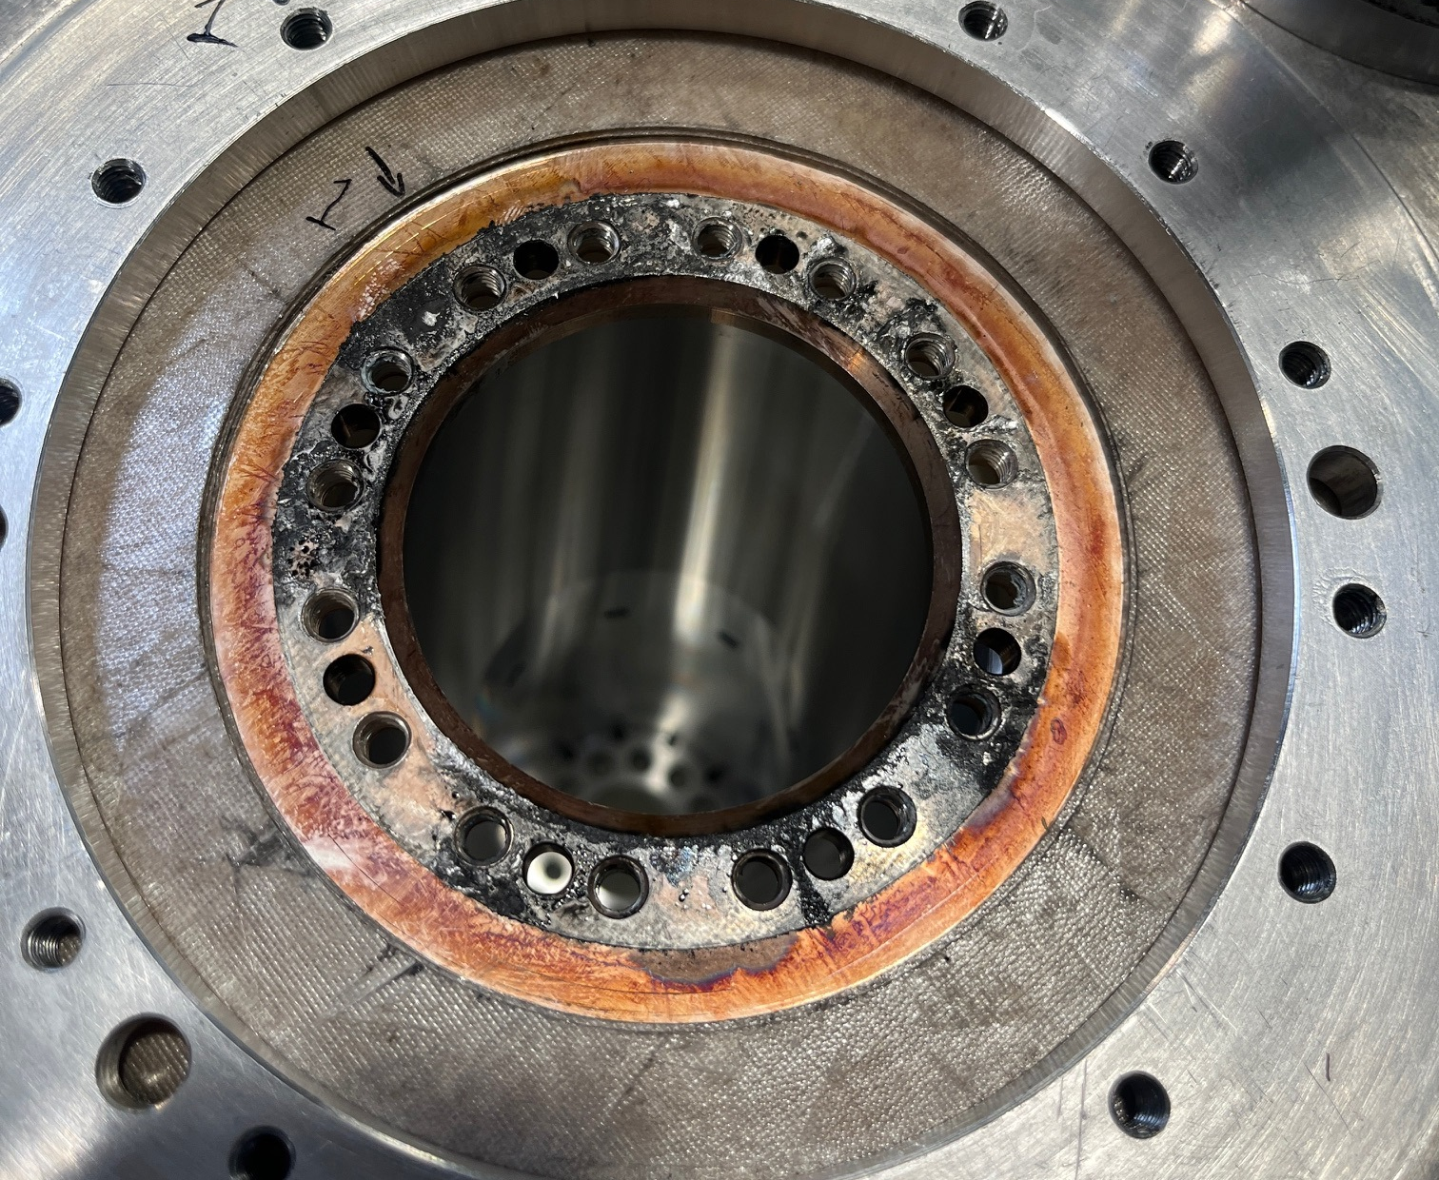
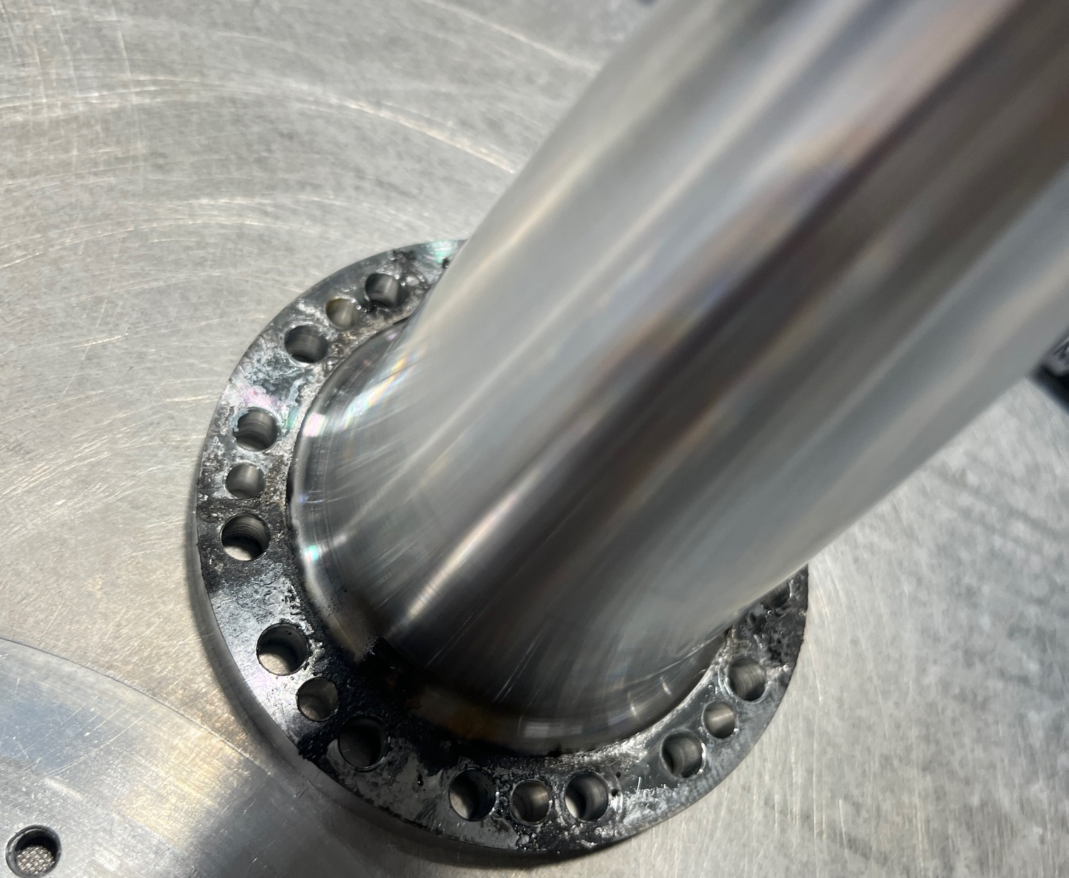
Sooth between surfaces

Slide 6
Conclusion
On the test horn too, flashover would have followed.
We are approaching an incremental understanding of the failure mode, which will bring us to a modified design solving the observed failures.
The concept of the internal interface makes it sensitive to the slightest deviation of the geometries
Replacement of the operational horn by a spare v.2 or v.1 horn without prior modification does not guarantee a long operation and will create highly radioactive waste

Slide 7
Actions
A horn v.2 is kept on standby for replacement within 36 hours after beam stops. In case of complete failure (or unacceptable low current) of the operational horn, an exchange will be executed with non-modified v1 and v2, expecting the same failure scenario.
Version 3 is being prepared with a modified geometry of the contact surfaces, more tolerant to deviations.
Engineering and parts ordering could be complete this week, manufacturing will take 10 days.
The new horn v.3 will be pulsed on the test bench followed by analysis before installation in YETS.

