Slide 1

AD/ELENA FACILITY
ADTC Meeting 26th Sept 2024
TELMAX exp area status

Slide 2



TEst Line for Machine
Antimatter and eXperiments

Slide 3
TELMAX main goals
New TELMAX exparea shall be used as a
test beamline :
  For machine equipment tests (RF setup, OP operation modes, instrumentation, vacuum…)
  By existing / new collaborations to test new equipment using standard or new beam structures
Already 2 collaborations expressed interest:
  ASACUSA emulsion detector - Nov 2024 ?
  PAX collaboration (antiProtonic Atom X-ray Spectroscopy) – Run 2025
Test of micro-bunches extraction into TELMAX

Slide 4
Current status
Shielding wall enclosure is complete
Electrical distribution is complete, including sockets, earth bar, AUL (not commissioned yet)
Access safety system operational
2 racks installed for exp setup usage
DSO tests complete
Beam permit validated
First beam observed on SEM below interface vacuum valve

Slide 5
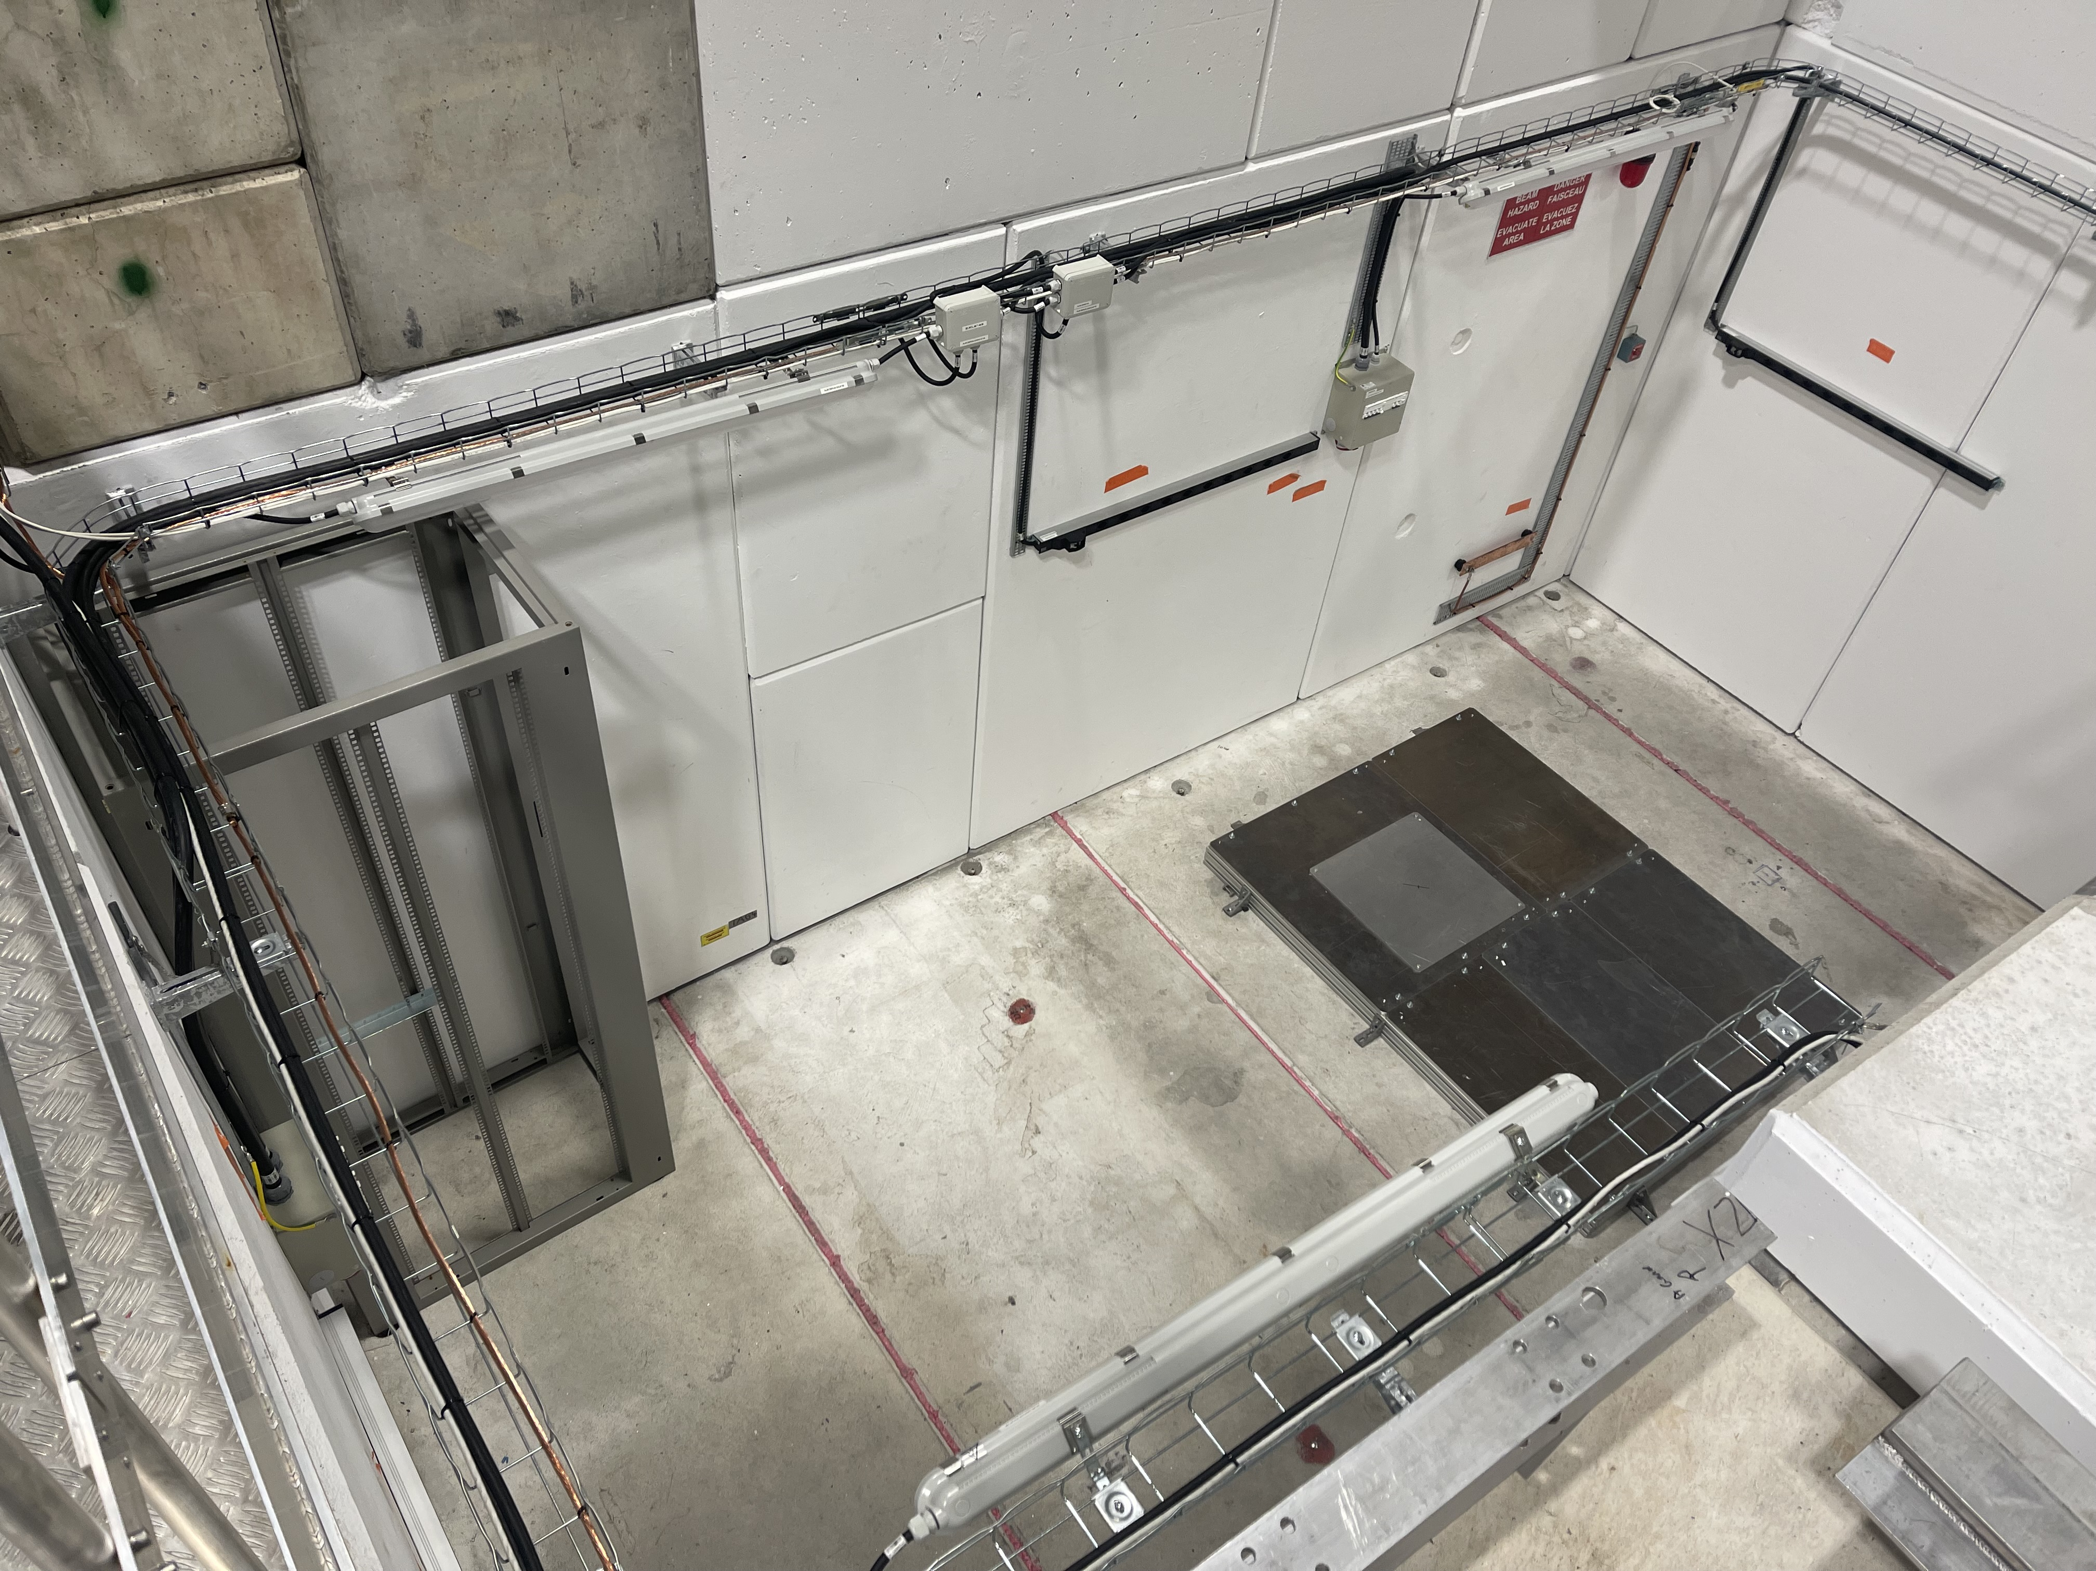
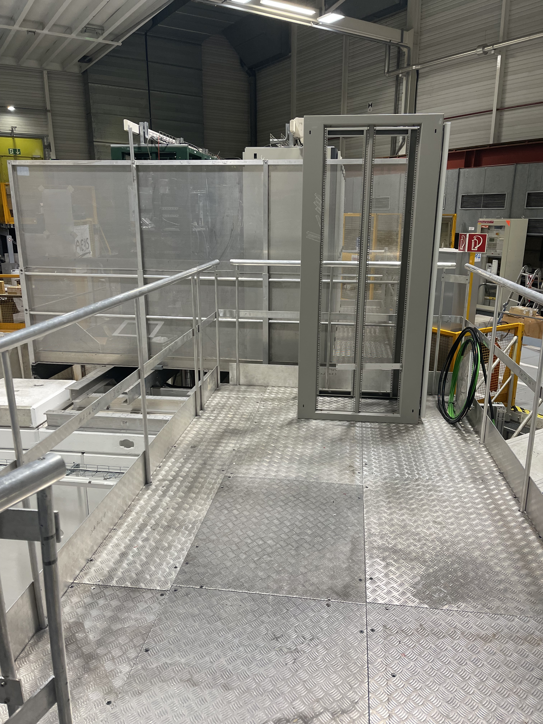
TELMAX exp area status
Rack
for experiment
TELMAX
Eaxp Area
Power
sockets
Rack
for experiment
Earth
bar
Cooling
water
Beam arrives
here
Opt fibre
To PUMA
CR
lighting
Platform accessible
during run

Slide 6
To be done in the near future
Demineralized water installation is pending (date TBC by CV)
Compressed air pipe to be extended
Networks will be installed during YETS (RJ45 ethernet sockets , timing, BTV signal)
Optical fibres arrive in rack on platform, connected to PUMA control room, to be adapted by users
The LNE03 line currently ends vertically in the Exp Area: eventually to be bent horizontally (LS3)
Optics and vacuum layout to be adapted

Slide 7
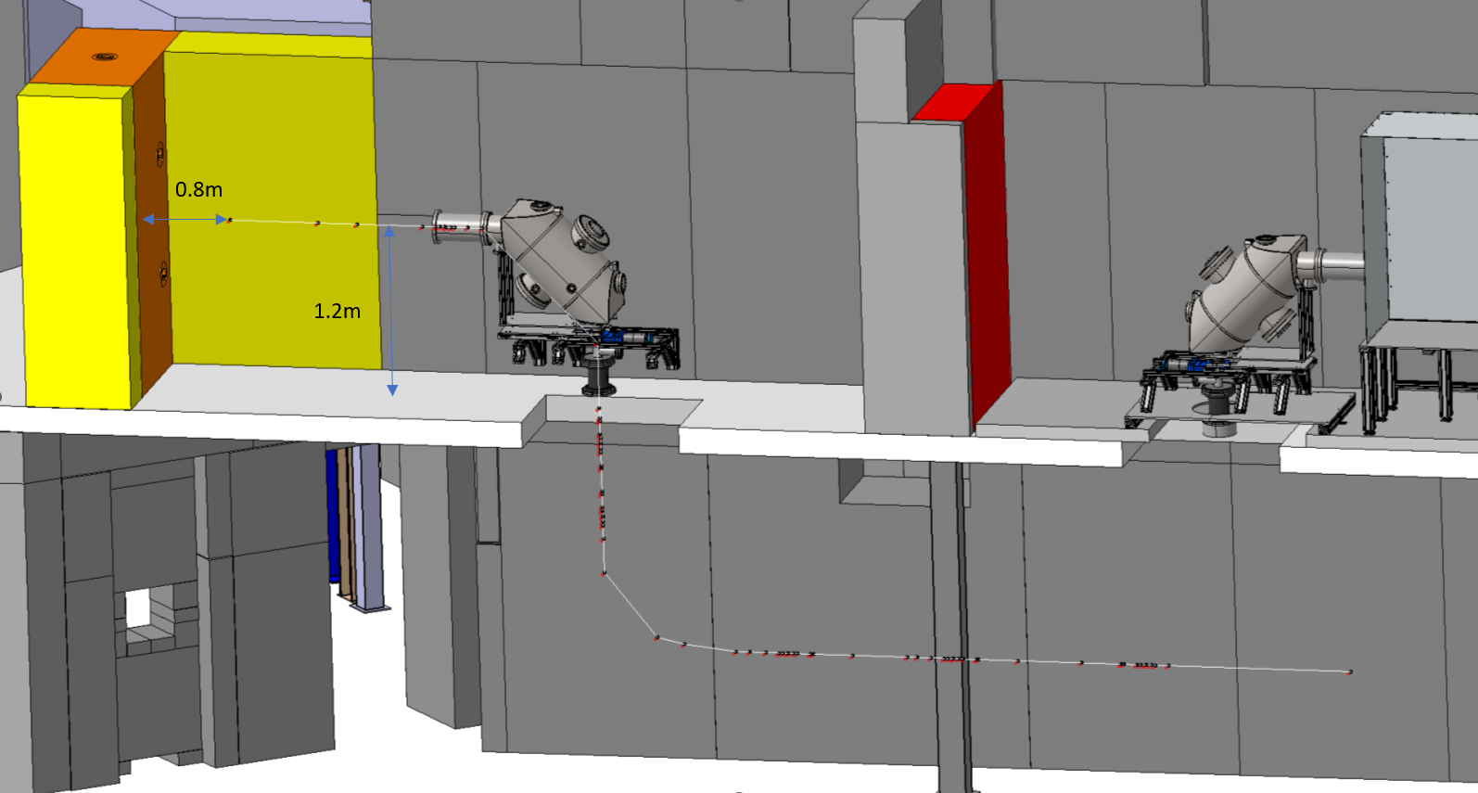
Future horizontal beam setup
Same technology as STEP.
MPI has agreed to produce a 90 deg deflector, details TBC.
New vacuum equipment to be installed is described in the ECR : EDMS 2975107.
Additional ZQNA + SEM
To be installed during LS3

Slide 8
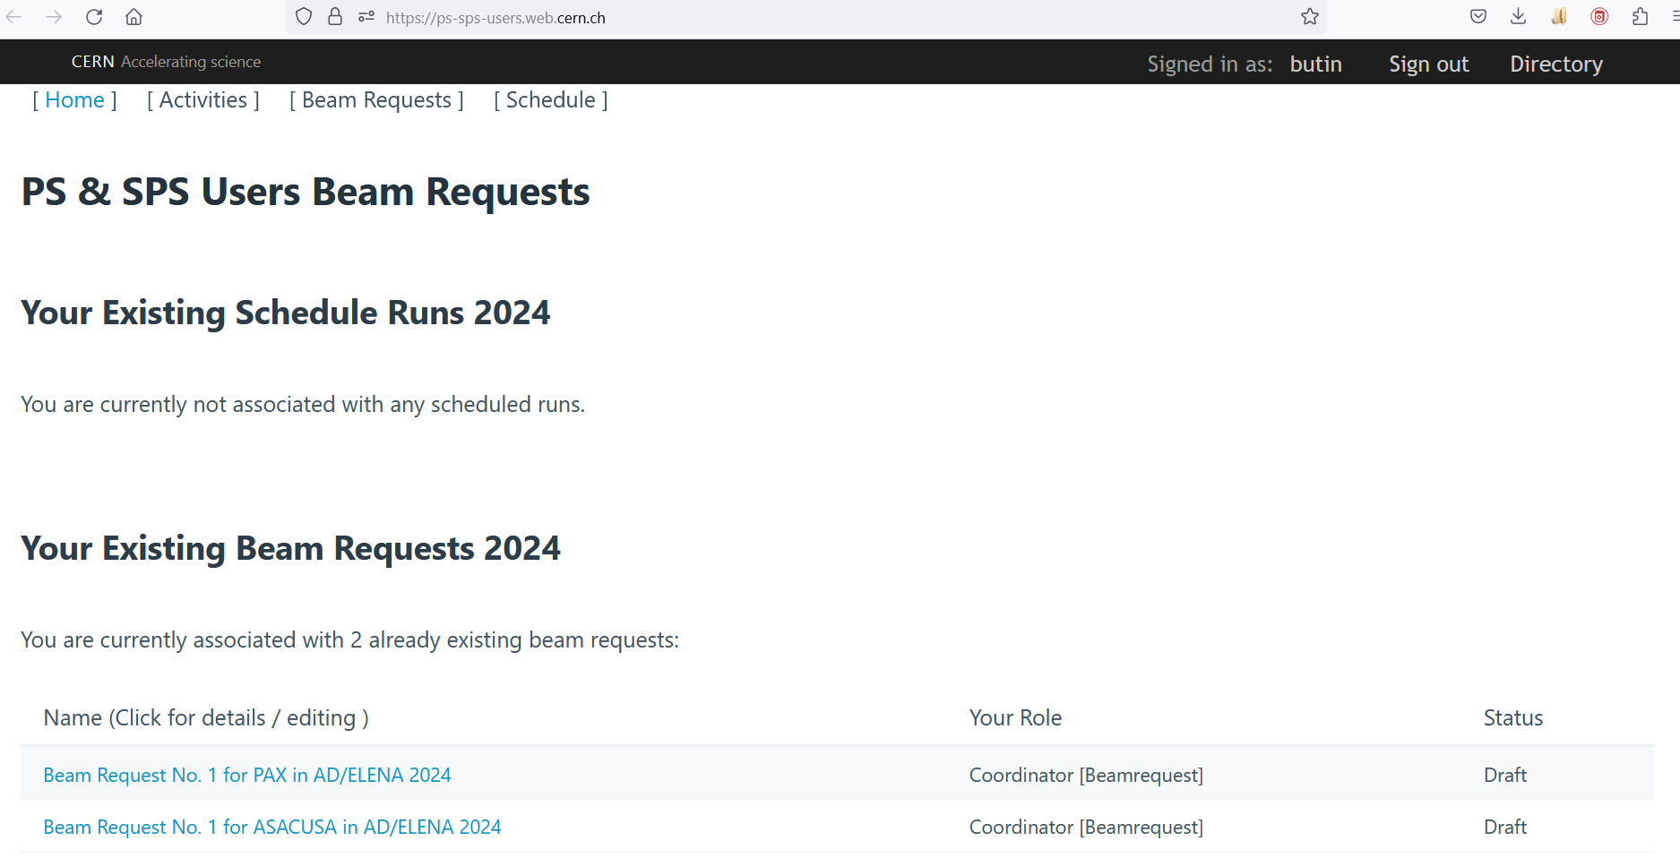
TELMAX beam time request
Defined with PS-SPS physics coordinator a process for beam time request

