Slide 1

AD/ELENA FACILITY
ADTC Meeting 28th Nov 2024
2024-2025 YETS fine tuning

Slide 2
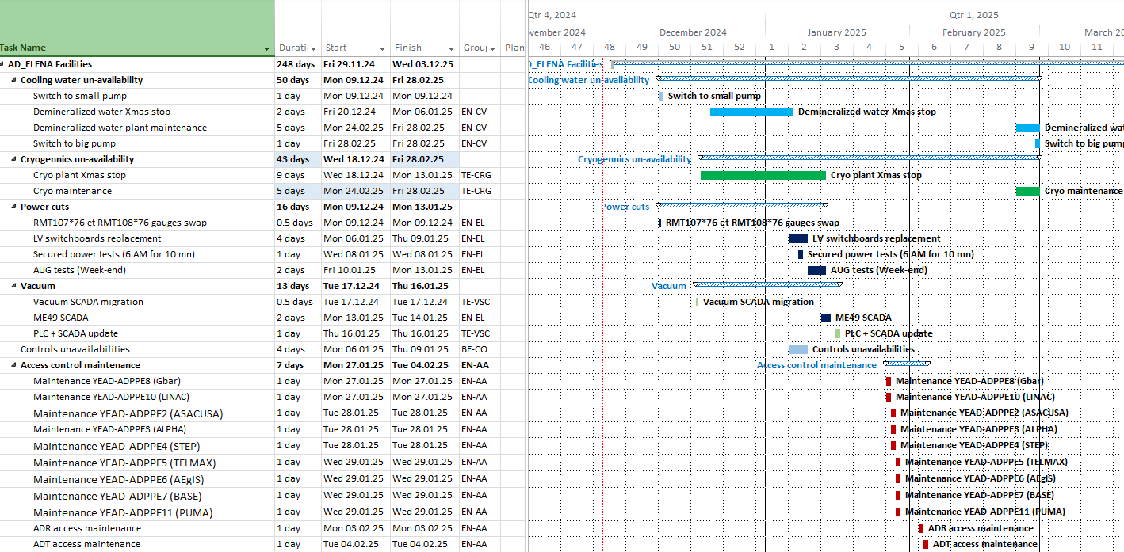
Anticipated Services Disruptions
TBC
Impact
TBC
Planning available at
https://oss-coordination.web.cern.ch/gantt/latest?facilities=AD/ELENA&scale=week&worktypeproject=

Slide 3
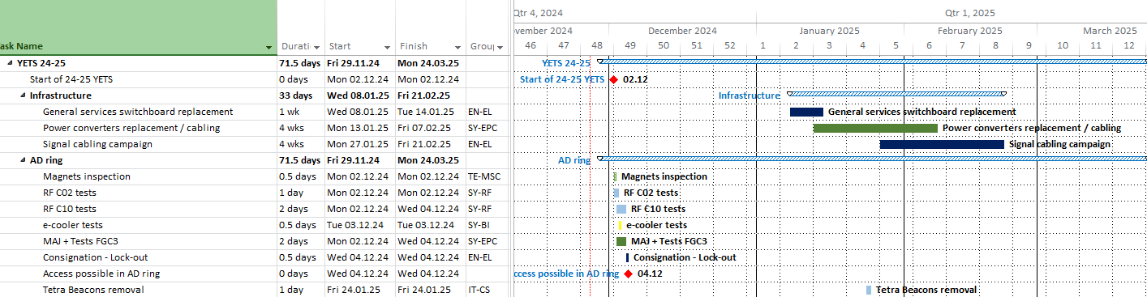
AD ring / infrastructure
Impact
TBC !

Slide 4
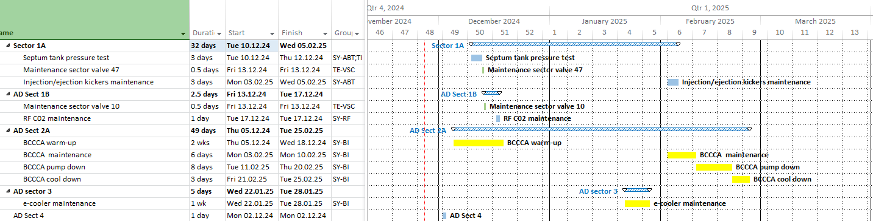
AD ring sector 1A, 1B,2A,3,4

Slide 5
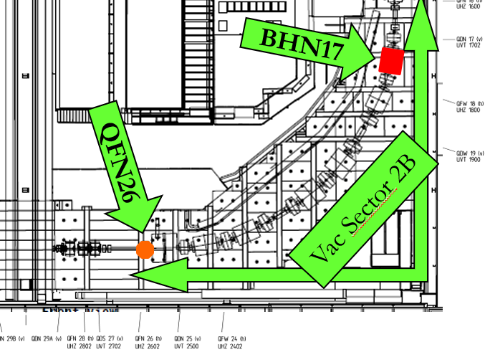
AD Ring sector 2B

Slide 6
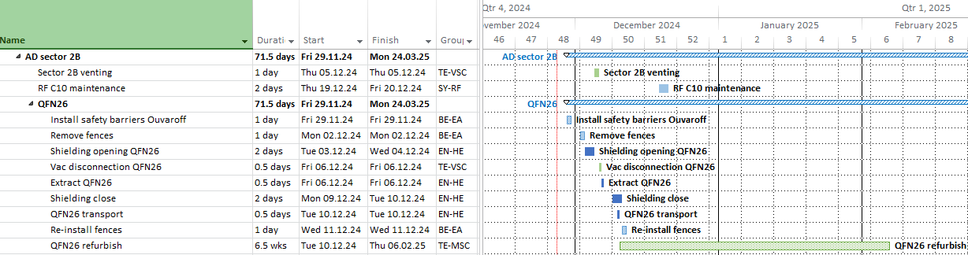
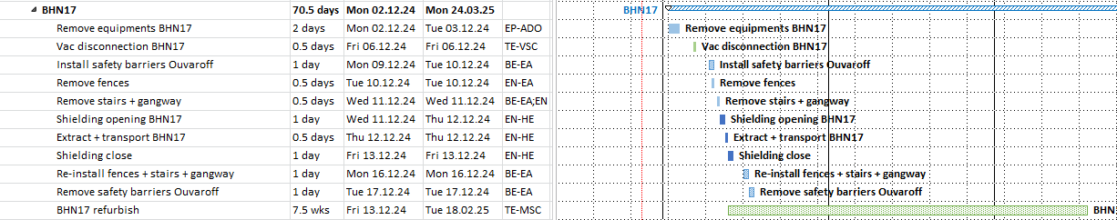
AD ring sector 2B - extraction

Slide 7
AREA 2
MAGNET QFN 26
AREA 1
MAGNET BHN 17

Slide 8
AREA 2
MAGNET QFN 26
CABLES ATTACHED TO THE BARRIER TO BE REMOVED
- RAIGUARD
- STEEL SHEET
TO BE REMOVED
QFN 26

Slide 9
AREA 1
MAGNET BHN 17
- RAIGUARD
- STAIRCASE
- PLATFORM
- STEEL SHEET
TO BE REMOVED
BHN 17

Slide 10
AREA 2
MAGNET QFN 26
REMOVE :
- CONCRETE Beam T 6820 x 1
- CONCRETE BLOC 24168 x 8
- CONCRETE BLOC 4088 x16
QFN 26

Slide 11
AREA 2
MAGNET QFN 26
STOCKAGE AREA - PROPOSAL
T6820 _ 18t
KEEP CIRCULATION SPACE
6x 4088(6.3t) _ 37.8t
10x 4088(6.3t) _ 63t
8x 24168(7.5t) _ 60t
Some blocks in
ASACUSA area

Slide 12
AREA 1
MAGNET BHN 17
REMOVE :
- CONCRETE BLOC T 9020 x 1
- CONCRETE BLOC 6484 x 1
- CONCRETE BLOC 24168 x 16
BHN 17

Slide 13
AREA 1
MAGNET BHN 17
STOCKAGE AREA - PROPOSAL
7x 24168(7.5t) _ 52.5t
T6412 _ 10.2t
4x 24168(7.5t) _ 30t
6484 _ 5.2t
5x 24168(7.5t) _ 37.5t

Slide 14
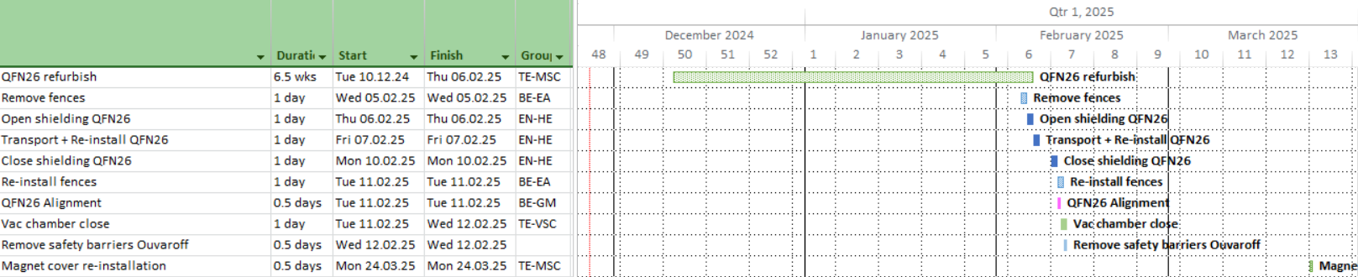
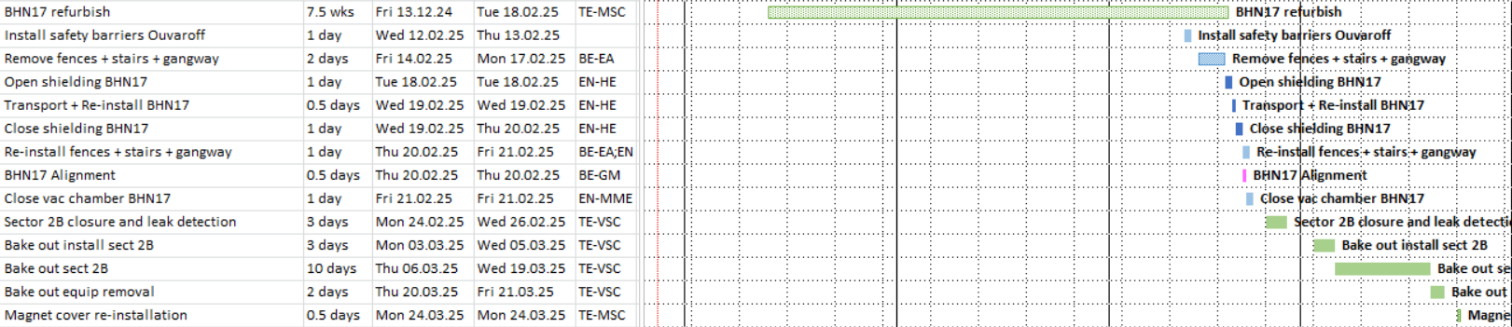
AD ring sector 2B – re-installation

Slide 15
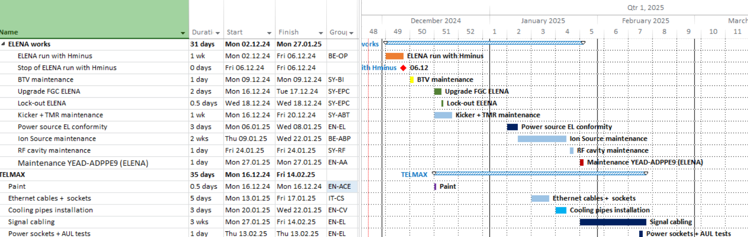
ELENA + TELMAX works
New
TBC
TBC

Slide 16
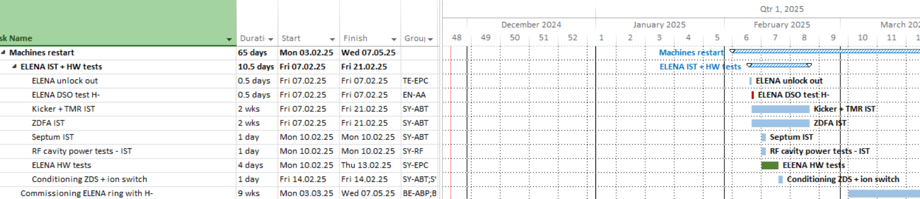
ELENA restart
New date
TBC

Slide 17
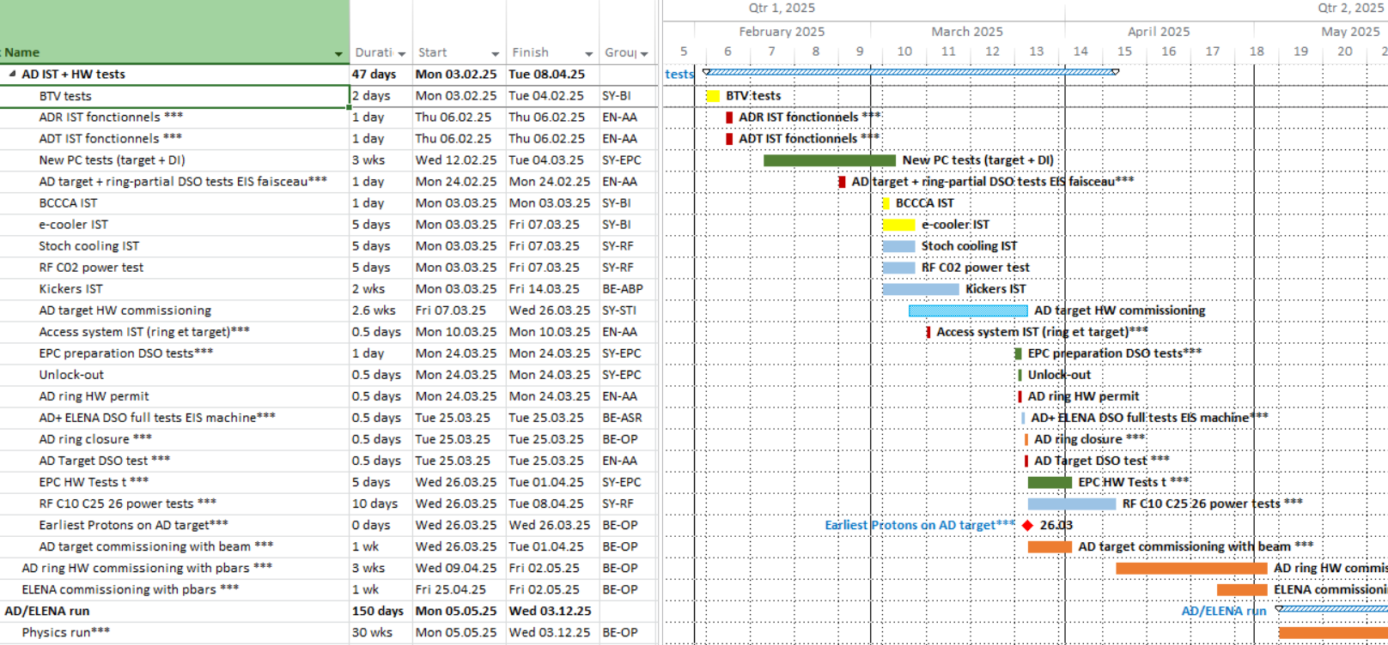
AD restart
New dates !

