Slide 1


Overview of tests of ReBCO stacks and coils
C. Accettura
Final Cooling Progress Meeting
https://indico.cern.ch/event/1418066/
31/05/2024, CERN

Slide 2
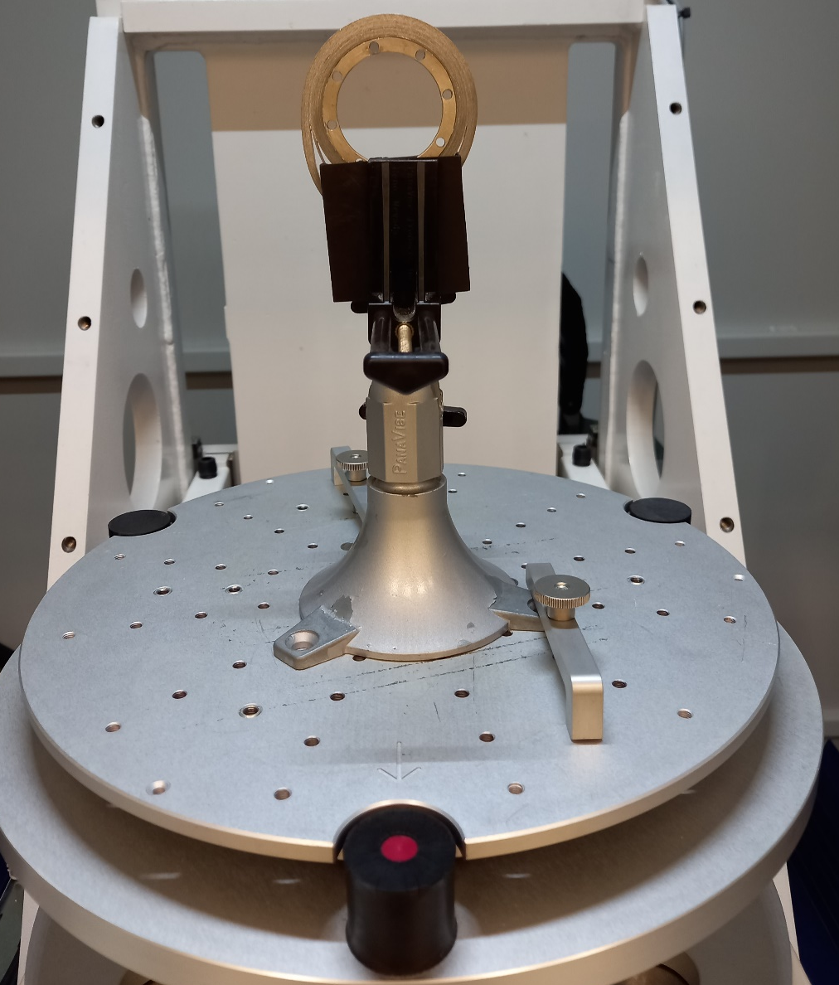
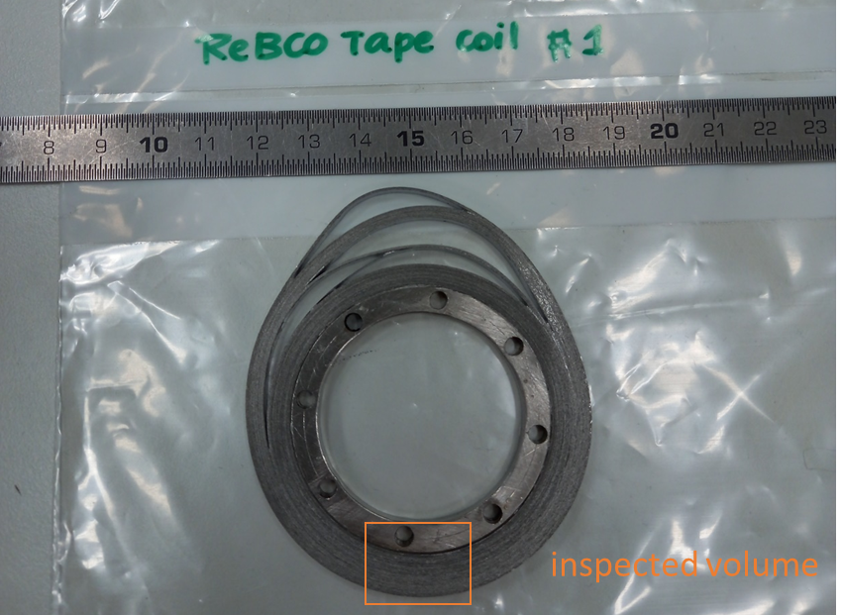
Sample 3
Coil – tomography
Courtesy of M. Celuch – EDMS 3093073

Slide 3
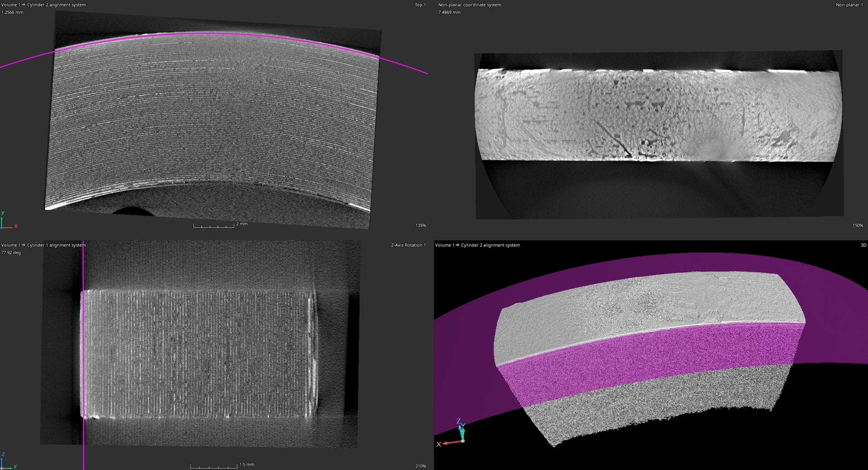
Sample 3

Slide 4
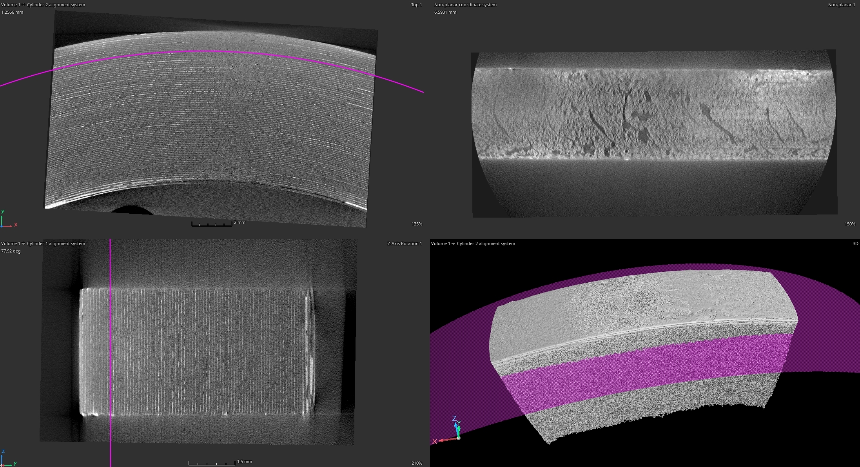
Sample 3

Slide 5
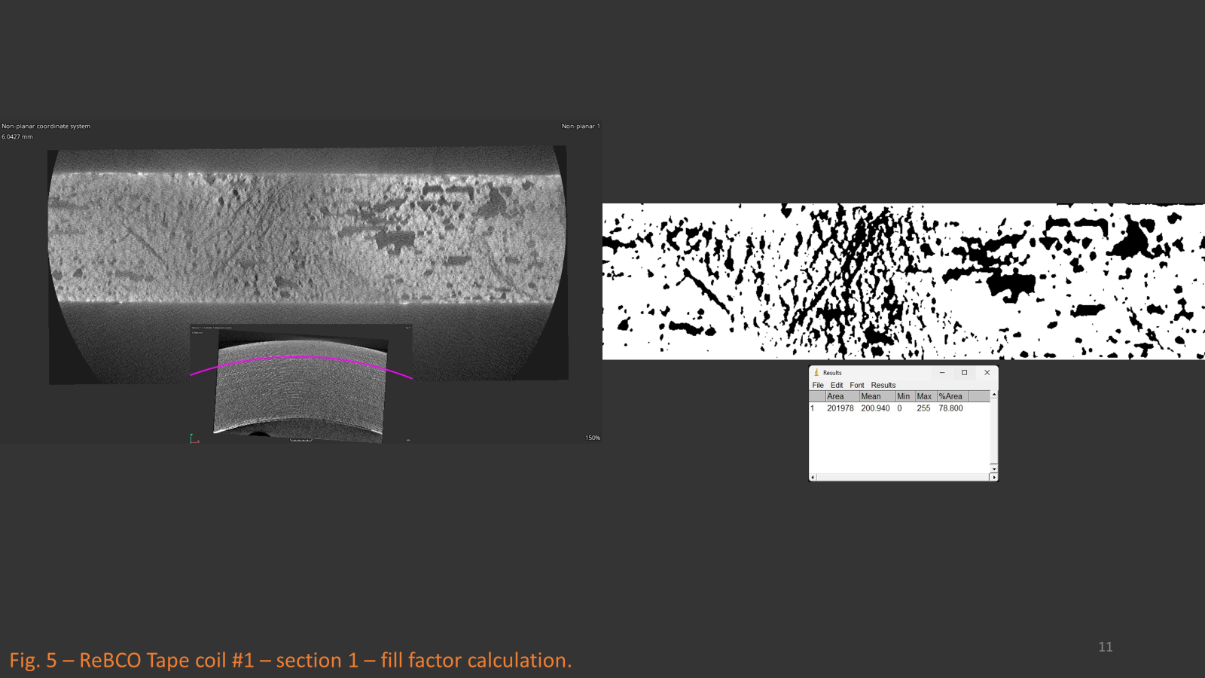
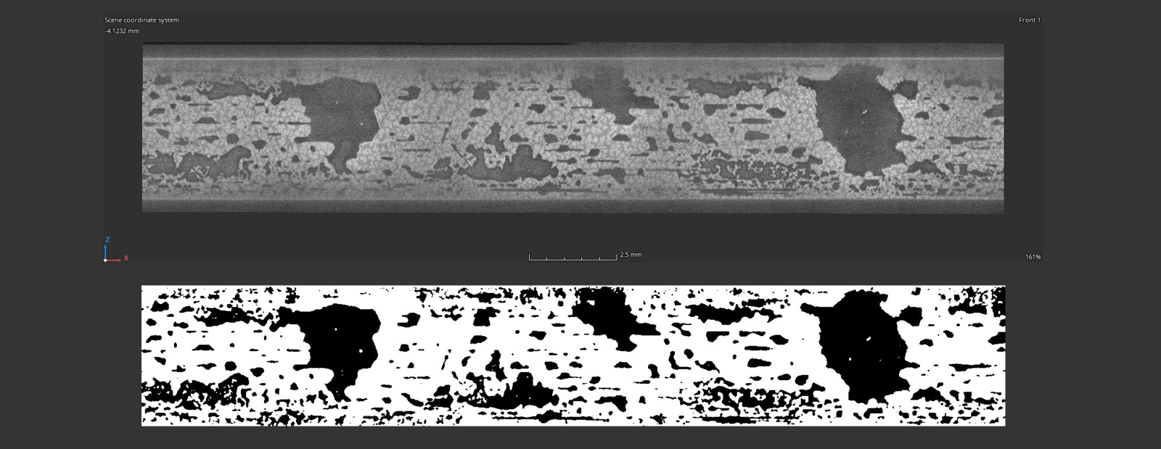
Filling factor
Coil
For several layers, the soldering fill factor was calculated.
The range of calculated fill factor values made on 5 random sections was from 60 to 79%→ similar to sample 1 (stacks in air)
Stack produced in air

Slide 6
Conclusions
Even if the area analyzed does not show macroscopy damage, the filling factor is quite low.
The distribution of the solder is not uniform, it is similar to the stack produced in air.

Slide 7
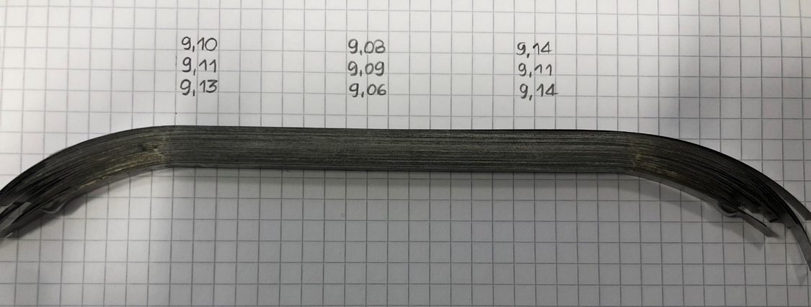
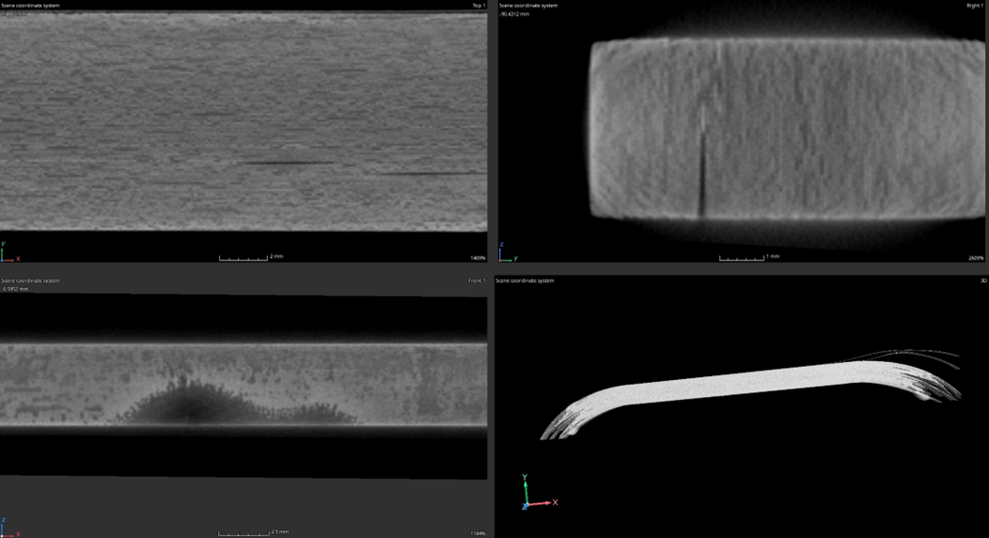
Sample 1
Sample 1: THEVA tape, 100 stacks, solder made of Tin-Lead, Tmax~200°C in air
Visible delamination
High quantity of residual solder from the thickness measurement
Porosity detected in the tomography
The range of calculated fill factor values made on 3 random sections was from 67 to 71%.
 | Position
 | 1 | 2 | 3
Soldering-max [mm] | 2.81 | 2.78 | 2.83
Soldering-min [mm] | 0.21 | 0.18 | 0.23
Courtesy of M. Celuch

Slide 8
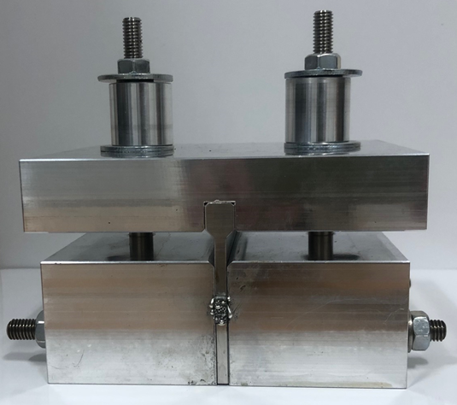
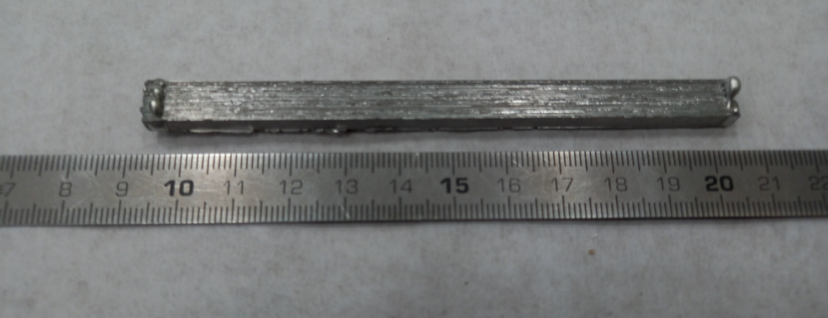
Sample 2
In order to minimize the porosity, the stacks is heated under vacuum
Sample cut for thermo-mechanical test (ongoing)

Slide 9
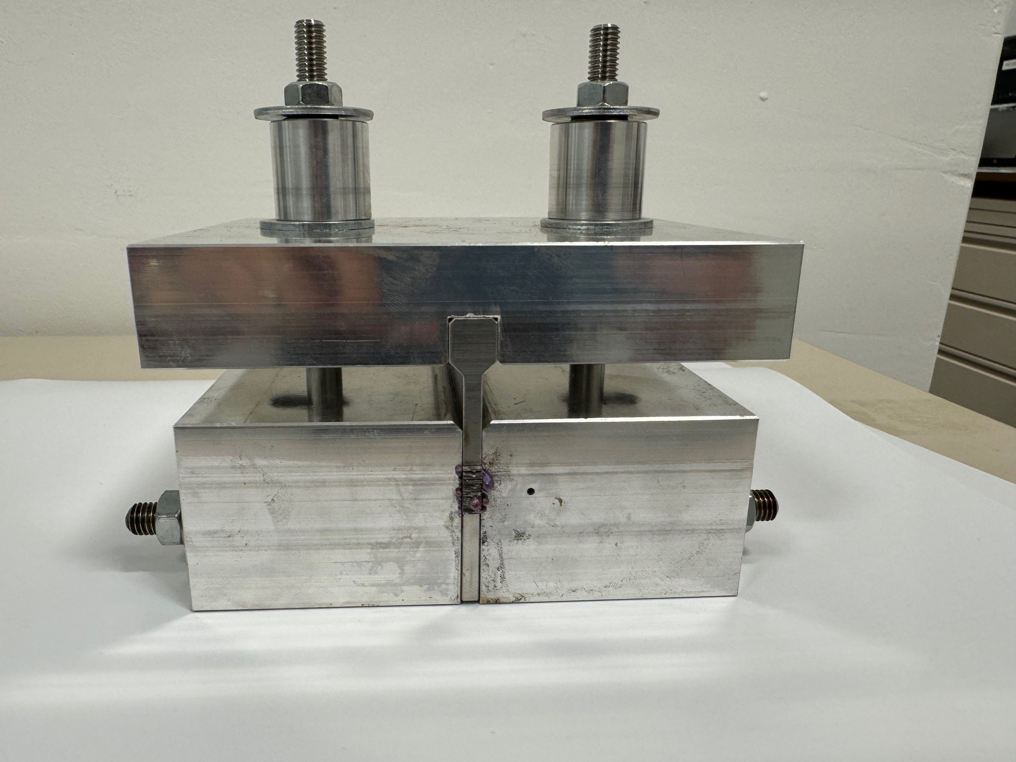
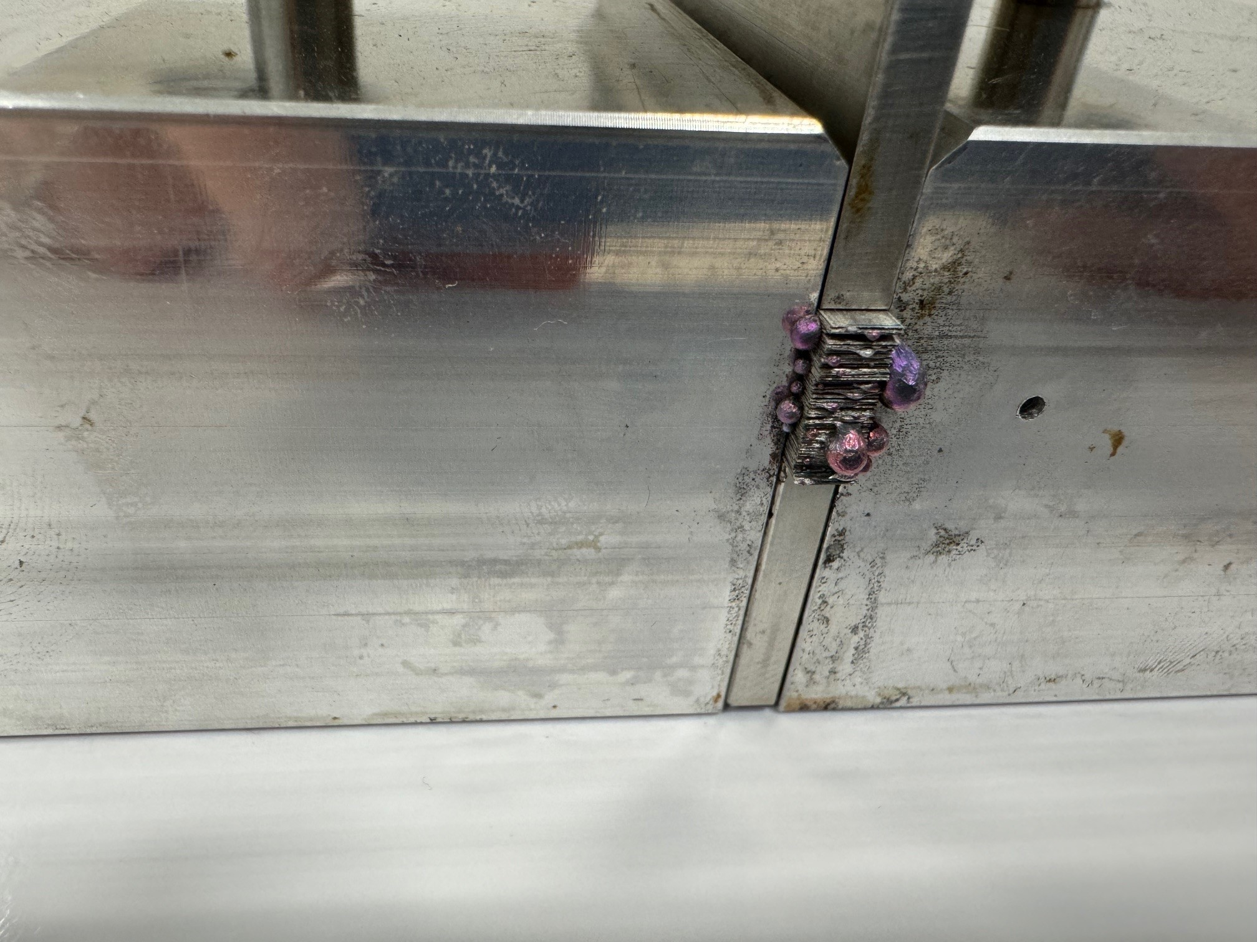
Sample 4
Same procedure of Sample 2?
Tomography?

Slide 10
What’s next
Planning for other stacks
Planning for coil

