Slide 1
Vertical Drift QC Jigs and Straightness Check
Akash Behanan and Brad Brown

Slide 2
Outline
Design of Vertical Drift QC jigs
How to use VD QC jigs
Design of table for straightness check
How to perform straightness check

Slide 3
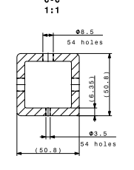
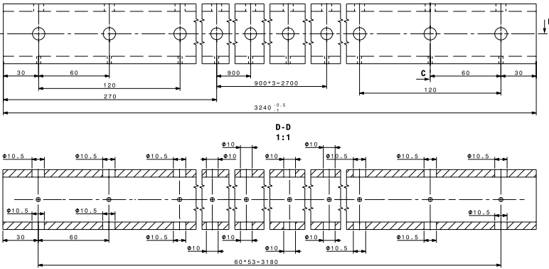
Design of the VD QC Jigs

Slide 4
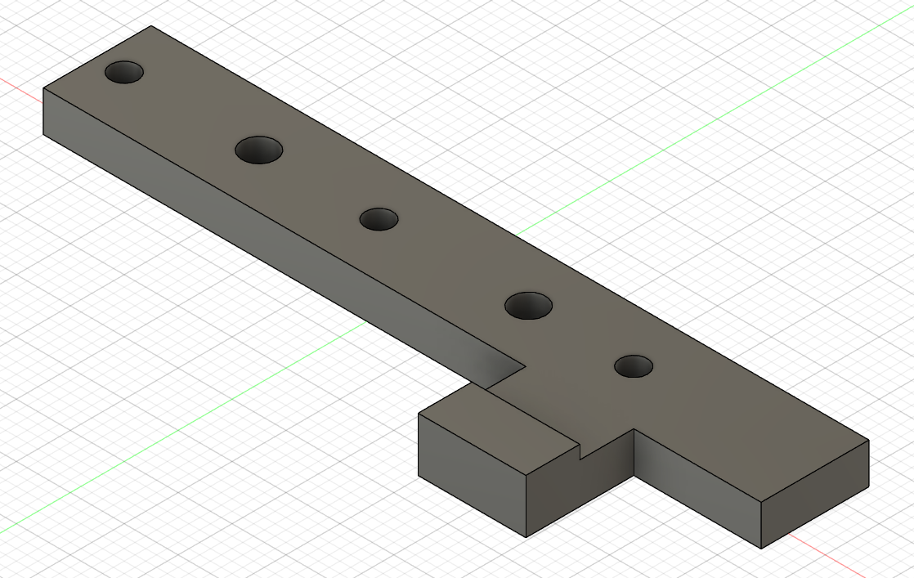
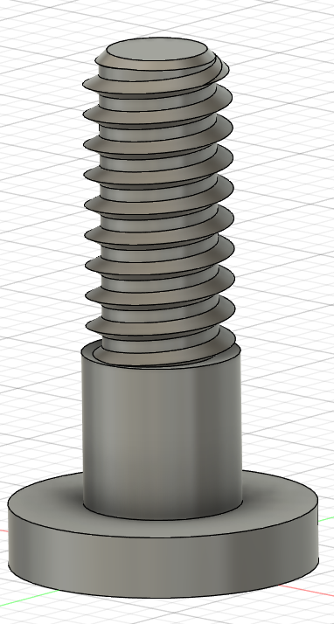
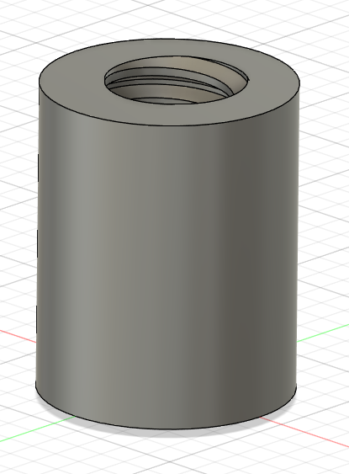
Design of the VD QC Jigs
Three components: Base Plate, Bolt, Cap
Caps check hole size and the base plate and bolt check position
Holes on base plate are slightly larger than the bolt to allow for 0.0025in of movement

Slide 5
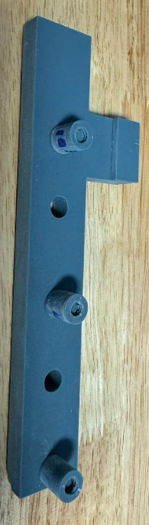
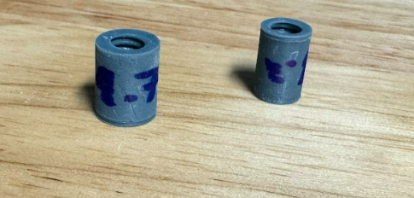
How to Use the VD QC Jigs
Assemble jig with correct caps for whatever holes being measured
Do not over tighten the caps, the bolt should wiggle slightly
Insert the jig into the holes on the box beam
Jig should fit in without a ton of force and sit flush, if not the beam should be hand checked

Slide 6
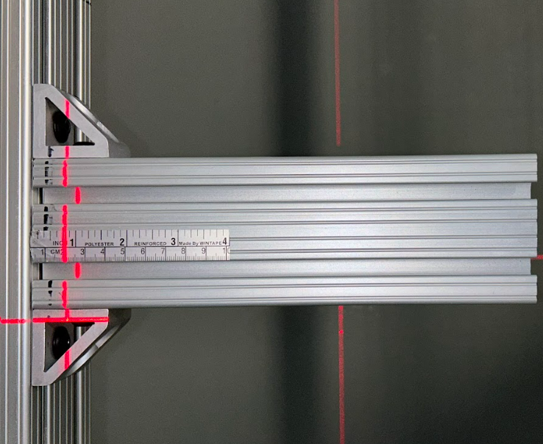
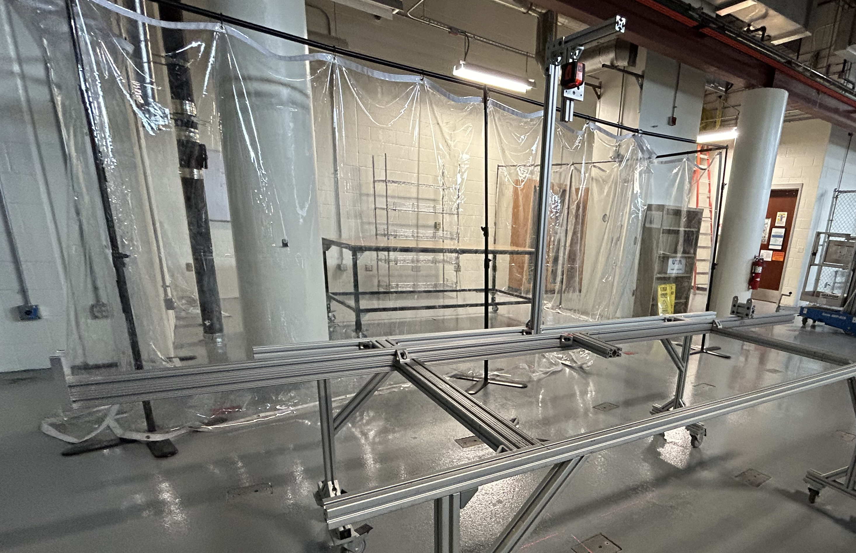
Design of Straightness Check Table
Table was built using pieces of the HD assembly table and an old QC table
Utilizes the 80/20 beam that is the length of an I-beam, a laser level, and an adhesive tape measure

Slide 7
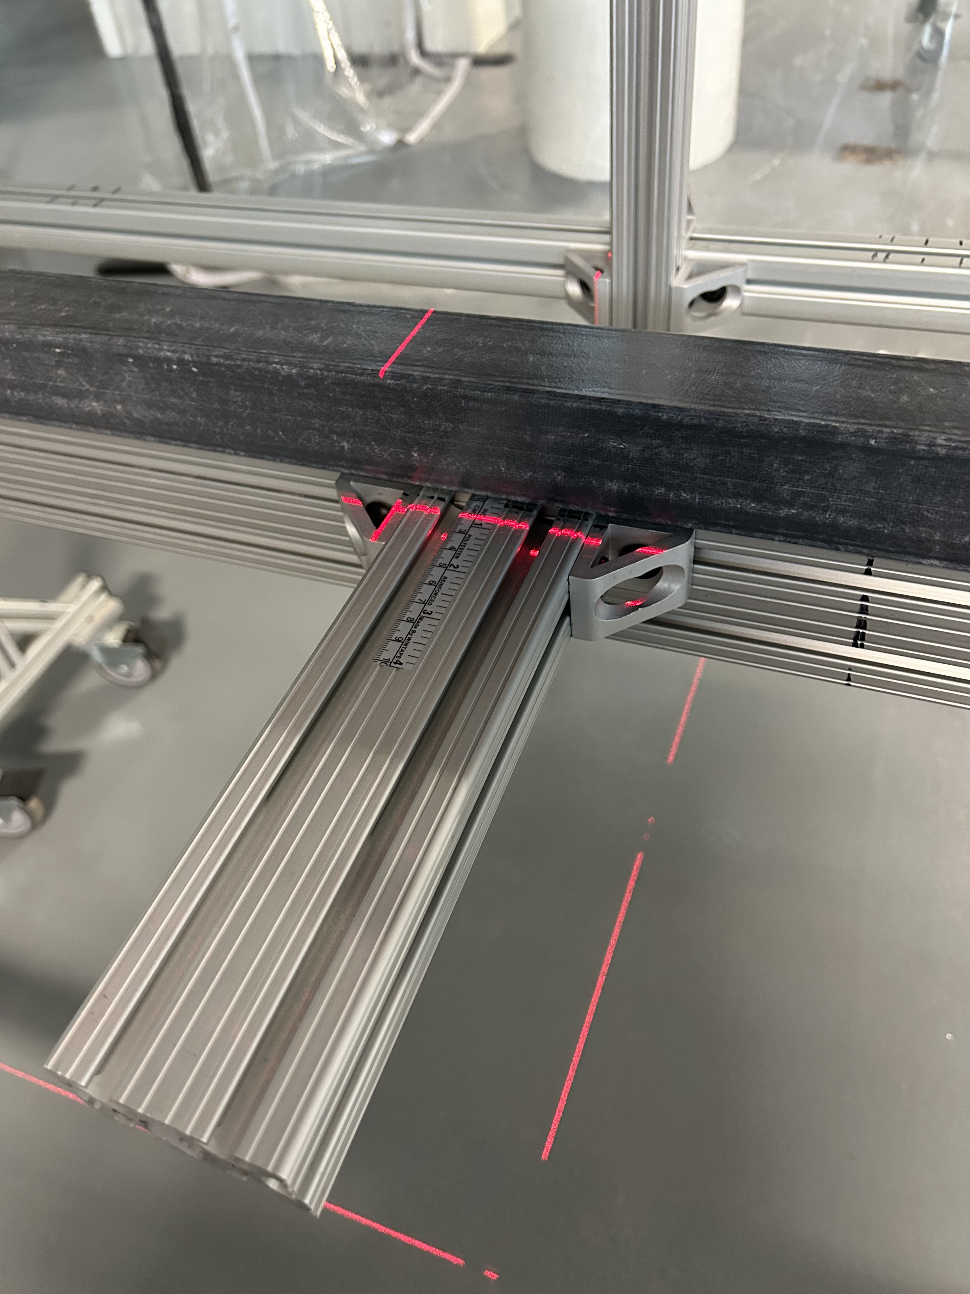
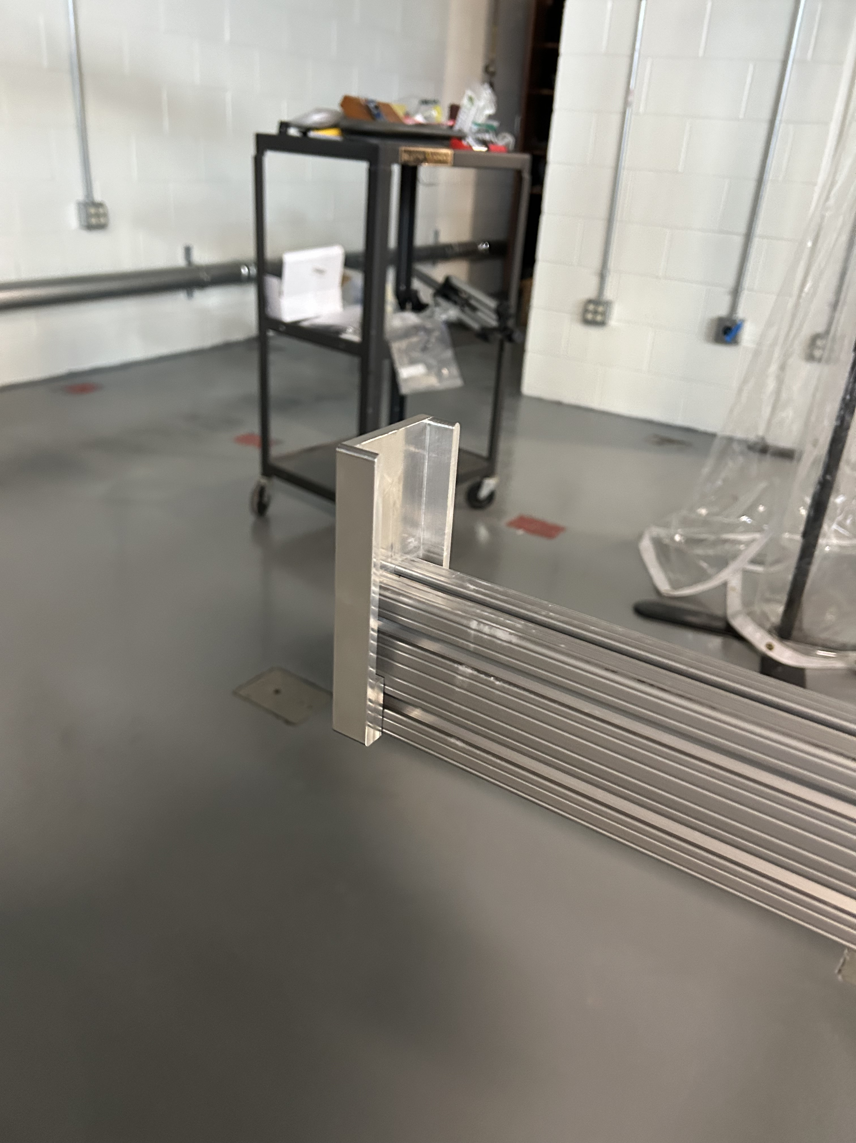
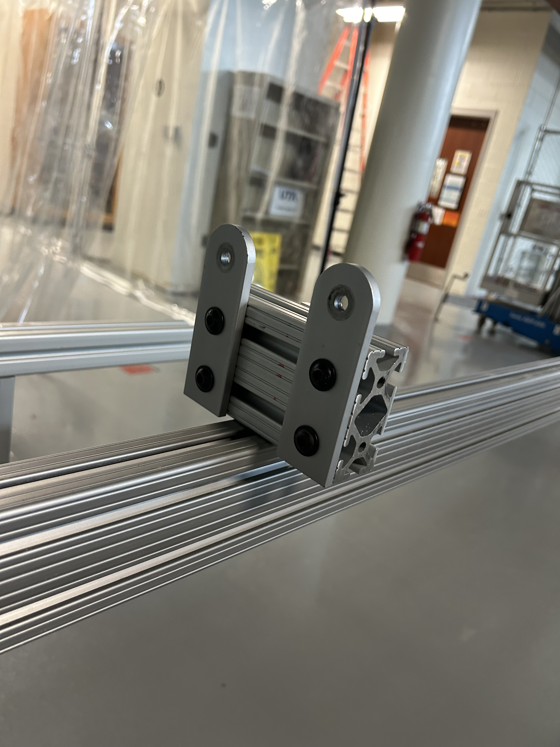
How to Use the Straightness Check Table
Beam is slotted into fixed end and the adjustable stop is used to secure the beam
The maximum deviation can then be measured using the adjustable side piece that has the ruler (must be less than 1cm)

Slide 8
Questions?

