Slide 1
VD FC Production Workshop
May 17, 2024
Jaehoon Yu
University of Texas at Arlington

Slide 2
Workshop Fundamentals
Goals : To learn the QC procedure and start processing FD2 (VD) box beams and plug pieces
Tasks to complete in the workshop
  Understand the scope and tasks involved in the project
  Hands-on training of the module parts QC procedure and exercise recording them into the QC iPADs
    To the level everyone knows how to process each part and QC them
  Process as many parts as possible and measure time needed to process and QC each one

Slide 3
Neutrino fundamentals – 1
Postulated in 1930 to explain the nuclear β-decay and detected experimentally in 1956 (1995 Nobel)
Fundamental particles of matter in the current Standard Model of Particle Physics
  Makes up a quarter of the whole particle table in TSM as massless particles
  Have three flavors – electron (ν_{e} – 2002 Nobel), muon (ν_{μ} – 1988 Nobel) , and tau (ν_{τ}) types
  Charge neutral and only interact via the weak force ➔ do not interact often in matter

Slide 4
Neutrino fundamentals – 2
Large numbers of low E neutrinos (ν_{e}) produced in the Sun (2002 Nobel) and in reactors
  ➔ 65x10⁹ ν_{e} /s/cm² (FFT: how many passes throughout your body/sec?)
Neutrino flavor oscillation (change their flavors in flight!) discovered & confirmed throughout late 1990 and early 2000 (2015 Nobel)
  Happens because flavor and mass eigenstates differ (oscillation probability dependent on L/E_{ν})
  Neutrinos have mass! ➔ SM in BIG trouble!

Slide 5
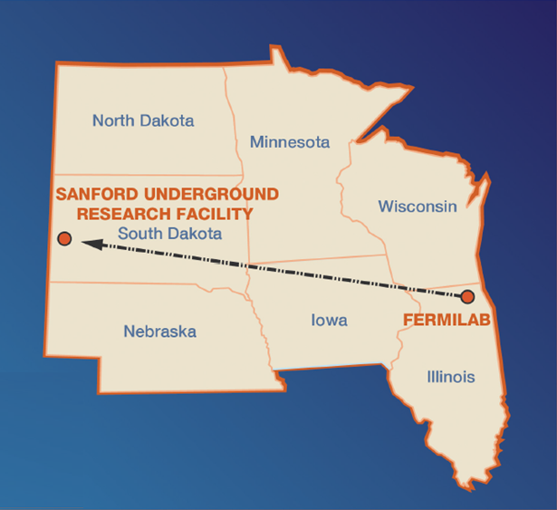
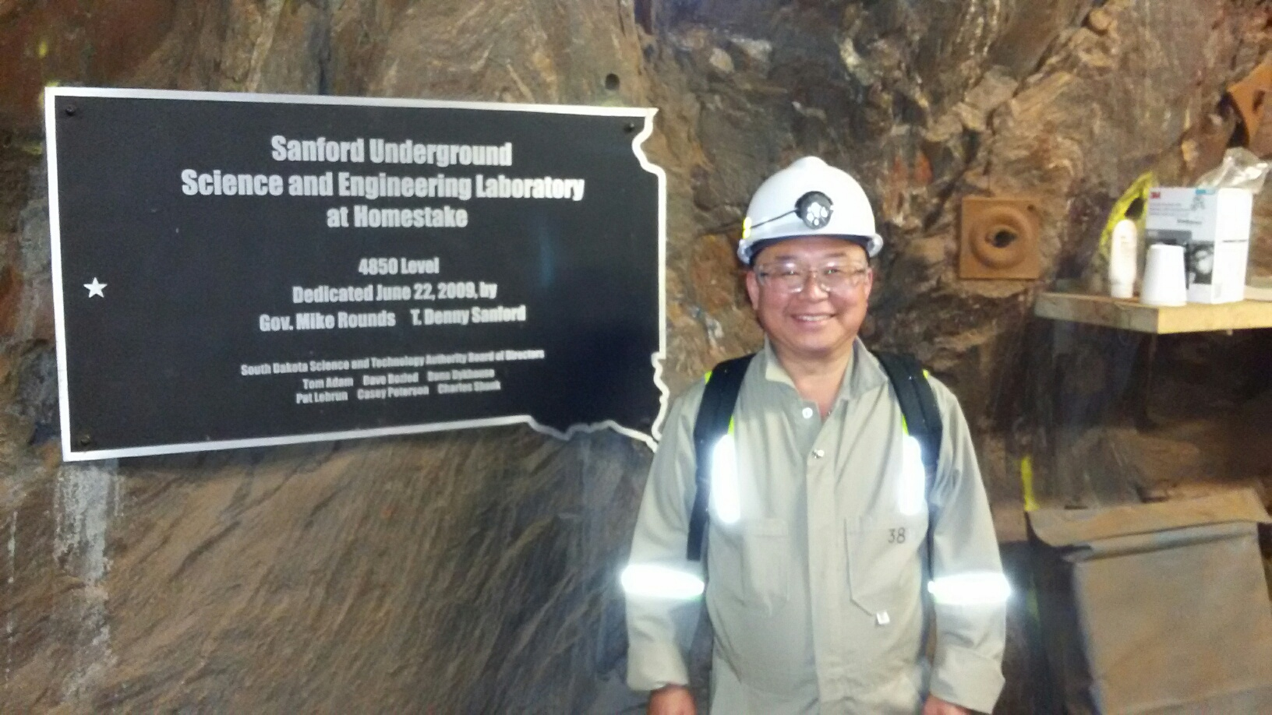
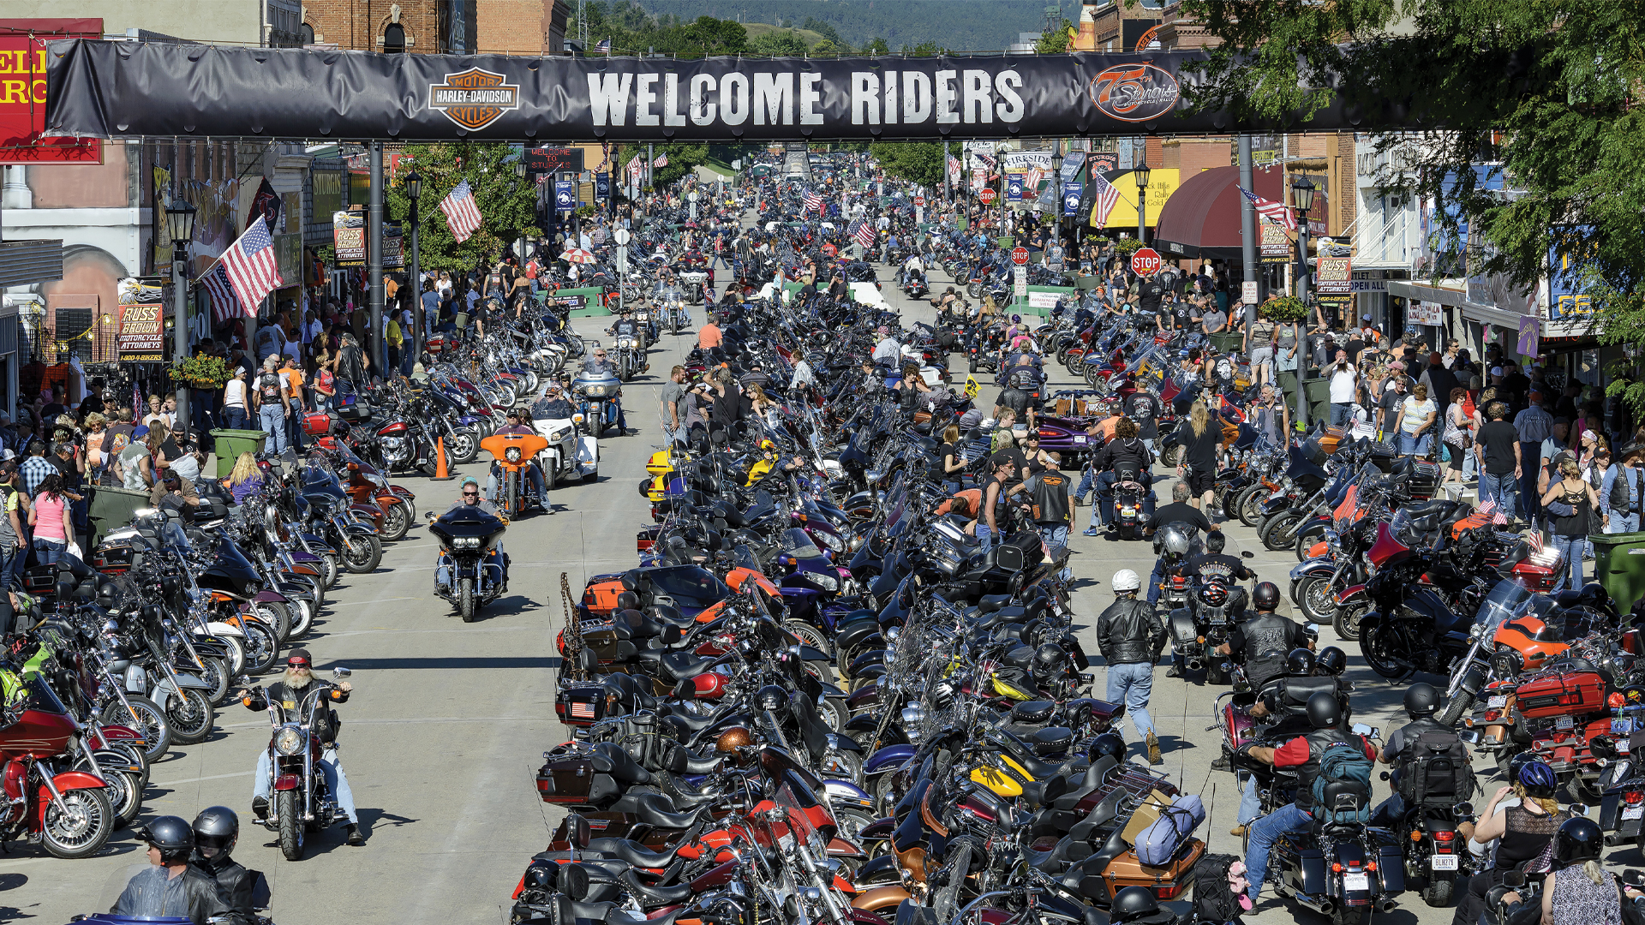
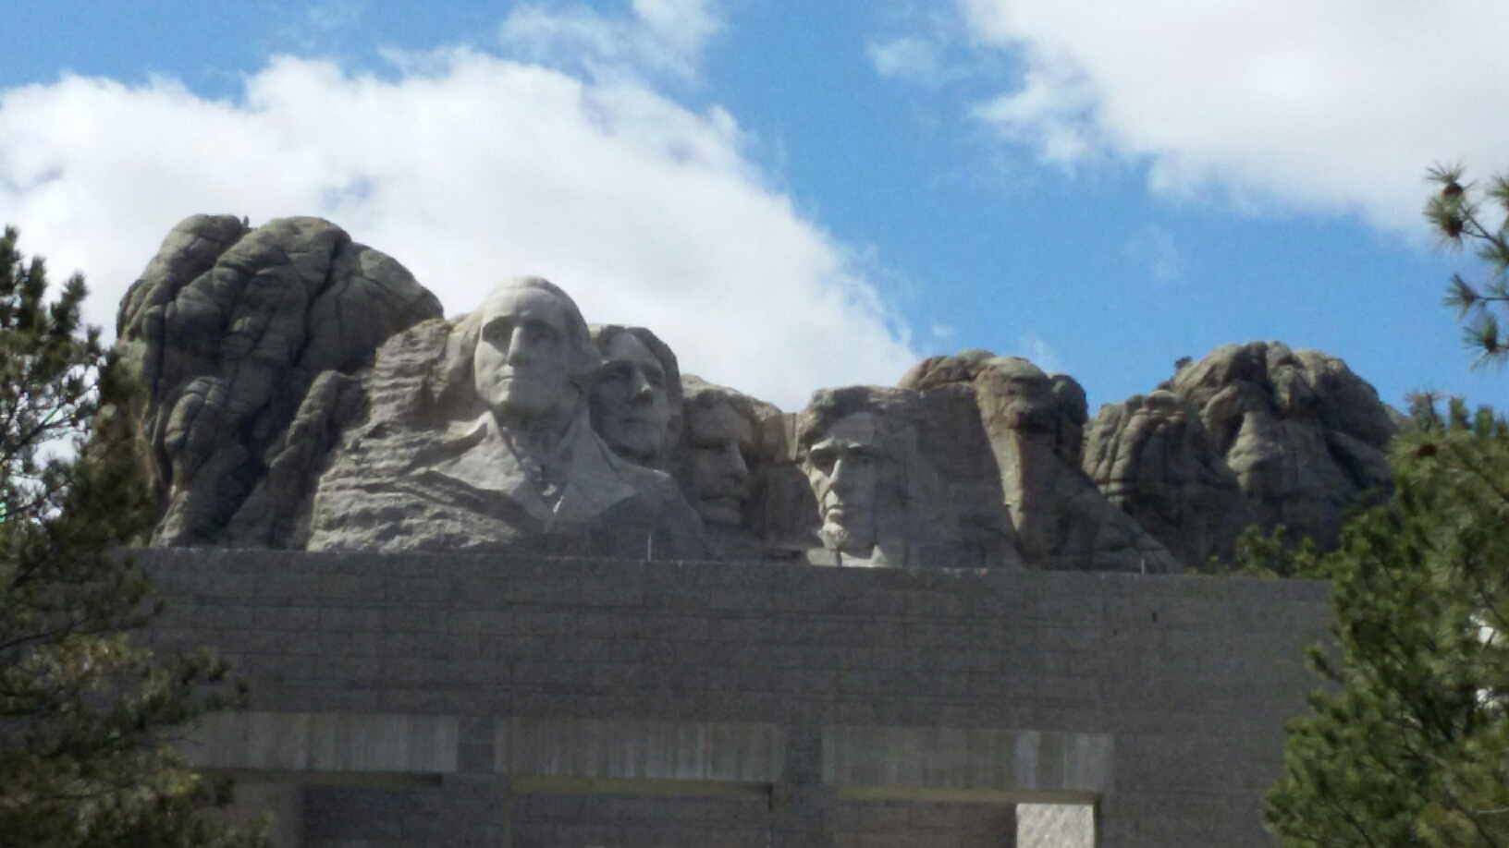
The Next Big Thing - DUNE Experiment
Stands for Deep Under Ground Neutrino Experiment
US flagship long baseline (1300km) ν experiment
  1500m underground in an old South Dakota gold mine
Yes, you are right, again!
That Sturgis is right next door!
Yes, you are right! Mount Rushmore!!
2002 Nobel Winning solar ν detection by Ray Davis
Many DM experimentsNew
DUNE area excavation completed on Jan. 25, 2024
Experiment infra work begun

Slide 6
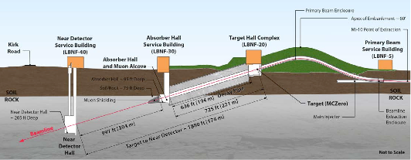
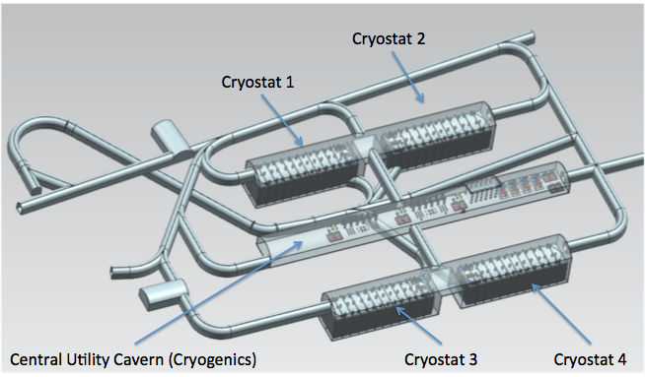
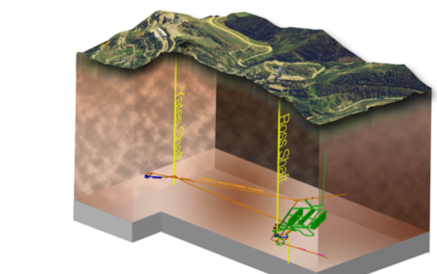
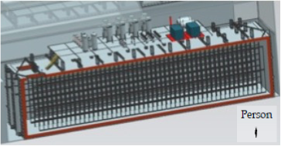
Anatomy of DUNE
LBNF ν Beam
Broadband ν from 60 – 120GeV p
P_{Beam} :1.2MW →2.4MW
Tgt
1300km (800 miles)
570m
ND
4 caverns for
M_{t}~ 70kt LAr
(>85% complete)
M_{A}~ 17kt LAr
LBNF Far Detector Site, SURF
1500m underground
18m
18m
66m

Slide 7
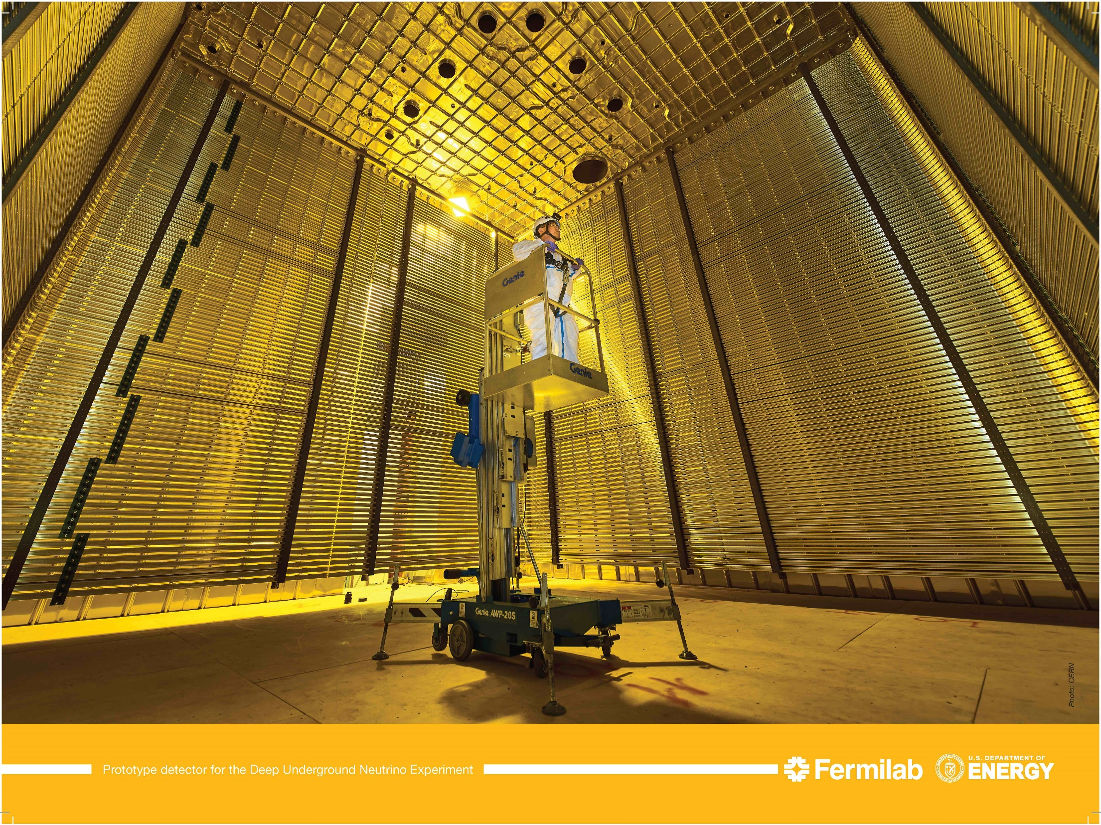
UTA-Built Prototype Field Cage @ CERN 2018
6m
6m
6m
V_{PD}=1/30 V_{FD}

Slide 8
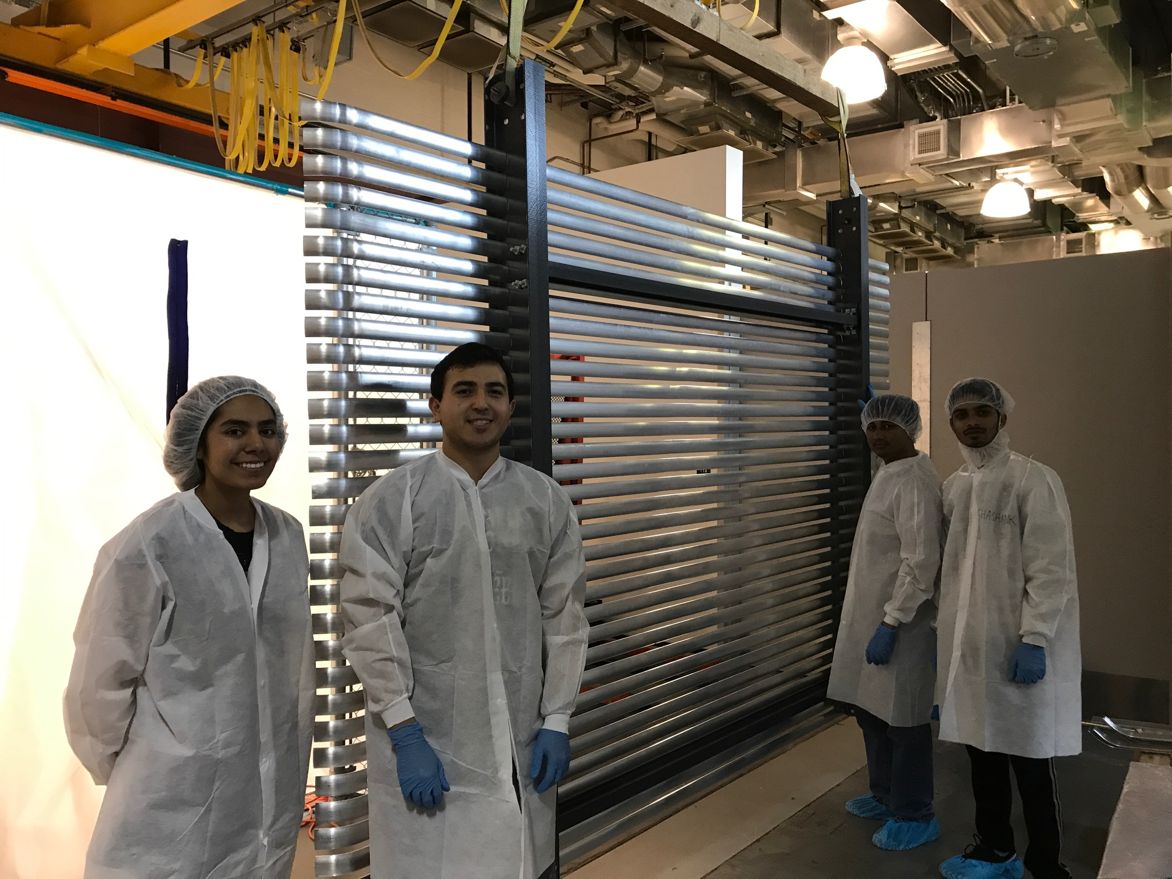
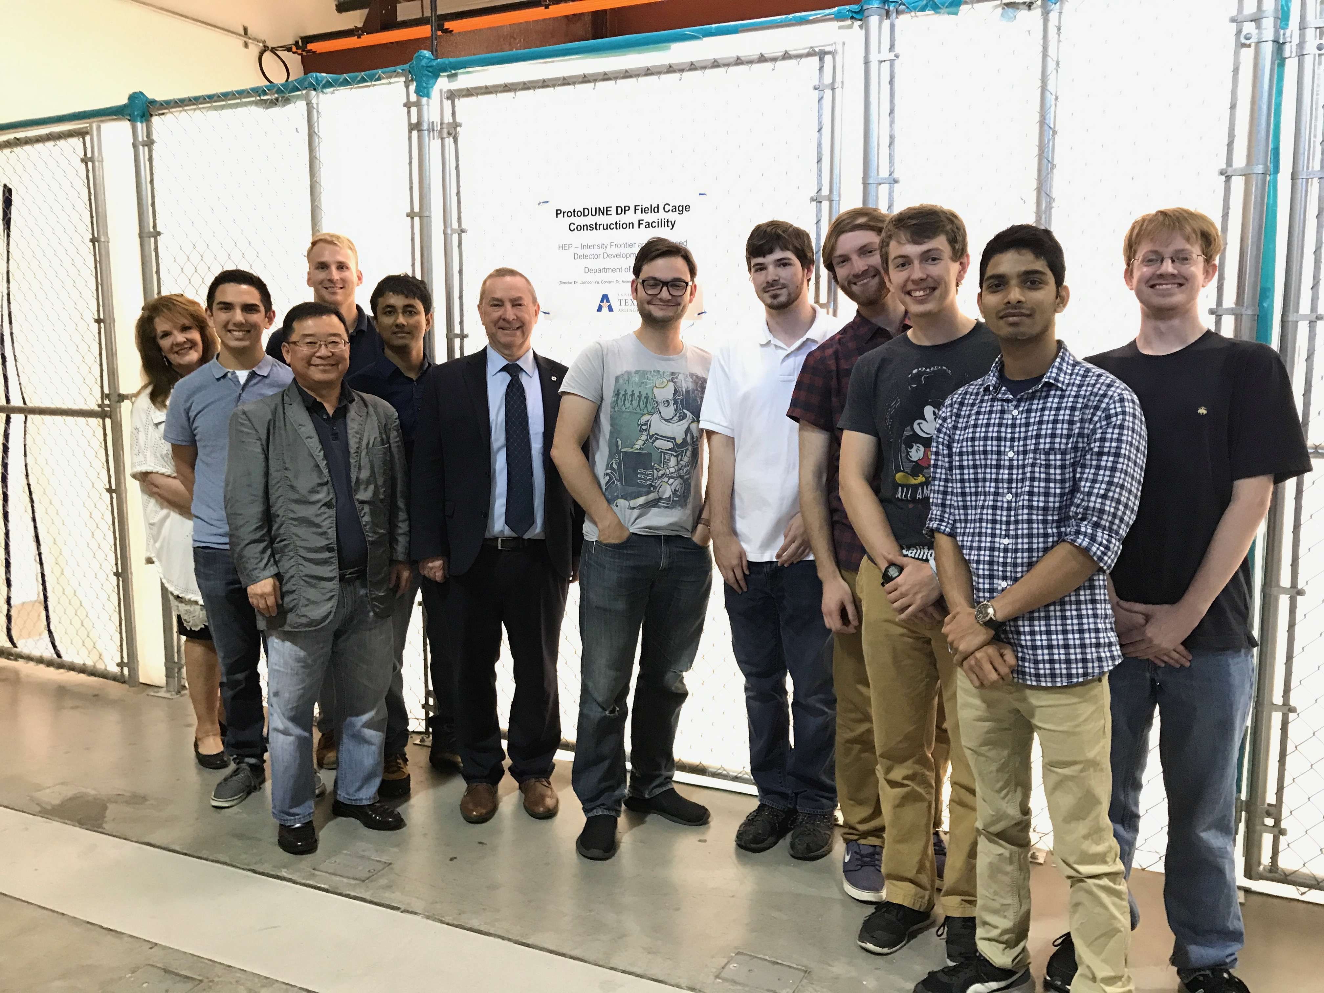
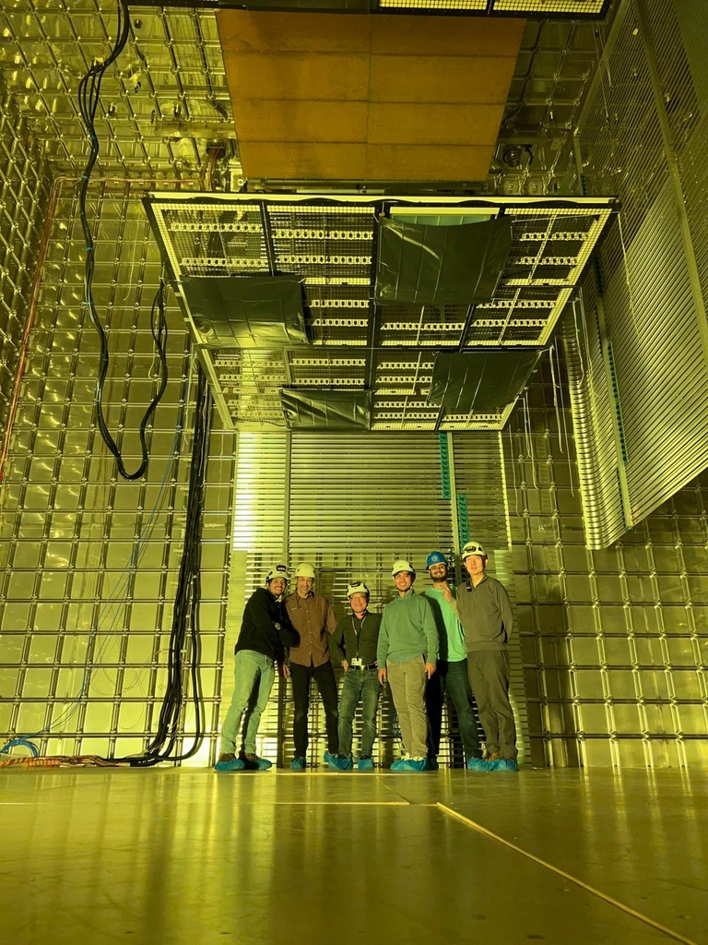
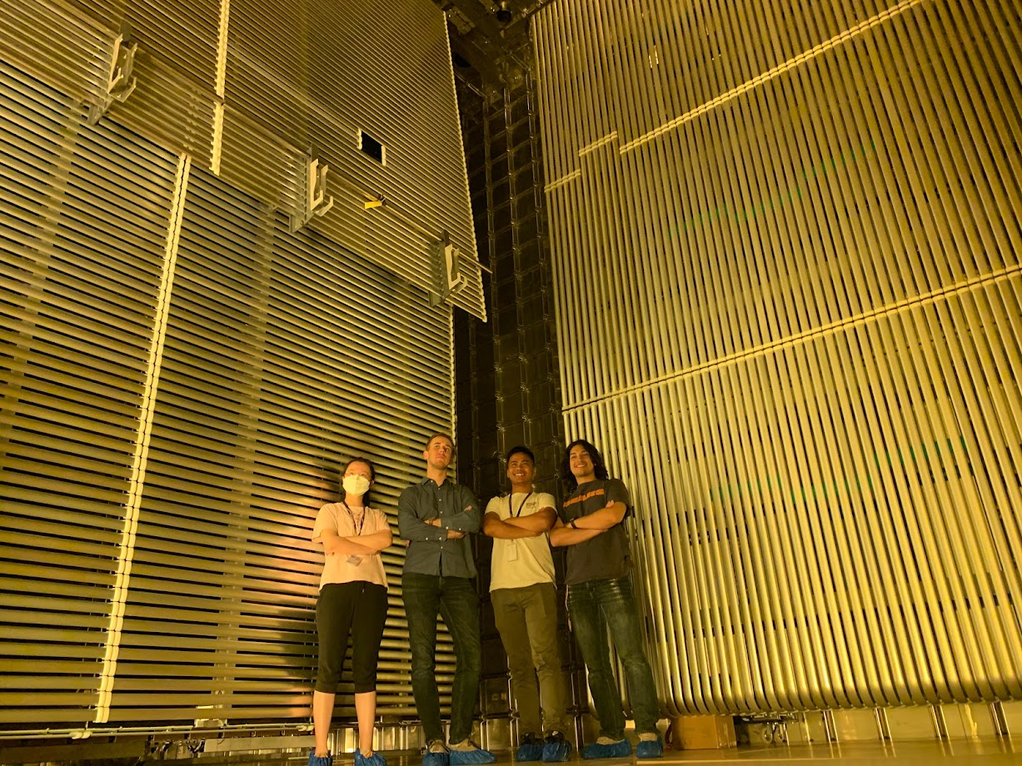
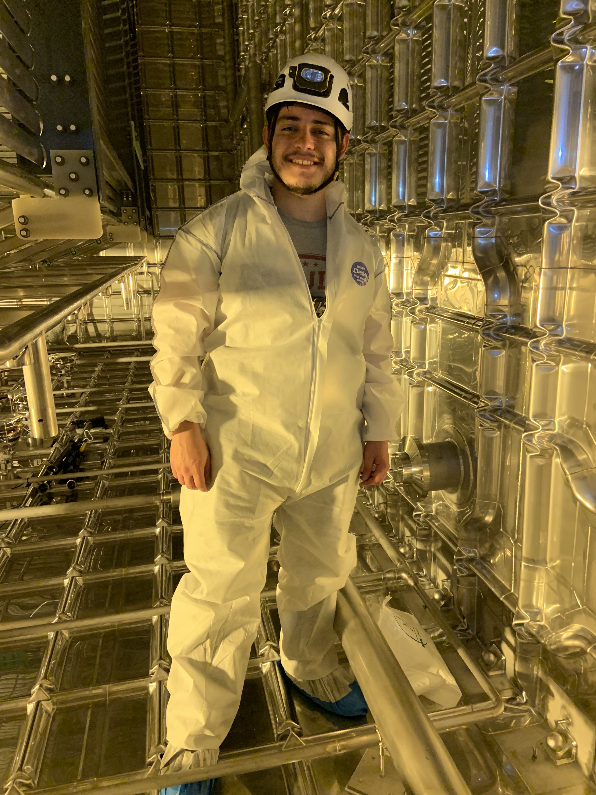
The UTA Field Cage Team 2017
Gajendra Gurung & Eric Garcia @ CERN, June 2022
Hector Carranza @ CERN, 2019
Eric Garcia, Gajendra Gurung & Atharva Dange @ CERN, March 2023

Slide 9
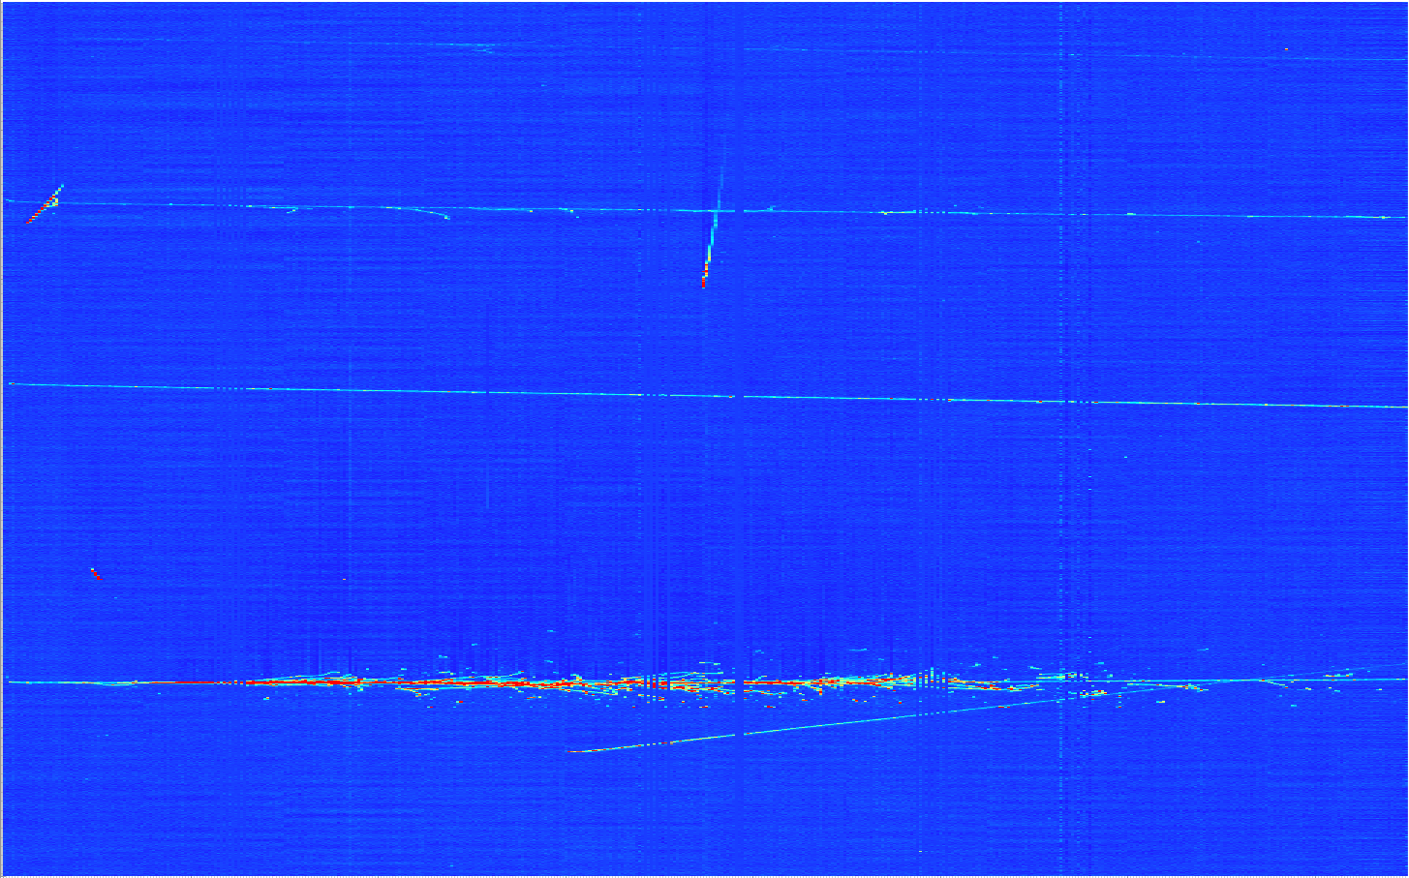
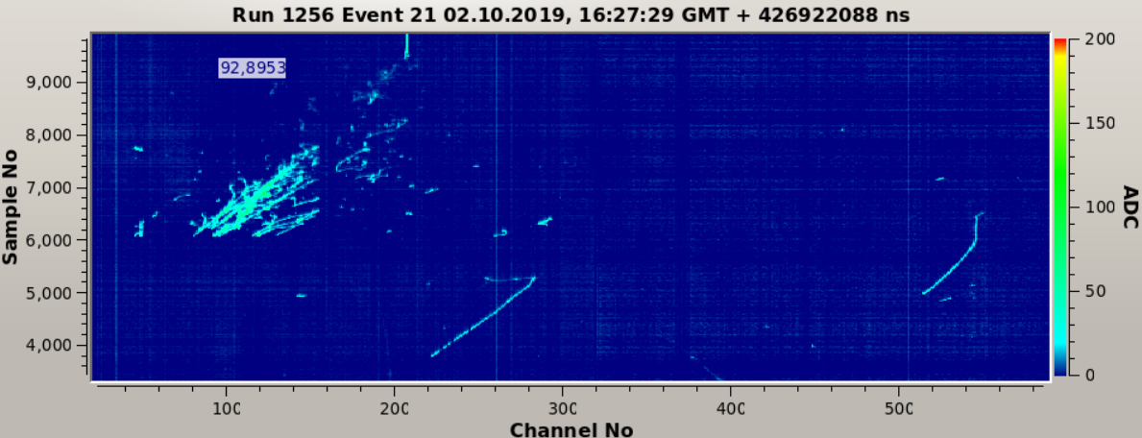
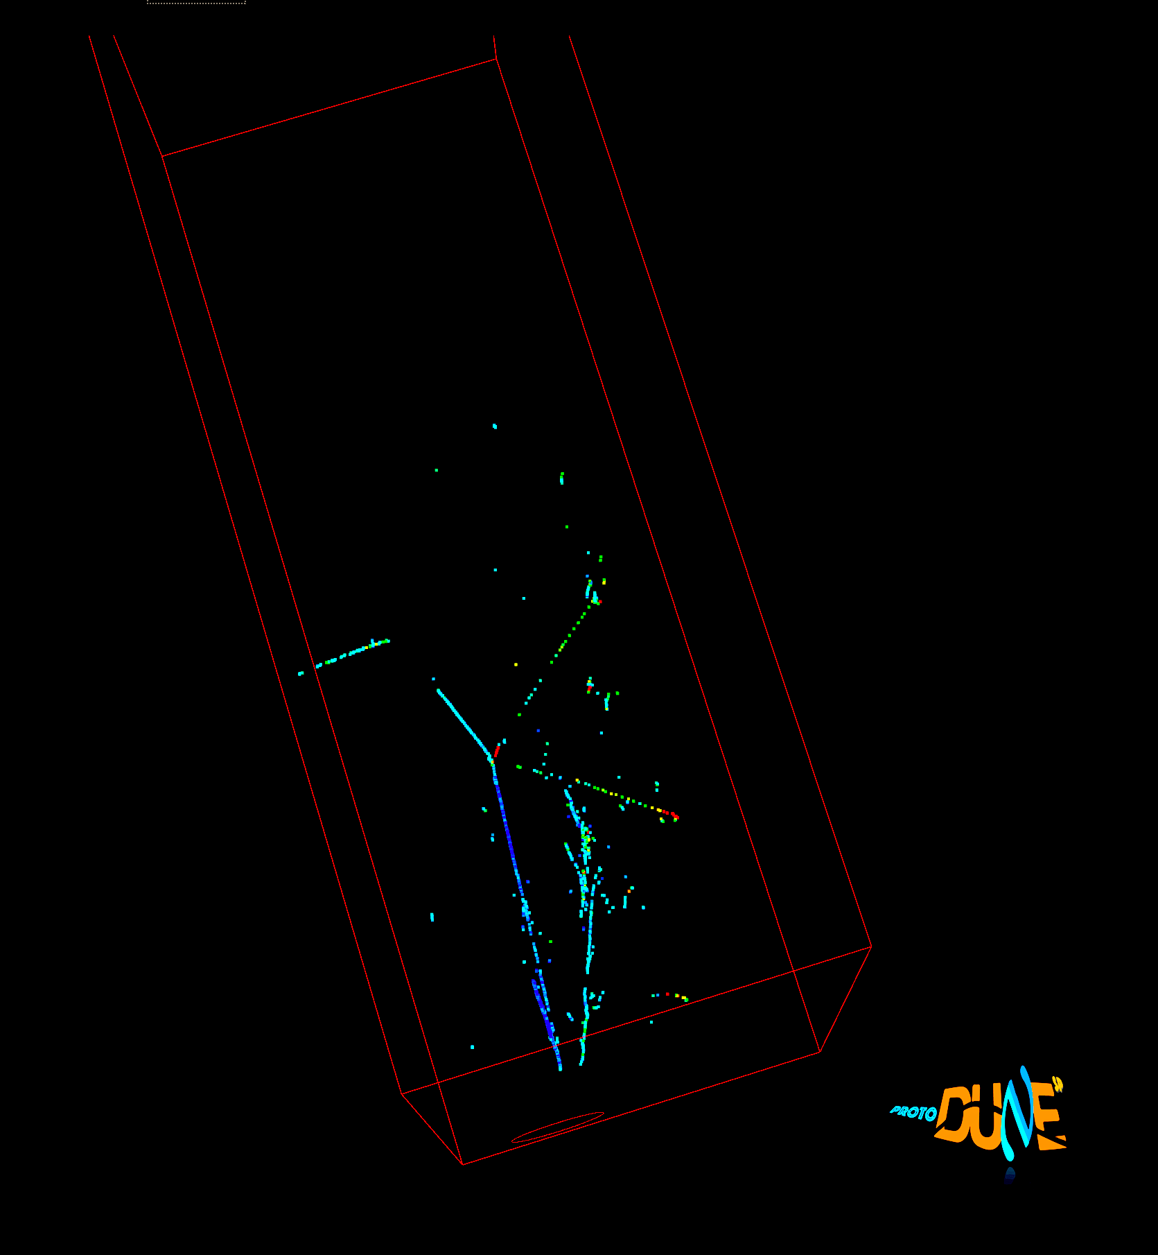
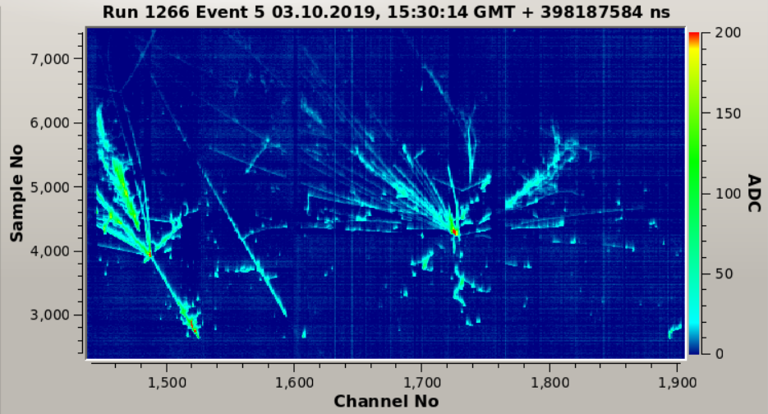
Images in DUNE LAr-TPC Prototypes
Throughgoing μ
Electromagnetic shower + two muon decays
E_{LEM} = 31 kV/cm
µ decay
EM shower
P = 1010 mbar
Multiple hadronic interactions in a shower
Run 4696, Ev 103:
2 EM showers and a pion interaction
E_{LEM} = 32 kV/cm
P = 1010 mbar

Slide 10
Latest news on DUNE
DUNE far detector cavern excavation completed Jan. 25 and the first set of steel parts for FD cryostat left Spain and to arrive in June
Both ProtoDUNE HD to take bean in June and allotted a couple of weeks more of beam time
ProtoDUNE VD PDS replacement work ongoing
FD2 VD installation mechanical mock-up testing in this summer at CERN
  Mock-up mechanical structure delayed due to safety calculations
  Will have 3 members staying at CERN in July 22 – Aug. 9 for the module assembly and other related tasks
  Will need 1 – 2 students for 2 – 3 weeks in the fall for installation exercise

Slide 11
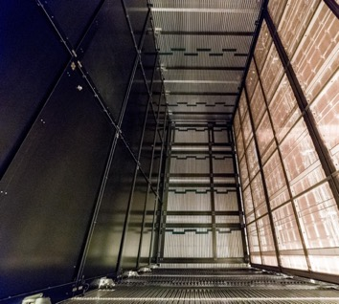
HVS Consortium Scope - FD1-HD TPC
Design, fabricate, test and assemble:
  100 CPA resistive panels forming two cathode arrays (1400m²)
  100 top + 100 bottom field cage modules, 48 End Wall field cage modules (1728m²)
  2 sets of HV power supplies, cables, ripple filters, and feedthroughs
  Digitizers for HVPS and ground plane monitoring
  Cameras for HV monitoring
Top Field Cage, TFC
Parts prep: 2025 – late 2025
Installation: 2026 – 2027 @SURF
End Wall Field Cage, EWFC
Cathode Plane Assembly, CPA
12m
TFC
E
58m
E
E
APA
E
Bottom Field Cage, BFC
Compared to
ProtoDUNE HD:
CPA: 33x
T/B FC: 17x
EW FC: 4x
CPA
Drift ~3.6mx4
EWFC
14m
BFC

Slide 12
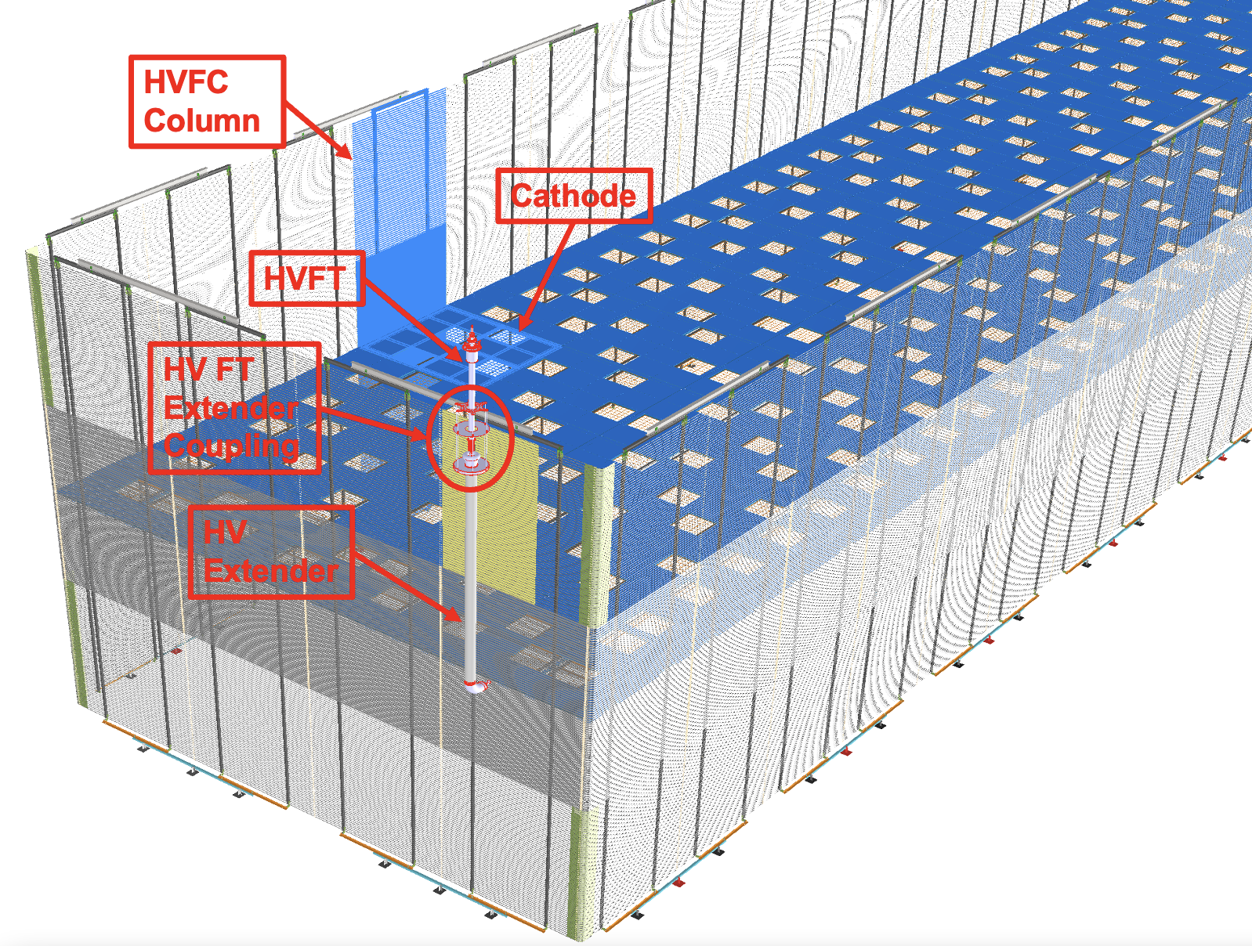
HVS Consortium Scope - FD2-VD TPC
Design, fabricate, test and assemble:
  80 Full Unit Cathode Planes (780m²) with embedded PD
  192 field cage modules – 160 Long Wall and 32 End Wall modules (~1781m²)
  One set of HV power supply, cable, ripple filter, and feedthrough
  Digitizers for HVPS and current monitoring
  Cameras for HV monitoring
E
70% Optical Transparency
E
13m
Drift 2x6.5m
2.5m
Long Wall Field Cage
60m
End Wall Field Cage
13m
Parts prep: Mid 2025 – late 2026
Installation: 2027 – 2028@SURF

Slide 13
What do we need to do?
Exercise, learn and adhere to the QA/QC procedures
Procure all FRP and other parts
Construct all tools for module assembly and installation
Train for profile bending
Train and get used to the different types of parts
Exercise the parts preparations, along with the QA/QC procedure and the use of the QA/QC tool
Construct the HD and VD assembly tables and exercise module constructions for training
Exercise the 3D printing of necessary QC jigs
Prepare for production readiness review (PRR) for both HD and VD parts production ➔ end of 2024 for VD and early 2025 for HD (driven by UMN?)

Slide 14
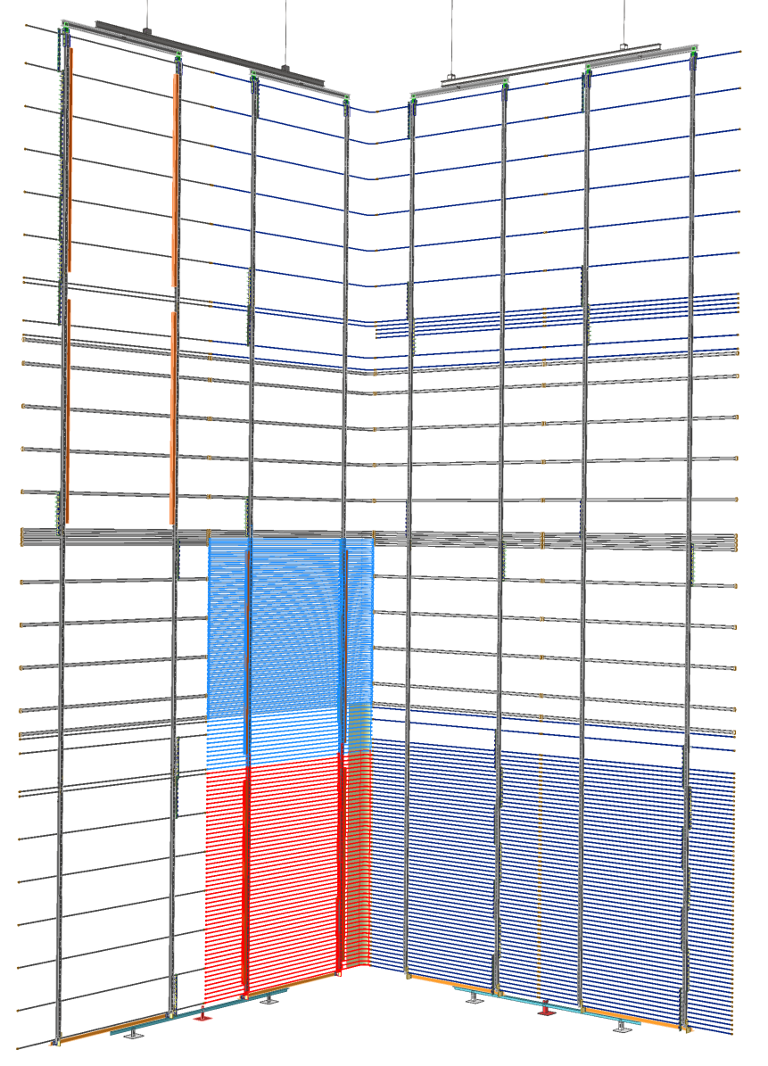
Field Cage Installation Test Configuration
LWSM
EWSM
Two dummy LW modules with fiber conduits, and top profiles to demonstrate new fiber connection scheme
4 FC support flanges with lift rods
Six dummy EW modules with subset of profiles:
Demonstrating cathode connection
Demonstrating row 3 to row 4 interconnects
Make cathode/HV bus connections
Two full(?) LW modules with fiber conduits to demonstrate old fiber connection scheme.
Time and motion study on assembly speed.
Two full EW modules to demonstrate final FC closing
(one split in 2 half modules?)
Remaining LW modules are dummies with sparce profiles

Slide 15
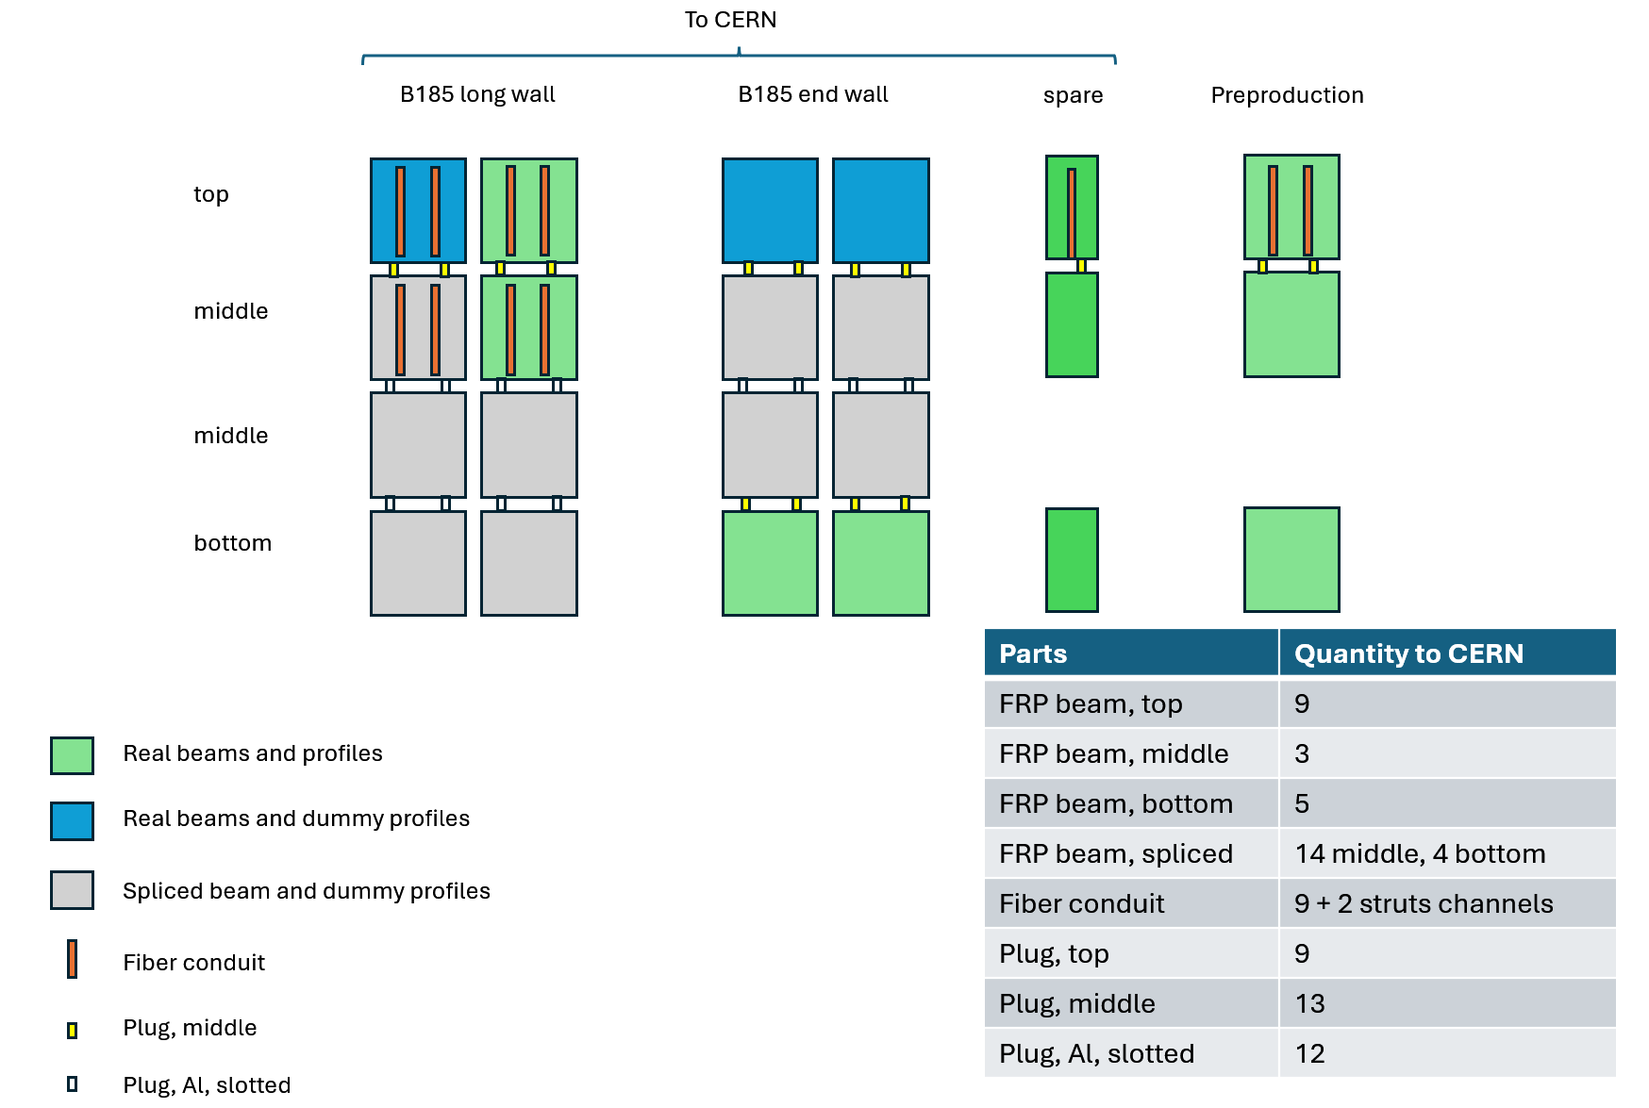
Mock-up Test and PreProduction Plan?

Slide 16
What do we need to build for Mock-up?
Process and QC
  FRP full size box beams from Liberty = 23 of which 19 out to CERN
    TFC Box beams: 4*2 + Spare = 11 (9 out to CERN, 2 @UTA)
    MFC Box beams: 1*2 + spare = 5 (3 out to CERN, 2 @UTA)
    BFC Box beams: 3*2 + spare = 7 (4+1=5 out to CERN, 2@UTA)
  Optical fiber conduit : 16 + spare = 18(8+1=9 @CERN, 9@UTA)
  Inserts
    6 hole mid box beam inserts: 6*2 + spare = 15 (12+1=13 @CERN, 2@UTA)
    3 hole top box beam inserts: 4*2 + spare = 11 (9@CERN, 2@UTA)
  Custom made beams for dummy modules
    UTA machine shop will make 18 each of 2.7m and 0.54m (14 mid+4bot) box beams + aluminum bx beam plugs of 18 two-hole pieces ➔ these make up 14 TFC and 4 BFC beams for dummy modules
      need to splice the two box beams with the Al box w/ the epoxy glue (all out to CERN)
    12 Al inserts for dummy module interconnect

Slide 17
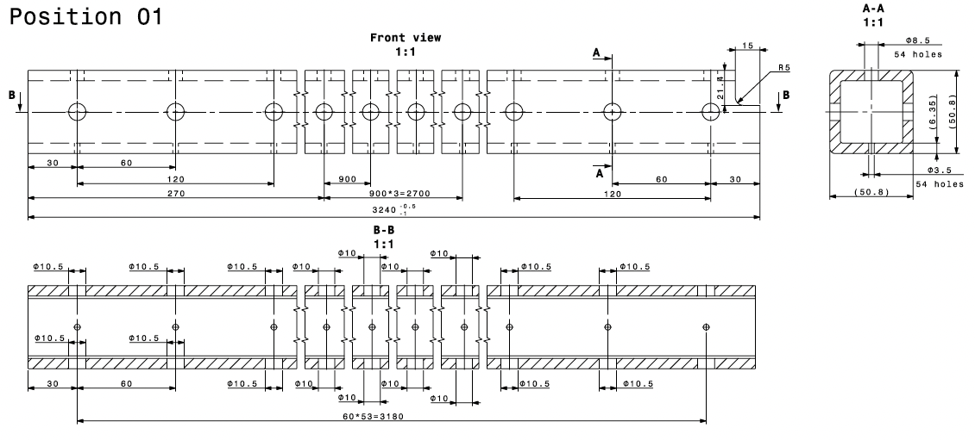
VD Top Module Parts
11 Liberty TFC FRP Box beams ➔ 9 to CERN & 2 @ UTA

Slide 18
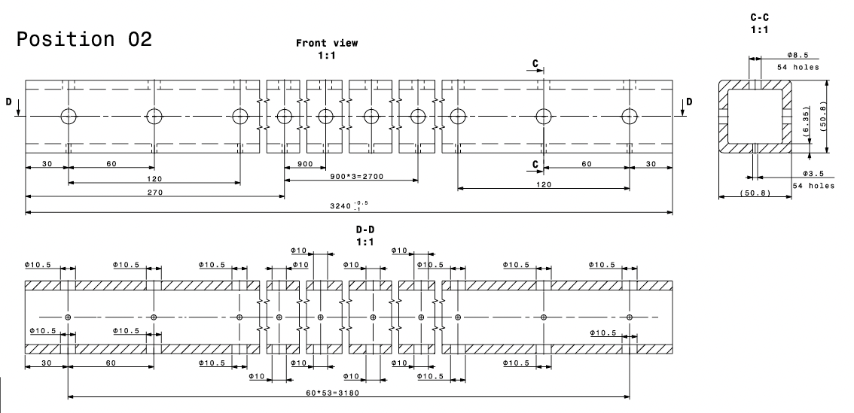
VD Mid FC Module Parts
5 Liberty MFC FRP Box beams + 14 additional spliced MFC beams : Total 19 ➔ 3 Liberty + 14 spliced MFC to CERN & 2 Liberty MFC beams @UTA

Slide 19
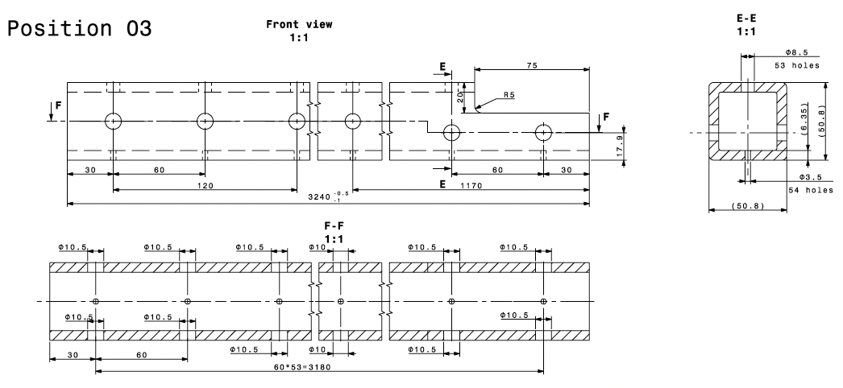
VD Bottom FC Module Parts
7 Liberty BFC FRP Box beams + 4 Spliced BFC beams: Total 11
➔ 5 Liberty + 4 Spliced BFC beams to CERN, 2 Liberty BFC @UTA

Slide 20
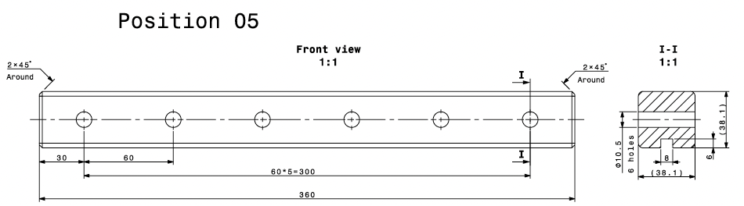
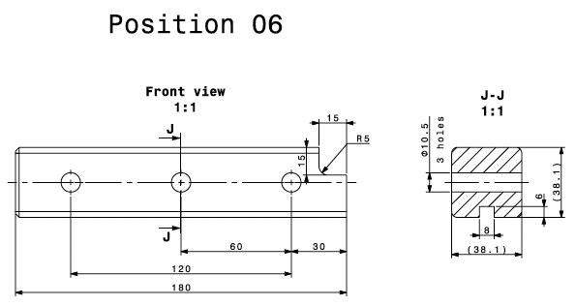
VD Inter-module Connections
15 Liberty 6-hole FRP interconnect Insert +12 Slotted Al from UTA machine shop: Total 17
➔ 13 Liberty + 12 Slotted Al to CERN, 2 Liberty @ UTA
11 Liberty 3-hole FRP Insert top connection ➔ 9 to CERN, 2@UTA

Slide 21
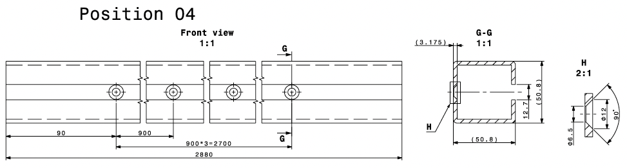
VD Optical Fiber Conduit
Fiber conduit: full size from Liberty ➔ 16 to CERN, 2@UTA)
Box beams with the slot cut out through the entire length and with four dish head screw holes for mounting on the FC frames

Slide 22
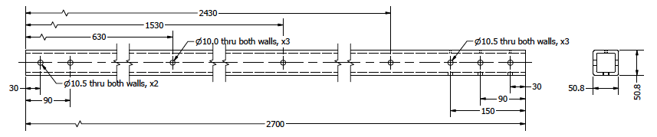
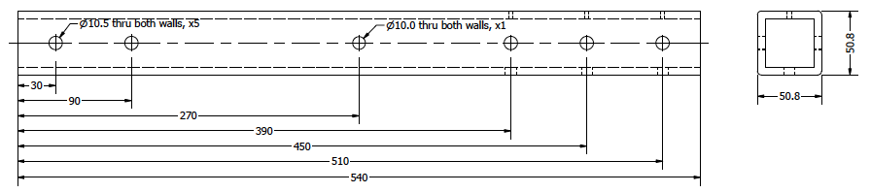
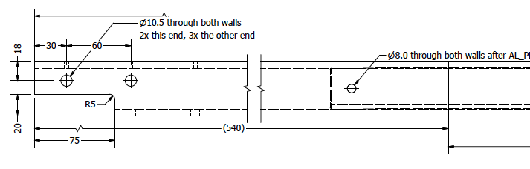
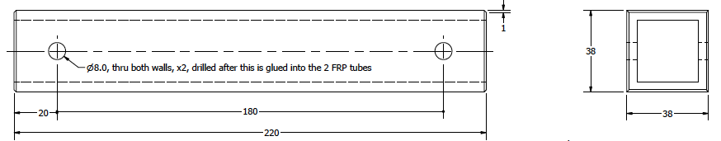
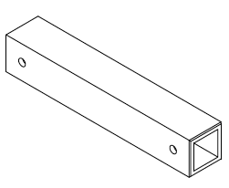
Box beams for dummy modules
One each of long and short box beams with 2-hole Al box beam splicing the two with the epoxy (3M DP190 – McMaster 7467A72) and screws.
Long (2.7m)
Short MFC (14x0.54m)
Short BFC (4x0.54m)
Al plug (18x0.22m)

Slide 23
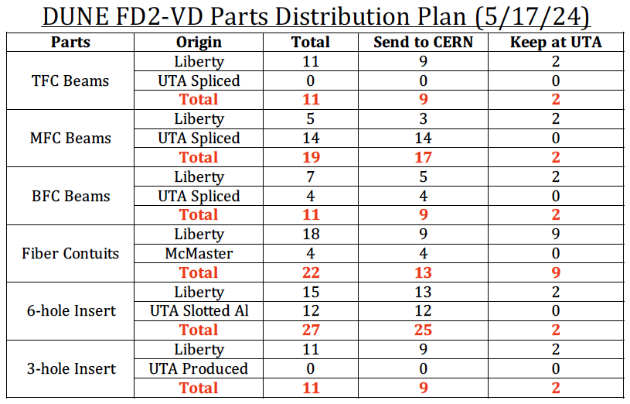

Slide 24
Mock-up Test Timeline
May 15: FRP Parts delivered & Visual Inspection
May 16: Deliver the 23 drop pieces to Scott at the engineering machine shop for additional machining ➔ return by the week of June 10
May 31: Complete Liberty FRP Parts processing and QC
  Further develop and refine the QC procedure (Sam C.)
  Pick up the machined parts from the engineering machine shop and process them
June 10: All machined drop pieces delivered from Engineering machine shop
June 21: Complete splicing the parts to put together 18 full size MFC box beams and QC
June 24: Crate and ship all parts to CERN
By July 12: crate to arrive at CERN
July 20: 3 UTA members depart to CERN
July 22 – Aug. 10: 3 UTA students at CERN to participate in the Mock-up installation process, developing installation and module QC procedures

Slide 25
Who’s available?
Gajendra Gurung
  @FNAL: 5/24 – 6/7
  @UTA: 6/8 – 6/20
  Depart to CERN: 6/20
Rohit Raut
  @UTA : through 6/6
  @CERN: 6/7 – 8/31
Eric Garcia
  @UTA: through 6/6
  @INFN, Italy: 6/7 – 8/15
Everyone else should be here through the end of June to finish preparing the parts and ship
Each and everyone of you should take responsibility on getting these parts processed to highest quality and ship in a timely fashion

Slide 26
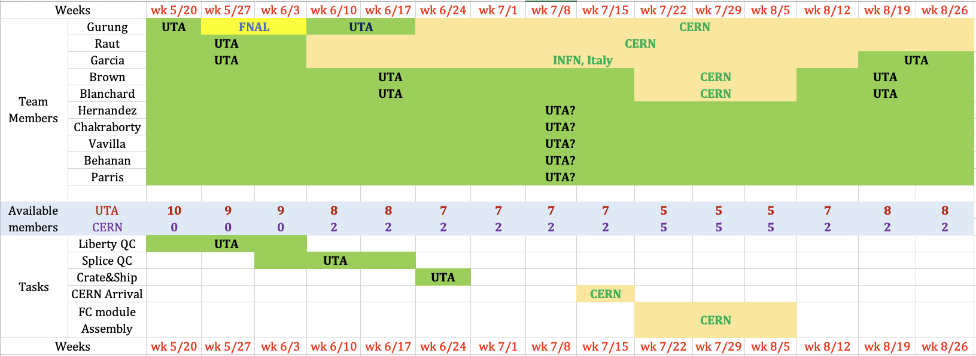
Member Availability and Task Matrix

Slide 27
Who’s available?
Gajendra Gurung
  @FNAL: 5/24 – 6/7
  @UTA: 6/8 – 6/20
  Depart to CERN: 6/20
Rohit Raut
  @UTA : through 6/6
  @CERN: 6/7 – 8/31
Eric Garcia
  @UTA: through 5/30
  @INFN, Italy: 6/7 – 8/15
Everyone else should be here through the end of June to finish preparing the parts and ship
Each and everyone of you should take responsibility on getting these parts processed to highest quality and ship in a timely fashion
Listen and fully adhere to the safety rules of the lab (Eric & Brad)

Slide 28
Group’s 3E Motto
Demand Yourself Excellence!
Demand Each Other Excellence!
Help Each Other Become Excellent!

