Slide 1





Muon Collider
D. Schulte
On behalf of the International Muon Collider Collaboration
Funded by the European Union (EU). Views and opinions expressed are however those of the author(s) only and do not necessarily reflect those of the EU or European Research Executive Agency (REA). Neither the EU nor the REA can be held responsible for them.
Roma, May, 2024

Slide 2
Muon Collider Overview
Would be easy if the muons did not decay
Lifetime is τ = γ x 2.2 μs
Short, intense proton bunch
Ionisation cooling of muon in matter
Acceleration to collision energy
Collision
Protons produce pions which decay into muons
muons are captured
2

Slide 3
Motivation
New strong interest in high-energy, high-luminosity lepton collider
Combines precision physics and discovery reach
Application of hadron collider technology to a lepton collider
Muon collider promises sustainable approach to the energy frontier
limited power consumption, cost and land use
Technology and design advances in past years
reviews did not find any showstoppers
Target integrated luminosities are based on physics
Increase as E_{cm}²
Reviews of the muon collider concept in Europe and US found
no insurmountable obstacle
Identified required R&D, documented in accelerator R&D Roadmap
3

Slide 4
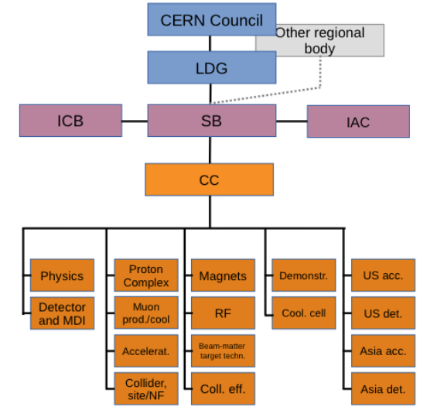
International Muon Collider Collaboration (IMCC)
IMCC was founded in 2021
Reports to CERN Council
Anticipate it will also report to DoE and other funding agencies
50 full members, a few additional contributors
IMCC goals
10 TeV high-luminosity collider
  Higher energies to be explored later
Develop initial stage to start operation by 2050
  Lower energy or luminosity
Identify potential sites
Implementing workplan following priorities from Roadmap
4
http://arxiv.org/abs/2201.07895

Slide 5
MoC and Design Study Partners
UK | RAL
 | UK Research and Innovation
 | University of Lancaster
 | University of Southampton
 | University of Strathclyde
 | University of Sussex
 | Imperial College London
 | Royal Holloway
 | University of Huddersfield
 | University of Oxford
 | University of Warwick
 | University of Durham
US | Iowa State University
 | Wisconsin-Madison
 | Pittsburg University
 | Old Dominion
 | BNL
 | Florida State University
 | RICE University
 | Tennessee University
IT | INFN
 | INFN, Univ., Polit. Torino
 | INFN, Univ. Milano
 | INFN, Univ. Padova
 | INFN, Univ. Pavia
 | INFN, Univ. Bologna
 | INFN Trieste
 | INFN, Univ. Bari
 | INFN, Univ. Roma 1
 | ENEA
 | INFN Frascati
 | INFN, Univ. Ferrara
 | INFN, Univ. Roma 3
 | INFN Legnaro
 | INFN, Univ. Milano Bicocca
 | INFN Genova
 | INFN Laboratori del Sud
 | INFN Napoli
Mal | Univ. of Malta
IEIO | CERN
FR | CEA-IRFU
 | CNRS-LNCMI
DE | DESY
 | Technical University of Darmstadt
 | University of Rostock
 | KIT
SE | ESS
 | University of Uppsala
PT | LIP
NL | University of Twente
FI | Tampere University
LAT | Riga Technical Univers.
CH | PSI
 | University of Geneva
 | EPFL
EST | Tartu University
BE | Univ. Louvain
China | Sun Yat-sen University
 | IHEP
 | Peking University
AU | HEPHY
 | TU Wien
ES | I3M
 | CIEMAT
 | ICMAB
KO | KEU
 | Yonsei University
India | CHEP
US | FNAL
 | LBL
 | JLAB
 | Chicago
5

Slide 6
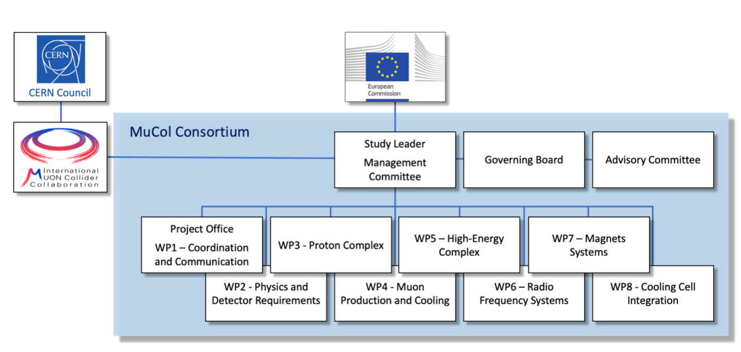
MuCol (EU co-funded)
Started March 2023, lasts until early 2027
3 MEUR from the EU, the UK and Switzerland, about 4 MEUR from the partners, CERN leads and contributes
Final deliverable is a report on the full IMCC R&D results
EU officer will come on 19th June.

Slide 7

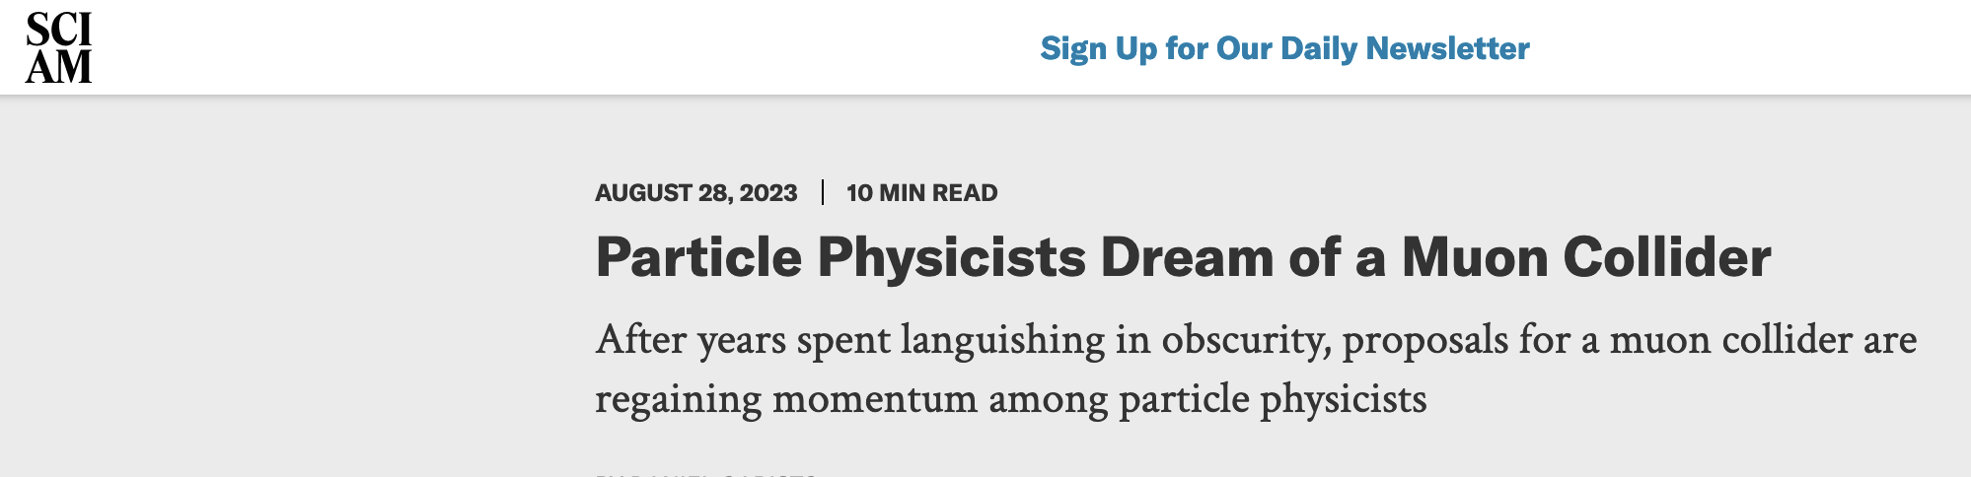
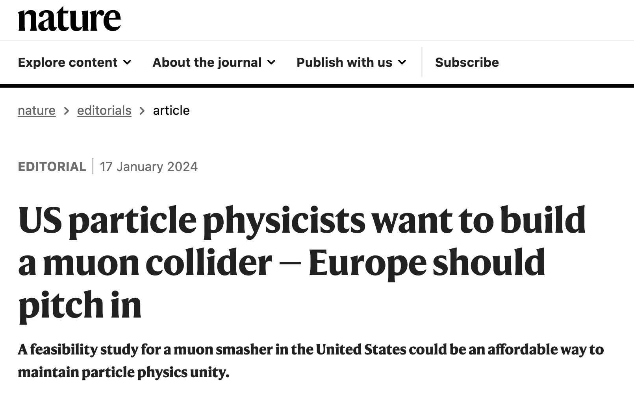
US P5: The Muon Shot
Particle Physics Project Prioritisation Panel (P5) endorses muon collider R&D: ”This is our muon shot”
Recommend joining the IMCC
Consider FNAL as a host candidate
US is already particpating to the collaboration
US ambition:
Want to reach a 10 TeV parton level collisions
Timeline around 2050
Fermilab option for demonstator and hosting
Reference design in a “few” years
Discussion with DoE (Regina Rameika, A. Patwa):
DoE wants to maintain IMCC as a global collaboration
Addendum to CERN-DoE-NSF agreement is in preparation
IMCC prepares plan B for Europe and plan A for the US in parallel
7

Slide 8
Tentative Staged Target Parameters
Parameter | Unit | 3 TeV | 10 TeV | 10 TeV | 10 TeV
L | 10³⁴ cm⁻²s⁻¹ | 1.8 | 20 | tbd | 13
N | 10¹² | 2.2 | 1.8 | 1.8 | 1.8
f_{r} | Hz | 5 | 5 | 5 | 5
P_{beam} | MW | 5.3 | 14.4 | 14.4 | 14.4
C | km | 4.5 | 10 | 15 | 15
<B> | T | 7 | 10.5 | 7 | 7
ε_{L} | MeV m | 7.5 | 7.5 | 7.5 | 7.5
σ_{E} / E | % | 0.1 | 0.1 | tbd | 0.1
σ_{z} | mm | 5 | 1.5 | tbd | 1.5
β | mm | 5 | 1.5 | tbd | 1.5
ε | μm | 25 | 25 | 25 | 25
σ_{x,y} | μm | 3.0 | 0.9 | 1.3 | 0.9
Target integrated luminosities
Need to spell out scenarios
Need to integrate potential performance limitations for technical risk, cost, power, …
Example as discussion basis
numbers will change
8

Slide 9
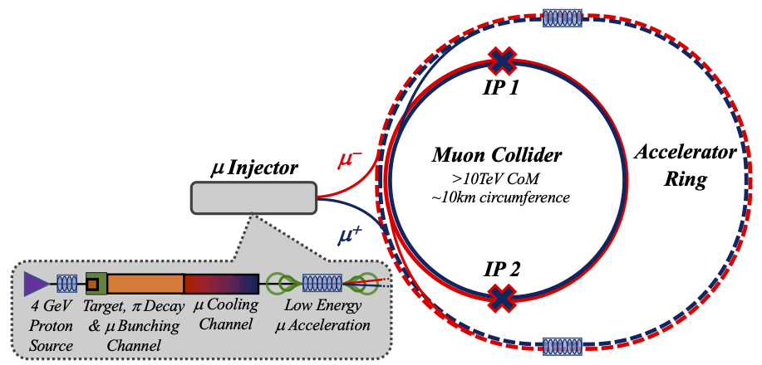
Key Challenges
0) Physics case
4) Drives the beam quality
MAP put much effort in design
optimise as much as possible
2) Beam-induced background
1) Dense neutrino flux
mitigated by mover system and site selection
3) Cost and power consumption limit energy reach
e.g. 35 km accelerator for 10 TeV, 10 km collider ring
Also impacts beam quality
9

Slide 10
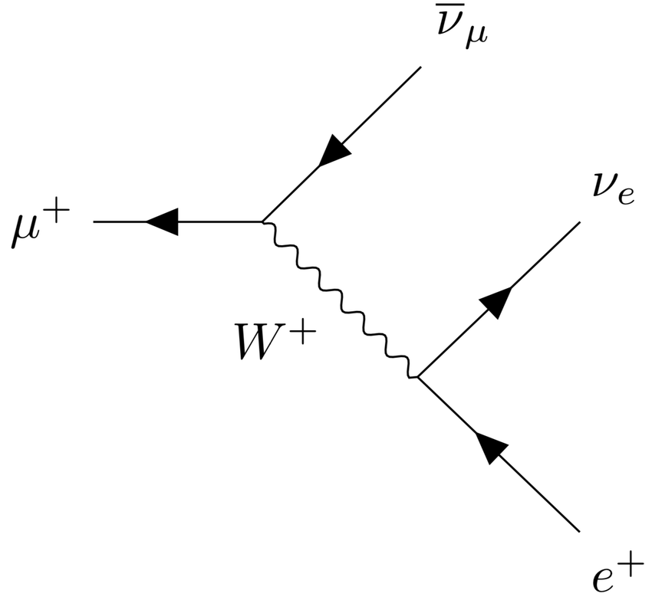
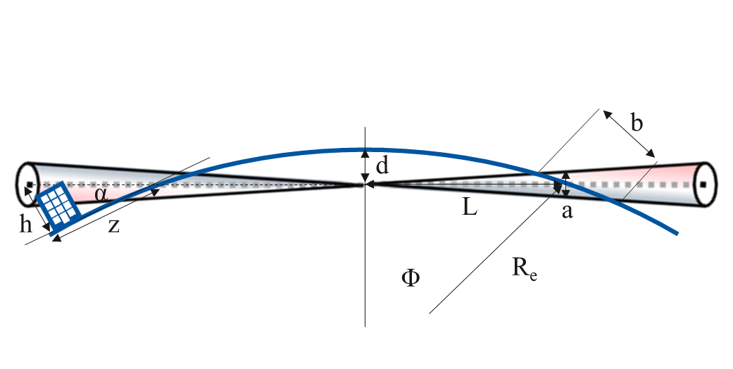
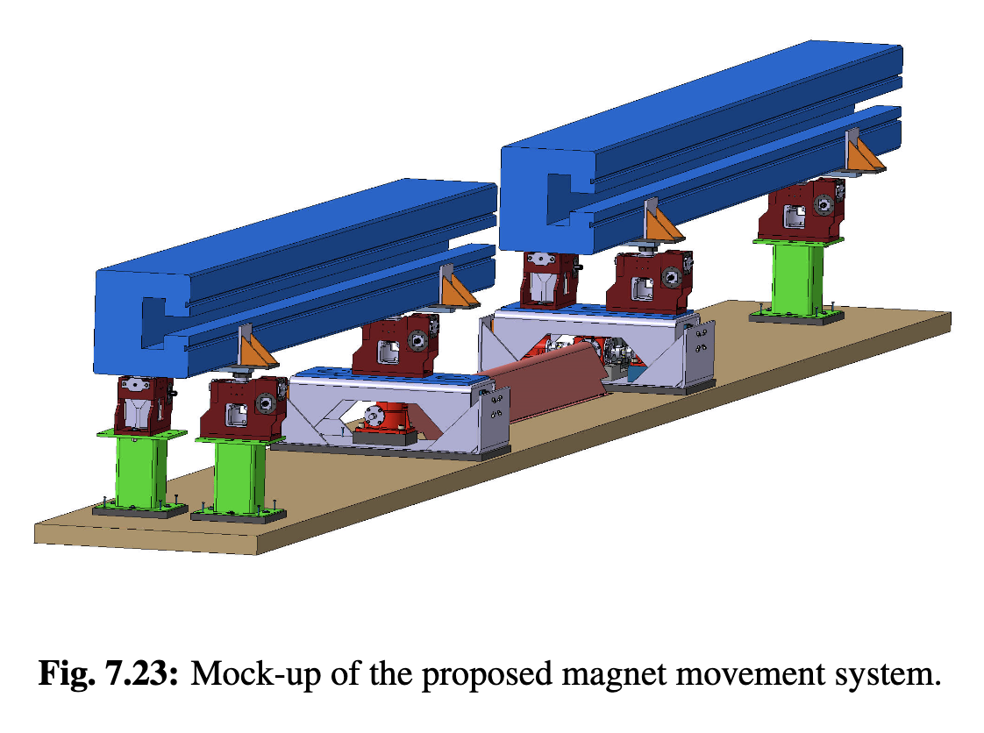
Muon Decay and Neutrino Flux
Muon decays in collider ring
Impact on detector, see Daniele
Have to avoid dense neutrino flux
Daniele, Massimo
Aim for negligible impact from arcs
Similar impact as LHC
At 3 TeV this is the case for 200 m depth
At 10 TeV go from acceptable to negligible with mover system
  Mockup of mover system planned
  Impact on beam to be checked
Impact of experimental insertions
3 TeV design acceptable with no further work
But better acquire land in direction of experiment, also for 10 TeV
t₁
t₂

Slide 11
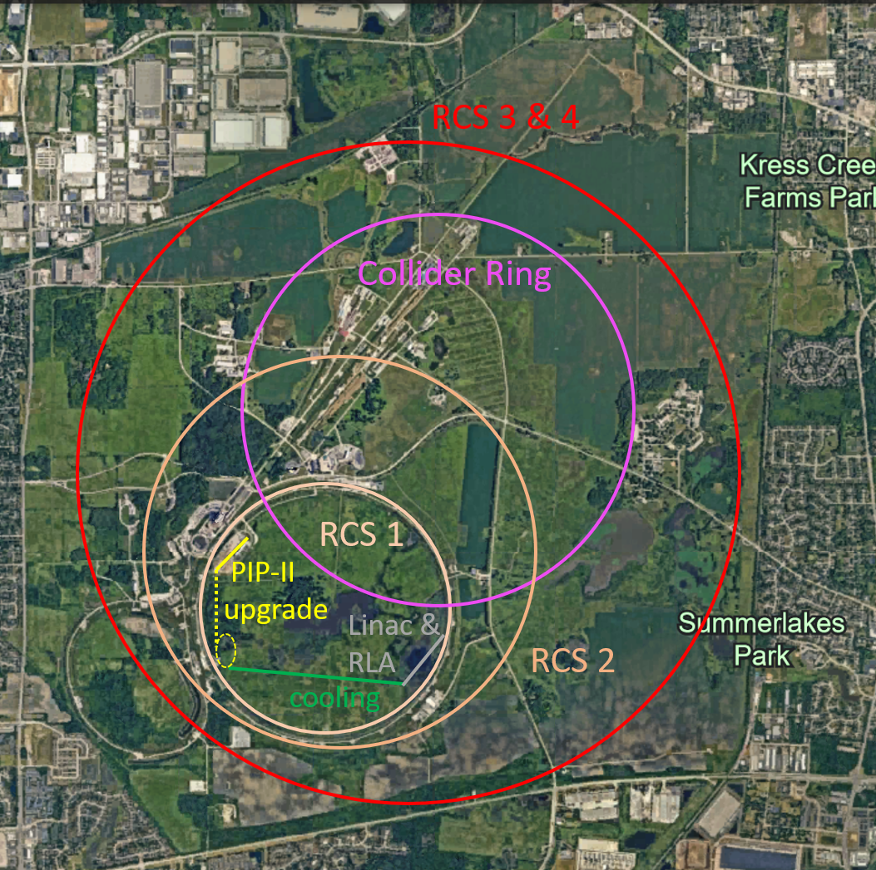
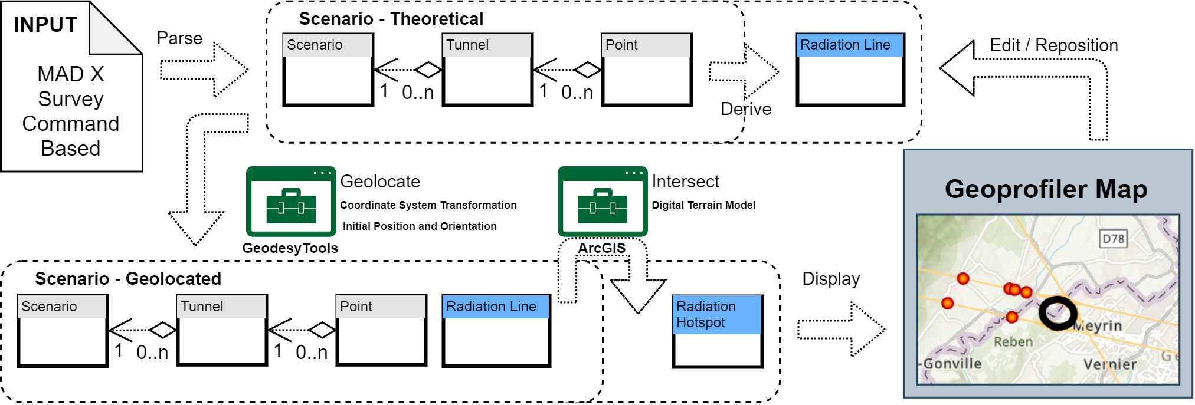
Site Studies
Candidate sites CERN, FNAL, potentially others (ESS, JPARC, … )
Study is mostly site independent
Main benefit is existing infrastructure
Want to avoid time consuming detailed studies and keep collaborative spirit
Will do more later
Some considerations are important
Neutrino flux mitigation at CERN
Accelerator ring fitting on FNAL site
Potential site next to CERN identified
Mitigates neutrino flux
  Points toward mediterranean and uninhabited area in Jura
Detailed studies required (280 m deep)

Slide 12
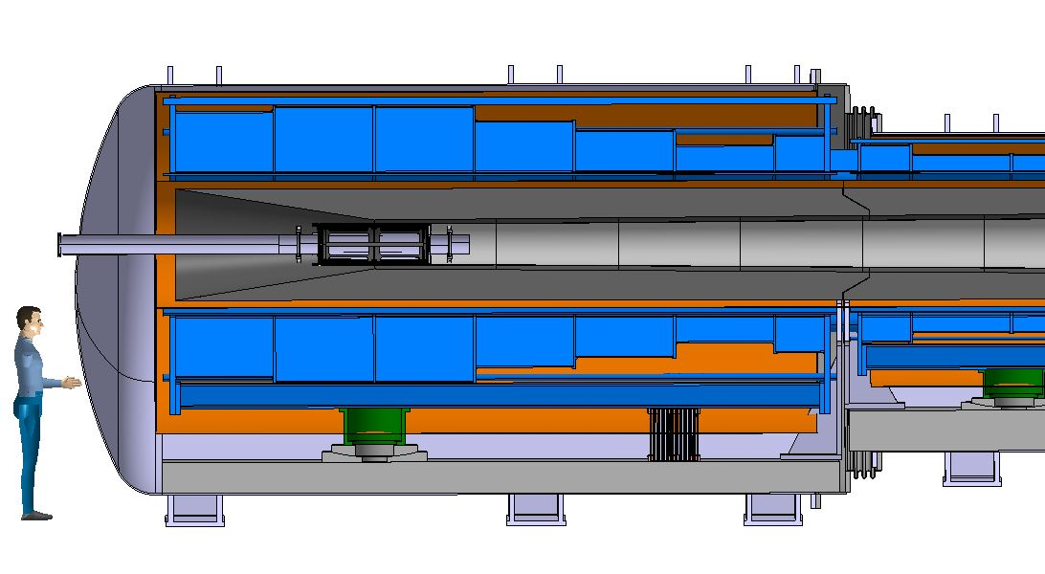
Proton Complex and Target
in target
decay
protons
pions
muons
400 kJ protons to produce 5 x 10¹³ captured muon pairs
5 GeV proton beam, 2 MW = 400 kJ x 5 Hz
Power is at hand
ESS and Uppsala are woring on merging beam into high-charge pulses
Indication is that 10 GeV would be preferred
Graphite Target
20 T solenoid
to guide pions and muons
Tunsten shielding
To protect magnet

Slide 13
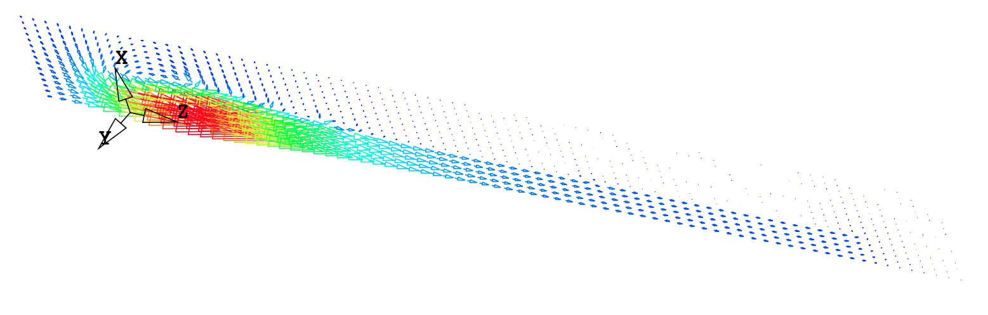
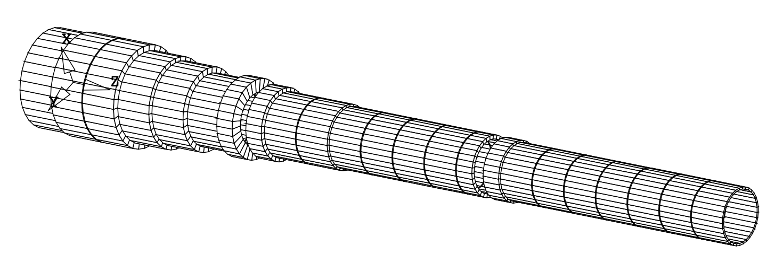
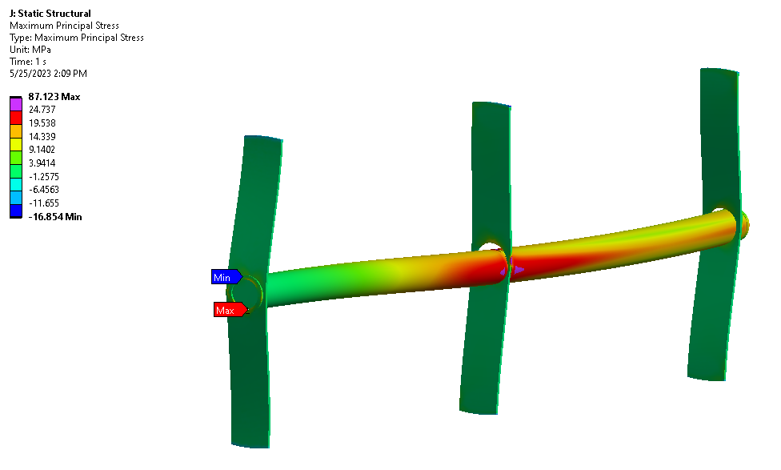
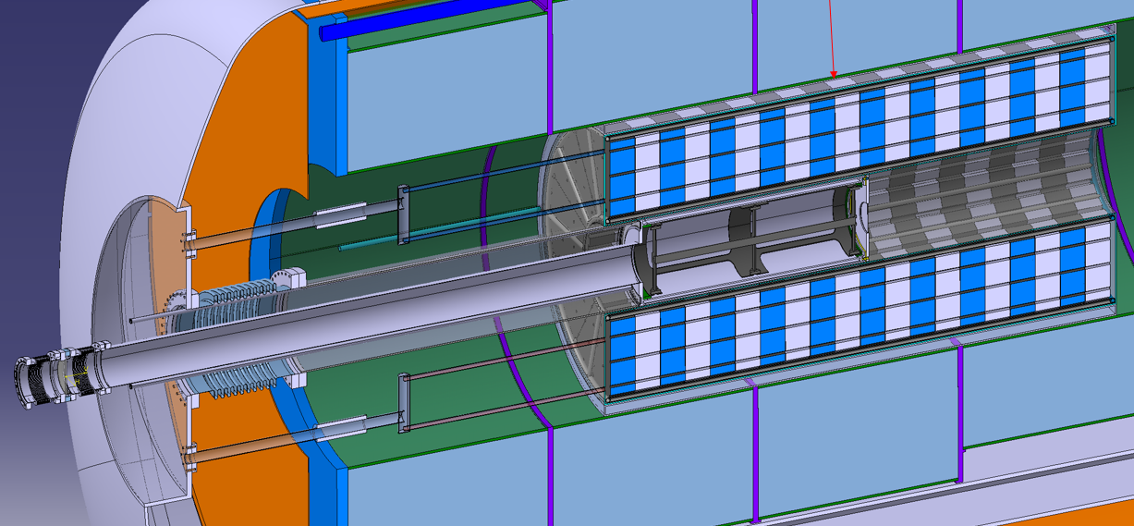
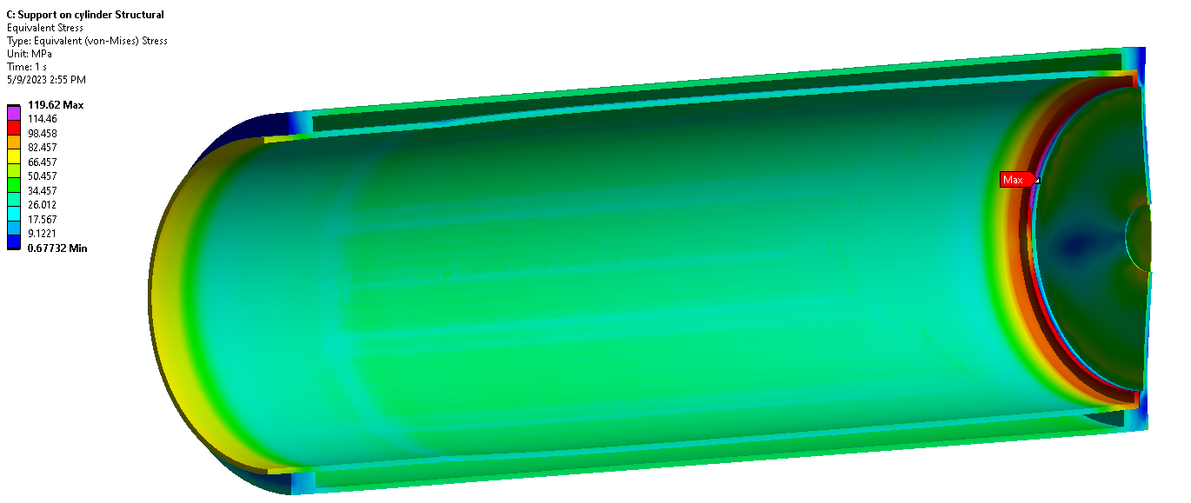
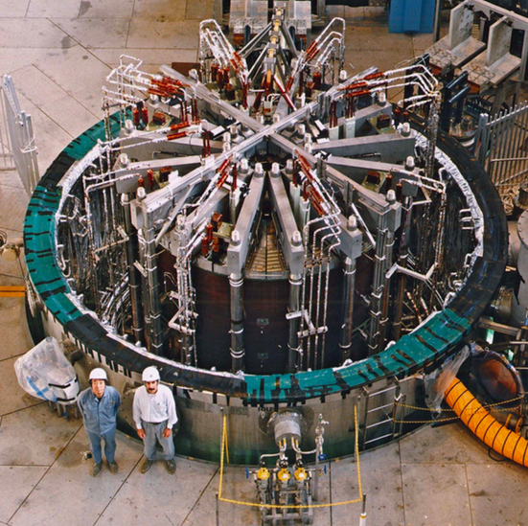
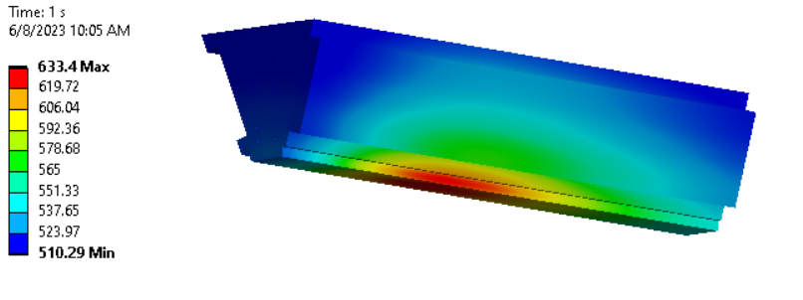
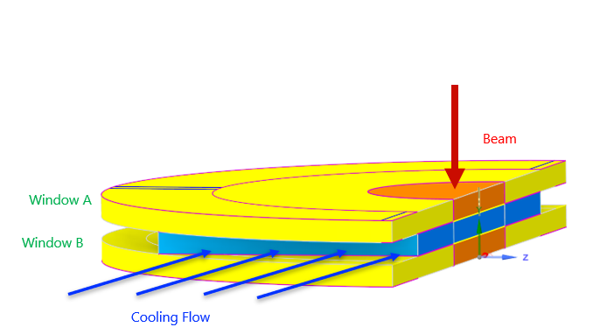
Target Technologies
Target solenoid design ongoing
Either large bore 20 T HTS or 15 T LTS with 5 T insert
FLUKA studies:
2 MW target: stress in target, shielding, vessel OK
Need to have closer look at window
Cooling OK
Integration
Target
HTS target solenoid: 20 T, 20 K
A Portone, P. Testoni,
J. Lorenzo Gomez, F4E
Our work is relevant for fusion
Vessel
Cooling, vacuum, mechanics, …
Liquid metal target
Serious alternative to graphite
Tunsten shielding
Window
ITER model coil: 13 T Nb₃Sn 1.7 m diameter
13
A. Lechner, D. et al.

Slide 14
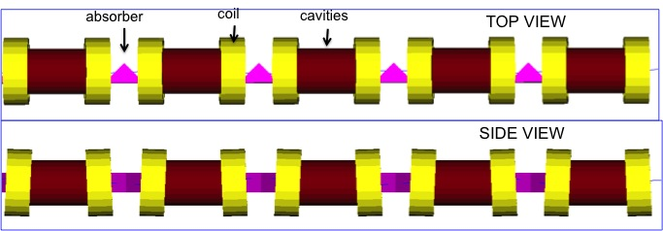
Muon Cooling Principle
High-gradient normal-conducting cavities
C. Rogers, B. Stechauner, E. Fol et al. (RAL, CERN)
Robust absorbers
High-field, superconducting solenoid
Principle has been demonstrated in MICE
Nature vol. 578, p. 53-59 (2020)

Slide 15
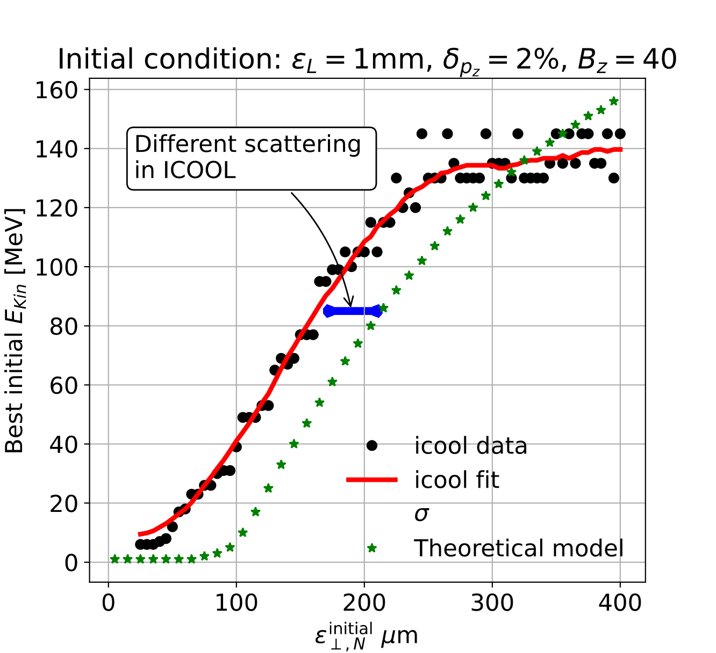
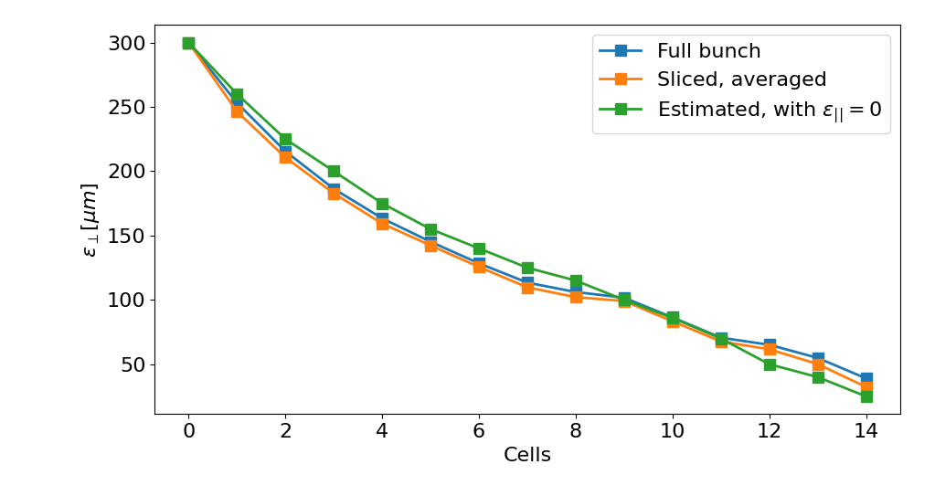
Muon Cooling Performance
MAP design achieved 55 um based on achieved fields
Can expect better hardware
Integrating physics into RFTRACK, a CERN simulation code with single-particle tracking, collective effects, …
A. Latina, E. Fol, B. Stechauner at al.
Working on improved, systematic design, also using better magnets and RF
Currently improved from 55 um to 33 um,
25 um is the goal
Ch. Rogers, Zhu Ruihu, R. Taylor, B. Stechauner, E. Vol et al.

Slide 16
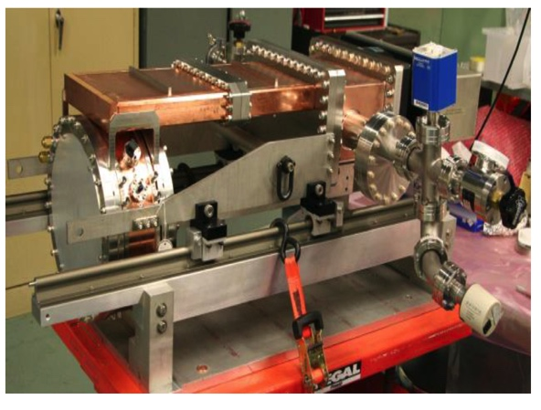
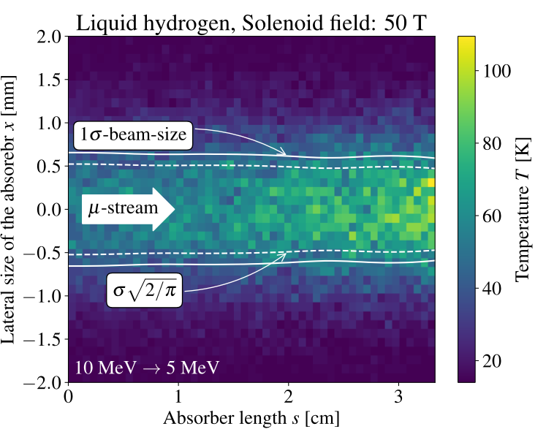
Cooling Cell Technologies
Most complex example 12 T
Are developing example cooling cell with integration
tight constraints
additional technologies (absorbers, instrumentation,…)
early preparation of demonstrator facility
Marco
HTS solenoids
Ultimate field for final cooling
Also consider cost
Windows and absorbers
High-density muon beam
Pressure rise mitigated by vacuum density
First tests in HiRadMat
L. Rossi et al. (INFN, Milano, STFC, CERN),
J. Ferreira Somoza et al.
RF cavities in magnetic field
Gradients above goal demonstrated by MAP
New test stand is important
Optimise and develop the RF
Different options are being explored
Need funding
MuCool demonstrated >50 MV/m in 5 T
H2-filled copper
Be end caps
Dario
D. Giove, C. Marchand, Alexej Grudiev et al. (Milano, CEA, CERN, Tartu)
16

Slide 17
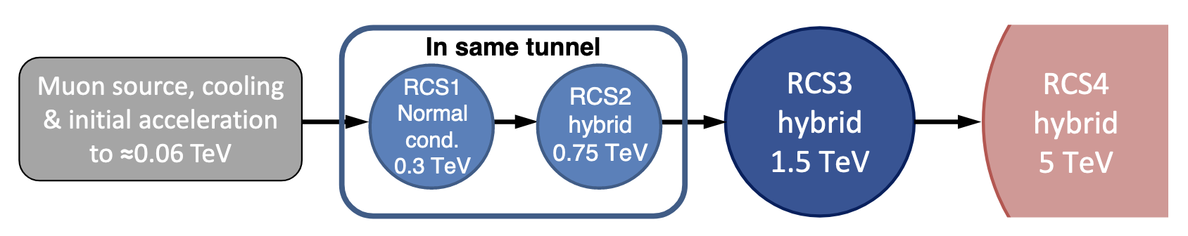
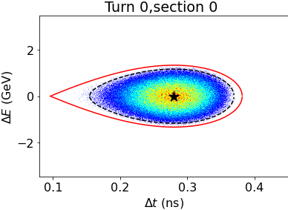
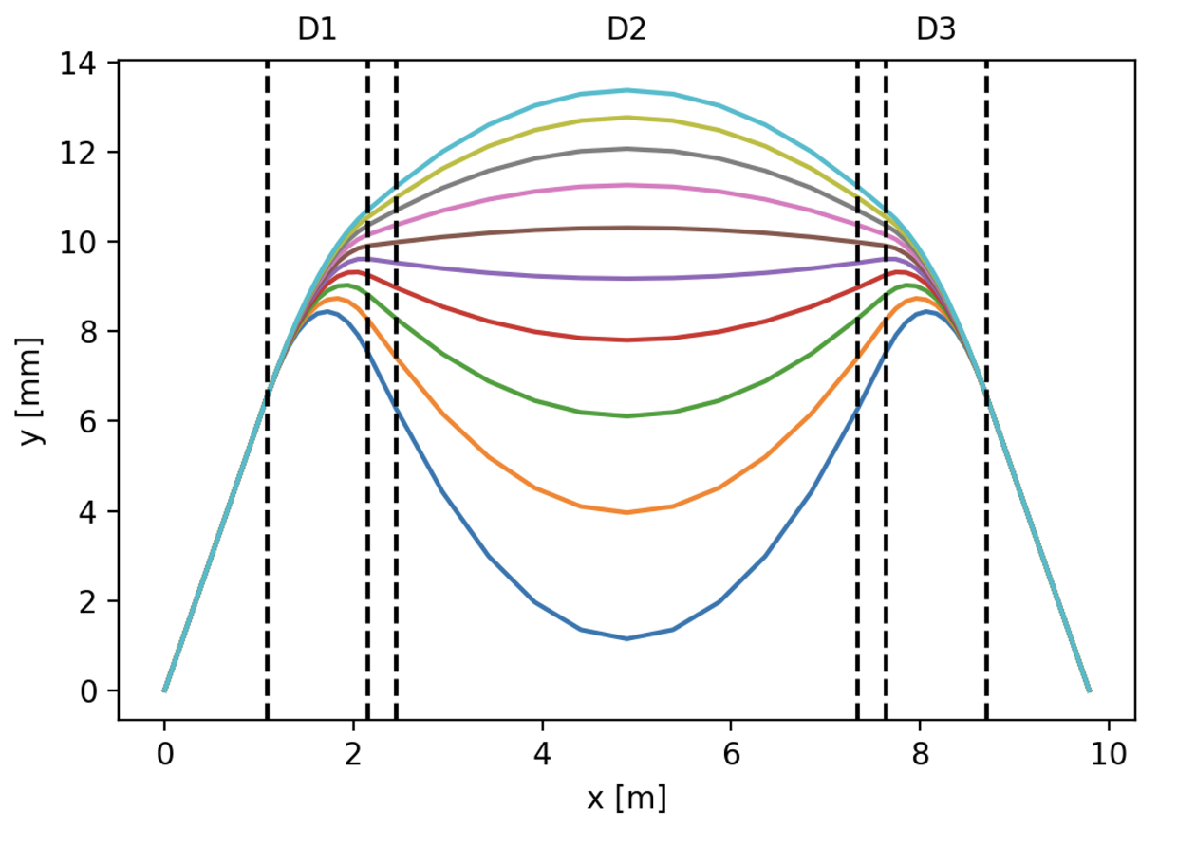
Acceleration Complex
Core is sequence of pulsed synchrotron (0.4-11 ms)
Alternative FFA
Long. Distribution assumed at injection in RCS1
Superconducting magnets
EMMA proof of FFA principle
Nature Physics 8, 243–247 (2012)
RF:
1.3 GHz cavities appear possible
in spite of high bunch charge
Lattice and integration: A. Chance et al. (CEA)
Long. dynamics and RF systems: H. Damerell, U. van Rienen, A. Grudiev et al. (Rostock, Milano, CERN)
Power converter: F. Boattini et al.
Magnets: L. Bottura et al. (LNCMI, Darmstadt, Bologna, Twente)
FFA: S. Machida et al. (RAL)
Lattice:
Hybrid design works
Can spread RF in the arcs
Fast-ramping magnets
17

Slide 18
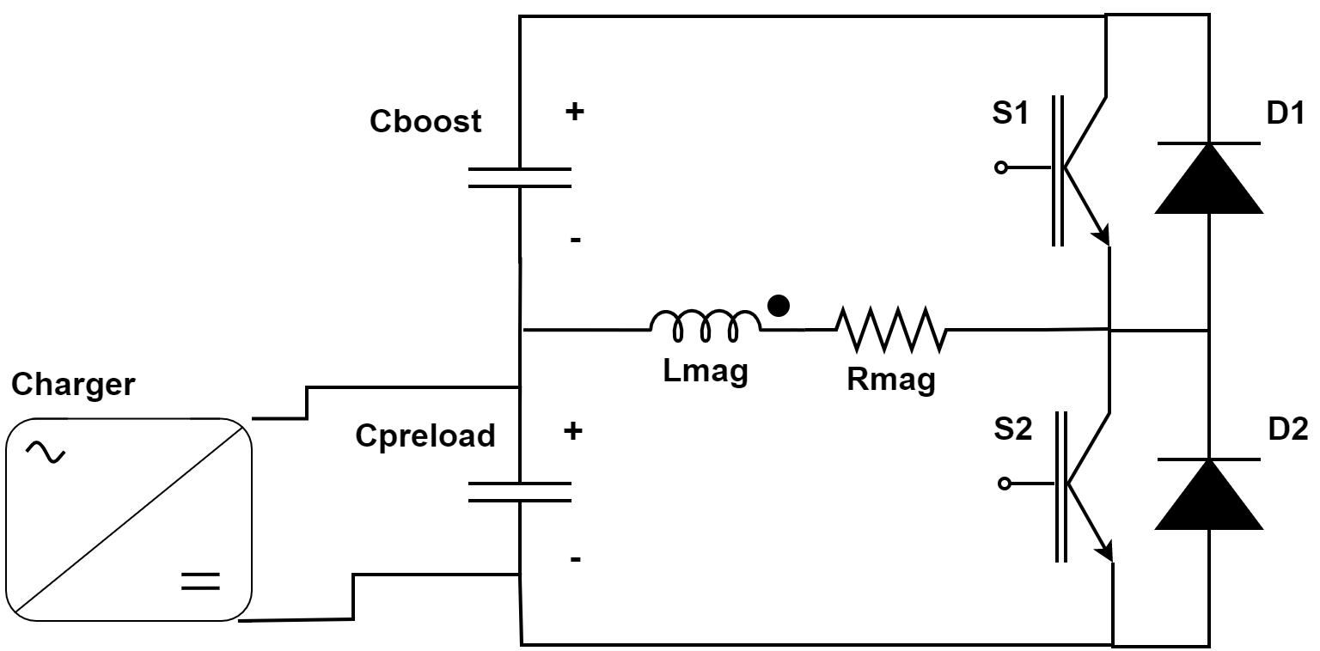
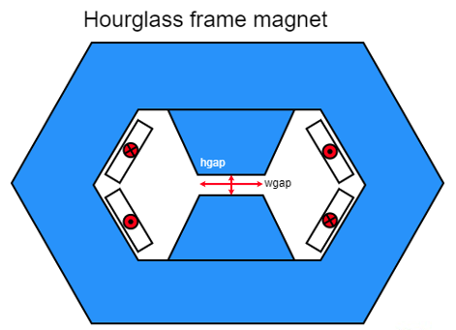
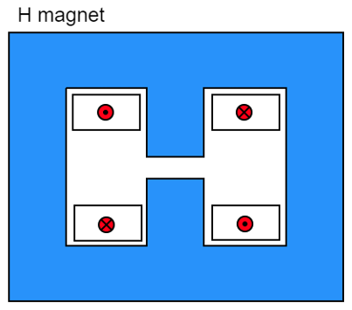
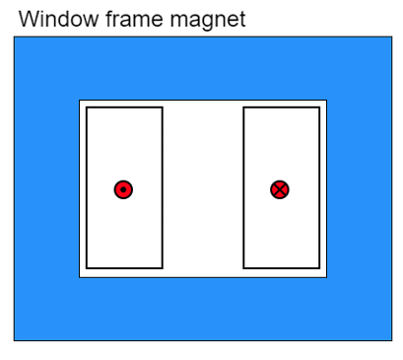
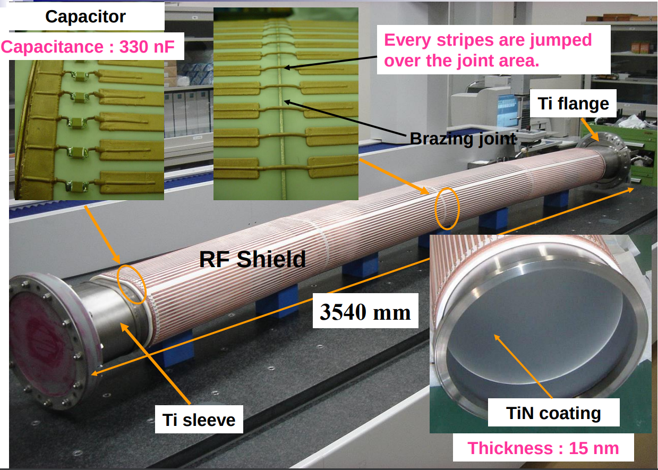
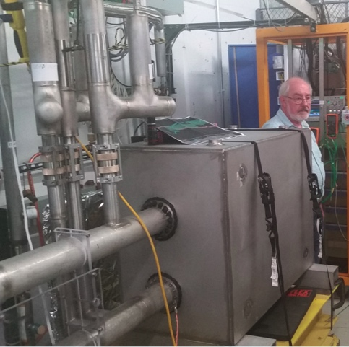
Fast-ramping Magnet System
Differerent power converter options investigated
Efficient energy recovery for resistive dipoles (O(100MJ))
Synchronisation of magnets and RF for power and cost
Commutated resonance (novel)
Attractive new option
Better control
Much less capacitors
5.07 kJ/m
5.65…7.14 kJ/m
5.89 kJ/m
Beampipe study
Eddy currents vs impedance
Maybe ceramic chamber with stripes
Could consider using HTS dipoles for largest ring
Simple HTS racetrack dipole could match the beam requirements and aperture for static magnets
FNAL 300 T/s HTS magnet
F. Boattini et al.

Slide 19
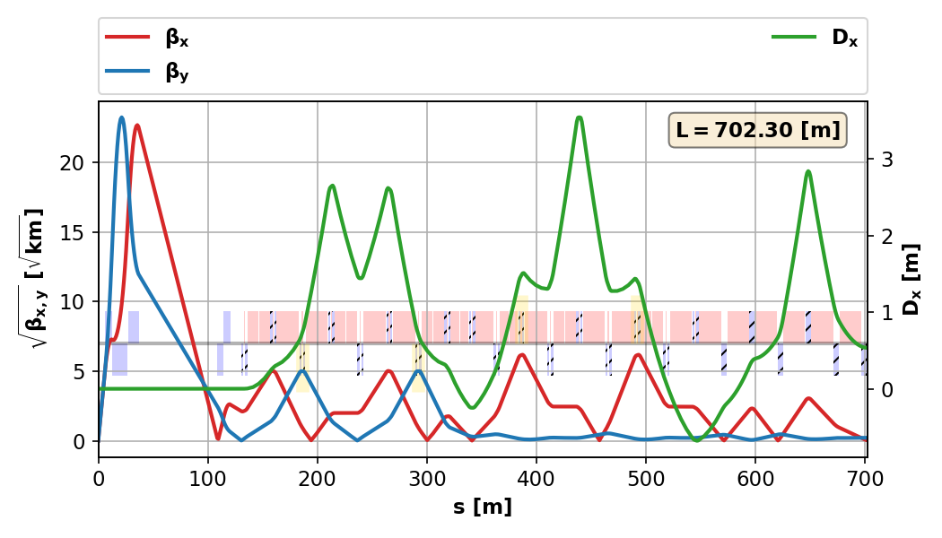
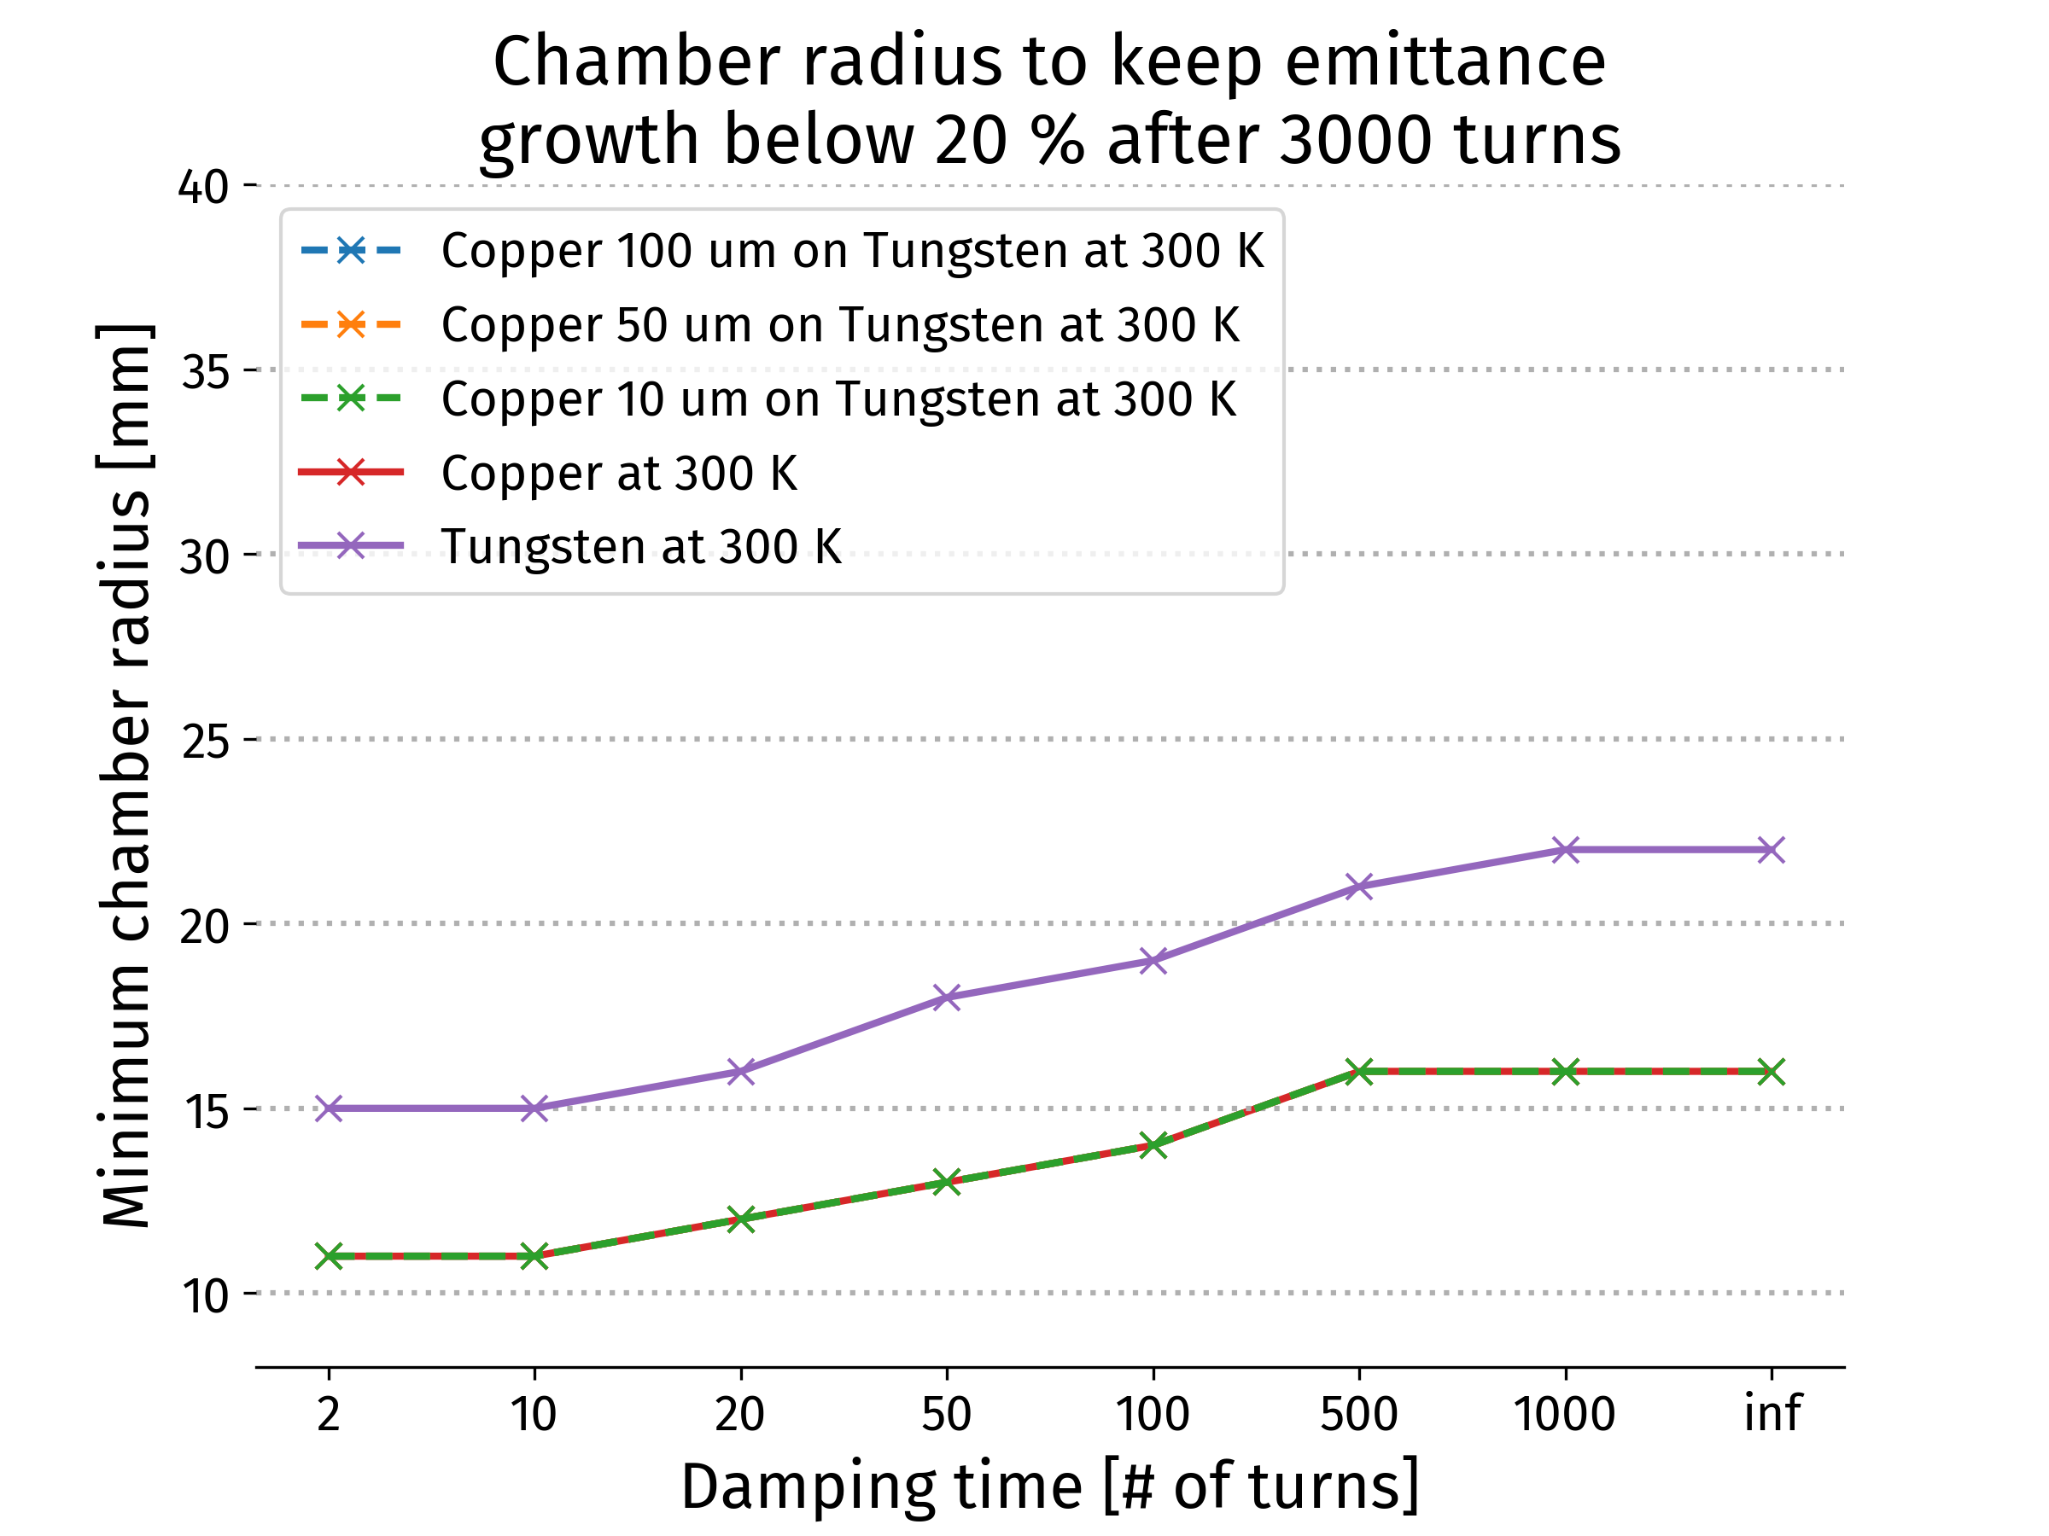
Collider Ring
High performance 10 TeV challenges:
Very small beta-function (1.5 mm)
Large energy spread (0.1%)
Maintain short bunches
3 TeV:
MAP developed 4.5 km ring with Nb₃Sn
magnet specifications in the HL-LHC range
5 mm beta-function
10 TeV collider ring in progress:
around 16 T HTS dipoles or lower Nb₃Sn
final focus based on HTS
Need to further improve the energy acceptance by small factor
E. Metral, D Amorim et al. (CERN)
Impedance studies
Single beam instability limits OK with
conservative feedback
K. Skoufaris, Ch. Carli, support from P. Raimondi, K. Oide, R. Tomas

Slide 20
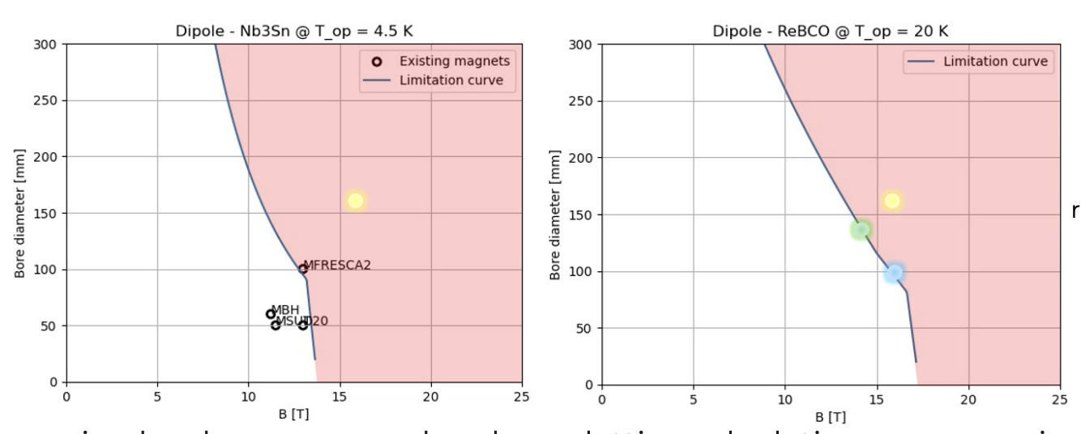
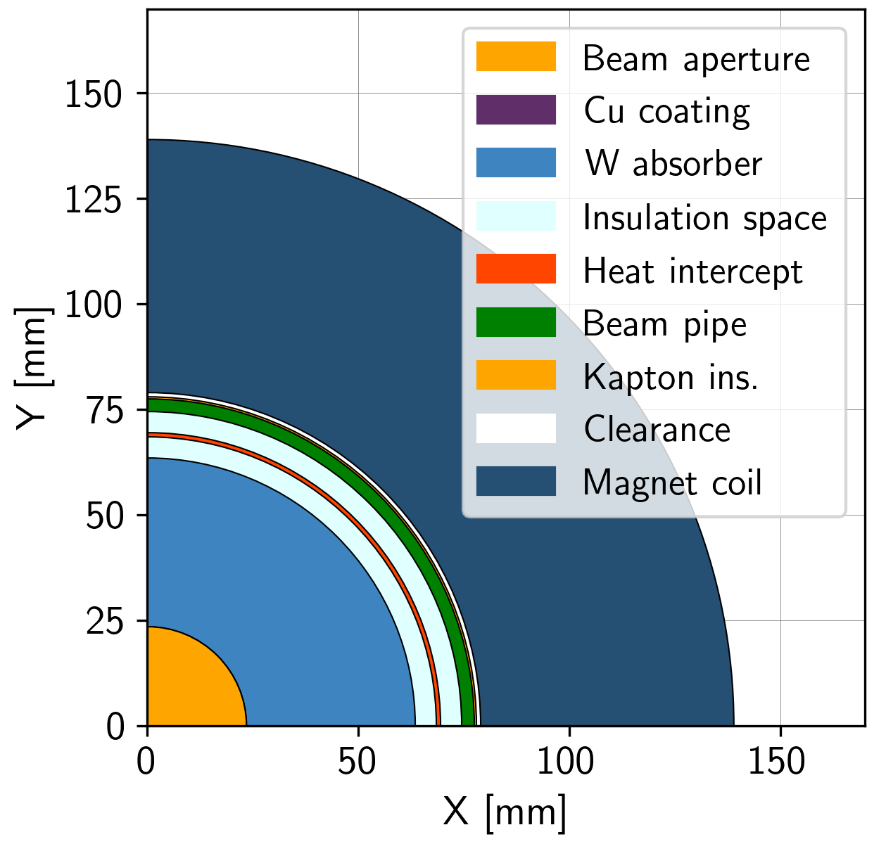
Collider Ring Technologies
D. Novelli,
L. Bottura et al.
Power loss due to muon decay 500 W/m
FLUKA simulation of required shielding:
20-40 mm tungesten shielding (about OK-safe)
Few W/m in magnets
No problem with radiation dose
Magnet coil radius 59-79 mm
Study of magnet limitations (stress, loadline, cost, …)
Possible at higher cost/lower temperature
3 TeV/early 10 TeV design
Coil
High luminosity 10 TeV design range
Nb3Sn at 4.5 K and 15 cm aperture
Can reach ~11 T, stress and margin limited
Maturity expected in 15 years
OK for current 3 TeV/early 10 TeV design
HTS at 20 K and 10-14 cm aperture
Can reach 16-14 T, cost limited
Factor 3 cost reduction assumed
Can reach 16 T and 16 cm with more material or lower temperature
Maturity takes likely >15 years
But maybe OK in 15 years at lower performance, similar to Nb3Sn
Different cooling scenarios studied
< 25 MW power for cooling possible
Shield with CO₂ at 250 K (preferred) or water
Support of shield is important for heat transfer
Discussion on options for magnet cooling
Shielding
K. Skoufaris, Ch. Carli, D. Amorim, A. Lechner, R. Van Weelderen, P. De Sousa, L. Bottura, D. Calzolari et al.

Slide 21
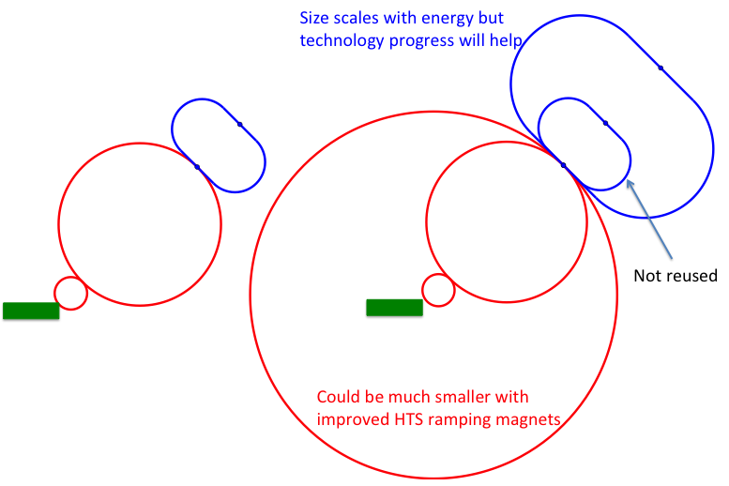
Staging
Important timeline drivers:
Magnets
HTS technology available for solenoids (expect in 15 years)
Nb₃Sn available for collider ring, maybe lower performance HTS (expect in 15 years)
High performance HTS available for collider ring (may take more than 15 years)
Muon cooling technology (expect in 15 years, with enough resources)
Detector technologies and design (expect in 15 years))
Marco
Dario
Daniele, Massimo
Energy staging
Start at lower energy (e.g. 3 TeV, design takes lower performance into account)
Luminosity staging
Start at with full energy, but lower luminosity
Main luminosity loss sources are arcs and interaction region
  Can later upgrade interaction region (as in HL-LHC)
Consider reusing LHC tunnel and other infrastructures

Slide 22
Tentative Timeline (Fast-track 10 TeV)
Only a basis to start the discussion, will review this year
Need at least two years of demonstrator operation (better more)
Need RF test stand before
Decision starting in 2036
Estimated10 TeV construction/installation
Different initial estimates for detector
seem to be fast enough
Buit need to develop robust timeline

Slide 23
Short-term Plan
March 2025, deliver promised ESPPU reports
Evaluation report, including tentative cost and power consumption scale estimate
R&D plan, including some scenarios and timelines
This requires to push as hard as possible with existing resources
February 2027, Fulfill EU contract
Final deliverable is report on all R&D
Support expected US process after the ESPPU
Likely requires Reference Design
Demonstrator design
LDG wants to increase the momentum that we built up
EU Roadmap continues
ESPPU submission
ESPPU result
Continuation as attractive option for Europe and for the US

Slide 24
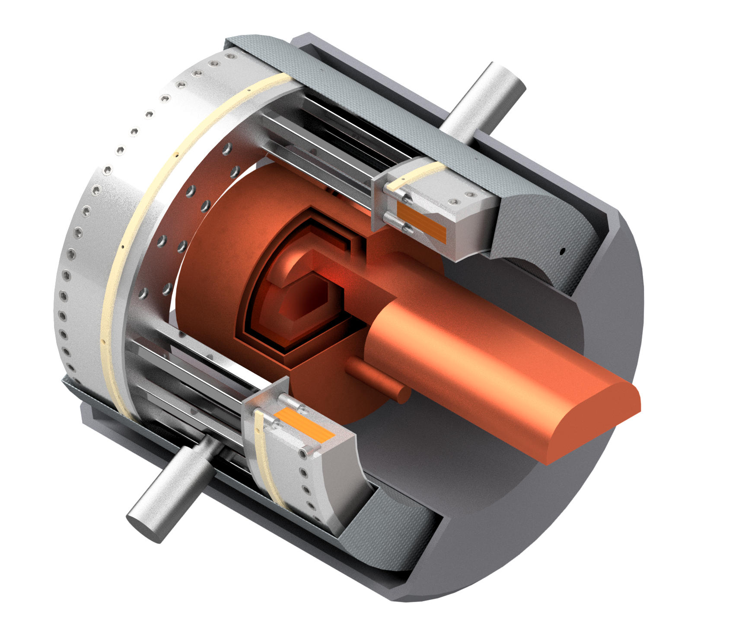
Time-critical Developments
Identified three main technologies that can limit the timeline
Muon cooling technology
RF test stand to test cavities in magnetic field
Muon cooling cell test infrastructure
Demonstrator
  Muon beam production and cooling in several cells
Magnet technology
HTS solenoids
Collider ring magnets with Nb3Sn or HTS
Detector technology and design
Can do the important physics with near-term technology
But available time will allow to improve further and exploit AI, MI and new technologies

Slide 25
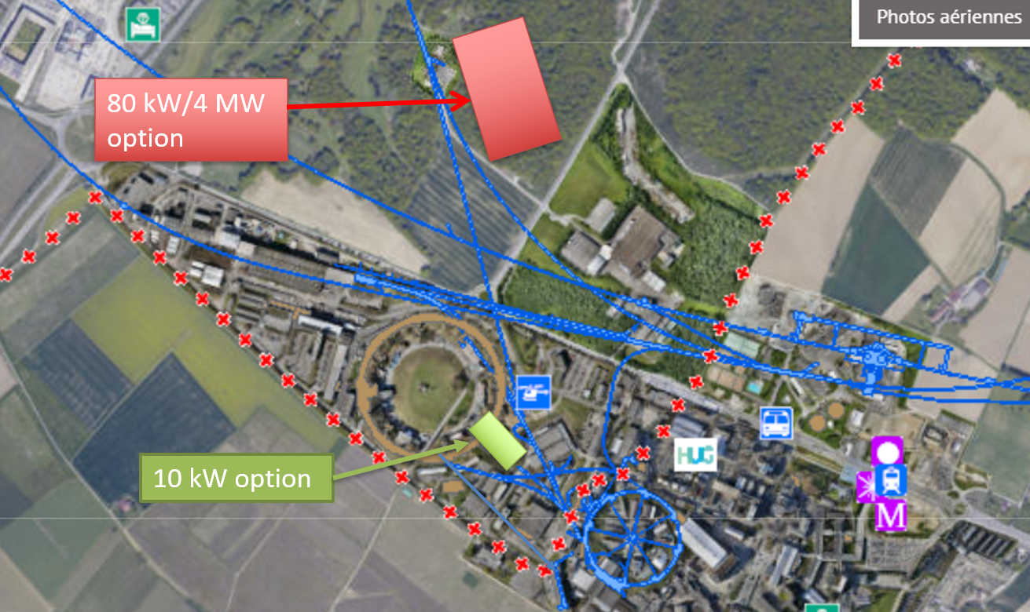
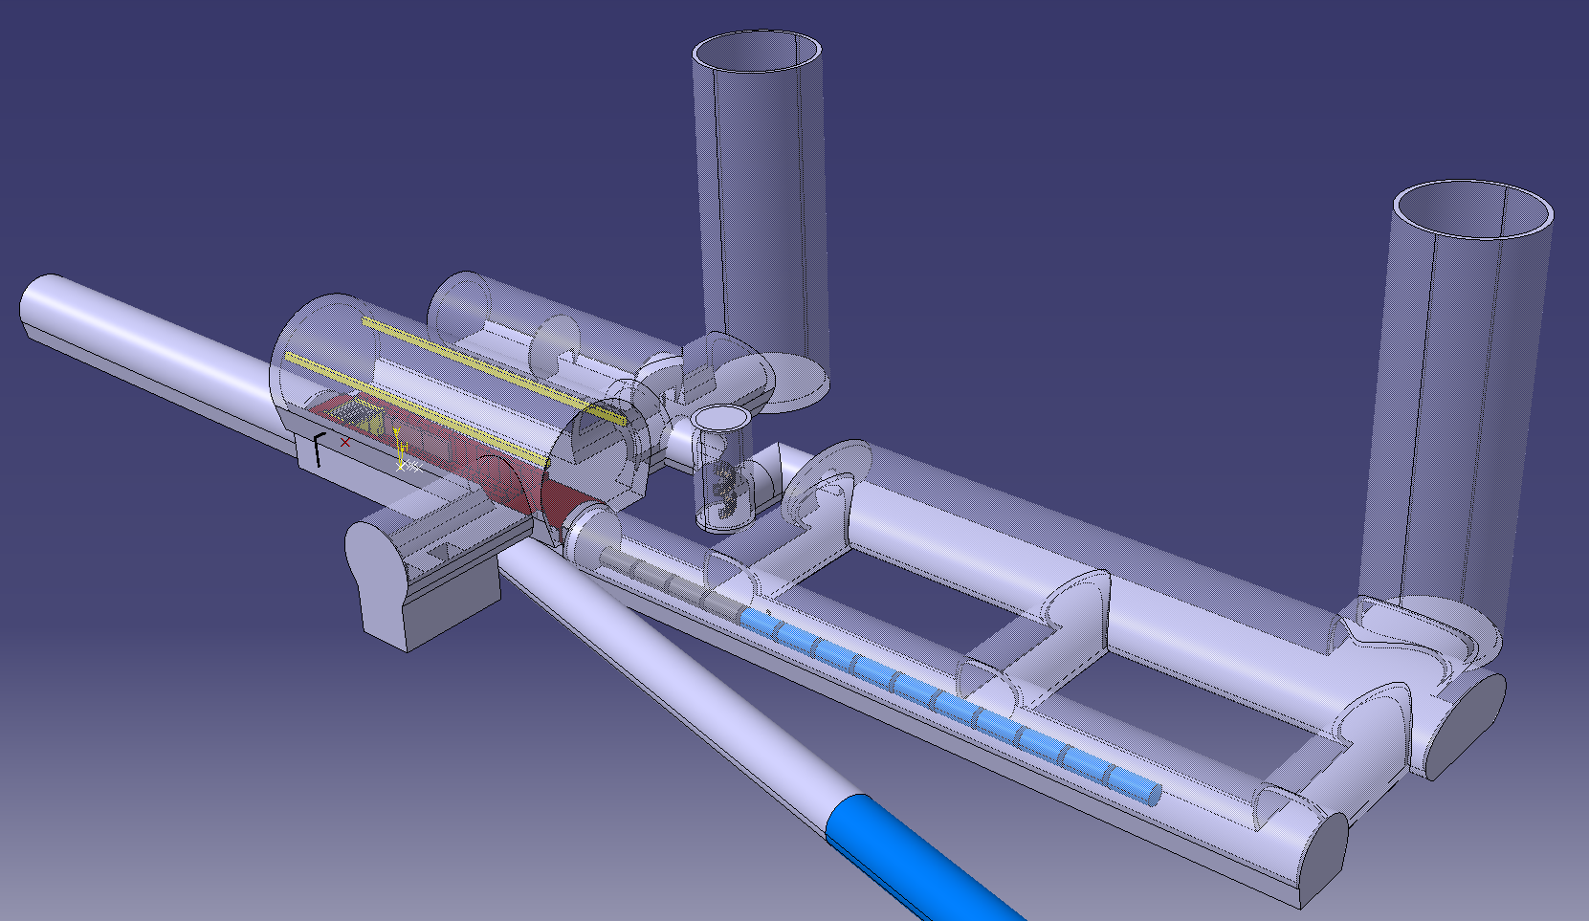
CDR Phase, R&D and Demonstrator Facility
M. Calviani, R. Losito, J. Osborn et al.
Broad R&D programme can be distributed world-wide
Models and prototypes
  Magnets, Target, RF systems, Absorbers, …
CDR development
Integrated tests, also with beam
Cooling demonstrator is a key facility
look for an existing proton beam with significant power
Different sites are being considered
CERN, FNAL, ESS …
Two site options at CERN
Muon cooling module test is important
INFN is driving the work
Could test it at CERN with proton beam
Two stage cryocooler
With cryostat
Thermal shield
Coil support structure
Tie rods for repulsion and compression forces
SC HTS coils

Slide 26
Synergies and Outreach
Training of young people
Novel concept is particularly challenging and motivating for them
Technologies
Muon collider needs HTS, in particular solenoids
Fusion reactors
Power generators
Nuclear Magnetic Resonance (NMR)
Magnetic Resonance Imaging (MRI)
Magnets for other uses (neutron spectroscopy, detector solenoids, hadron collider magnets)
Target is synergetic with neutron spallation sources, in particular liquid metal target (also FCC-ee)
High-efficiency RF power sources and power converter
RF in magnetic field can be relevant for some fusion reactors
High-power proton facility
Facilities such as NuStorm, mu2e, COMET, highly polarized low-energy muon beams
Detector technologies
AI and MI
Physics
26

Slide 27
Conclusion
Muon collider has a compelling physics case
R&D progress is increasing confidence that the collider is a unique, sustainable path to the future
We expect that a first collider stage can be operational by 2050
If the resources ramp up sufficiently
If decision-making processes are efficient
The muon collider collaboration has grown since the last ESPPU
See it will grow even more
Strong synergies with other fields ranging from particle physics to societal application
Need to continue ramping up the momentum
Many thanks to the collaboration for all the work
To join contact muon.collider.secretariat@cern.ch

Slide 28
Reserve

Slide 29
Recent Results: Interim Report
IAC regular members:
Ursula Bassler (IN2P3, interim Chair)
Mauro Mezzetto (INFN)
Hongwei Zhao (Inst. of Modern Physics, IMP)
Akira Yamamoto (KEK)
Maurizio Vretenar (CERN)
Stewart Boogert (Cockcroft)
Sarah Demers (Yale)
Giorgio Apollinari (FNAL)
Experts for this review
Marica Biagini (INFN)
Luis Tabarez (CIEMAT)
Giovanni Bisoffi (INFN)
Jenny List (DESY)
Halina Abramowicz (Tel Aviv)
Lyn Evans (CERN)
The IAC reviewed the Interim Report and prepared an excellent report on their findings

Slide 30

Proposal: EuMAHTS
Luca Botture et al.
Submitted to INFRA-2024-TECH-01-01
Short name | Country | Status
CERN | IERO | B
EMFL | Belgium | B
TAU | Finland | B
CEA | France | B
ESRF | France | B
EUXFEL | Germany | B
GSI | Germany | B
KIT | Germany | B
INFN | Italy | B
UMIL | Italy | B
UTWENTE | Netherlands | B
IFJ-PAN | Poland | B
PK | Poland | B
CIEMAT | Spain | B
CSIC | Spain | B
PSI | Switzerland | A
TERA-CARE | Switzerland | A
UNIGE | Switzerland | A
CNRS | France | A
HZDR | Germany | A
RU-NWO | Netherlands | A
Focus on HTS development
O(10 Meur) request
WP9 – Test Infrastructures
(G. Willering, E. Beneduce)
WP6 – 40T-class all-HTS solenoid
(B. Bordini, P. Vedrine)
WP5 – Materials and Technologies
(D. Bocjan, A. Bersani)
WP2 – Strategic Roadmap
(A. Ballarino, L. Rossi)
WP1 - Coordination and Communication
(L. Bottura, P. Vedrine)
WP4 – HTS Magnets Applications Studies
(P. Vedrine, M. Statera)
WP3 – Industry Co-innovation
(J.M. Perez, S. Leray)
WP7 – 10T/10MJ-class all-HTS solenoid
(S. Sorti, C. Santini)
WP8 – K=2 all-HTS undulator
(S. Casalbuoni, M. Calvi)
Strategy and context
Material and technology
Three core components (6 MEUR)
40 T solenoid, 50 mm bore
10 T/10 MJ/300 mm solenoid
HTS undulator
Test infrastructure

Slide 31
IMCC Organisation
Collaboration Board (ICB)
Elected chair: Nadia Pastrone
50 full members, 60+ total
Steering Board (ISB)
Chair Steinar Stapnes
CERN members: Mike Lamont, Gianluigi Arduini
ICB members: Dave Newbold (STFC), Mats Lindroos (ESS), Pierre Vedrine (CEA), N. Pastrone (INFN), Beate Heinemann (DESY)
Study members: SL and deputies
Advisory Committee
Coordination committee (CC)
Study Leader: Daniel Schulte
Deputies: Andrea Wulzer, Donatella Lucchesi, Chris Rogers
Will integrated the US also in the leadership

Slide 32
Magnet Roadmap
Assume: Need prototype of magnets by decision process
Consensus of experts (review panel):
Anticipate technology to be mature in O(15 years):
  HTS solenoids in muon production target, 6D cooling and final cooling
    HTS tape can be applied more easily in solenoids
    Strong synergy with society, e.g. fusion reactors
  Nb₃Sn 11 T magnets for collider ring (or HTS if available): 150mm aperture, 4K
This corresponds to 3 TeV design
Could build 10 TeV with reduced luminosity performance
  Can recover some but not all luminosity later
Operation start
2036+2037 decision process
Still under discussion:
Timescale for 10 TeV HTS/hybrid collider ring magnets
For second stage can use HTS or hybrid collider ring magnets
Strategy:
HTS solenoids
Nb₃Sn accelerator magnets
HTS accelerator magnets
Seems technically good for any future project

Slide 33
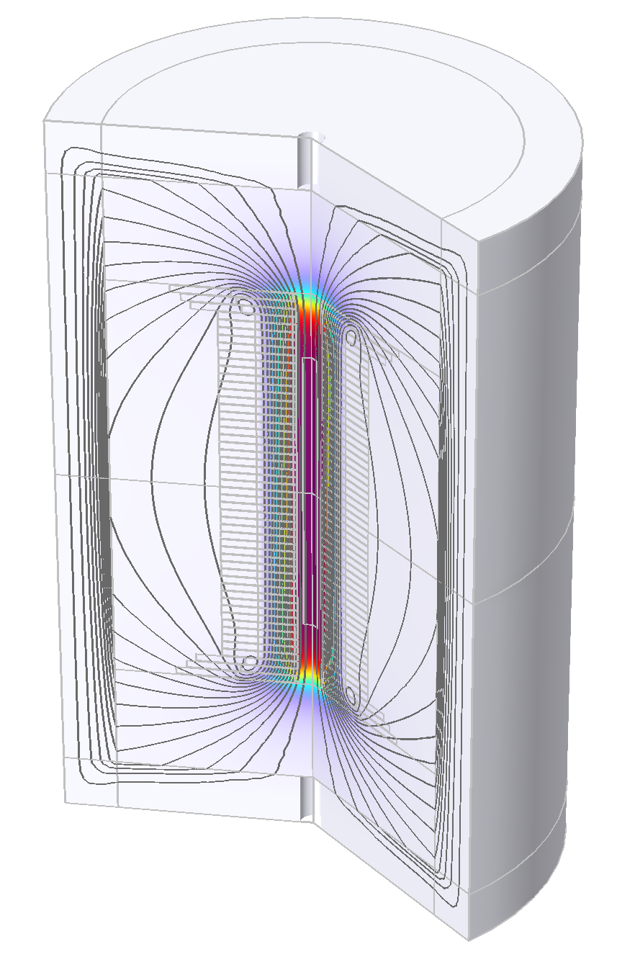
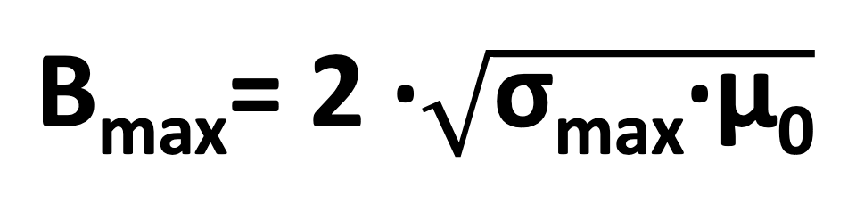
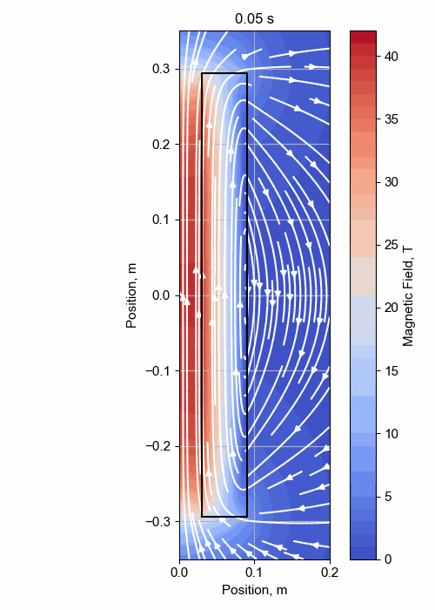

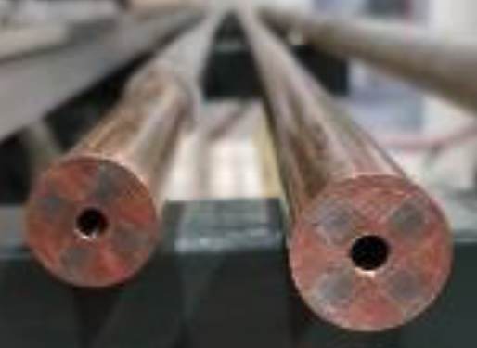
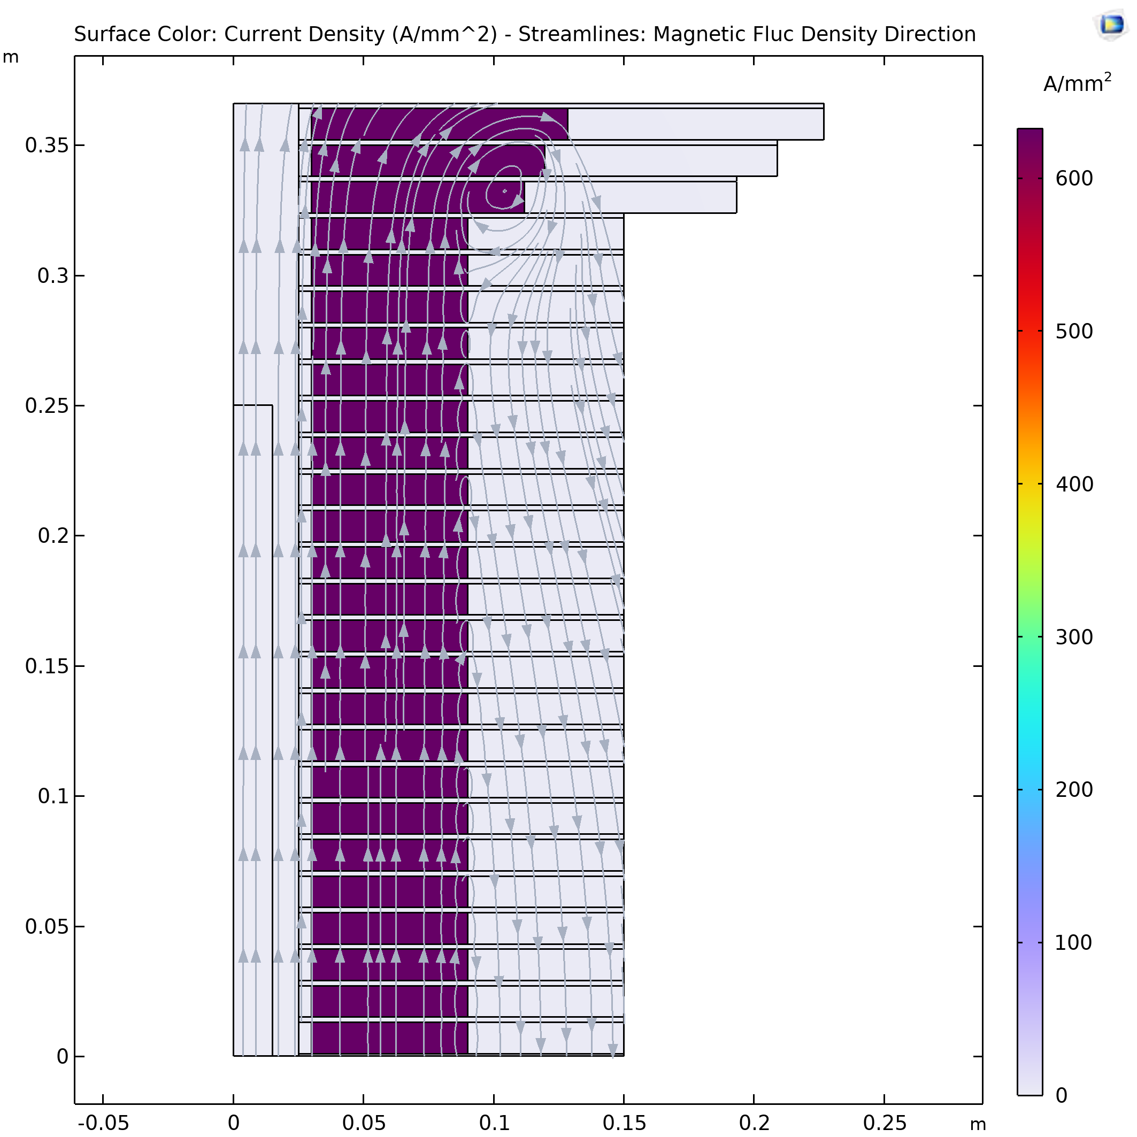
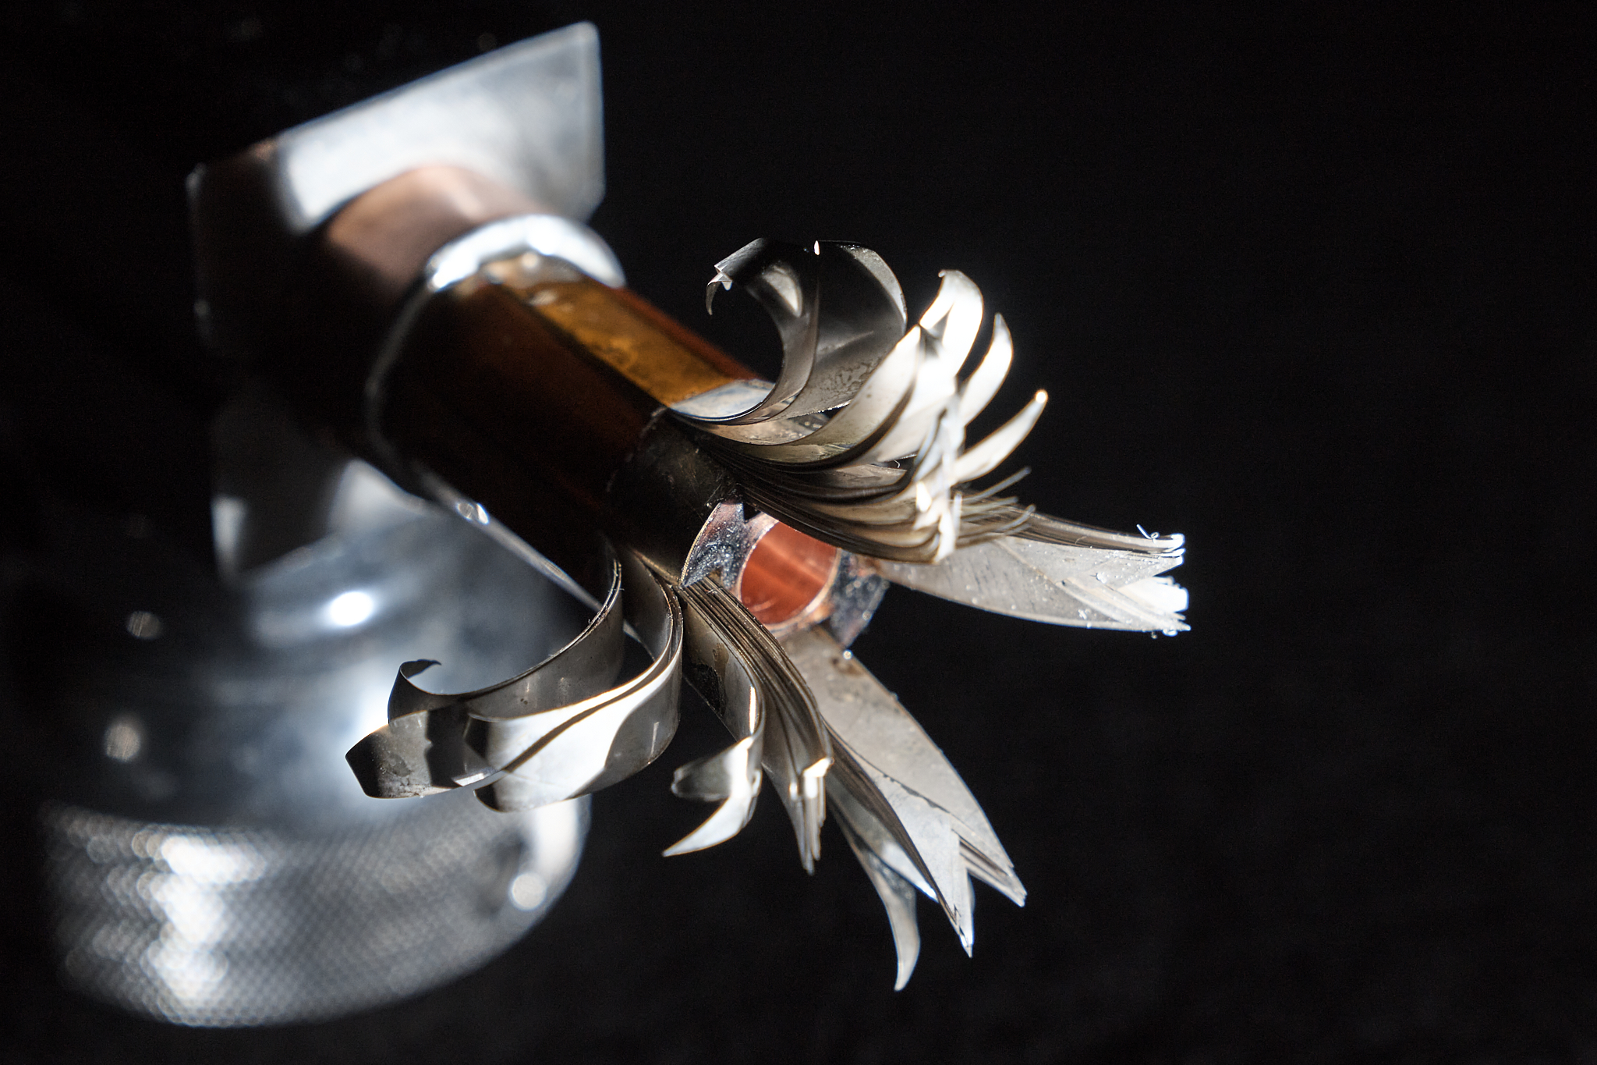
Solenoid R&D
Final Cooling solenoid
Started HTS solenoid development for high fields
Synergies with fusion reactors, NRI, power generators for windmills, …
A Portone, P. Testoni, J. Lorenzo Gomez, F4E
σ_{max} = 600 MPa
32 T LTS/HTS solenoid demonstrated
A. Dudarev, B. Bordini, T. Mulder, S. Fabbri
MIT “VIPER” conductor
Inner Ring
‘Correction’ Coil
Outer Ring
Bore
NHFML
32 T solenoid with HTS
‘Modular’ Coil
MuCol HTS conductor
Operating current: 61 kA
Target solenoid, 20 T, 20 K
1 % Field Homogeneity
Support Plate

Slide 34
Staging
Important timeline drivers:
Magnets:
In O(15 years):
  HTS technology available for solenoids
  Nb₃Sn available for collider ring, maybe lower performance HTS
In O(25 years):
  HTS available for collider ring
Muon cooling technologies and integration
Expect to be able with enough resources
Detector technologies and design
Can do the important physics with near-term technology
Energy staging
Start at lower energy (e.g. 3 TeV)
Build additional accelerator and collider ring later
3 TeV design takes lower performance into account
Luminosity staging
Start at with full energy, but less luminosity collider ring magnets
Main luminosity loss sources are arcs and interaction region
  Can later upgrade interaction region (as in HL-LHC)

