Slide 1


Short term Upgrades
2nd Beam Line
W. Farabolini on behalf of the CLEAR team:
R. Corsini – A. Aksoy – A. Malyzhenkov – P. Korysko – V. Rieker – L. Wroe – D. Gamba
E. Granados – M. Calderon – R. Rossel (Laser and Photocathode experts)
S. Doebert - S. Curt – A. Chauchet (RF experts)
K. Sjobaek (remotely from Oslo)

Slide 2
Motivations
CLEAR SCIENTIFIC BOARD REPORT 8/3/24
Near-term through 2025
Near-term improvements to the CLEAR facility include the introduction of a second beamline. This addition enables the creation of more areas for in-air and in-vacuum testing, reducing the need for frequent mounting and dismounting of experiments and diagnostics equipment. Consequently, it increases the available beam time and operational flexibility, allowing for the parallel execution of ‘non-compatible’ experiments within the same week or day, with a quick turnaround. This modification also broadens the beam parameter space, for example allowing for larger beam sizes and stronger focusing. Commissioning is scheduled for late 2024 or early 2025.
Finding 8: The second beamline and laser-system improvements will enhance reliability and flexibility for operations in 2024/25, and can be executed within the existing planned resource envelope.
Beyond 2025
Completion of the construction and commissioning of the new beamline will be crucial to support an extended programme beyond 2025. This will provide more flexibility to cope with the increasing beamtime demands and will enlarge the technical portfolio of the CLEAR facility. Moreover, as preparations progress towards a future Higgs factory at CERN, there is growing consensus on the need for relevant electron-beam test facilities including, for example, prototypes of key system elements of the FCCee injector complex. If such future electron facilities are designed for versatile use, they could continue and expand the CLEAR programme, attracting a broad user community, in addition to serving as a foundational step towards a Higgs factory.

Slide 3
Constraints for the second beam line
To fulfil new experiments requirement (large beam size, bunch compression, larger experimental areas)
Time: no operations interruption apart of the usual shutdowns (summer: 3 weeks, winter: 2 months)
Resources: Only the annual material budget (+ some Eurolabs founding)
Limited support availability.
Solutions:
  Optimize the design (accurate beam dynamic study, large chamber size, magnetic chicane, use of sextupoles)
  Reuse of the existing equipment (taken from Drive Beam or DL/CR)
  Reuse of the installed cables whenever possible, no general de-cabling
  Tasks driven or even executed by the CLEAR team during shutdown, with the support of various groups experts.
  Flexibility in the commissioning date.

Slide 4
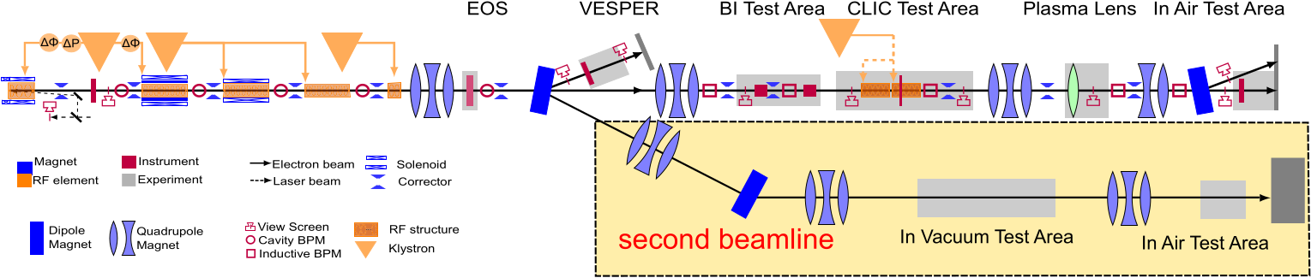
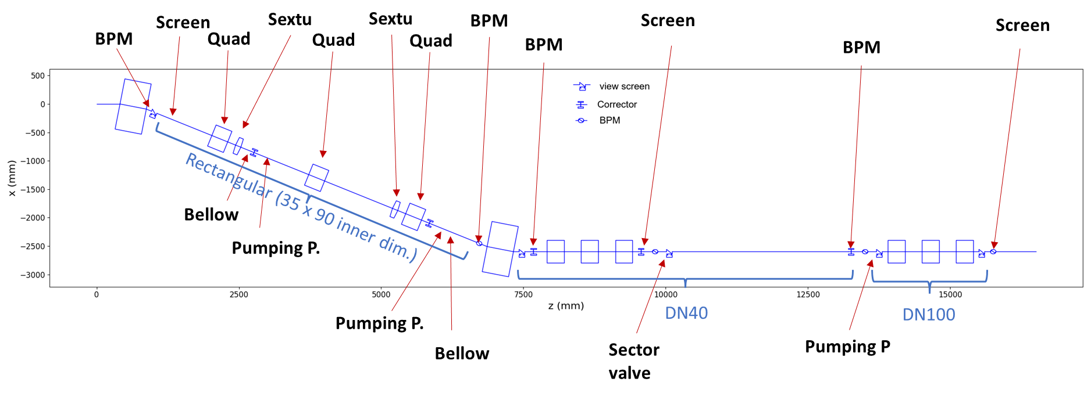
Proposition of Beamline Layout
6 m
40 m
22º Dogleg

Slide 5
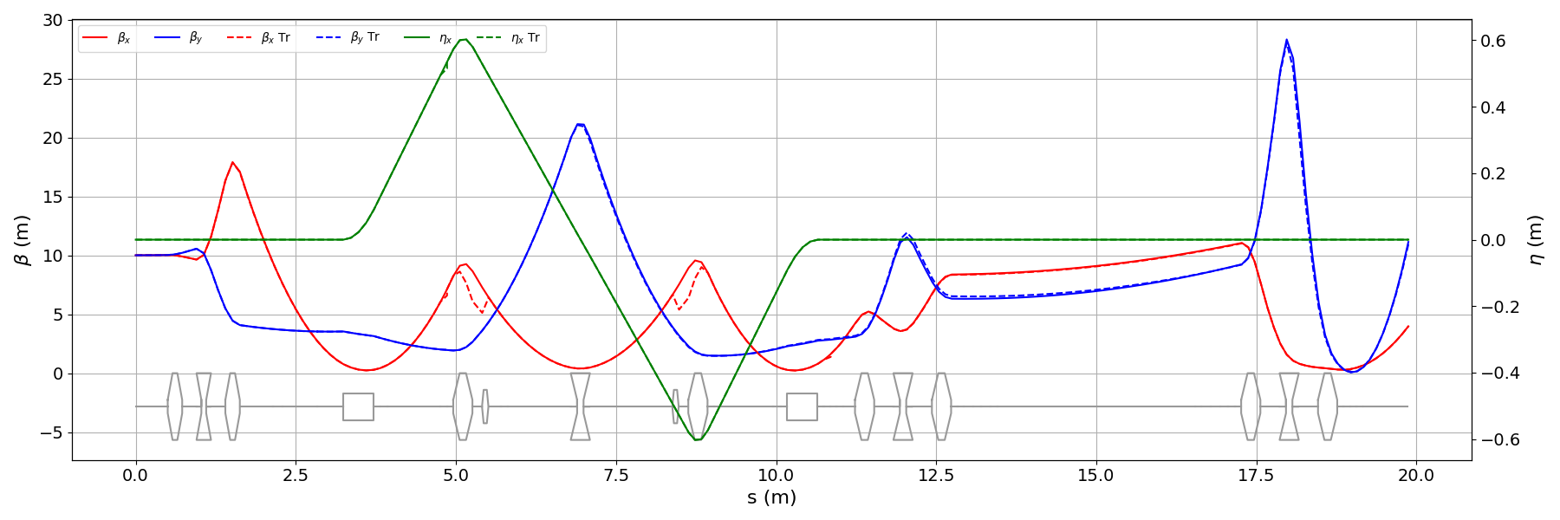
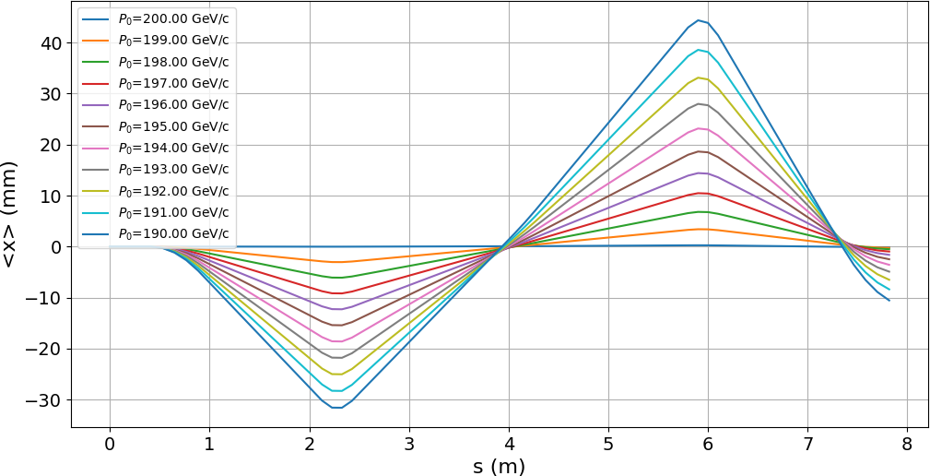
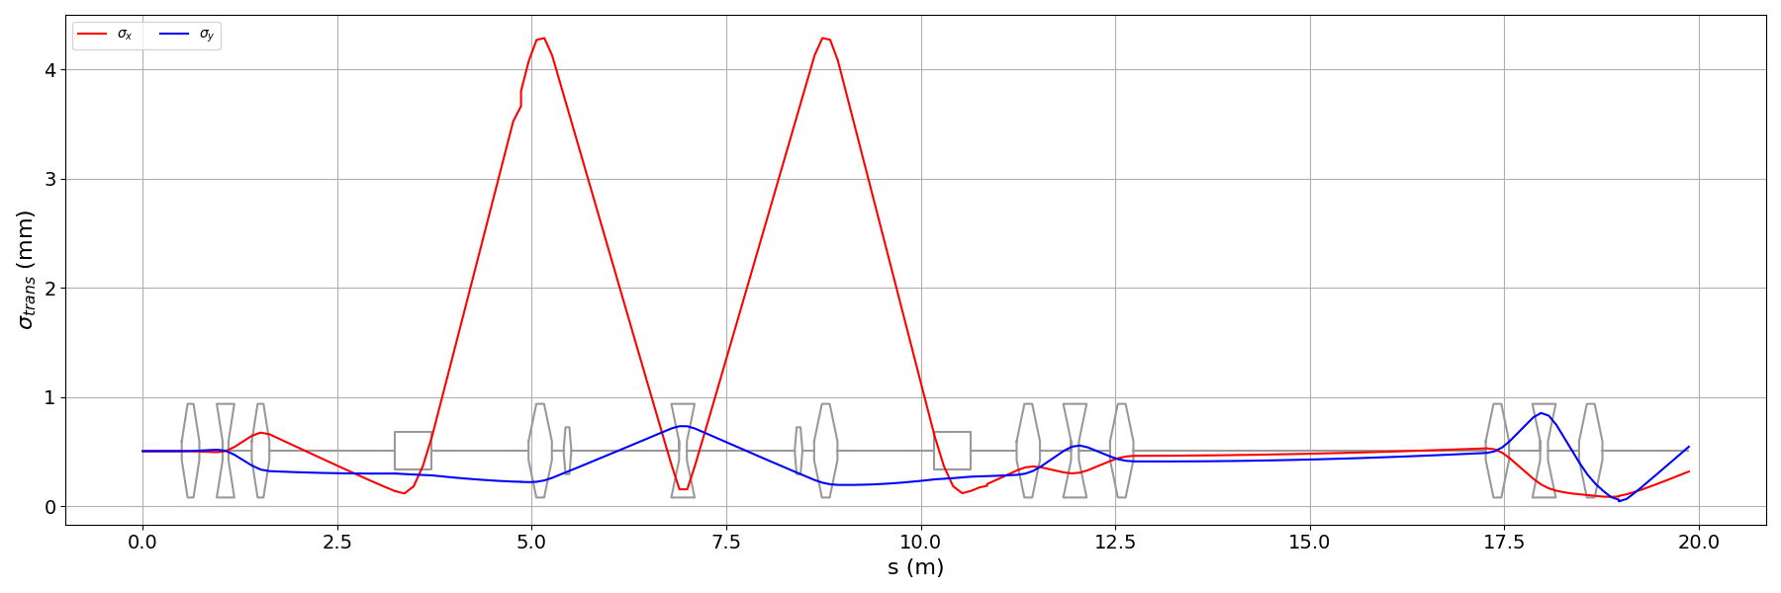
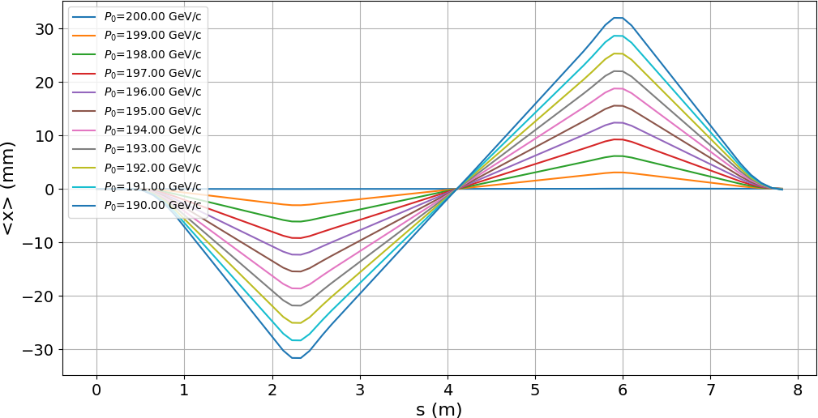
Beam dynamic studies and optimization
The dispersion is closed by side quadrupoles of a standard dogleg.
Flexible beam size adjustment with triplets on straight line
Sextupoles are adapted to close second order dispersion when energy spread is large
Credit: A. Aksoy
Twiss parameters
Beam orbit w/o sextupoles
Beam size
Beam orbit with sextupoles

Slide 6
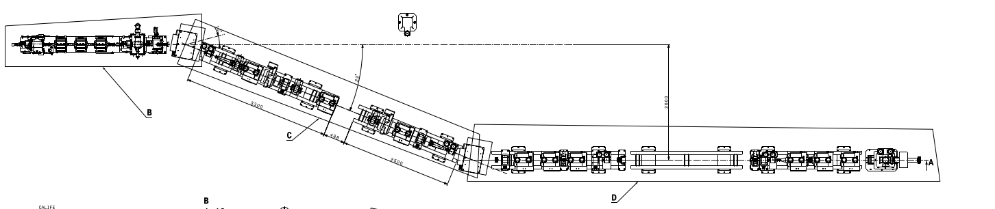
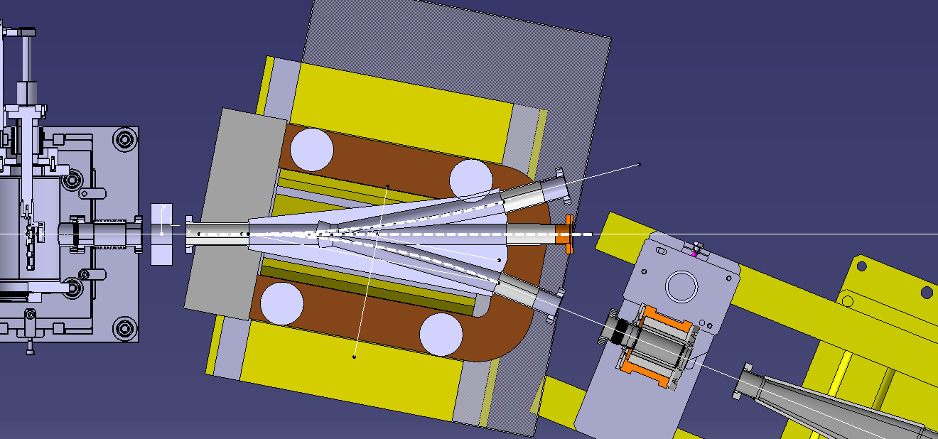
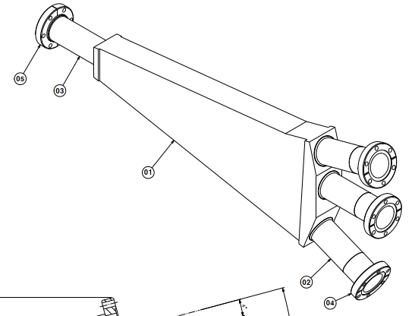
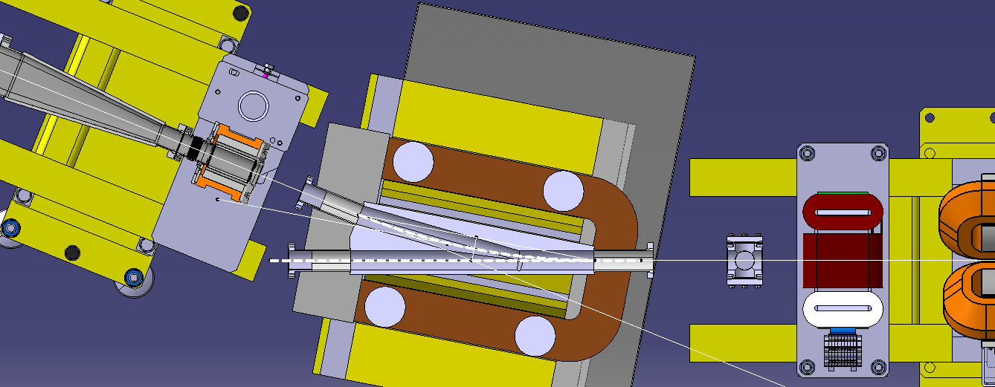
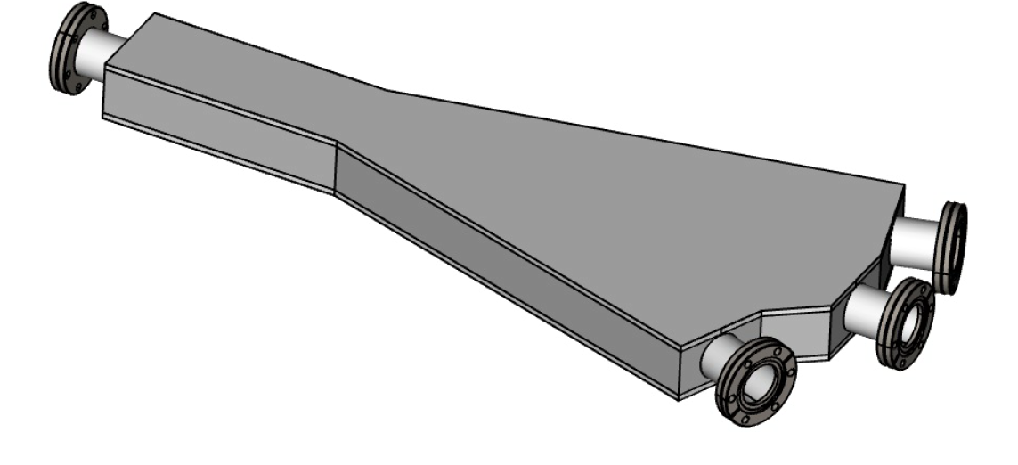
Implementation and manufacturing drawings
Credit: N. Chritin EN-MME
Footprint
New dipole chamber

Slide 7
Work Progress
Theoretical analysis performed (Luke, Alex, Avni), equipment location validated
Area cleared last summer (Transport group), cables sorting done (by ourself with the support of EN-EL)
10 Quad and 3 Sextupoles taken from the CR renewed by the Magnet group TE-MSC-NCM. 2 new dipoles being prepared.
Available Power supplies identified in the gallery by SY/EPC (former CTF3 equipment)
First part of survey work achieved (positions of the existing equipment and footprint tracing)
Vacuum chambers identified and result transmitted to EN-MME-EDS
Implementation and manufacturing drawings nearly achieved
Vacuum layout validated by TE-VSC
Beam dump simulated and validated by the RP and STI
New RP sensors installed by HSE-RP
Some components already received (YAG screens, cameras, BCM, optical breadboard). Others developed: New samples handling robot

Slide 8
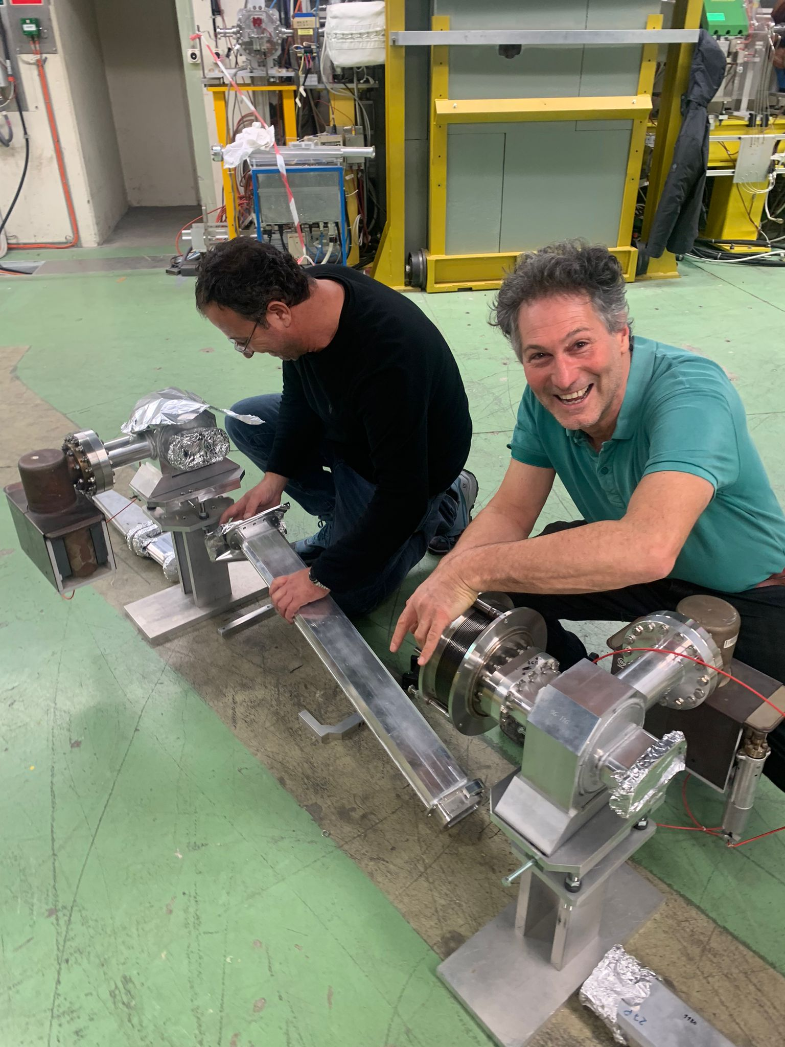
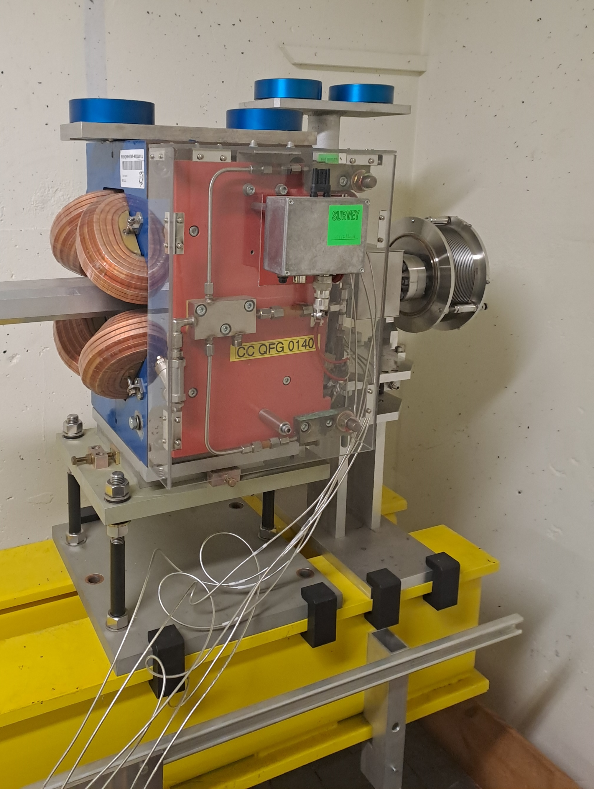
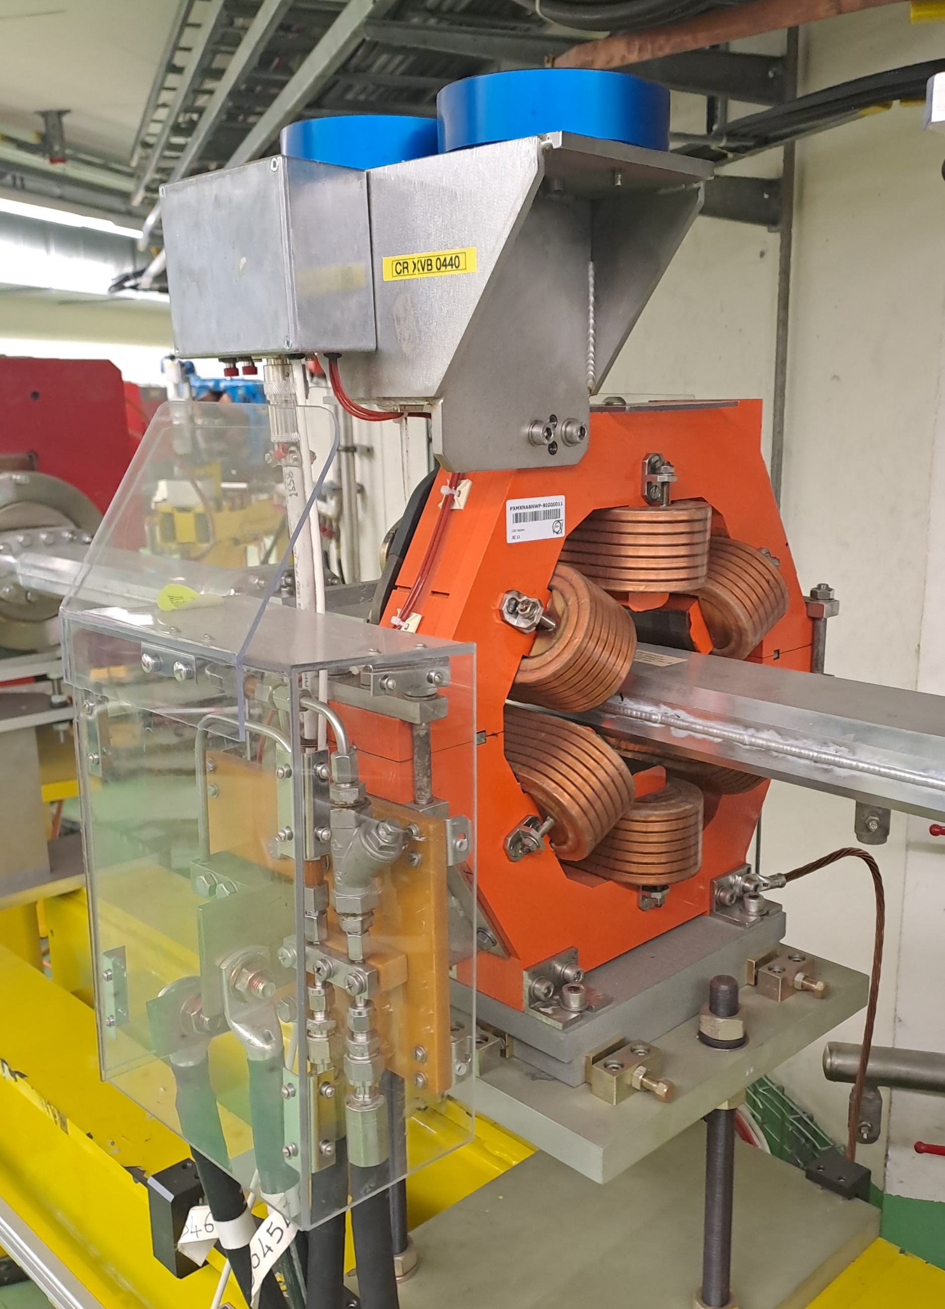
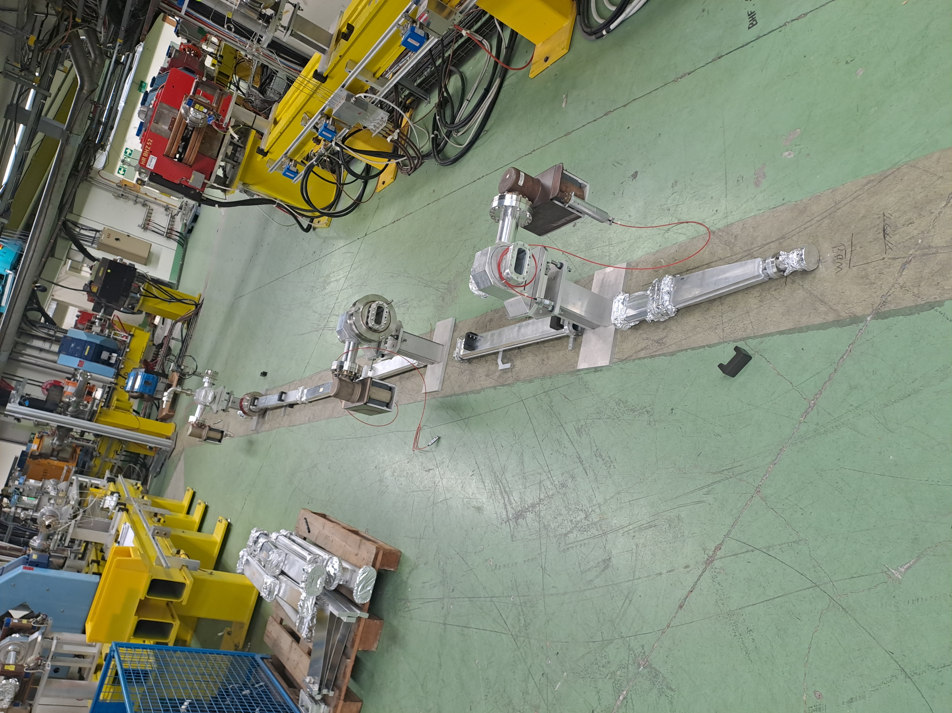
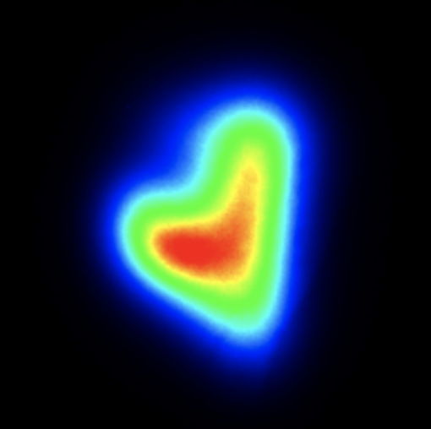
Some recent pictures
Renewed quads and sextupoles with large aperture
Blank mounting and obtained solution for the dogleg.
Stay in touch on our website:
https://clear.cern/
Thank you for your attention

