Slide 1
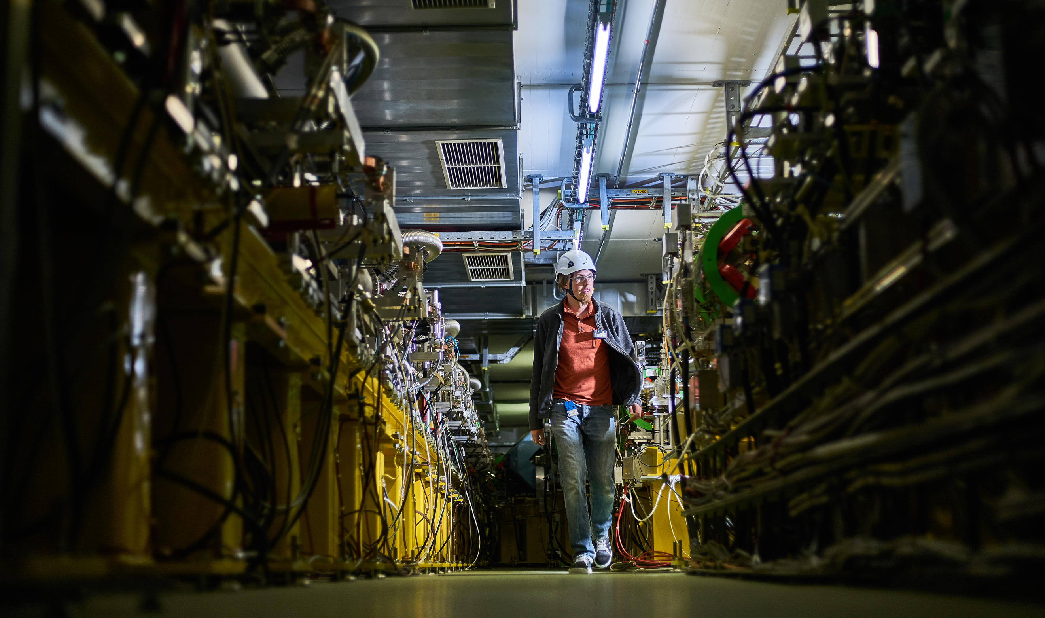
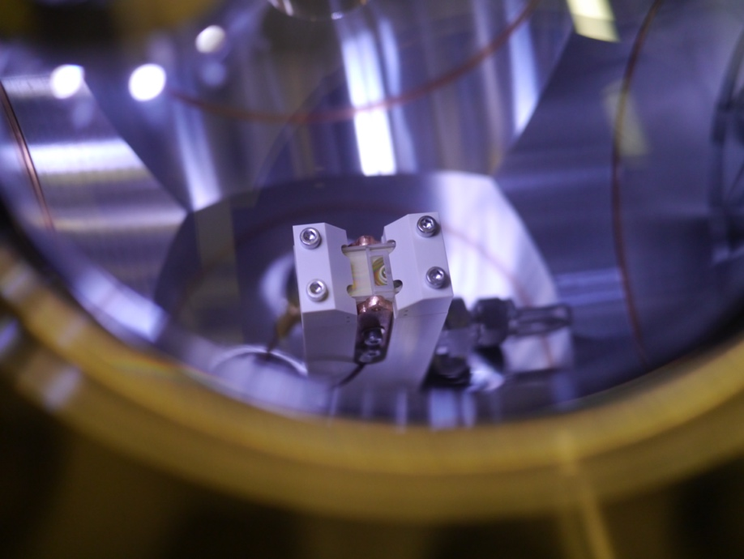
The CLEAR scientific program - past experience and outlook
R. Corsini
for the CLEAR team
CERN Linear
Electron Accelerator
for Research

Slide 2
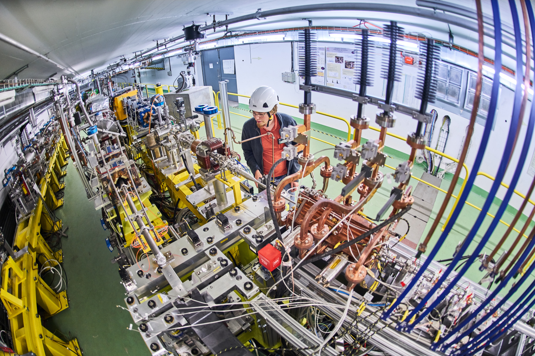
Talk outline
Introduction
Operation statistics
(users, beam time for different activities…)
Publications, PhD thesis, outreach…
Some experimental highlights
Recommendations from
the CLEAR Scientific Board
& Outlook

Slide 3
The CERN Linear Electron Accelerator for Research (CLEAR)
Scientific and strategic goals:
Providing a test facility at CERN with high availability, easy access and high quality e- beams.
  Performing R&D on accelerator components, including beam instrumentation prototyping and high gradient RF technology
  Providing an irradiation facility with high-energy electrons, e.g. for testing electronic components in collaboration with ESA or for medical purposes(VHEE/FLASH)
  Performing R&D on novel accelerating techniques – electron driven plasma and THz acceleration.
Maintaining CERN and European expertise for electron linacs linked to future collider studies
Using CLEAR as a training infrastructure for the next generation of accelerator scientists and engineers.
CLEAR is a versatile 200 MeV electron linac + a 20 m experimental beamline, operated at CERN as a multi-purpose user facility.

Slide 4
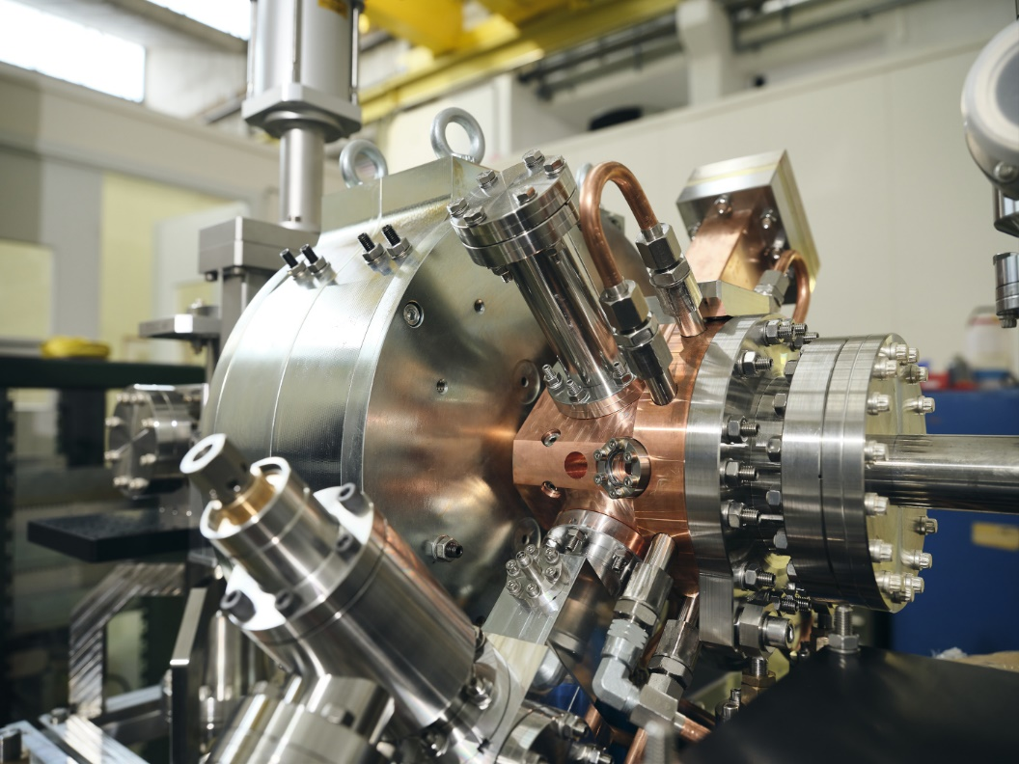
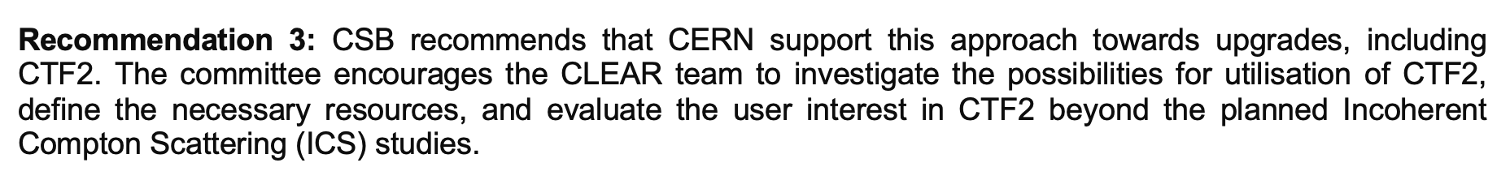
Introduction
Two reviews taking place in 2019 and 2021 confirmed and recommended the extension of CLEAR operation, currently approved until end 2025.
In view of the increased demand from experiments on CLEAR, its Scientific Board, held in February 2024, confirmed the scientific case to further extend CLEAR operation.
Future exploitation of CLEAR would profit from:
  a new beam line being built in CLEX to provide
  additional test areas for users
  a planned upgrade of the present laser system
  including a new front end
  the operation for users of the new electron source
  jointly developed by CLIC/AWAKE/CLEAR
From CLEAR Scientific Board Report 2024

Slide 5
CLEAR 2024 Review Mandate
The Review Panel is asked to assess whether:
1. The continued operation of the CLEAR facility beyond 2025 is scientifically justified based on the input provided by the CLEAR Scientific Board?
2. The current levels of resources, both in terms of workforce and material budget, are sufficient for ensuring the efficient operation of the facility?
3. The recommendations from the 2021 review have been effectively implemented.
4. The proposed consolidation and upgrade plans meet the following criteria:
  - Are they necessary for providing the required beams and reliability for researchers working in areas aligned with the global CERN strategy?
  - Are they adequately covered in terms of both workforce and budget?
  - Are they in alignment with CLEAR’s potential strategic role in providing a testbed for the construction of a future e+e- collider at CERN?
5. Additionally, the committee is encouraged to provide recommendations for organisational and operational improvements should an operation extension be approved.

Slide 6
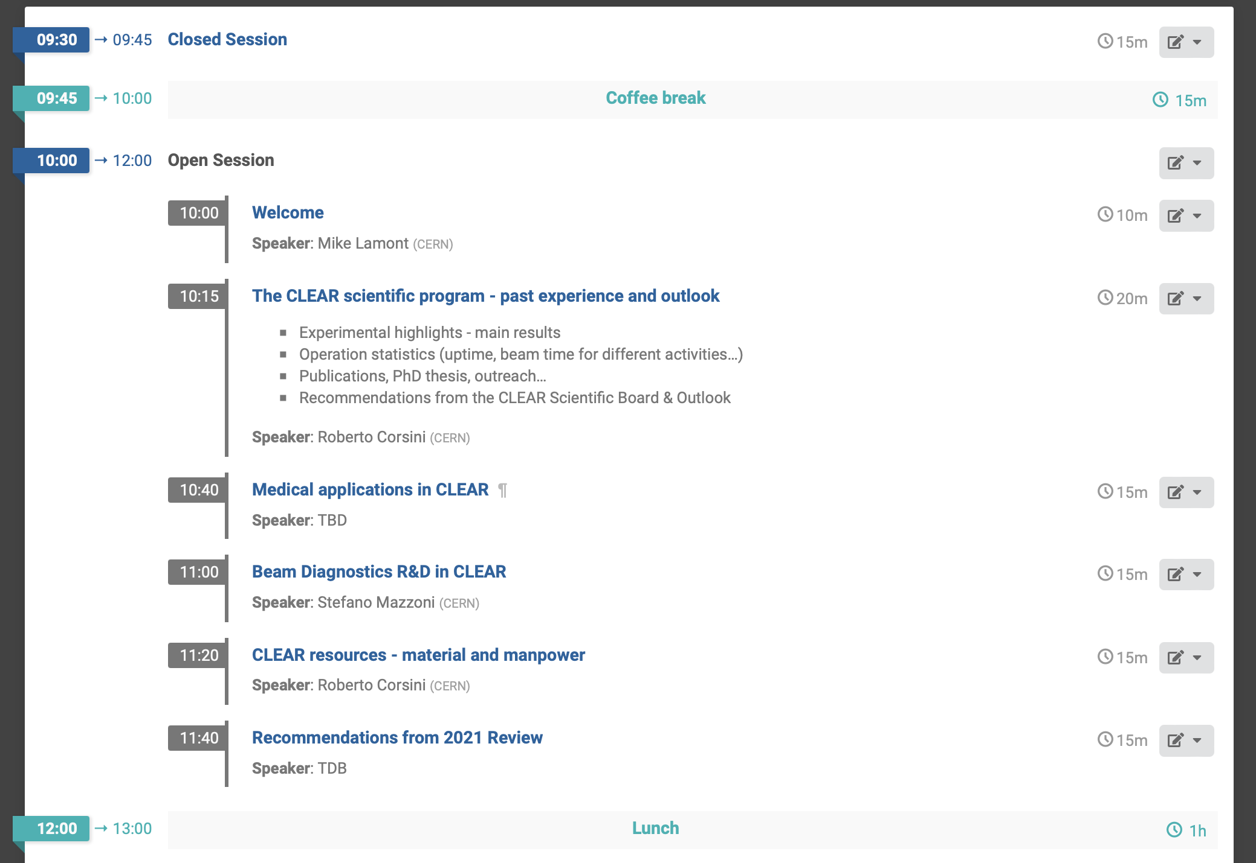
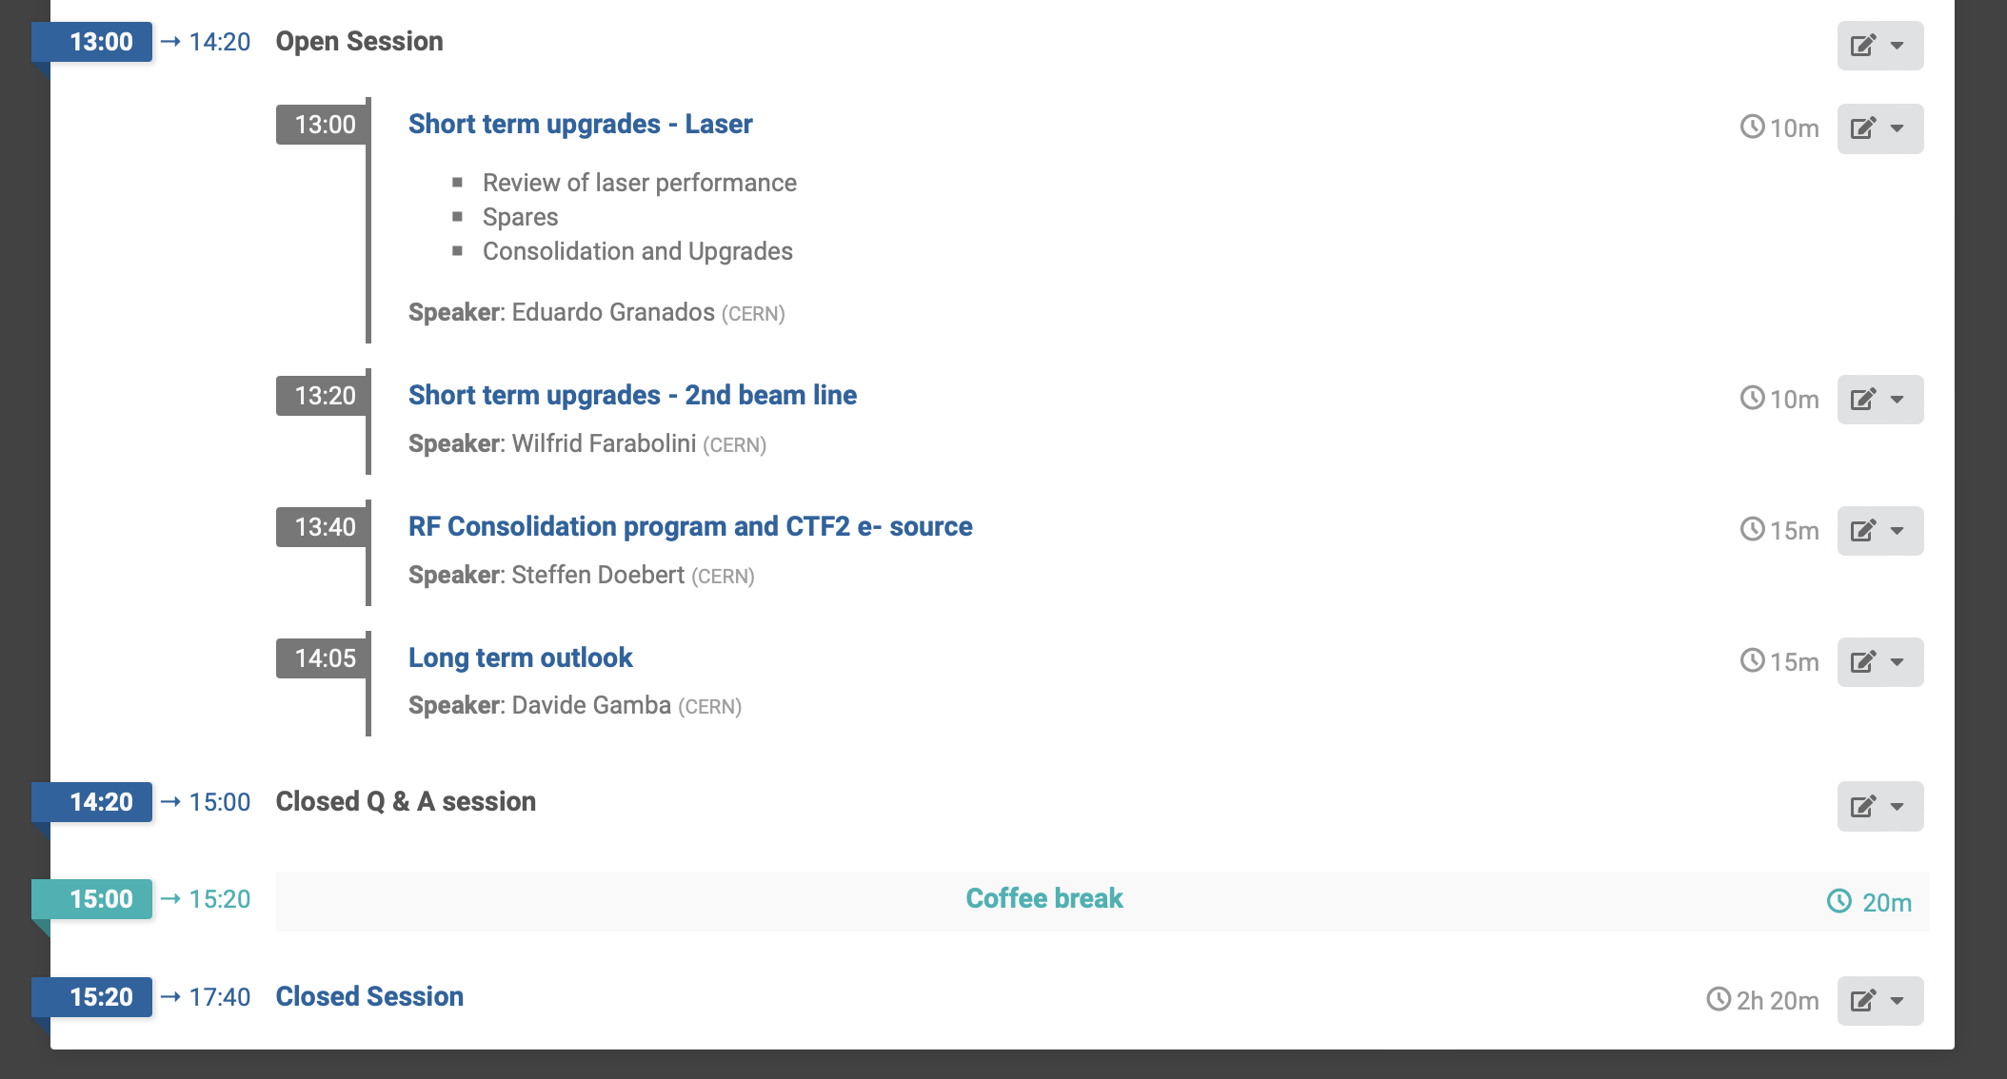
CLEAR Review Timetable
Morning
Afternoon

Slide 7
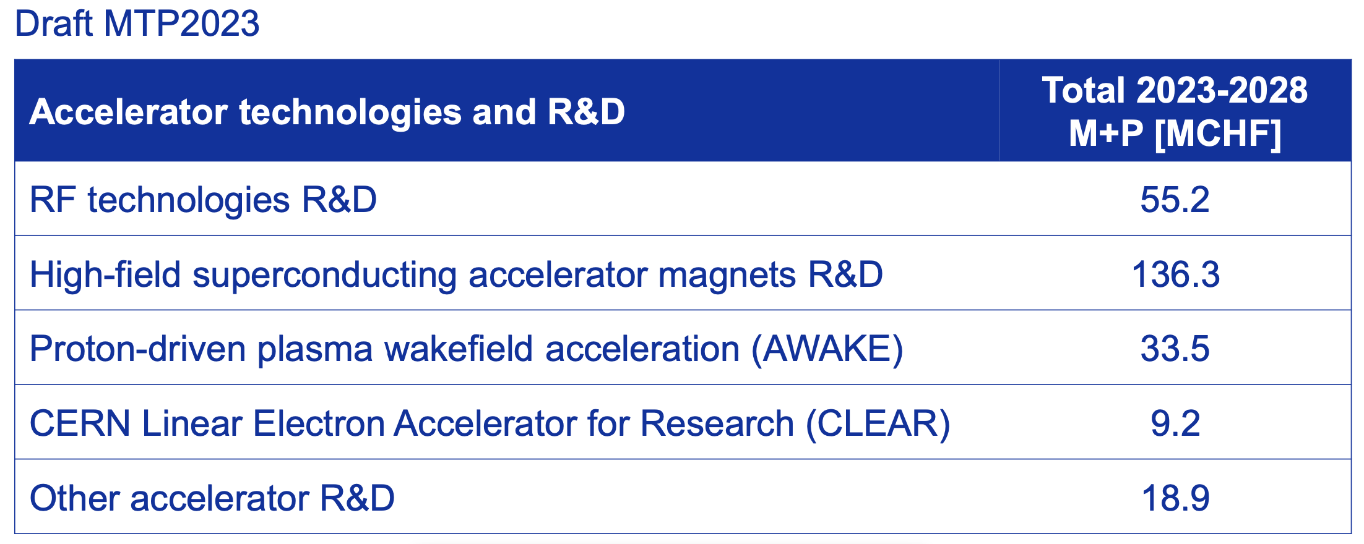
CLEAR operation & resource level
CLEAR is a standalone installation, running also during Long Shutdowns. In a typical year 30-40 weeks of beam operation are provided, between March and December.
The operation team comprises on average 1 staff, 1- 2 fellows and 1 associate, plus contributions of some students and part-time associates. A total of about 4 staff FTE/year is allocated to the facility, including technical support.
The CLEAR material budget is of the order of 800 kCHF/year (including M to P)
CLEAR operation is currently approved
until end 2025.
A CLEAR budget line (M+P) is present in
the current MTP beyond 2025.
A decision in mid 2024 allows to better
organize and possibly anticipate the long-term
consolidation of the infrastructure(substitution
of obsolete material, restock of spares),
as well as to prepare the manpower plan.
M. Lamont, 329th IEFC meeting

Slide 8
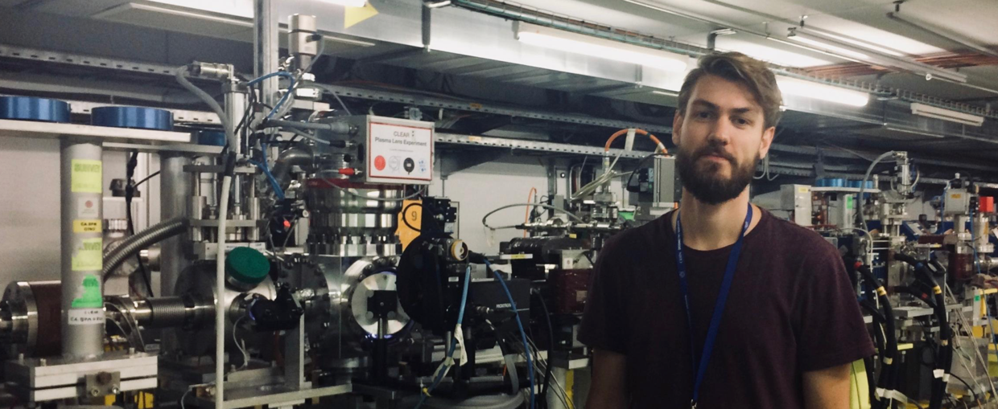
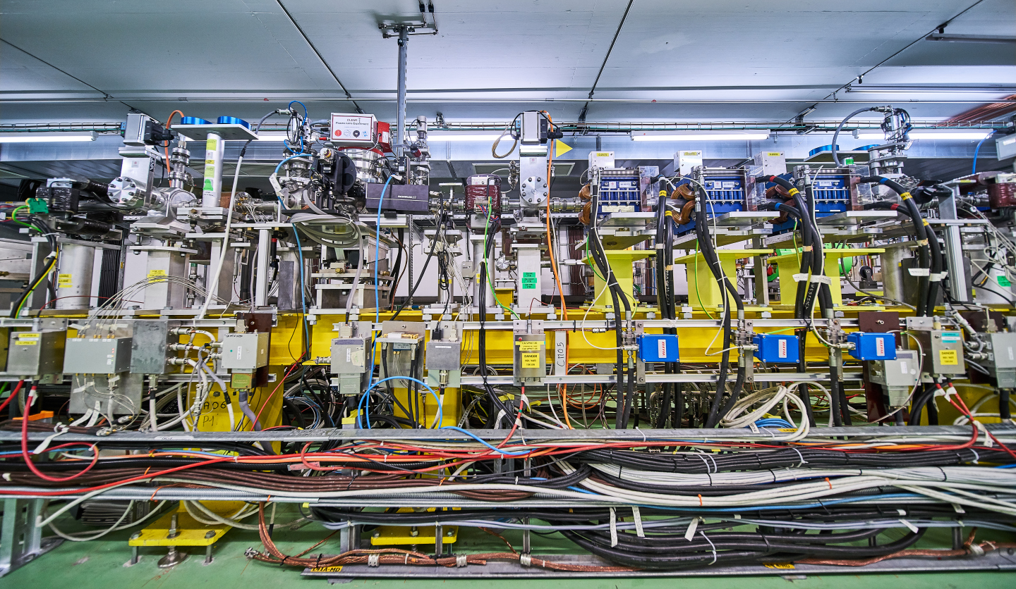
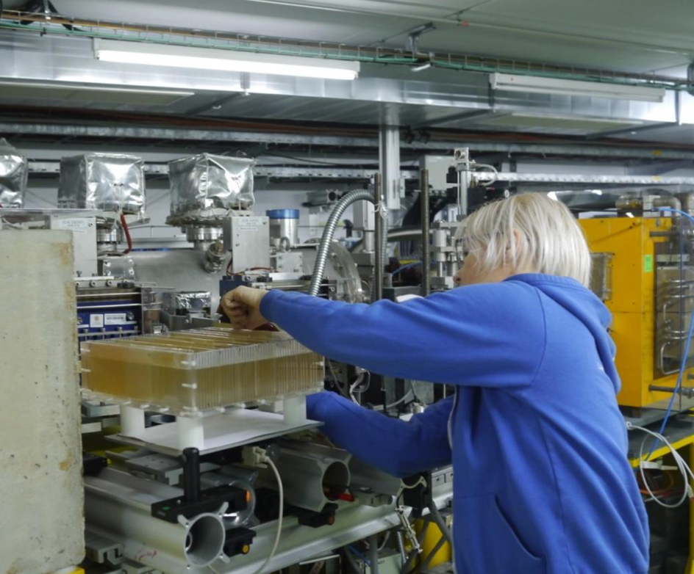
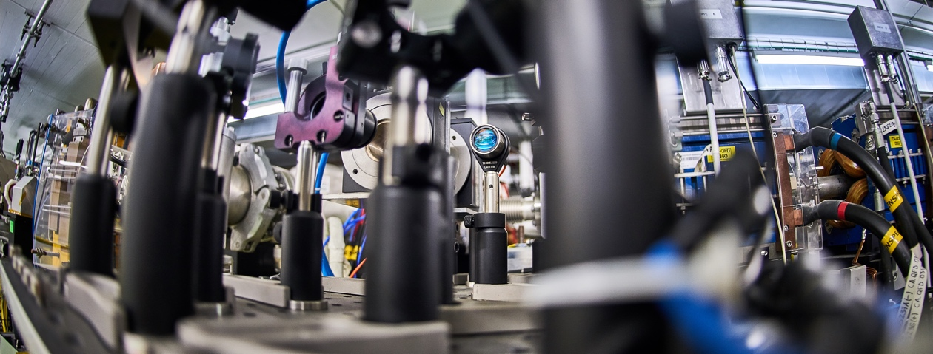
CLEAR Operation 2017 - 2023
Start with beam August 2017
  19 weeks of operation in 2017
  36 weeks in 2018
  38 weeks in 2019
  34 weeks in 2020
  35 weeks in 2021
  37 weeks in 2022
  38 weeks in 2023
Due to Covid-19 related measures,
2020-2021 activities were impacted,
and mainly limited to CERN users

Slide 9
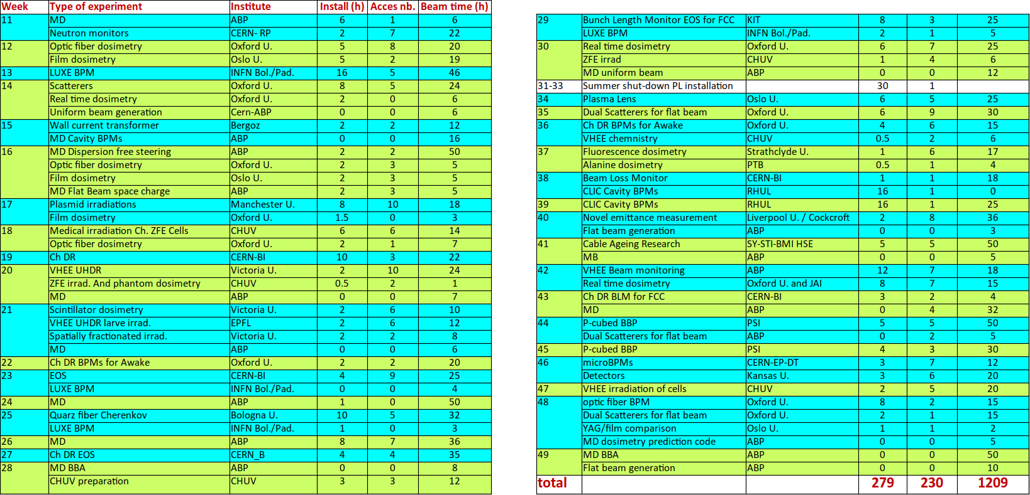
Example of a “typical” year - 2023
- 38 weeks of beam
- 279 hours of set-up installation
- 230 accesses with radioprotection
- 1209 hours of beam
- 40 hours of fatal failure
- 1.9 experiments per week in average

Slide 10
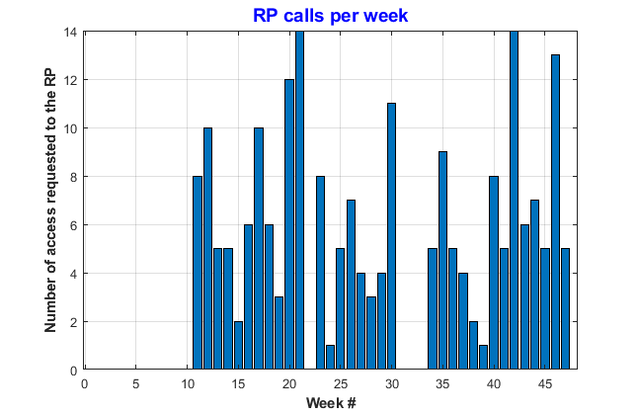
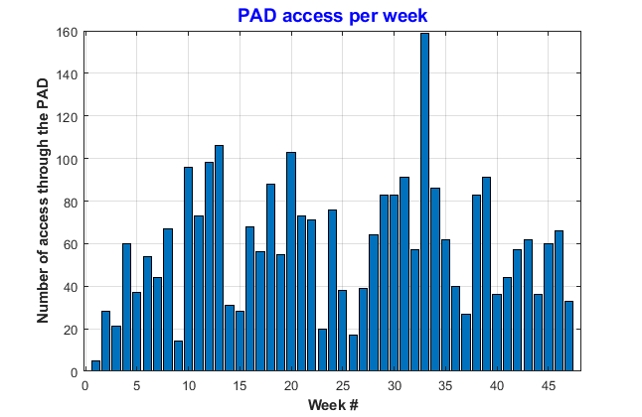
Operation flexibility - accesses
A very large number of accesses for experiment installation and user interventions.
  RP calls: > 213 (until 30/11/23) - minimum delay 30 min, require klystron stop, limited to working hours
  PAD accesses: 2802 (D. Chapuis)
In average:
- 9 per day
- 59 per week
- 253 per month
Summer shutdown
Winter shutdown
Mutualizing accesses with two experimental beam lines will increase the overall running time and allow more experiments per week. Complex set-up could stay installed for longer time.

Slide 11
Operation
CLEAR is a stand-alone installation, thus operation during general stops of the global CERN accelerator complex, including long shut-downs, is possible.
CLEAR is operated for 30 to 40 weeks/year – typically from March to December,
often 2-3 weeks stop in summer.
  Operation organized over 2 shifts, roughly during working hours, 5 days/week
  No night shifts or week-end running (apart few exceptions)
  Sometimes remotely supervised operation in nights/week-ends (low-charge irradiation – none recently)
Current operating team:
1 Staff, 1 ½ associates, 2 fellows, 1 PhD student, plus 1 part-time associate (in remote)
Support from CERN services and groups on technical systems, in general on best effort basis and subject to priorities
Detailed weekly activities organized at the Monday operation meeting (often followed by access in the hall) and coordinated by a weekly supervisor (member of the operation team)

Slide 12
CLEAR operation peculiarities
Flexibility:
  flexibility of access (see previous slide),
  flexibility in acceptance and scheduling of experiments,
  flexibility in beam conditions (from low charge single-bunch to trains of high charge bunches, beam sizes from a few tens of microns to cm size, different energies and bunch lengths…),
  flexibility in adapting hardware and experimental set-ups to evolving user requirements,
  flexibility in experiment locations (in-air and in vacuum),
  flexibility (not to be abused) in working after hours and week-ends
Availability: long experimental run (March-December), run during long shut-downs.
Support: the CLEAR team provides to the users specialized equipment, support for machining of small parts, assembly of experimental set-ups, small vacuum interventions, data acquisition, data analysis…
Collaboration: CLEAR is a user facility but in most cases, we don’t just provide a beam following user specs, but we help - if needed - to better define the experiment, optimize methods and adapt the measurement program, analyze and interpret the results. Many of the CLEAR experiments evolve in a full two (or more) sided collaboration.
Flexibility. Did I mention flexibility?

Slide 13
Origin of experiments
27 independent experiments (~ 35 including repetitions, plus MDs)
About 21 User Groups internal/external
More than 18 external collaborating institutes
CERN – ABP
CERN – BI
CERN – RP
CERN – EP
CERN – TE
CERN – SY
Manchester U.
Oxford U.
RHUL
London U.
Liverpool U.
Strathclyde U.
Oslo U.
Victoria U.
Kansas U.
Politecnico Milano
PSI
CHUV
EPFL
INFN Bologna
INFN Padova
KIT
Cockcroft Inst.
JAI
BERGOZ

Slide 14
Activities
Not always straightforward to classify (and quantify), however:
Two main activities:
  medical
  beam instrumentation R&D
Together they constitute about 2/3
of the total requests/beam time
In the following, I’ll give some highlights
mainly concentrating on the other activities
see following talks for medical and
beam instrumentation activities

Slide 15
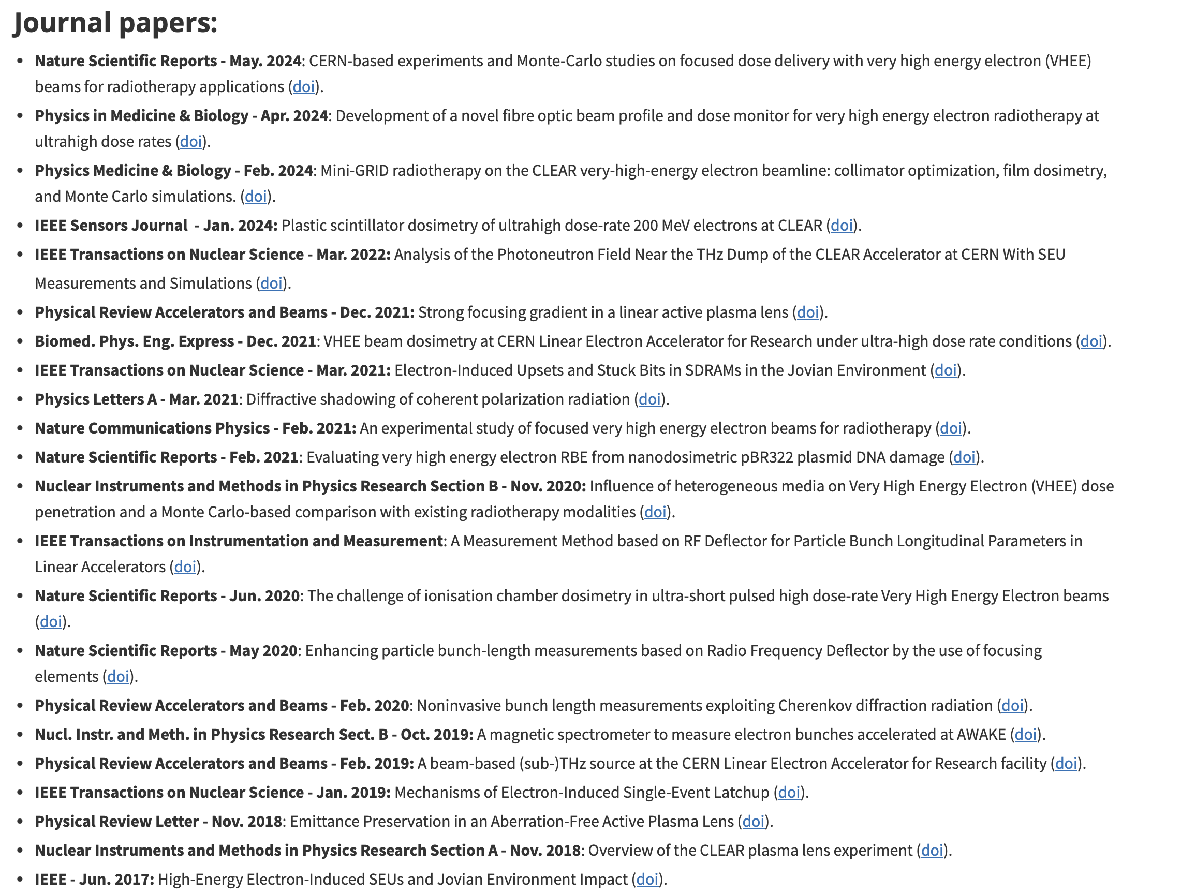
Publications – scientific output
In 6 ½ years of operation, the experimental activities carried out in the CLEAR user facility have generated:
  23 Journal papers
  36 Conference papers
  More than 12 completed
  PhD thesis, plus several ongoing.
  More than 17 outreach publications in specialized
  journals, press releases, …
https://clear.cern/content/publications

Slide 16
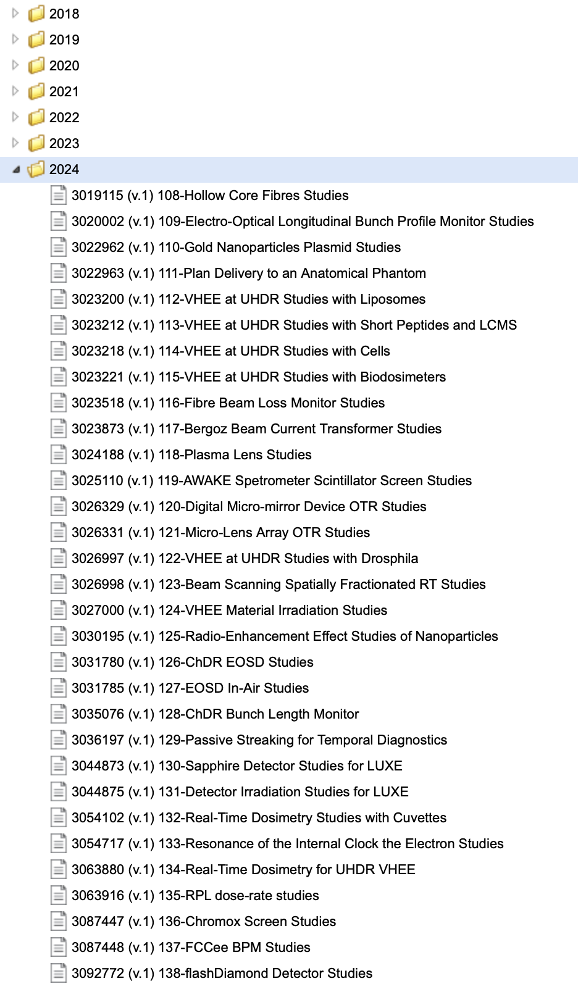
Experimental program 2017-2024
138 beam time requests received from 2017
116 experiments carried out and documented in the
experiment list:
(https://pkorysko.web.cern.ch/CLEAR/Table/CLEAR_experiments.html)
A few selected highlights
(medical applications and beam diagnostics covered in next two talks)

Slide 17
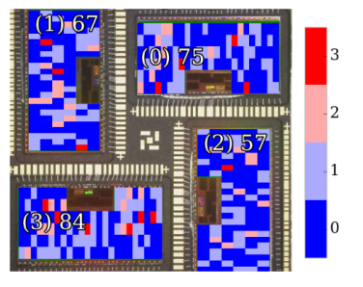
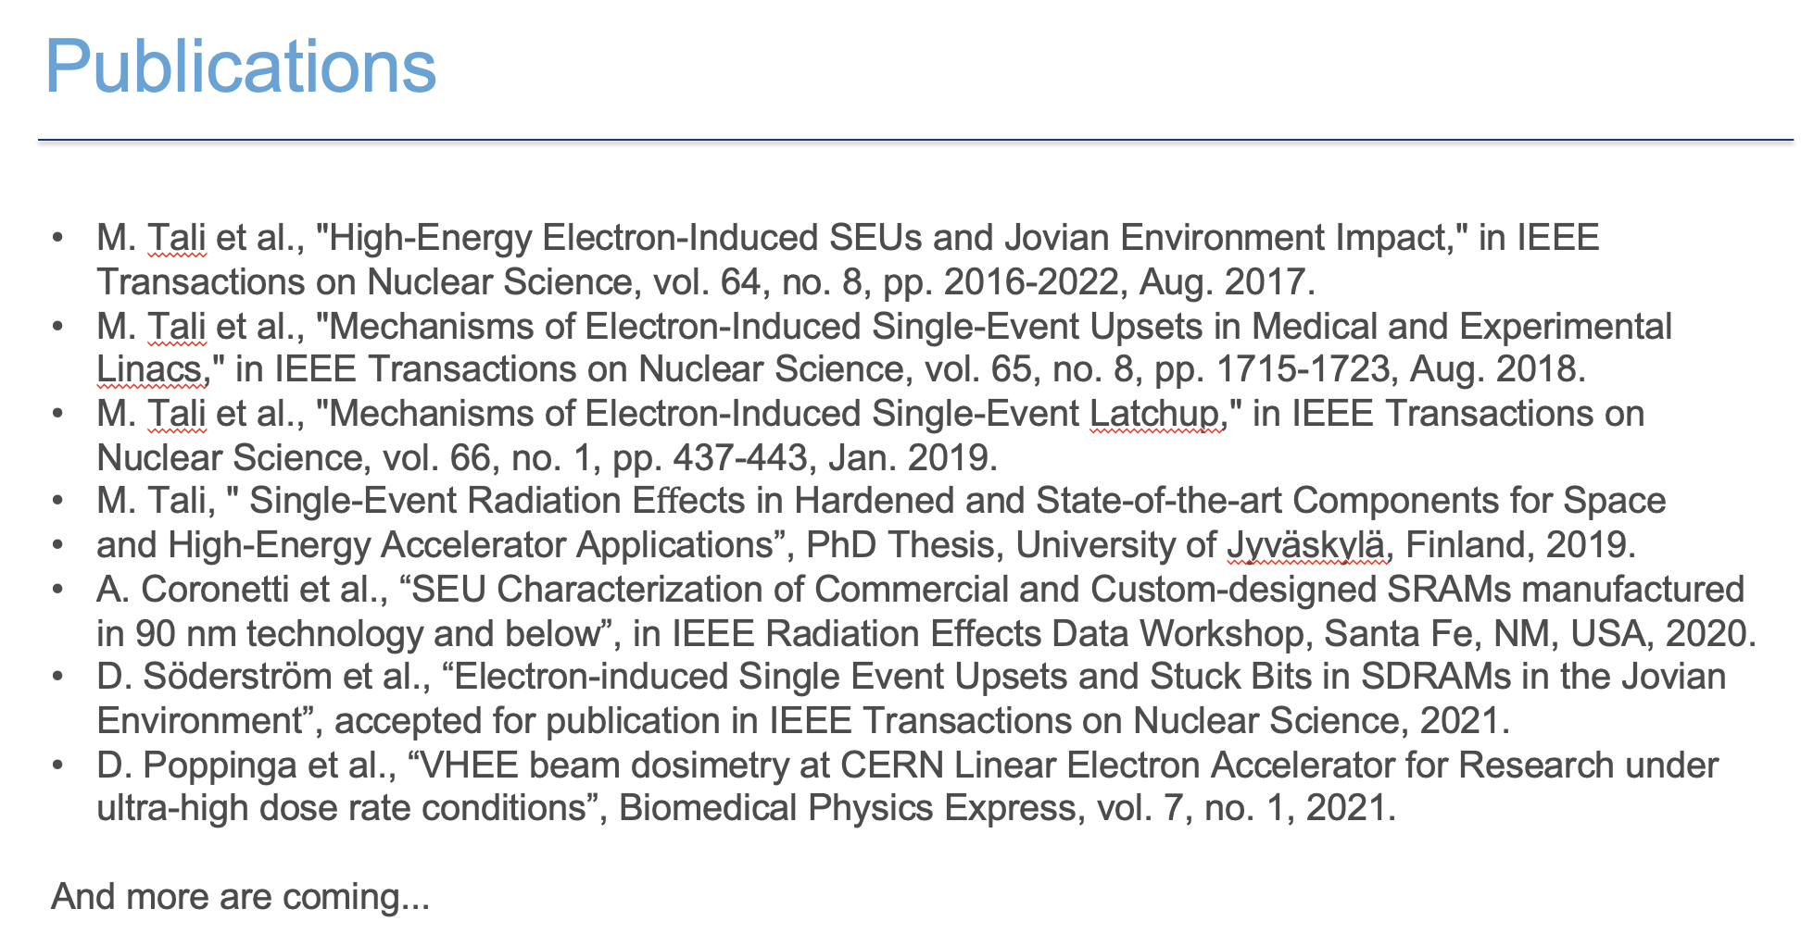
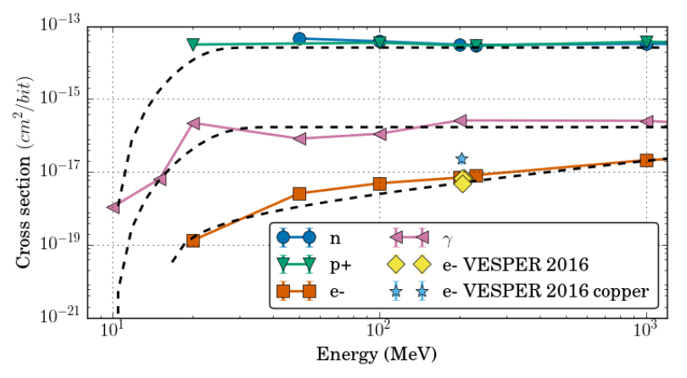
Irradiation on electronics
CLEAR has been important to R2E activities over the last years
Initial interest for Jovian environment space missions
(JUICE from ESA)
Electron-induced effects in electronics are not as well explored as those from ions, protons or neutrons. CLEAR is central to the investigation of these effects.
It enabled studying key radiation effects that it was not possible to study elsewhere
Explored electron-induced single-event effects over
a wider range of energy than what can be achieved
in medical LINACs.
Enabled first ever observation and demonstration that
HEE can trigger SEL in SRAM.
It enabled studying displacement damage effects in a short time and with low level of activation
Allowed studies on HEE SEU, SEL, stuck bits…
S. Coronetti
  ESA Monitor
  (reference chip, 250 nm)

Slide 18
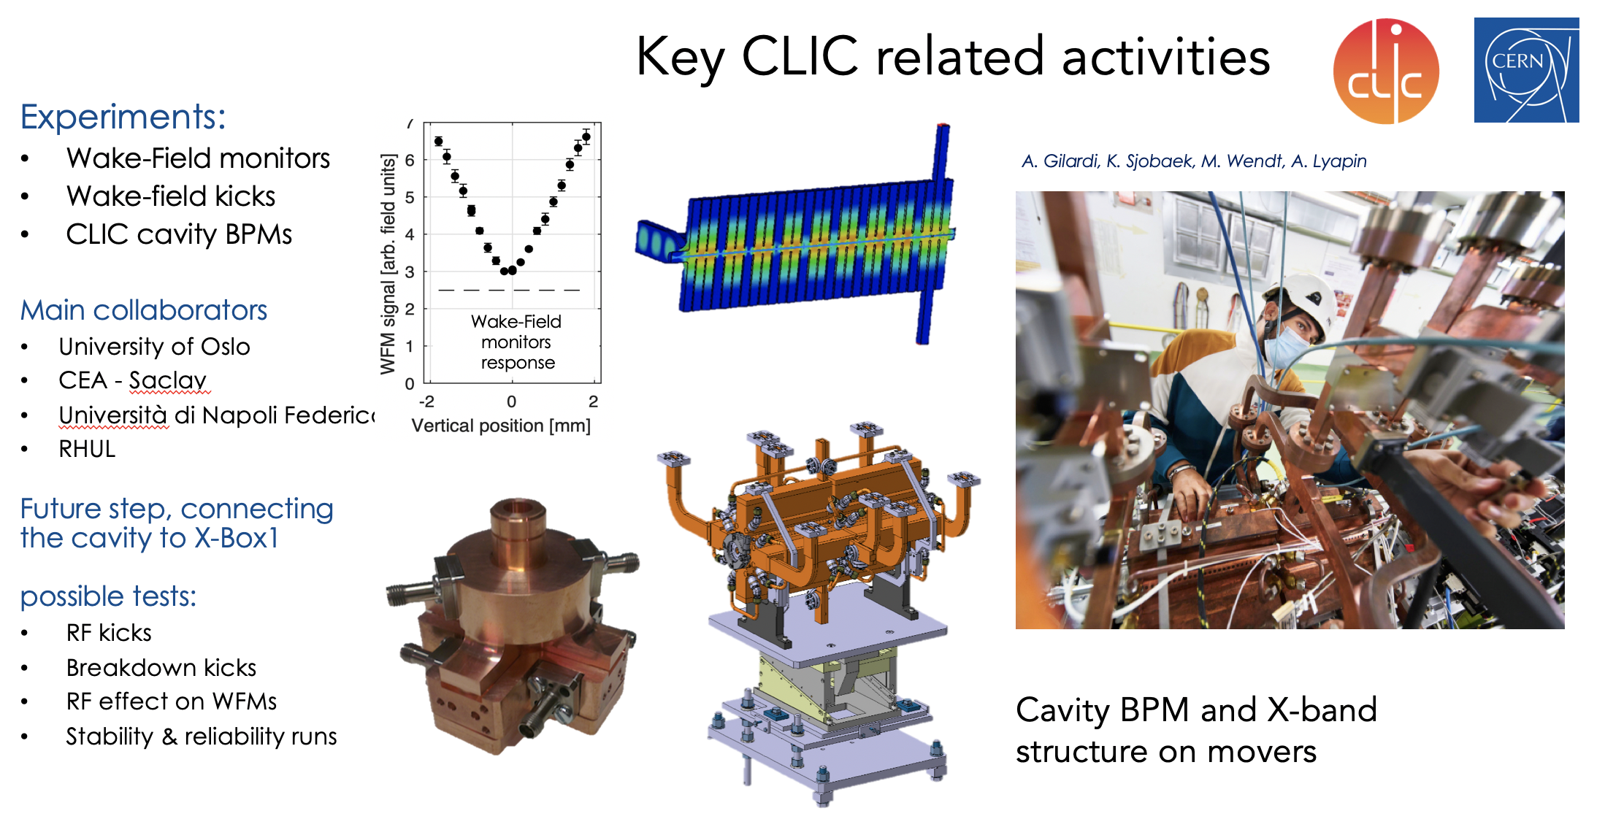
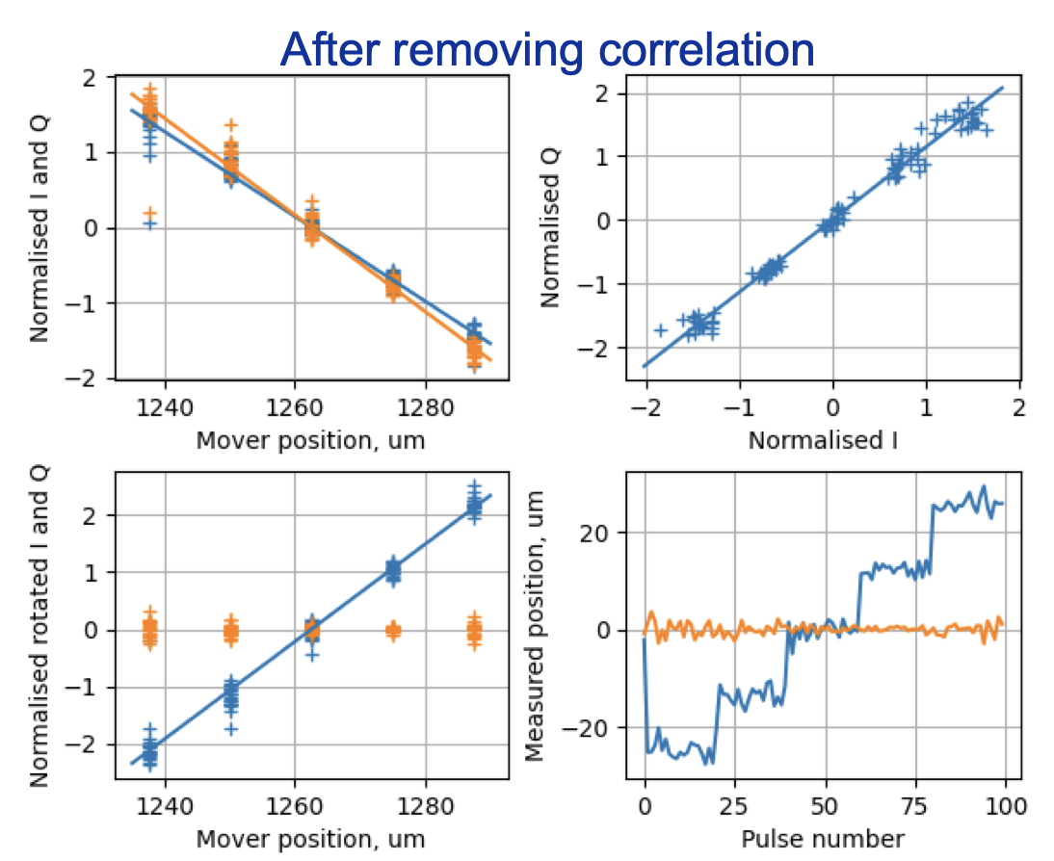
CLIC

Slide 19
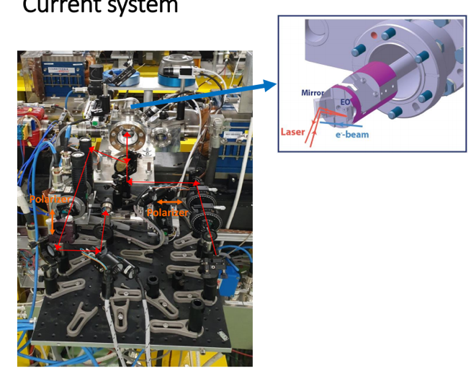
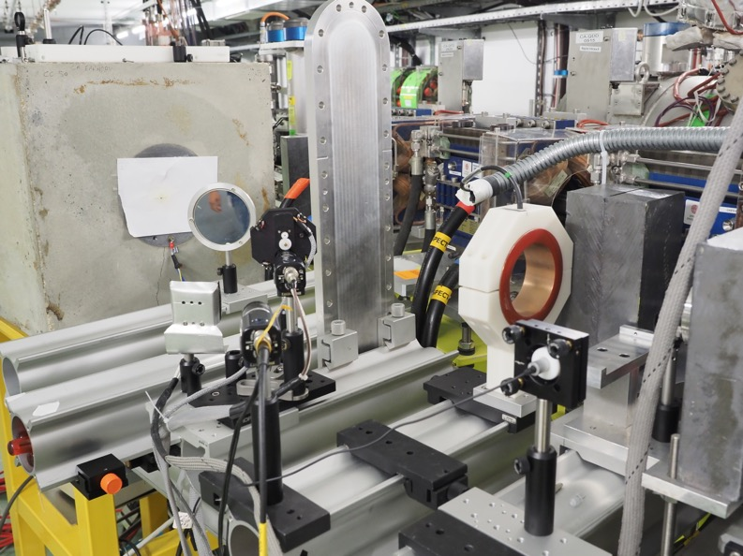
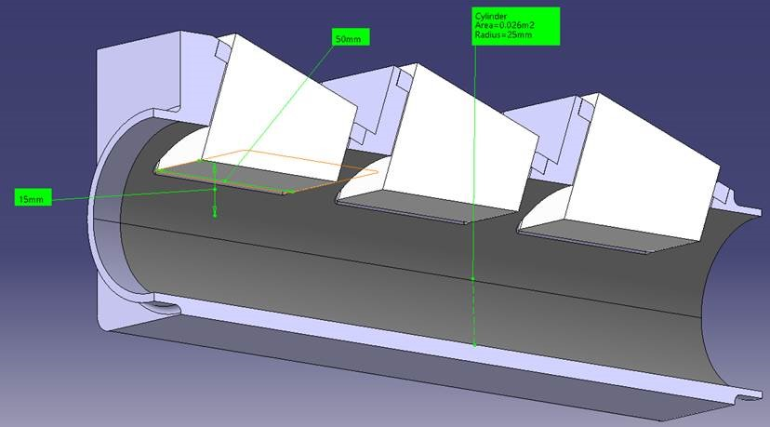
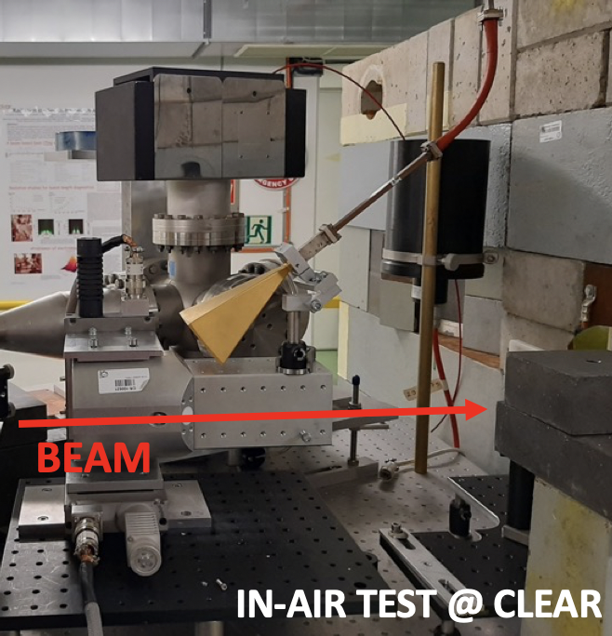
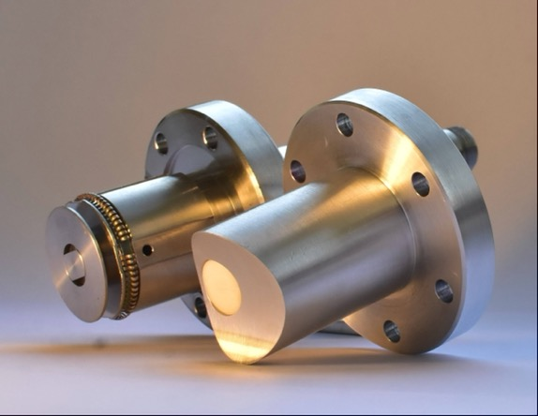
AWAKE
E. Gschwendtner
Charge calibration measurements of the AWAKE spectrometer scintillating screen/camera combination performed in 2017, 2018, 2019
Bunch length monitors:
EOS and ChhDR
Cherenkov BPMs
Beam Screen Survival Tests in Rubidium
Common development of novel electron source
CLIC-AWAKE-CLEAR

Slide 20
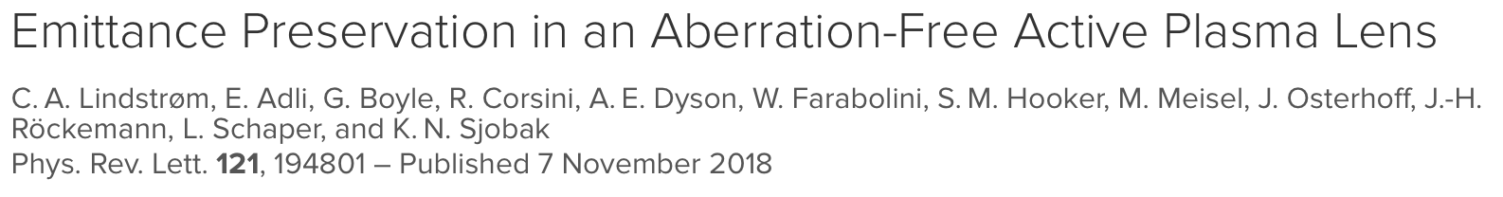
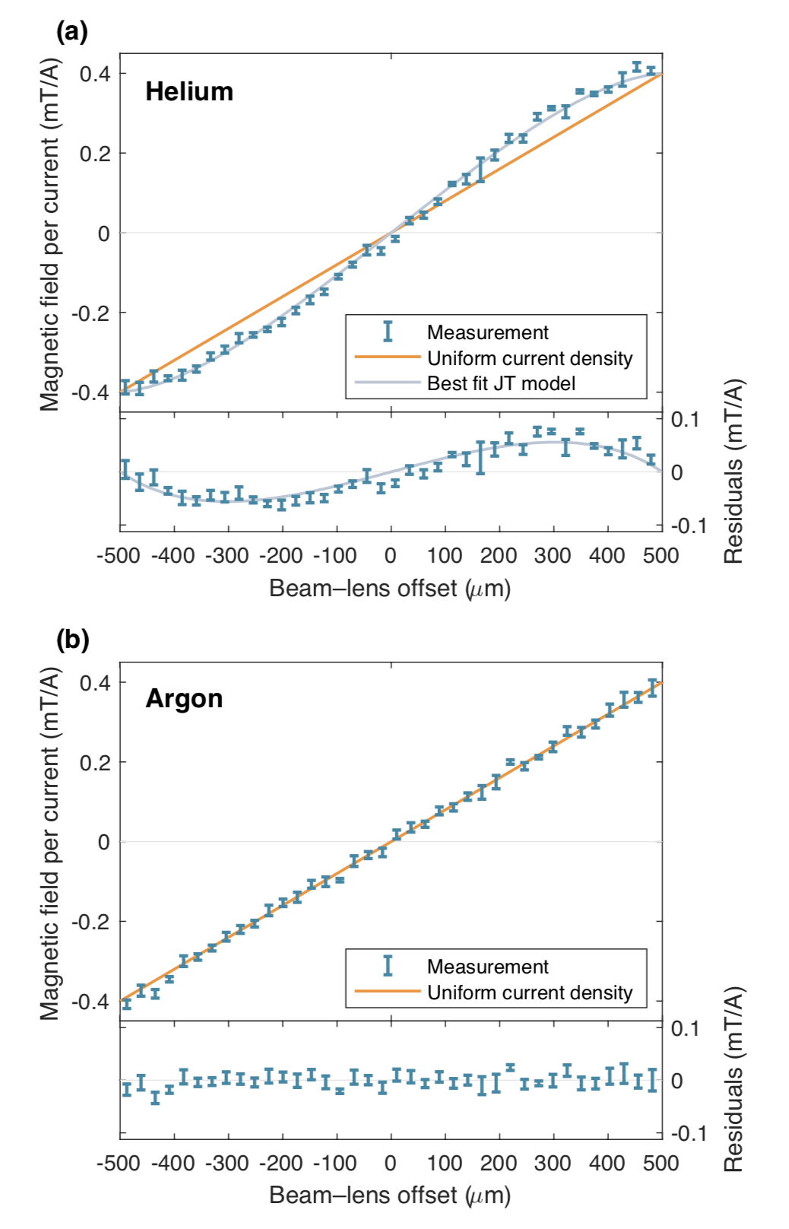
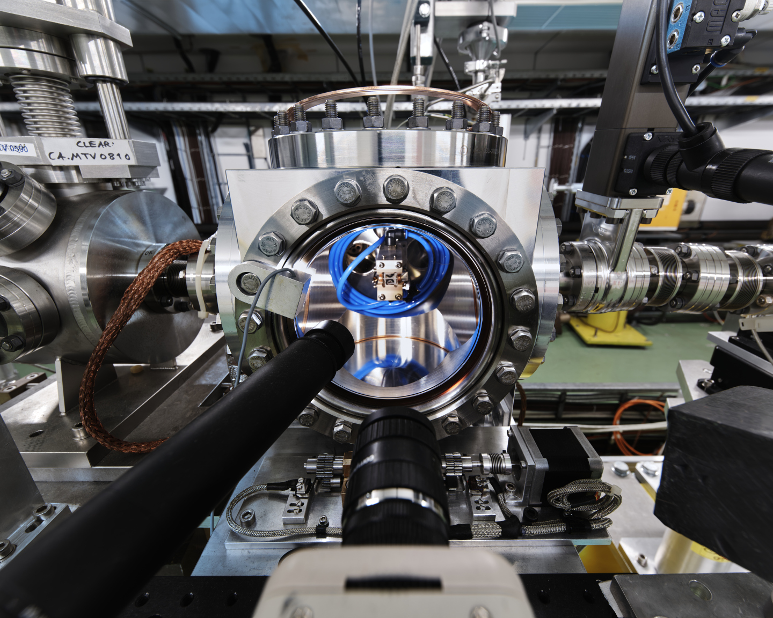
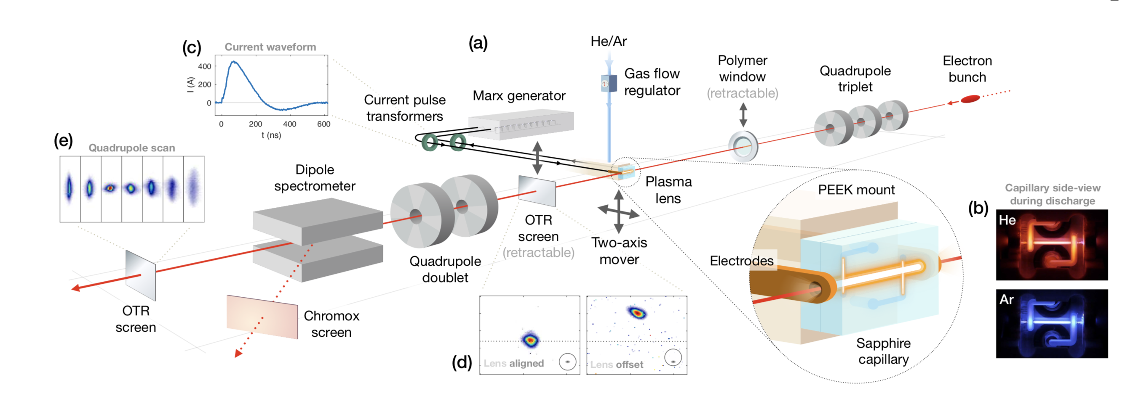
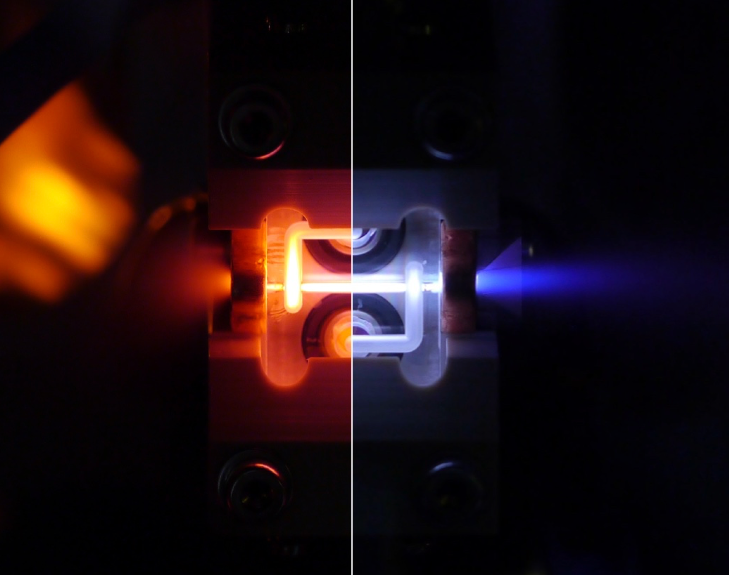
The Plasma lens experiment
Lead by Univ. of Oslo, in collaboration with CERN, DESY and Oxford Univ.
Helium
Argon
Emittance preservation in an active plasma lens demonstrated for the first time with the use of an argon-based discharge capillary.
Direct measurements of magnetic fields across the full aperture showed linearity in argon and nonlinearity in helium.
Quadrupole scans demonstrated expected emittance preservation and growth (respectively) consistent with the measured field profiles.
October 2019 – record magnetic field gradient of 5.2 kT/m !

Slide 21
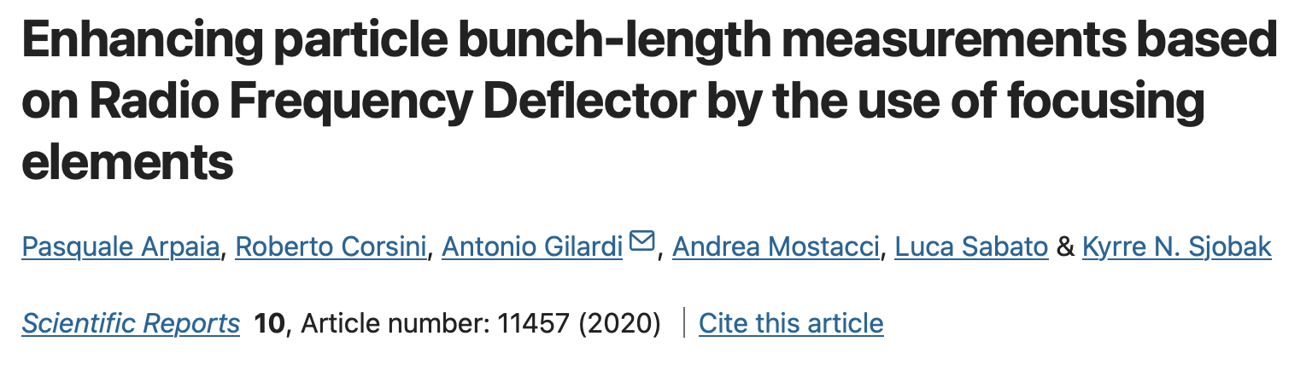
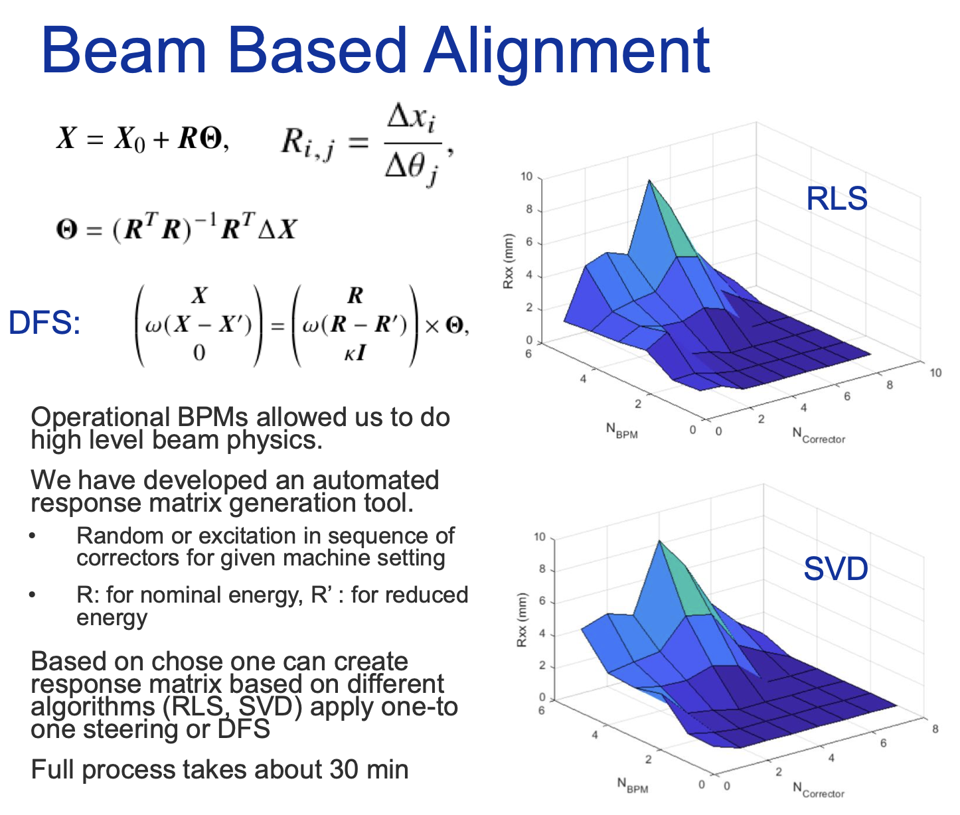
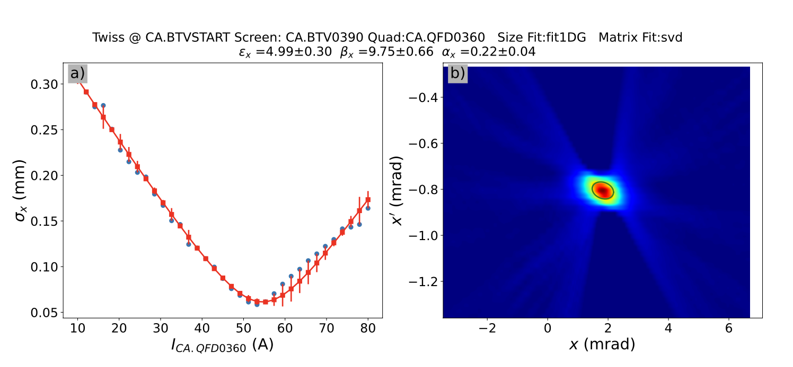
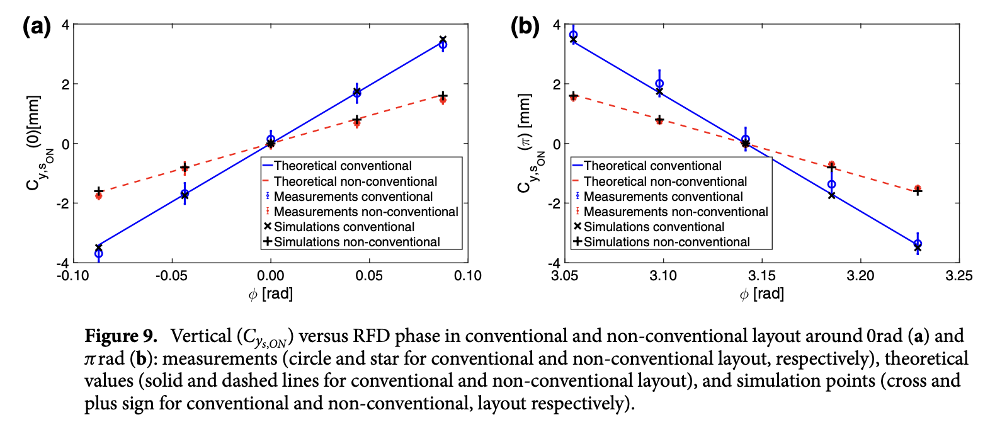
MDs, accelerator physics, beam dynamics
Apart from user experiments, some beam time is dedicated to Machine Development(MD) sessions, aimed at improving beam quality and expanding the beam parameter space.
In some cases, MD activities in CLEAR constitutes also a relevant contribution to the field of accelerator physics and beam dynamics.
Beam Tomography
A. Gilardi
A. Aksoy
A. Aksoy
Important to preserve dedicated beam time for MDs – user pressure doesn’t always allow us to do that…

Slide 22
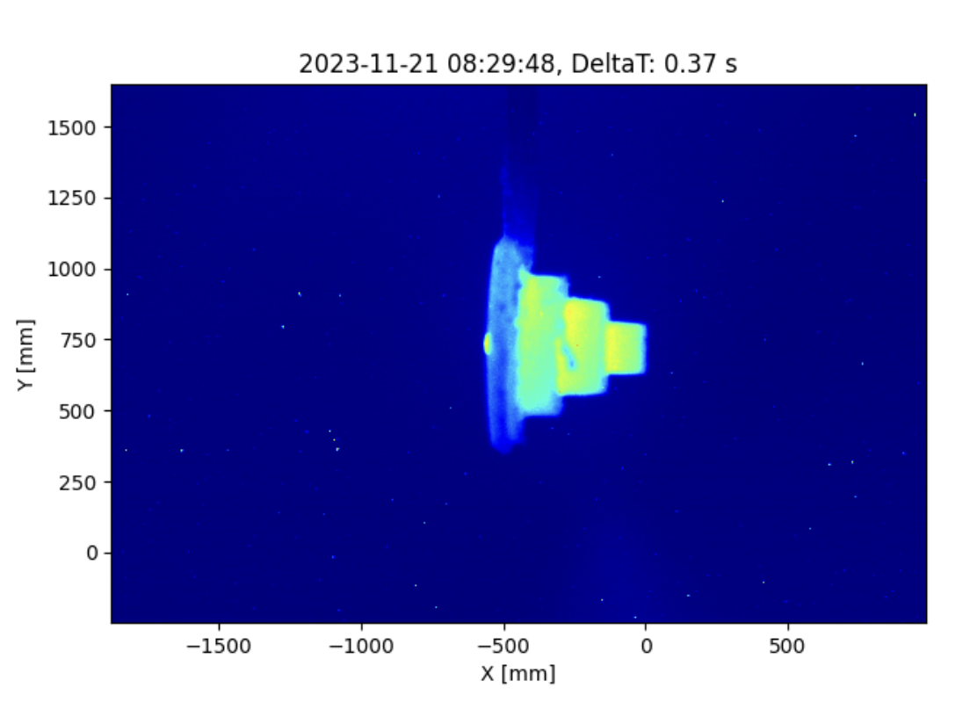
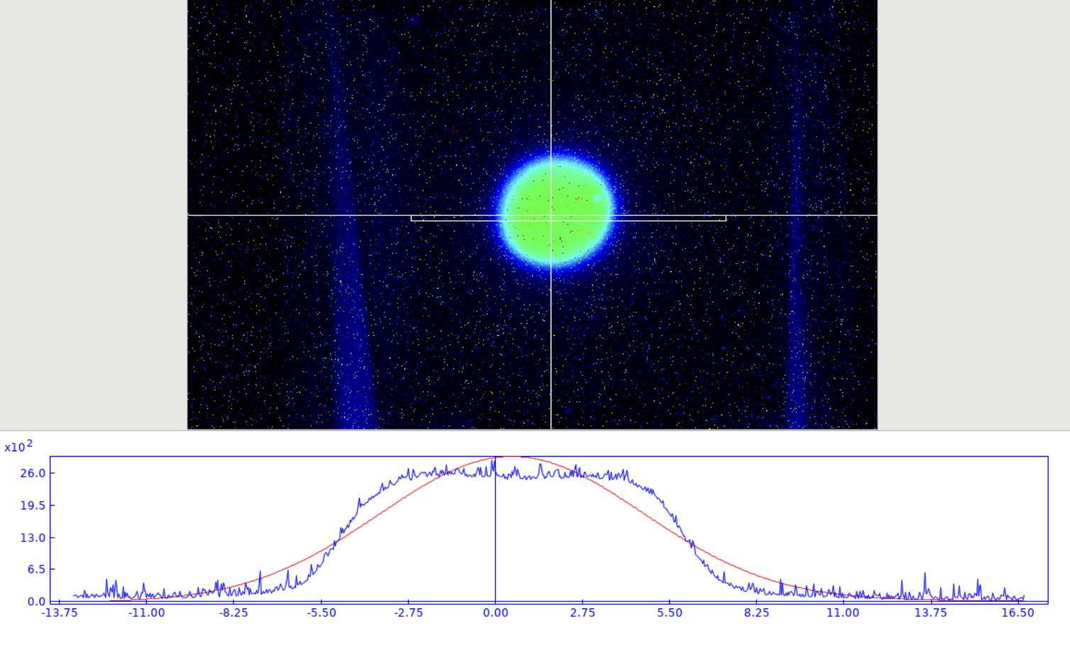
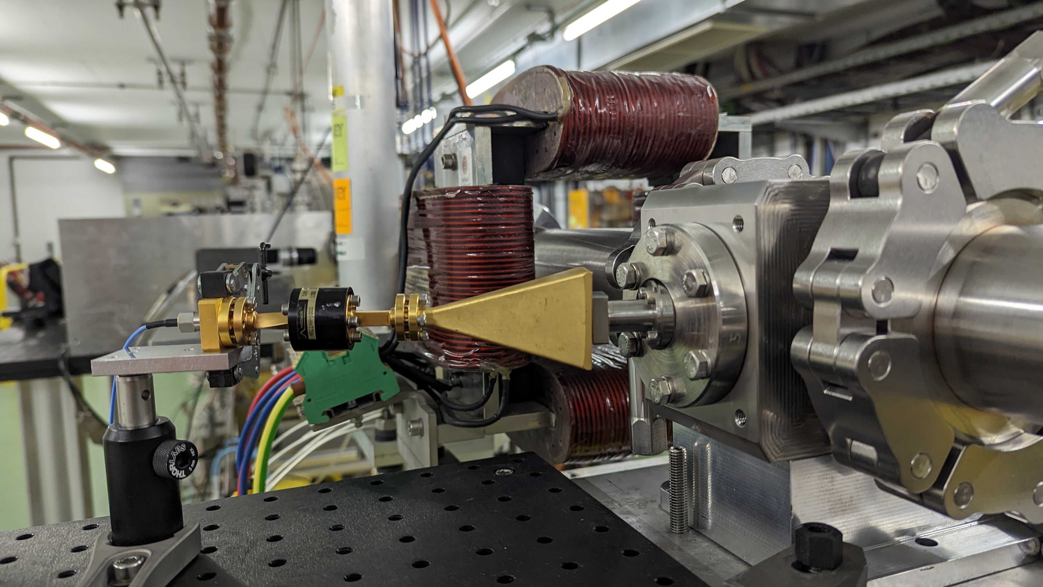
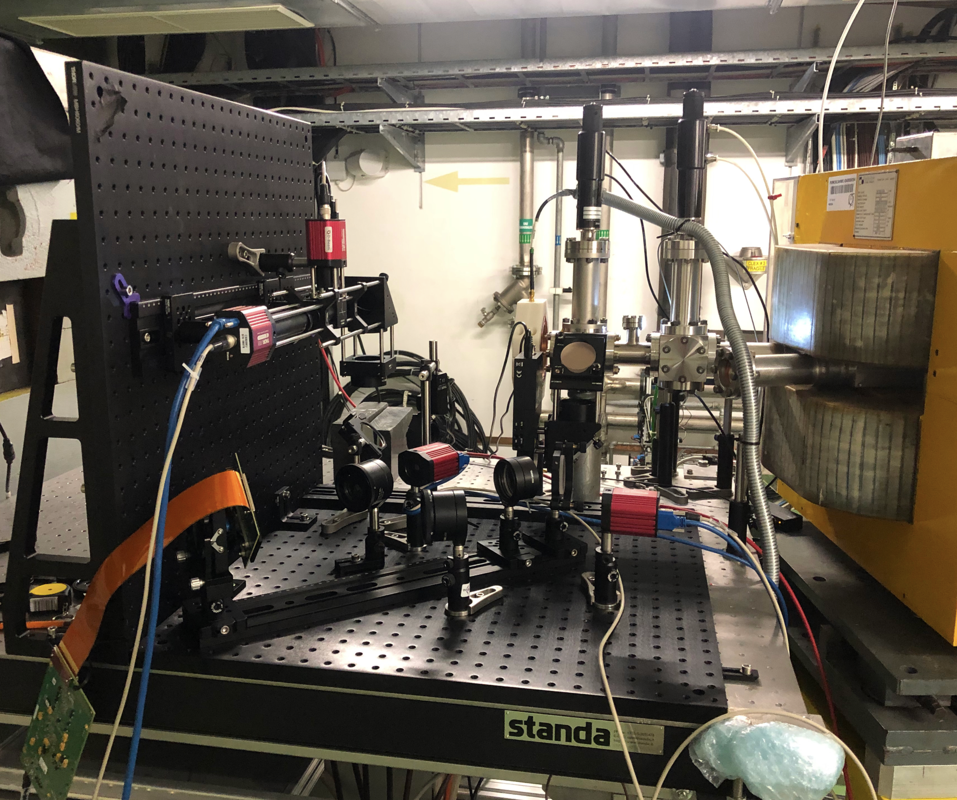
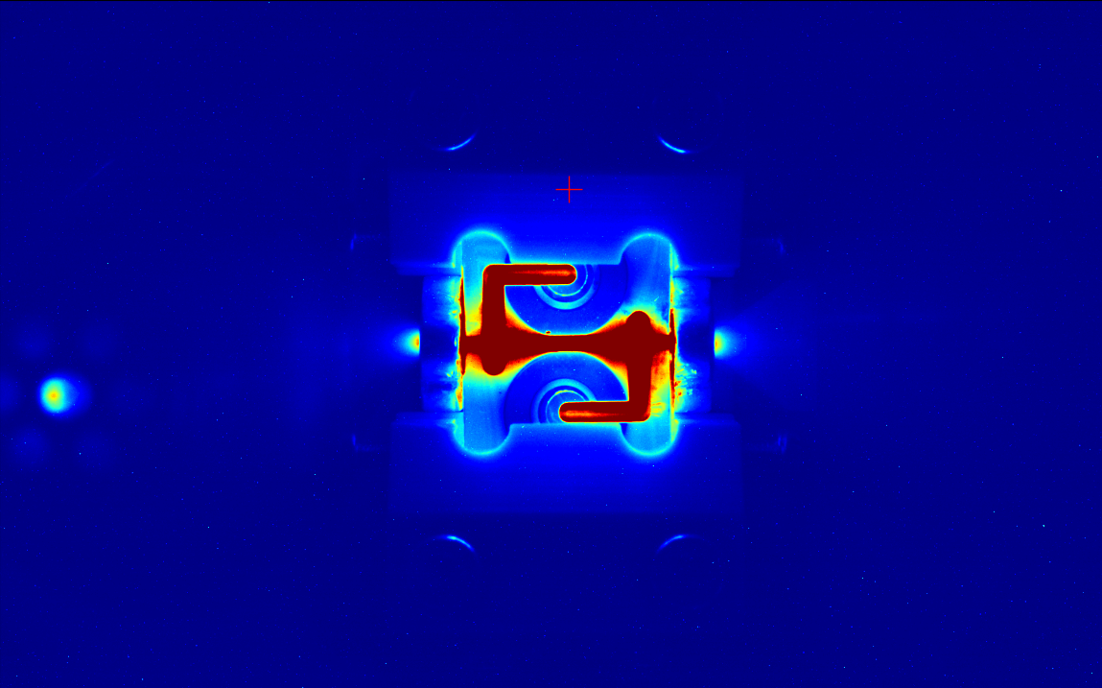
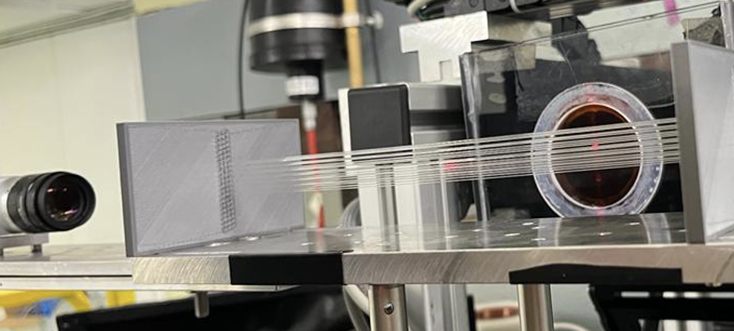
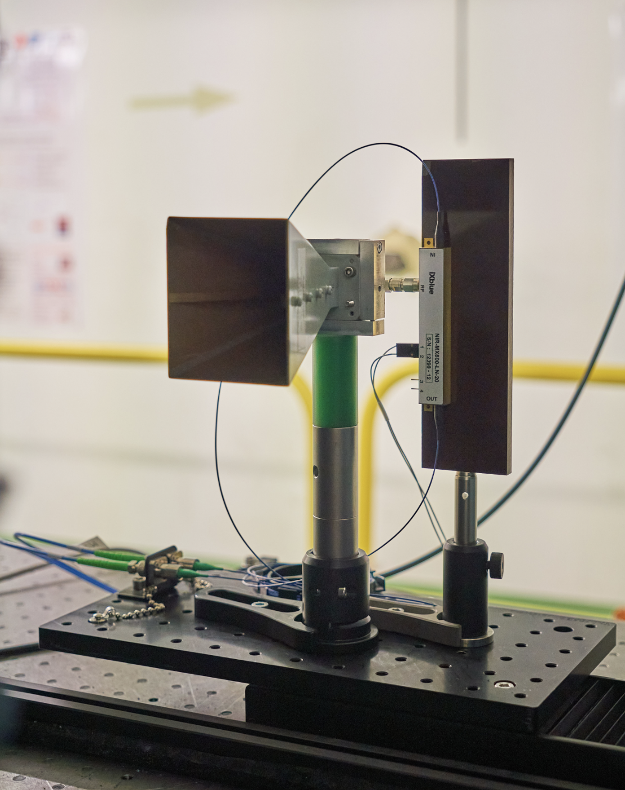
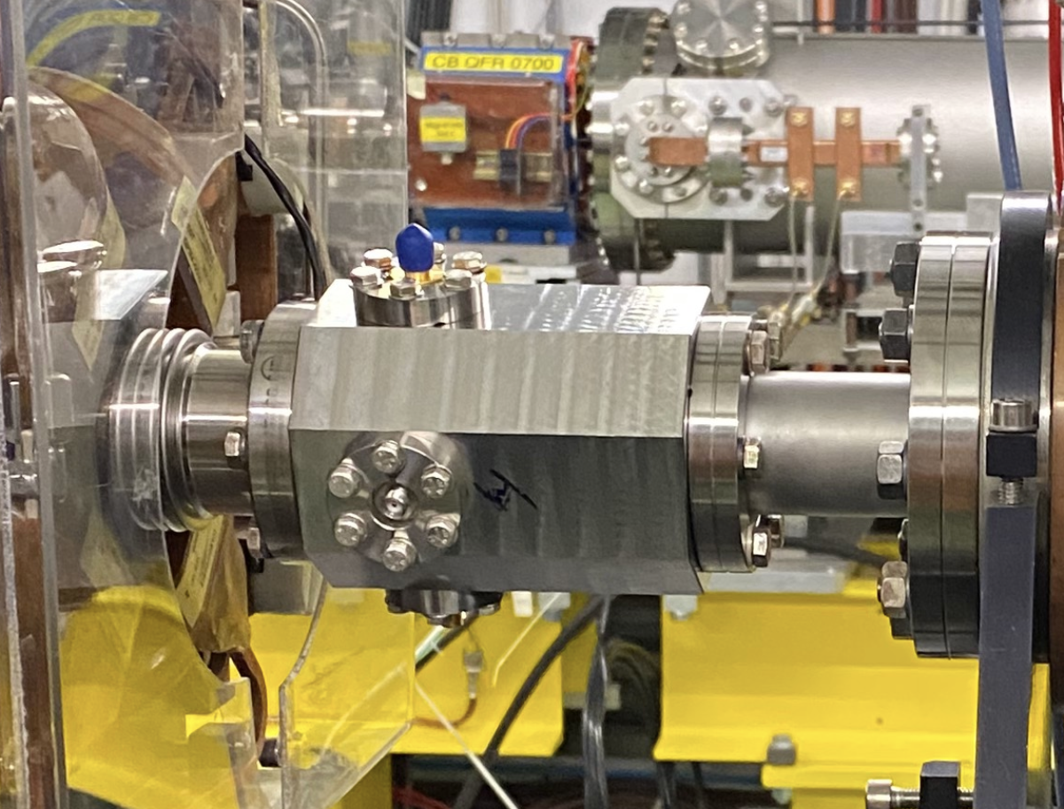
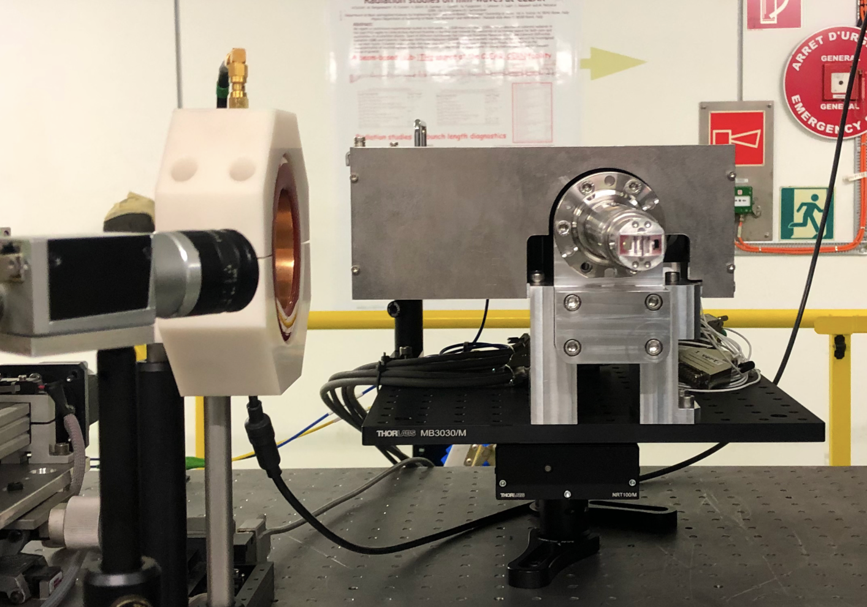
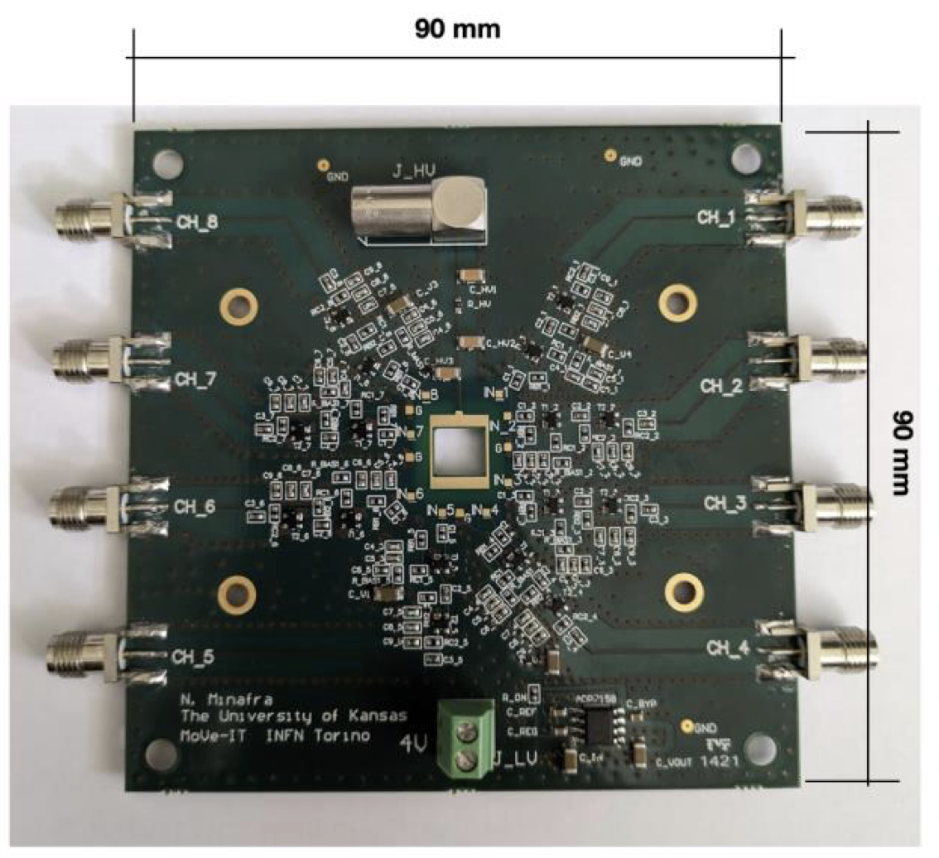
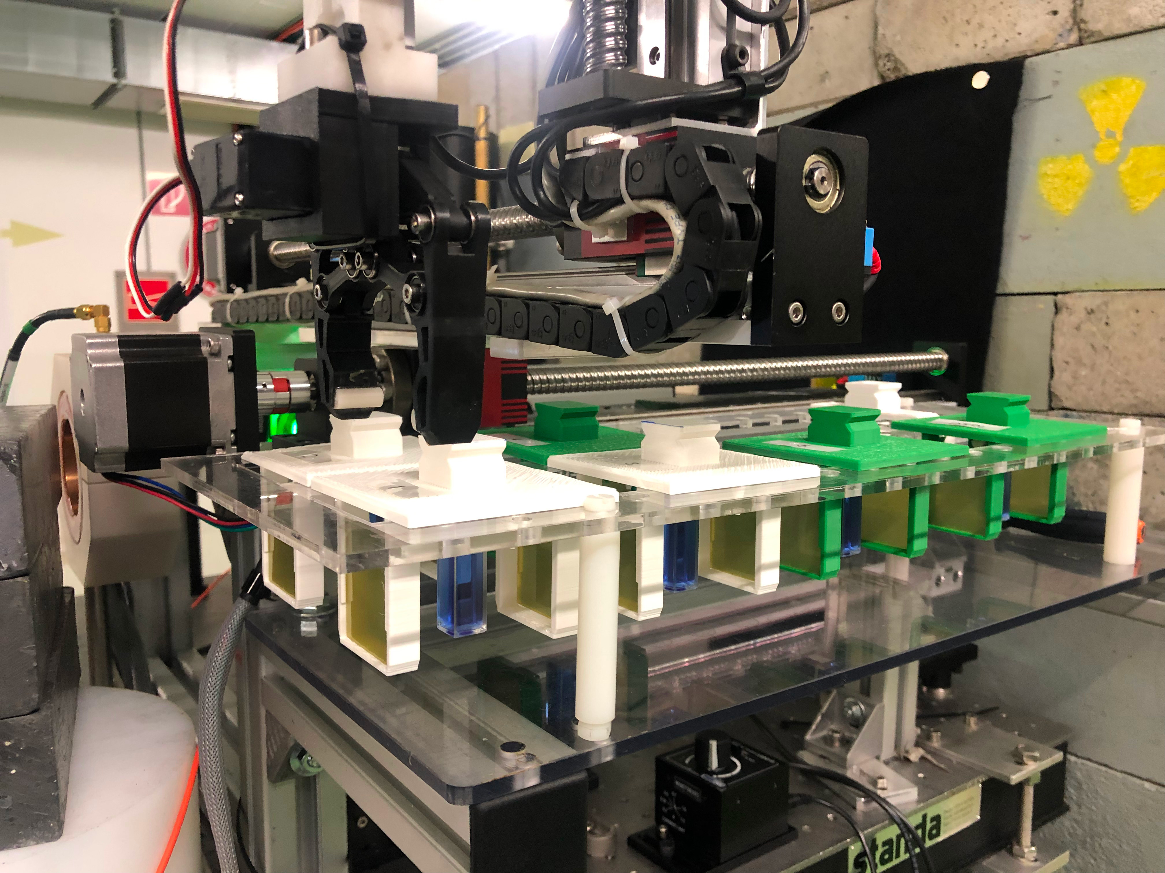
  27 Experiments
  About 21 User Groups internal/external
  More than 18 external collaborating institutes
  Beam from February 27th to December 15th
  (with 3 weeks summer stop)
  38 weeks of operation in total
Double-scattering system for uniform beam delivery
for VHEE radiotherapy (CERN/Oxford U.)
Operation
2023
A few Highlights
AWAKE Cherenkov Diffraction Radiation BPM
Plasma lens defocusing tests
(Oslo U./CERN/Oxford U./DESY)
Novel OTR-based emittance meas. system for AWAKE (Liverpool U.)
Fibre-optic beam profile and dose monitor for VHEE radiotherapy at ultra-high dose dates(CERN/Oxford U.)
Real-time dosimetry for VHEE radiotherapy using cuvettes (Strathclyde U.)
Coherent Cherenkov diffraction radiation dielectric buttons
(FCC-ee bunch length monitors)
Broadband Pick-up for the
PSI Positron Production Project (FCC-ee collaboration)
Bunch Profile Monitor for FCC-ee (Karlsruhe)
Beam testing of PCB + detectors using different technologies (Kansas U.)

Slide 23
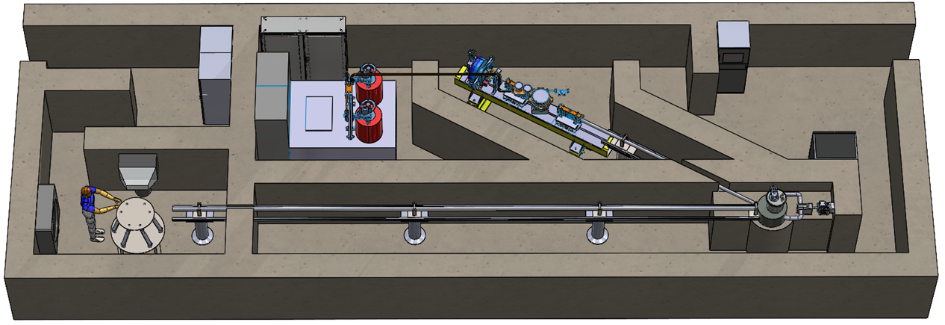
VULCAN - Overview
Versatile Ultra-Compact Advanced Neutron generator
Neutron Detector
Klystrons
e⁻ linac
VULCAN is a turn-key solution for generating thermal neutrons for:
Stress-strain analysis of bulk materials
Operational analysis of Li batteries and fuel cells electrodes
Optimised for industry – compact, affordable
Test Stand
Neutron Guide
TMR
(Target-Moderator-Reflector)
- design + experimental study in CLEAR
- initially presented to the CERN KT initiative CIPEA in June 2022, approved and funded in 2023

Slide 24
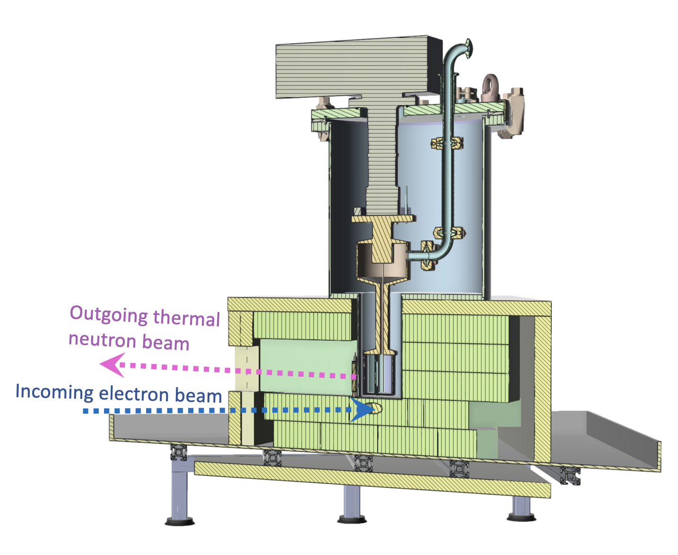
VULCAN in CLEAR
The Target-Moderator-Reflector (TMR)
Novel TMR design is key for VULCAN
Converts an incoming 35 MeV electron beam into ~ MeV neutron beam
Proof-of-concept of its performance to be undertaken in CLEAR
Flux and time-of-flight measurements
Complex experiment – issues with cryogenic – gas – safety…
Two weeks earmarked in July for
installation and test

Slide 25
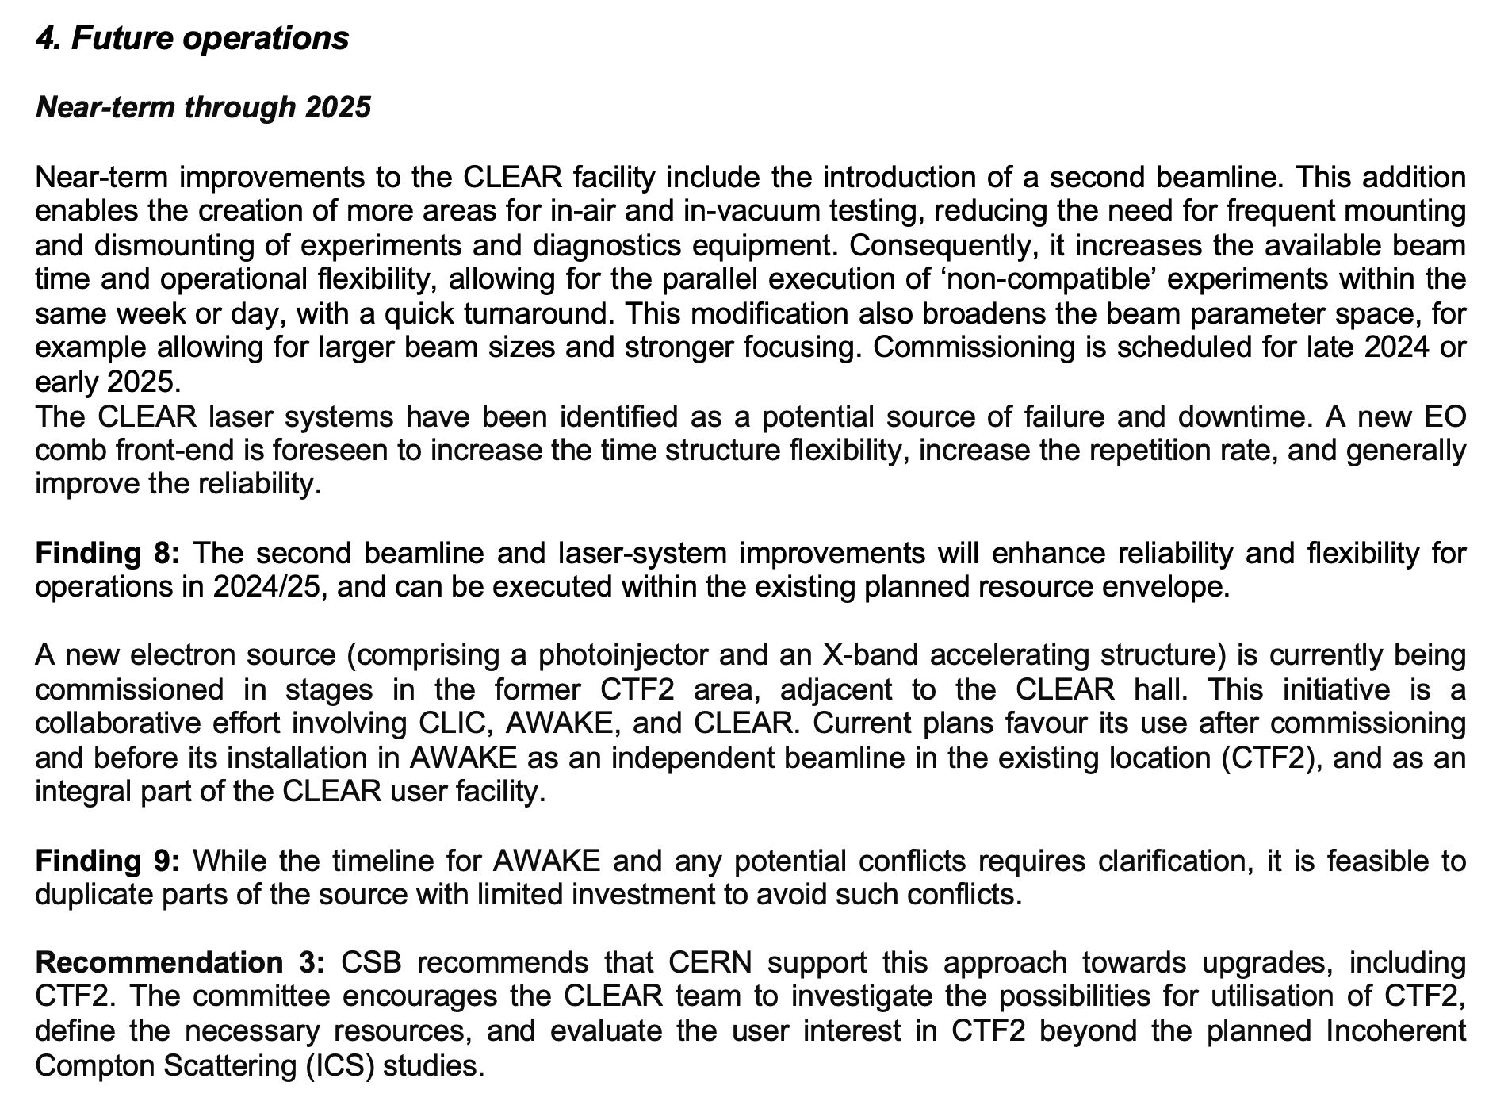

Outlook to end 2025
From CLEAR Scientific Board Report 2024

Slide 26


Outlook beyond 2025
From CLEAR Scientific Board Report 2024

Slide 27

Thanks for your attention!
Acknowledgements to the CLEAR dream team:
S. Doebert, W. Farabolini, A. Ghilardi, P. Korysko, A. Malyzhenkov,
A. Aksoy, K. Sjobaek, L. Dyks, V. Rieker, J. Bateman, C. Robertson, L. Wroe, E. Granados, M. Martinez, S. Curt, D. Gamba, …

