Slide 1
CLEAR: a Long-Term Outlook
R. Corsini, D. Gamba for the CLEAR Team
CLEAR Review 2024 – 29th May 2024 - CERN

Slide 2
Outline
Back to the Basics:
  Overview of CLEAR Infrastructure and Goals
Expected Use of CLEAR in the Coming Years:
  Contributions to a Higgs Factory at CERN: with an emphasis on FCC-ee
  Contributions to the Irradiation Facility Ecosystem for Detectors R&D
  Contributions to Accelerator Technology, including Training and Controls
Looking Ahead:
  CLEAR as an Incubator for FCC-ee Injector as CLEAR++
Conclusions

Slide 3
Outline
Back to the Basics:
  Overview of CLEAR Infrastructure and Goals
Expected Use of CLEAR in the Coming Years:
  Contributions to a Higgs Factory at CERN: with an emphasis on FCC-ee
  Contributions to the Irradiation Facility Ecosystem for Detectors R&D
  Contributions to Accelerator Technology, including Training and Controls
Looking Ahead:
  CLEAR as an Incubator for FCC-ee Injector as CLEAR++
Conclusions

Slide 4
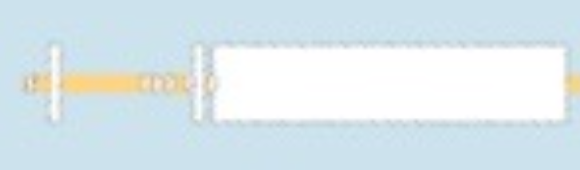
Back to the Basics: CLEAR and its Scientific and Strategic Goals
Bld. 2010/CLEX
CLEAR Beamline(s)
1 nC/b; ~200 MeV; 3 GHz
Bld. 2013/CTF2
ARTI Injector
0.1 nC/sb; 6(70) MeV; 3 GHz
Bld. 2003
Was CLIC DBRC prototype @CTF3
Was hosting EPA ring (C=125 m, 500 MeV)
Old EPA/CTF3 Complex
Bld. 2001
Was CLIC DB Linac Prototype (120 MeV, 4 A e⁻ train @1.5 GHz) @CTF3
Was hosting LIL injector (500 MeV e⁻/e⁺ (from 200 MeV e⁻))
Providing a test facility at CERN with high availability, easy access and high-quality e⁻ beams.
  Performing R&D on accelerator components, including beam instrumentation prototyping and high gradient RF technology
  Providing an irradiation facility with high-energy electrons, e.g. for testing electronic components (e.g. in collaboration with ESA) or for medical purposes (e.g. VHEE/FLASH)
  Performing R&D on novel accelerating techniques – electron driven plasma and THz acceleration
Maintaining CERN and European expertise for electron LINACs linked to future collider studies
Using it as a training infrastructure for the next generation of accelerator scientists and engineers

Slide 5
Outline
Back to the Basics:
  Overview of CLEAR Infrastructure and Goals
Expected Use of CLEAR in the Coming Years:
  Contributions to a Higgs Factory at CERN: with an emphasis on FCC-ee
  Contributions to the Irradiation Facility Ecosystem for Detectors R&D
  Contributions to Accelerator Technology, including Training and Controls
Looking Ahead:
  CLEAR as an Incubator for FCC-ee Injector as CLEAR++
Conclusions

Slide 6
Expectations and Outlook on Activities 2025+
Demand for experiments on CLEAR steadily increased (bar the pandemic period)
We expect requests will not decrease for the next few years (see CSB-2024):
  Beam diagnostics R&D is an important area, with about 30% of total tests, and now shared equally between CERN and external users.
  Novel acceleration techniques (plasma, THz, X-band, high gradient) are not growing, but there are a few long-term programs (including Plasma Lens, continued support to AWAKE, and potentially a full-fledged ICS experiment) which must be maintained with priority as part of the LDG roadmap.
  Medical activities are a highlight – the next 4-5 years will be critical to fully establish VHEE/FLASH.
  CLEAR will have a pivotal role in the field for several years a unique facility for VHEE/FLASH, including knowledge transfer to other labs with capability for animal testing.
  Activity in other areas (e.g. irradiation, neutron production, beam test of particle detectors/components) is also increasing overall, and it will provide further opportunities.
  The role of training and EU projects, with CLEAR being recognized as a valuable infrastructure in projects such as EURO-LABS.
We are saturating our capacity to provide beam time to all users. Planned improvement and consolidation will enable us to cope with a slightly higher load.
From a strategic viewpoint, the CSB-2024 finds that CLEAR could serve as a bridge towards an electron-beam test facility based around developing key components required for a Higgs factory and recommends CLEAR team be centrally involved in discussions for such a facility at CERN.
Notes:
LDG: Laboratory Directors Group

Slide 7
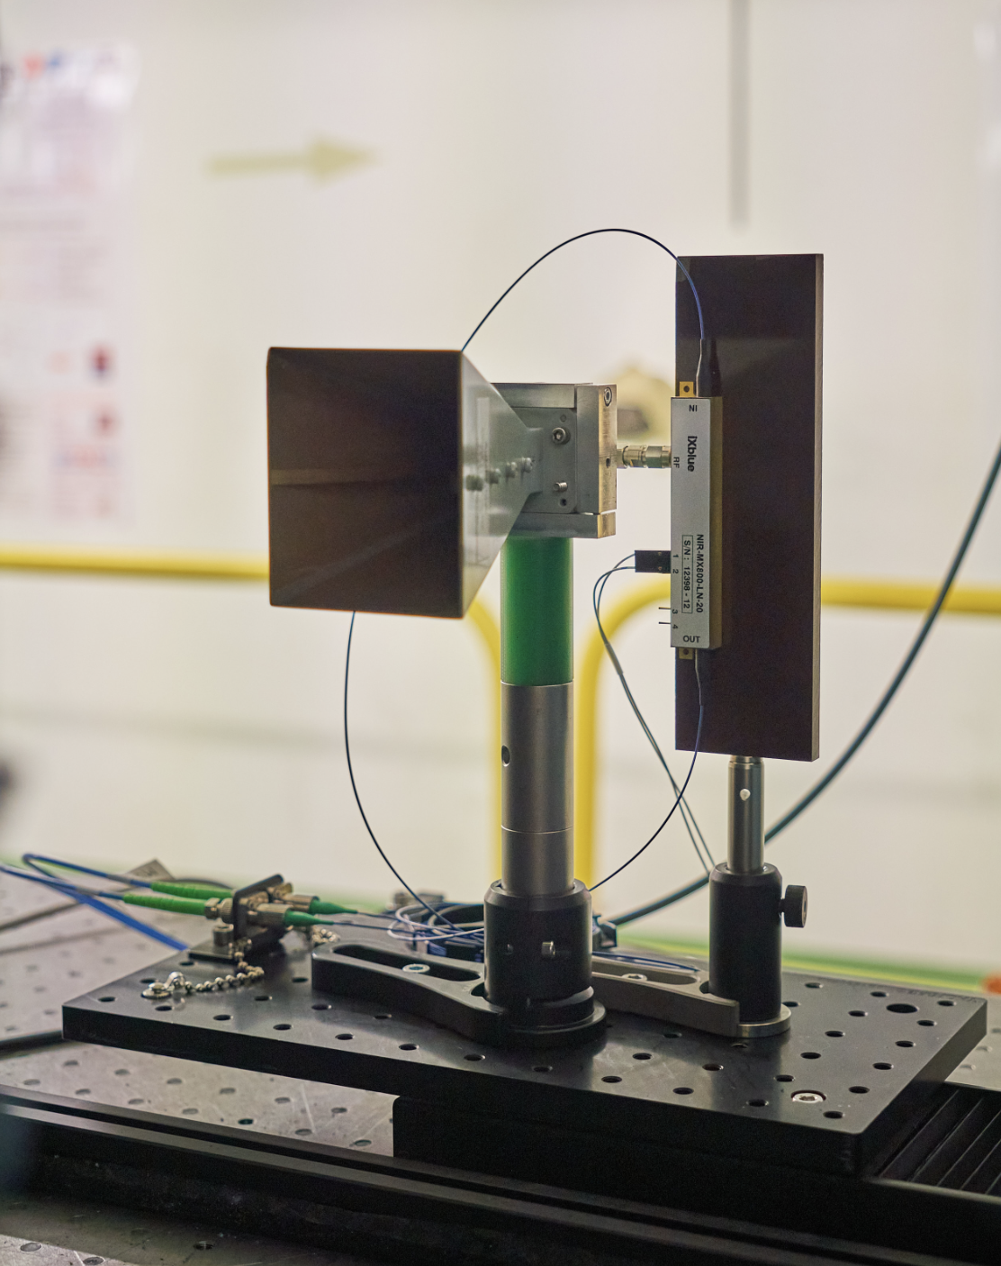
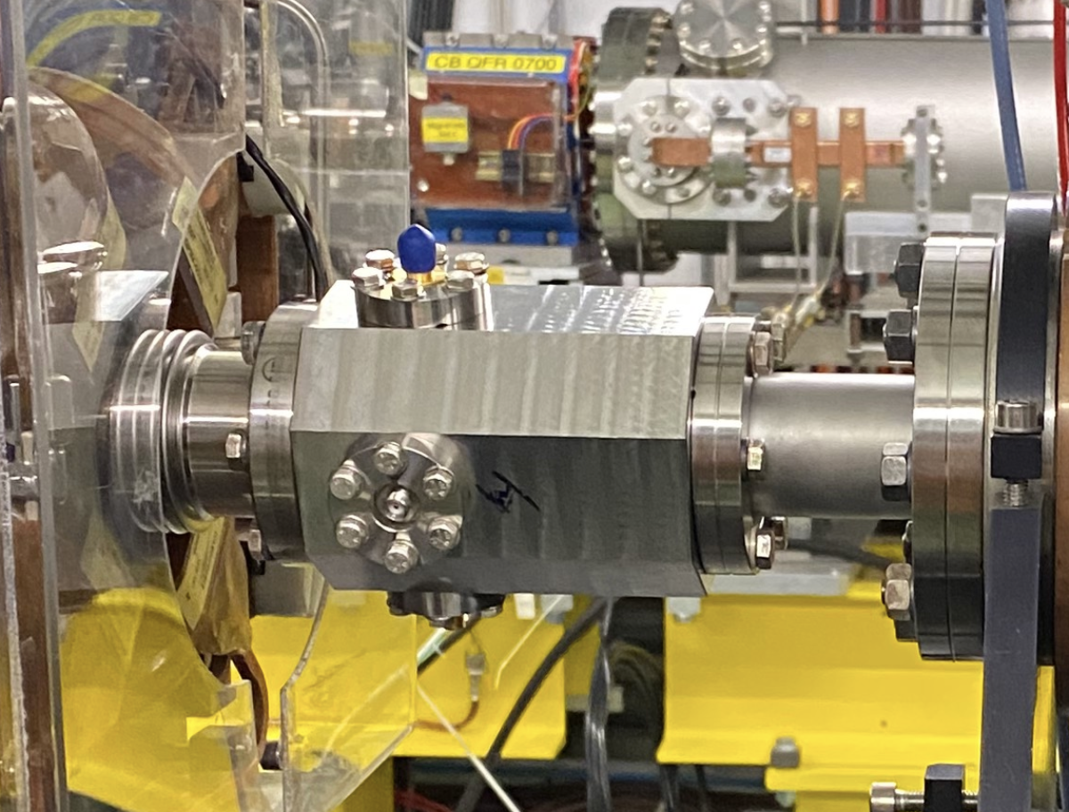
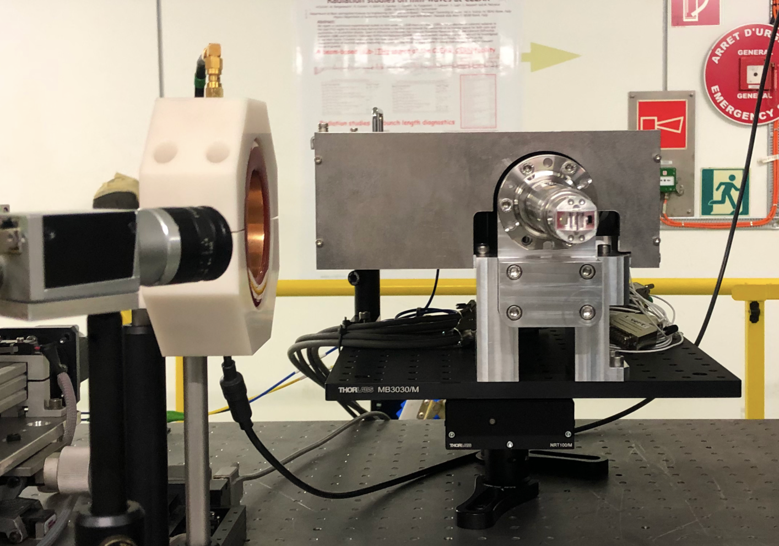
Present CLEAR Contributions to FCC-ee
Performed Beam
Diagnostics
Experiments in 2023
Performed by CERN & external institutes, usually in collaboration
Coherent Cherenkov diffraction radiation dielectric buttons
(FCC-ee bunch length monitors)
Broadband Pick-up for the
PSI Positron Production Project
(P³ - FCC-ee collaboration)
Bunch Profile Monitor for FCC-ee (KIT - Karlsruhe)
Planned
Experiments in 2024
Continuation of previous experiments:
Electro-Optical Longitudinal Bunch Profile Monitor for FCC-ee (KIT)
Coherent Cherenkov diffraction radiation dielectric buttons (CERN, BI)
NEW: Damage test of positron target materials (CERN/STI – M. Calviani, A. P. Marcone)
➯ discussion ongoing on the program, including positron detection, etc…

Slide 8
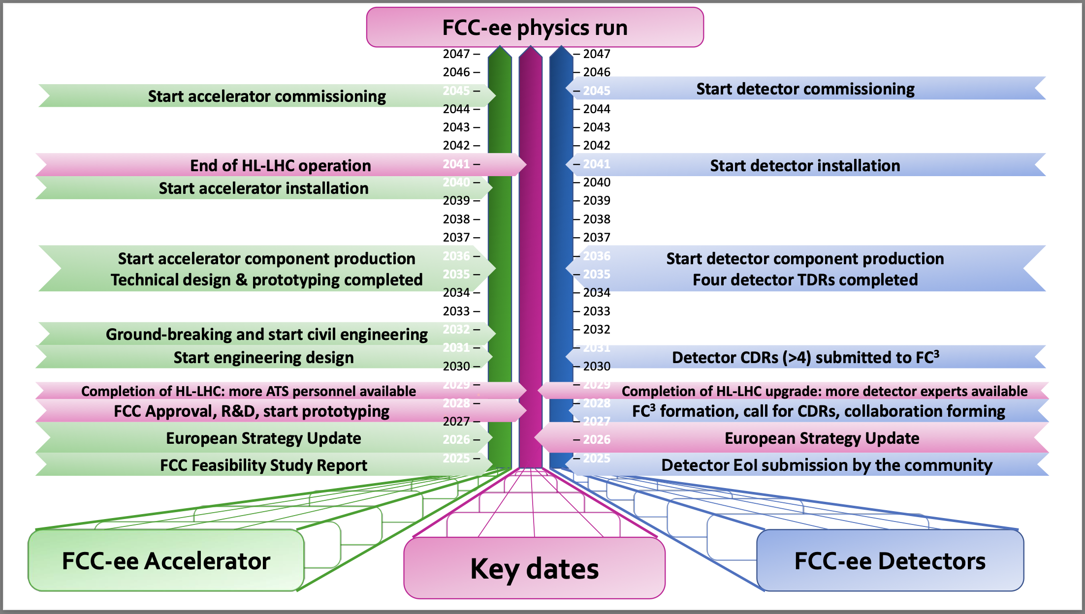
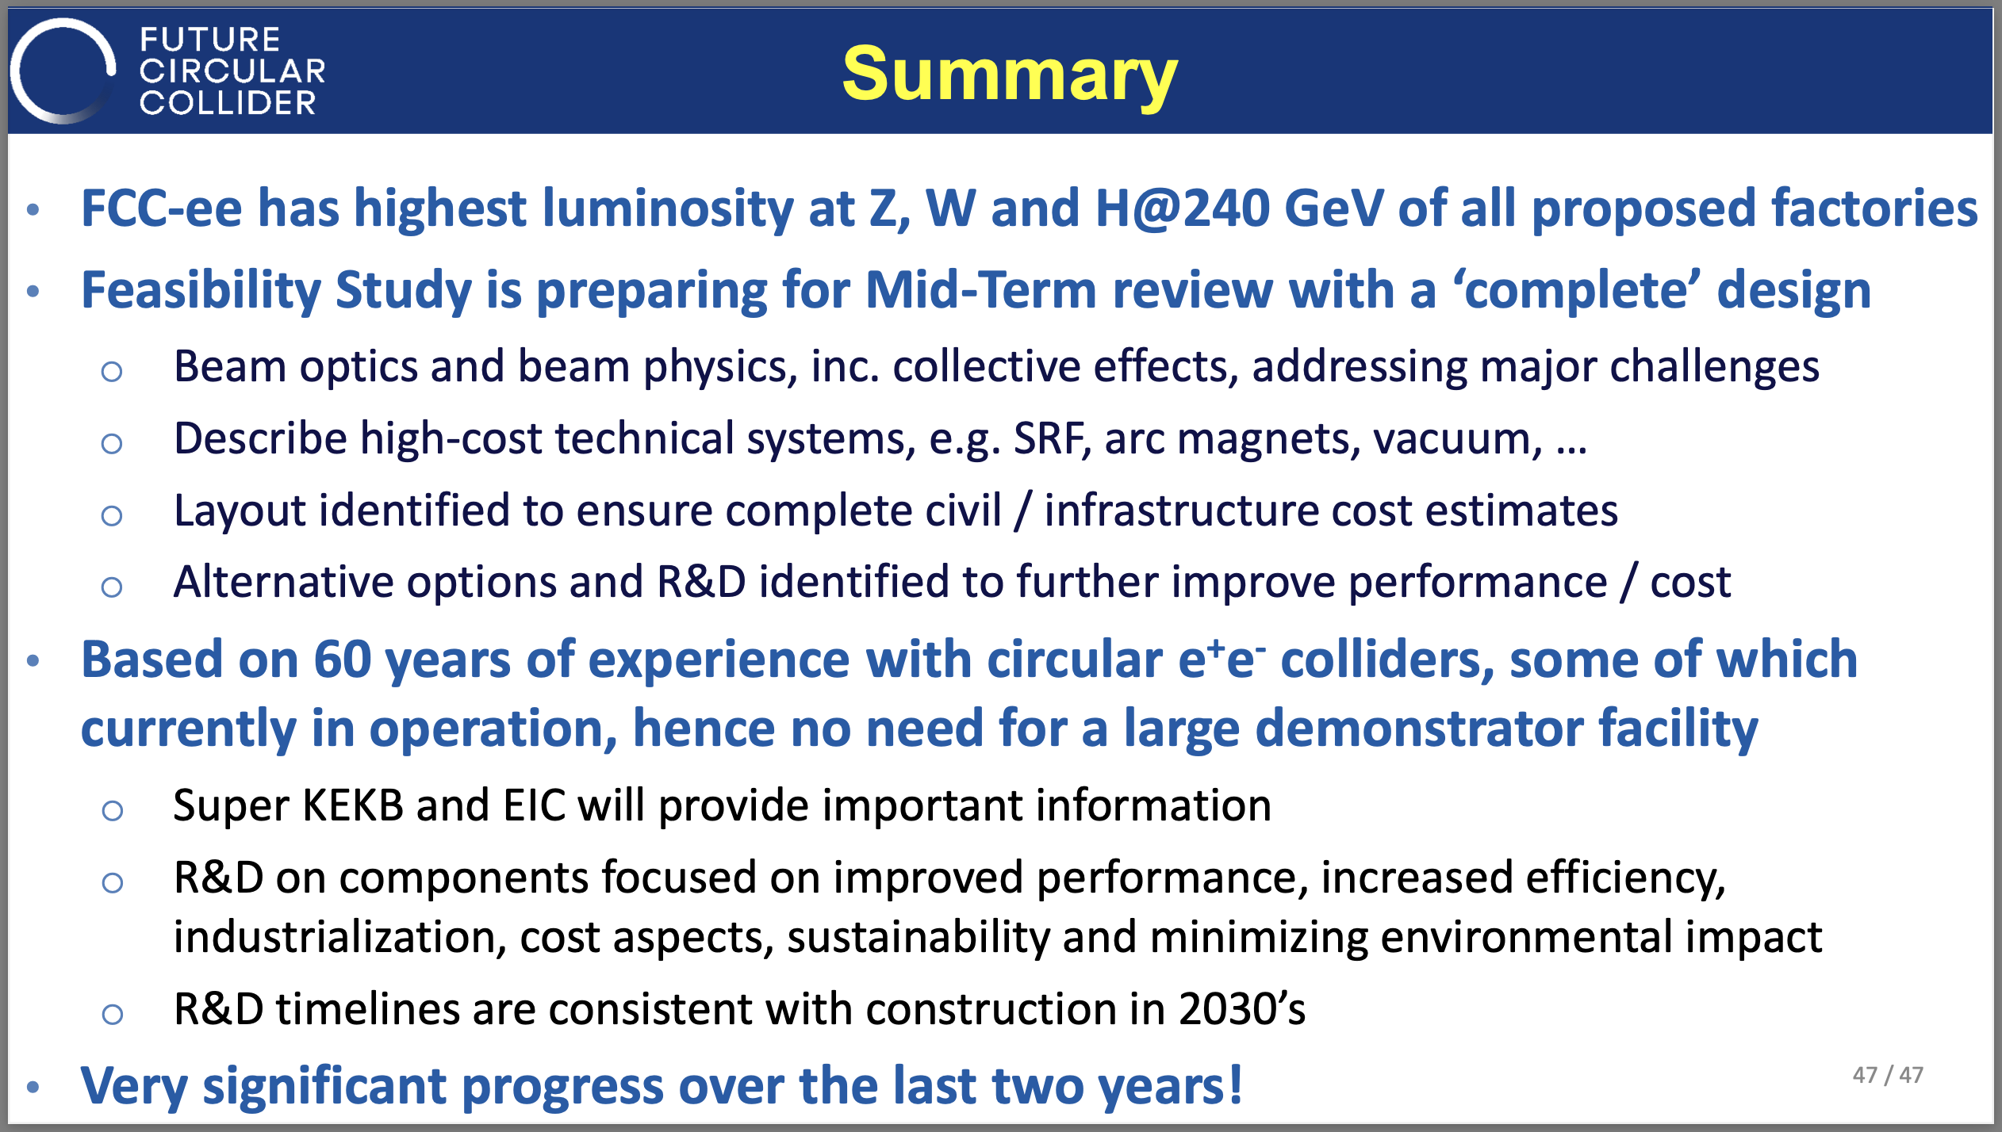
An Overview of FCC-ee: What to Expect
M. Benedikt, F. Zimmermann @FCC-Week-2023
CERN interest (and resources) in FCC-ee R&D expected to boost late 2020s
It is wise to bridge e⁻ LINAC know-how
at least till start of first stages of “final” facility,
i.e. early 2030s
A demonstrator facility is not to be expected!
If approved, CERN will likely build directly the final FCC-ee (injector) complex
Tor Raubenheimer @FCC-Week-2023

Slide 9
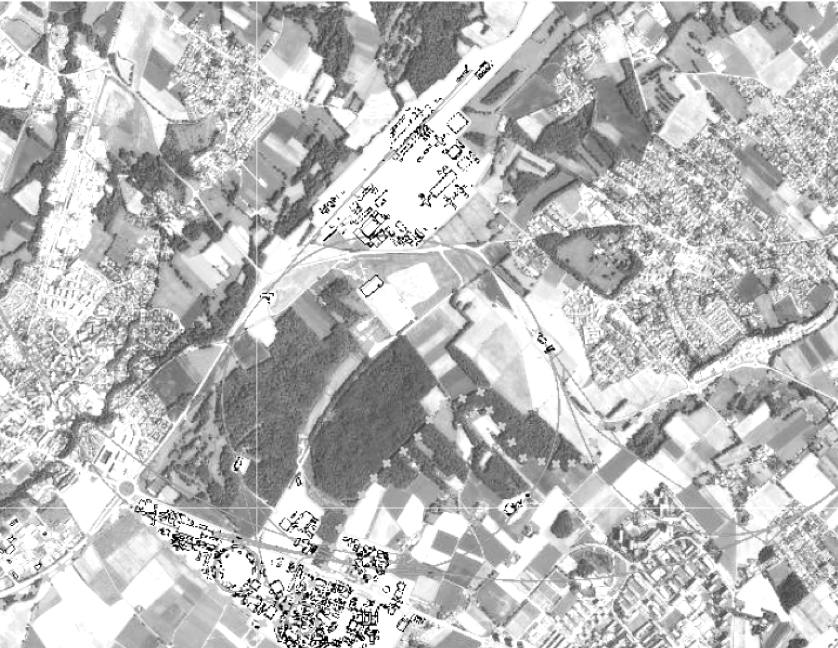
FCC-ee Complex and its Injector
Most likely injector option:
LINACs & damping ring on Prevessin site
Transfer to SPS BA4
1 beam through SPS tunnel
1 beam through TT40/TI8
  (can also send beam toward AWAKE)
In general, size/challenges of such a complex are not comparable to CLEAR
FCC-ee pre-injector
Baseline option
SPS
FCC
AWAKE
final energy: 16 GeV
LHC
1.54 GeV
CLEAR
final energy: 20 GeV
1.54 GeV
Option 2 is the present baseline
1.54 GeV
Parts of this slides from H. Bartosik @ PBCWS2024

Slide 10
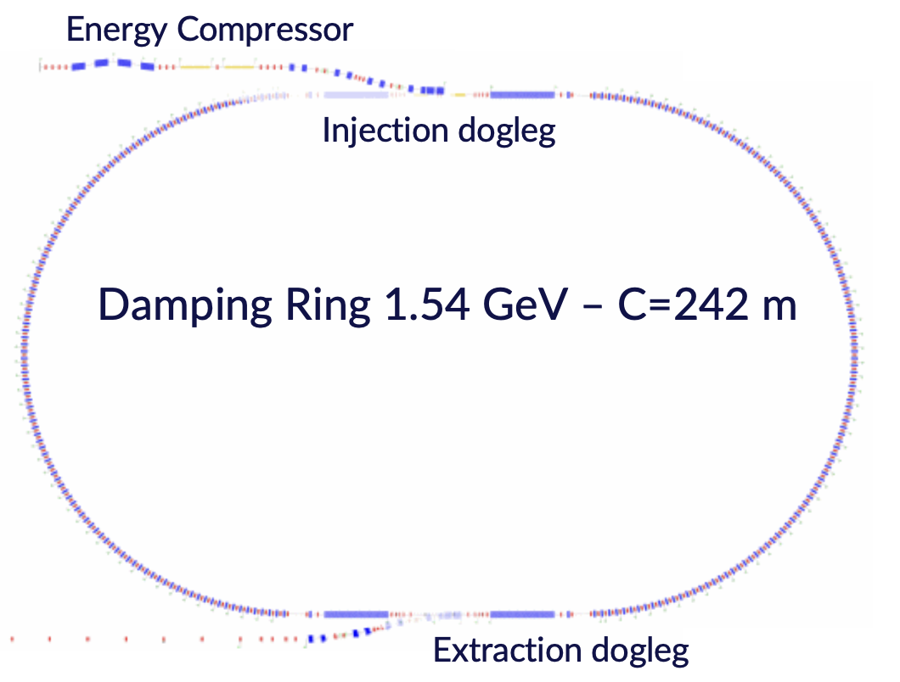
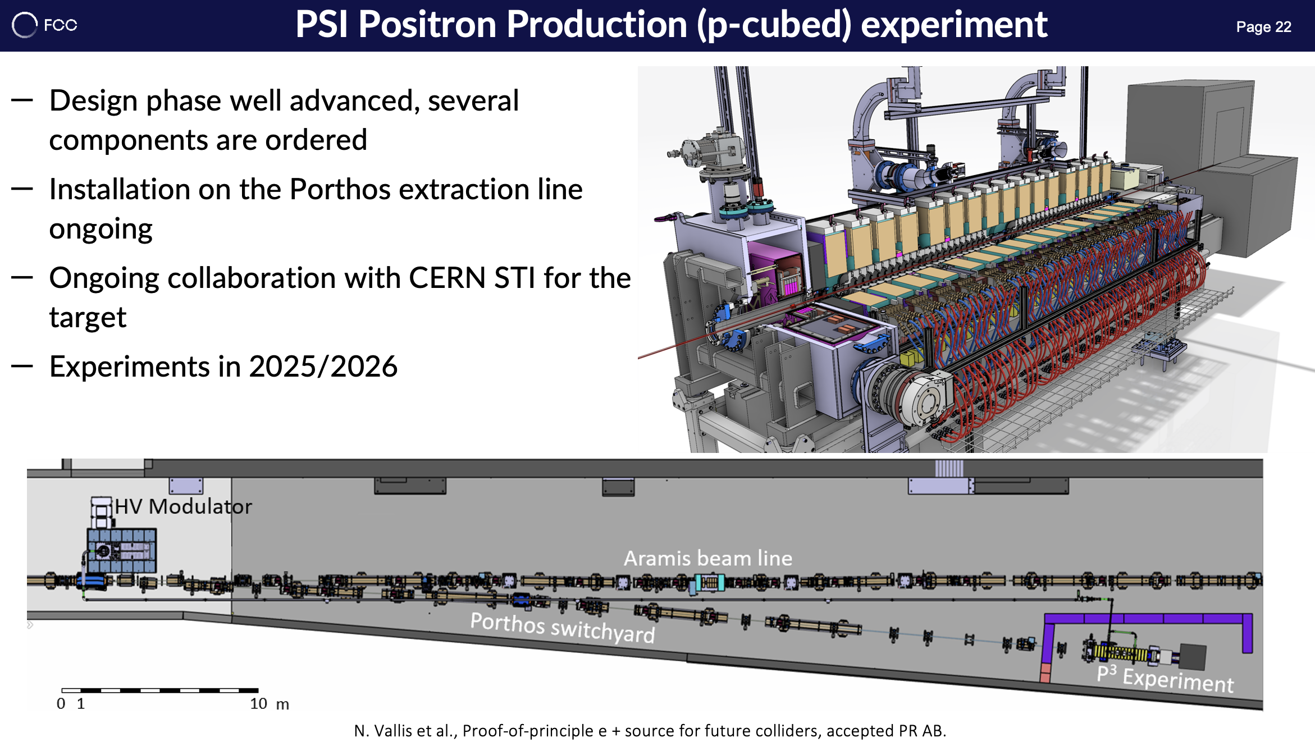
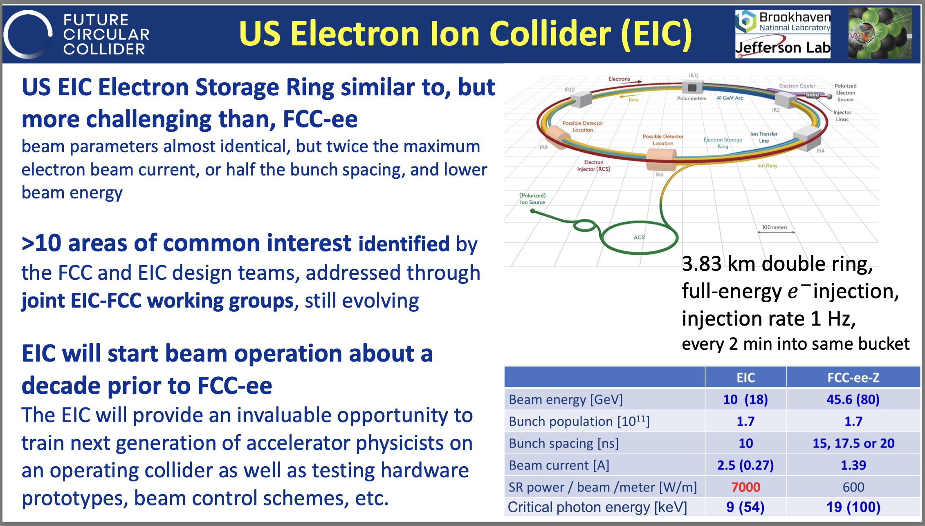
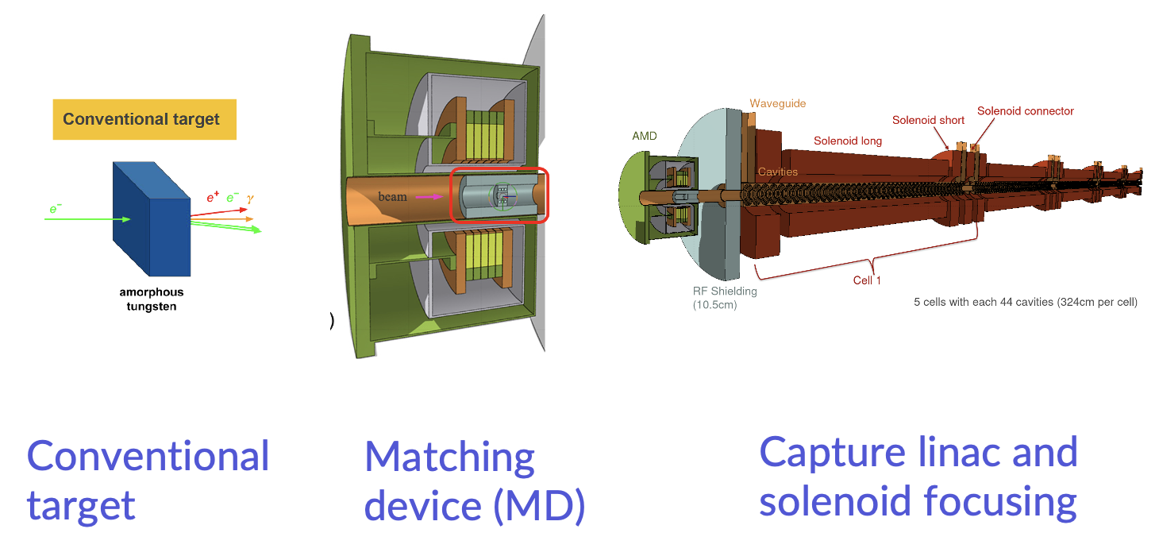
Selected FCC-ee challenges/considerations
Prototyping the positrion production at high energy (but not intensity), covered by P³
Damping Ring challenges maybe worth investigating… but no space at CLEAR
From P. Craievich @CERN-RF-Seminar
EPA ring was only 120 m in circumference
Possibly, some aspects already covered by tests in light sources?!
EIC in the US used as proof-of-principle?
Conventional
target
Matching
Device (MD)
Capture linac and
solenoid focusing
T. Raubenheimer @FCC-Week-2023

Slide 11
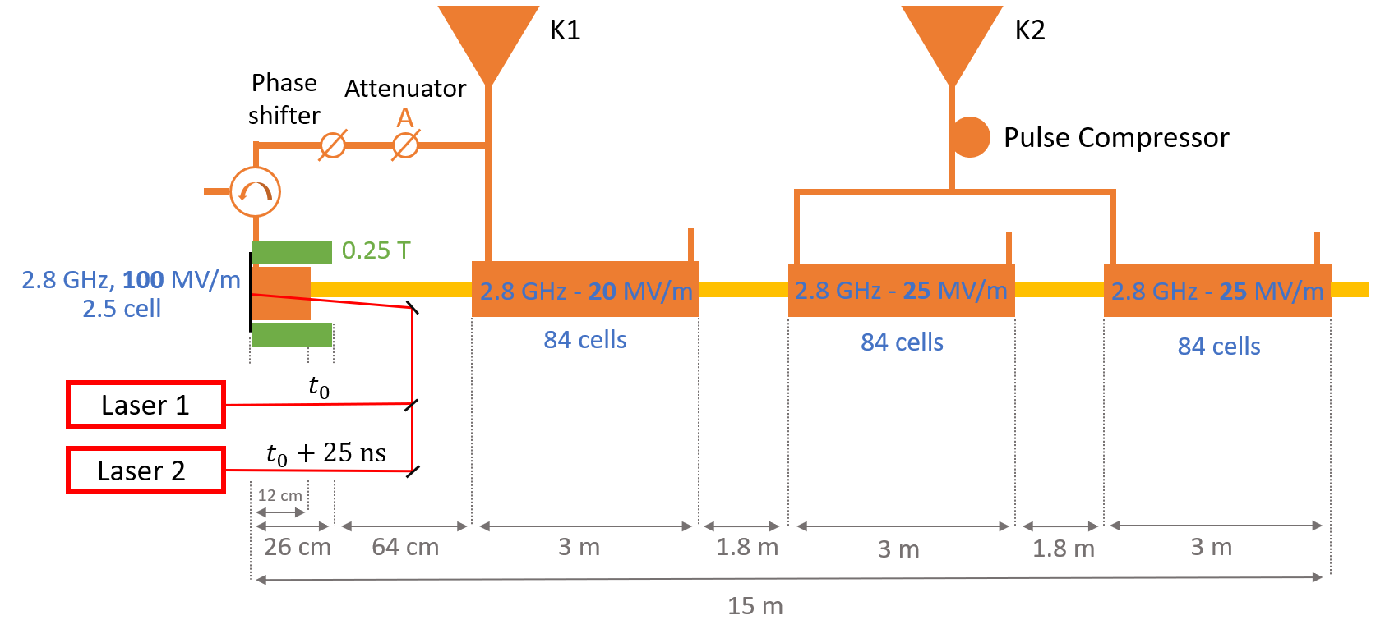
FCC-ee Electron Source Frontend
Not surprisingly, not very different than CLEAR Frontend, but slightly different parameters
CLEAR/CTF2 have expertise and space adapted to test prototypes and key concepts, e.g.:
2-bunches production as FCC-ee probably possible/testable at CLEAR
A prototype 2.8 GHz module from source to structure, with beam, could be tested in CLEAR/CTF2
CLEAR can be a test bed for tools/techniques for beam properties characterisation
CLEAR:
200 MeV
1 nC/bunch
σ_{z} = 1 mm
σ_{δ} = 0.2 %
ε_{N} < 20 μm
200 MeV
5 nC/bunch
σ_{z} = 1 mm
σ_{δ} = 0.2 %
ε_{N} < 5 μm
Courtesy of Zdenek Vostrel and Steffen Doebert
From P. Craievich @ FCC-Week-2023

Slide 12
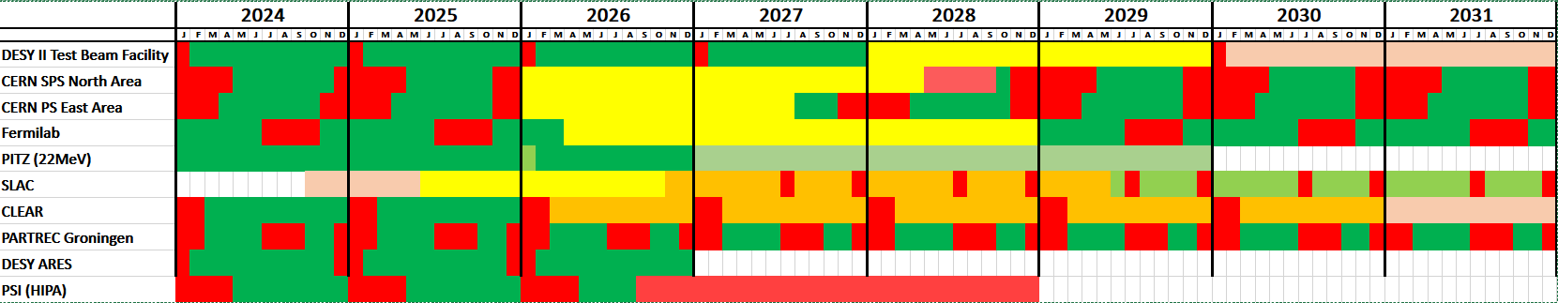
Plus: Shortage of Detectors R&D Test Facilities on the Horizon
Till today, CLEAR has been marginally used for Detectors R&D
  Might become relevant to bridge over LS3+, when most facilities will be in shutdown?
  CLEAR might be missing ”low intensity” capabilities
    Independent testing of low intensity beams (down to single electron) ongoing in 2024
  e⁻ irradiation possibly more adapted to FCC-ee components testing?
International Test Beam Schedule (from B. Holzer@Chamonix2024 and P. Pelissou@BTTB-SW24)
Compilation by the respective test beam coordinators
  See https://cern.ch/international-facilities
Aim: Rough estimate on available beam time to help the users with the planning of their test beams
HEP detector R&D mostly performed at CERN, DESY and Fermilab
Last Update January 2024
Running
Winter/Summer Shutdown
Longer Shutdown
Unclear
Likely
Pending Approval
Other CERN
Facilities
CLEAR

Slide 13
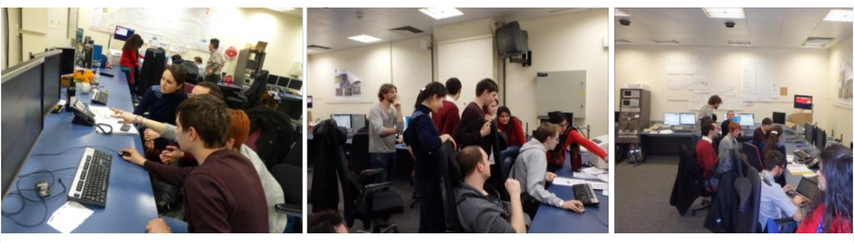
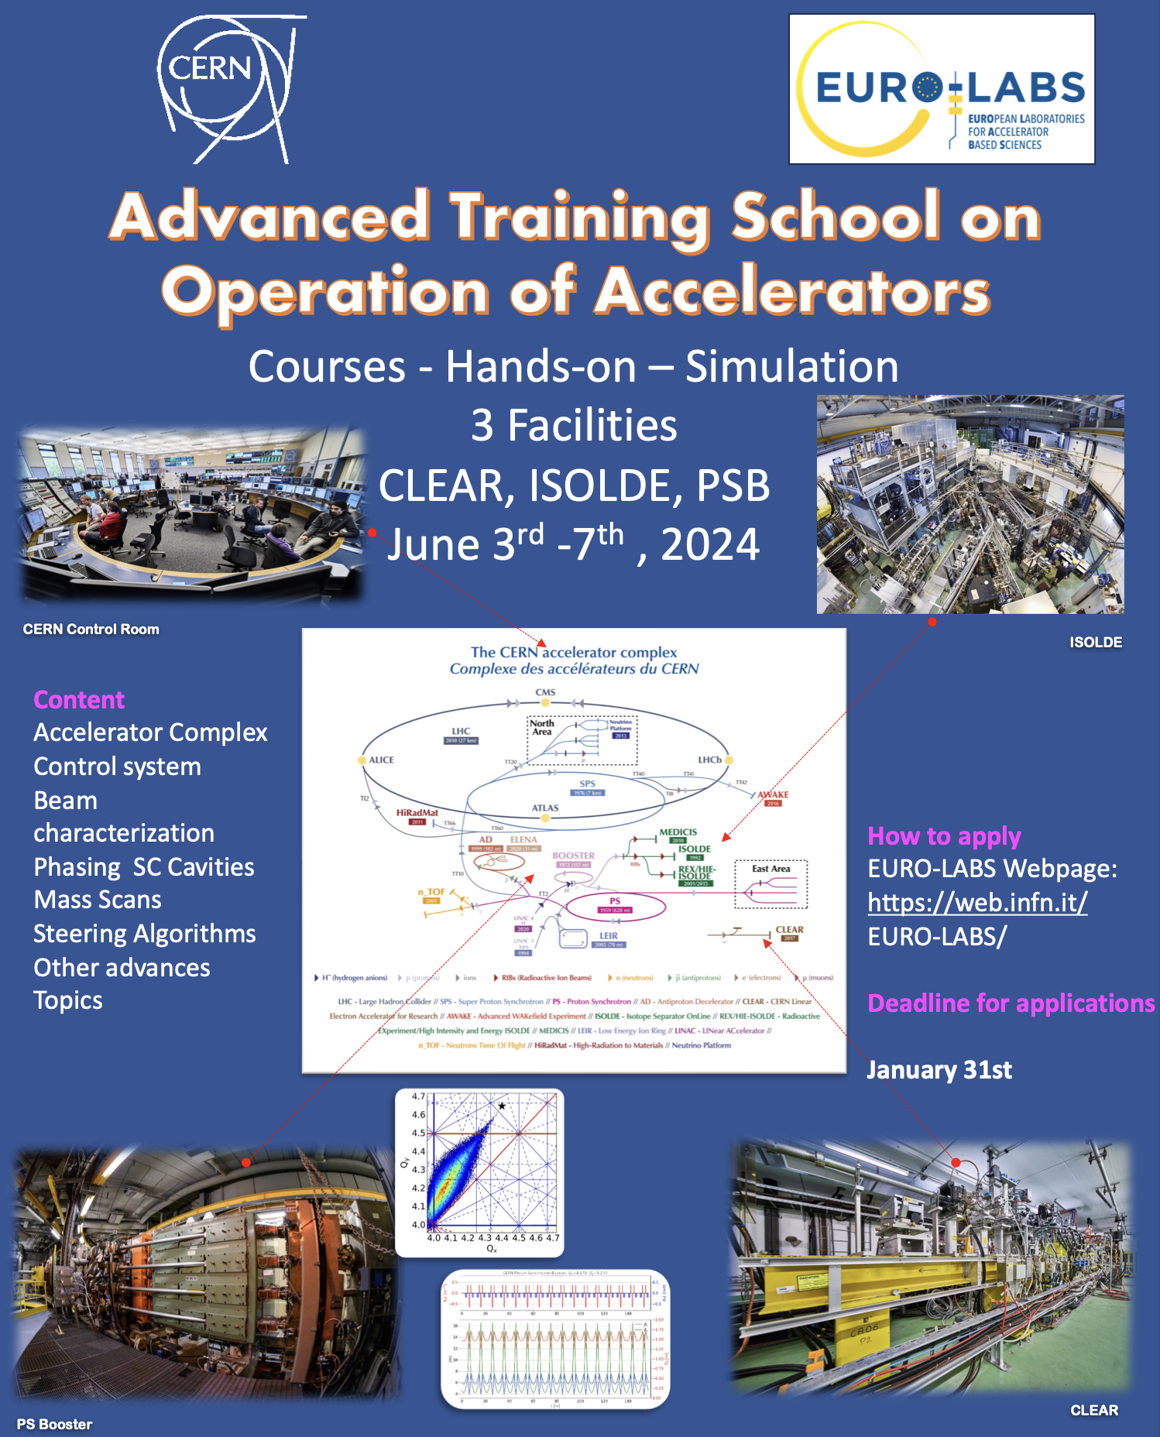

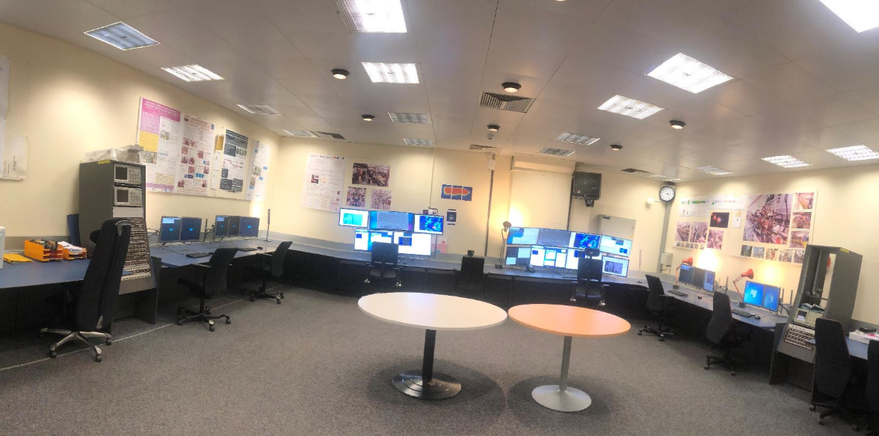
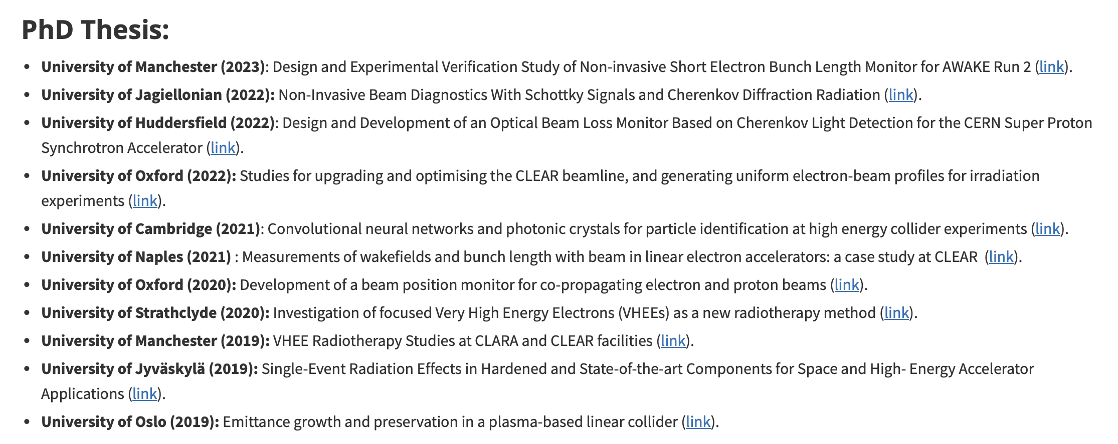
High Demand for Training Opportunities
Hands-on training (JUAS, EURO-LABS)
Hosting Trainees, Summer/Technical and
PhD students, Fellows, Associates…
Possible to develop specific trainings for people involved in future e⁻ machine design/operation !
Contributed to more than 10 PhD thesis in the last 5 years!

Slide 14
Prototyping of LINACs Control Technology
Most of CERN injector complex is based on “low” frequency RF, low-rep-rate machines and has developed associated technology to ensure their reliable operation
CTF3 before, and now CLEAR (and AWAKE) are custodian of high-frequency (up to
X-band), and high-rep rate (up to 50/100 Hz) accelerator/beam control technology
CLEAR is the ideal test bed to deploy future technologies relevant to any Higgs Factory:
  White rabbit timing distribution
  Test of new generation ADCs cards for fast digitisers (see AOS-3601)
  New generation of Digital Cameras for BTVs (and associated controls)
  Possibly many other systems, e.g. new LLRF components/controls, new transfer lines BPMs, …
  BONUS:
    Consolidation of CLEAR infrastructure with benefit to maintainability and reliability
    Low impact/risk of downtime/damages in case of failure of technology under test
CLEAR is the ideal test bed for new operation paradigm for LINACs, e.g. using Machine Learning models:
  Some AI-based experiment done in the past, e.g. Imaging experiment by G. Trad
  Presently working on an AI-based “energy-jitter predictor” by A. Gilardi
  Discussions ongoing with the Data Science for Beam Operation (BE-CCS-DSB) section

Slide 15
Outline
Back to the Basics:
  Overview of CLEAR Infrastructure and Goals
Expected Use of CLEAR in the Coming Years:
  Contributions to a Higgs Factory at CERN: with an emphasis on FCC-ee
  Contributions to the Irradiation Facility Ecosystem for Detectors R&D
  Contributions to Accelerator Technology, including Training and Controls
Looking Ahead:
  CLEAR as an Incubator for FCC-ee Injector as CLEAR++
Conclusions

Slide 16
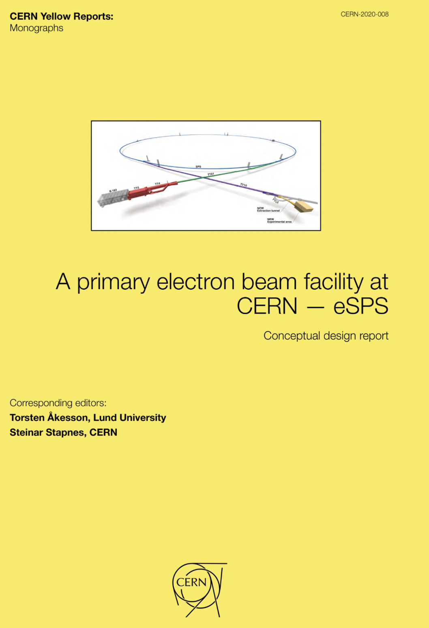
CLEAR++ during FCC-ee Construction!
Slide mostly from H. Bartosik @ PBCWS2024
Proposal for primary electron facility was already made in context of eSPS (original proposal for Light Dark Matter eXperiment – LDMX)
Inspired by this proposal, FCC-ee injector beams could be used for
a CLEAR-like facility (including also damping ring):
  R&D for accelerator components and beam diagnostics for FCC-ee
  or the injector itself (in particular if injector goes online ahead of FCC-ee
  and/or is built in stages)
  Irradiation facility (e.g. for testing electronics components)
  Medical research
  Use synchrotron light from damping ring to test coatings,
  photon desorption
  Plasma wakefield acceleration test facilities (electron driven, but maybe even in combination with proton driven plasma, see next slide)
  The present CLEAR User Community could be the seed of a wider user community of such a facility!
BONUS: FCC-ee injector layout could still work for eSPS proposal
(especially if SPS is part of the FCC-ee injector)

Slide 17
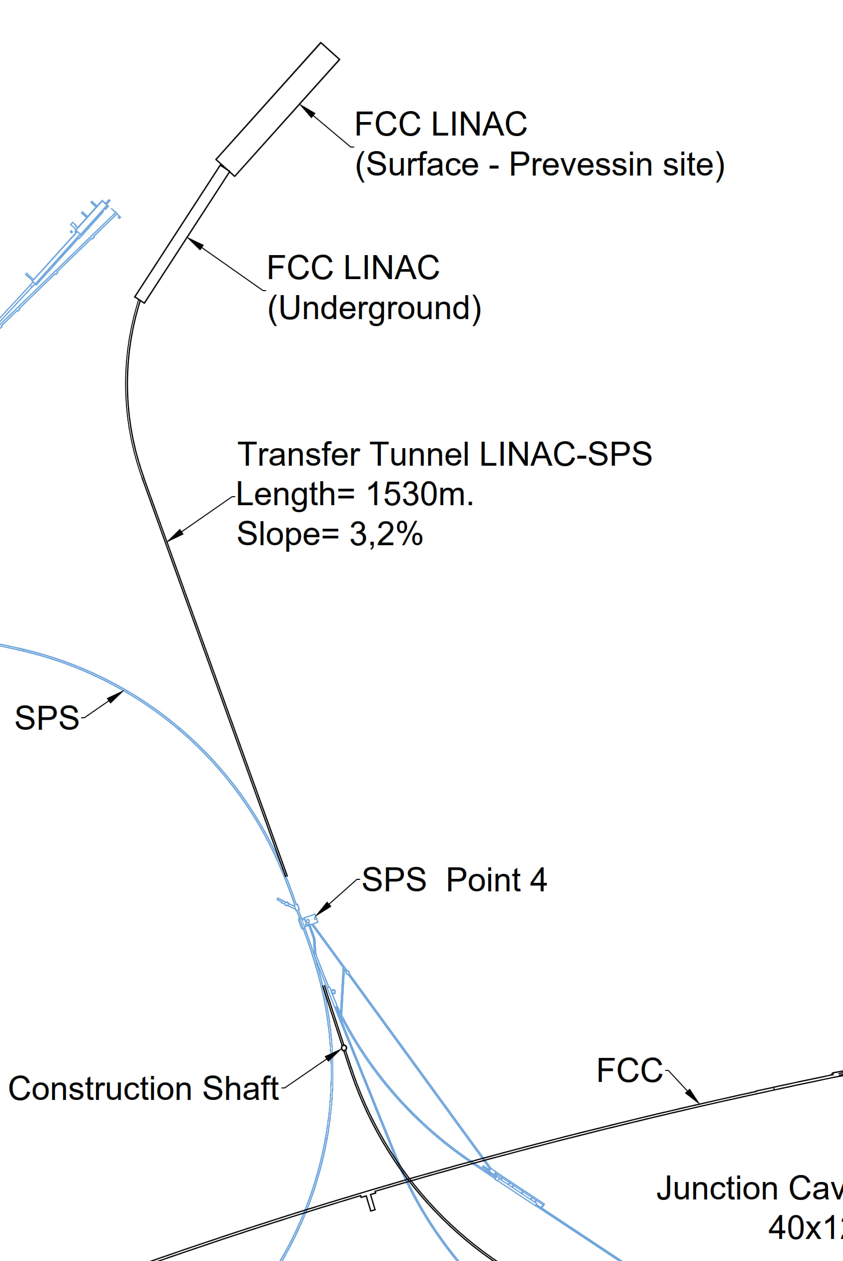
Plus: e+/e- beams interesting for AWAKE++!
17
Slide mostly from H. Bartosik @ PBCWS2024
The layout of the FCC-ee injector complex passes through SPS BA4, i.e. the SPS extraction point of protons for the plasma wakefield acceleration experiment AWAKE
Keeping SPS operation with protons, there would be a unique opportunity to perform proton driven plasma wakefield acceleration of 20 GeV electrons and positrons
  Lepton beam parameters fit extremely well for wakefield experiments
  Unique possibility of positron acceleration (currently no experiments worldwide)
With the two-bunches setup, also electron driven plasma
wakefield acceleration experiments can be performed
  1st electron beam is the drive beam, 2nd one is the witness beam
  In addition, another unique possibility to test positron acceleration
Proton beam line, experimental facility as well as lepton injection area
and tunnel to the experiment exists
  Would “only” require ~800 m transfer line for e+/e- in TT40/41 tunnel
CLEAR++ and AWAKE++: Perfectly Aligning with the LDG Roadmap to
Strengthen CERN's Ambitions in Novel Acceleration Techniques!
AWAKE

Slide 18
Outline
Back to the Basics:
  Overview of CLEAR Infrastructure and Goals
Expected Use of CLEAR in the Coming Years:
  Contributions to a Higgs Factory at CERN: with an emphasis on FCC-ee
  Contributions to the Irradiation Facility Ecosystem for Detectors R&D
  Contributions to Accelerator Technology, including Training and Controls
Looking Ahead:
  CLEAR as an Incubator for FCC-ee Injector as CLEAR++
Conclusions

Slide 19
Conclusions
Beam requests are growing, and the facility is very close to saturation
  The present and expected requests will amply keep the facility and its team fully busy for the next few years (at least until the early 2030s) with high-impact R&D and experiments [see previous talks]
The facility is already “expanding” where possible, with modest investments
  More “local space” is available, but a local major expansion is probably not justified, today
CLEAR is a potential steppingstone towards the next flagship accelerator at CERN,
FCC-ee (or its potential alternatives)
  Several FCC-ee related experiments have already been performed or are planned
  Additional synergies with design and prototyping exist, though mostly unexplored due to scarce resources and planning uncertainties
    This includes detectors R&D, especially during LS3 as the only running irradiation facility at CERN
The CLEAR facility is fundamental for maintaining and training e-beam know-how at CERN
  This applies not only to young physicist, but also to e-LINAC-specific system designers/engineers
Assuming FCC-ee will be approved, the present FCC-ee injector baseline design is compatible with being a CLEAR-like facility, with multi-purpose user-dedicated areas
  Such a use case could boost commissioning efficiency and maximize facility investment returns
  eSPS proposal exercise could be a starting point for a dedicated study in this direction
  CLEAR (and AWAKE) can bridge the present user community toward such a unique facility !

Slide 20
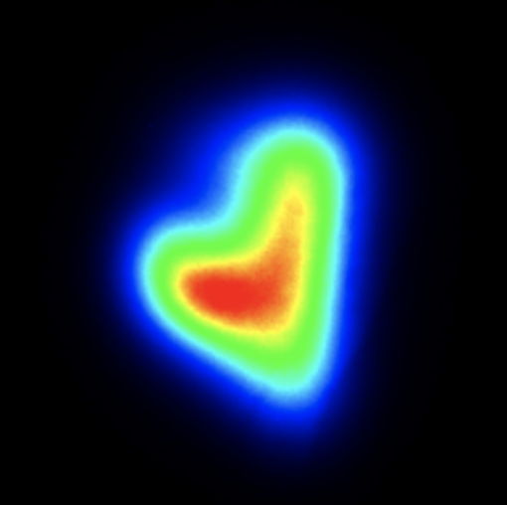
Thanks for your attention!
Acknowledgements to the CLEAR dream team:
R. Corsini, S. Doebert, W. Farabolini, D. Gamba, A. Ghilardi, P. Korysko,
A. Malyzhenkov, A. Aksoy, K. Sjobaek, L. Dyks, V. Rieker, J. Bateman,
C. Robertson, L. Wroe, E. Granados, M. Martinez, S. Curt, …

Slide 21
APPENDIX

Slide 22
CLEAR has a Strategic Role for Future Higgs Factories
Main relevant areas already being exploited:
Beam diagnostics R&D for FCC-ee
Other FCC-ee dedicated experiments in CLEAR
Both the CLEAR machine and its experimental team might be the seed for a future larger facility paving the way to FCC-ee
Keeping at CERN hands-on experience (both on hardware and beam operation) on electron accelerators – a role partly shared with AWAKE
Training of young scientists

Slide 23
Relevant Findings and Recommendations from CSB Meeting 2024
From CLEAR Scientific Board Meeting 2024:
Recommendation 1: More visibility should be given to the CLEAR capabilities for tests of advanced acceleration concepts in order to attract more users from other broad international collaborations such as EuPRAXIA.
Finding 7: A detailed run schedule will be prepared but it already seems clear that the in-hand requests can be expected largely to fill the available beamtime in 2024. If user demand continues to increase, a tighter selection of experiments may be required in the future.
Recommendation 3: CSB recommends that CERN support this approach towards upgrades, including CTF2. The committee encourages the CLEAR team to investigate the possibilities for utilisation of CTF2, define the necessary resources, and evaluate the user interest in CTF2 beyond the planned Inverse Compton Scattering (ICS) studies.
Finding 12: A CLEAR programme beyond 2025 could serve as a crucial step and bridge towards an electron-beam test facility based around developing key components required for a Higgs factory.
Recommendation 4: CSB recommends that the CLEAR team be centrally involved in discussion of electron test facilities for a future Higgs factory at CERN.

Slide 24
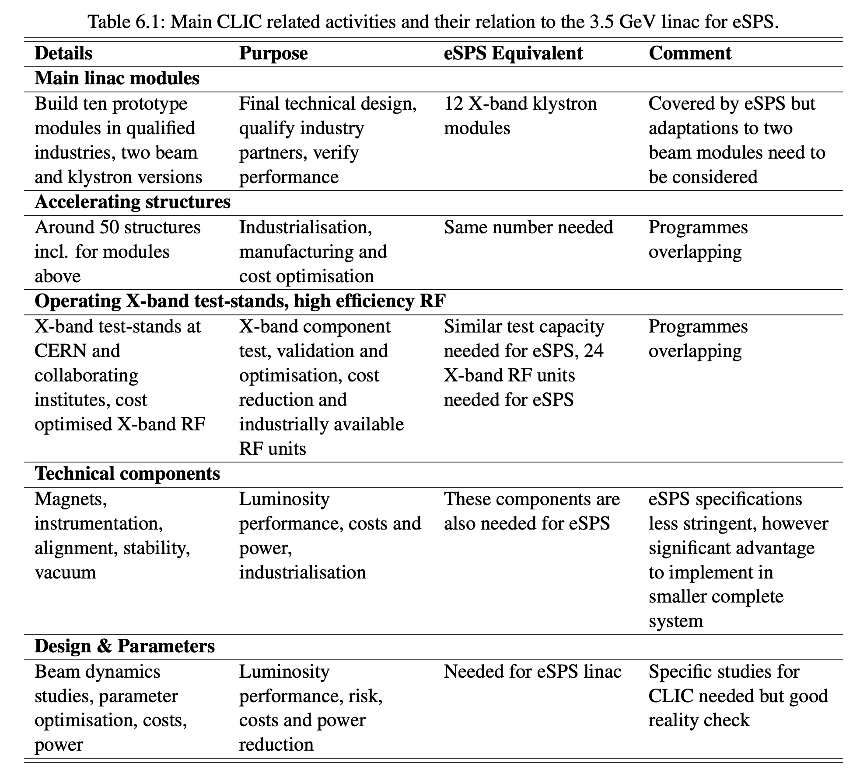
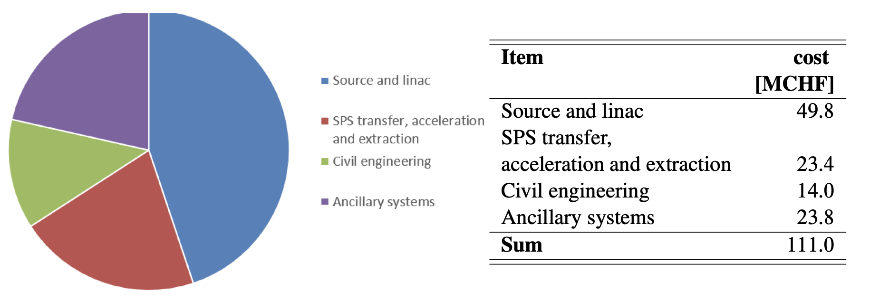
Relevance of e-SPS for CLIC, cost
May a similar project be developed based on requirements for FCC-ee ?
Is it the size/cost/time scale relevant/affordable?
Possibly, such facility should aim at being compatible with (parts of) the final FCC-ee injector complex

