Slide 1
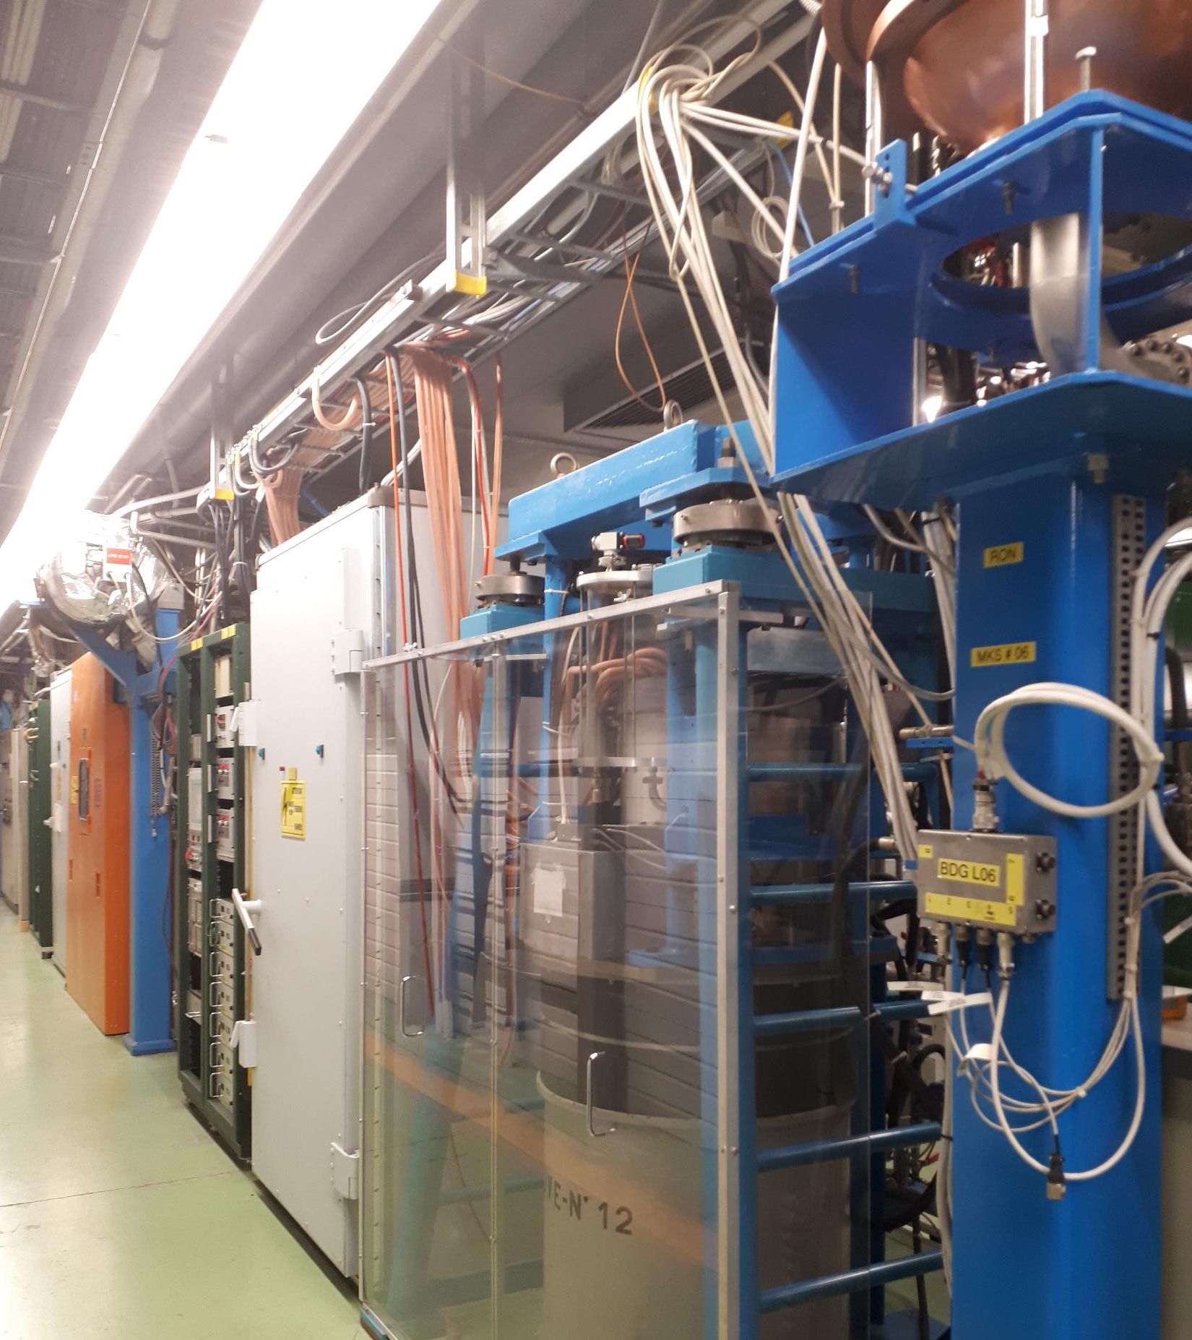
CLEAR RF system consolidation
What is needed for a smooth operation until 2030
Quick overview of the system
High-power RF future needs
LLRF necessary consolidation
Resources

Slide 2

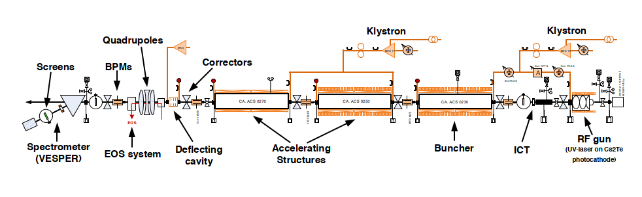
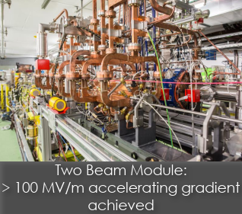
CLEAR RF Systems
HPRF: 4-5 S-band Modulator/Klystron systems,
1 X-band system
LLRF klystron: Klystron drive amp, amplitude and phase control, interlocks (safety),
3GHz diagnostic signals, PLC, FESA
RF reference signal generation (3 GHz reference oscillator synchronized with a 10 MHz signal)
and synchronization, frequencies: 12, 3, 1.5 GHz, 750,500,250, 19.2 MHz;
RF clocks: 96, 192 MHz,
all analogue no remote control
Fast, low jitter timing (ps level), based on obsolete ECL counters
for laser and instrumentation

Slide 3
Klystrons and Modulators for CLEAR
Currently 4-5 S-band klystrons in operation, 2 essential, 1 for RF deflector, 1 for CTF2 test area, test modulator
Four old PFN modulators, one solid state Scandinova
One x-band station for CTF2/CLEAR with old Scandinova Modulator
Maintenance contract with Scandinova exists.
Consolidation 2026-2030:
If money was no issue: Buy two new Scandinova modulators: ~ 1.4 MCHF → Increase rep.rate and stability
Alternative: Keep existing modulators alive as they are: spare parts exists, Scandinova maintenance contract
Buy or repair at least two TH2100 klystrons or equivalent: ~ 0.3-0.7 MCHF,
Difficult situation with klystron vendors concerning cost and delays !
Preferred solution would be repair of broken klystrons

Slide 4
Life extension for CLEAR up to 2030, LLRF
Consolidation between 2026-2030: Goals: more stability, better maintainability, higher repetition rate
Find and implement alternative for fast /low jitter timing (ECL counters obsolete, no spares), → VTU ?
Renovate\Replace synchronous frequencies and clock generation and distribution (as well based on ECL counters)
Improve drive amplifier spare situation (only budget)
LLRF of klystron and diagnostics
Go digital, replace klystron LLRF with uTCA a la Uppsala, in theory working prototype by 2025, needs to be integrated in
CERN control system and CLEAR safety chain
→ Uppsala University is working on a prototype system for AWAKE, already at CERN ready for testing
Very good synergy with AWAKE and future FCCee needs as well as standardisation of LLRF systems at CERN !

Slide 5
Maintenance and consolidation resources
Right now, minimum effort and basically no official LLRF support
2026-2030: Keep operational budget and person power constant (increase LLRF):
Additional investment cost for consolidation:
Item | Rough cost (kCHF) | Remarks
HPRF | 300 -600 | Depending on Scenario
LLRF | 300
M to P | 400 | 4 years Grad
May be consolidation can be partly financed out of operation budget, but there is at least a spending profile problem since the consolidation effort should be started now. Could CLEAR become part of the Consolidation Efforts ?
Person power: Clearly a LLRF problem, right now 0 in APT even so CLEAR is an official running facility
Consolidation effort would need likely a Quest/Origin for 4 years (starting 2025).
Could be shared with AWAKE and FCCee because largely similar work.
HPRF: likely OK, a change of klystron type would generate significant work, Current support needs to be maintained.

Slide 6
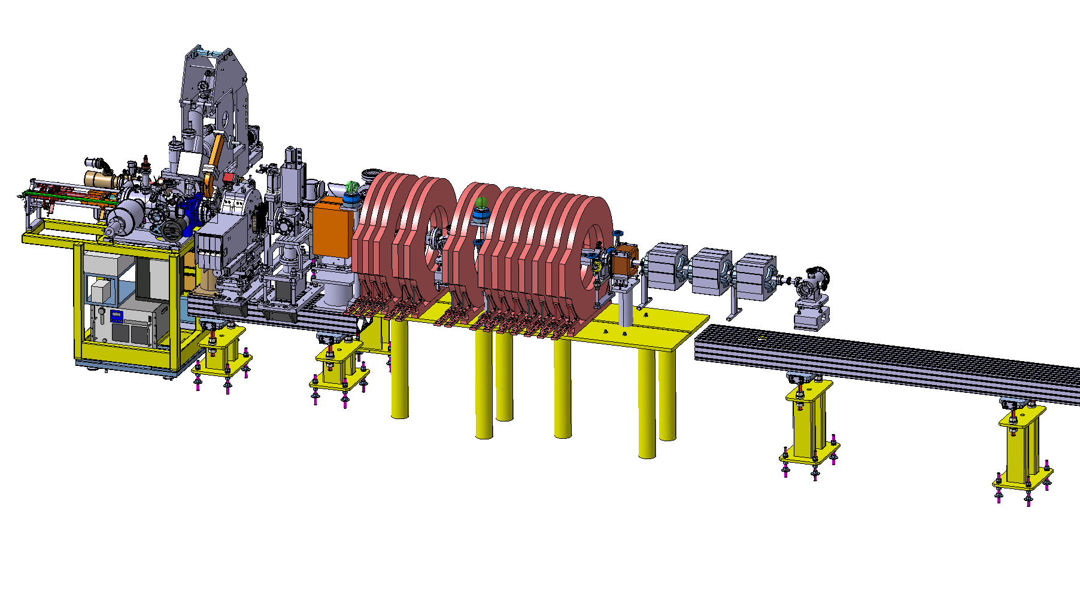
Injector prototype in CTF2 for CLEAR and AWAKE
ARTI (AWAKE Run2 Test Injector)
Reduced scale prototype, 60 MeV, INFN gun, CLIC-structure as buncher and PSI-linearizing structure for acceleration.
Goal: demonstrate the velocity bunching and emittance preservation with x-band
Prototyping of key accelerator hardware and diagnostics
Gaining experience before installation in the AWAKE tunnel

Slide 7
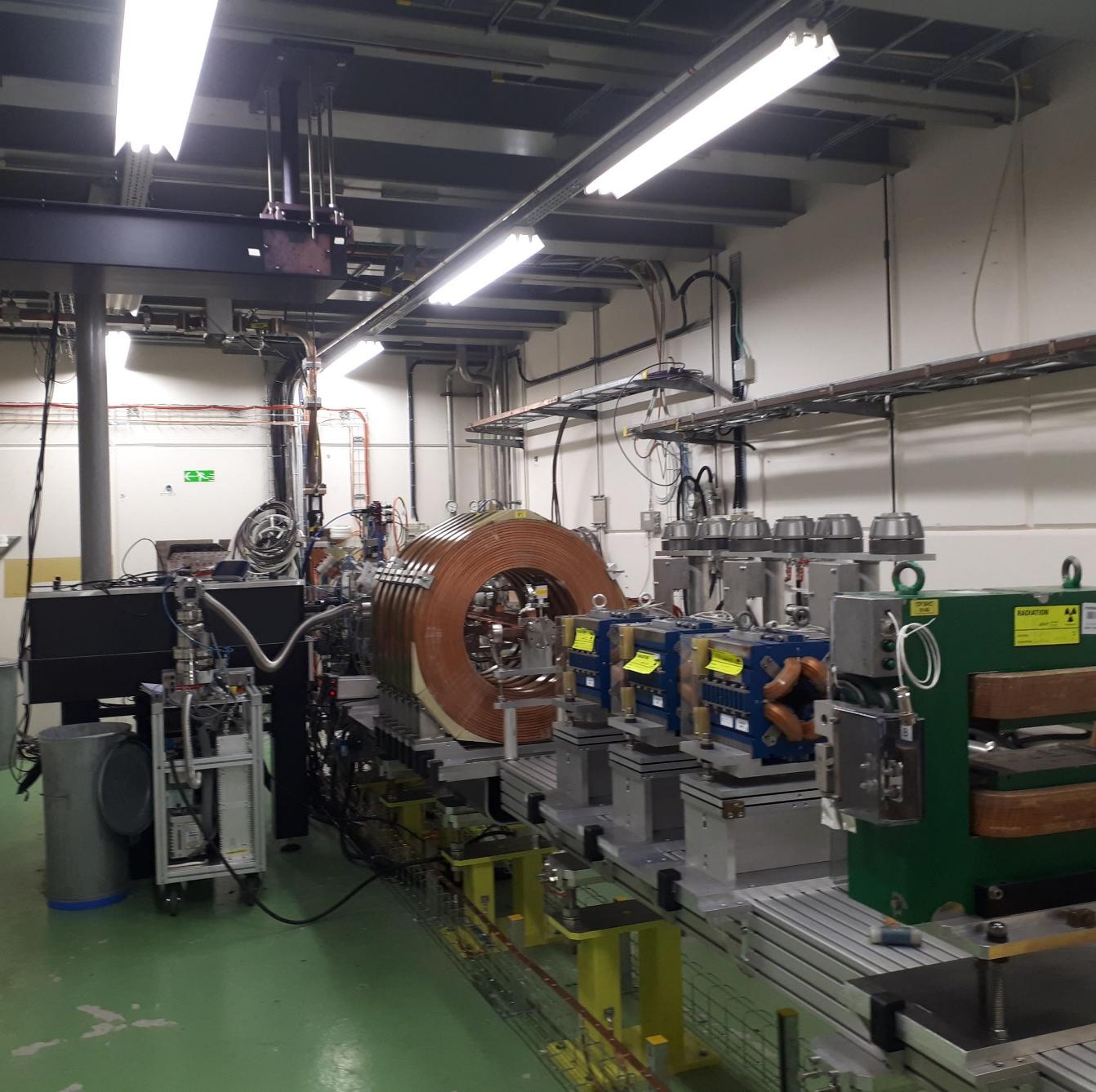
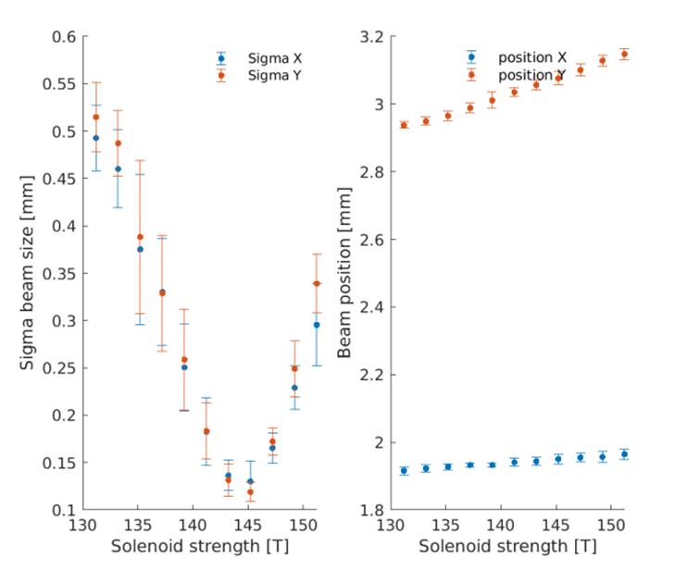
ARTI status
RF-gun (INFN contribution)
and diagnostics operational and under commissioning
Magnets for second phase installed
First ‘CLEAR user’ experiment planned in spring:
Vlad’s CBS experiment

Slide 8
CTF2 injector for CLEAR users
Potentially high-quality electron beam,
small emittance (1 um) , short electron bunch (200 fs), but low charge (100 pC) and single bunch
Can be used for some specific CLEAR users:
Instrumentation testing (bunch length)
Compton Scattering Experiment due to laser parameters
Some interest in THz related work
Eventually decision needed if some hardware goes to AWAKE in 2027
Current view: Profit from installation for some experiments and then dedicate to AWAKE
CTF2 could be a good place to become at some point a FCCee electron source test facility

Slide 9
Spare slides

Slide 10
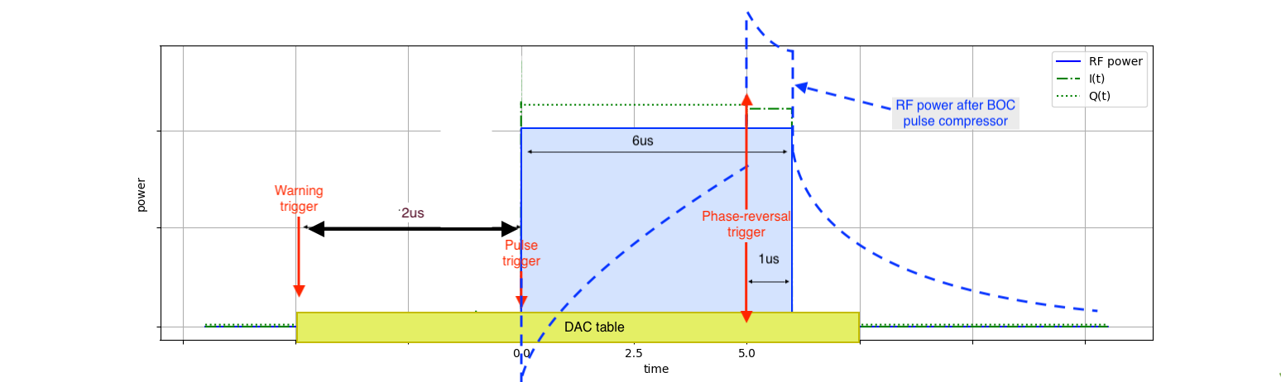
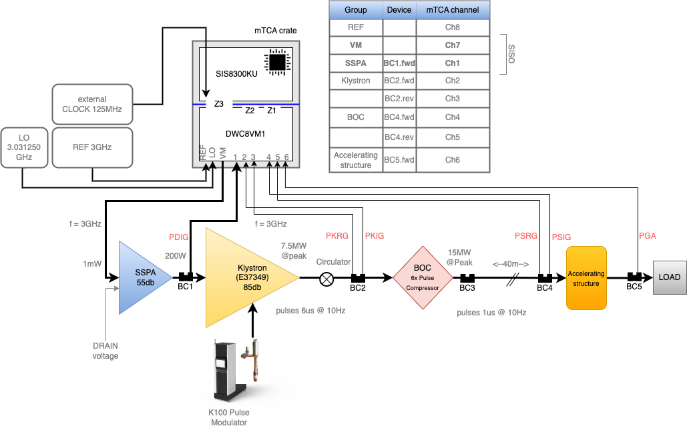
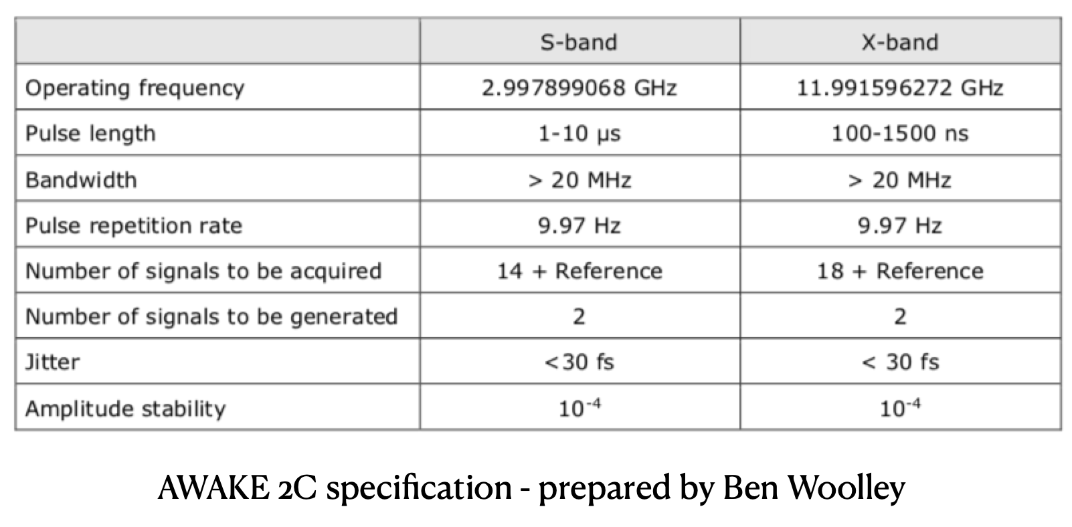

Setup: LLRF
1024 samples (8ns * 1024)

Slide 11
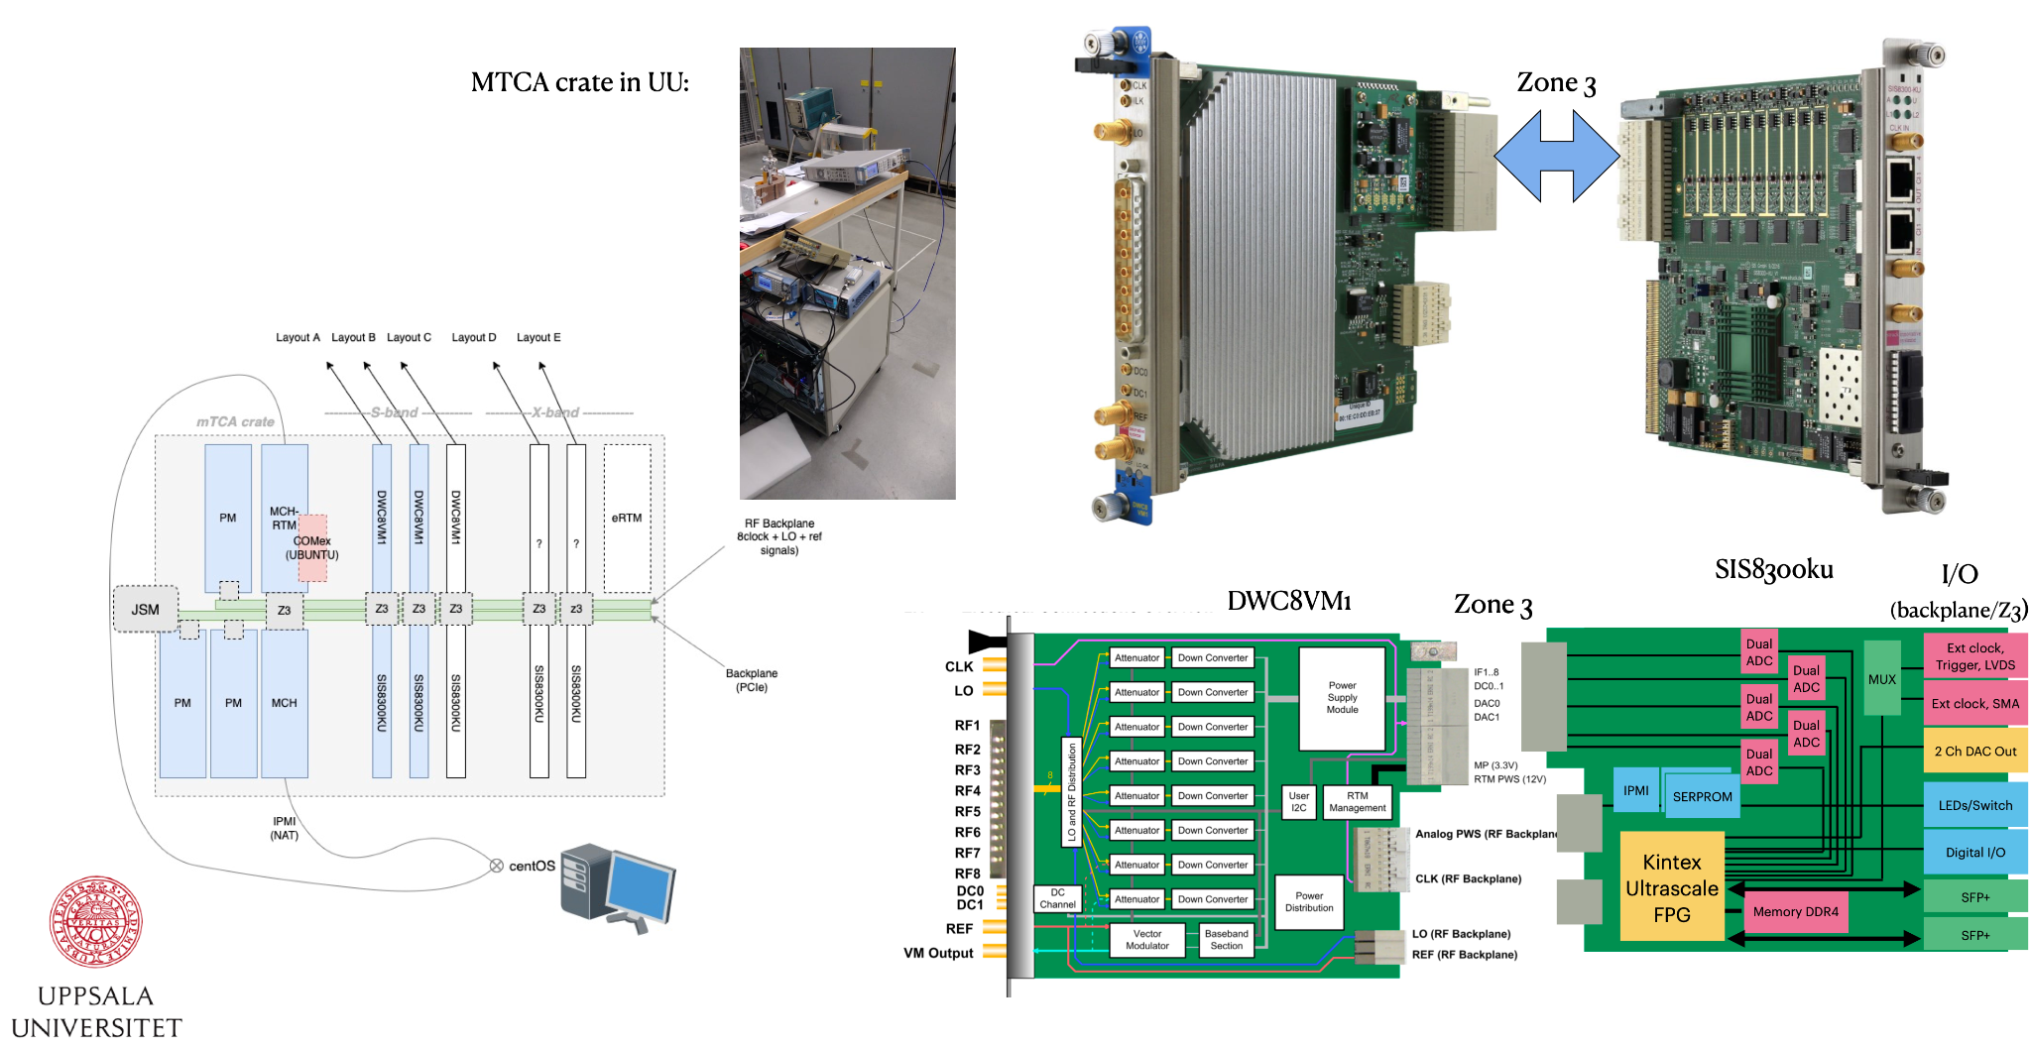
Setup: mTCA LLRF

Slide 12
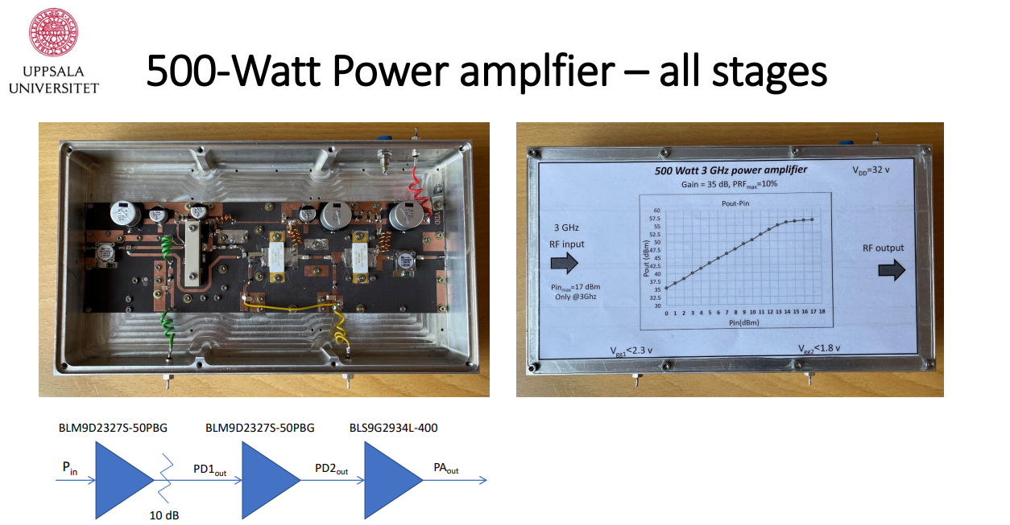

Slide 13
Klystrons and Modulators for CLEAR
3 GHz klystron situation: TH2100
by 2025 essentially out of spares
Thales does not seem to want to repair those klystrons anymore, a new one cost ~300 kCHF body only
(compared to 150 kCHF last purchase), not responsive on request for quotation (visit last week might change that)
PSI repaired some at CPI (cost 120 kCHF) but took 4 years, CPI has a huge delay problem
Canon has an alternative (100k, klystron body) but need to buy solenoid and adapt modulator sockets.
Examples from PSI exist but it represent some work and money. Let’s estimate another 100K per klystron for the first one.
In principle need to decide and launch order before end of the year !
Thyratron CX1836A: We have several spares but in unclear condition
In principle this model is still available on the market
Thyratron replacement with solid-state has been demonstrated with a prototype
→ Strategy: use the spares and build more solid-state switches

Slide 14
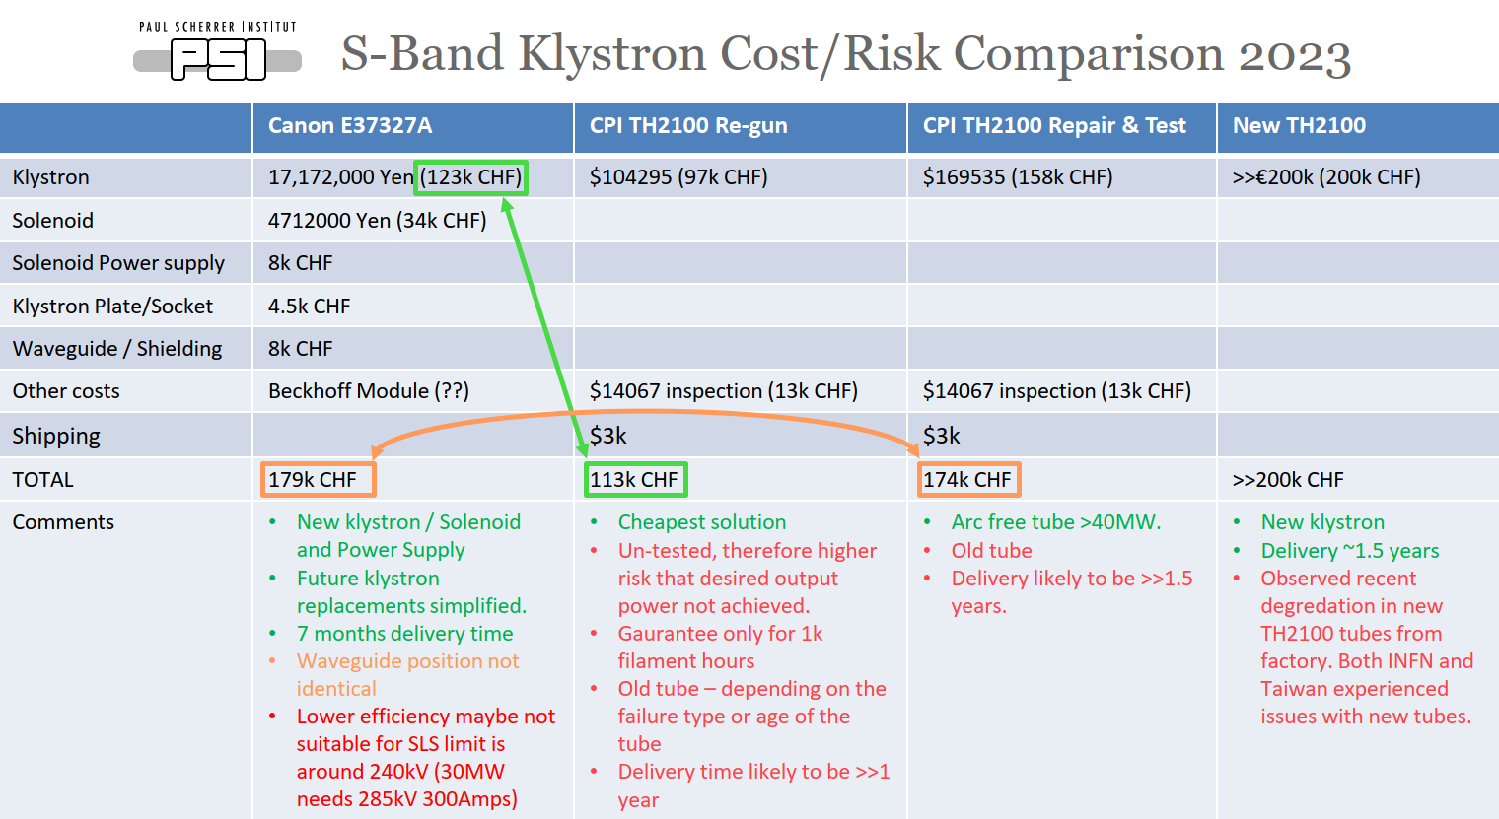

Slide 15
