Slide 1


Medical applications in CLEAR
P. Korysko*,
on behalf of the CLEAR team.
CLEAR Review 2024
May 29th 2024
*pierre.korysko@cern.ch

Slide 2
Outline
Context: VHEE beams and the FLASH effect.
Tools and Methods used.
Selected Medical Applications performed at CLEAR in 2022/2023.
Medical Applications planned at CLEAR in 2024/2025.
Conclusions.
Pierre Korysko - CLEAR Review 2024 - May 29, 2024
2

Slide 3

Very High Energy Electrons

Slide 4
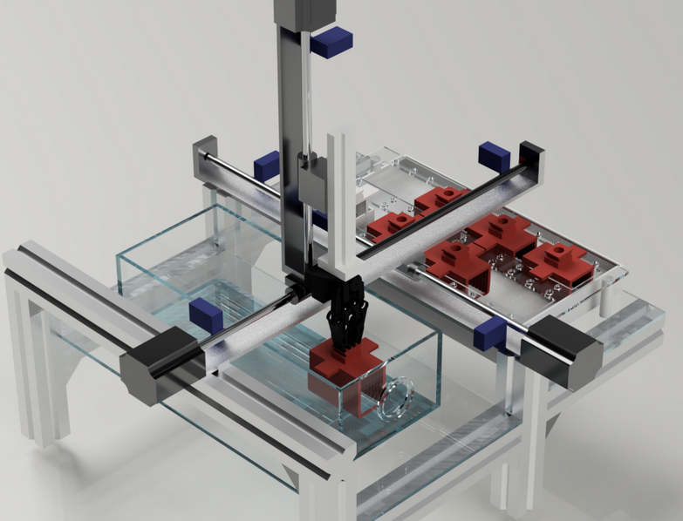
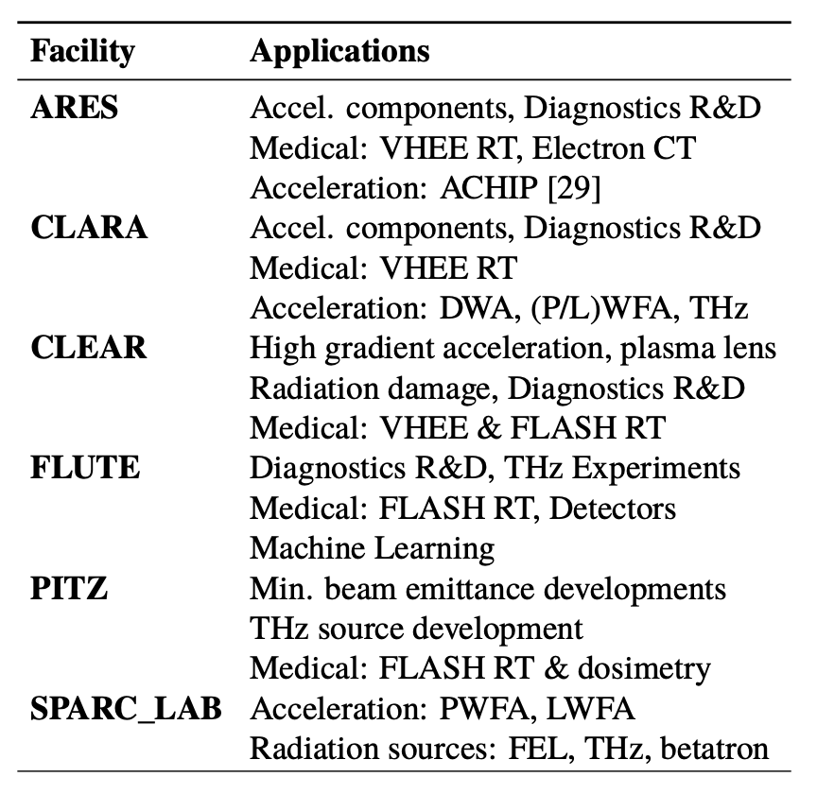
Very High Energy Electrons
The potential use of very high-energy electron (VHEE) beams
(50-250 MeV) for Radio Therapy (RT) recently gained interest,
since electrons at these energies can travel deep into the patient.
Potential advantages of VHEE RT:
  Depth – dose profile for electrons better than X-rays.
  Charged particles can be focused and steered (not possible with X-rays) .
  Electron beams rather unsensitive to tissue inhomogeneities .
  Electron accelerators comparatively more compact, simpler and cheaper than proton/ion machines .
This last advantage is now especially true given the recent advancements on high-gradient acceleration (e.g. X-band CLIC technology) .
Ultra-high dose rate (above 100 Gy/s) radiation delivery, also known as FLASH RT, showed normal tissue sparing capabilities, without compromising tumor control.
Most electron linacs can easily reach high beam currents needed for FLASH treatment of large fields.
More and more existing electron linac facilities are now being intensively used to investigate VHEE/FLASH RT.
VHEE/FLASH RT studies at the CLEAR facility (CERN)
Pierre Korysko - CLEAR Review 2024 - May 29, 2024
4

Slide 5
The FLASH Effect

Slide 6
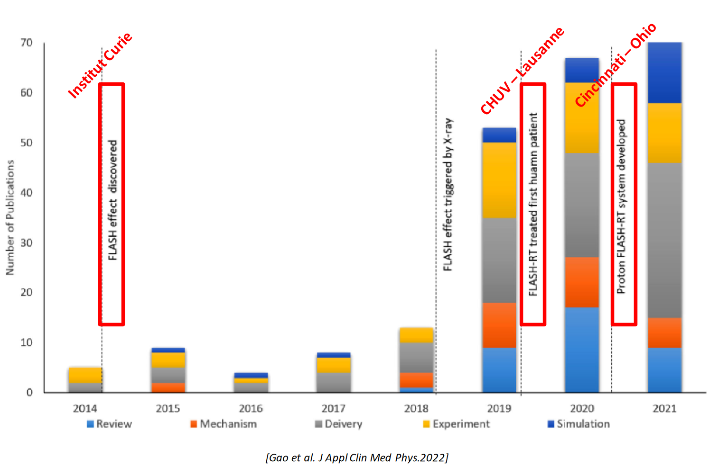
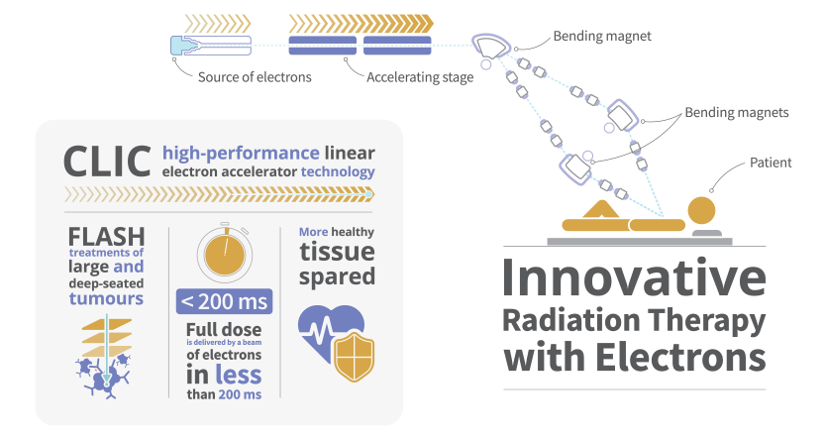
The FLASH Effect
The Flash effect is a biological effect that destroys cancerous cells while sparing healthy surrounding tissues.
Observed for the first time in 2014: mice tumors were irradiated with short pulses (≤500 ms) at Ultra High Dose Rate, UHDR (≥40 Gy/s).
The FLASH effect has been seen with protons, gamma and low energy electrons.
Very High Energy Electrons (VHEE) would be used to treat deep seated tumors.
The FLASH effect is extensively studied including in CLEAR.
Pierre Korysko - CLEAR Review 2024 - May 29, 2024
6

Slide 7
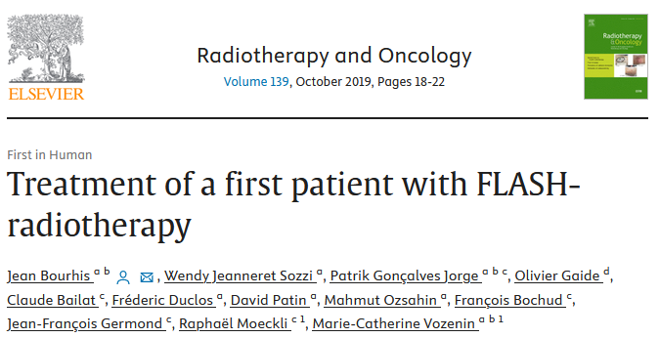
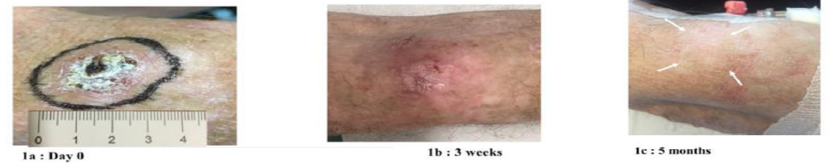
Treatment of a first patient with FLASH-radiotherapy
In 2019, 15 Gy delivered in 90 ms, using a 5.6-MeV electron linac, to a 75-years old patient with a multi-resistant cutaneous lymphoma:
  On healthy tissues: no decrease of the thickness of the epidermis and no disruption at the basal membrane with limited increase of the vascularization.
  On Tumor: Tumor response was rapid, complete, and durable with a short follow-up of 5 months.
Conclusions: This first FLASH-RT treatment was feasible and safe with a favorable outcome both on normal skin and the tumor.
Pierre Korysko - CLEAR Review 2024 - May 29, 2024
7

Slide 8
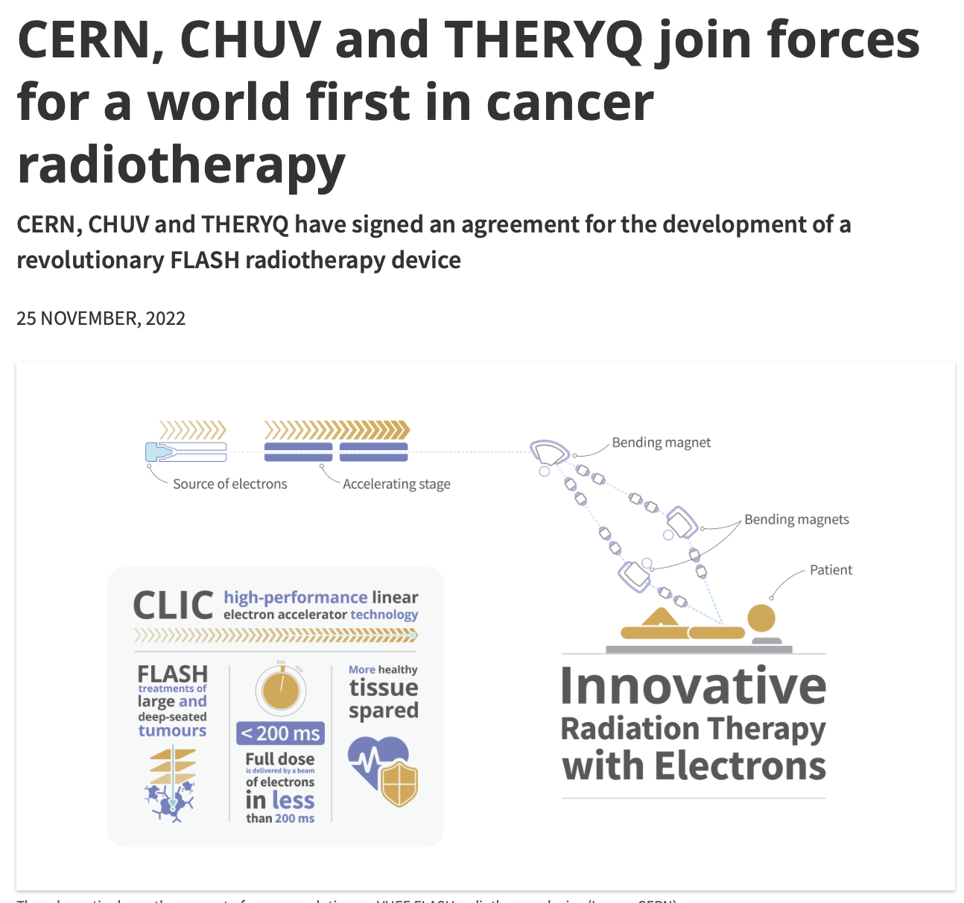
CERN/CHUV/THERYQ Collaboration
CHUV, CERN and now THERYQ are actively collaborating on the realization of a clinical facility for the treatment of large, deep-seated tumors by a VHEE beam in FLASH conditions.
The target is a facility that:
  Uses 100 MeV-range electrons and optimized dose delivery.
  Is compact enough to fit on a typical hospital campus.
The collaboration demonstrated that the facility is feasible and are now finalizing the details of its technical implementation aiming at first clinical tests in 1-2 years.
If successful, the facility may open the way for many future VHEE/FLASH facilities.
https://home.cern/news/news/knowledge-sharing/cern-chuv-and-theryq-join-forces-world-first-cancer-radiotherapy
Pierre Korysko - CLEAR Review 2024 - May 29, 2024
8

Slide 9
CLEAR
Tools and Methods

Slide 10


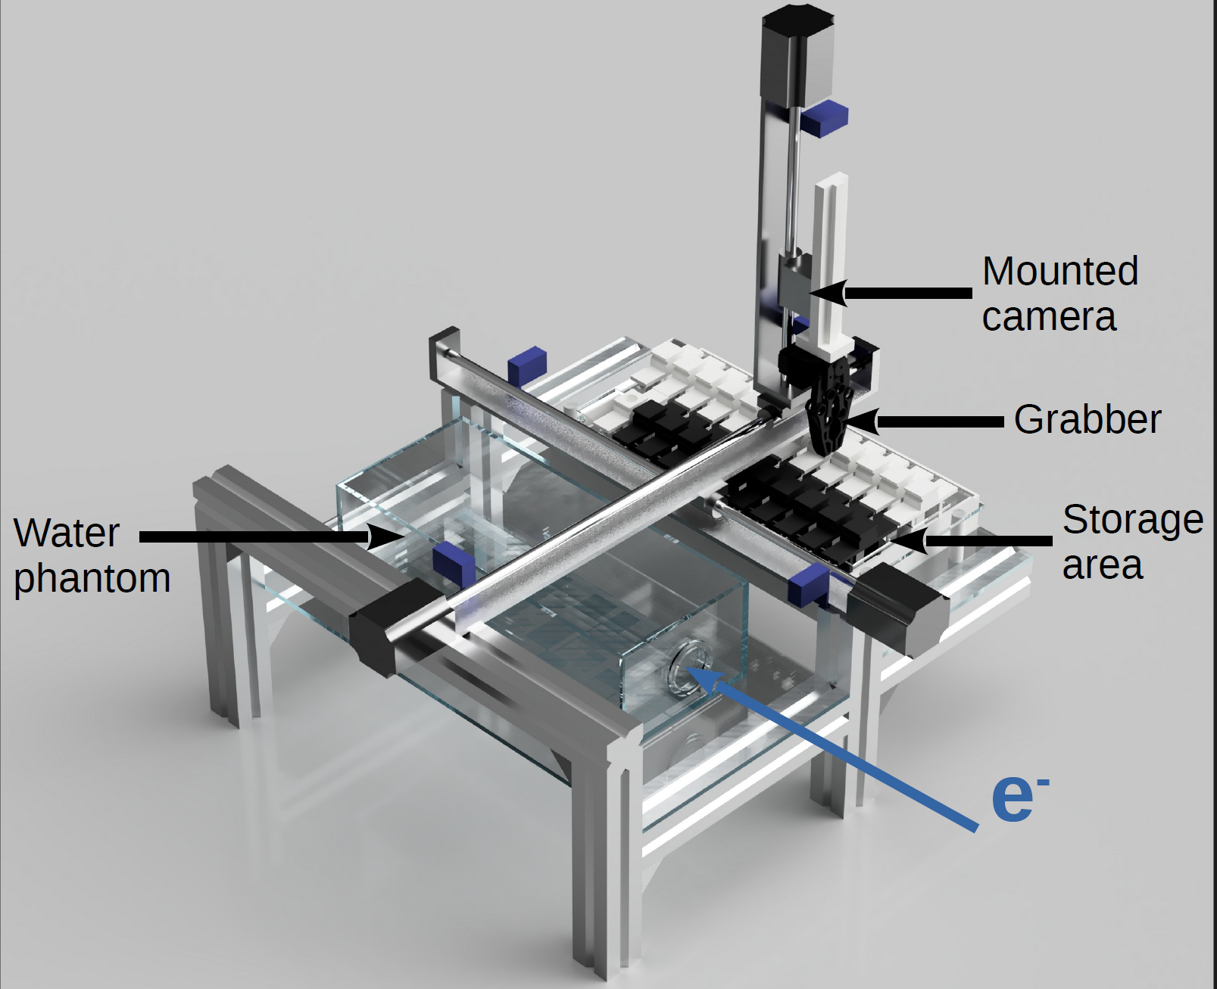
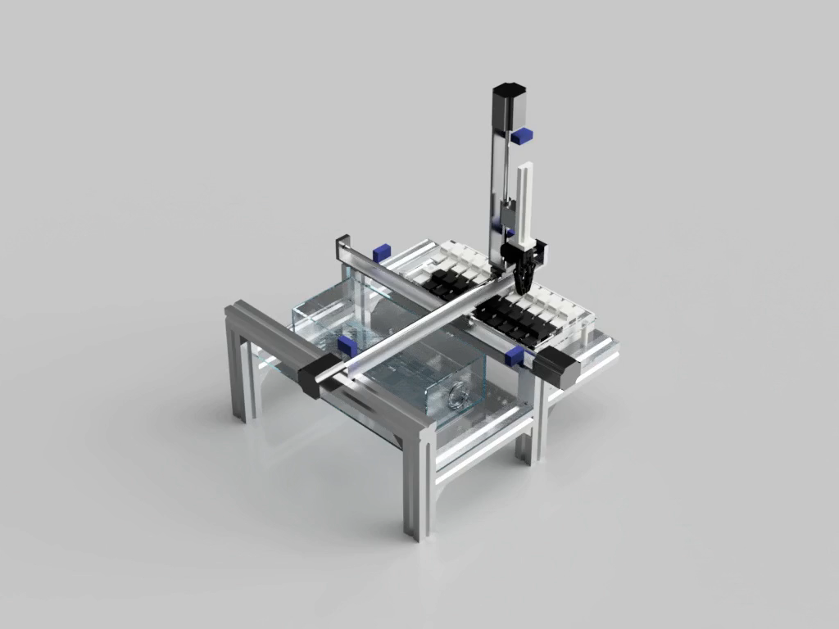
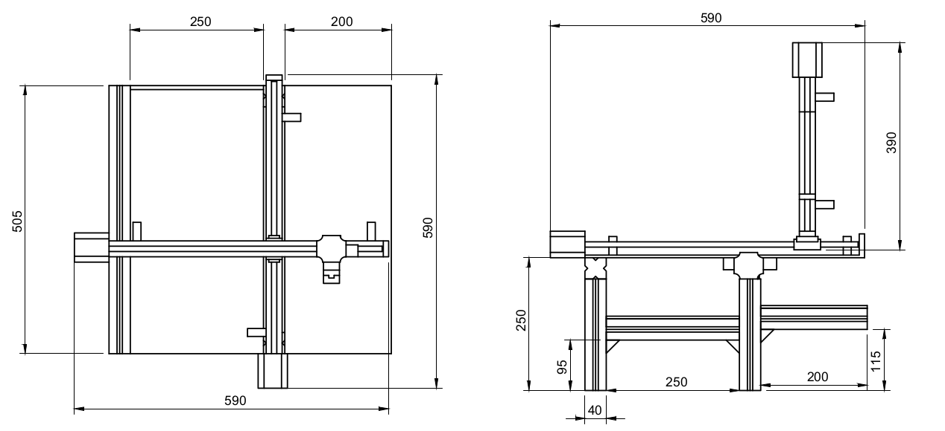


The C-Robot
In order to facilitate the precise control of samples for multiple irradiations, the CLEAR-Robot (C-Robot) was designed and built by members of the CLEAR Operation Team.
It consists of 3 linear stages, 6 limit switches, a 3D-printed grabber, two water tanks and an Arduino board.
It has a precision in position in 3 axis of 50 µm.
It is fully remotely controllable from the CERN Technical Network.
Thanks to a mounted camera, it can also measure the beam sizes and transverse positions at the longitudinal position of the sample.
It is an open-source project: pictures, 3D renders, drawings and all the codes for the Arduino and the Graphical User Interface can be found on:
https://pkorysko.web.cern.ch/C-Robot.html
Used for 100% of Medical Applications in CLEAR in 2023.
Pierre Korysko - CLEAR Review 2024 - May 29, 2024
10

Slide 11
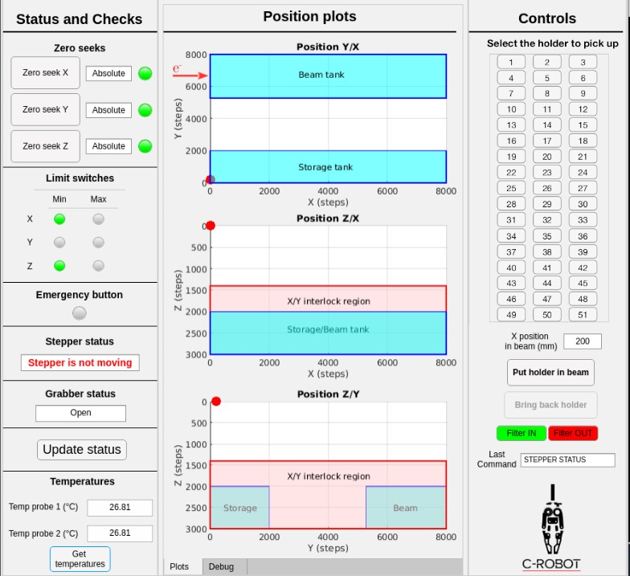
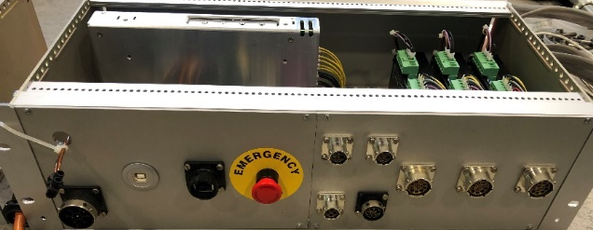
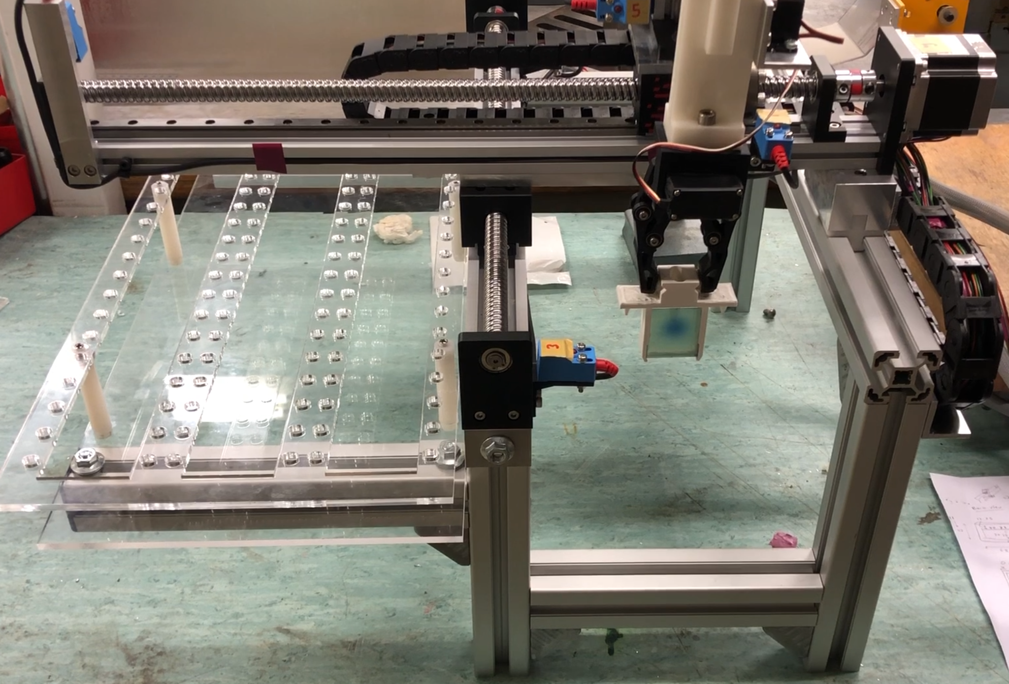
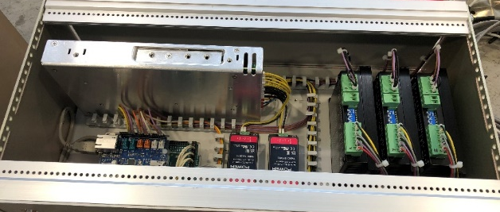
The C-Robot 2.0
A new robot was built for the new CLEAR beamline:
  Mirrored, to adapt to the new in-air test area.
  51 available slots.
  With temperature probes, mounted camera, optical filters.
  This robot was sent to PITZ (DESY Berlin) for them to build a copy.
I. Najmudin
Pierre Korysko - CLEAR Review 2024 - May 29, 2024
11

Slide 12
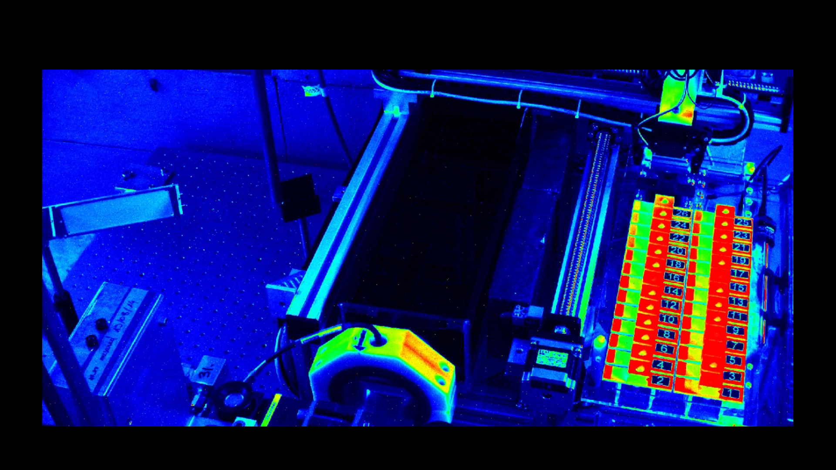
The C-Robot in action with beam
Pierre Korysko - CLEAR Review 2024 - May 29, 2024
12

Slide 13
Selected Medical Applications
performed at CLEAR in 2023:
Dosimetry Studies

Slide 14
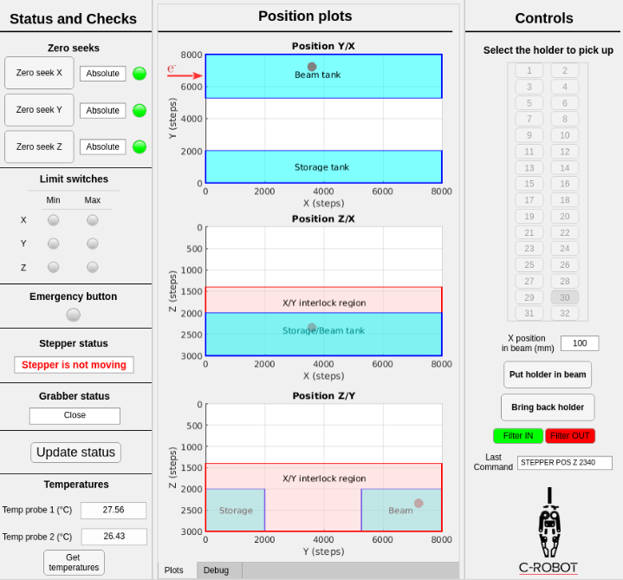
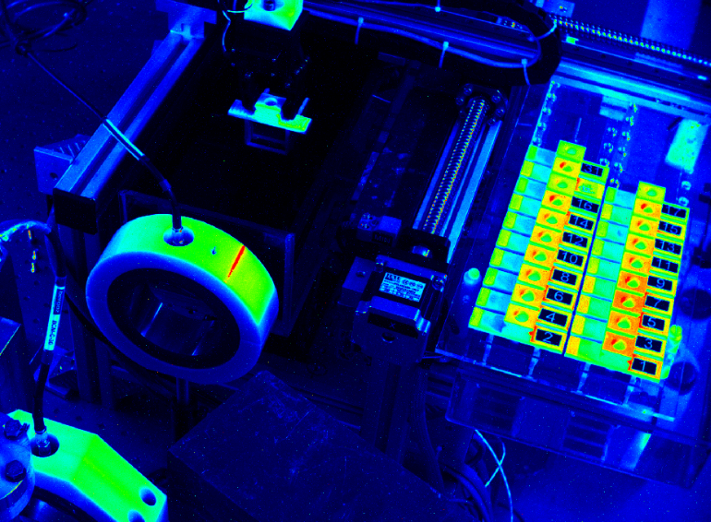
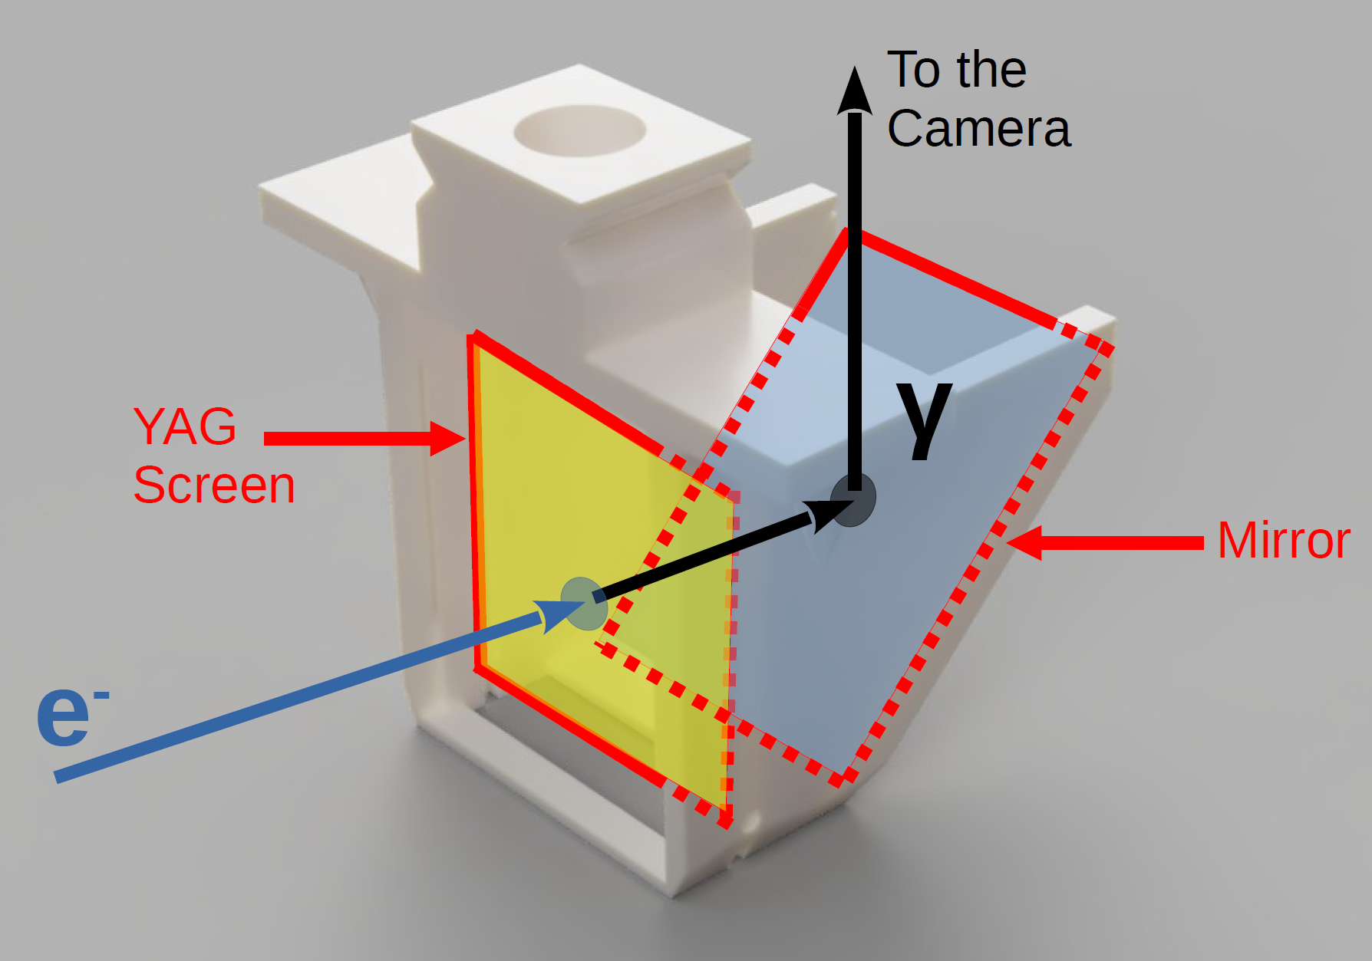
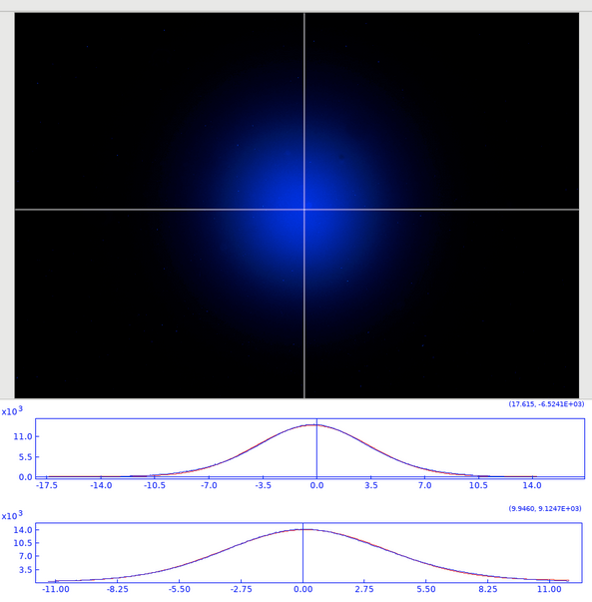
What can the C-Robot do?
Graphical User Interface
Experiment setup w/ beam
Camera
e⁻ beam
e⁻ beam
Storage area
Pierre Korysko - CLEAR Review 2024 - May 29, 2024
14

Slide 15
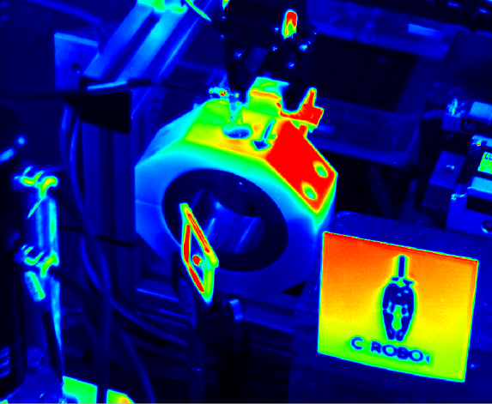
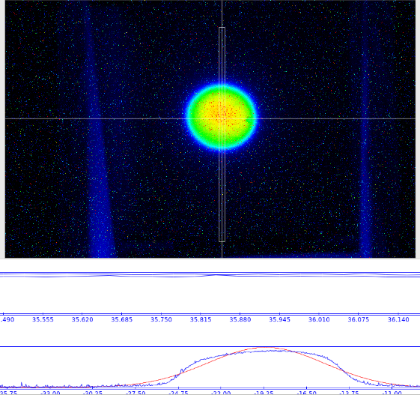
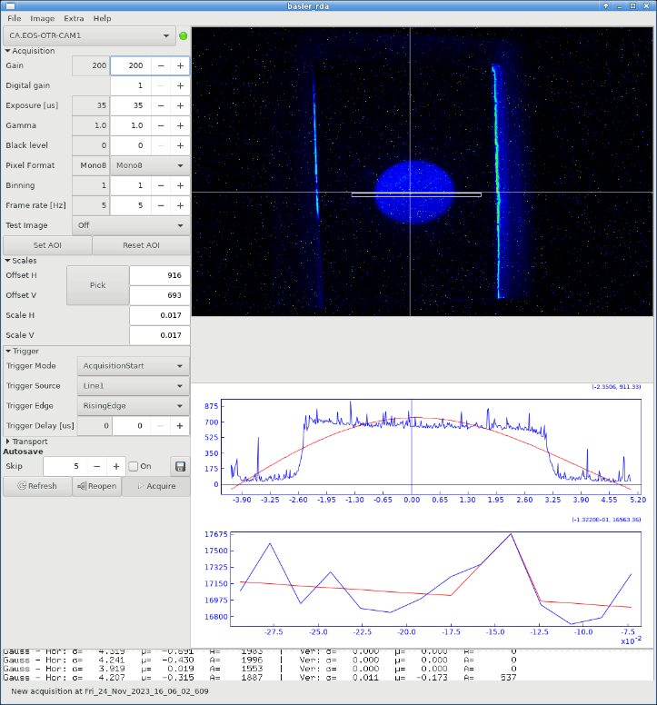
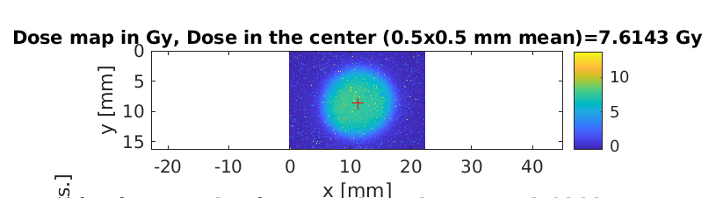
Real-Time Dosimetry
Camera
Camera
e⁻ beam
e⁻ beam
Gaussian Beam
Uniform Beam
A real-time dosimetry measurement is done using the charge and the beam size measurement with the scintillating screen (in air or in water).
The samples are then irradiated at the same exact location.
A similar method is being developed using a thin scintillating screen in air in front of the
water phantom for real-time dose measurement using charge density methods.
Pierre Korysko - CLEAR Review 2024 - May 29, 2024
15

Slide 16

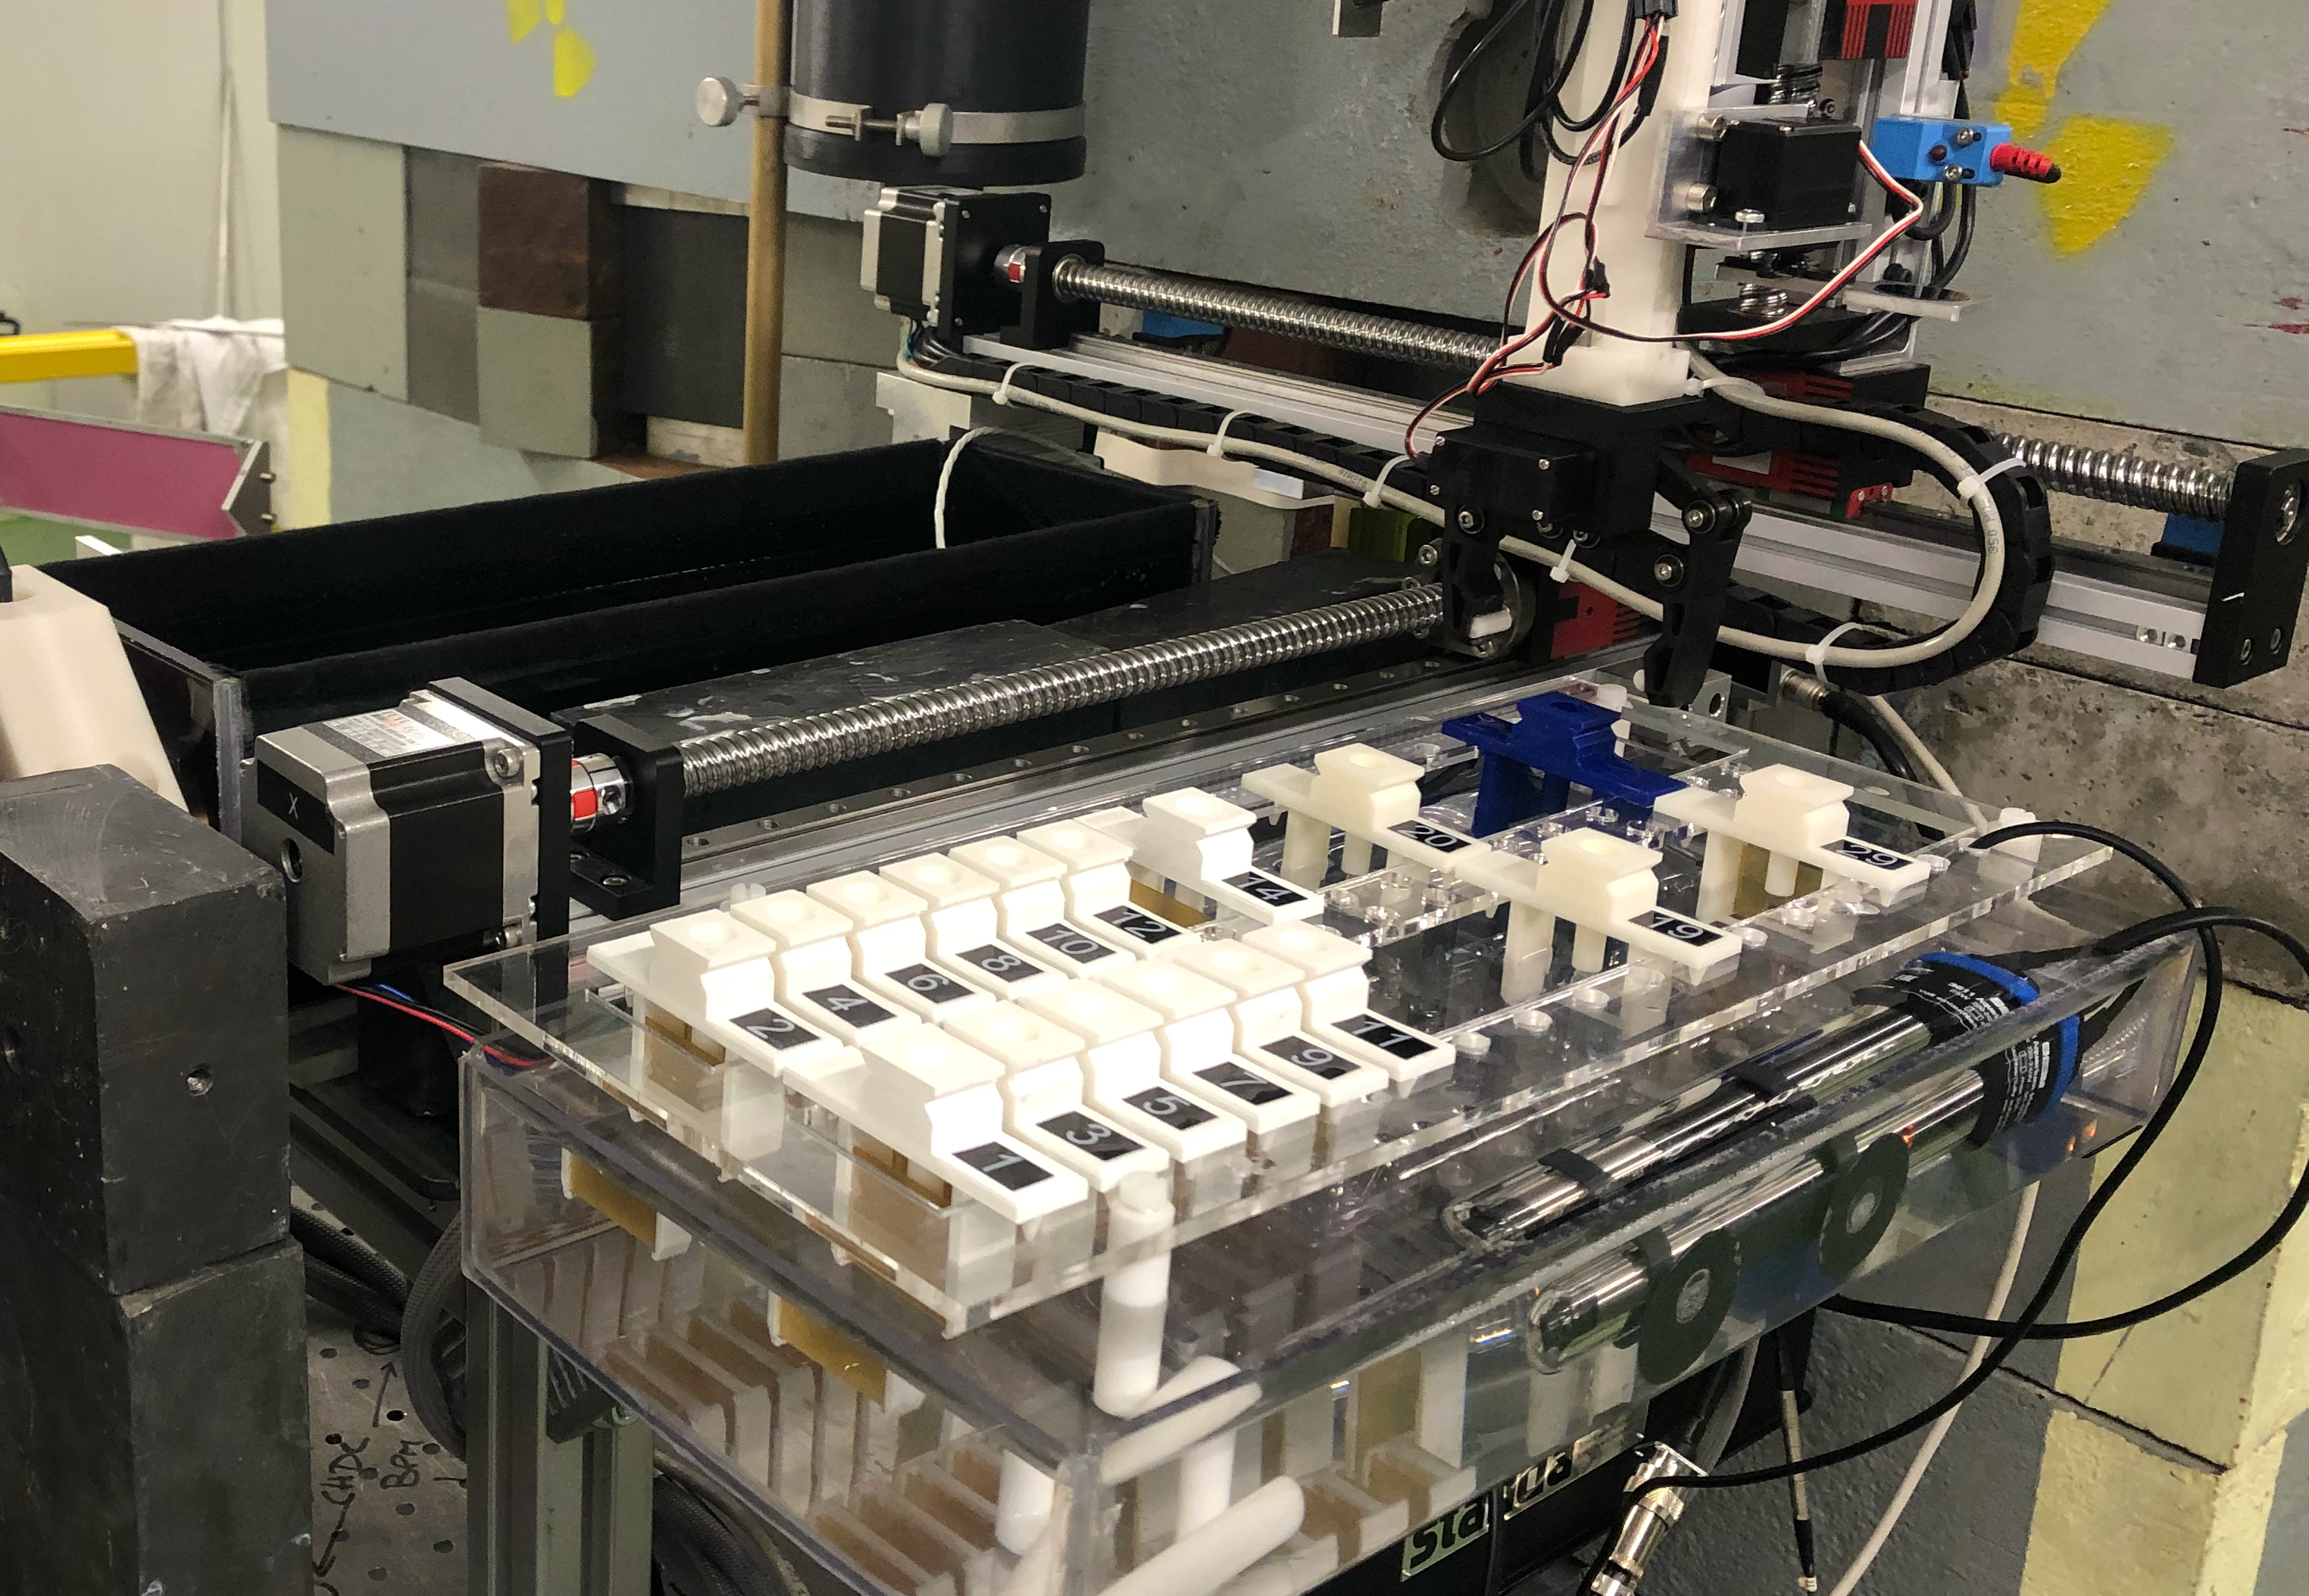
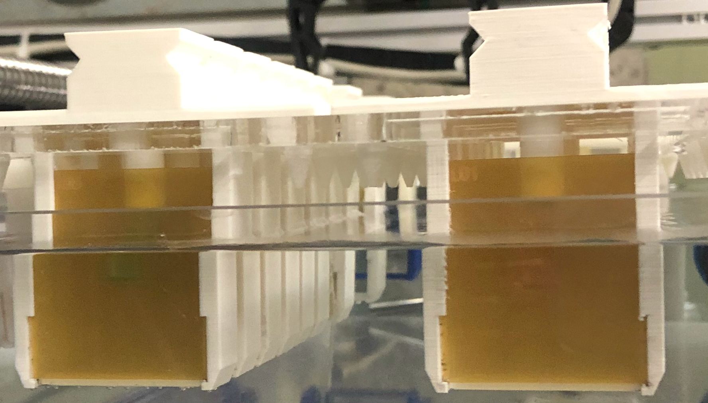
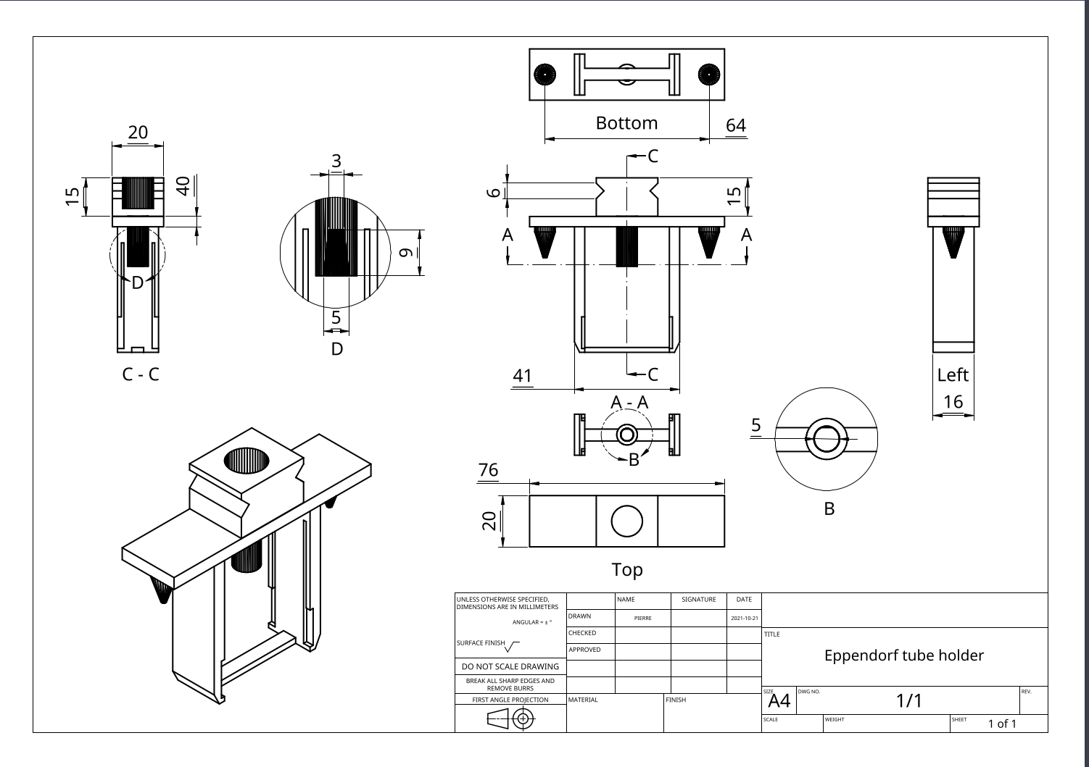

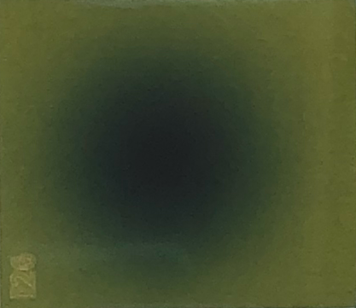
Experimental Setup & Dosimetry
for VHEE at UHDR irradiations
V. Rieker
Eppendorf tube with sample to irradiate
Beam water tank
Heated
storage
water tank
3D printed
holder with 2 films: one before and one after the sample
Laser cut
Radiochromic films to measure the delivered dose
Dose range:
1 – 100 Gy
Before irradiation
After
irradiation
This is the passive standard way to measure the delivered dose, but real-time dosimetry is crucial for clinical treatments.
Pierre Korysko - CLEAR Review 2024 - May 29, 2024
16

Slide 17

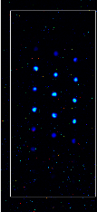
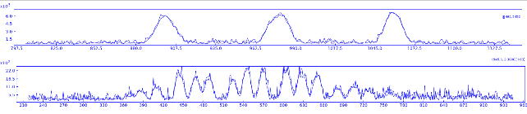
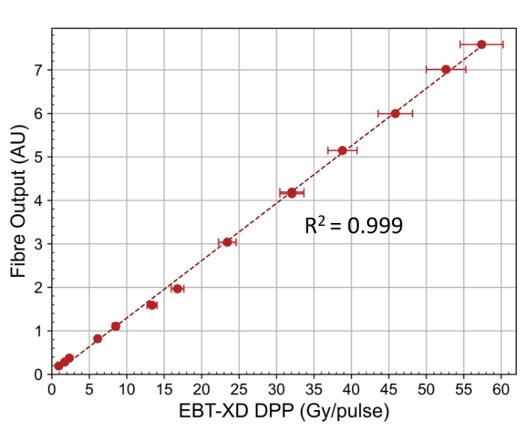
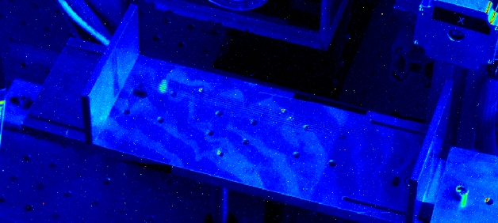
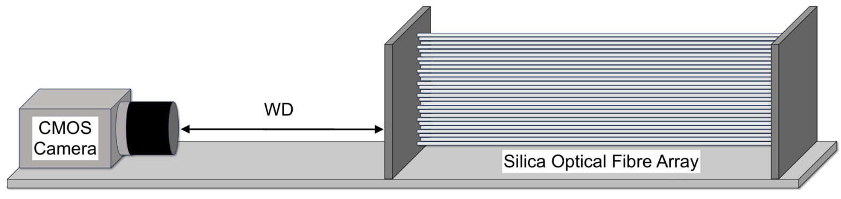
Optical Fibre Dosimetry
Goal :
Measure in real time the doses delivered by VHEE at UHDR and CDR with two arrays of optical fibers.
Experiment :
Recontruct the transverse profile of the VHEE beam to measure the dose in real time and compare with radiochromic films.
e⁻
e⁻
Published in Physics in Medicine & Biology
J. Bateman
Pierre Korysko - CLEAR Review 2024 - May 29, 2024
17

Slide 18

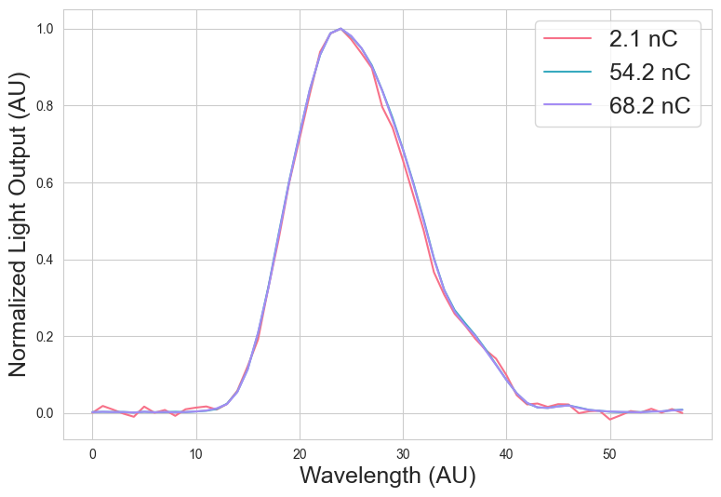
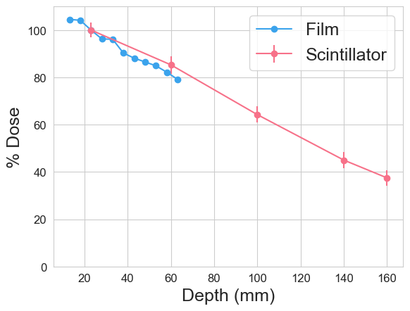
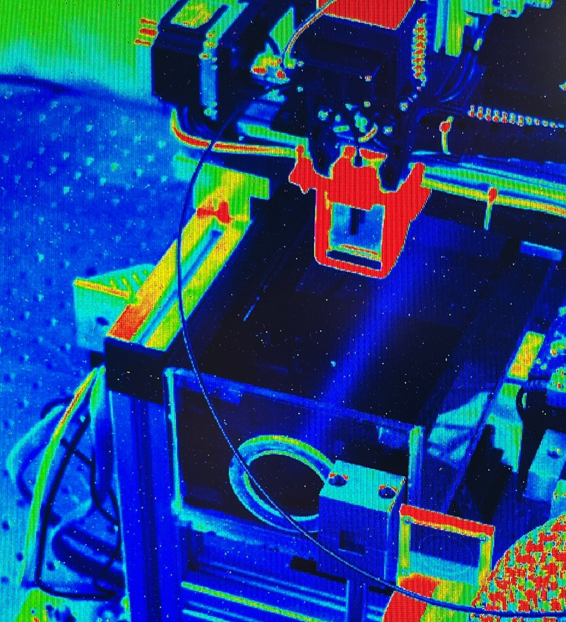
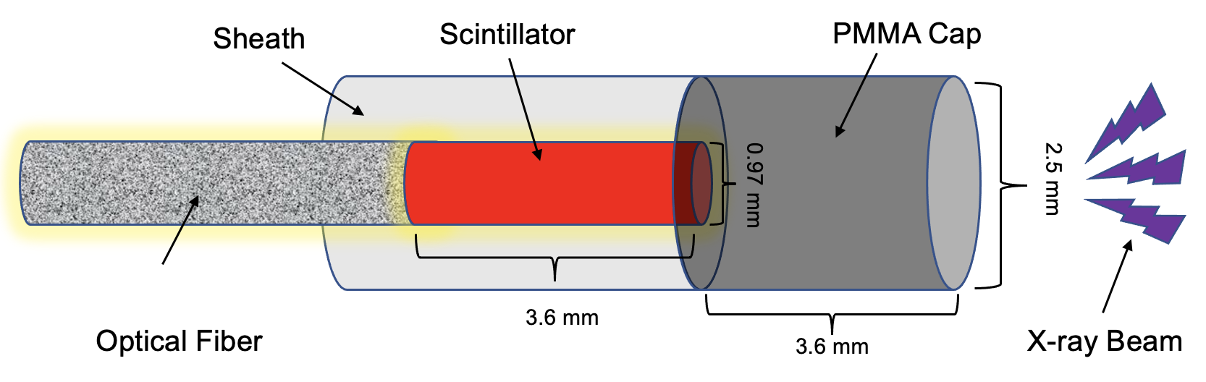
Scintillator Dosimetry
Goal:
Measure the dose at UHDR with a real-time readout and a high spatial resolution thanks to a scintillator and an optical fiber.
A. Hart &
C. Giguère
Experiment:
Measure the responses of the scintillator for different doses and water depths and compare them with the doses measured on films.
Published in IEEE Sensors Journal
Pierre Korysko - CLEAR Review 2024 - May 29, 2024
18

Slide 19
Selected Medical Applications
performed at CLEAR in 2023:
Irradiation Methods

Slide 20


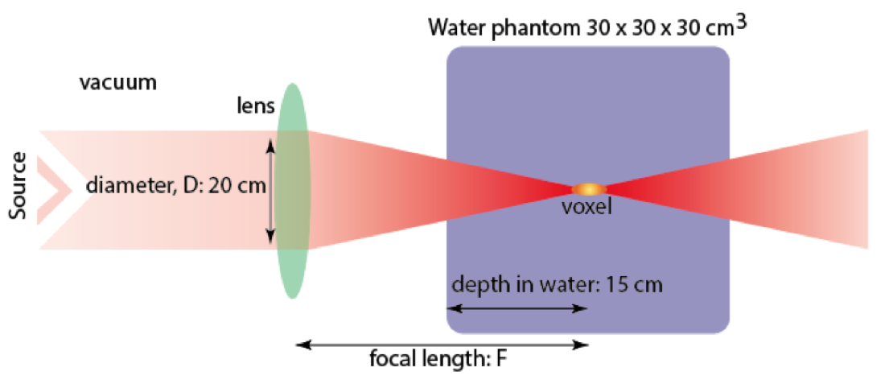
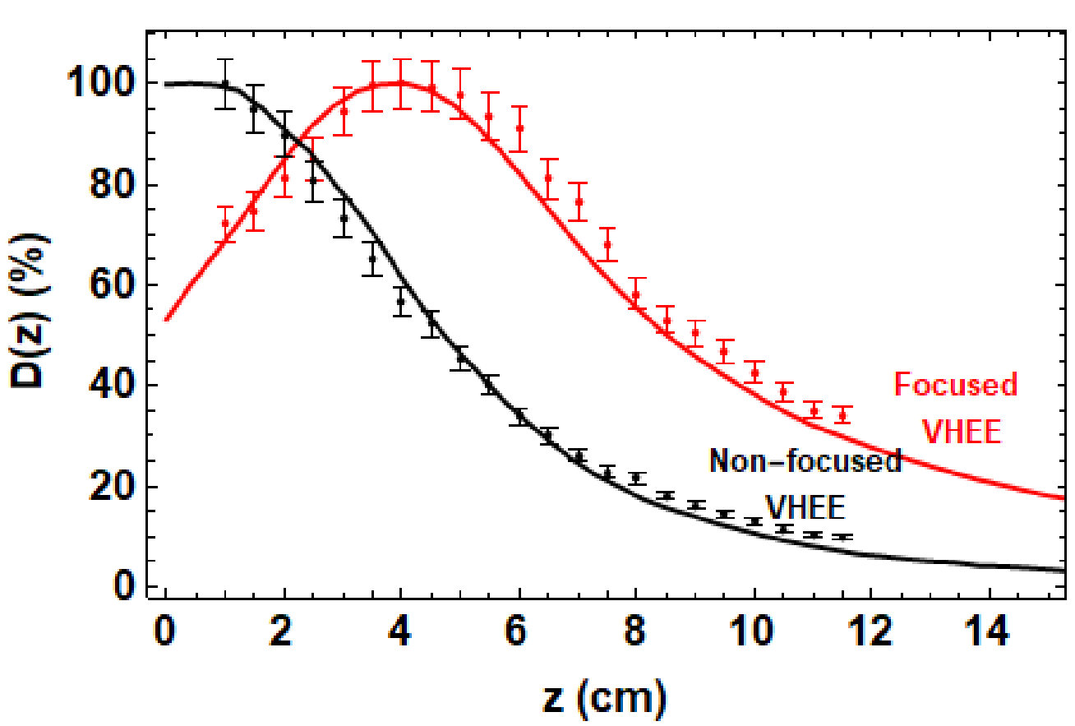
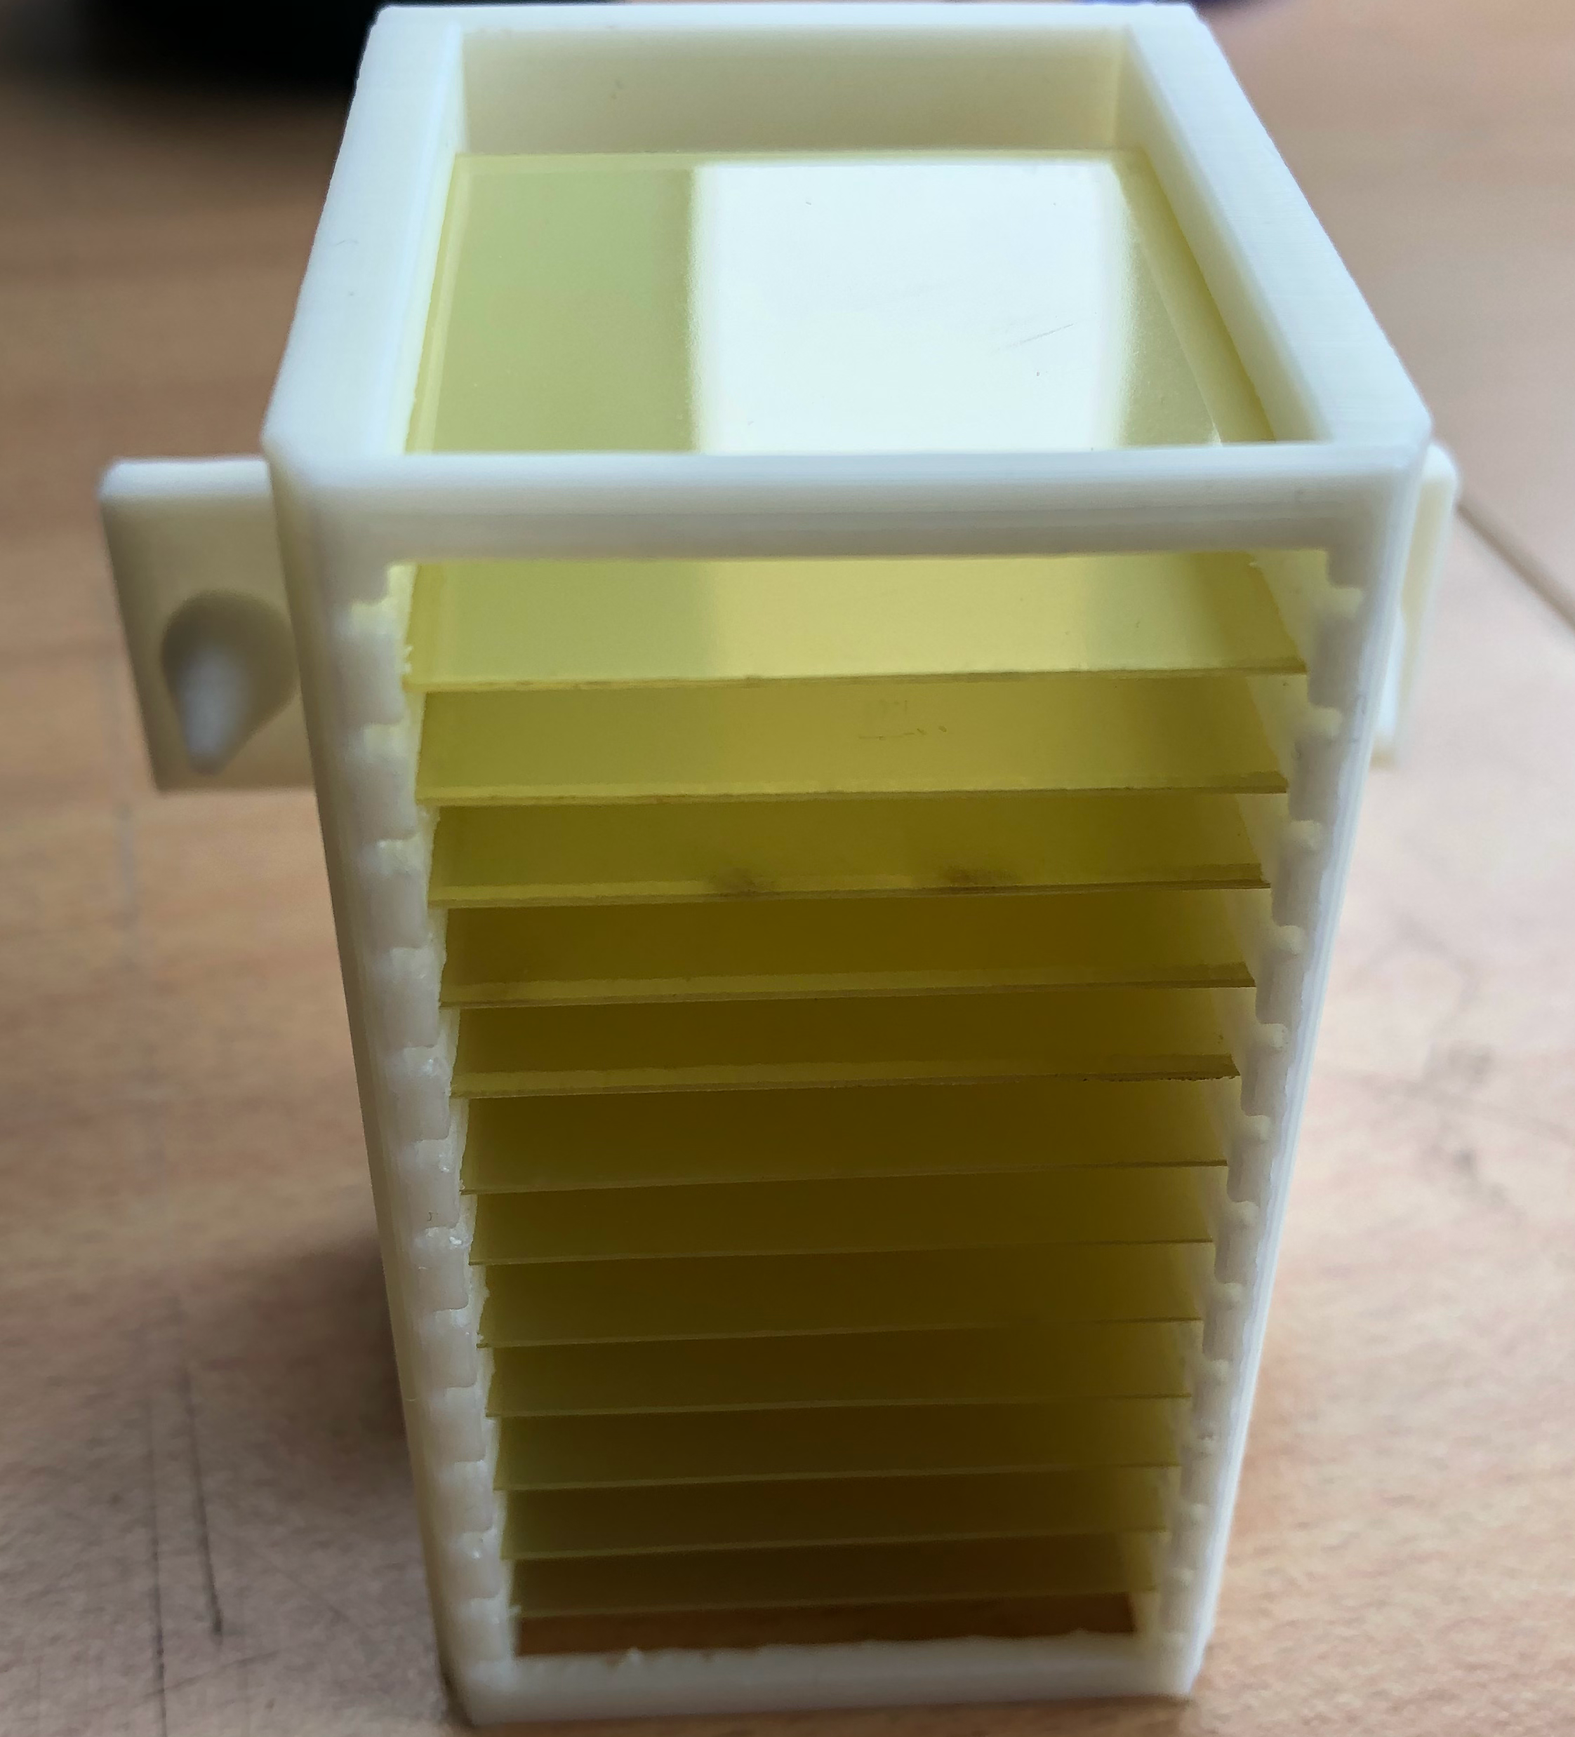
VHEE Strong Focusing
Goal:
Focus the beam on the tumor in order to minimize the dose and damage on the nearby healthy tissues.
Experiment:
Measure the beam sizes on a YAG screen in the water phantom (good model of the human body) and perform irradiations on long dosimetry films holders placed at different longitudinal positions.
Published in Nature Scientific Reports
L. Whitmore
Pierre Korysko - CLEAR Review 2024 - May 29, 2024
20

Slide 21
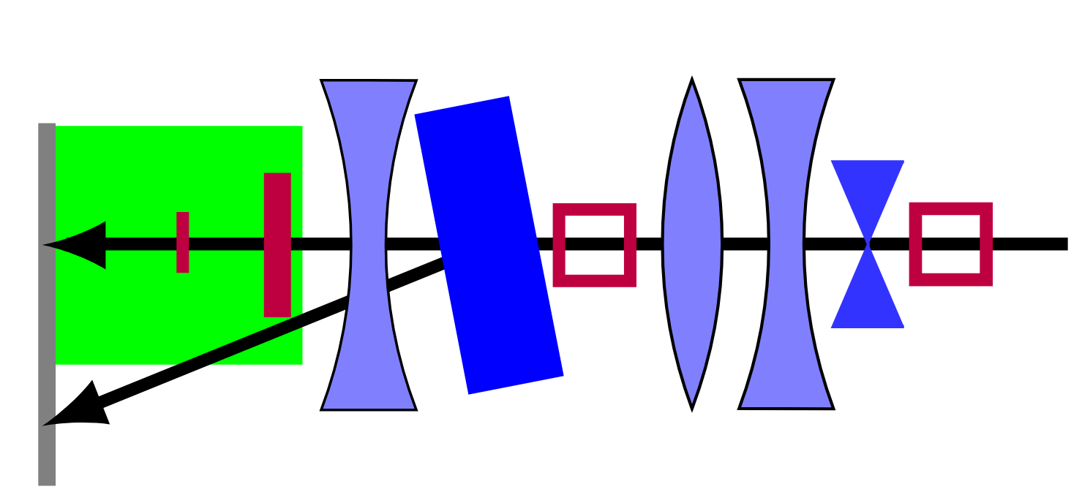

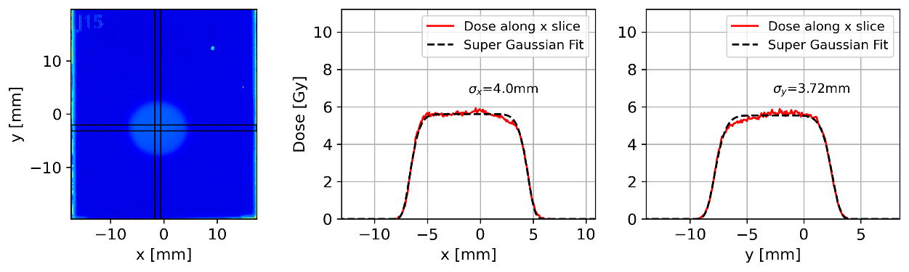
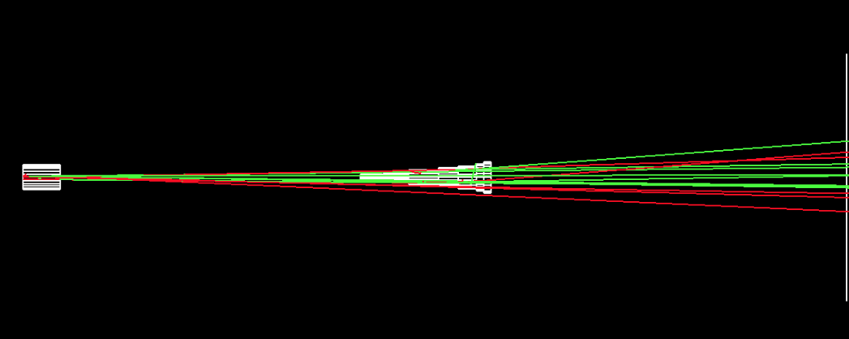
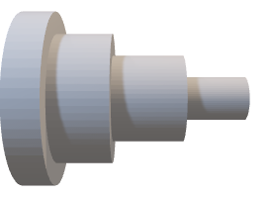
VHEE Scatterers
Goal:
Obtain a flat beam that has a constant transverse distribution at patient’s tumor in order to minimize the dose and damage on the nearby healthy tissues.
e⁻
Experiment:
Measure beam profiles, sizes and intensity on a YAG screen and films after carefully inserting two scatterers with the beam with the C-Robot.
YAG
Screen
Collimator
Paper under review
e⁻
Scatterer 1
Scatterer 2
Screen
X and Y beam profile
Now used by CLEAR Operation.
C. Robertson
Pierre Korysko - CLEAR Review 2024 - May 29, 2024
21

Slide 22
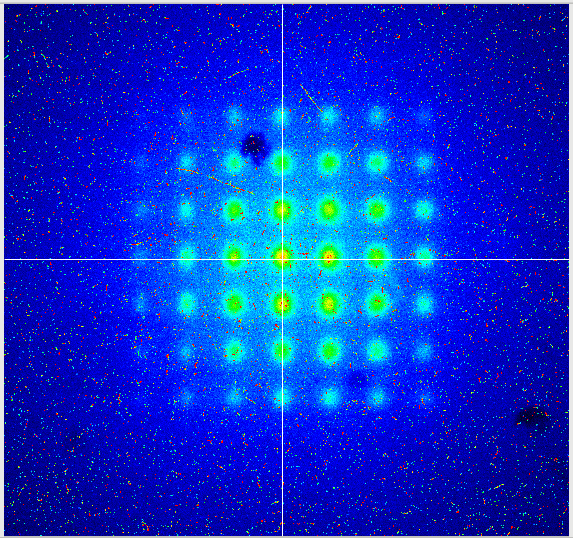
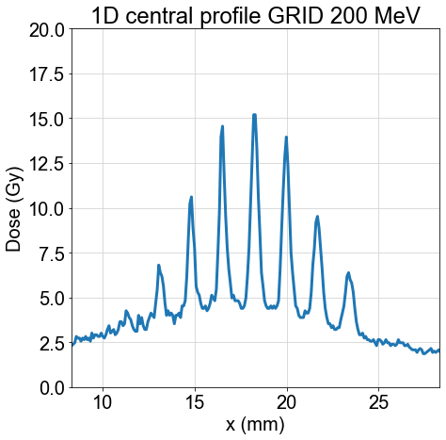
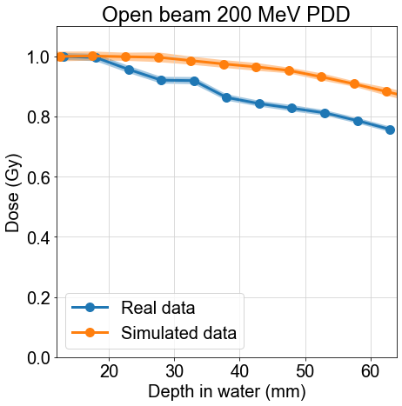
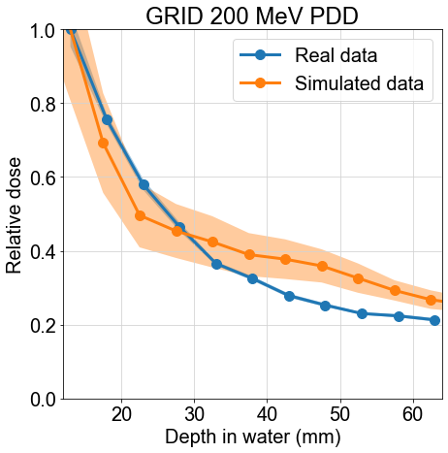
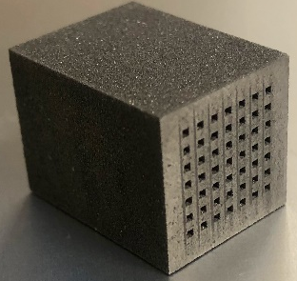
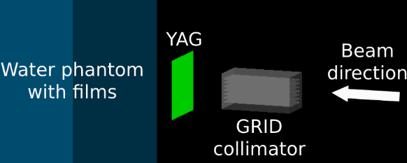
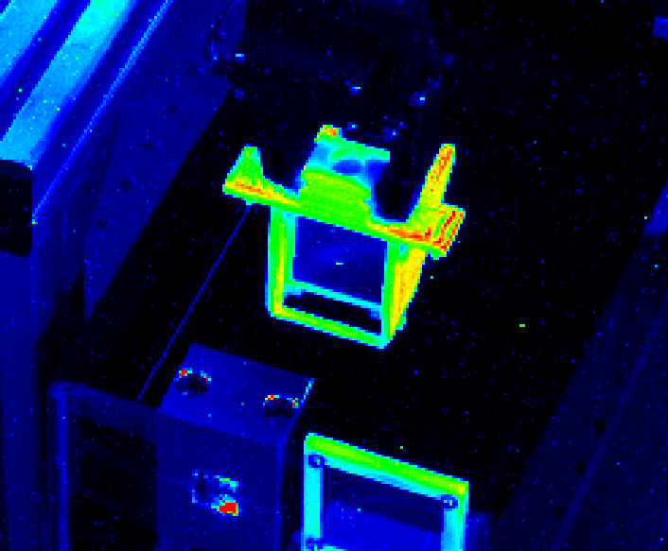
VHEE GRID
Goal:
Study the dose at UHDR for highly non-uniform dose distributions using a GRID Collimator (Spatially-fractionated RT, known for normal tissue sparing).
M. Bazalova-Carter, N. Clements, N. Esplen & A. Hart
Experiment:
Compare the dose values and profiles with and without the GRID collimator inserted for different water depths, with the YAG screen and films.
e⁻
Published in Physics in Medicine & Biology
Pierre Korysko - CLEAR Review 2024 - May 29, 2024
22

Slide 23
Selected Medical Applications
performed at CLEAR in 2023:
Looking for the FLASH effect

Slide 24



VHEE Chemistry Studies
Experiment:
Measure and compare the production of Reactive Oxygen Species (ROS) in water at Conventional Dose Rate (CDR) and Ultra High Dose Rate (UHDR).
UHDR=1.2 10⁹ Gy/s CONV=0.15-0.41 Gy/s
Paper under review
Holder with films and Eppendorf tube
C-Robot view when performing irradiations for chemistry studies
M-C. Vozenin & H. Kacem
Pierre Korysko - CLEAR Review 2024 - May 29, 2024
24

Slide 25


In vivo radiobiology at UHDR
Goal:
Compare the impact of 200 MeV VHEE irradiations at UHDR and CDR on Drosophila melanogaster larvae.
Preliminary results
Experiment:
Deliver 15 to 45 Gy at UHDR and CDR to larvae with VHEE and measure the eclosion rate.
Not yet published
A. Hart & T. Esmangart de Bournonville
Pierre Korysko - CLEAR Review 2024 - May 29, 2024
25

Slide 26


Biodosimeter Irradiations
Goal :
Measure the response effect of the dose and the dose rate on biodosimeters with VHEE.
Preliminary results
Experiment :
Irradiate biodosimeters with numerous doses and dose rates: UHDR (Ultra High Dose Rate) and CDR (Conventional Dose Rate) and measure the length defficit.
Paper under review
M-C Vozenin & J. Ollivier
Pierre Korysko - CLEAR Review 2024 - May 29, 2024
26

Slide 27
Selected Medical Applications
planned at CLEAR in 2024:

Slide 28





Selected Medical Applications in 2024
VHEE at UHDR Studies with Liposomes
VHEE at UHDR Studies with Biodosimeters
VHEE at UHDR Studies with Short Peptides & LCMS
VHEE at UHDR Studies with Cells
VHEE at UHDR Studies with Drosophilae
VHEE Material Irradiation Studies
Goal: explore dose and dose rate parameters for both healthy and cancerous cells.
Plan Delivery to an Anatomical Phantom
Radio-enhancement effect of
Nanoparticles in VHEE beams
& Gold Nanoparticles Plasmid Studies
Pierre Korysko - CLEAR Review 2024 - May 29, 2024
28

Slide 29
Directions for VHEE/FLASH Experiments
Studying the impact of the beam time structure on the FLASH effect (average dose rate, instantaneous dose rate, etc.)
Studying the FLASH effect on both healthy and cancerous cells (first experiment done on cancerous cells in Nov. 2023).
Studying the FLASH effect on several biodosimeters (Zebra Fish Embryos & Drosophila Larvae).
Pierre Korysko - CLEAR Review 2024 - May 29, 2024
29

Slide 30


Comments from the CLEAR Scientfic Board
Pierre Korysko - CLEAR Review 2024 - May 29, 2024
30

Slide 31
Conclusions
More and more users are studying the FLASH effect, Irradiation Methods and Dosimetry in CLEAR, leading to:
  14 weeks of beam dedicated to medical applications in 2023.
  More than 12 conference proceedings and 9 journal papers (published or being reviewed) for medical applications, see the full list on: https://clear.cern/content/publications
  13 Medical Application Experiments planned for 2024 (so far), see the full list on: https://pkorysko.web.cern.ch/CLEAR/Table/CLEAR_experiments_2024.html
  A new robot, the C-Robot 2.0 was built. 3 similar robots are being built in Germany (PITZ), Australia (Australian Synchrotron) and China (IHEP).
  New beam line with flexible optics, particularly suited for medical applications.
  New collaborations in 2024 with HUG and Gustave Roussy.
Pierre Korysko - CLEAR Review 2024 - May 29, 2024
31

Slide 32

Thank you

