Slide 1
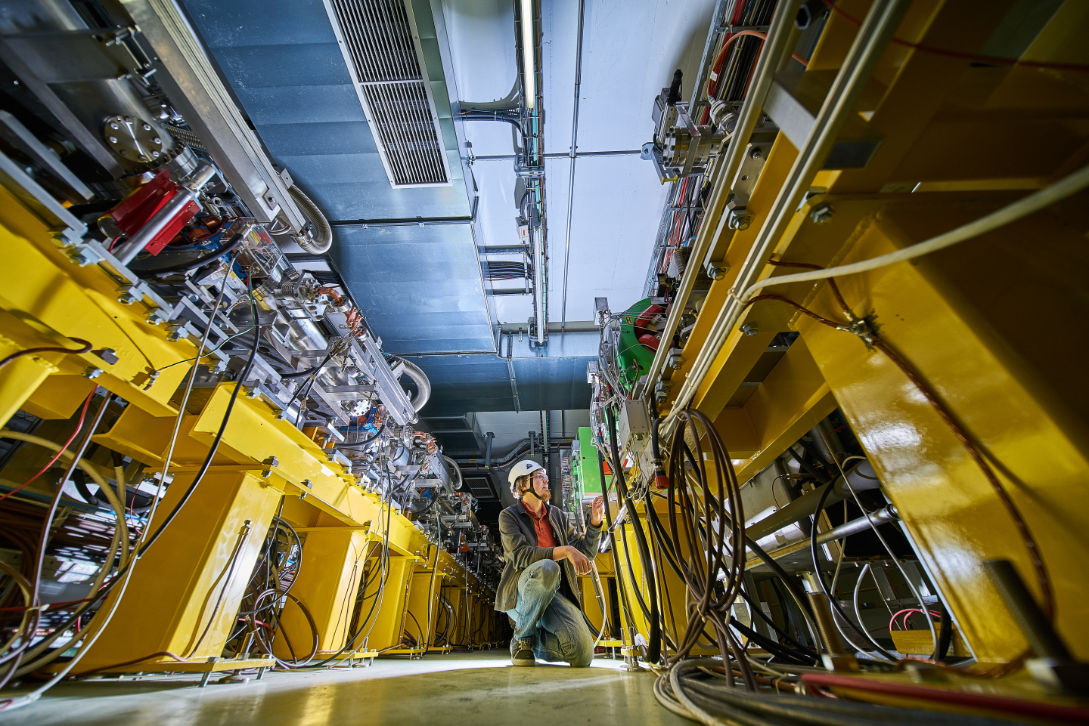
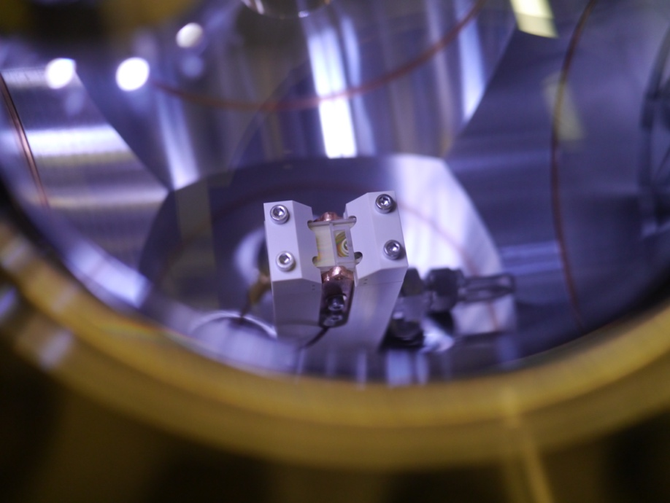
CLEAR resources - material and manpower
R. Corsini
for the CLEAR Team
CERN Linear
Electron Accelerator
for Research

Slide 2
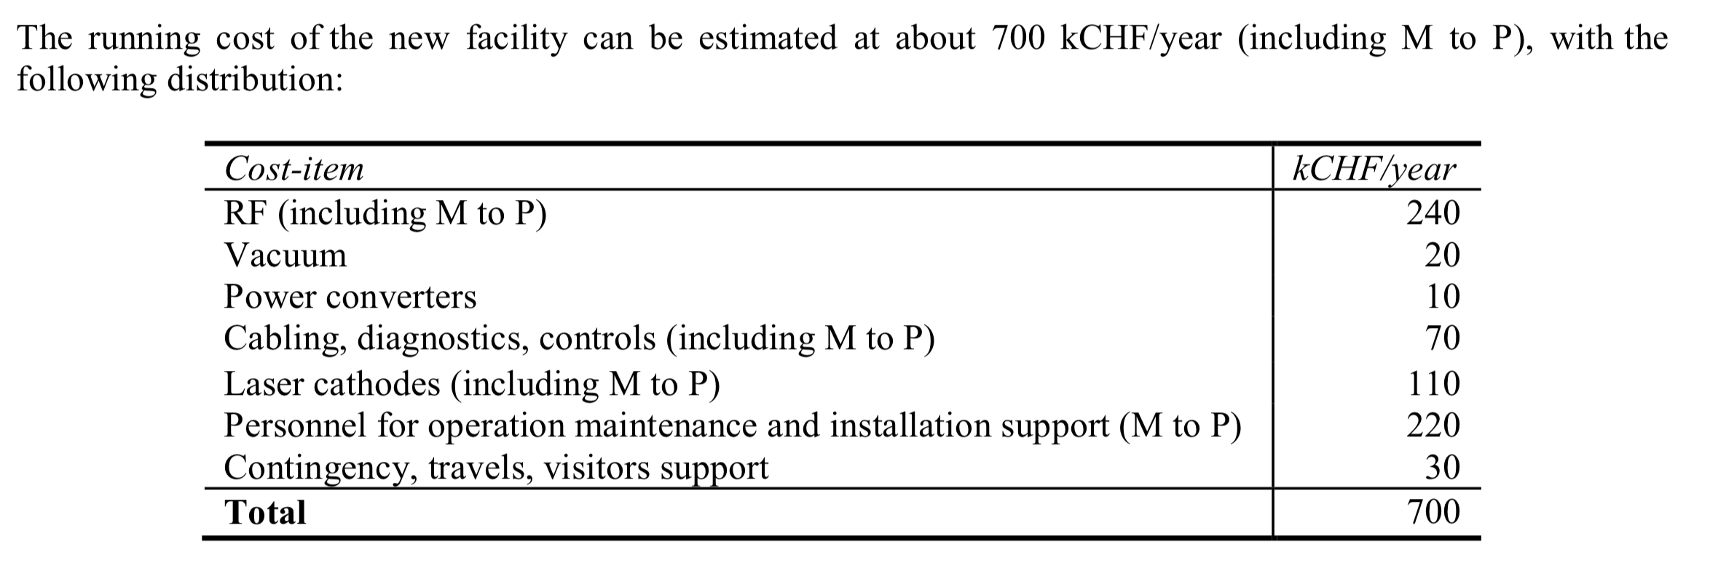
Resources: material
From the original CLEAR proposal
 | 2017 | 2018 | 2019 | 2020 | 2021 | 2022 | 2023
RF | 340 | 253 | 175 | 56 | 87 | 109 | 92
Others* | 30 | 97 | 82 | 79 | 48 | 64 | 92
Laser/cathodes | 40 | 75 | 78 | 48 | 61 | 105 | 127
Personnel** | 205 | 260 | 304 | 266 | 280 | 281 | 308
TOTAL | 595 | 685 | 639 | 449 | 479 | 560 | 610
*Vacuum, power converters, cabling, diagnostics, controls, consumables…
** students/Associates/FSUs
N.B.: average yearly budget 2017 – 2023 = 574 kCHF.
To be added, about 2 FTE/year fellow funding (~220 kCHF) ➯ ~ 800 kCHF

Slide 3
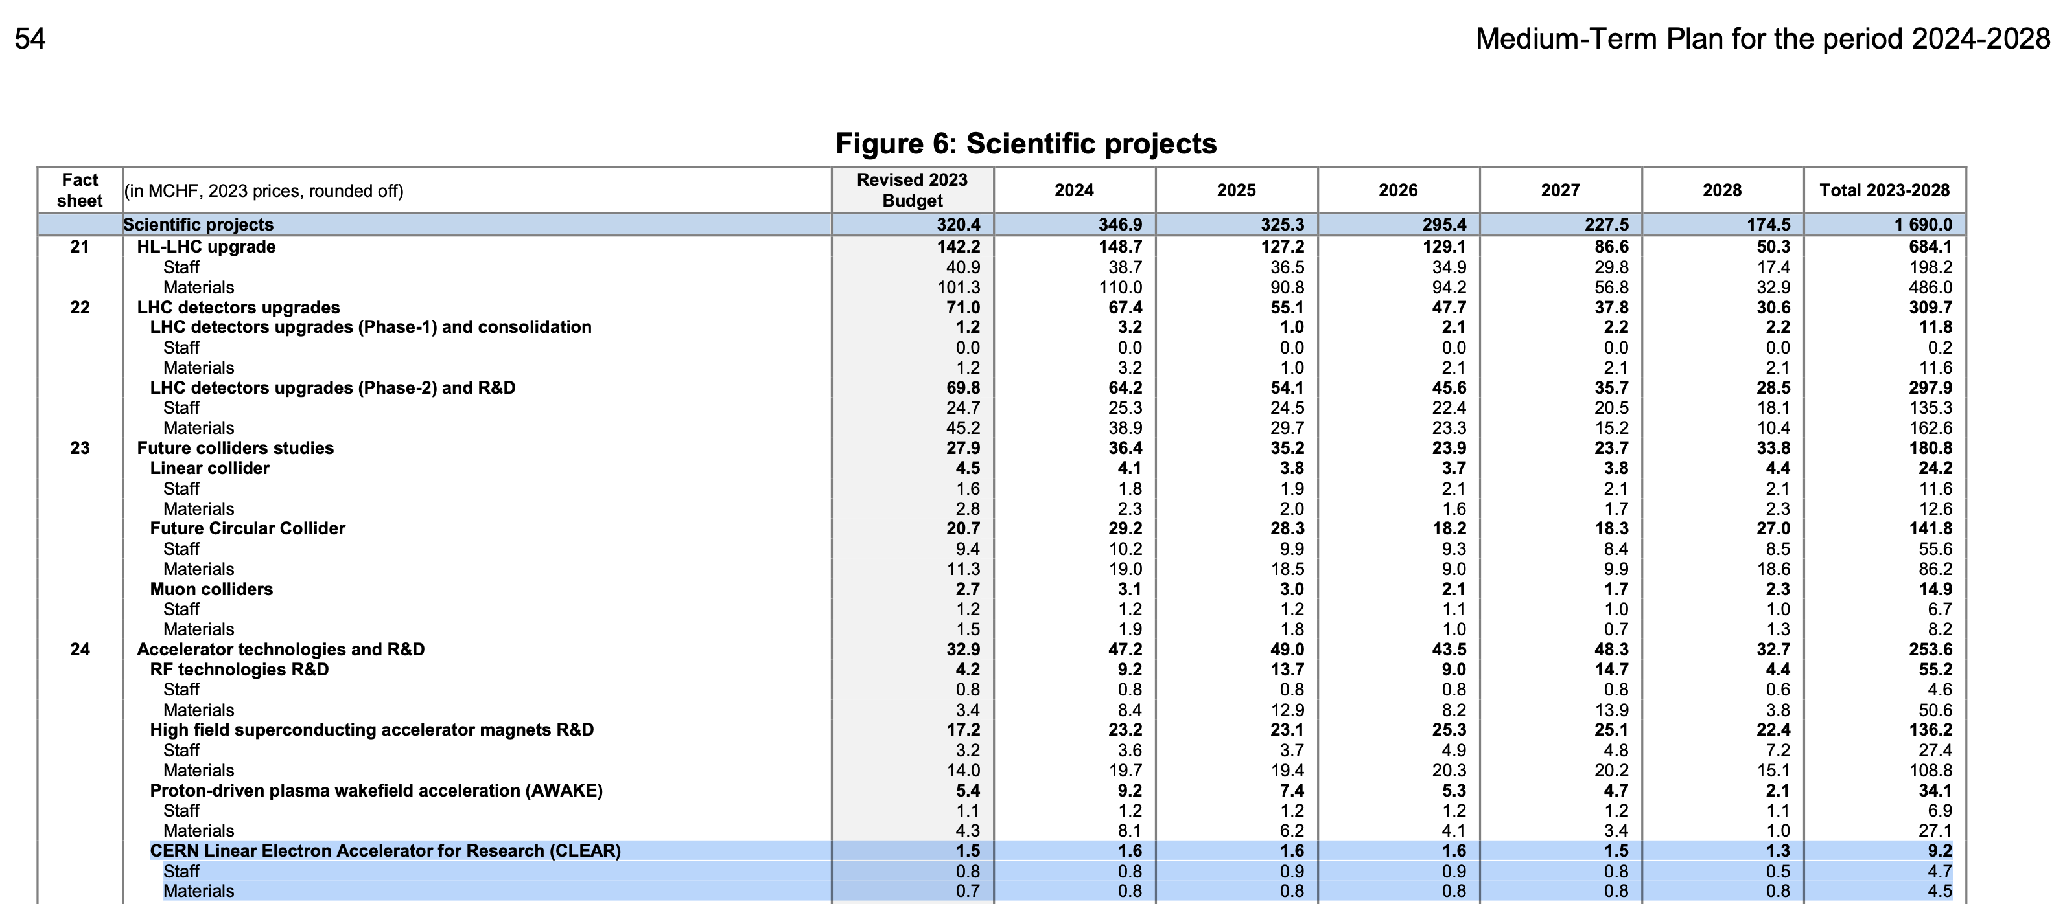
CLEAR Material Budget in MTP
Initial request (and initial allocation):
  800 kCHF/year = about 650 kCHF/year “material” + 1.5 Fellow on average
Allocation 2017-2023:
  750 – 790 kCHF/year
MTP (2023)
Sufficient so far – but tight, especially for M to P to grant operation.

Slide 4
Short term improvements - cost
New beam line - Preliminary cost evaluation ~ 160 kCHF
  42 kCHF are available from EURO-LABS funds
Consolidation (and improvement) of the laser system has also been approved.
This requires about 100 kCHF over 2023-2024
Total to be funded from CLEAR operational budget in the period 2023 – 2024
➯ About 110 kCHF per year
This is possible due to:
  main consolidation/spares items until 2025 already covered, and
  additional contributions to manpower (M to P) from external sources
  (DEFT, KT-CIPEA, Oxford U.)

Slide 5
Consolidation, spares situation
In the past years, a campaign was carried out to consolidate equipment and ensure we have enough spares at least until end 2025. In particular, the situation for the most expensive items (e.g., klystrons) is now OK, with some margin.
Beyond 2025, a few systems need further consolidation. More expensive items:
  Additional klystrons to cover until 2023
  Consolidation of low-level RF and timing systems (also manpower needed)
These two items will be covered in Steffen’s talk later

Slide 6
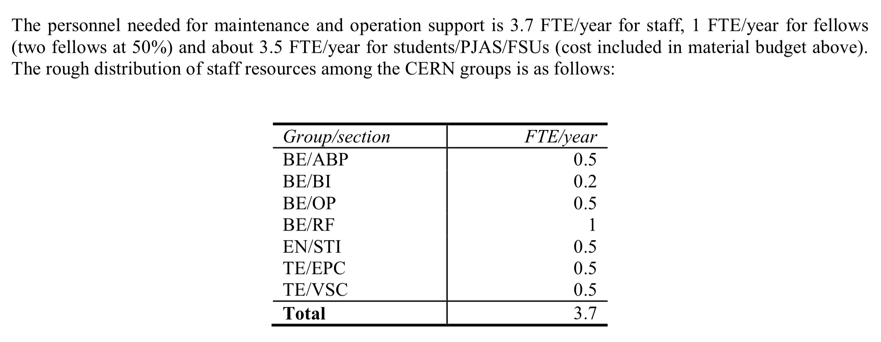
Resources: manpower
Present Status:
Group FTE/year
BE/ABP 1.45*
SY/BI 0.2
SY/RF 1.
BE/CO 0.2
EN/STI 0.8
TE/VSC 0.25
TOTAL 3.9
*0.8 (W. Farabolini) funded by DEFT/CLEAR material budget
From the original CLEAR proposal
From APT
Apart from staff, CLEAR manpower has been covered by ~ 2 FTE/year for Fellows
and about 3 FTE/year for students/associates/FSUs (cost included in material budget).

Slide 7
Status and main concerns on manpower
The present situation of technical support is adequate – with the possible exception of low-level RF (see Steffen’s talk).
Manpower for operation is marginal – but up to now we have managed
However:
  Might gain efficiency with some more resources
  Operation is for a large part covered by temporary personnel:
  fellows, associates and students (M to P) ➯
    Difficult to maintain a constant level
    Issues with continuity, knowledge transfer, maintenance of tools…
    Competition with budget for hardware, consumables,…
  Don’t expect to need more manpower for 2nd beam line but might need more to cover operation for users of new injector in CTF2. ➯
    Synergies with AWAKE ?
Main concern for longer term ➯
  Staff replacement around 2027/2028
  (retirement of myself & Wilfrid extension + retirement)

Slide 8
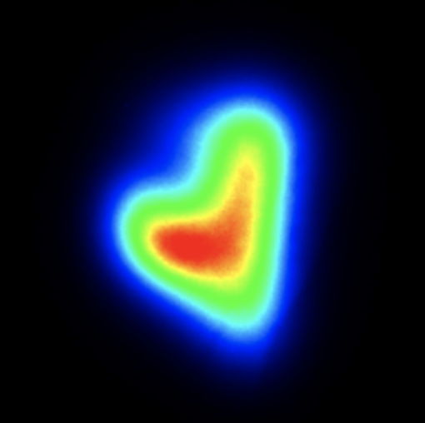
Thanks for your attention!
Acknowledgements to the CLEAR dream team:
S. Doebert, W. Farabolini, A. Ghilardi, P. Korysko, A. Malyzhenkov,
A. Aksoy, K. Sjobaek, L. Dyks, V. Rieker, J. Bateman, C. Robertson, L. Wroe, E. Granados, M. Martinez, S. Curt, D. Gamba, …

