Slide 1
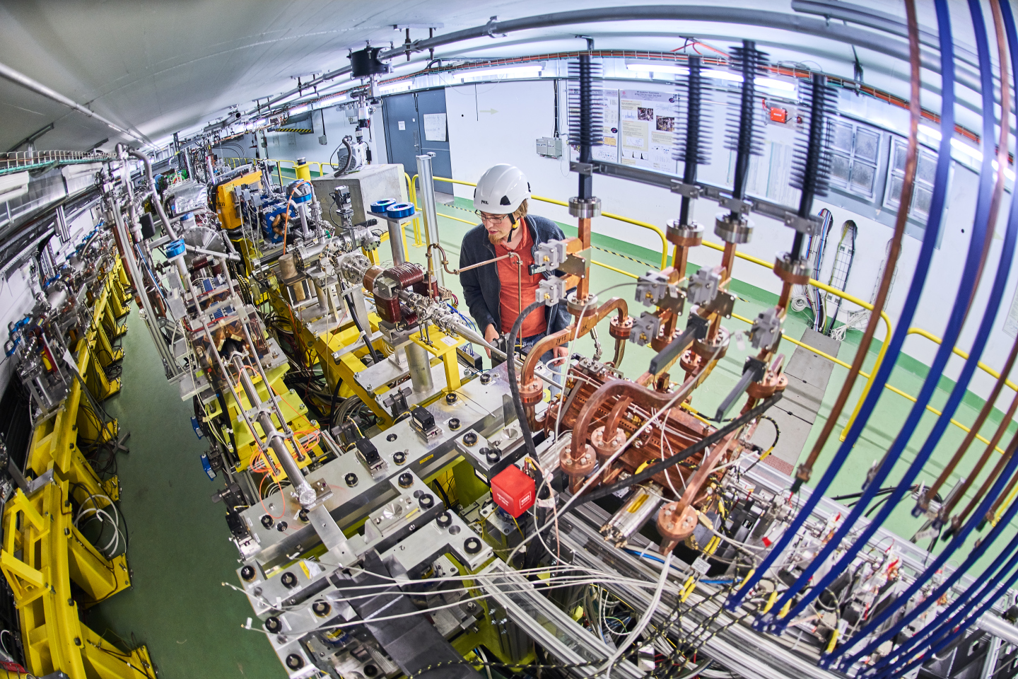
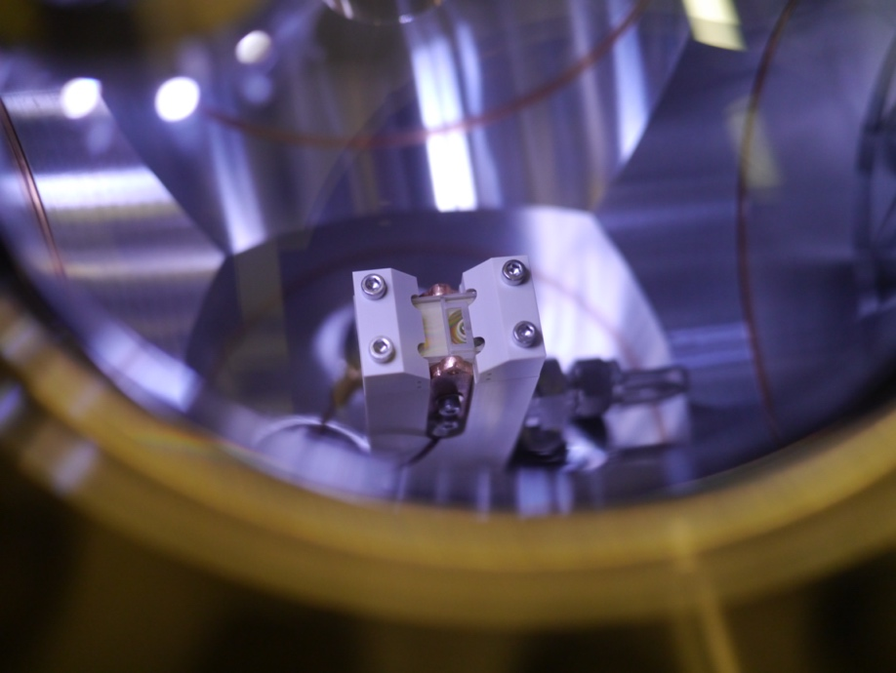
Recommendations of the CLEAR review 2021
CERN Linear Electron Accelerator for Research
R. Corsini
for the CLEAR team

Slide 2
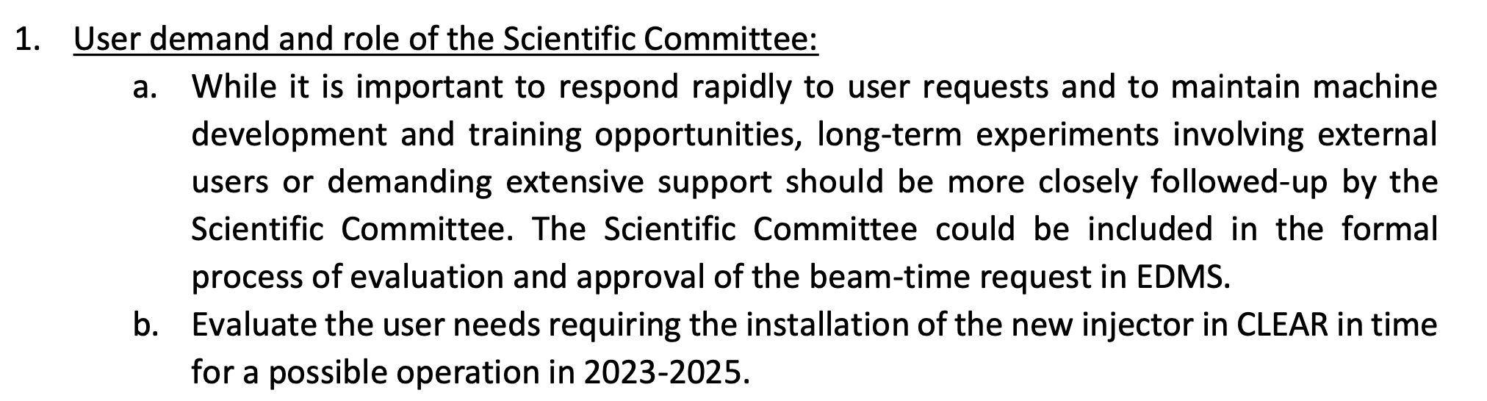
R. 1
a.
A formal process of approval has been implemented in EDMS.
The Scientific Board members are part of the formal approval in EDMS, commenting and potentially vetoing the requests.
A call for experimental request is done every year during the YETS.
The Scientific Board meets every year in February for assessment and evaluation of the requests received and to give overall recommendations.
Flexibility is retained by the possibility of accepting further requests during the year
The Scientific Board can be called in case priorities needs to be applied .
b.
No strong requests for two-beam experiments were expressed by the user community, the present option is to make use of the new injector as a separate beamline for selected users in the present location (CTF2)

Slide 3
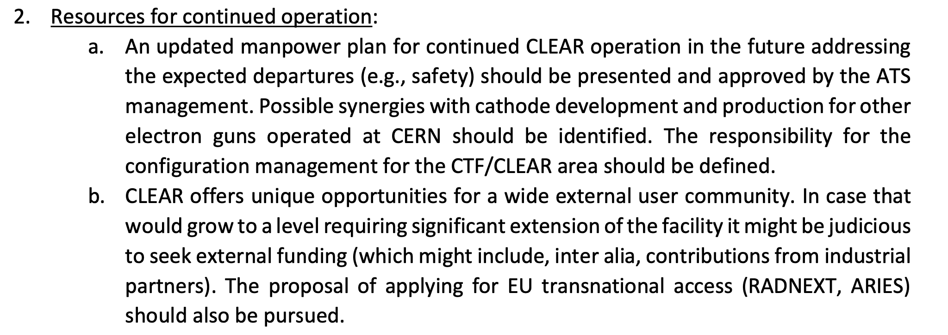
R. 2
a.
The manpower plan has been updated – in particular, a new staff post for operation (W. Farabolini) was funded.
The safety officer has been substituted (D. Gamba, first as temporary, now confirmed). Synergies (notably with AWAKE) on cathode development and production are exploited and remain fundamental. Attempts were made towards a configuration management for CLEAR, but not pursued due to lack of support and internal resources.
b.
External funding has been obtained through the EU transnational access project EUROLABS – mainly support to users, but also a limited amount for infrastructure improvements. Several other EU and Swiss funding opportunities were attempted, with some refusals but at least one (Swiss National Science Foundation - National Centres of Competence in Research) still ongoing. Additional funds and supports were obtained from CHUV through the DEFT collaboration and from the KT initiative CIPEA. We also acknowledge manpower contributions from Oxford and Oslo U.

Slide 4
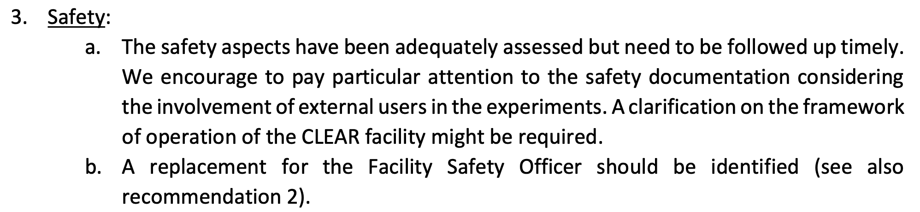
R. 3
a.
Safety officers (RP, ExSO, DSO) are now an integral part of the formal approval process. RP is routinely present at CLEAR weekly operation meetings. Special safety requirements for specific experiments (e.g., gas, cryogenic, …) and needed updates of the safety infrastructure and tools (e.g. lead shielding) are followed up and included in the (growing) safety documentation.
b.
See comments in R. 2.

Slide 5
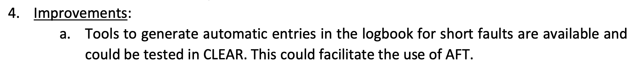
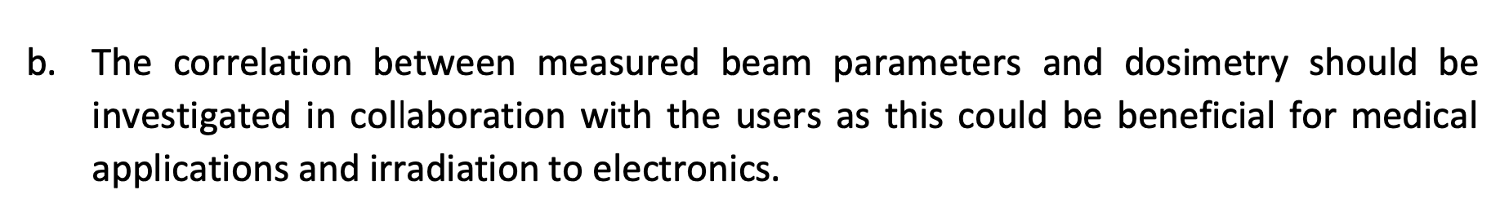
R. 4
a.
Automatic fault tools not implemented due to lack of resources. Improved documentation of faults thanks to systematic entries in the e-logbook and especially thanks to documentation in the weekly report.
b.
Full online dosimetry based on beam measurements (profile and charge) validated and now implemented.
(Ph.D. thesis of V. Rieker, online tooling by A. Malyzhenkov).

Slide 6
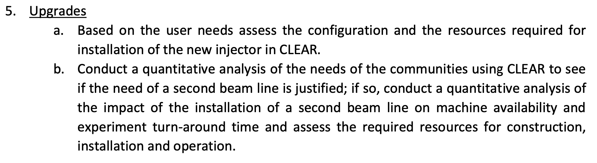
R. 5
a.
No real user needs for installation of new injector in CLEAR. Present alternative (operation in CTF2) pursued.
b.
The second beam line design has been adapted to user needs (energy acceptance and optics flexibility as required in particular by medical applications) and further simplified, in order to minimize cost and manpower. A full design and an assessment of resources needed for the construction and installation of the second beam line has been carried out, and the material budget identified within the present operational budget + EUROLABS contribution. Manpower is also available from the support groups and the activity is included in the PLAN tool. The second beam line construction and installation has been approved by the CERN management. Commissioning by the CLEAR operation team is planned for spring 2025 – about 6 weeks estimated commissioning time (can also be interleaved with operation).

Slide 7
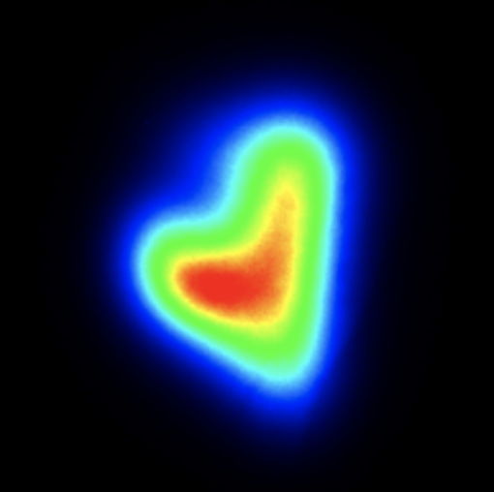
Thanks for your attention!
Acknowledgements to the CLEAR dream team:
S. Doebert, W. Farabolini, A. Ghilardi, P. Korysko, A. Malyzhenkov,
A. Aksoy, K. Sjobaek, L. Dyks, V. Rieker, J. Bateman, C. Robertson, L. Wroe, E. Granados, M. Martinez, S. Curt, D. Gamba, …

