Slide 1

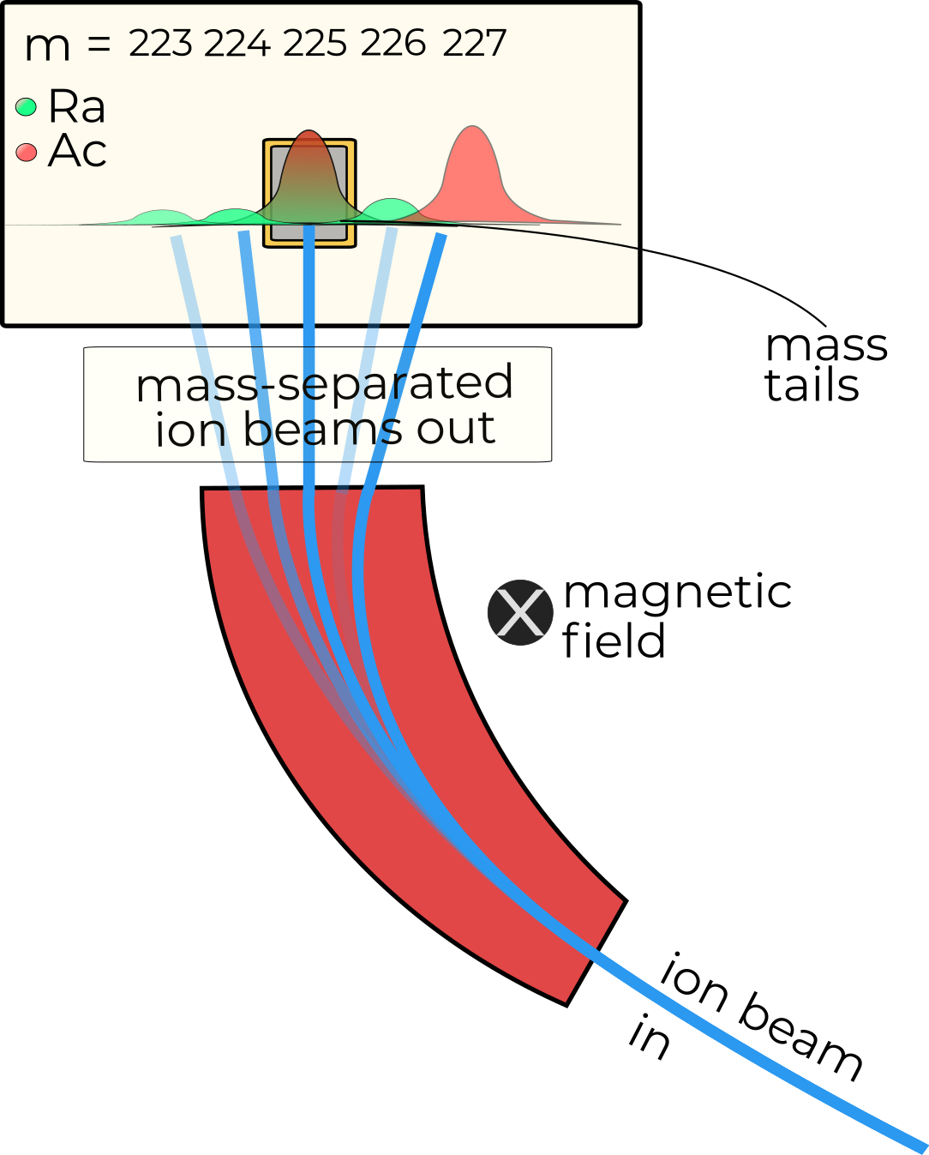
²²⁵Ac in Belgium: Sample purity and
²²⁵Ra / ²²⁵Ac collection efficiencies
MEDICIS collaboration board July 2024
Jake Johnson

Slide 2
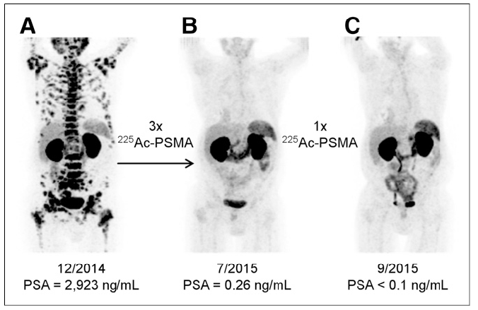

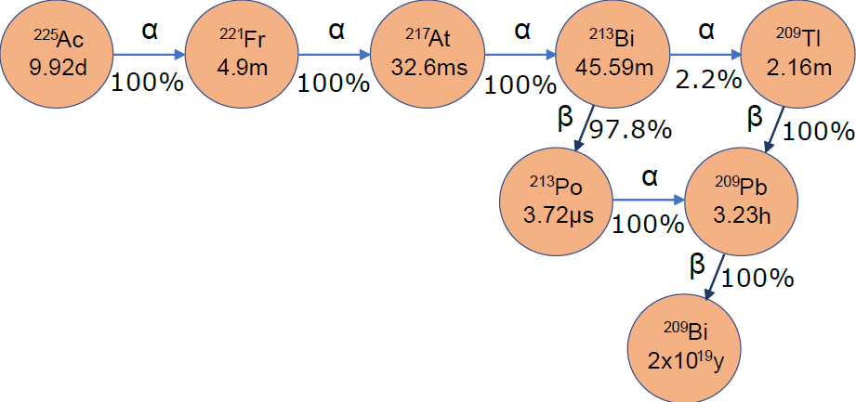
²²⁵Ac interest
²²⁵Ra
14.90d
100%
Kratochwil, C. et al.J. Nucl. Medicine 57, 1941–1944 (2016).
10 MBq patient doses.
7000 patient doses only produced WORLDWIDE via ²²⁹Th generators^{[1]}
New production methods needed
Notes:
Get on average cancer around 4 times a day.
Almost universally dealt with by our immune system
Reason we get cancer when older?

Slide 3
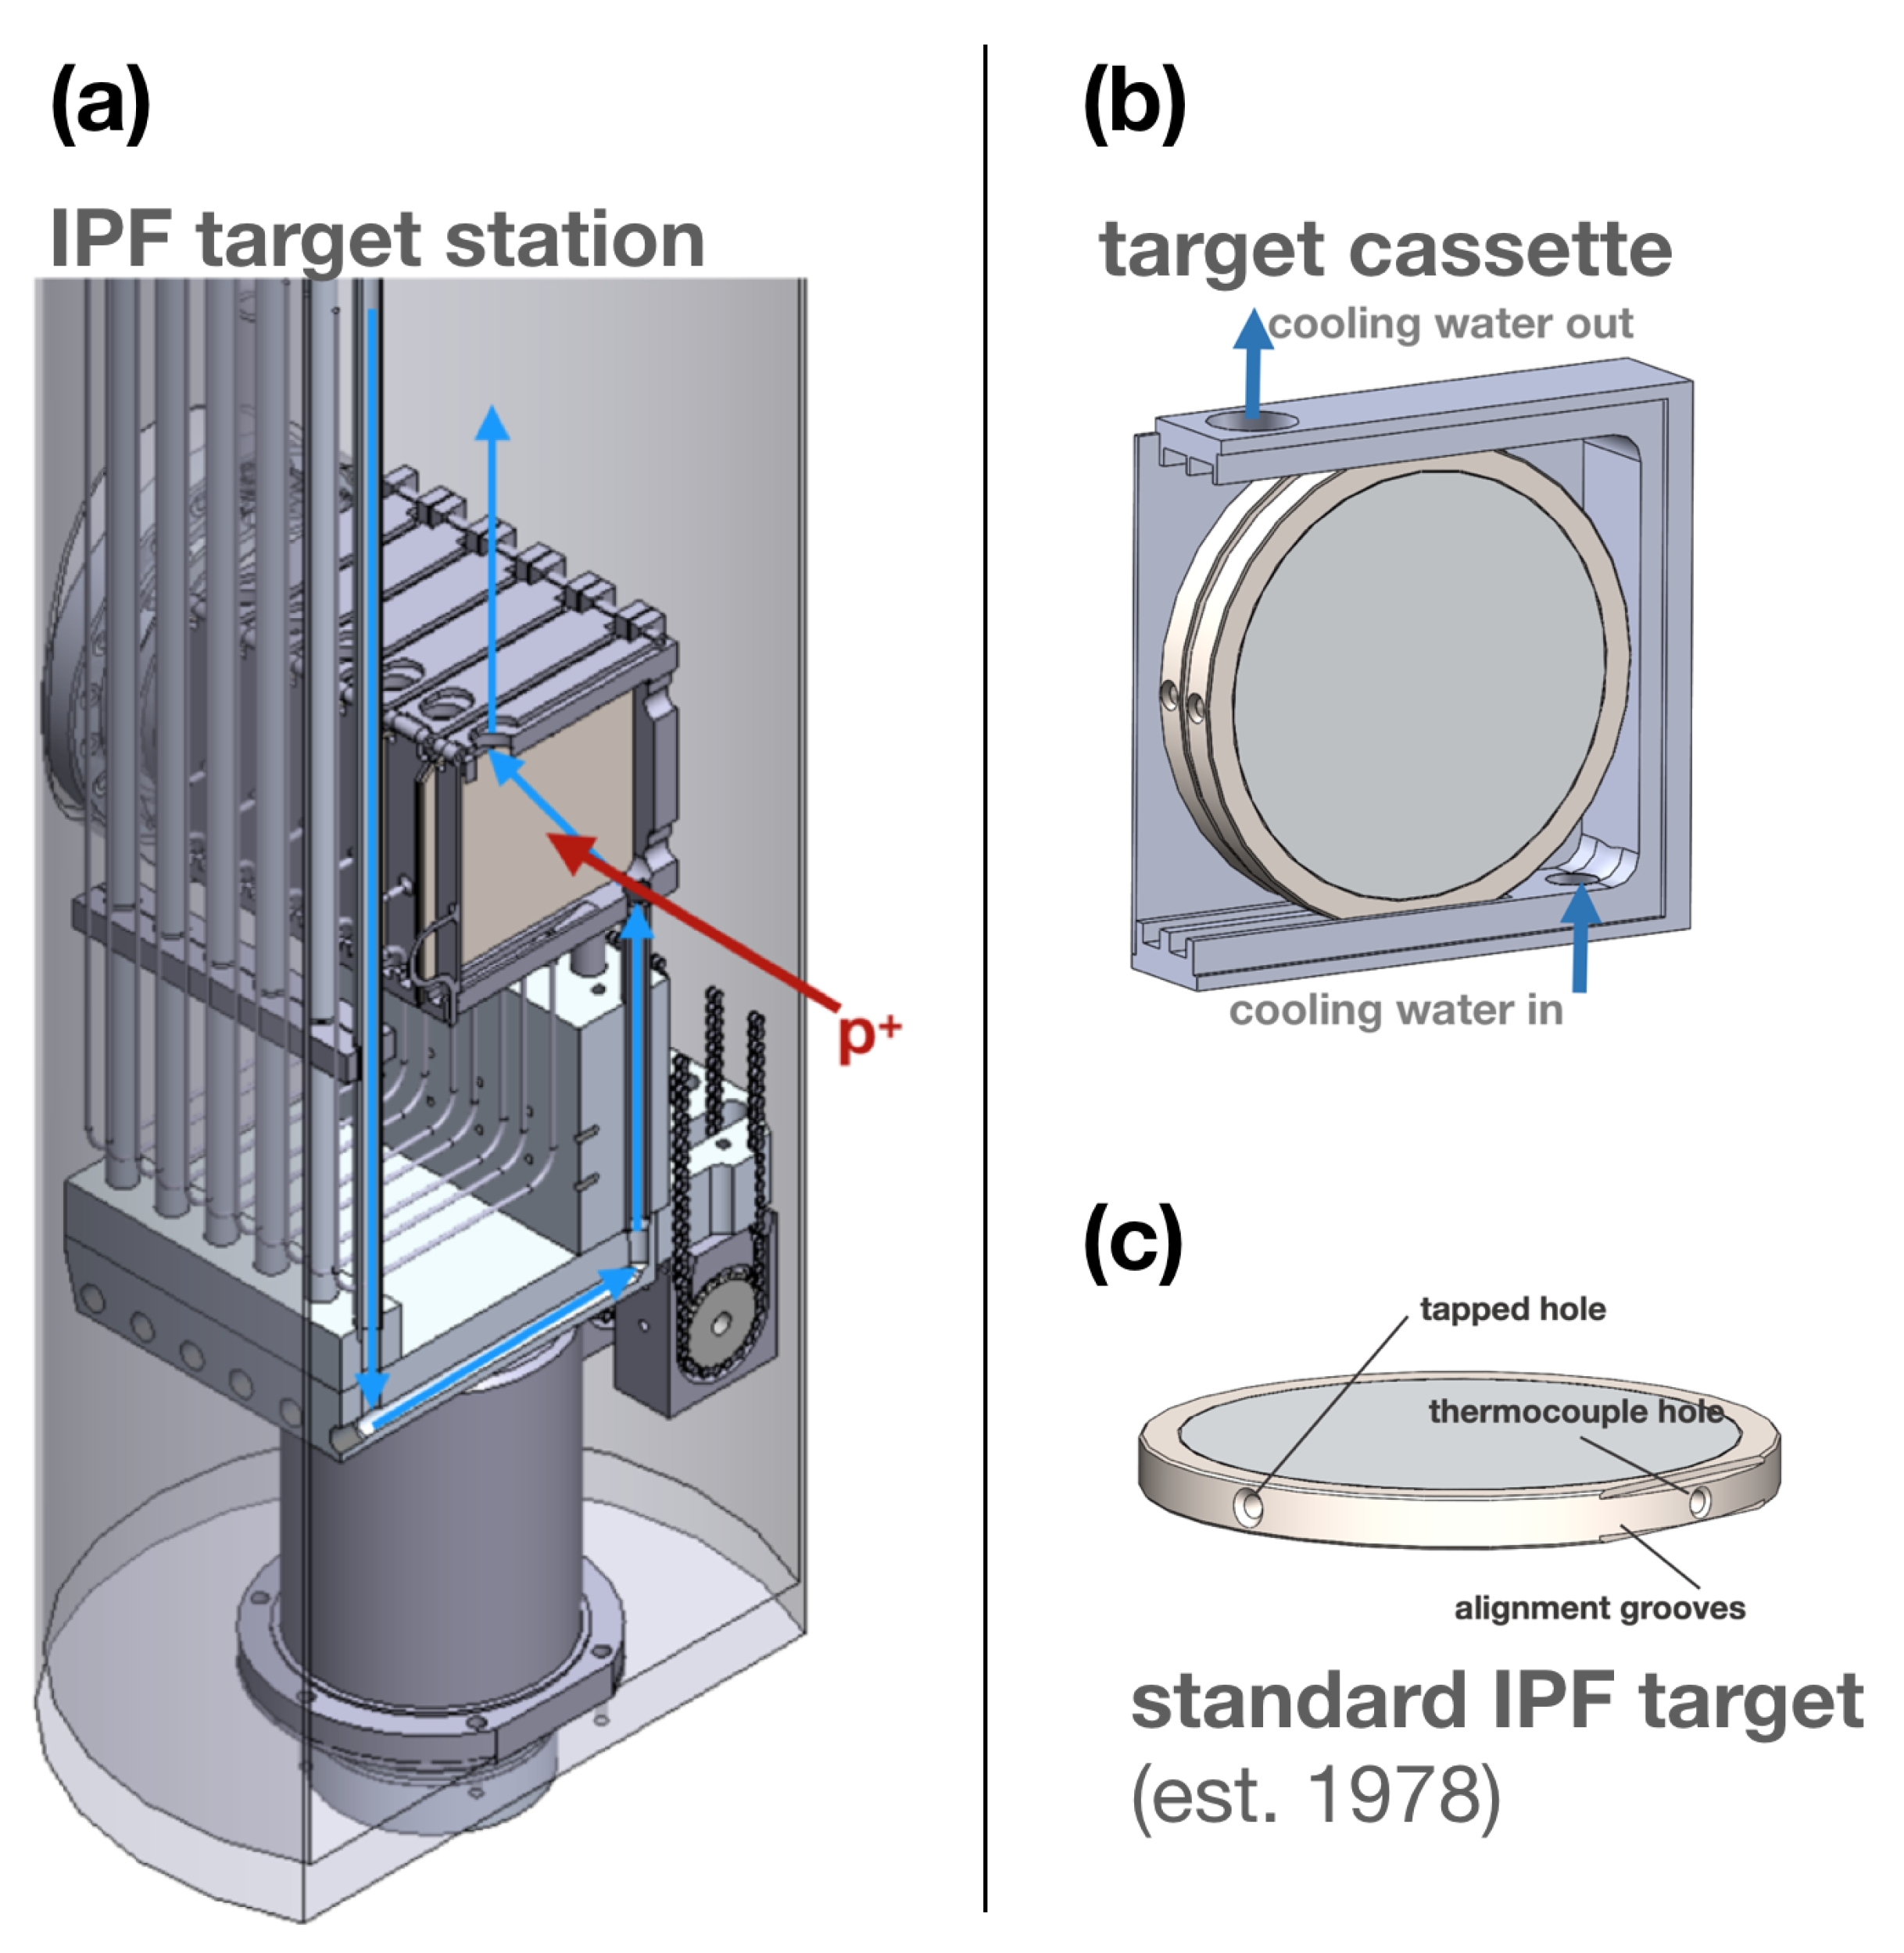
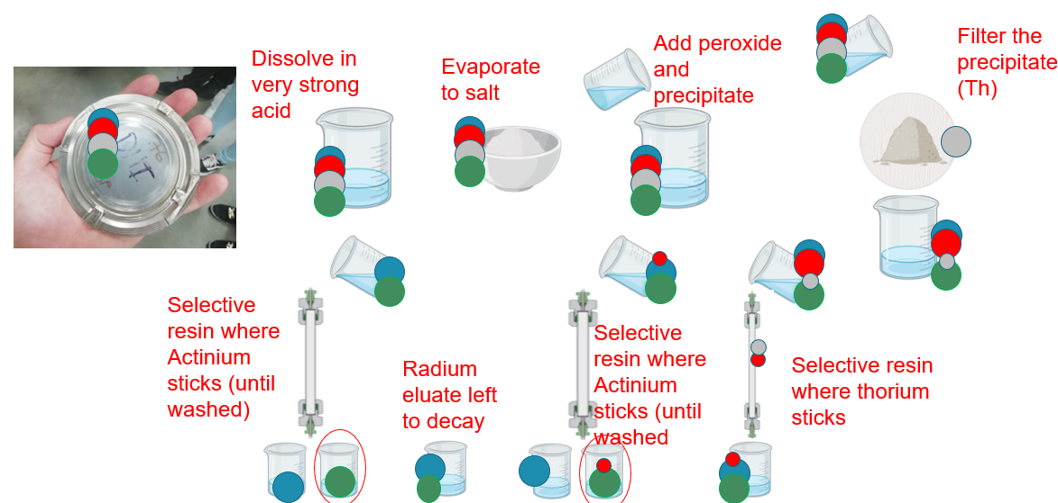
^{nat}Th (p , X / X’) ²²⁵Ac / ²²⁵Ra production route (1)
Production
Separation
44-98% efficient…
Robertson, Andrew KH, et al. Instruments 3.1 (2019): 18.
Robertson, Andrew KH, et al. Inorgan. Chem. 59.17 (2020): 12156-12165.
127.7 − 11267 GBq production of ²²⁵Ac per month^{[1]}
40.77 GBq of ²²⁵Ac in five years from tri lab effort^{[2]}
[1]Robertson, Andrew KH, et al. Curr. Radiopharm. 11.3 (2018): 156-172.
[2] https://www.isotopes.gov/information/actinium-225.

Slide 4
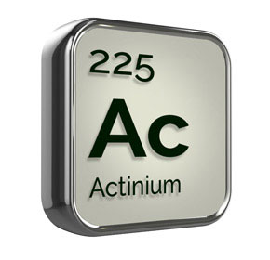
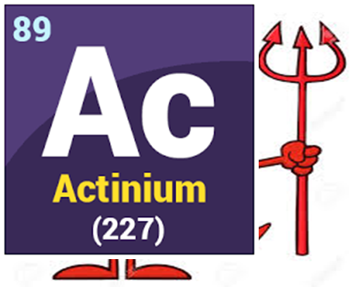
^{nat}Th (p , X / X’) ²²⁵Ac / ²²⁵Ra: The problem
²²⁷Ac (t_{1/2} = 21.8 y) co-produced ~equal cross section
> ~0.1 % of ²²⁵Ac activity
Measured in samples:
[1] 0.15%
[2] 0.142%
Mass separation enhances ²²⁵Ac/²²⁷Ac activity ratio with competitive efficiency to radiochemistry?
3 samples collected to analyse purity
Collection efficiency analysis performed
[1] Tollefson, A. D. et al. Appl. Radiat. Isot. 172,109693 (2021)
[2] Robertson, A. K. et al. Inorg. Chem. 59, 12156–12165(2020).

Slide 5
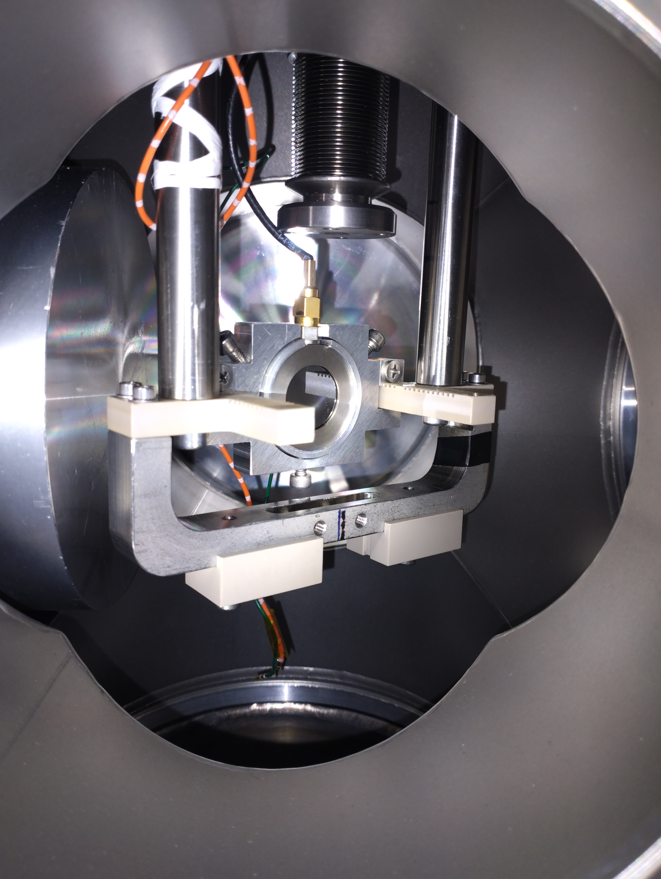
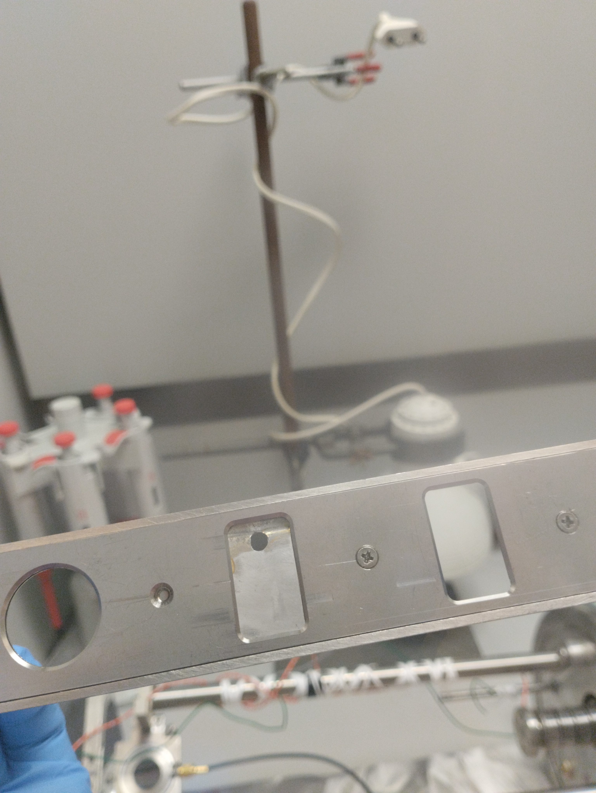
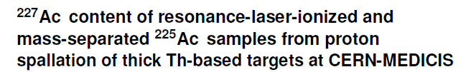
Purity

Slide 6
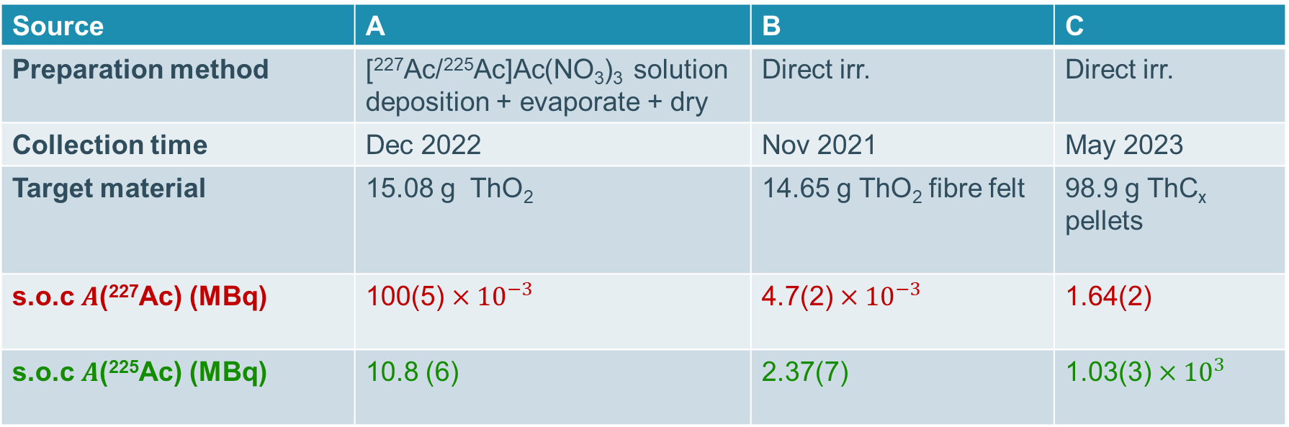
3 samples collected from 3 “sources”
Source | A | B | C
Preparation method | [²²⁷Ac/²²⁵Ac]Ac(NO₃)₃ solution deposition + evaporate + dry | Direct irr. | Direct irr.
Collection time | Dec 2022 | Nov 2021 | May 2023
Target material | 15.08 g ThO₂ | 14.65 g ThO₂ fibre felt | 98.9 g ThC_{x} pellets
s.o.c $A$(²²⁷Ac) (MBq) | 100(5) $×{10}^{−3}$ | 4.7(2) $×{10}^{−3}$ | 1.64(2)
s.o.c $A$(²²⁵Ac) (MBq) | 10.8 (6) | 2.37(7) | 1.03(3) $×{10}^{3}$

Slide 7
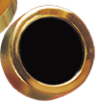
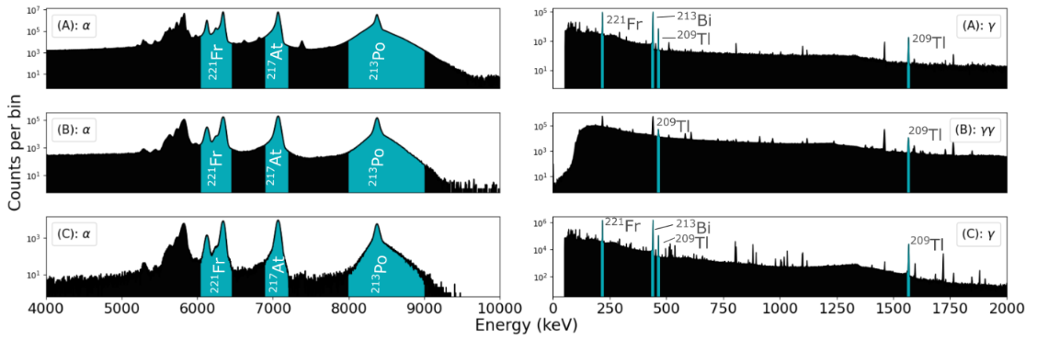
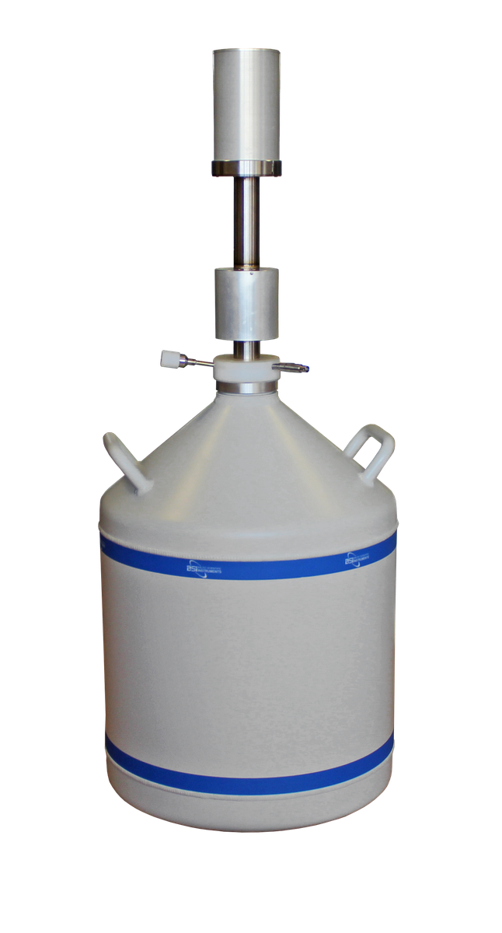
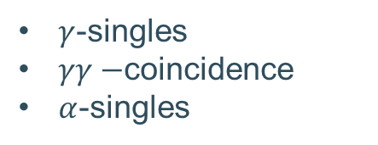
²²⁵Ac / ²²⁵Ra activity through nuc. decay spec.
$γ$-singles
$γγ−$coincidence
$α$-singles

Slide 8
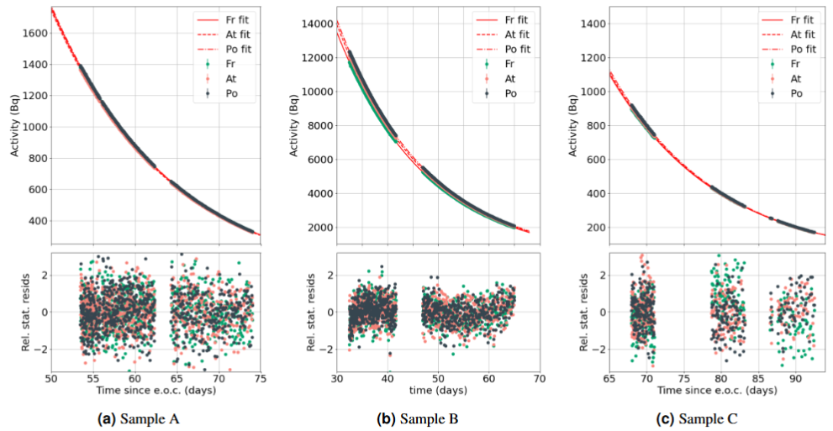
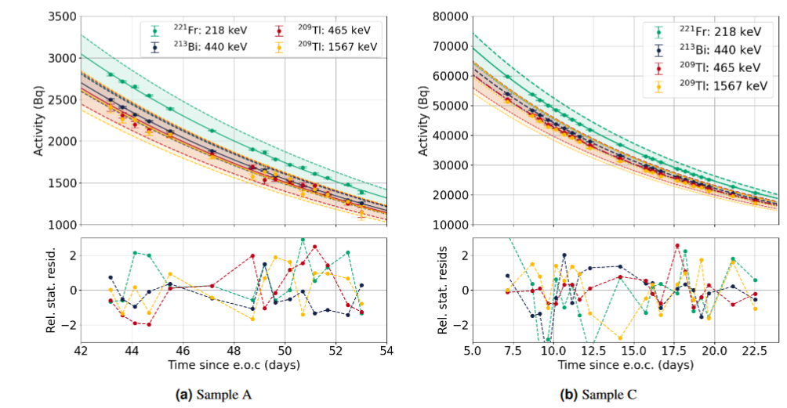
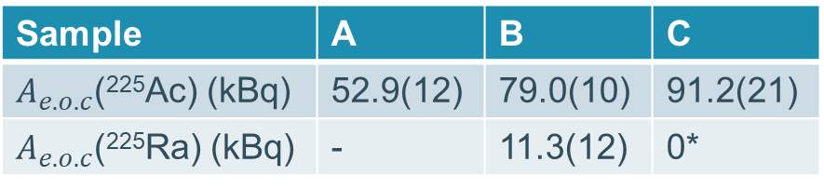

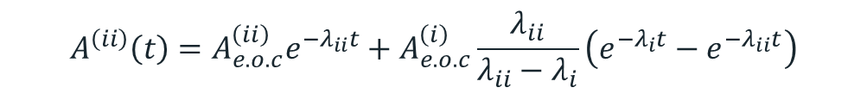

E.O.C activities: ²²⁵Ac and ²²⁵Ra
*
sA:
$$A^{\left(ii\right)}\left(t\right)=A_{e.o.c}^{\left(ii\right)}e^{−λ_{ii}t}$$
Sample | A | B | C
$A_{e.o.c}$(²²⁵Ac) (kBq) | 52.9(12) | 79.0(10) | 91.2(21)
$A_{e.o.c}$(²²⁵Ra) (kBq) | - | 11.3(12) | 0*
$$A^{\left(ii\right)}\left(t\right)=A_{e.o.c}^{\left(ii\right)}e^{−λ_{ii}t}+A_{e.o.c}^{\left(i\right)}\frac{λ_{ii}}{λ_{ii}−λ_{i}}\left(e^{−λ_{i}t}−e^{−λ_{ii}t}\right)$$
sB+C:
*
$$∗ ii=225Ac, i=225Ra$$

Slide 9
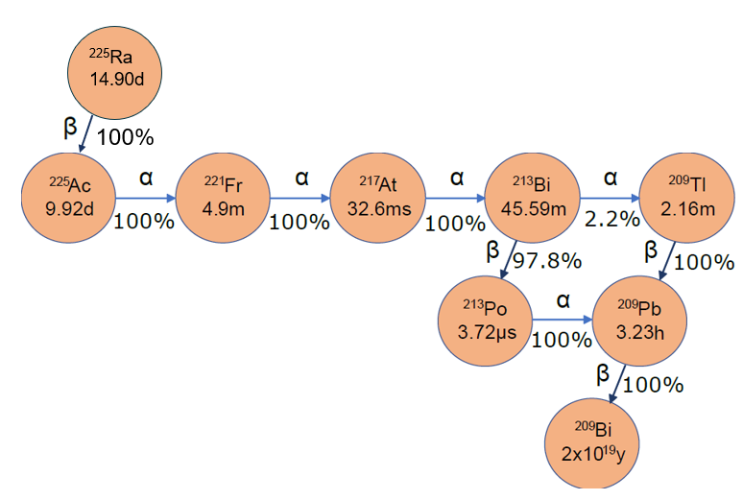
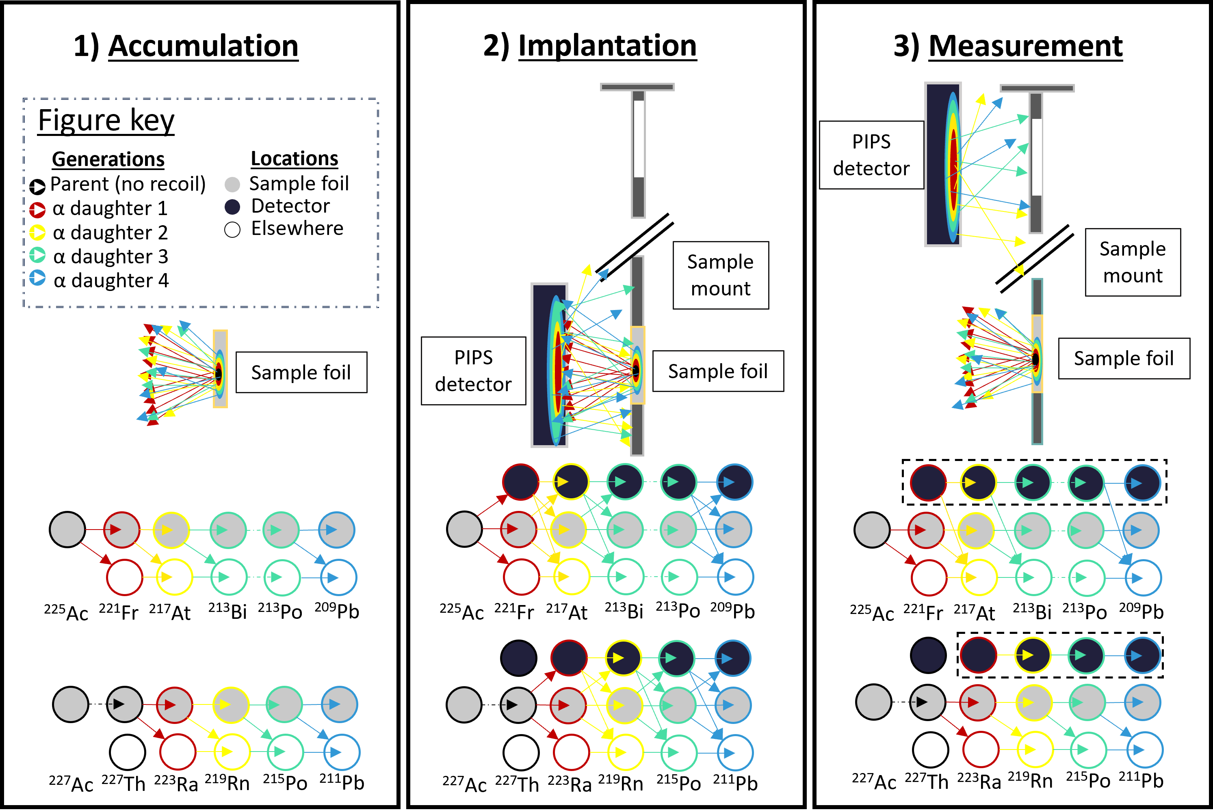
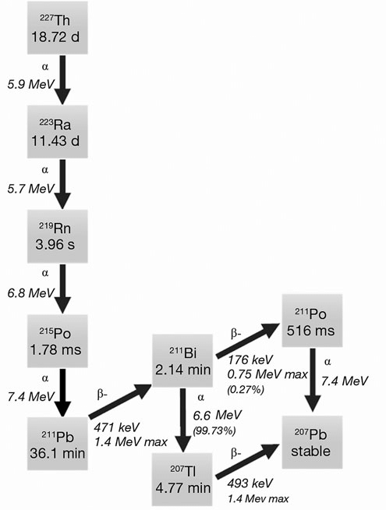

²²⁷Ac activity measured using $α$-recoil spectroscopy
Frantellizzi, Viviana, et al. Cancer biother. radiopharm. 35.6 (2020): 437-445.

Slide 10
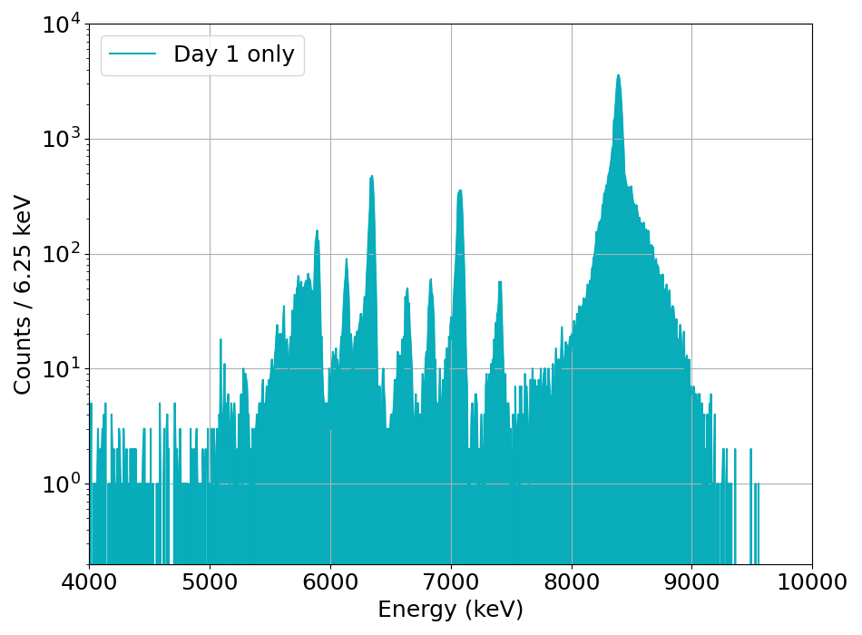
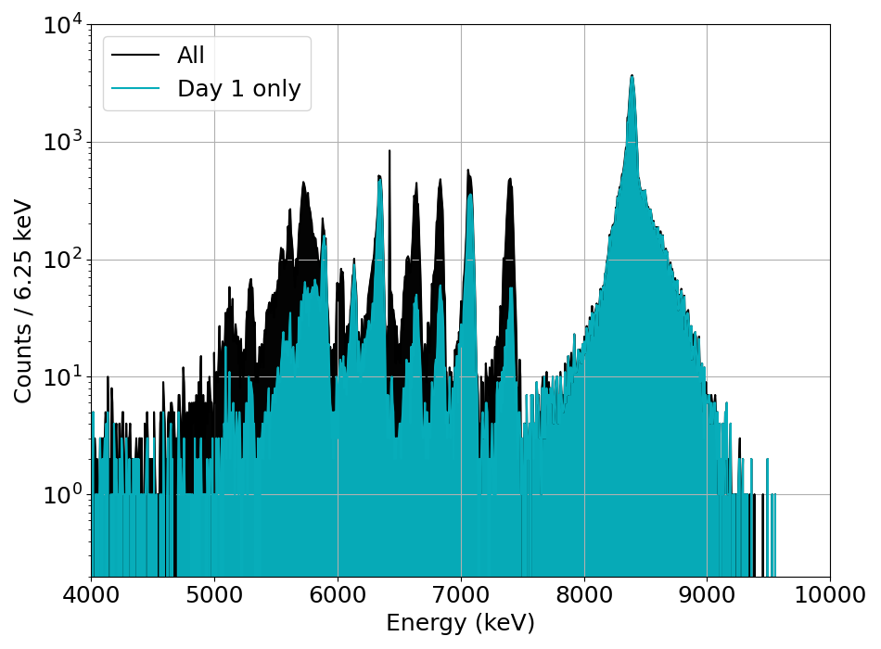
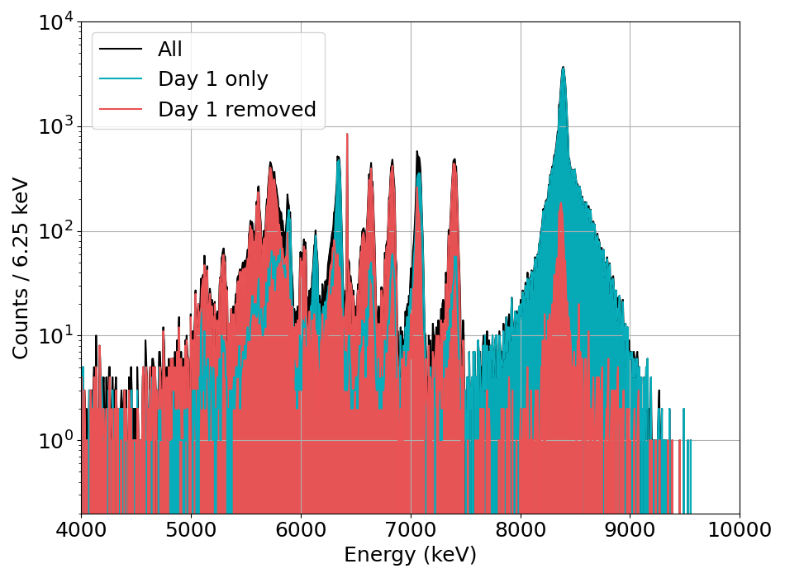

$α$-decay recoil spectra
²²⁵Ac chain
²¹⁷At
²¹³Po
²²⁷Ac chain
²¹⁹Rn
²¹⁵Po
Notes:
Emphasis: Exciting method as it allows the 227 Activity to be evaluated much quicker than just waiting.

Slide 11
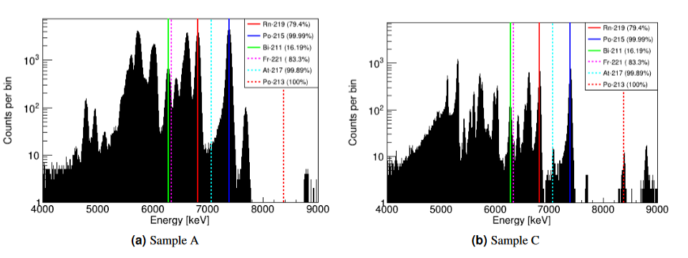


Direct alpha decay spectrometry validation
$Δ$t since E.O.C:
297 days
276 days
Recoil method
3.90 (13) Bq
0.244 (33) Bq
Direct $α$ spec
3.70 (25) Bq
0.248 (17) Bq

Slide 12
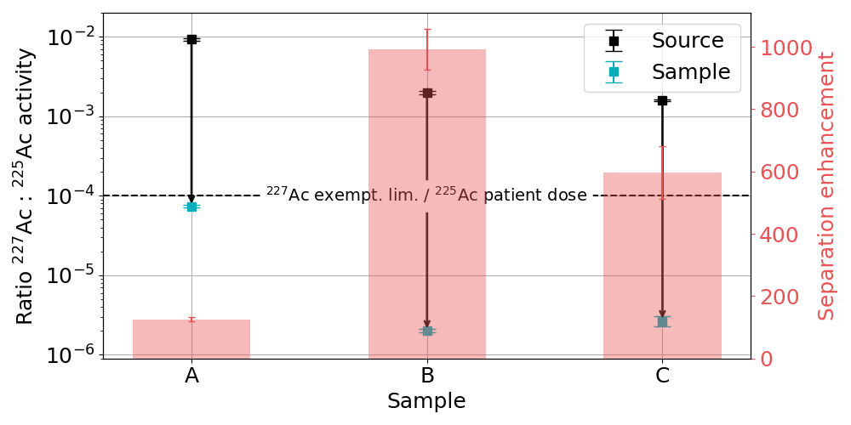
²²⁷Ac / ²²⁵Ac activity ratio result
Mass separation enhances the ²²⁵Ac / ²²⁷Ac by a factor of ~500 – 1000.
Isotopic purity ~O(10) > than reasonable limit.

Slide 13
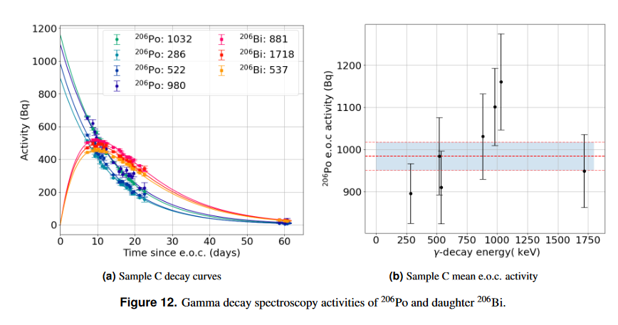
Other contaminants?
²⁰⁶Po¹⁸O⁺
1% of ²²⁵Ac activity at e.o.c
Not seen in all samples
Implies even more (#) ²⁰⁹Po in collected sample.
²⁰⁸Po, ²¹⁰Po seen in alpha spec…
Also…
²¹⁴Po and ²¹⁸Po seen in alpha spec… ²²⁶Ra daughters…

Slide 14
Collection efficiency

Slide 15
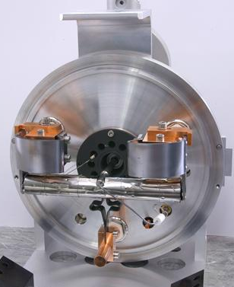
ThC_{x} targets irradiated in 2023
Proton charge ($μ$Ah) | 42 | 40.7 | 159 | 95
Aug
Sep
May
Jun
In target ²²⁵Ac (MBq) | 1030 | 997 | 611 | 2400
In target ²²⁵Ra (MBq) | 149 | 144 | 100 | 348
Fluka simulations for in-target activity performed by C. Duchemin
Notes:
100s of patient doses produced per 1 day irradiations…

Slide 16
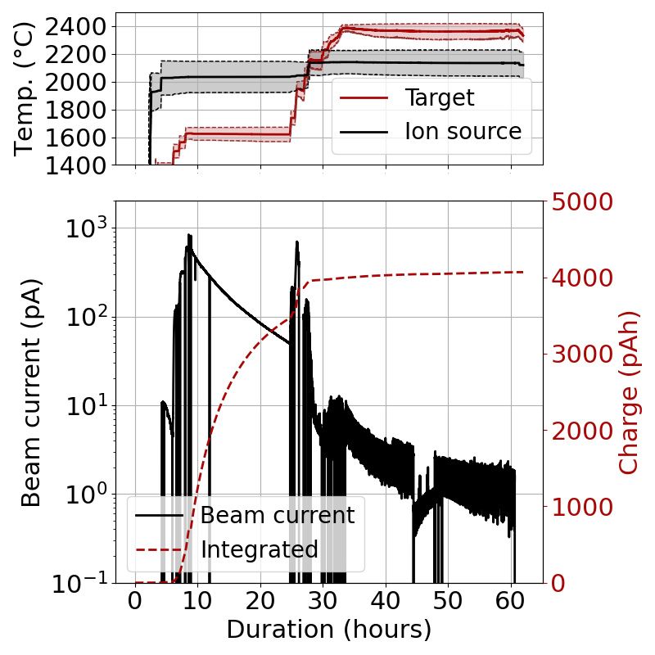
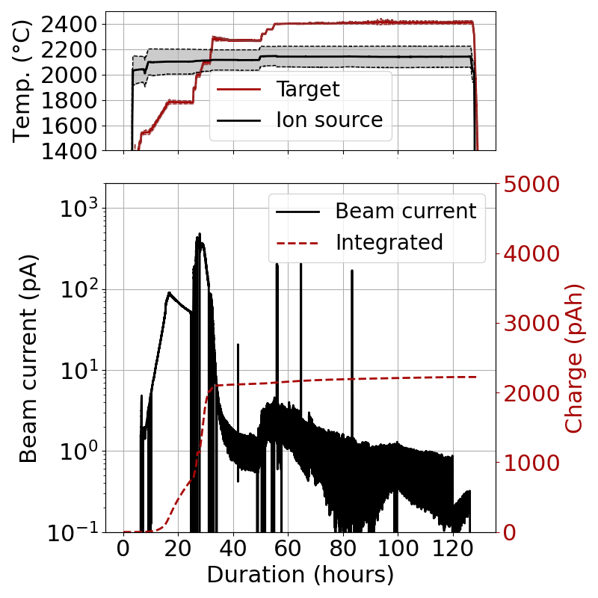
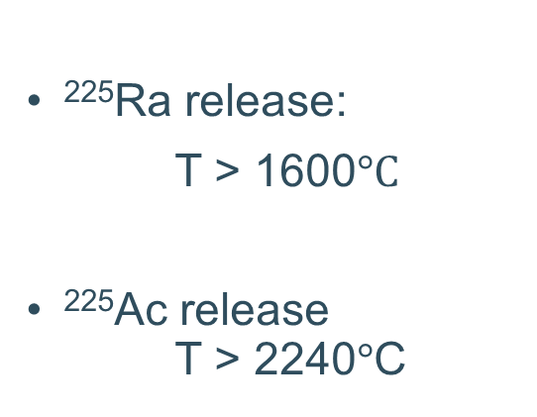
Collections in 2023
²²⁵Ra release:
T > 1600$°C$
²²⁵Ac release T > 2240$°$C

Slide 17
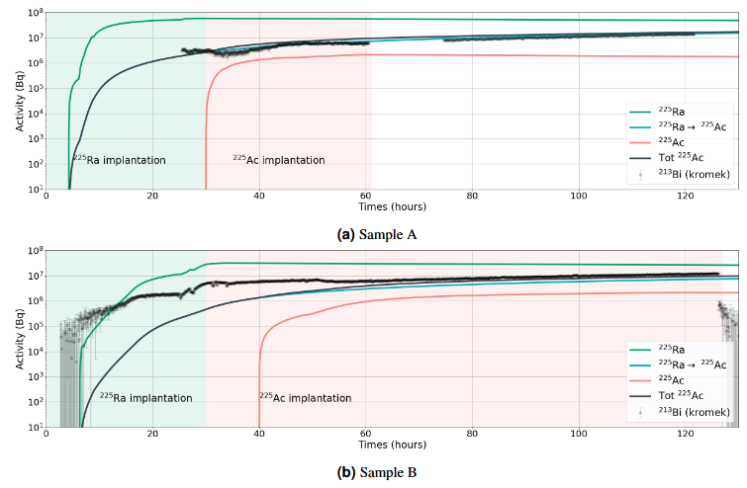
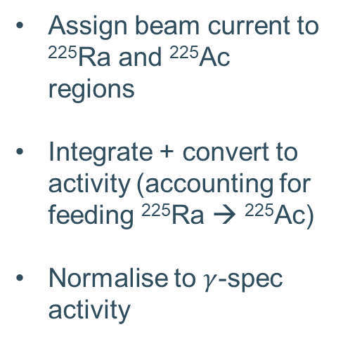
Preliminary collection efficiency estimate from beam current
May
Assign beam current to ²²⁵Ra and ²²⁵Ac regions
Integrate + convert to activity (accounting for feeding ²²⁵Ra → ²²⁵Ac)
Normalise to $γ$-spec activity
²²⁵Ra: 55 MBq → 37% coll. eff. (Prelim)
²²⁵Ac: 2.2 MBq → 0.2% coll. eff. (Prelim)
Jun
²²⁵Ra: 25.9 MBq → 18% coll. eff. (Prelim)
²²⁵Ac: 2.1 MBq → 0.2% coll. eff. (Prelim)

Slide 18
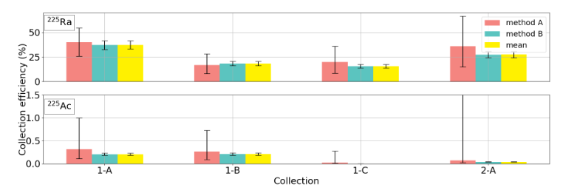
All ²²⁵Ac / ²²⁵Ra collection efficiencies (2023)
Aug
Sep
May
Jun

Slide 19
Conclusions:
Outlook:
²²⁵Ac and ²²⁵Ra has been produced at MEDICIS
The isotopic purity of the collected ²²⁵Ac samples has ²²⁷Ac content below a reasonable limit for medical use
Most ²²⁵Ac can be produced from ²²⁵Ra implantation and decay
Target reuse is possible, but efficiency is reduced if target is ‘punished’
Possible “Best” ²²⁵Ac production:
Irradiate ²³²Th metal target
Radiochemistry to separate Ra and Ac fractions
Use the Ra fraction as ²²⁵Ac generator
Perform mass separation on the Ac fraction
More research:
Ionize Ra using Raman laser at MEDICIS
Re-use of target at lower temperature, collecting ²²⁵Ra/²²⁴Ra only, not ²²⁵Ac
…

Slide 20

Thanks to wonderful colleagues
Mia Au², Cyril Bernerd^{1,2}, Frank Bruchertseiffer³, Thomas E. Cocolios¹, Marie Deseyn¹, Charlotte Duchemin², Michael Heines¹, Max Keppens¹, Laura Lambert², Nathan Meurrens¹, Ralf E. Rossel², Thierry Stora², Viktor Van den Bergh¹, Wiktoria Wojtaczka¹
MEDICIS collaboration, CERN SY-STI group…
[1] KU Leuven
[2] CERN
[3] JRC Karlrushe
20
SY-STI coffee hour 21/10/2022

Slide 21
Backup slides…

Slide 22
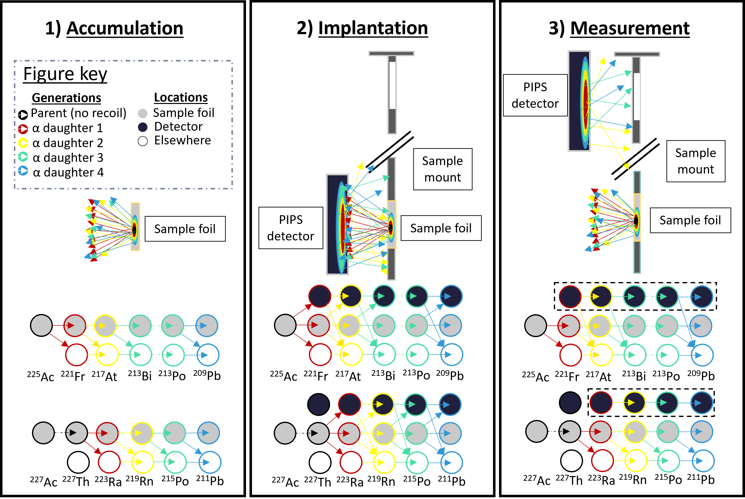

How to get Ac-227 activity from recoil spectrum (1)
~Same for same generation daughters in ²²⁷Ac and ²²⁵Ac chains

Slide 23
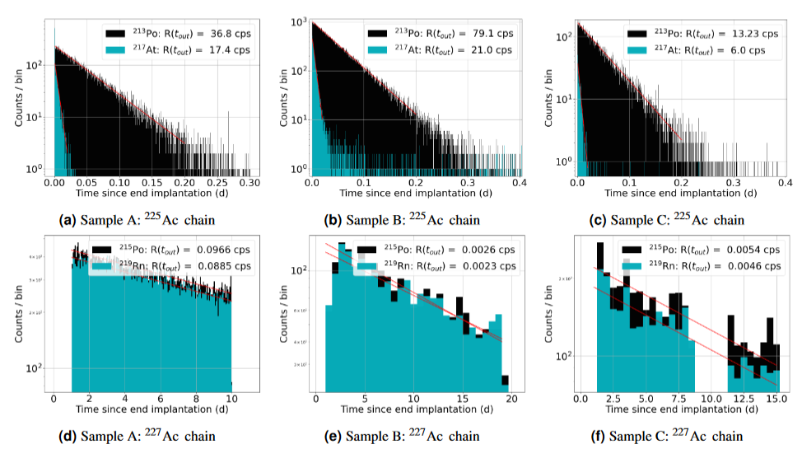
How to get Ac-227 activity from recoil spectrum (2)

Slide 24
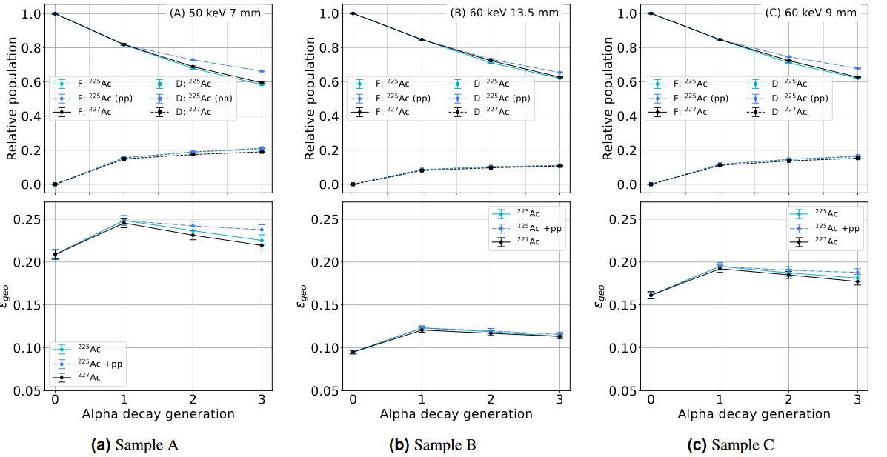
Geometric corrections due to recoil + ping pong

Slide 25
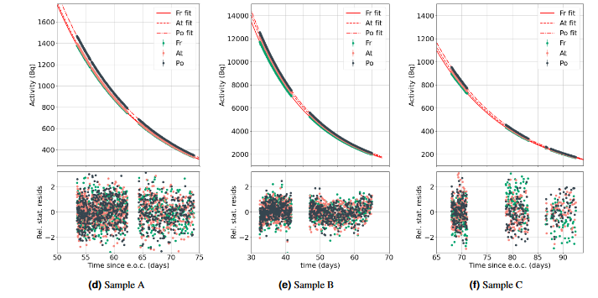
Alpha decay activities of Fr, At, Po with and without ping pong

Slide 26
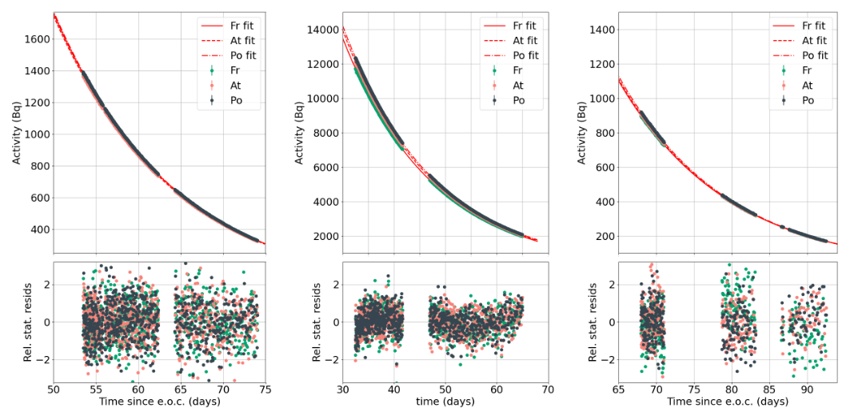

Slide 27
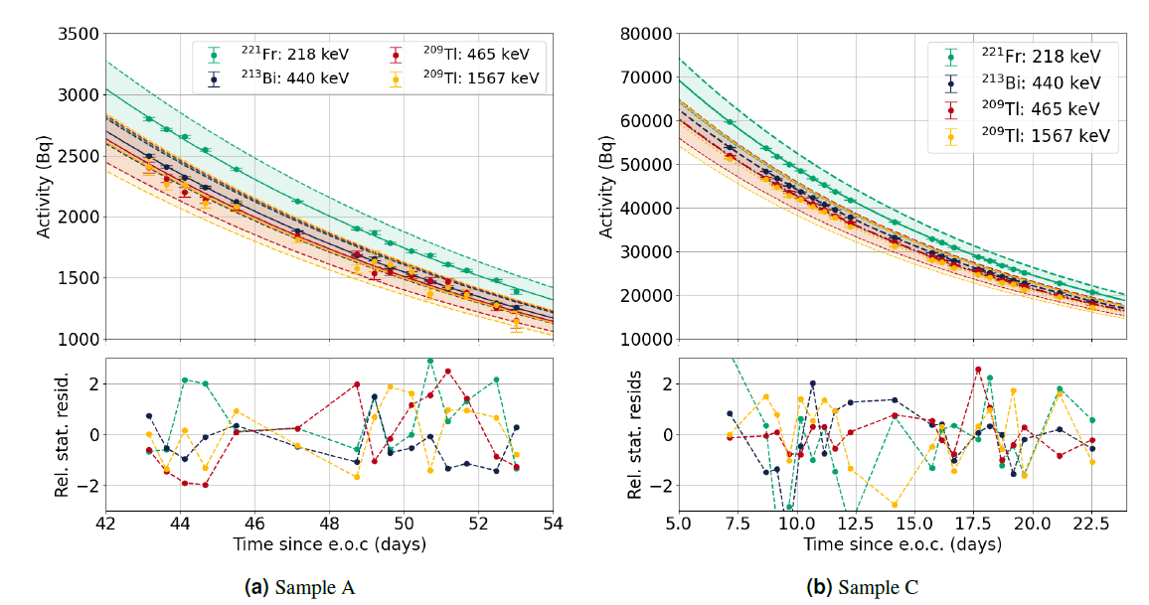
Gamma spectroscopy curves

Slide 28
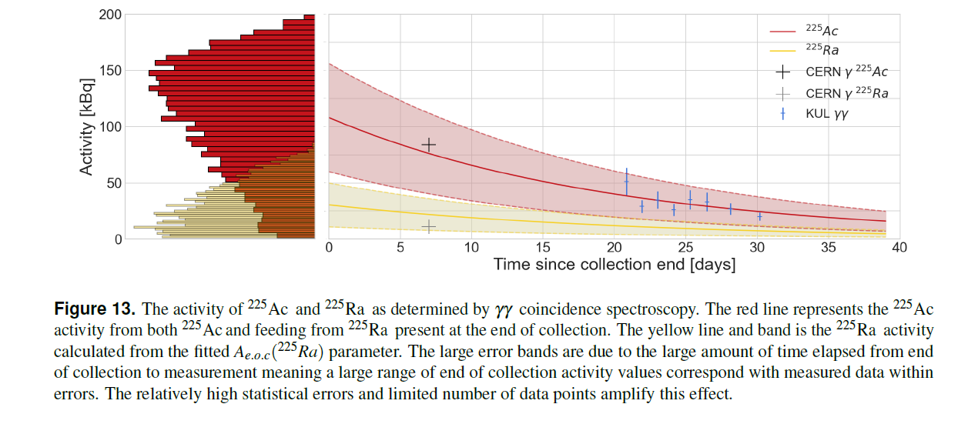
Gamma-gamma spectroscopy curve

Slide 29
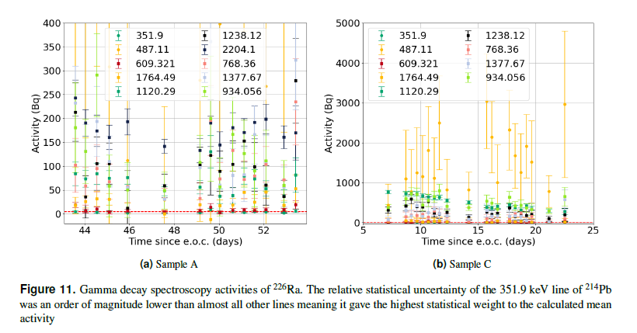
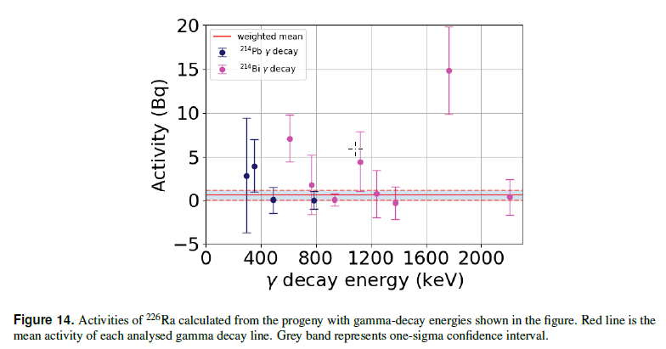
Ra-226 contamination
Activities:
A | B | C
4.7 (4) Bq | 0.6 (6) Bq | 4.1 (7) Bq

Slide 30
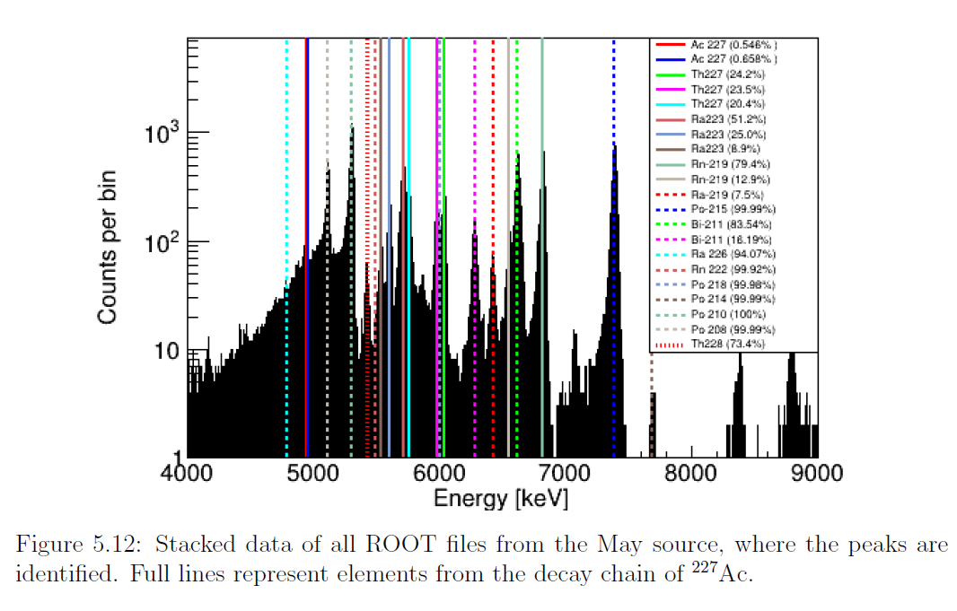

Slide 31
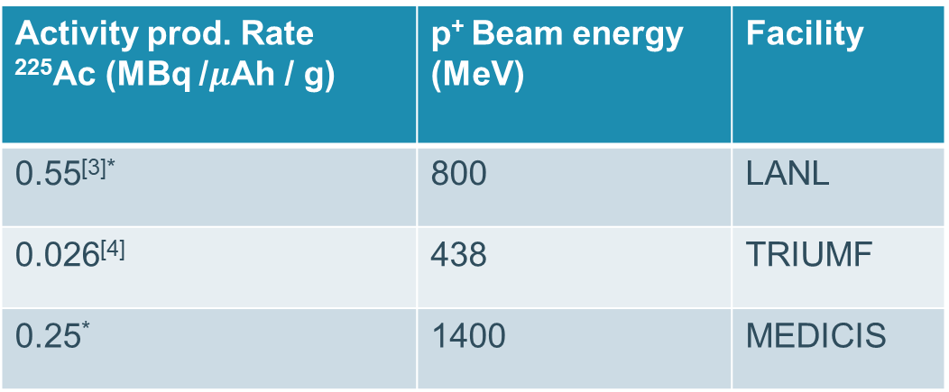
Production
Activity prod. Rate ²²⁵Ac (MBq /$μ$Ah / g) | p⁺ Beam energy (MeV) | Facility
0.55^{[3]*} | 800 | LANL
0.026^{[4]} | 438 | TRIUMF
0.25* | 1400 | MEDICIS

Slide 32
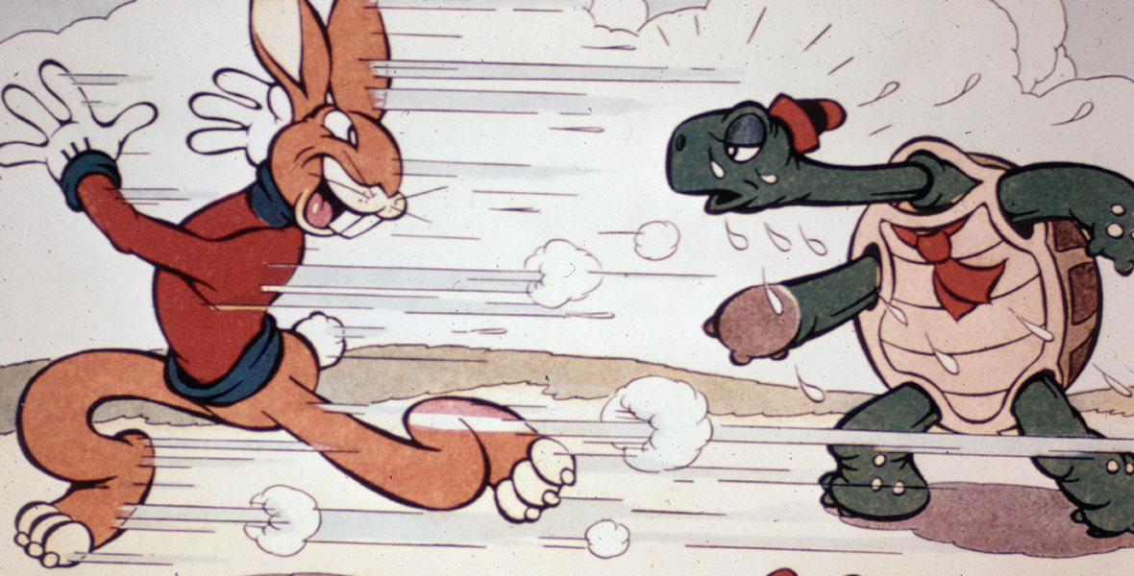
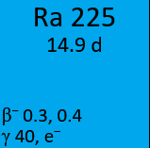
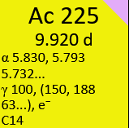
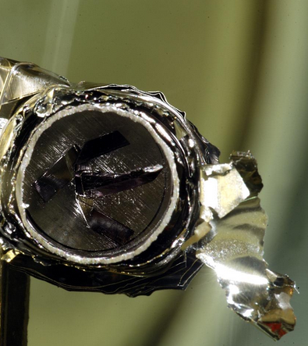

Slide 33


ThC_{x} target reuse: effect on collection efficiency
From implanted ion current from fresh target:
²²⁵Ra activity = 50.1 MBq → 34% efficiency
²²⁵Ac activity = 1.7 MBq → 0.17% efficiency
Irradiation conditions 2nd time round almost identical.
For re-used target:
²²⁵Ra activity = 25.6 MBq → 18% efficiency
²²⁵Ac activity = 2.1 MBq → 0.21% efficiency
Notes:
Overlay the two plots of ion current vs time on top of each other, along with target temperature. Show the decrease in Ra release, but the overall increase of Ac efficiency. Talk about the laser test done on mass 227 showing that Ac-227 was present even at low temperature.

Slide 34


Influence of ion source temperature on Ra and Ac beam
Laser ionization efficiency improves with temperature
Surface ionization efficiency improves with temperature
Several x improvement in efficiency possible
$ε_{s}=\frac{α\exp\left(−\frac{Φ}{k_{b}T}\right)}{1+α\exp\left(−\frac{Φ}{k_{B}T}\right)}, α=\frac{g_{+}}{g_{0}}\exp\left(\frac{φ−V_{ion}}{k_{B}T}\right)$.
$Φ$ and normalization constant only free parameters.
Higher temperature → Better ion confinement → higher surface / laser ionization efficiency

Slide 35


Influence of target temperature on Ac beam
Increase temperature: Good for collecting quicker, bad for collecting more efficiently!
Temperature systematics well described by Arrhenius-law for diffusion…
$$I≈\frac{N_{0}ε_{ion}}{a^{2}}D_{0}\exp\left(−\frac{ΔH_{diff}}{k_{B}T}\right)$$

Slide 36





How easy is it to get α-emitters?
Medical alpha emitters production
Only few choices
Often high-Z
“Difficult” target material or beams
Notes:
Ra-226 target for producting Ra-223 and Ac-225 and Th-227.
Natural neodymium, praseodymium targets for Tb-149 wih carbon beam
Natural bismuth or enriched bismuth targets with alpha beam.

Slide 37


Collections as they happened
What do we implant on our foils?
Exp1: integrated ion current consistent with measured 10% collection efficiency
Exp2: Integrated ion current overestimates implanted ²²⁵Ac activity, Kromek gets it right!
Exp3: Integrated ion current: wtf? Kromek gets it (mostly) right, but misses implanted ²²⁵Ra
[1] Bernerd C., et al. "Production of innovative radionuclides for medical applications at the CERN-MEDICIS facility." NIM B [in progress] (2023): 541 .
Notes:
10.0 % vs 10.1 % so in very very good agreement with each other for ex 1
in ex2: relative overestimation of 30% compared with offline spectroscopy measurement, while kromek has a relative overestimation of less than 10% and agrees with the measured result to within 1-sigma.
In ex3, the relative overestimation by simply counting ions is plain wrong. The kromek on the other hand is roughly in agreement with the 200kBq measured offline.
This begged the question – what on earth have we collected?

Slide 38


A wolf in Sheep’s clothing: The beam at mass 225
Intense ion beams of masses have significant mass tailing, in all experiments so far with varying degrees…
Major contributor to ion beam current at mass 225
Precludes identification with resonance laser ionization enhancement
Notes:
Talk about the mass tailing effect coming from the Lanthanide region.
Beam scatter of extremely intense beams. 3 orders of magnitude less than the peak of an intense beam, it still contributes significantly at these higher masses.
Reason for lower collection efficiencies is the need to go to very high target temperatures for a very modest beam of Ac225
While doing that all other beams that can be produced, are, which builds up background ions on our mass of interest. The background makes it much more difficult to identify Ac225. Our tactic now is to thoroughly outgas the target before beginning collection. In online collection we just collect radium at first.

Slide 39

Most mass scans ever taken…

Slide 40


Laser enhancement

Slide 41

Ra-225 ID during beamtime

