Slide 1
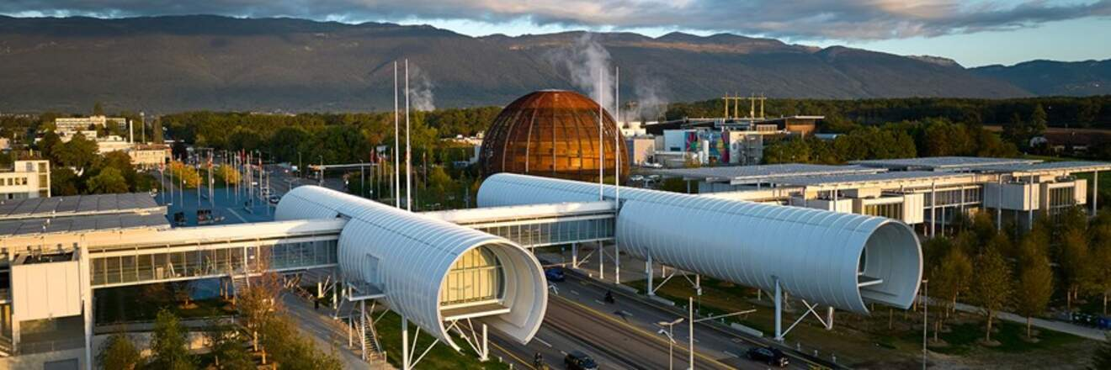
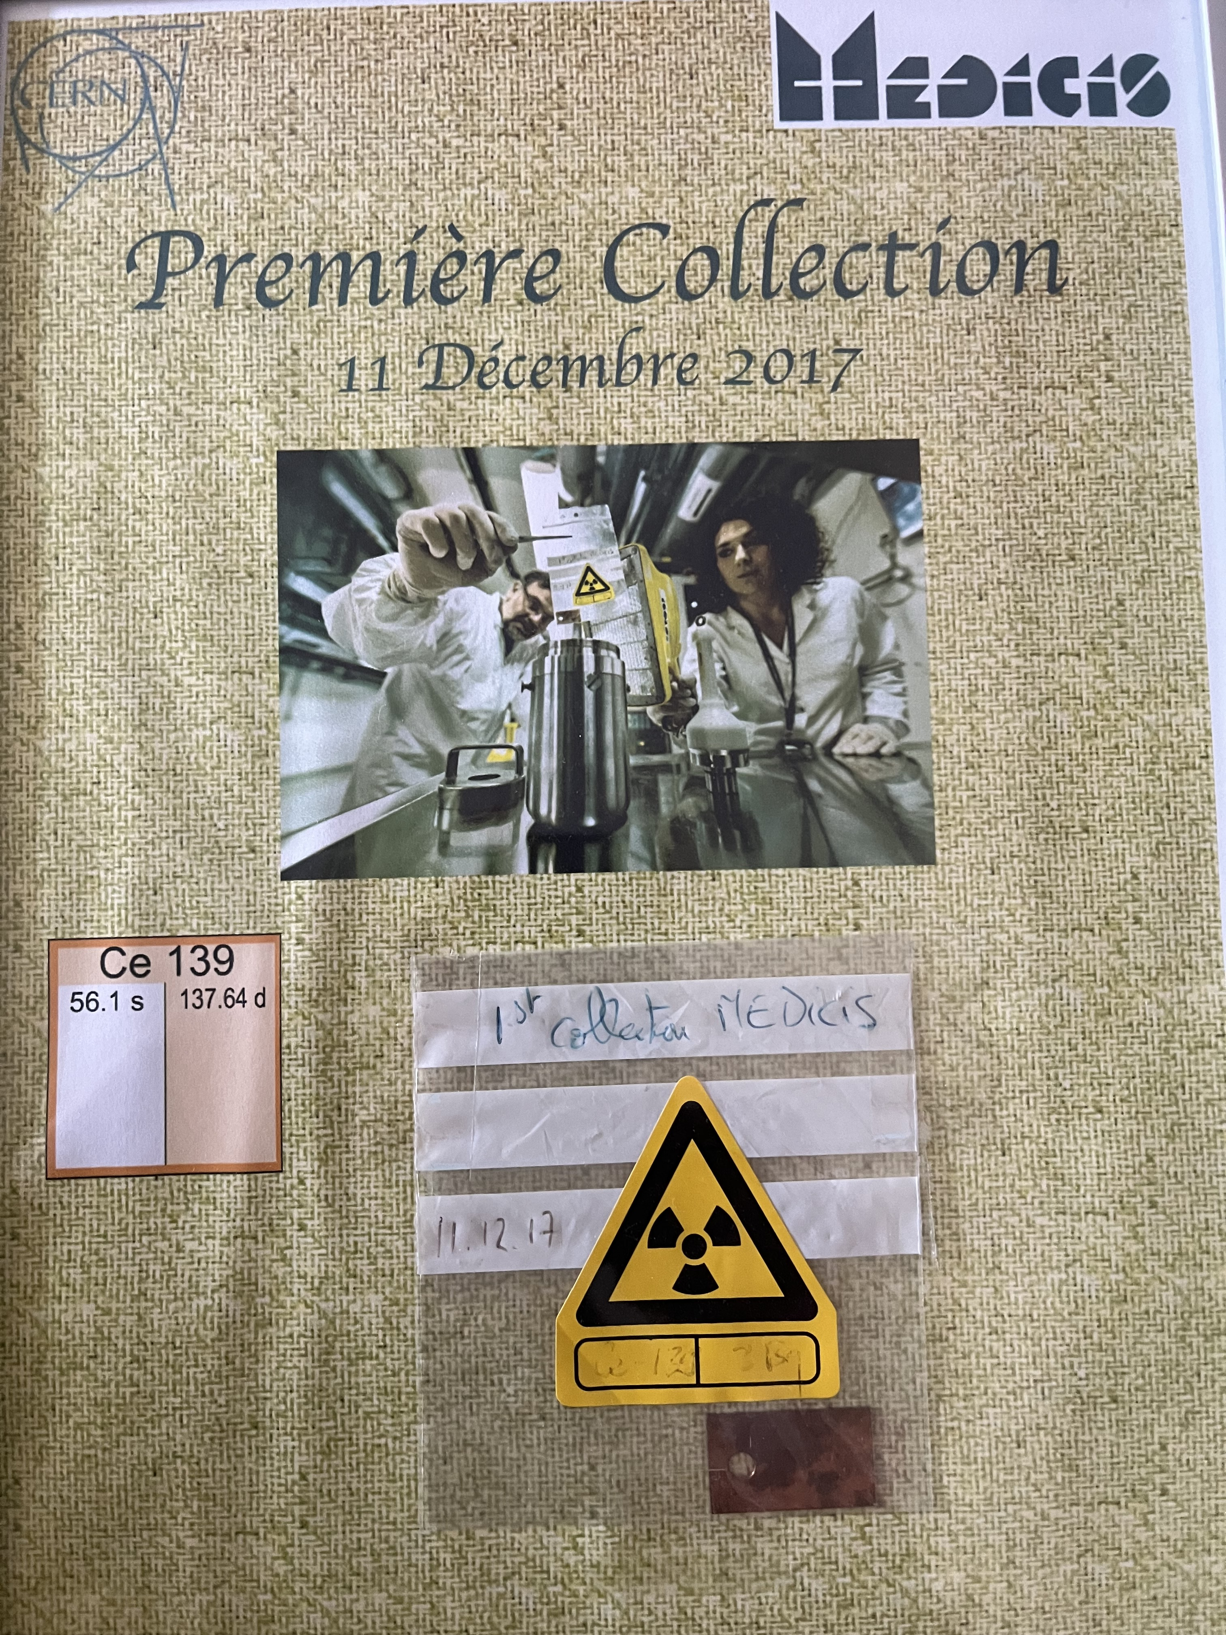
Anniversary MEDICIS – on CERN site
Globe of innovation @ Science Gateway
11 Dec 2024
To celebrate the Collection of the 1st isotope at MEDICIS

