Slide 1


MED-015: Scandium radionuclide production and mass separation.
Edgars Mamis
Patrīcija Kalniņa, Rūdolfs Jānis Zabolockis, Elīna Pajuste
Maija Radziņa, Toms Torims
02/07/2024

Slide 2

Outline:
Results from the research on production and mass separation;
Outcome of the project;
Proposal of the next project.
02/07/2024

Slide 3
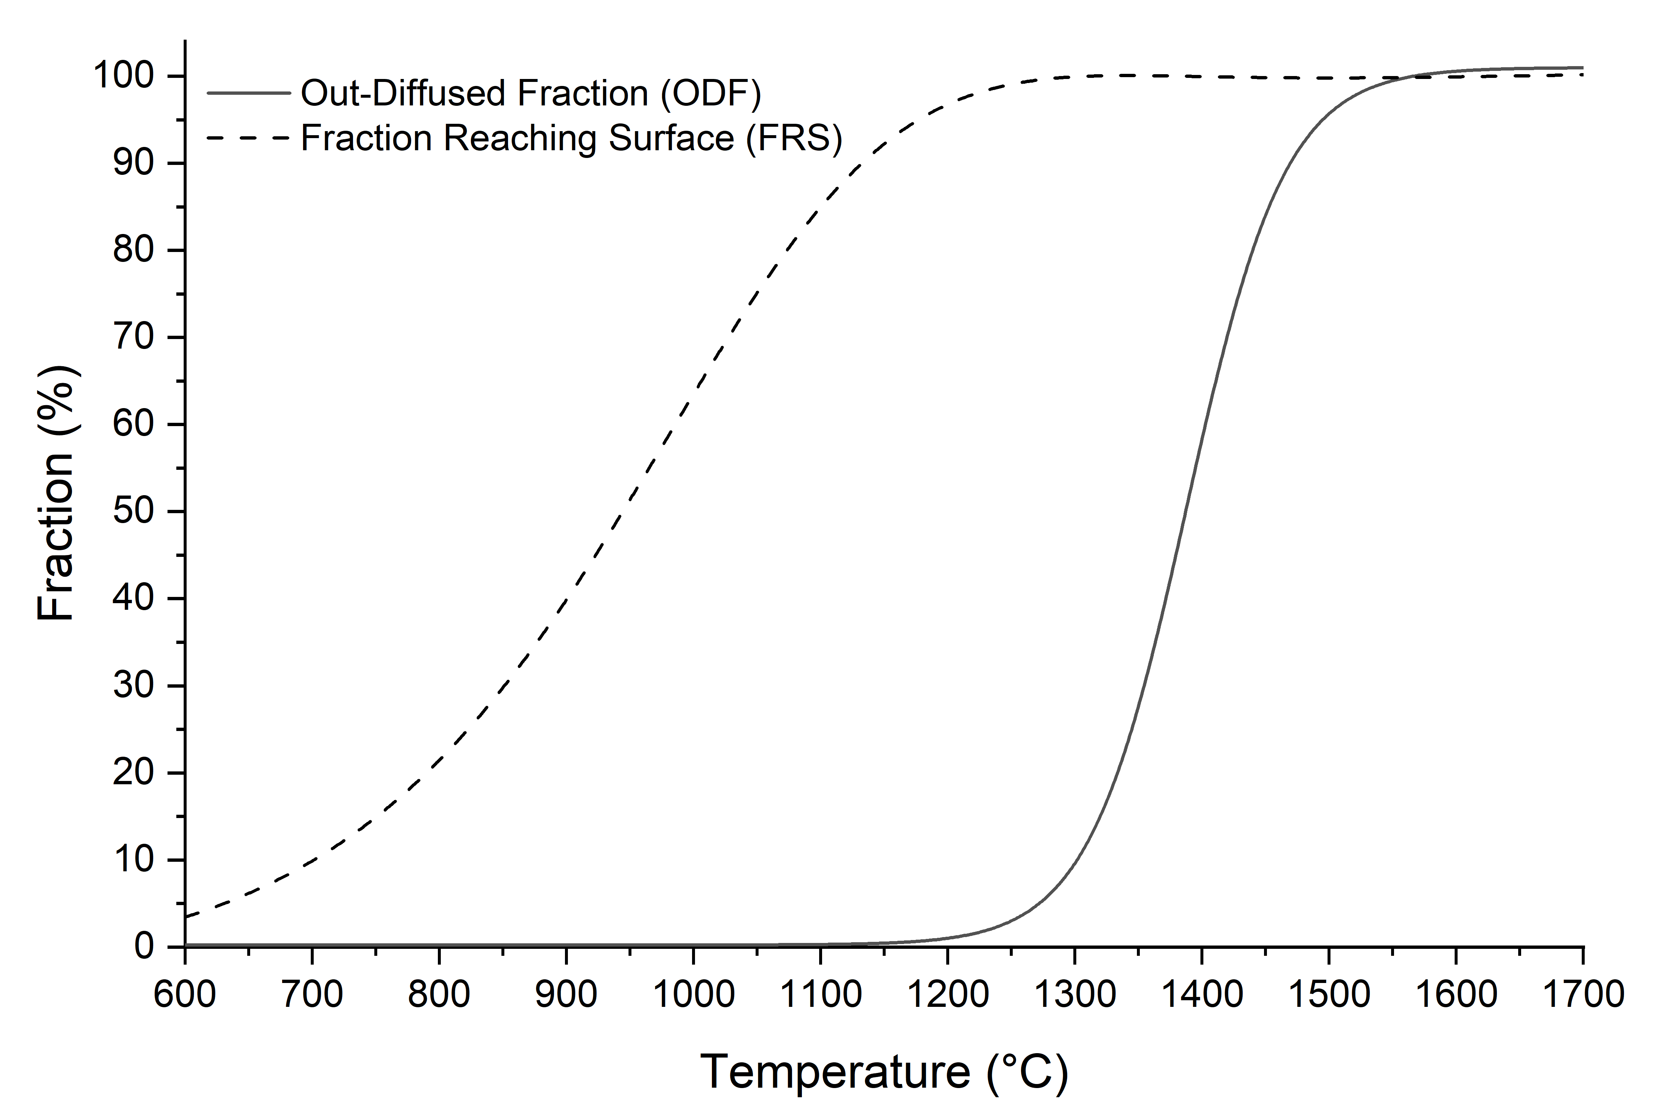
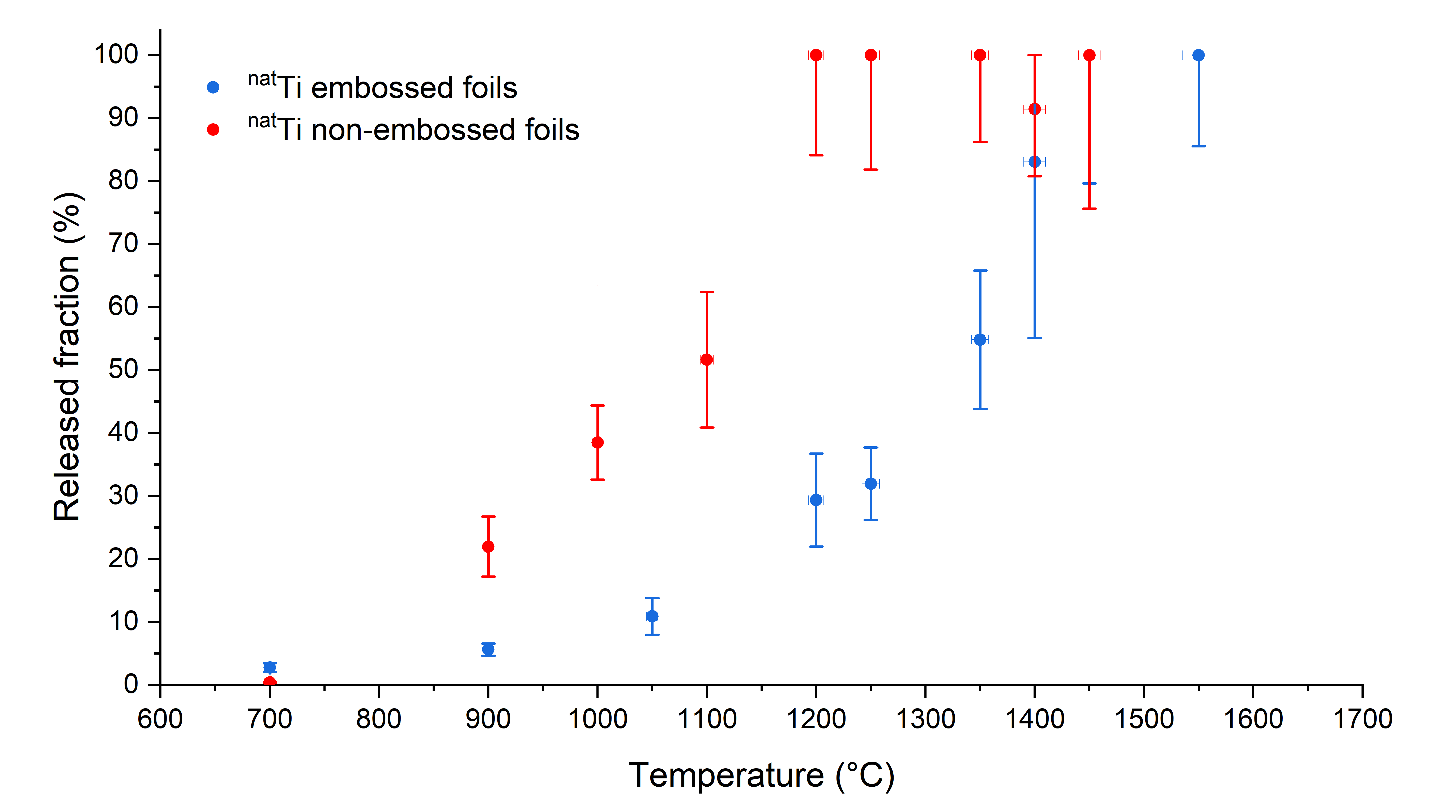
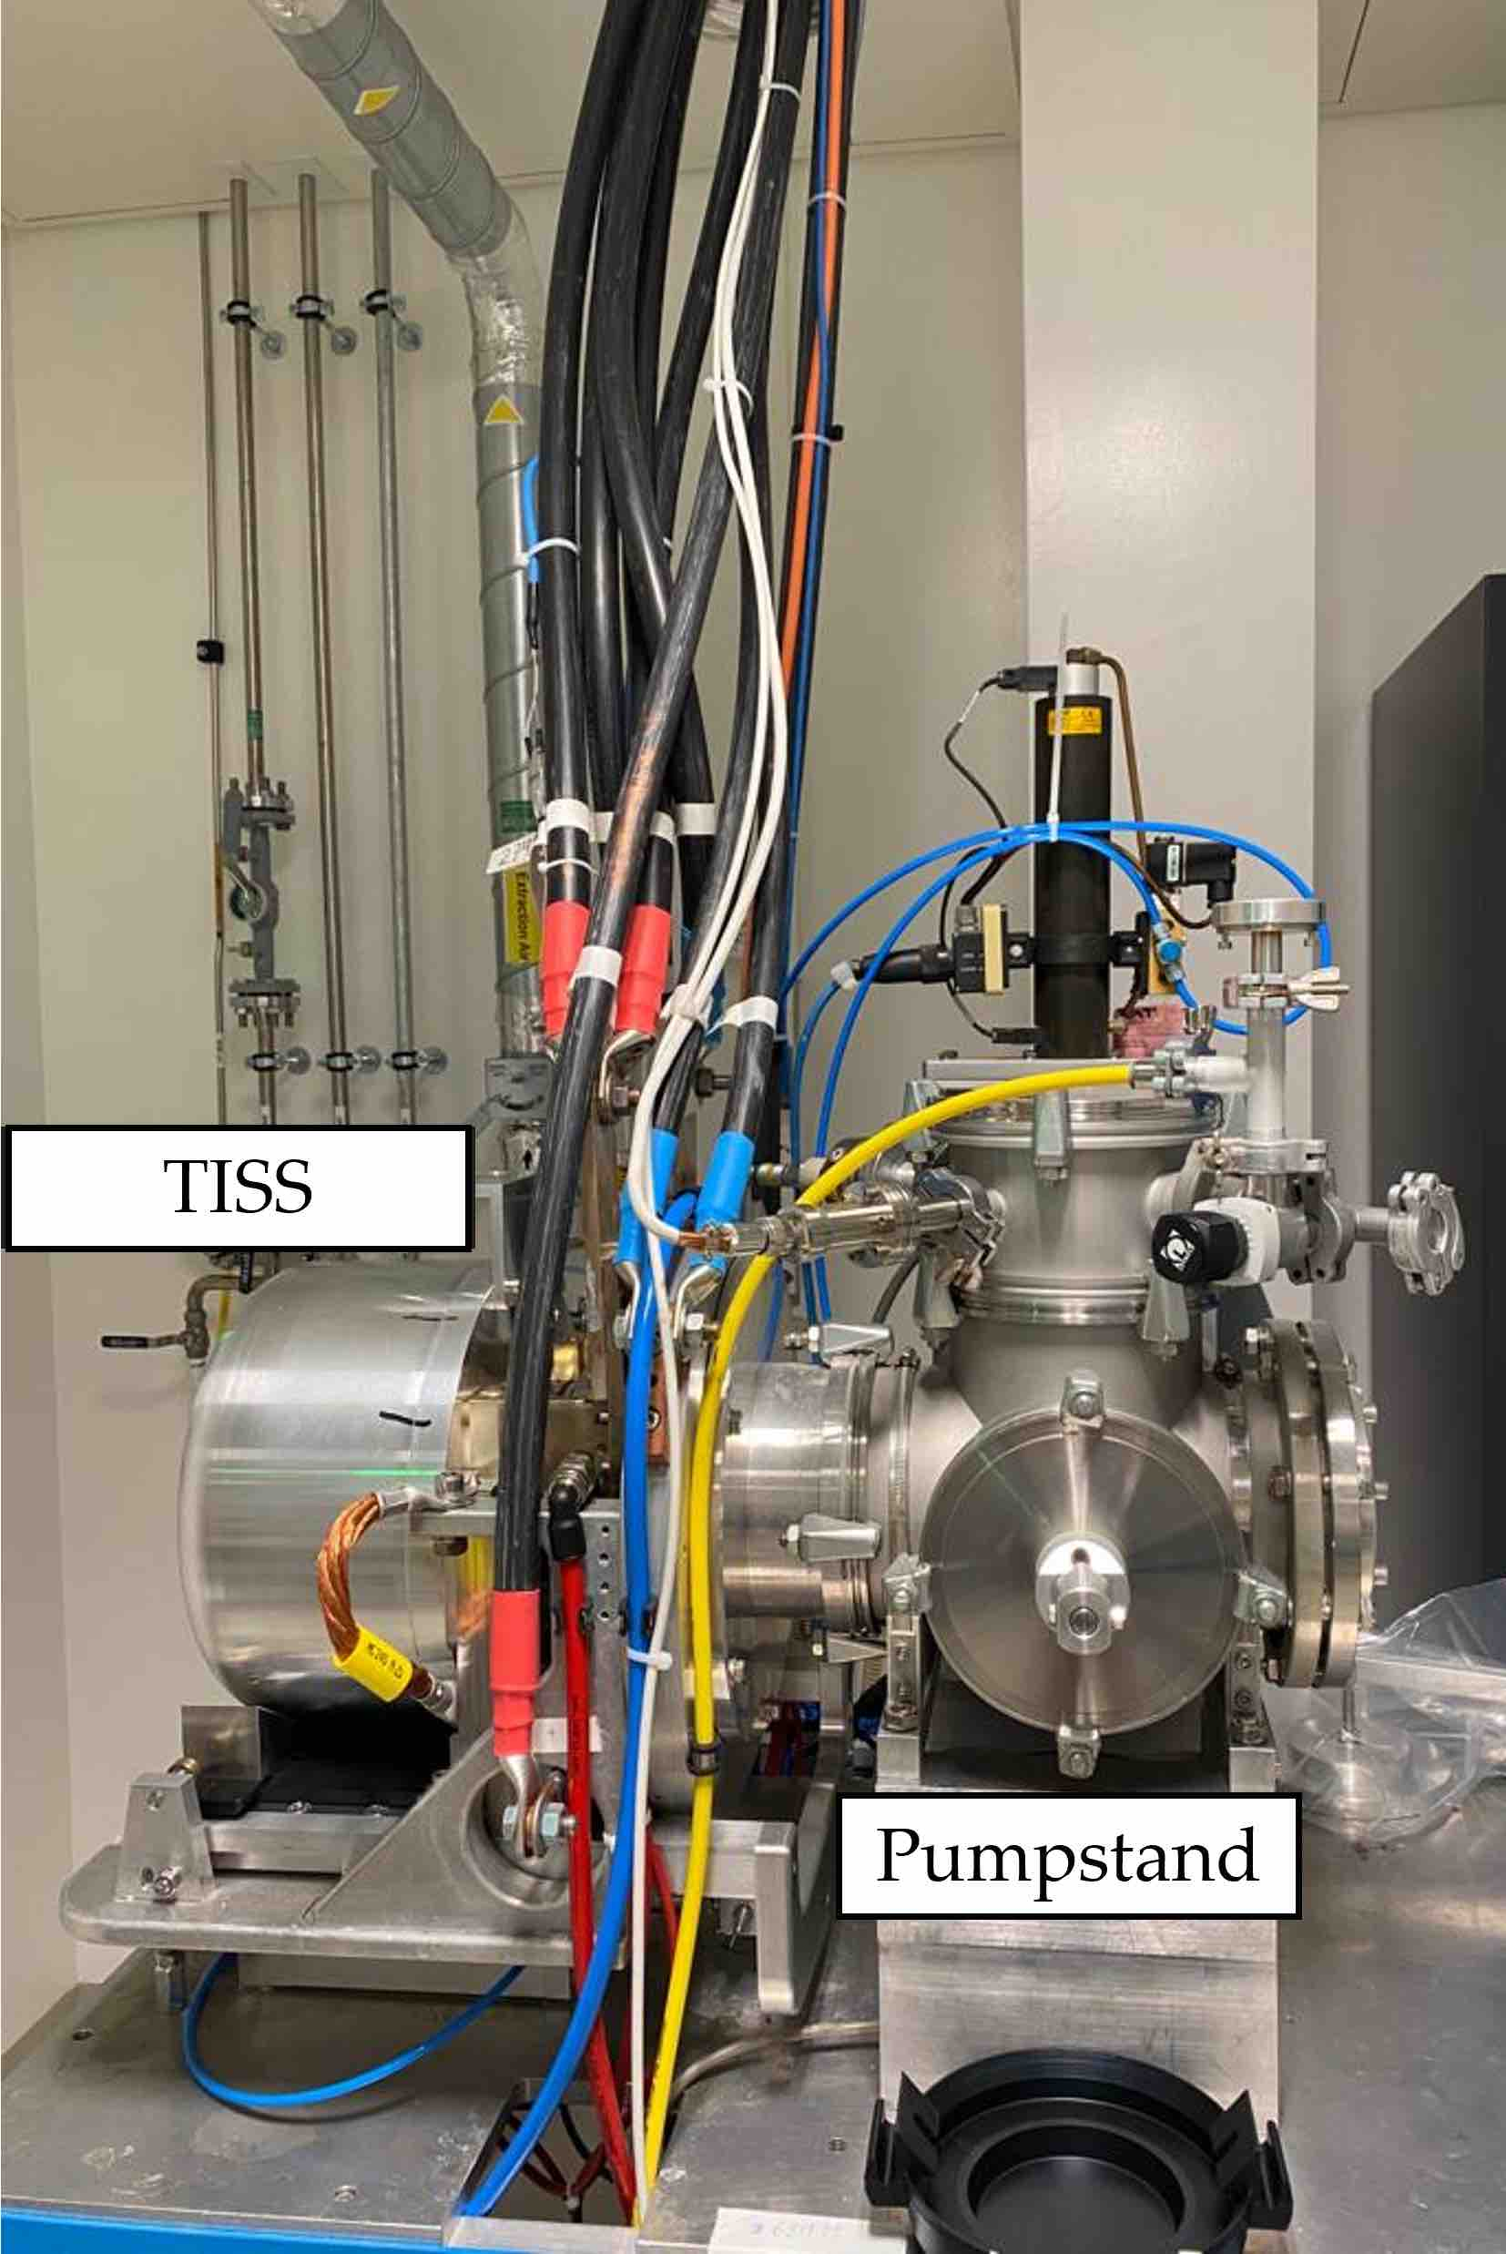
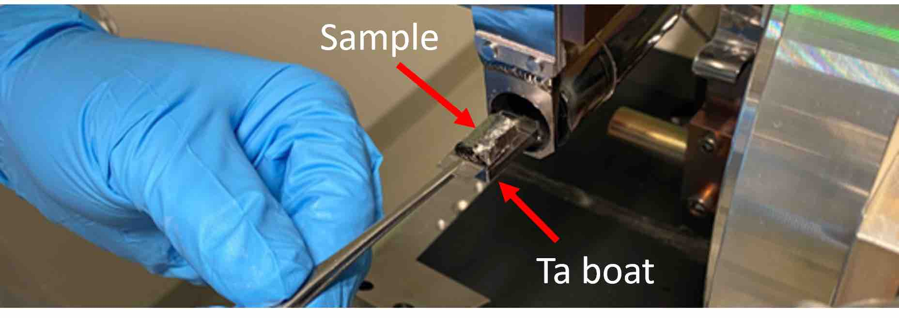
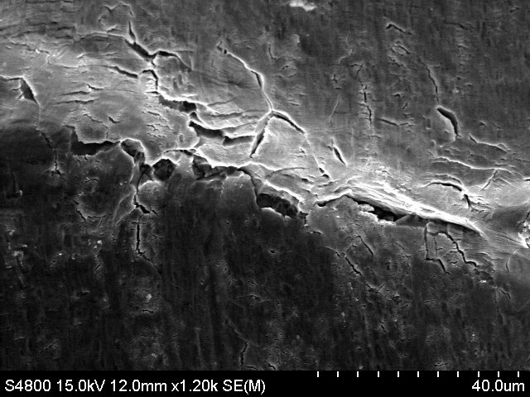
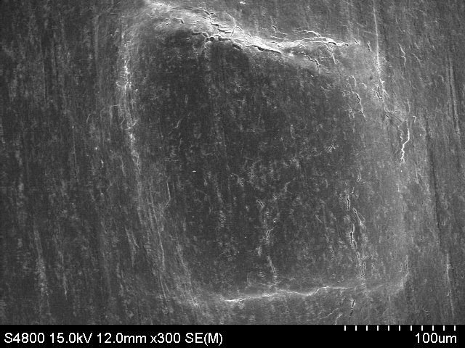
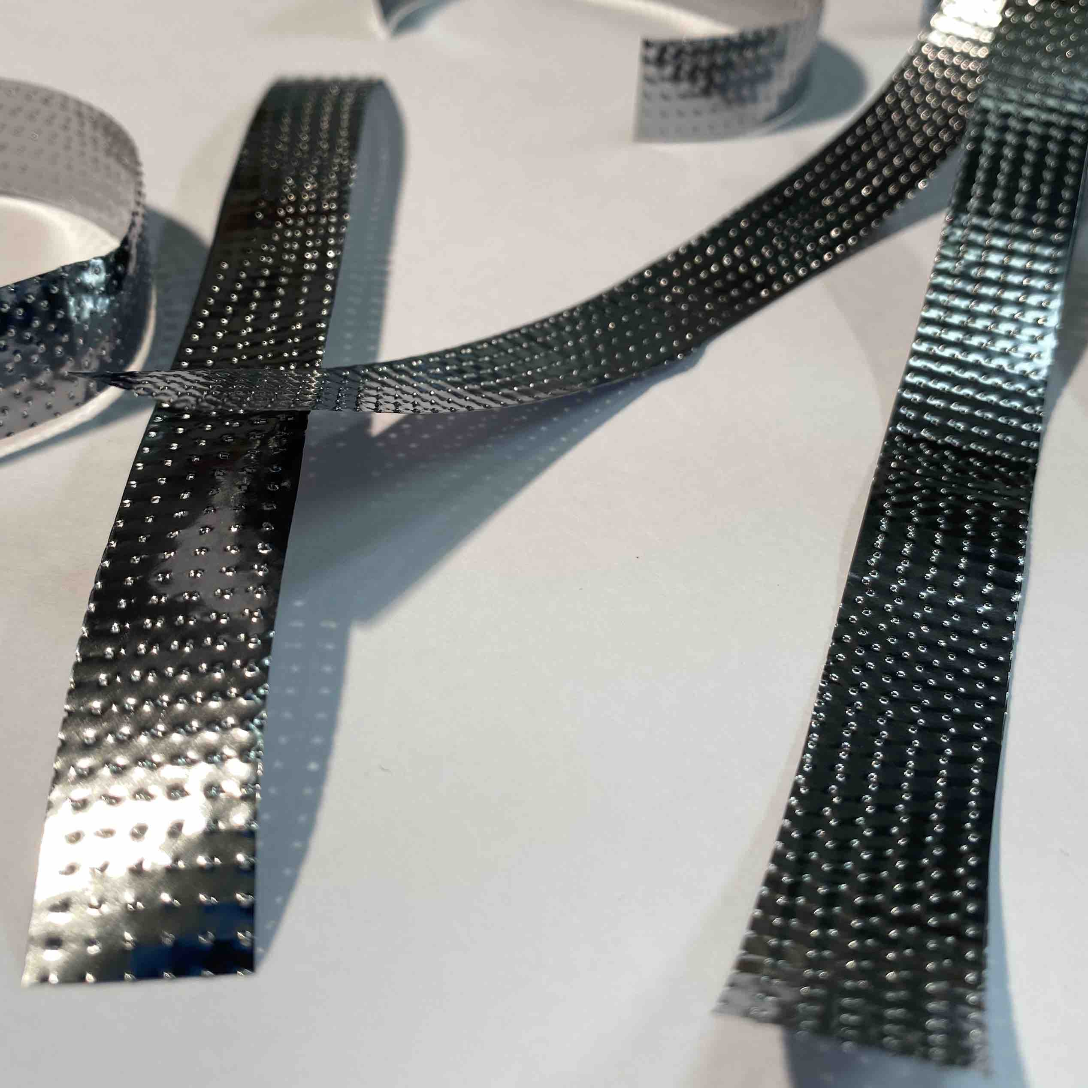
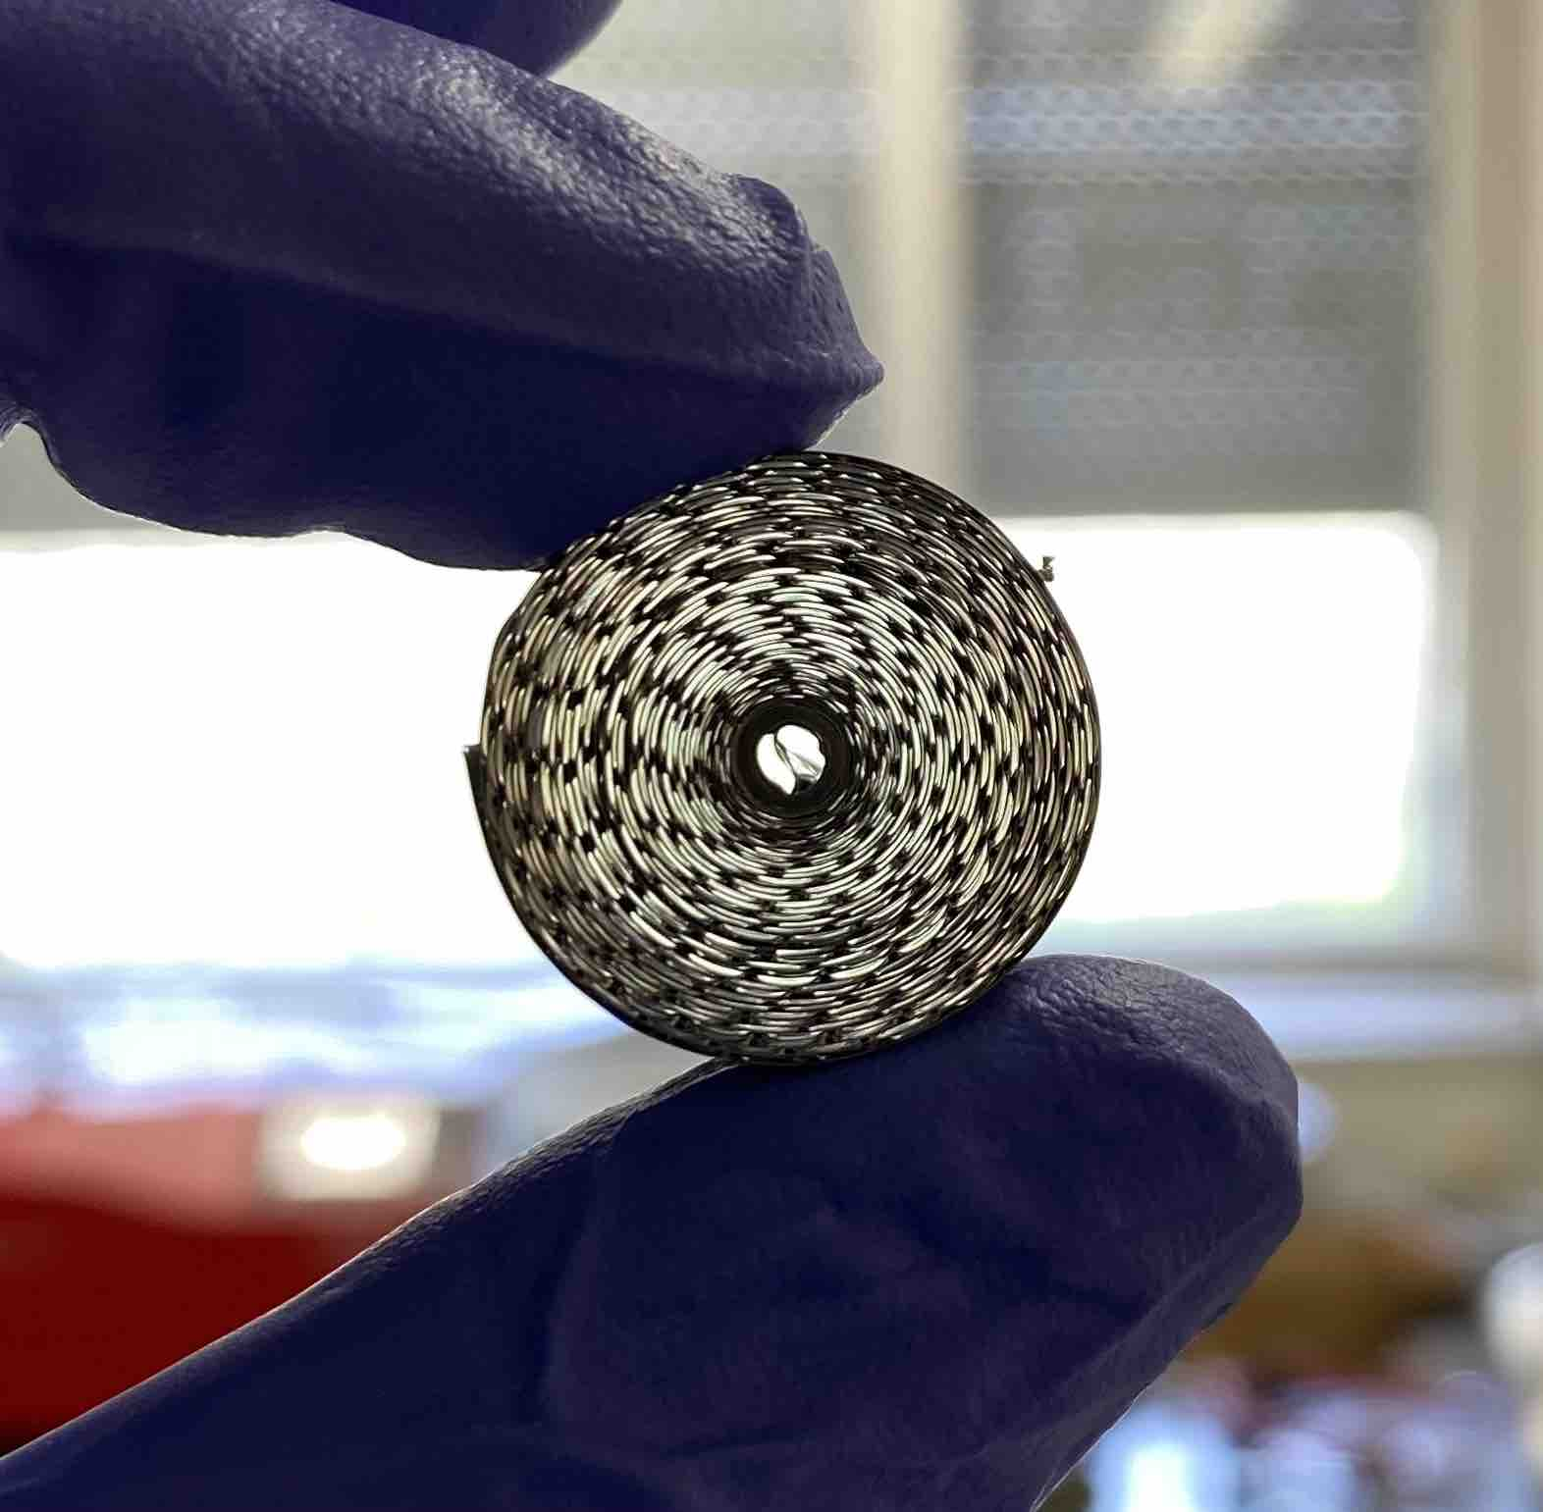
Sc radionuclide thermal release
Mamis, E.; Kalnina, P.; Duchemin, C.; Lambert, L.; Conan, N.; Deschamps, M.; Dorsival, A.; Froeschl, R.; Ruiz, F.O.; Theis, C.; Vincke, H.; Crepieux, B.; Rothe, S.; Pajuste, E.; Stora, T. Scandium thermal release from activated natTi and natV target materials in mixed particle fields: Investigation of parameters relevant for isotope mass separation. Nuclear Instruments and Methods in Physics Research Sec- tion B: Beam Interactions with Materials and Atoms 2024, 553, 165400.
Figure 3. Pumpstand with TISS.
Figure 4. Estimations with the theoretical model formulated and described by F. Ogallar Ruiz [1].
Figure 5. Sc fractional thermal release results from ^{nat}Ti foil roll samples.
  Full Sc radionuclide release in 1 hour of hold time at the peak temperature
    Embossed sample: 1450 °C;
    Non-embossed: 1200 °C;
  The impact of heating ramp for ^{nat}Ti foil roll at 1400 °C
    0 h hold time: F_{rel} of 51 ± 11 %
    1 h hold time: F_{rel} was 91 ± 19 %
Figure 2. Sample loading in TISS on Ta boat.
Figure 1. Embossed foils and roll sample.
Figure 6. Scanning Electron Microscopy (SEM) images of embossed foil.
[1] F. Ogallar Ruiz, Ph.D. thesis, Evaluation and criticality assessment of radiologi- cal source terms to be used for fire risk studies at accelerator facilities., University of Granada (2021), https://cds.cern.ch/record/ 2802879
02/07/2024

Slide 4
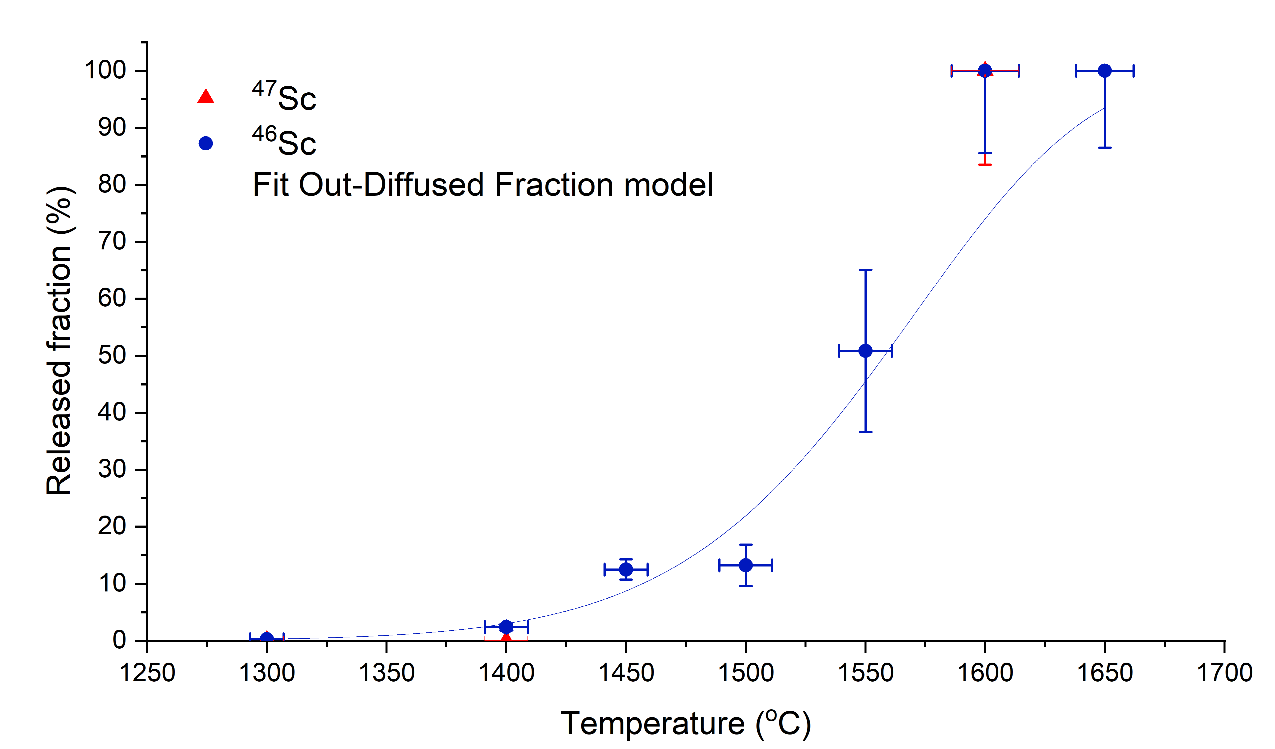
Sc radionuclide thermal release from ^{nat}V
Mamis, E.; Kalnina, P.; Duchemin, C.; Lambert, L.; Conan, N.; Deschamps, M.; Dorsival, A.; Froeschl, R.; Ruiz, F.O.; Theis, C.; Vincke, H.; Crepieux, B.; Rothe, S.; Pajuste, E.; Stora, T. Scandium thermal release from activated natTi and natV target materials in mixed particle fields: Investigation of parameters relevant for isotope mass separation. Nuclear Instruments and Methods in Physics Research Sec- tion B: Beam Interactions with Materials and Atoms 2024, 553, 165400.
^{nat}V
Figure 7. Sc radionuclide fractional thermal release results from ^{nat}V foil roll samples.
  Full Sc radionuclide release in 1 hour of hold time at the peak temperature for non-embossed foil samples: 1600 °C;
02/07/2024

Slide 5
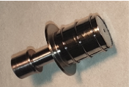
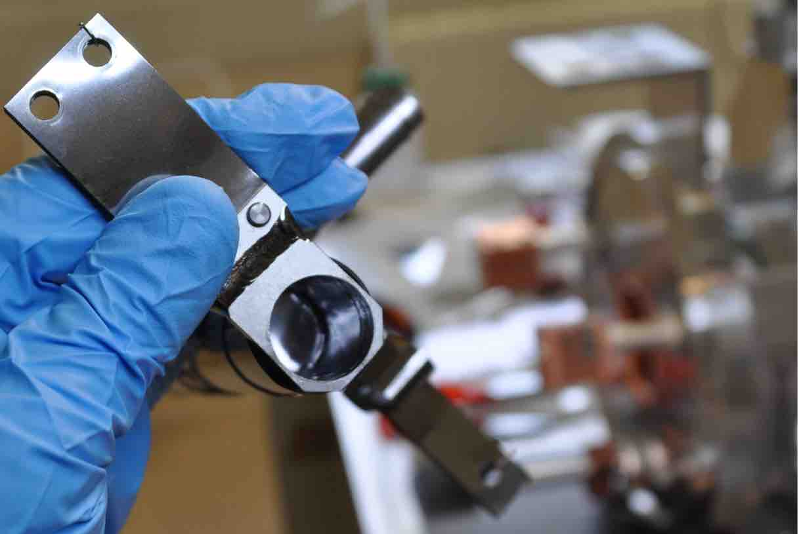
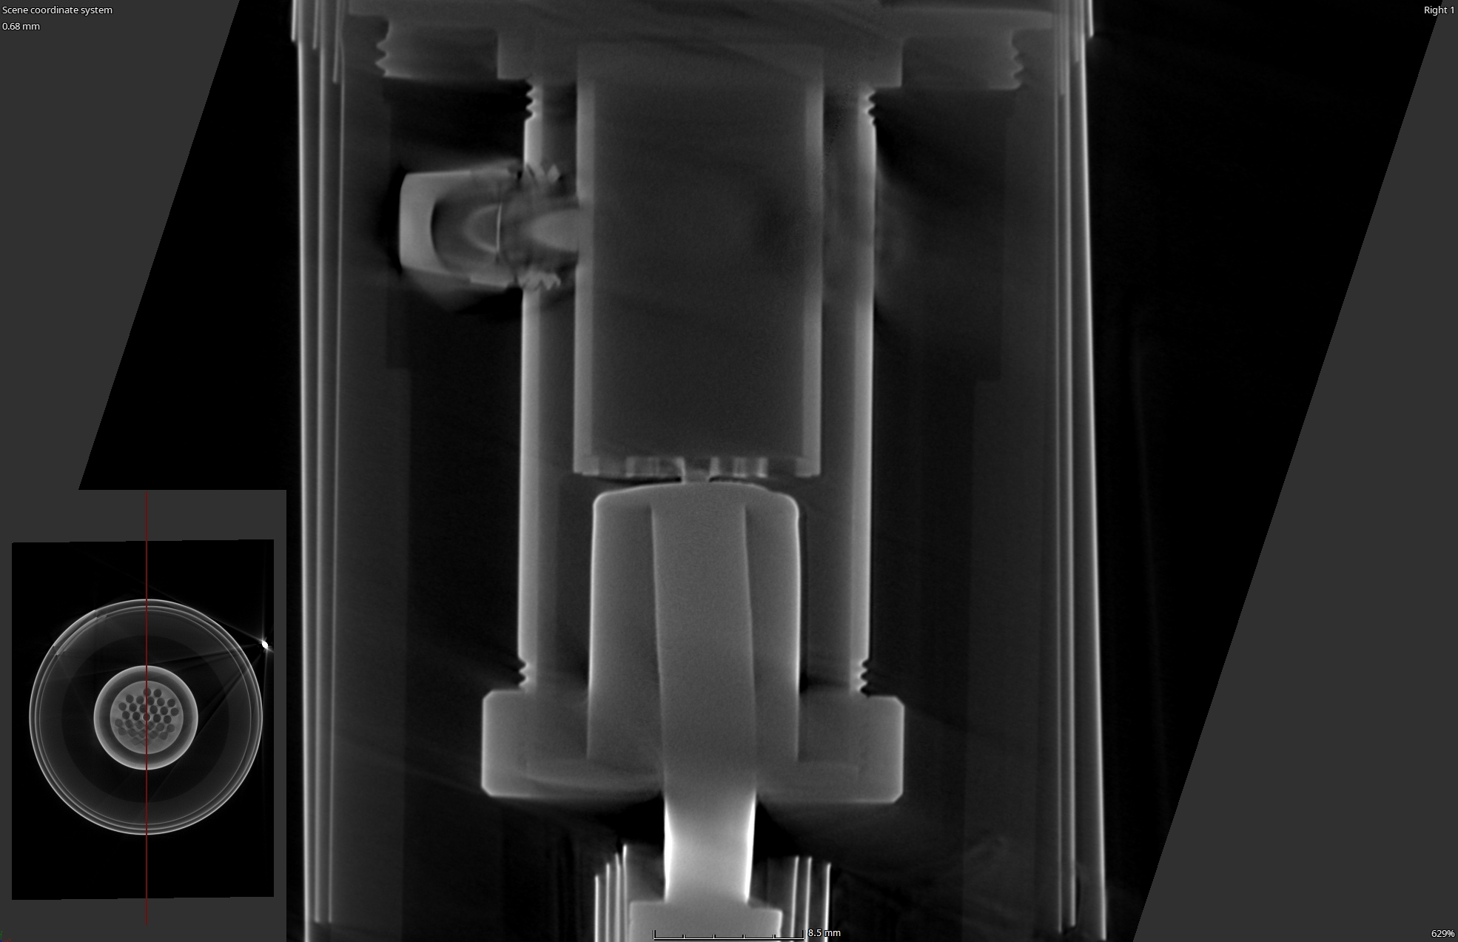
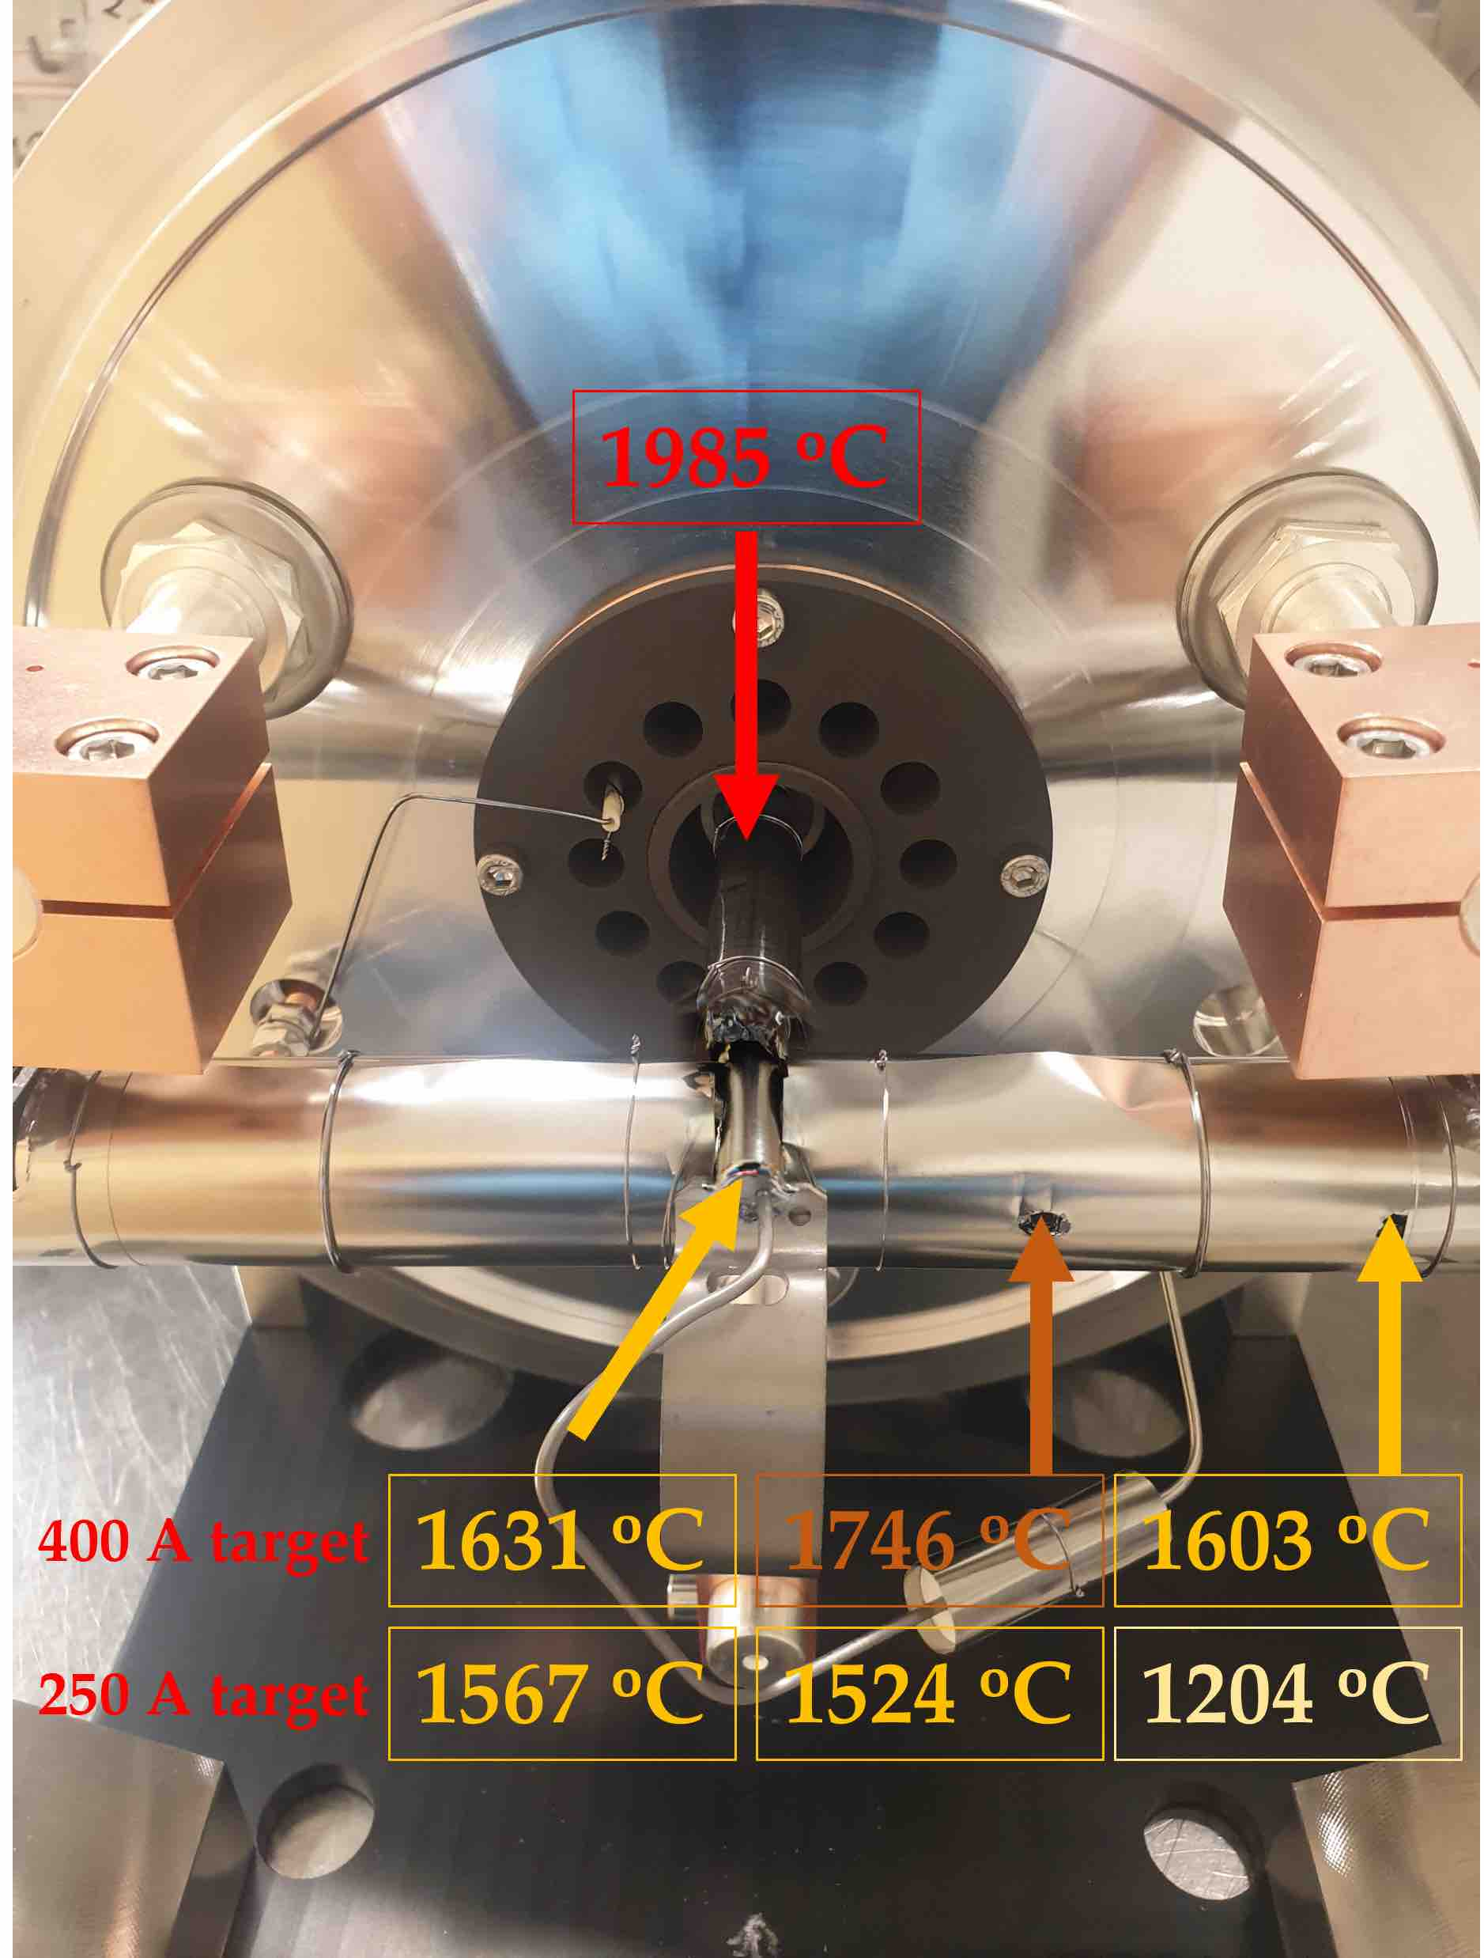
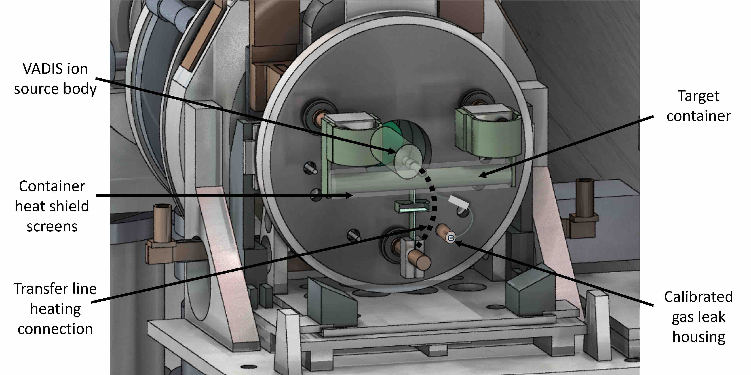
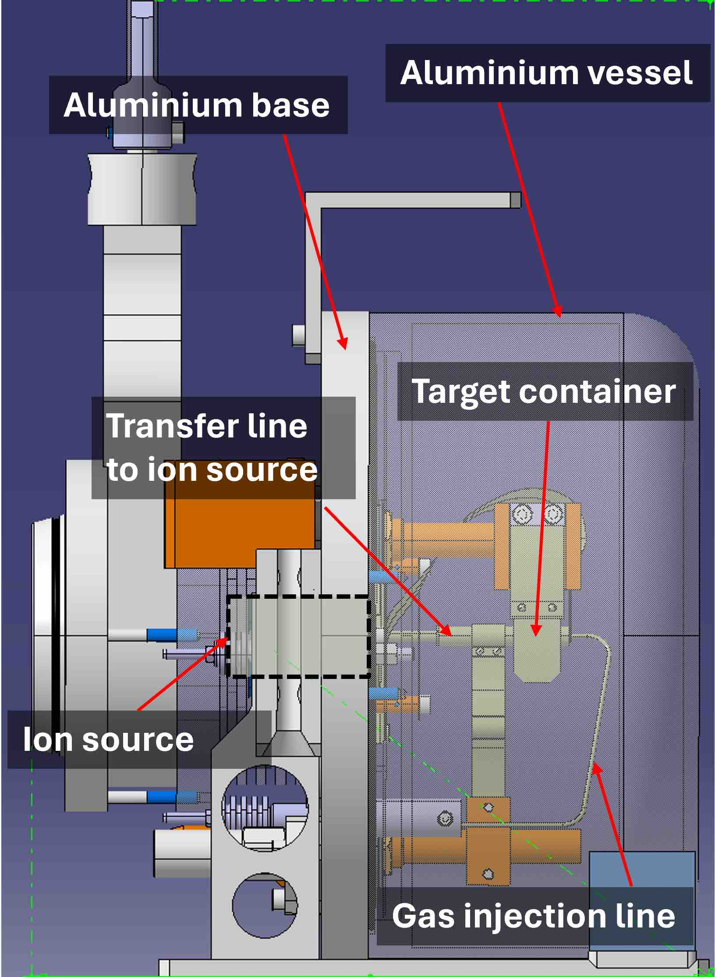
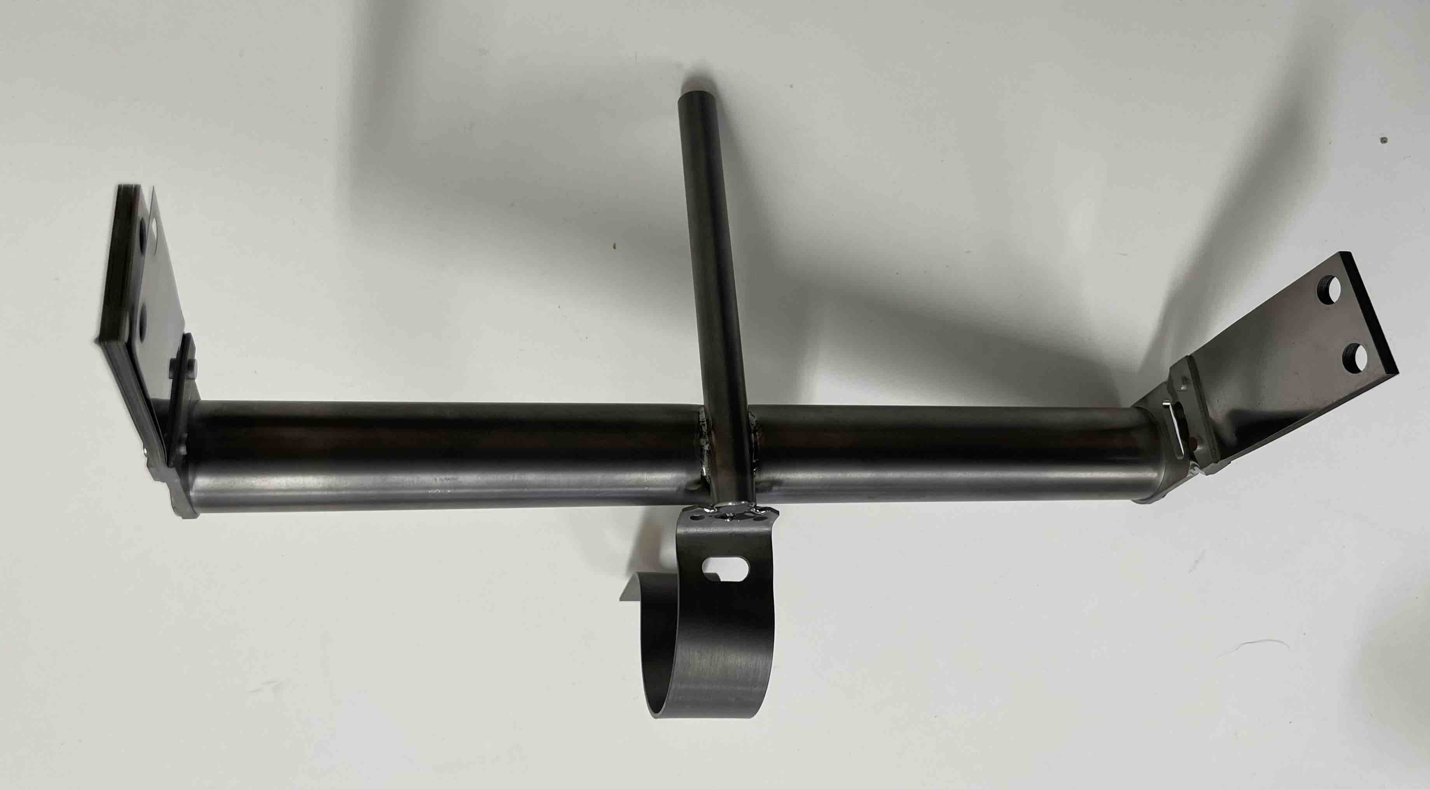
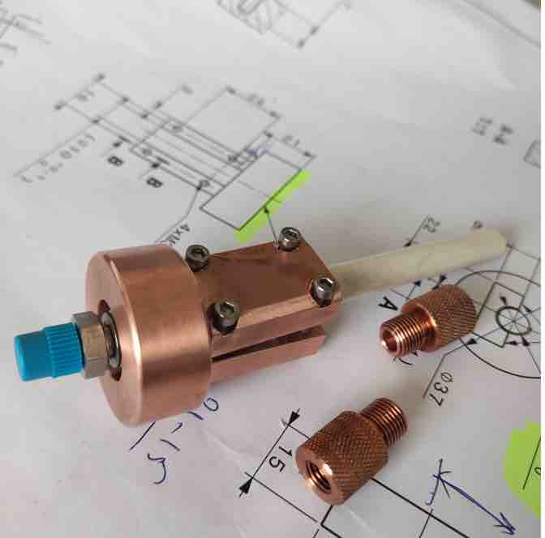


Target and ion source system developments
Mamis, E.; Duchemin, C.; Berlin, V.; Bernerd, C.; Bovigny, M.; Chevallay, E.; Crepieux, B.; Gadelshin, V.M.; Heinke, R.; Hernandez, R.M.; Pajuste, E.; Stora, T. et al. Target Development towards First Production of High-Molar-Activity 44gSc and 47Sc by Mass Separation at CERN-MEDICIS. Pharmaceuticals 2024, 17, 390.
Table 1: Target and ion source system configurations for Sc mass separation and collection studies.
VD-5 VADIS TISS with hot transfer line (~2000 ºC)
Figure 8. Target and ion source system with its main components and modifications.
VADIS – Versatile Arc Discharge Ion Discharge
02/07/2024

Slide 6
Collection efficiency of Sc at CERN-MEDICIS
Table 2: Collection efficiencies of Sc radionuclides from various target materials and TISS.
Table 3: Collection efficiencies of Sc generator mother radionuclides from various target materials and TISS.
Table 4: Hypothetical ⁴⁷ScF₂⁺ collection rates from the given TISS and target materials and corresponding collection batches.
  The developments in this study resulted in the first mass separation and collection of isotopically pure ^{44g/m}Sc, ⁴⁶Sc and ⁴⁷Sc radionuclides with collected activity ranging from few kBq up to ∼10 MBq.
  The obtained efficiencies in most cases are not the maximum achievable due to stopped collections from TISS failures
Stora, T.;; Mamis, E.; et. al. CERN-MEDICIS: Operational indicators to support the production of new med- ical radionuclides by mass separation. Journal of Physics: Conference Series 2024, 2687, 8, 082039, IOP Publishing.
02/07/2024

Slide 7
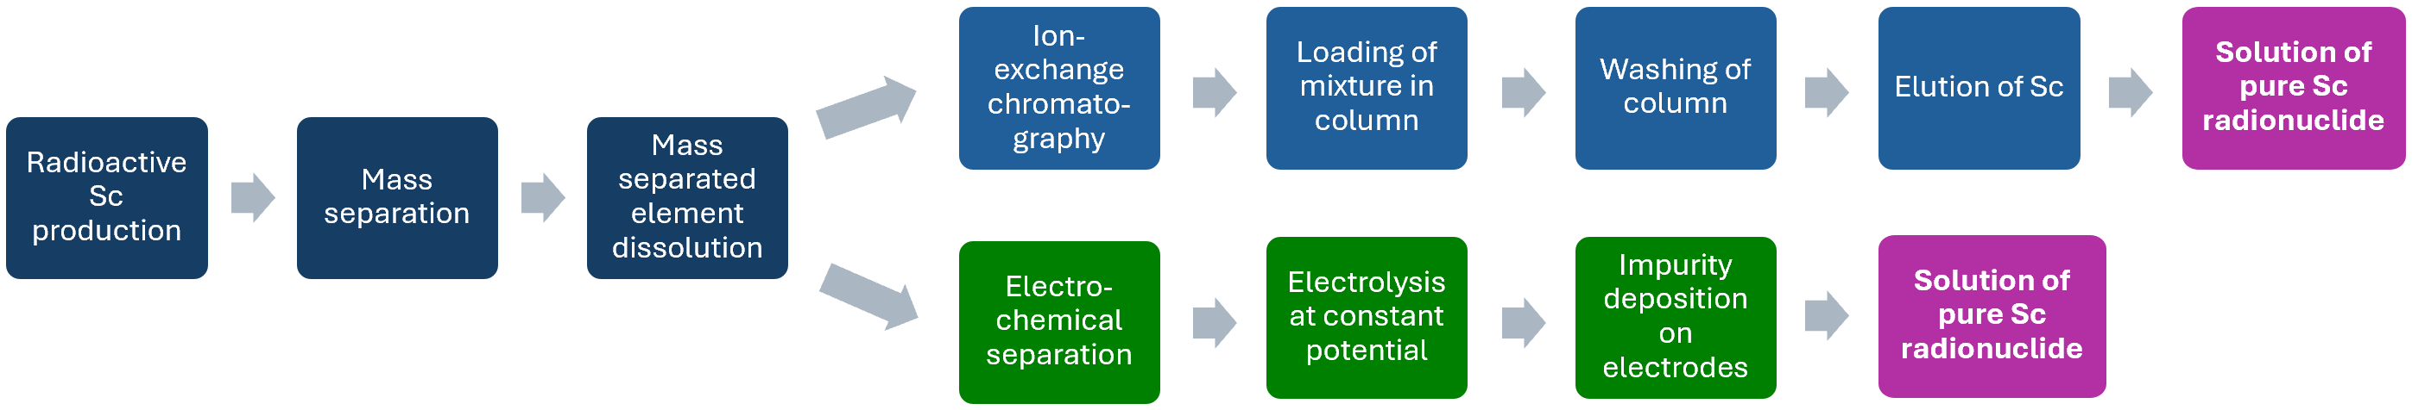
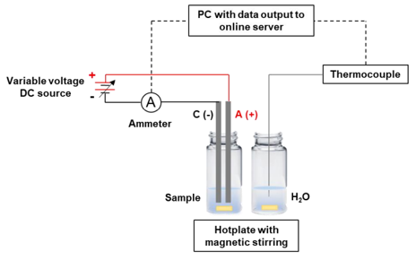
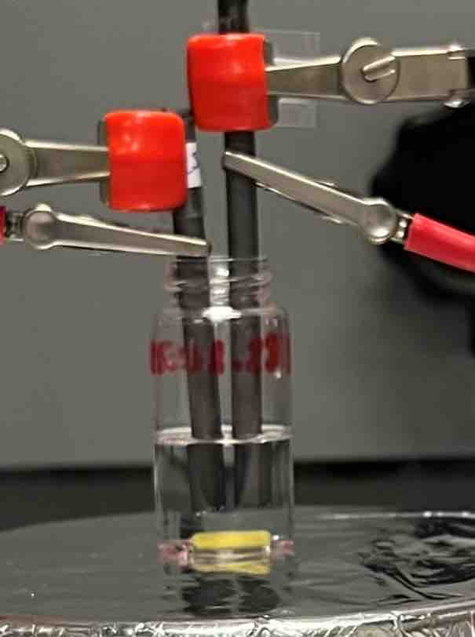
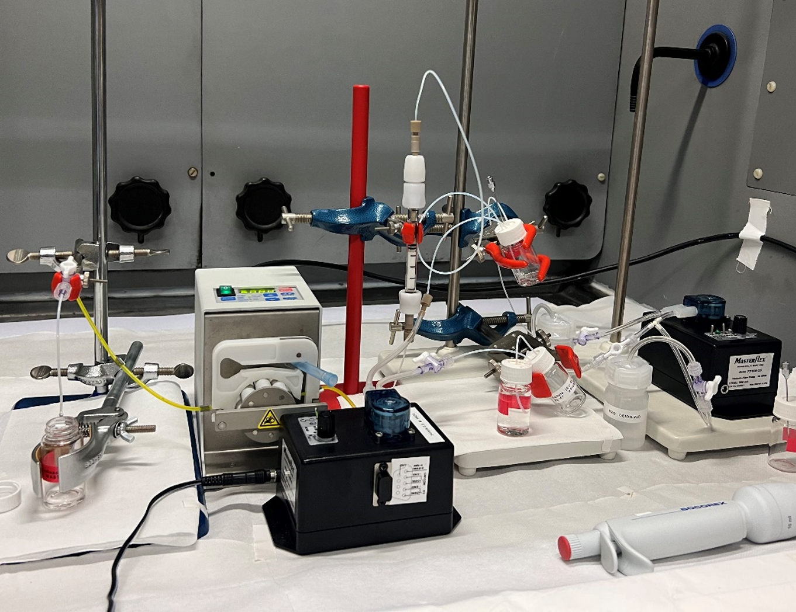
Radiochemical separation
Figure 9. Full Sc radionuclide separation and purification process flowchart.
  No ⁴⁷Sc was trapped within the column or capillaries of the system, indicating a high recovery yield (>99%).
  The radiochemical yield:
    81 ± 9 % with Diba Omnifit Benchmark Microbore 3 mm column
    76 ± 12 % with Diba Omnifit EZ 5 mm column
  The automated setup assembly with the radiochemical separation took ~2.5 hours in total;
  The electrochemical method - for large­scale isobar contaminant removal before ion exchange separation.
  The results from the electrochemical separation confirmed that Sc cannot be deposited on an electrode in aqueous electrolysis, which becomes very useful for collection on a Cu foil.
Figure 11. Schematic of electro-radiochemical separation setup.
Figure 10. Automated radiochemical separation test setup.
  Special thanks to R. J. Zabolockis and L.D. Pakalniete
02/07/2024

Slide 8
Outcome
  Thermal release studies:
    Publication;
    Master’s thesis defended by P. Kalniņa;
    Set-up employed for other radionuclide release studies.
  Target and ion source system developments:
    Publication;
    Two-step laser resonant ionization scheme employed at MELISSA;
    Outlook for other target material investigations on Sc production and mass separation.
  Radiochemical and electrochemical separation:
    Bachelor’s thesis defended by L.D. Pakalniete,
  Molecular radioactive ion beam studies:
    Acquired data which will be used for publication;
    Plan for another Sc external sample mass separation;
    PhD thesis submitted by E.Mamis.
02/07/2024

Slide 9
MED-039: Tb and Sc radionuclide separation and purification from solid targets and liquids for theranostic radiopharmaceutical development.
Edgars Mamis
Patrīcija Kalniņa, Rūdolfs Jānis Zabolockis, Elīna Pajuste
Maija Radziņa, Toms Torims
02/07/2024

Slide 10
Main tasks:
Obtain bulk target material, suitable for ¹⁴⁹Tb, ¹⁵²Tb and ¹⁵⁵Tb radionuclide production at CERN-MEDICIS and cyclotrons, coupled with mass separation and/or chemical purification:
  Investigate composite target materials with resistance to sintering, good mechanical stability and high specific surface area.
  Material sample characterization prior and after the thermal treatment and preparation for irradiation and mass separation by the means of Scanning Electron Microscopy (SEM), Energy Dispersive X-ray analysis EDX, Brunauer, Emmett and Teller (BET) method, pycnometry, Fourier Transform Infra-Red (FT-IR) spectroscopy.
  Experiments on Tb release from the TaC matrix by doping target material with stable Tb compounds can be made to test the suitability of the proposed composite materials.
Perform mass separation of Tb radionuclides from irradiated Ta target materials:
  Produce ¹⁴⁹Tb, ¹⁵²Tb and ¹⁵⁵Tb radionuclides with proton irradiation and perform mass separation and radionuclide collection at CERN-MEDICIS facility.
Perform obtained Tb radionuclide separation and purification by conventional radiochemical methods and ion exchange resins, which includes developing a semi-automated radionuclide separation prototype system (also electrochemical methods).
  Evaluate the separation efficiency, yield and radiochemical purity for method optimization.
02/07/2024
10

Slide 11
Main tasks:
Prepare, characterize and investigate target materials such as VC, VB, TiC (nanoscale) for the Sc production and mass separation with collected Sc sample post purification using the already developed chemical separation methods.
Test the separation of Tb and Sc radionuclide from mass separation collection foils with electrochemical methods.
  Investigate non-aqueous electrolysis as means of the radionuclide separation from isobaric contaminants.

Slide 12
