Slide 1
CERN Summer 2024 Project:
R&D of Crystal-based EM calorimeter for precision particle energy measurements
Jessaly Zhu
28 May 2024

Slide 2
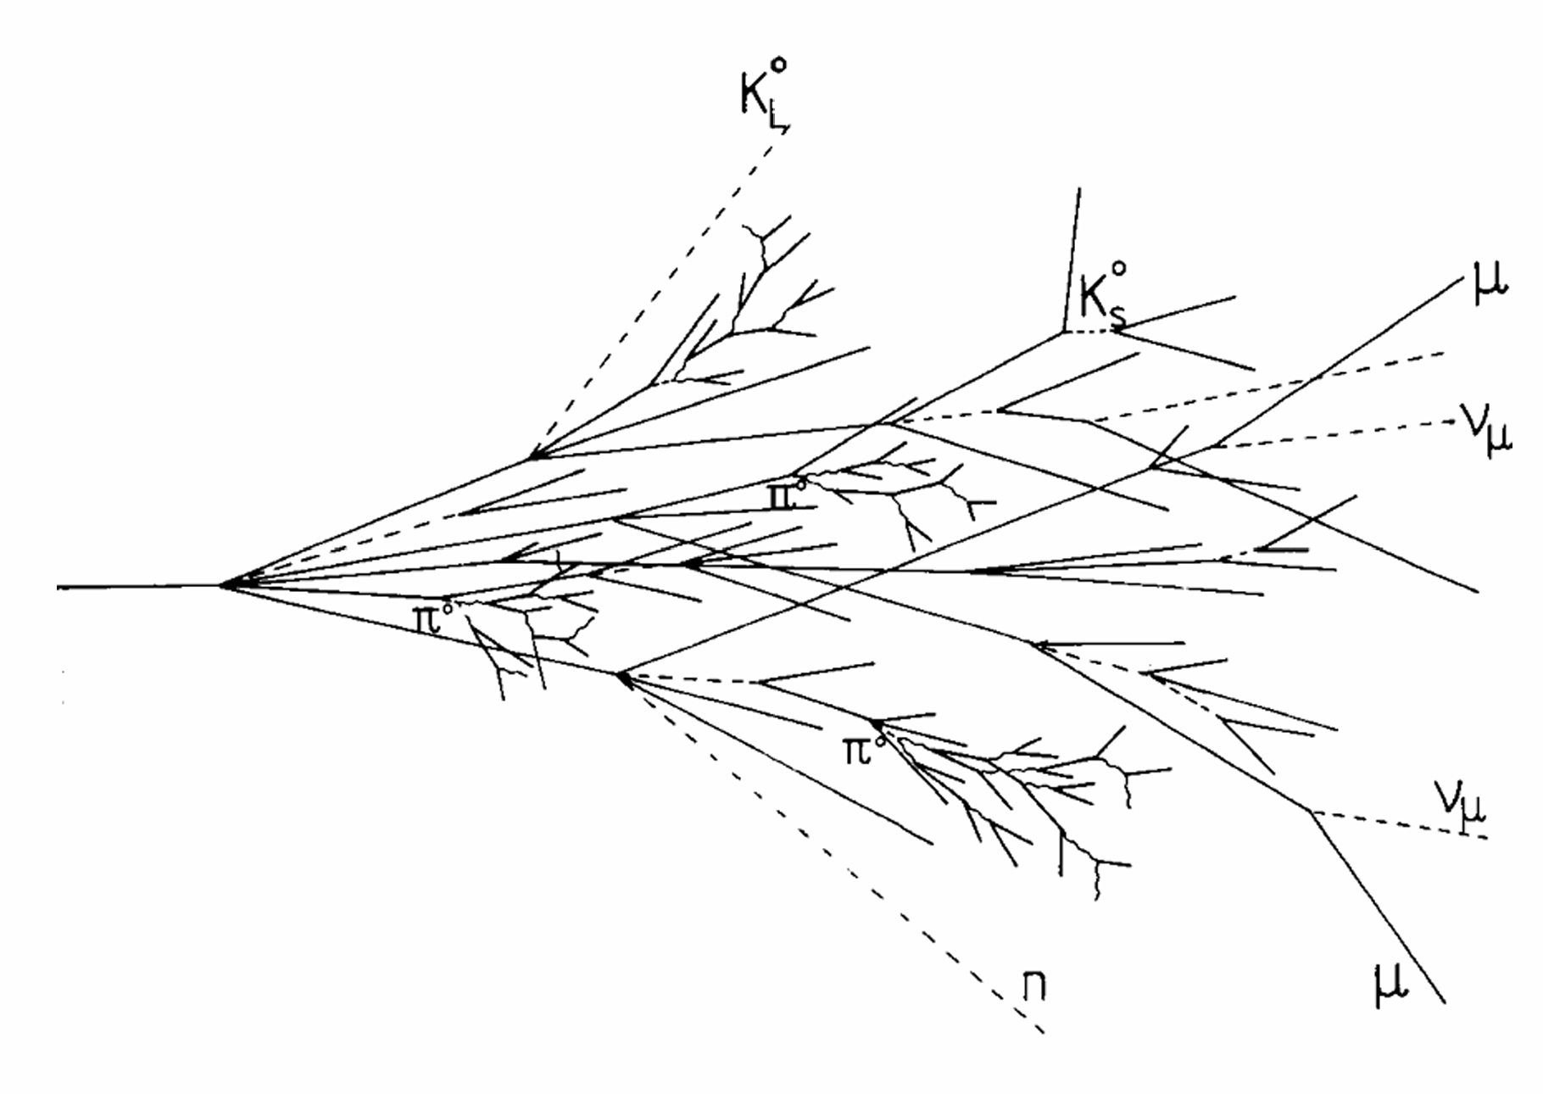
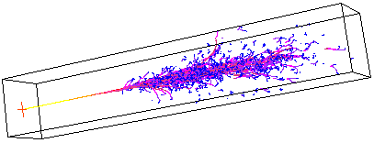
Calorimeters
In a dense material, primary particles will create showers of secondary particles.
2 Types of Showers:
Electromagnetic Showers
  Small
  well understood
Hadronic Showers
  strong force: complex and unpredictable
  “invisible” energy
Image Source: https://www.mpp.mpg.de/~menke/elss/
Image Source: https://www.fisgeo.unipg.it/~fiandrin/didattica_fisica/rivelatori1617/lez09_310317_riv1617.pdf
Notes:
A calorimeter is a detector made of a dense material like a crystal that absorbs the particles that it detects. When a particle beam hits the calorimeter, it initiates a chain of inelastic collisions in the formation called a shower. We differentiate between two types of showers: electromagnetic and hadronic. Electromagnetic showers are made of electrons, positrons and photons. It is much smaller and more well-understood than its counterpart. Hadronic showers are made of hadrons like protons and neutrons. It is mediated by the strong force which is much more complex and unpredictable. A fraction of its energy is actually invisible to the calorimeter. Of course, there is no perfect calorimeter that can detect 100% of the energy that is deposited, but the nature of these showers and our technology limit the resolution of electromagnetic and hadronic calorimeters, which in turn limits our understanding of what is going on.

Slide 3
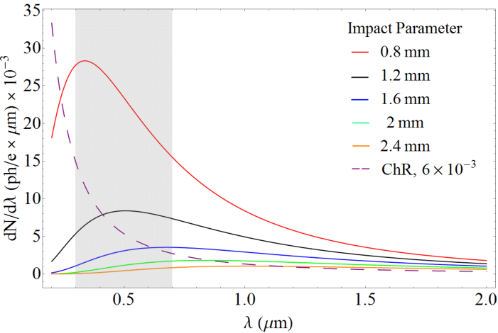
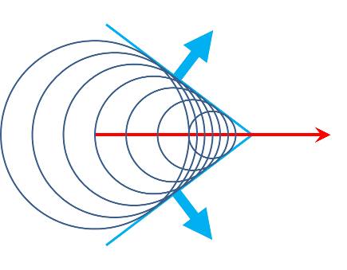
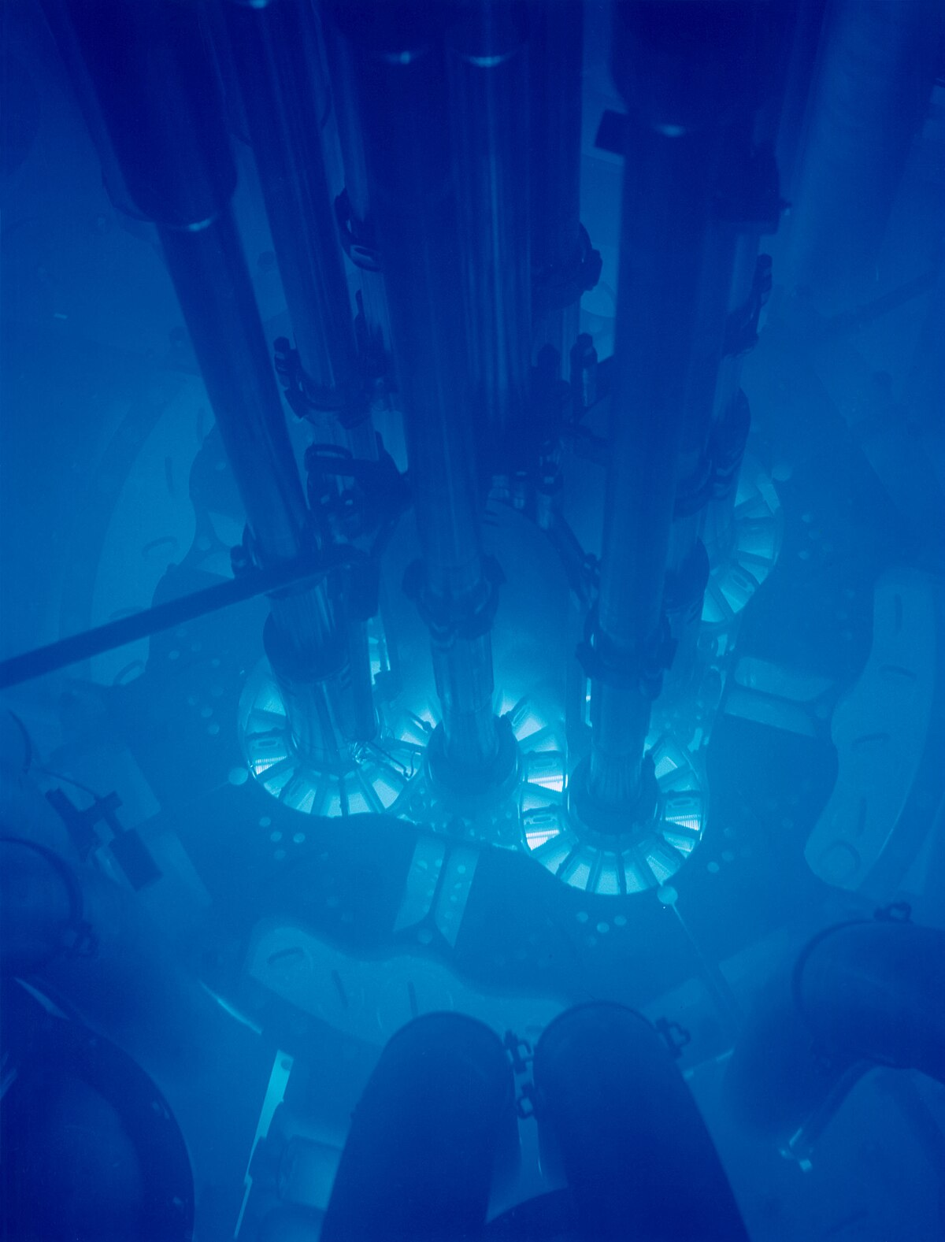
Scintillation and Cherenkov light
Scintillation light
  Dominant radiation
Cherenkov light
  Produced when particle is traveling faster than the speed of light in the medium
Image Source: https://www.researchgate.net/figure/Cherenkov-diffraction-photon-spectrum-from-a-53-GeV-positron-propagating-at-impact_fig2_326752664
Image Sources:
https://essnusb.eu/glossary/water-cherenkov-detector/ (left), https://en.wikipedia.org/wiki/Cherenkov_radiation (right)
Notes:
One way to improve the resolution is to look at scintillation and Cherenkov light generated in the showers. The majority of photons released is scintillation light, but a small fraction of it is Cherenkov light which happens when the particle is traveling faster than the speed of light in the medium creating this wave front. Think of it like a sonic boom. Cherenkov light is not yet well-understood. The dominating scintillation light makes it difficult to study Cherenkov light. However, if we attenuate where the scintillation light dominates then we can better study the Cherenkov component.

Slide 4
Experimental Setup
Optical filter: attenuates unwanted signals
Photon beam
Amplifier: converts photoelectrons into something computer readable
crystal
SiPM: converts photons into photoelectrons
Notes:
So, how do we detect these photons? We send a high-energy photon beam at the crystal creating electromagnetic showers. The secondary photons pass through an optical filter to attenuate the unwanted signals. The SiPM or silicon photomultiplier converts the photons into an electric signal. The amplifier amplifies the signal to a level that can be digitized. The setup looks like this.(point) Once the data is collected, we can start analyzing the waveforms. This is an example. (point) My role in this project is to analyze and find an algorithm of the noise of these waveforms. Many setups are being tested to study how Cherenkov light behaves from the angle of the photon beam, the crystal, and the calibration of the instruments. Understanding Cherenkov light is essential in increasing the resolution to allow us to reconstruct the particle interactions with better precision and accuracy.

Slide 5
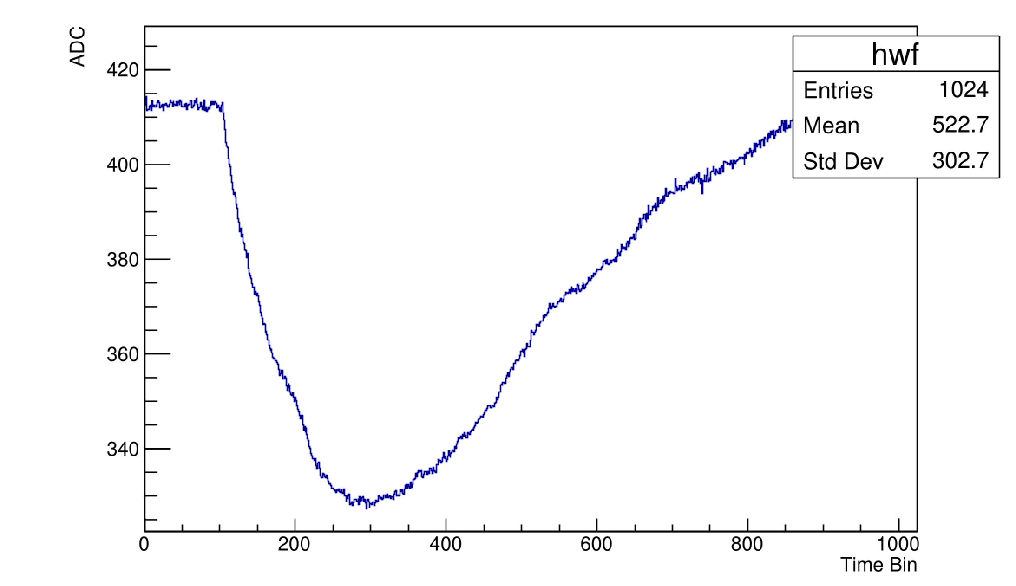
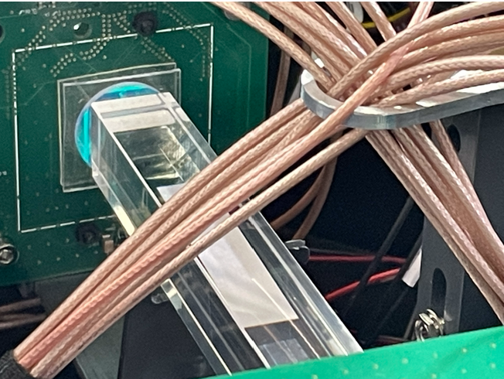
The Project
My role: Analyze the noise in the waveforms produced by crystal-based electromagnetic calorimeter
Mentors: Liang Guan and Hui-Chi Lin in collaboration with Calvision
Notes:
The setup looks like this.(point) Once the data is collected, we can start analyzing the waveforms of the Cherenkov signal. This is an example. (point) My role in this project is to analyze and find an algorithm of the noise of these waveforms. Many setups are being tested to study how Cherenkov light behaves from the angle of the photon beam, the crystal, and the calibration of the instruments. Understanding Cherenkov light is essential in increasing the resolution to allow us to reconstruct the particle interactions with better precision and accuracy. My mentors are Liang and Hui-Chi who are both working on this collaboration called Calvision, a multi institutional project looking to improve crystal-based calorimetry for the future circular collider.

Slide 6
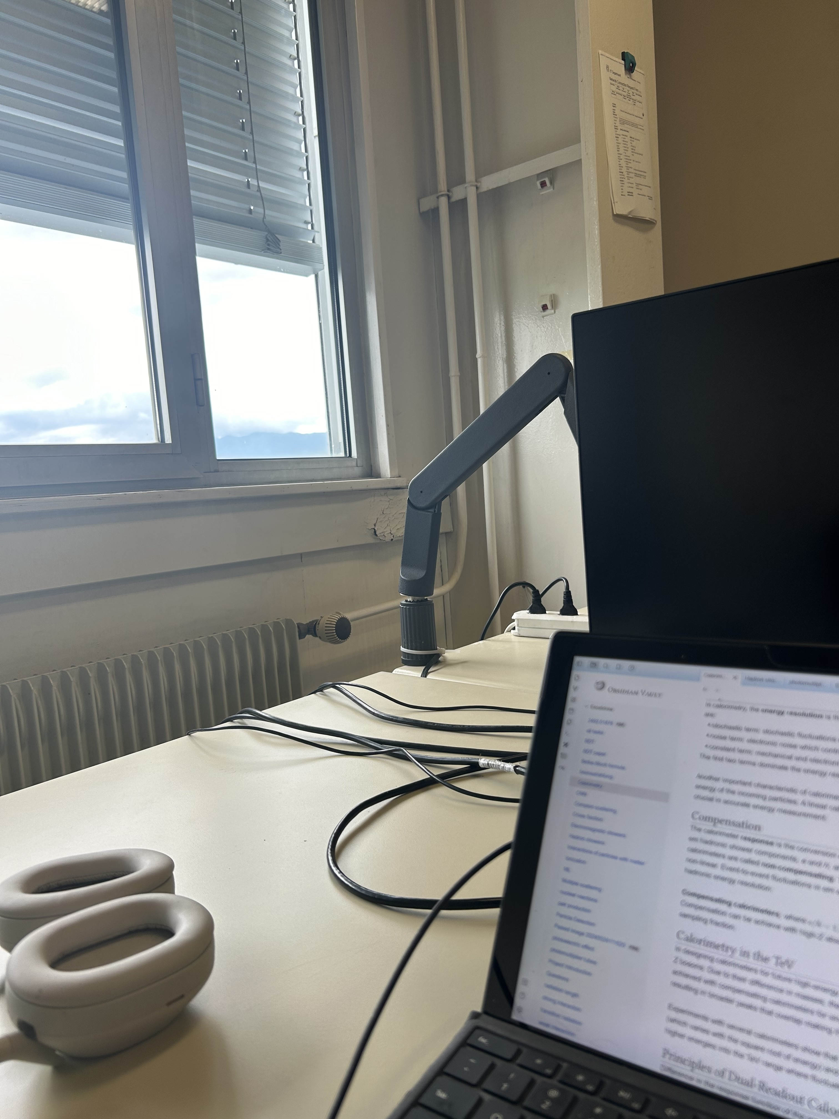

Accomplishments since arrival
Project Background Research

Slide 7
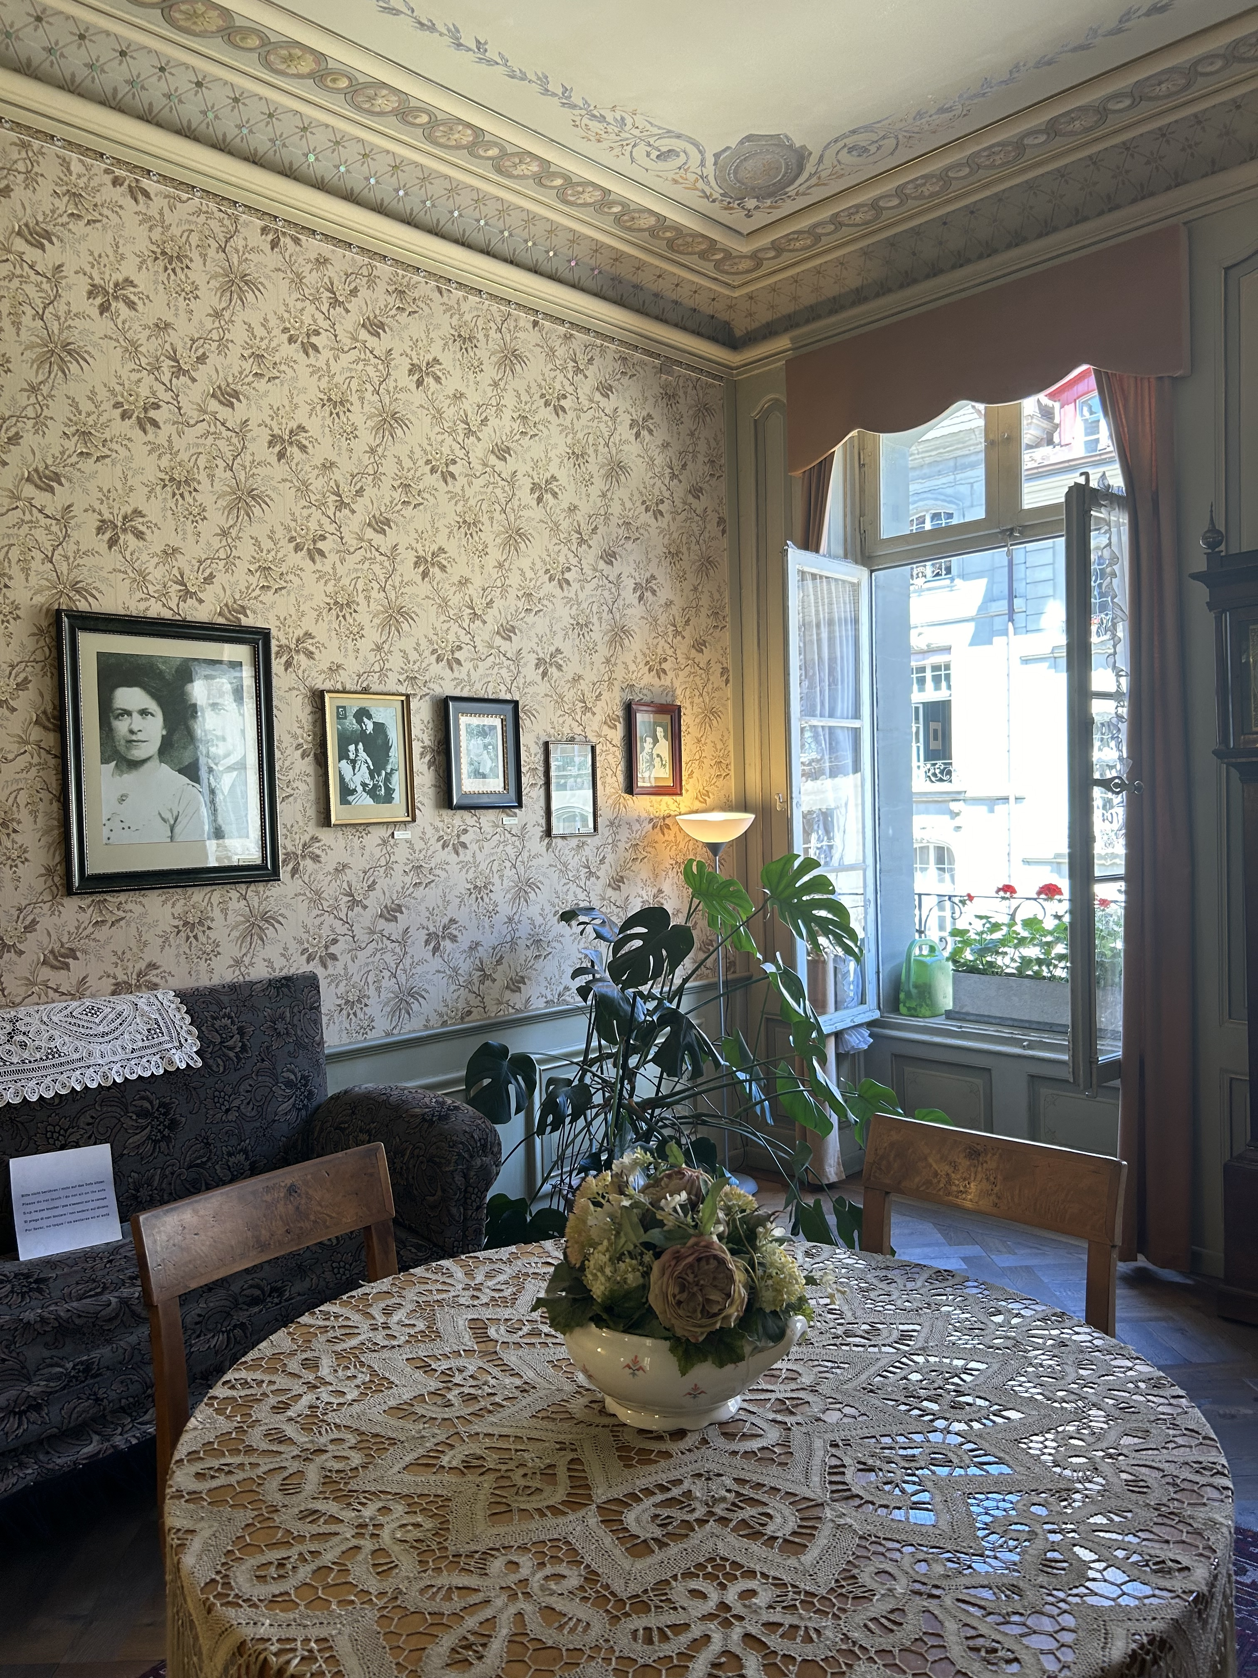
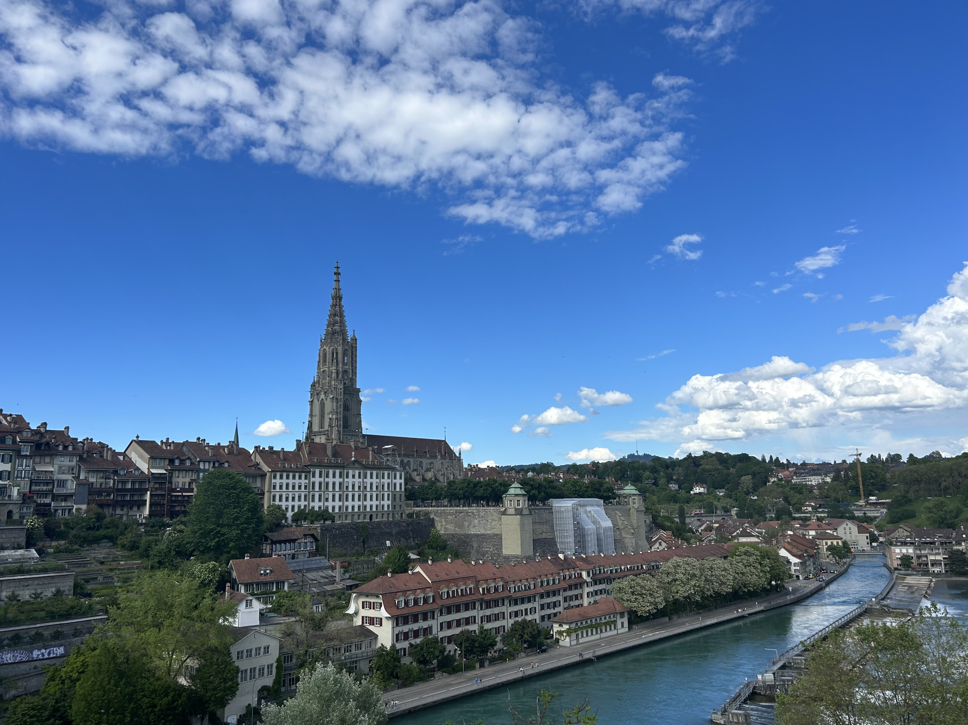
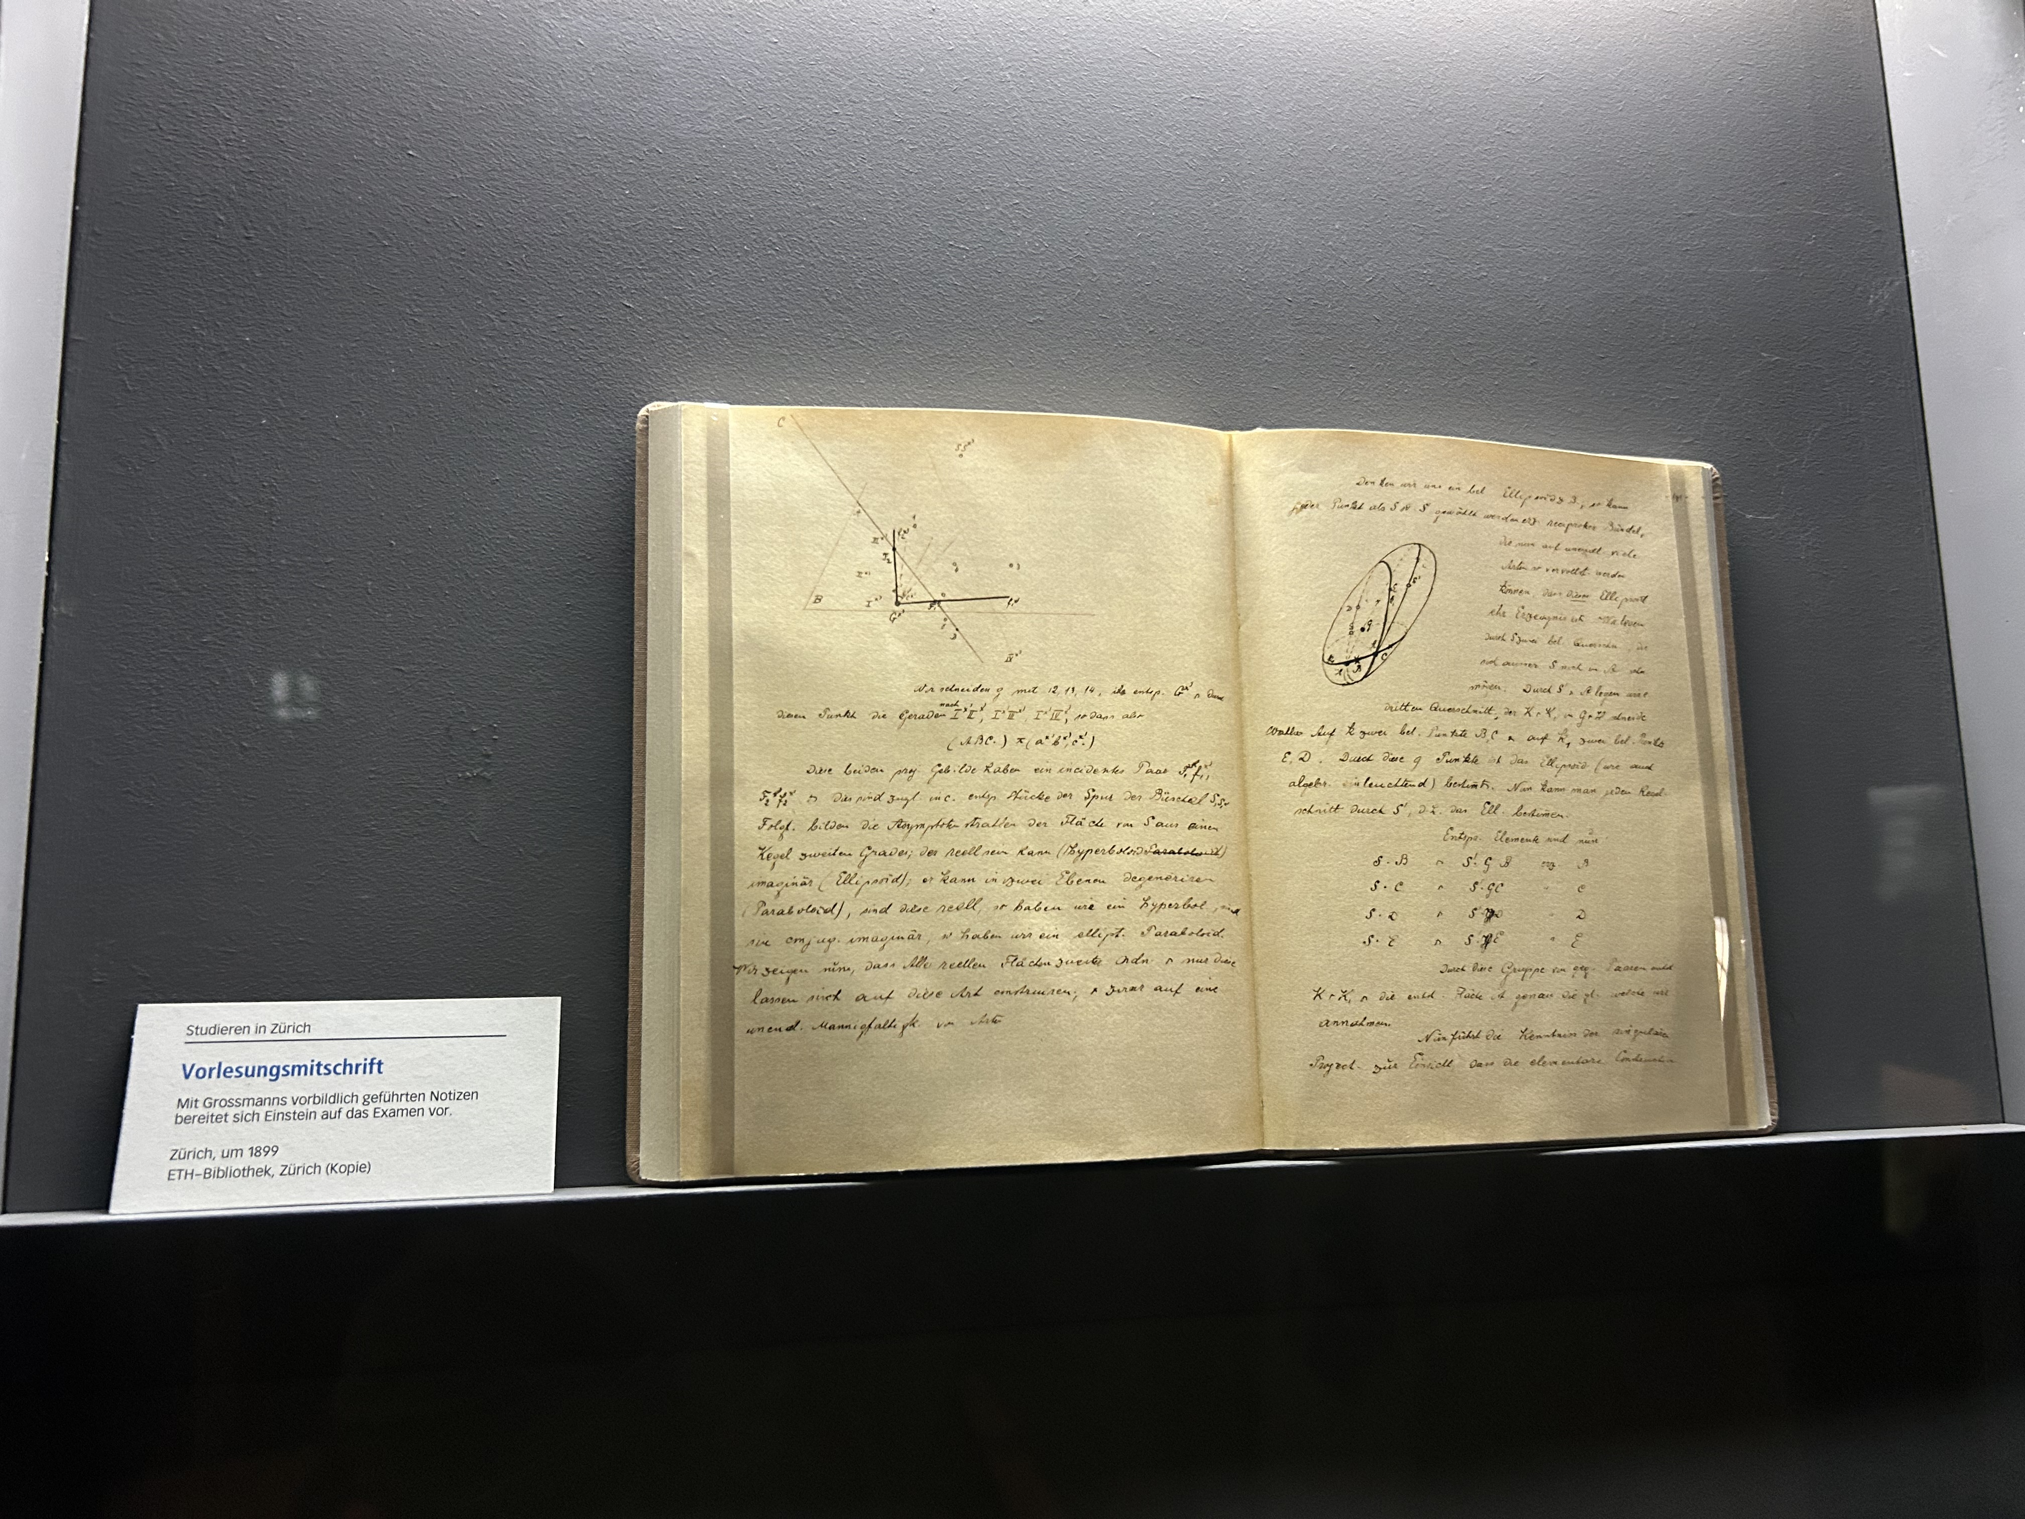
Accomplishments since arrival
Trip to Bern

