Slide 1

Physics Beyond Collider Technology Working Group
Welcome
5th mini-workshop
Superconductivity Technologies
Workshop Organizing Committee: A. Perin, M. Mentink, A. Siemko, H. ten Kate
PBC Technology Conveners: Sergio Calatroni, Babette Döbrich
https://indico.cern.ch/event/1418701/

Slide 2
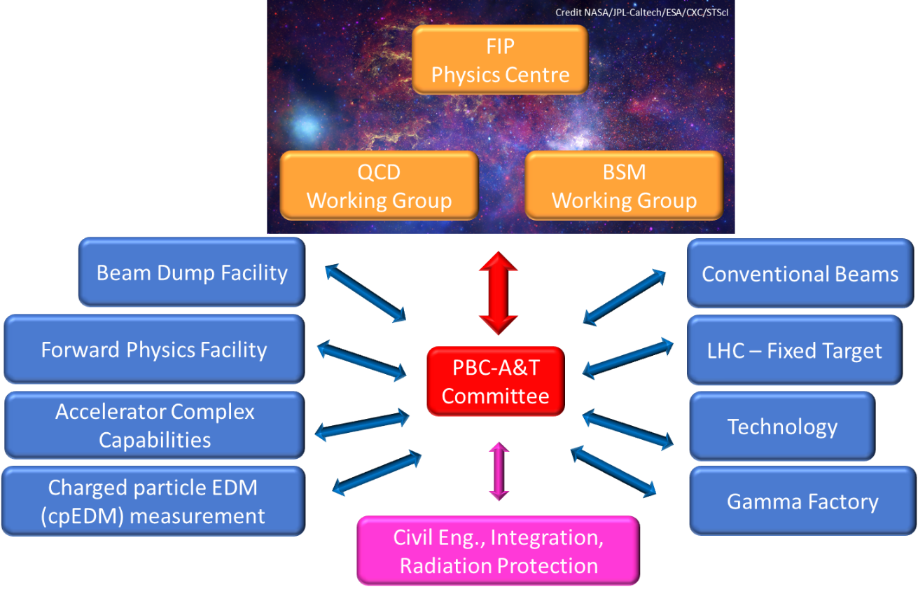
The Physics Beyond Colliders Study Group
Overview
Physics Beyond Colliders (PBC) is an exploratory study aimed at exploiting the full scientific potential of CERN's accelerator complex and technical infrastructure, as well as its know-how in accelerator and detector science and technology. PBC projects complement the goals of the main experiments of the Laboratory’s collider programme. They target fundamental physics questions that are similar in spirit to those addressed by high-energy colliders, but require different types of beams and experiments. The PBC mandate is available here.

Slide 3
The PBC Technology Working Group
Mandate
The Technology WG will explore and evaluate possible technological contributions of CERN primarily to non-accelerator-related experimental physics initiatives and projects that may also be hosted elsewhere, and will survey technologies that could become relevant to CERN accelerator and non-accelerator projects. The working group will favour the exchange of experience and expertise in technological domains such as superconducting and normal conducting magnet and RF technology, cryogenics, optics, vacuum and surface technology to support the development of new physics experiments and detection methods like quantum sensing and new (accelerator and non-accelerator) experiment proposals aiming at fundamental Standard Model physics measurements and/or addressing physics Beyond the Standard Model questions.
5 mini-workshops organized
Sep 2021: Superconducting RF https://indico.cern.ch/event/1057715/
Dec 2021: Lasers & Optics https://indico.cern.ch/event/1092283/
Apr 2022: Vacuum, coating and surface technologies https://indico.cern.ch/event/1134154/
Sep 2022: Cryogenics https://indico.cern.ch/event/1180067/
Sep 2024: Superconductivity Technologies https://indico.cern.ch/event/1418701/
Future workshops: Mechanical & Materials Technologies, PBC meets Quantum Initiative

Slide 4
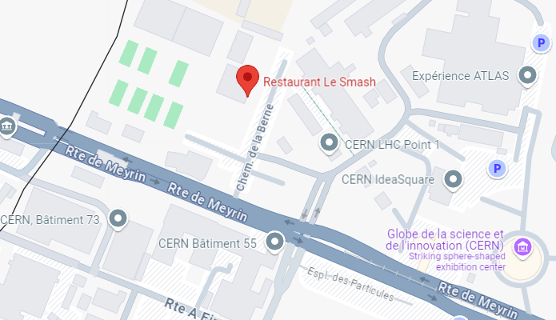
Program
Wednesday 25 September
14:00 → 14:15 Welcome, Antonio Perin (CERN)
14:15 → 14:45 BabyIAXO Axion Helioscope Superconducting Dipole, Matthias Mentink (CERN)
14:45 → 15:15 Particle Physics in Ultra-high Magnetic Fields, Pierre Pugnat (Lab. des Champs Magnet. Intenses (FR))
15:15 → 15:45 Progress in REBCO Conductor Technologies for Ultra-High Field Application, Carmine Senatore, University of Geneva
15:45 → 16:15 Coffee break
16:15 → 16:45 AMS-100 Space-based Superconducting Detector Magnet, Tim Mulder (CERN)
16:45 → 17:15 Superconductivity Technologies in the CERN Magnet Group, Amalia Ballarino (CERN)
19:30 Dinner : restaurant “Le Smash”, Meyrin
Car park
Entrance B

Slide 5
Program
Thursday 26 September
09:00 → 09:30 Superconducting devices as particle detectors, Michael Doser (CERN)
09:30 → 10:00 transition-Edge Sensors: Enabling Discoveries in Particle Physics and Beyond, Carlo Pepe (INRiM, Istituto Nazionale di Ricerca Metrologica)
10:00 → 10:30 Superconducting Detector Magnets at the Japan Proton Accelerator Research Complex, Toru Ogitsu (KEK)
10:30 → 11:00 Coffee break
11:00 → 11:20 The SHiP Spectrometer Magnet, Lucie Baudin (CERN)
11:20 → 11:40 High temperature SC magnet for SHiP muon shield, Magnus Dam (Karlsruhe Institute of Technology (KIT)
11:40 → 12:10 Magnetic Shielding and the SuShi Magnet, Daniel Barna (Wigner Research Centre for Physics)
12:10 → 13:40 Lunch (self-organized)
13:40 → 14:10 MADMAX detector magnet: technology concepts, Clement Lorin (CEA)
14:10 → 14:40 RAT an Open Source Magnet-Design Tool, Jeroen van Nugteren (Little Beast Engineering)
14:40 → 15:10 Superconducting magnets for production and trapping of antihydrogen, Jeffrey Scott Hangst (Aarhus University)
15:10 → 15:40 Technologies for Magnet-Detector Interface magnets, Michael Koratzinos (Paul Scherrer Institute)
15:40 → 16:10 Final discussion and close up

Slide 6
Practical information
The presentations are on the Indico website of the workshop.
Coffee will be served during the afternoon break today and tomorrow morning in the room adjacent to the main meeting room.
Dinner of 25th September: at Restaurant “Le Smash”, across the road from entrance “B”.
Lunch for 26th September: light food is available at the cafeteria on this floor, restaurant 2 easily reachable.

