Slide 1
Superconducting Magnets for
J-PARC Physics Experiments
Toru Ogitsu
On be half of J-PARC Cryogenics Section

Slide 2
Major Physics Projects at J-PARC with Superconducting Magnets
Under construction
  COMET (Coherent Muon to Electron Transition)
  g-2/EDM experiment
Being proposed
  MLF 2nd Target Station

Slide 3

Major Physics Projects at J-PARC with Superconducting Magnets
Under construction
  COMET (Coherent Muon to Electron Transition)
  g-2/EDM experiment
Being proposed
  MLF 2nd Target Station
Materials and Life Science Experimental Facility (MLF)
Hadron Experimental Facility
Rapid-Cycling Synchrotron (RCS) 3 GeV
LINAC 400 MeV
Neutrino Experimental Facility
J-PARC Facility (KEK/JAEA)
MR (Main Ring
Synchrotron) 30 GeV

Slide 4
Major Physics Projects at J-PARC with Superconducting Magnets
Under construction
  COMET (Coherent Muon to Electron Transition)
  g-2/EDM experiment
Being proposed
  MLF 2nd Target Station

Slide 5
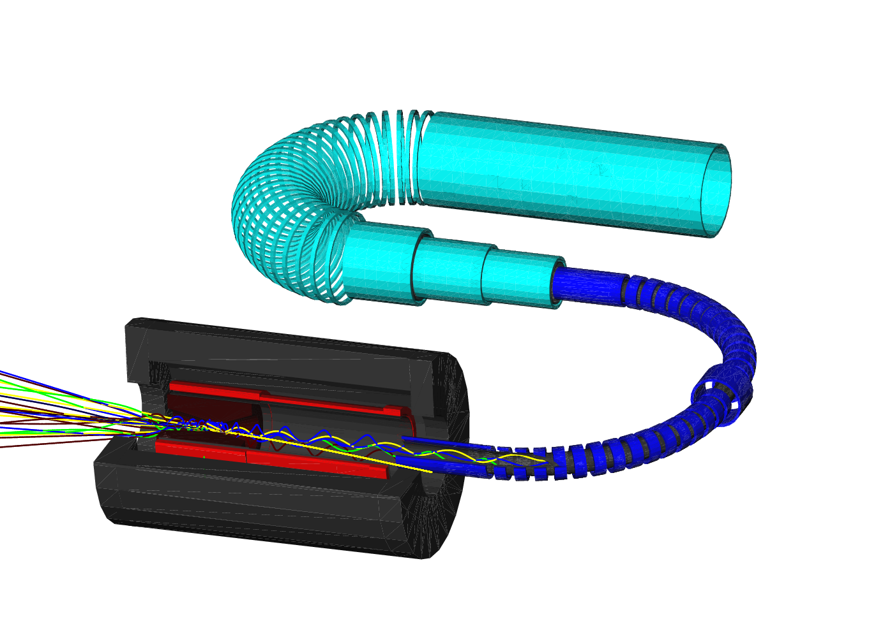
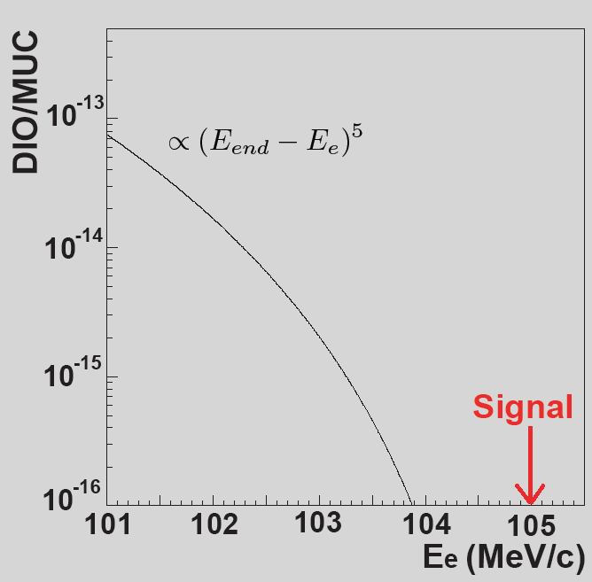
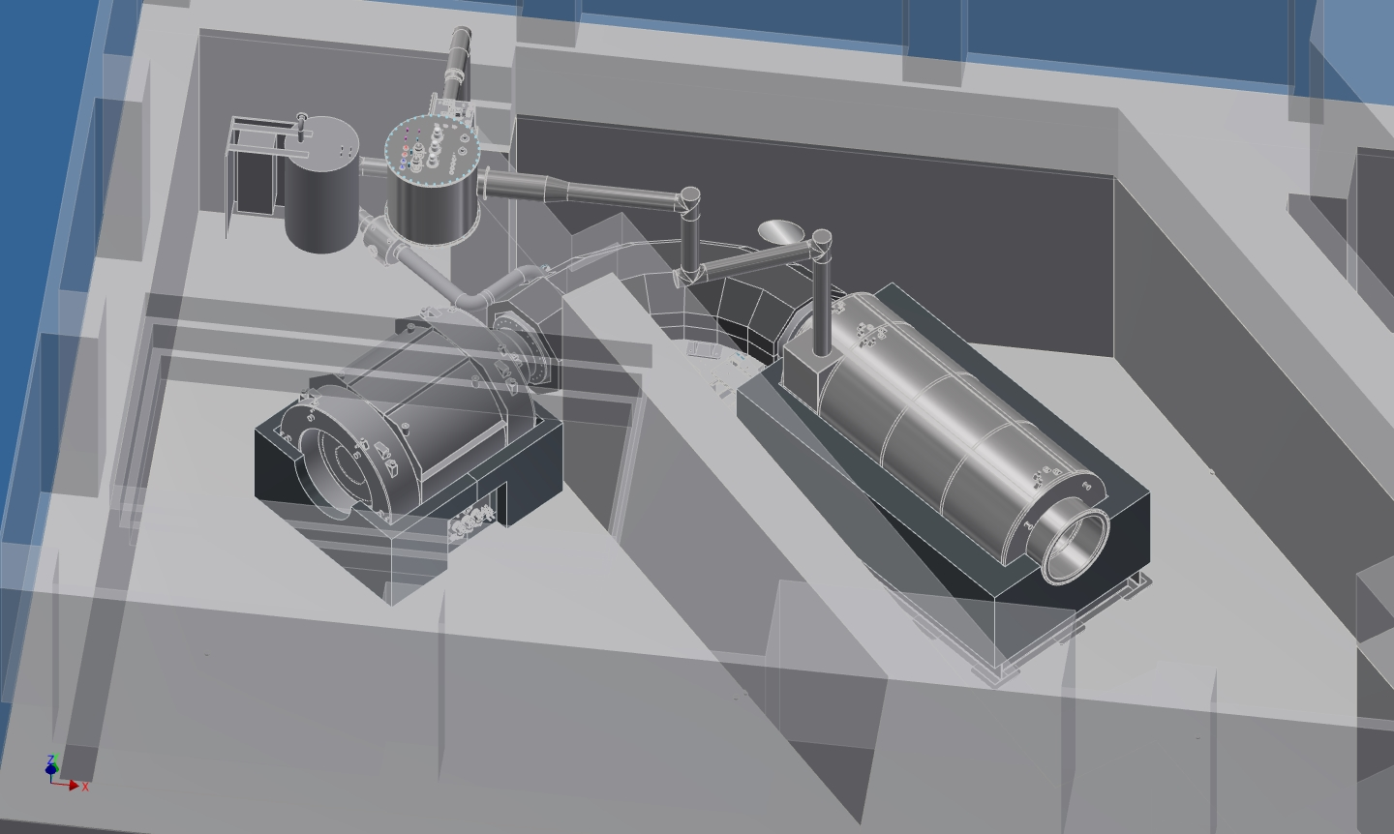
The COMET
Experiment
Detector
Solenoid
Spectrometer
Solenoid
radiation shield
nucleus
pion production
target
Muon Transport
Solenoid
μ⁻
stopping μ⁻ → Muonic atom
nuclear muon capture
decay in orbit
proton beam
Pion Capture Solenoid
μ→e conversion
COMET Phase II
Detect monoenergetic electrons from μ-e conversion
Physics Reach: Br<10⁻¹⁶ （PhaseII)
<10⁻¹⁴ （PhaseI)
→ 2x10¹⁸ muon stops
→ 10¹¹ μ⁻/sec
COMET Phase I

Slide 6
Requirements for COMET magnets
Goal: 10¹¹ μ⁻/sec
Produce high intensity muon beam
  Large acceptance to collect pions from production target
  High field on pion production target
  Graded field to focus pions forward
Reduce pion contamination / high energy muons
  Long solenoids from production to muon stopping target
  Curved solenoid with dipole corrector to select momentum / charge
Solenoid field for spectrometer
  Large aperture for detectors

Slide 7
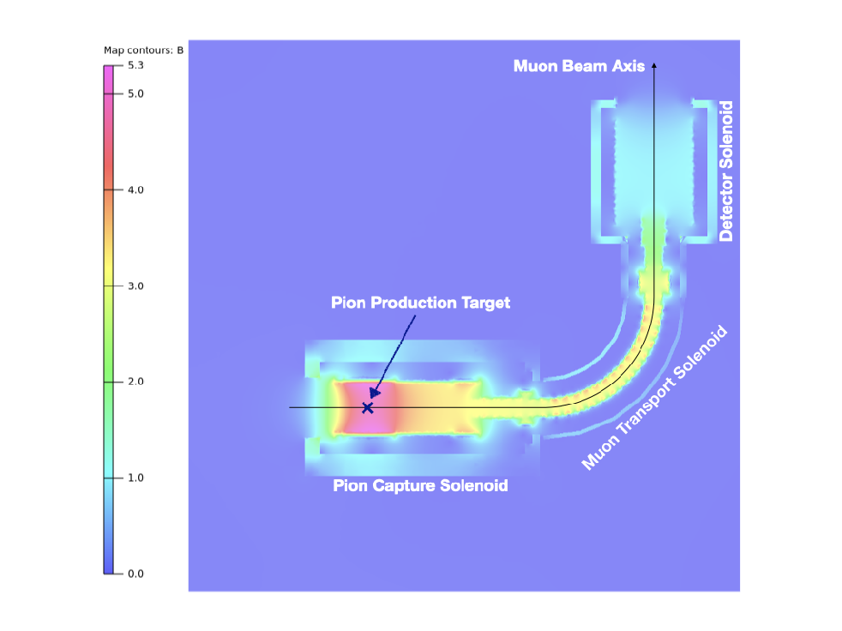
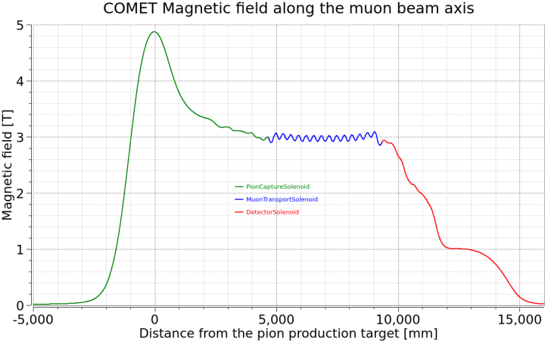
Magnetic Field Design
(COMET phase-1)
Pion Capture Solenoid
  5T on Target embedded in magnet bore
Muon Transport Solenoid
  3T curved solenoid
  Correction dipole max. 0.07T
Detector Solenoid
+Bridge Solenoid
  graded field from 3T to 1T

Slide 8
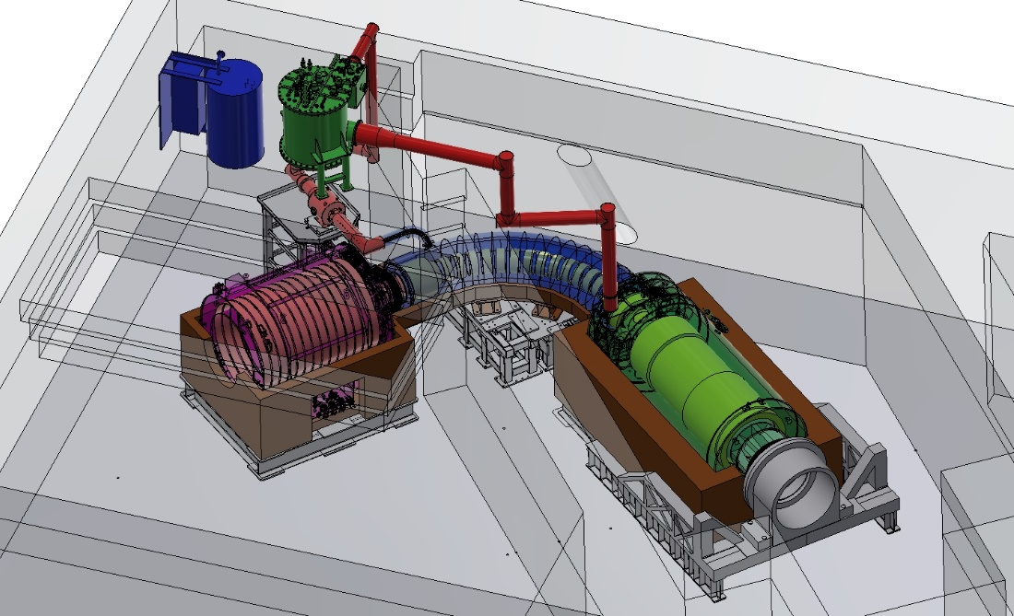
Superconducting Magnet System for COMET Phase-1
PowerSupply
CurrentLeadBox
TransferTube
to MTS
ColdBox
TransferTube
to PCS
Pion Capture
Solenoid (PCS)
Detector
Solenoid
Muon Transport
Solenoid (MTS)

Slide 9
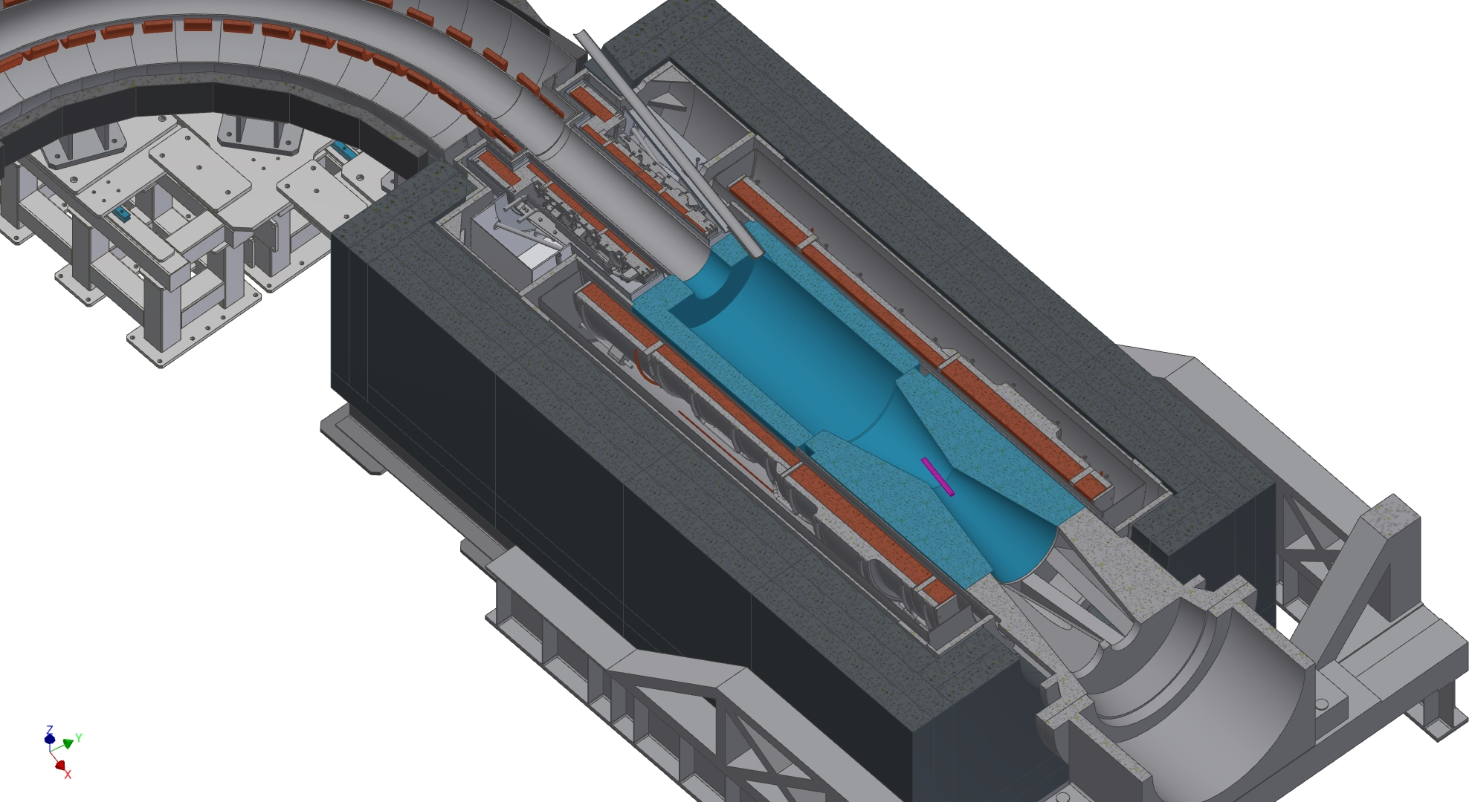
COMET Pion Capture Solenoid
built-in SUS shield (t170)
as magnet vessel
Proton Beam
Superconducting
Solenoid Coils of
Al-stabilized Conductor
TS1
μ, π
Support Shell of
Forged Aluminum Alloy
MS2
6 m
MS1
φ1.3m
CS1
CS0
Production Target
CS Inner Shield

Slide 10
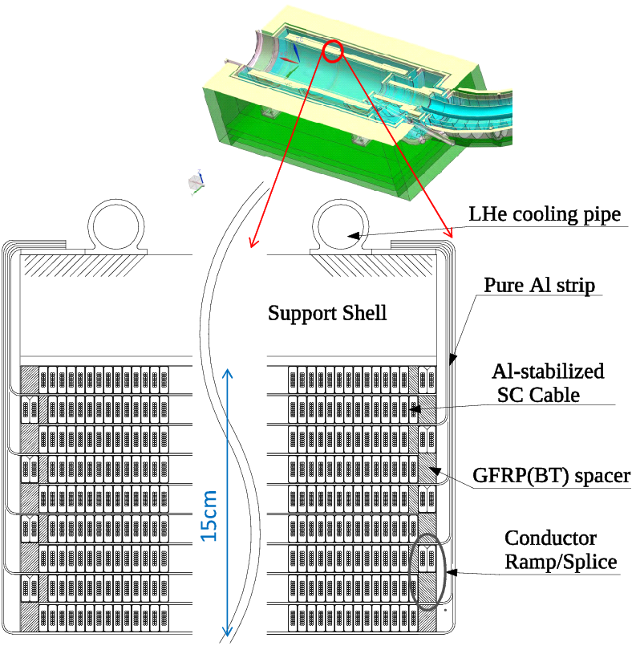
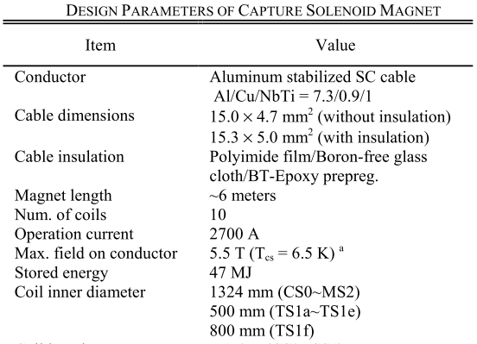
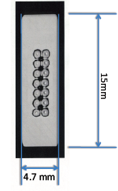
Coil Structure
Aluminum stabilized SC cable
  for less nuclear heating
Radiation resistant insulator, resin
  Polyimide film, Bismaleimide-Triazine resin
  Boron-free glass in GFRP
Pure aluminum strips in between layers
  to cool down a coil inside
Al stabilized SC cable
Size: 4.7x15mm
Offset yield point of Al@4K: >85MPa
RRR@0T: >500
Al/Cu/SC: 7.3/0.9/1
14 SC strands: 1.15mm dia.

Slide 11
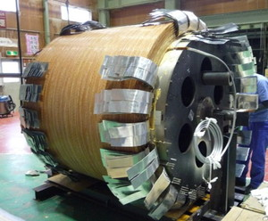
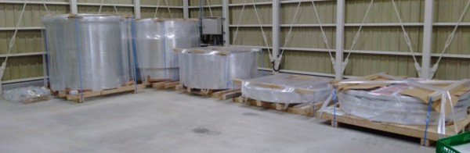
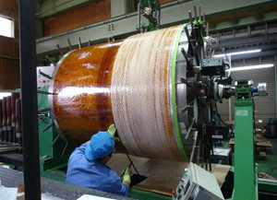
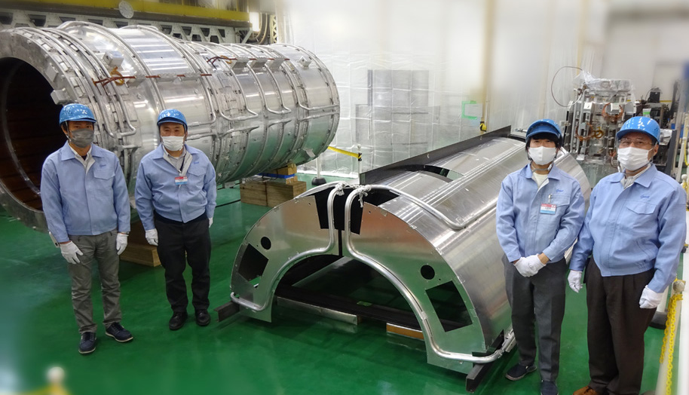
Coldmass Fabrication
Support shell of forged A5083
heat curing
Impregnation with BT+Expoxy
CS coldmass
Wet winding with BT+Epoxy resin
CS thermal shield

Slide 12
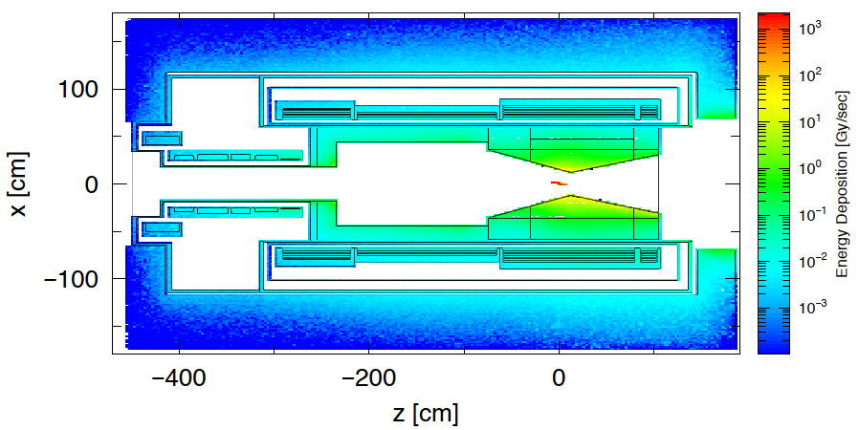
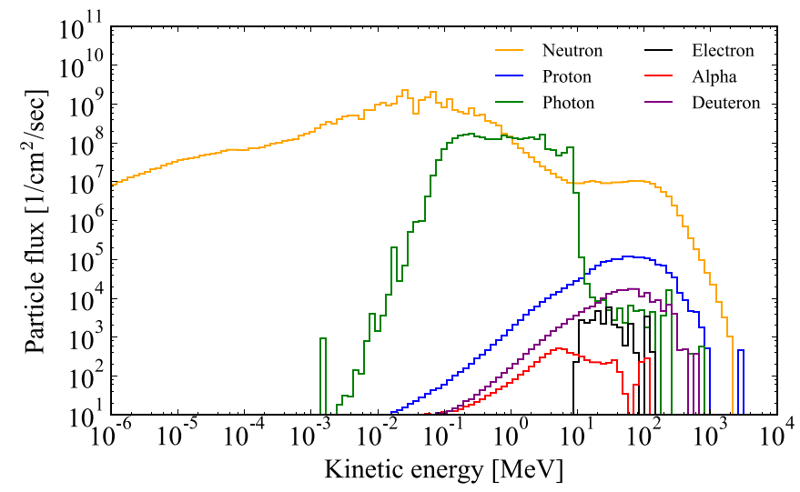
Radiation Environment for Pion Capture Solenoid
56kW proton beam
COMET Phase-2
  56kW 8GeV proton beam
  Tungsten target
  Tungsten shield
Peak heat deposit
  ~40 mW/kg
  → 1MGy for 300day operation
Peak neutron flux
  ~4x10¹⁴ n/m²/s
  → 10²¹ n/m² for 30day operation
tungsten
target
Radiation-tolerant magnet is mandatory

Slide 13
Neutron Irradiation / Annealing Effect in Electrical Resistance of Stabilizer
2.83μΩ
2.78μΩ
2.61μΩ
Preliminary
Al: 0.03 nOhm.m for 10²⁰ n/m²
Cu: 0.01 nOhm.m for 10²⁰ n/m²
All Al samples show “full” recovery of electrical resistivity after thermal cycle to RT.
“Repetitive Irradiation Tests at Cryogenic Temperature by Neutrons and Protons on Stabilizer Materials of Superconductor,“ M. Yoshida et al., IEEE Trans. Appl. Supercond, 32(6), 7100405 (2022); doi:10.1109/TASC.2022.3178944

Slide 14
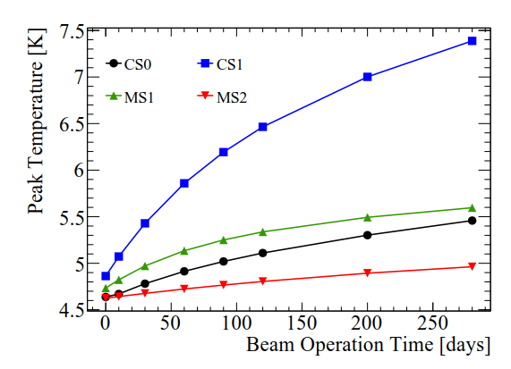
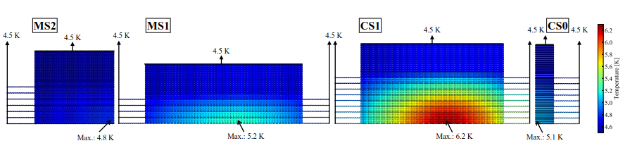
Coil Temperature during Beam Operation
(phase-2)
Simulation including heating by irradiation
Peak temperature in coil is estimated assuming irradiation by 56kW beam operation
Temperature will rise as thermal conductivity degrades by irradiation
Irradiation damage in aluminum can be recovered perfectly by thermal cycling to room temperature.
Tcs
Y. Yang et al., IEEE Trans. App. Supercond., 28(3), 4001405 (2018).

Slide 15
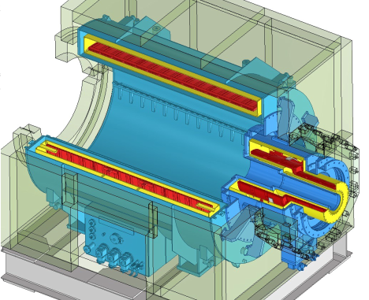
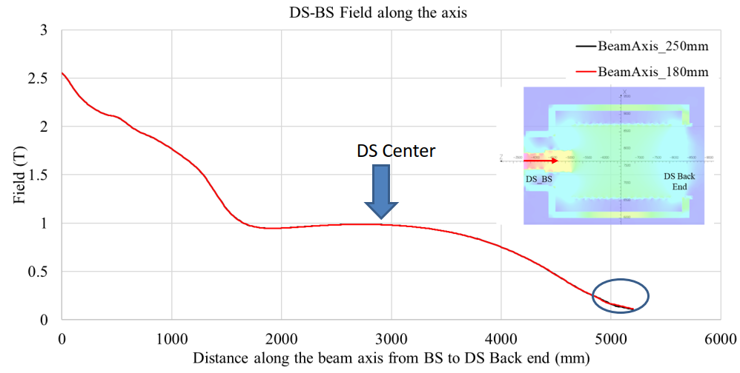
DSBS assembly
Field bump between MTS and DS can be tuned by BS
Detector Solenoid (DS)
BS
Bridge Solenoid (BS)

Slide 16
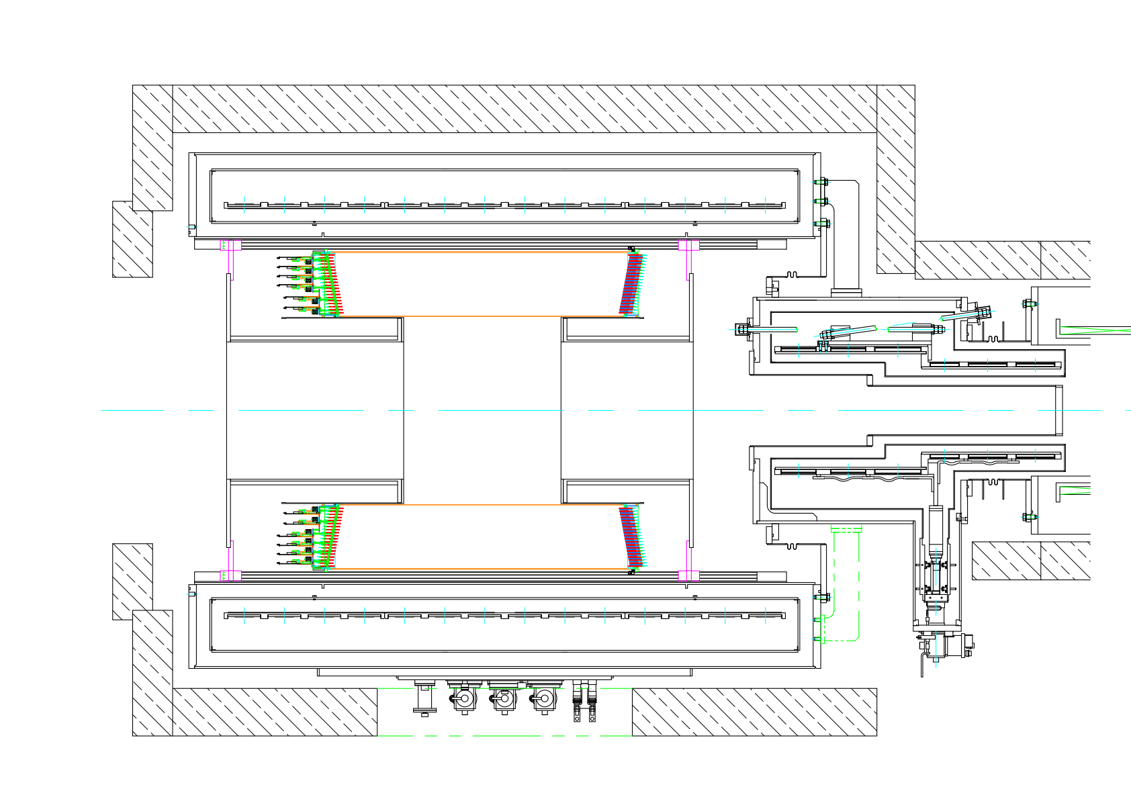
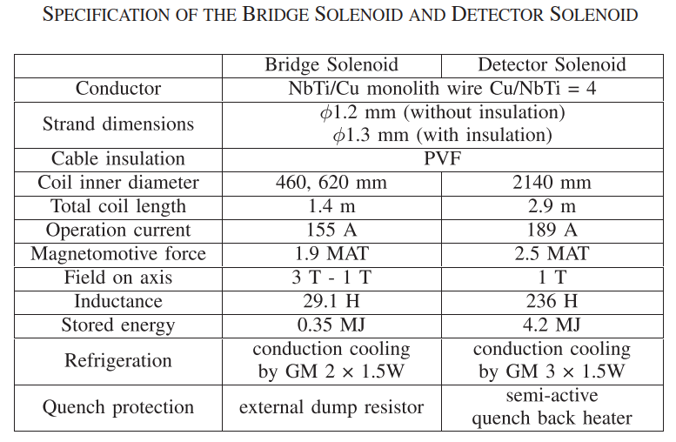
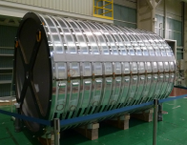
Detector Solenoid
3320mm
CDC
1800mm
muon
stopping
target
muon beam
1 Tesla on the muon stopping target
Large aperture for CDC and trigger hodoscope
Cyogen-free magnet
  Cooled by 3 GM cryocoolers
Bridge Solenoid
Detector Solenoid
2948
φ 2188
DS coil

Slide 17
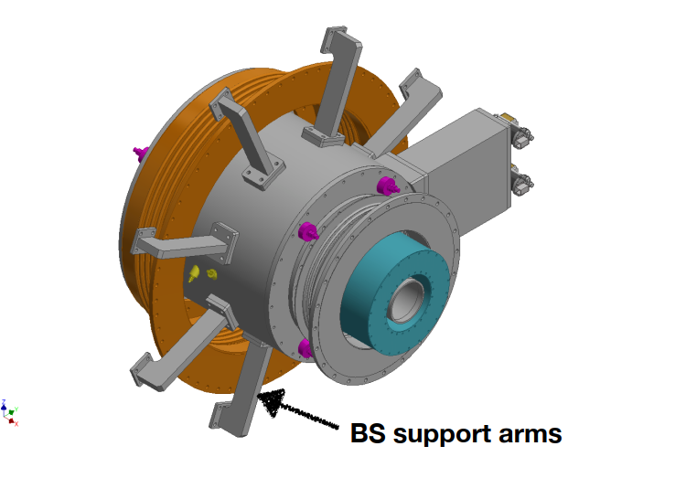
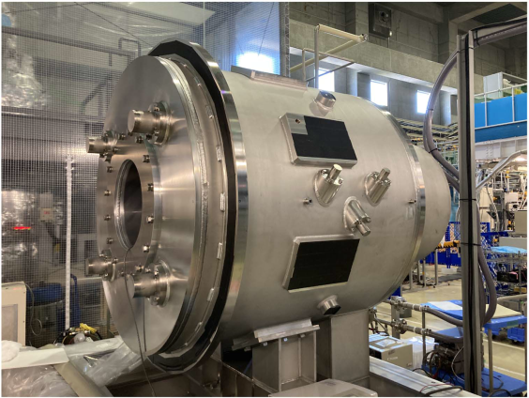
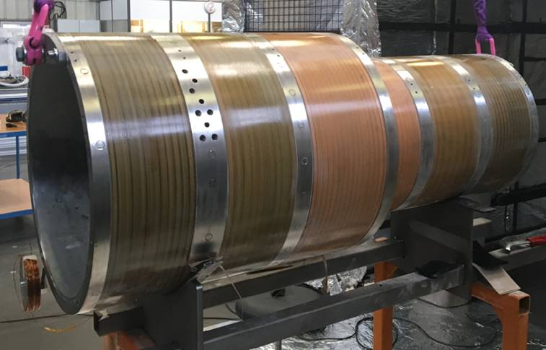
Bridge Solenoid
To be installed between DS and MTS
Magnet vessel is mounted on DS end flange, due to space limitation
Need supports for large magnetic force and vacuum sealing
  200kN with DS,MTS
  430kN with MTS
  240kN with DS
BS coil

Slide 18
COMET SCM Summary
Superconducting Magnets
  Capture Solenoid
    Construction completed
    Soon to be installed to the experimental hall
    Connection to the cryogenics and cold testing in next year
  Transport Solenoid
    Construction and Installation Completed
    Cold testing and field measurements also completed
  Bridge and Detector Solenoid
    Construction completed
    Now waiting for installation

Slide 19
Major Physics Projects at J-PARC with Superconducting Magnets
Under construction
  COMET (Coherent Muon to Electron Transition)
  g-2/EDM experiment
Being proposed
  MLF 2nd Target Station

Slide 20
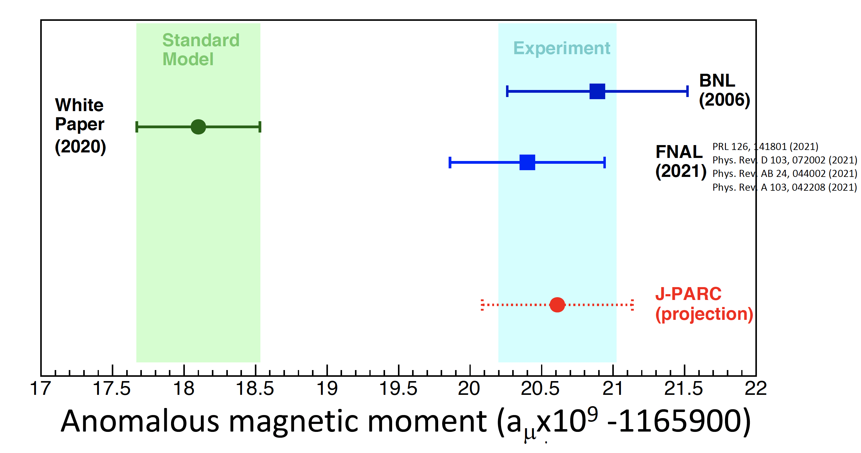
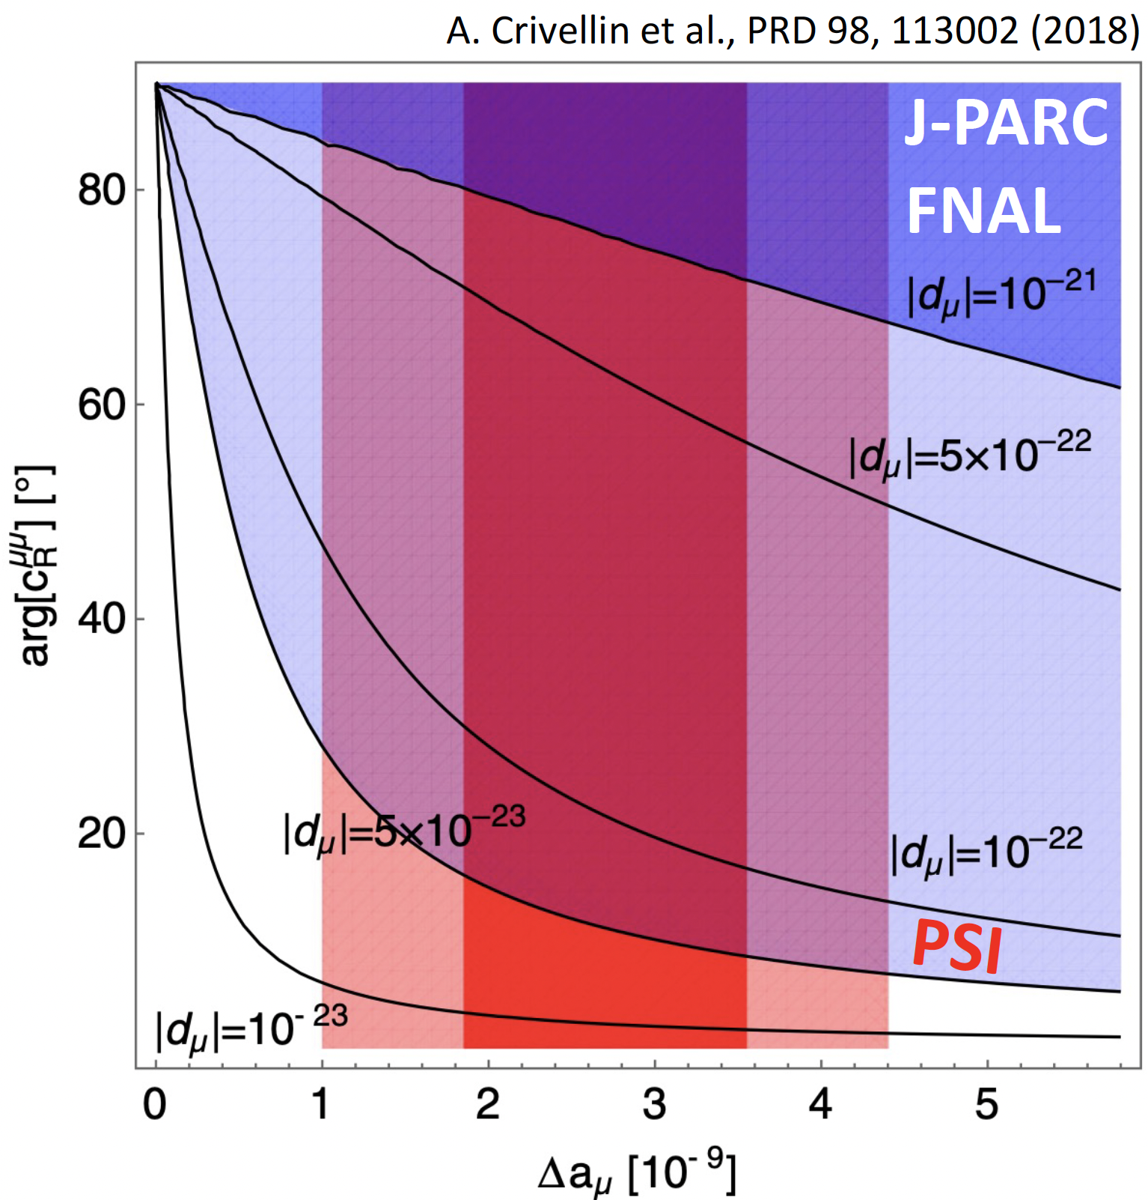
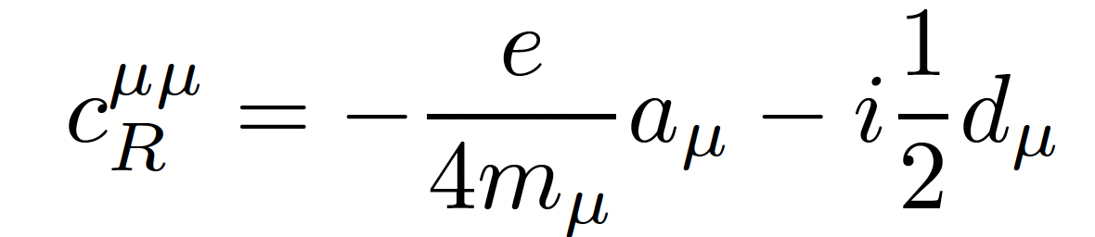
Background
Muon anomalous magnetic moment (g-2)
  5.0 σ discrepancy between FNAL measurement and prediction
  Measurement (FNAL): 116 592 055(24) × 10-11 (200 ppb)
  SM prediction : 116 591 810(43) × 10-11 (370 ppb)
  Can be a contribution from new physics
Muon EDM
  Upper limit given by BNL : 1.8 × 10-9 e・cm (95% C.L.)
  EDM and g-2 can be induced by the same new physics

Slide 21
Slide by Mibe

Slide 22
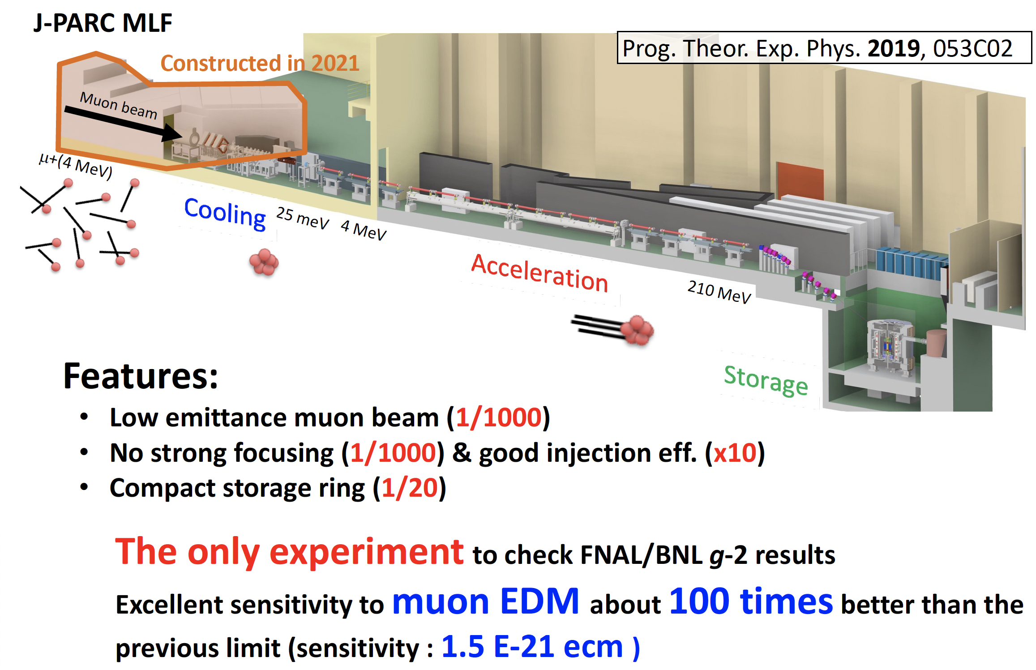
J-PARC muon g-2/EDM experiment
Injection

Slide 23
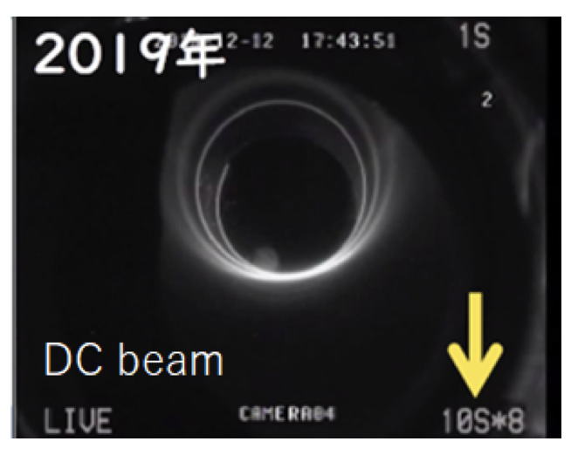
Muon storage magnet ~ SC solenoid
Important requirement for muon storage region
  Storage region :
    radius : 33.3±5.0 cm
    height : ±10 cm
  Field strength 3 T
  Spatial and temporal homogeneity : ±0.1 ppm
MRI magnet
technology !
How to inject muons to the storage region in the center of SC solenoid
Spiral injection scheme
Inject the beam from magnet end
Spirally down to magnet center
Apply vertical kick field to the beam around magnet center (storage region)
Apply weak focus field to store the beam in to the storage region
Demonstration of spiral injection with DC beam ->

Slide 24
Specifications
  Storage region :
    radius : 33.3±1.5 cm, height : ±5 cm
    Field strength : 3T
    Bz uniformity : ±0.1 ppm (Azimuthal integral)
  Injection region :
    Smooth field for beam injection
  Weak focus field:
n: 1.0×10⁻⁴ – 2.0×10⁻⁴

Slide 25
Overall Design
Superconducting coils : NbTi
  Main solenoid coil
    Persistent current operation
  Weak focusing coil
    Power supply operation
  Shim coils
    Power supply operation
Field tuning system using iron pieces
Iron yoke
  Adjust field shape
Cooled by liquid Helium
  Cryocoolers to recondense LHe
Separated cold box from magnet cryostat
  Isolate vibration
Vibration isolation/control system

Slide 26
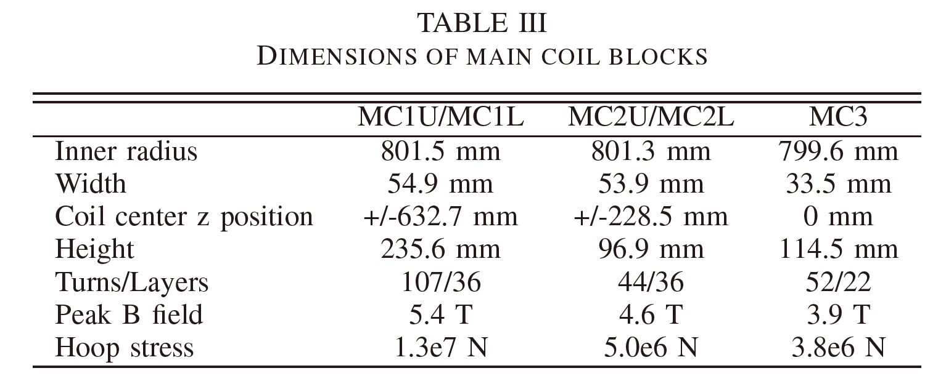
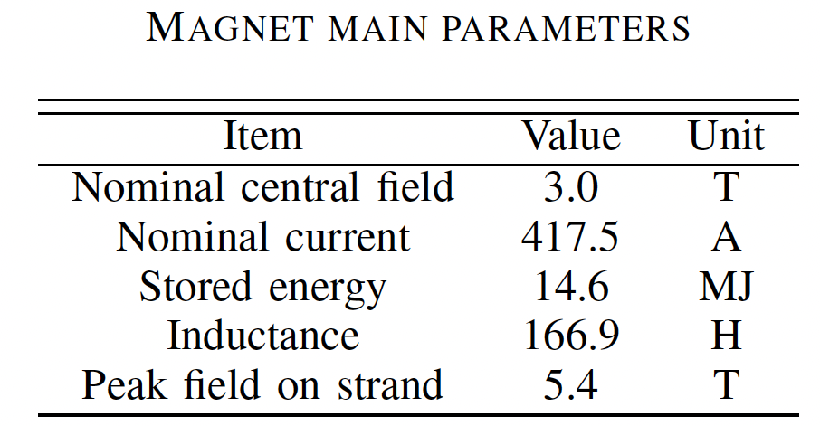
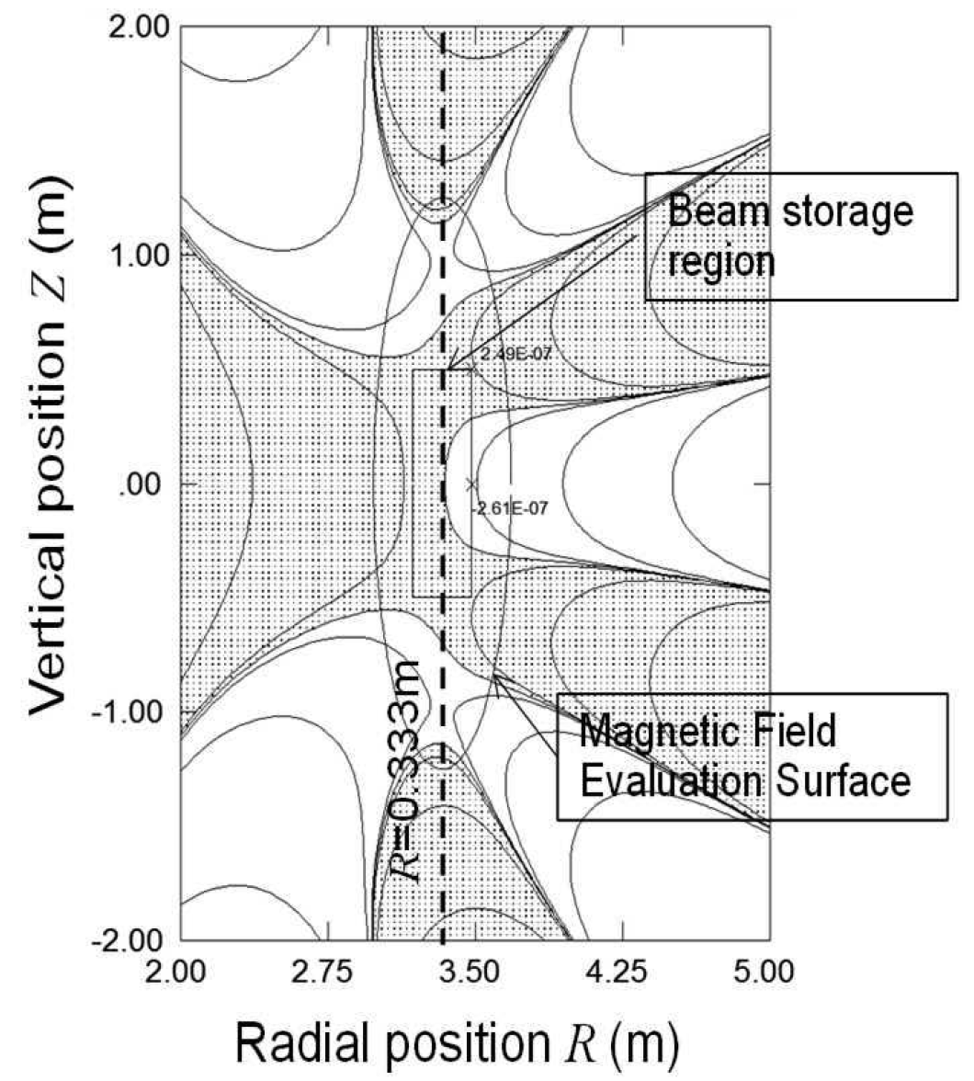
Main coil parameters
5 coil blocks
Total weight~150 ton
  *Persistent current operation
SC strand
  NbTi with Cu Stabilizer
  Cu/Sc = 4
  Cu RRR ~100
  Load line :~65%
Expected homogeneity ±0.085 ppm

Slide 27
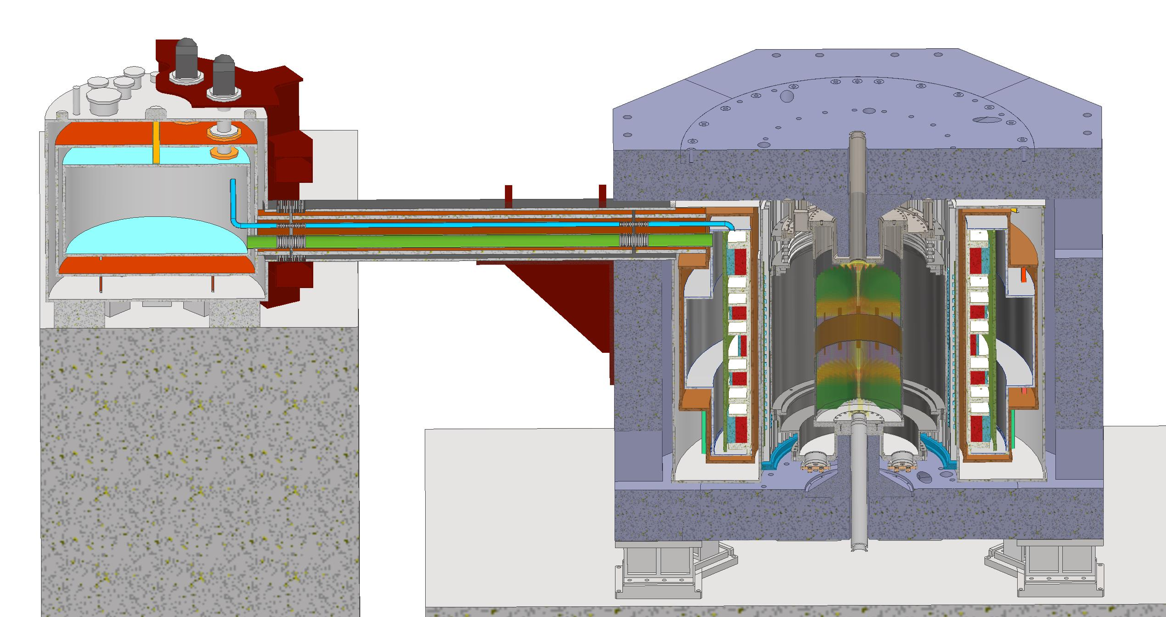
Cryogenics
Basic concept
  LHe pool boiling
  GHe re-condensation system
  Cold box with GM cryocooler separated from magnet
  Open dewer (GHe recovery)
<- Temperature stability
<- Vibration damping
Other conditions
  Main coils : persistent current mode
  Weak focus coil and shim coils
    driven by individual PS
    100 A HTS lead x 2
    10 A HT lead x 24
Cryocoolers
  2 stage 1.8W GM : ~4
  1 stage 160W GM : 1
Notes:
1L/hour -> 0.7 W
5.8 W -> 8.3L/hour
3000L消費には36時間(液体に全ての熱が入る場合）
ガスに入熱だとその１０倍の時間

Slide 28
Schedule (Mar. 2024)
JFY
 | 2022 | 2023 | 2024 | 2025 | 2026 | 2027 | 2028 and beyond
KEK Budget
Surface muon
Bldg. and facility
Muon source
LINAC
Injection and storage
Storage magnet
Detector
DAQ and computing
Analysis
Funding
Secured!
✓Beam at H1 area
★ Beam at H2 area
Final design ★
★ Completion
Data taking
Commissioning
✓ Ionization test @S2
★ Ionization test at H2
★ 80keV acceleration@S2
★ 210 MeV
★ 4.3 MeV@ H2
★ fabrication complete
★ Completion of
electron injection test
★ muon injection
★ B-field probe
ready
★ Install
★ Shimming done
✓ Quoter vane prototype
★ Mass production ready
★ Installation
✓ grid service open
★ small DAQ system
operation test
★ common computing
resource usage start
★ Ready
★ Tracking software ready
★ Analysis software ready
might be delayed, depending on budget approved by government

Slide 29
Major Physics Projects at J-PARC with Superconducting Magnets
Under construction
  COMET (Coherent Muon to Electron Transition)
  g-2/EDM experiment
Being proposed
  MLF 2nd Target Station

Slide 30
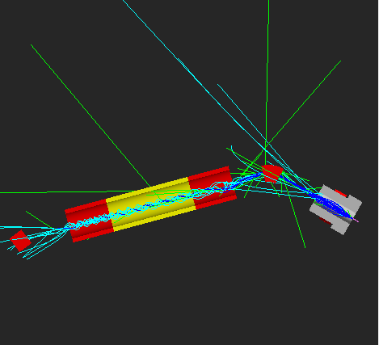
J-PARC MLF 2nd Target Station TS2
TS2-Pion Capture Solenoid
(10 years operation)
Heat Deposit: ~450 W
Neutron fluence: 7.8 x 10²¹ n/m²
Absorbed Dose: > 100 MGy
Materials and Life Science Experimental Facility (MLF)
Hadron Experimental Facility
Rapid-Cycling Synchrotron (RCS) 3 GeV
LINAC 400 MeV
Requirements for operation in high radiation environments
Neutrino Experimental Facility
J-PARC Facility (KEK/JAEA)
MR (Main Ring
Synchrotron) 30 GeV
PHITS Code
Pion Capture Solenoid (PCS)
for Muon Beamline
Proton Beam
Proton Beam
Solenoid
Production
Target
AVG. flux at the top 100 mm of the coil
Simulation for muon beam transportation

Slide 31
Challenging issue 1: Conductor
It is difficult to maintain the 5K temperature range of the LTS conductor under a heat load caused by nuclear heat of over 450 W.
REBCO coated conductor
High temperature margin (T_{C}=93 K)
- Conduction cooling operation in the temperature range of 20 K
High magnetic field tolerance of Ic
- Potential for 20T class high field magnet
R&D have been performing to realize a conduction-cooled solenoid at 20K based on REBCO conductors.
Stack of double pancake coil
ID=1600 mm, T=21 mm, L=10 mm, 70 turns/layer
Number of double pancake coils: 60 (20 x3)
Conductor : REBCO, W=4 mm, T=0.1 mm
Insulation: Mineral, t=0.1 mm
Operation Temperature: 20 K (He gas cooling with pipe)
Transport current: 200 A (Load line ratio: 0.48)
Peak Field: 1.11 T at center, 2.25 T (B//c) at coil (200 A)

Slide 32
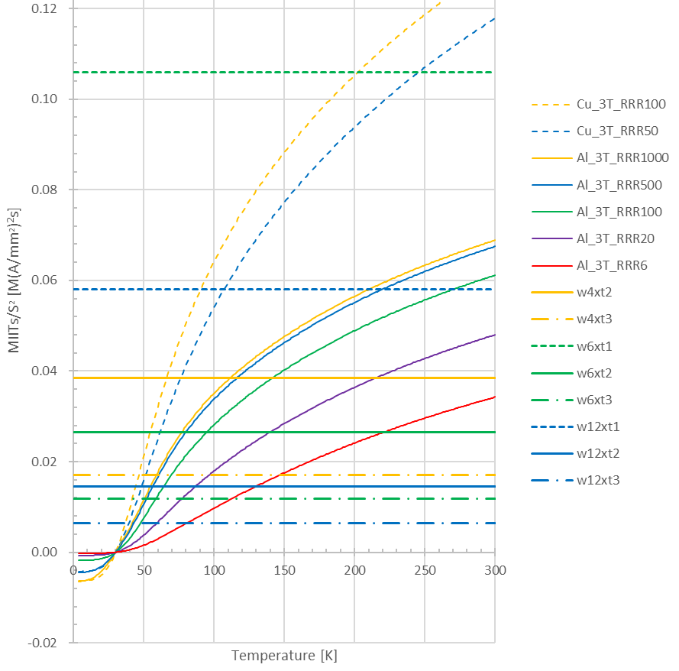
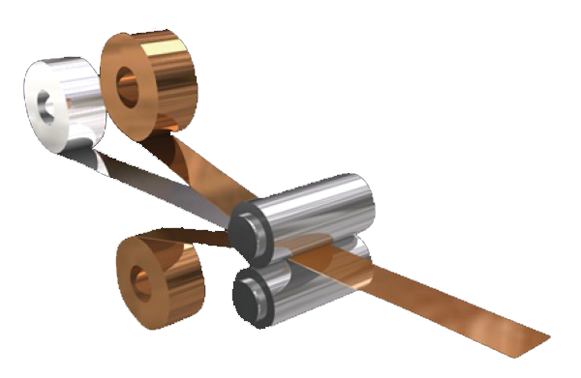
Design case study of conductor and magnet
TS2-solenoid quench protection is difficult due to its large inductance (~36 H)
Conductor Width | mm | 12.0 | 6.0 | 4.0
Operating Current | A | 1200 | 600 | 400
Allowable coil voltage | V | 500 | 500 | 500
Inductance | H | 4 | 16 | 36
Dump Resistor | W | 0.42 | 0.63 | 1.25
Decay Time Constant | sec | 9.6 | 19.2 | 28.8
Quench detection time | sec | 1.0 | 1.0 | 1.0
Current Square Integral | MA².s | 8.4 | 3.8 | 2.5
KEK has begun development of REBCO conductors with increased stabilizer content
Al-stabilized HTS conductor
Integration REBCO tapes and CCA ribbon by soldering
REBCO tapes with their superconducting layers facing each other
REBCO
(t=0.1 mm)
Cu-clad Al ribbon
(t=2.0mm)
REBCO
(t=0.1mm)
6 mm
Copper-clad Aluminum (CCA)
7 mm

Slide 33
Jointing test on short samples
CCA flat wire : 0.17 mm thick, 4 mm wide
(T_{Cu}=0.015-0.02 mm, Al: 8030 Alloy)
REBCO: YBCO with AP x2
(SCS4050HM, W4mm, Ic= 70A)
Joint length: 200 mm
Temperature conditions:
195℃-2min / 210℃-2.5min / 220℃-4min
No. of trials: 39 (25 successes / 14 failures)
50mm
50mm
50mm
3.0
2.5
V/cm]
REBCO and CCA are successfully joined by soldering
All 17 failures are caused by the tilt of the press jig
I_{C} decrease of about 20% has been observed
Mechanical testing is underway
After further short sample Jointing tests, long tapes will be tried with reel to reel system
2.0
μ
1.5
Voltage [
1.0
0.5
0.0
60
70
80
90
100
110
120
130
Current [A]

Slide 34
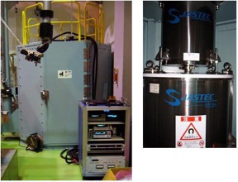
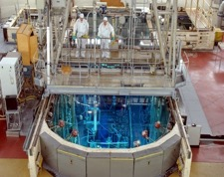
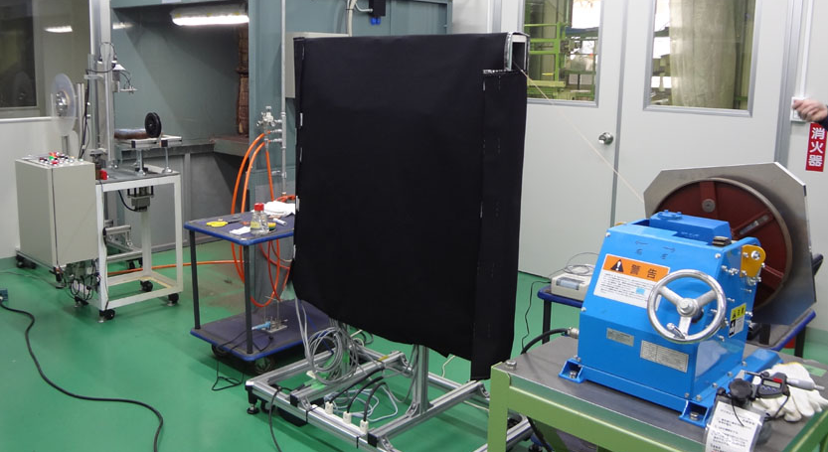
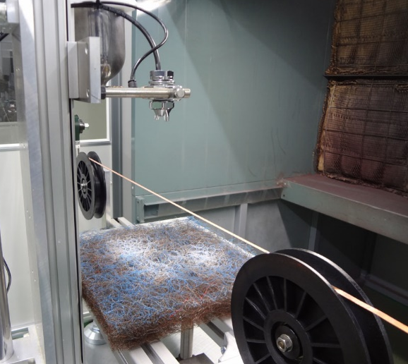
MLF TS2 Summary
HTS Irradiation Effect Measurements
BR2 @Belgian nuclear research center
15.5 T Magnet
MLF Second Target
  Now under consideration
  First proposal is intensively discussed
  Basic technology research for superconducting magnet is started
    HTS solenoid under high radiation environment
    Aluminum stabilizer for quench protection
    Radiation hardness of the magnet
      Irradiation tests of various HTS conductors
      Development of inorganic insulation
Ic Measurement Magnet in Hot Lab.
Reel to Reel Ceramic Coating System
Heat treatment section (8.4m)
Automatic spray
Horizontal control pulleys
Succeeded in 25 ± 4.7 (σ) μm thick ceramic
coating 40 m length on both sides of a REBCO tape

Slide 35
One more thing
ITDC Workshop
Superconducting magnets for Accelerator Sciences -Prospects and Issues-
https://kds.kek.jp/event/51828/timetable/#20240925.detailed

