Slide 1
Radiation-sensitive TE/VSC equipment in the FCC-ee arcs
7th FCC-ee Radiation and Shielding Meeting, 22 May 2024
Gregory Pigny on Behalf of TE/VSC

Slide 2
Arc vacuum sectorization
1600m
400m
S1
S2
S3
S4
Collider b1
Cables up to 850 m left side
Cables up to 850 m right side
Collider b2
Controlled from alcove n+1
Booster
Arc length = 9.6 km, 8 arcs, 6 alcoves per arc
Distance between alcoves = 1600 m
Vacuum sector length = 400 m for the collider and booster
12 vacuum sectors controlled from one alcove
Signal cables split into two for the left/right sides
Signal transmission between alcoves using optical fibre
Alcove n

Slide 3
Collider – Arc vacuum layout per sector
400m
125m
150m
125m
50m
50m
NEG
NEG
NEG
NEG
NEG
NEG
Pe+Pi
Pe
Pe
Pe+Pi
NEG-coating
1x NEG pump every 50m (8x NEG pumps)
  Connection of 4x NEG pumps in series (reduction of cables alcove-tunnel for NEG by 4)
1x SIP every 50m (8x SIPs)
  Connection of 2x SIP in parallel (reduction of cables alcove-tunnel by 2)
  SIP can be used as pressure measurements and interlock sources
2x Pirani and 4x Penning gauges
Sector gate valve interlocked by the previous/next Penning gauges and SIPs

Slide 4
Booster - Arc vacuum layout per sector
400m
125m
150m
125m
10m
Pe+Pi
Pe
Pe
Pe+Pi
No NEG coating, no NEG pumps
1x SIP every 10m (40x SIPs)
  Connection of 4x SIP in parallel (reduction of cables alcove – tunnel by 4)
  SIP can be used as pressure measurements and interlock sources
2x Pirani and 4x Penning gauges per sector
Sector gate valve interlocked by the previous/next Penning gauges and SIPs

Slide 5
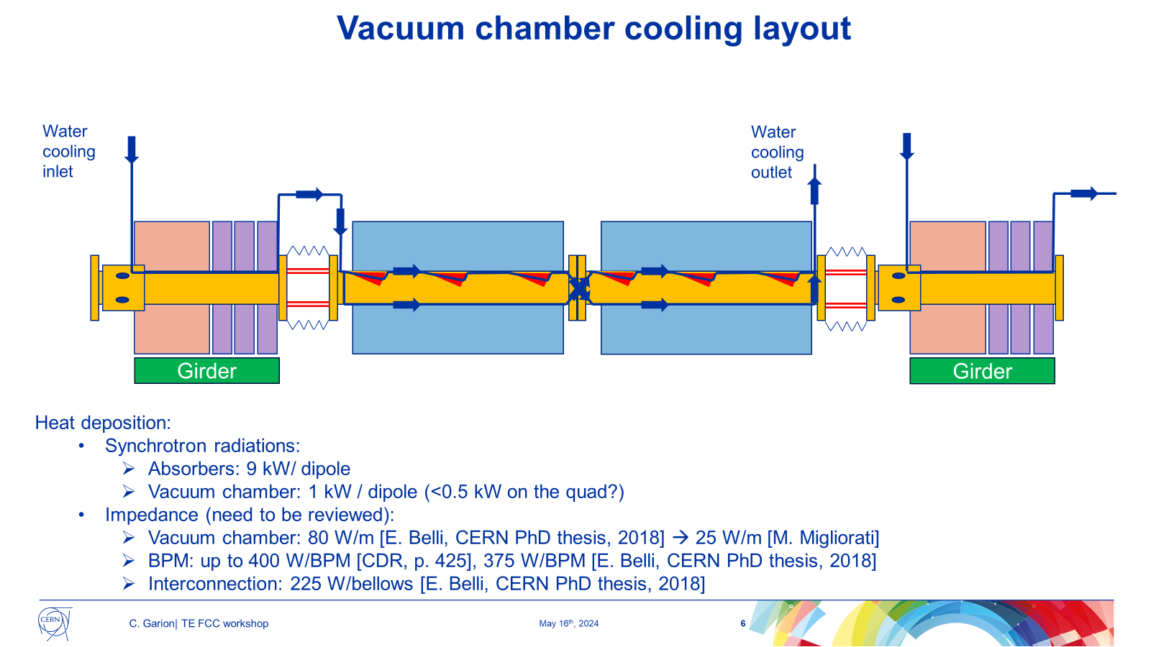
Vacuum chamber cooling circuit
One cooling circuit per half-cell and per beam
  Cell length ~56m
  ~ 685 cooling circuits per arc
Radiation hard sensors and conditioning electronics (EN/CV?)
  Flow meter at the inlet/outlet
  Water temperature at the inlet/outlet
Critical for machine protection
Courtesy of C. Garion

Slide 6
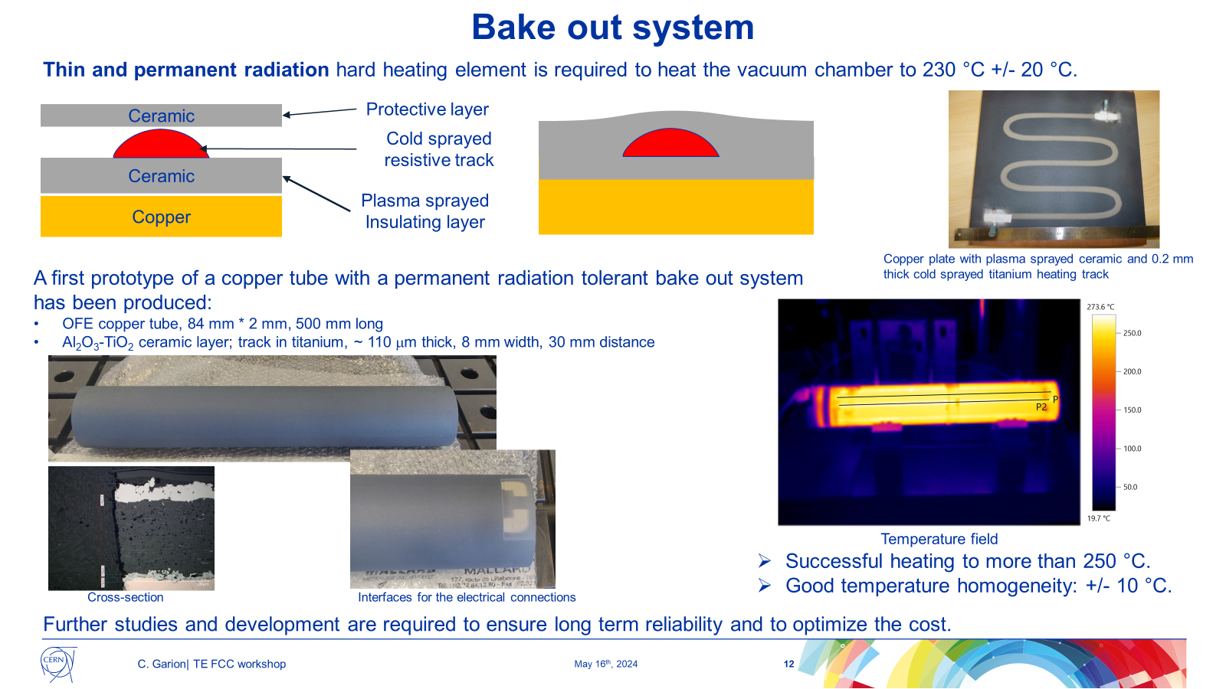
Bake out system
Rad-hard heating element (ceramic, titanium)
Rad-hard thin (5 mm) insulation layer not defined yet (aerogels, glass cloth, fibreglass with glass cloth, etc)
Temperature measurement during bake-out
  Rad-hard thermocouples permanently installed OR
  possibility to insert thermocouples between the insulation layer and the vacuum chamber
Circuit terminals accessible for power supply connection
Courtesy of C. Garion

Slide 7
Cables and racks per alcove
Cables
Tunnel-alcove: 172 cables
Tunnel-tunnel: 200 cables for NEG/SIP interconnections
Total length per alcove (collider + booster) ~ 75 km (3600 km for the 8 arcs!)
  LSS and SSS vacuum layout not defined and not considered
  Temperature measurements at specific locations not defined and not considered
Racks
7x racks 45U per alcove
Industrial and custom controllers
Non-radiation tolerant

Slide 8
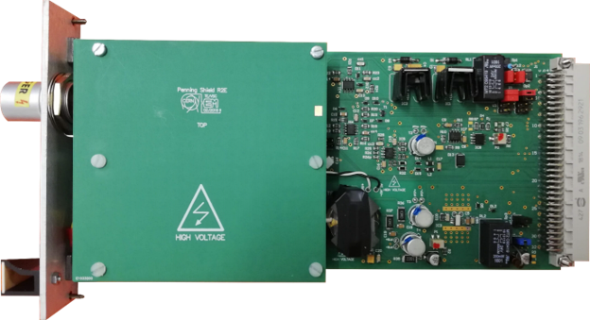
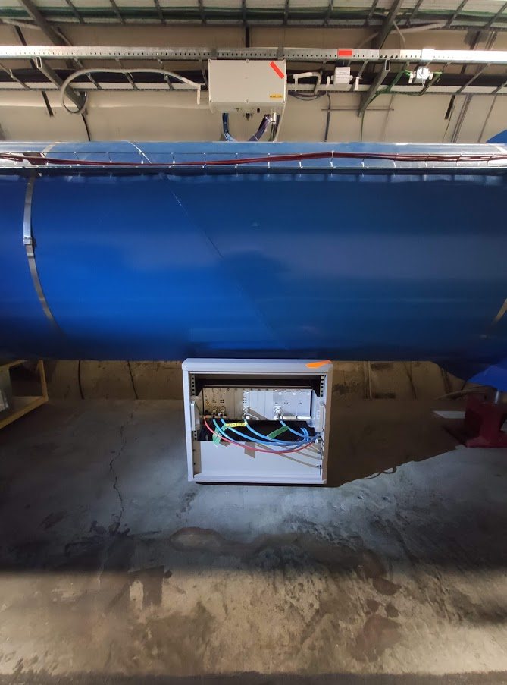
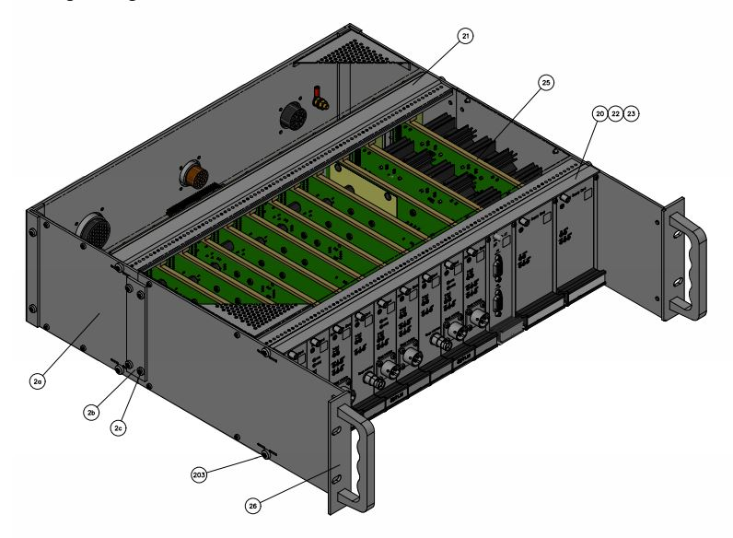
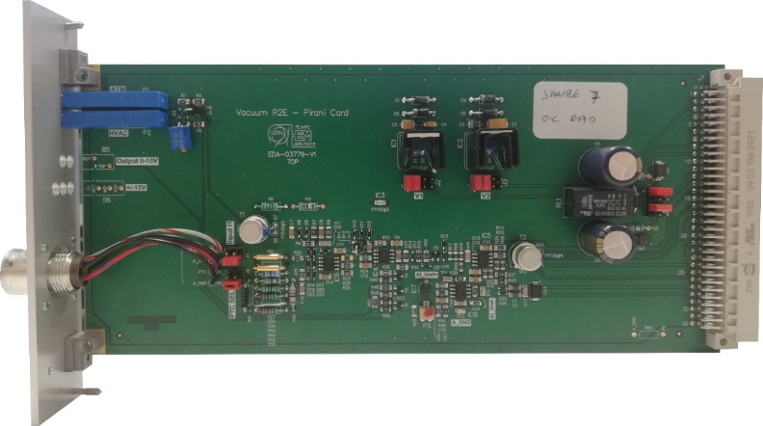
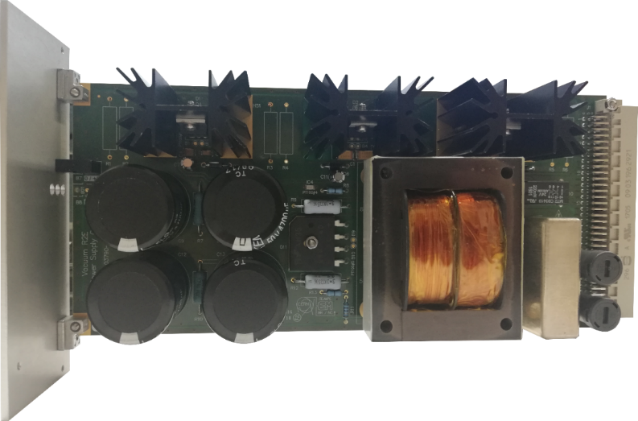
Reduction of cables – Example of (HL-)LHC
Arc and DS areas: one multi-conductor cable (ND100) and rad-tol electronics installed in the tunnel
Digital commands and analog 4-20 mA transmission from/to alcoves
Rad-tol electronics developed for HL-LHC using COTS qualified at PSI and CHARM:
  TID = 500 Gy; HEH = 4 x 10¹¹ cm⁻²; 1 MeV-n-eq = 3.5 x 10¹² cm⁻²
Penning card
Pirani card
Power supply card

Slide 9
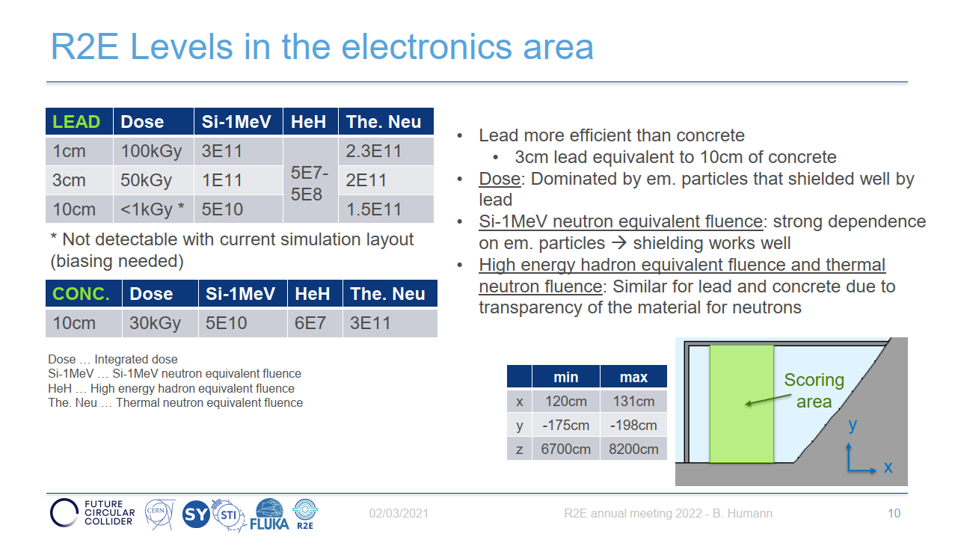
Reduction of cables – FCC-ee
Multi-conductor cables and rad-hard electronics installed in the tunnel only for Penning and Pirani gauges would replace 72x individual cables (32.4 km) by 4x multi-conductor cables (3.4km) per alcove (-1392 km for the 8 arcs!)
Rad-hard field bus (copper, optical fibre) and rad-hard electronics is the ideal solution, but implies more rad-hard components (ADC, memories, complex logic, etc.).
Rad-hard wireless communication would also be a cost-effective solution for non-critical signals (indico 1374546).
Radiation levels for FCC-ee with 3 cm of lead compared with the qualifications of rad-tol electronics developed for HL-LHC (10 y of operation):
  TID: x 1000 (500 kGy vs 500 Gy)!
  1MeV n-eq: x1 (10¹² cm⁻²)
  HEH: x0.01 (10⁹ cm⁻² vs 10¹¹ cm⁻²)
This level of TID requires the development of rad-hard ASICs:
  Cost of rad-hard ASICs development and production?
  Reliability in the FCC-ee tunnel?
  Collaboration with EP-ESE-ME for rad-hard ASICs design?
  ACCURATE – An ultra-low current measurement ASIC (indico 1389955) HSE-RP-IL / EP-ESE-ME
Courtesy of B. Humann

Slide 10
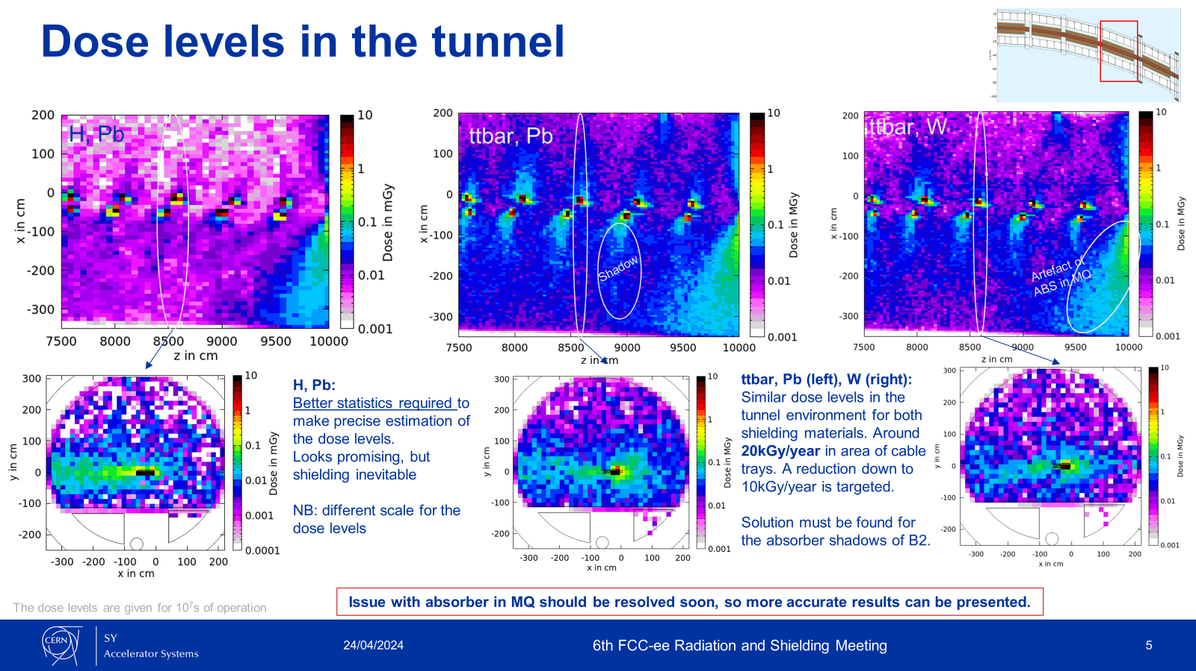
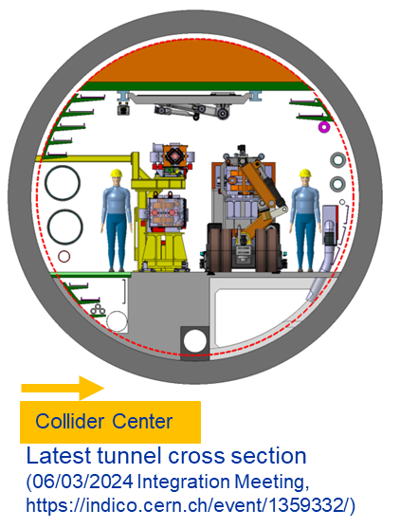
Impact of the dose levels in the tunnel
~ 20kGy/year in the vicinity of the cable trays
> 200kGy/year in the vicinity of the beam pipes
Courtesy of B. Humann, A. Lechner

Slide 11
Radiation resistance of vacuum instruments
Sputter ion pumps (Agilent - Starcell):
  Radiation Resistance: 10 MGy => maximum dose reached after 50 years
  HV coax socket insulation in ceramic (HV 5-7kV)
NEG pumps (SAES Getter - CapaciTorr):
  Radiation Resistance: 10 MGy
  Multipole socket insulation in ceramic
Penning gauge (Pfeiffer - IKR070):
  Radiation Resistance: 10 MGy
  HV triax socket insulation in PEEK* (HV 3kV)
Pirani gauge (Pfeiffer - TPR018 (w/o built-in temperature compensation)):
  Radiation resistance: 10 MGy
  Multipole socket (Burndy) insulation in Ryton® R4**
Vacuum gate valve (VAT - RF all-metal gate valve Series 47):
  Radiation Resistance: 1 MGy => maximum dose reached after 5 years due to actuator, position indicators and solenoid (preventive maintenance required). Valve body up to 100 MGy.
  Burndy socket/plug with insulation in Ryton® R4
*PEEK: Polyether ether ketone
** Ryton® R4: 40% glass fiber reinforced Poly(p-phenylene sulfide) (PPS)

Slide 12
Radiation resistance of cables
IS23 safety instructions (now SSI-FS-2-1)
  Recommend including a safety factor of 5 in the specifications due to the Enhanced Low Dose Rate Sensitivity (ELDRS)
Standard cables (cat 1)
  Qualified up to 500 kGy (100 kGy in operation)
  Max. dose reached after 5 years of operation in the vicinity of the cable trays; after 6 months in the vicinity of the beam pipes
  Today: 100% of cables used for vacuum available in cat 1
Rad-tol cables (cat 2)
  Qualified up to 3.5 MGy (700 kGy in operation)
  Max. dose reached after 35 years of operation in the vicinity of the cable trays; after 3.5 years in the vicinity of the beam pipes
  Today: 0% of cables used for vacuum available in cat 2
Rad-hard cables (cat 3)
  Qualified up to 10 MGy (2 MGy in operation)
  Max. dose reached after 100 years of operation in the vicinity of the cable trays; after 10 years in the vicinity of the beam pipes
  Today: ~ 80% of cables used for vacuum available in cat 3

Slide 13
Open points
Feasibility study of rad-hard electronics design according to the radiation level simulations
  Development and production costs?
  Reliability in the FCC-ee tunnel?
  Synergy with other groups? Common controls architecture?
  Accessibility of rad-hard electronics in the tunnel?
Study and test SR effects on Penning gauges and their cables (and SIPs)
  Are we going to be able to do reliable vacuum measurements with beam?
  What is the optimum cables routing and gauge/SIP positioning?
  Do we need shielding?
Cable specifications and validation for cat 2 and missing cables in cat 3 (for vacuum)
  Manufacturers?
  Cost?
New cost evaluation with and without rad-hard electronics, with cat 2 and cat 3 cables

Slide 14
Thank you for your attention

