Slide 1

ALICE Status Report
106th LHCC meeting - Open session
Andrea Rossi, on behalf of the ALICE collaboration

Slide 2
ALICE publications in pp collisions
Multiplicity & distributions
  900 GeV; EPJC: Vol. 65 (2010) 111
  900,2.36 TeV; EPJC: Vol. 68 (2010) 89
  7 TeV EPJC: Vol. 68 (2010) 345
pbar/p ratio (900 GeV & 7 TeV) PRL: Vol. 105 (2010) 072002
Momentum distributions (900 GeV) PLB: Vol. 693 (2010) 53
Bose-Einstein correlations (900 GeV) PRD: Vol. 82 (2010) 052001
Strangeness (K₀,Λ,Ξ,Ω,φ) at 900 GeV EPJC: Vol: 71, (2011) 1594
Identified charged particle spectra (900 GeV)
  http://arxiv.org/abs/1101.4110 accepted by EPJC
Pion Bose-Einstein correlations at 0.9 and 7 TeV
  http://arxiv.org/abs/1101.3665v1 submitted to Phys. Rev. D
J/Ψ production at 7 TeV :
  http://arxiv.org/abs/arXiv:1105.0380 submitted to Phys. Lett. B
In this talk, focus on PbPb results

Slide 3


ALICE Talks at
22-28 May
Plenary:
ALICE overview: J. Schukraft
Global properties: A. Toia
HBT: A. Kisiel
Flow: R. Snellings
R_{AA}: H. Appelshaeuser
Identified Particles: M. Floris
Correlations (I_{AA}): Jan Fiete GO
J/Psi: G. Martinez Garcia
Heavy Flavour: A. Dainese
Identified hadrons
PID methods: A. Kalweit
π/K/p in pp: M. Chojnacki
π⁰,η in pp: K. Reygers
Resonances: A. Pulvirenti
Λ/K⁰: I. Belikov
Ξ, Ω pp Pb: D. Chinellato
R_{AA} Λ/K⁰ : S. Schuchmann
ρ,ω,φ pp: A. de Falco
Experiments
Upgrades: T. Peitzmann
cross section pp: K. Oyama
Global & Collective
N_{ch}, centrality: C. Loizides
'strong CP viol': P. Christakoglou
directed flow v₁: I. Selyuzhenkov
elliptic flow high p_{t}: A. Dobrin
elliptic flow PID: M. Krzewicki
Ultra-peripheral: C. Oppedisano
Diffraction pp: M. Poghosyan
Heavy Flavour
HF μ: X. Zhang
HF e: S. Masciocchi
J/Ψ pp: R. Arnaldi
J/Ψ Pb: P. Pillot
D mesons R_{AA}: A. Rossi
Correlations & Fluctuations
Elliptic flow: A. Bilandzic
Triggered dihadrons: A. Adare
Untriggered dihadrons: A. Timmins
Dihadrons pp: Y. Mao
pT fluctuations: S. Heckel
HBT: J. Mercado
HBT K₀^{s} pp: T. Humanic
In this talk: focus on highlights of PbPb results
Jets
Jet reconstruction: C. Klein-Boesing
R_{AA} charged: J. Otwinowski
R_{AA} π⁰: G. Conesa Balbastre

Slide 4
2011 runs

Slide 5
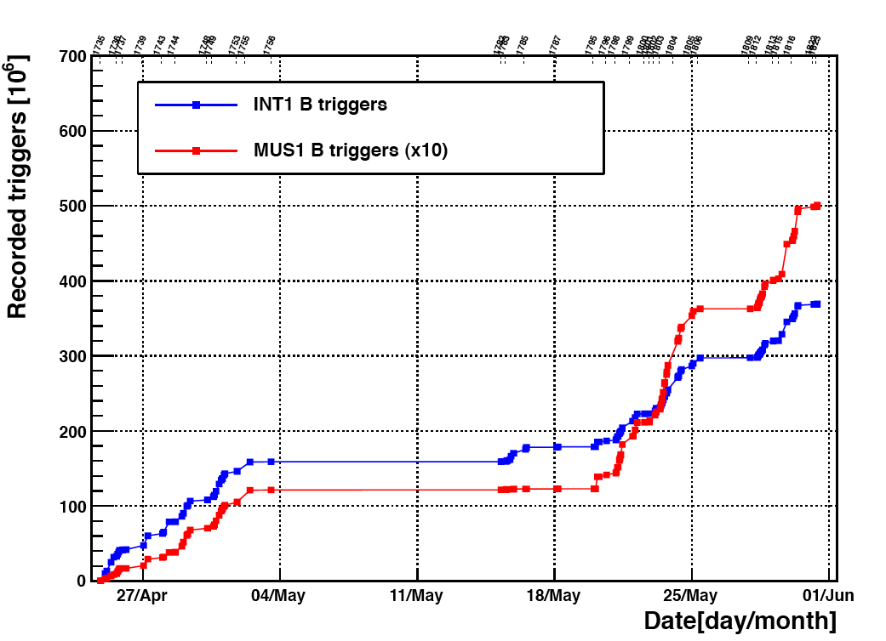
2.76 TeV pp run statistics
2.76 TeV pp run: … not only a fundamental reference for PbPb analyses
System | Energy (√s_{NN}) | Trigger | Integr. Lum.
pp | 2.76 | Min. Bias* | 1.37 nb⁻¹
pp | 2.76 | Muon SPD high mult. EMCal | 20 nb⁻¹
*w/o SDD (0.65 nb⁻¹ w/ SDD)
ongoing 7 TeV pp run
  now L_{int}>400 nb⁻¹ with unlike sign muon pair trigger
min. bias
single muon trigger (x10)
~ 71 nb⁻¹

Slide 6
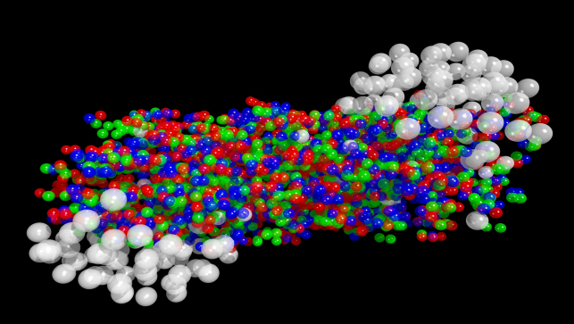
Study of the QGP expanding fireball
An expanding and cooling fireball
HIC complex system of strongly interacting matter
Extended size
Local thermodynamical equilibrium
25 years experimental research to answer fundamental questions like:
How does the system evolve?
How does the collision geometry manifest itself and what can we learn from it?
Can we access medium global properties (energy density, temperature, size)?
How is particle production modified?
How do high energetic partons interact with the medium?

Slide 7
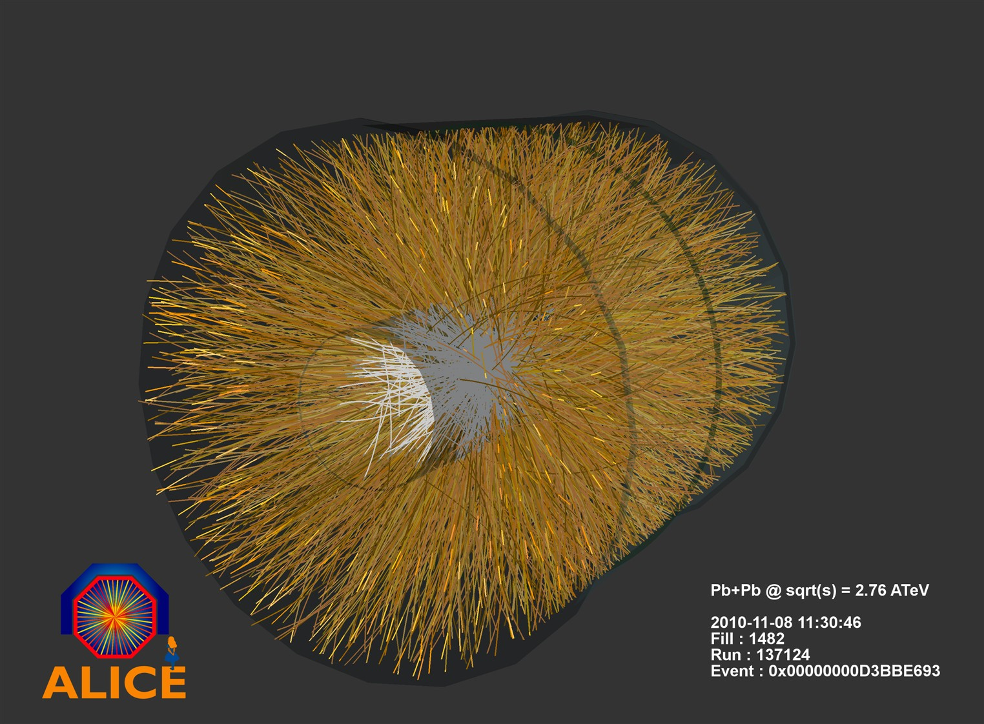
A challenging environment!

Slide 8
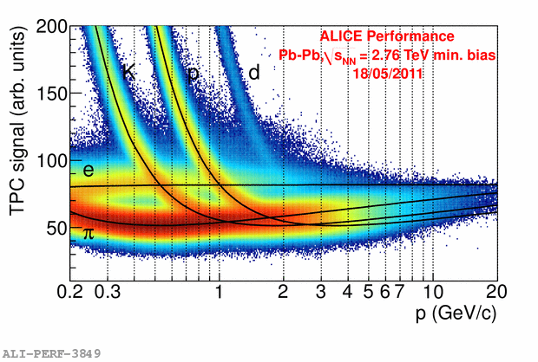
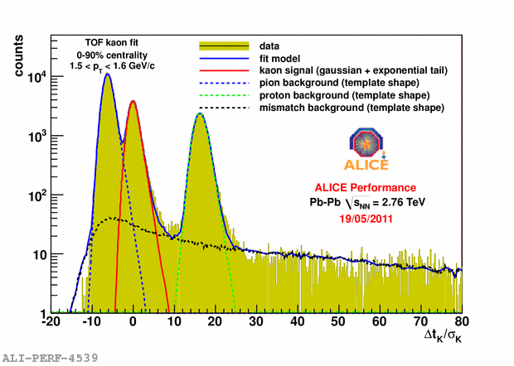
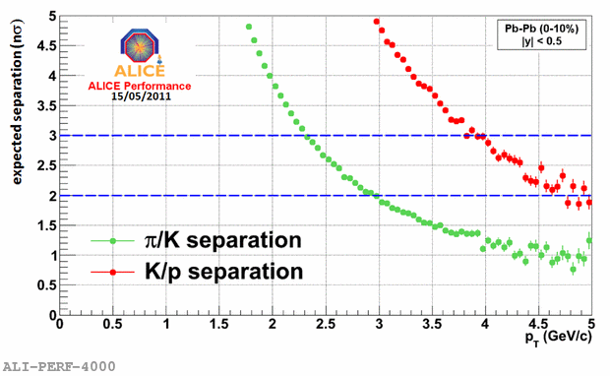
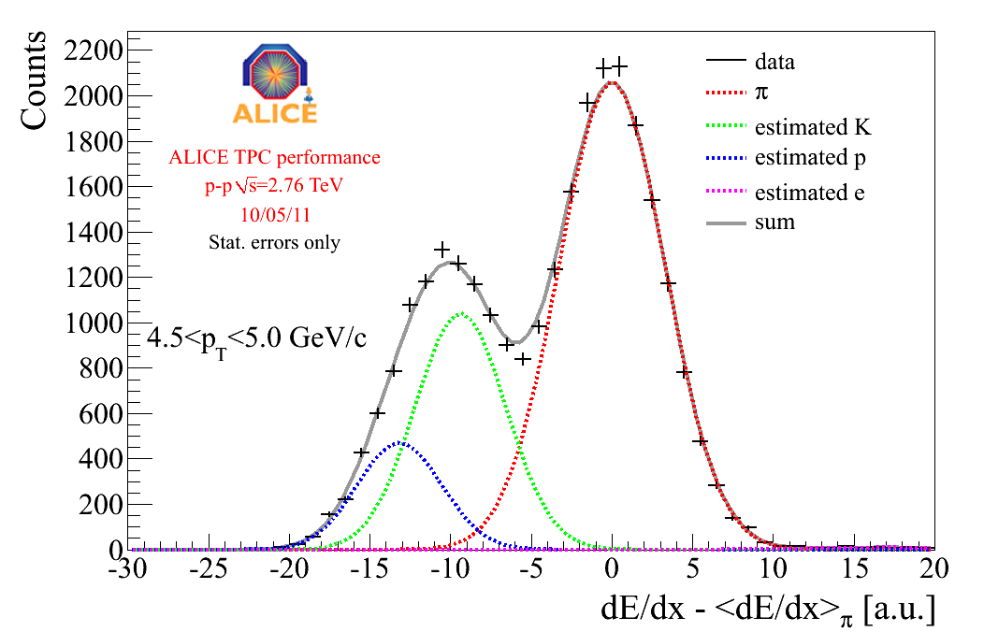
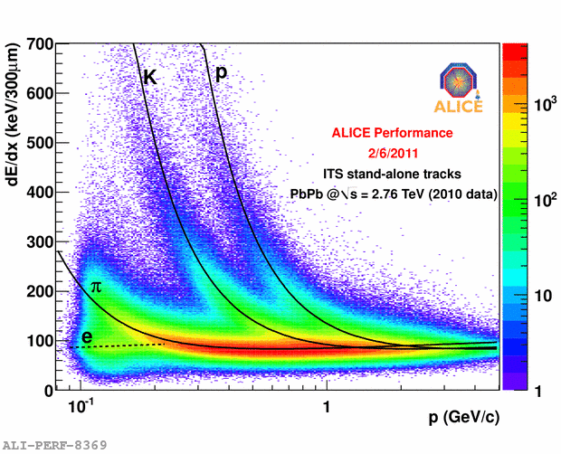
Particle Identification
TPC dE/dx
Time Of Flight
ITS

Slide 9
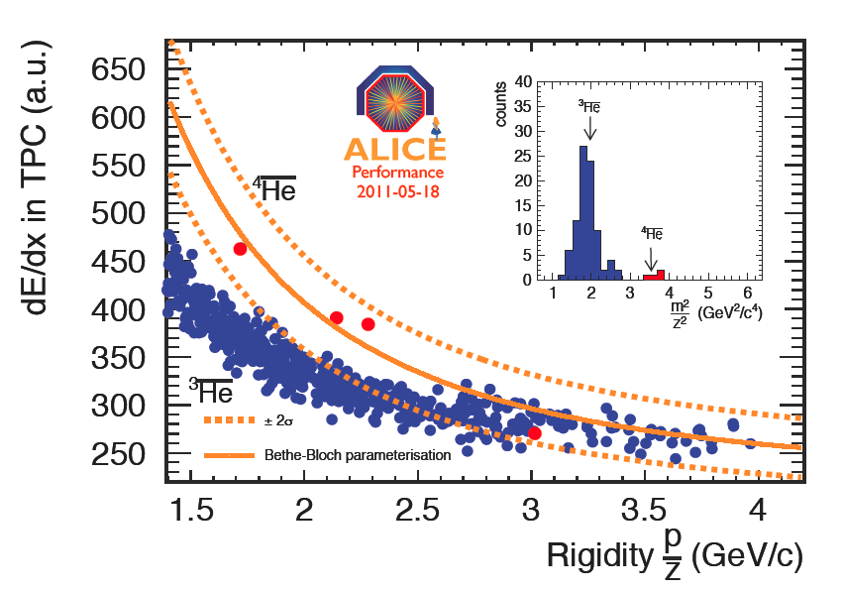
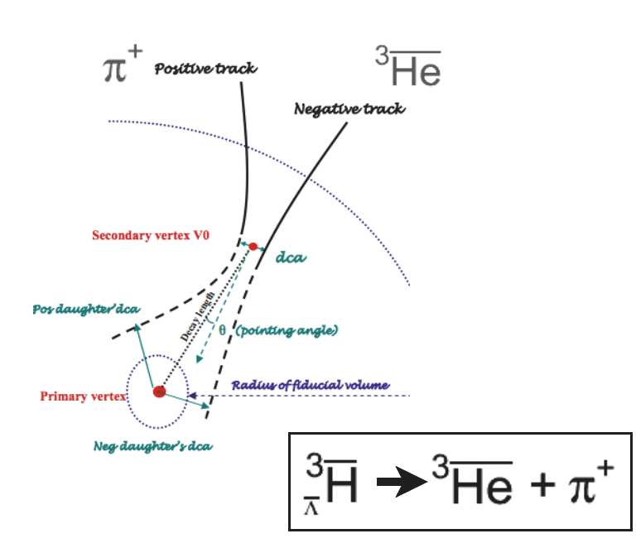
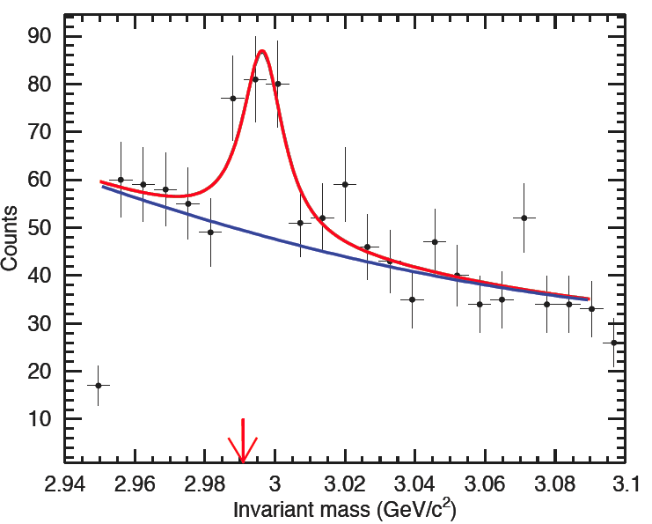
Anti-Matter PID
Anti-Hypertriton

Slide 10
Study of the QGP expanding fireball
An expanding and cooling fireball
HIC complex system of strongly interacting matter
Extended size
Local thermodynamical equilibrium
25 years experimental research to answer fundamental questions like:
How does the system evolve?
How does the collision geometry manifest itself and what can we learn from it?
Can we access medium global properties (energy density, temperature, size)?
How is particle production modified?
How do high energetic partons interact with the medium?

Slide 11
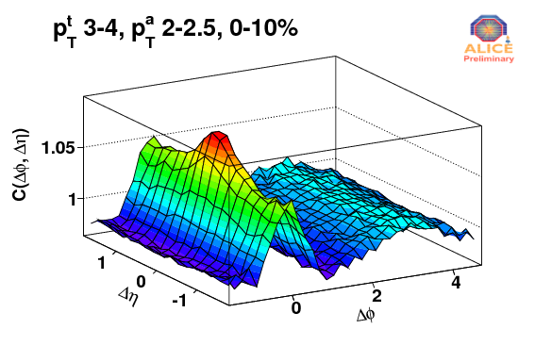
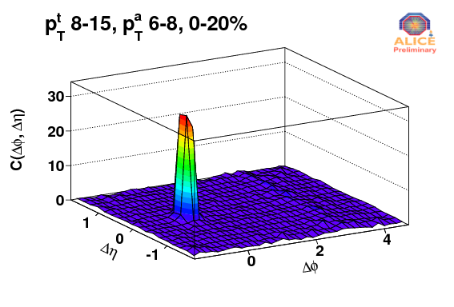
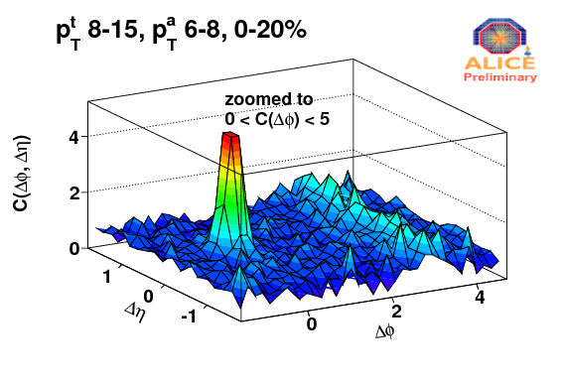
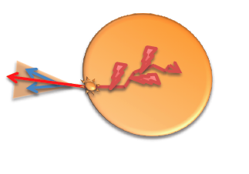
Triggered Azimuthal Correlations
One of the main highlights at Quark Matter 2011
Triggered correlations: choose a particle from one p_{T} region ("trigger particle") and correlate with particles from another p_{T} region ("associated particles") where
p_{T,assoc} < p_{T,trig} in bins of p_{T,trig} and p_{T,assoc}
Lower p_{T}
  Assess the bulk of the correlations
  Dominated by hydrodynamics and flow
  Ridge
Higher p_{T}
  Dominated by jets
  Quenching/suppression, broadening
Away-side jet disappears

Slide 12
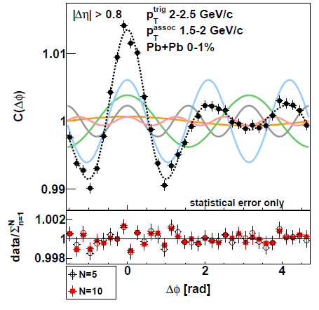
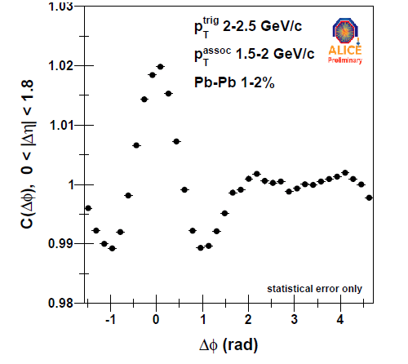
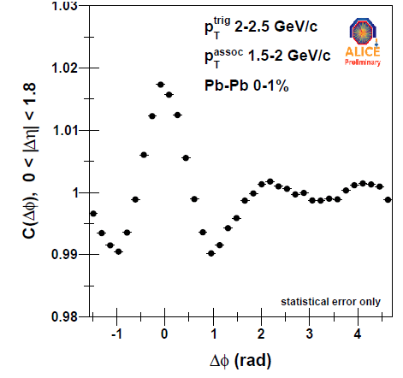
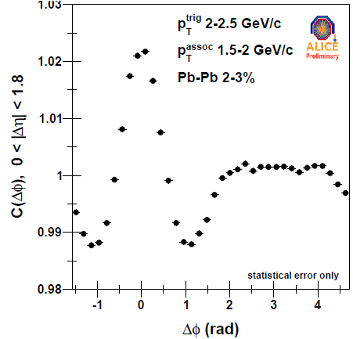
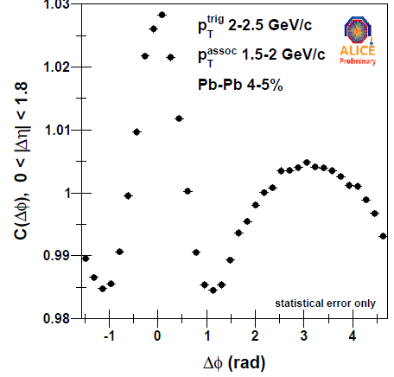
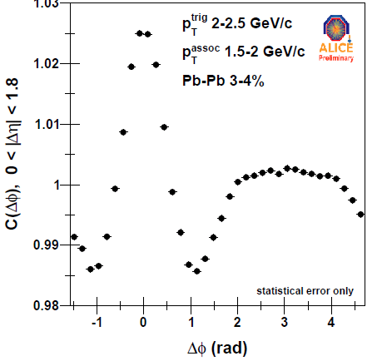
Triggered Azimuthal Correlations
v₁+v₂₊v₃₊v₄₊v₅
'Near Side Ridge'
broad away side structure
v₃
v₂
2 Particle correlation C(ΔηΔφ)
Δη > 0.8
Any function can be described with enough coefficients… can we interpret them?
Projection on Δφ for Δη > 0.8
Clean double Hump (aka 'Mach Cone') appears for ultra-central
(without any flow subtraction !)
Full correlation structure described by Fourier Coefficients v₁,v₂, v₃, v₄,v₅ (for |η|>0.8)
v3 very visible, indeed, v3 ≈ v2 for very central
'Mach Cone' & 'Near Side Ridge' shapes evolve smooth with magnitude of v₂ and v₃

Slide 13
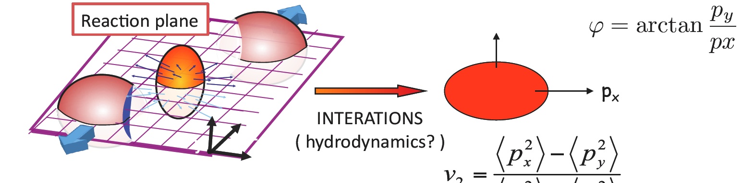
Anisotropic transverse flow
p_{y}
p_{y}
(elliptic flow)
Final momentum anisotropy
Reflected in azimuthal distribution
Initial spatial anisotropy
Smooth matter distribution in the colliding nuclei
  Ψ_{n}=Ψ_{RP}
  v_{2n+1} = 0 by symmetry

Slide 14
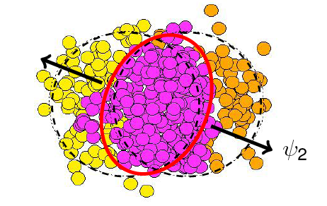
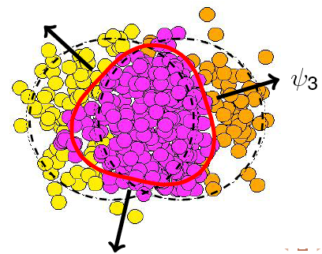
Anisotropic transverse flow
p_{y}
p_{y}
(elliptic flow)
Final momentum anisotropy
Reflected in azimuthal distribution
Initial spatial anisotropy
Smooth matter distribution in the colliding nuclei
  Ψ_{n}=Ψ_{RP}
  v_{2n+1} = 0 by symmetry
Fluctuations in the matter distribution
  event by event fluctuation of the plane of symmetry around Ψ_{RP}
  non negligible odd harmonics
v₃,v₅,.. magnitude regulated by shear viscosity to entropy density ratio (η/s)
ψ₃
ψ_{RP}
ψ₂

Slide 15
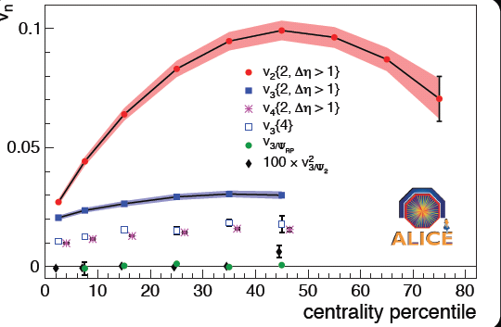
Higher Order Flow v₃,v₄,..
arXiv:1105.3865
Accepted by PRL
v₂
v₄{2} = <cos(4(φ₁-φ₂))>
v₃{2} = <cos(3(φ₁-φ₂))>
v₃{4} 4 particle cumulant
v₃ relative to reaction & participant planes
V₃:
small dependence on centrality
v₃{4} > 0 => not non-flow
v₃{4} < v₃{2} => geometry fluctuations !
V₃{Ψ_{RP}} ≈ 0 => Ψ₃ indep. fluctuations w.r.t. Ψ_{RP}

Slide 16
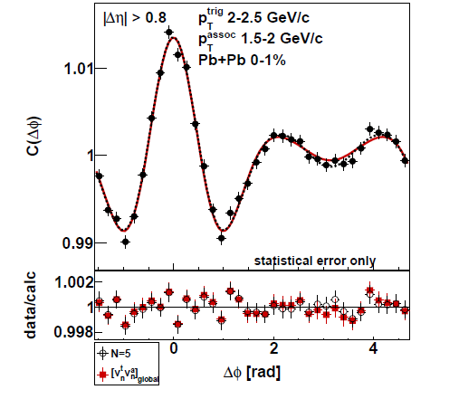
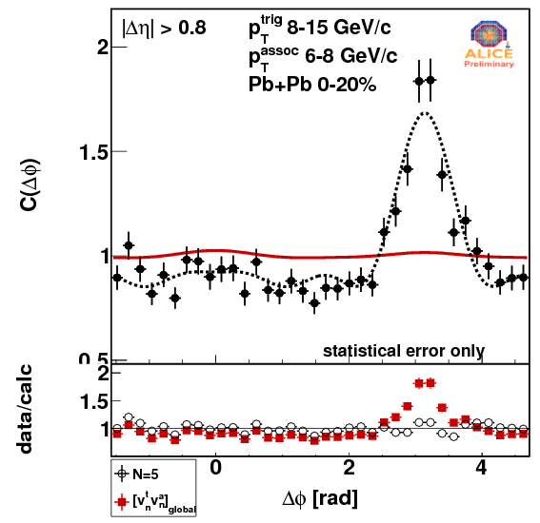
Flow & Triggered Correlations
'away side jet'
≈ coefficients from flow analysis
v₃ : explain the 'near side long range ridge' and the away side 'Mach cone’ for |η| > 0.8 and p_{Τ} < 3-4 GeV !
coefficients from C(P_{T}1,P_{T}2) analysis
Any function can be described with enough coefficients
- But not if we impose factorization C(p_{T}^{trig}, p_{T}^{assoc})=v(p_{T}^{trig})*v(p_{T}^{assoc}) (or take coefficients from flow analysis).
Correlations (|η|>0.8) can be described consistently with 'collective flow' hypothesis
for p_{T} < 3-4 GeV ( consistent with 'collectivity ')
only partially or not at all for p_{T} > 5 GeV

Slide 17
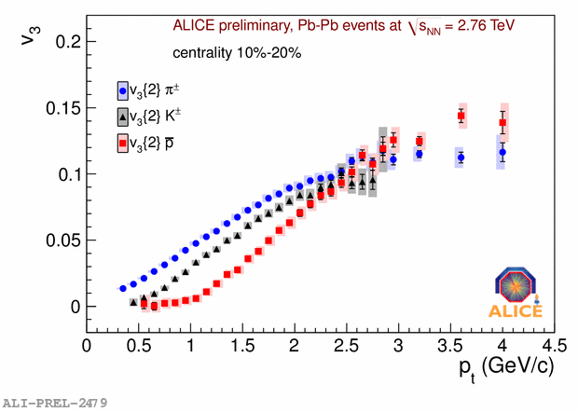
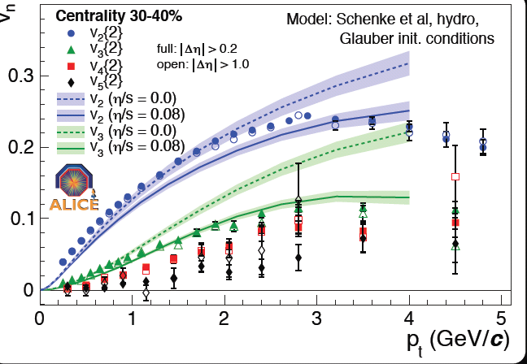
Triangular Flow v3
v₃ for π/K/p
v₃ v₄ v₅ versus p_{T}
v₃ :
- Explain the 'near side long range ridge' and the away side 'Mach cone’ for |η| > 0.8 and p_{Τ} < 3-4 GeV !
Compatible with hydrodynamic predictions
Induced by geometry fluctuations
v₂
π
v₃
K
v₄
p
v₅
Hydro calculation for v₃
v₃ shows mass splitting expected from hydro flow
Has the magnitude (and p_{T} dependence) expected from geometry fluctuations
(and has different sensitivity to η/s than v₂ )

Slide 18
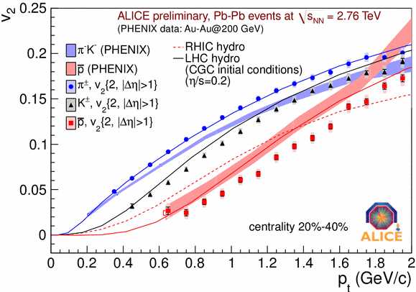
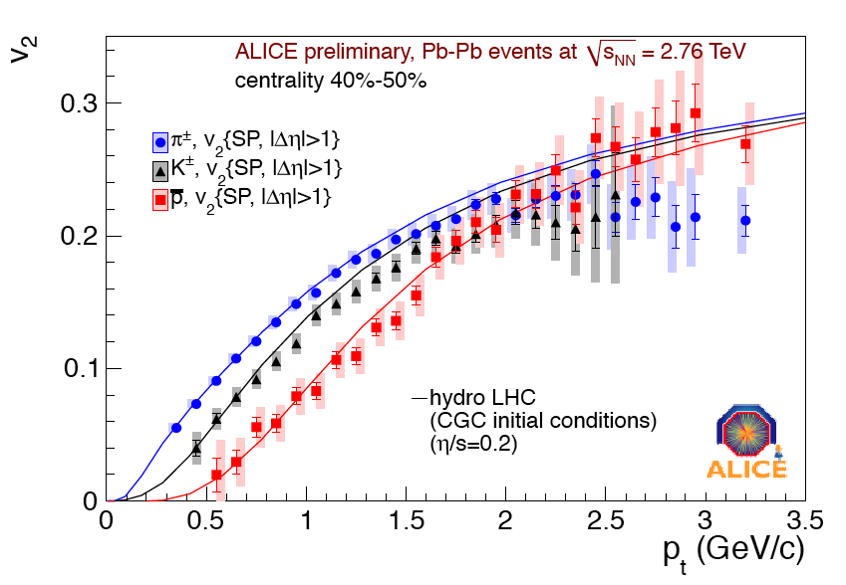
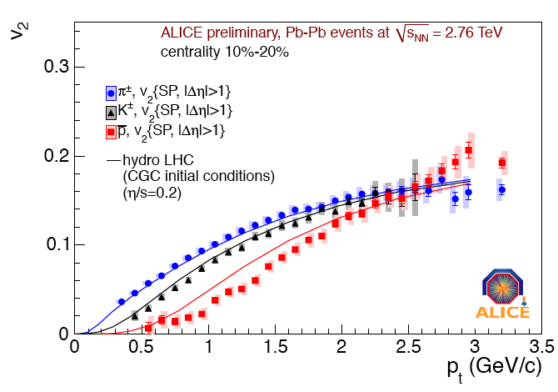
More on v₂: identified particle flow
π/K/p v₂
Centraliy 40%-50%
RHIC
PID flow:
Mass splitting and ordering ≈ hydro
π and anti-p are 'pushed' further compared to RHIC
≈ expected from hydro (with larger radial flow)
π and K flow well described by hydro
anti-p flow not well described by hydro in more central collisions
Centraliy 10%-20%

Slide 19
Study of the QGP expanding fireball
An expanding and cooling fireball
HIC complex system of strongly interacting matter
Extended size
Local thermodynamical equilibrium
25 years experimental research to answer fundamental questions like:
How does the system evolve?
How does the collision geometry manifest itself and what can we learn from it?
Can we access medium global properties (energy density, temperature, size)?
How is particle production modified?
How do high energetic partons interact with the medium?

Slide 20
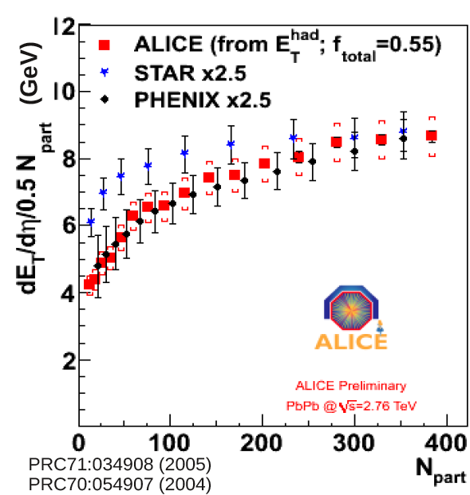
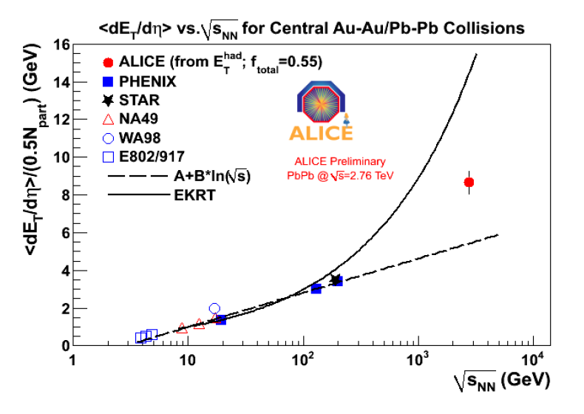
Transverse energy & energy density
Grow with power of CM system energy faster than simple logarithmic scaling extrapolated from lower energy (similar trend than dN_{ch}/dη)
Energy density (Bjorken)
ετ ≈16 GeV/(fm²c)
factor 2.7 larger than RHIC

Slide 21
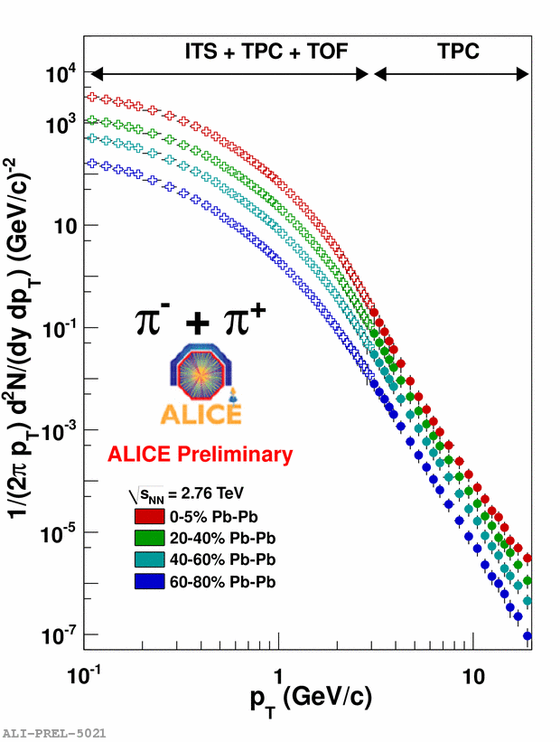
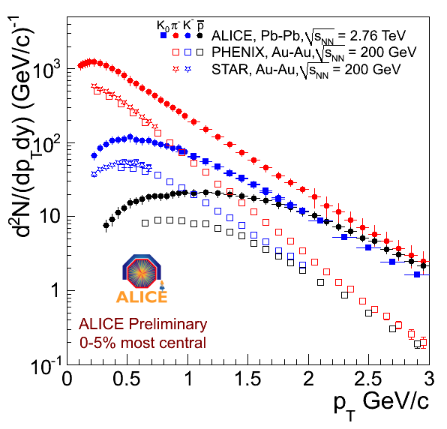
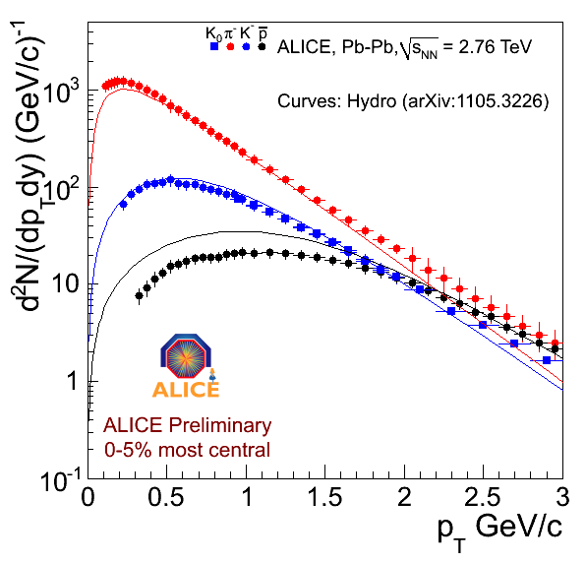
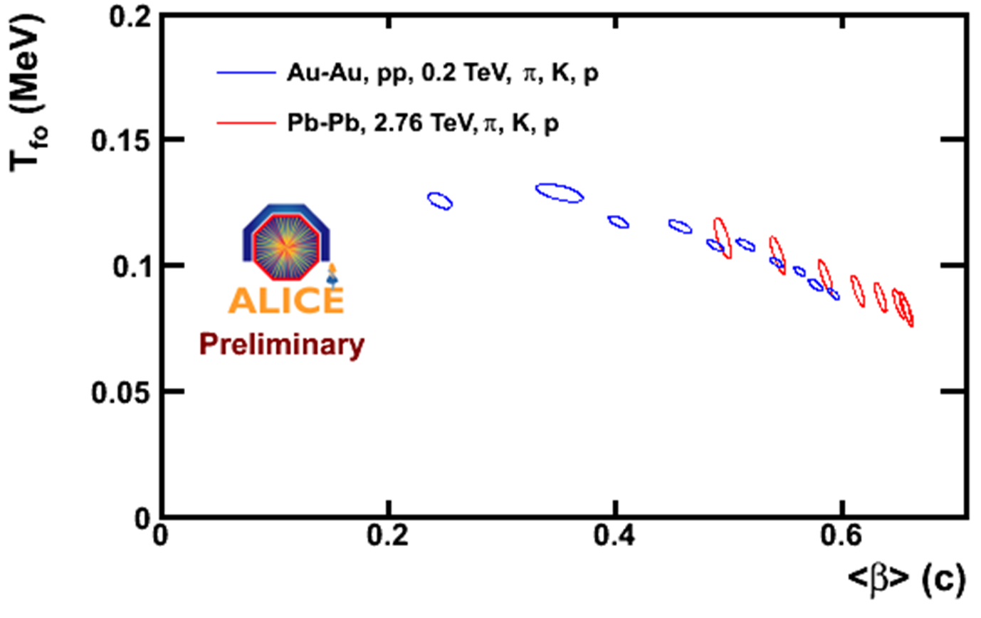
Identified Particle spectra
π⁻
RHIC
Hydro Prediction
K⁻
-p
K₀
RHIC
Very significant changes in slope compared to RHIC
Most dramatically for protons
Very strong radial flow, β ≈ 0.66
even larger than predicted by most recent hydro
more central
Hydro parameters from Blast Wave Fit

Slide 22
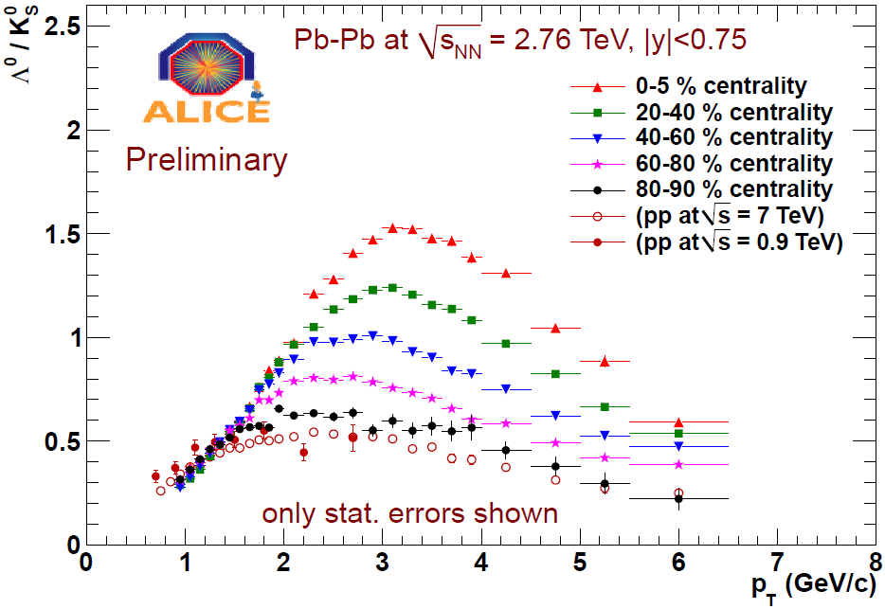
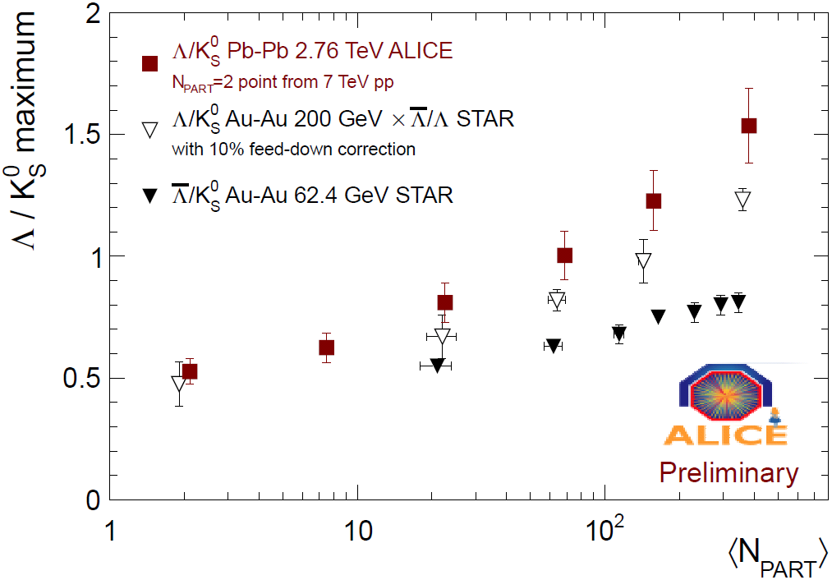
'Baryon anomaly': Λ/K⁰
x 3
RHIC
Λ/K₀
Ratio at Maximum
Baryon/Meson ratio still strongly enhanced
x 3 compared to pp at 3 GeV
Enhancement slightly larger than at RHIC 200 GeV
Still present at 6 GeV/c
- Maximum shift very little in p_{T} compared to RHIC
despite large change in underlying spectra !
Recombination + Radial flow?

Slide 23
Study of the QGP expanding fireball
An expanding and cooling fireball
HIC complex system of strongly interacting matter
Extended size
Local thermodynamical equilibrium
25 years experimental research to answer fundamental questions like:
How does the system evolve?
How does the collision geometry manifest itself and what can we learn from it?
Can we access medium global properties (energy density, temperature, size)?
How is particle production modified?
How do high energetic partons interact with the medium?
    in-medium partonic energy loss
    parton nature (quark/gluon), mass dependence?

Slide 24
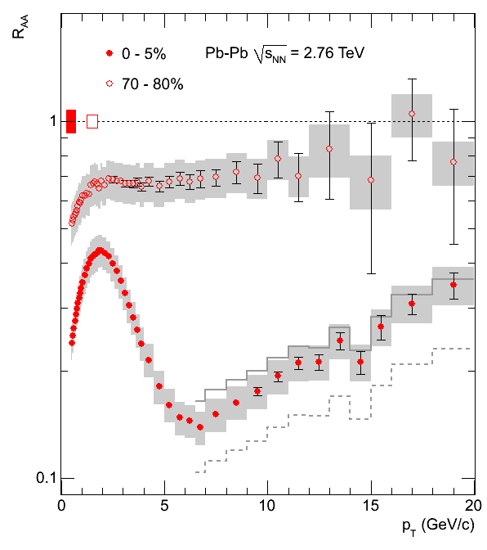
Charged particle nuclear modification factor (R_{AA})
PLB 696 (2011) 30-39
Extrapolated reference
=> large syst. error

Slide 25
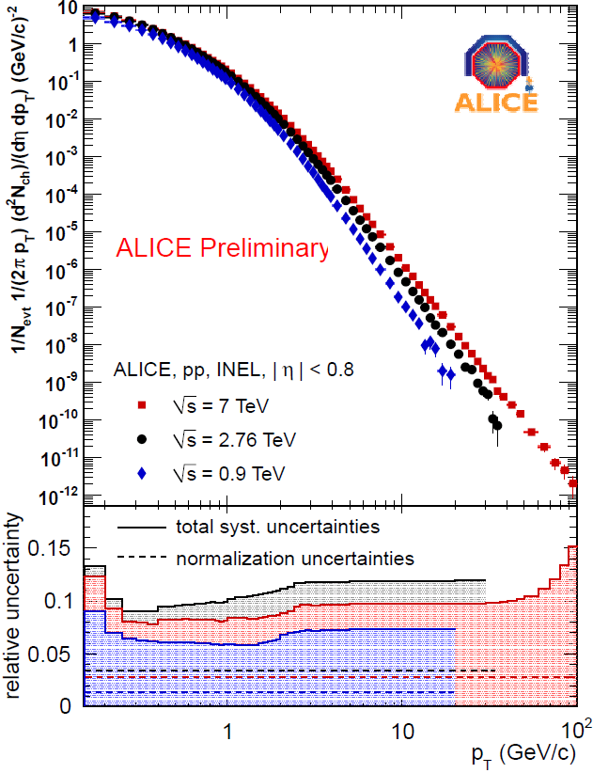
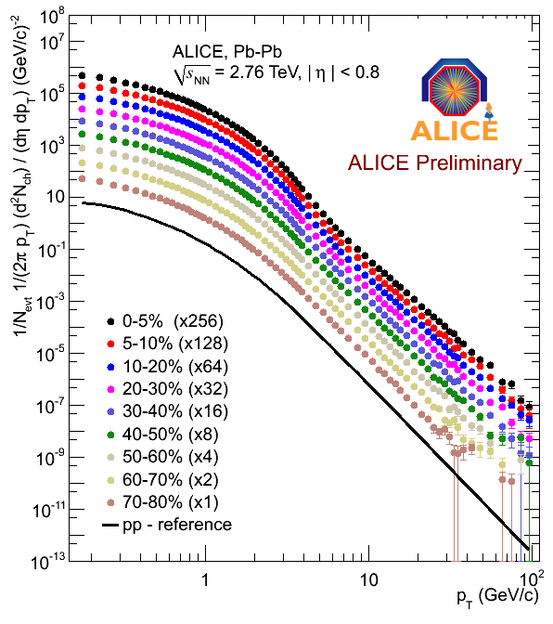
Charged Particle R_{AA:} Ingredients
pp spectrum
Pb-Pb
2.76 TeV
pp reference
Measured reference, still needs extrapolation for p_{T}> 30 GeV
(but not in √s => smaller syst. error)
Note: measured spectrum somewhat different than previous extrapolation
(R_{AA} goes down, but stays well within old systematic error bands)

Slide 26
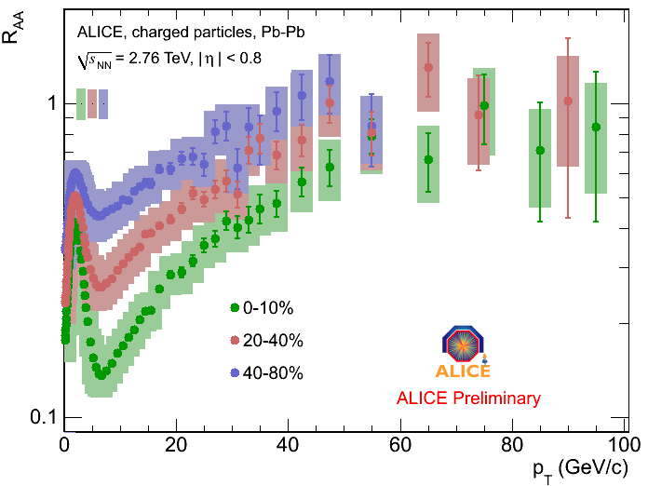
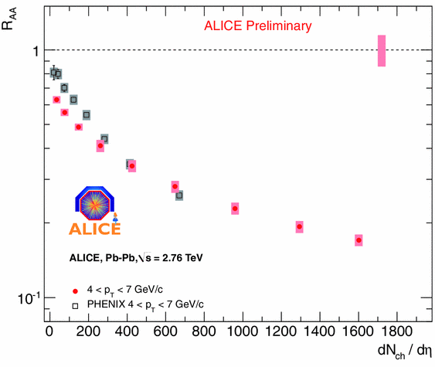
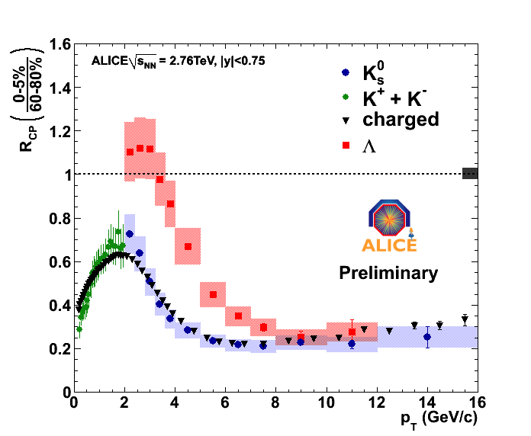
R_{AA}: Results
R_{AA} versus p_{T}
<R_{AA} > in p_{T} bins vers. N_{ch}
PHENIX
p_{T} 4-7 GeV
4-7 GeV
R_{CP} Λ, K
Rise continues beyond 20 GeV
Gradual change of slope above 30-40 GeV
Note: centrality dependence is independent of reference spectrum !
Λ
Identified particle R_{AA}(K/Λ):
- Interesting differences < 6 GeV
- R_{AA} universal > 6 GeV
K₀
K ±

Slide 27
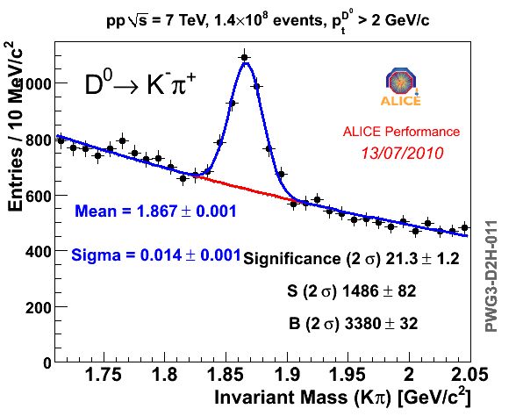
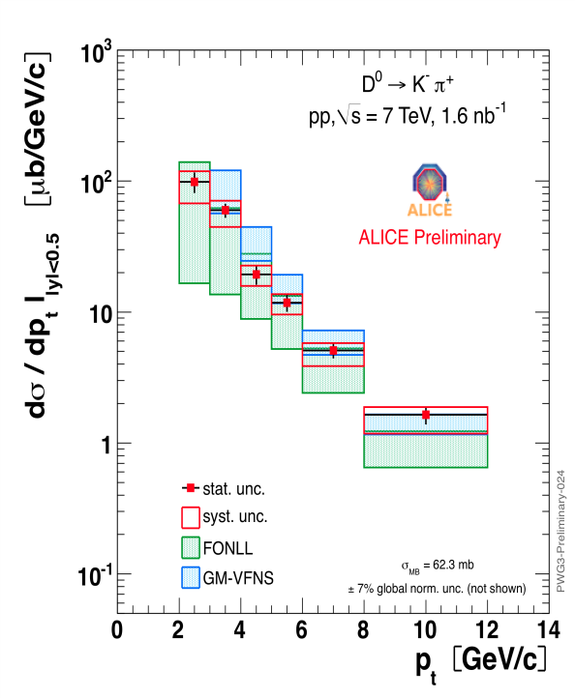
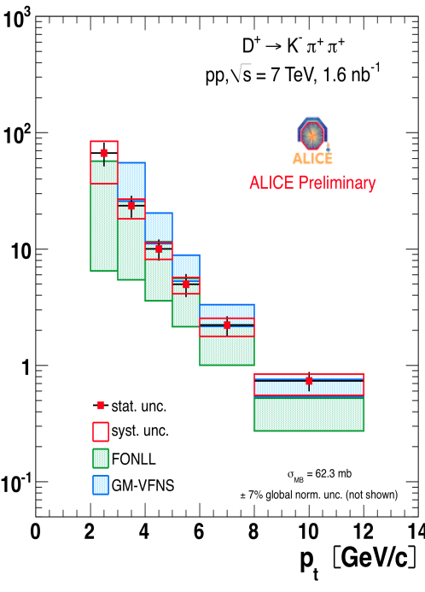
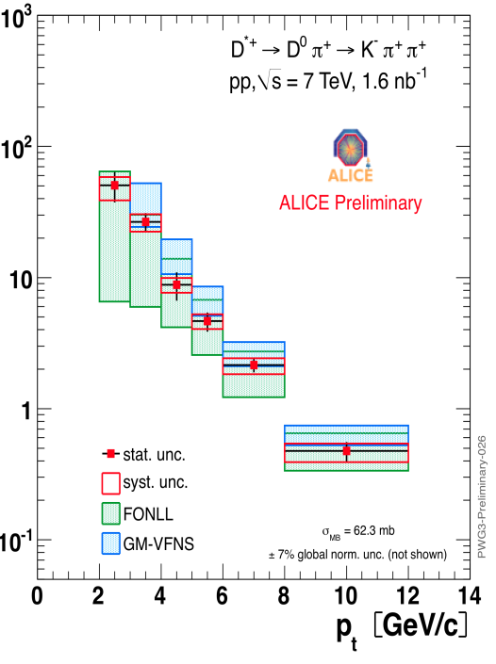


Charm R_{AA}: Ingredients
Total Charm cross section
D⁰→ Κ⁻π⁺
D⁺→ Κ⁻π⁺π⁺
D*⁺→ D⁰ π⁺
ALICE
ATLAS
LHCb
D⁰→ Κ⁻ π⁺
pp 2.76 TeV
- charm in pp @ 7 TeV
- subtract B feed down
- absolute cross section
- scale (FONLL) to 2.76 TeV
- check with CDF & data @ 2.76 TeV
- compare with other expts
=> Charm Cross section for comparison

Slide 28


Charm R_{AA}: results
D⁰→ Κ⁻π⁺
D⁺→ Κ⁻π⁺π⁺
- charm central in Pb-Pb!
- subtract B feed down
- absolute cross section (T_{AA})
=> prompt charm R_{AA} (p_{T}, centrality)
- check consistency D⁰, D⁺

Slide 29


Charm R_{AA}: results
Strong suppression observed in central (0-20%) collisions, factor ~4-5 for p_{t} >5 GeV/c
(π⁺ + π⁻) R_{AA}
little shadowing
Hot medium effect
- R_{AA} prompt charm ≈ R_{AA} pions for p_{T} > 5-6 GeV
- R_{AA} charm > R_{AA} π for p_{T} < 5 GeV ?
p-Pb run at LHC crucial to understand the low-p_{t} rise
Qualitative expectation: R_{AA} Charm > R_{AA} Mesons
  - ΔE gluon > ΔE quark (Casimir factor)
  - ΔE massless parton > ΔE massive quark ('dead cone')
Needs quantitative comparison with quenching calculations

Slide 30

Heavy Flavour decay muons
single prompt muon cross section (c,b) pp @ 7 TeV

Slide 31



Heavy Flavour Electrons
Inclusive Electrons pp
Beauty Electrons
Beauty + Charm
pQCD
Background
Inclusive electron spectrum pp 7 TeV
Background 'cocktail' based on measured π±
subtract => heavy flavour electrons (c, b)
consistent with pQCD (and measured charm!)
impact parameter cut => select beauty
consistent with pQCD

Slide 32



Heavy Flavour decay Electrons
Inclusive Electrons Pb
Data / Background => hint of excess around 2 GeV
interesting region (thermal radiation ? seen at RHIC…)

Slide 33

Heavy Flavour decay Electrons & Muons RAA
- pp reference: 7 TeV measurement scaled (FONLL) to 2.76 TeV
Resulting HFe R_{AA} consistent wit HFμ for p_{T} > 3-4 GeV

Slide 34



Heavy Flavour R_{AA} Comparison
D⁰ p_{t} > 6 GeV/c μ p_{t} > 6 GeV/c e p_{t} > 4.5 GeV/c
Consistent centrality dependence
Muons ~ Electrons ~ CMS J/ψ from B (QM2011)
D mesons clearly lower (charm vs beauty?)

Slide 35





J/ψ suppression: Ingredients
7 TeV pp J/ψ → μμ
pp J/ψ Cross Section
7 TeV pp 4 LHC expts
7 TeV
Atlas
e⁺e⁻
CMS
μμ
2.76 TeV
LHCb
2.76 TeV pp
7 TeV
J/ψ cross section dσ/dydp_{T}
7 TeV & 2.76 TeV
Agreement with pQCD
Agreement among 4 LHC experiments (in region of overlap)
2.76 TeV

Slide 36


J/ψ suppression: Results
PbPb
Di-muon channel
p_{T} > 0, 2.5 <y<4
0-10%
Rather small suppression & centrality dependence

Slide 37



J/ψ suppression: Compared to..
R_{AA}
Surprisingly (?) : less suppression than RHIC !
Phenix μμ
R_{CP}
e⁺e⁻
R_{CP}(Alice/Atlas): suppression stronger at high p_{T} ??
R_{CP}
ATLAS
Complementary measurements

Slide 38
Progressing analyses
pp exclusive analyses:
Resonances in pp
Event shape characterization in pp
Analyses in both systems:
R_{AA}
J/ψ (paper on pp results submitted)
  study of polarization
Single electron from heavy-flavor decays
Single muons
Open charm
π⁰ production cross-section & R_{AA}
Azimuthal correlations
Λ/K⁰_{s}
Multi‐strange particles
Pb-Pb exclusive analyses:
Identified particle
  Including nuclei and
anti‐nuclei
Azimuthal anisotropy
v_{n}
Chiral magnetic effects
Event-by‐event fluctuations
HBT vs centrality

Slide 39
Extra slides

Slide 40



Resonances & Hyperons
Resonances
Hyperons

Slide 41
Data Samples
Beam | Energy | # of Events
pp | 900 GeV | 300 k MB | 2009, analysis finished
pp | 900 GeV | ~ 8 M MB | 2010, partially analyzed
pp | 2.36 TeV | ~ 40 k MB | 2009, only ITS, dN_{ch}/dη
pp | 7 TeV | ~ 800 M MB ~ 50 M muons ~ 20 M high N_{ch} | 2010
PbPb | 2.76 TeV/N | ~ 30 M MB | 2010
pp | 2.76 TeV | ~ 70 M MB ~ 20 nb⁻¹ (rare triggers) | 2011, analysis started
30 h only

Slide 42



User activity – month on month increase
Running jobs per user
Average 5000 jobs, 190 users
Factor x2.5 increase over 2010 average
Average 5600 (+ 12%), 240 users (+20%)
Average 7100 (+27%), 280 users (+16%) 1/4 of CPU resources

Slide 43


User activity – month on month increase
Average 7500 jobs, 290 users
Two weeks before final review - 10000 jobs in average
5-6 May – all grid resources freed for users – 80% job slots
utilization ONLY from chaotic user analysis
Stress-test for the GRID & Offline …OK!

Slide 44

5x increase of read traffic from Jul-Aug 2010 to today

Slide 45




ALICE
Central Barrel
2 π tracking & PID
Δη ≈ ± 1
ACORDE (cosmics)
V0 scintillator centrality
|η|:1.7-3.7, 2.8-5.1
T0 (timing)
ZDC (centrality)
FMD (N_{ch} -3.4<η<5)
PMD (Nγ, N_{ch})
Muon Spectrometer
2.5 < η < 4
Detector:
Size: 16 x 26 meters
Weight: 10,000 tons
Collaboration:
> 1000 Members
> 100 Institutes
> 30 countries
45

Slide 46
Detector Status
Complete since 2008:
ITS, TPC, TOF, HMPID,
FMD, T0, V0, ZDC,
Muon arm, Acorde
PMD , DAQ
Partial installation (2010):
4/10 EMCAL* (approved 2009)
7/18 TRD* (approved 2002)
3/5 PHOS (funding)
~ 60% HLT (High Level Trigger)
2011
10/10 EMCAL
10/18 TRD
TRD to be completed end 2011
EMCAL
HMPID
TOF
TRD
TPC
ITS
L3 Magnet
PHOS
*upgrade to the original setup
46
PLC 20J. Schukraft

Slide 47

J/ψ suppression: Compared to..
R_{CP}
e⁺e⁻
R_{AA}
Phenix μμ
R_{CP}
ATLAS
Complementary measurements
Surprisingly (?) : less suppression than RHIC !
R_{CP}(Alice/Atlas): suppression stronger at high p_{T} ??
Caveats:
- J/ψ (B) about 10% (LHCb) => R_{AA}(prompt) lower by ≈ 0.05
- compare to Phenix e⁺e⁻ ? => less difference, still significant
- shadowing(LHC) > shadowing(RHIC) ? => R_{AA} goes up ?
- cold nuclear matter suppression ?
shadowing range

Slide 48

Anisotropic transverse flow
p_{y}
p_{y}
(elliptic flow)
Final momentum anisotropy
Reflected in azimuthal distribution
Initial spatial anisotropy
More on v₂
Non-flow contribution (δ)
Measure flow fluctuations (σ)
  different cumulants
Identified particle flow (sensitive to radial expansion)
from last LHCC

Slide 49

More on v₂
Non-Flow corrections
v₂ no eta gap between particles
v₂ |η|>1
both v₂ corrected for remaining non-flow
(Hijing or scaled pp)

Slide 50

More on v₂
Non-Flow corrections
v₂ Fluctuations
Flow fluctuations:
- comparable to RHIC (driven mostly by geometry)

Slide 51
More on v₂
Non-Flow corrections
v₂ Fluctuations
π/K/p v₂
Flow fluctuations:
- comparable to RHIC (driven mostly by geometry)
PID flow:
- Mass splitting and ordering ≈ hydro
- π and p are 'pushed' further compared to RHIC
≈ expected from hydro (with larger radial flow)
RHIC

Slide 52

Triggered correlation at high p_{t} & jets: I_{AA}
Extract near and away-side jet yields from per-trigger yields
  Compare central and peripheral collisions → I_{CP}
  Compare Pb+Pb and pp → I_{AA}
Non-jet component (baseline) needs to be removed (no known assumption-free methods… pedestal at π/2, ALICE flow… )
Measure in a region where the signal dominates over pedestal and v₂ modulation
(8 GeV/c < p_{T,trig} < 15 GeV/c)
near
away

Slide 53

Triggered correlation at high p_{t} & jets: I_{AA}
central
peripheral
Away Side
Near Side
central
Near-side of central events slightly enhanced
I_{AA} ~ 1.2 … unexpected and interesting
Away side of central events suppressed:
I_{AA} ~ 0.6 … expected from in-medium energy loss
Peripheral events consistent with unity

Slide 54


Multiplicity & system size
Multiplicity at central rapidity (Ingredient for many models)
Study of system “size” at decoupling & decoupling time (within hydrodynamic scenario) via HBT analysis (quantum interference of identical bosons emitted close in phase space from a common source) Phys.Lett.B 696:328-337,2011
}
K. Aamodt et al. (ALICE), Phys. Rev. Lett. 105, 252301 (2010)
K. Aamodt et al. (ALICE), Phys. Rev. Lett. 106, 032301 (2011)
Last LHCC
Multiplicity at forward rapidity
Total multiplicity
~linear increase with N_{part}

Slide 55




Tracking & Vertexing
SDD at nominal resolution

Slide 56

π±,π⁰ R_{AA}
π⁰ from reconstruction of gamma conversions
Being cross-checked with π⁰ spectra measured with EMCal & PHOS calorimeters

Slide 57




Particle Ratios
pp: 900 GeV & 7 TeV
Pb-Pb: K/π
RHIC
Range of Thermal model prediction
- pp: Thermus thermal fit rather poor
(wasn't this better for pp at lower energies ??)
- K/π grows slightly from pp value
- p/π ≈ like pp
Pb: p/π off by factor > 1.5
from predictions !
but very compatible with RHIC !!
p/π
STAR (including feed down)
?
Before we can conclude anything
we need more particle species..
PHENIX, Brahms (feed down corrected)

Slide 58




Comparing v_{n} with ε_{n}
v₂ {2}/ε{2} & v₂{4}/ε{4}
v₂ & v₃ ultra-central (0% →5%)
CGC
Glauber
Glauber
CGC
v₂ Fluctuations
v₂ /ε₂ & v₃/ε₃
Glauber
'Flow Tomography' has the
potential to constrain geometry
improved precision on η/s
when comparing full hydro to measurements
Glauber
CGC
CGC

Slide 59

Heavy Flavour decay muons
Semi-peripheral
Pb-Pb 40-80%
Central Pb-Pb
0-10%
- single prompt muon cross section (c,b) pp @ 7 TeV
- scaled (FONLL) to 2.76 TeV
- R_{AA} (p_{T}, centrality) with inclusive muons

Slide 60

Geometry of AA collisions

Slide 61



Centrality
2.8<η<5.1
-3.7<η<-1.7

Slide 62


Charm R_{AA}: results
Strong suppression observed in central collisions (0-20%) wrt T_{AA}-scaled pp reference
Significant suppression also in semiperipheral (40-80%) wrt T_{AA}-scaled pp reference

Slide 63

J/ψ Suppression
QM 2008 (P. Seyboth)
T/T_{C}
1/⟨r⟩
4
2
1
ϒ
SPS ≈ RHIC
J/ψ, ϒ’
χ_{b}’
χ_{c}
Υ’’
ψ’
LHC??
Can LHC solve the puzzle (measuring J/ψ and Υ families) ?
  suppression only: suppression for Y'(2S) ≈ ψ', Y''(3S) ≈J/ψ
  suppression + recombination: Y', Y'' ~unaffected, J/ψ less suppression than @ RHIC
 | ψ’ | χ | Y’’(3S) | Y’(2S) | J/ψ | Y
T_{d}/T_{c} | 1-1.2 | 1-1.2 | 1.1-1.3 | 1.2-2 | 1.5-2.5 | 3-5
Lattice QCD based predictions
of 'melting' temperature T_{d}
(a bit dated..)

Slide 64


Chiral Magnetic Effect ('strong parity violation')
RHIC
B
+
?
-
RHIC
B
Same charge correlations positive
Opposite charge correlations negative
RHIC ≈ LHC
somewhat unexpected
  should decrease with N_{ch}
  may decrease with √s
RHIC : (++), (+-) different sign and magnitude
LHC: (++),(+-) same sign, similar magnitude
?
+
Local Parity Violation
in strong magnetic Field ?
-

