Slide 1
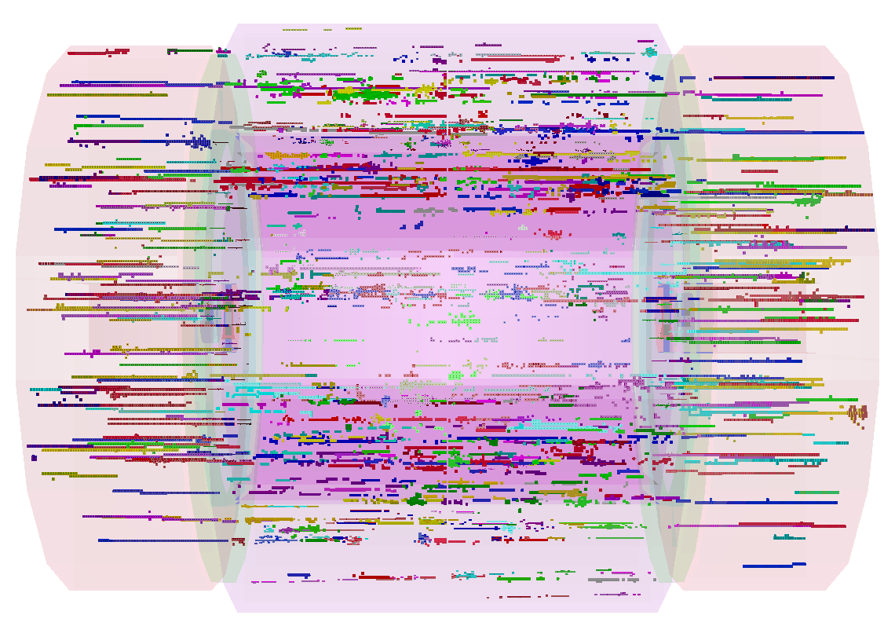
Muon Background in Calorimeters
Mark Thomson
University of Cambridge

Slide 2
Detector Simulation
Simulated events with entire bunch train of beam halo muon
background using files from Laurence with spoilers
  assumed 5 muons/BX
  full Geant 4 detector simulation
  full high granularity particle flow reconstruction

Slide 3
Hit counts etc.
Use new files with Spoilers from Laurence Deacon
  Assume 5 muons per BX
  Integrate over whole bunchtrain
In 150 ns from start of bunchtrain:
  ECAL
    Total = 1.5 TeV (54k hits)
    Barrel = 0.8 TeV (18k)
    Endcap = 0.7 TeV (36k)
  HCAL
    Total = 10.8 TeV (128k hits)
    Barrel = 5.3 TeV (32k)
    Endcap = 5.5 TeV (96k)

Slide 4
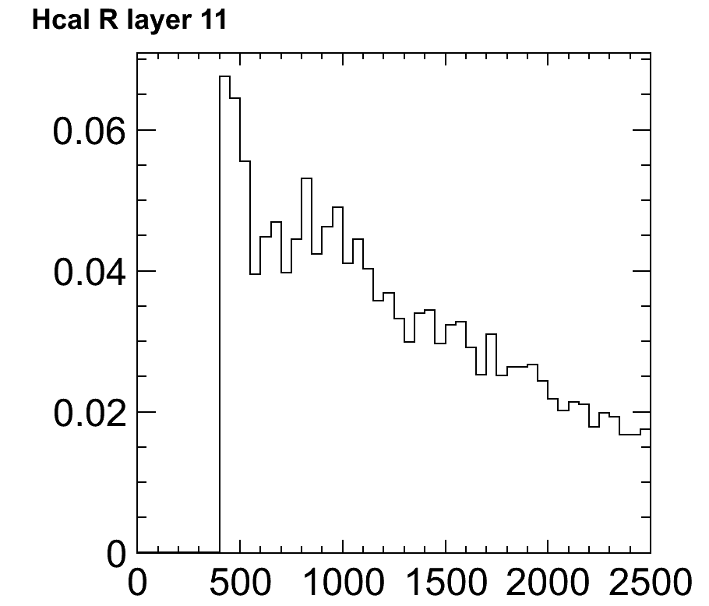
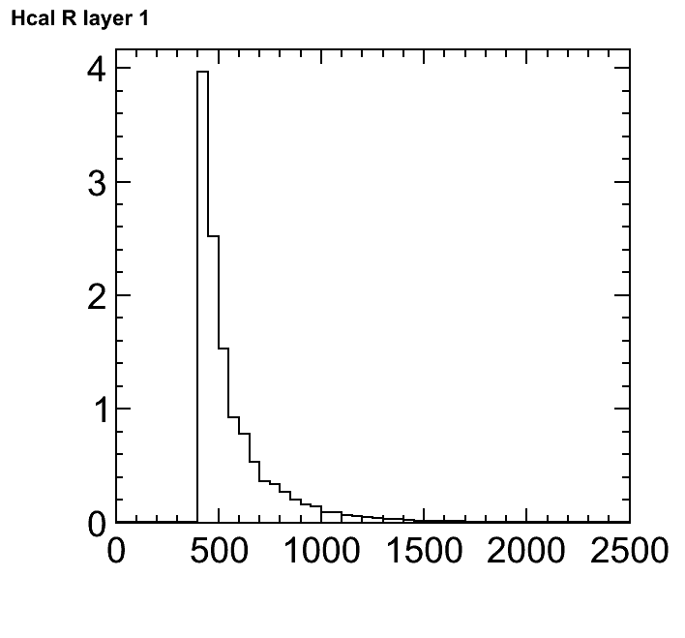
Calorimeter Occupancies
not large, due to spread in x, y.
e.g. HCAL (entire bunch train)
Beam Halo Muon
c.f. gamma gamma
Mean cell occupancy
Mean cell occupancy
R/mm
R/mm

Slide 5
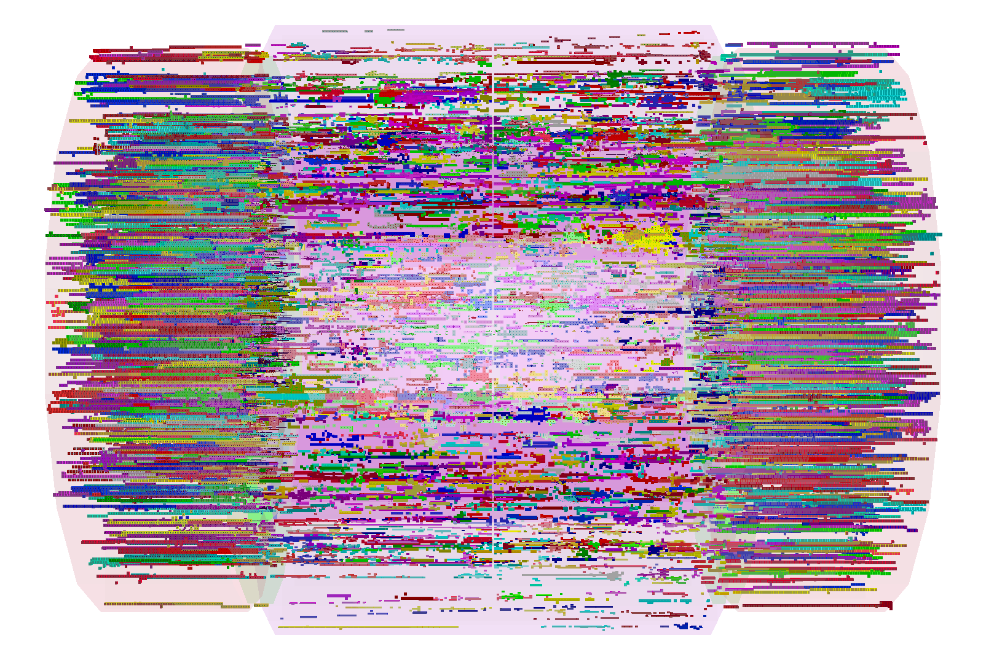
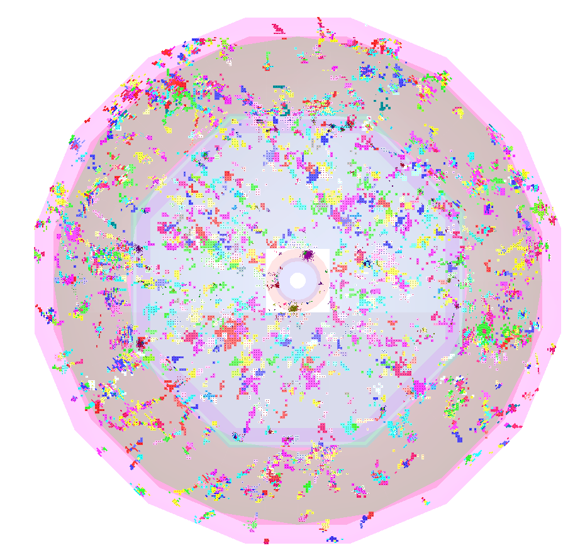
Total Energy Deposit
From entire bunch train, 5 muons per BX
Average energy deposition (50 events) per bunch train:
13.2 TeV

Slide 6
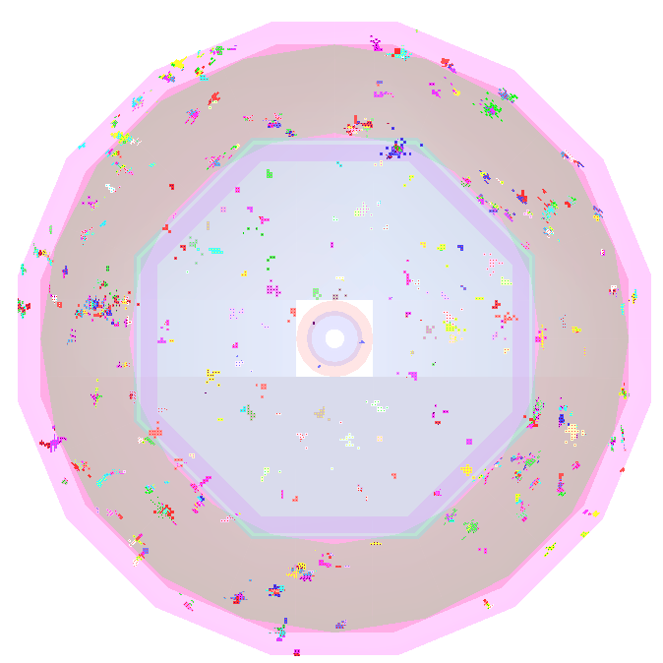
Total In-Time Energy Deposit
Assuming standard timing cuts in calorimeters
  ECAL integrates over 10 ns
  HCAL endcap integrates over 10 ns
  HCAL barrel (Tungsten) integrates over 50 ns
5 muons per BX in time with assumed calorimeter readout
2.2 TeV

Slide 7
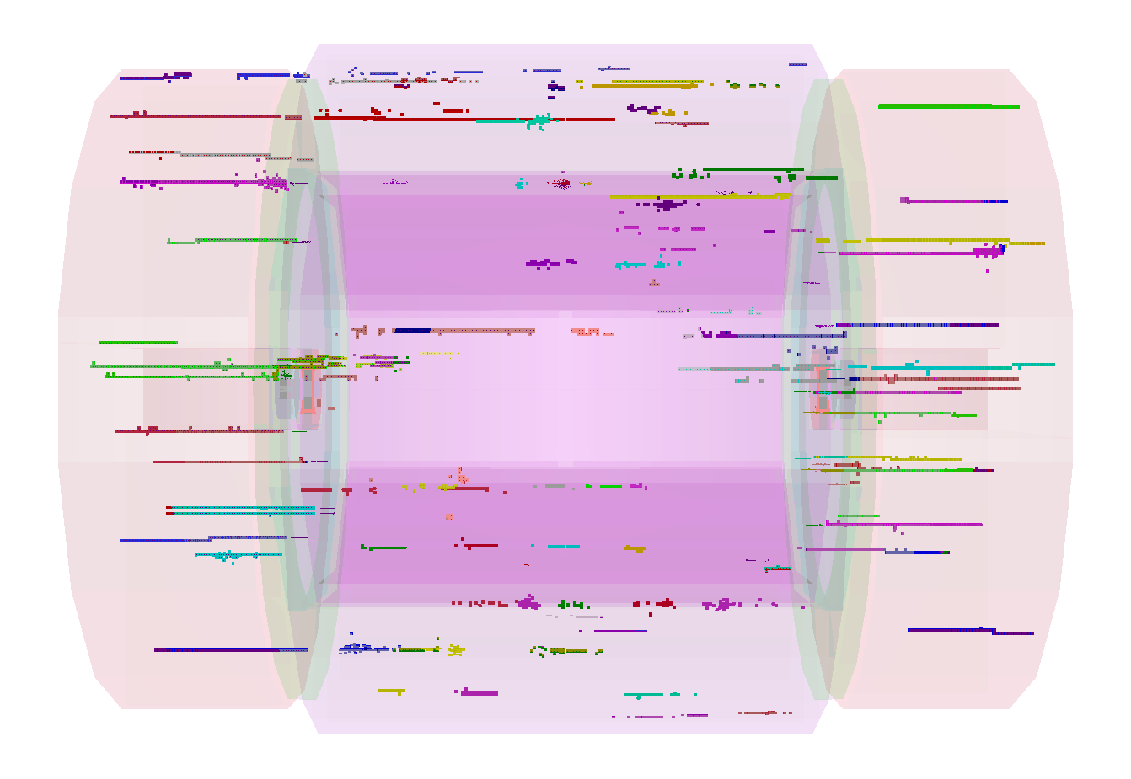
Offline Cluster Time Cuts
Apply timing cuts to “offline” reconstructed clusters
  “Tight” PFO Selection
  Time cuts: require cluster within 1 - 2 ns of physics BX
5 muons per BX in time with O(1-2 ns) time cuts
420 GeV

Slide 8
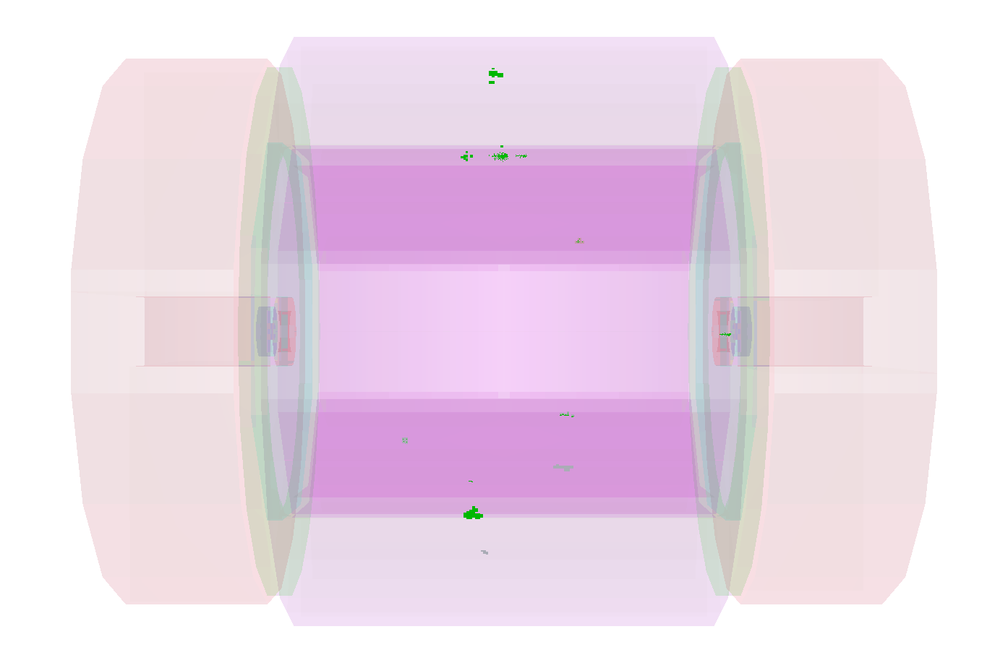
Modified Reconstruction
Implement algorithms in Particle Flow Reconstruction to remove
“clusters” consistent with being from beam halo muons
  Only uses shape information
  Algorithm is run deep down in reconstruction chain
  Quite sophisticated – approximation to realistic pattern
  recognition
30 GeV

Slide 9
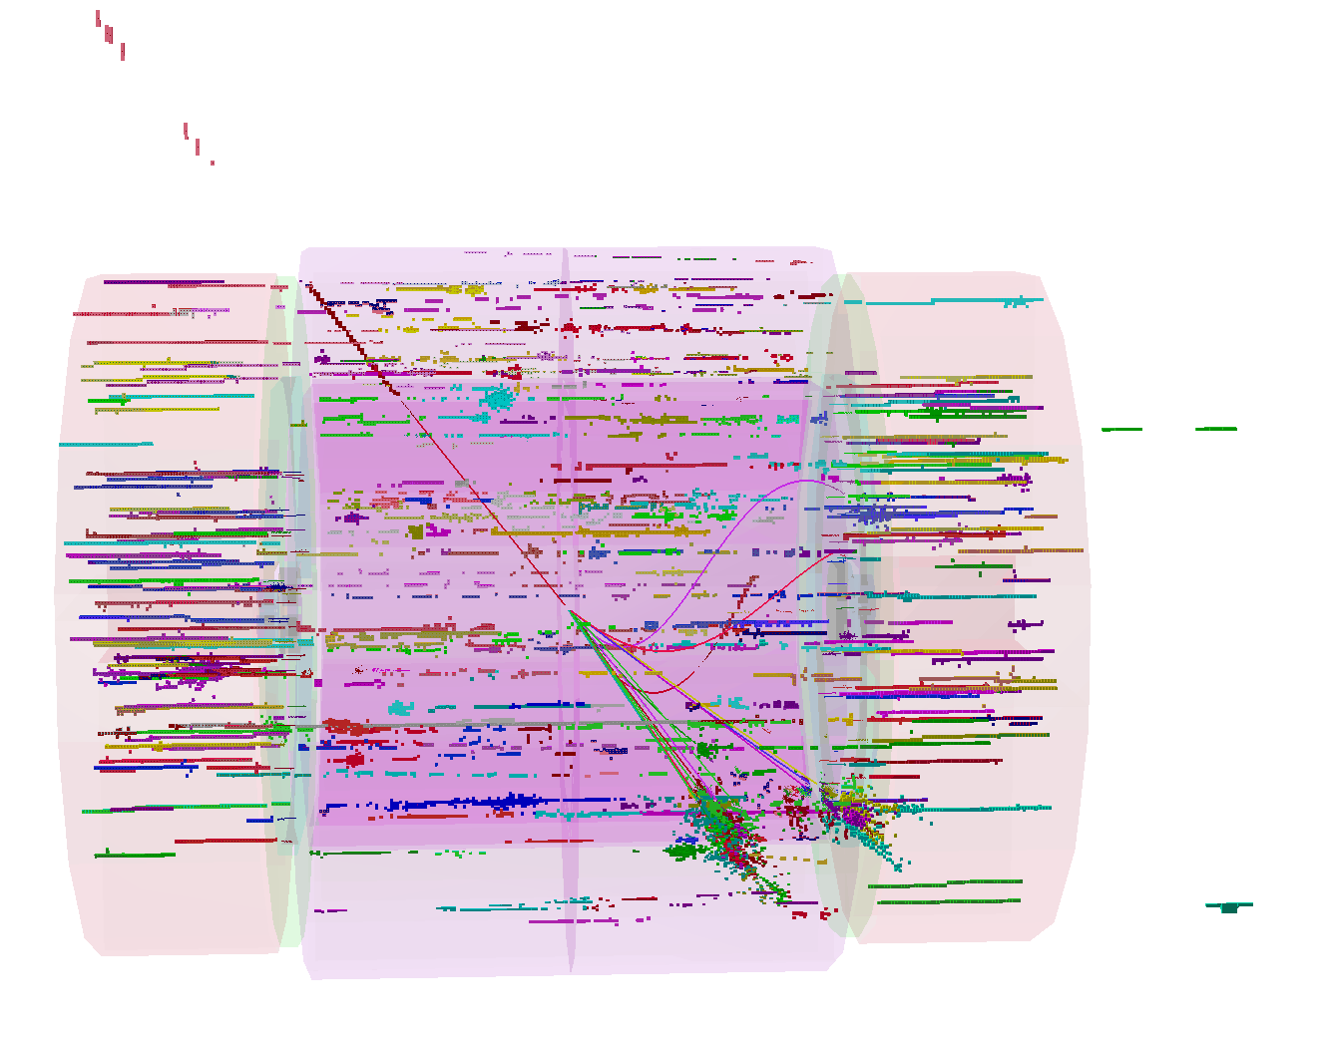
Impact on Physics Observables
Simulated 10000 WW-> qqmn events at 1 TeV
  500 GeV W-> qq
  Overlay full bunch train of beam halo muns
  Reconstruct event using 10/50 ns time windows in calorimeters

Slide 10
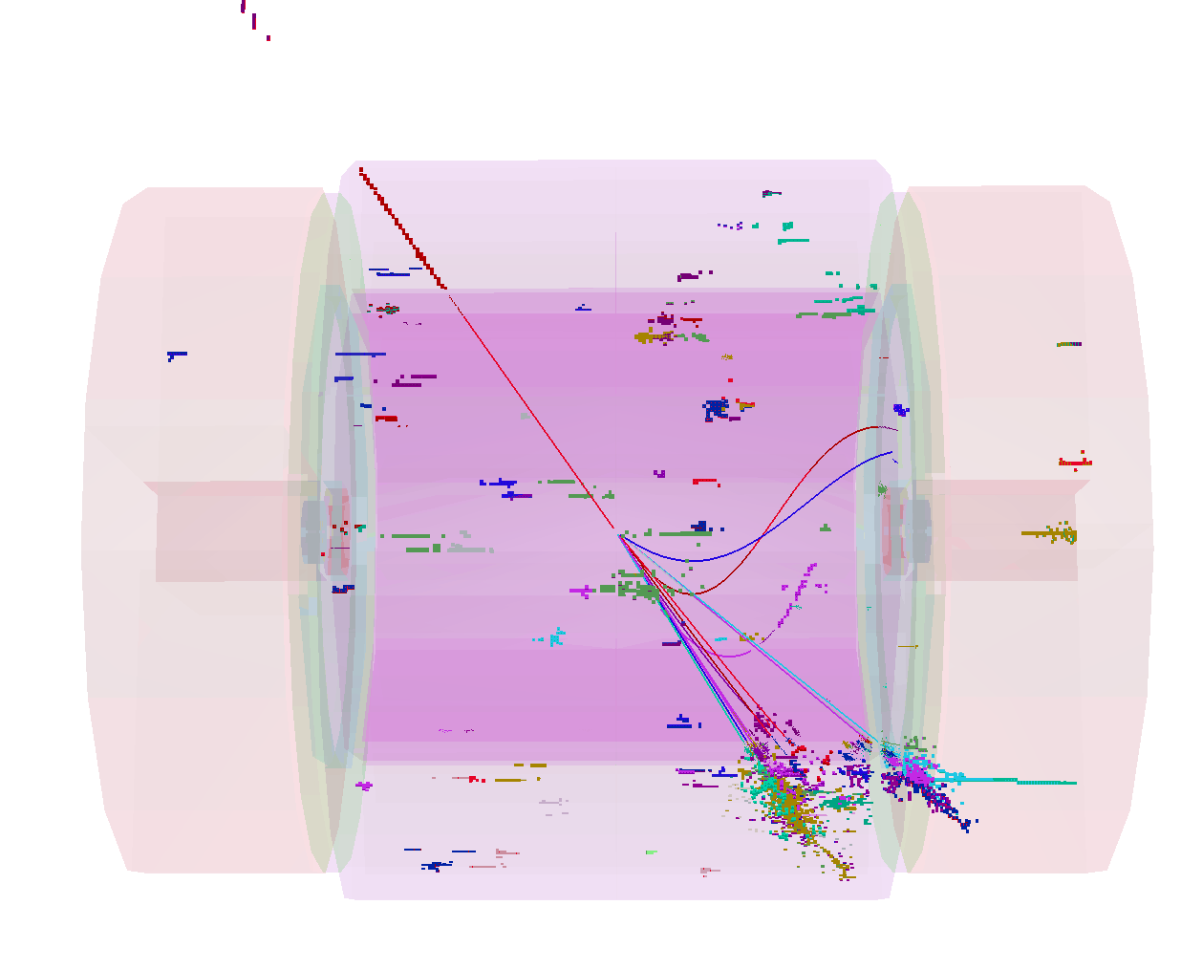
Apply tight timing cuts
Apply tight timing cuts
  1-2 ns timing cuts on cluster time

Slide 11
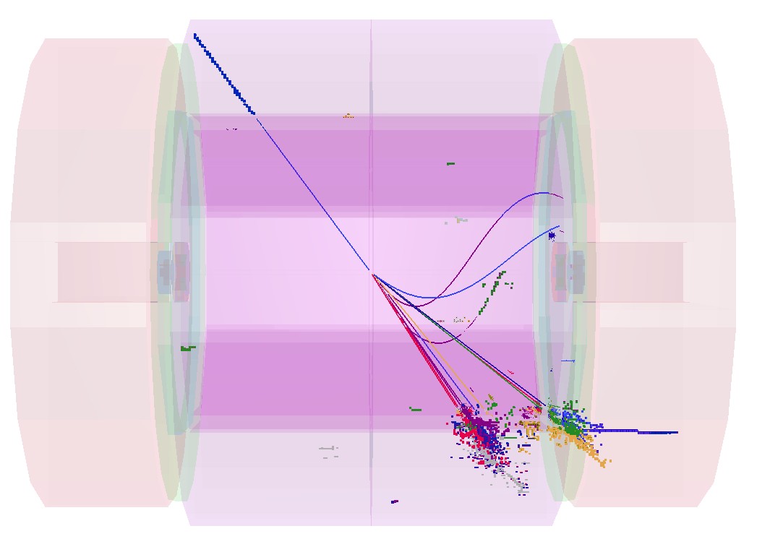
With modified PatRec
Two effects
  30 GeV of energy in clusters from beam halo muons
  (mainly Brems)
  Energy of reconstructed jets also biased “pick” up hits from
  muons ~30 GeV
  Patrec could be improved: conservative estimate of impact

Slide 12
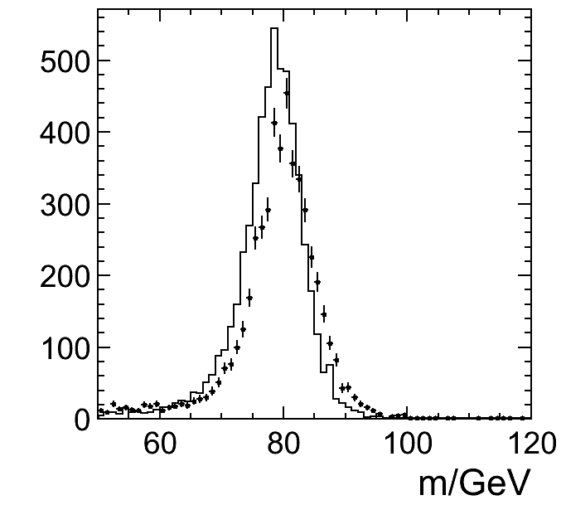
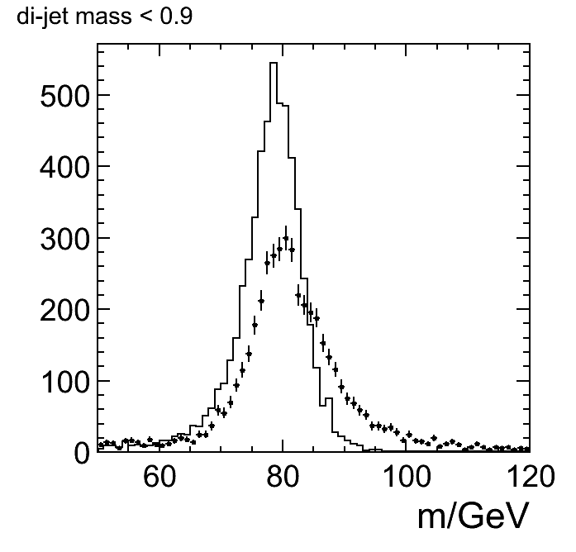
Impact on W reconstruction
W reconstruction
  Remove muon
  Force remainder of event in to 2 jets – using k_{T} algorithm, R = 0.5
  Plot di-jet mass resolution
  Compare full reco no background, to full reco with background
  For comparison look at impact of gamma gamma → hadrons
γγ → hadrons
muon halo (5/BX)

Slide 13
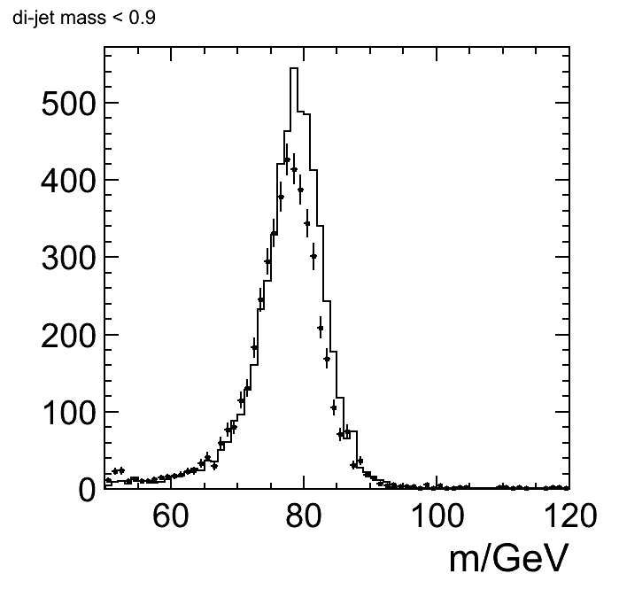
Impact on W reconstruction
Compare impact of 5/BX to 1/BX
  Beam halo background at level of 1 muon/BX is acceptable
  “Safety-margin” of 5/BX is not safe from point of view of physics
  PatRec could be improved but already quite sophisticated
muon halo (5/BX)
muon halo (1/BX)

Slide 14
Conclusions
Beam halo muon background at level of 1/BX is
survivable (but still not comfortable)
At level of 5/BX physics, performance of
the detector greatly compromised
Ideally would look to design machine for beam
halo background at level of 0.1-0.2 per BX
(allows factor 10 safety margin)

