Slide 1
IEEE President’s Remarks
Tom Coughlin, 2024 IEEE President & CEO
CERN
30 May 2024

Slide 2
My Professional Background
Founder and president of Coughlin Associates, located in San Jose, California, and provides market and technology analysis as well as data storage, memory technology, and business consulting services
More than 40 years of experience in the data storage industry and has been a consultant for over 20 years
Granted six patents
Author of Digital Storage in Consumer Electronics: The Essential Guide, which is in its second edition
Regular contributor on digital storage for Forbes blog and other news outlets
IEEE Life Fellow, Past President IEEE-USA, Past Director IEEE Region 6, General Chair of the 2011 Sections Congress and Past Chair Santa Clara Valley IEEE Section
Also active with Storage Networking Industry Association and Society of Motion Picture and Television Engineers
For more information on Tom Coughlin go to www.tomcoughlin.com

Slide 3

Imagine the Future of IEEE
Painting by Rick Guidice, courtesy NASA.

Slide 4
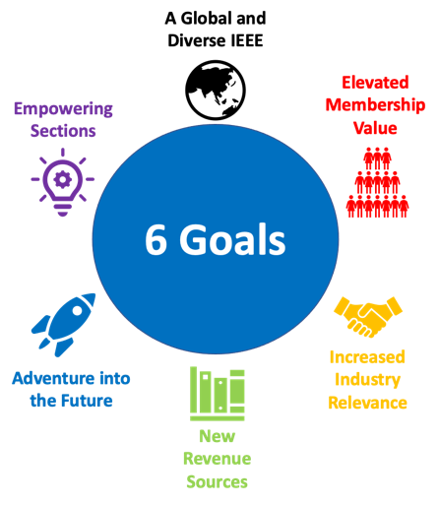
My Priorities for 2024
Increase our retention of younger members
Increase our engagement with industry
Increase our outreach to the broader public
Make investments in new products and services

Slide 5

Inspiring a Global Community of Innovation
Where forward-thinking technology professionals collaborate
Discover what’s next in technological innovation
Create international standards
Build technical communities
Shape and share research
Our Mission
The core purpose of IEEE is to foster technological innovation and excellence for the benefit of humanity
Our Vision
IEEE will be essential to the global technical community and to technical professionals everywhere, and be universally recognized for the contributions of technology and of technical professionals in improving global conditions
www.ieee.org
Notes:
IEEE information is more than just electrical engineering and computer science, IEEE wants to look at the big picture and solve global problems.
What does that mean?
It means that IEEE:
Expands and enables diverse communities to help individuals from around the world to share, collaborate, network, debate, and engage with one another.
Provides technically vital forums for the discussion, development, and dissemination of authoritative knowledge related to traditional, emerging and disruptive technologies.
Leads humanitarian efforts around the world to use technology to solve the world’s most challenging problems.
Leverages IEEE’s technology-related insight to provide governments, NGOs and other organizations, and the public with innovative and practical recommendations to address public policy issues.
Develops business solutions that are vital to both companies and their employees.

Slide 6

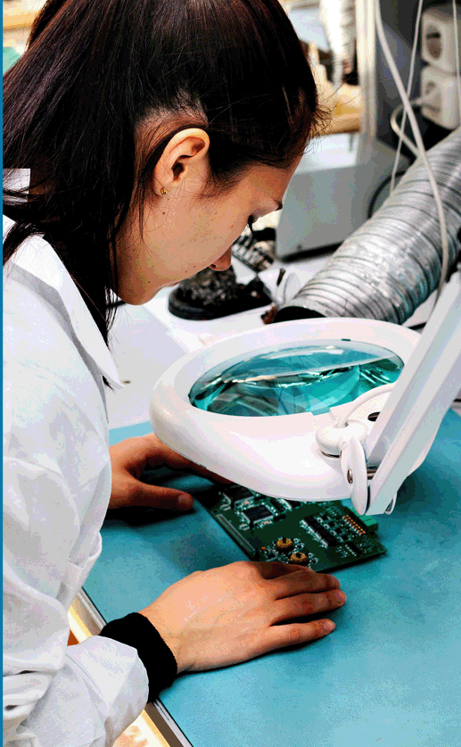
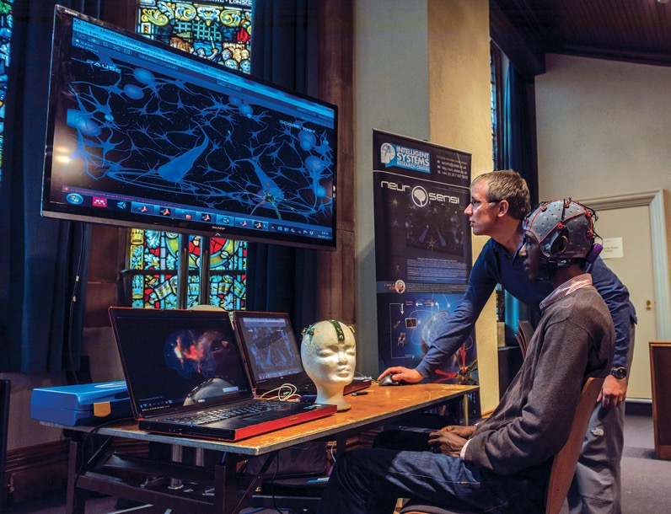
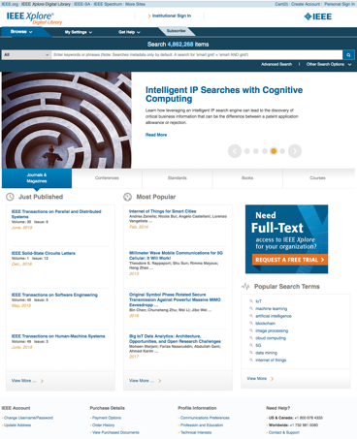
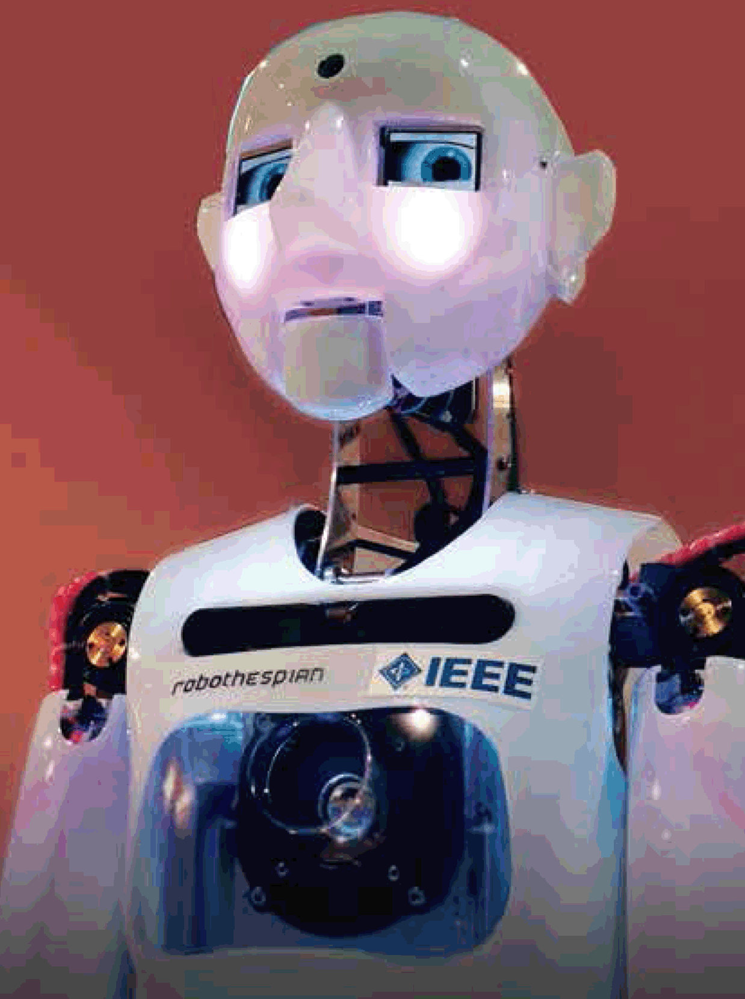


IEEE at a Glance
460,000+ members in more than 190 countries
  More than 171,000 Student members
39 technical Societies and eight technical Councils representing the wide range of IEEE technical interests
6 million+ documents in the IEEE Xplore® digital library, with 24 million+ downloads each month
1,144 active standards and 1,000+ standards under development
Publishes approximately 200 transactions, journals, and magazines
Sponsors 2,000+ conferences in 190 countries a year
Continuing Technology Education Resources
Global public policy and professional ethics
International Climate Change engagement
All figures as of December 2023

Slide 7

IEEE: A Resource For Technology Decisions
Technology of all sorts drive the world’s economy.
IEEE is the largest technical professional organization in the world.
IEEE members are involved in all aspects of technology creation and use.
IEEE research powers patents and IEEE creates many of the world’s technical standards.
IEEE fosters efforts in future directions, technical roadmaps and tracking megatrends.
IEEE can inform public policy and is a resource for technical discussions.

Slide 8

Technical Know-How that is Broad and Deep
Access to ideas and innovations developed in other disciplines
Electrical and electronic engineering, computer science, and beyond:
Aerospace
Biomedical Engineering
Broadcasting
Circuits
Communications
Computing
Control and Automation
Electronics
Environment
Industrial systems
Information Technology
Internet of Things
Life Sciences
Nanotechnology
Optics
Power and Energy
Robotics and AI
Semiconductors
Smart Cities
Smart Grid
Transportation and Vehicles
And more…

Slide 9





The world’s most successful technology leaders and organizations rely on IEEE information
Corporations
24 of the top 30 Semiconductor
8 of the top 10 IT Software and Services
All top 10 Aerospace and Defense
8 of the top 10 Technology Hardware and Equipment
3 of the top 5 Consumer Durables (Electronics/Automotive)
8 of the top 10 Telecommunications
Universities
All the top 100 engineering schools in the US*
(U.S. News and World Report, Top Engineering Graduate Schools of 2023, ranked in 2022)
98 of the top 100 Engineering
and Technology Universities Worldwide* (Times Higher Education, Subject Ranking 2021-2022: Engineering & Technology)
Government
Defense research and aerospace agencies
Communications and energy labs
Patent offices and scientific councils
Government R&D centers in North America, Europe, Asia, and the Middle East
(Forbes Global 2000 Rankings, 2023)
* As of August 2023

Slide 10

IEEE Xplore Digital Library
Top research organizations in the world rely on to fuel imagination and drive innovation
IEEE journals, conference proceedings and standards plus select partner content dating as far back as 1884
More than 6 million documents, 24 million downloads per month, and over 8 million unique users
Over 1.2 million articles from over 200 top-cited IEEE journals, magazines, and transactions
Over 4 million conference papers from as far back as 1936, with up to 200,000 added each year
More than 4,900 approved and published IEEE standards
eBook collections covering emerging topics in engineering, computer science, telecommunications, AI and more
eLearning topics such as AI, High Performance Computing, Configuration Management, and more; plus a suite of Professional Development options now available
https://ieeexplore.ieee.org/

Slide 11

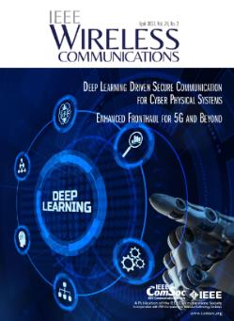
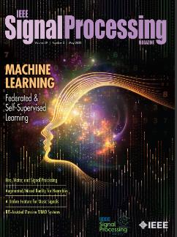



IEEE Publications: Quality, Trusted Resources
Latest studies reinforce that IEEE has more top cited publications in
IEEE fields of interest than any other publisher.
Citation Ranking by Journal Impact Factor:
15 of the top 20 journals in Electrical and Electronic Engineering
10 of the top 10 journals in Telecommunications
3 of the top 5 journals in Automation and Control Systems
5 of the top 10 journals in Computer Science, Artificial Intelligence
3 of the top 5 journals in Computer Science, Hardware & Architecture
The top 3 journals in Computer Science, Cybernetics
3 of the top 5 journals in Computer Science, Information Systems
2 of the top 5 journals in Computer Science, Software Engineering
3 of the top 5 journals in Imaging Science and Photographic Technology
Source: Journal Citation Reports (Clarivate Analytics, 2023)
Notes:
The annual Journal Citation Results (JCR) study by Clarivate examines the influence and impact of scholarly research and offers a systematic, objective means to evaluate the world's leading journals. By compiling articles' cited references, the JCR helps to measure research influence and impact, and shows the relationship between citing and cited journals.
The rankings demonstrate the important role of IEEE publications in publishing important new discoveries in IEEE fields of interest and disseminating that critical new information to the global community of millions of IEEE Xplore users.

Slide 12






IEEE Standards Association (IEEE SA)
Standards nurture, develop, and advance the building of global technologies.
Consumers around the world enjoy the benefits of IEEE Standards:
  Provide the bricks and mortar
  for a globally level playing field
  for innovation
  Protect public safety,
  health & wellbeing
  Contribute to a
  sustainable future
CONFIDENCE
Demonstrating quality to customers by meeting expectations & requirements
Standards nurture, develop, and advance the building of global technologies.
COMPETITION
Influencing the competitiveness of industries & companies
Global
IEEE
Standards
INNOVATION
Providing an essential platform on which new technologies & processes can build
GROWTH
Facilitating trade & economic growth
PERFORMANCE
Fine-tuning performance and improving efficiency
SUSTAINABILITY
Making technology safer, interoperable and sustainable for the future
Learn more: standards.ieee.org

Slide 13
Technology. Standards. Innovation.
The world is at a critical nexus as we strive toward the SDGs, address global challenges and realize the importance of SMEs and developing economies in technology and standards development
The world is in a radical transformation in which innovative technologies cannot work in isolation
They are based on connected ecosystems and function in an interconnected world where objects, machines, people and the environment are increasingly interlinked and impacted
Standard play a pivotal role as they . . .
Facilitate ongoing digitalization by promoting interoperability and compatibility and competition in open markets
Make available specifics of innovations to the wider public—spurring technical knowledge and generating new ideas and products
Create ecosystems that promote economies of scale and healthy competition
Provide leadership in socio-technical areas, such as environmental sustainability and ethical values-based design

Slide 14
Standards in the Digital Economy
Standards are accelerators of change by promoting innovation and helping with the uptake of new digital technologies—helping boost development of the digital economy
They play an impactful role in addressing digital economy challenges
Cybersecurity
Privacy
Data resilience, governance
and value chains
And they do so across industries and sectors
Agri-food
Advanced manufacturing
Health and bioscience
Technology ethics
Environmental impact
Human well-being
Transportation and mobility
Human well-being
Telecommunications and more

Slide 15
The Use of AI Systems Is Growing …
Worldwide revenues for the artificial intelligence (AI) market, including software, hardware, and services, are forecast to grow year over year in 2021 to ~ $1,800B by 2030
There is a conscious increase by services providers to applying AI to solve industry- and domain-specific problems for clients
~80M US Adults use an AI assistant in their cars at least once a month
50+% of companies monitor AI-created bias
Regional and National strategies have only increased investments into horizontal and vertical-oriented AI systems – coordination across University systems and research bodies is key.
Source: IDC, Markets&Markets, O’Reilly
Notes:
The development of AI systems brings an IT opportunity.
From an economic View of earning almost 1 Trillion US dollars by 2028, and an
Optimistic View for a growing field of hundreds of AI use-cases to solve humanity’s problems. Imagine being able to generate efficient, sustainable energy, reverse climate change, diagnose and treat cancers, control epidemics, and solve the world’s food crisis!
AI’s ability is driven by the availability of data, embedded devices, connectivity, compute power, deep learning methods, and of course financial returns that are increasing all of the time through subsidies and demand.

Slide 16
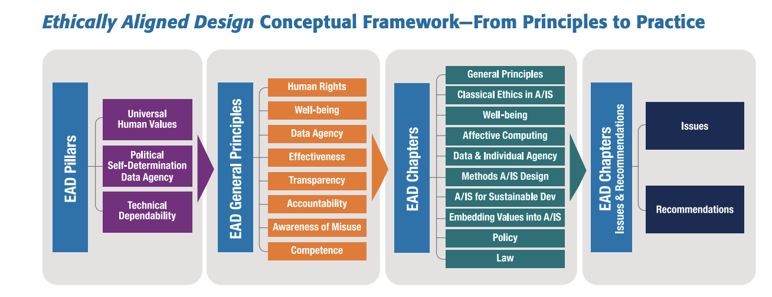
ETHICALLY ALIGNED DESIGN
AIS Ethics in Action Since 2015
      First version released in 2016.
      Latest version released March 2019.
      Received over 500 pages of feedback.
      Written by more than 700 global thought leaders.
      Over 300 pages long – not just a list of AI Principles.
      Features hundreds of evergreen, pragmatic recommendations.
      Inspired IEEE’s AIS Ethics Certification work.
      EAD,v2 used by OECD for their AI principles.
      EAD, v2 used by IBM for “Everyday Ethics for AI.”
      EAD, v2 used by FLI for their AI Principles.
      EAD, v2 used by UNICEF for their Children’s Data principles.
      EAD, v2 used by UNESCO for their AI Principles.
      EAD in all versions mentioned in more than three dozen academic journals, AI Principles and media since 2016
16
Notes:
Basic intro of EAD and its value with a focus on the fact the work began in 2015.
Governance in the form of applied ethics and design was always the focus; not philosophy for philosophy’s sake.
Overall logic is teaching people to fish (use human-centric, values-driven design methodologies) versus just give them a fish (lists of AI Principles in isolation).

Slide 17




IEEE’s Path: Make the Implicit Explicit & Verifiable for the Entire AI Ecosystem
STANDARDS
CERTIFICATION
GOVERNANCE
LITERACY
Developing a growing series of standards that promote innovation, foster interoperability and honor human values.
Technical
Socio-technical
Developing metrics and processes towards the implementation of a certification methodology.
Transparency
Accountability
Algorithmic bias
Privacy
Enterprise Governance
Support responsible Artificial Intelligence Systems innovation through proper governance mechanisms for:
Business
Municipalities/ Cities
Public Sector/ Governments
Through AIE+ framework and partner ecosystem offering tools and training/education globally to support AI and AIE system literacy
Business
Municipalities/Cities
Public Sector/ Governments
Programs
https://standards.ieee.org/initiatives/artificial-intelligence-systems

Slide 18











Participate in the Future of Technology
Discover technical community that best match your ​interest​s​
IEEE Future Directions fosters IEEE’s efforts to create new and emerging technology initiatives
Technical Communities
are focused on technology challenges or cutting-edge subject areas with direct impacts on industry
18
Learn more: ieee.org/futuredirections

Slide 19





IEEE Roadmaps
Published roadmaps
roadmaps.ieee.org
Evaluate, recommend, implement technical IEEE Roadmaps
Four published, others under construction

Slide 20
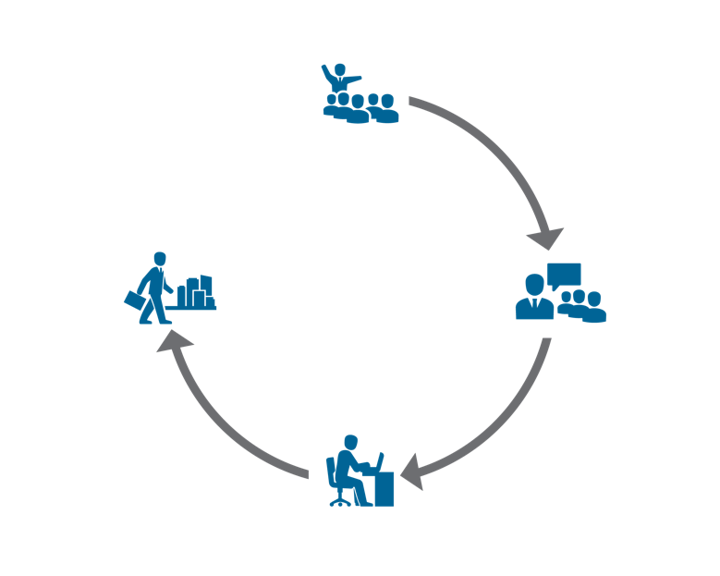










A sampling of IEEE’s Education Programs
PRE-UNIVERSITY
ADVANCED AND
MID-CAREER
PROFESSIONALS
UNIVERSITY
YOUNG PROFESSIONALS
Notes:
IEEE believes we have the responsibility to engage with engineers and technology professionals throughout their lives. As such, we have programs across their lifecycle.
In the Pre-University space, we have programs designed to inspire the next generation to consider engineering, especially students from under resourced areas across the globe. We do most of that through our “TryEngineering” Programs. The whole idea behind TryEngineering, when it was started almost 20 years ago, and today, is to focus on getting children to just “Try” Engineering at an early age. From our main website TryEngineering dot Org that has over 130 completely free lesson plans and other engagements for teachers, to our TryEngineering Together mentoring program for Title 1 school districts, and our High School Summer Institutes, our goal is to open engineering to more students each year though their teachers. We also have the IEEE REACH program designed to teach engineering and technology through Social Studies and History teachers.
At the University level, many of you know we are the largest participating society in ABET activities, and coordinate volunteers to review over 800 engineering and engineering technology programs. And you all also know, and many of you are past inductees of IEEE Eta Kappa Nu which celebrated a decade since is merger with IEEE recently. Our EPICS in IEEE Program has resulted in over $1M in grants to student service learning We also recently launched the IEEE Teaching Excellence Hub designed to be a resource for university teachers and administrators who came to IEEE looking for resources during the Pandemic. This program is in it’s infancy and could use more content to increase its strength as a resource. So if you think you or anyone in your university would be interested, please let me know.
Finally, for those who have completed their Undergraduate or Graduate Education, we have a lot of continuing education resources. Of course our journals and magazines are a key resource, but we also have the IEEE Learning Network, IEEEtv, and many of our technical societies have abundant resources centers full of educational content.

Slide 21














































And so much more from so many units across IEEE…
IEEE History Center
IEEE Human Resources
Humanitarian Activities
Life Members Committee
IEEE MGA
IEEE Alaska Section
IEEE Canada and Canadian Sections
IEEE Chicago Section
IEEE Dayton Section
IEEE France Section
IEEE Lexington Section
IEEE Japan Sections
IEEE India Sections
IEEE Malaysia Section
IEEE Philadelphia Section
IEEE Phoenix Section
IEEE Puerto Rico/Caribbean
IEEE Region 4
IEEE Region 7
IEEE Region 9
IEEE Region 8
IEEE Region 10
IEEE San Diego Section
IEEE UKRI Section
And more..
IEEE’s many units educate our community
Magazines, books, eBooks, journals, and websites
Conferences, short courses, and seminars
Videos, webinars and podcasts
Volunteer training and leadership opportunities

Slide 22


The bridge to your professional career!
IEEE Students and YP Focus
Connecting academia and industry by stewarding local and global IEEE Young Professionals (YP) communities that support Members at each stage of their professional journey
Expanding professional networks of early-career practitioners and elevate their professional images
Creating meaningful collaborative opportunities that jumpstart and advance Members’ careers
Providing pathways for leadership development that refine skills through leadership opportunities
IEEE Member Benefits
Access to current technical information via numerous publications
Career advancement and volunteer opportunities respective to Members’ time/capacity
Invitations to technical and non-technical events including conferences, webinars, completions, social gatherings, and more
Networking, including high-quality mentoring experiences
Members only Discounts on Life Insurance and a variety of products and services
Access to the IEEE JobSite

Slide 23
Opportunities
Leadership Transitions
Elevate Member Grade
Student
Young Professional
Enhance Professional Career
SB Mentor/Advisor
Mentorship
SB Officer (Chair)
Gain Experience
Upgrade to
Senior leadership roles
Section YP AG officer
Section SAC Officer (SSRs)
Develop Skills
Section/Chapter officer
Expand your
Professional Network
Region SAC Team
(webmaster)
Work with Senior Leadership
Other Regionals/MGA
volunteer roles
Ambassador Programs
(IEEExtreme)
Expand Network
Enhance your profile
MAKE A CHANGE
MAKE A CHANGE
23

Slide 24
Learn, Contribute, and Boost your Resume by Volunteering
Many of the key benefits of volunteering are also skills essential to continued professional success
Advance your knowledge in all aspects of technology and the sciences
Help guide the evolution of your field
Network with others from around the world
Gain confidence and develop presentation skills
IEEE offers a variety of volunteering opportunities suited to various needs and interests
  Communications
  K-12 STEM Education
  Diversity and Inclusion
  Employment and Career Services
  Public Policy Committees
  Standards Development
  Chapter and Section Leadership
  Society Leadership
  Conferences and Publications

Slide 25
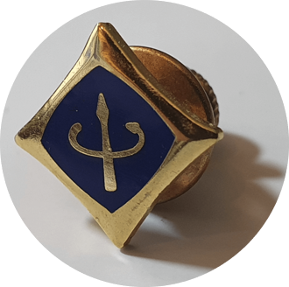
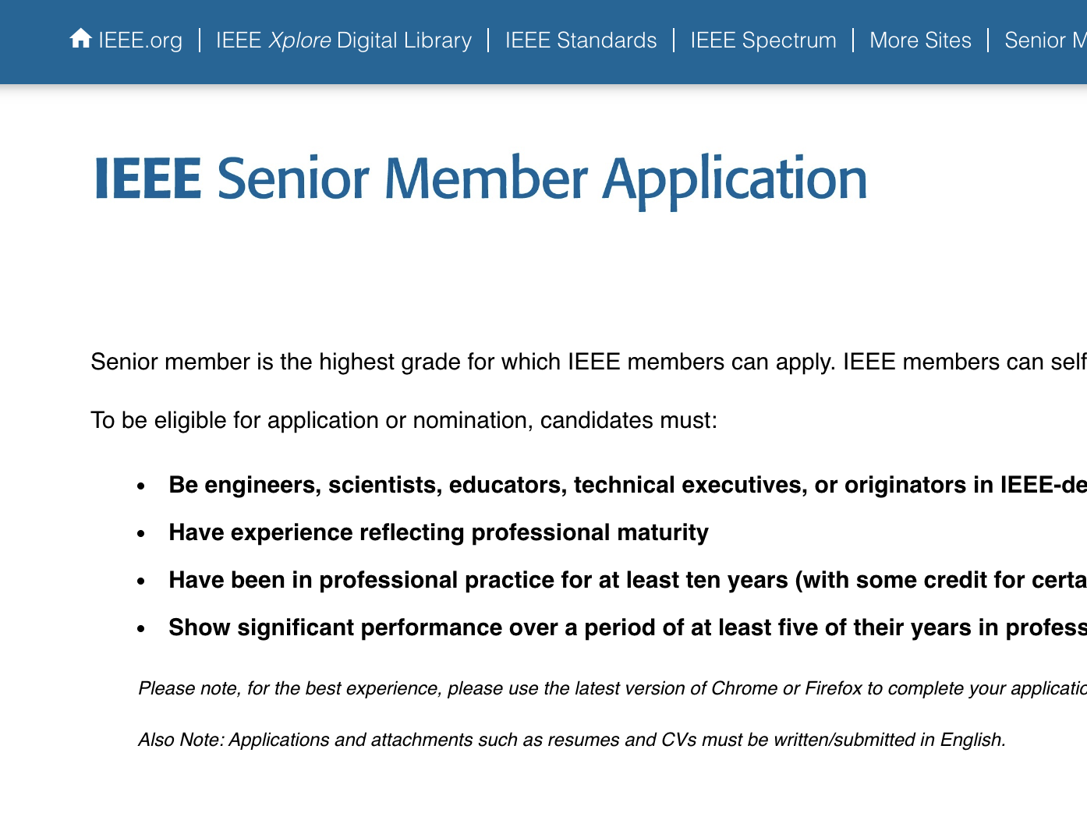
Are you a Senior Member?
Many volunteer roles require senior membership, apply today to expand the pool and increase the diversity of available volunteers!
  Recognition: The professional recognition of your peers for technical and professional excellence.
  Leadership eligibility: Senior members are eligible to hold executive IEEE volunteer positions.
  Ability to refer other candidates: Senior members can serve as a reference for other applicants for Senior membership.
  Review panel: Senior members are invited to be on the panel to review Senior member applications.
  Complimentary Society Membership: You may join one new IEEE Society for one year.
Apply today!

Slide 26






Stay Current with IEEE
The technology landscape is constantly evolving and so are IEEE products and services.
IEEE introduces new publications to address growing areas of research that transform our lives such as AI, big data, blockchain, machine learning, nextgen wireless, renewable energy, robotics, secure computing, semiconductors and more.
With over 250,000 new documents added each year to IEEE Xplore, coverage of all these technologies can be found in current and forthcoming publications from IEEE.
IEEE has an active portfolio of more than 1,100 standards with more under development that standardize the internet, the metaverse, blockchain, sustainable and ethical design, and age-appropriate design

Slide 27
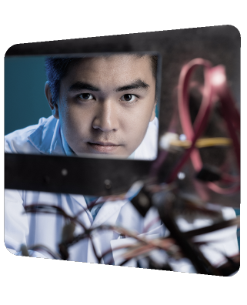

Industry Engagement – A Priority
To better serve industry by identifying and developing value added industry relevant products and services.
New industry focus content – technical content/material for practicing engineers such as articles, videos, podcast, courses, and others
Industry-focused non-technical skills learning – for example, Leading Technical Teams, AI Training, and Building Business Relationships
Local Industry Affinity Groups – city, community, or company specific groups of industry professionals that come together to network and discuss relevant technical topics impacting their communities such as aerospace, energy, semiconductors, and AI

Slide 28

Industry Engagement – A Priority Continued
To better serve industry by identifying and developing value added industry relevant products and services.
Career development and job fairs - developing new ways to help companies recruit high-quality workforce
Corporate Social Responsibility (CSR) - Support for companies looking to engage in social good activities, corporate social responsibility, and environmental sustainability
Industry events driven by industry and for industry – companies identify the technical topics and IEEE develops events addressing such topics to meet industry needs (for example, World Technology Summit and HTX)

Slide 29
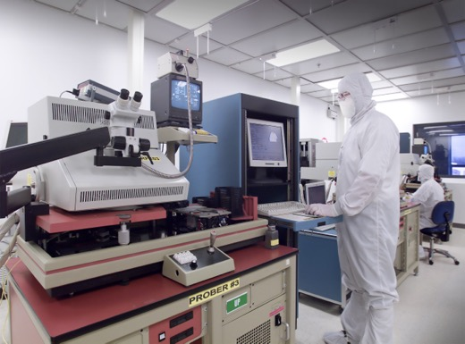
Semiconductor Workforce Development
Partnering to create free global Semiconductor Job Skills Catalog website highlighting technician and operator roles and competencies
  Derivative products can be created from this, including curriculum, assessments, and stackable credentials (revenue opportunities)
  Some external partners that may participate include Semiconductor Industry Association and SEMI Foundation
Exploring our conference tutorials and other IEEE training materials with micro-credentialing options for semiconductor careers
Notes:
Questions about semiconductor activities can be directed to TAB Reps (Bill Tonti/Denise Manning) or Jennifer Fong in EA.

Slide 30


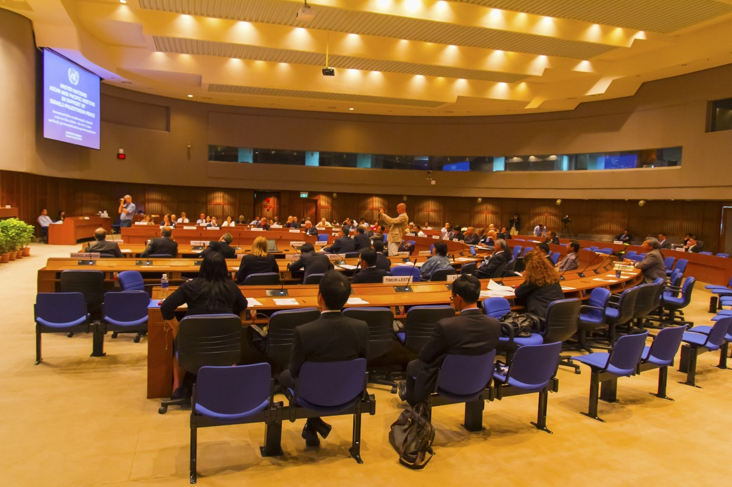
Industry Focused Events
Industry Selects Topics
Challenges
Technology Interests
Needs to get Product
What they want to hear
IEEE & Industry SMEs
Speakers on Topics
Panels
    Research Summaries
    Studies
    Sharable Elements
Industry Events
Agenda approved by industry
Agenda aligned to their topics
Sessions
Exhibitions
Keynotes/Panels
Networking
These are not academic or research events – there is no call for papers.

Slide 31

Tom Coughlin
2024 IEEE President & CEO
president@ieee.org
ieee.org

