Slide 1
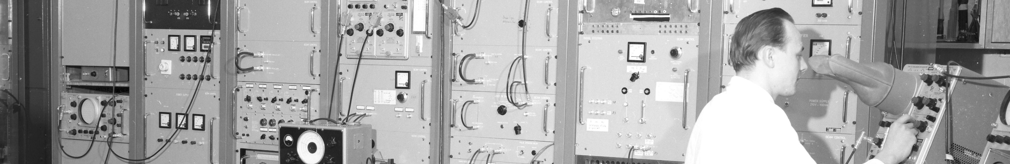
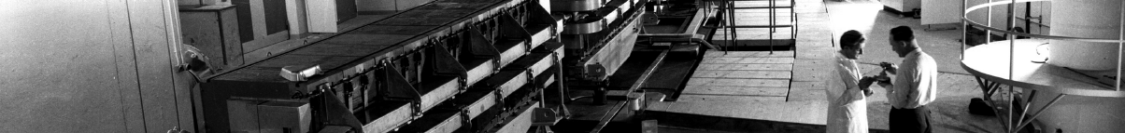
PS Report week 21
Many thanks
to the PS OP and coordination teams as well as all equipment experts and support teams!
A. Lasheen SY-RF-BR
1

Slide 2
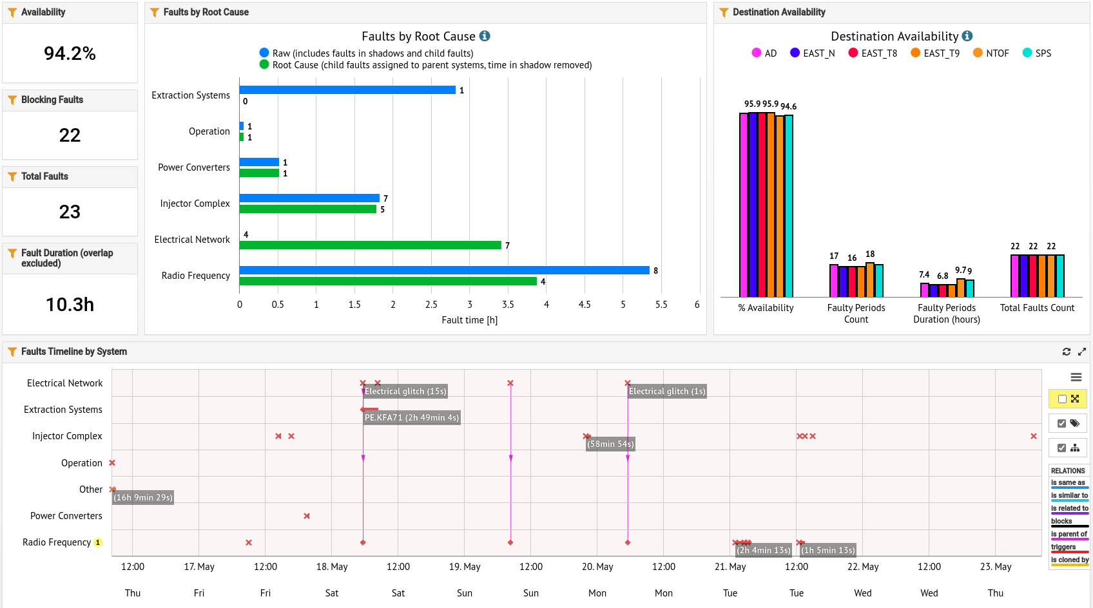
Availability W20/21 (Thu – Thu 9am)
Issues with C10 overnight
Beam stop access C80
Electrical glitches over the weekend
A. Lasheen SY-RF-BR

Slide 3
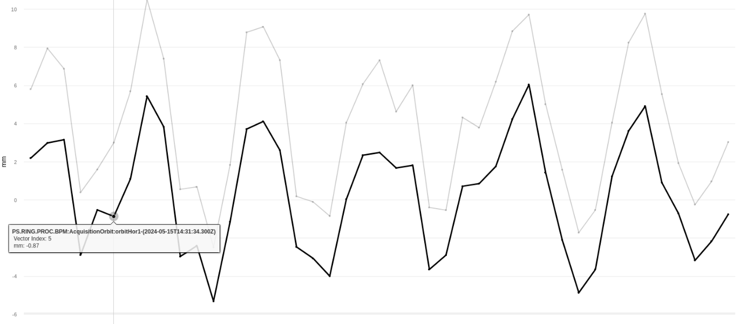
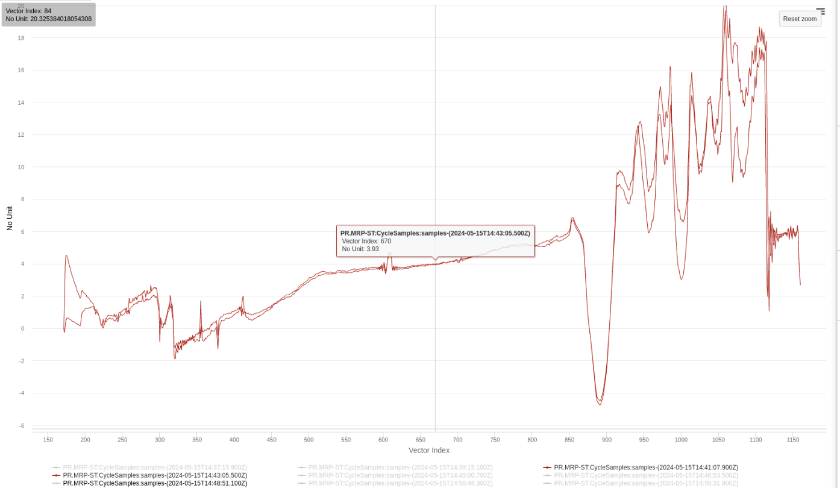
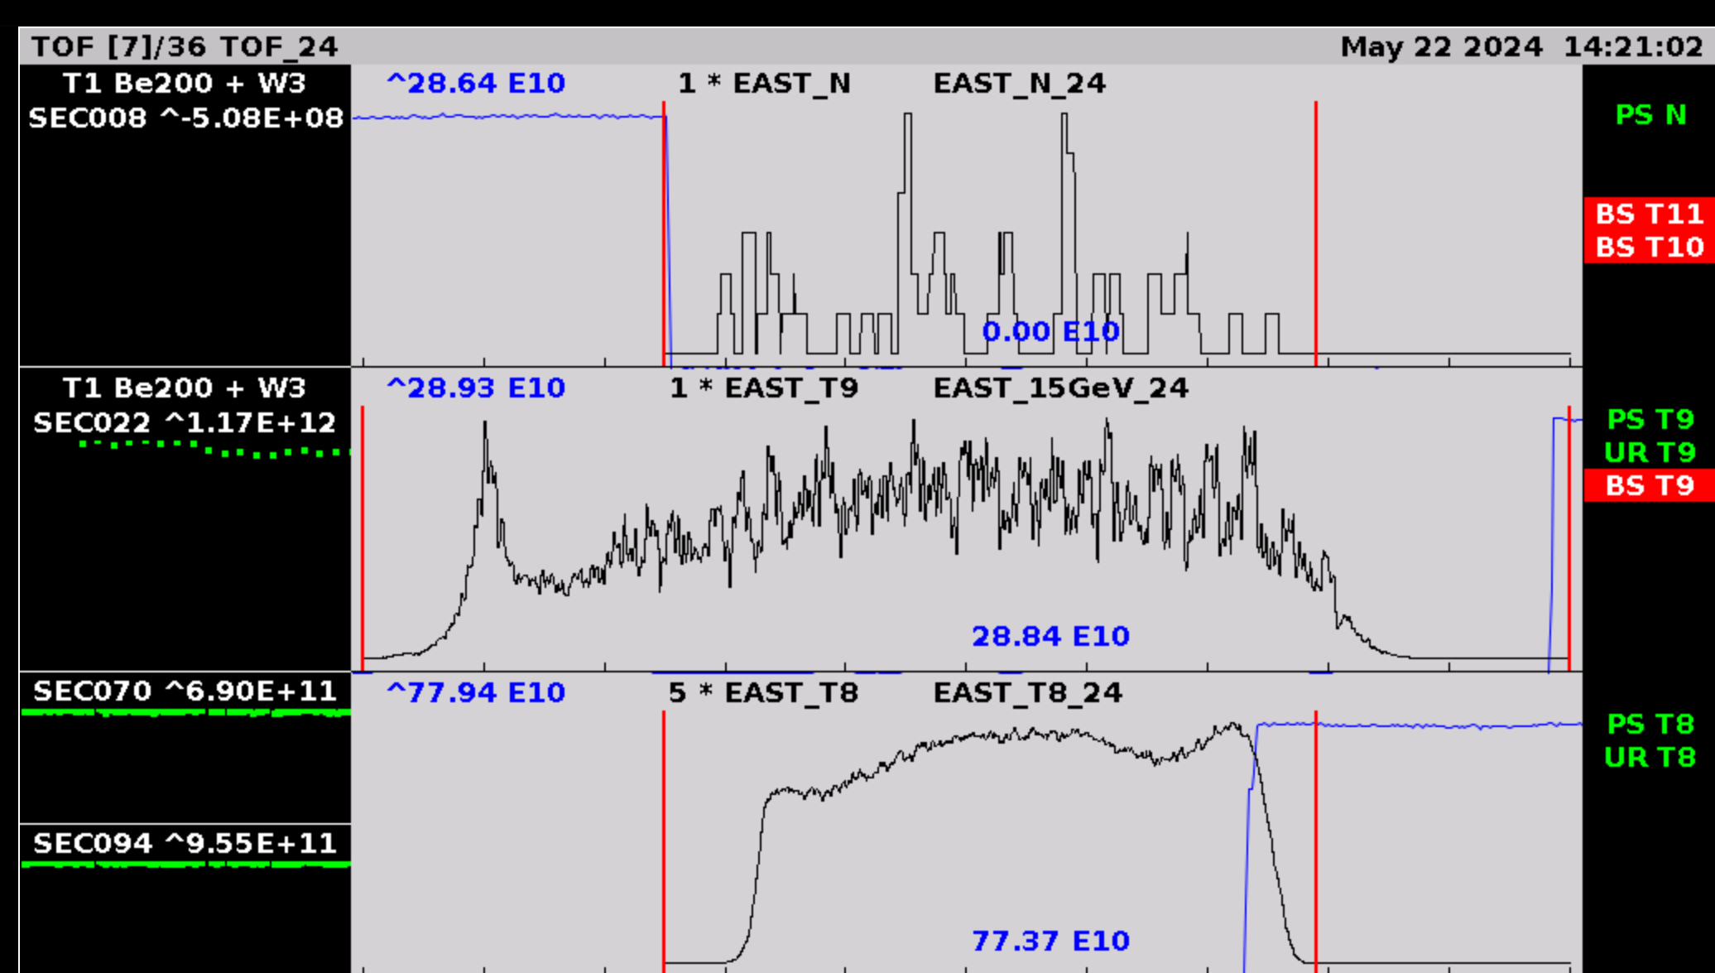
Main issues and activities
Orbit at injection and cycle
Good availability since last Thursday
Important issues on all beams reported on Wed 15.05
  Root cause of the issue remains unclear, large variations in orbit already from injection propagating later during the cycle.
  Sudden change, appearing from one supercycle to the next, also linked to change in PSB-PS energy matching
  All beams brought back to operational conditions on Thu 16.05
Beam prepared for EAST T9 with longer spill at 15 GeV
Issues with RF systems overnight Mon-Tue and Tue (broken power supplies) swiftly fixed by RF experts
EAST 15 GeV
A. Lasheen SY-RF-BR

Slide 4
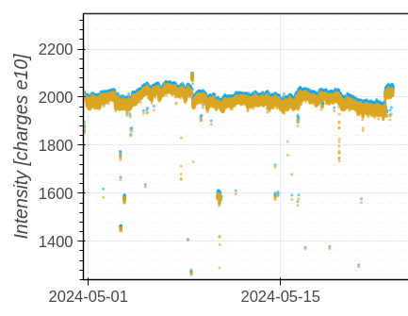
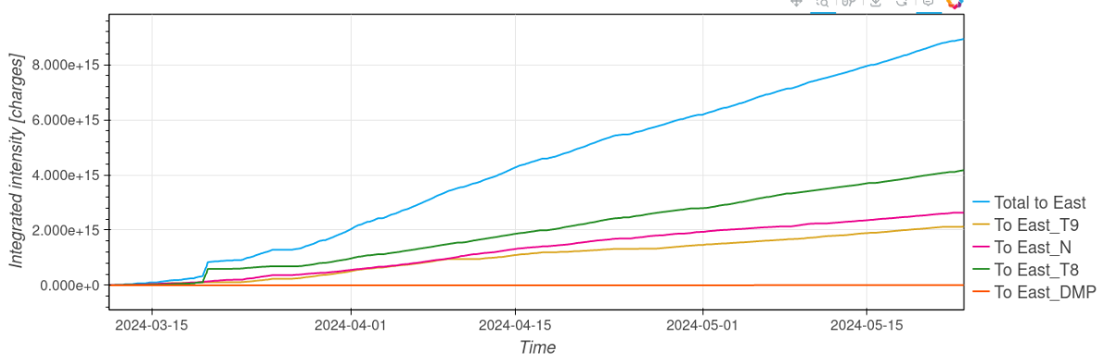
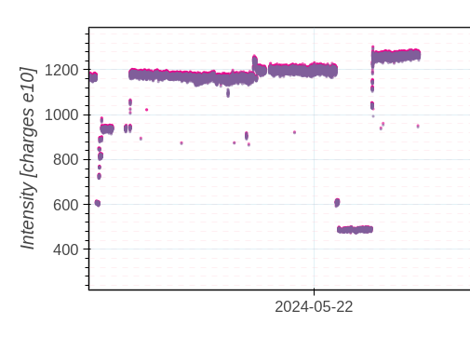
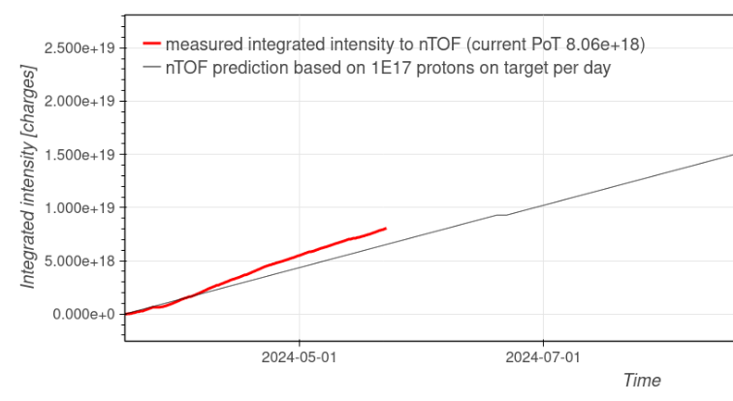
AD
Delivered intensity
EAST
SFTPRO
TOF
A. Lasheen SY-RF-BR
https://bpt.web.cern.ch/

Slide 5

Questions and Comments
PS Coordinator for week 21 – Alexandre Lasheen
PS Coordinator for week 22 – Denis Cotte
9:00 live meeting at the CCC on Wednesday/Friday
Zoom link to follow the meeting on remote: https://cern.zoom.us/j/9372114100?pwd=L29BcmlHUENCdFBRSytXYVcrM1B4Zz09
Meeting ID : 937 211 4100
Passcode: 525463
A. Lasheen SY-RF-BR
5

