Slide 1
Topics for MD simulations

Slide 2
SUMMARY
Dislocations vs film thickness
Dislocations vs ions energy
Dislocations vs interrupted growth
Surface smoothening vs ions energy
Cristallinity vs ions energy
Surface oxide as a barrier to Hydrogen diffusion
Toward Nb3Sn?

Slide 3
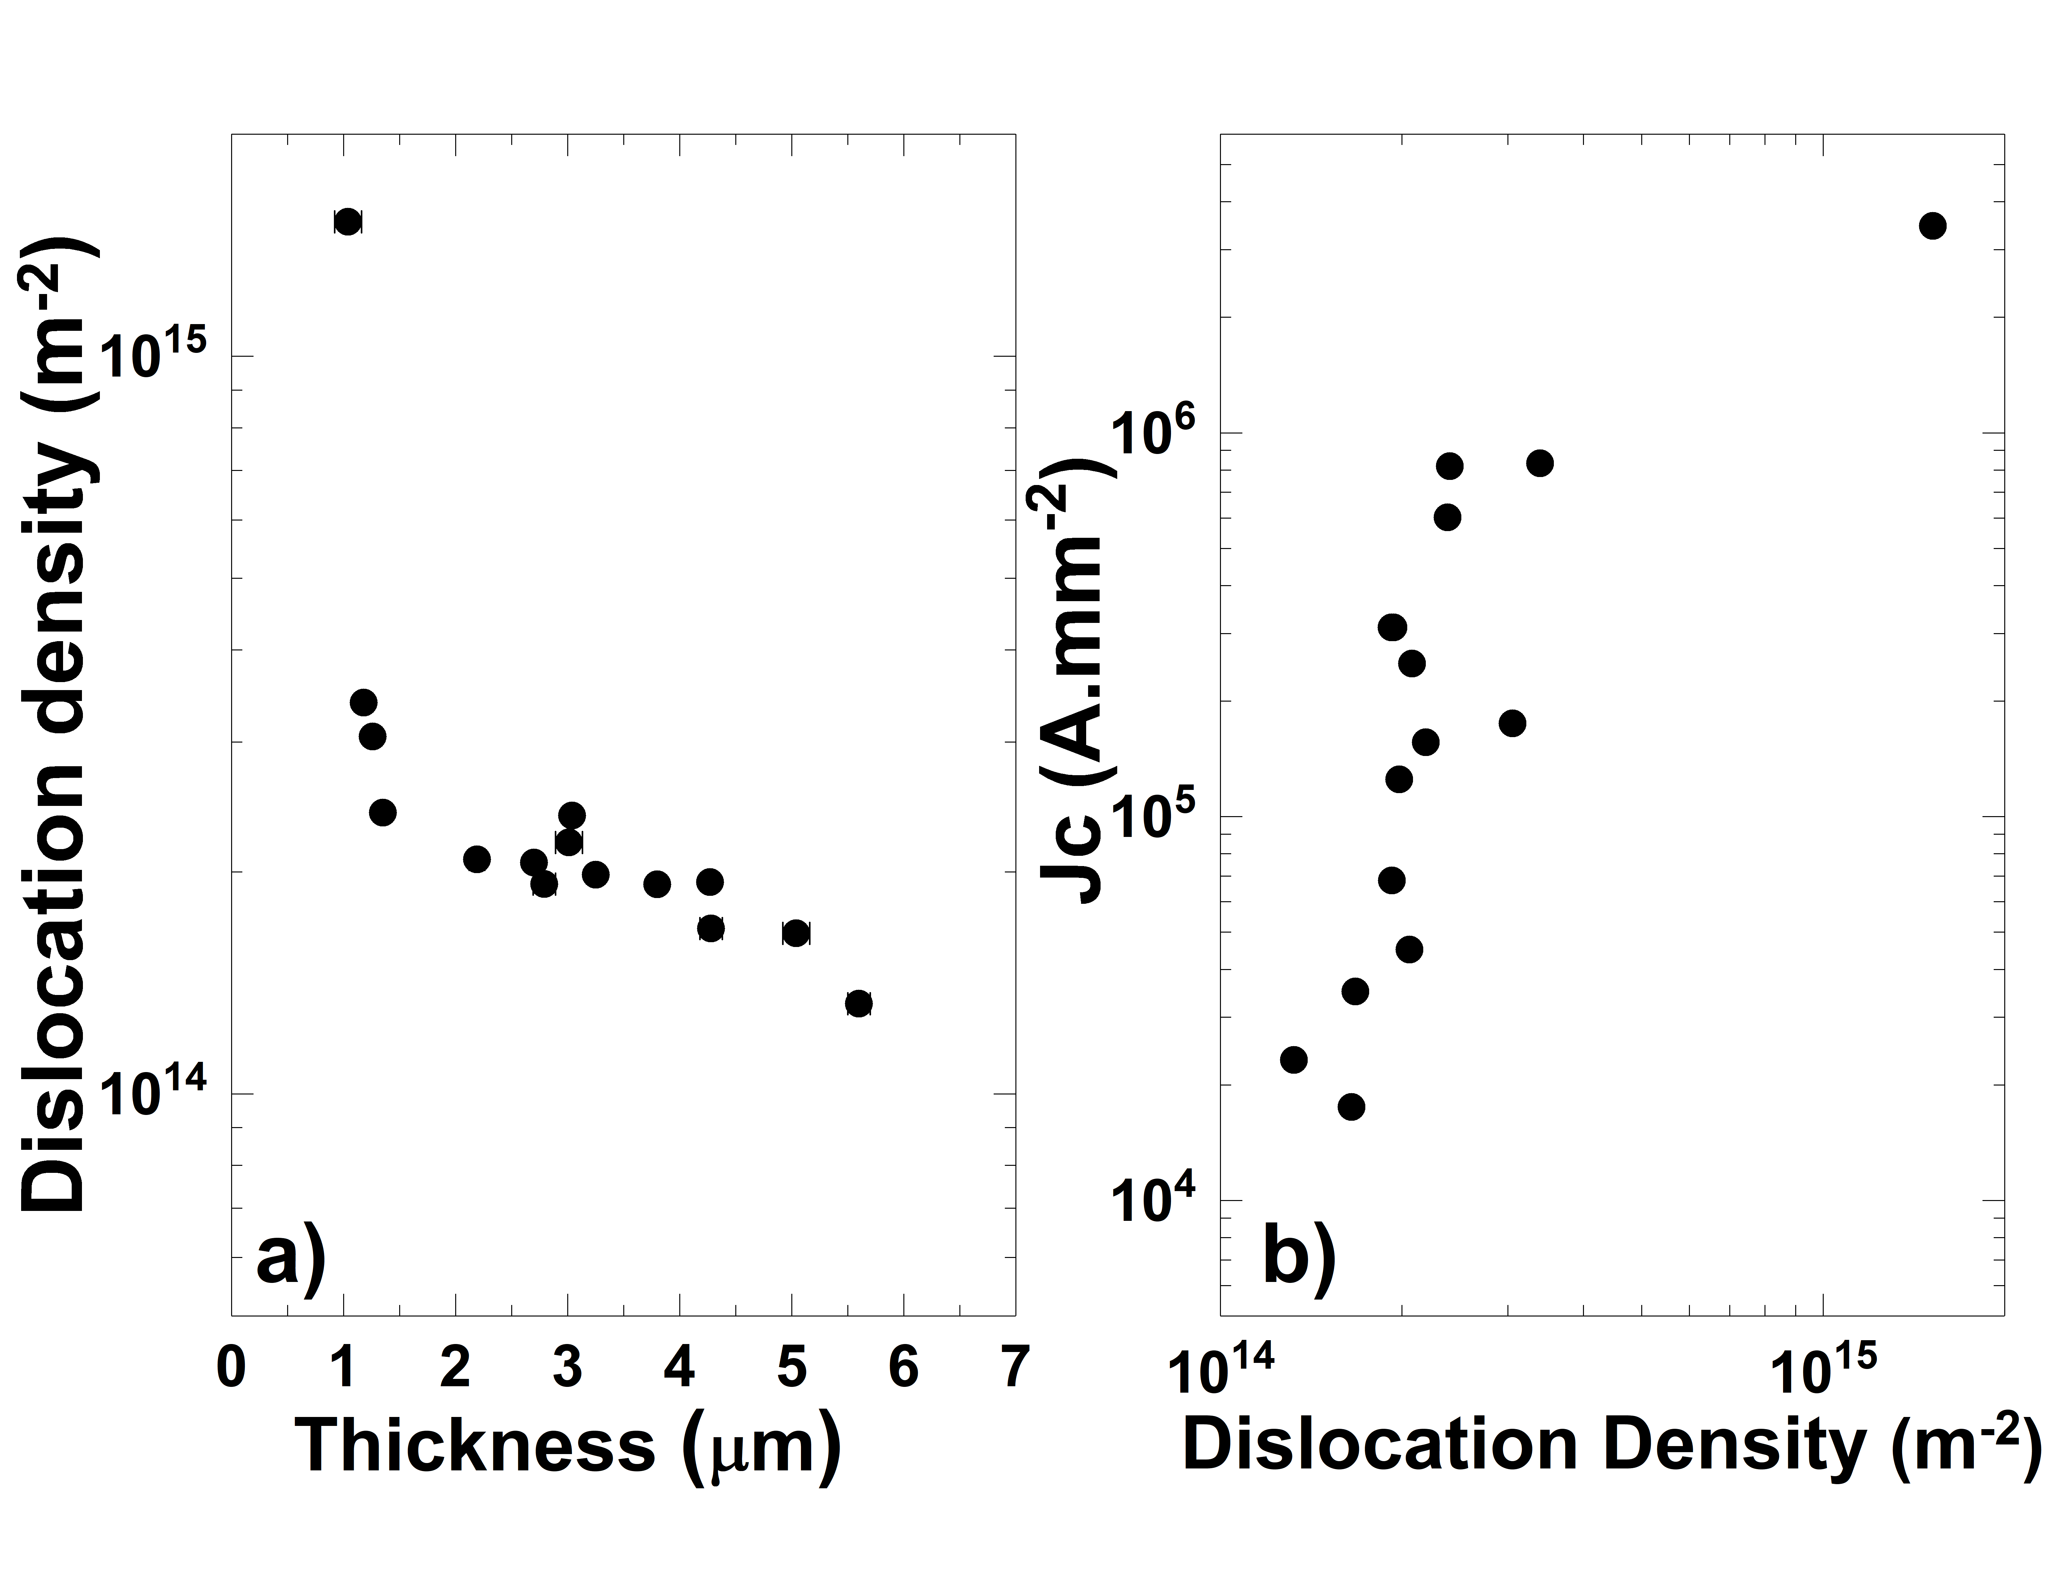
Dislocations vs Thickness
Single layer growth
2.3.10⁻³ mbar, Kr
Dislocation density measured by GIXRD (incidence angle 2 degrees)

Slide 4
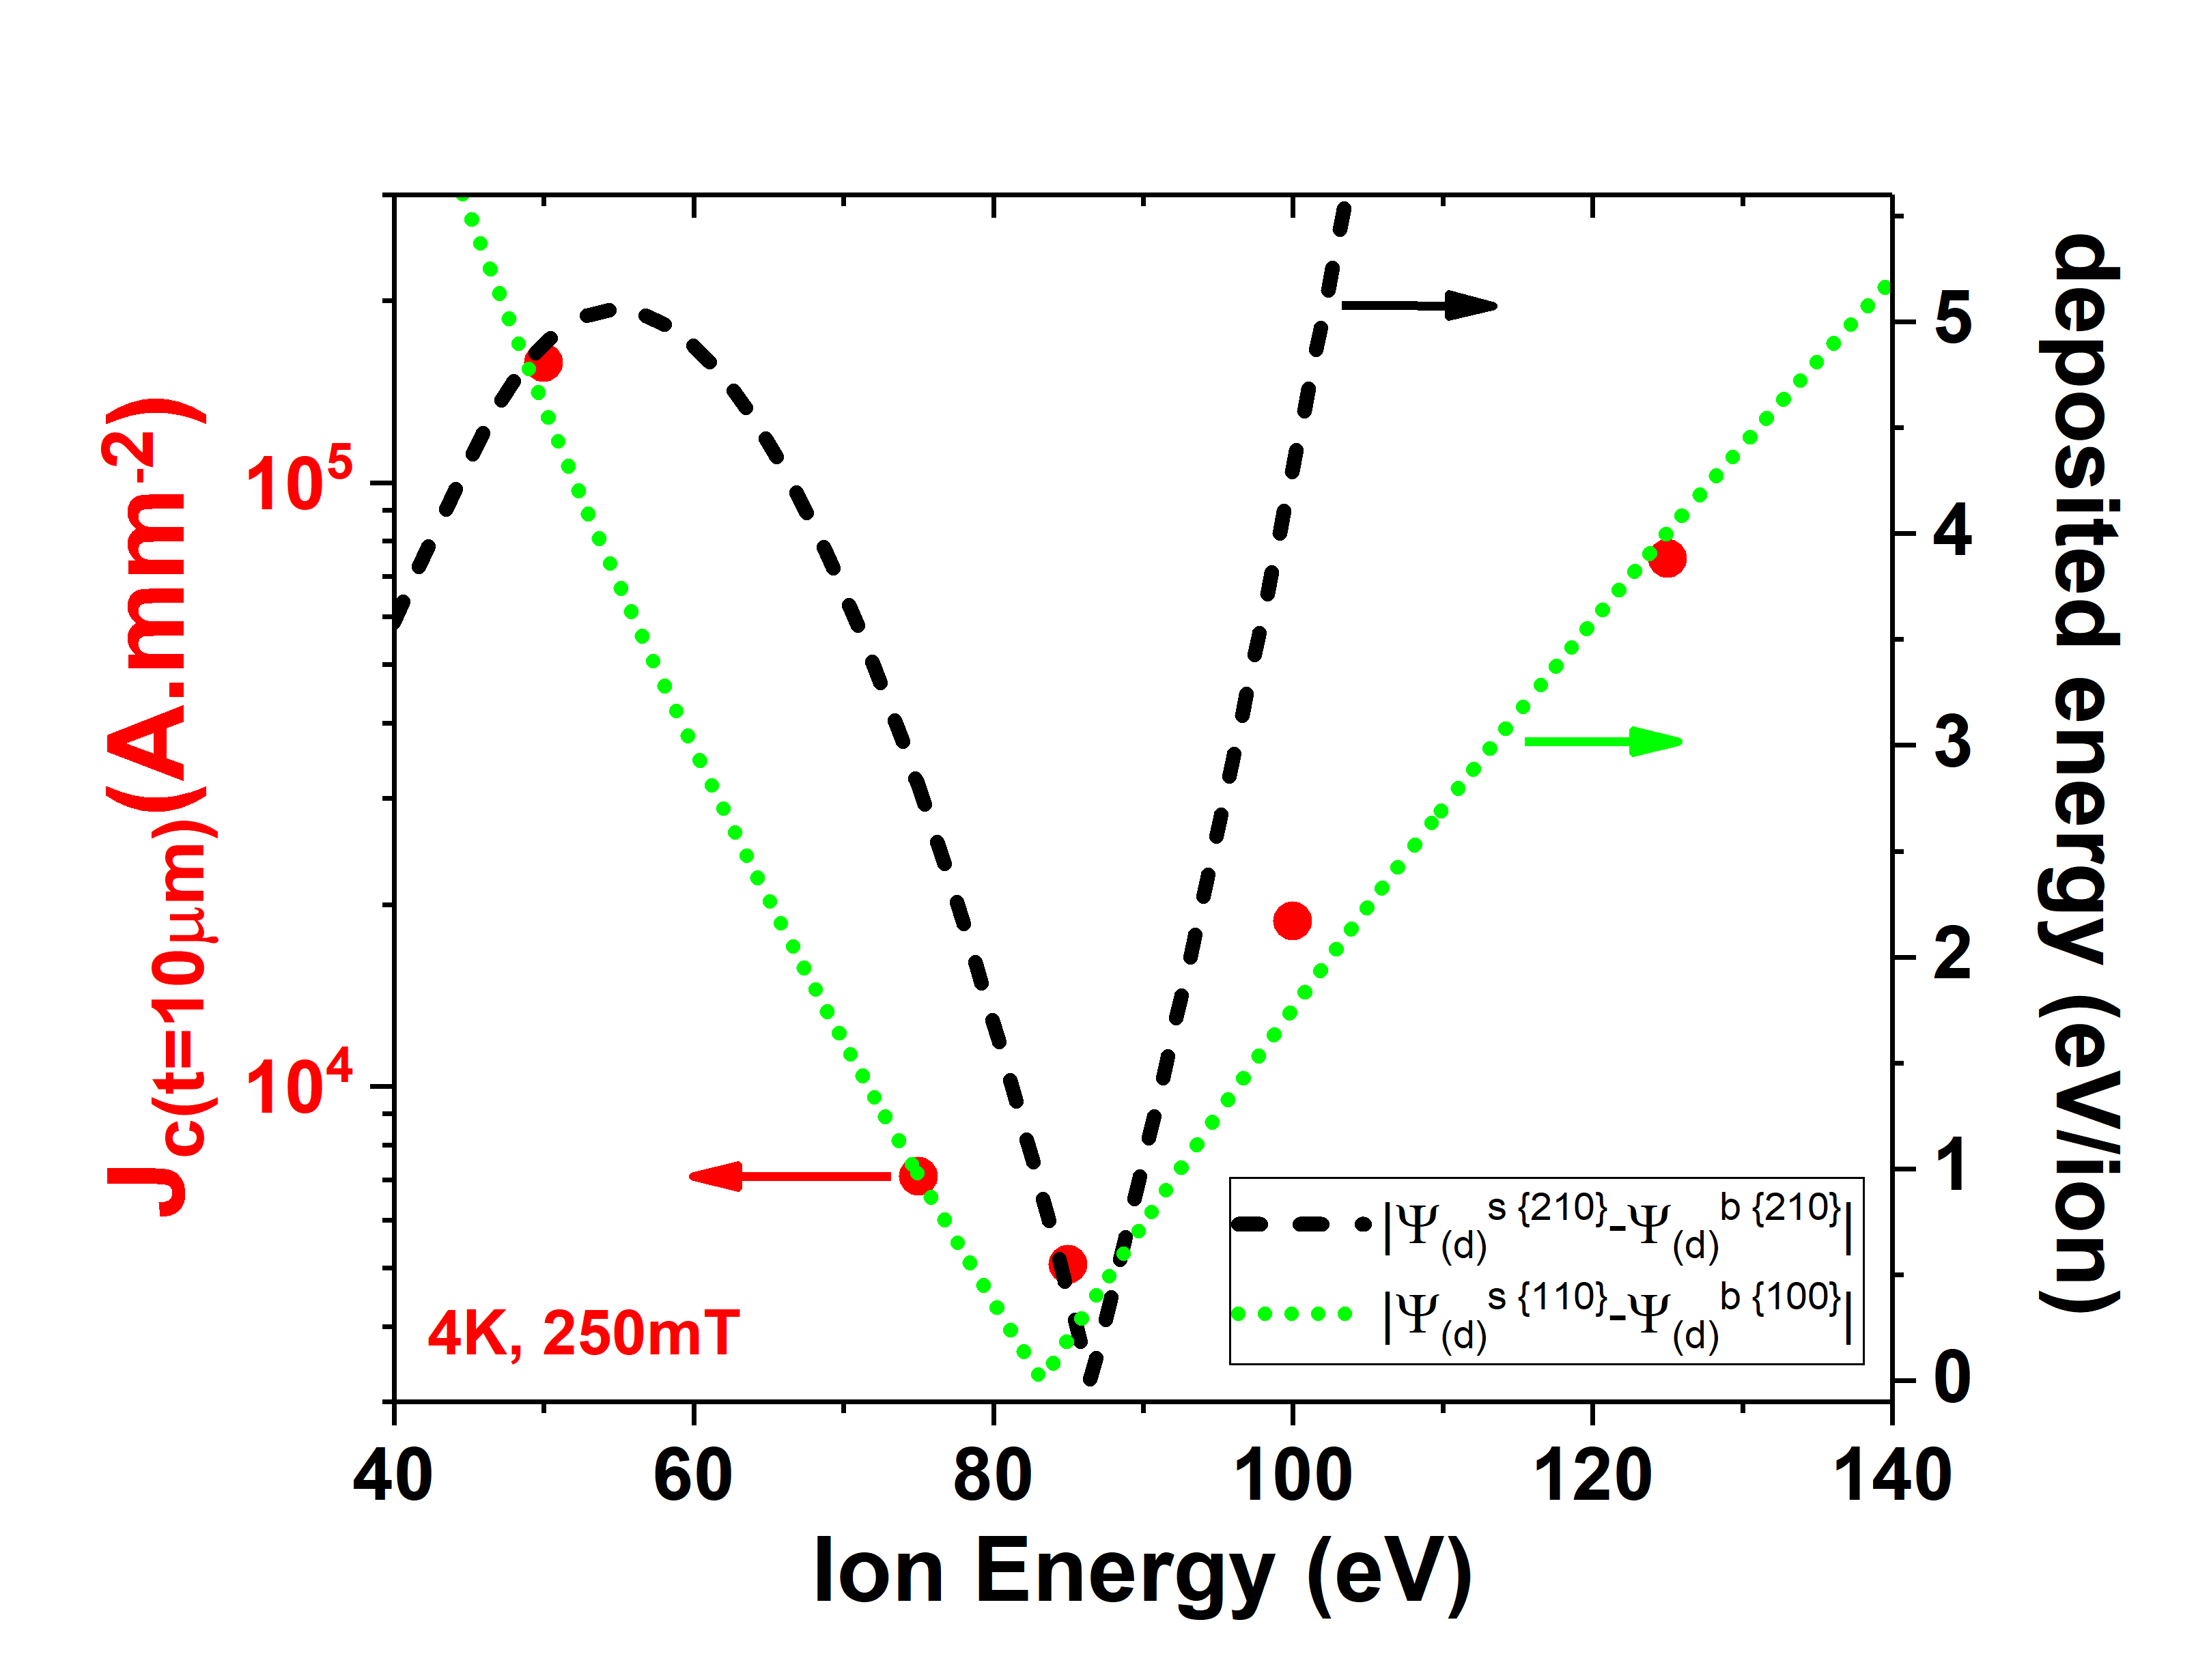
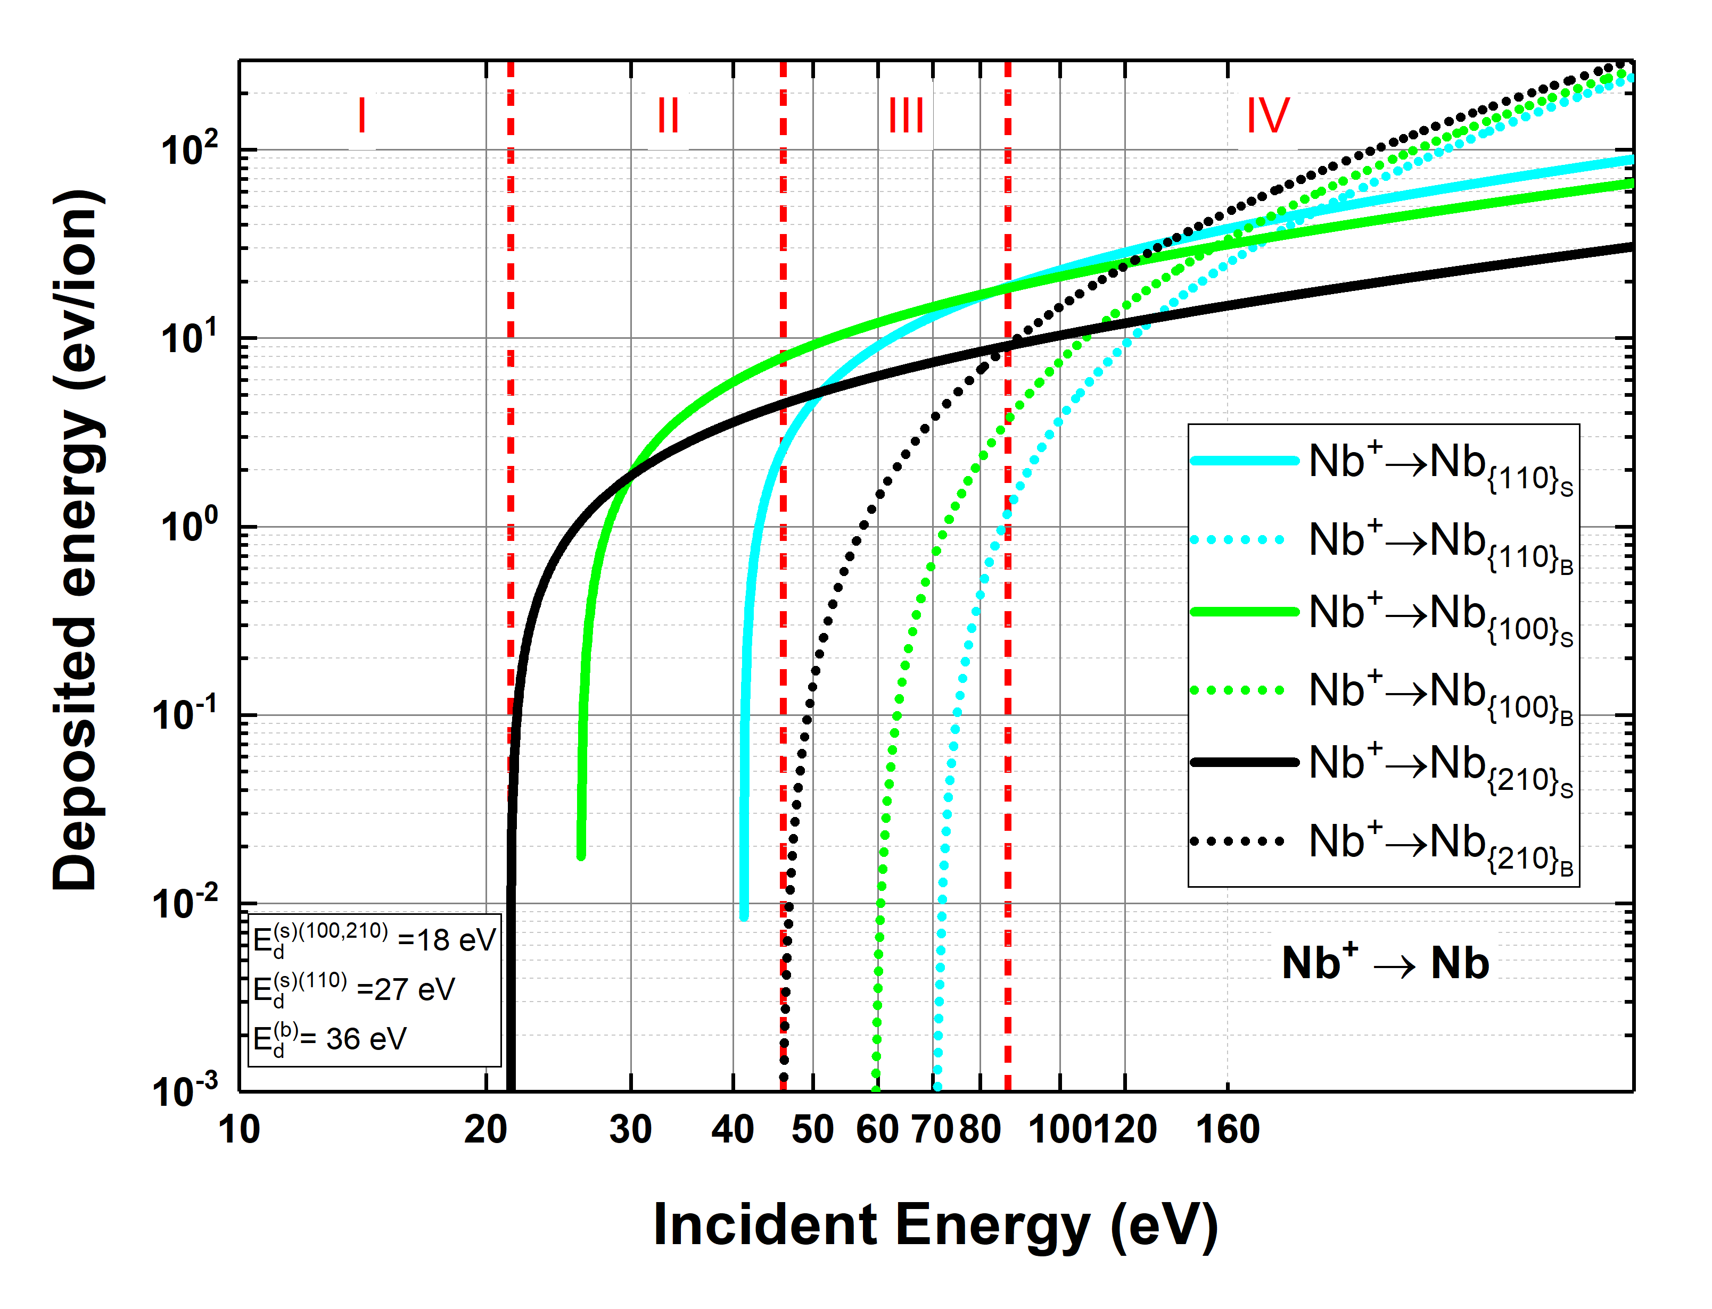
Dislocations vs ions energy

Slide 5
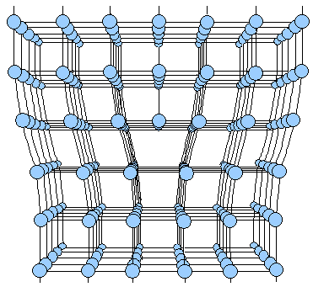


Dislocations vs interrupted growth
Interrupted growth:
30 min
Dislocations (~ size to niobium’s coherence length) = pinning sites
30 min
Nb
Cu
Change number of layers (i.e. layer thickness) but maintain total thickness 2 µm
Maintain thickness of each layer around 0.67 um, but change total number of layers
Disloc. density increases with more layers?
3 layers, 0.67 µm each
Interrupted growth possible strategy to decrease film’s dislocation density

Slide 6
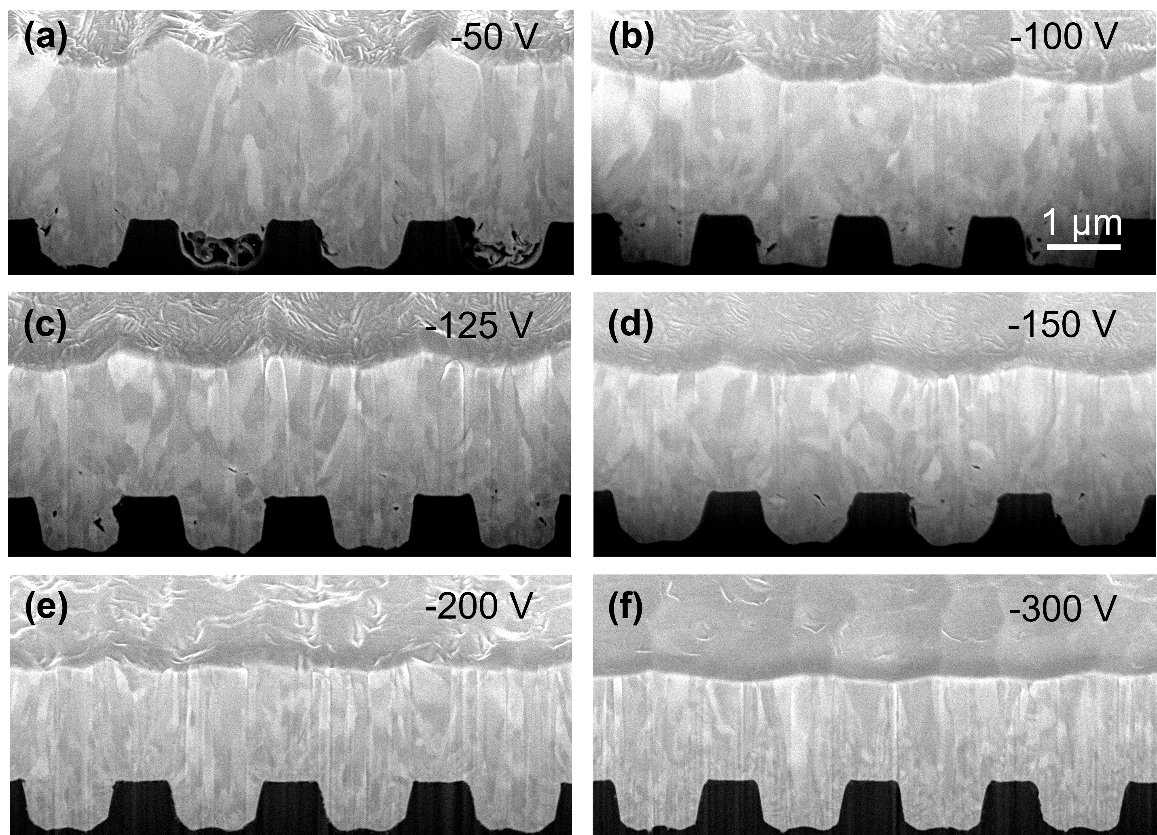
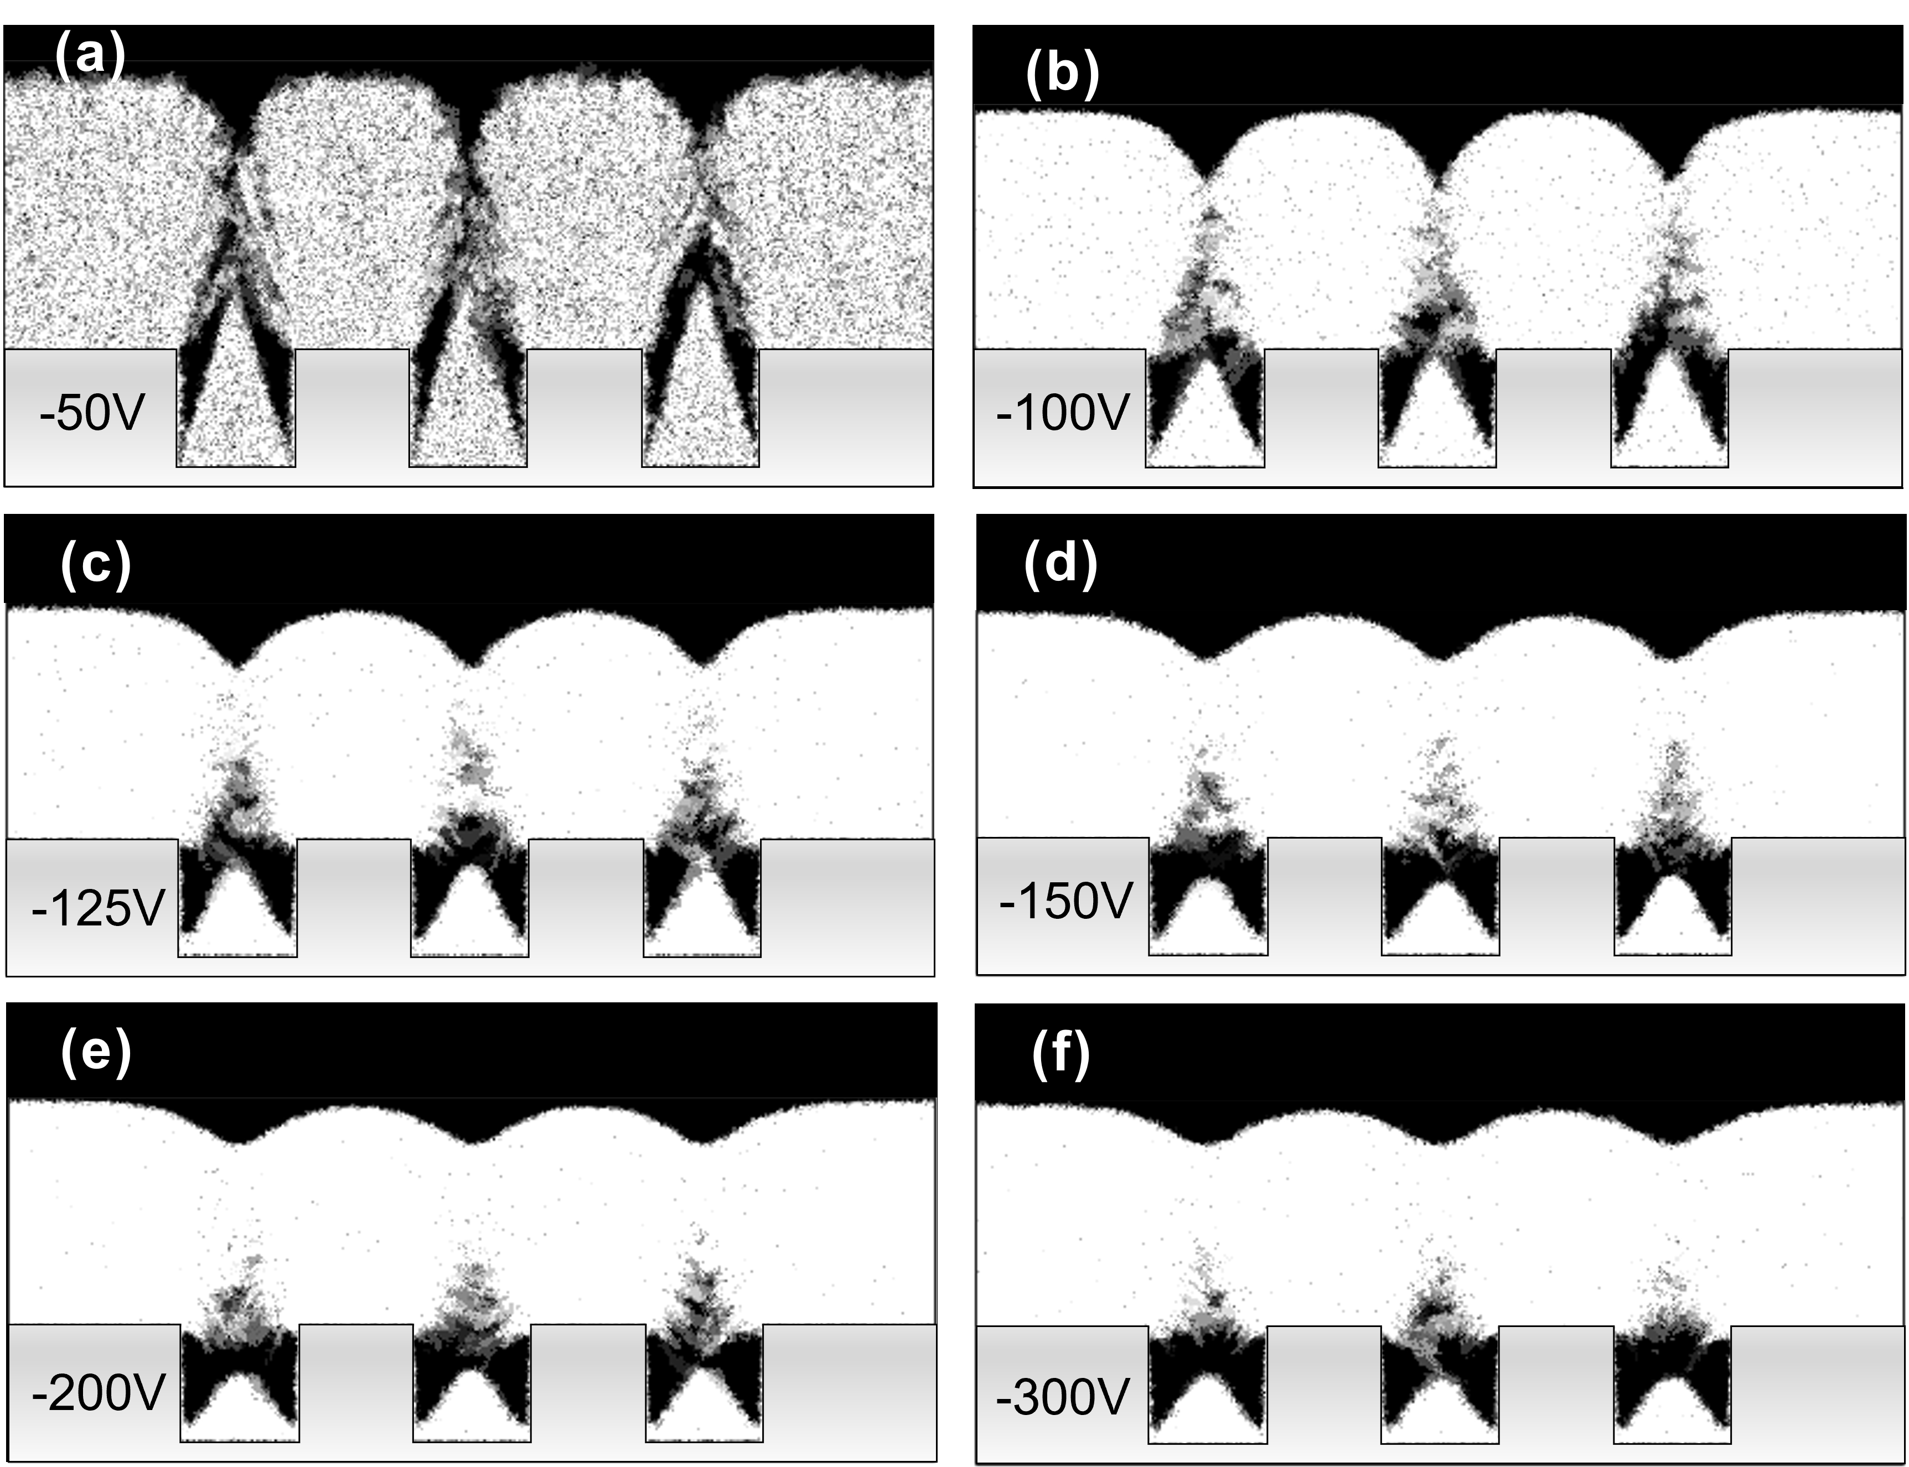
Surface smoothening vs ions energy

Slide 7
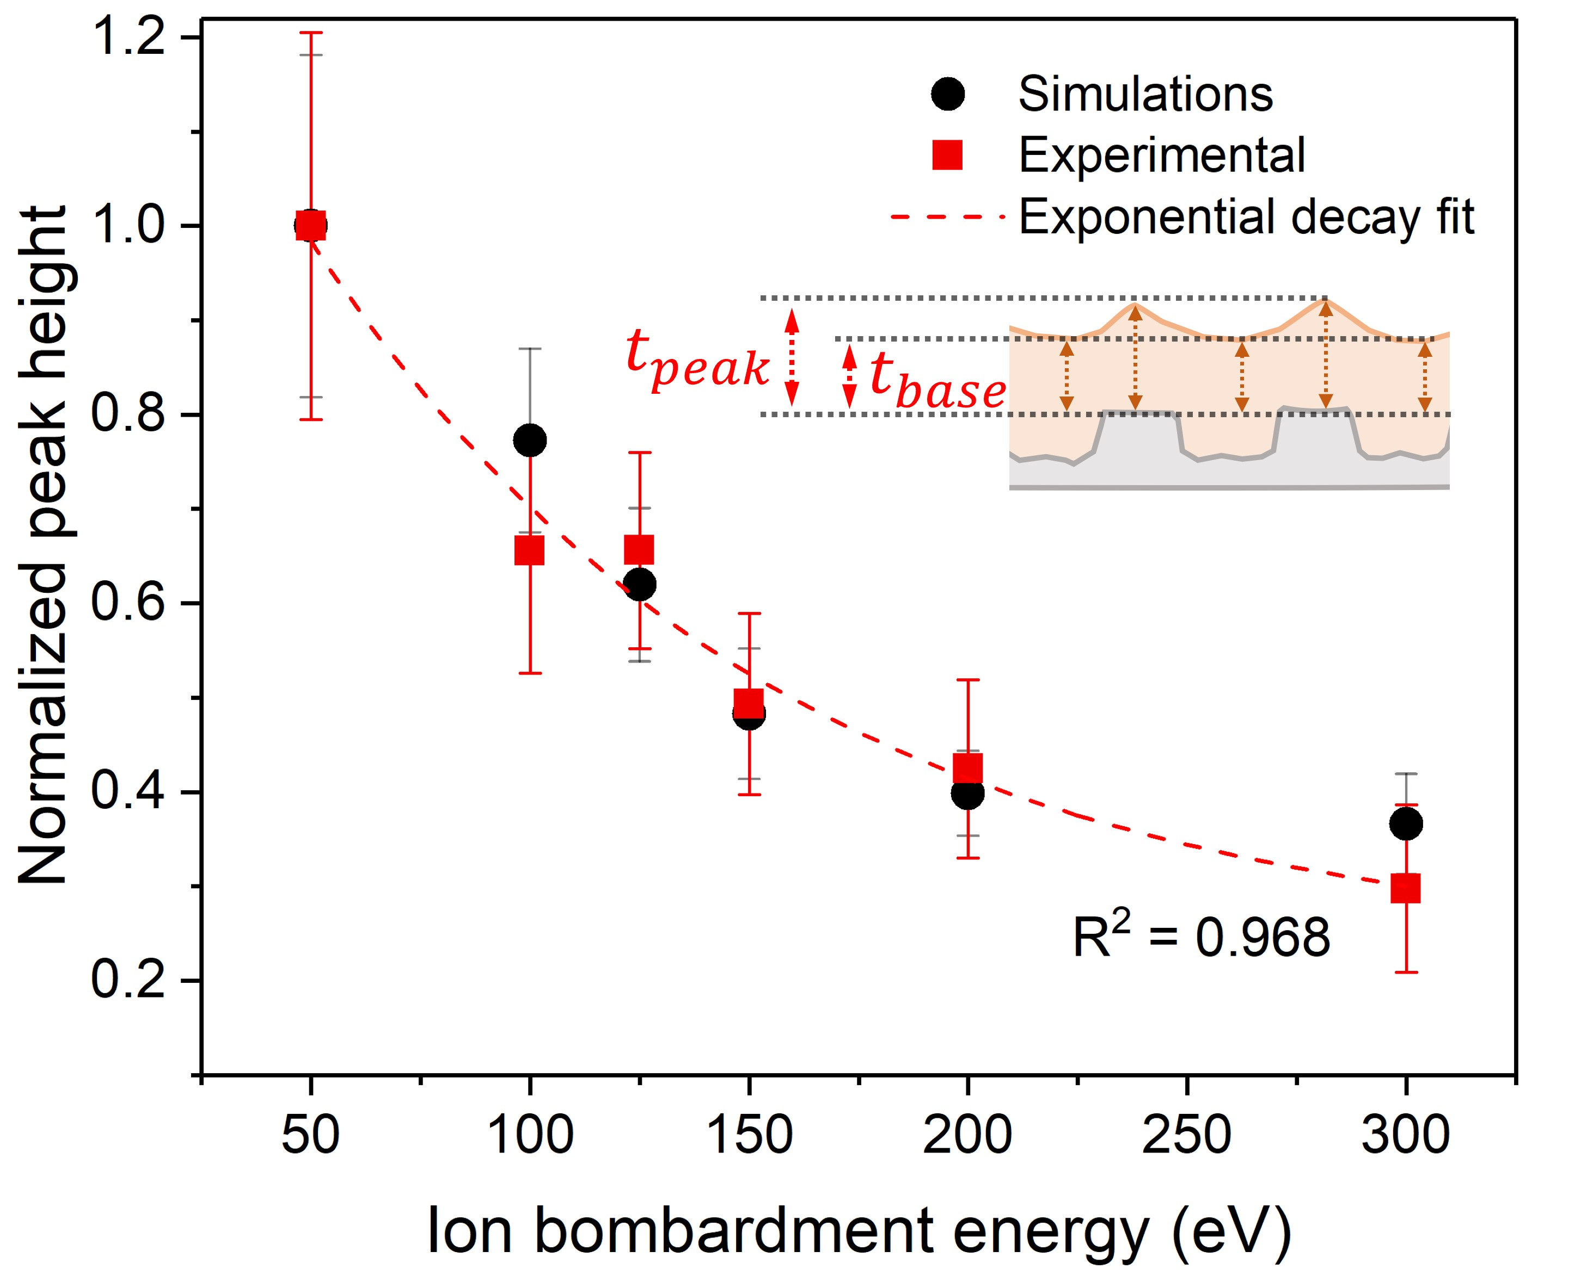
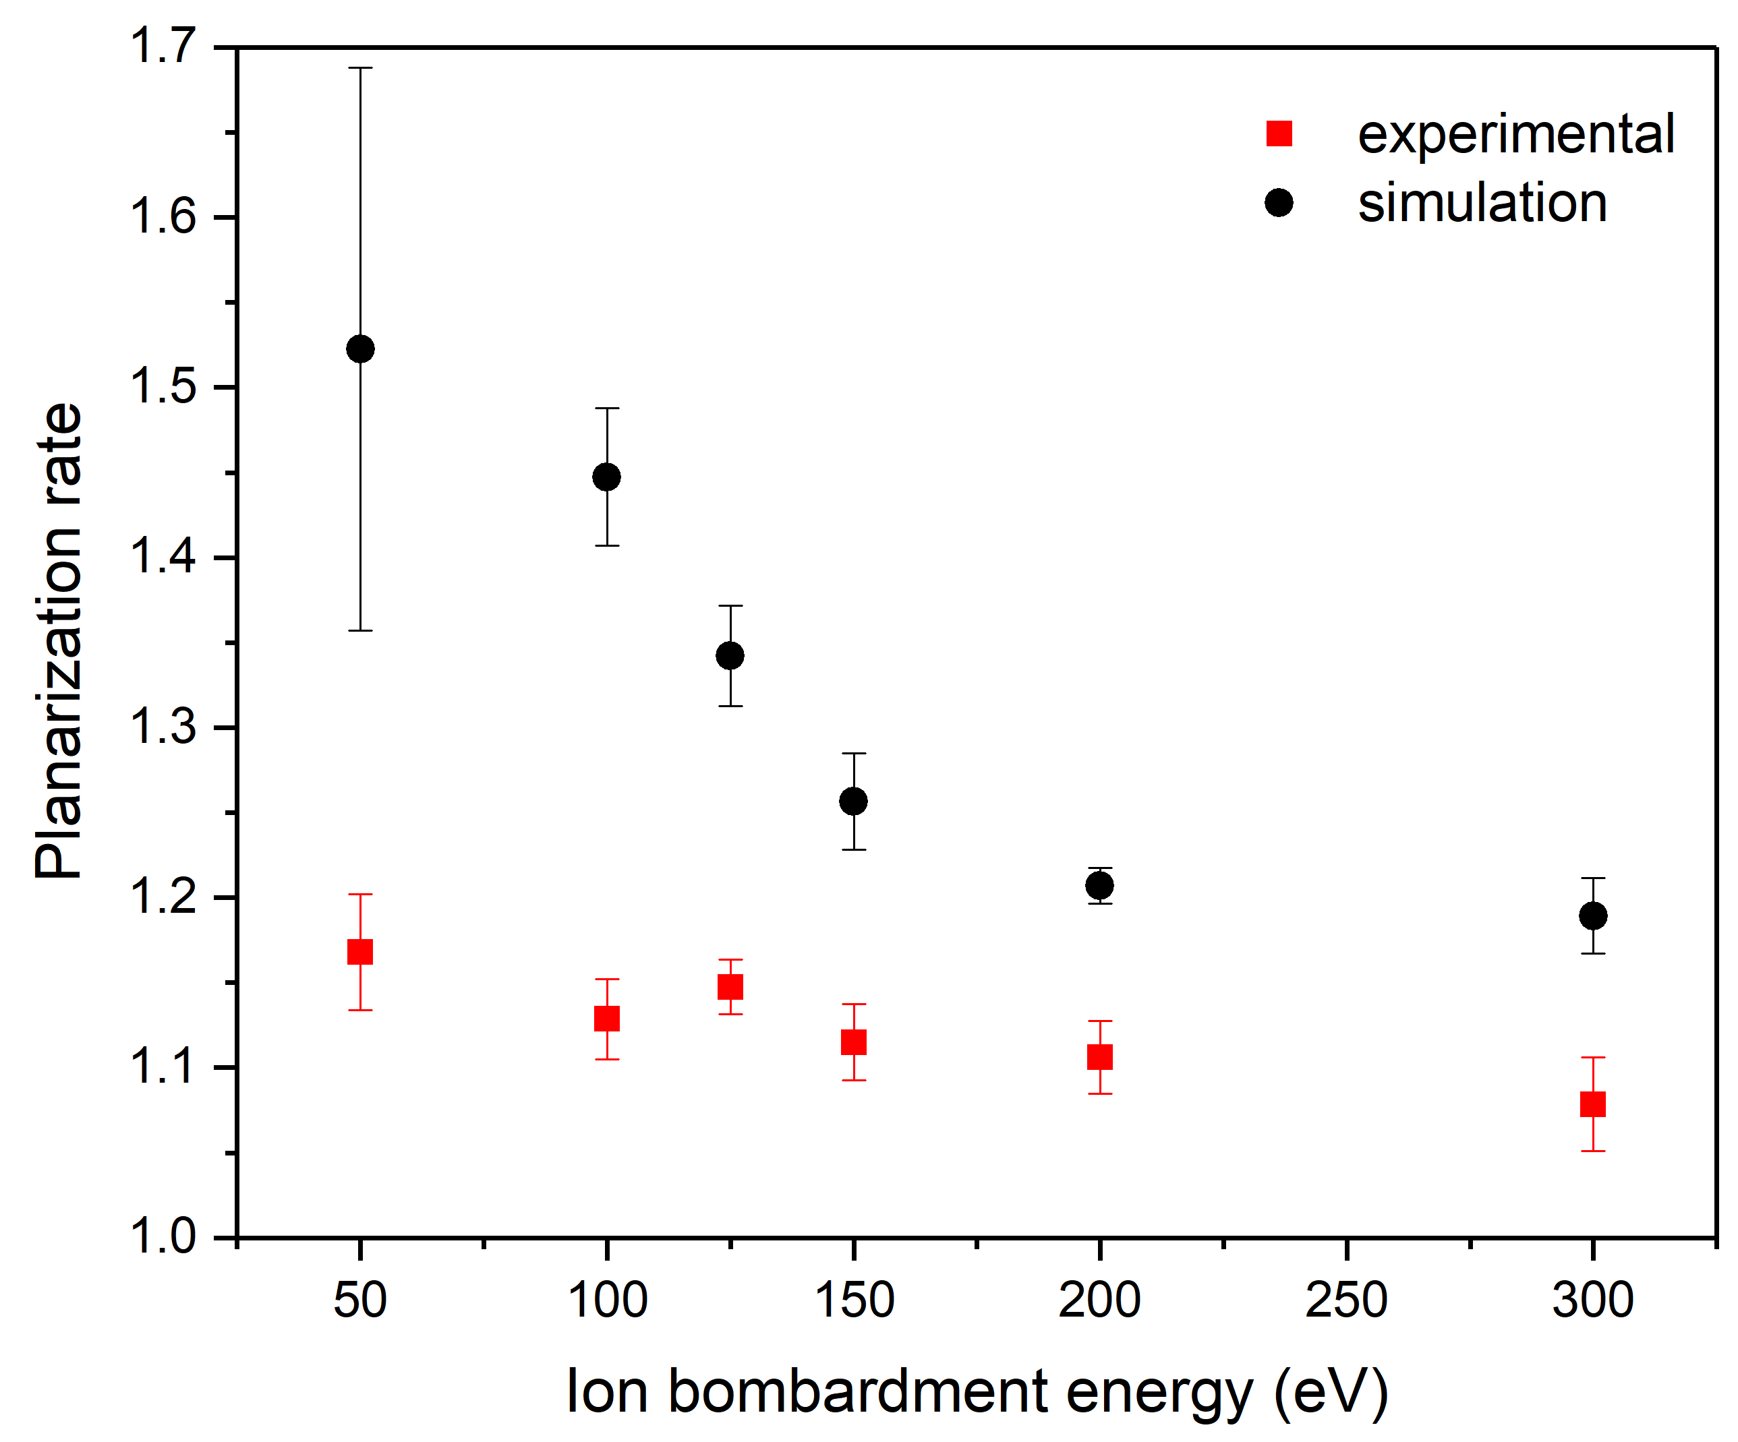
Surface smoothening vs ions energy

Slide 8
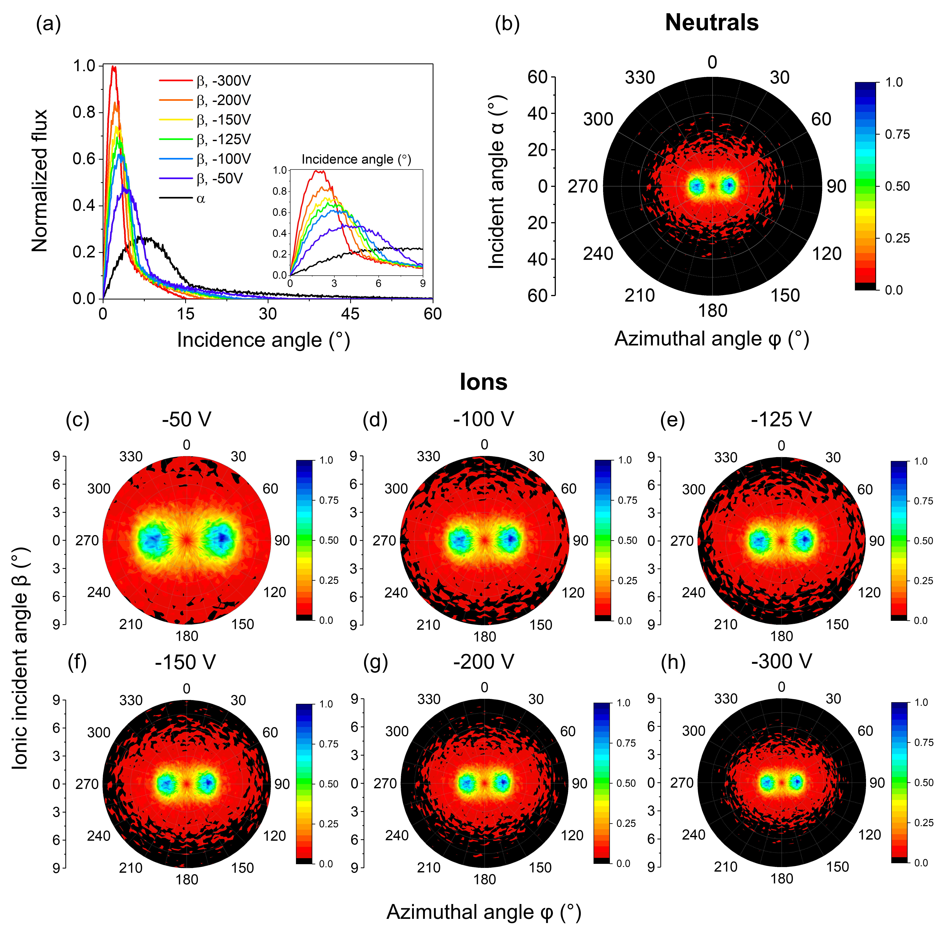
Surface smoothening vs ions energy

Slide 9
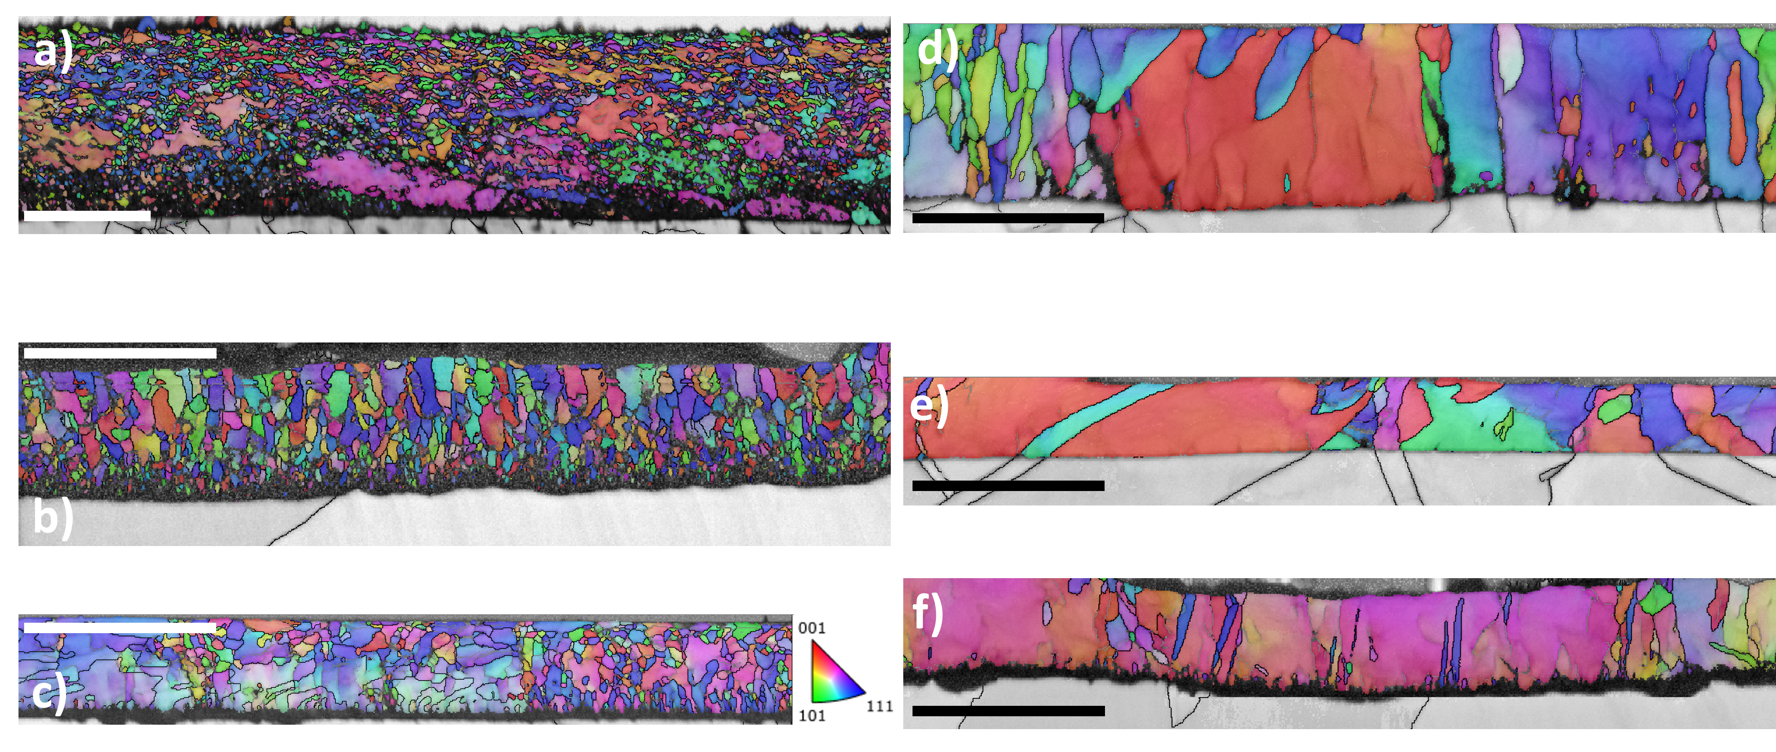
Cristallinity vs ions energy (Nb/Cu)
0V
-50V
-75V
-85V
-100V
-125V
150C
Simulation with different Cu surface orientations?

Slide 10
Surface oxide as a barrier diffusion to hydrogen
At the end of the coating process, 2 routes
Cavity is left cooling down from 200C to RT and then vented with dry air
Cavity is oxidized at 200C, 5.10-3 mbar O2 for 2 hours, then cooled down, tehn vented with dry air
Is the second scenario a good way to reduce residual hydrogen pumping?

Slide 11
Toward Nb3Sn?
Much more complex system
Nb, Sn target. 75%, 25%
Bi-Polar HiPIMS
High temperature coatings (600C – 750C)
RF DATA AVAILABLE – 3 different coating pressures

