Slide 1
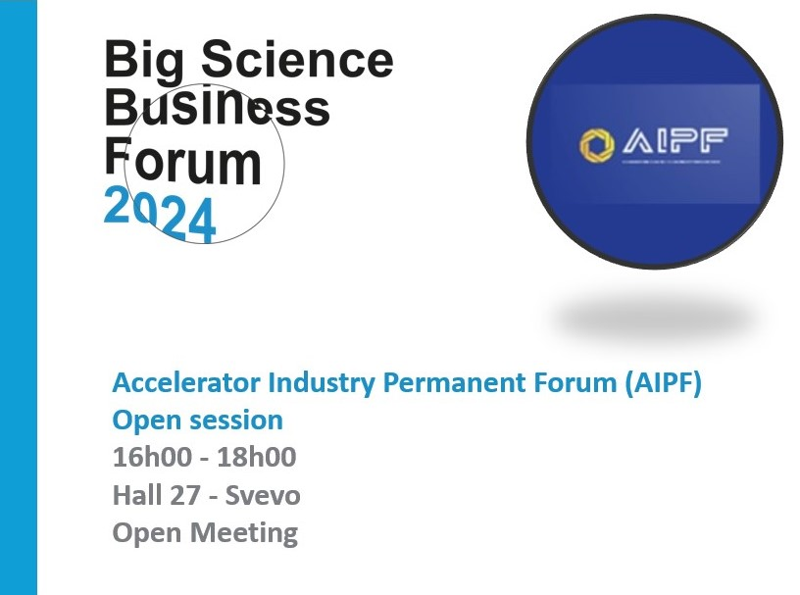

Slide 2
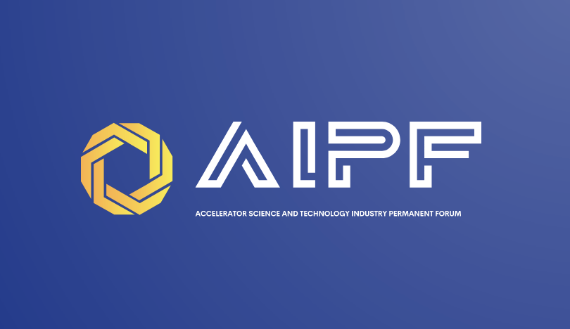
AIPF - Accelerator Science and Technology Industry Permanent Forum
Endorsed by the TIARA (https://www.eu-tiara.org/ Governing Council on February 21, 2023
Established to:
  bring together the Accelerator Science and Technology (ASc&T) community
  foster a coordinated approach between industry and RI&TI in advancing knowledge
  increase integrated innovation capacities
  address together societal challenges

Slide 3
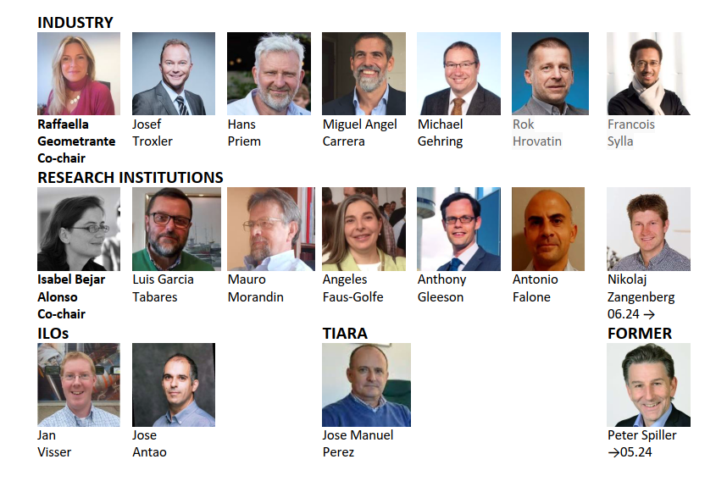
AIPF GOVERNANCE
The AIPF STEERING COMMITTEE is composed by:
7 representatives of the industrial partners
7 representatives of the ASc&T European Centers and Institutions
2 representatives of governmental agencies working as Industry Liason Officers
The TIARA coordinator is an ex-officio member of the Forum

Slide 4
Vision
Mission
Act as an efficient link between industry and research institutions, representing the collective voice of the entire Accelerator Science and Technology (ASc&T) community.
In subjects related to the link between industry and research institutions, become the main permanent reference forum for future European projects and decisions pertaining to ASc&T.
Strive to exploit ASc&T capabilities, aligning them with societal needs and addressing pressing challenges in our society.
Promote collaborations between industry and research labs at early engagement to enhance scientific achievements.
Promote and streamline innovation by the generation of innovative solutions ready for industrialization, market entry and exploitation.
Create a coherent and accessible roadmaps for co-innovation in accelerators, fostering strategic scientific innovation and societal progress.

Slide 5

AIPF Goals organized into 5 main areas
Industry Collaboration and Partnership
Funding and Investment
Knowledge Transfer and Communication
Advocacy and Policy Influence
Roadmap Development and Technology Transfer

Slide 6

2024-2025 Action plan
Five key priorities:
Promote the integration, classification, and distribution of information on new initiatives, calls, projects and infrastructure upgrades.
Promote the integration of roadmaps within synergetic communities.
Work on R&D Funding programs focused to industry.
Strength the relationship of Industry with the Research Institutions, being proactive in the ASc&T strategic development plans.
Promote mechanism to share the risk between Research infrastructures and Industry for the development of prototypes and low TRL components.

Slide 7

TO KNOW MORE
Web page: https://aipf.web.cern.ch/
Annual report: AIPF ANNUAL REPORT
Linkedin: https://www.linkedin.com/in/aipf-asct-permanent-forum-215332296/
TO PARTICIPATE
Working groups: https://aipf.web.cern.ch/?page_id=161

