Slide 1

HL-LHC BLM layout proposal for
IP1 & IP5
B.Salvachua, S.Morales (SY-BI)
Valuable contributions from R.Calaga, E.Effinger, N.Joannon, A.Lechner, F.P.Nicoletti,
F.X.Nuiry, J.Oliveira, F.Sanchez Galan, G.Girardot, C.Zamantzas
27 May 2024 - BLMTWG #99 BLM Thresholds Working Group

Slide 2
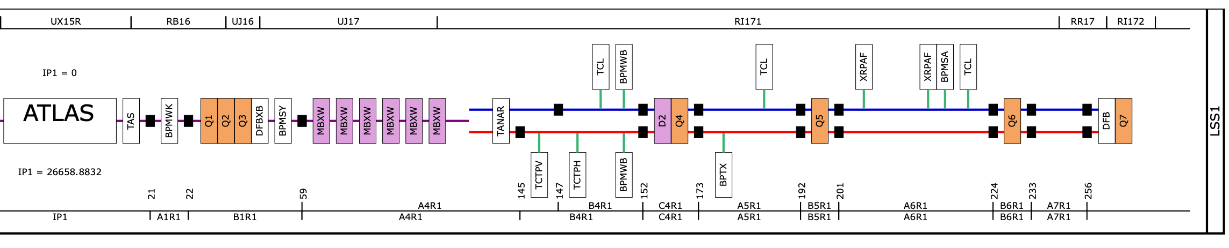
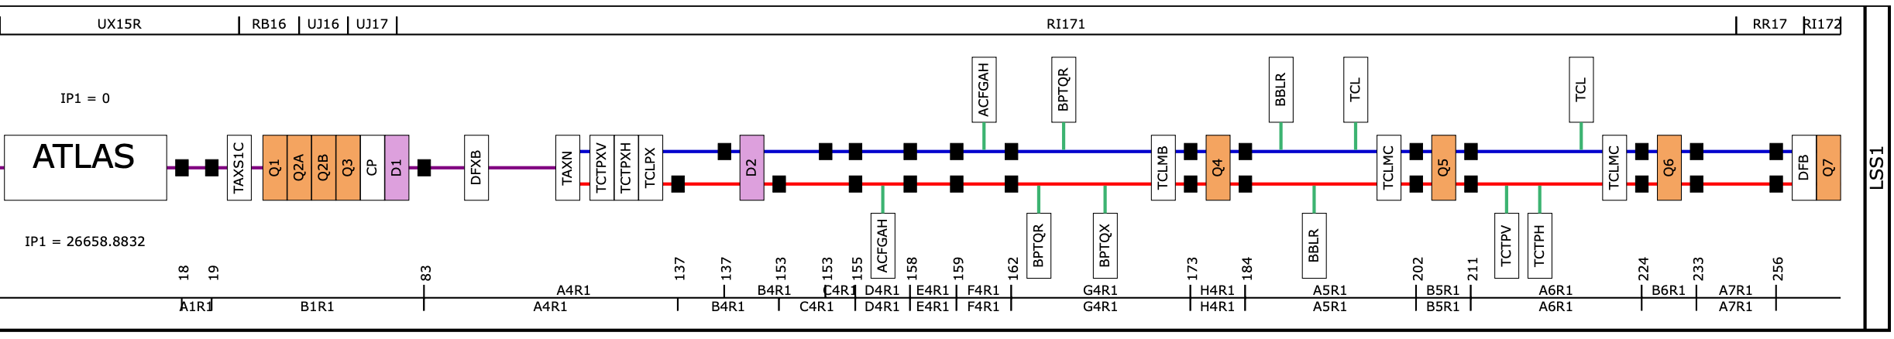
Introduction
Several upgrades for HL-LHC with the goal of increase the integrated luminosity by a factor of 10 beyond the LHC design values (250 fb-1/year for 12 years)
  Cell1 to Cell3 will be completely renovated
  Cell4 to Cell6 new recabling, new elements and displacement of present elements
LHC today
HL-LHC
Figures from https://accelerator-synoptics.web.cern.ch (the distances in the figure are not to scale)

Slide 3
Introduction
Several upgrades for HL-LHC with the goal of increase the integrated luminosity by a factor of 10 beyond the LHC design values (250 fb-1/year for 12 years)
  Cell1 to Cell3 will be completely renovated
  Cell4 to Cell6 new recabling, new elements and displacement of present elements
LHC today
Complete new BLM layout on the triplet area up to the DFXB
New TAXN and Cell 4 Collimators
D2 separated from Q4
Q4 separated from D2
BBLR
Q5 displaced
Q6 displaced
HL-LHC
Crab Cavities
TCL6
TCL5
TCT cell 6
Figures from https://accelerator-synoptics.web.cern.ch (the distances in the figure are not to scale)

Slide 4

BLM layout for IP1/IP5
Cell 1 to Cell 3:
    New layout for Cell 1 to Cell 3 for the renovation of the triplet area
Cell 4:
    New TAXN
    New TCTPXH, TCTPXV and TCL4
    D2 which is separated from Q4
    Crab-Cavities
    Q4 which is separated from D2
    BBLR (between Cell4 and Cell 5)
Cell 5:
    TCL5
    Q5 displaced
Cell 6:
    TCTPV, TCTPH
    TCL6
    Q6 displaced

Slide 5
Triplets BLM layout (Cell 1 - Cell 3)
Integration started long time ago ~ 2020
  HL-LHC WP15 Integration meeting: https://indico.cern.ch/event/968283/ with the estimation of number of BLM monitors in that area to go through the cabling request.
  Several discussions since then but integration was not finalised.
  Most material is in BI-BL cernbox folder until formalised into ECR
        CERNBox/eos/project/be-bi-bl/BLM/BLMLHC_LS3_HL
Expected beam loss contribution on the triplets:
  Two beam loss contributions:
        physics debris + abnormal collimation losses (accidental loss scenario)
  Difficult to disentangle from these two contributions as the BLM detectors will measure both.

Slide 6
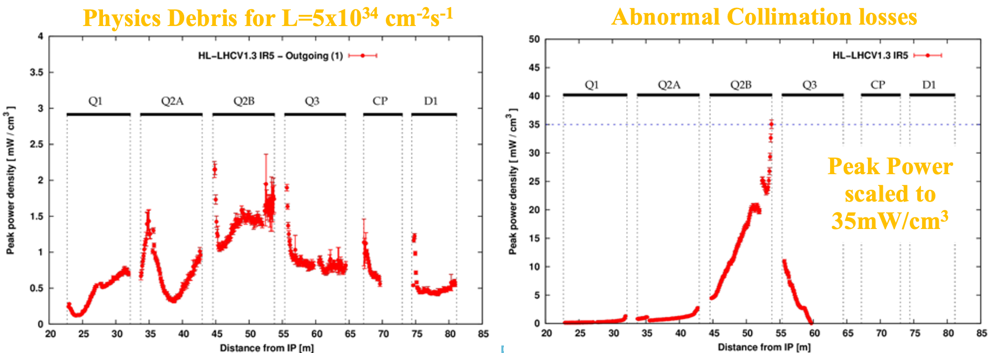
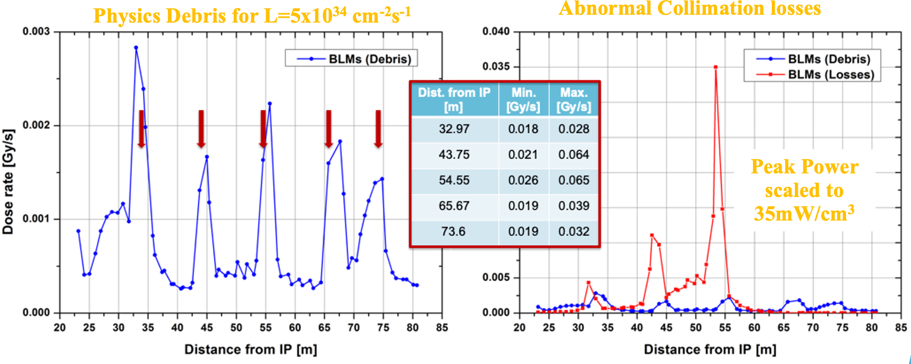
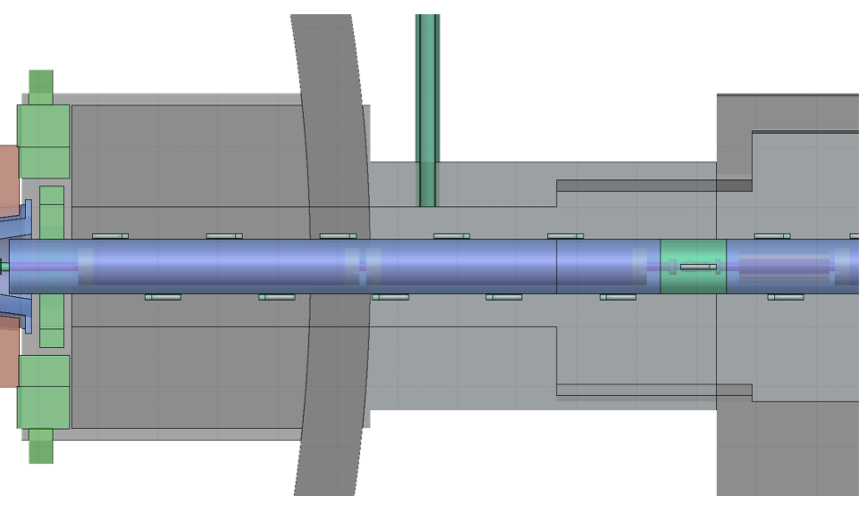
Recap of beam loss simulations
Tracking simulations of beam losses in the HL-LHC triplet, Ye Zou (HL-LHC WP13)
BLM response simulations for the HL-LHC triplet, Andrea Tsinganis (HL-LHC WP13) using layout optics HL-LHC v1.3, 255 μrad half crossing angle, β*=20cm.
External ring side
TOP view
Internal ring side
Similar signal for Internal or External BLM
BLM on top of the interconnect has more signal due to less shielding

Slide 7
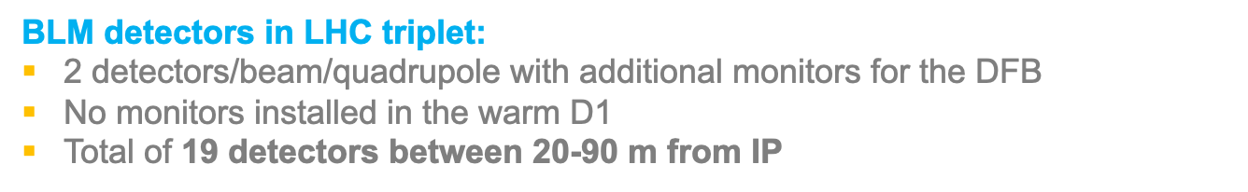
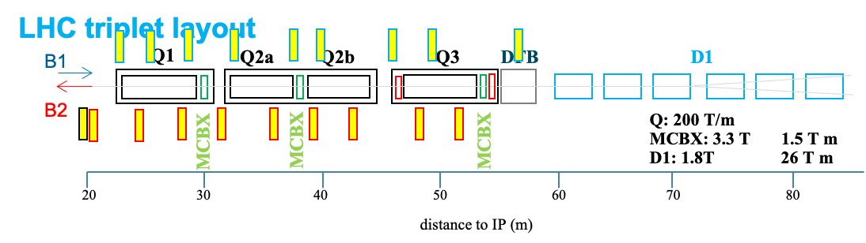
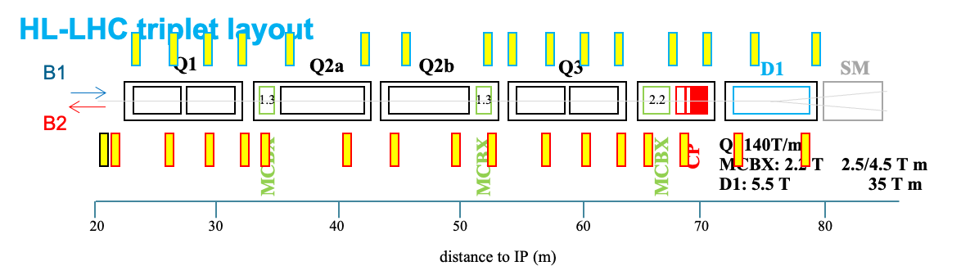
Initial BLM detectors proposal
HL-LHC triplet (2020):
  2 detectors/beam/quadrupole including super-conducting D1 and CP
  Total of 33 detectors between 20-90 m from IP:
    8 BLM at Q1/Q2/Q3
    4 BLM at D1 and 4 BLM at CP
    1 BLM BPMSW @ 21 m
  Additional monitors in selected locations read-out by the R&D rad-hard read-out with ASIC.
See next talk by C.Zamantas
Update on 2024:
Avoid External side of the ring - difficult/impossible of access for maintenance and irradiation test.
Reduce number of detectors with the standard read-out —> lose redundancy
Add 1 detector at EACH location with the new ASIC read-out —> gain redundancy

Slide 8
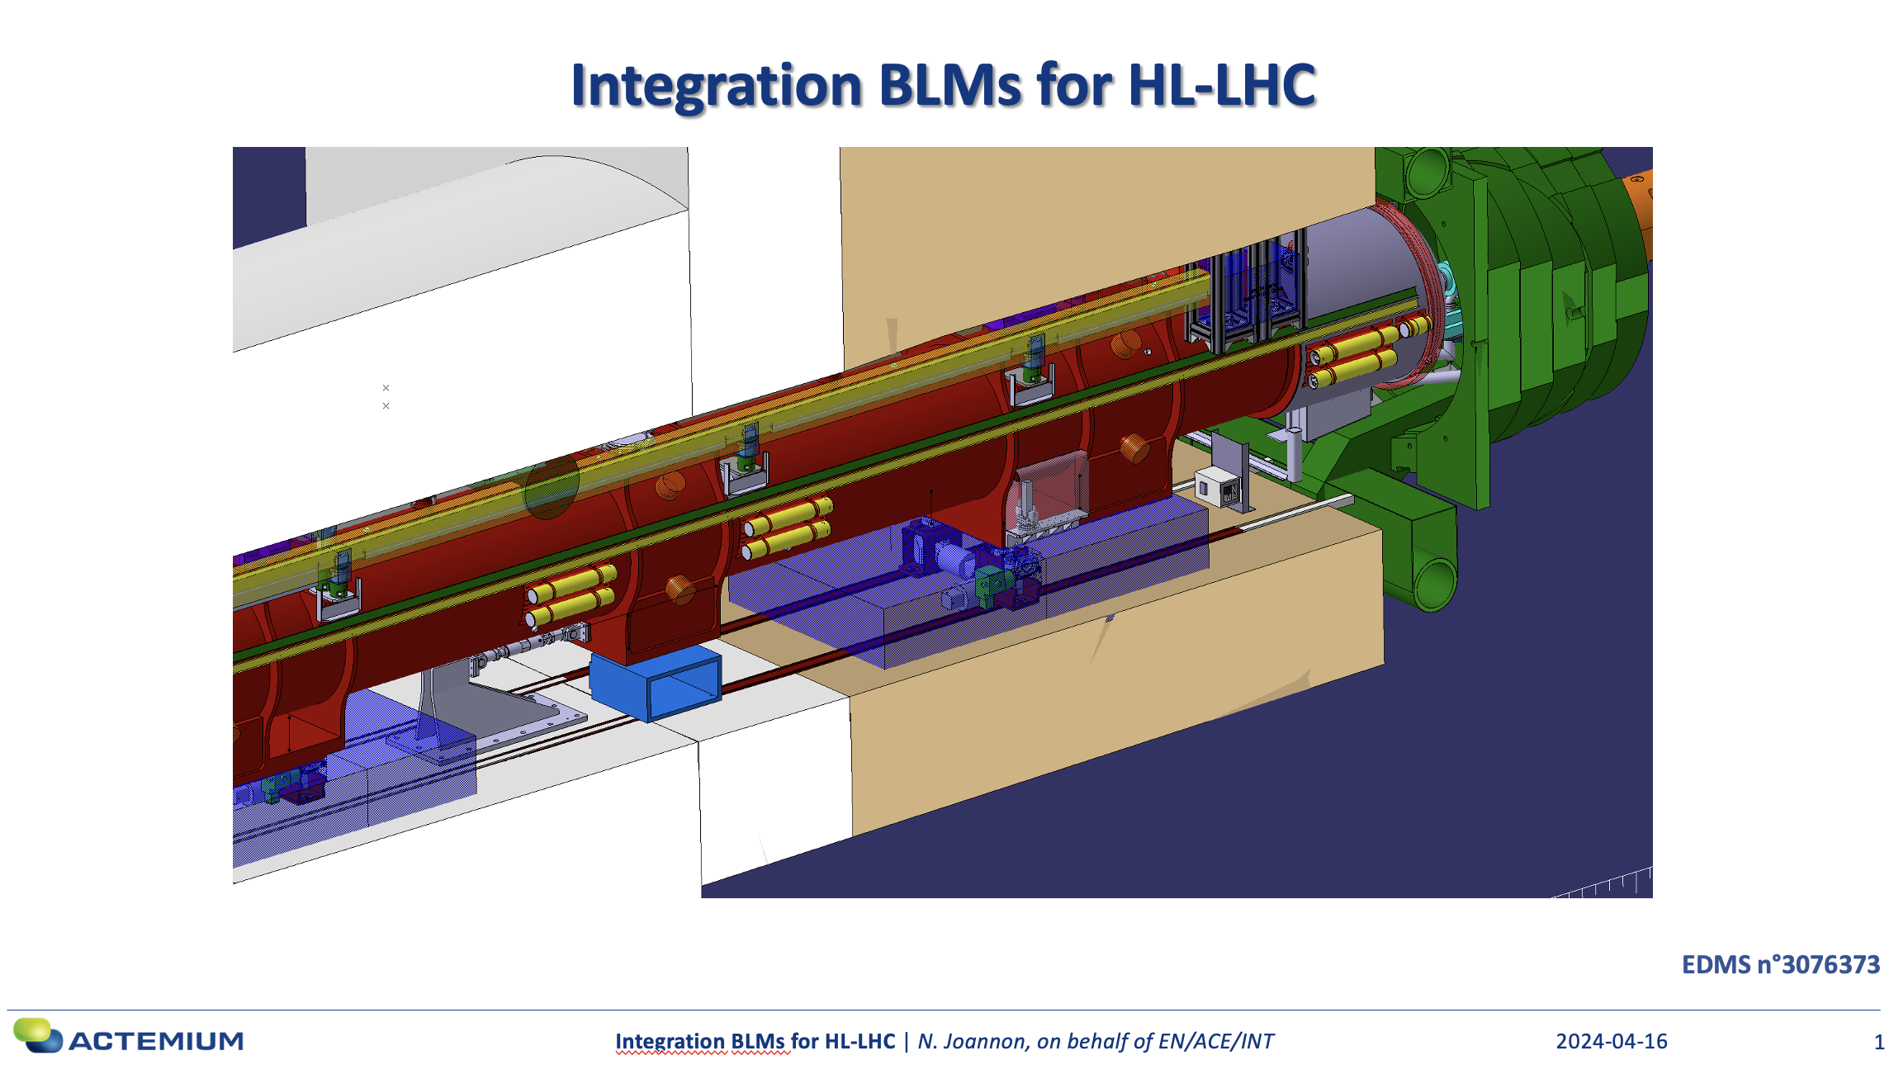
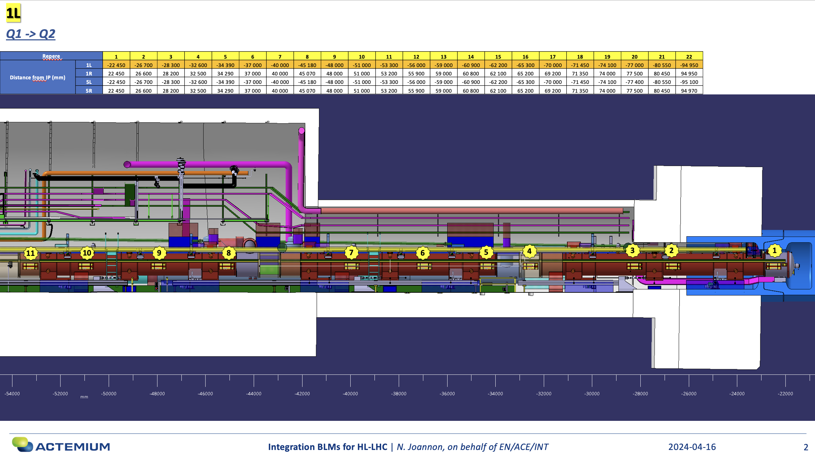

Integration of cell 1 - cell 3
N. Joannon EN/ACE/INT
All proposed cell1-3 locations have been discussed and analysed. A complete the integration study has been done.
Few modifications need to be checked.
1 BLM read by standard BLM electronics (no change wrt LHC)
1 BLM read by new rad-hard electronics.

Slide 9
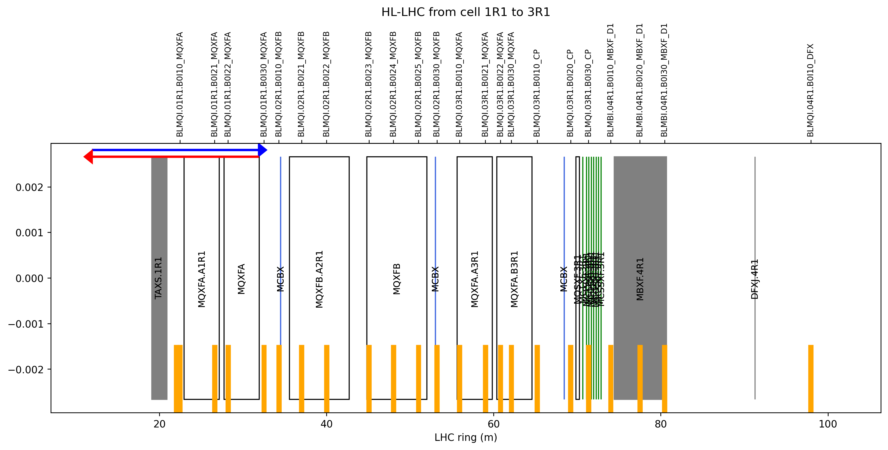
Proposal for Expert names
Notice:
B0 but position at element (10,20,30) is with respect the outgoing beam.
BLM equivalent locations

Slide 10
Corrections to this layout proposal
Small modifications to be assed with integration (equivalent for all IP1/IP5 L/R):
  Q3 BLMQI.03R1.B0I21_MQFA to be displaced -1 m
  Q3 BLMQI.03R1.B0I30_MQFXA (should be at the end, currently at the middle) to be displaced + 2m
  CP the 3 BLMs 10,20,30 to be displaced + 2 m
  D1 BLMBI.04R1.B0I10_MBXF_D1 to be displaced + 1 m
Please have a look for additional changes and do not hesitate to send us feedback
Both on position and naming

Slide 11
Cell 4 - Cell 6
Complete new BLM layout on the triplet area up to the DFXB
New TAXN and Cell 4 Collimators
D2 separated from Q4
Q4 separated from D2
BBLR
Q5 displaced
Q6 displaced
HL-LHC
Crab Cavities
TCL6
TCL5
Let’s now propose the layout for the rest of the LSS

Slide 12
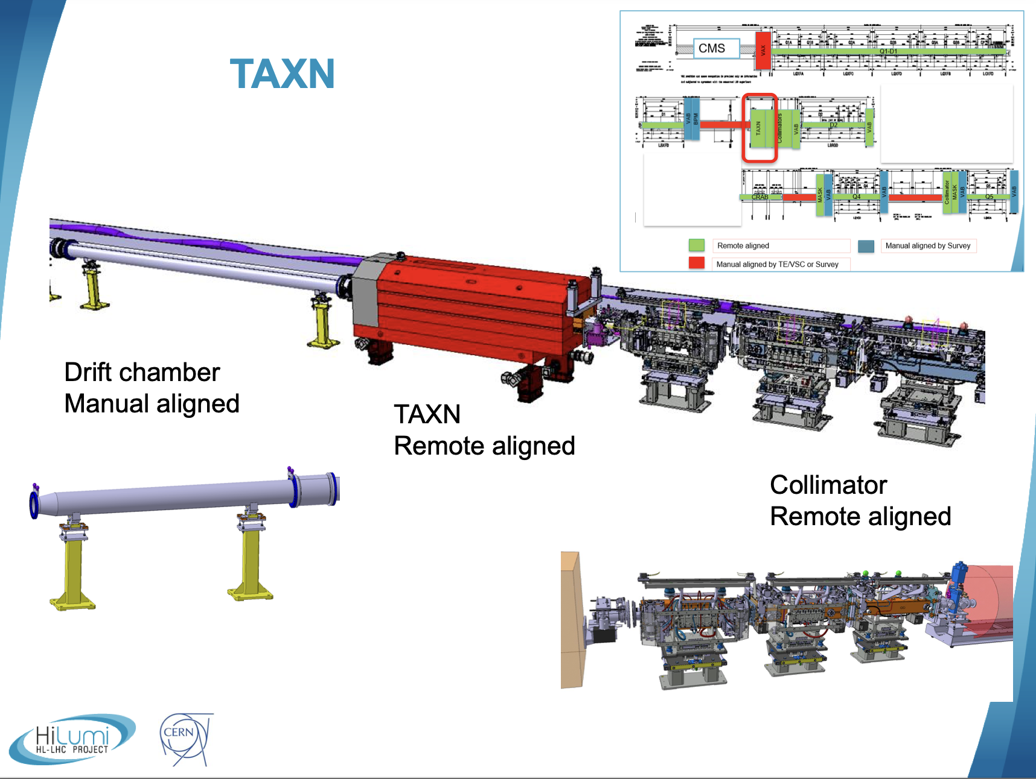
TAXN
F.Sanchez Galan
Holding the recombination chamber and several detectors (ZDC ad BRAN)
Proposal to add 1 BLM for the TAXN (towards the IP), similarly to the present configuration.
Integration not done yet, but there is space, we just need to avoid the reserved space on the side and the removal/installation of the TAXN.
Installation could be done with the standard BLM support.
We do not install another BLM after the TAXN because cell 4 collimators are right after (TCT BLM between collimator and TAXN)
https://edms.cern.ch/document/2370677

Slide 13
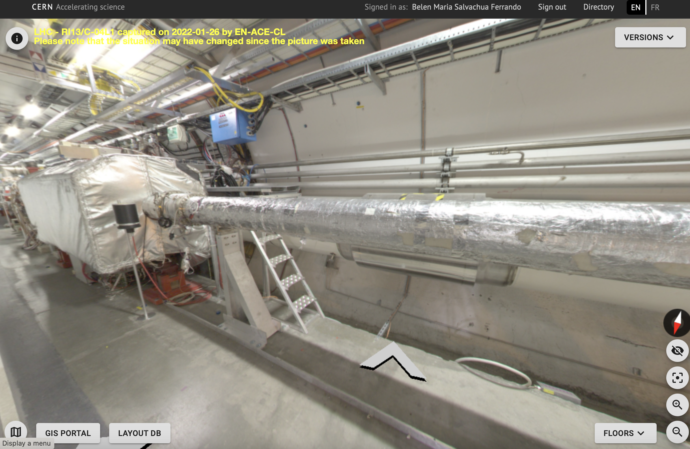
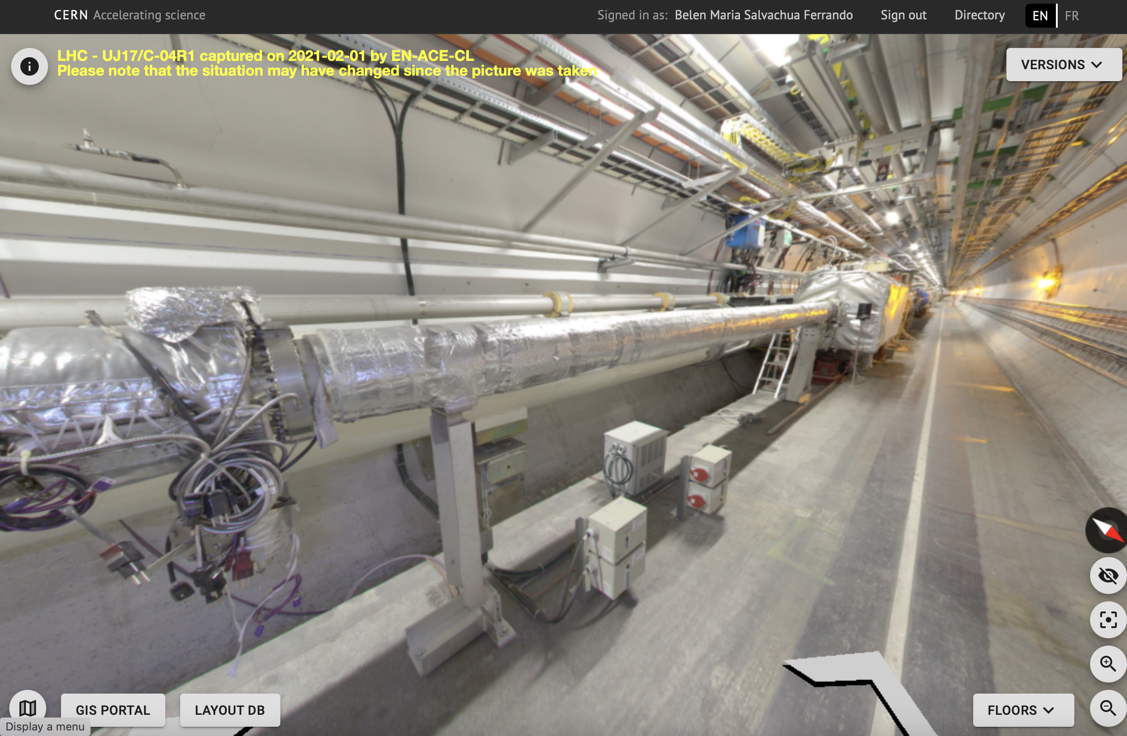
TAXN
BLM
R1
L1

Slide 14
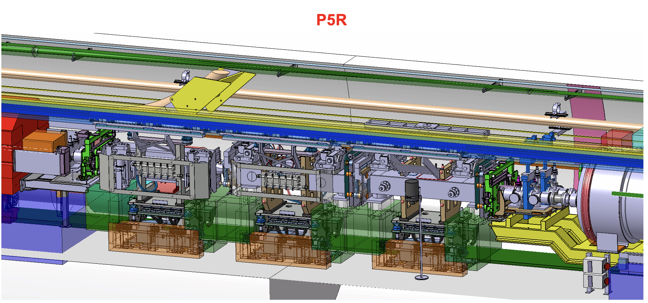
Collimators - Cell 4/5/6
F-X. Nuiry
TCTs in Cell 4 and Cell 6
TCL4, TCL5 and TCL6
Integration needs to be finalised, work on going with STI for the supports and locations of BLMs.
Space is very tight, but we are aiming at making a more uniform configuration.
We provide today the approximate locations of the BLMs to be verified with integration WP15 (attached to the agenda)
TCT
TCT
TCL
Adapting BLM support in collaboration with STI

Slide 15
D2 and Crab-Cavities
D2
For HL, D2 is separated from Q4.
We need certain monitoring.
Proposal
2 BLMs:
  1 between D2 and the correctors
  1 on the correctors side
  Already 1 BLM expected between TCL and D2
In this area, we are adding BLM external/internal in order to keep it similar to present system.

Slide 16
D2 and Crab-Cavities
R.Calaga
Crab-Cavities
Proposal
2 BLMs
  1 BLM upstream
  1 BLM downstream
No installation on the side of the cavities, because there is no space, since the cryogenics go up to the transport area.

Slide 17
Q4 and BBLR
Q4
Proposal
6 BLMs
Similarly distributed as Q5/Q6

Slide 18
Q4 and BBLR
BBLR
Proposal
2 BLMs
  Before/After

Slide 19
Q5 and Q6
Q5
Q6
6 BLMs per quadrupole

Slide 20
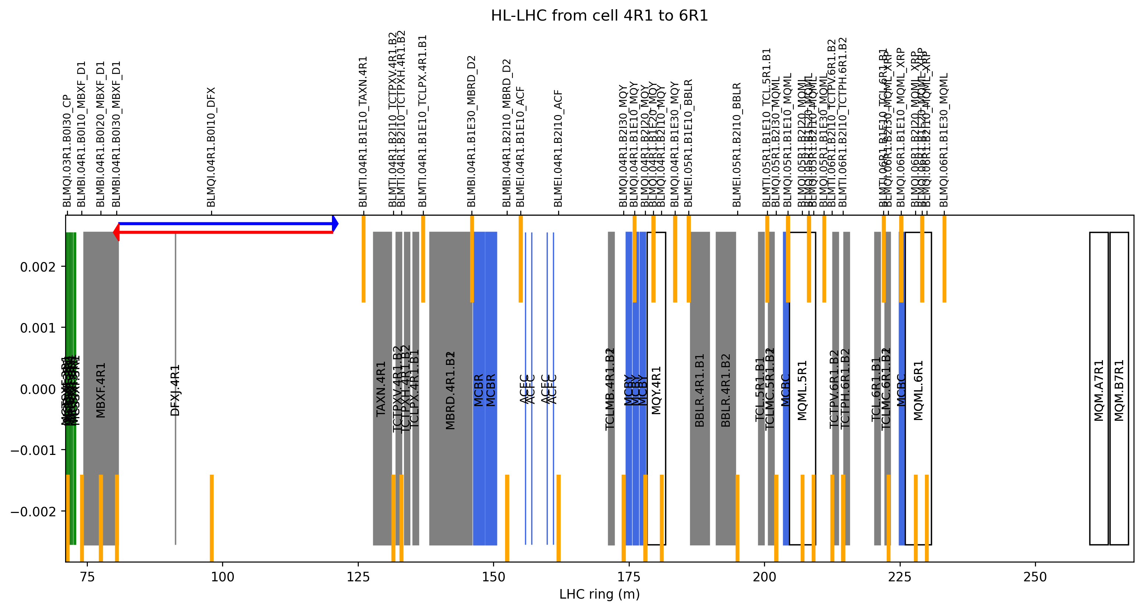

Slide 21
Conclusions
Draft of all BLM layout from Cell 1 to Cell 6.
      248 BLMs in total IP1 + IP5 (with additional 92 for the new ASIC read-out)
Missing only to include XRP - but for IP5 the BLMs will be integrated in the XRP support directly.
Next:
  Share the new BLM positions with integration to finalise the layout
  Integrate BLM signal and power boxes
  Integrate ASIC crates (3 per IP-side)

Slide 22
BACK-UP

Slide 23
Approximate positions Cell 1 - 3
•Approximate locations for the placement of the monitors:
  •After interconnect + middle/close to interconnect + after interconnect + before interconnect
  •Q1: 21 (IC+LIC) + 27 + 28 + 32
  •Q2: 34 + 37 + 40 + 45 + 48 + (51) + 53
  •Q3: 56 + 59 + 61 + 63
  •CP: 65 + 70 + 71.5
  •D1: 74 + 77 +80
  •IC right after D1
  •D2 will need also BLMs

Slide 24
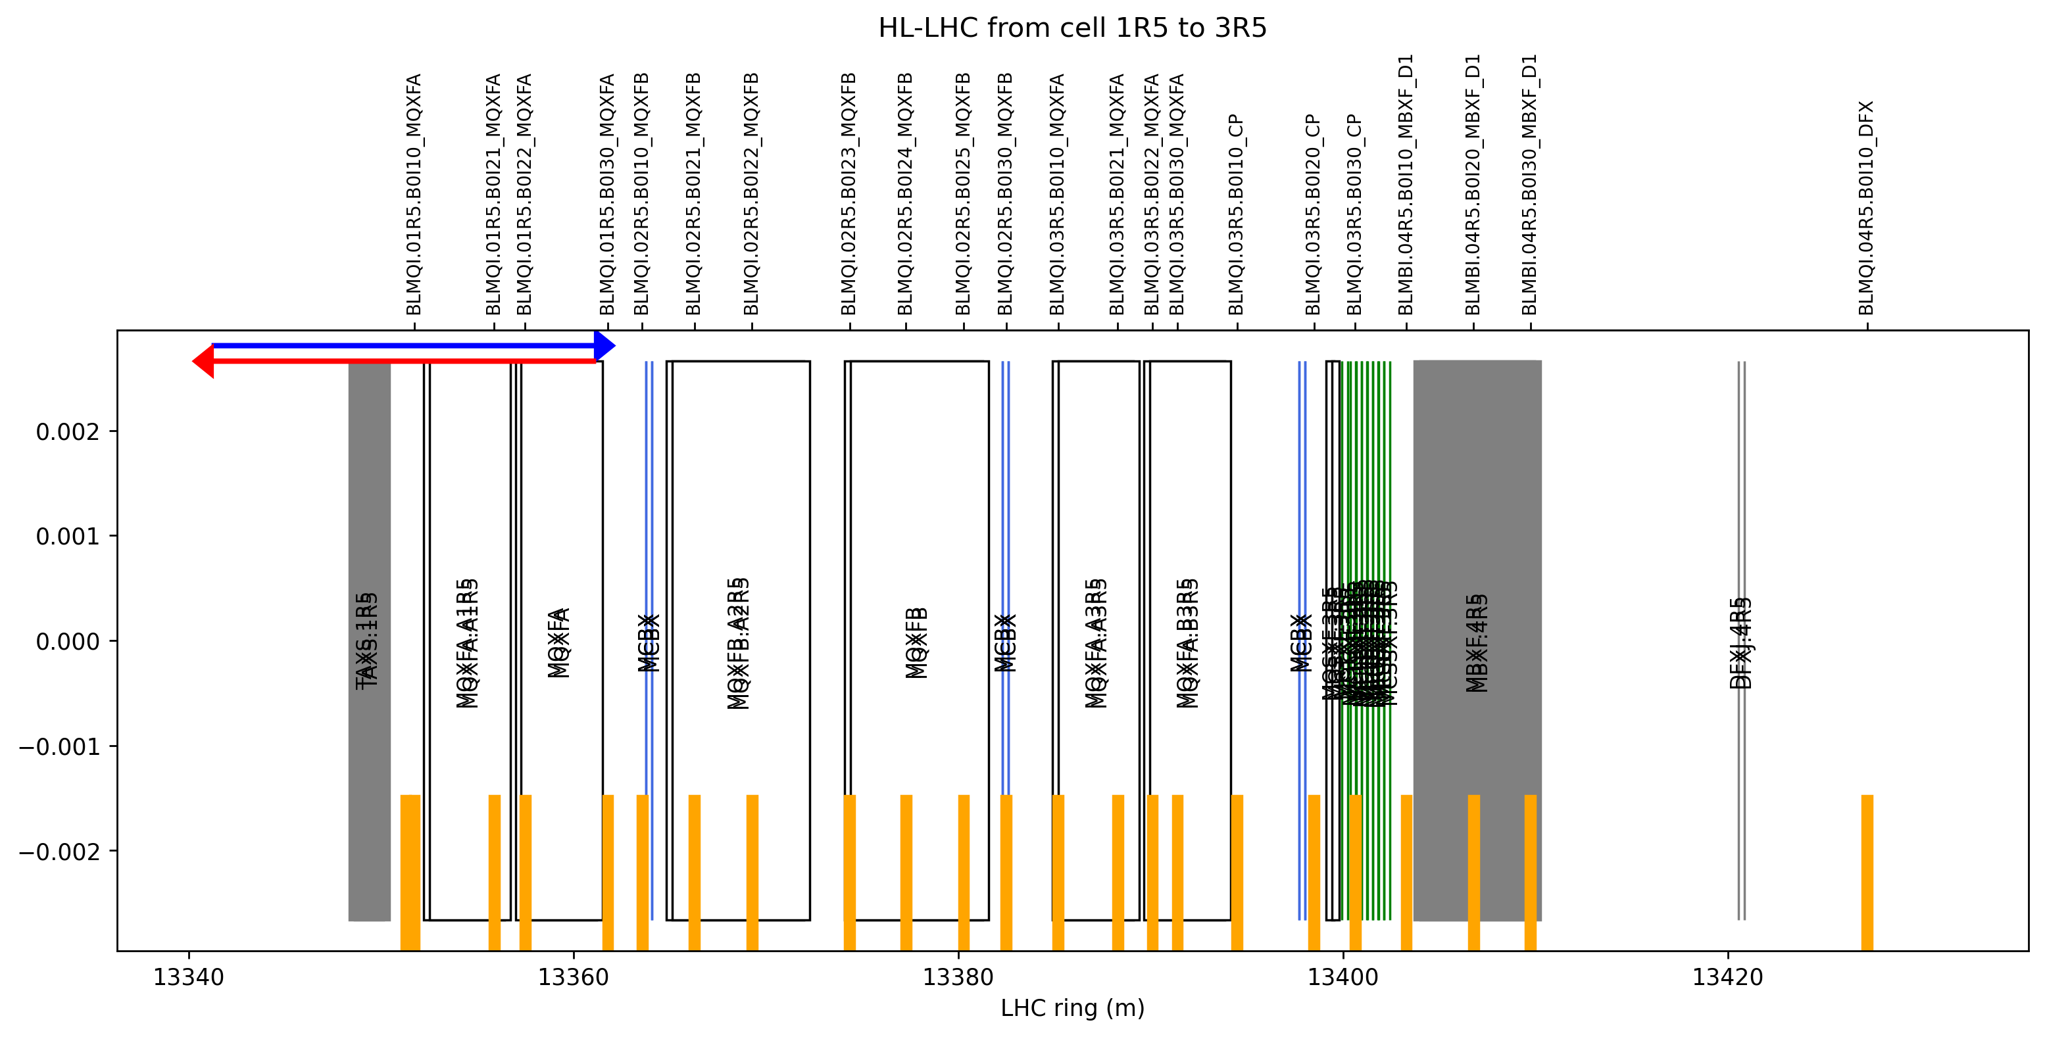

Slide 25
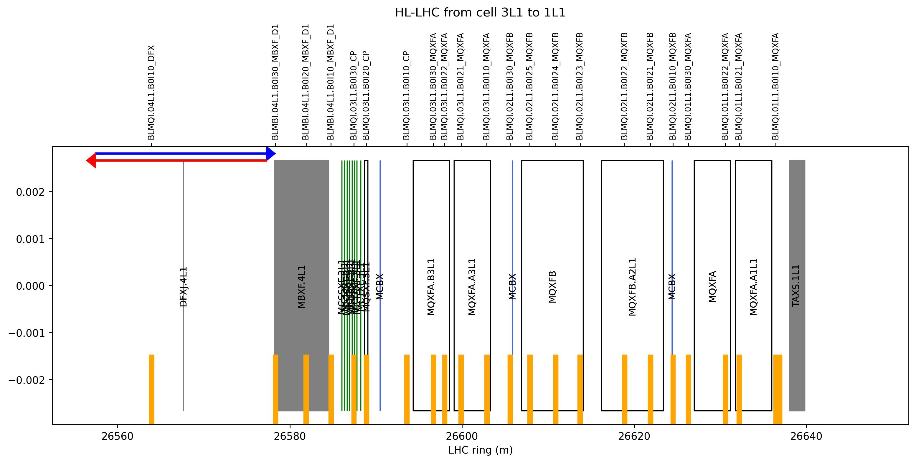

Slide 26
