Slide 1

BLM ASIC: Development Summary & future Prospect
BLM Thresholds WG
https://indico.cern.ch/event/1419391/
Christos Zamantzas on behalf of SY-BI-BL

Slide 2
Overview

Slide 3
HL-LHC BLM Deployment Plan
LS3
  Extension of the current BLM system with additional detectors following HL changes
    e.g. IP1 & IP5 Triplet, Collimation, BBLR, etc. areas
  First deployment of the full new electronic stack at strategic locations in parallel to the current electronics
    to complete and validate development
LS4
  Full deployment of new electronics
    replacement of the complete tunnel electronics stack (mini-racks, crates, power supplies etc.).
WP13.1 – Christos Zamantzas

Slide 4
BLM detectors at LS3 Triplet Layout
Work in progress between SY-BL, SY-STI & WP15;
Final integration might change numbers
LHC triplet layout
During LS3 will extend the current system for the new topology and deploy the new system (BLEIC) in parallel in half of the locations.
Will allow validation for full deployment during LS4 and (some) redundancy in this critical area long-term.
B1
B2
Q1
Q2a
Q2b
Q3
DFB
D1
LIC
MCBX
MCBX
MCBX
20
30
40
50
60
70
80
HL-LHC triplet layout
distance to IP (m)
B1
B2
Q1
Q2a
Q2b
Q3
D1
SM
Current system w/ BLECF // BLEIC/2
(Half channel redundancy)
1.3
1.3
2.2
MCBX
CP
Number of detectors: Total for IP1 + IP5 (both sides) | Number of detectors: IP1 + IP5 (both sides)
 | Present System Run 3 | HL-LHC Upgrade Run 4 | New in Run 4
BLECF – standard | 72 | 128 | 56
BLEIC – new | 0 | 64 | 64
Total IP1+IP5 | 72 | 192 | 120
MCBX
MCBX
20
30
40
50
60
70
80
BLECF #1
BLECF #2
BLECF #3
BLECF #4
Single multiwire cable per module
One BLECF or BLEIC module accepts 8 channels
WP13.1 – Christos Zamantzas

Slide 5

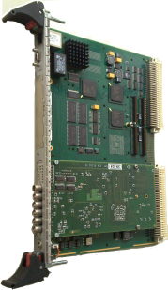

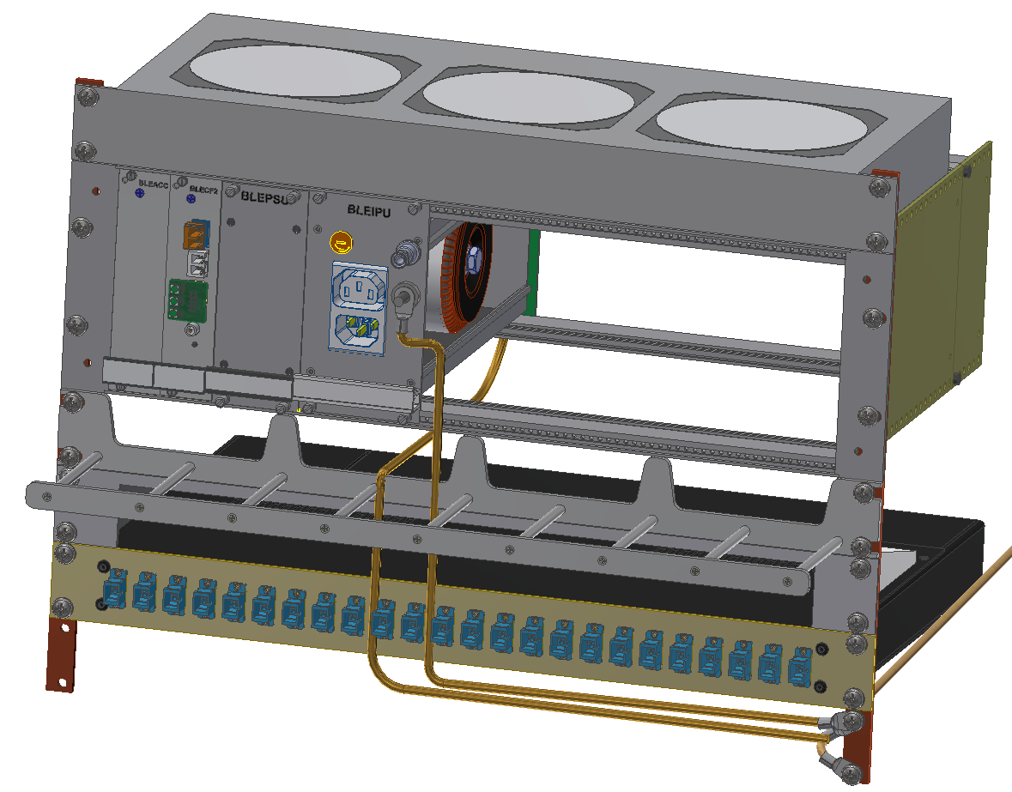
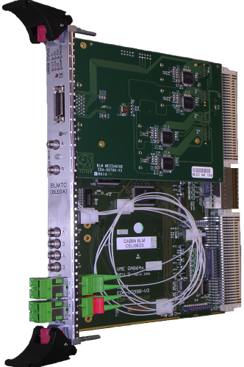
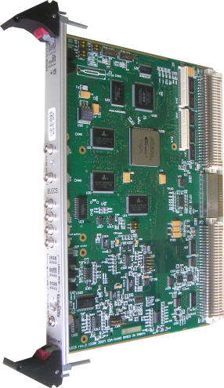
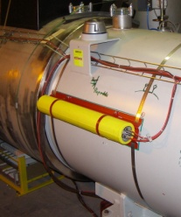
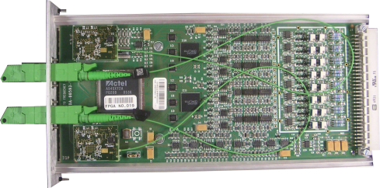
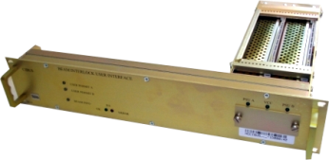
LHC Beam Loss Monitoring System – Upgrades
LS2
Funding through R2E, CONS & HL-LHC projects
LS2:
New FESA & OS
Databases (LAYOUT, LSA & NXCALS)
Firmware for data processing
Settings and Thresholds
Front-end CPU
Logging, PM, fixed displays…
LS3:
New processing electronics
Temp. optical receivers
Firmware for data processing (new FPGA)
Prototype tunnel electronics installations at LHC & SPS
LS4:
New mini-crate & acq. electr.
Firmware for data processing
Bidirectional optical link
x27
LS4
LS3
LS3
Acquisition & Digitisation
Processing, Analysis & Decision
LS3+
Combiner & Survey
LS3+
Beam Loss Monitors
Beam Interlock System Interface
LS3+:
Add. Detectors
New BIS Interlock concentrator (CIBFX)
x16
x4000
x750
x400
x27
Tunnel
Surface
around the LHC ring
grouped in 8 points

Slide 6
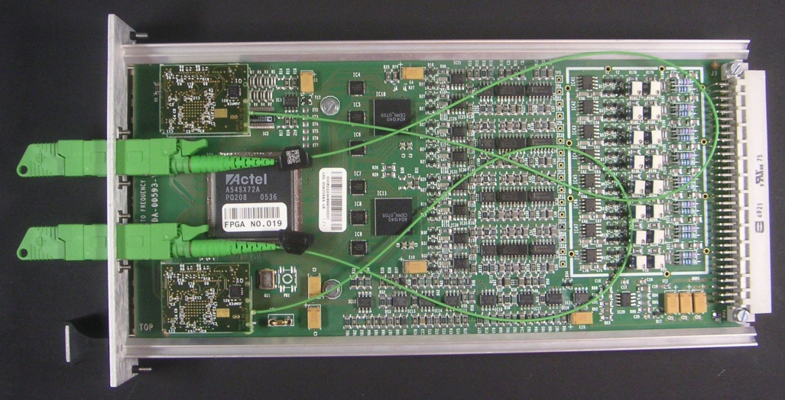
BLM LHC Acquisition module
Specifications:
Radiation tolerant up to 500 Gy
Reliability level SIL3 (1E-7 to 1E-8 failure/h) to damage of equipment
Current measurement range 2.5pA to 1mA
Integration time of 40 us
Input protection
  Current ~ 10A @100us
  Voltage ~ 1500V @100us
Redundant optical data transfer to surface
Test features for system check
  Survey of the card voltage supplies
  Survey of detector high voltage supply
Components:
8 inputs Current-to-Frequency Converter (COTS)
AD41240 ADC (EP-ESE)
LM4140 voltage reference
Antifuse FPGA for data collection
Redundant GOH from CMS (GOL from EP-ESE)
CRT910 Line driver (EP-ESE)
AD5346 DAC

Slide 7
Future Specifications Summary
Main functionalities
  Radiation tolerant electronics up to 1 kGy
  10 μs acquisition period & real-time processing
  8 orders of dynamic range (from few pA to 1 mA)
  On-board diagnostics and telemetry
  Bidirectional communication with the acquisition electronics
Equal/similar specifications needs for SPS and LHC
  Deployment at LHC during LS4, i.e. after validation in SPS
  Harmonisation across the Accelerator Complex with two systems to maintain (PS Complex and LHC/SPS systems)
    Reduce effort in procurement, testing and spares management

Slide 8
Design Objectives
Requirement | Critical/Wish | Target
Radiation tolerance | C | 1kGy / 20 years
Chassis MTTF calculated with handbook 217plus at 40˚C | C | > 1 E+07 h
Power supply MTTF (using MIL217plus at 40˚C) | C | > 1 E+06 h
Component derating | C | < 50%
Global Power requirement | C | ≥ 50 W
Mini-crate height | C | < 400 mm
Chassis height | C | 3U
Chassis depth | C | 220 mm
Connector Pins pitch | C | ≥2.54 mm
Connector mating cycles | C | 500
Backplane connector P.N. | W | 09 03 264 2825
Backplane PCB thickness | C | 2.2 mm
PCBAs quality | C | * See note below
Required voltage 1 | C | +1.5 VDC (5 W)
Required voltage 2 | C | +2.5 VDC (10 W)
Max ripple for digital voltages | C | 50 mVpp
Required voltage 3 (with linear voltage regulator) | C | +5 VDC (5 W)
Required voltage 4 (with linear voltage regulator) | C | -5 VDC (5 W)
Max ripple for analog voltages | C | 10 mVpp
Ventilation air flow | C | 500m³/h
FAN MTTF (using MIL217plus at 40˚C) | C | > 4 E+05 h
Component quality | W | Automotive
Build a configuration able to host both the BPM & BLM upgrades:
  those systems share location and resources (power, fibres etc.)
Harmonise electronics across machines:
  Common SPS & LHC BLM architecture (on-going global harmonization effort)
  Share elements between LHC & INJ BPM systems
Maintain backwards compatibility (on the LHC BLM side)
  BLM Acquisition module & Power Supply Units
  i.e. pin to pin compatible with the current chassis backplane
Improve the acquisition system performance:
  Radiation tolerant up to 1 kGy (currently at 500 Gy).
  Integration period of 10 µs (currently at 40 µs).
Improve safety:
  Additions to maintain the SIL3 for safety critical systems.
  Protection against direct contact to HV or 230 V_{AC}.
  Grounding improvement
Improve reliability:
  All modules encapsulated in metal boxes (prevent transport damage)
  Reduce number of interconnections
  Simplify manufacturing
  Simplify optical transceiver interconnection.
Improve maintainability:
  Reduce repair time
  Declassify the repairing complexity
  Additional diagnostics.

Slide 9
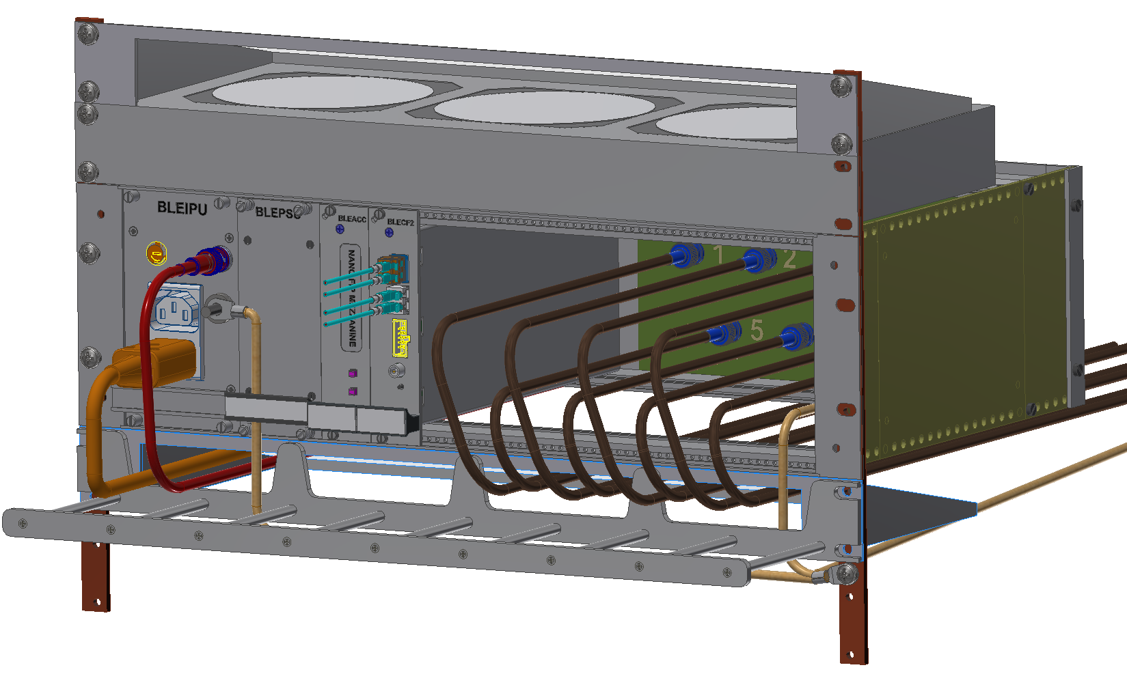
New BLM mini-crate
Input Power Unit
BLM Channels Input Cables
Air deflector
Characteristics:
Front access
  Applies to all connections and modules
  Allows mini-crate to be installed at the wall side
  Easier access during maintenance
Controller card
  Redundant functionality
  nFIP connection
Custom backplane
  Targeted design
  Completely passive
  Better cable management, i.e. 8x CB50 (coaxial) with BNC connectors
FAN Tray
Power Supply Unit
Air deflector
Controller Card (Optional)
BLM Acquisition Card
GND Star Point

Slide 10
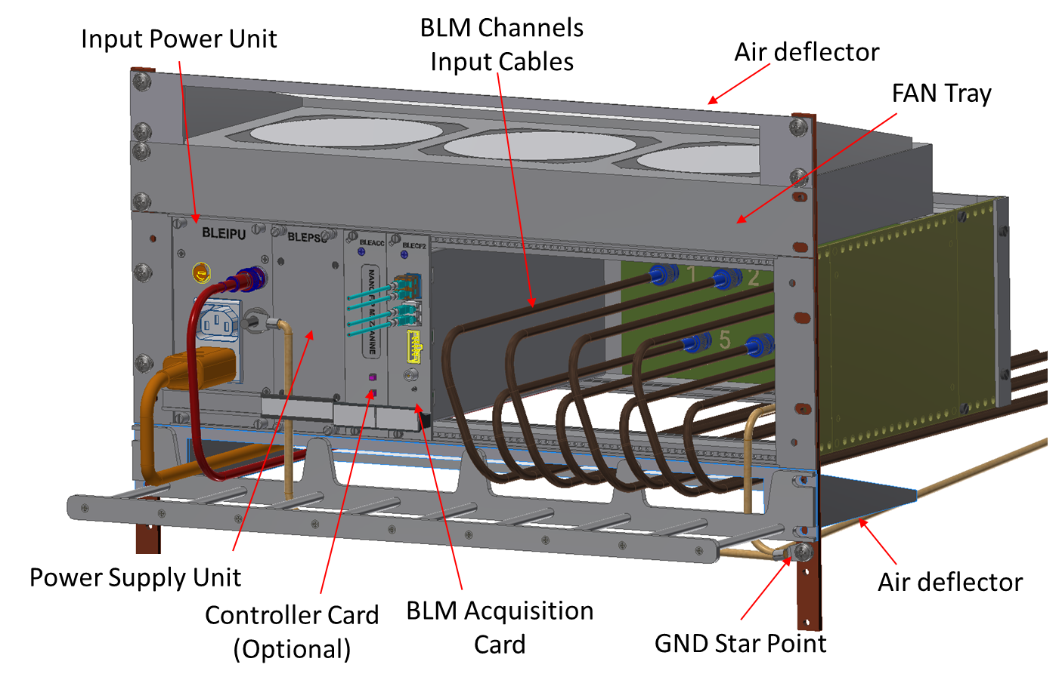
New BLM mini-crate
New crate design completed
  Optimised or reliability, low current measurements and quick interventions
  Prototype version available
  All critical components in-stock or ordered
Rad-Tol Power Supply prototype
  Using several EP-ESE ASICs
  Tested at CHARM (two runs, ~ 2.5 kGy accumulated)
  Tested in climatic chamber
Rad-Tol Front-end prototype
  Using custom BLM ASIC & several EP-ESE ASICs
  Tested at PSI (seven runs, ~ 3.5 kGy)
Currently working on system integration
  Development of back-end firmware for communication and control
  First version of the real-time data processing & decision making under test

Slide 11
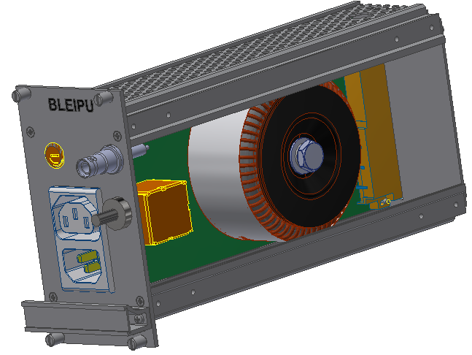
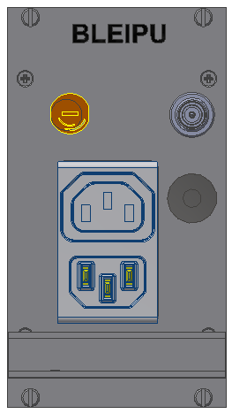
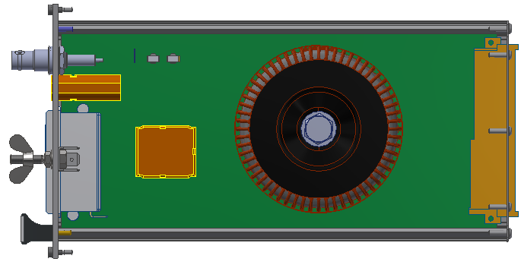
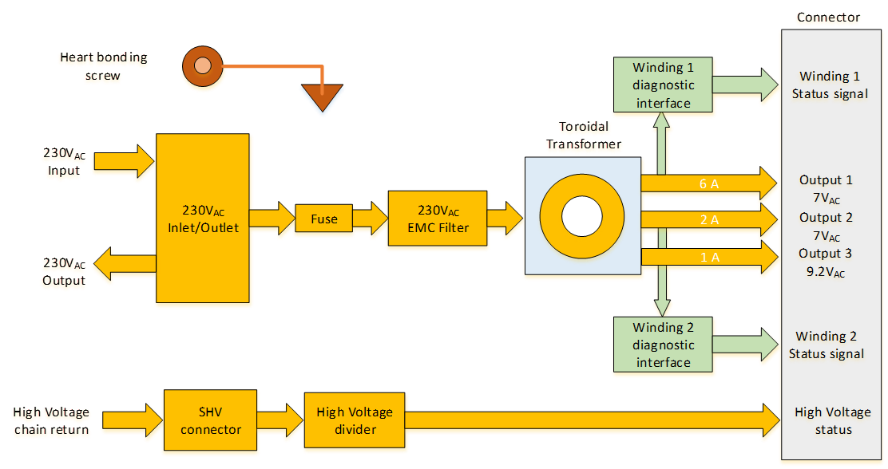
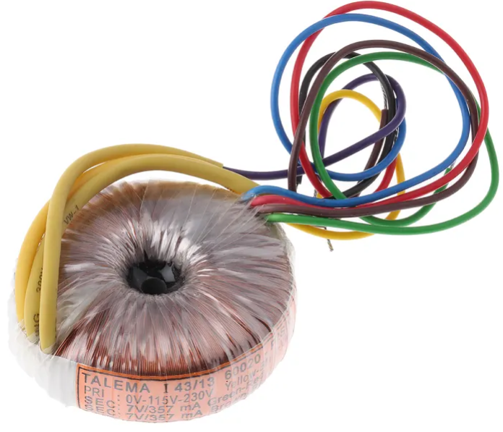
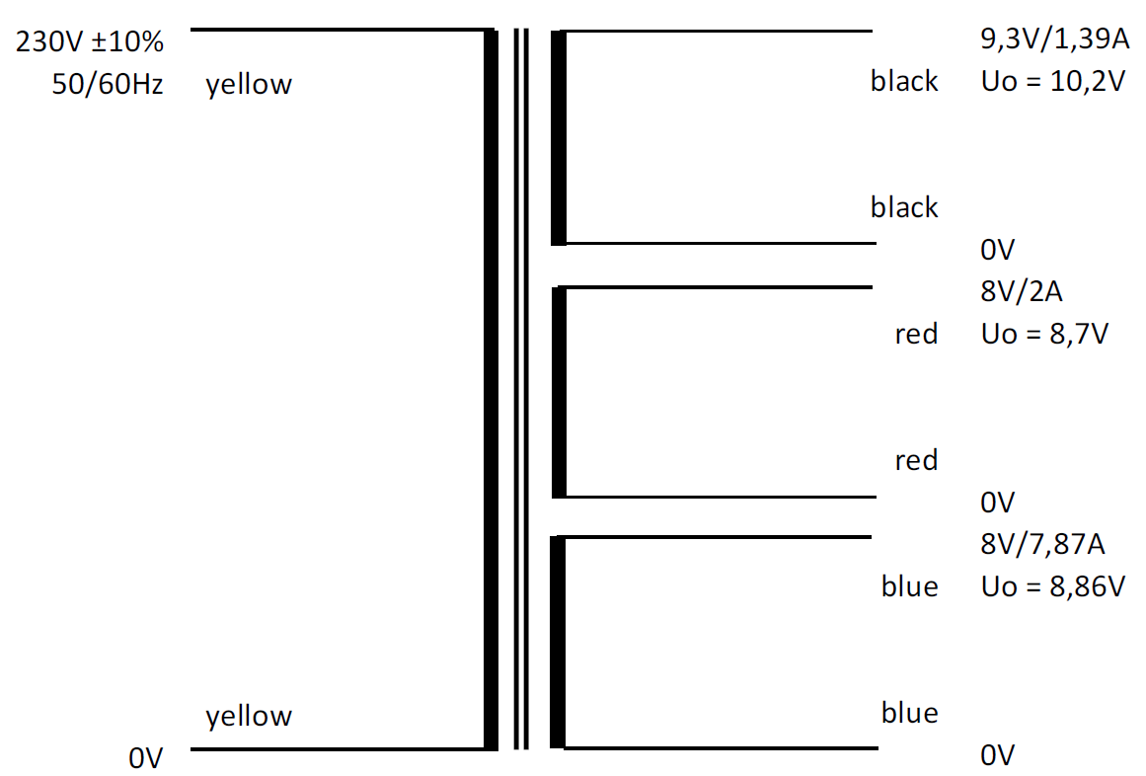
BLEIPU: BLM/BPM Rad-Tol Input Power Unit
The Input Power Unit (BLEIPU) converts the 230 V_{AC} power input in the AC output voltages delivered to the Power Supply Unit
  EDA-03918
Provides also
  transformer diagnostic and
  the detector bias chain return with voltage conversion
HV input connector
230 V_{AC} Inlet/Outlet
Main Fuse
Earth bonding
Radiation tolerant power transformer (custom design)
HV divider
Input filter
3D model of BLEIPU
Transformer & output voltages

Slide 12
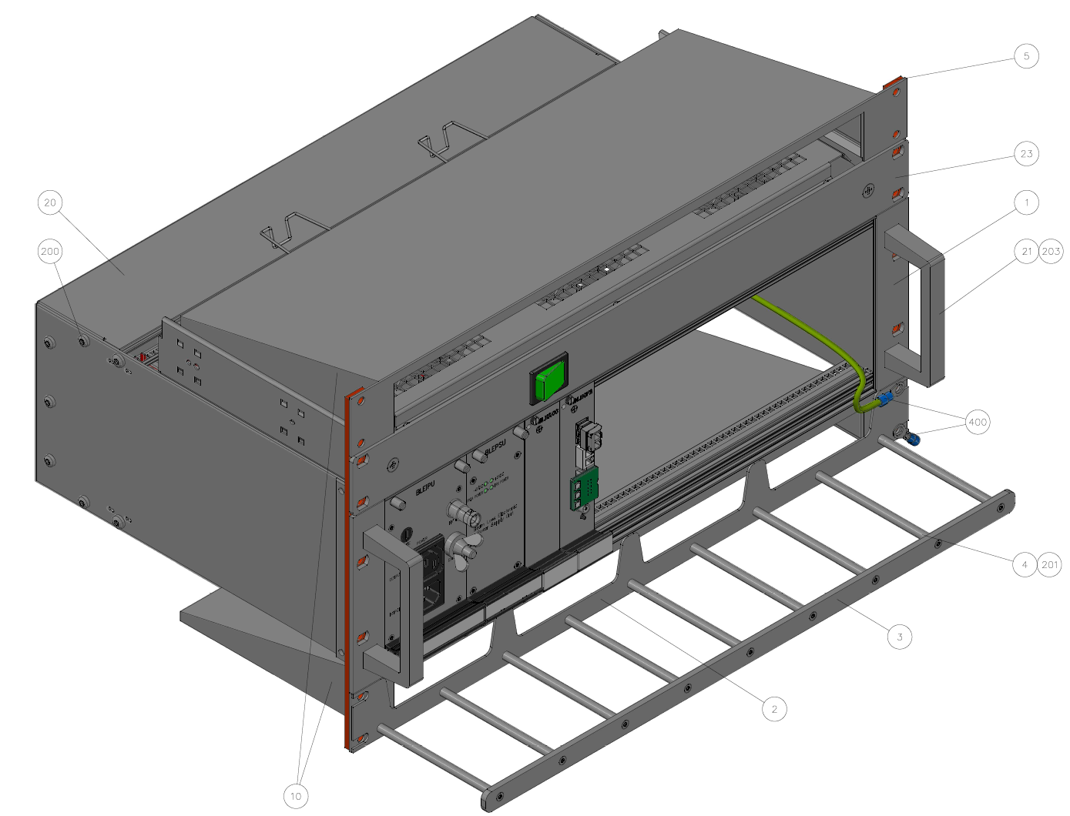
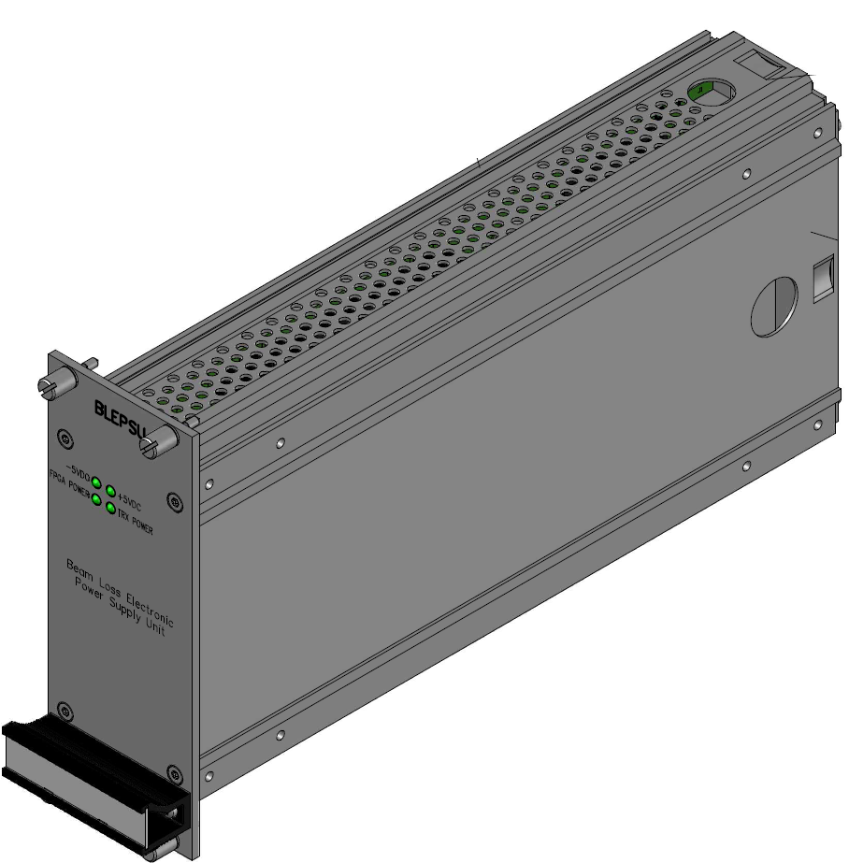
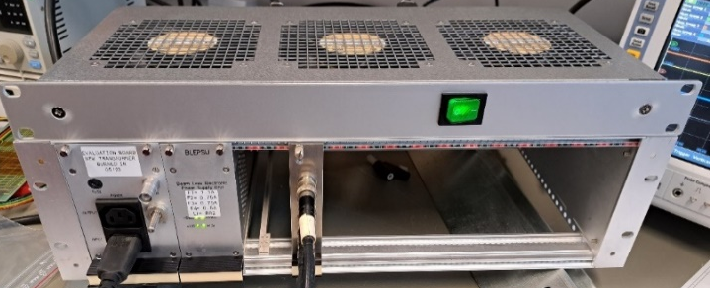
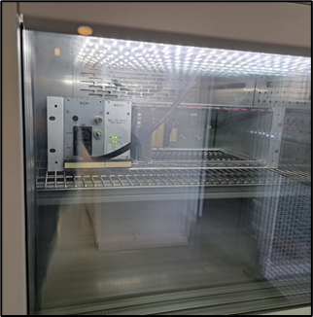
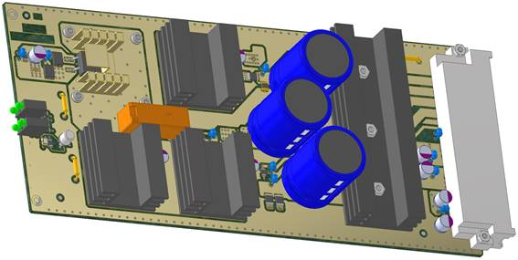
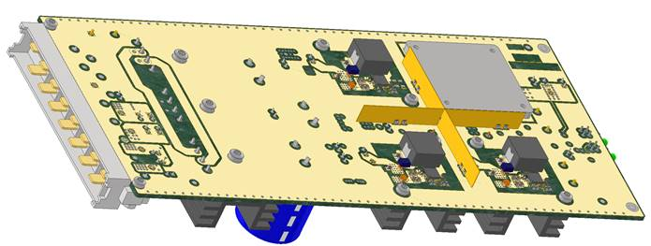
BLEPSU: BLM/BPM Rad-Tol PSU
V2 redesign mandatory
  due to already obsolete ST linear voltage regulators and FEAST DC/DC converters
V3 based on bPOL (rad-hard ASIC)
  Achieves all electrical specifications (long list of tests targeting power-on ramp, ripple, load, heat dissipation, short-circuit protection etc.)
  Tested at CHARM for two weeks (reached 940 Gy) without any issue
V4 prototype validation completed
  https://edms.cern.ch/item/EDA-03919-V4-0/0
  Changes on PCB stackup for shielding, and better capacitors for the rectifier and output filtering as well as lifetime.
  All tests and validations completed, e.g.
    CHARM (reached ~ 1500 Gy accumulated)
    Climatic chamber (150h stress-test up to 100°C)
Collaborative effort with EP-ESE and BE-CEM
Setup for CHARM & Climatic chamber
3D models of BLEPSU v4

Slide 13
BLM ASIC & BLEIC module

Slide 14
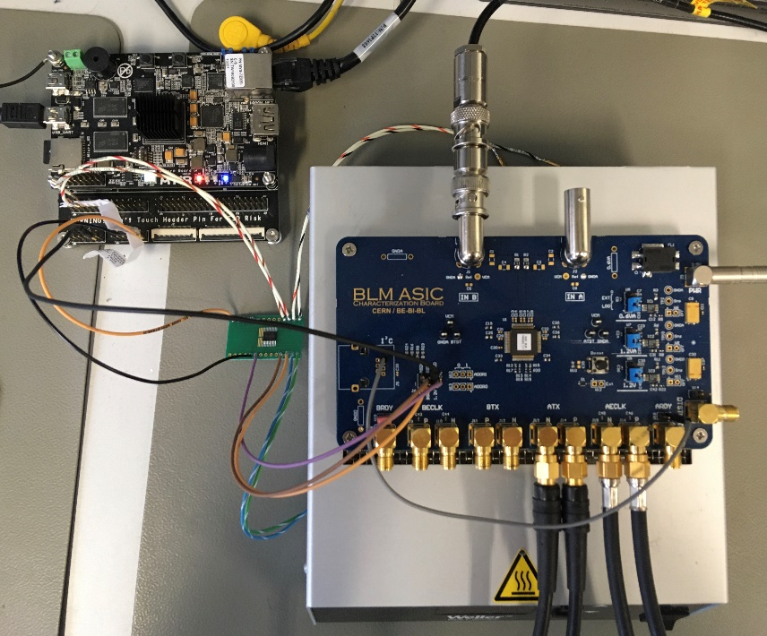
BLM ASIC R&D Timeline
Prototype development timeline:
2018 Q1: project start; technology selection and feasibility
  Parallel design of two methods:
    CFC asynchronous better suited to handle large currents and quickly varying signals
    Delta-Sigma ideal for high accuracy due to oversampling and filtering
2019 Q4: V1 delivery
  Issue with internal power distribution and ESD protection
  Could not test full range
2020 Q4: V2 delivery (some delays due to COVID)
  Mostly functional;
  Metastability issues with the sync between the analogue and digital domains
  High current leakage of the input stage FETs; poor low current meas.
  Decision to continue with the CFC asynchronous method only
2022 Q1: V3 delivery
  Analogue & digital circuits fulfil needs; all currently known issues resolved
  New minor issue w/ sync between CFC & ADC data; mitigation possible at the backend
Development of custom ASIC verification testbench

Slide 15
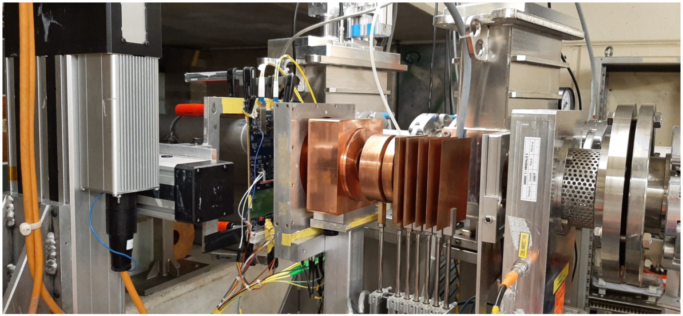
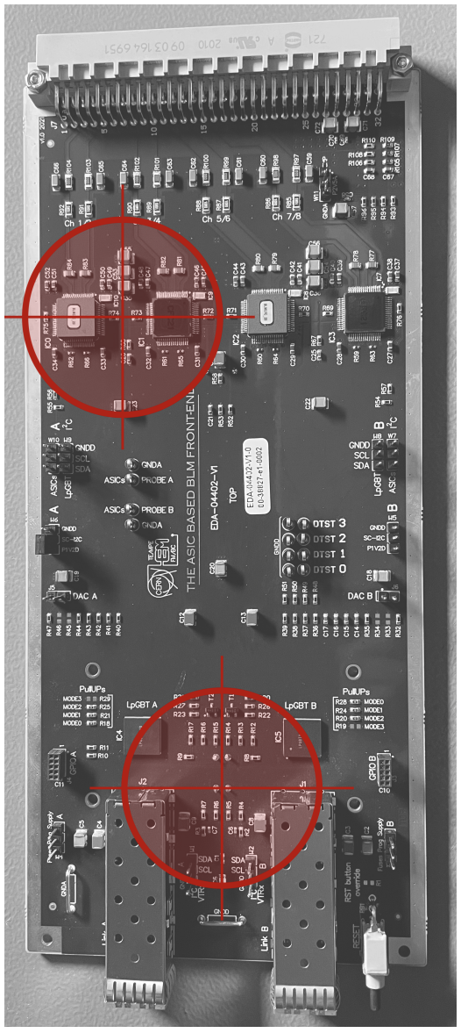
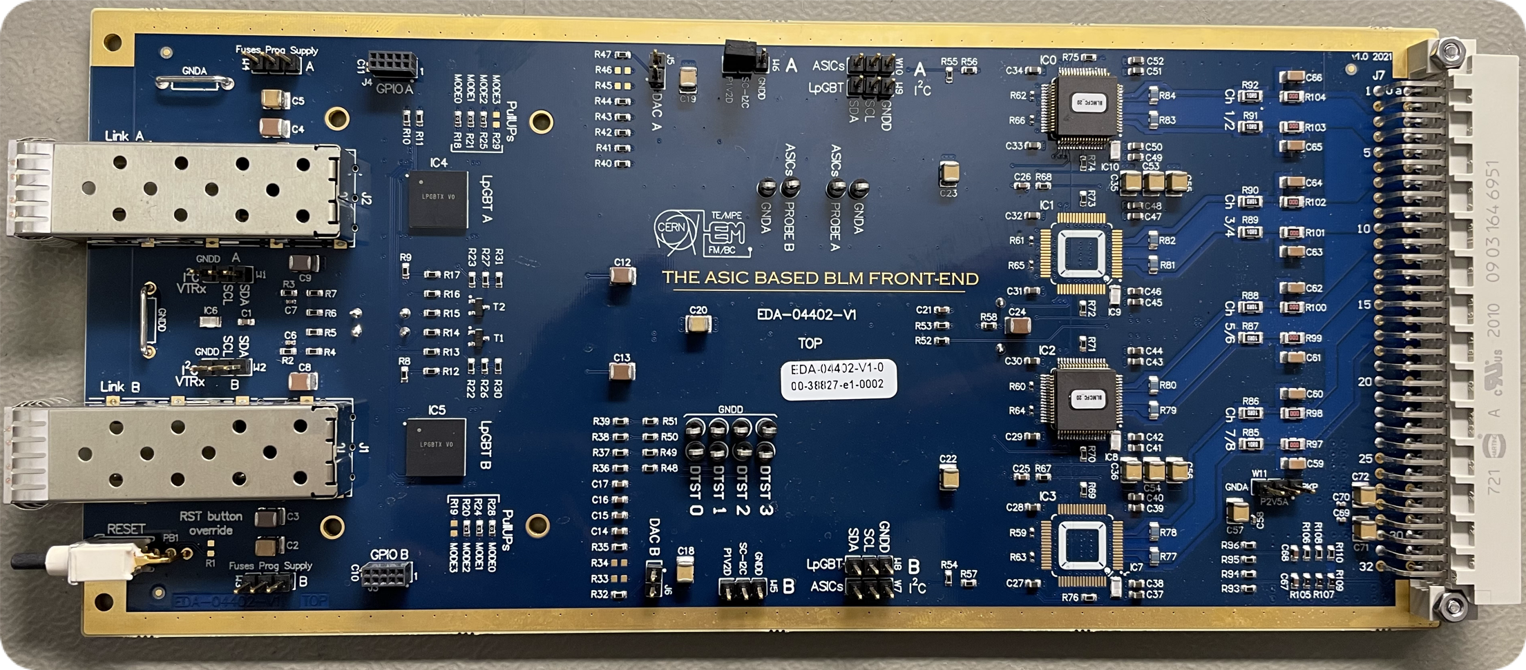
BLEIC: BLM Rad-Tol Front-end
New prototype PCB design complete
  Based on rad-hard components only
  Includes all functionalities expected from the final system
  Common digital parts, control and form with standard BLM acquisition board.
Prototype production completed and tested to be functional
  This board variant is able to accommodate both BLMASIC v2 & v3
Currently working on system integration
  Development of back-end firmware for communication and control
  Next step, integration in the real-time data processing and decision making
Radiation testing at PSI:
  Beam energy of 200 MeV and
  Flux, at maximum current of 10 nA, was 3.7 × 108 p*cm−2*s−1
  Run 1-6 targeted two ASICs and linPOL12V reaching ~3.3 kGy
  Run 7 (short) targeted the transceivers with 200 kGy
Comparison of old and new technology
of radiation tolerant front-ends
 | BLECF COTS & ASIC hybrid version | BLEIC ASIC version
Components | > 2000 parts | < 400 parts
Cost | > 3 kCHF/unit | ~ 1 kCHF/unit
2 x SM-VTRx
2 x LpGBT
4 x BLMASIC

Slide 16
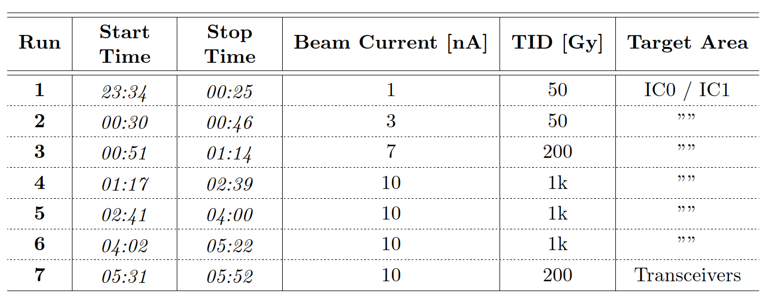
Irradiation – Protons (PSI)
Beam energy of 200 MeV and
Flux, at maximum current of 10 nA, was 3.7 × 10⁸ p*cm⁻²*s⁻¹
Run 1-6 targeted two ASICs and linPOL12V reaching ~3.3 kGy
Run 7 (short) targeted the transceivers with 200 kGy
Run 1-6
Run 7

Slide 17
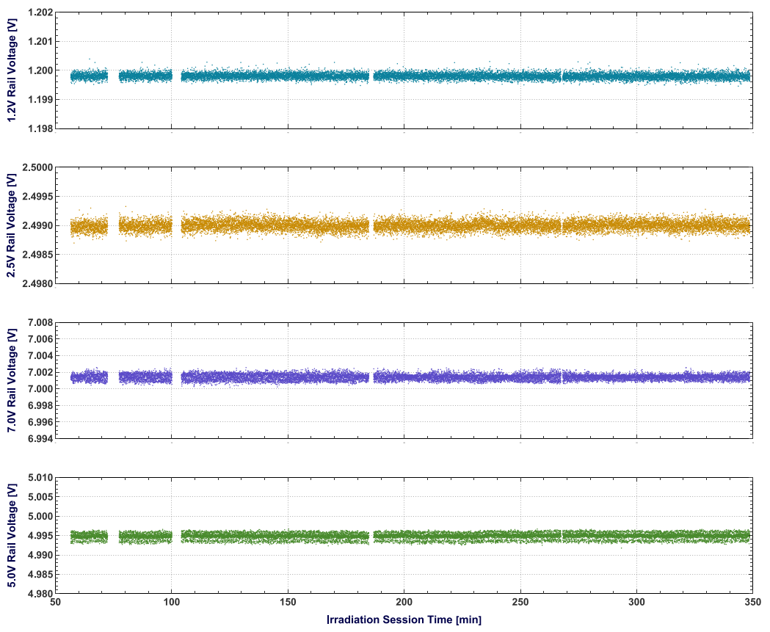
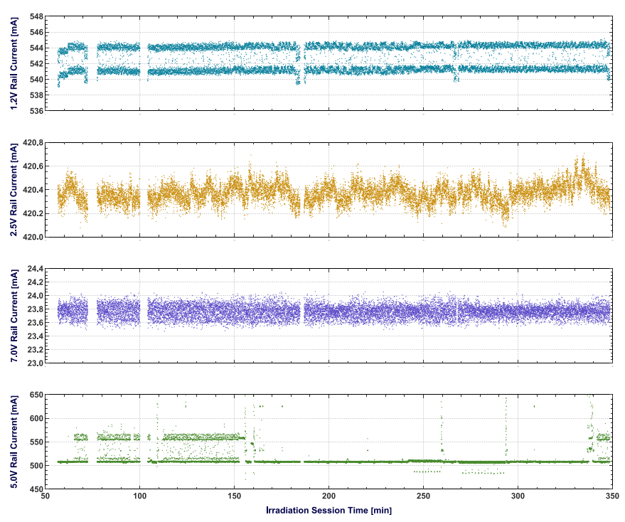
Irradiation – Protons (PSI)
1.2 V
2.5 V
7.0 V
5.0 V
Voltage (left) and Current (right) measurements of the supply rails
The 1.2 V rail ﬂuctuates into an interval of ≈ 3 mA. This is an intrinsic behaviour of the board that does not relate to radiation exposure nor to an abnormal condition
No significant change observed. We conclude the onboard regulation is functional and has maintained stable supply throughout the session

Slide 18
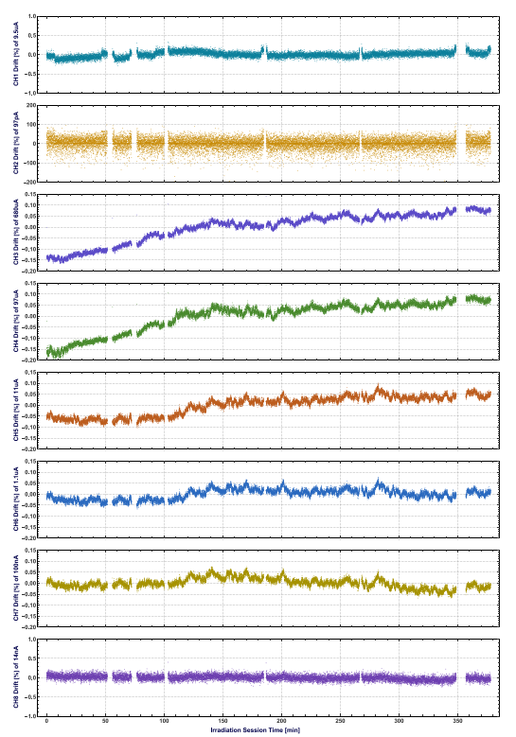
Irradiation – Protons (PSI)
CH1
Percentage drifts of the current measurements during the irradiation session for each channel
Channels 1-4 irradiated only
Max. measurement deviations never exceed 0.5%
Digital domain check
no errors detected in the 8b/10b coding and the frame parity check between the BLMASICs and the LpGBTs.
continuity of samples was guaranteed
no unexpected changes in the registers were observed in any BLMASICs.
This means that even if SEUs might have occurred, the internal triple redundancy managed to mitigate it.
…
CH8

Slide 19
Next steps & Conclusions

Slide 20
Next steps
Production of BLM ASICs underway
  Submission to the July 2024 MPW for 2 wafers, i.e. 400 units
  Dicing & Packaging in October 2024
  All other ‘special’ components & ASICs bought or secured, e.g. VME, VFC, bPOL, LpGBT, nFIP, VTRx, transformer etc. all procured
Tests to be performed
  using a radiation source to induce a signal in the detector,
  installation in the machine for beam measurements and
  some destructive tests
Finalise design of the BLEIC module
  Series production expected Q3 2025 of 100 units
Up to 12 extra crates will be available for LS3 installation in LHC
  Cables have been requested in IP1 & 5 for 48 channels/IP; need to finalise positions
  All material have been ordered
Production of all other modules on-going
  Design office (BE-CEM) has started RHA for BLEICU, BLEPSU, BLECCM modules

Slide 21
Conclusions
On-going program to harmonise Beam Loss Monitoring across the Accelerator Complex with two systems
  Common back-end electronics & detectors across the complex
  Two acquisition systems (PS Complex/TLs and LHC/SPS)
Development and procurement efforts on-going
  BLM ASICs available before end of 2024
  All other ‘special’ components & ASICs bought or secured for both SPS & LHC
Prototype system in parallel to the LHC BLM
  Together with the new processing electronics
  Validation and development of future firmware & software stacks

Slide 22
Spares

