Slide 1
AOB: Increase of the RS12 thresholds in IR7
27/05/2024
Sara Morales and Belen Salvachua for the SY-BI-BL section
99th BLM Thresholds Meeting

Slide 2
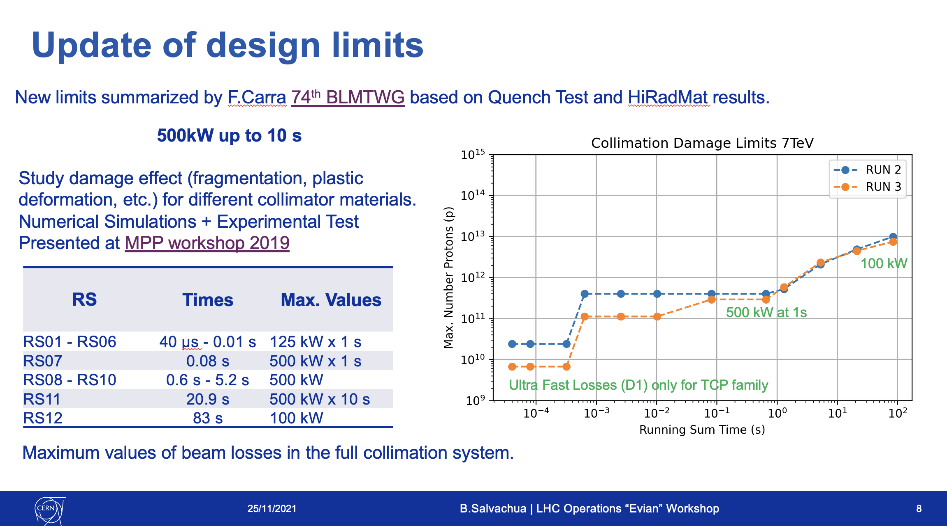
Reminder collimation specifications for LHC
BLM thresholds collimation model was reviewed and updated for Run 3 during LS2:
  Summary at 88th BLMTWG: https://indico.cern.ch/event/1096834/
  At the moment, we are running with MF = 0.6
60kW with MF=0.6
Maximum allowed power loss for master thresholds
For HL-LHC, specifications for the maximum power load go to 1MW (factor 2 higher!)

Slide 3
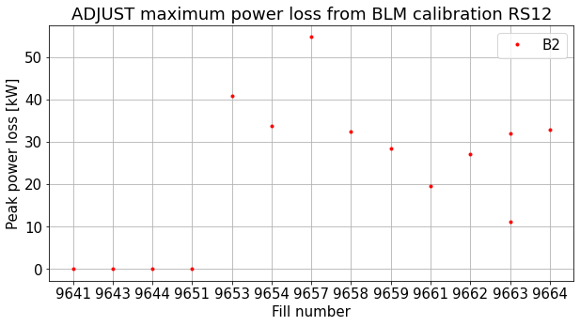
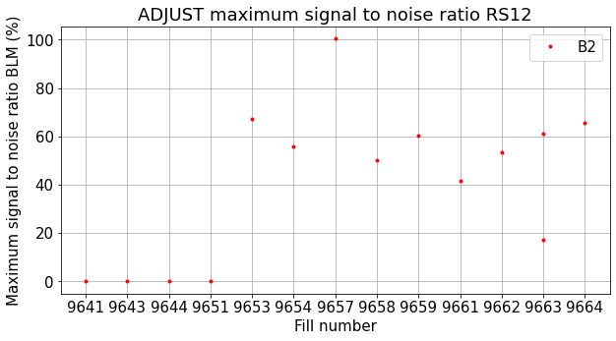
RS12 limitation during operation
RS12 reaching warning and even dump levels for B2 at the start of ADJUST (most limiting BLMTI.06R7.B2I10_TCP.B6R7.B2)
BLM thresholds well aligned with the estimated power loss using the BLM calibration with RS12

Slide 4
RS12 limitation during operation - Proposal
The beam lifetime goes indeed well below 1h at the start of ADJUST when the beams are going into collisions, but by the time RS12 (~83 s integration time) triggers, the lifetime is already recovered
It has been observed that for some fills, the BLM signal to dump ratio was:
  RS12 at 40%
  RS11 at 14%
  RS09 at 10%
Should we give more margin to RS12 (factor of 2 wrt lower RS)?
  Aiming to have RS12 at 20%, better aligned with the other RS and still within HL-LHC specifications
This would imply a change in the RS12 master thresholds of the 9 BLM thresholds families in IR7
  1/2 shift for the preparation of the change (in the shadow)
  Apply the change during a rampdown

