Slide 1
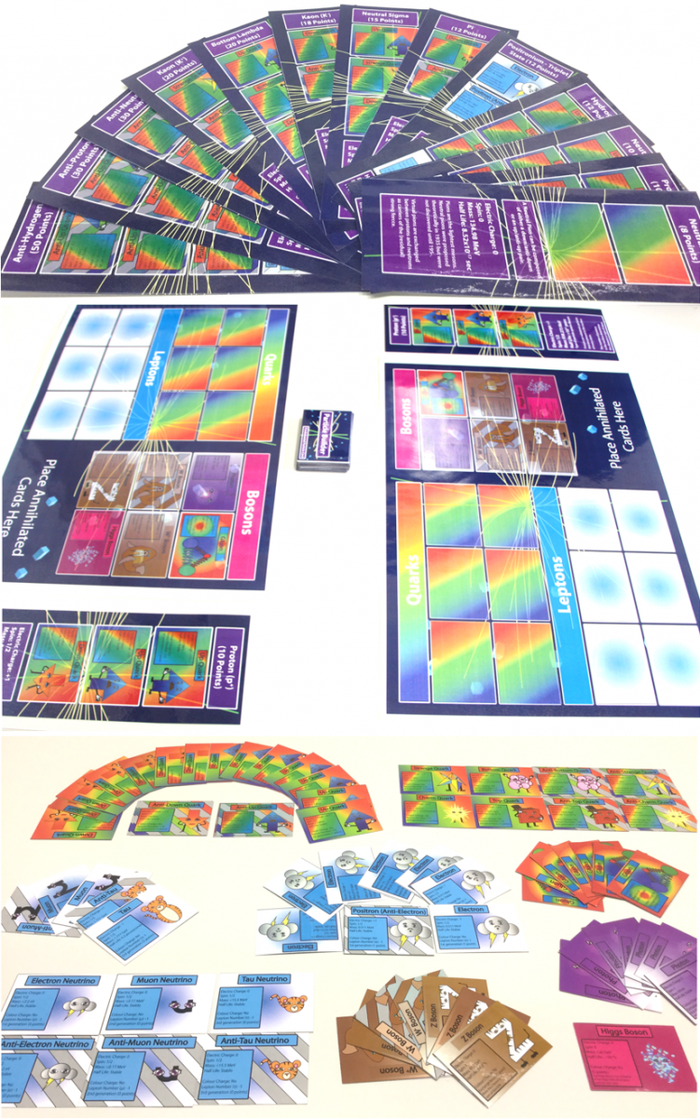
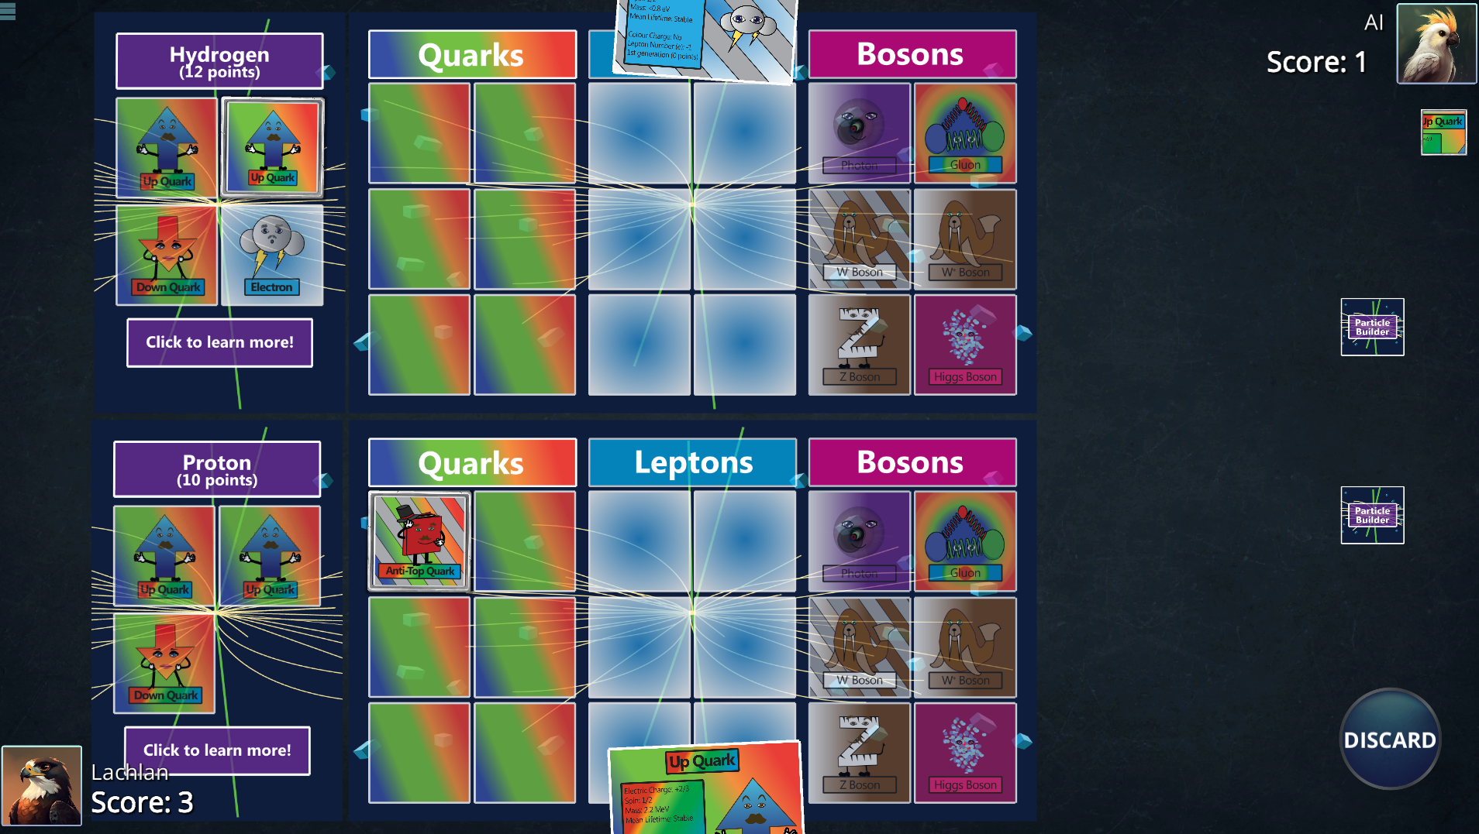
Particle Builder

Slide 2
Why use Particle Builder?
Particle Builder is a good balance of both fun and learning a wide range of particle physics concepts.
If your syllabus has particle physics in it, then Particle Builder will almost definitely address content in it.
Of the students we tested it with:
95% said that it was more enjoyable than a normal science lesson
75% said that they learned more than a normal science lesson.

Slide 3
Online Game: https://particle-builder.anu.edu.au/
Use full screen.
Doesn’t work on phones.

Slide 4

Physical Game is free too!
Go to Zenodo: https://zenodo.org/records/14210858

